Slide 1
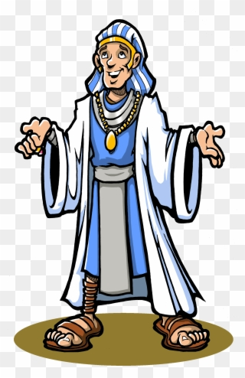
Joseph’s life
From younger son to Pharoah’s Right hand man

Slide 2
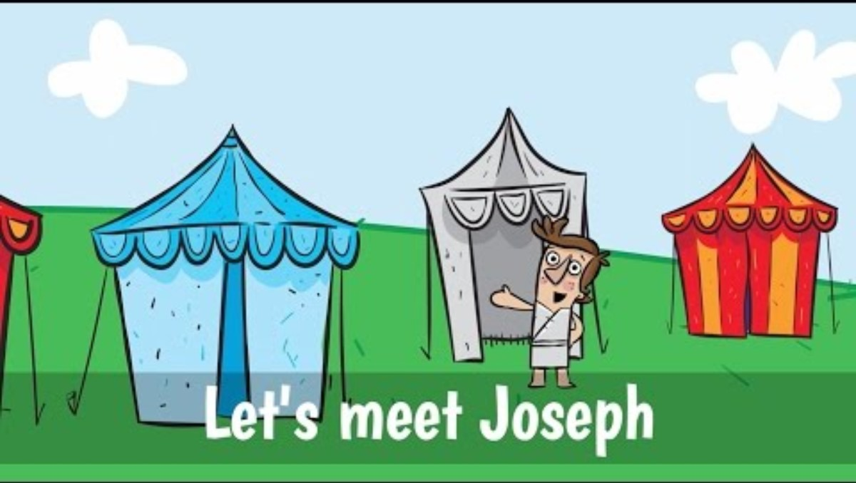
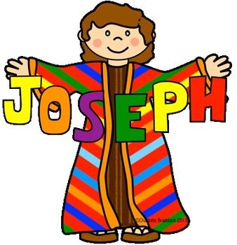

Slide 3
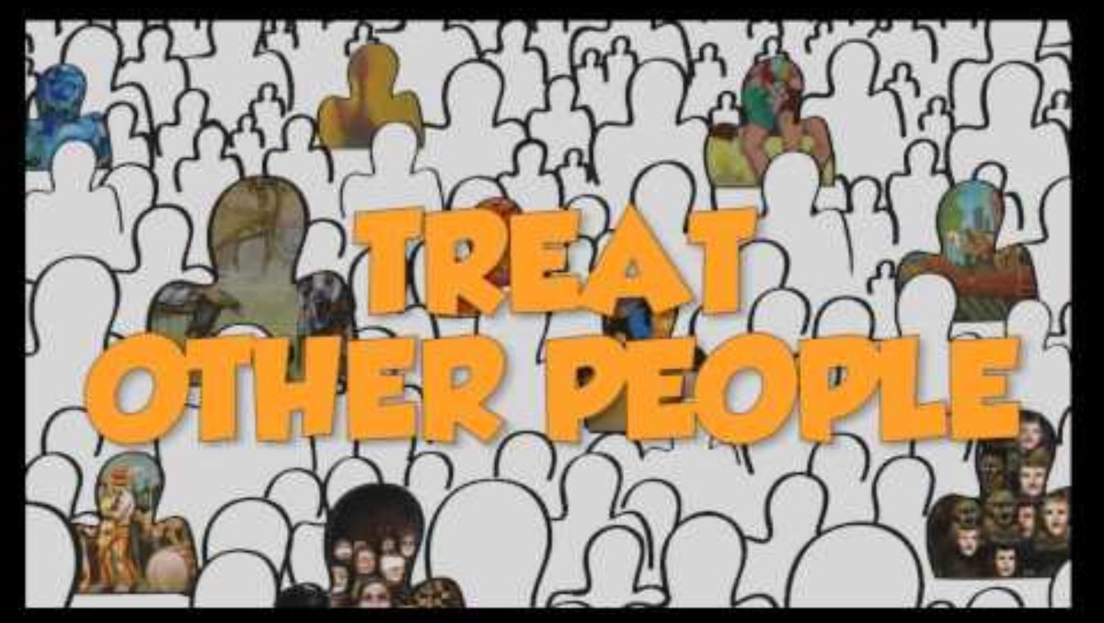
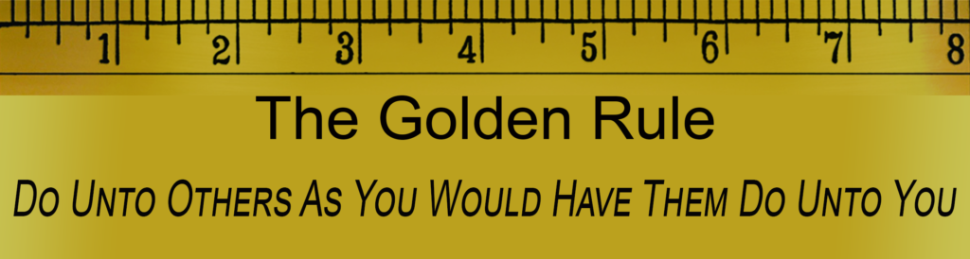
The Golden Rule: ^{Luke 6:31} Do for others what you want them to do for you.

Slide 4
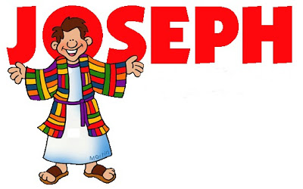
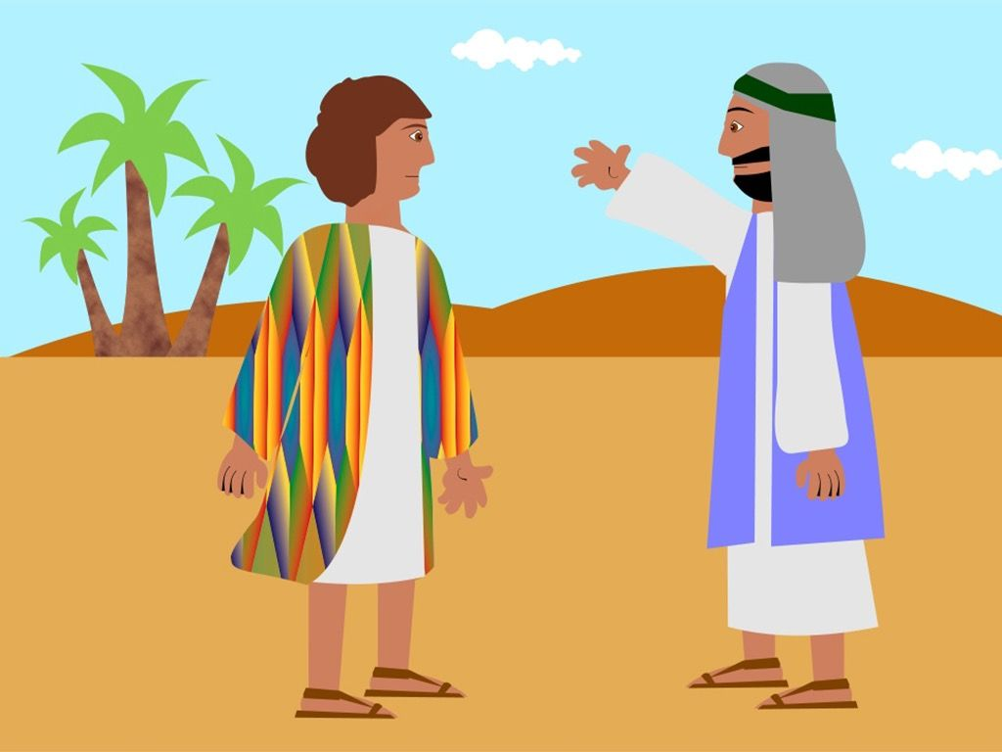

& THE COAT OF MANY COLORS
Jacob loved
Rachel’s son, Joseph very much!
He gave him a coat of many colors.
Jacob trusted Joseph.

Slide 5

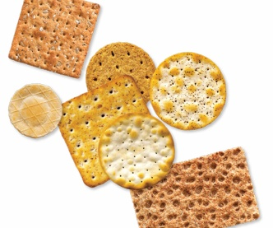
& THE COAT OF MANY COLORS
Go see how your brothers are doing and take them some food.
Snack Time
Story review
What does the napkin remind you of?
What do the crackers remind you of?

Slide 6
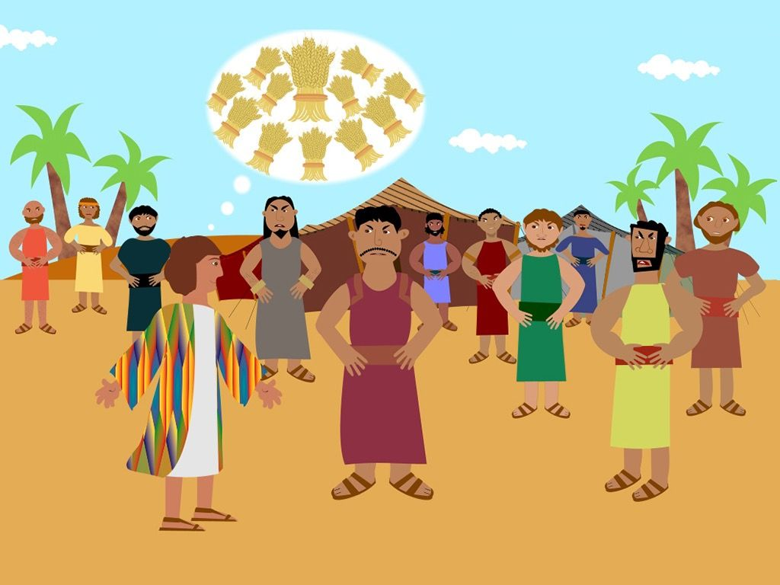
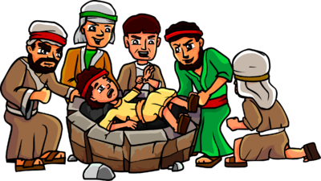
& THE COAT OF MANY COLORS
Joseph’s brothers were jealous.
Joseph had dreams that showed that they would bow down to him.
They were mad!
What did they do?
(Genesis 37:19-34)

Slide 7
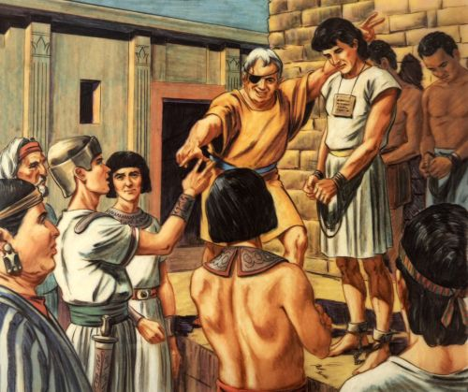
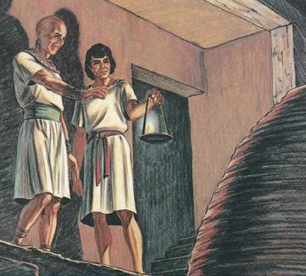
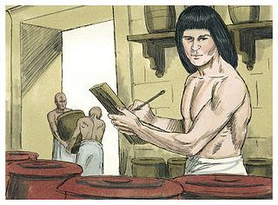
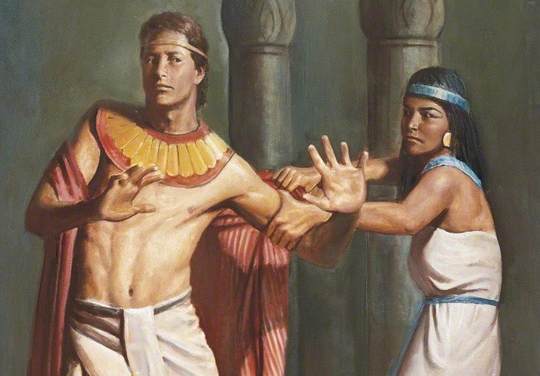
SERVES POTIPHAR
Joseph was
sold to Potiphar.
He worked hard, served faithfully.
Potiphar
promoted Joseph.
Joseph said NO
to Potiphar’s wife.
Potiphar’s wife accused Joseph.

Slide 8
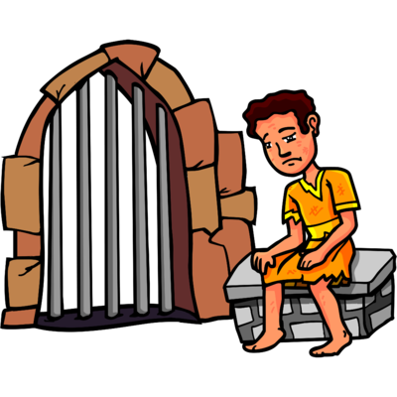
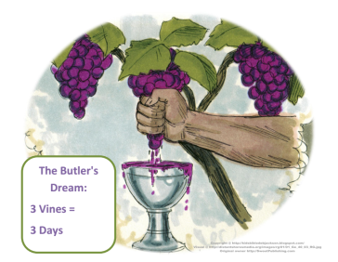
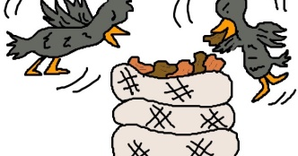
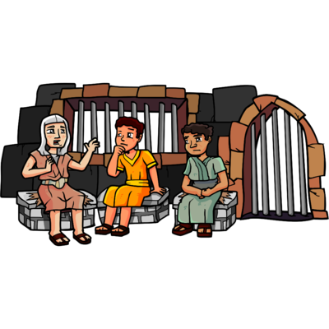
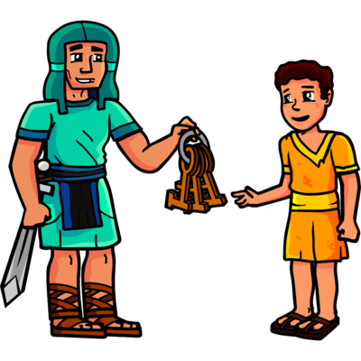
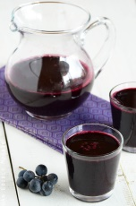
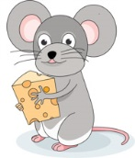
SERVES IN PRISON
Joseph was put in prison.
The prison guard trusted him.
Joseph took care of other prisoners and listened to them.
What did the Pharaoh’s cup bearer and baker tell him?
(Genesis 40)
Mmm mm grape juice!

Slide 9
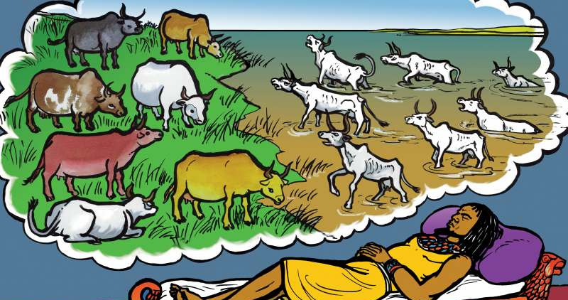
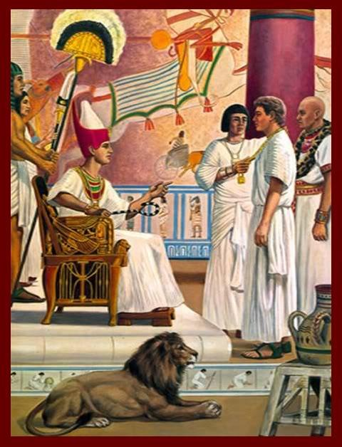
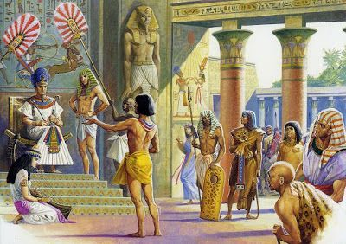
SERVES PHARAOH
Pharaoh had a dream.
What did it mean?
No one knew.
The cup bearer remembered Joseph.
Joseph told what the dream meant.
What did it mean?
Genesis 41:28-32
Pharaoh made Joseph the ruler next to him.
He put Joseph in charge of saving food for the famine.
then

Slide 10
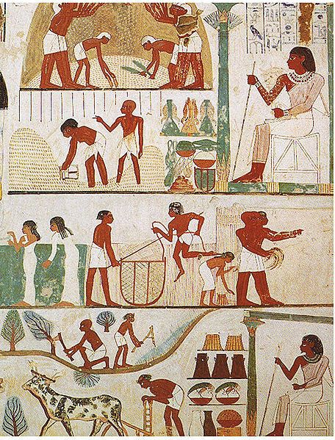
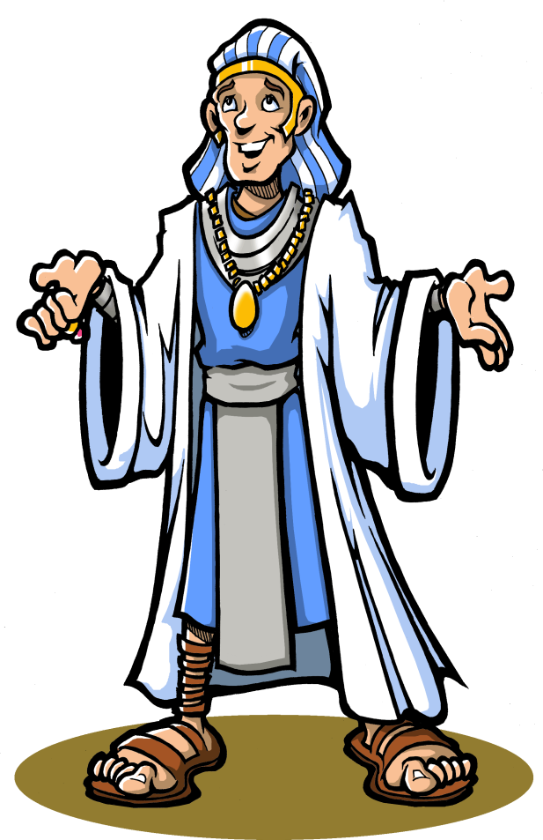


SERVES EGYPT
Joseph stored
the extra grain
for 7 years.
The famine started.
Joseph gave
people the grain.

Slide 11
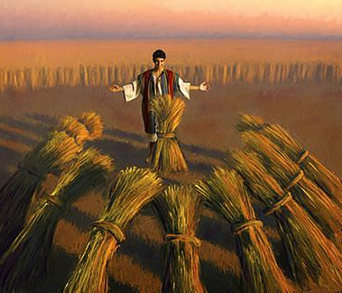
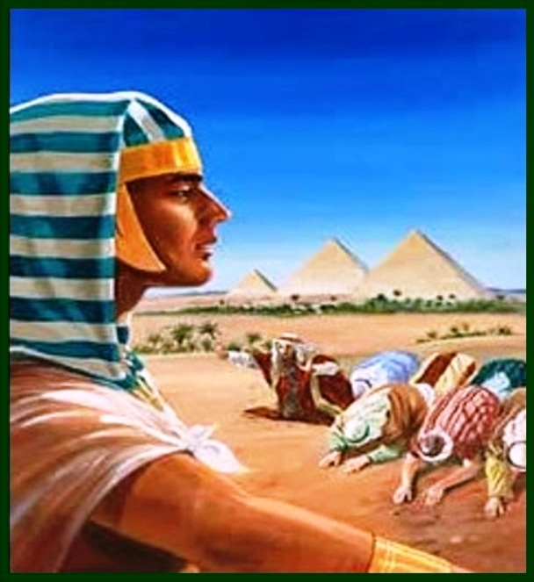
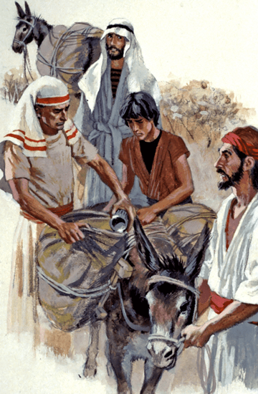
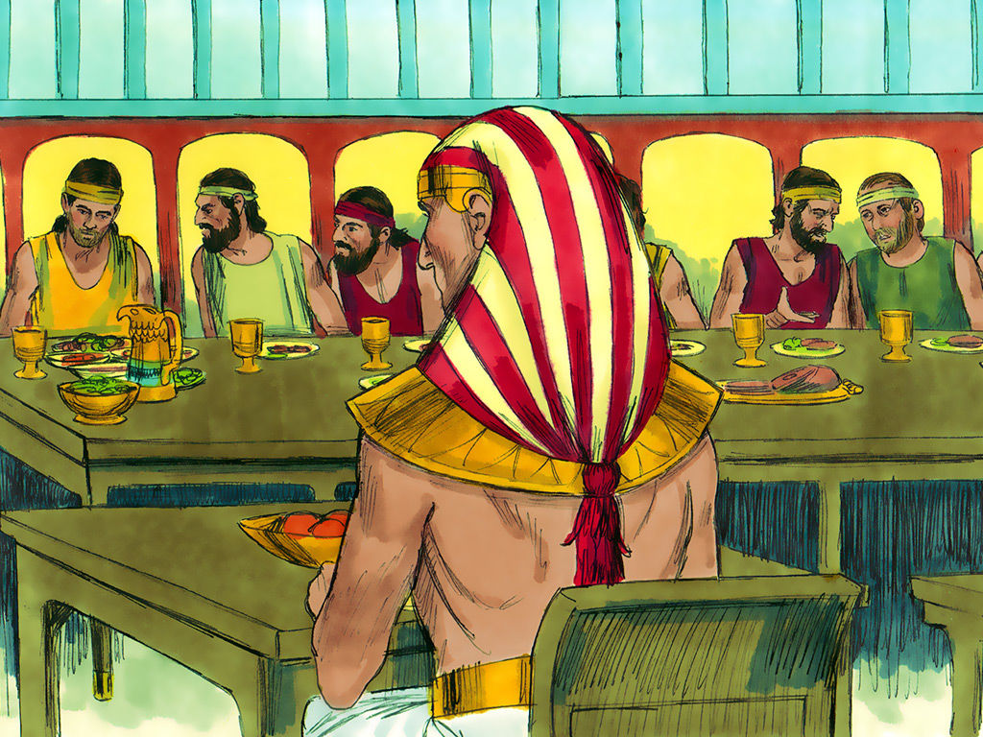
SERVES HIS FAMILY
Joseph saw his brothers come for food and bow. He remembered his dream.
Joseph gave his brothers food, but tested their honesty. Were they kind?
Later, he invited them to a feast. He told them that he was Joseph!
He gave them food and told them to bring their families to Egypt.

Slide 12
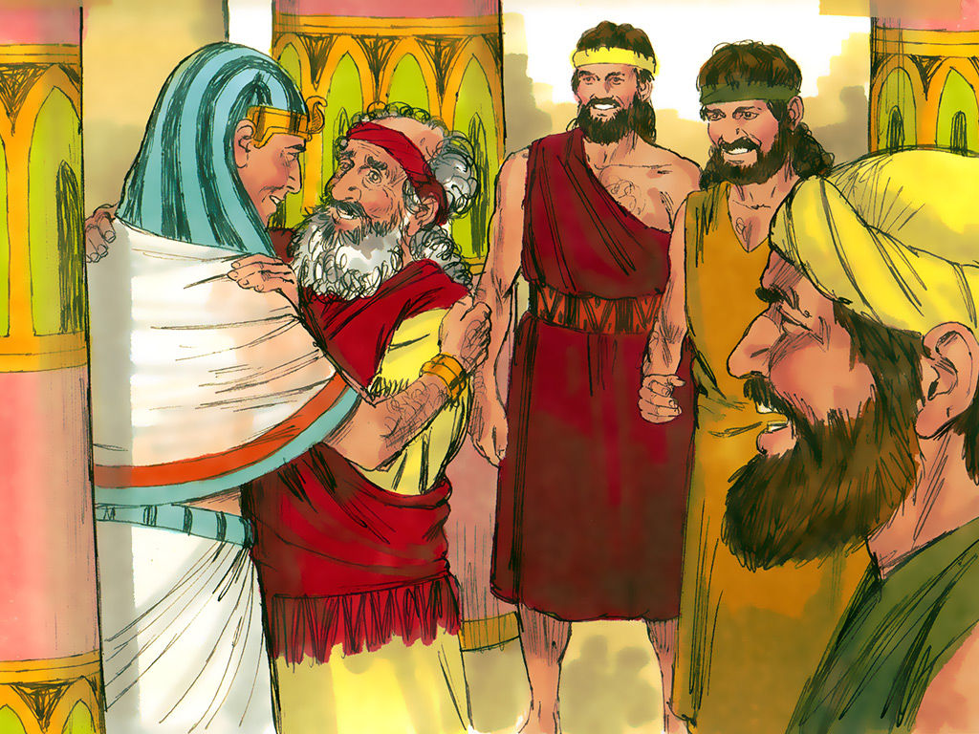
SERVES HIS FAMILY
Jacob,
Joseph’s brothers
and their families
came to Egypt to live
where there was food.
Joseph welcomed them!
Pharaoh gave them
a great place to live.
They took care of
Pharaoh’s cattle and sheep.

Slide 13

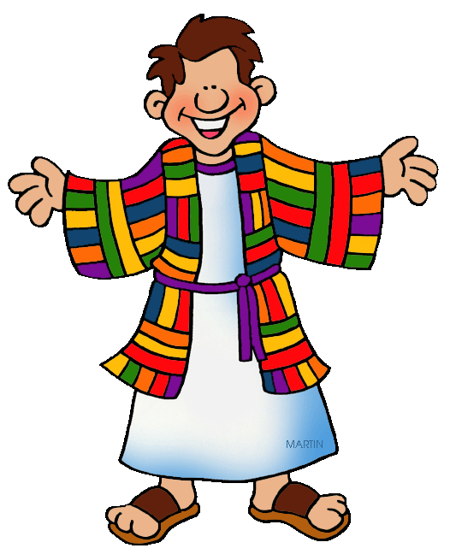


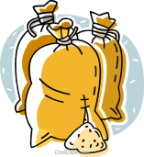
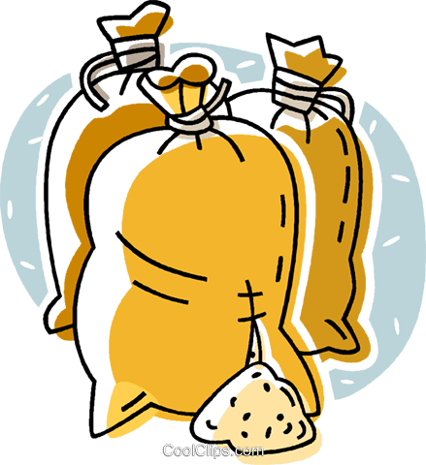

GOD’S WORD SAYS:
^{Galatians 6:10}
Therefore, as we have opportunity,
let us do good
to all people,
especially to those
who belong to the family of believers.

Slide 14
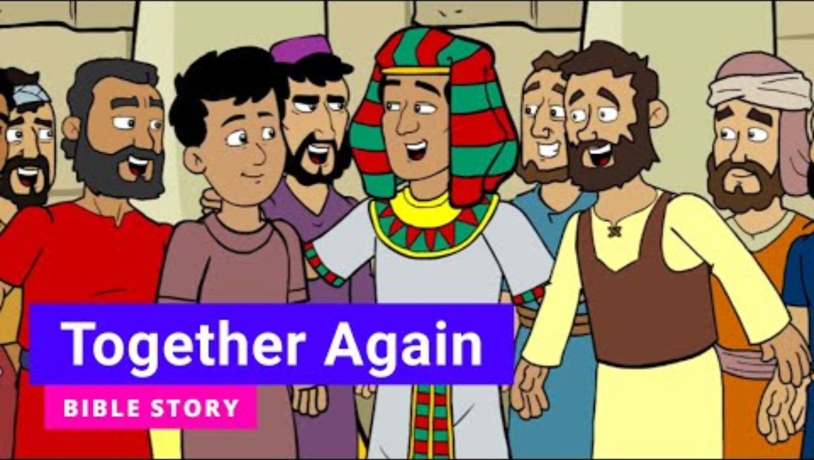

Slide 15
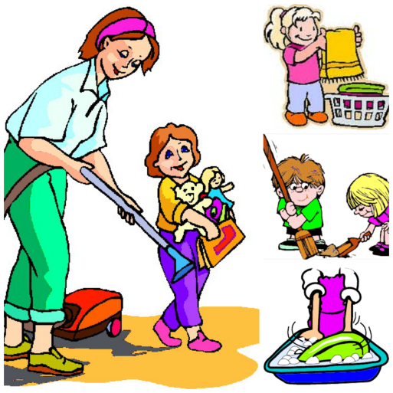
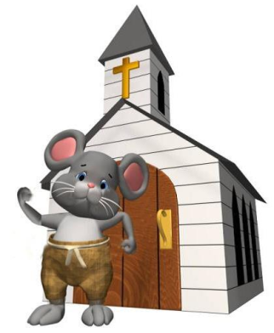

GOD’S WORD SAYS:
^{Galatians 6:10}
Therefore, as we have opportunity,
let us do good
to all people,
especially to those
who belong to the family of believers.
How can you help your family?
How can you help the church?

Slide 16
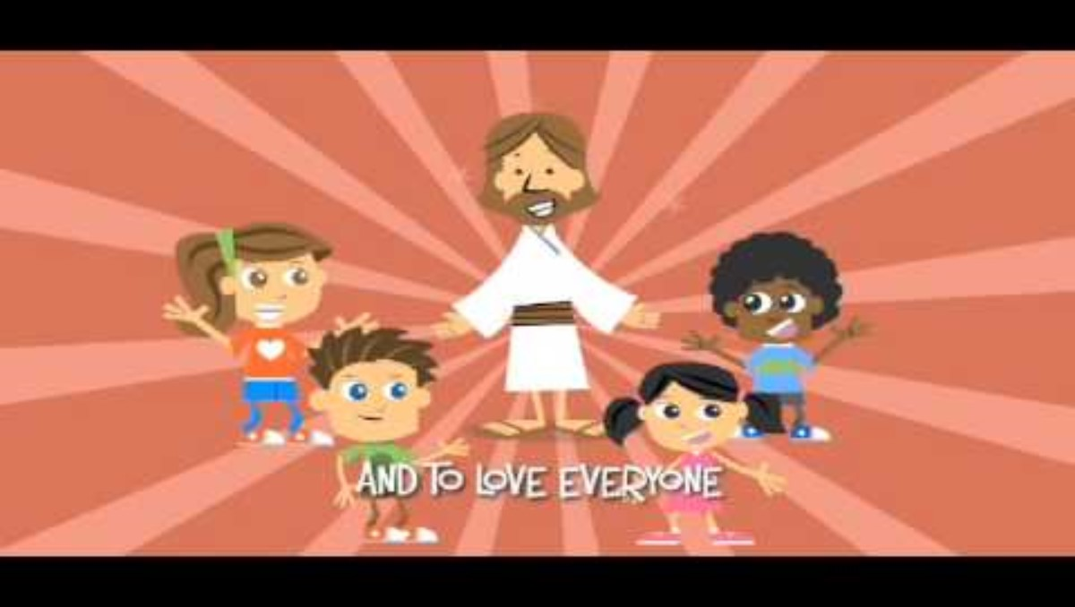
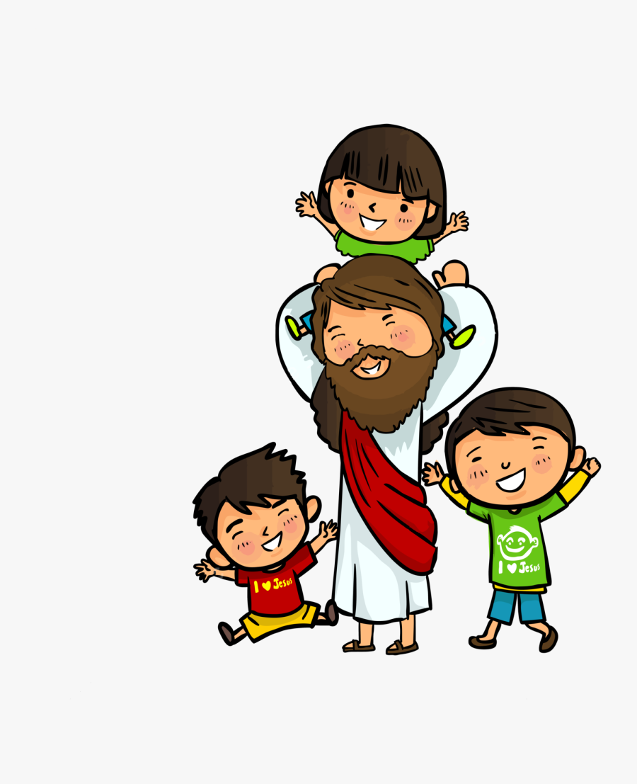
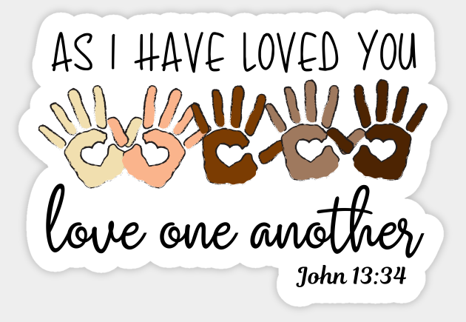

Slide 17
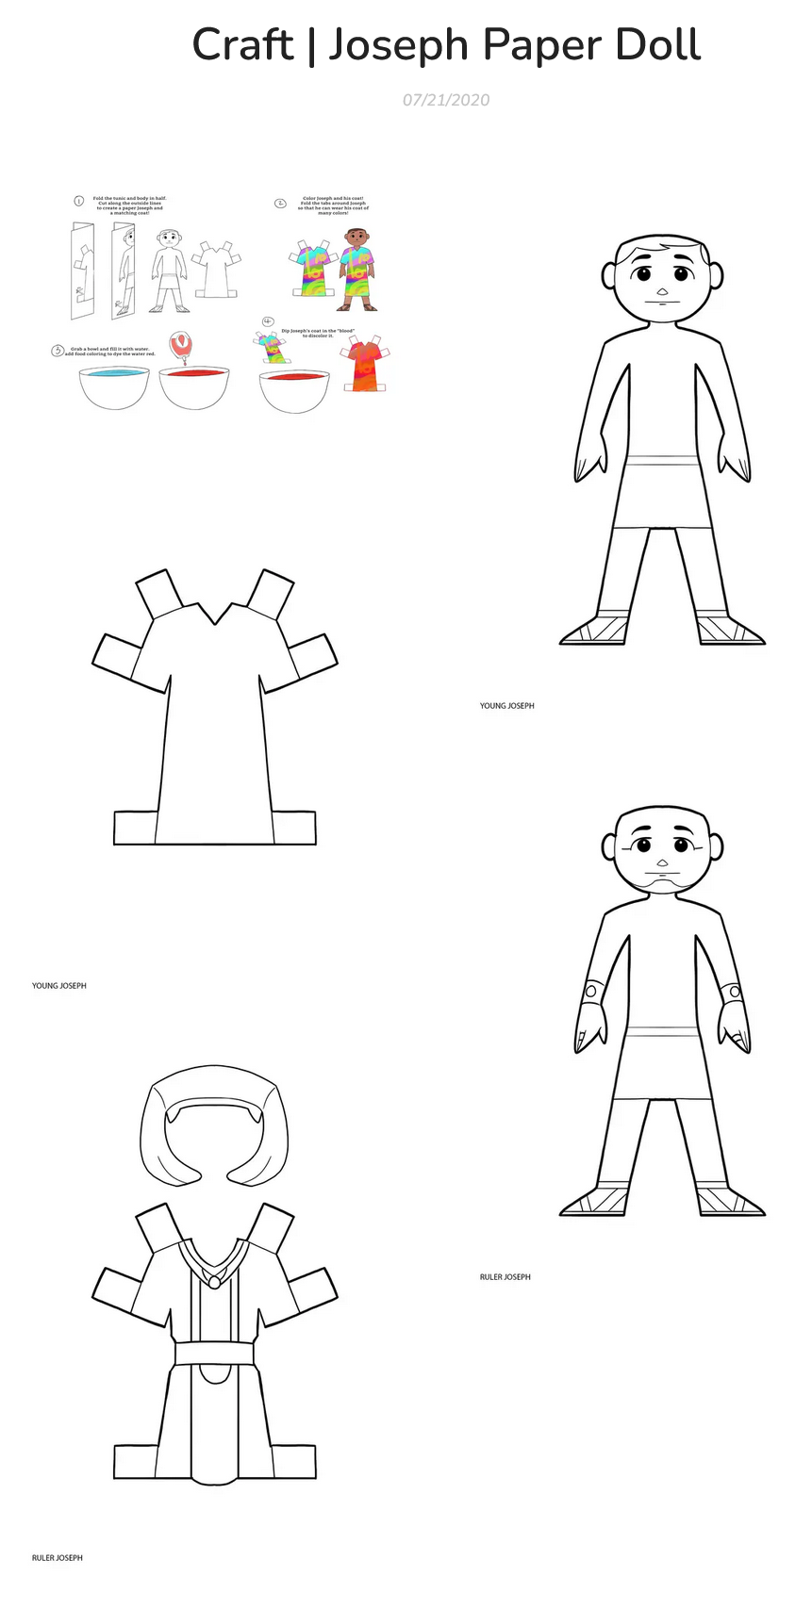

CRAFT TIME
Joseph Paper doll
https://www.biblicaltoolbelt.com/l/craft-joseph-paper-doll/
Coat of many colors
Coat as Pharoah’s right hand man
Coat as Potiphar's slave
https://www.biblicaltoolbelt.com/l/craft-joseph-paper-doll/

Slide 18
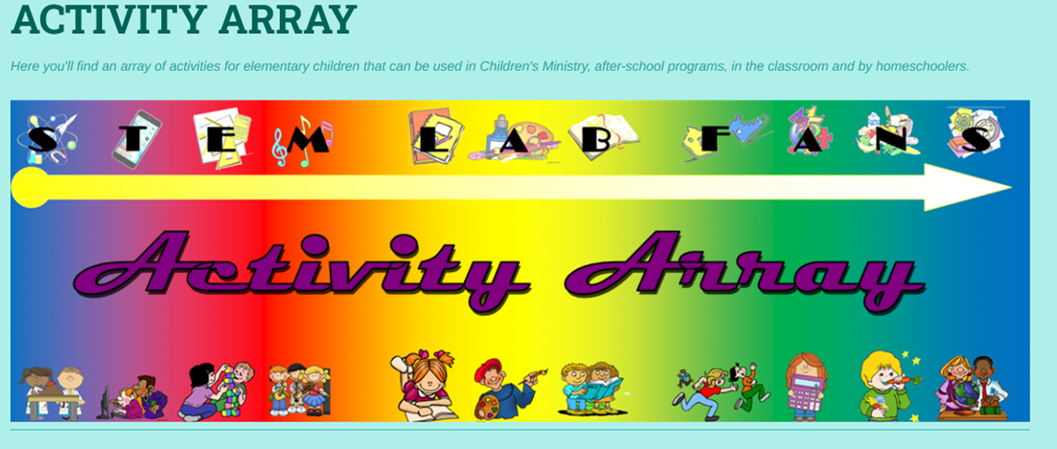
Find more at

