Slide 1
Joseph
Working for Potiphar
Genesis 39-40

Slide 2

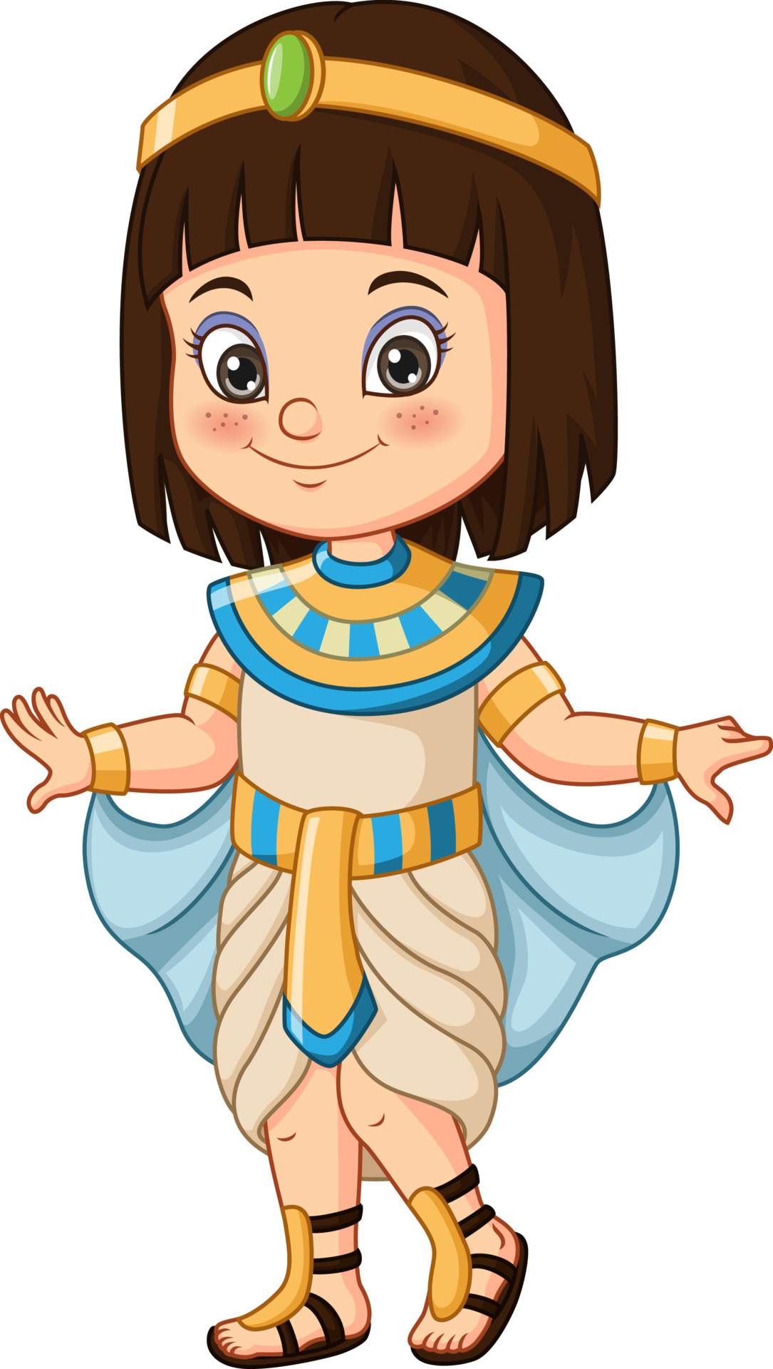
¹⁶ Rejoice always, ¹⁷ pray continually, ¹⁸ give thanks in all circumstances; for this is God’s will for you in Christ Jesus.
1 Thessalonians 5:18
Thank you God, for
_______________
and everything!

Slide 3
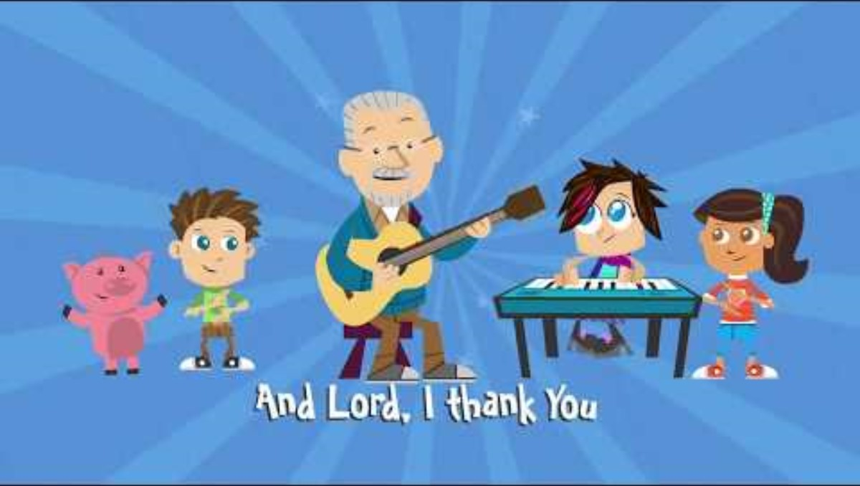
LORD, I Thank You

Slide 4
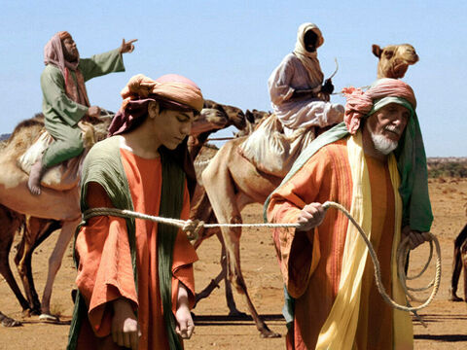
Genesis 39
Going to Egypt
You kept Your promises to my father, Jacob. You were with him and brought him home safely.
I choose to be faithful to You.
Help me to faithfully obey and honor You.
Lord God Almighty,
I believe that You faithfully keep your promises.
Remember Jacob made Joseph a beautiful, colorful coat.
Remember Joseph had dreams that his brothers would bow down to him.
These things made Joseph’s brothers angry and jealous. They tore Joseph’s beautiful coat off of him, threw him in a pit, then sold him to the Ismaelite traders. They covered the coat in a goat’s blood and showed it to their father Jacob. Jacob believed that a ferocious wild beast had devoured Joseph.
But, Joseph had been taken down to Egypt.
Joseph decided to be faithful to God no matter what.

Slide 5
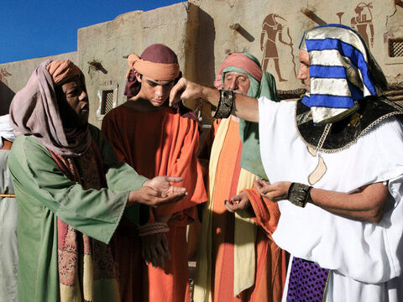
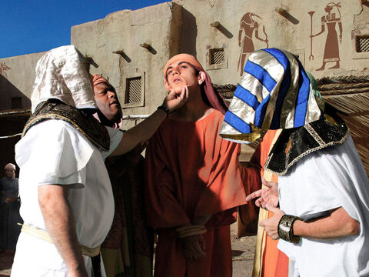
Genesis 39
Sold as a slave
Look at this one Potiphar.
He is well built and healthy.
Yes, I will buy this one.
Now Joseph had been taken down to Egypt.
Potiphar, an Egyptian who was one of Pharaoh’s officials, the captain of the guard, bought him from the Ishmaelites who had taken him there.

Slide 6
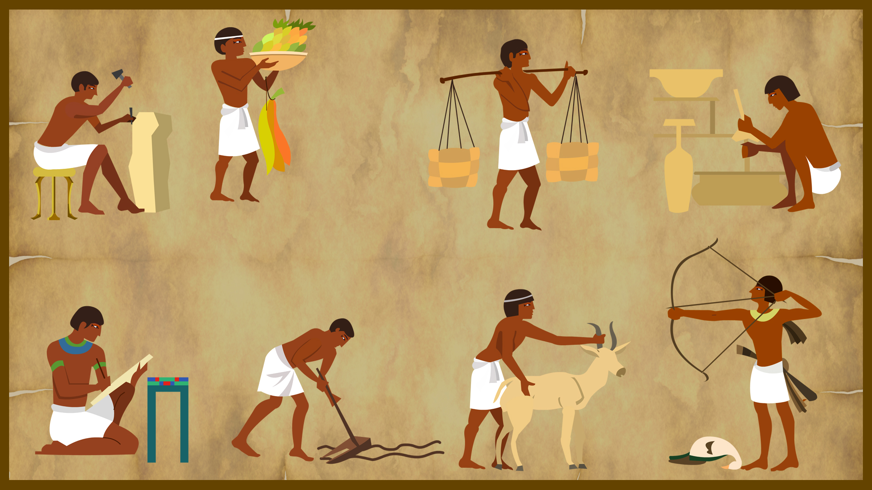
Promoted
² The Lord was with Joseph so that he prospered, and he lived in the house of his Egyptian master.
Maybe it was like this:
The wheat fields that Joseph worked in produced more wheat than the others.
The gardens he worked in produced more.
The animals that Joseph took care of were healthier and had more babies.
When Joseph went to the market, he got really good deals and received more for the money.

Slide 7
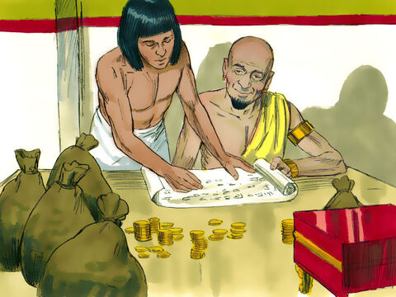
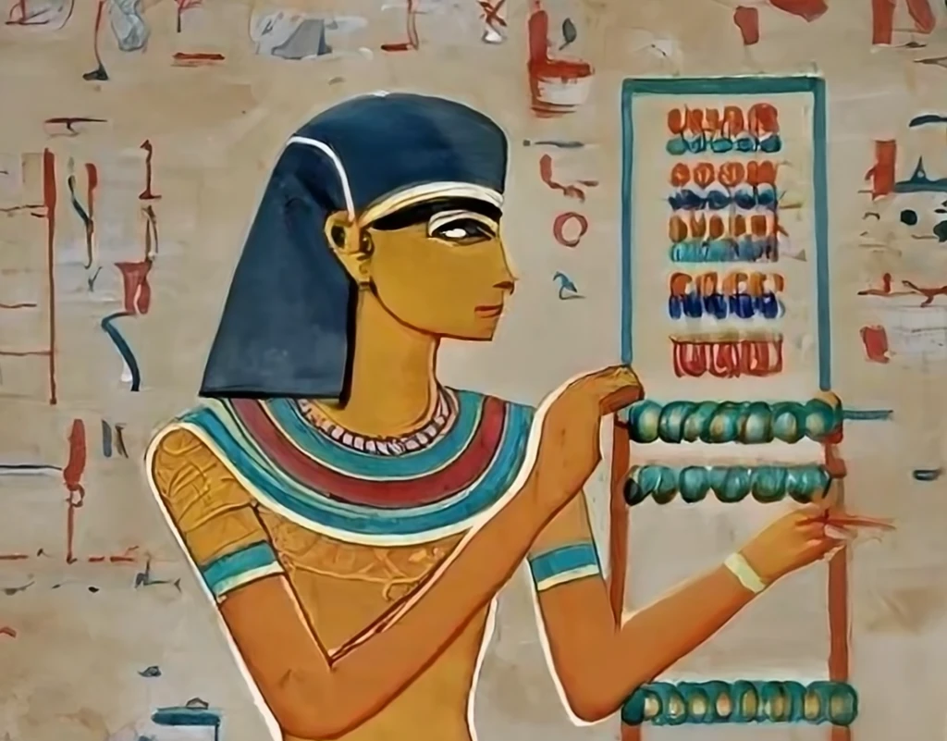
Promoted
Potiphar, the Lord God is blessing you.
Joseph, I see that my riches are growing with you in charge!
Today, I’m putting you in charge of everything in both my house and field.
³ When his master saw that the Lord was with him and that the Lord gave him success in everything he did, ⁴ Joseph found favor in his eyes and became his attendant. Potiphar put him in charge of his household, and he entrusted to his care everything he owned.

Slide 8
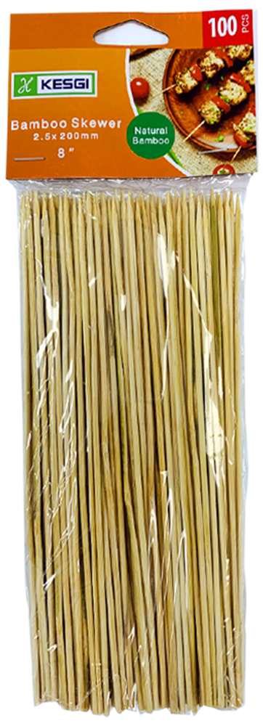
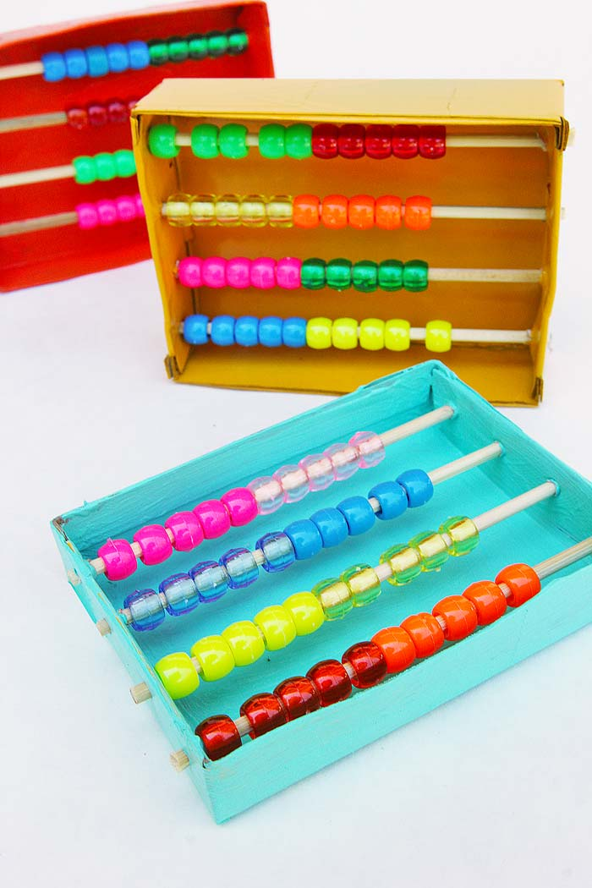

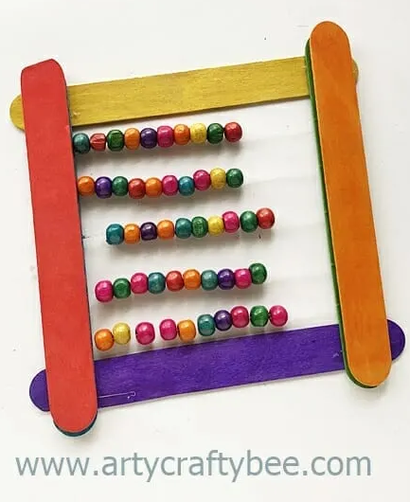
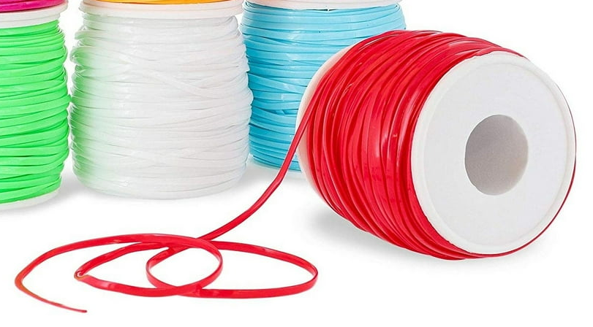
CRAFT TIME Abacus Count your blessings one by one.
You will need: a frame such as a box, picture frame, or DIY popsicle frame
sticks for the beads such as bamboo skewers, thin dowels, pipe-cleaners or even lacing cord
beads of various colors to go on your chosen sticks/cords
Put 5 beads of one color and 5 beads of another color on your chosen ‘stick’. (The 5’s help with counting.)
Repeat for the number of ‘sticks’ that fit on your chosen ‘frame’. Click on ideas to go to website.

Slide 9
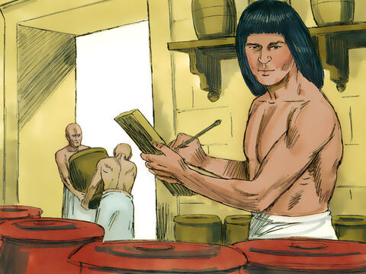
Blessed!
⁵ From the time he put him in charge of his household and of all that he owned, the Lord blessed the household of the Egyptian because of Joseph. The blessing of the Lord was on everything Potiphar had, both in the house and in the field.
⁶ So Potiphar left everything he had in Joseph’s care; with Joseph in charge, he did not concern himself with anything except the food he ate.

Slide 10
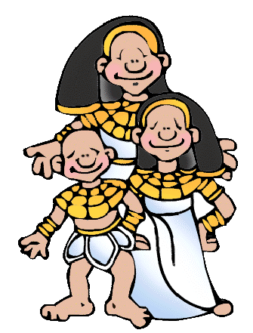
¹⁶ Rejoice always,
¹⁷ pray continually,
¹⁸ give thanks in
all circumstances;
for this is God’s will
for you
in Christ Jesus.
1 Thessalonians 5:18
Thank you God,
for a good job
and money
and plenty of food
and clothes…
and everything!
Count
Your
Blessing
Name them
One by one

Slide 11
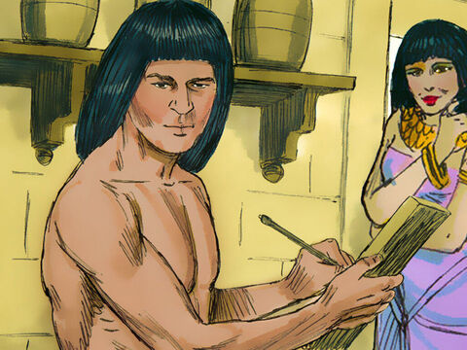
Temptation
Joseph, you are so handsome!
Come to bed with me.
Now Joseph was well-built and handsome, ⁷ and after a while his master’s wife took notice of Joseph and said, “Come to bed with me!”
⁸ But he refused. “With me in charge,” he told her, “my master does not concern himself with anything in the house; everything he owns he has entrusted to my care. ⁹ No one is greater in this house than I am. My master has withheld nothing from me except you, because you are his wife. How then could I do such a wicked thing and sin against God?”
No. My master has put me
in charge of everything,
but you are his.
I will not sin against him
nor God by doing this wicked thing. NO, I will not!

Slide 12
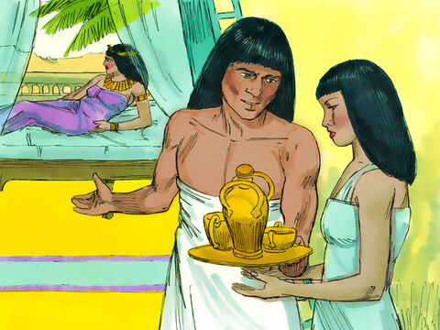
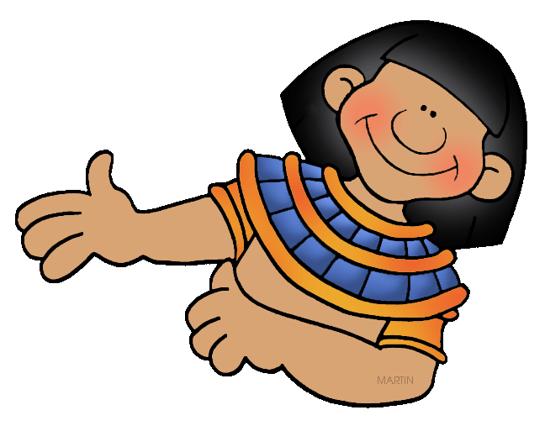
Resolve & Boundaries
Will you take this to the Mistress, please. I will not go near her nor give in to her desire to have me go to bed with her..
¹⁰ And though she spoke to Joseph day after day, he refused to go to bed with her or even be with her.
I know I can trust Joseph. He knows and does
what is right.
Ok Joseph

Slide 13
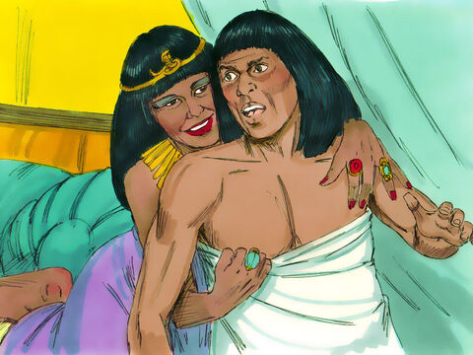
Commanded
No one else is anywhere near.
Come to bed with me!
NO!
I’m not your husband!
¹¹ One day he went into the house to attend to his duties, and none of the household servants was inside.
¹² She caught him by his cloak and said, “Come to bed with me!”

Slide 14
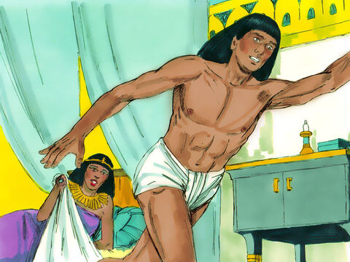
RUN!
¹² …But he left his cloak in her hand and ran out of the house.

Slide 15
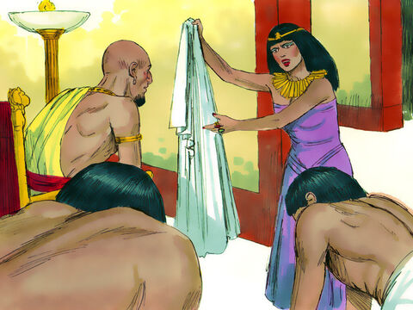
Look
Servants come here!
Look, this Hebrew has come to make sport with us.
He came in here to sleep with me, but I screamed.
When he heard me scream, he left his cloak beside me
and ran out of the house.
¹³ When she saw that he had left his cloak in her hand and had run out of the house, ¹⁴ she called her household servants.
“Look,” she said to them, “this Hebrew has been brought to us to make sport of us! He came in here to sleep with me, but I screamed. ¹⁵ When he heard me scream for help, he left his cloak beside me and ran out of the house.”

Slide 16
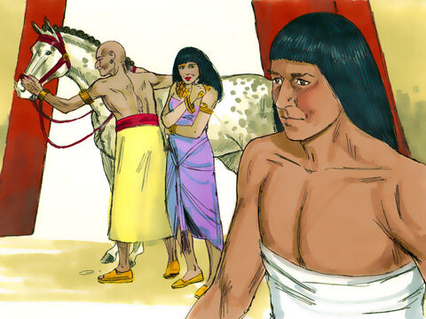

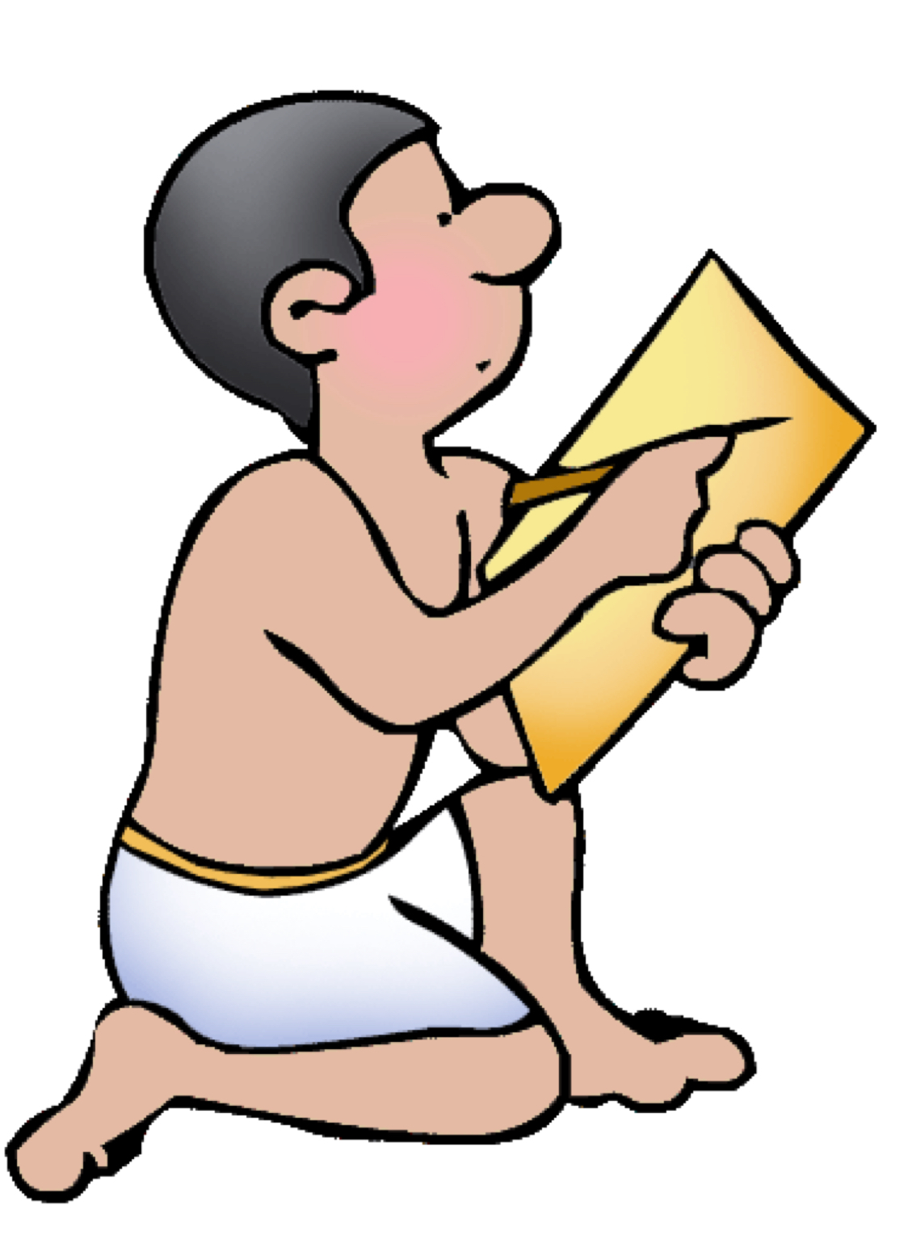
That Hebrew slave you brought us came to me to make sport of me. But as soon as I screamed for help, he left his cloak beside me and ran out of the house.
¹⁶ She kept his cloak beside her until his master came home.
¹⁷ Then she told him this story: “That Hebrew slave you brought us came to me to make sport of me. ¹⁸ But as soon as I screamed for help, he left his cloak beside me and ran out of the house.”
¹⁹ When his master heard the story his wife told him, saying, “This is how your slave treated me,” he burned with anger.
Is that the true story?

Slide 17
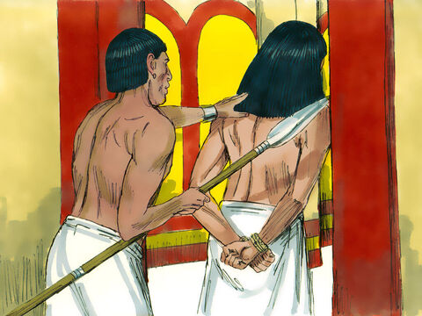
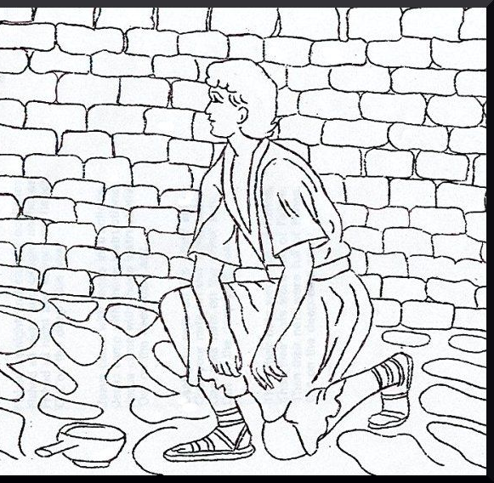
Prisoner
This isn’t fair,
but I will trust God.
He will make things right.
⁰ Joseph’s master took him and put him in prison, the place where the king’s prisoners were confined.

Slide 18
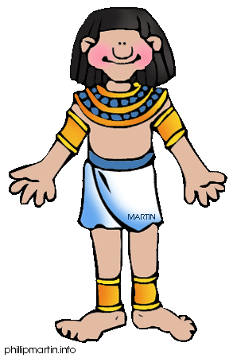
¹⁷ Do not repay anyone
evil for evil….
¹⁹ Do not take revenge, my dear friends, but leave room for God’s wrath, for it is written: “It is mine to avenge; I will repay,” says the Lord…..
²¹ Do not be overcome by evil, but, overcome evil with good.
Romans
12:17-21
What should we do if we are wronged and treated unfairly?

Slide 19
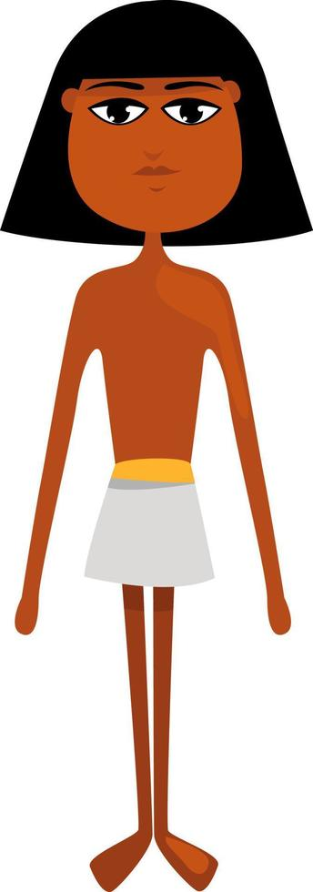

Thank you God
That I am alive
And that I didn’t
give into temptation
and sin.
Sometimes what feels like
a really tough time,
is God training us for something really important. When we look for things
to be thankful for,
we are giving ourselves
the gift of a positive attitude. Then we are better able to share God's love
and be faithful to Him.
¹⁶ Rejoice always,
¹⁷ pray continually,
¹⁸ give thanks in
all circumstances;
for this is God’s will
for you
in Christ Jesus.
1 Thessalonians 5:18

Slide 20
CRAFT TIME Abacus Count your blessings one by one.
Finish your abacus by writing our verse (or putting stickers with the verse) on the sides of your frame.
“Count your blessings”
“Give thanks in all circumstances”
Give Thanks
Count your blessings
In all circumstances

Slide 21
What are you thankful for?
Use your abacus to count your blessings.
As we say something we are thankful for, move a bead over.
Count
Your
Blessing
Name them
One by one

Slide 22
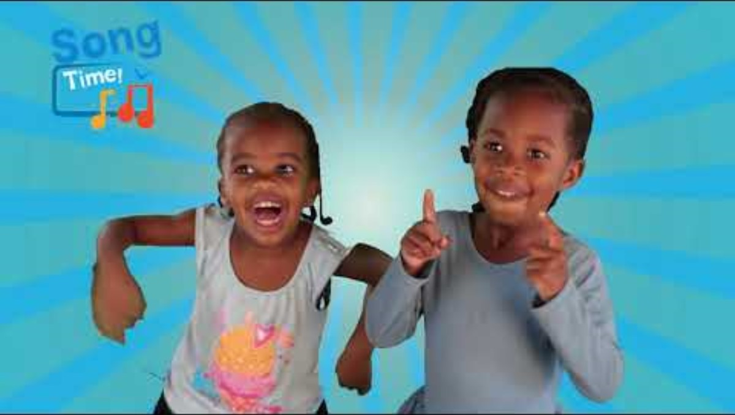
Count Your Blessings

Slide 23
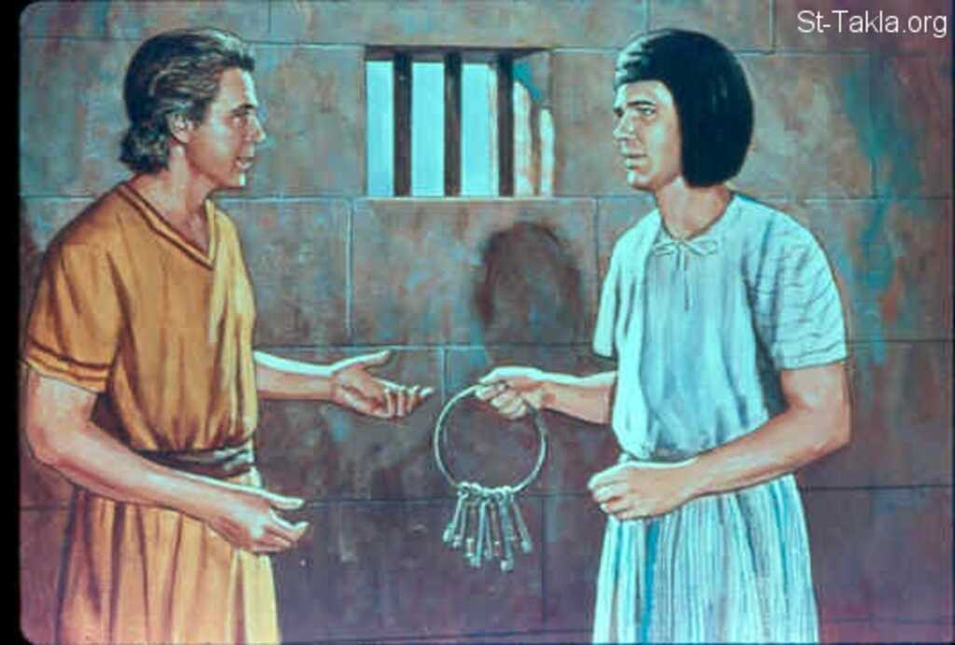
Appreciated
Joseph, I appreciate all your help.
I see that I can trust you.
I’m putting you in charge of everything that needs to be done,
But while Joseph was there in the prison, ²¹ the Lord was with him; he showed him kindness and granted him favor in the eyes of the prison warden.
²² So the warden put Joseph in charge of all those held in the prison, and he was made responsible for all that was done there. ²³ The warden paid no attention to anything under Joseph’s care, because the Lord was with Joseph and gave him success in whatever he did.

Slide 24
¹⁶ Rejoice always,
¹⁷ pray continually,
¹⁸ give thanks in
all circumstances;
for this is God’s will
for you
in Christ Jesus.
1 Thessalonians 5:18
Thank you, God
That I am still trusted.
Thank you that I can help others.

Slide 25
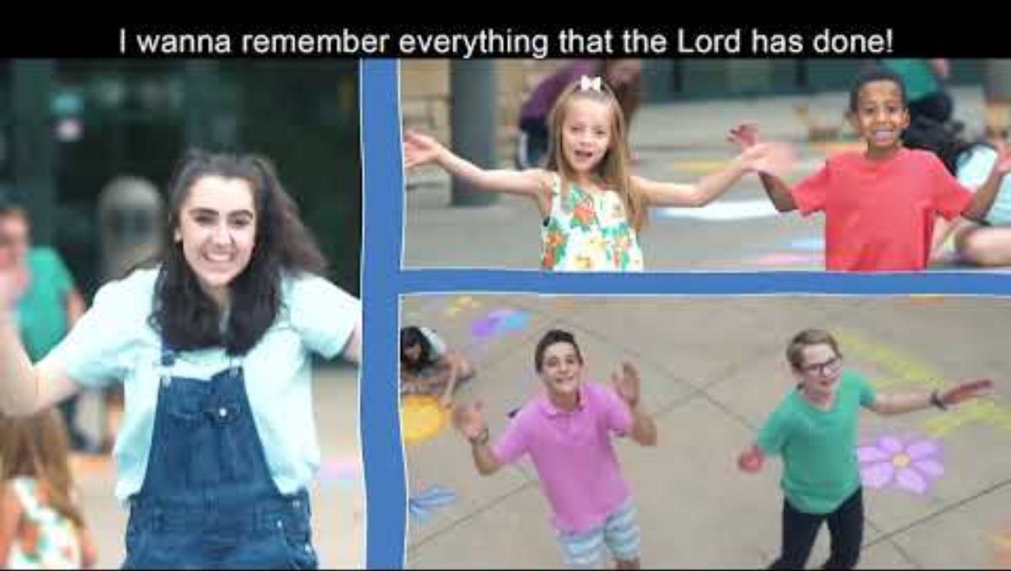
Thankful -- Roar VBS

Slide 26
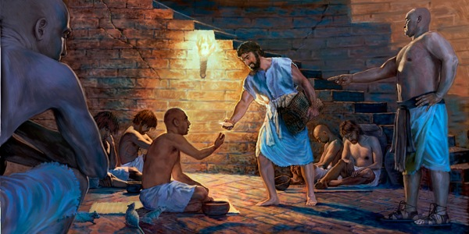
Genesis 40
Baker & Cupbearer
This is Joseph.
Listen to him.
He is in charge.
Here is some good bread to sustain you.
Can I get you anything else?
Some time later, the cupbearer and the baker of the king of Egypt offended their master, the king of Egypt.
² Pharaoh was angry with his two officials, the chief cupbearer and the chief baker, ³ and put them in custody in the house of the captain of the guard, in the same prison where Joseph was confined.
⁴ The captain of the guard assigned them to Joseph, and he attended them.
Thank you

Slide 27
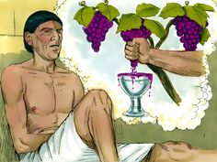
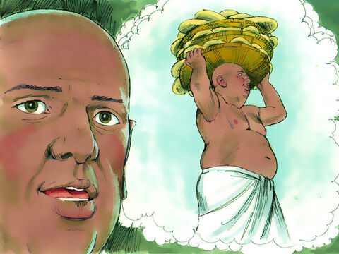
Dreams
I wonder what the dream means?
-- 3 branches of grapes
-- poured into a cup
I wonder what the
dream means?
-- 3 baskets
-- birds eating the bread
After they had been in custody for some time, ⁵ each of the two men—the cupbearer and the baker of the king of Egypt, who were being held in prison—had a dream the same night, and each dream had a meaning of its own.

Slide 28
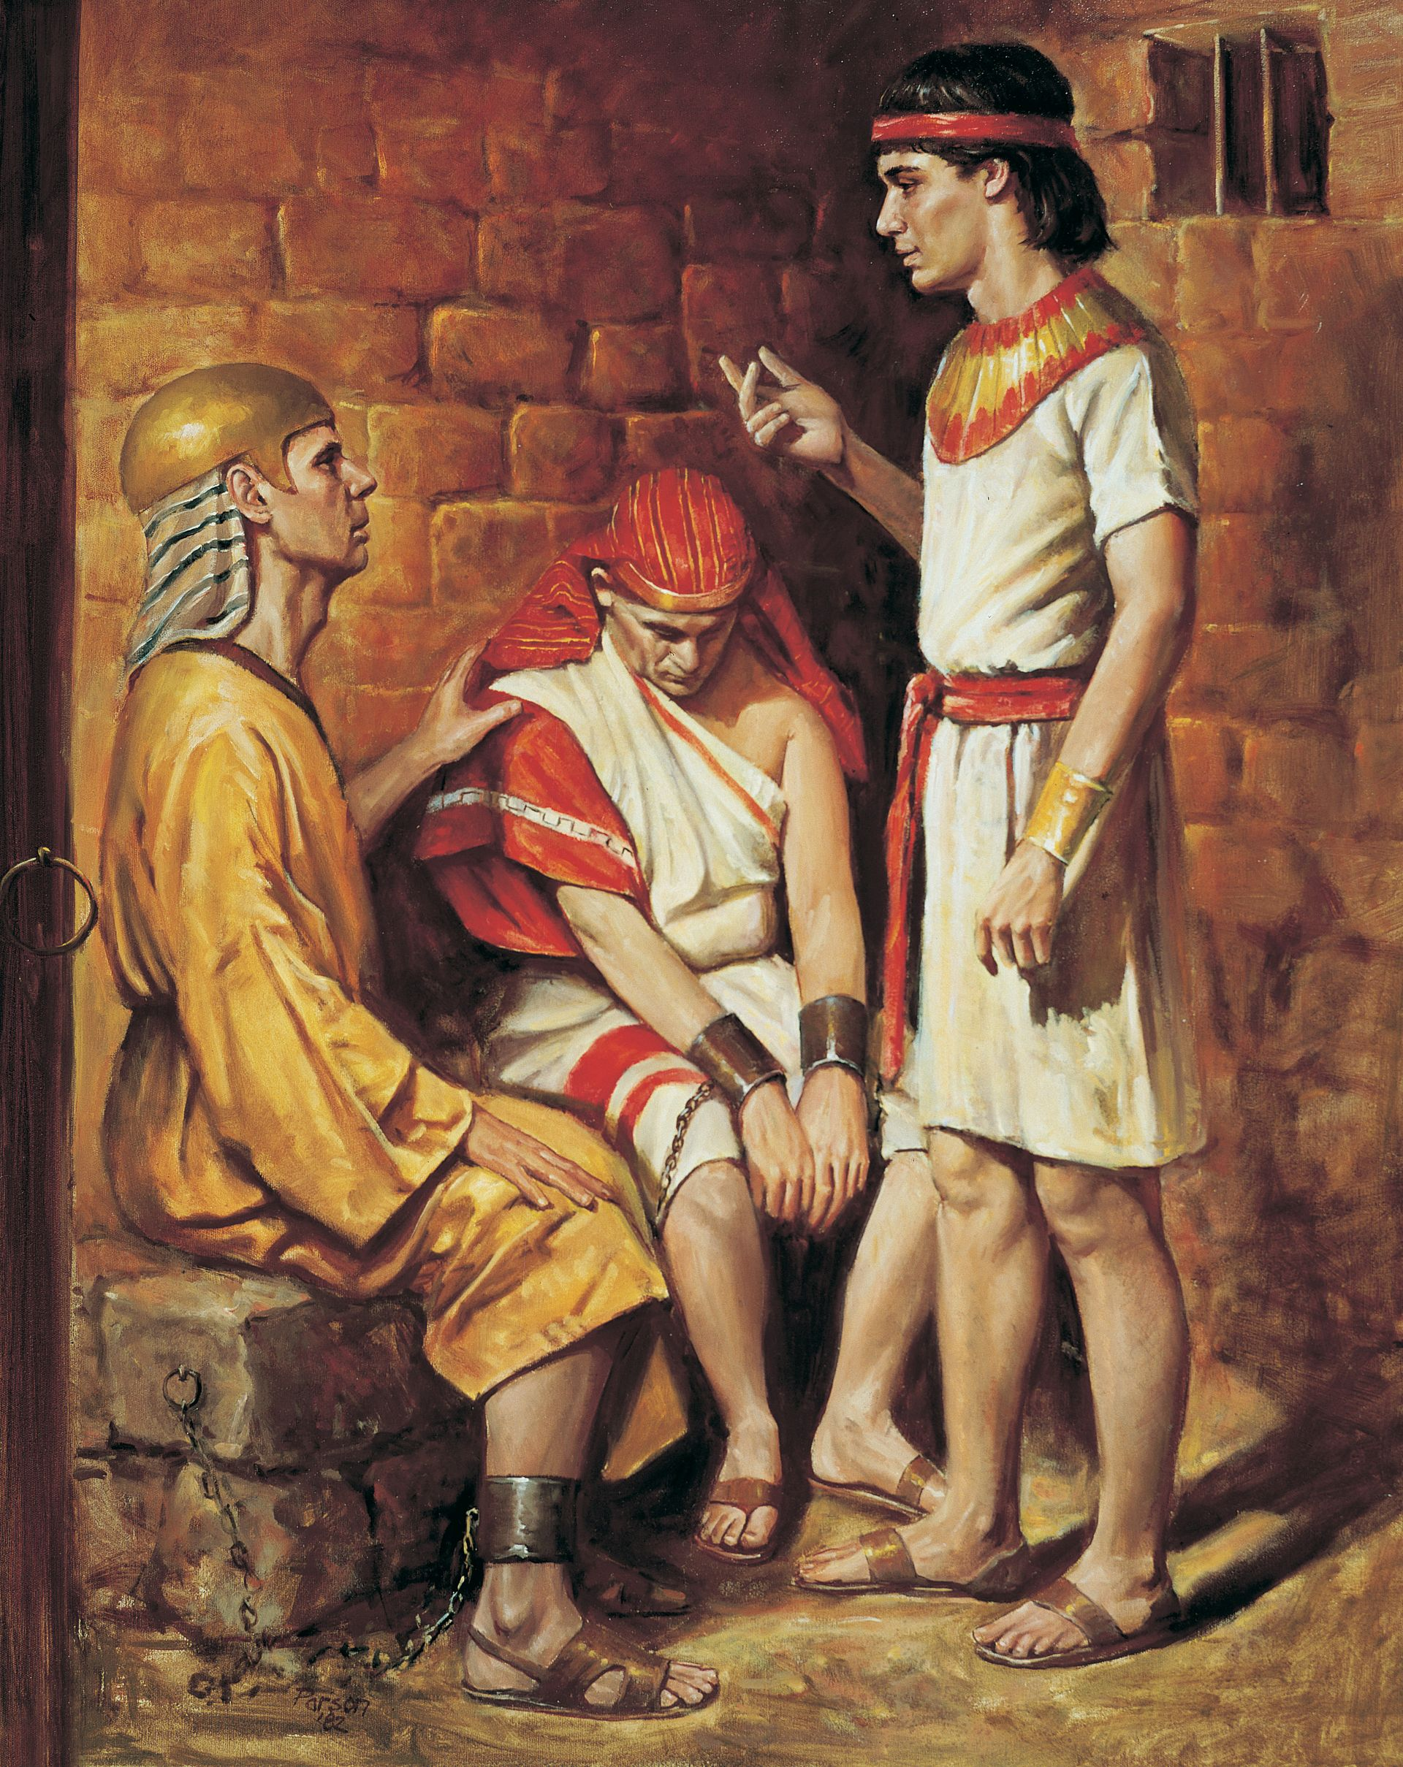
Dreams
Why are you looking so sad today?
Don’t interpretations belong to God?
Tell me your dreams.
We both had important dreams, but we don’t know what they mean.
⁶ When Joseph came to them the next morning, he saw that they were dejected. ⁷ So he asked Pharaoh’s officials who were in custody with him in his master’s house, “Why do you look so sad today?”
⁸ “We both had dreams,” they answered, “but there is no one to interpret them.”
Then Joseph said to them, “Do not interpretations belong to God? Tell me your dreams.”

Slide 29
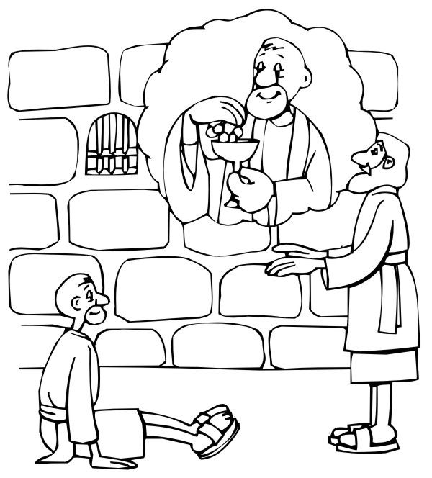
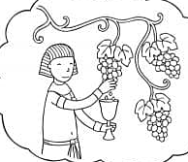
Cup bearer
In my dream I saw a grape vine with 3 branches. They quickly grew and produced fruit.
I had Pharoah’s cup.
I squeezed the grapes and put the grape juice in his cup and gave it to him.
When you get out, please remember me and get me out of prison. I haven’t done anything wrong.
Your dream means that in 3 days you will be called to Pharoah and will again be his cupbearer.
⁹ So the chief cupbearer told Joseph his dream. He said to him, “In my dream I saw a vine in front of me, ¹⁰ and on the vine were three branches. As soon as it budded, it blossomed, and its clusters ripened into grapes. ¹¹ Pharaoh’s cup was in my hand, and I took the grapes, squeezed them into Pharaoh’s cup and put the cup in his hand.”
¹² “This is what it means,” Joseph said to him. “The three branches are three days. ¹³ Within three days Pharaoh will lift up your head and restore you to your position, and you will put Pharaoh’s cup in his hand, just as you used to do when you were his cupbearer.
¹⁴ But when all goes well with you, remember me and show me kindness; mention me to Pharaoh and get me out of this prison. ¹⁵ I was forcibly carried off from the land of the Hebrews, and even here I have done nothing to deserve being put in a dungeon.”

Slide 30
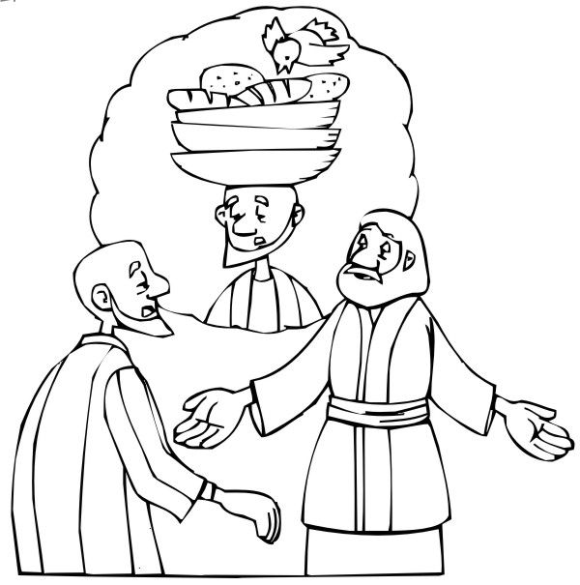
Baker
That’s awesome!
I had a dream too.
I dreamt that I had 3 baskets on my head.
The birds were eating the bread out of the top basket.
The 3 baskets are 3 days.
In 3 days, Pharaoh will
lift up your head.
You will die.
The birds
will eat your flesh.
¹⁶ When the chief baker saw that Joseph had given a favorable interpretation, he said to Joseph, “I too had a dream: On my head were three baskets of bread.^{[a]} ¹⁷ In the top basket were all kinds of baked goods for Pharaoh, but the birds were eating them out of the basket on my head.”
¹⁸ “This is what it means,” Joseph said. “The three baskets are three days. ¹⁹ Within three days Pharaoh will lift off your head and impale your body on a pole. And the birds will eat away your flesh.”

Slide 31

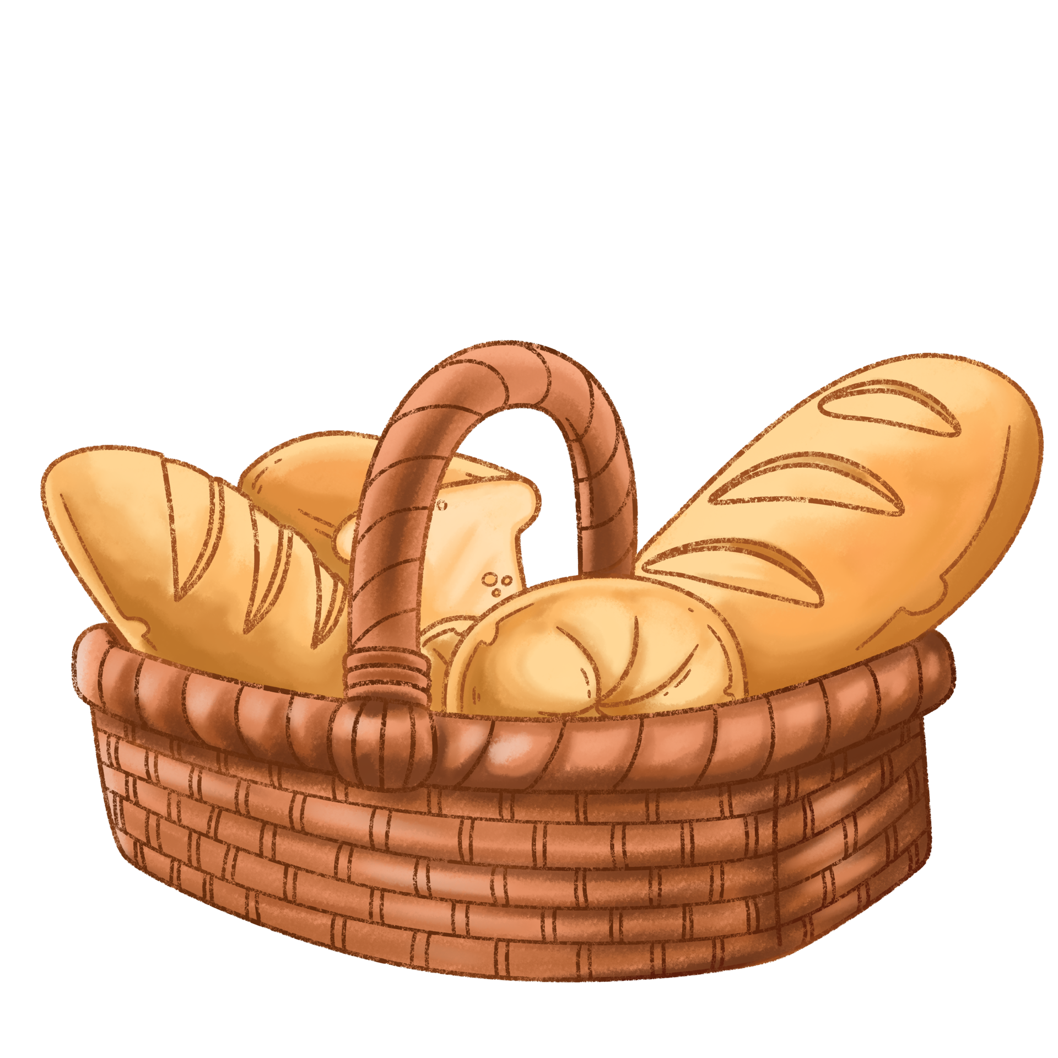
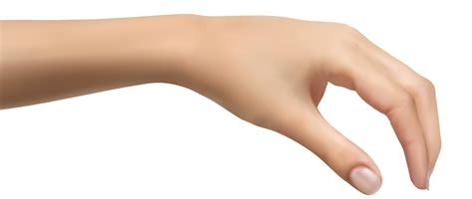
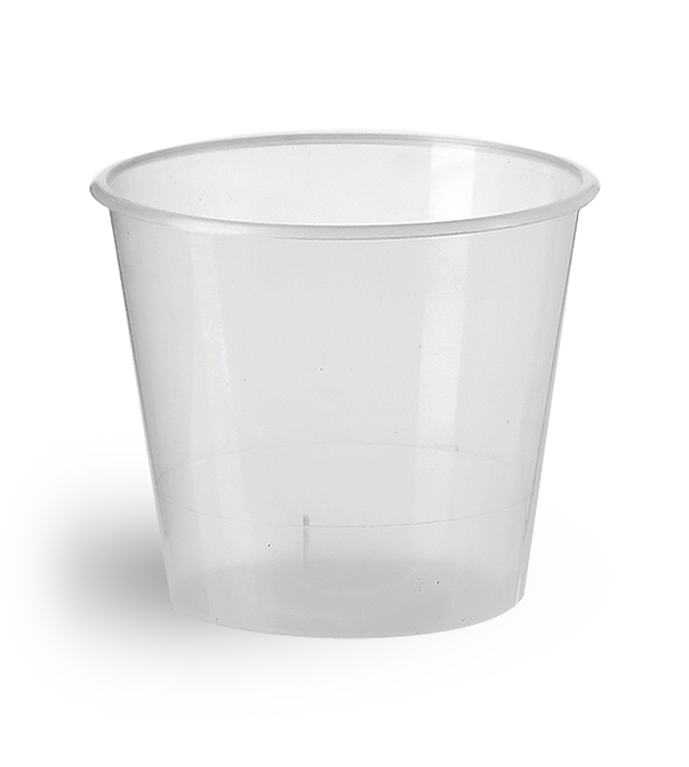
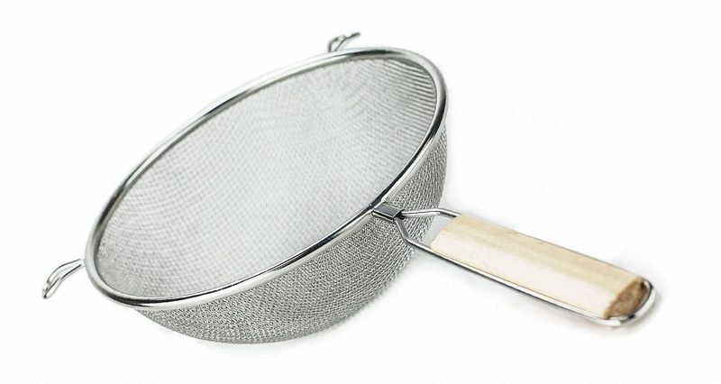
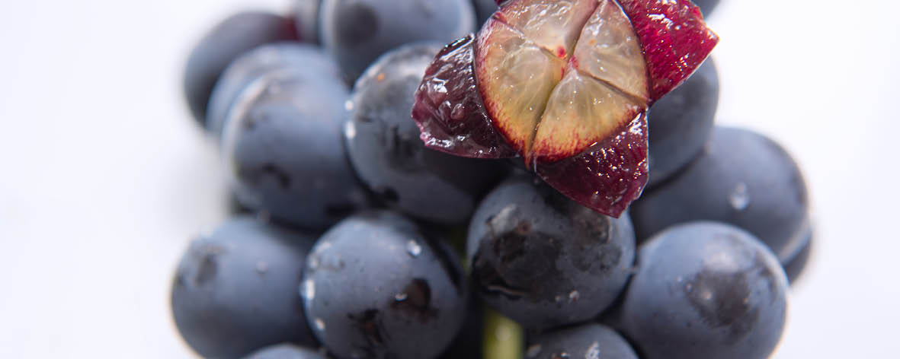


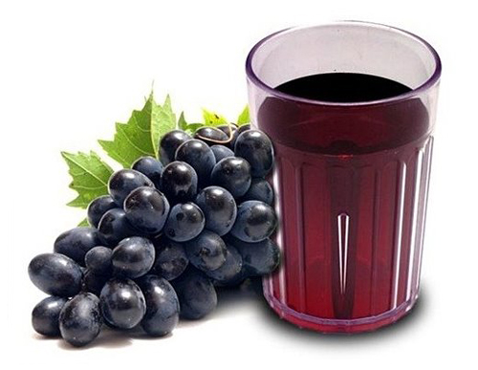
Snack Time
Pretend you are the cup bearer.
You can press some grapes in a sieve so that it makes fresh juice in a cup.
We’ll give you some more grape juice to add to it.
Then you can pretend like you are birds.
You can come get bread out of the basket on my head to eat for your snack.

Slide 32
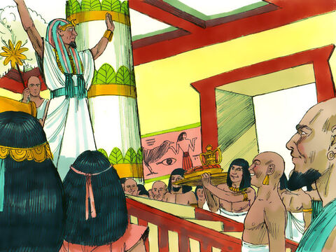
Birthday Favor
The cup bearer is innocent.
He will be my cupbearer again.
The baker is guilty. Cut off his head. Impale his body on a pole. Let all know that I will discover all wicked schemes and judge decisively.
Listen everyone.
My cupbearer or my baker did wrong.
I have looked at the evidence.
Bring them before me and I will give my decision.
²⁰ Now the third day was Pharaoh’s birthday, and he gave a feast for all his officials.
He lifted up the heads of the chief cupbearer and the chief baker in the presence of his officials:
²¹ He restored the chief cupbearer to his position, so that he once again put the cup into Pharaoh’s hand—
²² but he impaled the chief baker, just as Joseph had said to them in his interpretation.
Happy Birthday
Pharaoh!

Slide 33
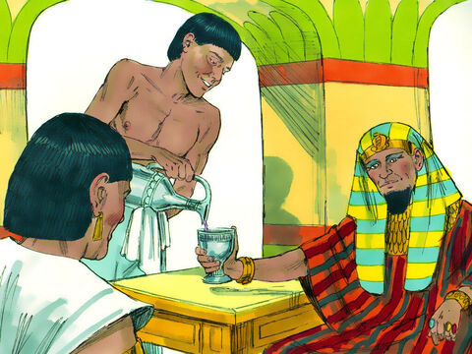
Forgotten
²³ The chief cupbearer, however, did not remember Joseph; he forgot him.

Slide 34

Thankful by The Juicebox Jukebox

Slide 35

I am Thankful

Slide 36
EXTRA EXTRA

Slide 37
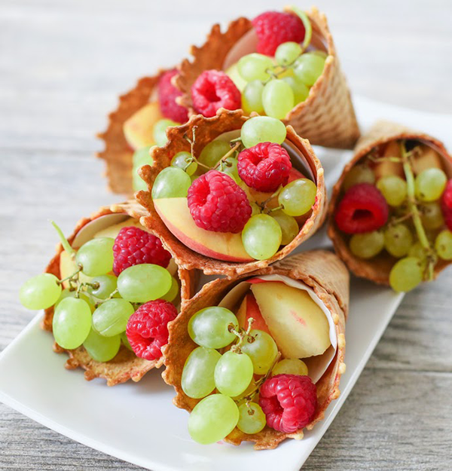

Slide 38
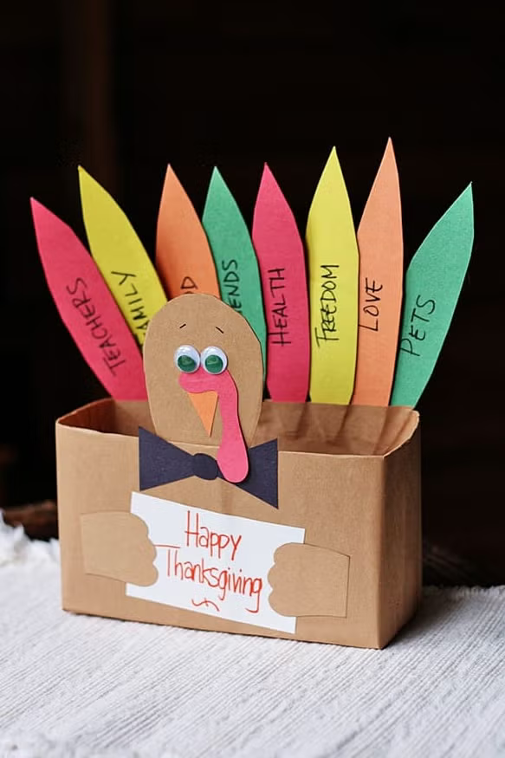
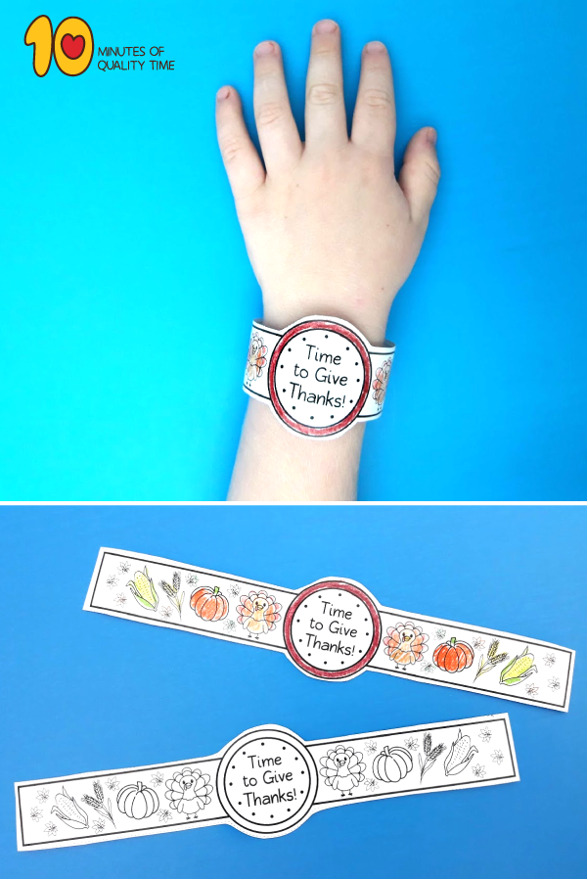
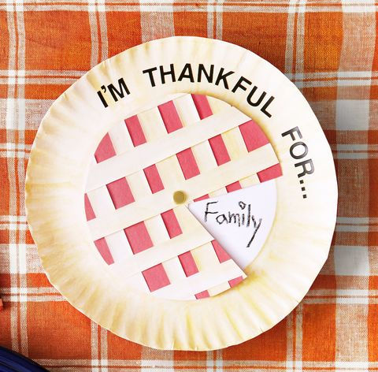
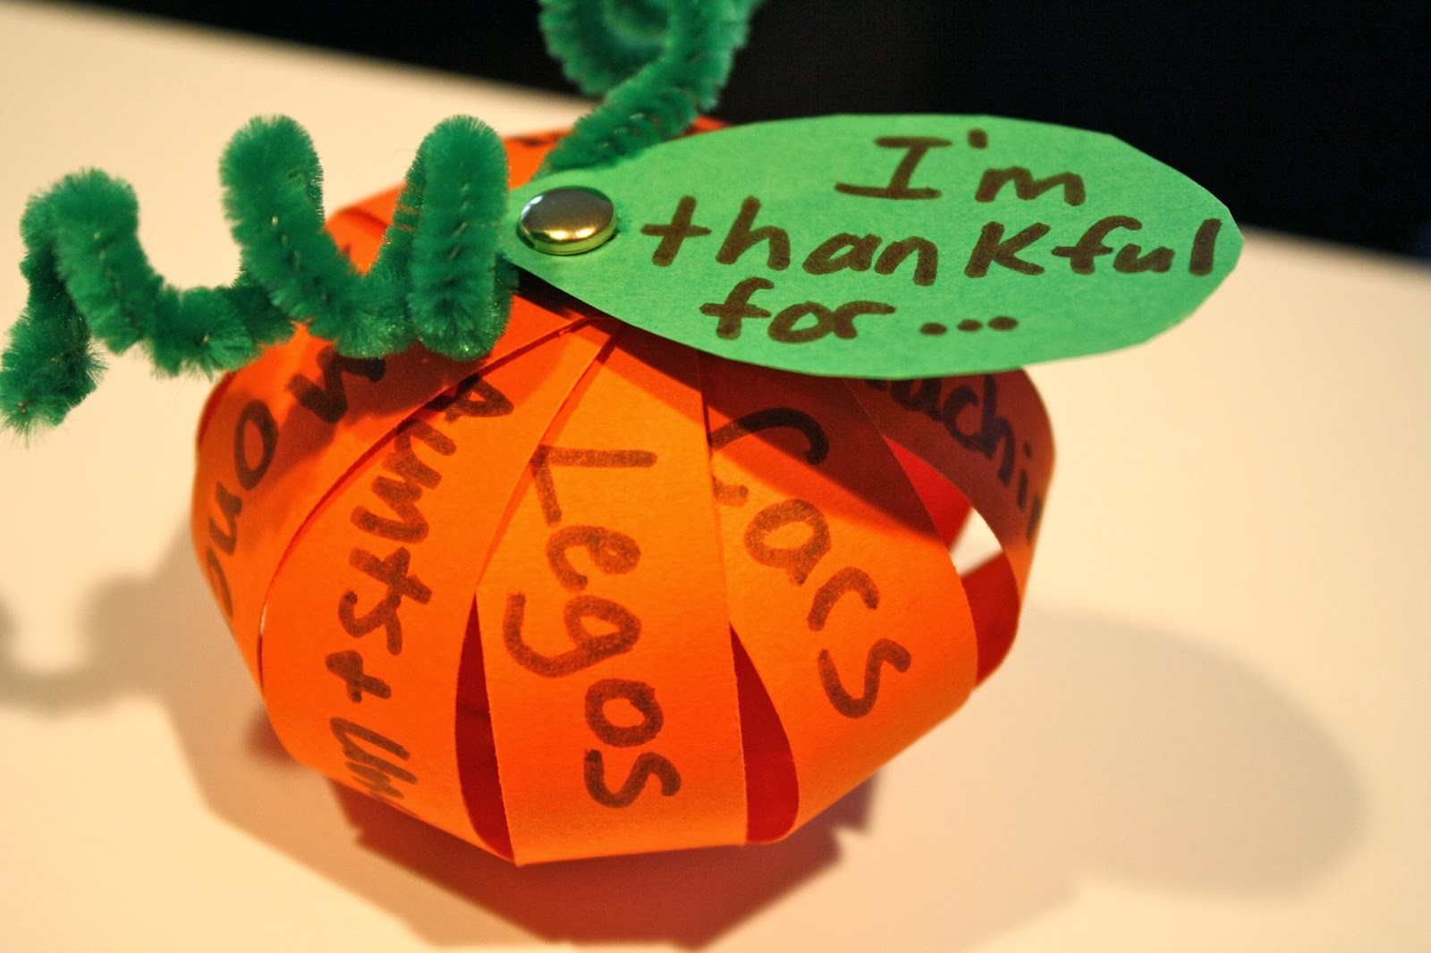
Craft Time

