Slide 1

Joseph Forgives
His Brothers
Genesis 42-45

Slide 2
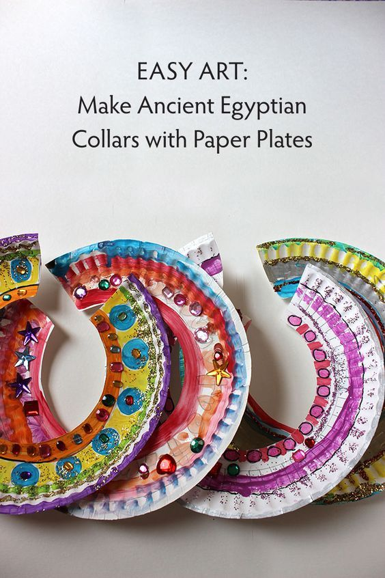
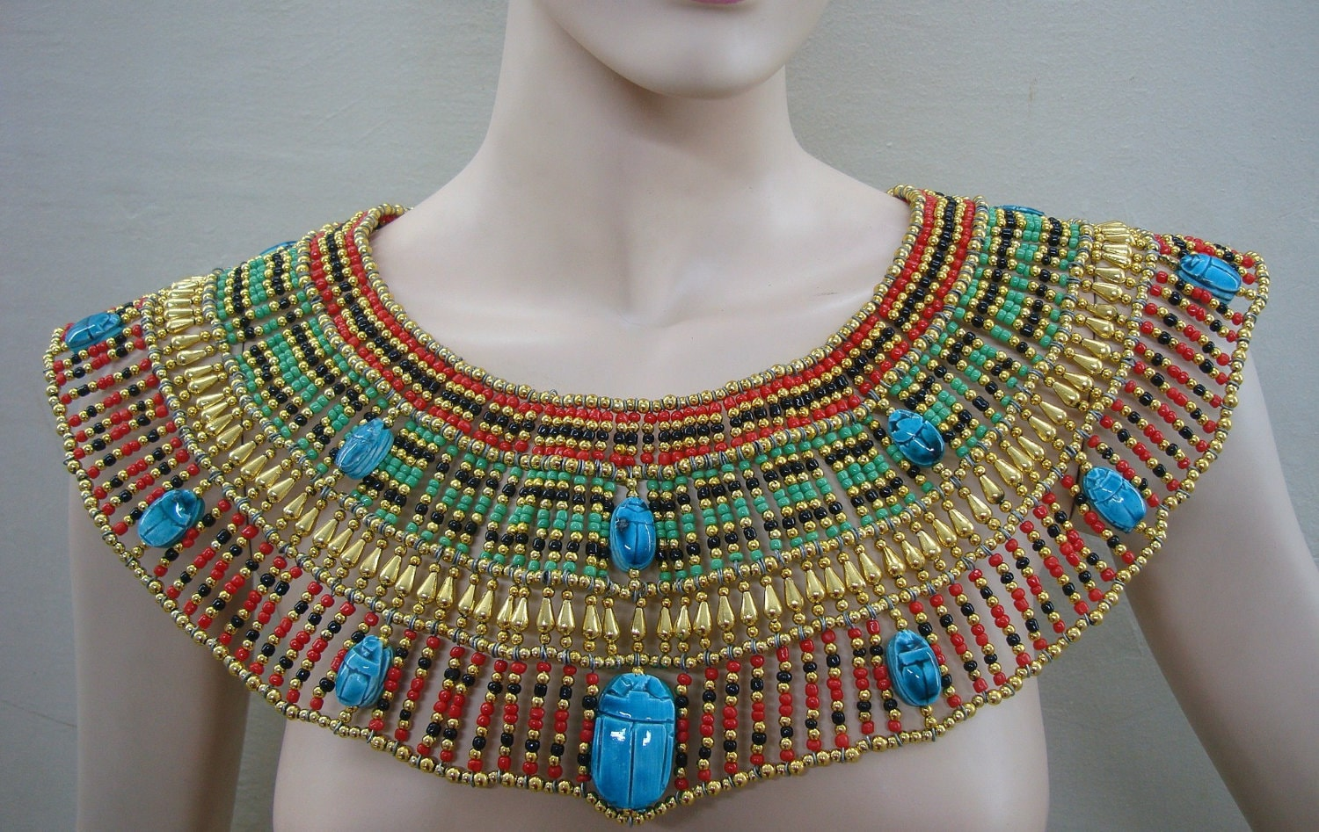
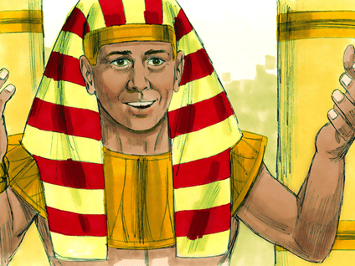
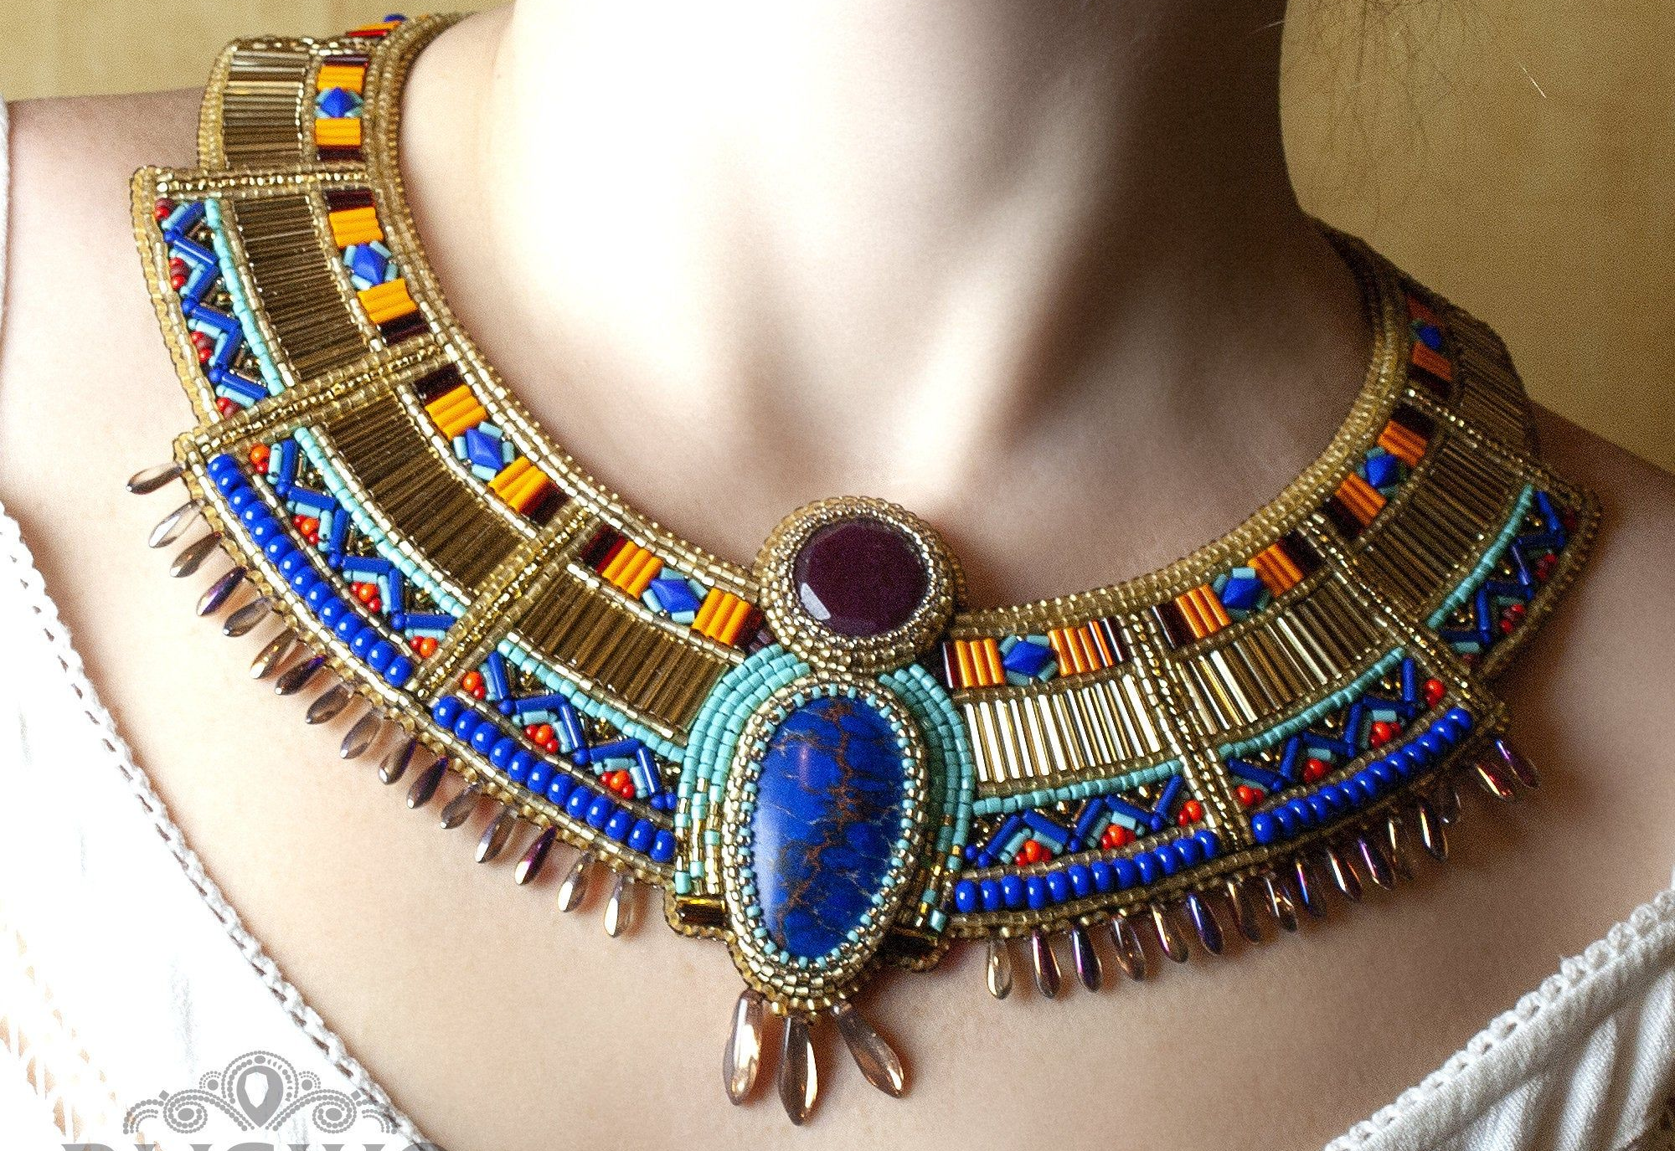
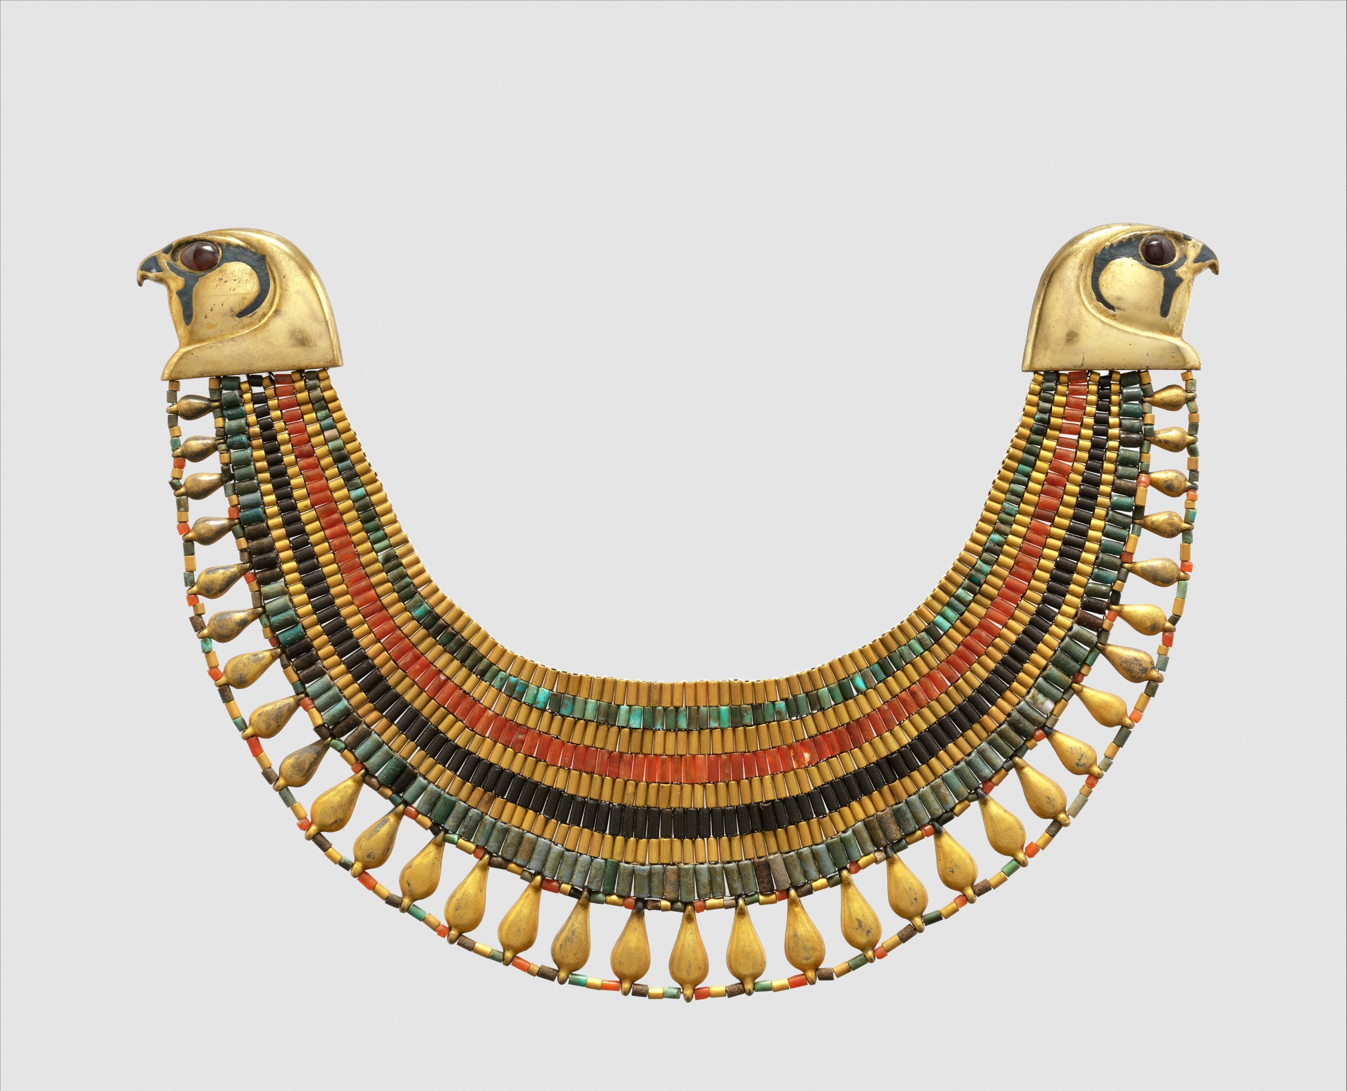
Craft Time
Joseph was the governor of Egypt
Make a collar like he probably would have worn.
Color it with many colors.
Add jewels.
You can also paper punch holes around the edges and weave yarn and beads around the edge.
www.Arthistorymom.com

Slide 3
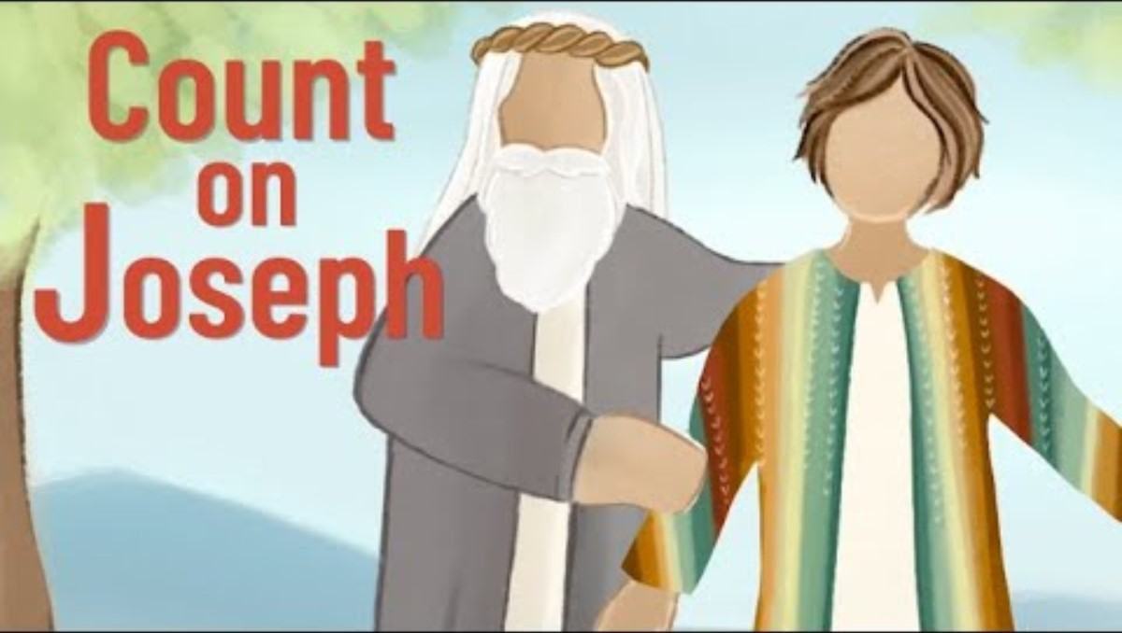
Lord, I Thank You

Slide 4
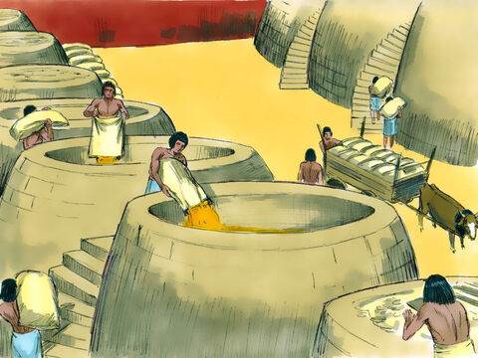
Genesis 41
Store the extra food
⁴⁷ During the seven years of abundance the land produced plentifully.
⁴⁸ Joseph collected all the food produced in those seven years of abundance in Egypt and stored it in the cities. In each city he put the food grown in the fields surrounding it.
⁴⁹ Joseph stored up huge quantities of grain, like the sand of the sea; it was so much that he stopped keeping records because it was beyond measure.
We’ve stored so many bags of grain,
I don’t have a measurement that high.
We need to build more storage buildings!

Slide 5
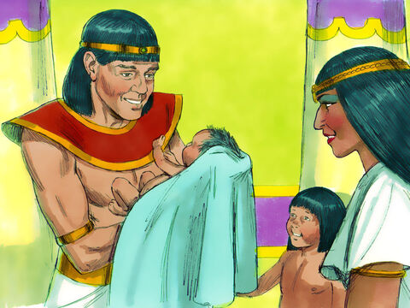
Blessed with sons
Look Manasseh
You have a baby brother! We will name him Ephraim.
God has blessed me!
⁵⁰ Before the years of famine came, two sons were born to Joseph by Asenath daughter of Potiphera, priest of On.
⁵¹ Joseph named his firstborn Manasseh^{[e]} and said, “It is because God has made me forget all my trouble and all my father’s household.”
⁵² The second son he named Ephraim^{[f]} and said, “It is because God has made me fruitful in the land of my suffering.”

Slide 6
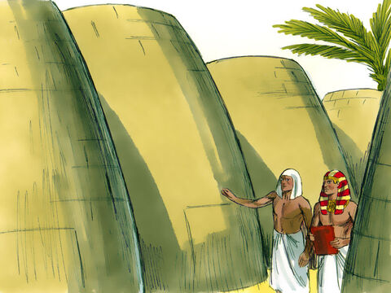
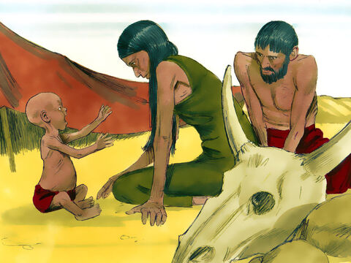
Food during Famine
⁵³ The seven years of abundance in Egypt came to an end, ⁵⁴ and the seven years of famine began, just as Joseph had said. There was famine in all the other lands, but in the whole land of Egypt there was food.
We’re so hungry! The food is gone!
Our animals have starved to death.
What will we eat? Is there any food anywhere?
The famine has started, but we have plenty of food.
Soon people will be coming to get food.

Slide 7
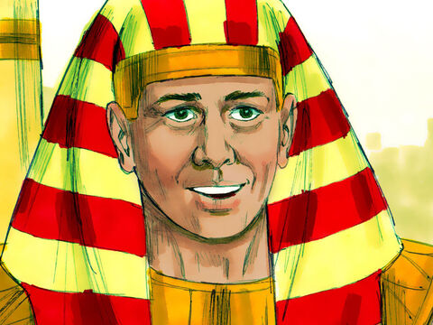
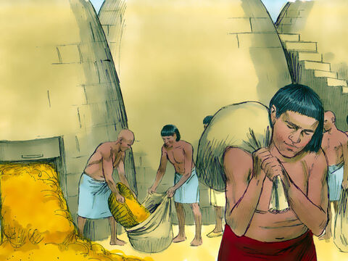
Food for everyone
Open the store houses.
We will sell grain to all who need it.
People from Egypt and all over the world can buy grain here.
God has provided plenty for everyone.
⁵⁵ When all Egypt began to feel the famine, the people cried to Pharaoh for food. Then Pharaoh told all the Egyptians, “Go to Joseph and do what he tells you.”
⁵⁶ When the famine had spread over the whole country, Joseph opened all the storehouses and sold grain to the Egyptians, for the famine was severe throughout Egypt. ⁵⁷ And all the world came to Egypt to buy grain from Joseph, because the famine was severe everywhere.
⁵⁵ When all Egypt began to feel the famine, the people cried to Pharaoh for food. Then Pharaoh told all the Egyptians, “Go to Joseph and do what he tells you.”
⁵⁶ When the famine had spread over the whole country, Joseph opened all the storehouses and sold grain to the Egyptians, for the famine was severe throughout Egypt. ⁵⁷ And all the world came to Egypt to buy grain from Joseph, because the famine was severe everywhere.

Slide 8
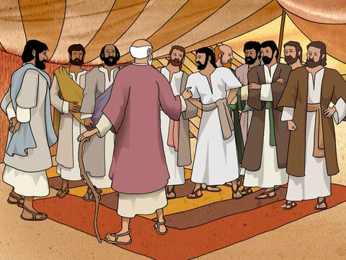
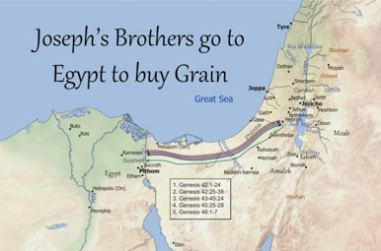
Genesis 42
Hungry Brothers
Go down to Egypt and buy some grain for us so that we will live and not die!
Why do you just keep looking at each other? I know we have no food.
I have heard that there is grain in Egypt.
When Jacob learned that there was grain in Egypt, he said to his sons, “Why do you just keep looking at each other?” ² He continued, “I have heard that there is grain in Egypt. Go down there and buy some for us, so that we may live and not die.”

Slide 9
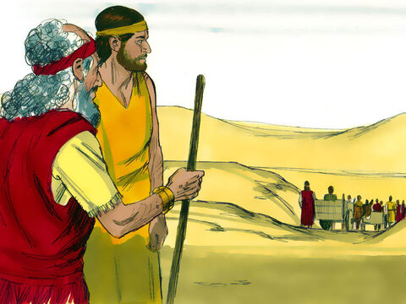
Going to Egypt
Benjamin, I need you here.
Hopefully, they will come back with the grain we need so much.
³ Then ten of Joseph’s brothers went down to buy grain from Egypt. ⁴ But Jacob did not send Benjamin, Joseph’s brother, with the others, because he was afraid that harm might come to him.
⁵ So Israel’s sons were among those who went to buy grain, for there was famine in the land of Canaan also.

Slide 10
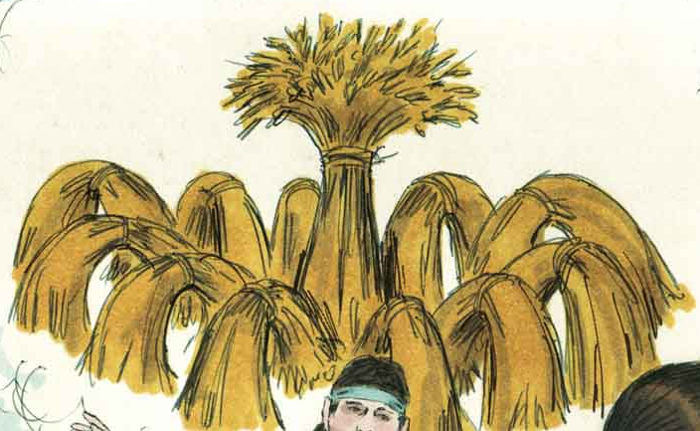
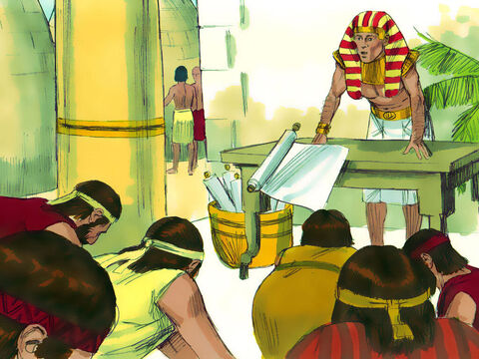
Bowing to Joseph
They are my brothers!
Where do you come from?
You are spies!
You have come to see where
our land is unprotected!
⁶ Now Joseph was the governor of the land, the person who sold grain to all its people. So when Joseph’s brothers arrived, they bowed down to him with their faces to the ground. ⁷ As soon as Joseph saw his brothers, he recognized them, but he pretended to be a stranger and spoke harshly to them. “Where do you come from?” he asked.
“From the land of Canaan,” they replied, “to buy food.”
⁸ Although Joseph recognized his brothers, they did not recognize him. ⁹ Then he remembered his dreams about them and said to them, “You are spies! You have come to see where our land is unprotected.”
We have come from Canaan to buy food.

Slide 11
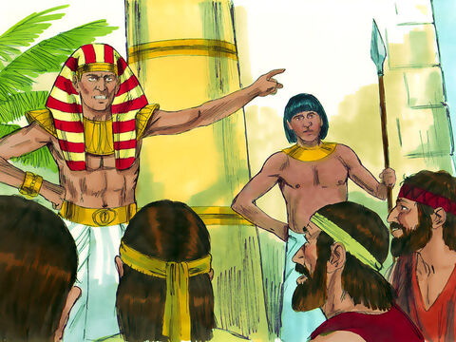
Bowing to Joseph
I’ll test them
It is just as I told you, you are spies!
This is how I will test you:
One of you go home to get your youngest brother.
If you don’t, I’ll know your are spies!
Ha! They’ve never been honest!
No! You are spies!
You have come to see where
our land is unprotected!
⁶¹⁰ “No, my lord,” they answered. “Your servants have come to buy food. ¹¹ We are all the sons of one man. Your servants are honest men, not spies.”
¹² “No!” he said to them. “You have come to see where our land is unprotected.”
¹³ But they replied, “Your servants were twelve brothers, the sons of one man, who lives in the land of Canaan. The youngest is now with our father, and one is no more.”
¹⁴ Joseph said to them, “It is just as I told you: You are spies! ¹⁵ And this is how you will be tested: As surely as Pharaoh lives, you will not leave this place unless your youngest brother comes here. ¹⁶ Send one of your number to get your brother; the rest of you will be kept in prison, so that your words may be tested to see if you are telling the truth. If you are not, then as surely as Pharaoh lives, you are spies!”
Your servants are 12 brothers. The youngest is with our father and one is no more.
No, my lord, we are all sons from one man.
Your servants are honest men, not spies.

Slide 12

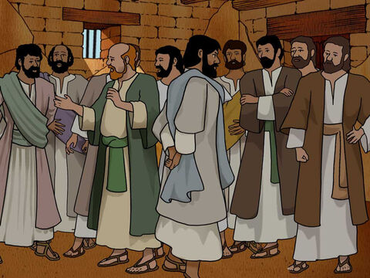

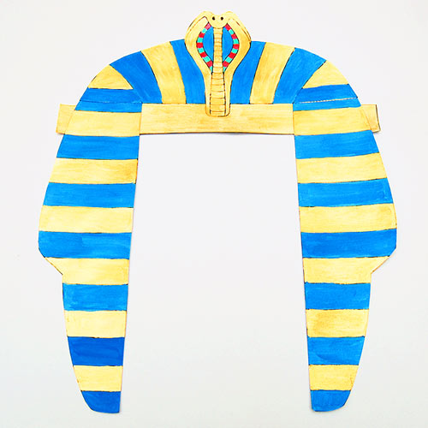
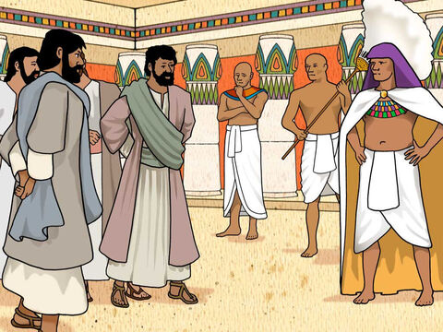
Brothers in Prison
They don’t know that I can understand them.
At least they are thinking about how they treated me!
Do this and you will live, for I fear God.
If you are honest men, let one of your brothers stay here and the rest can take food back to your families.
Bind that one (Simeon).
He must stay here.
But when you come back, you must bring your youngest brother.
Surely, we are being punished because of how we treated our brother.
¹⁷ And he put them all in custody for three days.
¹⁸ On the third day, Joseph said to them, “Do this and you will live, for I fear God: ¹⁹ If you are honest men, let one of your brothers stay here in prison, while the rest of you go and take grain back for your starving households. ²⁰ But you must bring your youngest brother to me, so that your words may be verified and that you may not die.” This they proceeded to do.
²¹ They said to one another, “Surely we are being punished because of our brother. We saw how distressed he was when he pleaded with us for his life, but we would not listen; that’s why this distress has come on us.”
²² Reuben replied, “Didn’t I tell you not to sin against the boy? But you wouldn’t listen! Now we must give an accounting for his blood.” ²³ They did not realize that Joseph could understand them, since he was using an interpreter.
Didn’t I tell you not to sin against God, but you wouldn’t listen.

Slide 13
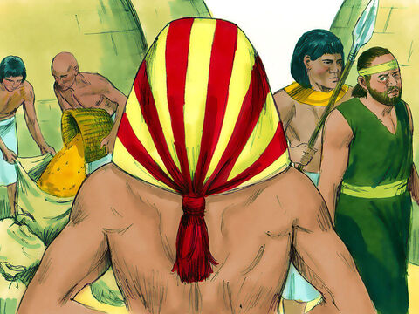
A test of honesty
²⁵ Joseph gave orders to fill their bags with grain, to put each man’s silver back in his sack, and to give them provisions for their journey. After this was done for them, ²⁶ they loaded their grain on their donkeys and left.

Slide 14
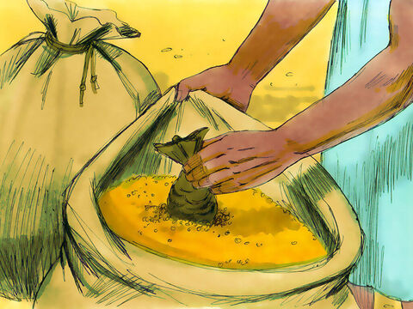
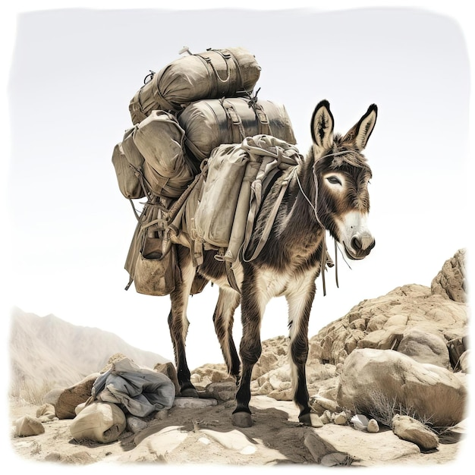
Oh no!
My silver is in my bag of grain! They will think we are thieves!
What is happening
to us?
²⁵ Joseph gave orders to fill their bags with grain, to put each man’s silver back in his sack, and to give them provisions for their journey. After this was done for them, ²⁶ they loaded their grain on their donkeys and left.
²⁷ At the place where they stopped for the night one of them opened his sack to get feed for his donkey, and he saw his silver in the mouth of his sack. ²⁸ “My silver has been returned,” he said to his brothers. “Here it is in my sack.”
Their hearts sank and they turned to each other trembling and said, “What is this that God has done to us?”

Slide 15
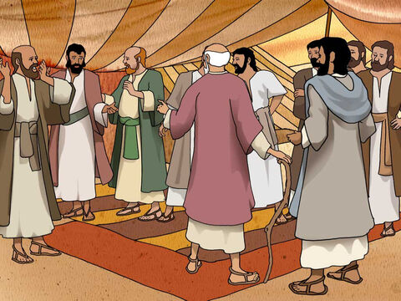
Back home
You have returned!
How did it go?
Where is Simeon?
²⁹ When they came to their father Jacob in the land of Canaan, they told him all that had happened to them. They said, ³⁰ “The man who is lord over the land spoke harshly to us and treated us as though we were spying on the land. ³¹ But we said to him, ‘We are honest men; we are not spies. ³² We were twelve brothers, sons of one father. One is no more, and the youngest is now with our father in Canaan.’
³³ “Then the man who is lord over the land said to us, ‘This is how I will know whether you are honest men: Leave one of your brothers here with me, and take food for your starving households and go. ³⁴ But bring your youngest brother to me so I will know that you are not spies but honest men. Then I will give your brother back to you, and you can trade^{[a]} in the land.’”
The lord who is in charge of the land spoke harshly to us.
He called us spies.
We told him we are honest men –
12 brothers, but he didn’t believe us. He said Simeon had to stay until we brought Benjamin down there.

Slide 16
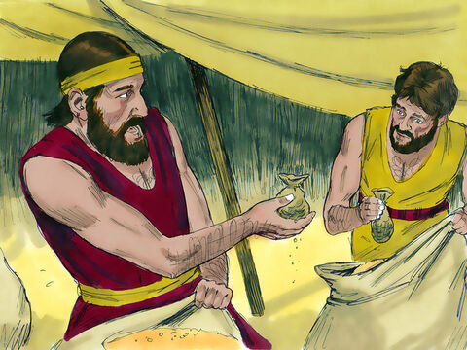
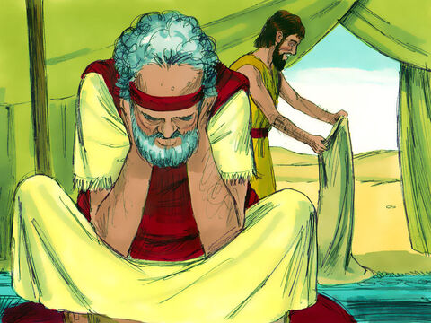
My silver was returned too!
Mine too!
What will we do?
³⁵ As they were emptying their sacks, there in each man’s sack was his pouch of silver! When they and their father saw the money pouches, they were frightened. ³⁶ Their father Jacob said to them, “You have deprived me of my children. Joseph is no more and Simeon is no more, and now you want to take Benjamin. Everything is against me!”
³⁷ Then Reuben said to his father, “You may put both of my sons to death if I do not bring him back to you. Entrust him to my care, and I will bring him back.”
³⁸ But Jacob said, “My son will not go down there with you; his brother is dead and he is the only one left. If harm comes to him on the journey you are taking, you will bring my gray head down to the grave in sorrow.”
Joseph is no more.
Simeon is no more.
Now you want Benjamin!?
NO! You will bring my gray head down in sorrow.

Slide 17
Genesis 43
Time passed … then:
Our crop is not growing.
The grain from Egypt is gone.
You need to go and get more before we starve.
Why did you bring this trouble on me by even mentioning Benjamin?
Now the famine was still severe in the land. ² So when they had eaten all the grain they had brought from Egypt, their father said to them, “Go back and buy us a little more food.”
³ But Judah said to him, “The man warned us solemnly, ‘You will not see my face again unless your brother is with you.’ ⁴ If you will send our brother along with us, we will go down and buy food for you. ⁵ But if you will not send him, we will not go down, because the man said to us, ‘You will not see my face again unless your brother is with you.’”
⁶ Israel asked, “Why did you bring this trouble on me by telling the man you had another brother?”
⁷ They replied, “The man questioned us closely about ourselves and our family. ‘Is your father still living?’ he asked us. ‘Do you have another brother?’ We simply answered his questions. How were we to know he would say, ‘Bring your brother down here’?”
⁸ Then Judah said to Israel his father, “Send the boy along with me and we will go at once, so that we and you and our children may live and not die. ⁹ I myself will guarantee his safety; you can hold me personally responsible for him. If I do not bring him back to you and set him here before you, I will bear the blame before you all my life. ¹⁰ As it is, if we had not delayed, we could have gone and returned twice.”
Send Benjamin with me Father.
If I don’t bring him back, you can blame me.
Please don’t delay us. We could have gone and come back twice by now.
Remember the man told us that we must bring Benjamin, our youngest brother.
If you won’t let him go, we can’t go.
The man questioned us closely.
We only answered his questions.

Slide 18
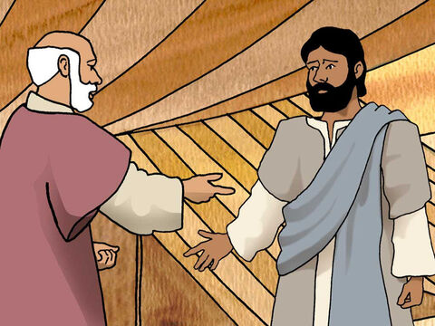
The plan
Alright Judah, if it must be do this.
Take a gift to the man – a little balm and honey, some spices and myrrh, some pistachio nuts and almonds.
Also pack your bags with the silver that was returned and more to buy grain perhaps it was a mistake.
May God Almighty grant you mercy so that Simeon can return and Benjamin can come back with you.
¹¹ Then their father Israel said to them, “If it must be, then do this: Put some of the best products of the land in your bags and take them down to the man as a gift—a little balm and a little honey, some spices and myrrh, some pistachio nuts and almonds. ¹² Take double the amount of silver with you, for you must return the silver that was put back into the mouths of your sacks. Perhaps it was a mistake. ¹³ Take your brother also and go back to the man at once. ¹⁴ And may God Almighty^{[a]} grant you mercy before the man so that he will let your other brother and Benjamin come back with you. As for me, if I am bereaved, I am bereaved.”

Slide 19
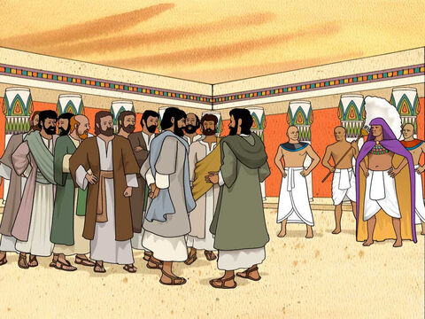
When they got to Egypt
Steward, take these men to my house.
Prepare a meal, they are to eat with me at noon.
¹⁵ So the men took the gifts and double the amount of silver, and Benjamin also. They hurried down to Egypt and presented themselves to Joseph. ¹⁶ When Joseph saw Benjamin with them, he said to the steward of his house, “Take these men to my house, slaughter an animal and prepare a meal; they are to eat with me at noon.”

Slide 20
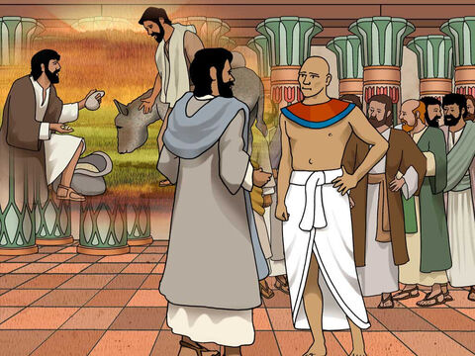
He brought us here to attack us!
¹⁷ The man did as Joseph told him and took the men to Joseph’s house. ¹⁸ Now the men were frightened when they were taken to his house. They thought, “We were brought here because of the silver that was put back into our sacks the first time. He wants to attack us and overpower us and seize us as slaves and take our donkeys.”
¹⁹ So they went up to Joseph’s steward and spoke to him at the entrance to the house. ²⁰ “We beg your pardon, our lord,” they said, “we came down here the first time to buy food. ²¹ But at the place where we stopped for the night we opened our sacks and each of us found his silver—the exact weight—in the mouth of his sack. So we have brought it back with us. ²² We have also brought additional silver with us to buy food. We don’t know who put our silver in our sacks.”
²³ “It’s all right,” he said. “Don’t be afraid. Your God, the God of your father, has given you treasure in your sacks; I received your silver.”
Then he brought Simeon out to them.
²⁴ The steward took the men into Joseph’s house, gave them water to wash their feet and provided fodder for their donkeys. ²⁵ They prepared their gifts for Joseph’s arrival at noon, because they had heard that they were to eat there.
I beg your pardon Sir.
We found the silver which we brought to pay for the grain,
in our sacks of grain. We brought it back and more so that we could buy more grain.
It’s all right.
Don’t be afraid.
I received your silver.
Your God, the God of your father put treasure in your sacks.
Your donkeys will be fed.
Wash your feet and prepare for dinner.

Slide 21
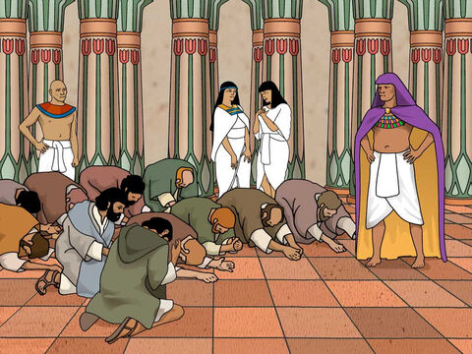
Before Joseph again
Is this your youngest brother, the one you told me about?
God be gracious to you, my son.
Thank you!
How is your aged father?
Is he still living?
²⁶ When Joseph came home, they presented to him the gifts they had brought into the house, and they bowed down before him to the ground. ²⁷ He asked them how they were, and then he said, “How is your aged father you told me about? Is he still living?”
²⁸ They replied, “Your servant our father is still alive and well.” And they bowed down, prostrating themselves before him.
²⁹ As he looked about and saw his brother Benjamin, his own mother’s son, he asked, “Is this your youngest brother, the one you told me about?” And he said, “God be gracious to you, my son.”
Sir, your servants have brought you a small gift – balm and honey, myrrh and spices,
pistachios and almonds
Our father is still alive and well.

Slide 22


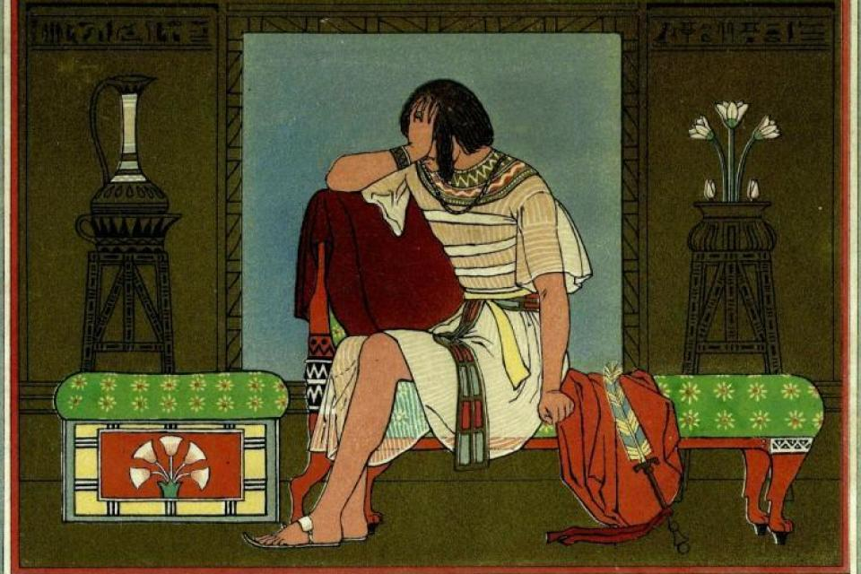
Weeping
My brother, Benjamin!
I didn’t think I would
ever see you again!
³⁰ Deeply moved at the sight of his brother, Joseph hurried out and looked for a place to weep. He went into his private room and wept there.

Slide 23
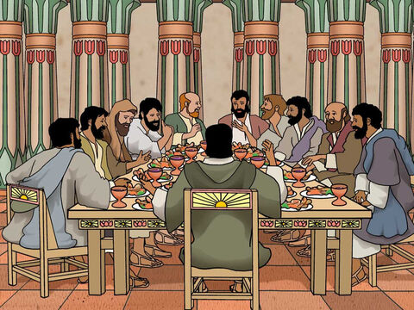
Let’s eat – snack time!
Look! We’ve been seated according to our ages from oldest to youngest!
Benjamin is getting 5 times as much as us.
³¹ After he had washed his face, he came out and, controlling himself, said, “Serve the food.”
³² They served him by himself, the brothers by themselves, and the Egyptians who ate with him by themselves, because Egyptians could not eat with Hebrews, for that is detestable to Egyptians. ³³ The men had been seated before him in the order of their ages, from the firstborn to the youngest; and they looked at each other in astonishment. ³⁴ When portions were served to them from Joseph’s table, Benjamin’s portion was five times as much as anyone else’s. So, they feasted and drank freely with him.

Slide 24
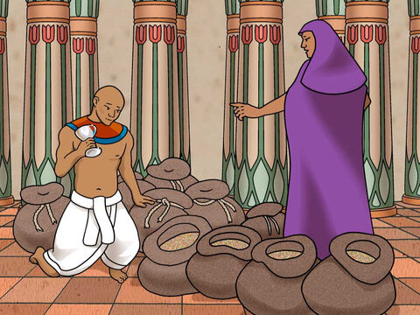
One more test
Fill the men’s sacks
with as much food as they can carry.
Also put their silver
in the top of their sacks.
Put my silver cup in the top of the youngest one’s sack along with his silver.
Now Joseph gave these instructions to the steward of his house: “Fill the men’s sacks with as much food as they can carry, and put each man’s silver in the mouth of his sack. ² Then put my cup, the silver one, in the mouth of the youngest one’s sack, along with the silver for his grain.” And he did as Joseph said.

Slide 25
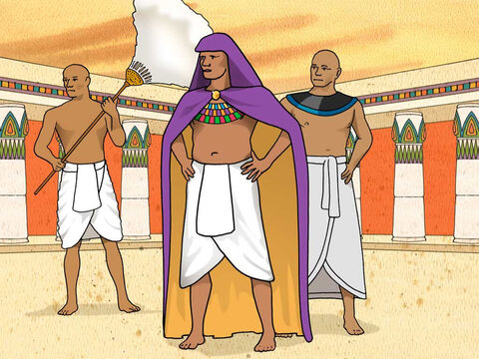
Thieves?
My brothers should be well on their way. Quick! Go after them.
Ask why they have taken my cup!
³ As morning dawned, the men were sent on their way with their donkeys.
⁴ They had not gone far from the city when Joseph said to his steward, “Go after those men at once, and when you catch up with them, say to them, ‘Why have you repaid good with evil? ⁵ Isn’t this the cup my master drinks from and also uses for divination? This is a wicked thing you have done.’”
⁶ When he caught up with them, he repeated these words to them. ⁷ But they said to him, “Why does my lord say such things? Far be it from your servants to do anything like that! ⁸ We even brought back to you from the land of Canaan the silver we found inside the mouths of our sacks. So why would we steal silver or gold from your master’s house? ⁹ If any of your servants is found to have it, he will die; and the rest of us will become my lord’s slaves.”
¹⁰ “Very well, then,” he said, “let it be as you say. Whoever is found to have it will become my slave; the rest of you will be free from blame.”

Slide 26
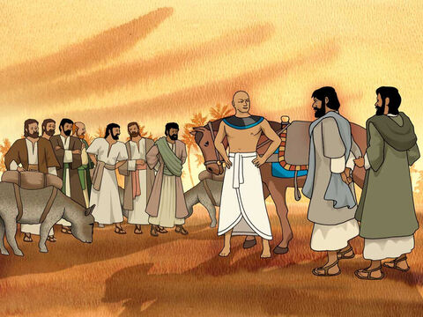
Accusations
Why have you repayed good with evil?
Why did you take our lord’s silver cup?
Very well, let it be as you have said.
Whoever is found to have it,
will become my slave. The rest of you will be free brom blame.
³⁶ When he caught up with them, he repeated these words to them. ⁷ But they said to him, “Why does my lord say such things? Far be it from your servants to do anything like that! ⁸ We even brought back to you from the land of Canaan the silver we found inside the mouths of our sacks. So why would we steal silver or gold from your master’s house? ⁹ If any of your servants is found to have it, he will die; and the rest of us will become my lord’s slaves.”
¹⁰ “Very well, then,” he said, “let it be as you say. Whoever is found to have it will become my slave; the rest of you will be free from blame.”
¹¹ Each of them quickly lowered his sack to the ground and opened it. ¹² Then the steward proceeded to search, beginning with the oldest and ending with the youngest. And the cup was found in Benjamin’s sack.
Why are you saying such things?
If anyone has it, he will die and the rest of you will become my lord’s slaves!

Slide 27
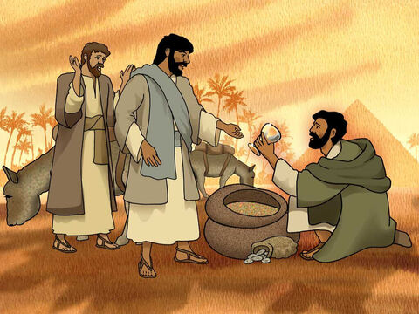
Will they let Benjamin die?
And the cup was found in Benjamin’s sack. ¹³ At this, they tore their clothes. Then they all loaded their donkeys and returned to the city.
What?!
The cup is in my sack.
I didn’t put it there!
Oh no!
Not in Benjamin’s sack!
We will all go back.

Slide 28
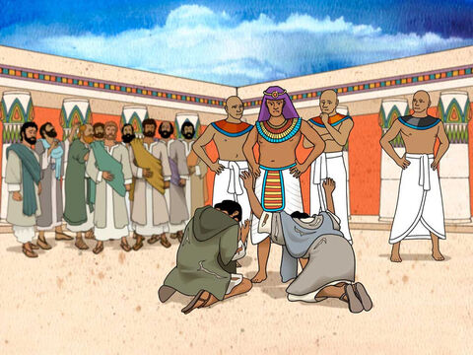
We are guilty
What is this that you have done?
Don’t you know that a man like me,
can find out all things?
Far be it from me to do such a thing!
Only the one with the cup will be my slave! The rest of you go in peace.
¹⁴ Joseph was still in the house when Judah and his brothers came in, and they threw themselves to the ground before him. ¹⁵ Joseph said to them, “What is this you have done? Don’t you know that a man like me can find things out by divination?”
¹⁶ “What can we say to my lord?” Judah replied. “What can we say? How can we prove our innocence? God has uncovered your servants’ guilt. We are now my lord’s slaves—we ourselves and the one who was found to have the cup.”
¹⁷ But Joseph said, “Far be it from me to do such a thing! Only the man who was found to have the cup will become my slave. The rest of you, go back to your father in peace.”
What can we say my lord?
How can we prove our innocence.
God has uncovered our guilt.
Now we are your slaves –
All of us including the one with the cup.

Slide 29
¹⁸ Then Judah went up to him and said: “Pardon your servant, my lord, let me speak a word to my lord. Do not be angry with your servant, though you are equal to Pharaoh himself. ¹⁹ My lord asked his servants, ‘Do you have a father or a brother?’ ²⁰ And we answered, ‘We have an aged father, and there is a young son born to him in his old age. His brother is dead, and he is the only one of his mother’s sons left, and his father loves him.’
²¹ “Then you said to your servants, ‘Bring him down to me so I can see him for myself.’ ²² And we said to my lord, ‘The boy cannot leave his father; if he leaves him, his father will die.’ ²³ But you told your servants, ‘Unless your youngest brother comes down with you, you will not see my face again.’ ²⁴ When we went back to your servant my father, we told him what my lord had said.
²⁵ “Then our father said, ‘Go back and buy a little more food.’ ²⁶ But we said, ‘We cannot go down. Only if our youngest brother is with us will we go. We cannot see the man’s face unless our youngest brother is with us.’
²⁷ “Your servant my father said to us, ‘You know that my wife bore me two sons. ²⁸ One of them went away from me, and I said, “He has surely been torn to pieces.” And I have not seen him since. ²⁹ If you take this one from me too and harm comes to him, you will bring my gray head down to the grave in misery.’
³⁰ “So now, if the boy is not with us when I go back to your servant my father, and if my father, whose life is closely bound up with the boy’s life, ³¹ sees that the boy isn’t there, he will die. Your servants will bring the gray head of our father down to the grave in sorrow. ³² Your servant guaranteed the boy’s safety to my father. I said, ‘If I do not bring him back to you, I will bear the blame before you, my father, all my life!’
³³ “Now then, please let your servant remain here as my lord’s slave in place of the boy, and let the boy return with his brothers. ³⁴ How can I go back to my father if the boy is not with me? No! Do not let me see the misery that would come on my father.”
What love!
They have changed!
How can I go back to my father without him? No! Do not let me see the misery that would come on my father!
I will accept the responsibility .
Oh sir! Let my brother go free.
Enslave me instead.
I have promised our father that I will be held responsible for any bad thing that happens to Benjamin. Enslave me.

Slide 30

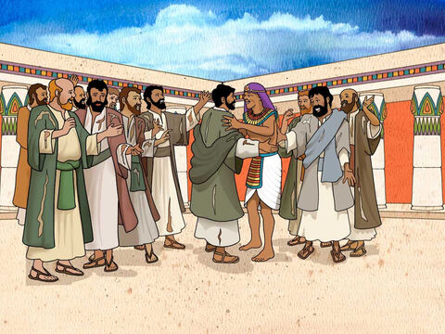

Come to me
Come close to me!
I am your brother!
Stewards and officials leave me with these men.
God has shown that there will be 7 years of terrible famine. 2 years have passed and there will be 5 more years of famine.
Do not be distressed. Don’t be angry with yourselves. It is God who has sent me here before you so that lives can be saved
I am Joseph!
Is my father still living?
Then Joseph could no longer control himself before all his attendants, and he cried out, “Have everyone leave my presence!” So there was no one with Joseph when he made himself known to his brothers. ² And he wept so loudly that the Egyptians heard him, and Pharaoh’s household heard about it.
³ Joseph said to his brothers, “I am Joseph! Is my father still living?” But his brothers were not able to answer him, because they were terrified at his presence.
⁴ Then Joseph said to his brothers, “Come close to me.” When they had done so, he said, “I am your brother Joseph, the one you sold into Egypt! ⁵ And now, do not be distressed and do not be angry with yourselves for selling me here, because it was to save lives that God sent me ahead of you. ⁶ For two years now there has been famine in the land, and for the next five years there will be no plowing and reaping. ⁷ But God sent me ahead of you to preserve for you a remnant on earth and to save your lives by a great deliverance.^{[a]}
⁸ “So then, it was not you who sent me here, but God. He made me father to Pharaoh, lord of his entire household and ruler of all Egypt.

Slide 31
Come live here
So, God has sent me here to save you.
Go back and quickly bring your families and our father to come live here in Egypt where there is food saved from the 7 years of plenty.
We will give you a good place to live.
⁹ Now hurry back to my father and say to him, ‘This is what your son Joseph says: God has made me lord of all Egypt. Come down to me; don’t delay. ¹⁰ You shall live in the region of Goshen and be near me—you, your children and grandchildren, your flocks and herds, and all you have. ¹¹ I will provide for you there, because five years of famine are still to come. Otherwise you and your household and all who belong to you will become destitute.’
¹² “You can see for yourselves, and so can my brother Benjamin, that it is really I who am speaking to you. ¹³ Tell my father about all the honor accorded me in Egypt and about everything you have seen. And bring my father down here quickly.”
See it really is me – Joseph!

Slide 32
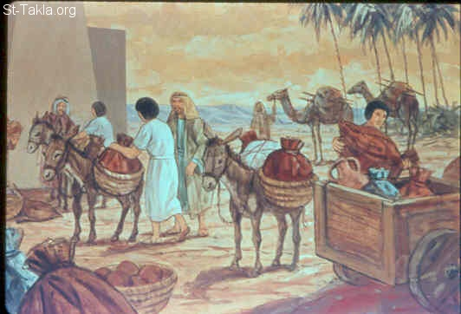
Here take these carts. Pharaoh is giving them to you along with provisions for the journey.
Here are some new clothes and donkeys with the best things of Egypt for Father.
Don’t quarrel on the way!
See you soon!
¹⁴ Then he threw his arms around his brother Benjamin and wept, and Benjamin embraced him, weeping. ¹⁵ And he kissed all his brothers and wept over them. Afterward his brothers talked with him.
¹⁶ When the news reached Pharaoh’s palace that Joseph’s brothers had come, Pharaoh and all his officials were pleased. ¹⁷ Pharaoh said to Joseph, “Tell your brothers, ‘Do this: Load your animals and return to the land of Canaan, ¹⁸ and bring your father and your families back to me. I will give you the best of the land of Egypt and you can enjoy the fat of the land.’
¹⁹ “You are also directed to tell them, ‘Do this: Take some carts from Egypt for your children and your wives, and get your father and come. ²⁰ Never mind about your belongings, because the best of all Egypt will be yours.’”
²¹ So the sons of Israel did this. Joseph gave them carts, as Pharaoh had commanded, and he also gave them provisions for their journey. ²² To each of them he gave new clothing, but to Benjamin he gave three hundred shekels^{[b]} of silver and five sets of clothes. ²³ And this is what he sent to his father: ten donkeys loaded with the best things of Egypt, and ten female donkeys loaded with grain and bread and other provisions for his journey. ²⁴ Then he sent his brothers away, and as they were leaving he said to them, “Don’t quarrel on the way!”

Slide 33


https://activity-array.com/

