Slide 1
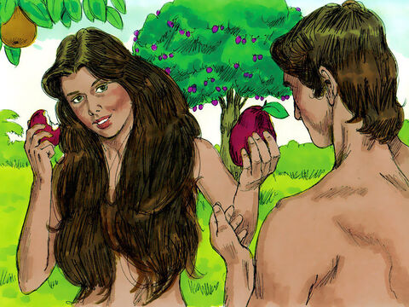
Adam and Eve make a bad choice
C
H
A
P
T
E
R
3
G
E
N
E
S
I
S

Slide 2

I have a box with some special things inside it.
But don’t look inside. Don’t even come near it.

Slide 3

¹³ When someone is being tempted, he should not say, “God is tempting me.” Evil cannot tempt God, and God himself does not tempt anyone.
¹⁴ It is the evil that a person wants that tempts him. His own evil desire leads him away and holds him.
¹⁵ This desire causes sin. Then the sin grows and brings death.
James
1:12-25

Slide 4

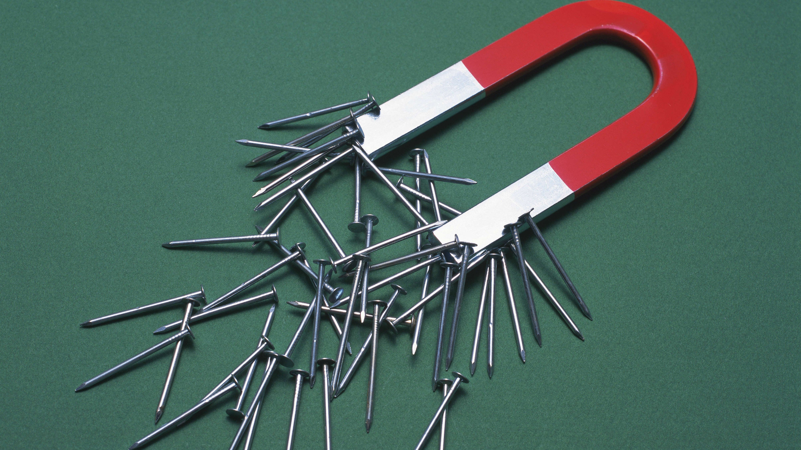
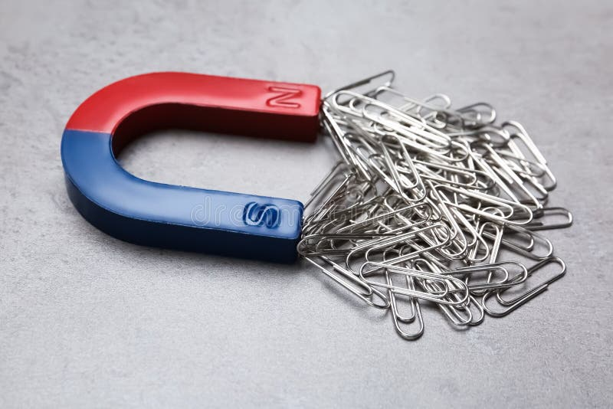
OBJECT LESSON: This is like how a magnet attracts metal objects.
When we want, what is bad, we are tempted. We (like the magnet) can choose to draw closer to the bad influence and draw the sin close to us.
OR
We can choose to go a different way. We can choose to ask God to help us go away from evil and towards good choices. We can attract what is good.
¹³ When someone is being tempted, he should not say, “God is tempting me.” Evil cannot tempt God, and God himself does not tempt anyone.
¹⁴ It is the evil that a person wants that tempts him. His own evil desire leads him away and holds him.
¹⁵ This desire causes sin. Then the sin grows and brings death.
James 1:12-15
SIN
GOOD

Slide 5
¹³ When someone is being tempted, he should not say, “God is tempting me.” Evil cannot tempt God, and God himself does not tempt anyone.
¹⁴ It is the evil that a person wants that tempts him. His own evil desire leads him away and holds him.
¹⁵ This desire causes sin. Then the sin grows and brings death.
²¹ So put out of your life every evil thing and every kind of wrong you do. Don’t be proud but accept God’s teaching that is planted in your hearts. This teaching can save your souls…..
²⁵ But the truly happy person is the one who carefully studies God’s perfect law that makes people free. He continues to study it.
He listens to God’s teaching and does not forget what he heard. Then he obeys what God’s teaching says. When he does this, it makes him happy.
James
1:12-25

Slide 6
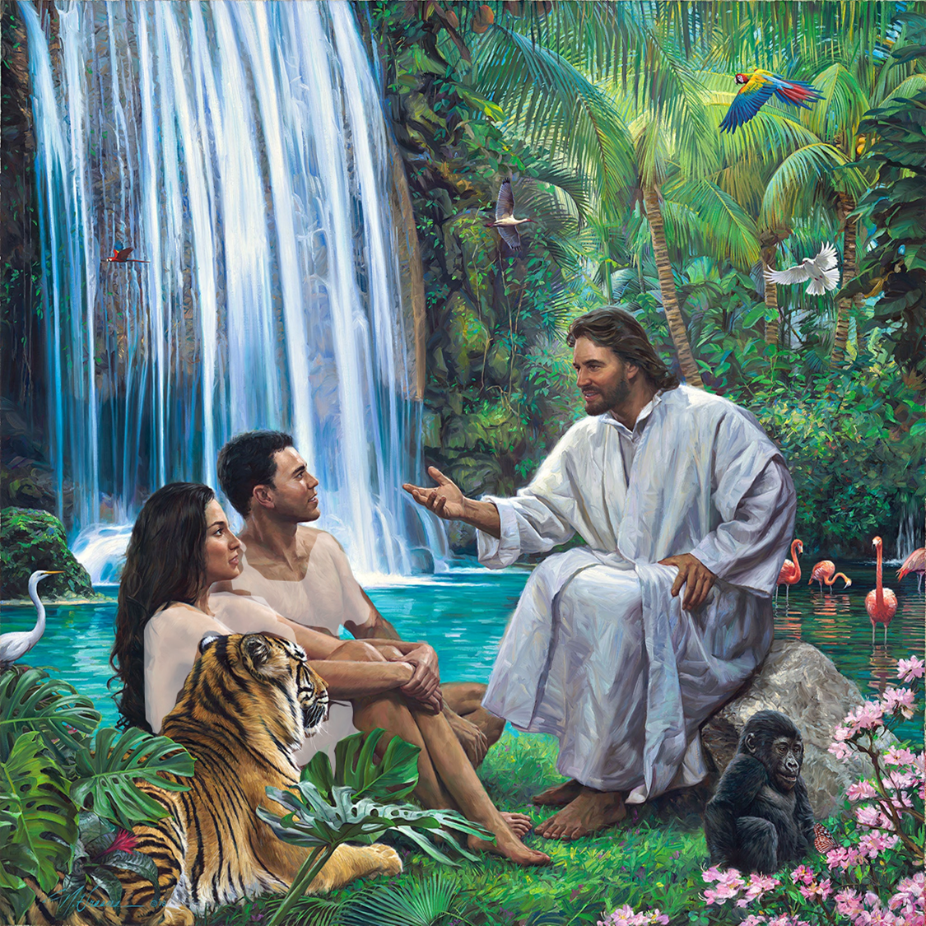
Each evening
God came to visit.
That sounds like so much fun!
I love seeing you happy and contented and full of joy!
Let’s end our time together with a song.
I love your idea for a shelter Adam.
I look forward to seeing it!
If you want help, just let me know.
We had fun exploring the river Pishon.
We found beautiful stones including gold! I want to make a shelter and use some of them.
I have come for our special evening time together. I’m excited to hear about what you did today!
God made the world and everything in it.
God made Adam and Eve. He placed them in the beautiful garden of Eden, which He had made to be their home.
The beavers and otters were having so much fun playing in the water! We had fun splashing and swimming, too!

Slide 7


Slide 8
Two Trees
We hope you choose life, not death.
We hope you choose to humbly obey, not to be proud and rebellious.
We hope you choose to love not hate.
Let’s end our time together with a song.
Eve, thank you for asking me about that. You can eat from all the trees in the garden especially from the tree of life. We want you to live happily forever! But we want you to have a choice.
Will you love, respect, and obey God always?
Remember to stay away from the Tree of Knowledge of Good and Evil that is where Satan is. He lies and deceives. His pride has caused him to fall. He wants to destroy and kill.
Oh, it’s beautiful!
You can cut down trees and use them for walls or build bricks by mixing water with the clay soil or keep building with rocks.
I’ll look forward to seeing your progress!
Today we looked around and decided where to build our shelter. Look we used some of the beautiful stones as the foundation!
I have come for our special evening time together. I’m excited to hear about what you did today!
Genesis 2:9 --
In the middle of the garden were the tree of life and the tree of the knowledge of good and evil.
Isaiah 14:12-15 --
12 How you have fallen from heaven, morning star, son of the dawn! You have been cast down to the earth, you who once laid low the nations!
13 You said in your heart, “I will ascend to the heavens; I will raise my throne above the stars of God; I will sit enthroned on the mount of assembly, on the utmost heights of Mount Zaphon.
14 I will ascend above the tops of the clouds; I will make myself like the Most High.”
15 But you are brought down to the realm of the dead, to the depths of the pit.
While we were looking around, we passed the 2 trees you pointed out in the middle of the garden. Please tell us more about them.

Slide 9
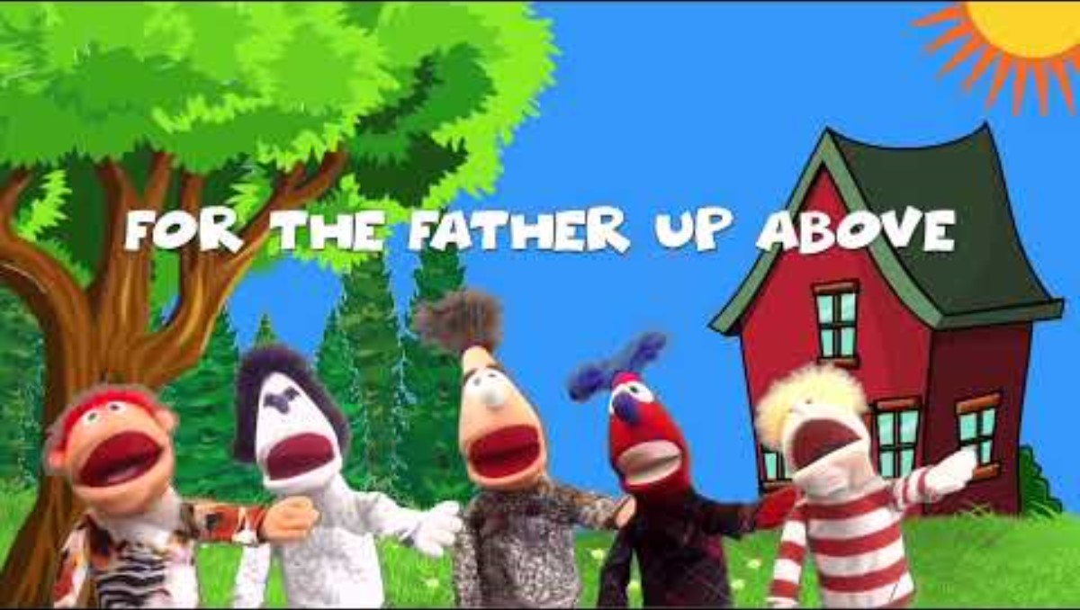

Slide 10
“Watch and pray
so that you will not fall into temptation.
The spirit is willing,
but the flesh is weak.”
Mark
14:38

Slide 11
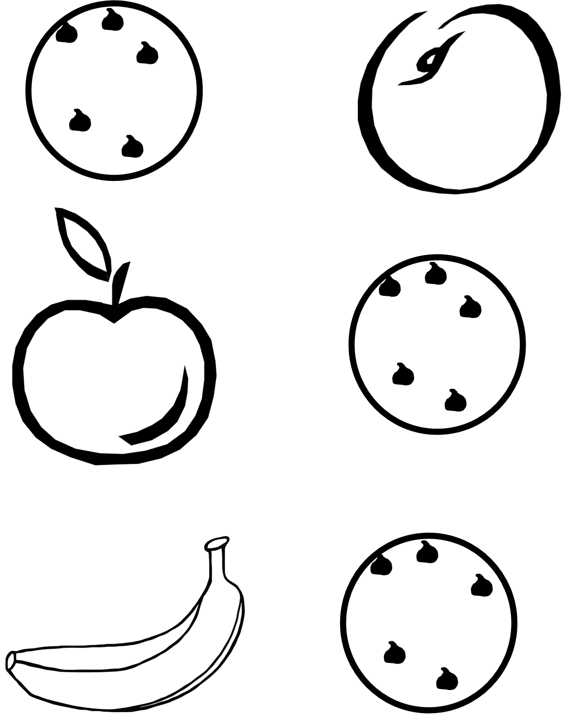
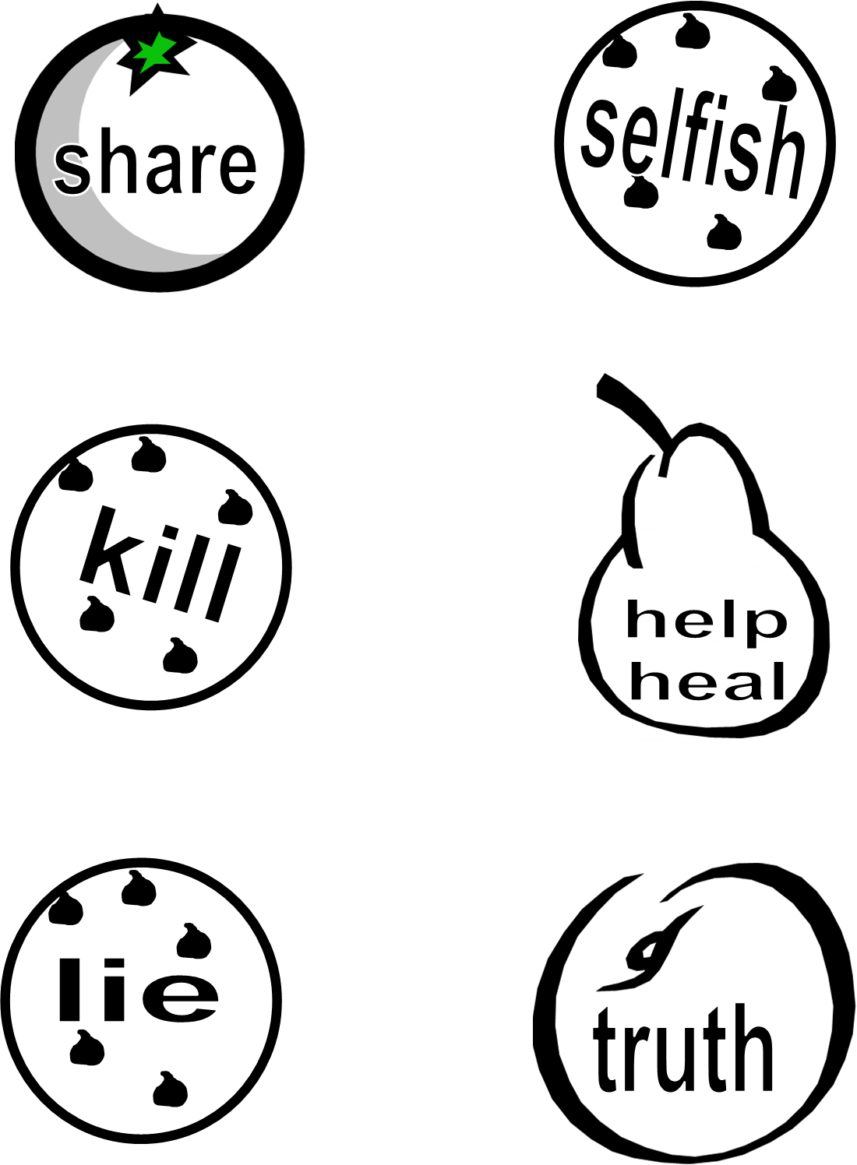
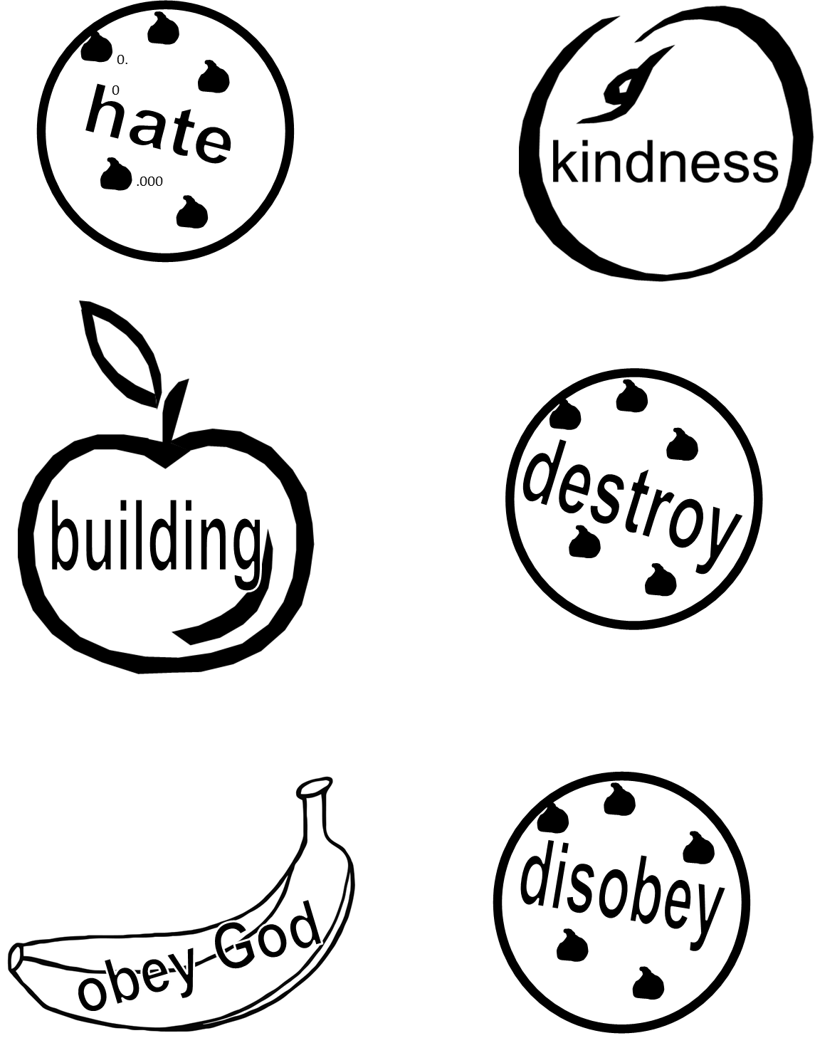
ACTIVITY TIME 1
Color everything very pretty!
Tape on a loop of string.
We will use them in our story in a little bit.

Slide 12


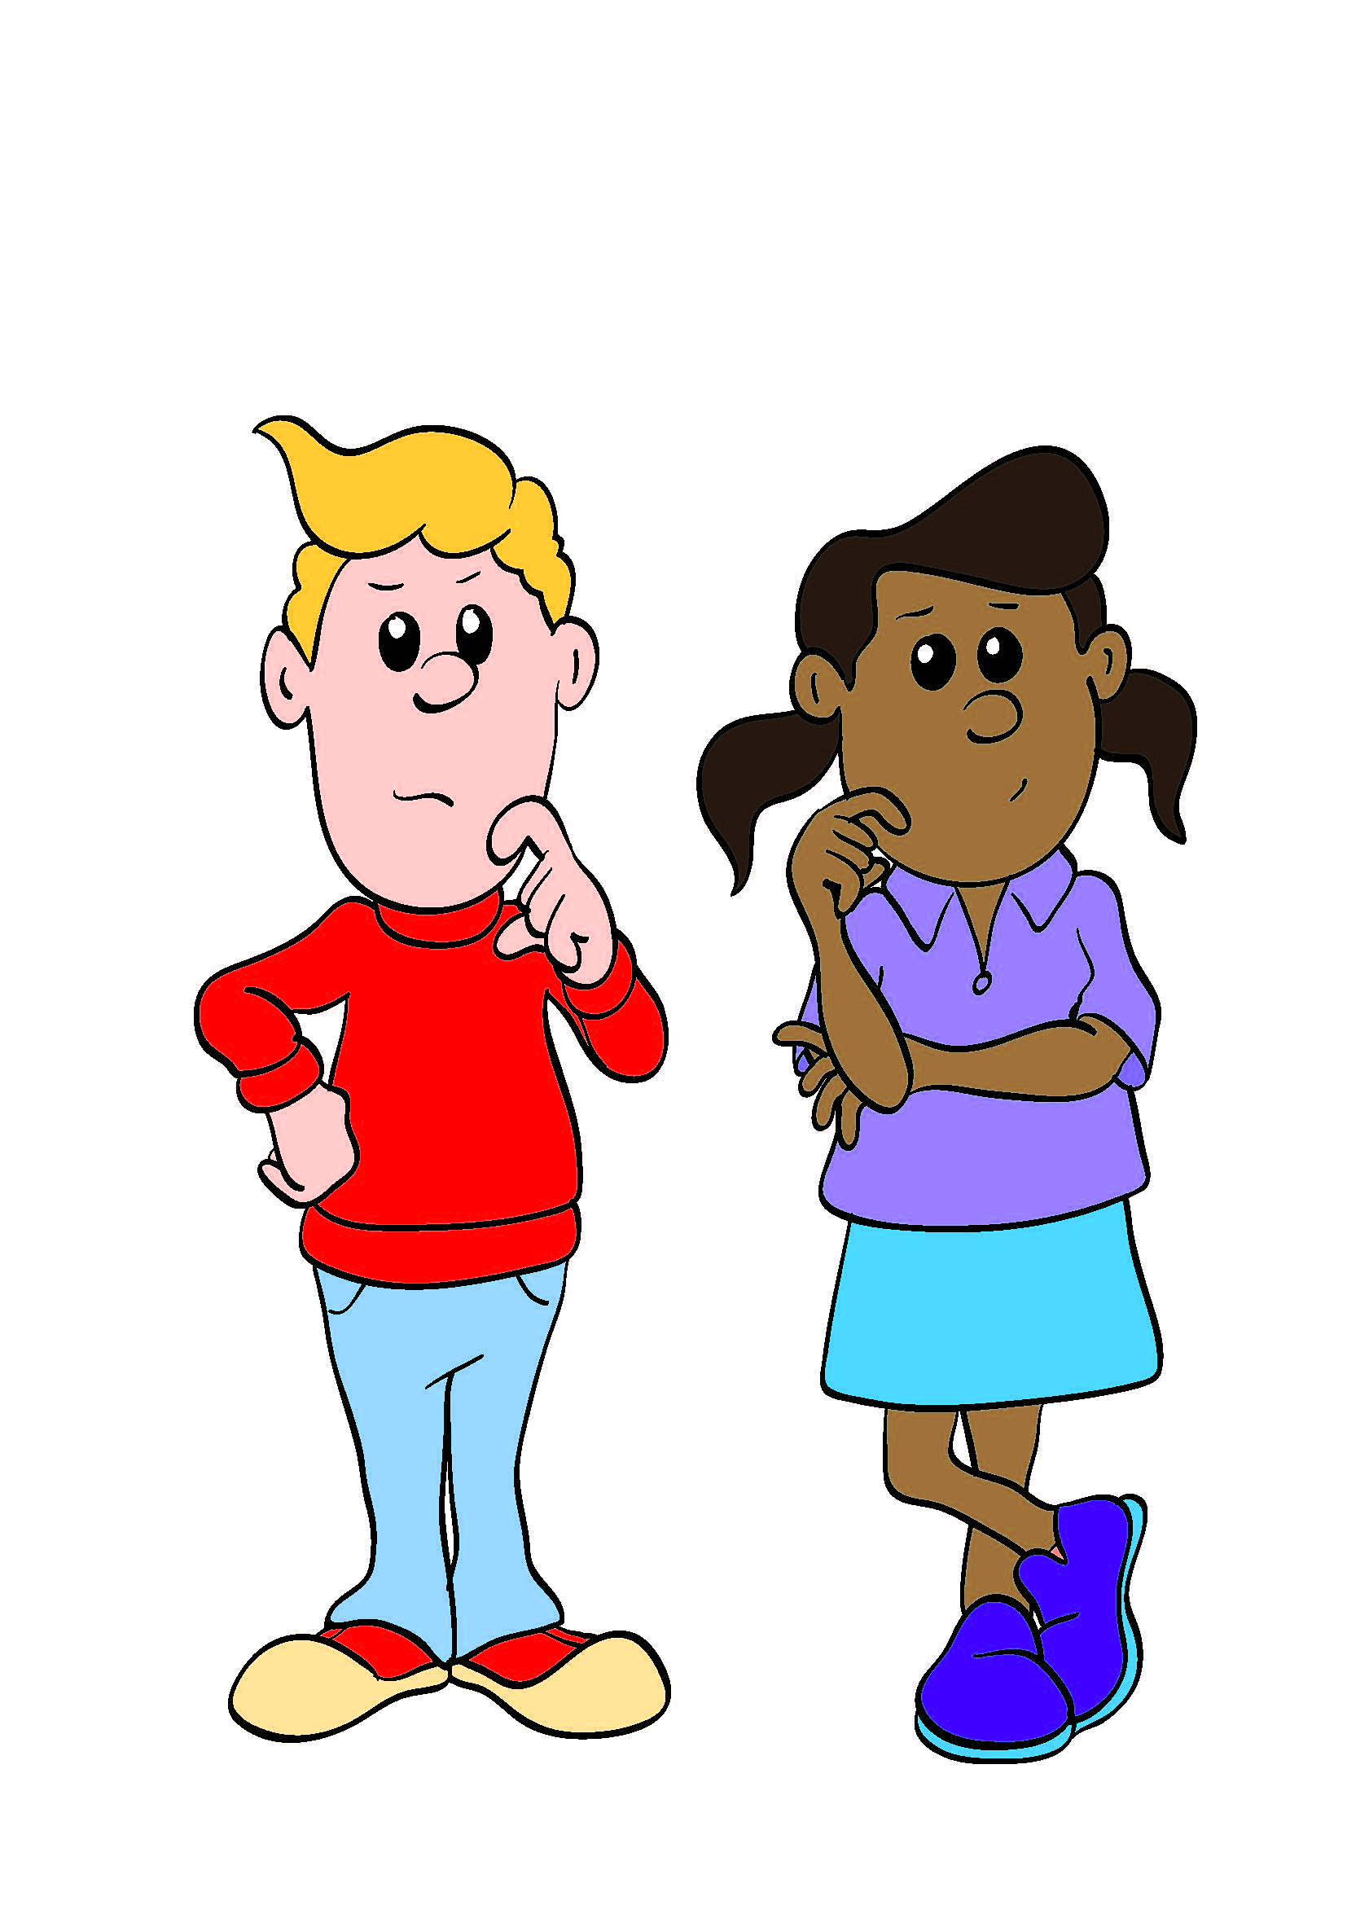
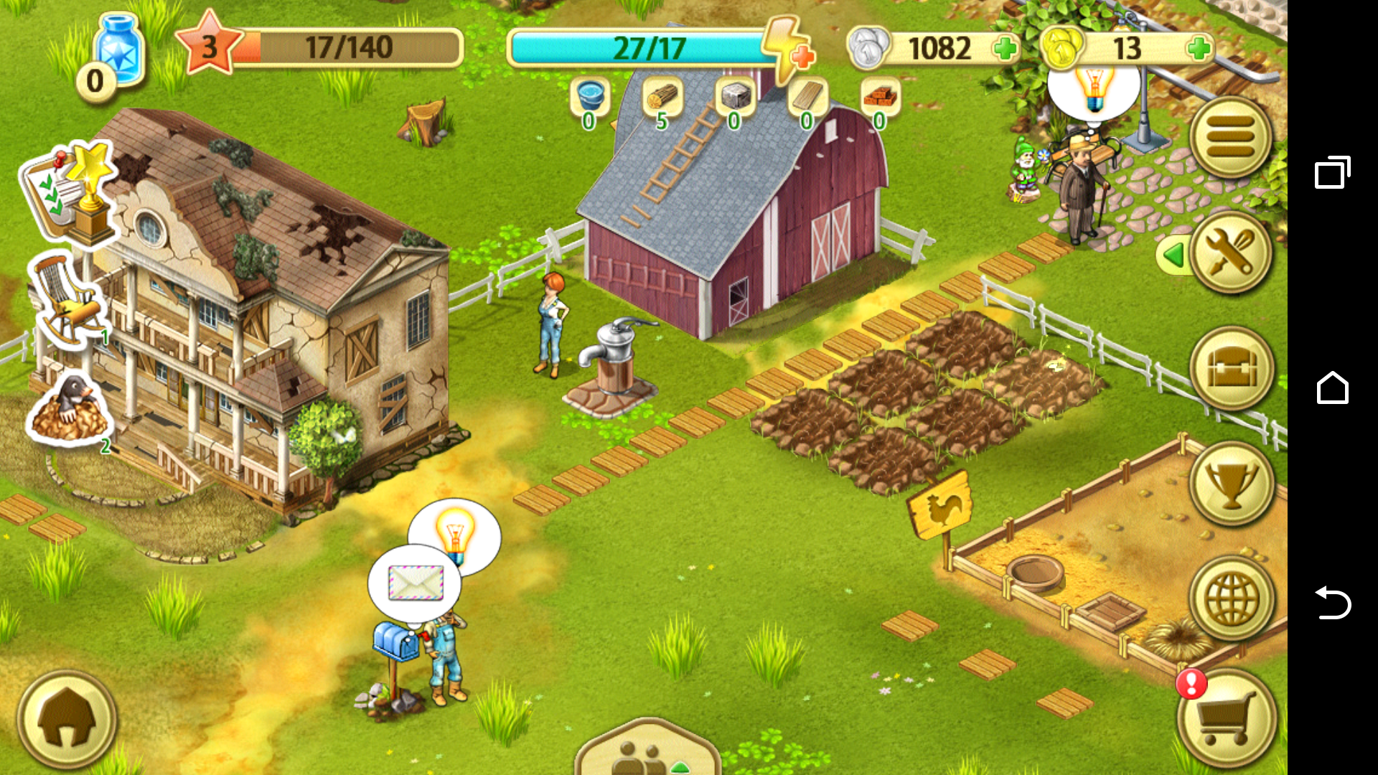
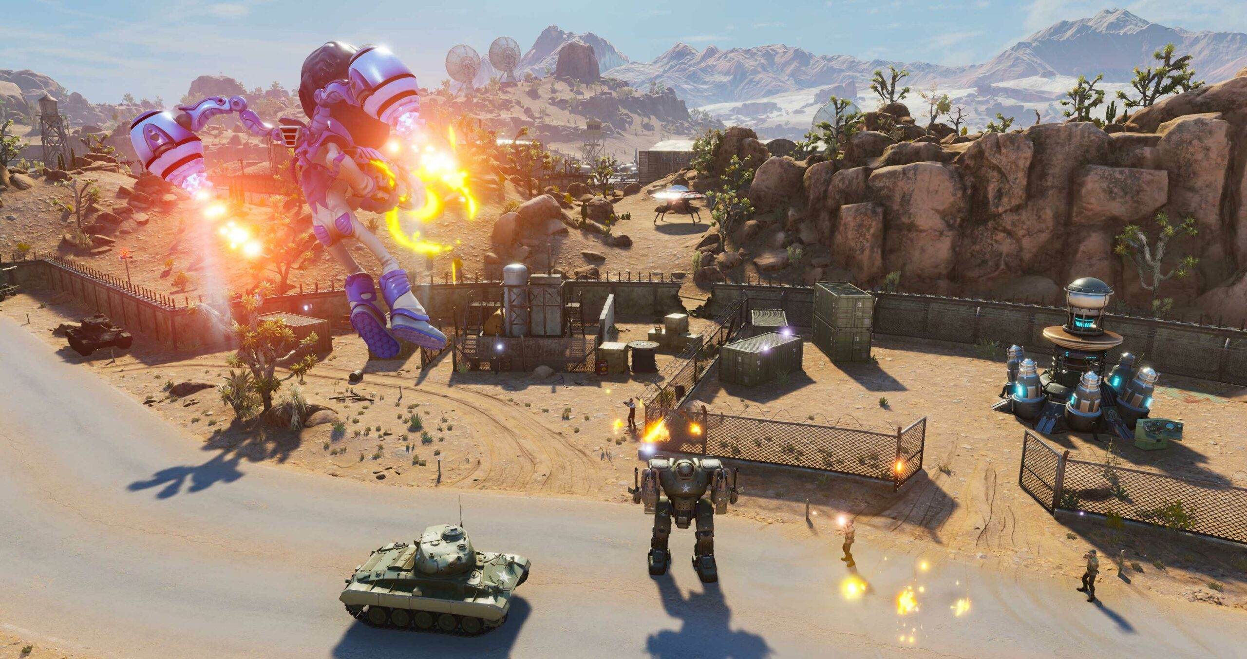
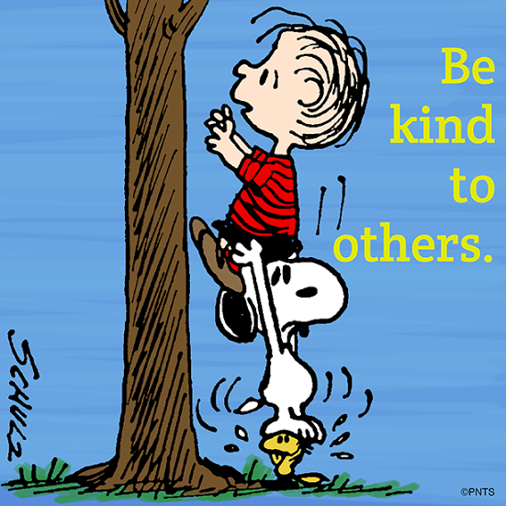
Choices
We have choices too.
What will you watch or do ….
On the computer or tablet?
On the phone?
Will you choose games and shows that encourage killing, stealing, lying, and death?
Or will you choose games and shows that encourage helping others, love, life, truth, and making good choices?
How will you act or behave?

Slide 13
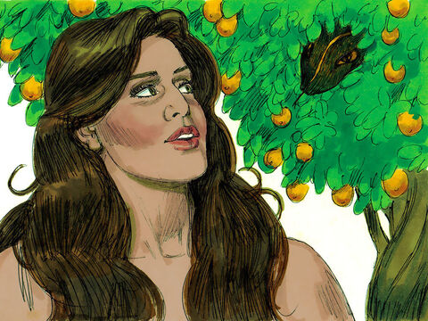
Genesis 3
Did God really say,
“You must not eat from any tree in the garden?”
We may eat fruit from the trees in the garden!
Will here you are!
Except, we may not eat from the tree in the middle of the garden.
You will not certainly die.
We should not even touch it or we will die!
God knows that your eyes will be opened.
You will be like God, knowing good and evil.
Now the serpent was more crafty than any of the wild animals the Lord God had made. He said to the woman, “Did God really say, ‘You must not eat from any tree in the garden’?”
² The woman said to the serpent, “We may eat fruit from the trees in the garden, ³ but God did say, ‘You must not eat fruit from the tree that is in the middle of the garden, and you must not touch it, or you will die.’”
⁴ “You will not certainly die,” the serpent said to the woman. ⁵ “For God knows that when you eat from it your eyes will be opened, and you will be like God, knowing good and evil.”

Slide 14
Think about it
Hmmm
I want to be like God.
Why did God say not to eat from this tree?
Often the devil mixes truth with lies to trick us. Do we want to be like God?
Yes! We want to be kind, loving, true, and faithful like God. We do enjoy being creative like God. We enjoy beautiful and fun things like God.
BUT… We are not God. We are not THE CREATOR. We are not the KING of kings. We can not BE God!

Slide 15
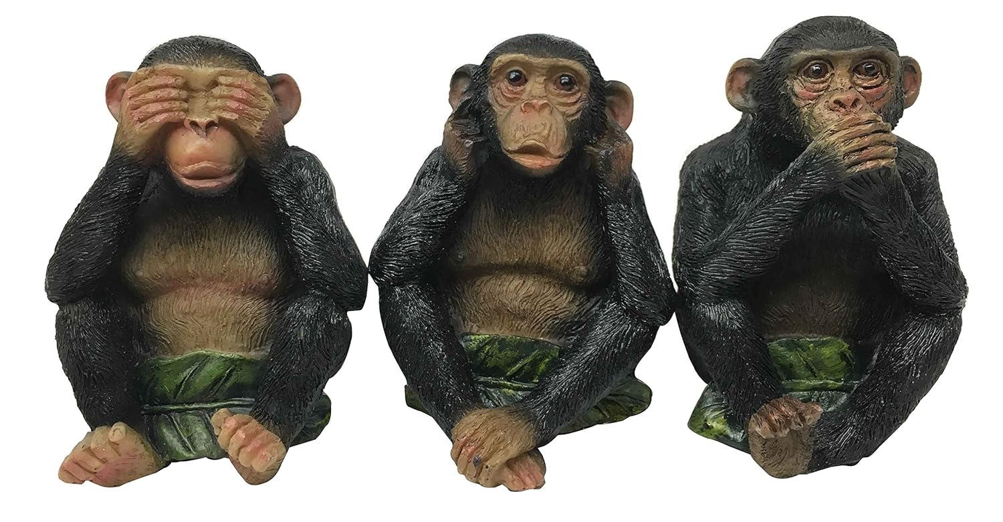
Think about it
Hmmm
I want wisdom.
Why did God say not to eat from this tree?
Learning and getting wisdom is a good thing. God wants us to learn truth.
BUT learning about evil and bad things is not good. Thinking about bad things is NOT good.
What we watch, what we listen to, what we read, and what we think about is what we will most likely do if given a choice.
See no evil. Hear no evil. Speak no evil.

Slide 16
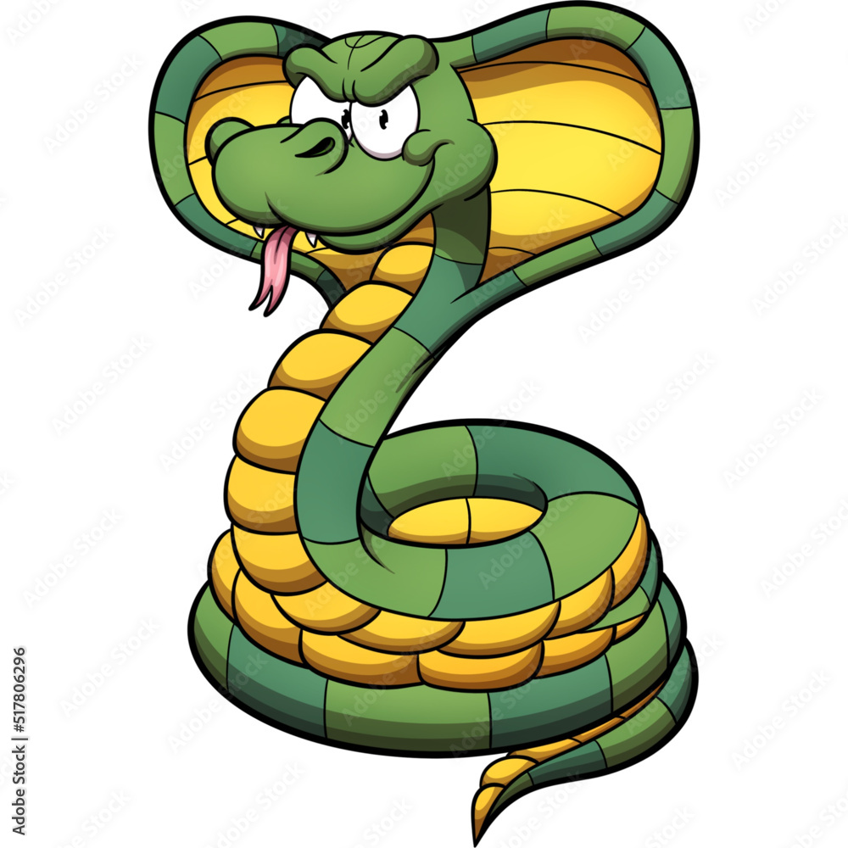
Wise King Solomon told his son:
“My son, if you accept my words
and store up my commands
within you,…
then you will understand the fear of the Lord
and find the knowledge of God….
For the Lord gives wisdom;
from his mouth come knowledge
and understanding.”
Proverbs
2:1, 5, 6
Never mind about what God said, experience & learn evil.

Slide 17
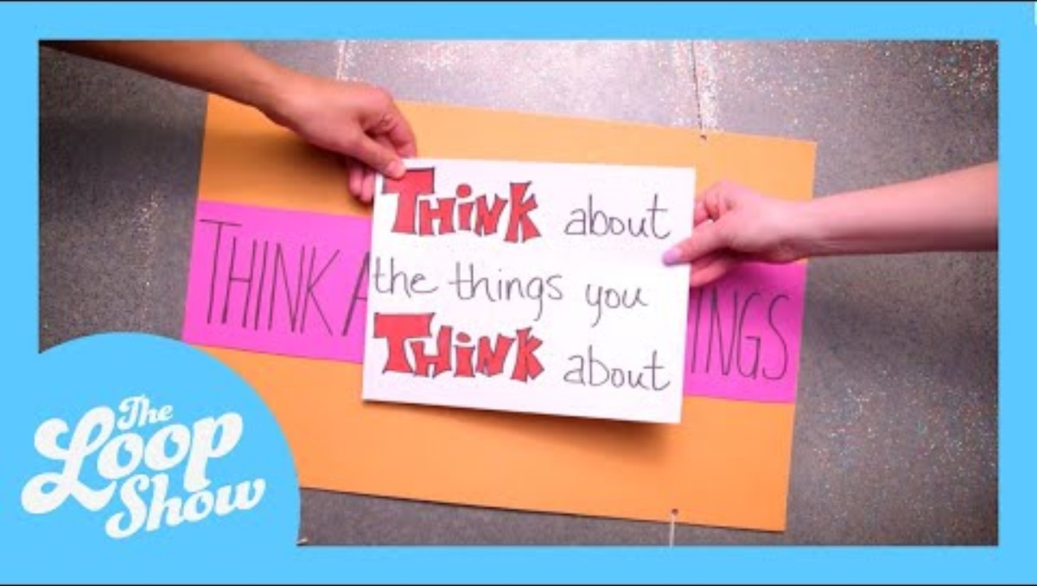
Philippians 4:8

Slide 18
Genesis 3
Like I said, you will be like God, knowing good and evil.
Hmmm. Maybe you’re right.
See, I’m not dead.
The fruit is good!
Now the serpent was more crafty than any of the wild animals the Lord God had made. He said to the woman, “Did God really say, ‘You must not eat from any tree in the garden’?”
² The woman said to the serpent, “We may eat fruit from the trees in the garden, ³ but God did say, ‘You must not eat fruit from the tree that is in the middle of the garden, and you must not touch it, or you will die.’”
⁴ “You will not certainly die,” the serpent said to the woman. ⁵ “For God knows that when you eat from it your eyes will be opened, and you will be like God, knowing good and evil.”

Slide 19
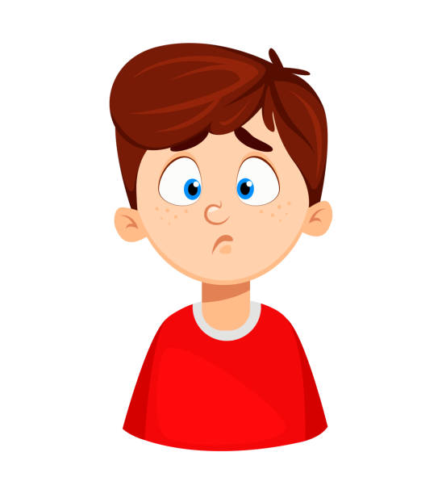
But, one day…..
The beautiful serpent said the fruit is good.
It will make us wise.
The serpent was alive, beautiful and talked!
Let’s eat!
Hmmm.
OK
⁶ When the woman saw that the fruit of the tree was good for food and pleasing to the eye, and also desirable for gaining wisdom, she took some and ate it.
She also gave some to her husband, who was with her, and he ate it.
That was a bad choice!

Slide 20
ACTIVITY TIME 2
Did you finish coloring and cutting out your fruit? Tape on a loop of string.
They all look so beautiful! God made fruit so beautiful, sweet, and good for us!
The devil likes to use beautiful, sweet things to trick us that it is good, but it is not good.
We have 2 trees up front. The one with the snake is the bad tree, the Tree of Knowledge of Good and Evil. Put the circles with bad choices on that tree.
The tree with different kinds of fruit on it is the good tree, the Tree of Life. Put the good choices on that tree.
You can make some of your own fruit of good and bad choices, too.

Slide 21
Drawing Time
While we finish the story, you can draw what happens next.

Slide 22
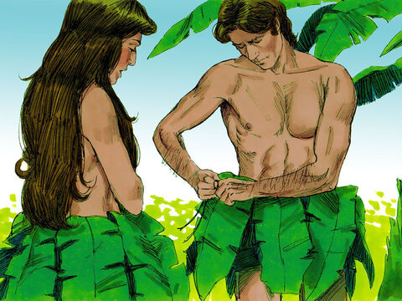
Sin brings shame
We can sew these leaves together.
Oh no!
We need to cover ourselves.
Hurry!
I hear God coming!
Hide!
Adam and Eve chose to stay and listen to the devil serpent and to eat from the Tree of Knowledge of Good and Evil, which God said not to eat from.
⁷ Then the eyes of both of them were opened, and they realized they were naked; so they sewed fig leaves together and made coverings for themselves.

Slide 23
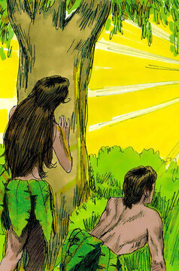
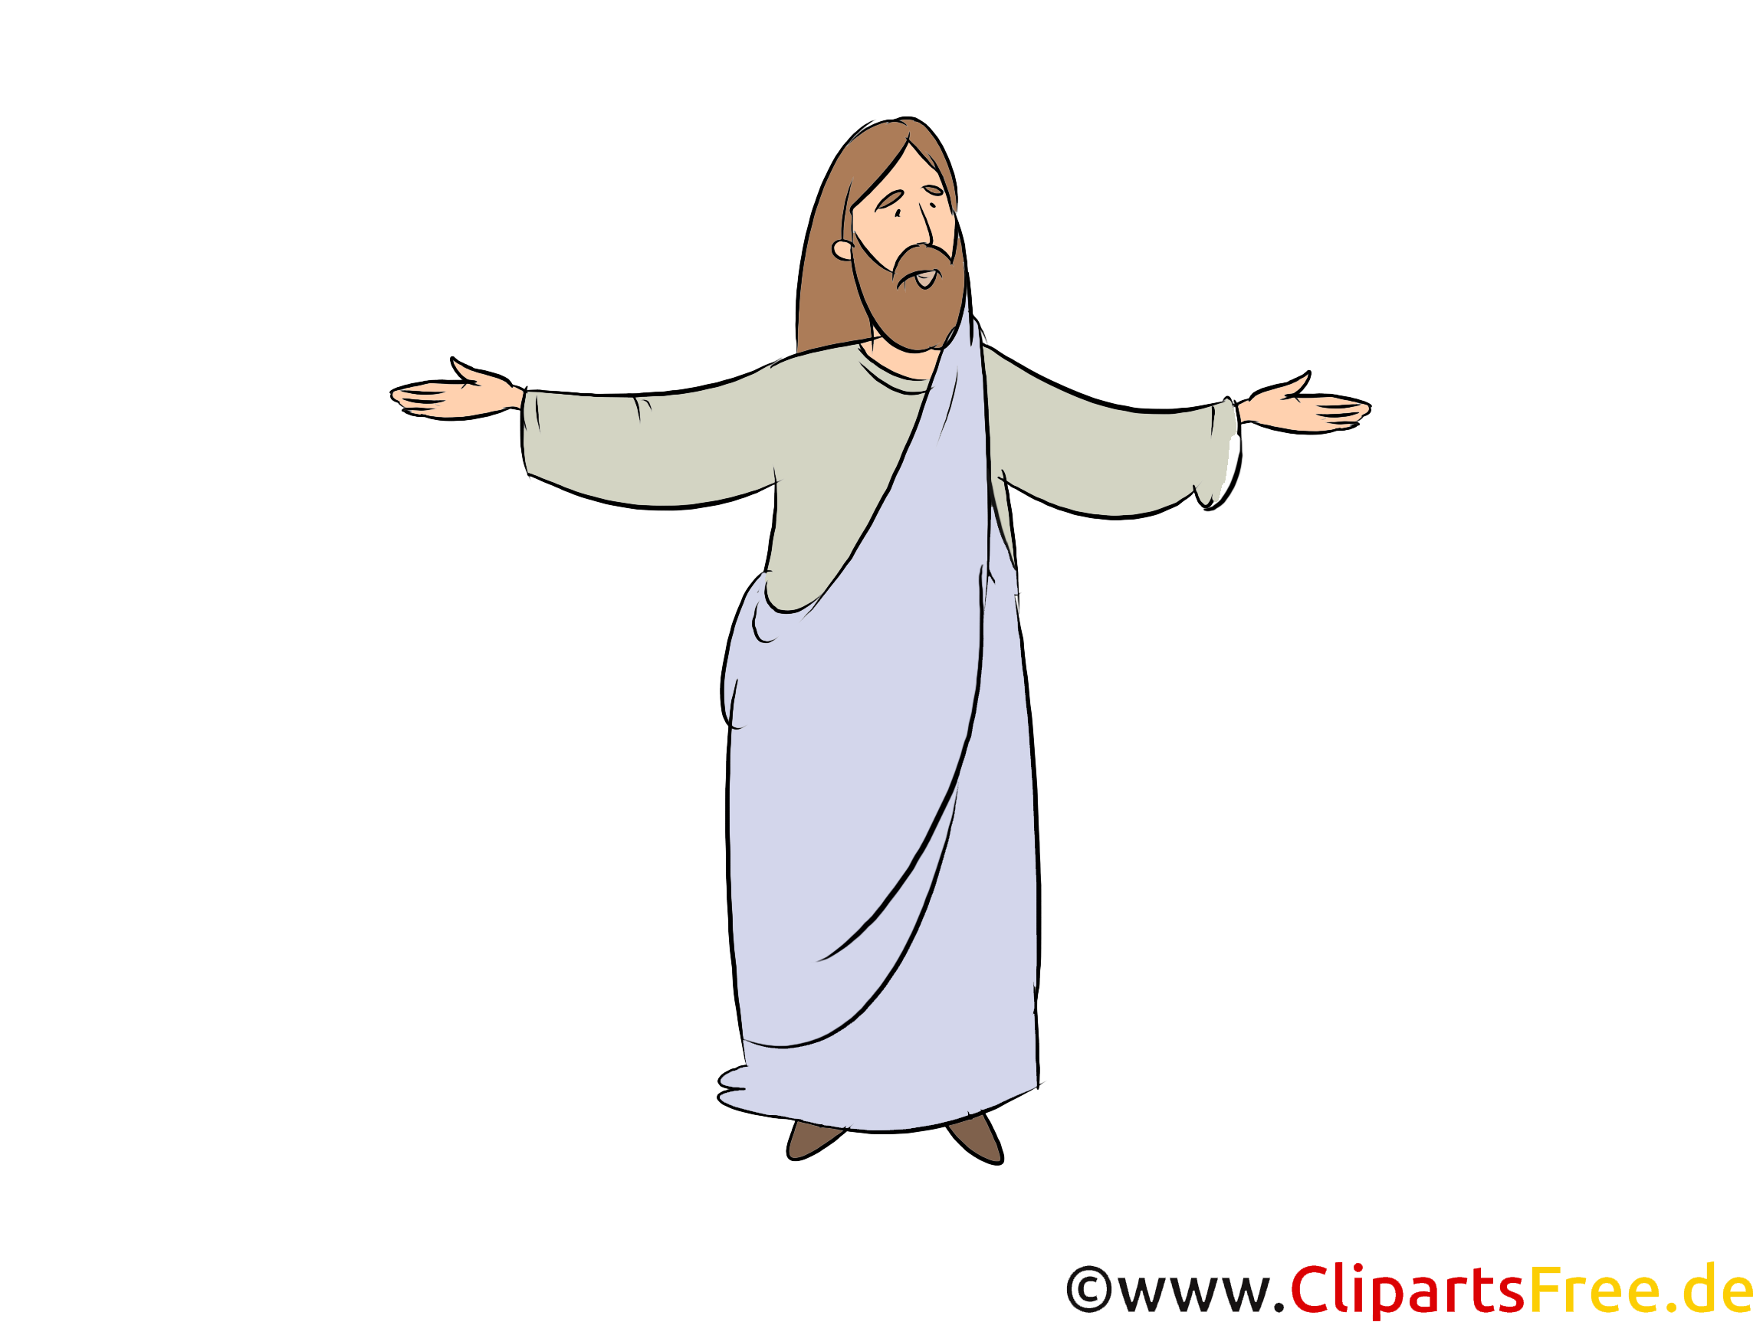
Shame brings hiding
Adam and Eve.
It’s our special time together.
Where are you?
⁸ Then the man and his wife heard the sound of the Lord God as he was walking in the garden in the cool of the day, and they hid from the Lord God among the trees of the garden.
⁹ But the Lord God called to the man, “Where are you?”
Why were Adam and Eve hiding?

Slide 24
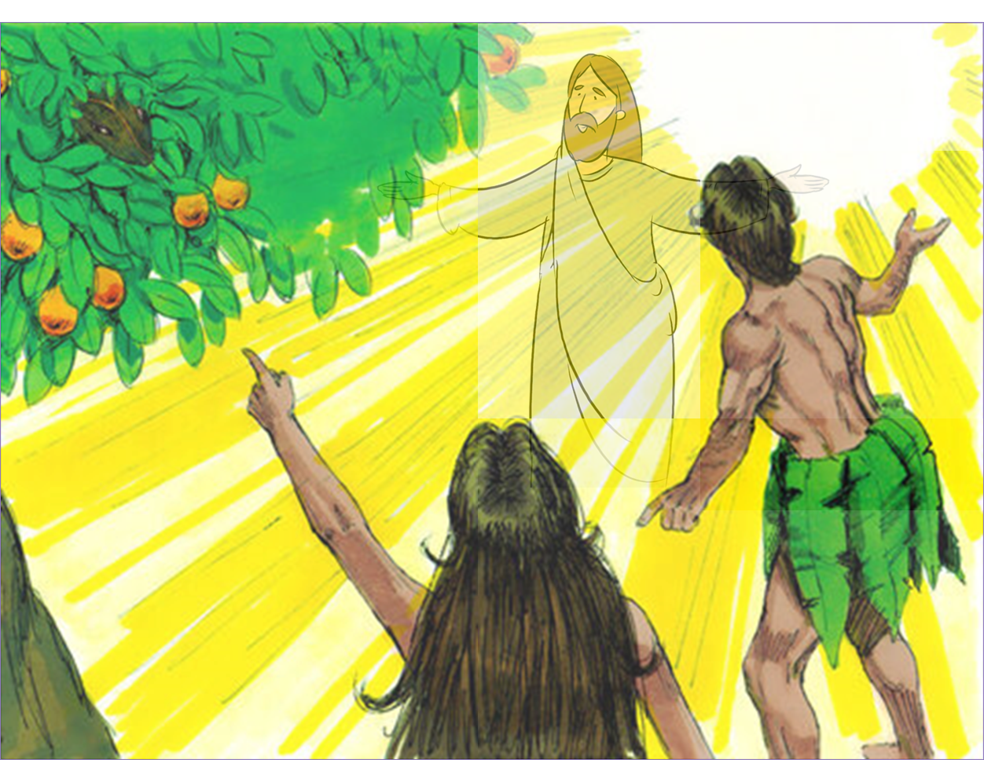
Why?
Why were you trying to hide from me?
Why were you afraid?
Did you eat from the tree I told you not to eat from?
What have you done?
The woman you put here with me – she gave me the fruit and I ate it.
I heard you in the garden, but I was afraid, so I hid.
¹⁰ He answered, “I heard you in the garden, and I was afraid because I was naked; so I hid.”
¹¹ And he said, “Who told you that you were naked? Have you eaten from the tree that I commanded you not to eat from?”
¹² The man said, “The woman you put here with me—she gave me some fruit from the tree, and I ate it.”
¹³ Then the Lord God said to the woman, “What is this you have done?”
The woman said, “The serpent deceived me, and I ate.”
The serpent tricked me and I ate the fruit.

Slide 25
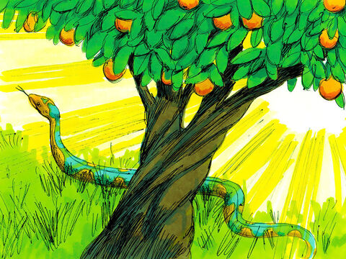
Consequences for the serpent
Serpent, because you have done this you will be cursed.
Her offspring will crush your head.
You will strike his heel.
You will crawl on your belly and eat dust as long as you live.
The woman and her children will hate you.
You will hate them.
¹⁴ So the Lord God said to the serpent, “Because you have done this,
“Cursed are you above all livestock
and all wild animals!
You will crawl on your belly
and you will eat dust
all the days of your life.
¹⁵ And I will put enmity
between you and the woman,
and between your offspring^{[a]} and hers;
he will crush^{[b]} your head,
and you will strike his heel.”

Slide 26
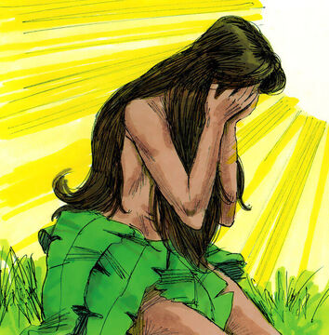
Consequences for Eve
Eve, having kids will be painful..
You will desire your husband.
He will rule over you.
¹⁶ To the woman he said,
“I will make your pains in childbearing very severe;
with painful labor you will give birth to children.
Your desire will be for your husband,
and he will rule over you.”

Slide 27
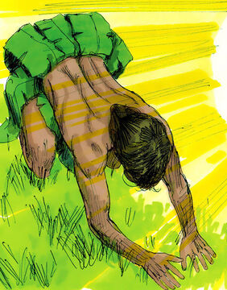
Consequences for Adam
Adam, Because you listened to your wife and ate the fruit which I told you not to eat, the ground will produce thorns and thistles.
Growing food will be a lot of hard work!
I made you from the ground
when you die, you will return to the dust.
¹⁷ To Adam he said, “Because you listened to your wife and ate fruit from the tree about which I commanded you, ‘You must not eat from it,’
“Cursed is the ground because of you;
through painful toil you will eat food from it
all the days of your life.
¹⁸ It will produce thorns and thistles for you,
and you will eat the plants of the field.
¹⁹ By the sweat of your brow
you will eat your food
until you return to the ground,
since from it you were taken;
for dust you are
and to dust you will return.”

Slide 28
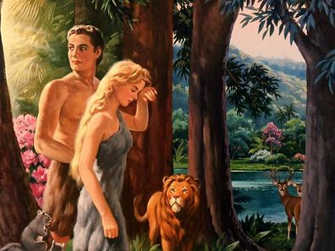
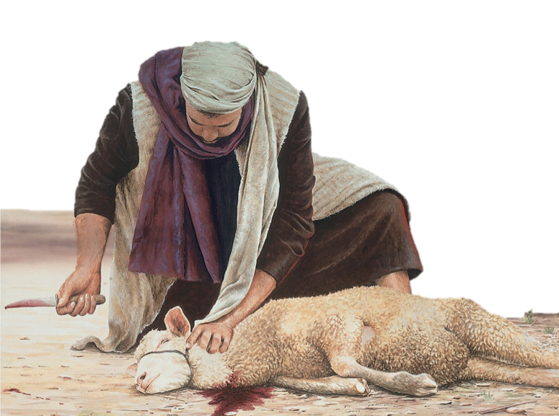
God made clothes
This animal will die and
I will make some clothes for you.
Someday a Savior will be born.
I will die for you so that you may be forgiven and clothed with righteousness.
²⁰ Adam^{[c]} named his wife Eve,^{[d]} because she would become the mother of all the living.
²¹ The Lord God made garments of skin for Adam and his wife and clothed them.

Slide 29
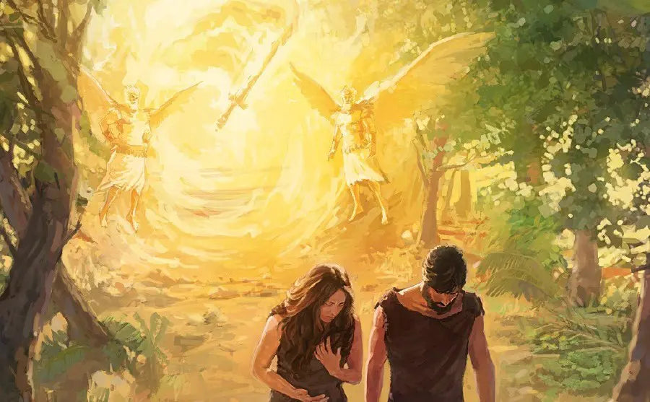
More Consequences
You have chosen to know evil.
You may not eat from the tree of life.
This angel will guard the way to the tree.
You may not stay in the Garden of Eden.
Now leave!
But I am not leaving you.
Our time together will be different now.
But you can still talk to me.
I will listen.
²² And the Lord God said, “The man has now become like one of us, knowing good and evil. He must not be allowed to reach out his hand and take also from the tree of life and eat, and live forever.”
²³ So the Lord God banished him from the Garden of Eden to work the ground from which he had been taken. ²⁴ After he drove the man out, he placed on the east side^{[e]} of the Garden of Eden cherubim and a flaming sword flashing back and forth to guard the way to the tree of life.

Slide 30
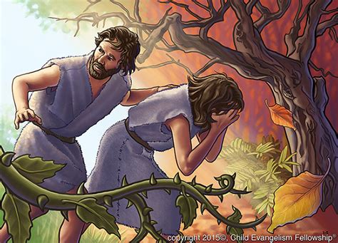
How sad!
Oh Adam. I’m so sorry!
I didn’t think it would be like this at all!
What a sad, sad day that was!
Will our hearts ever be full of joy again?
I didn’t think so either! We should have obeyed God’s warning!
We have lost so much!

Slide 31

3 minutes

Slide 32
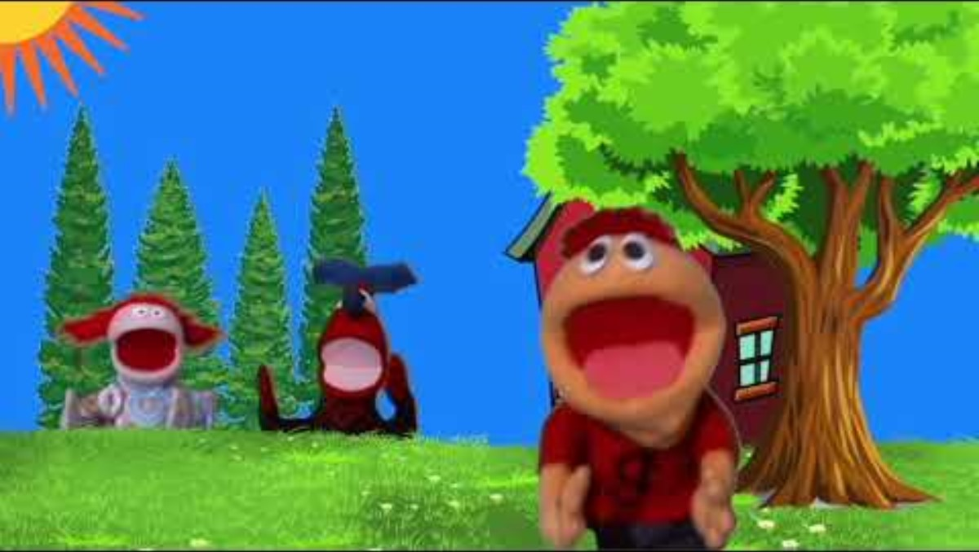

Slide 33

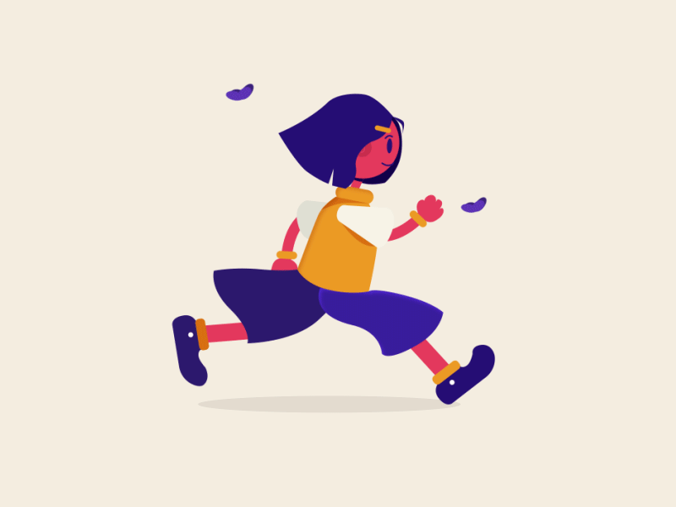
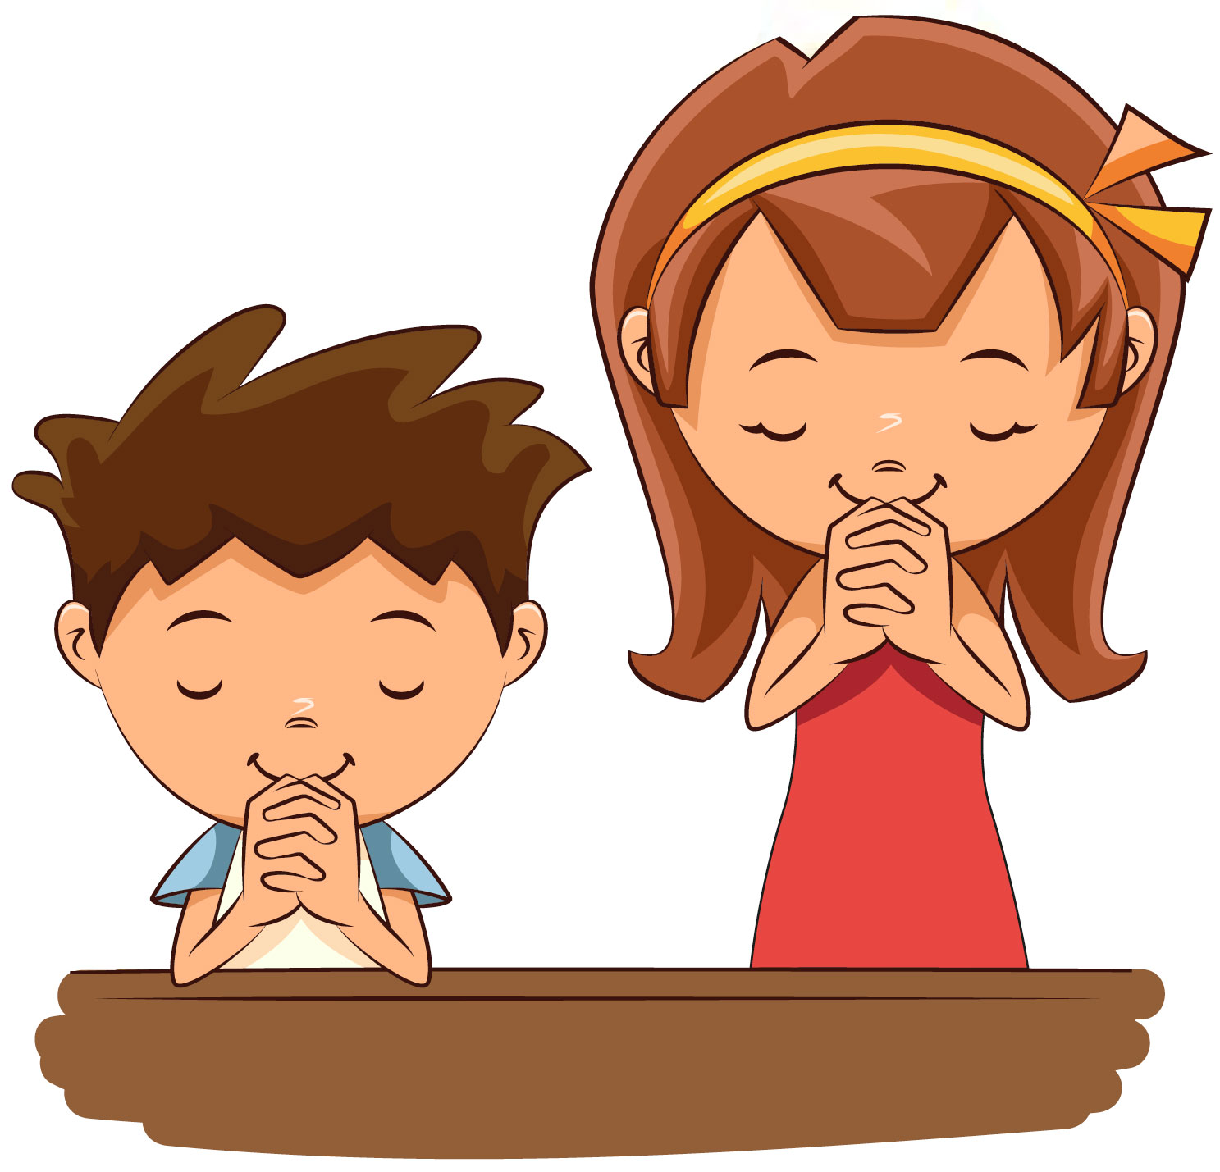
Temptations
No! I’m not doing that!
I’m leaving!
God, help us to be strong and obedient!
When we are tempted we should
Pray!
RUN
Think about something good.
Say NO!
Go find something good to do.
God can and will help us overcome temptation.
God, help us to think good thoughts!

Slide 34
“Watch and pray
so that you will not fall into temptation.
The spirit is willing,
but the flesh is weak.”
Mark
14:38

Slide 35
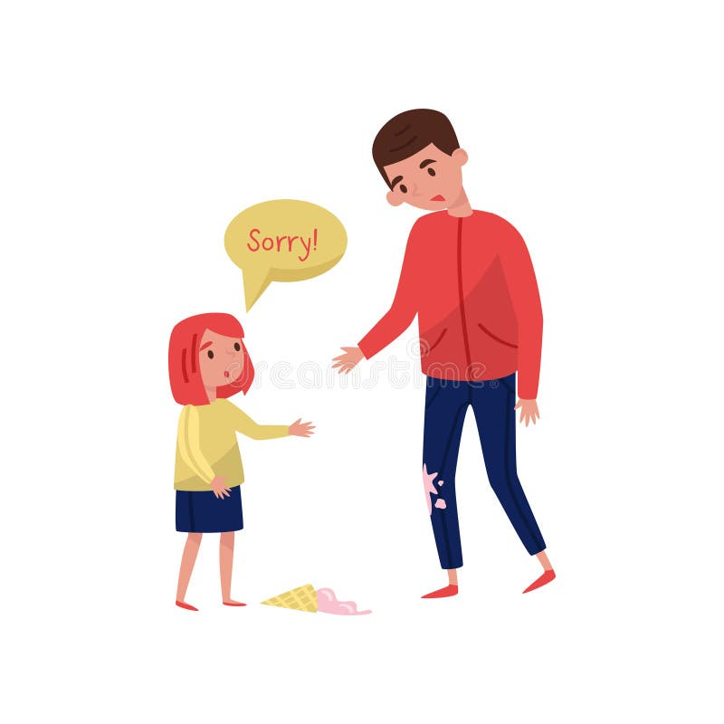
Make things right
Adam and Eve blamed others when they had done wrong. They didn’t take responsibility for their actions. They didn’t say sorry. They didn’t try to make things right.
What should we do if we make a bad choice or do something wrong?
Please help me fix it.

Slide 36
Finally, brothers and sisters, whatever is true,
whatever is noble,
whatever is right,
whatever is pure,
whatever is lovely,
whatever is admirable—
if anything is excellent
or praiseworthy—
think about such things.
Philippians 4:8

Slide 37

https://activity-array.com/

