Slide 1

FORGIVE
Matthew 18:21-33

Slide 2
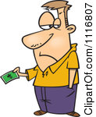
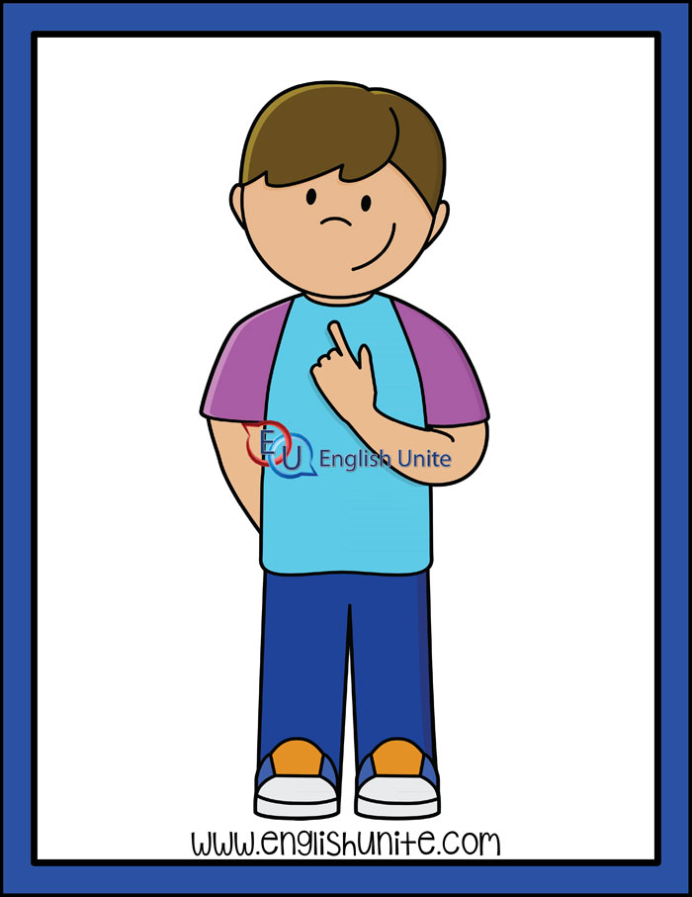
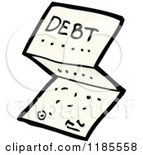






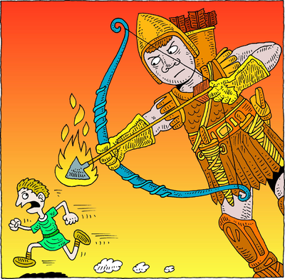
Figure out the key word for today by saying the first letter of the following things. Then unscramble them.
O
I
G
V
R
F
E
Notes:
OWE
GIFT
I
RIGHT
FROWN
ENEMY
VALENTINE – LOVE
FORGIVE

Slide 3
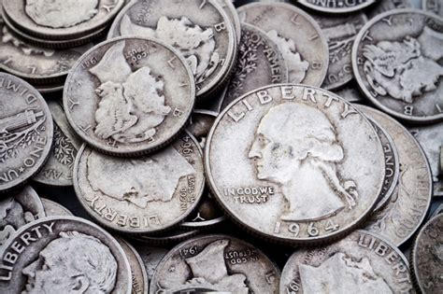
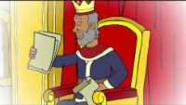

Slide 4
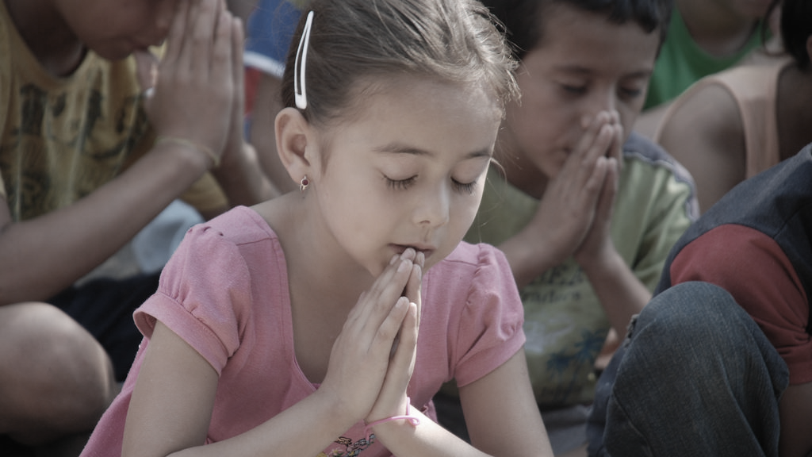
Let’s Pray
Our Father in heaven,
Hallowed be Your name.
¹⁰ Your kingdom come.
Your will be done
On earth as it is in heaven.
¹¹ Give us this day our daily bread.
¹² And forgive us our debts,
As we forgive our debtors.
¹³ And do not lead us into temptation,
But deliver us from the evil one.
For Yours is the kingdom and the power and the glory forever. Amen.

Slide 5



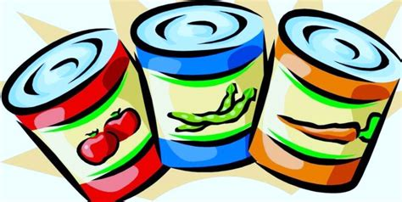


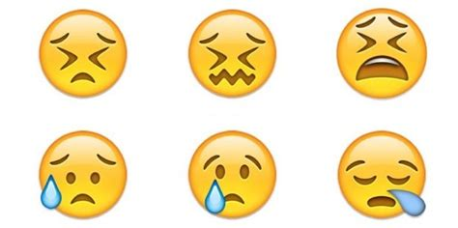
I need a strong volunteer
.
Please put on this backpack.
The backpack represents your heart.
I also have some full cans.
They represent sadness, anger, jealousy….
Notes:
HAVE A BACKPACK AND CANS

Slide 6
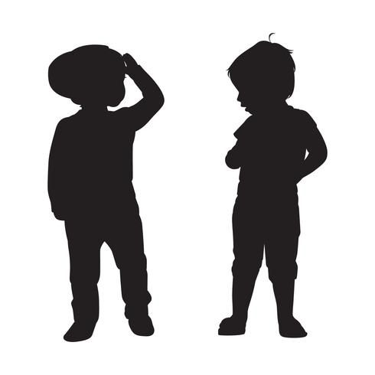
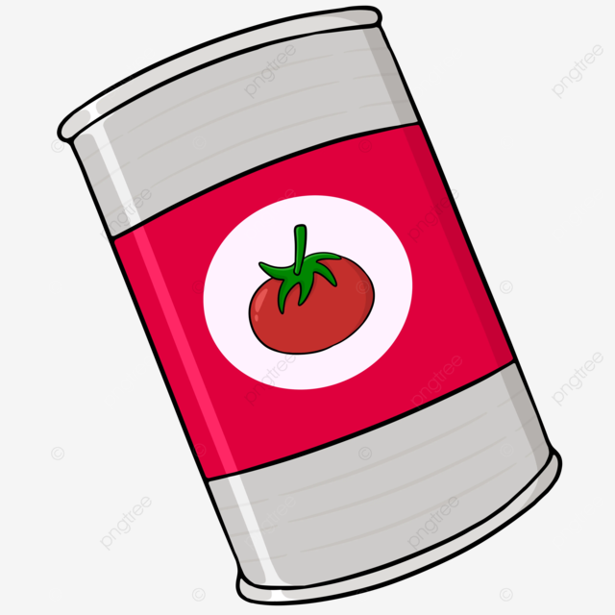
Will you forgive?
Riley doesn’t want to play Johnny’s game.
No. We have to play my game!
Riley doesn’t want to be a peace maker.
He is proud and stubborn.
Johnny is mad. This is a burden.
(Put a can in the backpack)

Slide 7

Will you forgive?
Riley calls you names.
You old fart.
#@*
Riley doesn’t want to be a peace maker.
He is mean.
Johnny is sad. This is a burden. But he won’t forgive.
(Put another can in the backpack)

Slide 8
Will you forgive?
Riley breaks your favorite toy.
Oops. Sorry
Riley doesn’t want to be a peace maker.
He is not careful nor respectful.
Johnny is mad. This is a burden. But he won’t forgive.
(Put another can in the backpack)

Slide 9
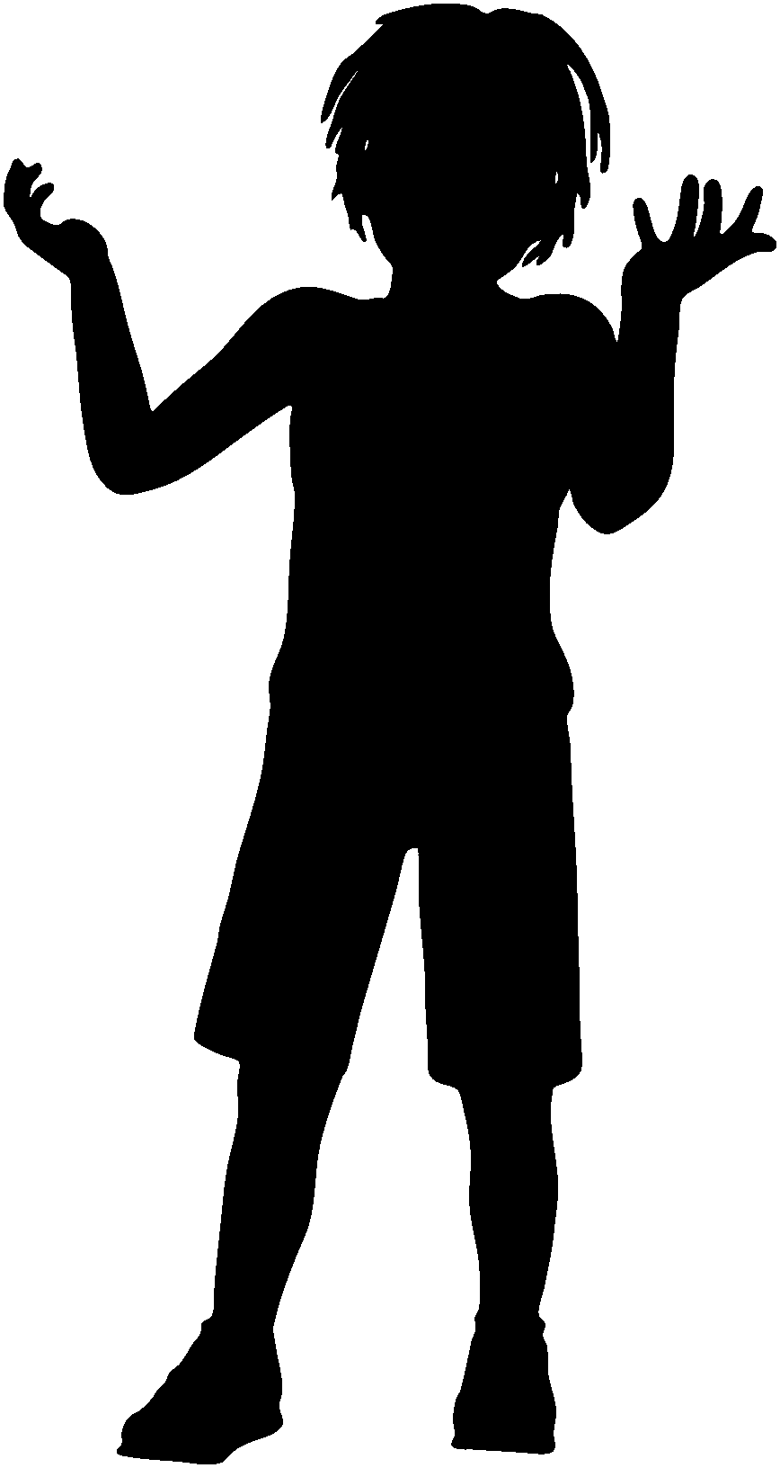

Will you forgive?
Riley trips you. You fall and get hurt.
I didn’t mean to.
Riley sees how mad Johnny is and he might apologize.
But Johnny is angry and he isn’t ready to forgive.
Johnny is mad. This is a burden. But he won’t forgive.
(Put another can in the backpack)

Slide 10


Will you forgive?
Riley gets mad at you.
Riley messes with your game and you have to start it over on level 1.
Aargh!
I didn’t know

Slide 11
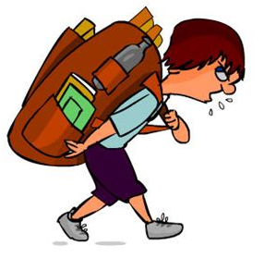
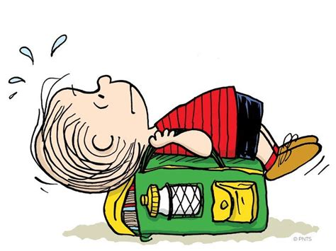
What is forgiveness?
.
Take off your backpack. Leave it here.
Get rid of all that sadness, anger, and jealousy.
FORGIVE = leave or abandon it
Do not stay angry
Will you let your heart be heavy?
OR
Let go of all the negative feelings?
^{Micah 7:18} Who is a God like you,
who pardons sin and forgives the transgression
of the remnant of his inheritance?
You do not stay angry forever
but delight to show mercy.
¹⁹ You will again have compassion on us;
you will tread our sins underfoot
and hurl all our iniquities into the depths of the sea.
Notes:
HAVE THE VOLUNTEER PUT A BACK PACK ON
PUT A CAN INTO THEIR BACKPACK TO REPRESENT EACH NEGATIVE FEELING WE HAVE WHEN OTHERS DO WRONG TO US --
DO THIS FOR THE FOLLOWING SCENARIOS TOO
TAKE BACKPACK OFF WHEN THEY CHOOSE TO FORGIVE

Slide 12
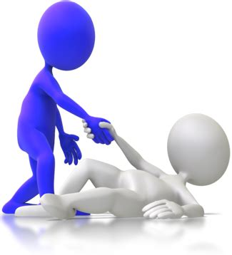
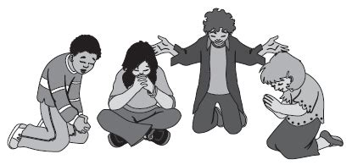
What is forgiveness?
.
FORGIVE = leave or abandon it
Do not stay angry
Show mercy
Pray for the person
Let God deal with them
It does NOT mean that what was done is OK or right
^{Numbers 14:18} ‘The Lord is slow to anger, abounding in love and forgiving sin and rebellion. Yet he does not leave the guilty unpunished
^{1 John 1:9} But if we confess our sins, God will forgive us. We can trust God to do this. He always does what is right. He will make us clean from all the wrong things we have done.

Slide 13


Let’s Sing Forgiveness Song For Children + Learn All About Emotions - BlackBerry Jam Kids Music

Slide 14
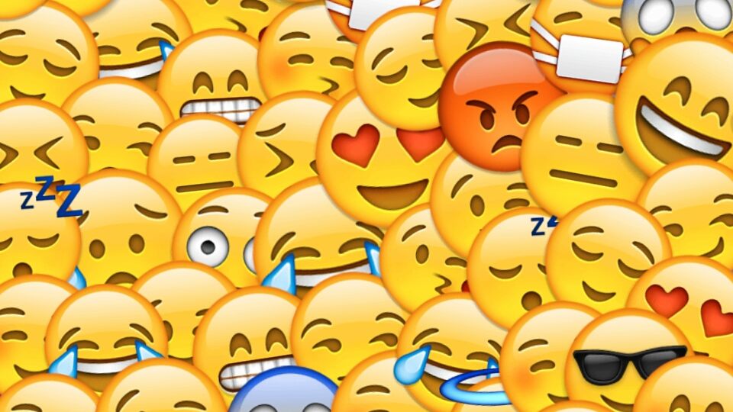
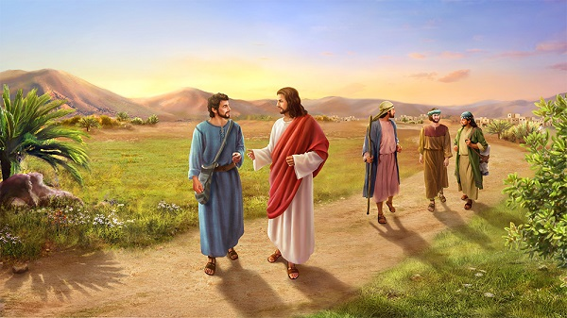
Matthew 18
Lord, when someone won’t stop doing wrong to me, how many times must I forgive them?
7 times?
I tell you, you must forgive them even more. Continue to forgive them 70 x 7 times.
²¹ Then Peter came to Jesus and asked, “Lord, when someone^{[a]} won’t stop doing wrong to me, how many times must I forgive them? Seven times?”
²² Jesus answered, “I tell you, you must forgive them more than seven times. You must continue to forgive them even if they do wrong to you seventy times seven times.
7 times? 70 x 7
Let me tell you a story.

Slide 15
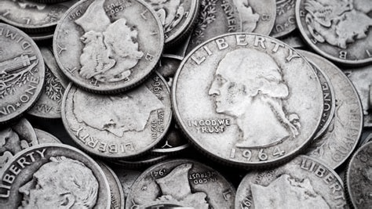
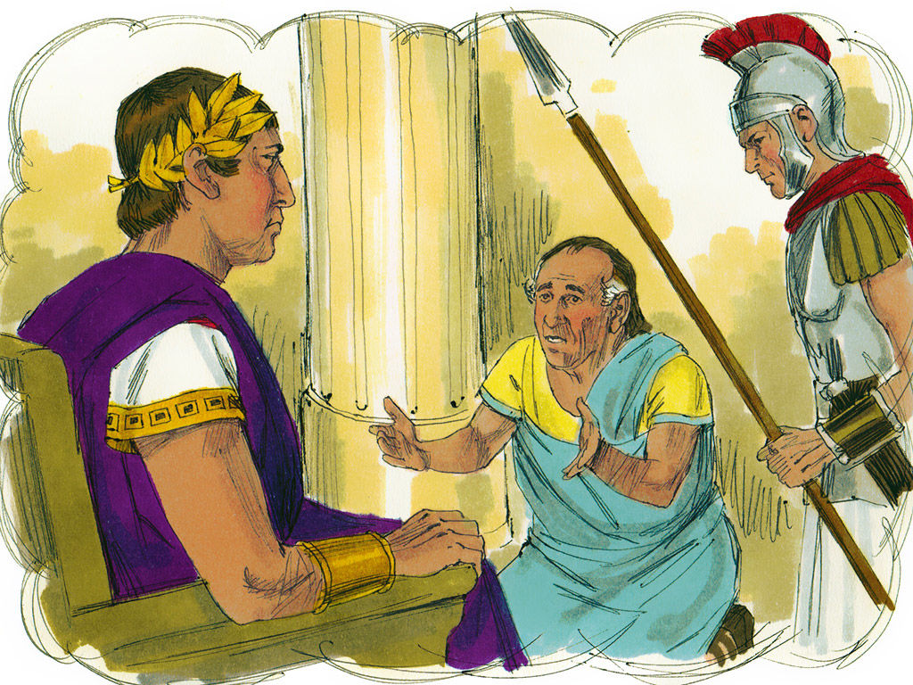
A story about
FORGIVENESS
I would have to work 10,000 years to pay it back! I’ll never be able to do it!
You owe me 10,000 pounds of silver.
Everything you own will be sold to pay for your debt. Even your wife and kids.
Be patient.
I will pay it back.
²³ “So God’s kingdom is like a king who decided to collect the money his servants owed him. ²⁴ The king began to collect his money. One servant owed him several thousand pounds^{[c]} of silver. ²⁵ He was not able to pay the money to his master, the king. So the master ordered that he and everything he owned be sold, even his wife and children. The money would be used to pay the king what the servant owed.
²⁶ “But the servant fell on his knees and begged, ‘Be patient with me. I will pay you everything I owe.’ ²⁷ The master felt sorry for him. So he told the servant he did not have to pay. He let him go free.
Please have mercy!
All right. I will have mercy.
Your debt is forgiven. I will take the loss.
Now you don’t owe me anything.

Slide 16
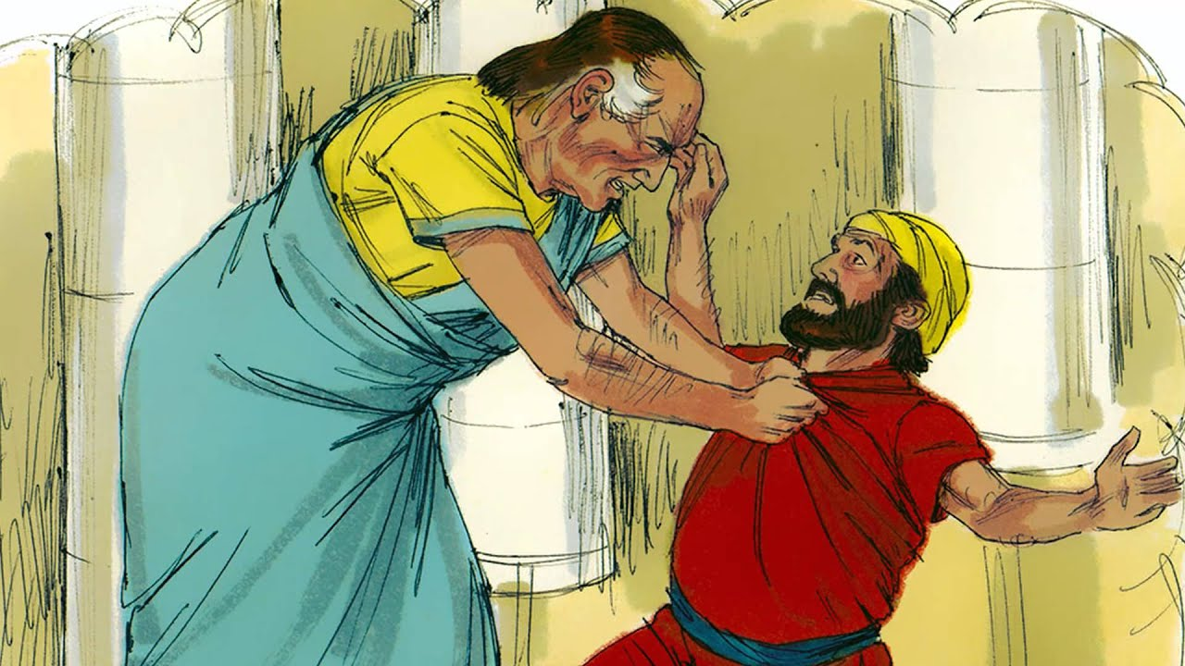
The Unmerciful Servant
If I give you all my earnings for 3 months, it will be paid.
Pay me back!
Give me my 100 coins NOW!
Be patient.
I will give you it all!
²⁸ “Later, that same servant found another servant who owed him a hundred silver coins. He grabbed him around the neck and said, ‘Pay me the money you owe me!’
²⁹ “The other servant fell on his knees and begged him, ‘Be patient with me. I will pay you everything I owe.’
³⁰ “But the first servant refused to be patient. He told the judge that the other servant owed him money, and that servant was put in jail until he could pay everything he owed.
NO! I WANT IT NOW!
YOU’RE GOING TO JAIL!

Slide 17
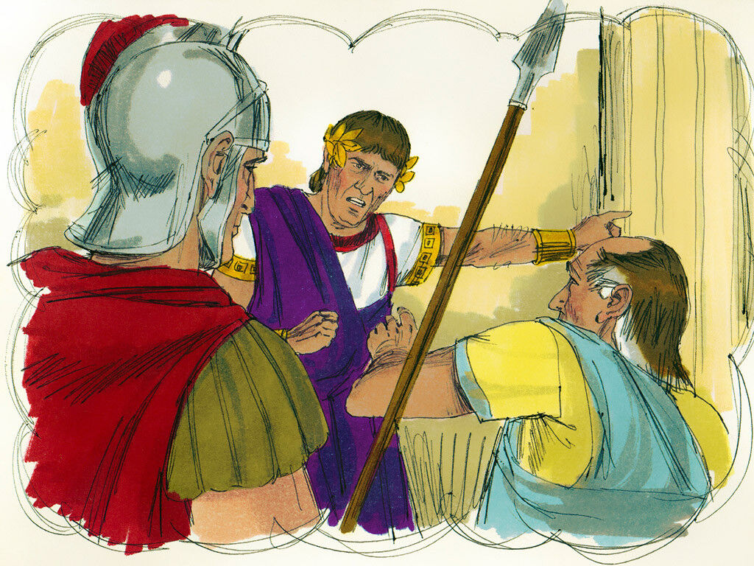
I forgave you much!
You did not forgive.
You are going to jail!
³¹ All the other servants saw what happened. They felt very sorry for the man. So they went and told their master everything that happened.
³² “Then the master called his servant in and said, ‘You evil servant. You begged me to forgive your debt, and I said you did not have to pay anything! ³³ So you should have given that other man who serves with you the same mercy I gave you.’ ³⁴ The master was very angry, so he put the servant in jail to be punished. And he had to stay in jail until he could pay everything he owed.

Slide 18
Matthew 18
This king did the same as my heavenly Father will do to you.
You must forgive with all of your heart or my Heavenly Father will not forgive you.
35 “This king did the same as my heavenly Father will do to you. You must forgive your brother or sister with all your heart, or my heavenly Father will not forgive you.”

Slide 19
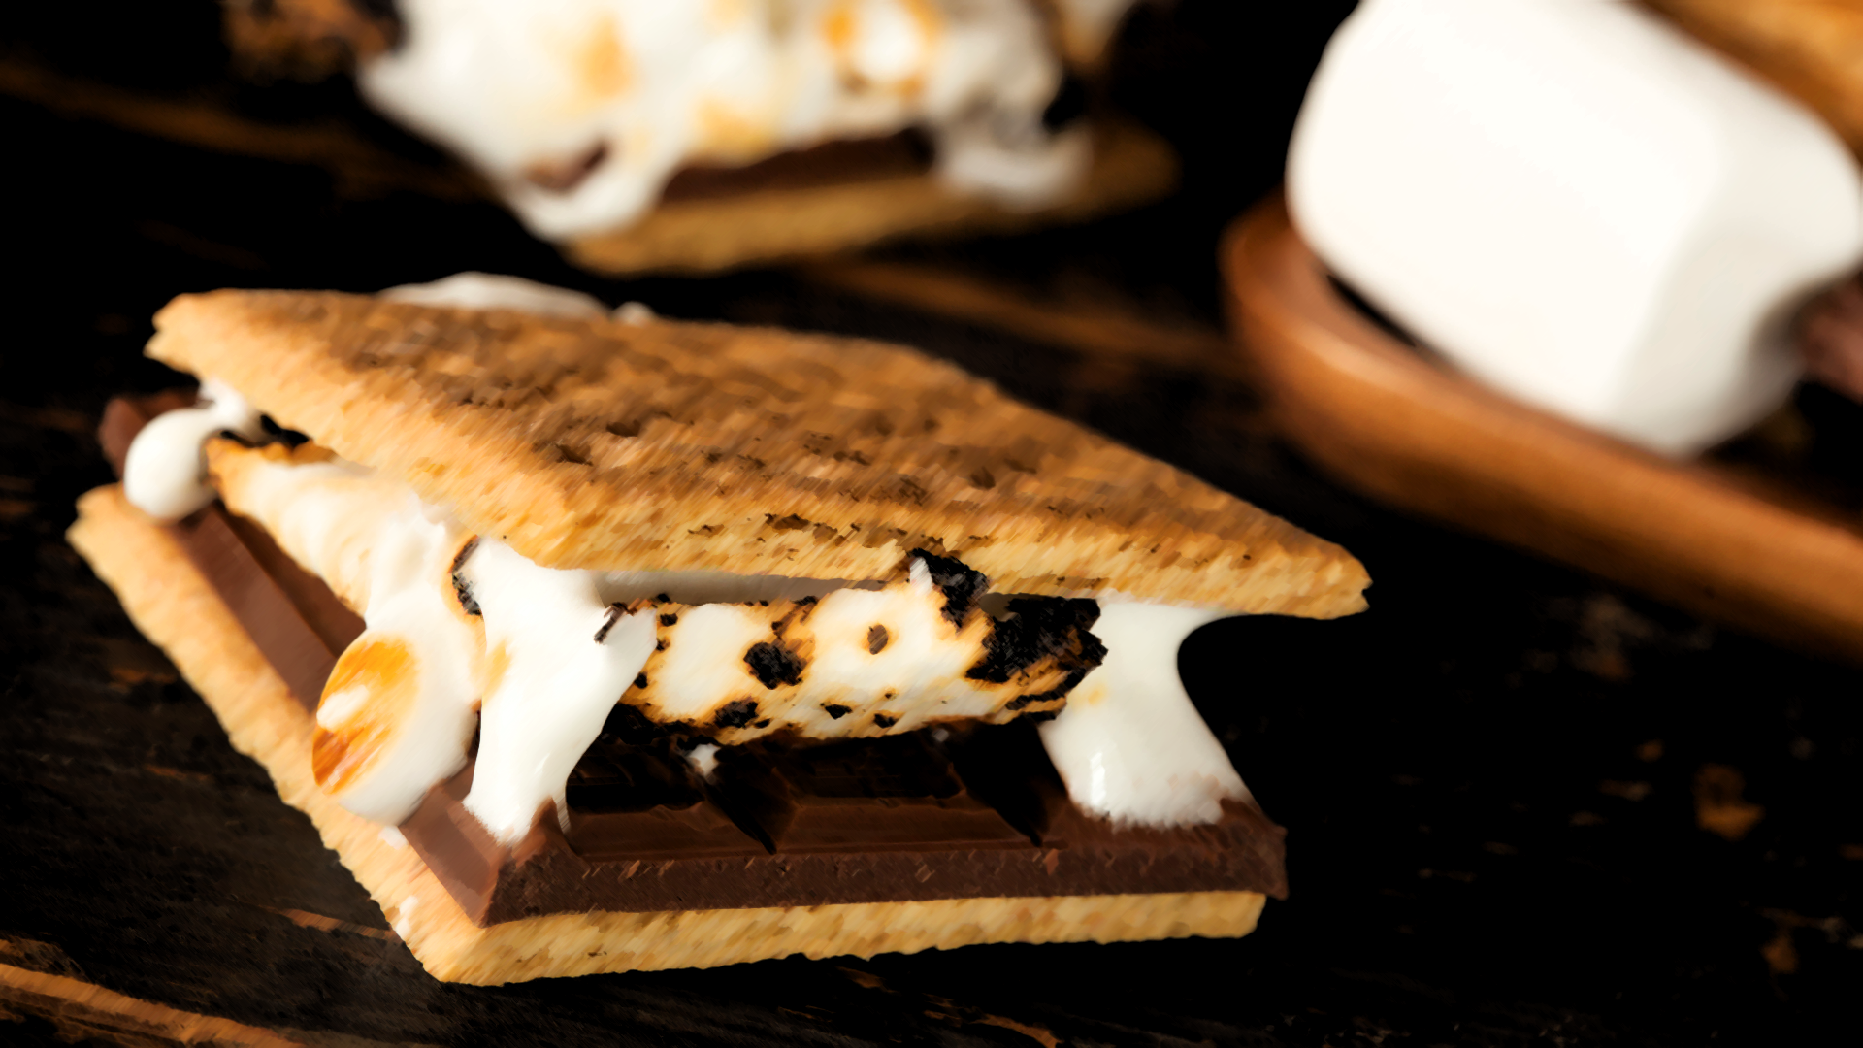
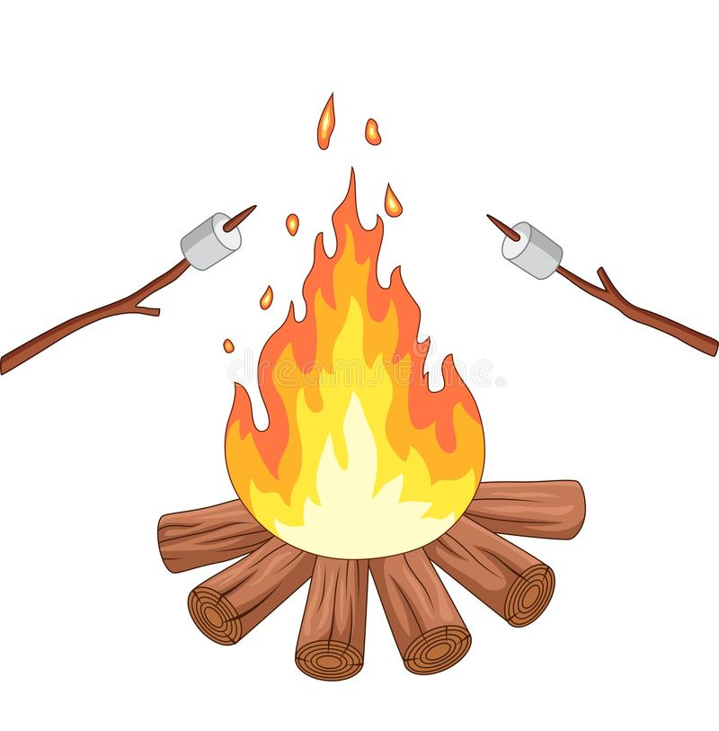
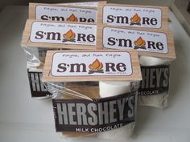
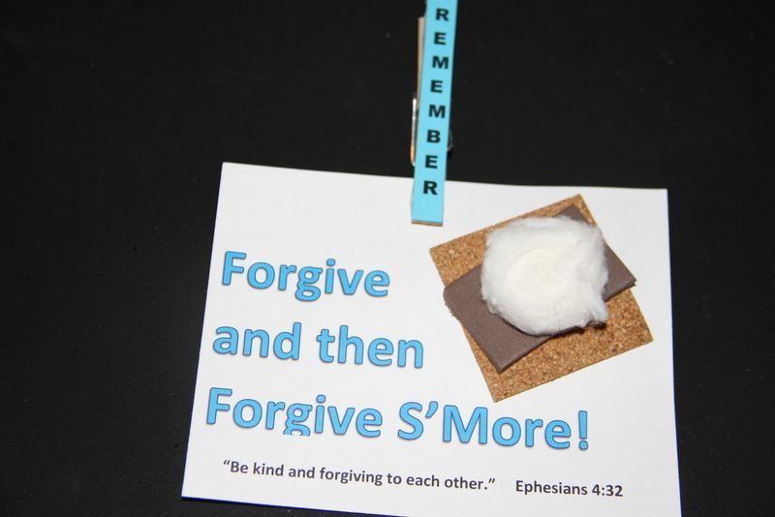
I will forgive you s’more
Put in a bag:
2 marshmallows
1 Hershey bar
4 graham cracker halves
Put on Card:
Sandpaper square “graham cracker”
Brown foam paper “chocolate”
Cotton ball “marshmallow”

Slide 20
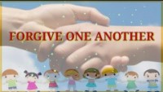
Let’s Sing FORGIVE ONE ANOTHER

Slide 21
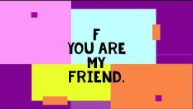
Let’s Sing FORGIVE ONE ANOTHER

Slide 22
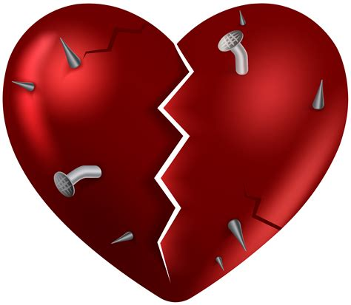
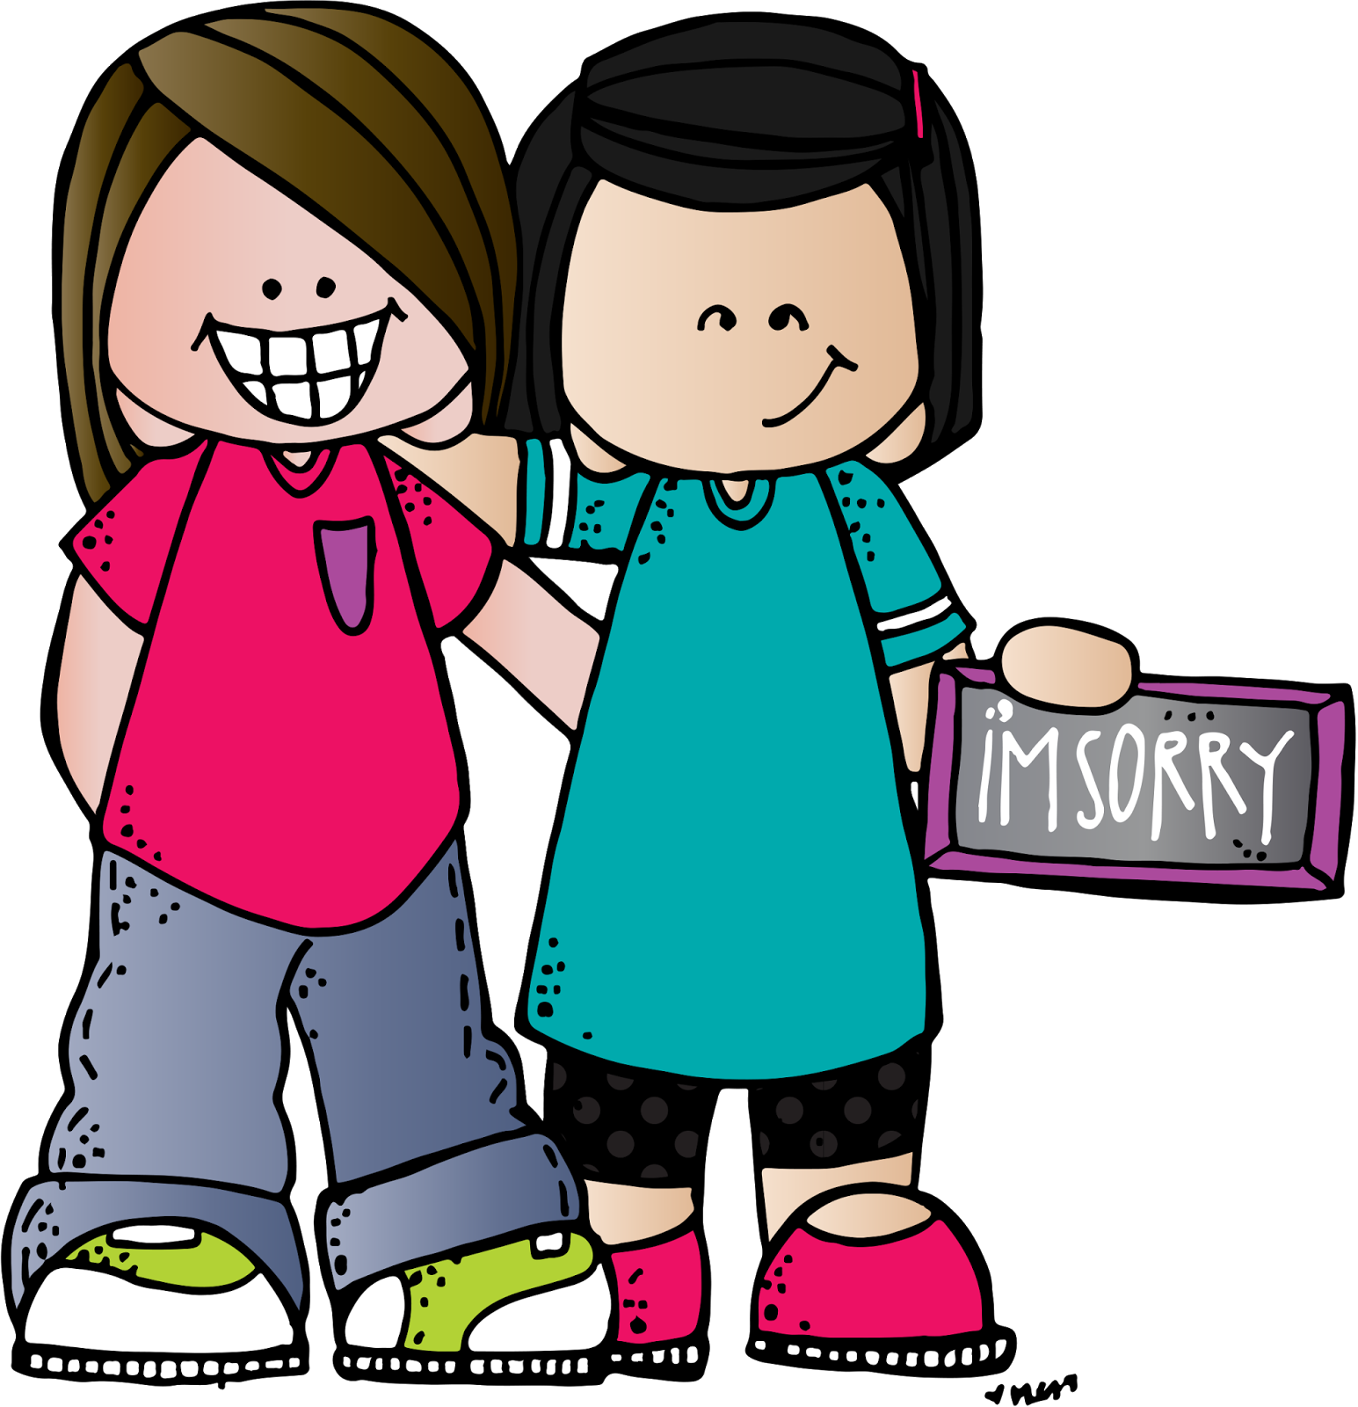
Jesus died for your sins
You are forgiven
FORGIVE
When you are praying and you remember that you are angry with another person about something, forgive that person. Forgive them so that your Father in heaven will also forgive your sins.”
Mark 11:25

Slide 23
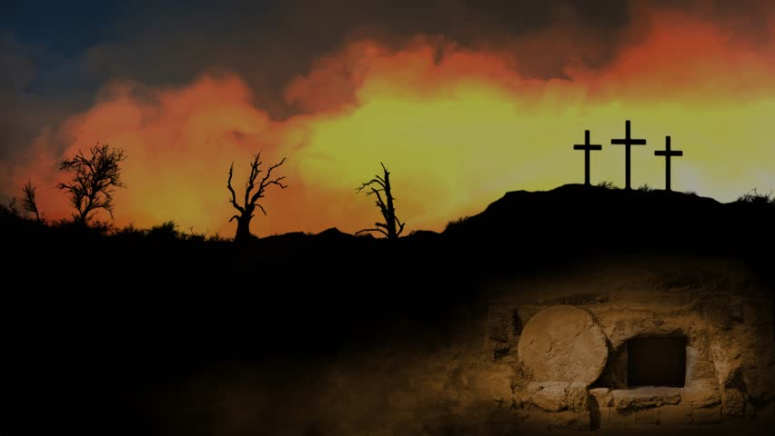
Jesus died for your sins.
Your debt is paid.
You are forgiven.
FORGIVE
And be kind to one another, tenderhearted, forgiving one another, even as God in Christ forgave you.
Ephesians 4:32

Slide 24

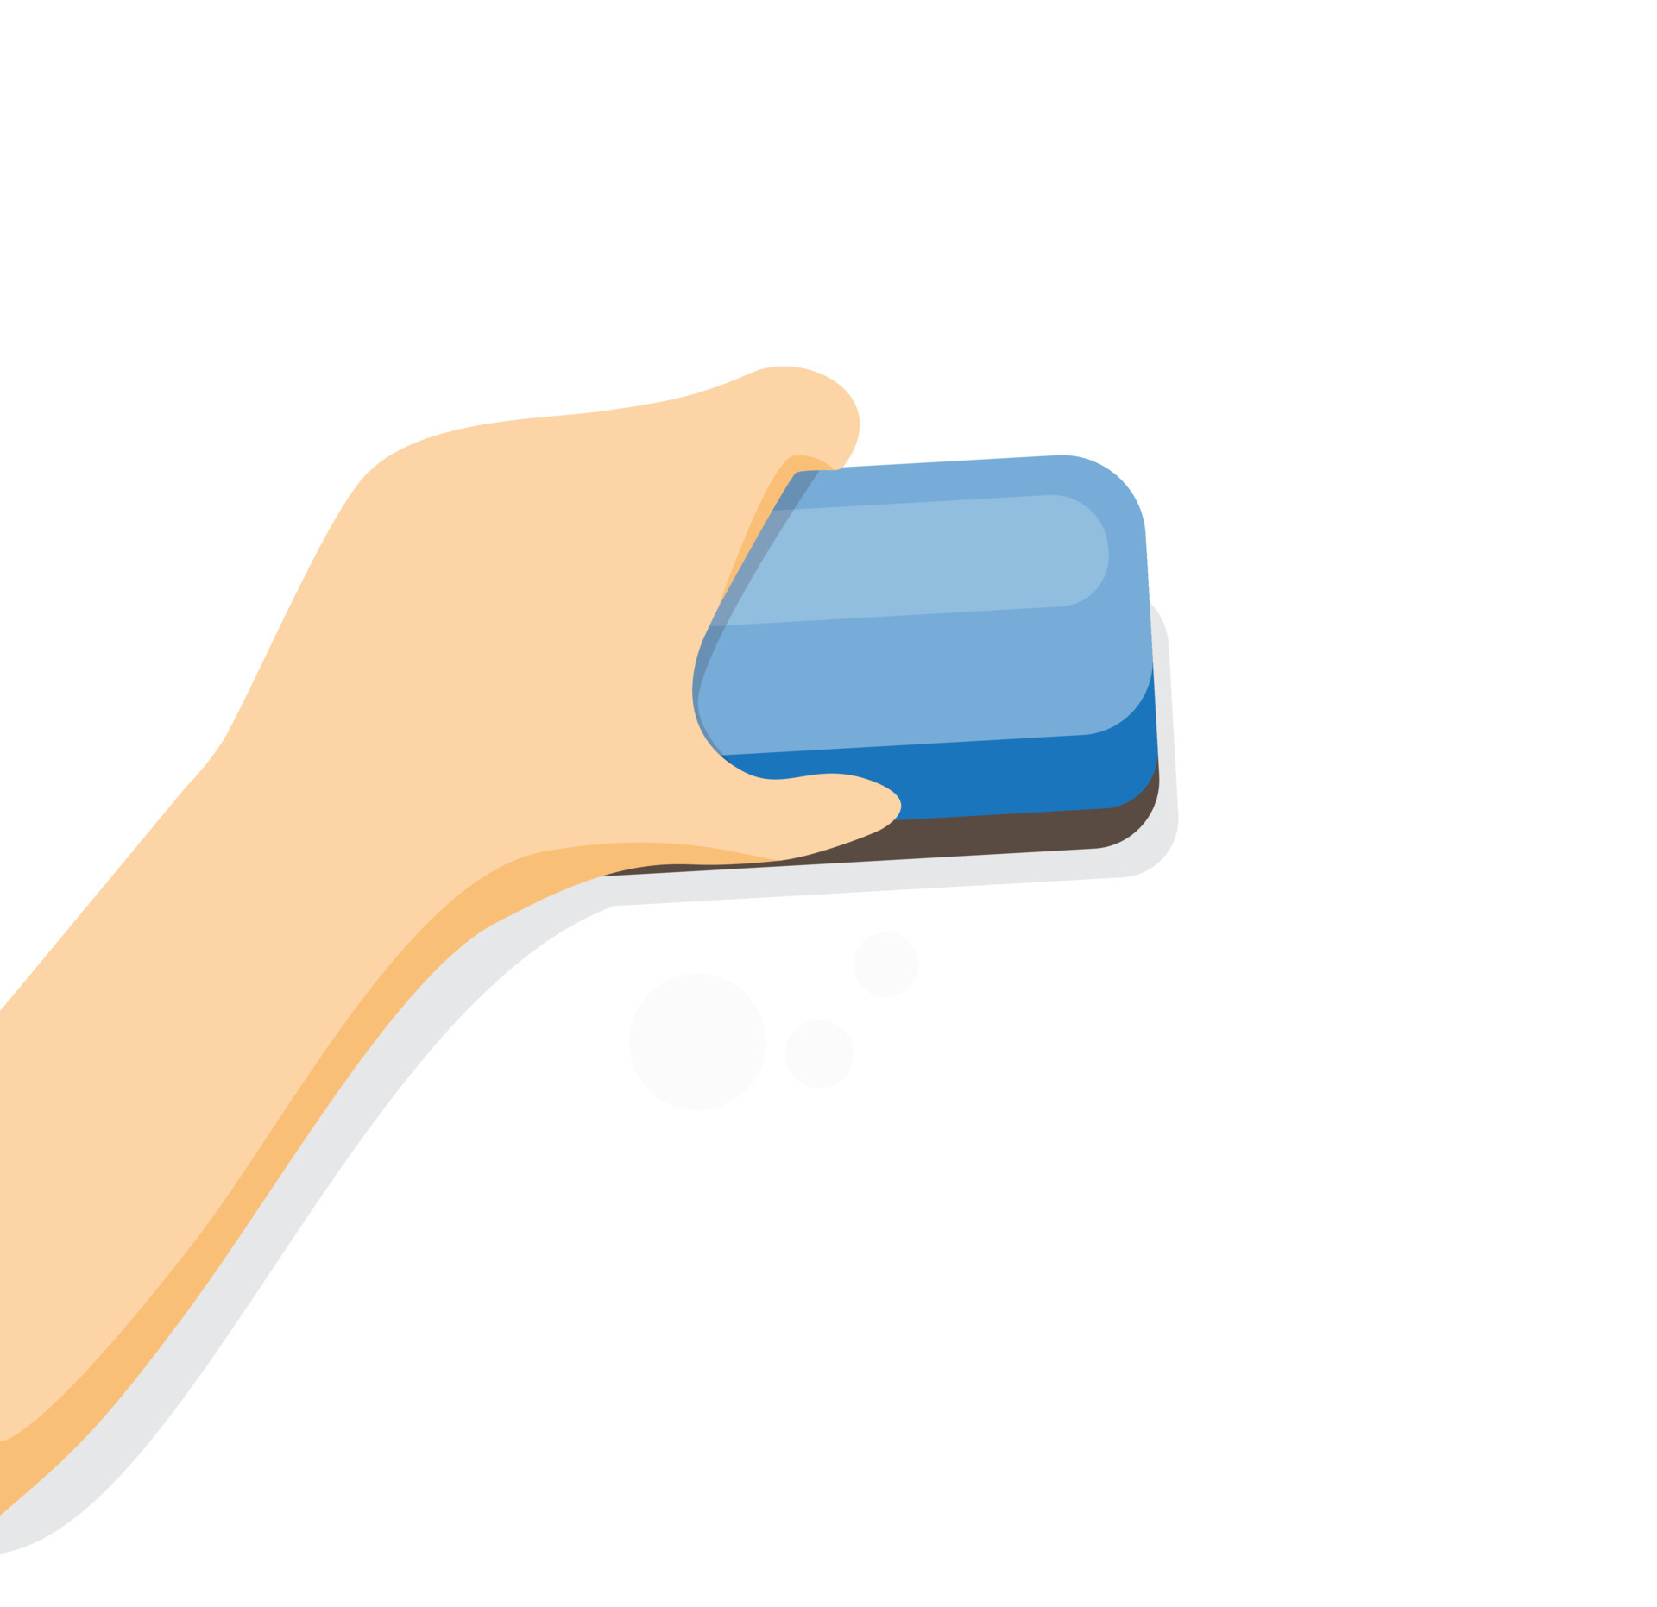

OBJECT LESSON
What is forgiveness?
Scribble on a white board.
Fill it up with angry scribbles.
Fill it up with bad things other do to you.
Forgiveness says I’m sorry.
It chooses to forget all those bad things.

Slide 25
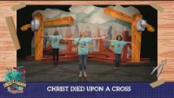
Let’s Sing FORGIVENESS
Concrete Crane VBS

Slide 26

Let’s Sing YOU FORGIVE ME
Maker Fun Factory

Slide 27
EXTRA

Slide 28

https://activity-array.com/

Slide 29
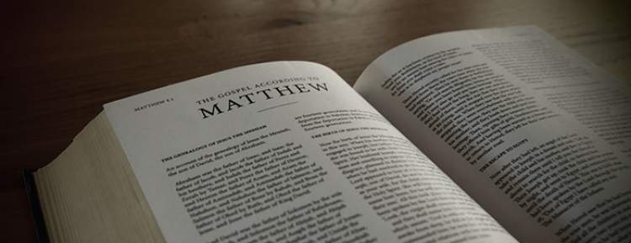

Let’s read our story from the Bible Find Matthew 18:21-33

Slide 30
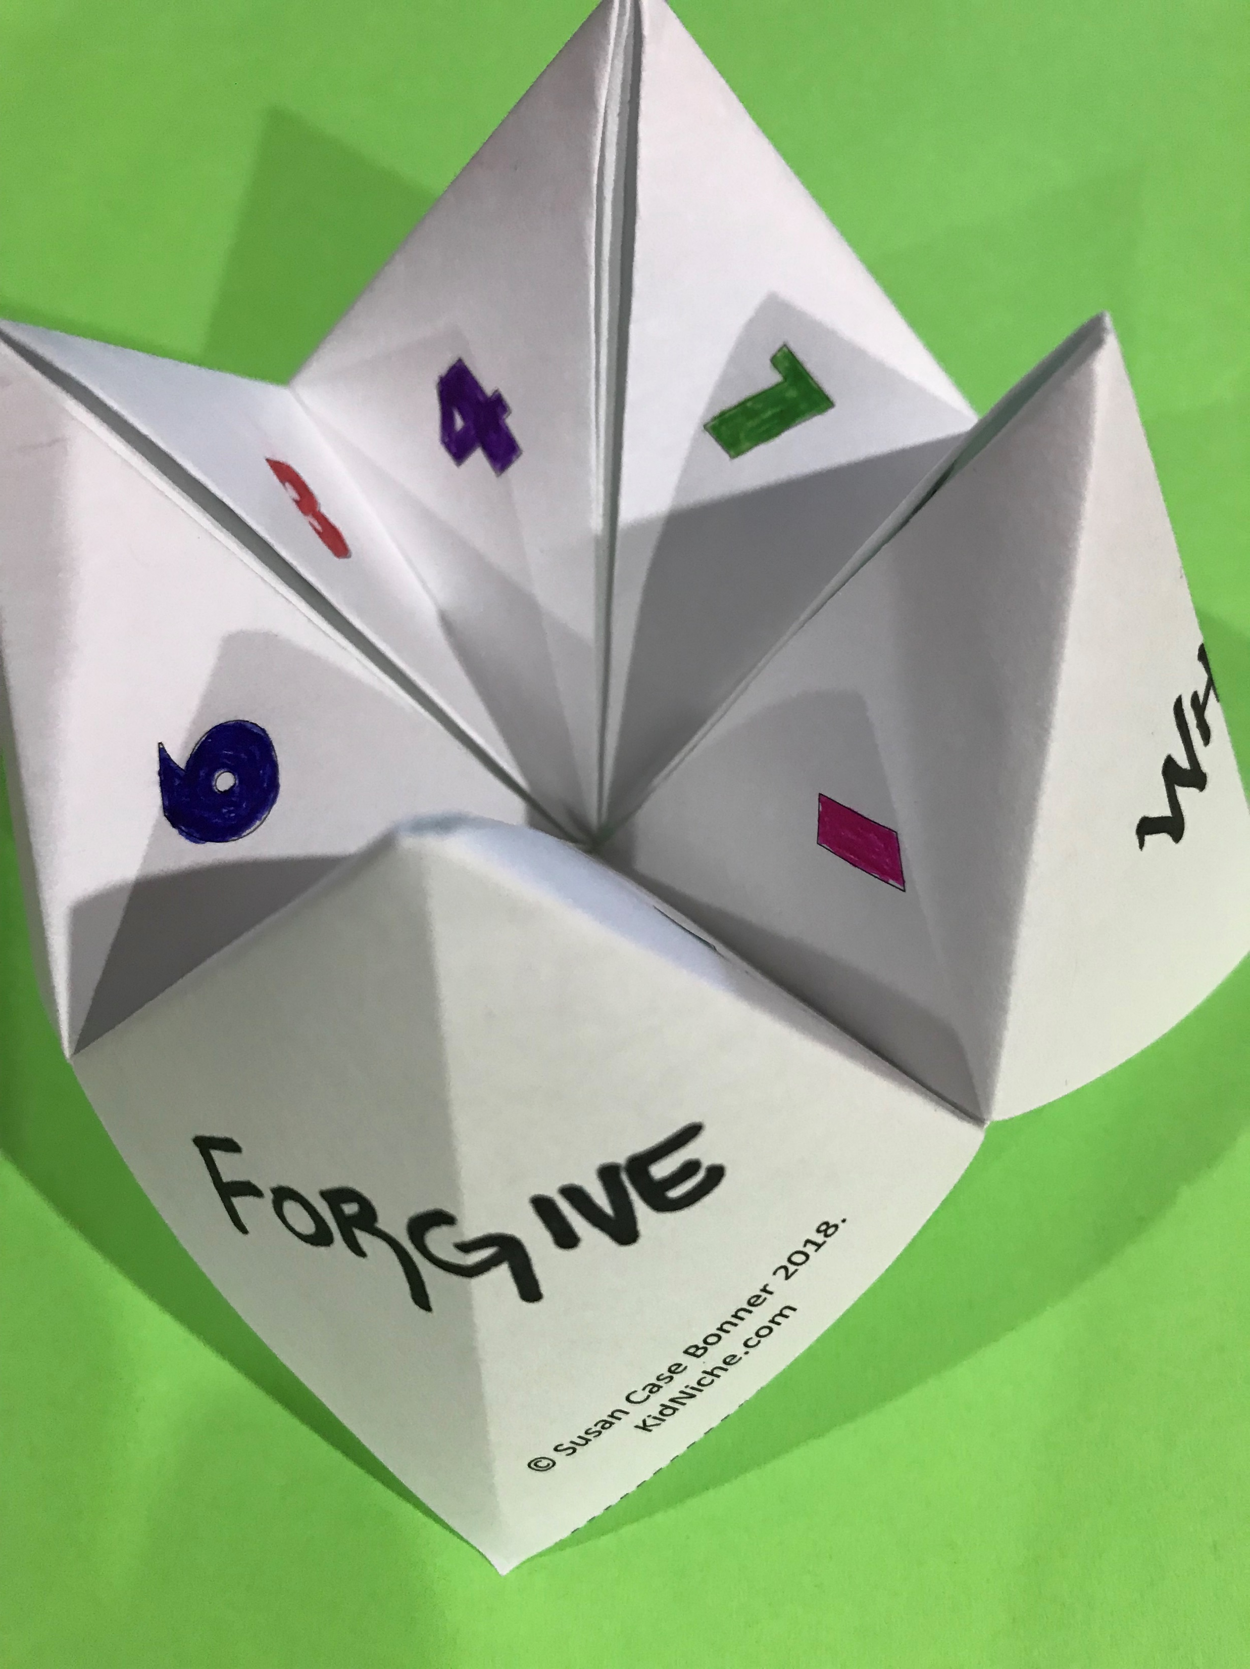

EXTRA for older kids
How to forgive – craft and lesson

