Slide 1
Humility
The First will be Last

Slide 2
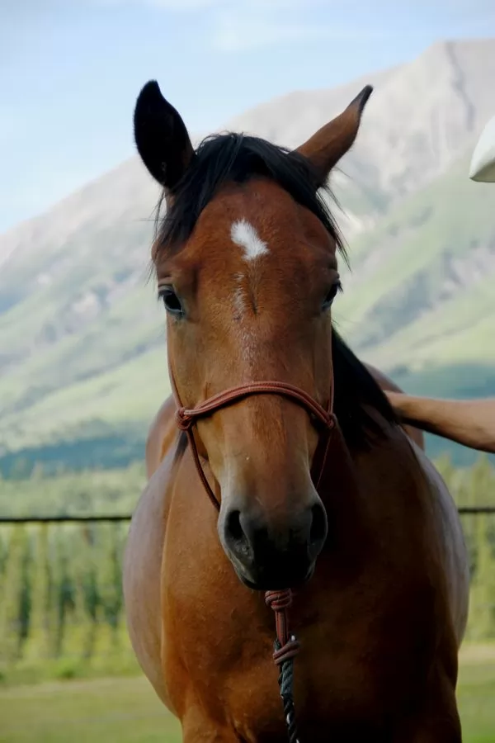
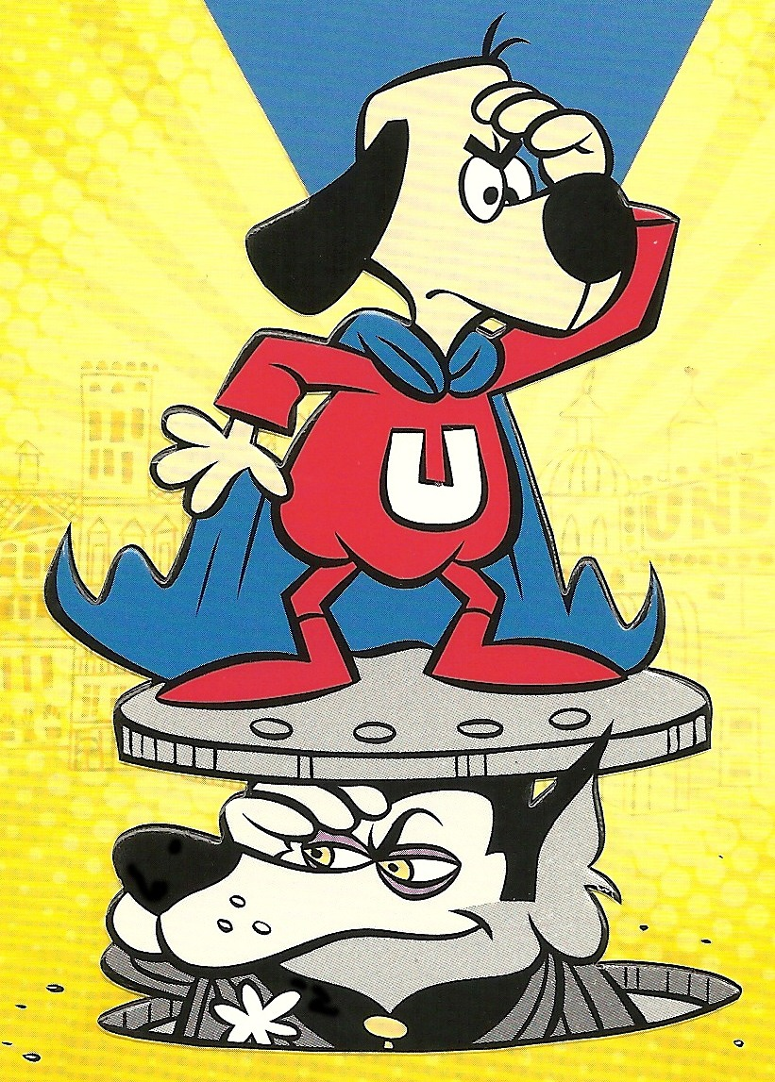
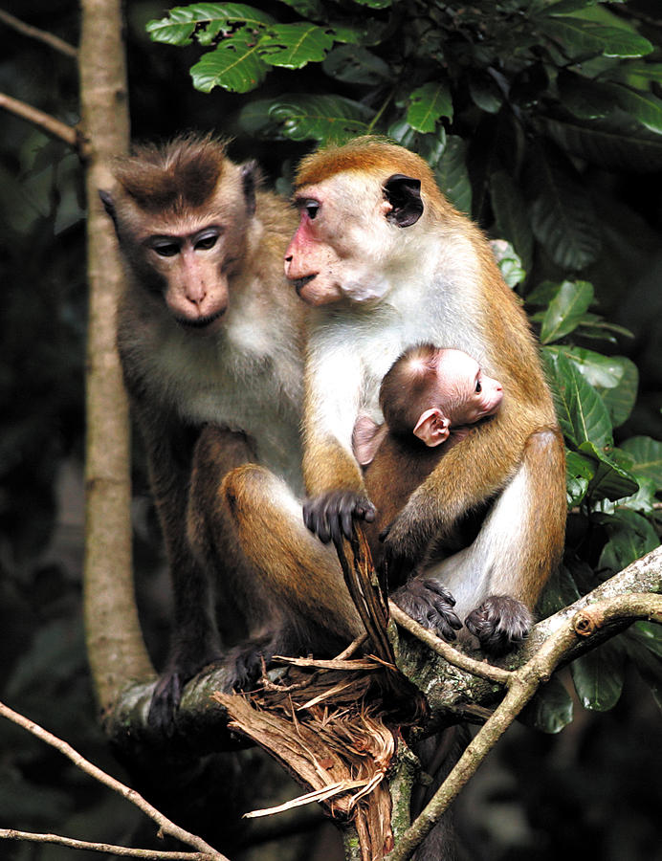
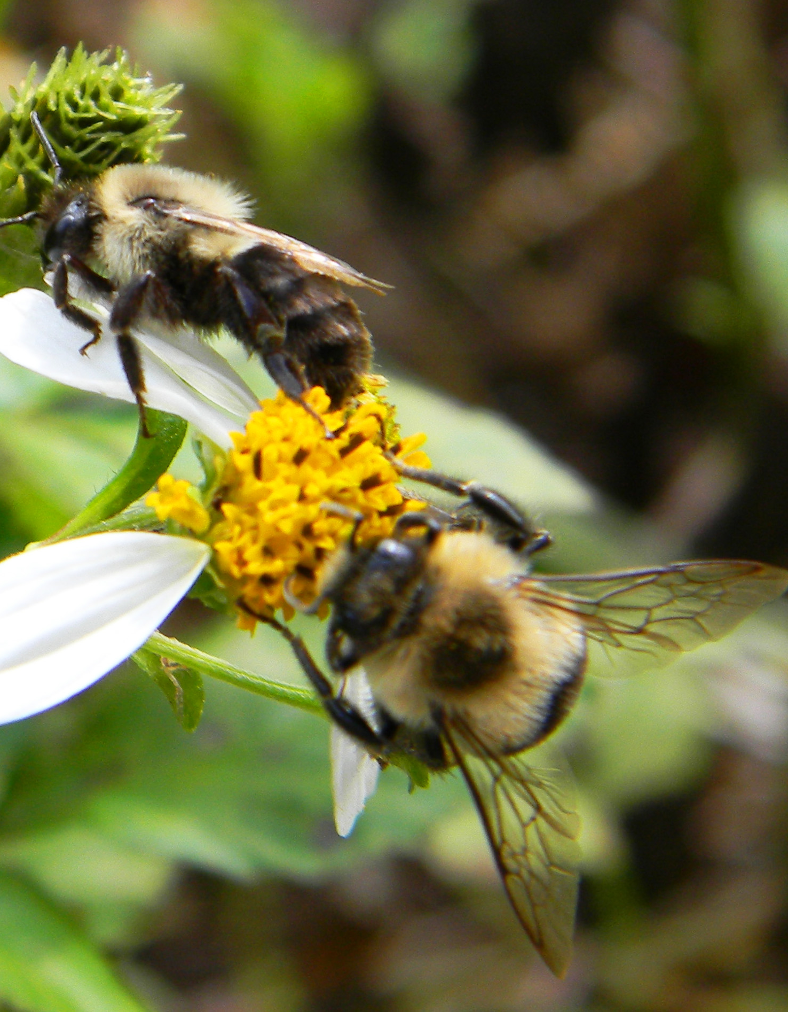
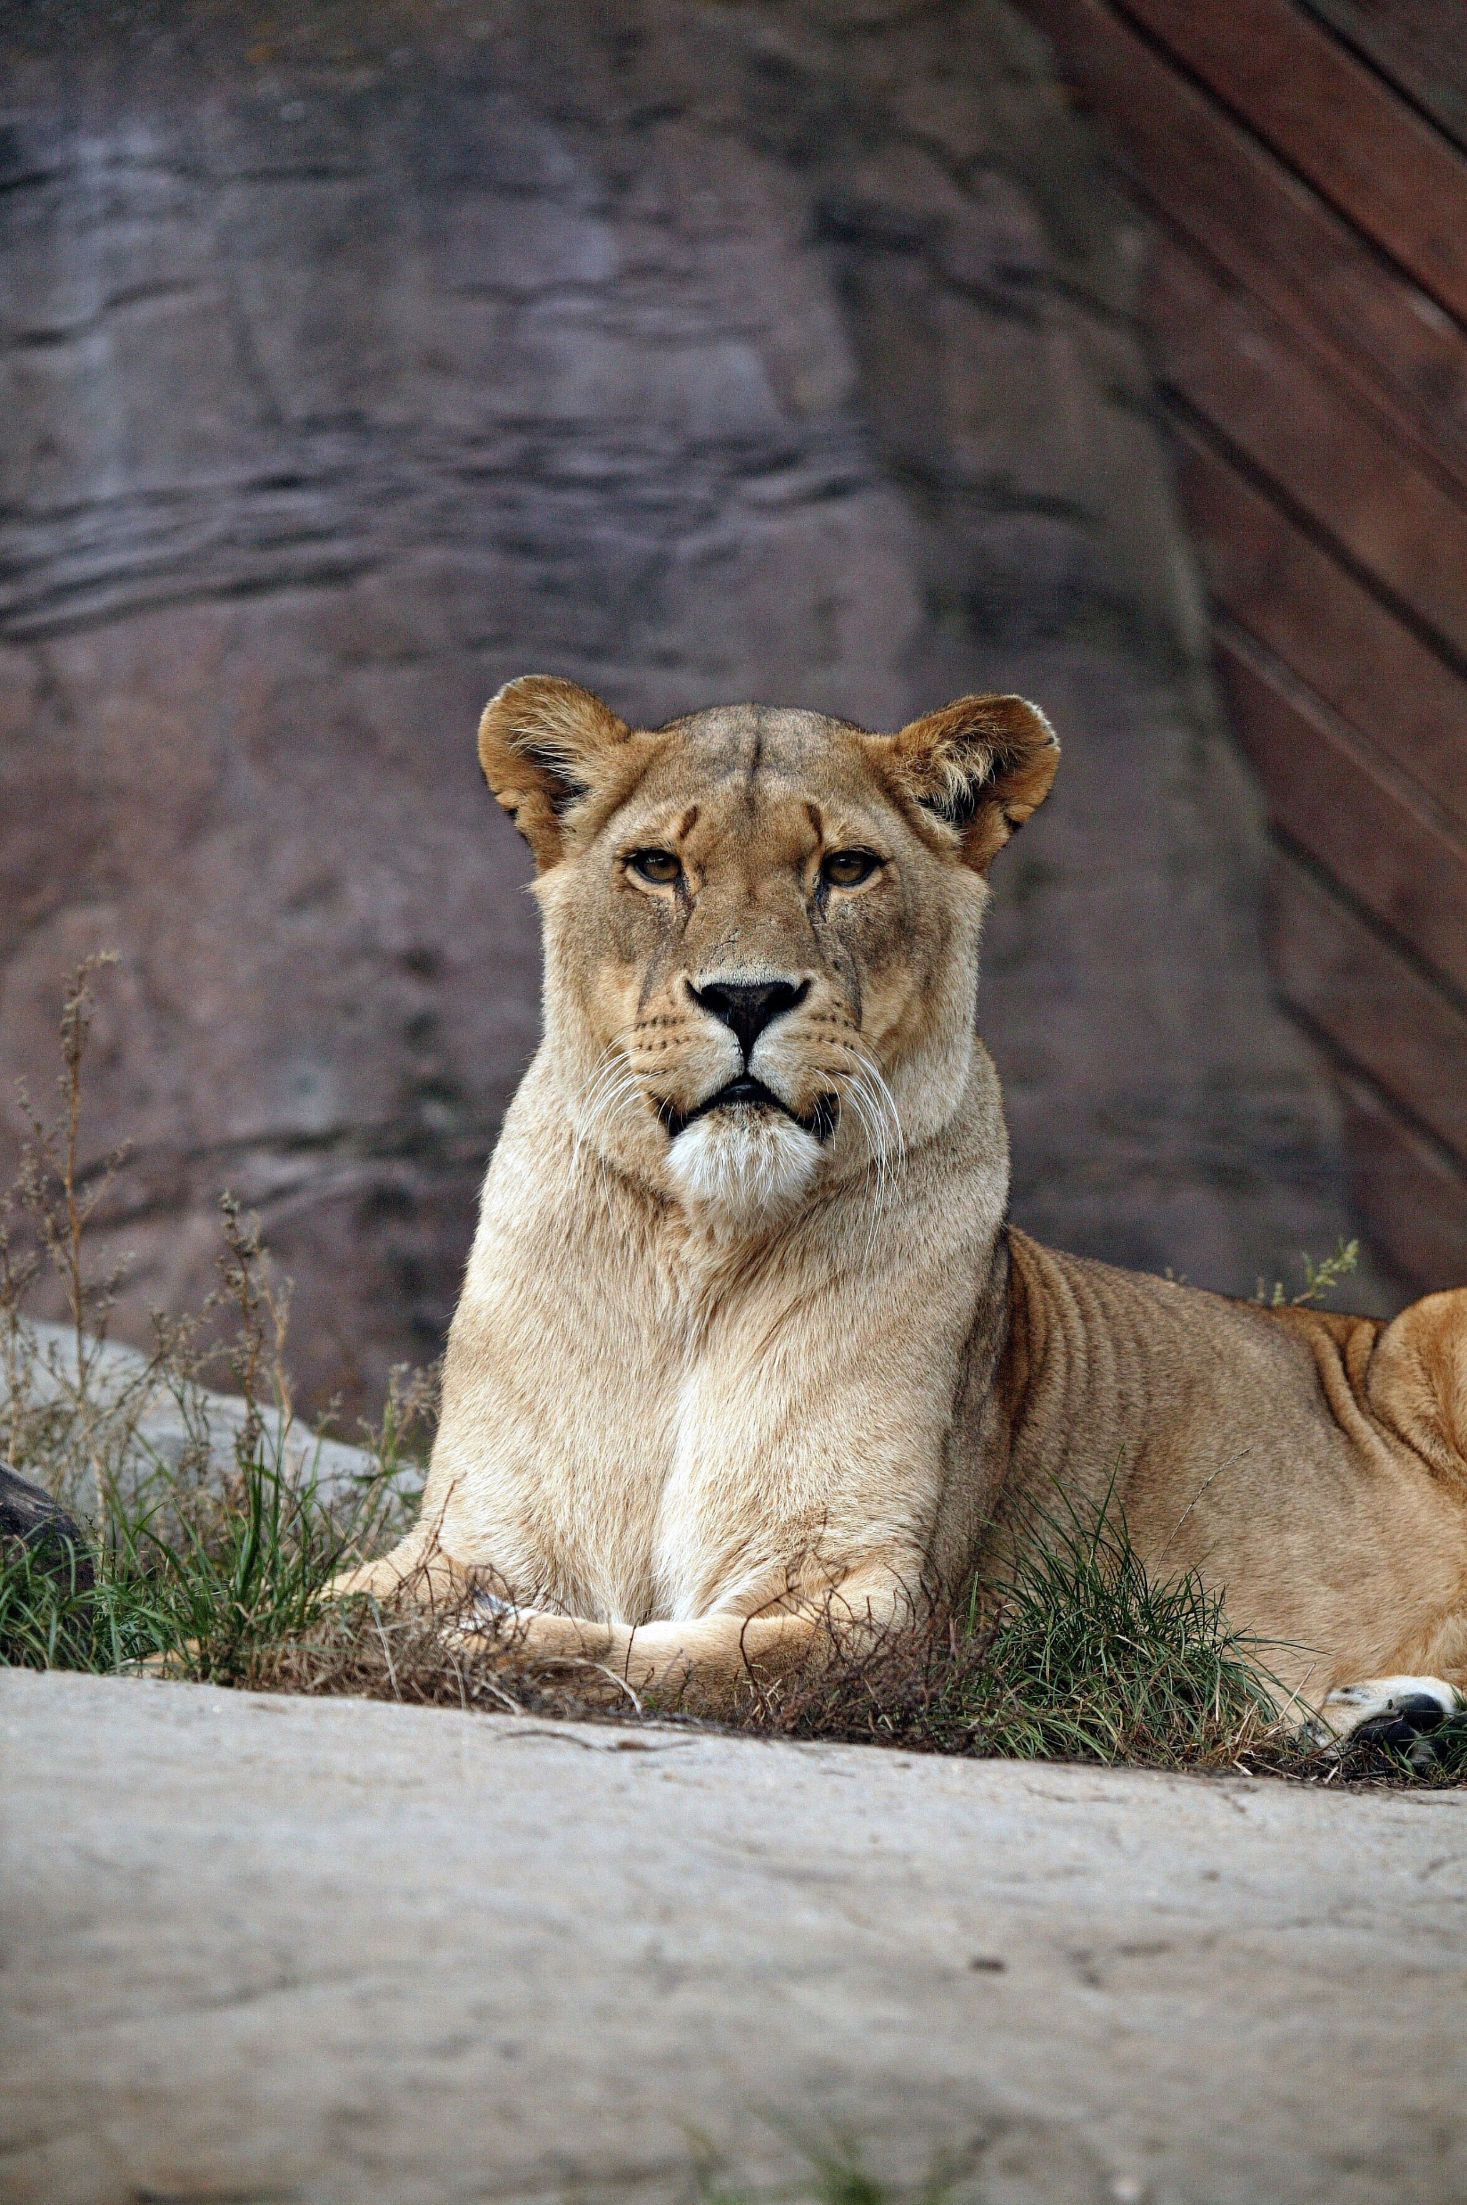
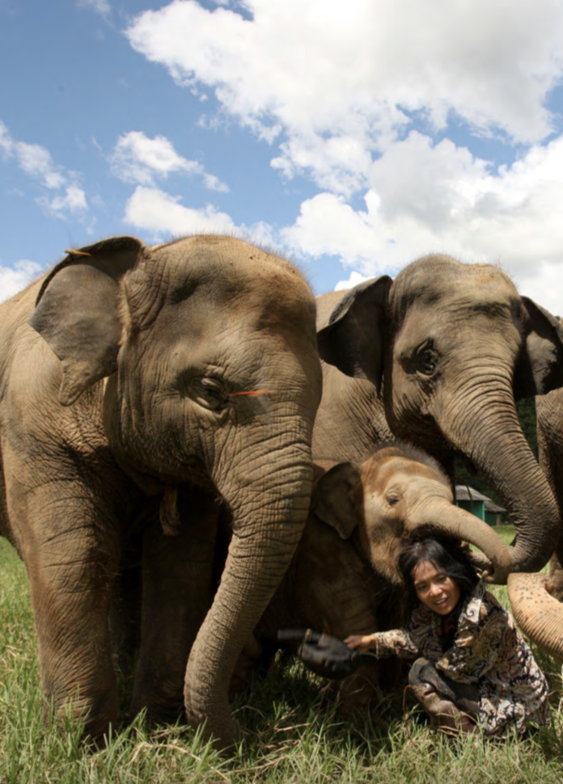
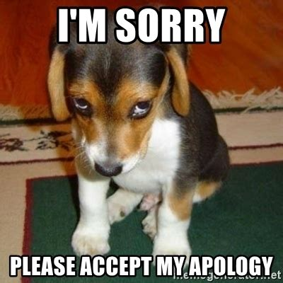
The key word for today is _ _ _ _ _ _.
Write the first letter of each word, to find the key word.
h
u
m
b
l
e
Horses let their rider choose the route. You can guide them with reins.
Has the underdog been humbled? LOL
Actually, dogs do seem to apologize for their mistakes.
Monkeys care for and serve each other.
Bees work together and help each other do their jobs. But they don’t try to boss each other.
When a lioness catches dinner for their family pride, they give it first to the dad lion and then to their babies before they eat.
Elephants help each other and people too. They are compassionate and get along well with each other.
How is each one humble?

Slide 3
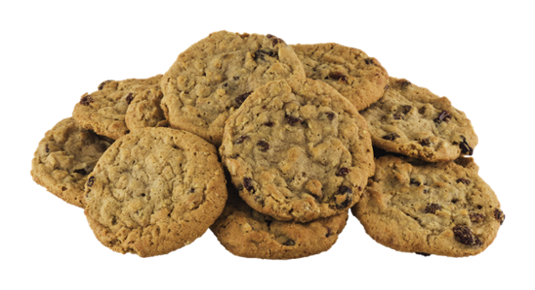
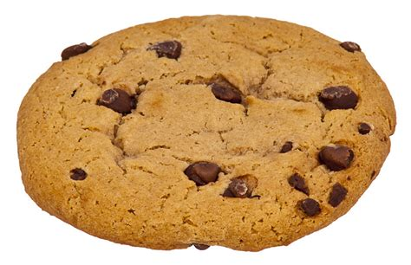
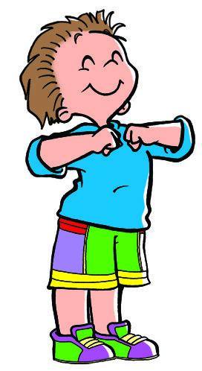
Have you ever wanted the
BIGGEST or the BEST?
I’m the best and greatest!
Have you ever bragged about winning or doing something great?
That’s not being humble

Slide 4
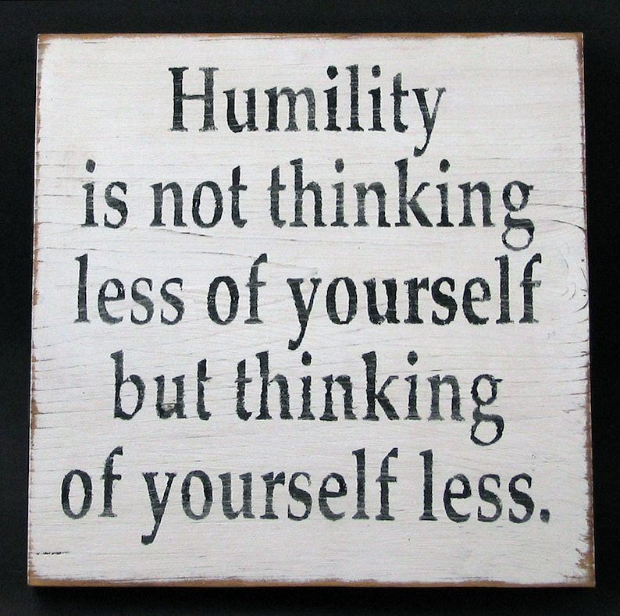
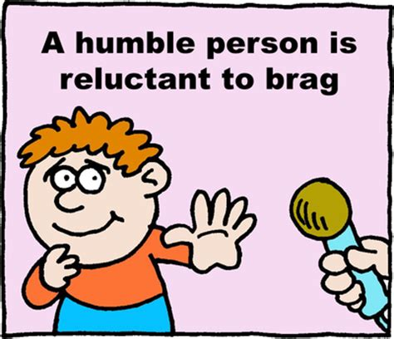
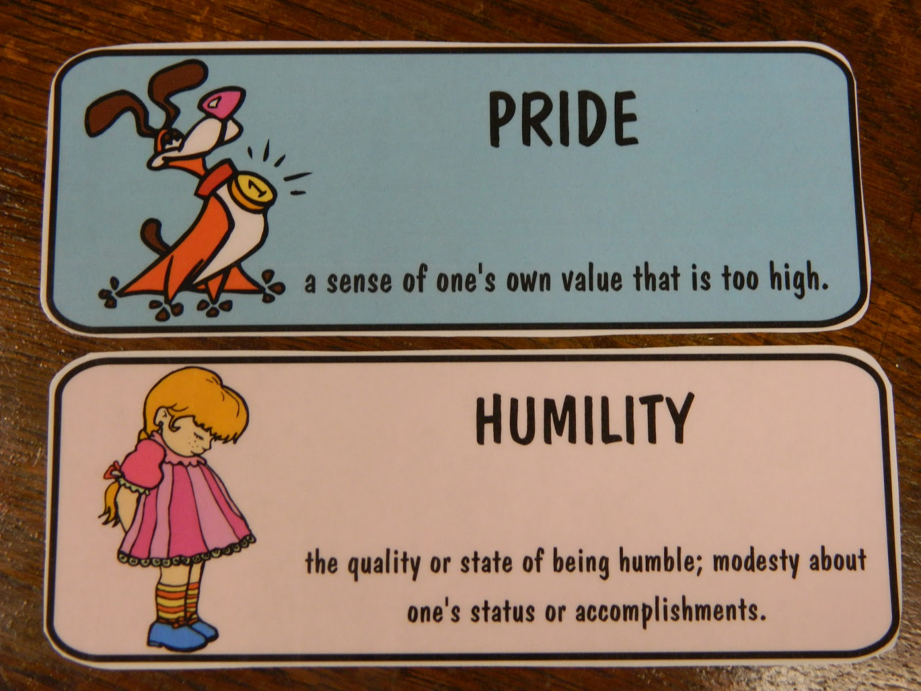
What does it mean to be humble?
Marked by meekness or modesty in behavior, attitude, or spirit;
Not arrogant or prideful.
Showing submissive respect.

Slide 5

Just Be Humble

Slide 6
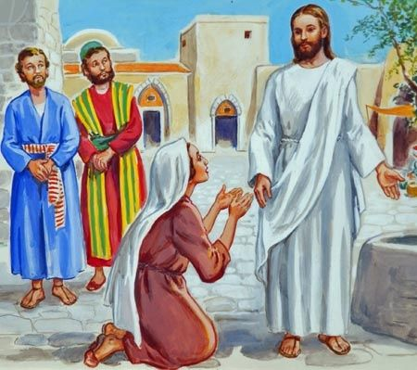
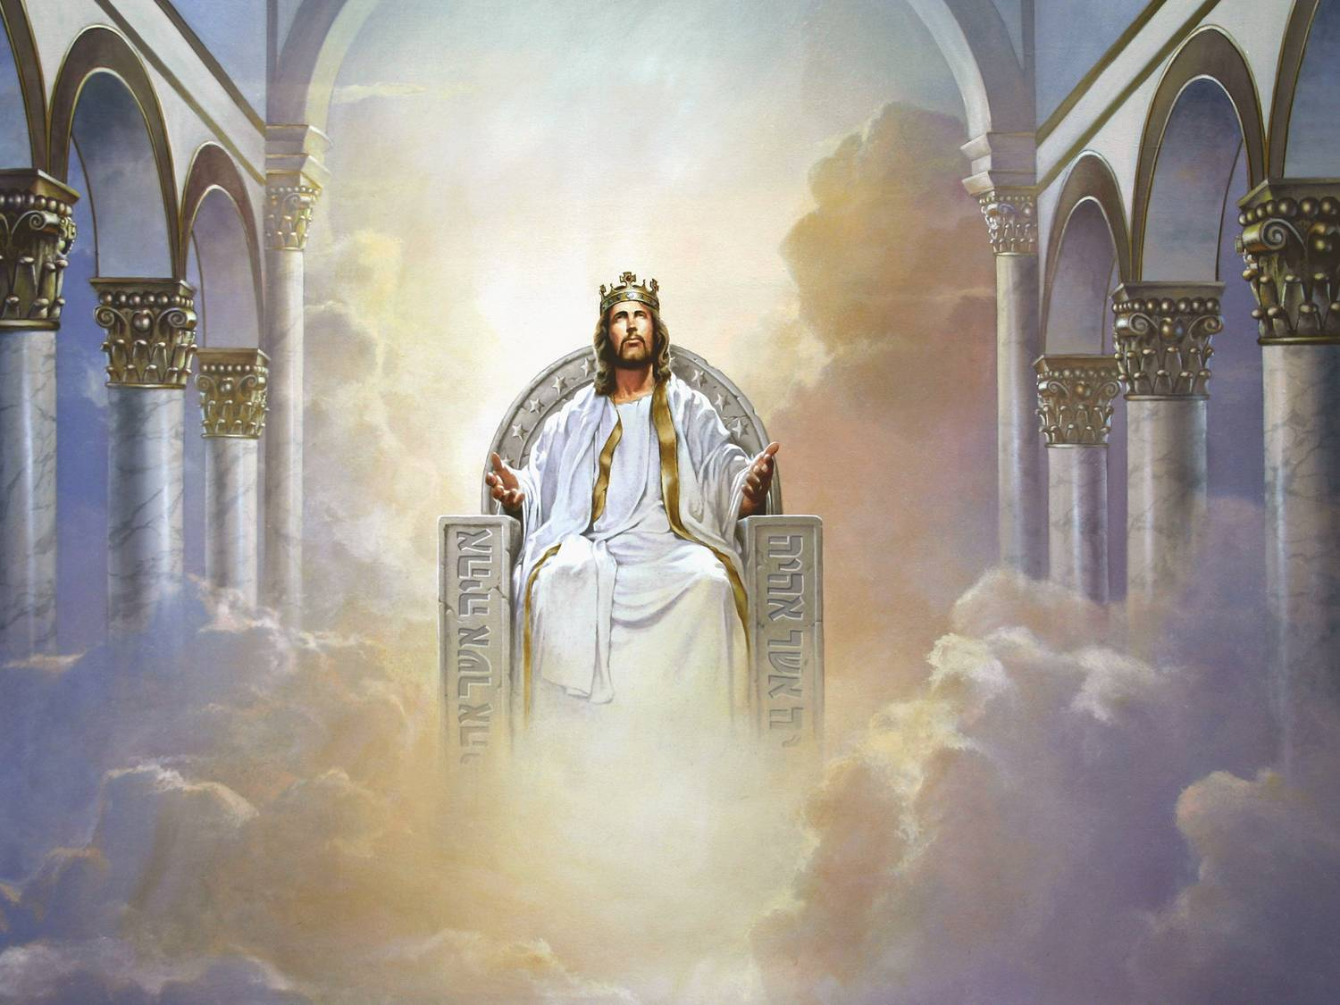
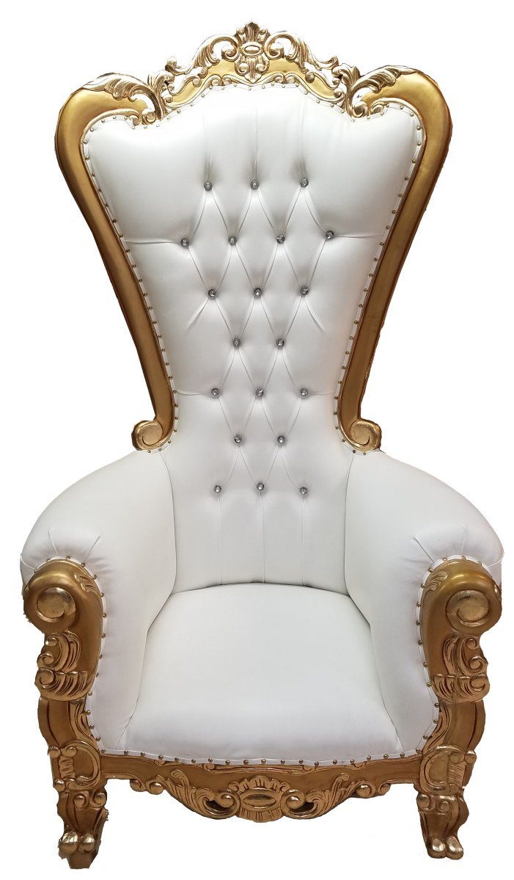
Matthew 20
A Mother’s Request
What is it you want?
²⁰ Then the mother of Zebedee’s sons came to Jesus with her sons and, kneeling down, asked a favor of him.
²¹ “What is it you want?” he asked.
She said, “Grant that one of these two sons of mine may sit at your right and the other at your left in your kingdom.”
Please, may my sons sit on the left and right of you in your kingdom?

Slide 7

Matthew 20
A Mother’s Request
You don’t know what you are asking.
Can you handle the trouble I will face?
We can
²² “You don’t know what you are asking,” Jesus said to them. “Can you drink the cup I am going to drink?”
“We can,” they answered.
²³ Jesus said to them, “You will indeed drink from my cup, but to sit at my right or left is not for me to grant. These places belong to those for whom they have been prepared by my Father.”
You will face trouble, but it is God who will choose who will sit to my left and right.
Did you hear that Jesus willingly let God make important decisions?

Slide 8
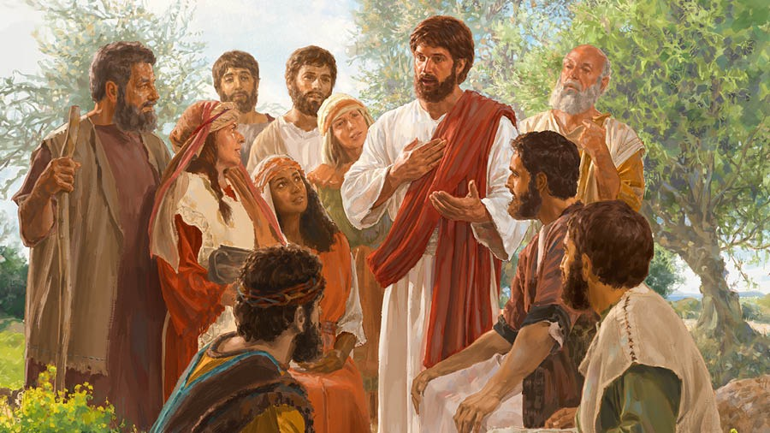
Matthew 20
Be great by serving
You know most rulers lord it over their subjects.
That’s not our way.
James and John, you are no more important than any of us!
²⁴ When the ten heard about this, they were indignant with the two brothers.
²⁵ Jesus called them together and said, “You know that the rulers of the Gentiles lord it over them, and their high officials exercise authority over them.
²⁶ Not so with you. Instead, whoever wants to become great among you must be your servant, ²⁷ and whoever wants to be first must be your slave— ²⁸ just as the Son of Man did not come to be served, but to serve, and to give his life as a ransom for many.”
The way to be great in my kingdom is to serve one another.
I came to serve and give my life for everyone.
Jesus was humble.
He came to serve
and give His life.

Slide 9

Have the same mindset of Jesus:
He was God, but took on the nature of a servant,
He humbled himself.
Philippians
2:1-11
Jesus said –
…I am gentle and humble in heart…
Matthew 11:29
So be humble like Jesus

Slide 10
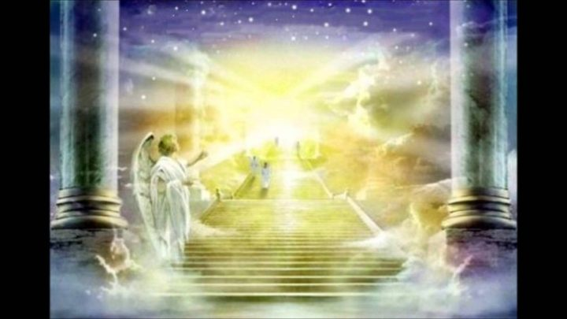
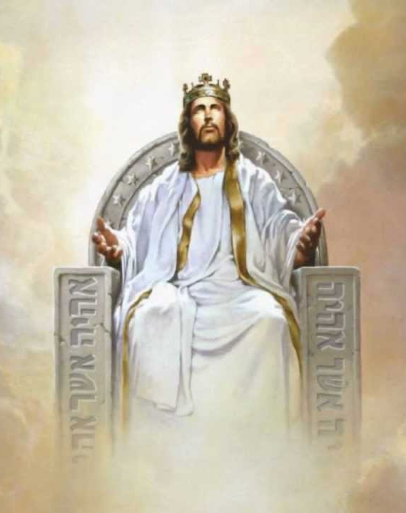
Think about it
Come, my Son, sit at my right hand.
⁹ Therefore God exalted him to the highest place
and gave him the name that is above every name,
¹⁰ that at the name of Jesus every knee should bow,
in heaven and on earth and under the earth,
¹¹ and every tongue acknowledge that Jesus Christ is Lord,
to the glory of God the Father.
Jesus was humble.
He came to this earth to take our punishment and give us a way to eternal life.
What did God do after He returned to heaven?
Who is sitting on the right hand of God?
Jesus did not exalt himself. He was humble!
God exalted Jesus.

Slide 11
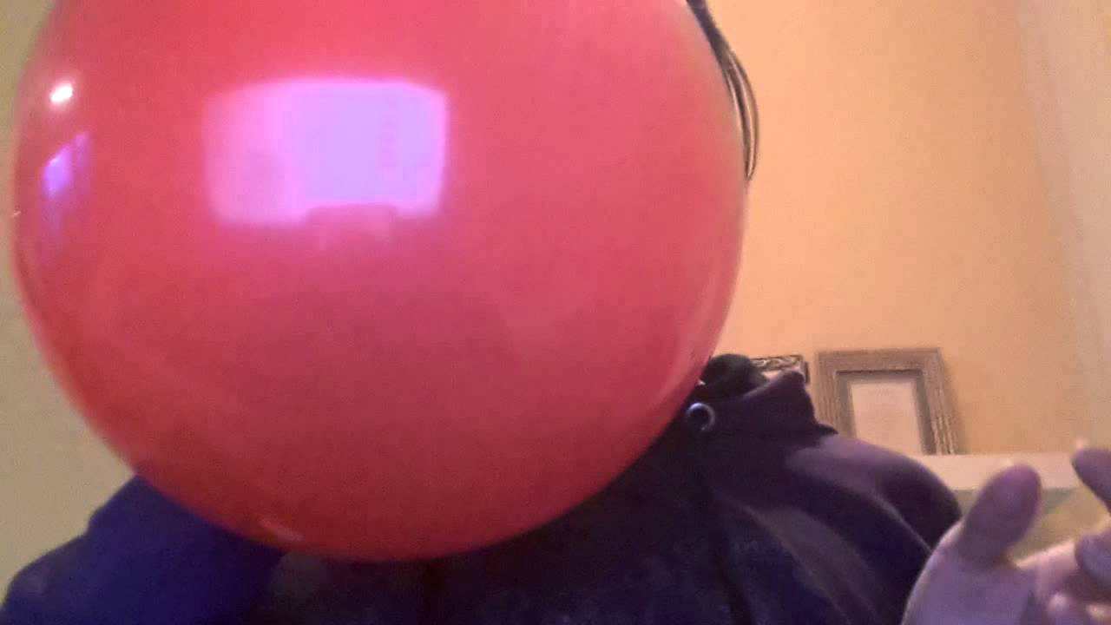

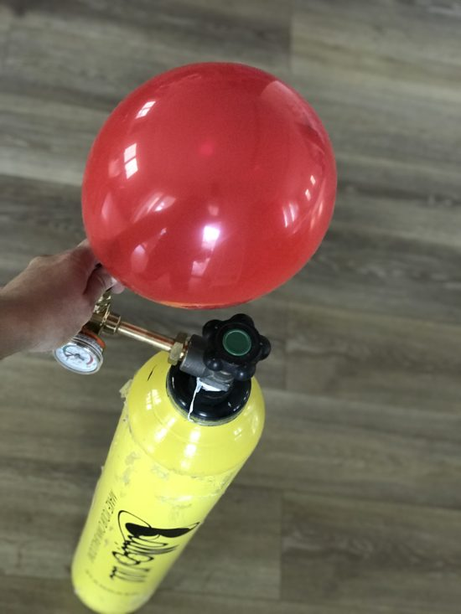

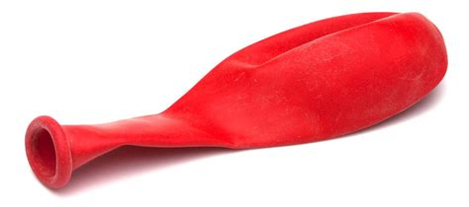
It’s like balloons
This balloon is full
of hot air
like prideful boasting
But God fills us
And lifts us up.
Pride goes before a fall

Slide 12
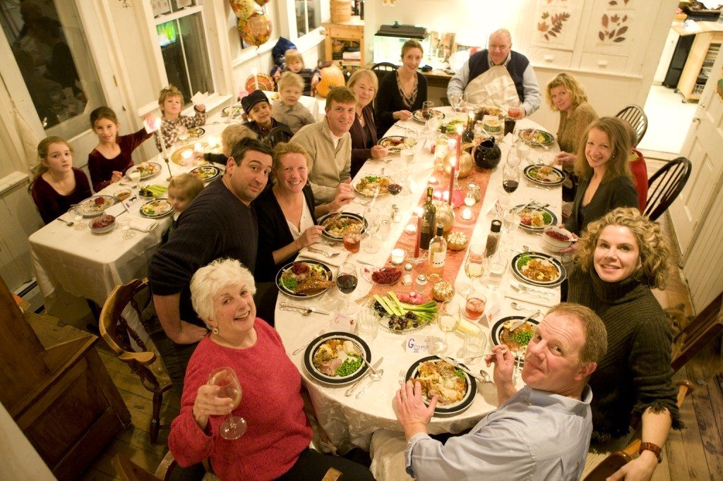
Family Holiday Seating
When I was a child, when we were at Grandpa and Grandma’s home and all the Aunties and Uncles were there and it was time to eat, us kids sat at the ‘kids table’.
The adults sat at the big table nearby.

Slide 13
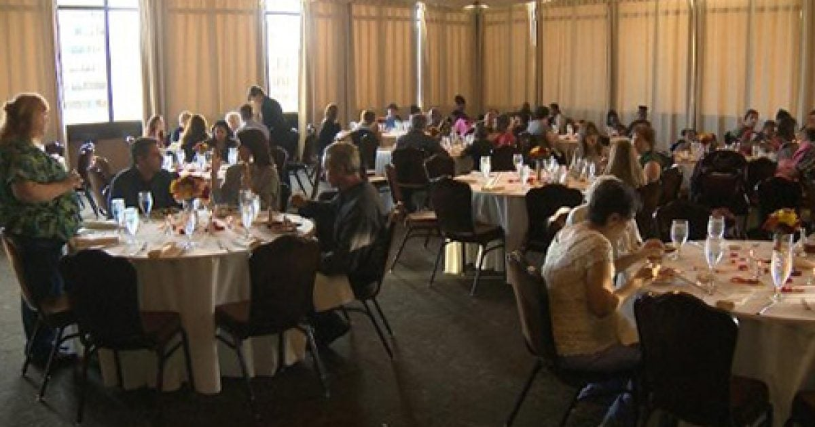
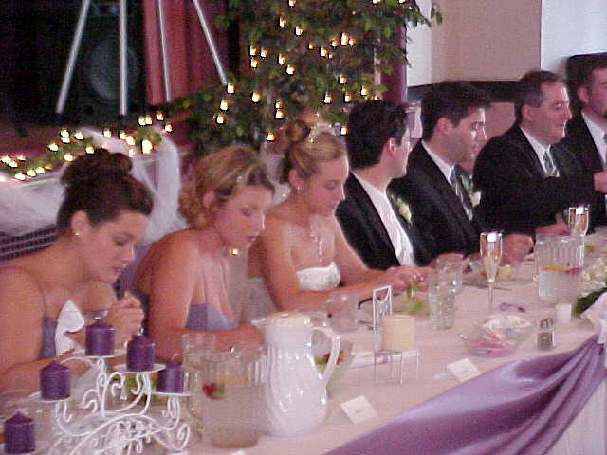
Wedding Seating
Often when I go to a wedding reception there are lots of tables for guests.
There is also a special table for the groom & bride and their attendants.
If I’m a guest, where should I sit?

Slide 14
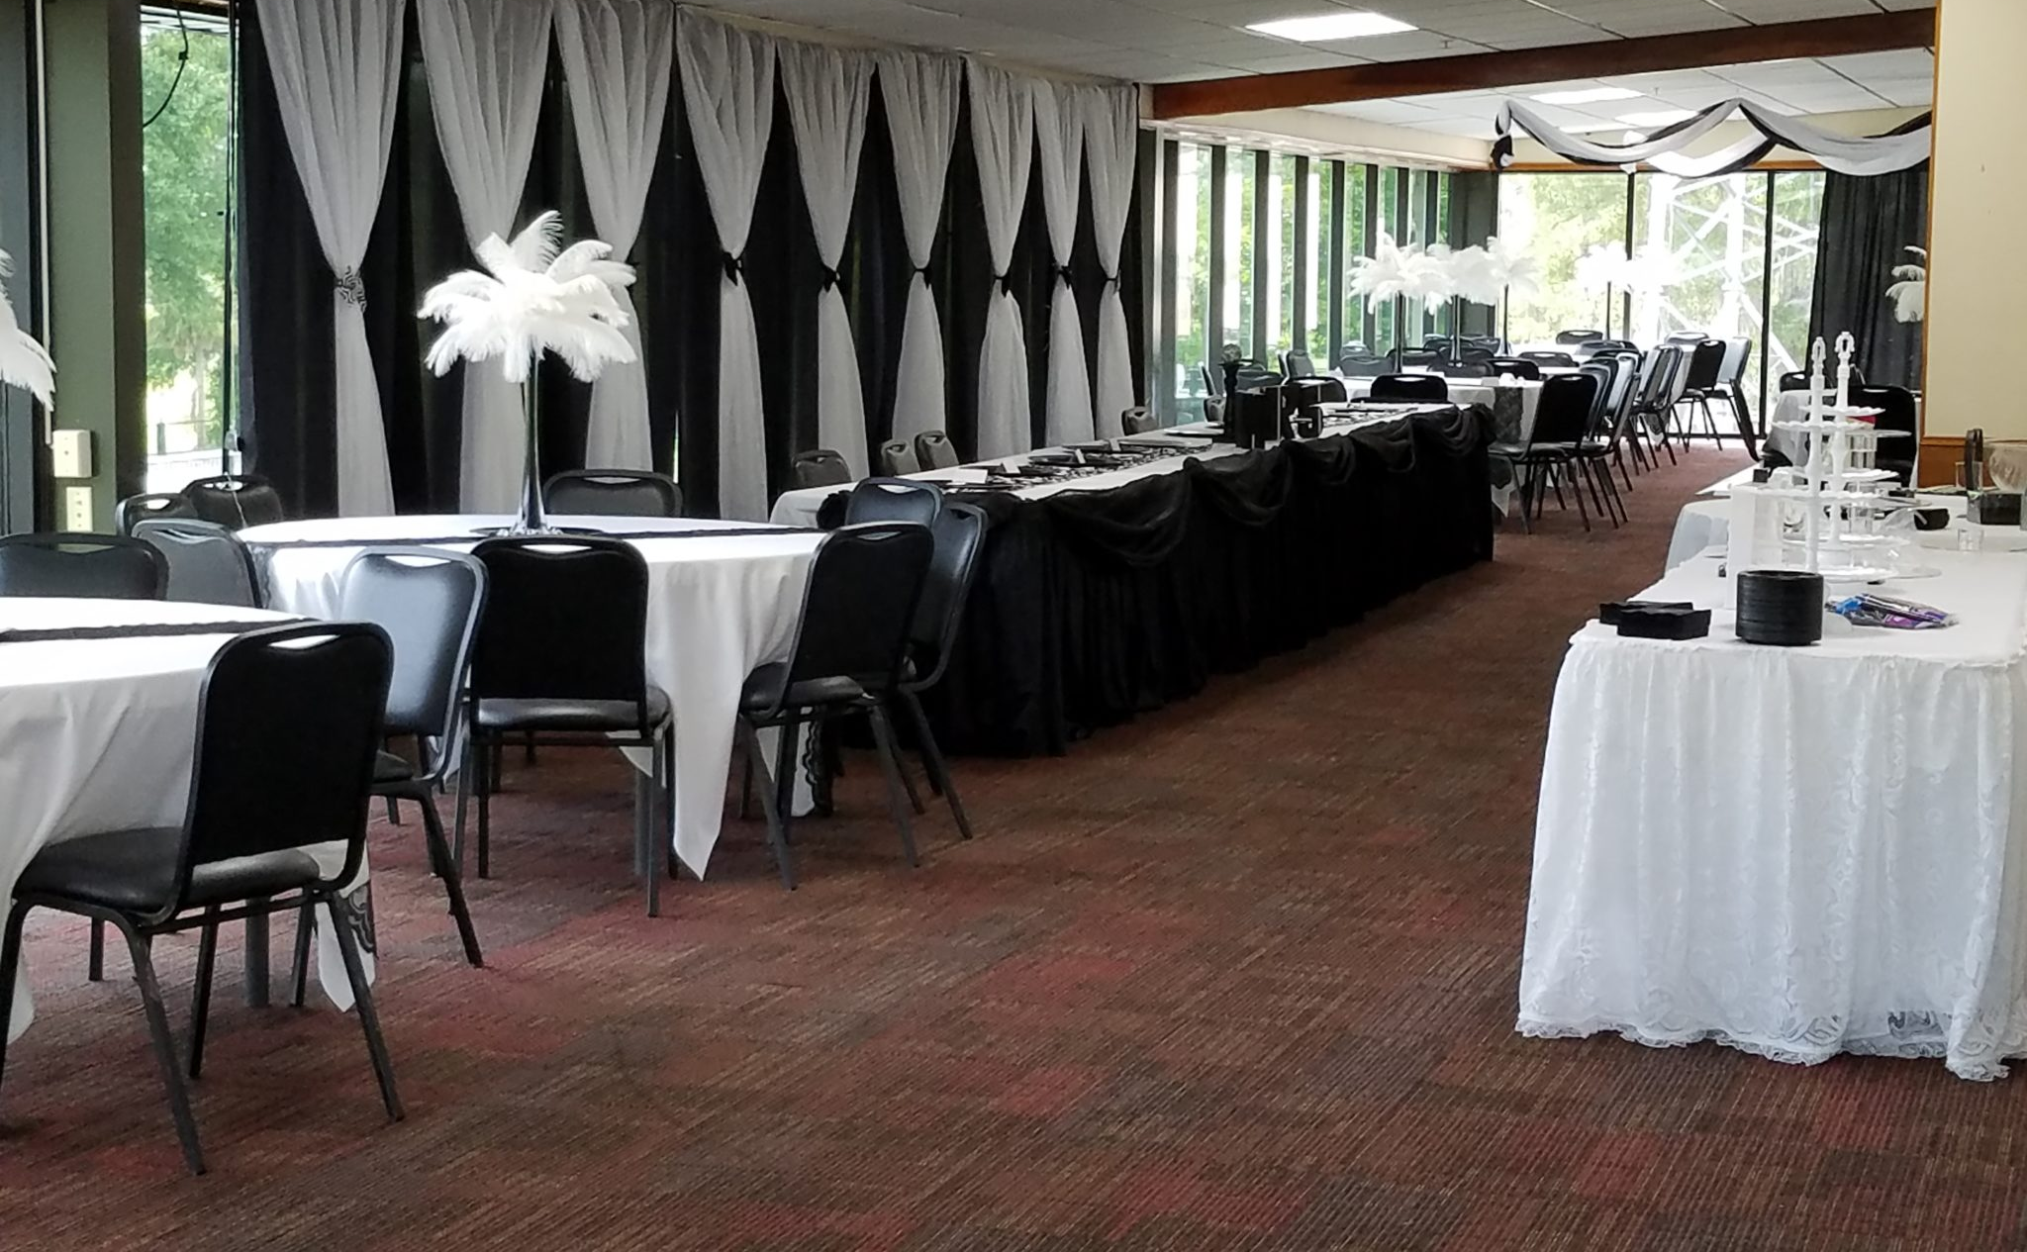
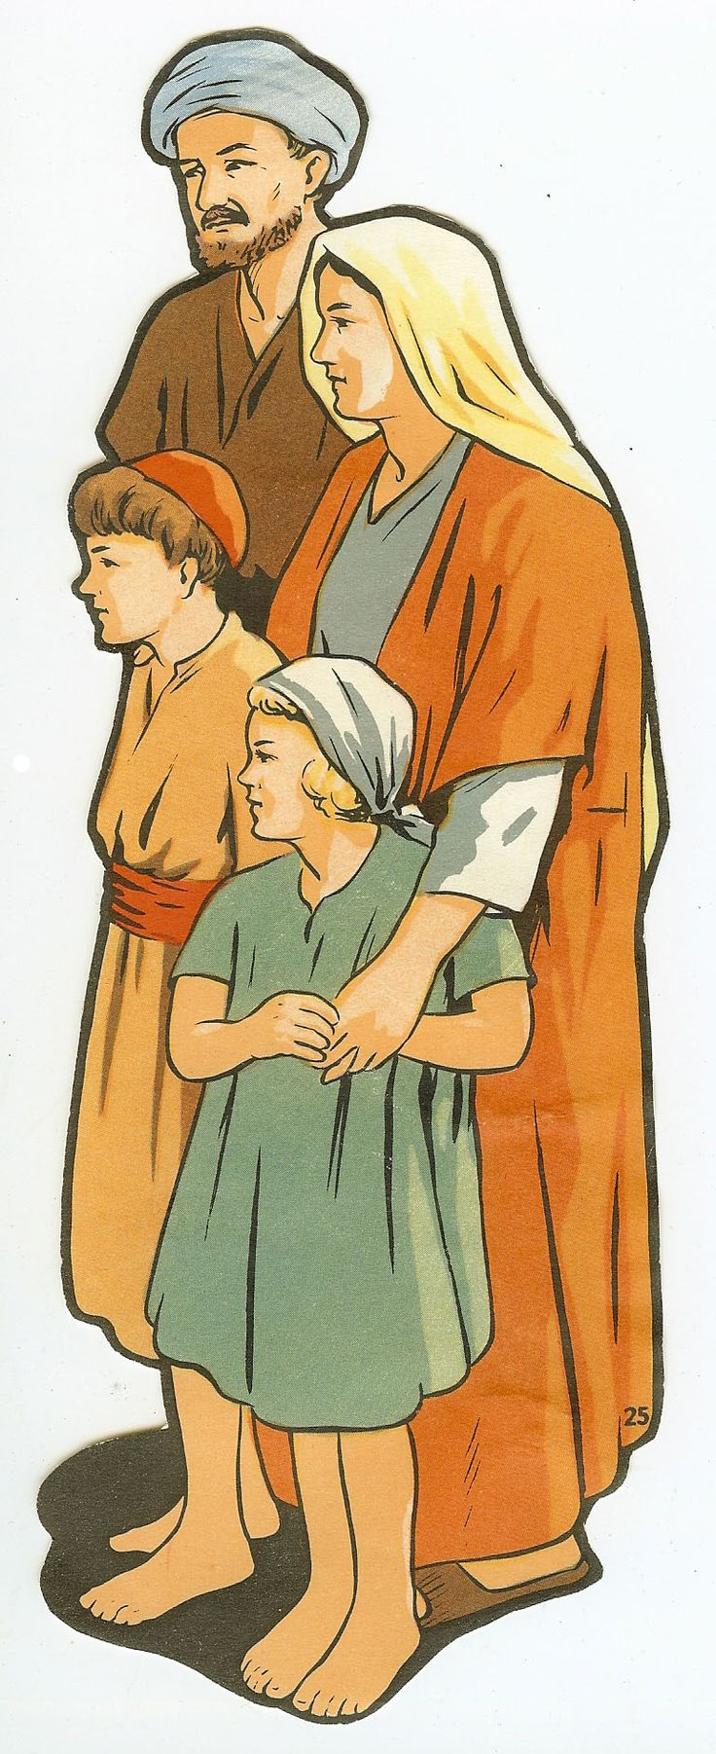
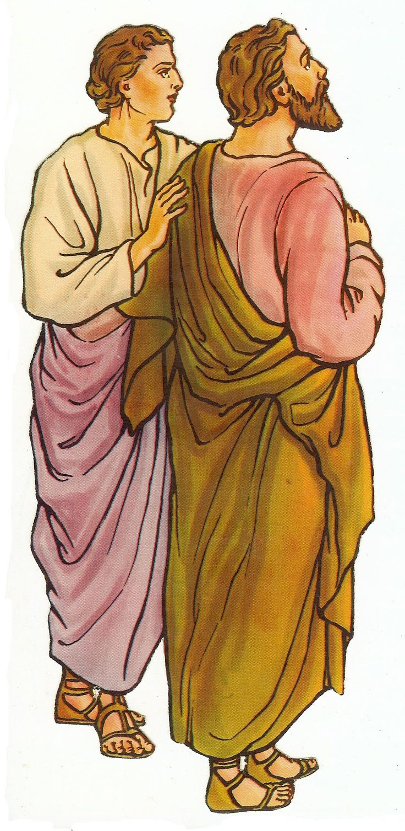
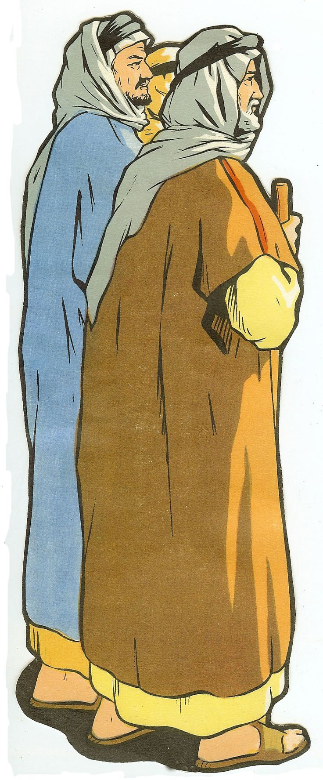
Luke 14
Banquet Seats
If we hurry, we can sit at the head table where all the important people sit.
I’m sure we are very important friends.
Let’s sit beside the host.
14 One Sabbath, when Jesus went to eat in the house of a prominent Pharisee, …
⁷ When he noticed how the guests picked the places of honor at the table, he told them this parable:
⁸ “When someone invites you to a wedding feast, do not take the place of honor, for a person more distinguished than you may have been invited.

Slide 15
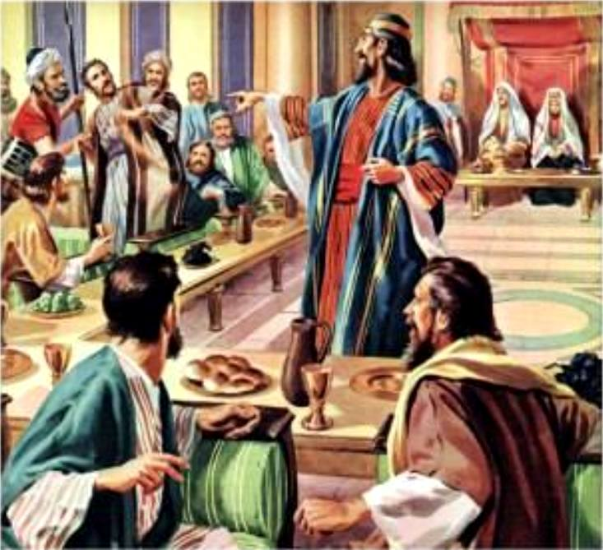
Luke 14
Banquet Seats
That seat is reserved for the official. You must move.
⁹ If so, the host who invited both of you will come and say to you, ‘Give this person your seat.’ Then, humiliated, you will have to take the least important place.
¹⁰ But when you are invited, take the lowest place, so that when your host comes, he will say to you, ‘Friend, move up to a better place.’ Then you will be honored in the presence of all the other guests.
¹¹ For all those who exalt themselves will be humbled, and those who humble themselves will be exalted.”

Slide 16
For all those who exalt themselves will be humbled, and those who humble themselves will be exalted.”
Luke 14:11
A man’s pride will bring him low,
But the humble in spirit will retain honor.
Proverbs 29:23
NKJV
So be humble.

Slide 17
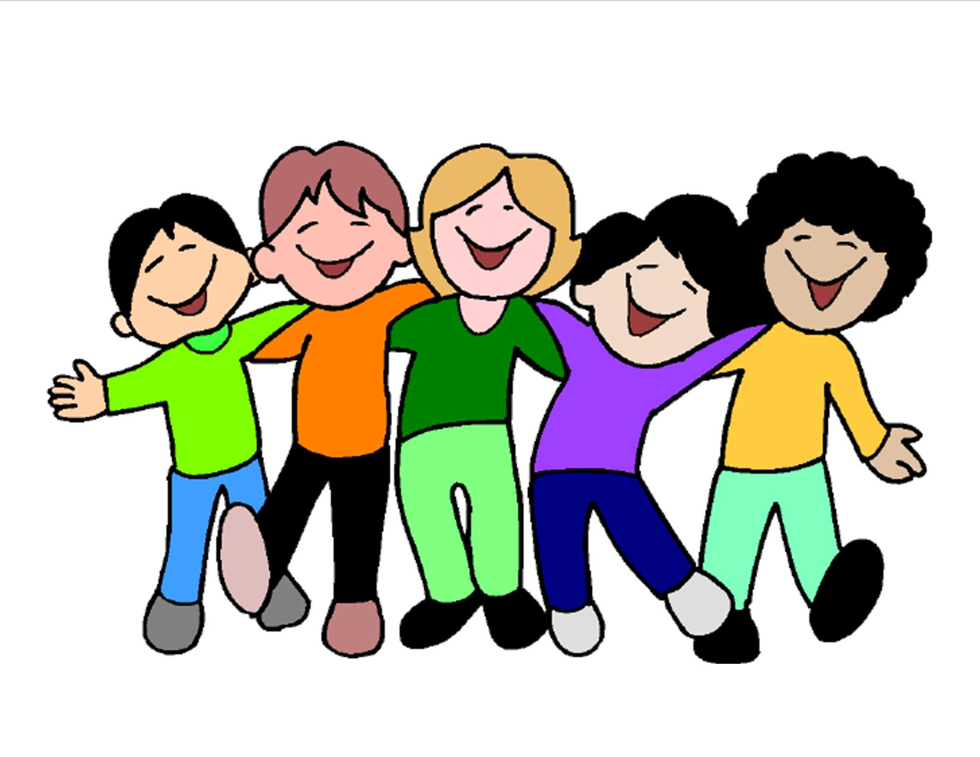
We all have things we do really well.
We all also have weaknesses and need help.
We are all important.
This time we’ll do what you want to do.
I would love
to help you.
I’m glad you help me.

Slide 18
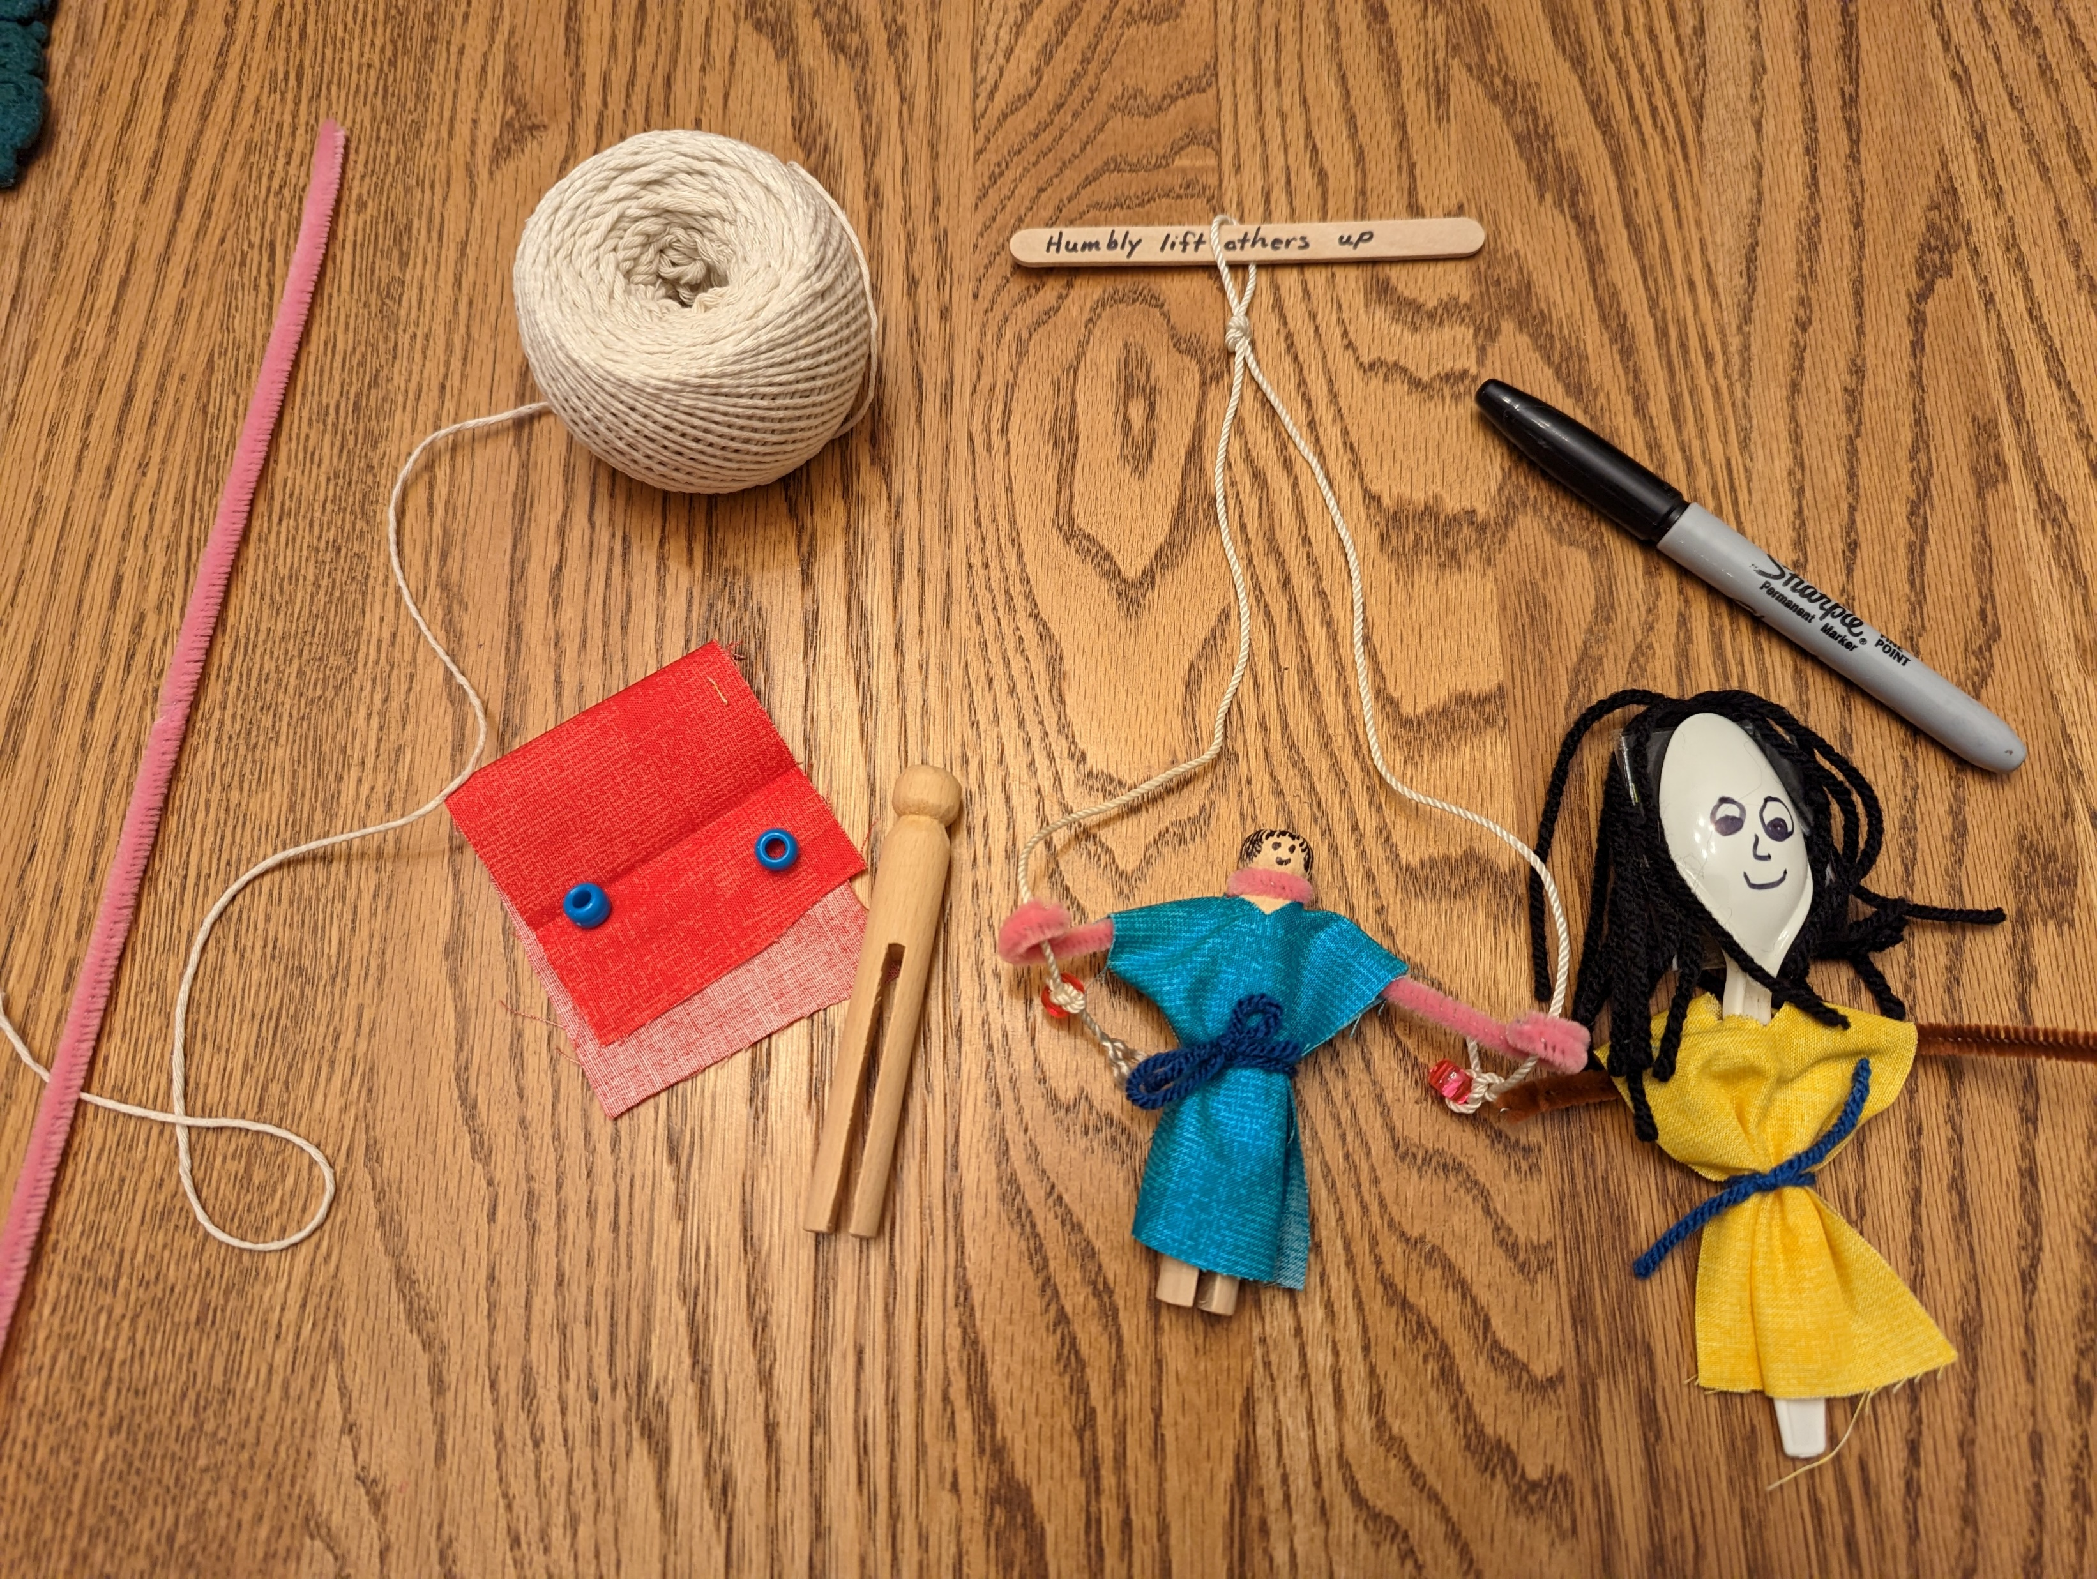
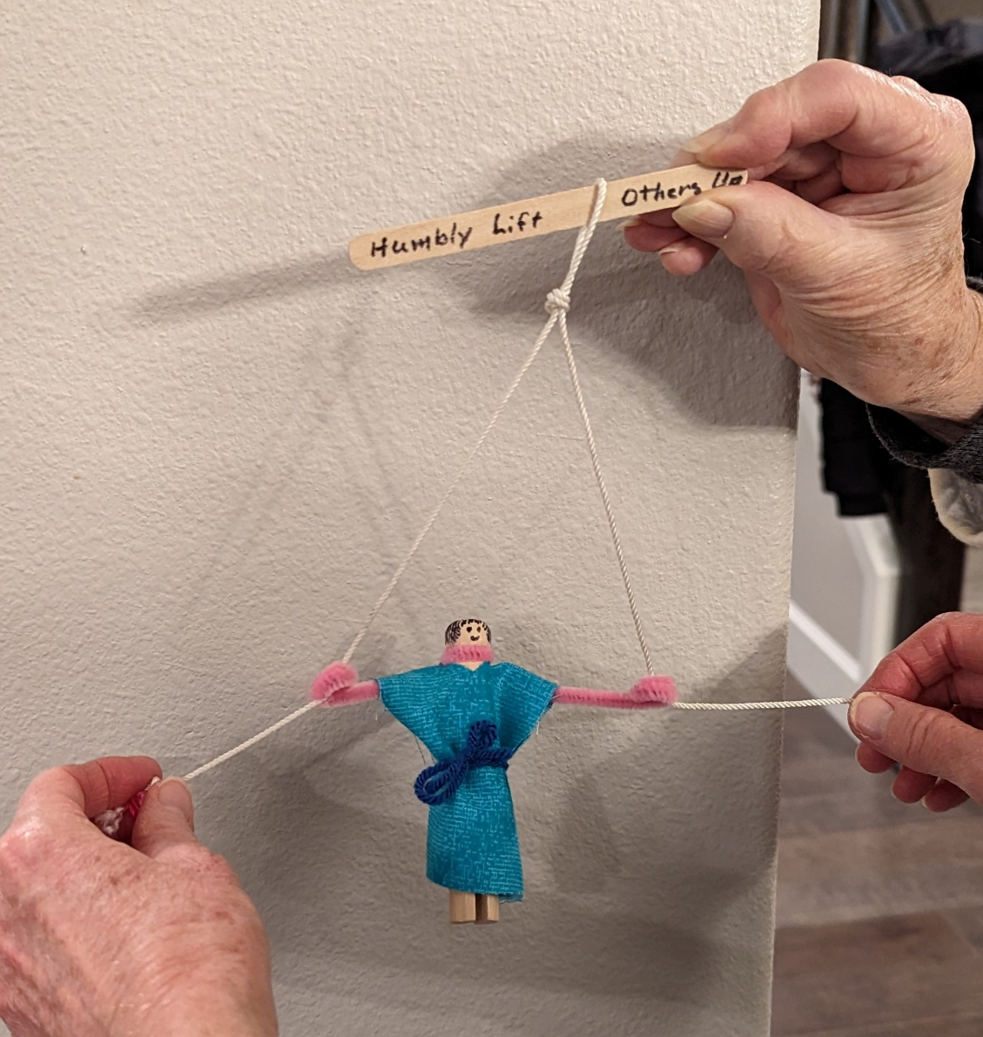
Craft Time
Directions:
Wrap pipe cleaner around top of spoon or clothespin
Wrap ends of pipe cleaner around a pencil to make the hands.
Cut a piece of fabric 2.5”x 6” Fold fabric in fourths and cut a very small notch for the head to go thru.
Put the fabric on the clothespin or spoon as shown.
Tie the waist with yarn or string.
Draw a face and add hair
On a popsicle stick write: “Humbly lift others up”
Cut 2 feet of string.
Tie the middle of the string in the middle of the stick. Tape or glue it in place.
Put one end through one hand and the other end through the other hand.
Tie a bead on the end of each string.
Have a person hold the stick.
Pull both strings to lift the person up.

Slide 19

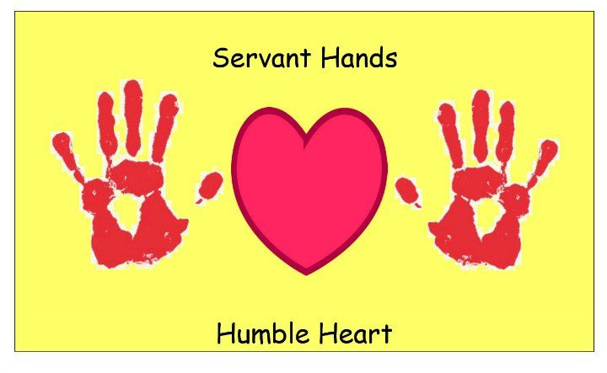
Craft Time options
You are
Awesome!

Slide 20
Just Be Humble

Slide 21

Song on Humility

Slide 22

Lay It Down

Slide 23

Be Humble

Slide 24

https://activity-array.com/

