Slide 1
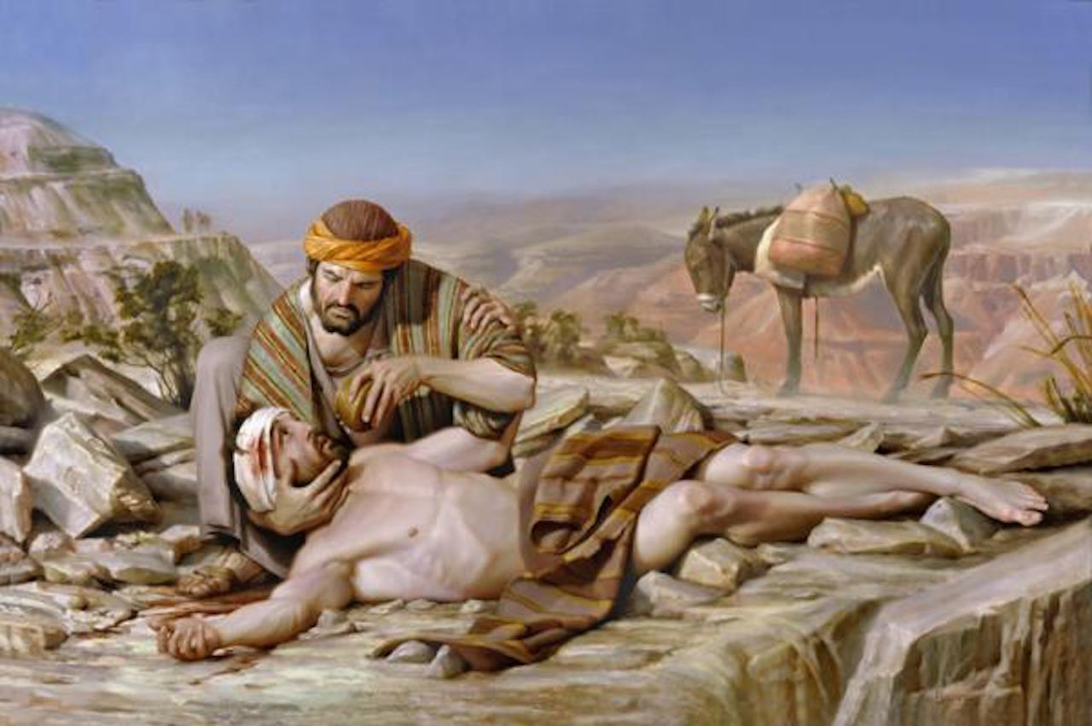
The Good Samaritan
Whom should I love?
Luke 10:25-37

Slide 2
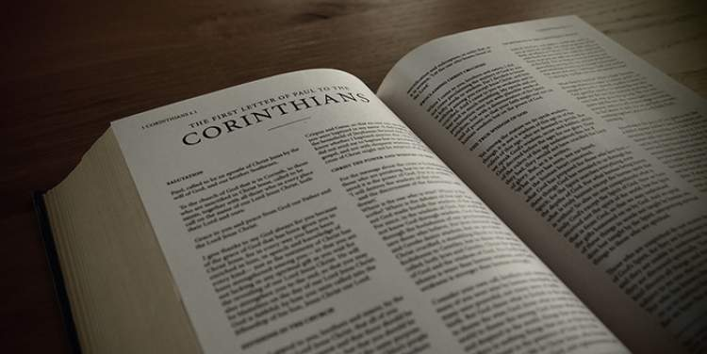
Find and read 1 Corinthians 13:4-8
LOVE
is
⁴ Love is patient,
love is kind.
It does not envy,
it does not boast,
it is not proud.
⁵ It does not dishonor others,
it is not self-seeking,
it is not easily angered,
it keeps no record of wrongs.
⁶ Love does not delight in evil but rejoices with the truth.
⁷ It always protects,
always trusts,
always hopes,
always perseveres.
⁸ Love never fails.

Slide 3

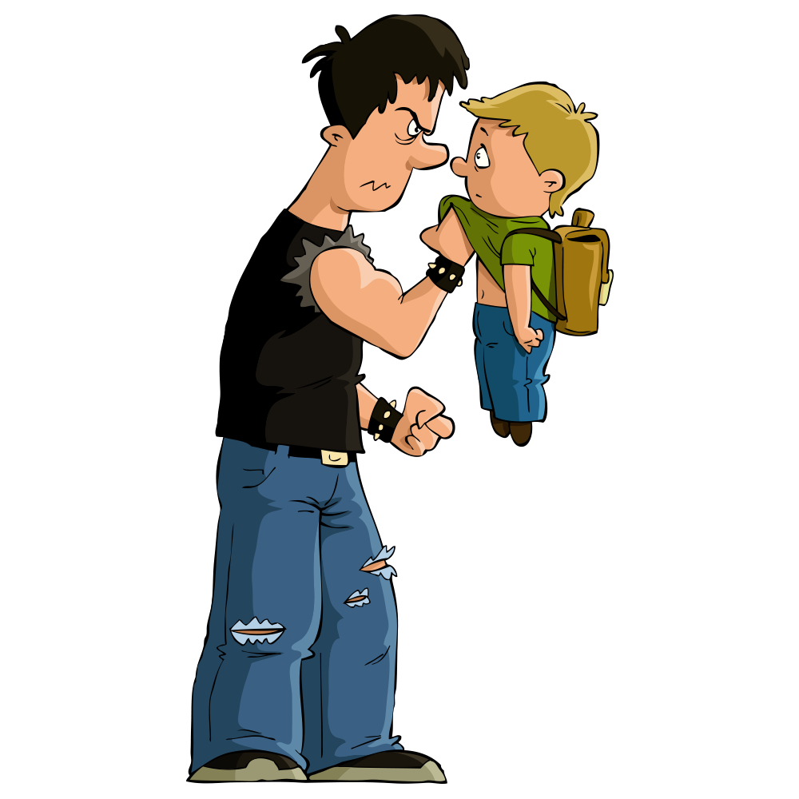
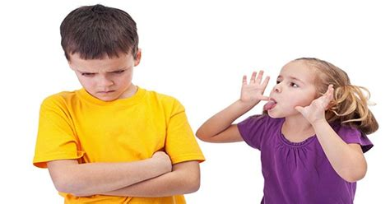
Be nice
Pray for them
Tell an adult
Have you ever been
BULLIED?
Have you ever been bullied?
What should you do?
Tell them to STOP!
leave

Slide 4

Listen
Mission Story
The bully

Slide 5
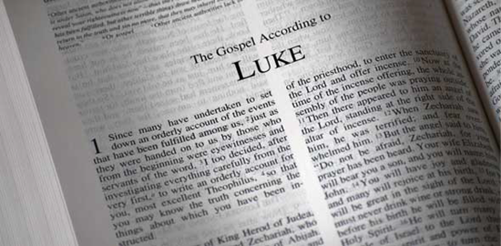
Find and read Luke 6:27-28
LOVE
Even…
²⁷ “But to you who are listening I say: Love your enemies, do good to those who hate you, ²⁸ bless those who curse you, pray for those who mistreat you. ²⁹ If someone slaps you on one cheek, turn to them the other also. If someone takes your coat, do not withhold your shirt from them. ³⁰ Give to everyone who asks you, and if anyone takes what belongs to you, do not demand it back. ³¹ Do to others as you would have them do to you.

Slide 6

My command is this:
Love
each other
as I have loved you.
John 15:12

Slide 7
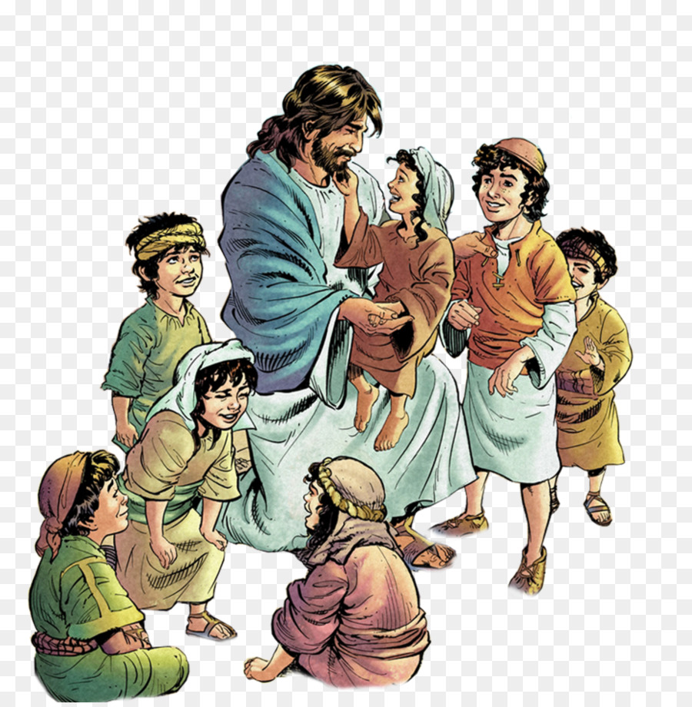
My command is this:
Love each other as I have loved you.
John 15:12

Slide 8
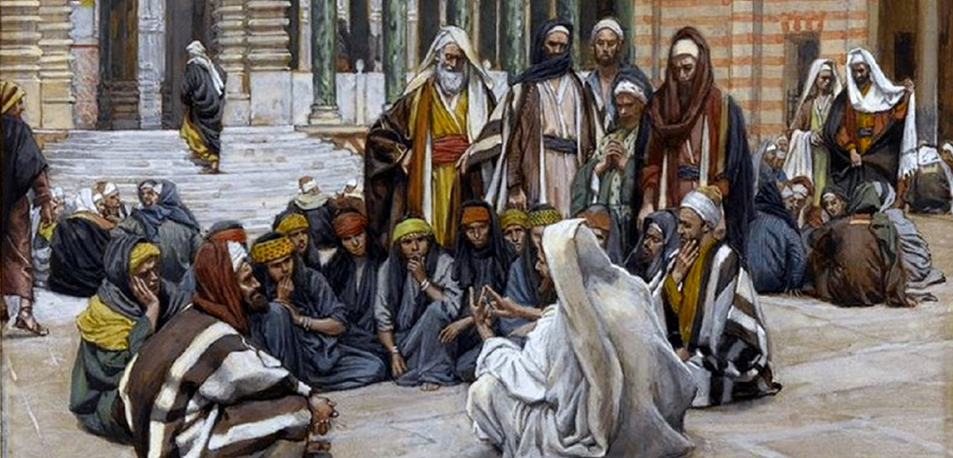
The greatest Law =
LOVE
What must I do to inherit eternal life?
Which commandment is the greatest?
^{Luke 10}
²⁵ On one occasion an expert in the law stood up to test Jesus. “Teacher,” he asked, “what must I do to inherit eternal life?”

Slide 9
LOVE GOD
Love one another
“‘Love the Lord your God with all your heart and with all your soul and with all your strength and with all your mind
Love your neighbor as yourself
What is written in the law? What does it mean?
²⁶ “What is written in the Law?” he replied. “How do you read it?”
²⁷ He answered, “‘Love the Lord your God with all your heart and with all your soul and with all your strength and with all your mind’^{[c]}; and, ‘Love your neighbor as yourself.’^{[d]}”

Slide 10
The greatest Law =
LOVE
Who is my neighbor?
You have answered correctly. Do this and you will have eternal life.
²⁸ “You have answered correctly,” Jesus replied. “Do this and you will live.”
²⁹ But he wanted to justify himself, so he asked Jesus, “And who is my neighbor?”
³⁰ In reply Jesus said:
I will tell you a story.

Slide 11
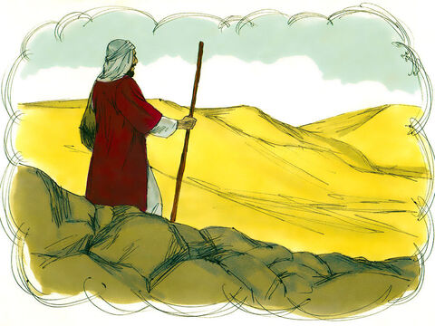
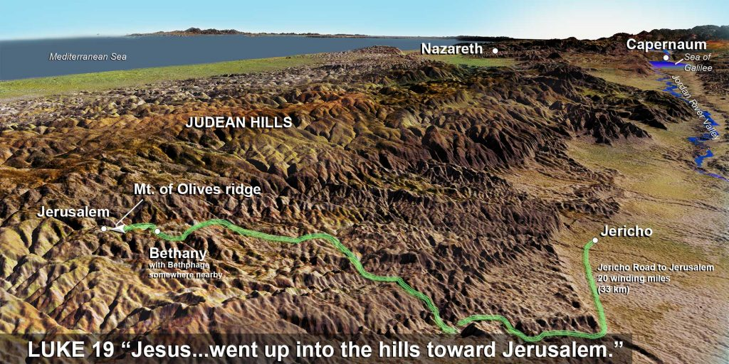
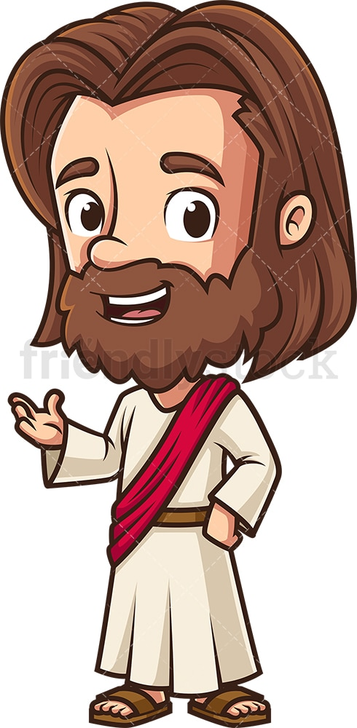
“A man was going down from Jerusalem to Jericho,

Slide 12
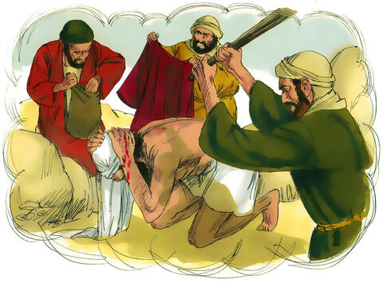
That’s not
love
when he was attacked by robbers. They stripped him of his clothes, beat him and went away, leaving him half dead.

Slide 13
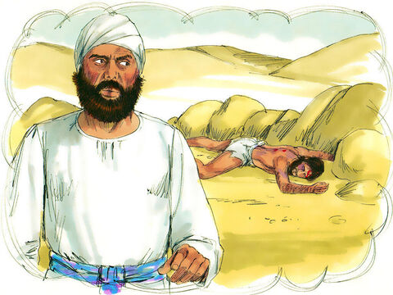
That’s not
love
I mustn’t touch anything dead. I must stay clean.
³¹ A priest happened to be going down the same road, and when he saw the man, he passed by on the other side.

Slide 14
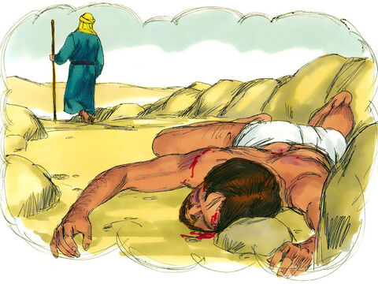
Not my problem.
That’s not
love
³² So too, a Levite, when he came to the place and saw him, passed by on the other side.

Slide 15
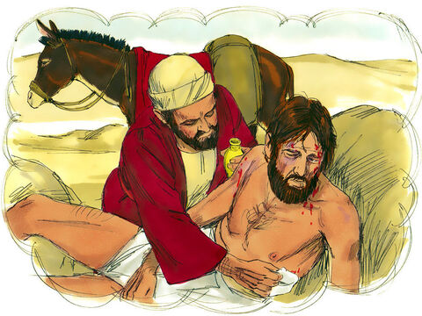
Oh my! This poor man! I will help him.
Love is kind
& heals
³³ But a Samaritan, as he traveled, came where the man was; and when he saw him, he took pity on him. ³⁴ He went to him and bandaged his wounds, pouring on oil and wine. Then he put the man on his own donkey,

Slide 16
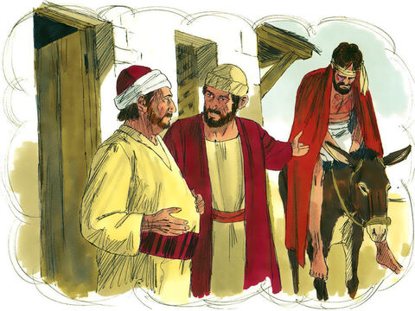
I need a room for myself and this man.
Love cares & takes time
He put the man on his own donkey, brought him to an inn and took care of him.

Slide 17
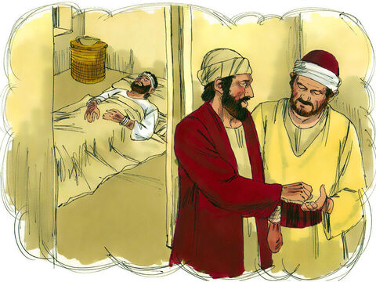
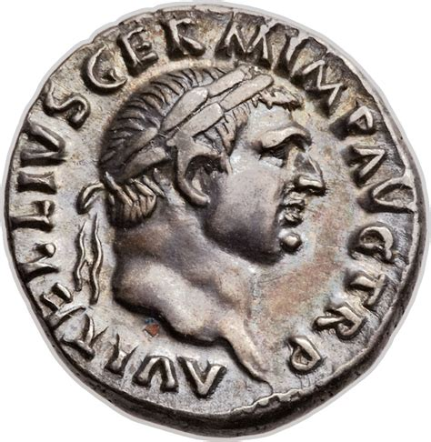
Please let this man sleep here. Here is some money.
I will give you more later.
Love pays
³⁵ The next day he took out two denarii^{[e]} and gave them to the innkeeper. ‘Look after him,’ he said, ‘and when I return, I will reimburse you for any extra expense you may have.’

Slide 18
LOVE
Shows mercy
Who was this poor mans’ neighbor?
The one who had mercy on him.
³⁶ “Which of these three do you think was a neighbor to the man who fell into the hands of robbers?”
³⁷ The expert in the law replied, “The one who had mercy on him.”
Jesus told him, “Go and do likewise.”
Go and do likewise.

Slide 19
My command is this:
Love each other as I have loved you.
John 15:12

Slide 20
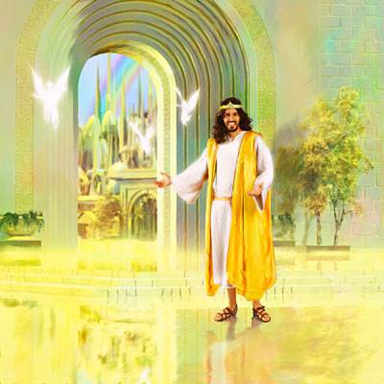
Loving others shows love to God
Welcome!
Take your inheritance –
The kingdom prepared for you since the creation of the world.
I was hungry – You fed me
I was thirsty – You gave me drink
I was a stranger – You welcomed me
I needed clothes – You gave me some
Matthew 25:34-36
Another time Jesus was talking about when he comes again. He said:
³⁴ “Then the King will say to those on his right, ‘Come, you who are blessed by my Father; take your inheritance, the kingdom prepared for you since the creation of the world.
³⁵ For I was hungry and you gave me something to eat, I was thirsty and you gave me something to drink, I was a stranger and you invited me in, ³⁶ I needed clothes and you clothed me, I was sick and you looked after me, I was in prison and you came to visit me.’

Slide 21
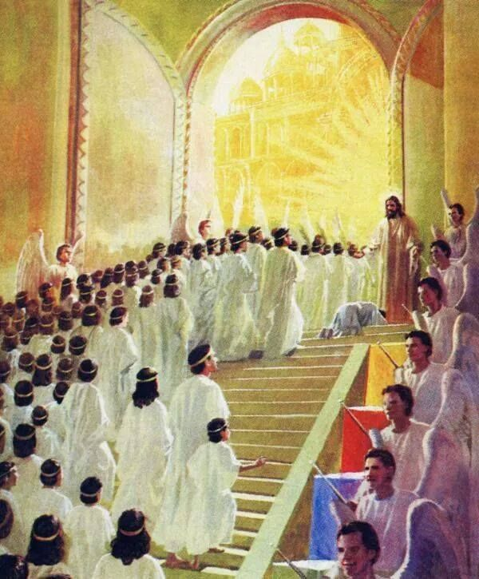
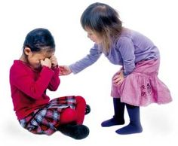
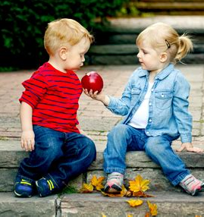
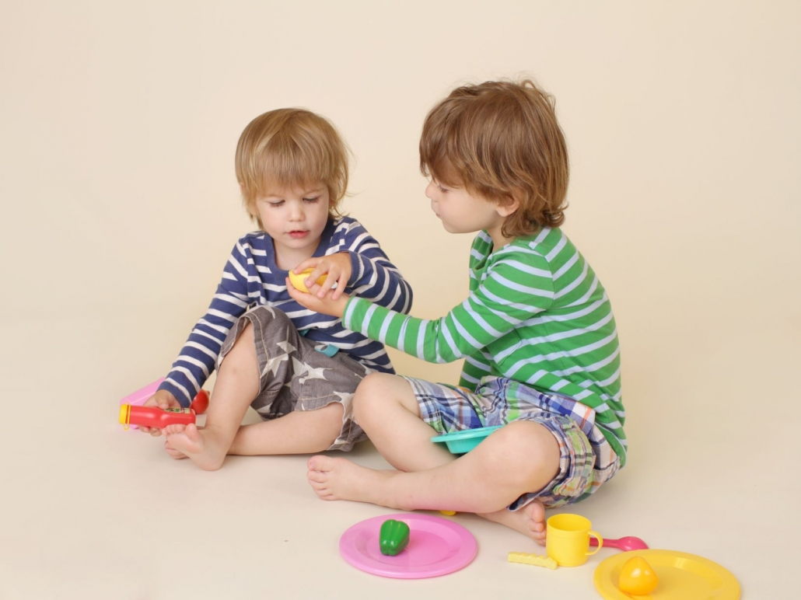
Loving others shows love to God
Whatever you did to the least of one of these brothers and sisters,
you did it to me.
When did we see you a stranger or in need?
Matthew 25:37-40
³⁷ “Then the righteous will answer him, ‘Lord, when did we see you hungry and feed you, or thirsty and give you something to drink? ³⁸ When did we see you a stranger and invite you in, or needing clothes and clothe you? ³⁹ When did we see you sick or in prison and go to visit you?’
⁴⁰ “The King will reply, ‘Truly I tell you, whatever you did for one of the least of these brothers and sisters of mine, you did for me.’

Slide 22
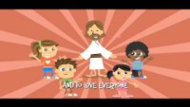
Sing
Love One Another

Slide 23
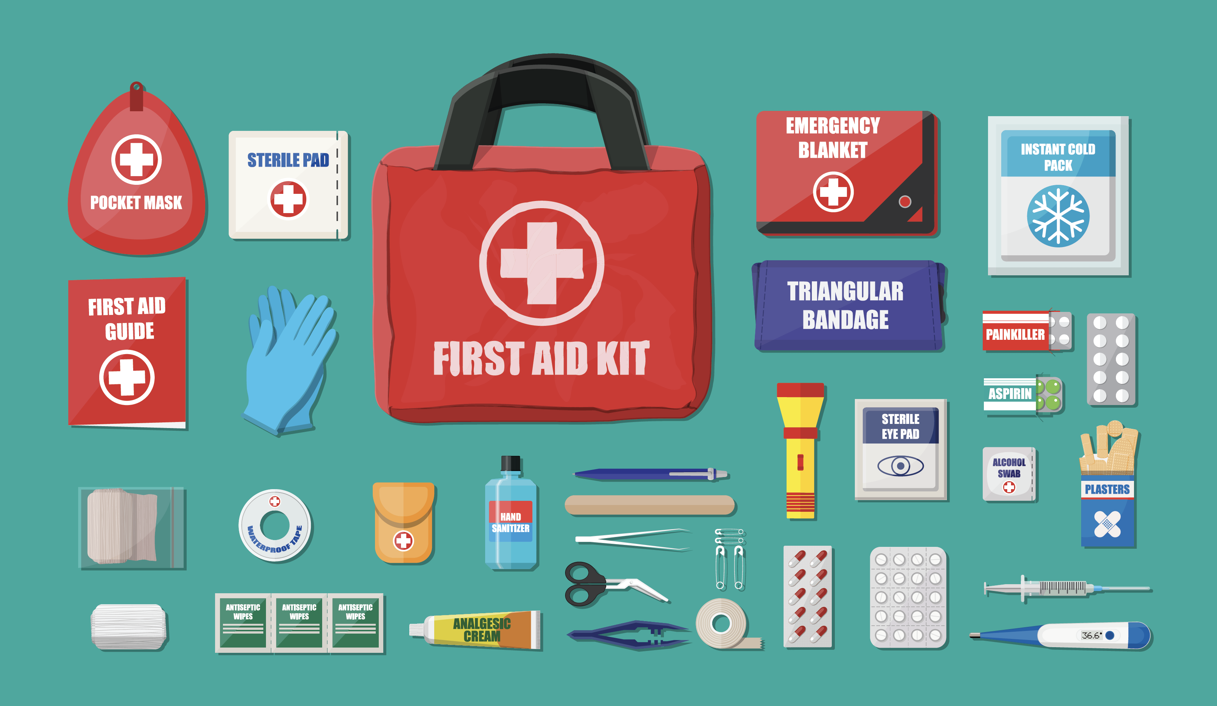
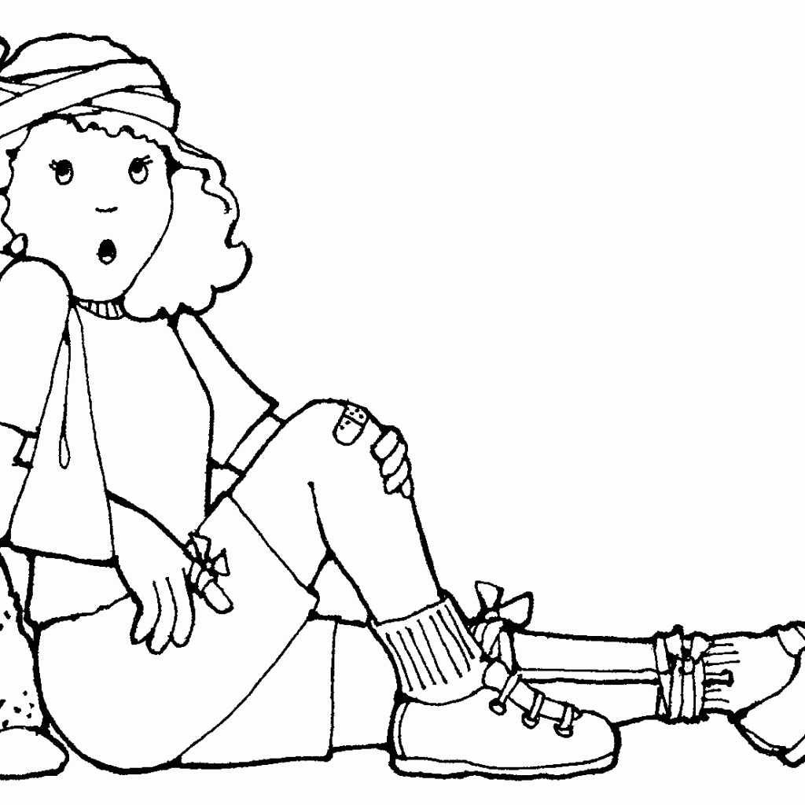
Can you
Help?
What should you do if someone gets hurt? How do you help the wounded?
Make a little kit.
Wear gloves
Clean the wound
Cover the wound
Pressure to stop extreme bleeding
Call 9-1-1 if they can’t breathe

Slide 24
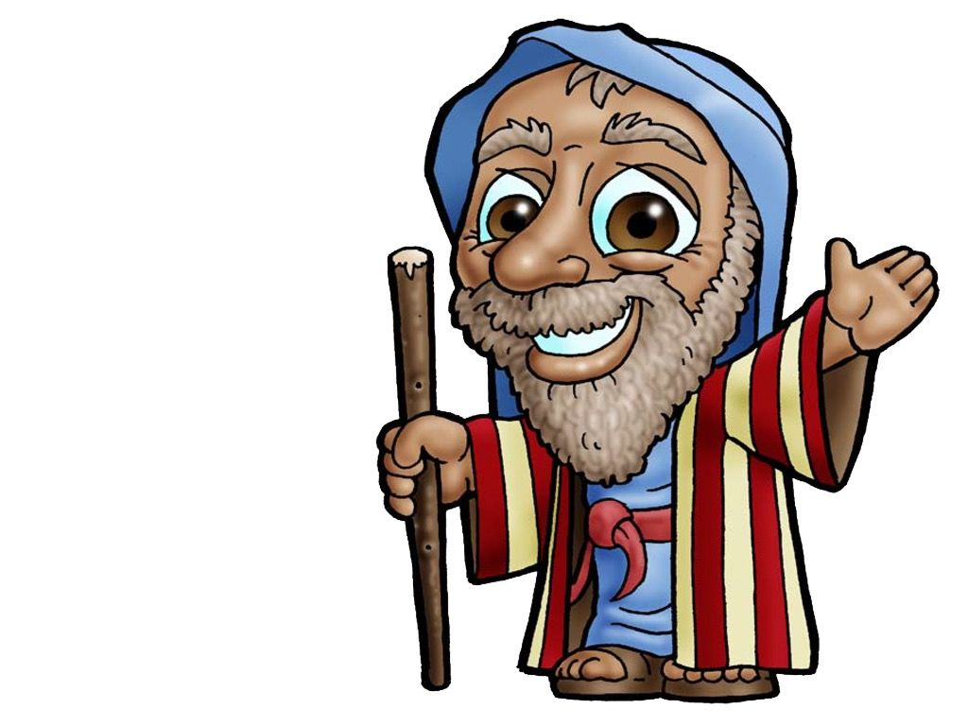
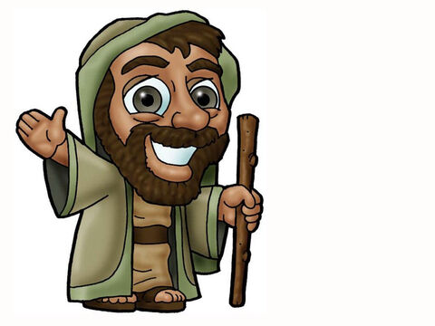
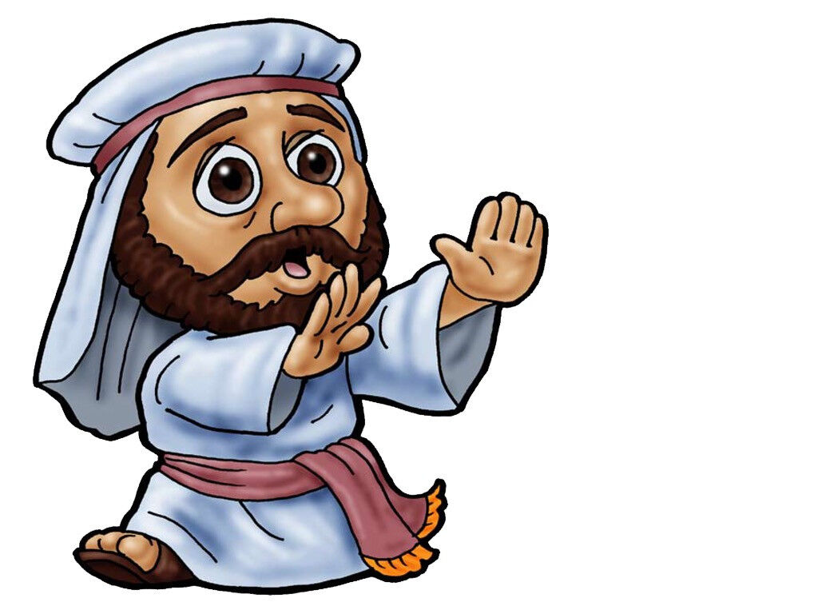
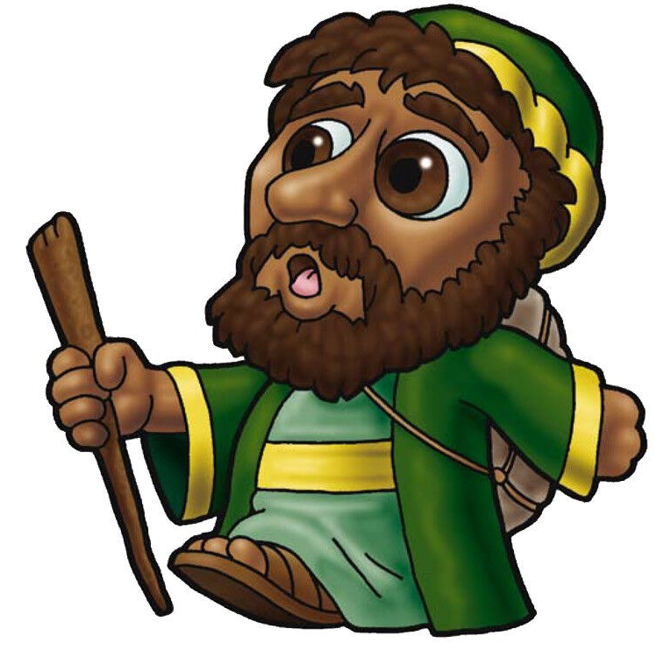
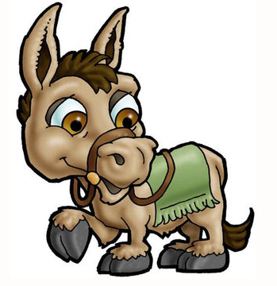
Let’s
do it
Choose which character you want to be
Man Priest Levite Samaritan Innkeeper
Read the story from the Bible
Luke 10:25-37
Encourage the kid actors to do the action as you read.

Slide 25
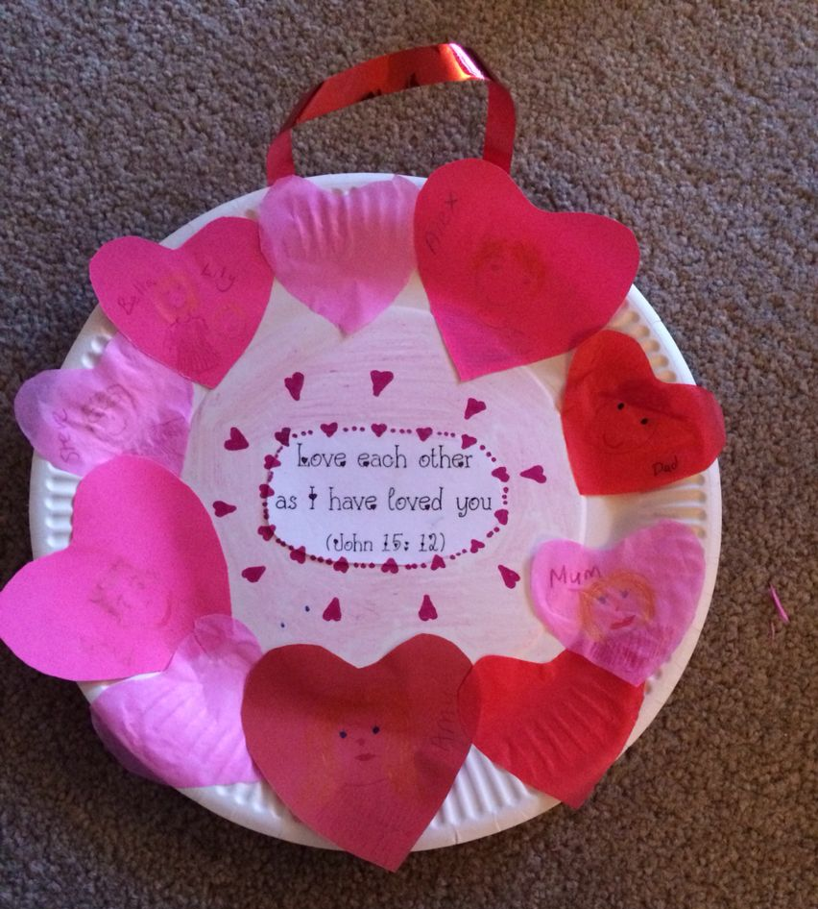
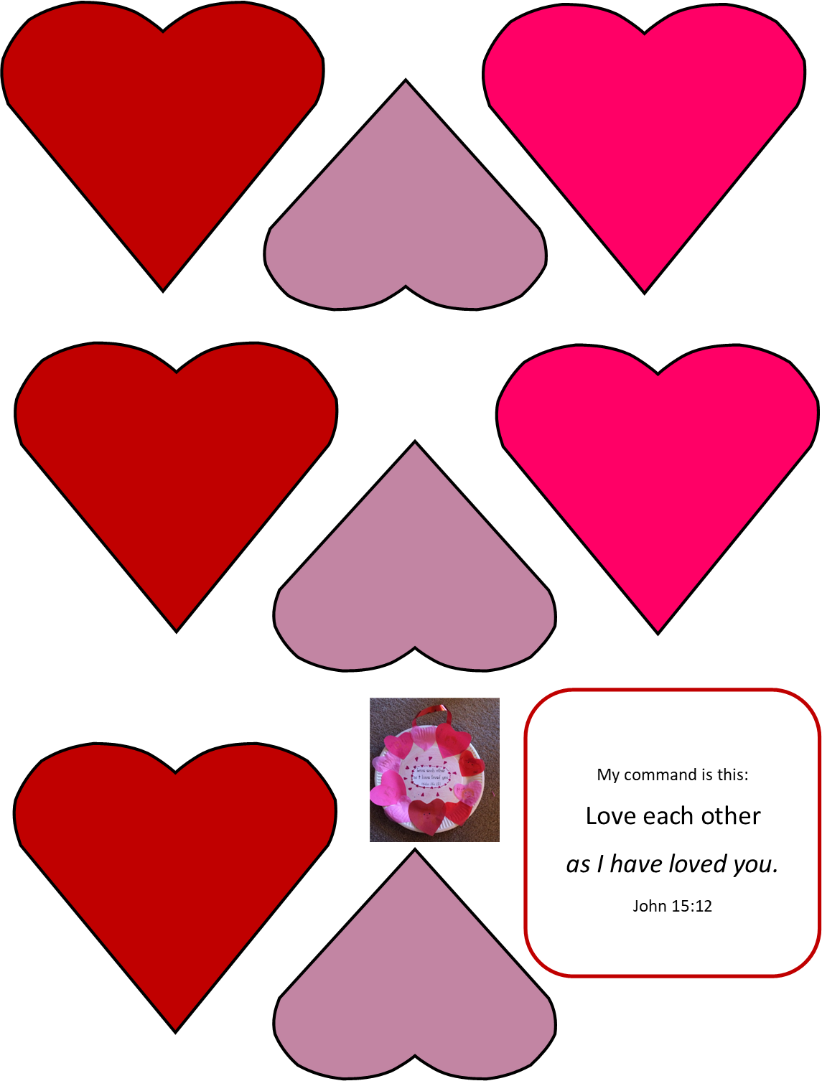
Craft
Time
My command is this:
Love each other
as I have loved you.
John 15:12
Directions:
Glue the verse in the middle of your plate
Cut out / choose 7 big hearts and some small hearts
Glue the hearts around the outside edge of the plate to make a wreath
Tape a ribbon on the back to hang the craft.

Slide 26
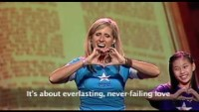
Listen
L-O-V-E, Love

Slide 27
Sing
Love One Another

Slide 28

Sing
Yes, Jesus Loves Me

Slide 29

Sing
Love the Lord

Slide 30

More
https://activity-array.com/

