Slide 1
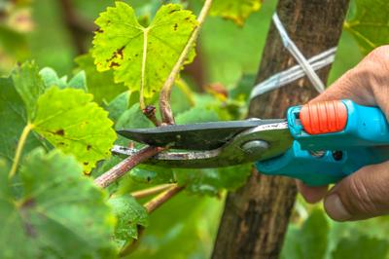
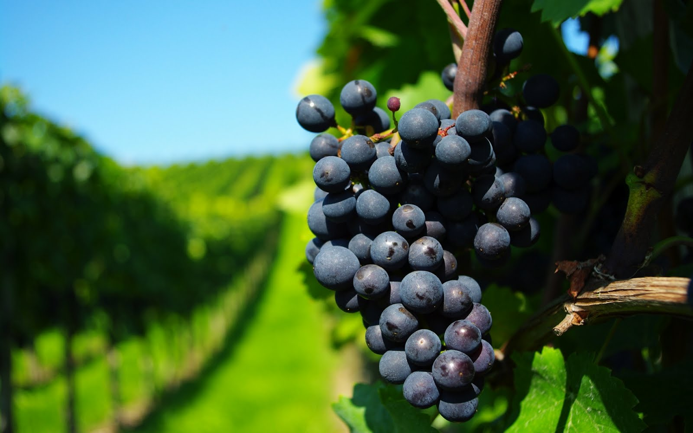

Parable of the Vineyard
Matthew 20:1-16
This Photo by Unknown Author is licensed under CC BY-NC-ND

Slide 2
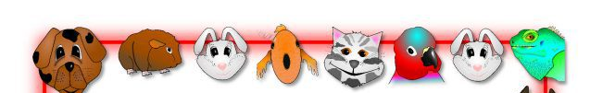

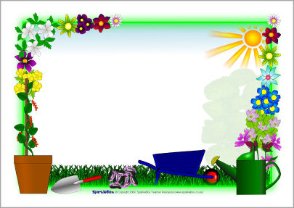
What kind of work do your parents ask you to do? When it’s your turn, draw a picture or act it out in a charade.
We’ll guess what it is
you do.

Slide 3

Why should a person work?

Slide 4

” In all the work
you are given,
do the best you can. Work as though
you are working for the Lord,
not any earthly master.”
Colossians 3:23

Slide 5

Everyone who works gets some kind of reward.
It may be a good feeling, or it may be money, or it may be something you get to use, or something else.
I have something for you.
SO
Everyone line up.
Note to presenter: give the reward to the last person first

Slide 6
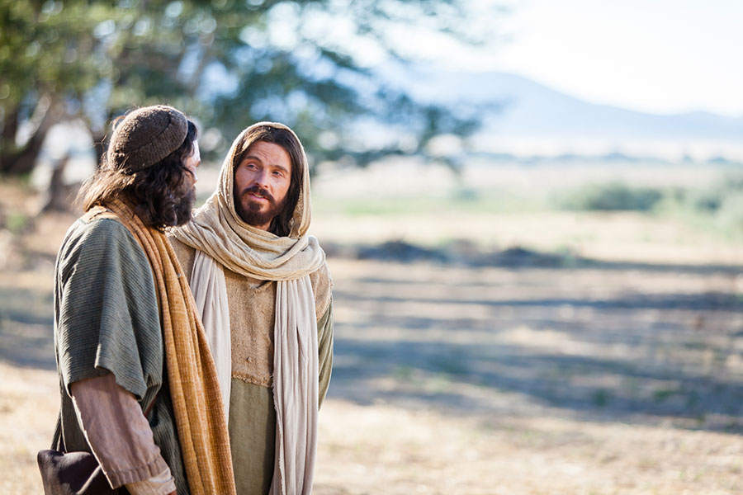
Peter asked a question.
Jesus told a parable.
We find it in Matthew 19
We have left everything we have to follow you. What will be our reward?
Jesus had just told a rich man, who wanted to be perfect, to sell his things, give them to the poor and to follow Him. The rich man didn’t want to do that, so he went away sad.
²⁷ Peter said to him, “We left everything we had and followed you. So, what will we have?”
²⁸ Jesus said to them, “When the time of the new world comes, the Son of Man will sit on his great and glorious throne. And I can promise that you who followed me will sit on twelve thrones, and you will judge the twelve tribes of Israel. ²⁹ Everyone who has left houses, brothers, sisters, father, mother, children, or farms to follow me will get much more than they left. And they will have eternal life. ³⁰ Many people who are first now will be last in the future. And many who are last now will be first in the future.
When the time of the new world comes…. You and those who have also left everything will get much more than what you have left.
They and you will have eternal life.
Many who are first now, will be last.
The last will be first.

Slide 7
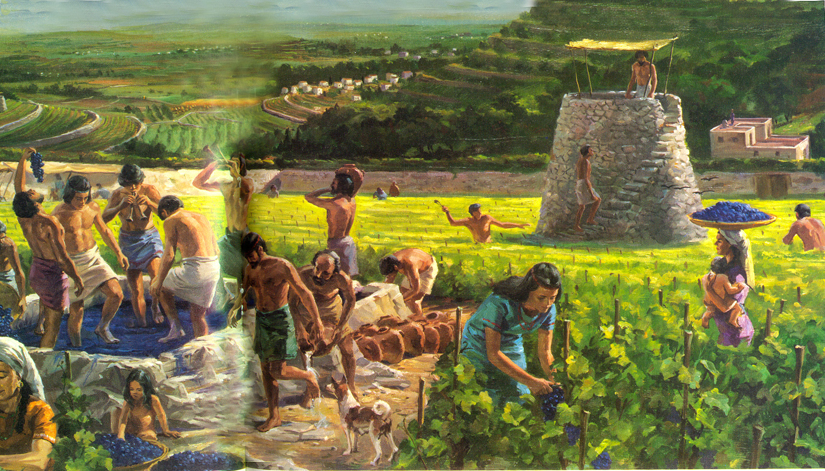
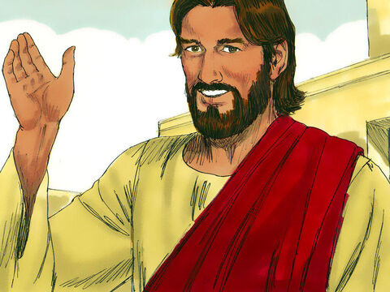
^{Matthew 21:33}
“Listen to this story: There was a man who owned a vineyard. He put a wall around the field and dug a hole for a winepress. Then he built a tower.
This is our story’s setting. What do you see?

Slide 8
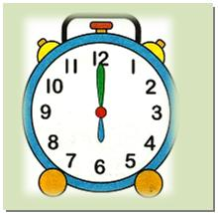
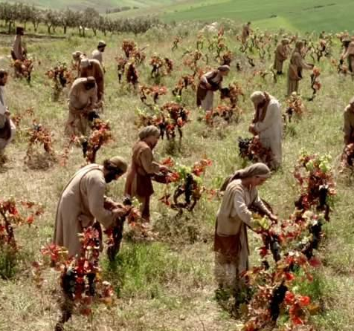
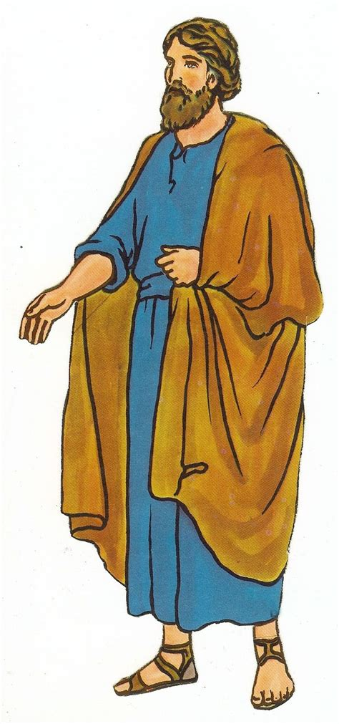
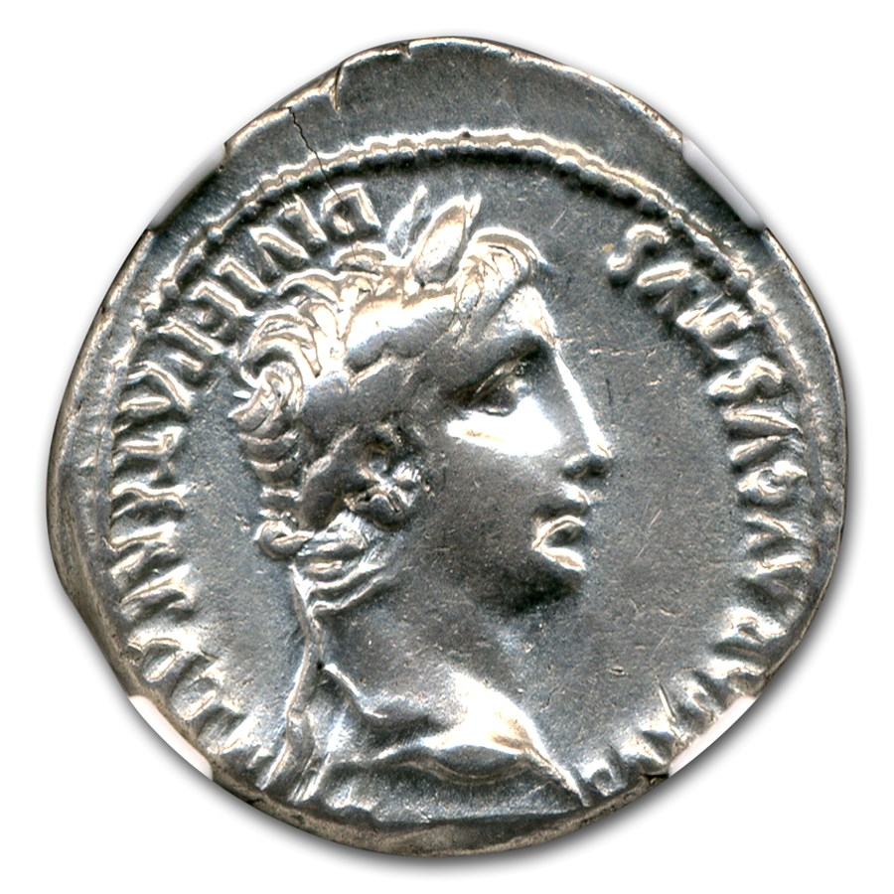
I have a job for you!
Matthew 20:1-16
Come work for me. I will pay you a silver coin.
“God’s kingdom is like a man who owned some land.
One morning, the man went out very early to hire some people to work in his vineyard.
² He agreed to pay the workers one silver coin for working that day. Then he sent them into the vineyard to work.
This Photo by Unknown Author is licensed under CC BY-NC-ND

Slide 9

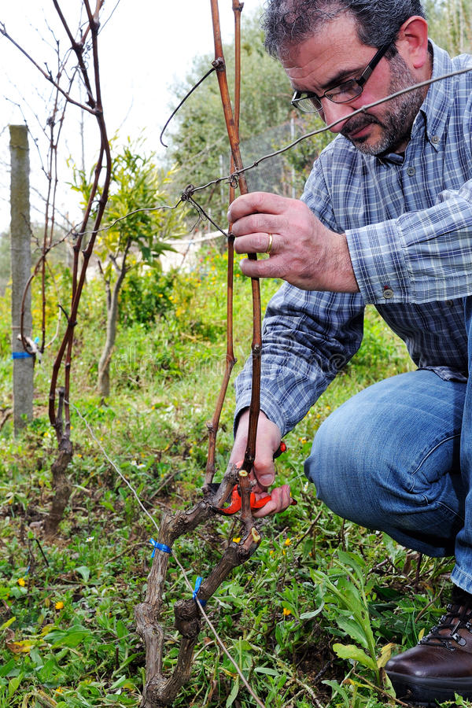
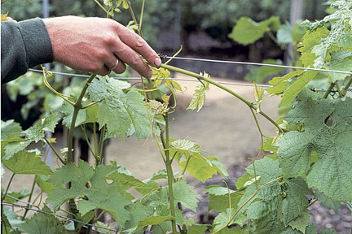
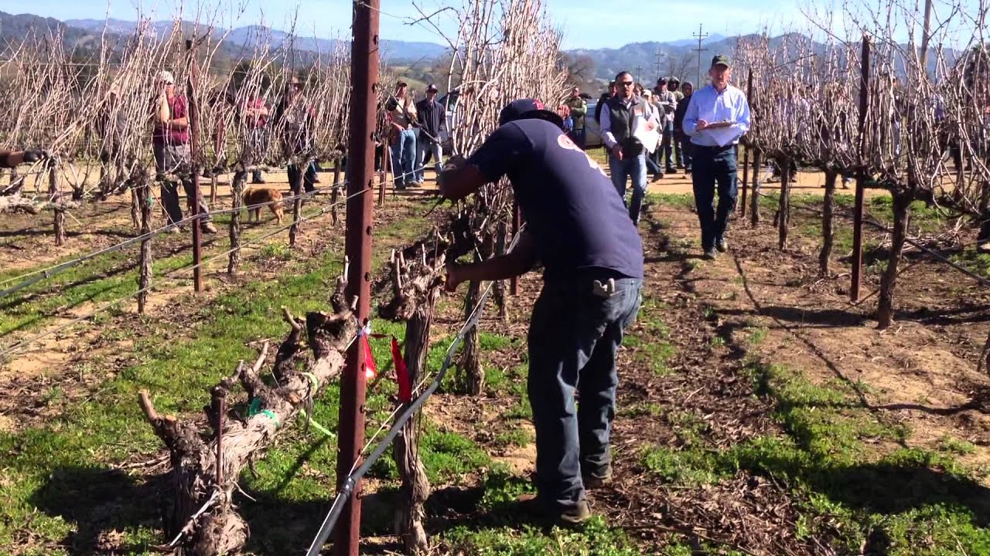
What would they do in the vineyard?
They need to care for the vines by:
Pruning the vines
Training the vines

Slide 10
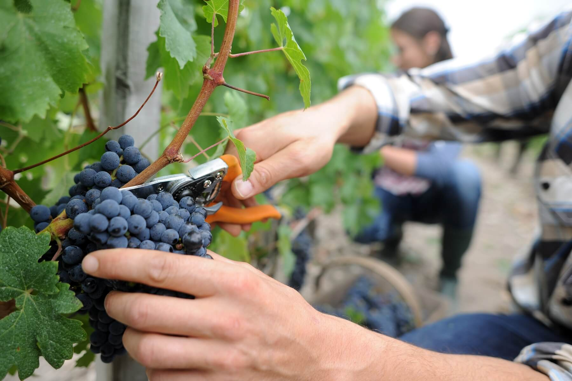
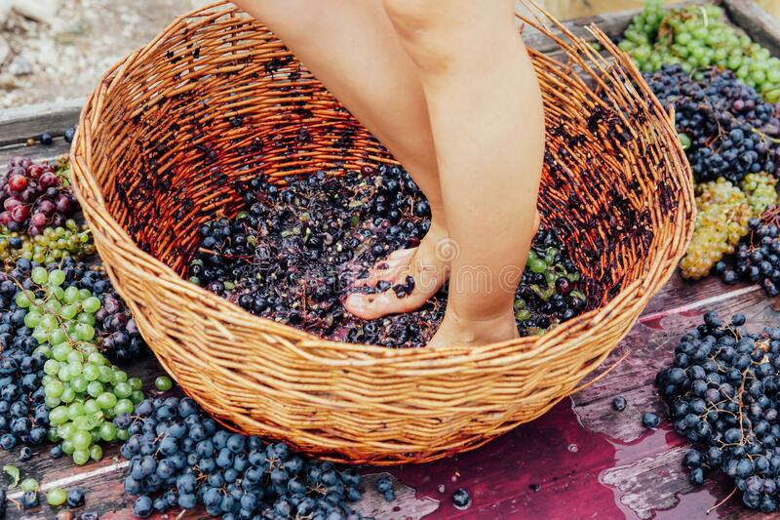
In the fall they would pick grapes.
” In all the work you are given, do the best you can. Work as though you are working for the Lord, not any earthly master.”
Colossians 3:23

Slide 11
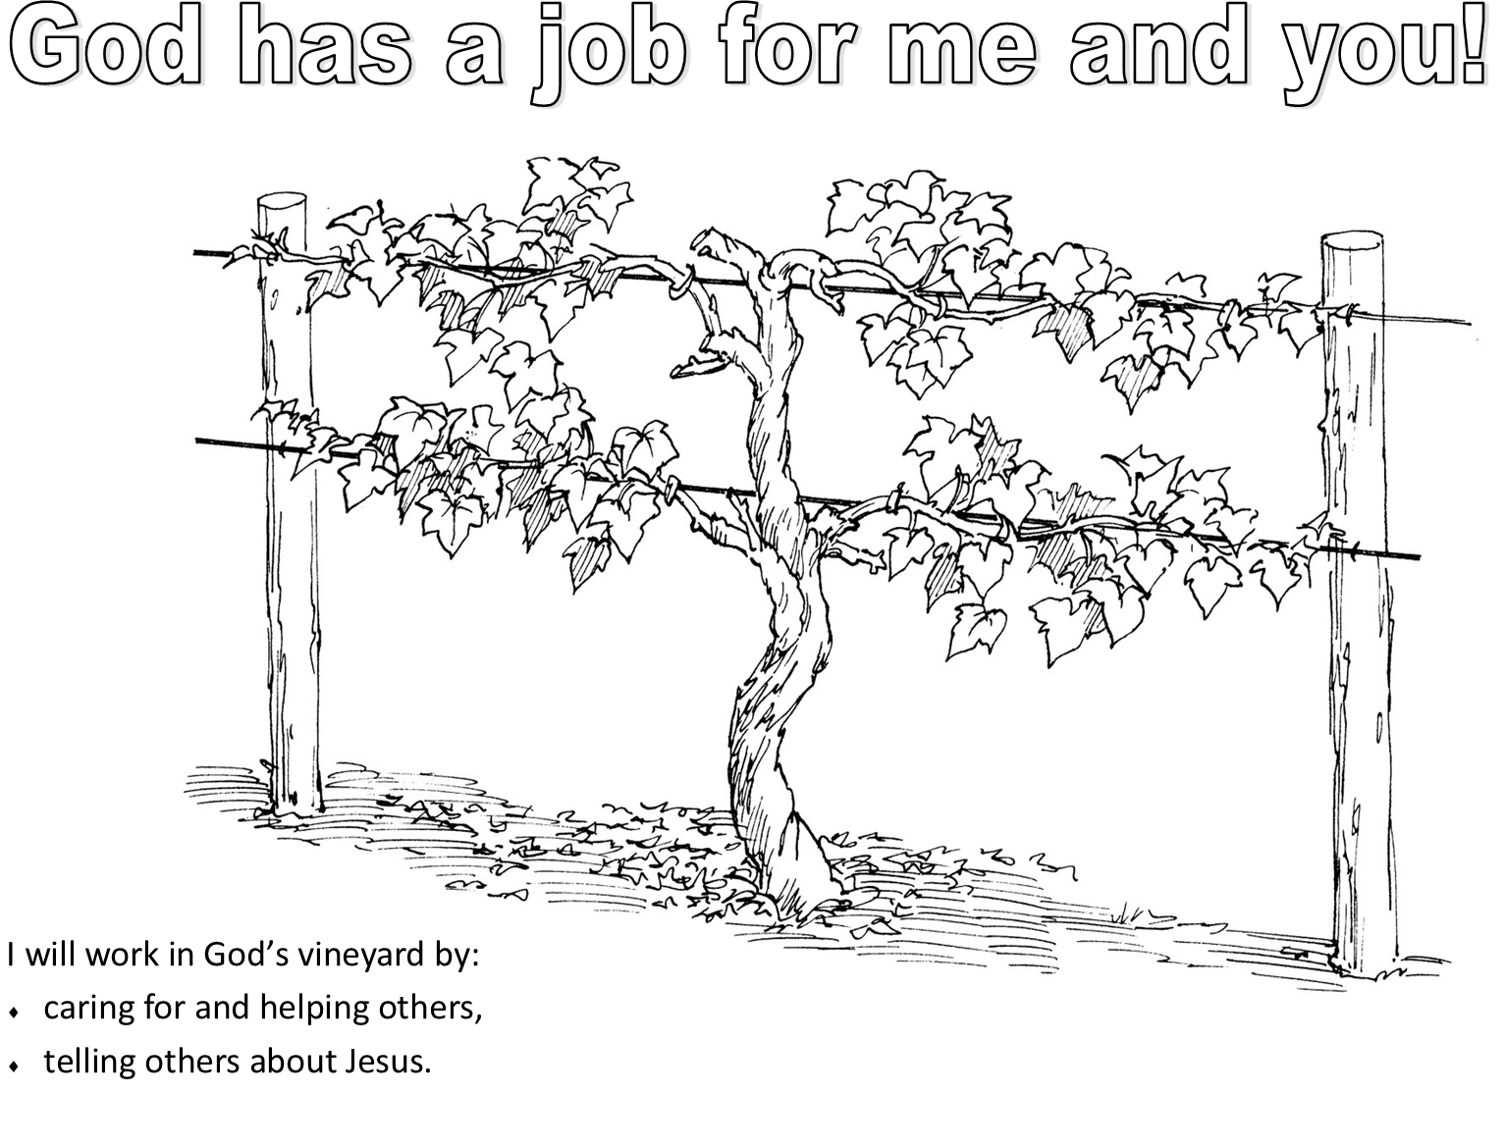
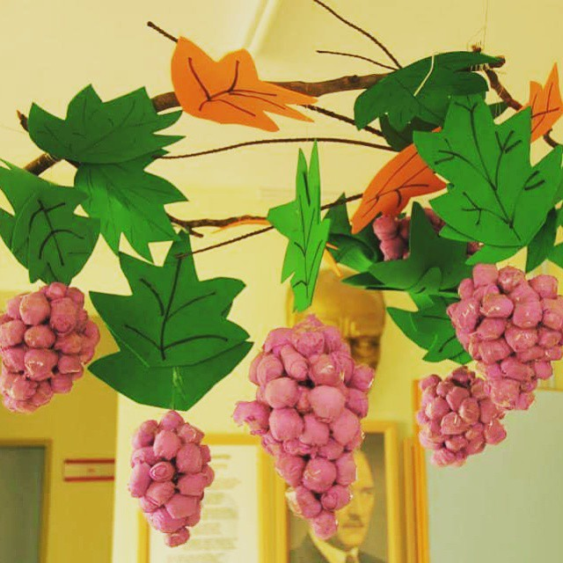
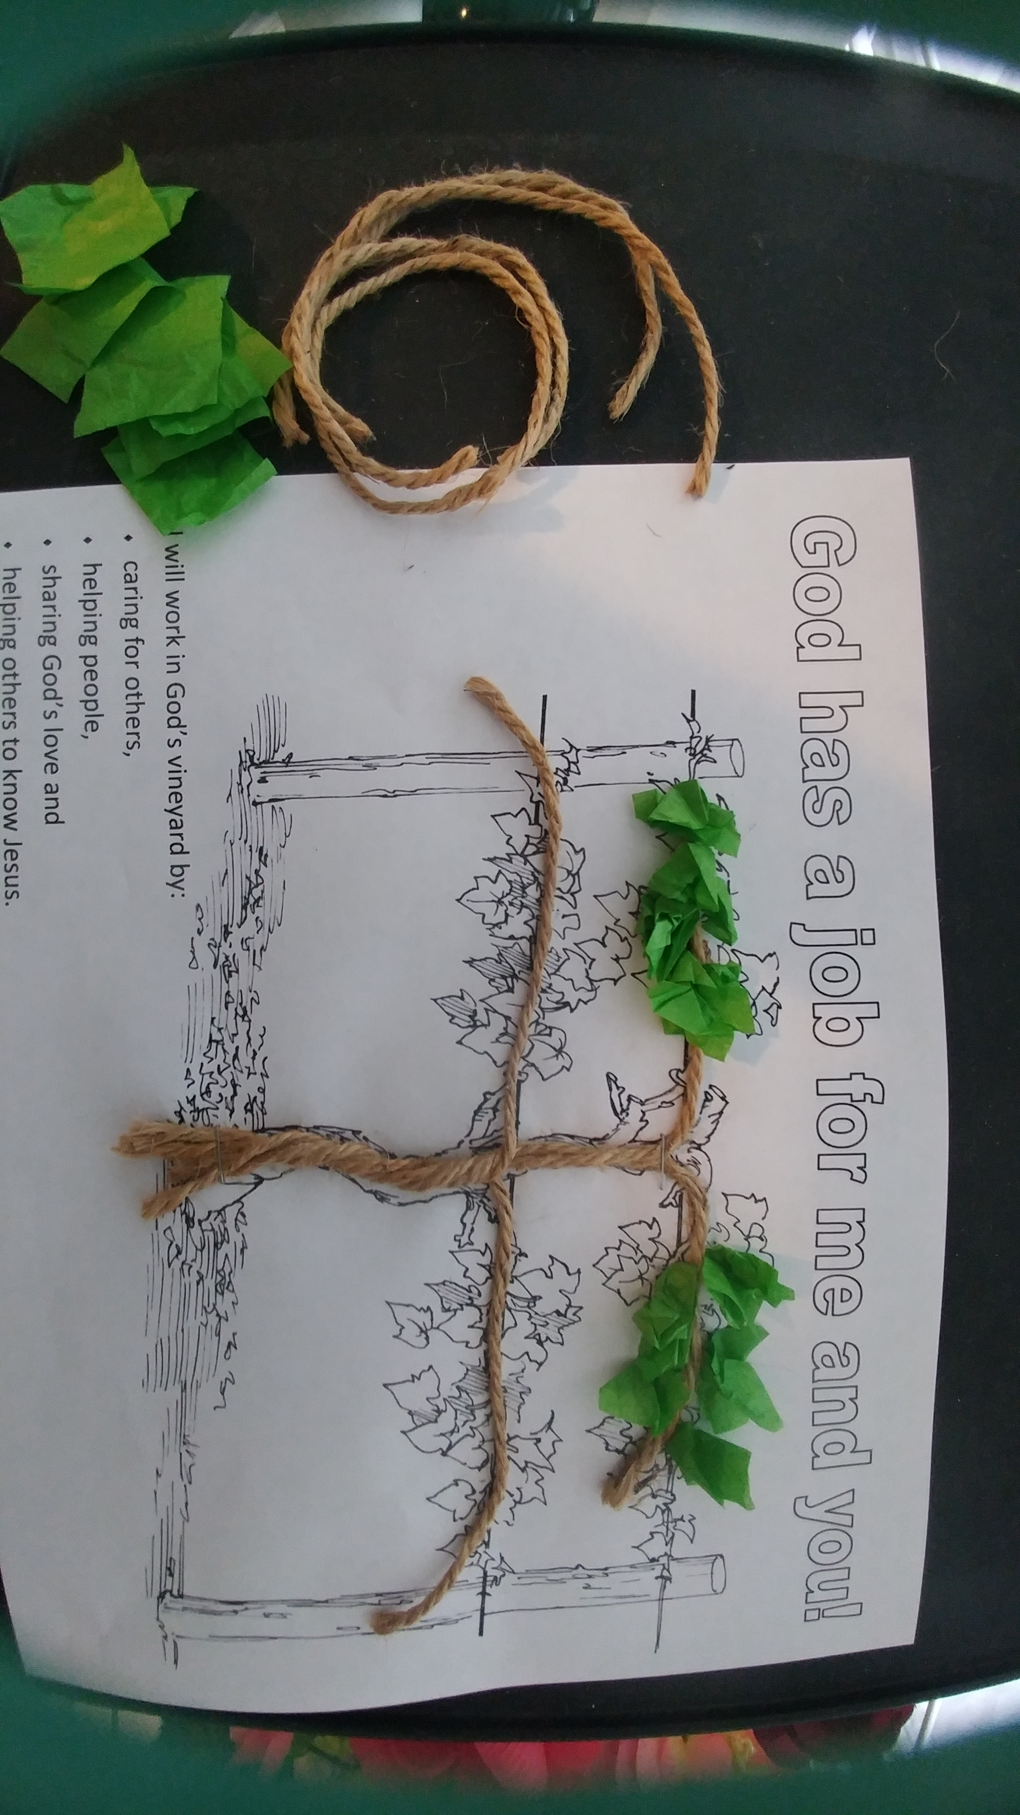
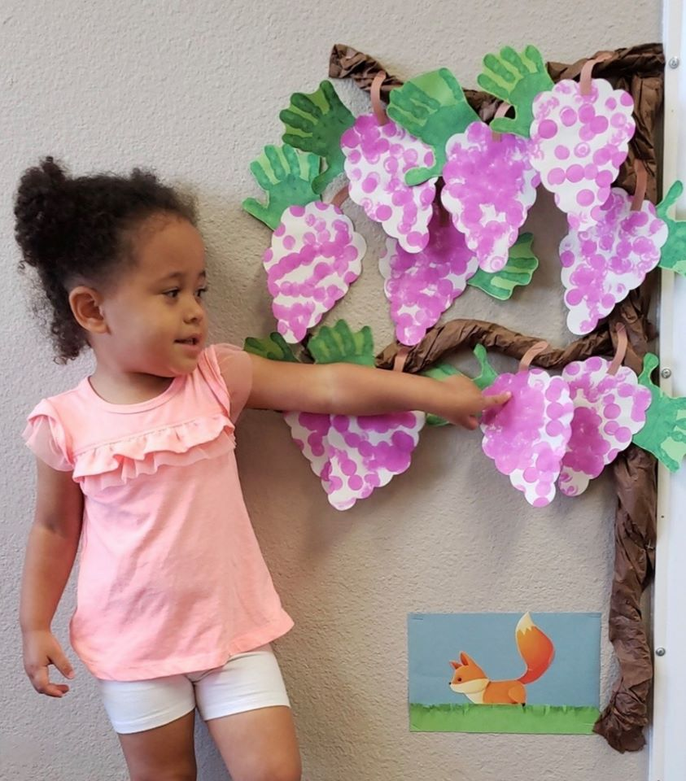
Time to get to work!
Let’s make a grape vine.
Train your vines by gluing the 4 loose strings along the wire like the 4 pictured branches.
Cut off any extra long string.
It’s important to train the vines to keep them off the ground. You don’t want dirty, bug filled fruit!
Our parents and God train us too.
The vines grow lots and lots of long branches. They need to be trimmed so that the vine has enough energy to produce lots of big grapes.
>Sometimes our parents and God have to tell us “no” to things that we want, because its not what is best for us.

Slide 12
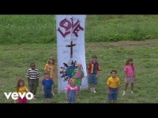
Sing
This Photo by Unknown Author is licensed under CC BY-NC-ND

Slide 13
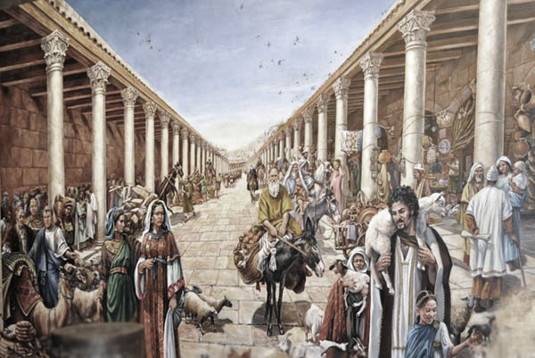
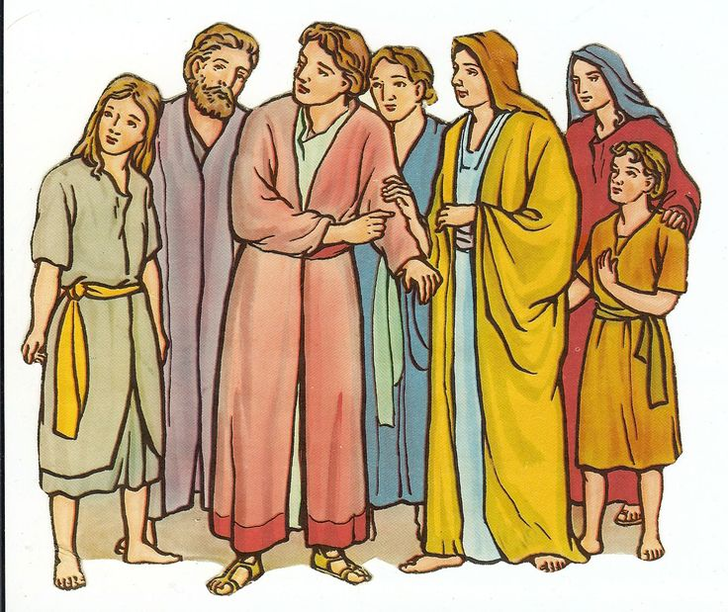

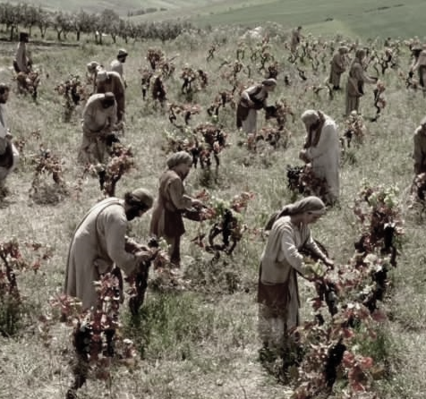


I have a job for you!
Matthew 20:1-16
³ “About nine o’clock the man went to the marketplace and saw some other people standing there. They were doing nothing. ⁴ So he said to them, ‘If you go and work in my field, I will pay you what your work is worth.’ ⁵ So they went to work in the vineyard.
“The man went out again about twelve o’clock
and again at three o’clock. Both times he hired some others to work in his vineyard.
Come work for me. I will pay you a fair wage.
Come work for me. I will pay you a fair wage.
Come work for me. I will pay you a fair wage.
This Photo by Unknown Author is licensed under CC BY-NC-ND

Slide 14
Keep working!
Let’s make a grape vine with leaves.
Train your vines by gluing the 4 loose strings along the wire like the 4 pictured branches.
Cut off any extra long string.
Make leaf by bunching a 1 inch square of tissue paper and gluing it to a branch
Make more and more leaves.
Leaves collect the sunlight and make energy for the plant. It’s called photosynthesis.
When we spend time with God, pray, and read the Bible we are collecting God’s energy so we can grow.

Slide 15

Sing
This Photo by Unknown Author is licensed under CC BY-NC-ND

Slide 16

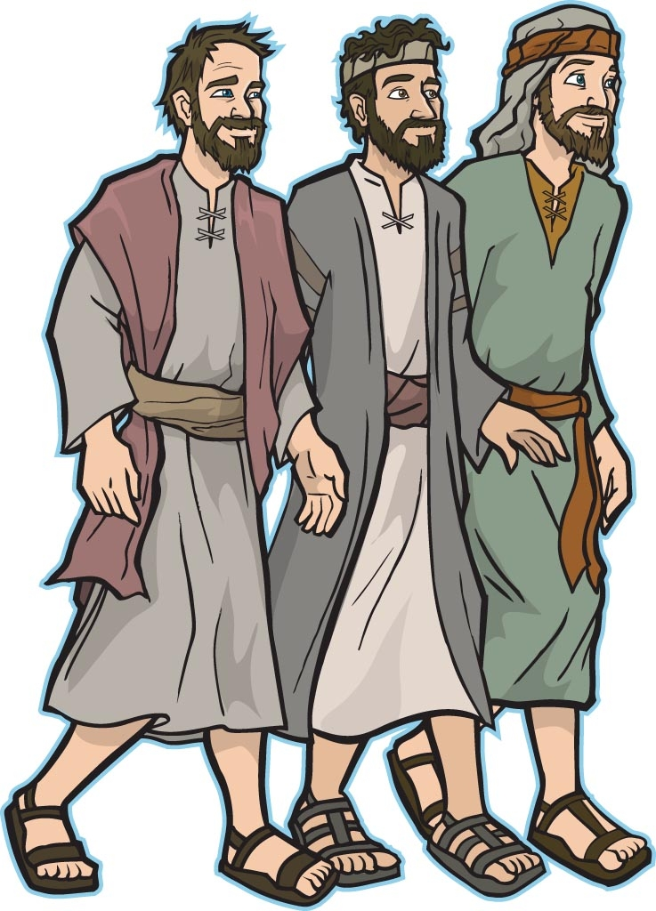
I have a job for you!
Matthew 20:1-16
No one has given us a job.
⁶ About five o’clock the man went to the marketplace again. He saw some other people standing there. He asked them, ‘Why did you stand here all day doing nothing?’
⁷ “They said, ‘No one gave us a job.’
“The man said to them, ‘Then you can go and work in my vineyard.’
Come work for me. I will pay you a fair wage.
This Photo by Unknown Author is licensed under CC BY-NC-ND

Slide 17
Keep working!
Let’s make a grape vine with grapes.
Train your vines by gluing the 4 loose strings along the wire like the 4 pictured branches.
Cut off any extra long string.
Make leaf by bunching a 1 inch square of tissue paper and gluing it to a branch
Make more and more leaves.
Now you can draw and color some bunches of grapes
You’re doing awesome!
God really wants lots of fruit!
He wants lots of people to know and trust Him.
He wants each of us to have the fruit of love, joy, peace, patience, gentleness, self control….

Slide 18

Sing
This Photo by Unknown Author is licensed under CC BY-NC-ND

Slide 19
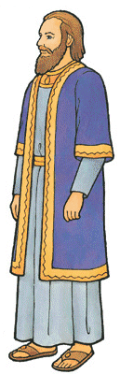
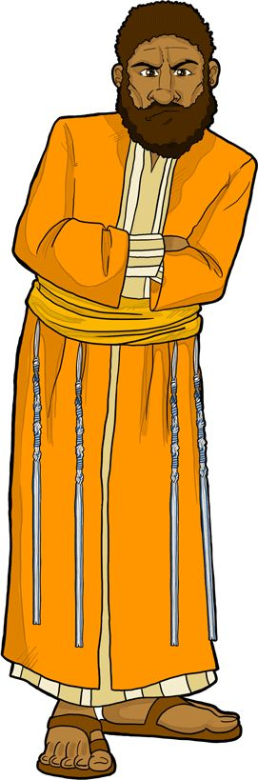
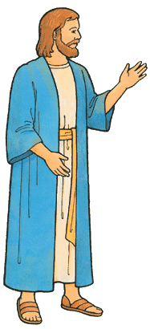
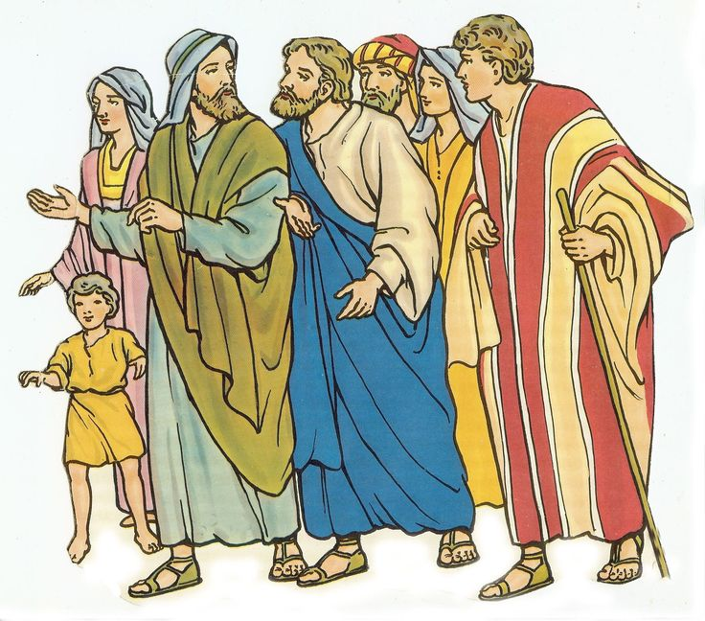
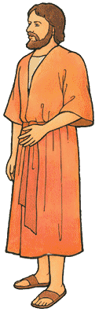
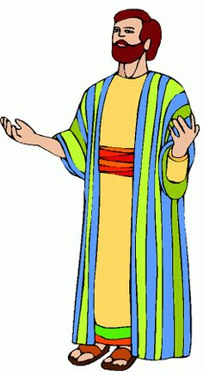
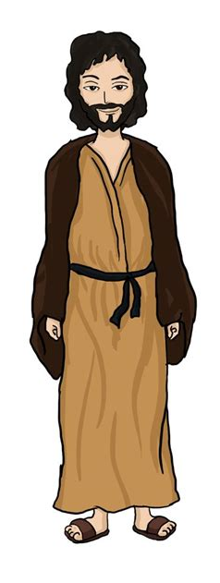
What do you think would be a fair wage for each group?
Remember the first group was promised 1 silver denarius.
Hours worked: | 12 | 11 | 10 | 9 | 8 | 7 | 6 | 5 | 4 | 3 | 2 | 1
This Photo by Unknown Author is licensed under CC BY-NC-ND

Slide 20
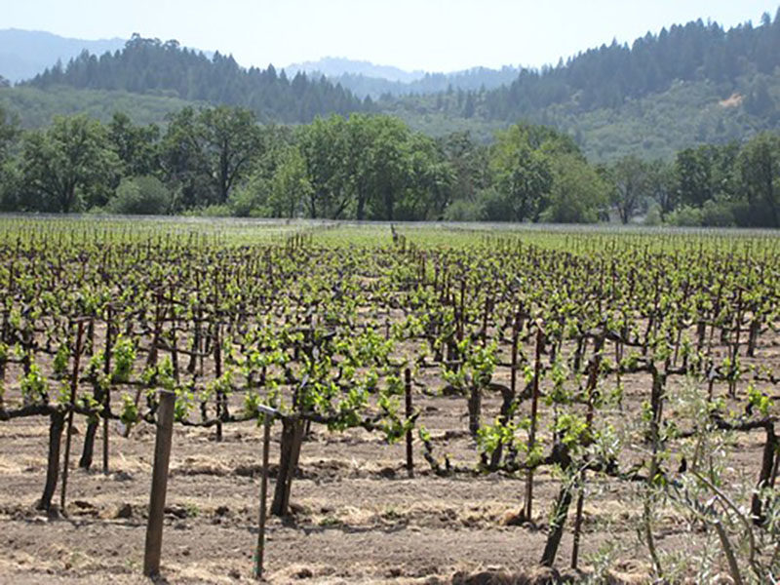
I will pay you
Matthew 20:1-16
The day of work is done.
It’s time to get paid!
Here is a silver coin.
“⁸ “At the end of the day, the owner of the field said to the boss of all the workers, ‘Call the workers and pay them all. Start by paying the last people I hired. Then pay all of them, ending with the ones I hired first.’
⁹ “The workers who were hired at five o’clock came to get their pay. Each worker got one silver coin.
This Photo by Unknown Author is licensed under CC BY-NC-ND

Slide 21
I will pay you
Matthew 20:1-16
Here is your pay.
A silver coin.
But we worked all day in the hot sun! We should get paid more than everyone else!
¹⁰ Then the workers who were hired first came to get their pay. They thought they would be paid more than the others. But each one of them also received one silver coin. ¹¹ When they got their silver coin, they complained to the man who owned the land. ¹² They said, ‘Those people were hired last and worked only one hour. But you paid them the same as us. And we worked hard all day in the hot sun.’
¹³ “But the man who owned the field said to one of them, ‘Friend, I am being fair with you. You agreed to work for one silver coin. Right? ¹⁴ So take your pay and go. I want to give the man who was hired last the same pay I gave you. ¹⁵ I can do what I want with my own money. Why would you be jealous because I am generous?’
¹⁶ “So those who are last now will be first in the future. And those who are first now will be last in the future.”
Are you jealous because I am generous?
See the last will be first.
The first will be last.
Friends. I am being fair with you.
You agreed to work for 1 silver coin. Right? If I want to generously give the others the same wage, that is my choice.
This Photo by Unknown Author is licensed under CC BY-NC-ND

Slide 22
What is important to God?
What’s most important is to get to work when God gives us a job.
God gives us so much more than we deserve!
He does not show favoritism. He is very generous!
There will be a reward!
This Photo by Unknown Author is licensed under CC BY-NC-ND

Slide 23
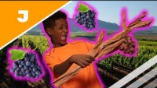
Sing
While we are talking about grapes, Jesus also said:
This Photo by Unknown Author is licensed under CC BY-NC-ND

Slide 24
What is our work?
Our work is to bear fruit.
We bear fruit by
caring for others,
helping people,
sharing God’s love and
helping others to know Jesus.
That takes
Love
Joy
Peace
Patience
Gentleness
Self-control
This Photo by Unknown Author is licensed under CC BY-NC-ND

Slide 25
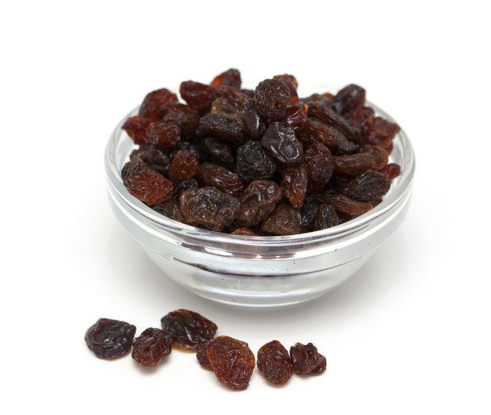

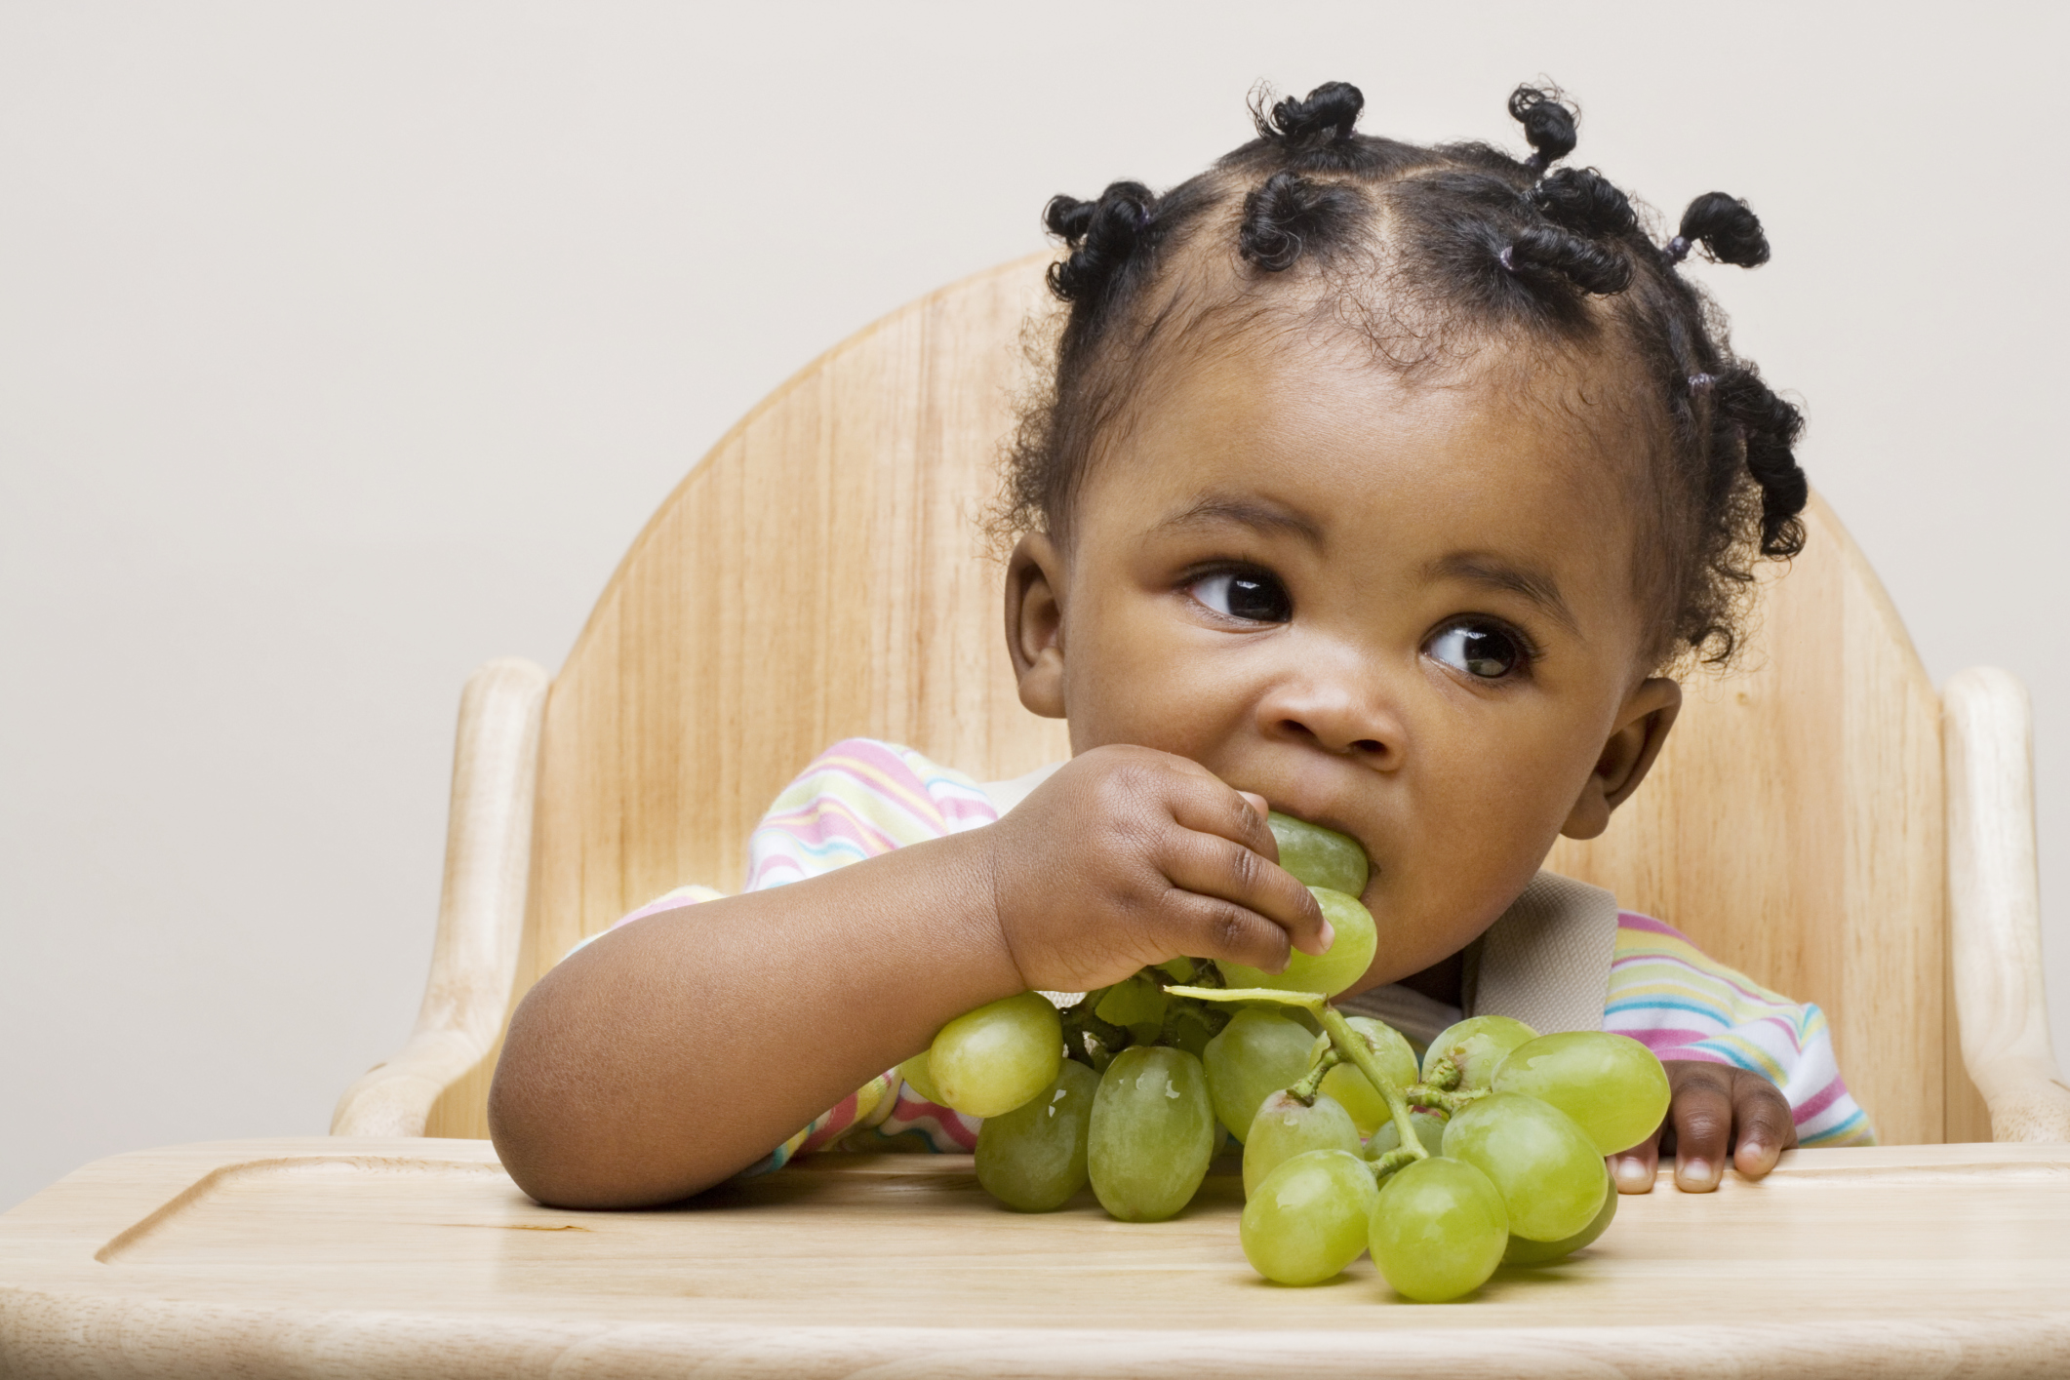
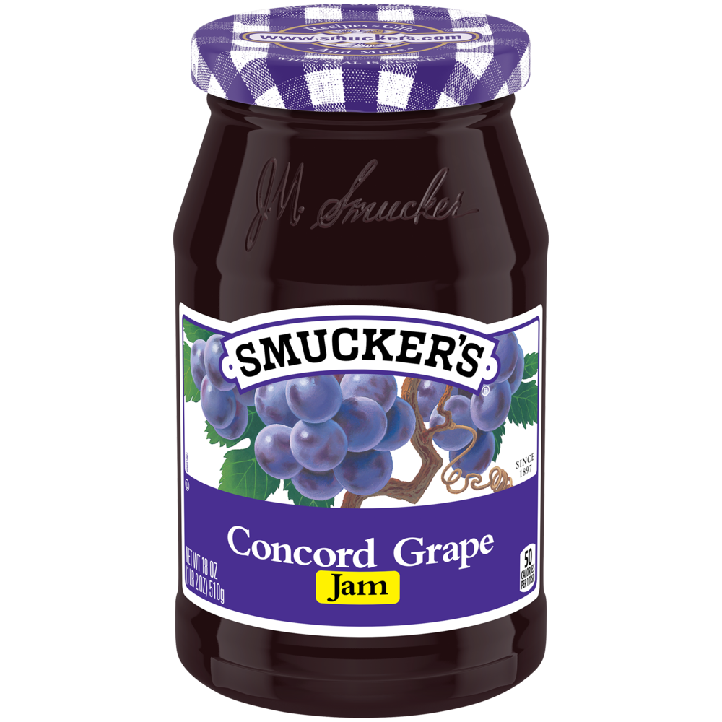
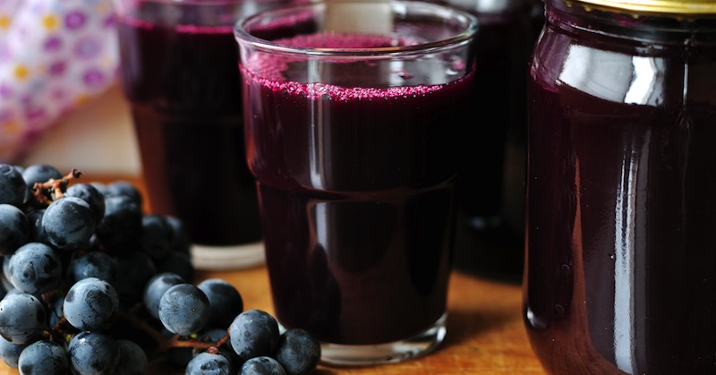

Talking about fruit
How do you eat grapes?
This Photo by Unknown Author is licensed under CC BY-NC-ND

Slide 26
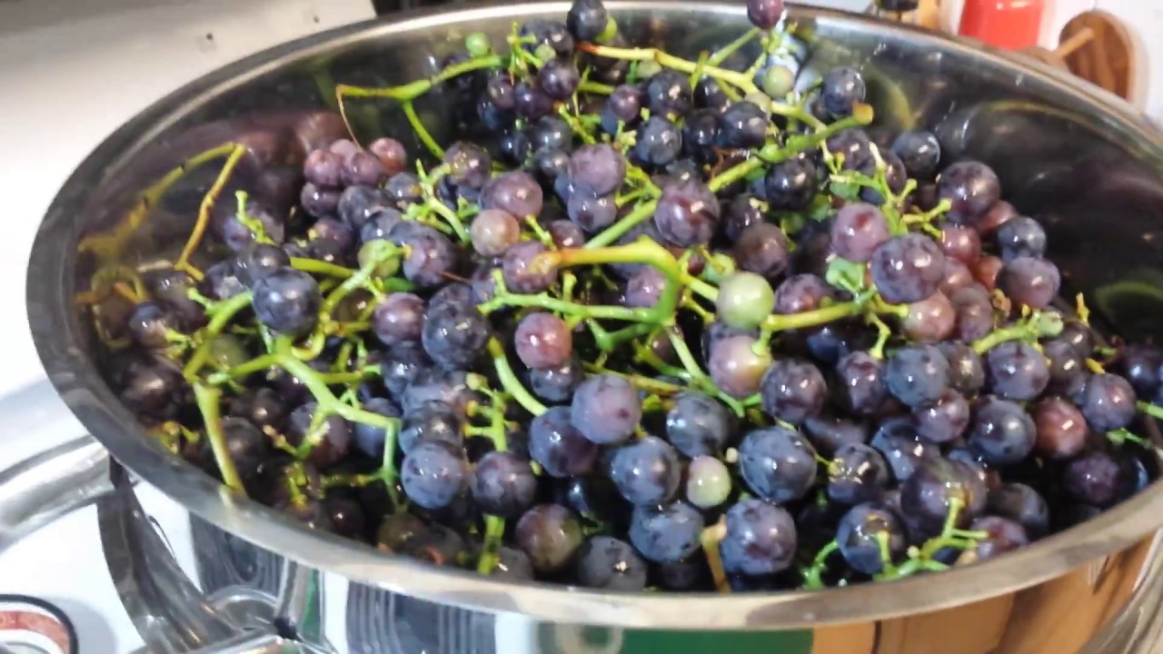
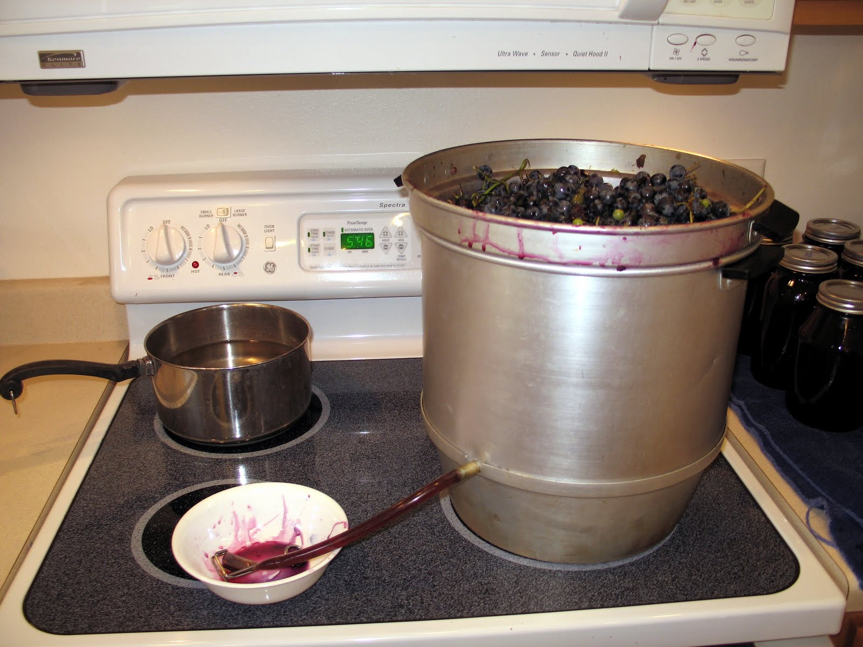
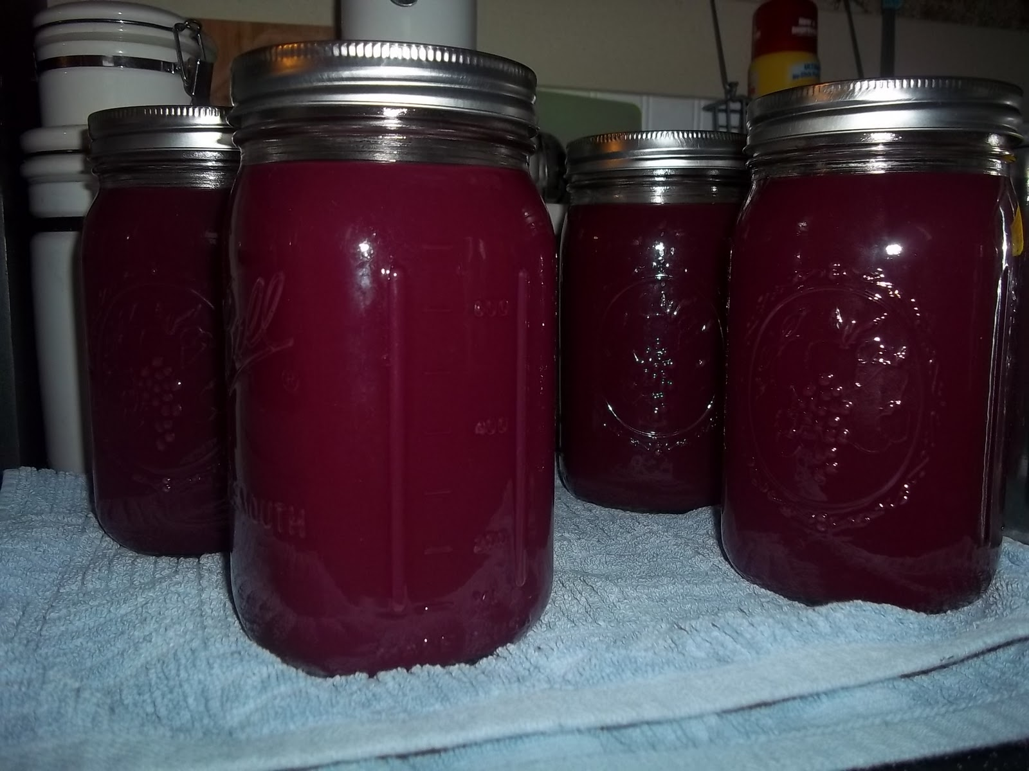
How do you make grape juice?
Wash the grapes
Put them in the top of the canner to cook
Juice will go into the middle section
Open the valve and put the juice in the jars.
Put on the lid
It will seal
Open later and enjoy grape juice!
This Photo by Unknown Author is licensed under CC BY-NC-ND

Slide 27
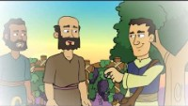
Story
This Photo by Unknown Author is licensed under CC BY-NC-ND

Slide 28
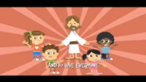
Sing
This Photo by Unknown Author is licensed under CC BY-NC-ND

Slide 29

Notes to the Teacher…..
https://activity-array.com/
This Photo by Unknown Author is licensed under CC BY-NC-ND

Slide 30
Teacher: Craft PREP
Materials:
Handout picture like this one >
4 strands of 8” yarn or twine
About 20 1” square green tissue papers for leaves
Prep:
Staple yarn strands at base of vine
Twist all 4 to bottom line then twist only 2 to top line and staple at the top.

