Slide 1

Lost and Found
Lost Sheep
Lost Coin
Lost Son

Slide 2
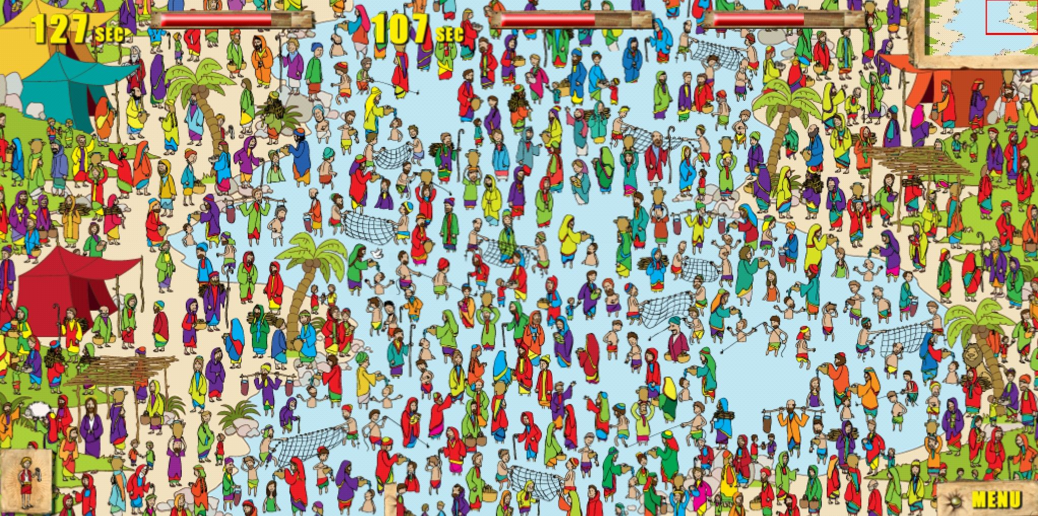
Where’s Jesus?
What else can you find? Name it. See if we can find it.

Slide 3


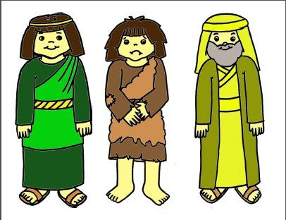
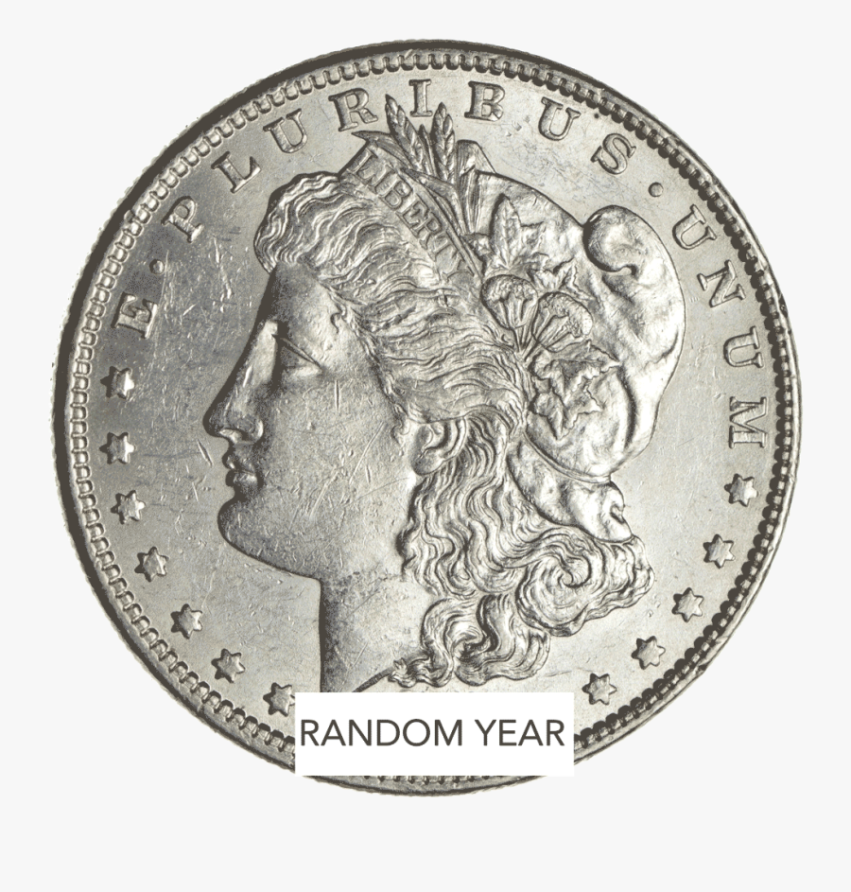
Have you ever lost something?
Lost Sheep
Luke 15:3-7
Lost Son
Luke 15:11-32
Lost Coin
Luke 15:8-10
Were you happy when you found it?
Did you celebrate?

Slide 4
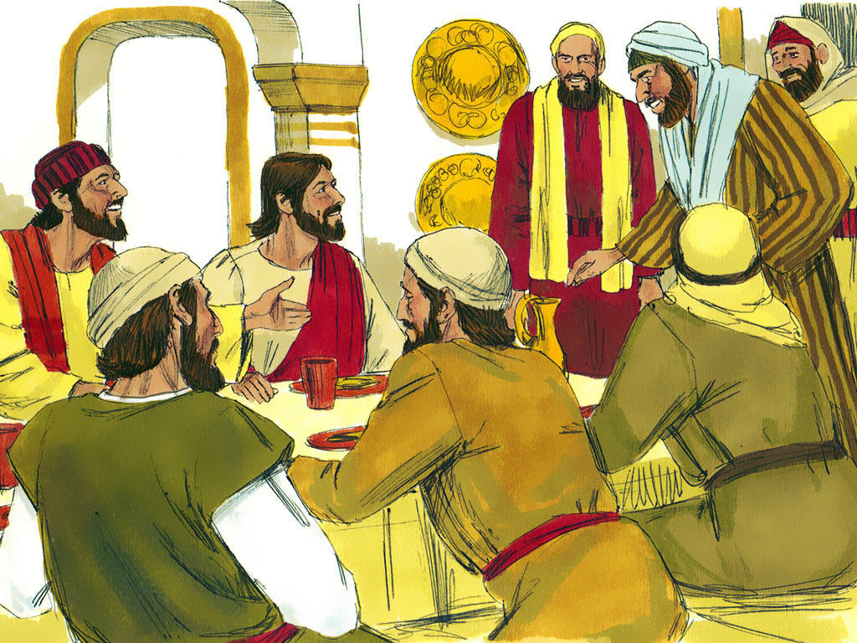
Luke 15
Jesus welcomes sinners
Many tax collectors and “sinners” came to listen to Jesus. ² The Pharisees and the teachers of the law began to complain:
“Look! This man welcomes sinners and even eats with them!”

Slide 5
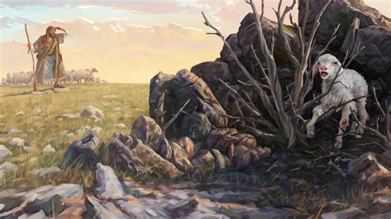
Luke 15:3-4
Lost Sheep
³ Then Jesus told them this story:
⁴ “Suppose one of you has 100 sheep, but you loses 1 of them.
What will you do?
Then you will leave the other 99 sheep alone and go out and look for the lost sheep.
You, the shepherd, will keep on searching for the lost sheep until you finds it.
Choose someone to hide a lamb (or be the lamb and hide).
Others look for it.
DO
IT
everyONE is important!

Slide 6

everyONE is important!
DO
IT
Choose someone to hide a lamb (or be the lamb and hide).
Others look for it.

Slide 7
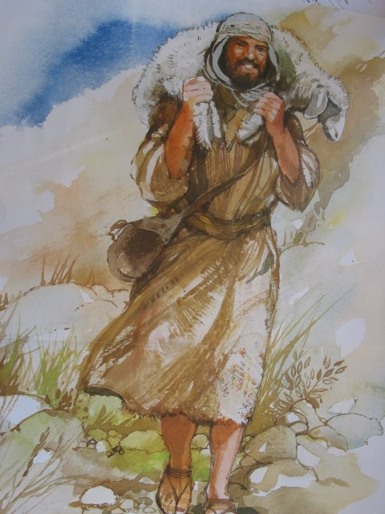
Luke 15
⁵ And when he finds it, the man is very happy.
He puts it on his shoulders ⁶ and goes home.
He calls to his friends and neighbors and says, ‘Be happy with me because I found my lost sheep!’
When you find it. Smile! Be excited!
Bring it back. Tell others to be happy with you!
DO
IT

Slide 8
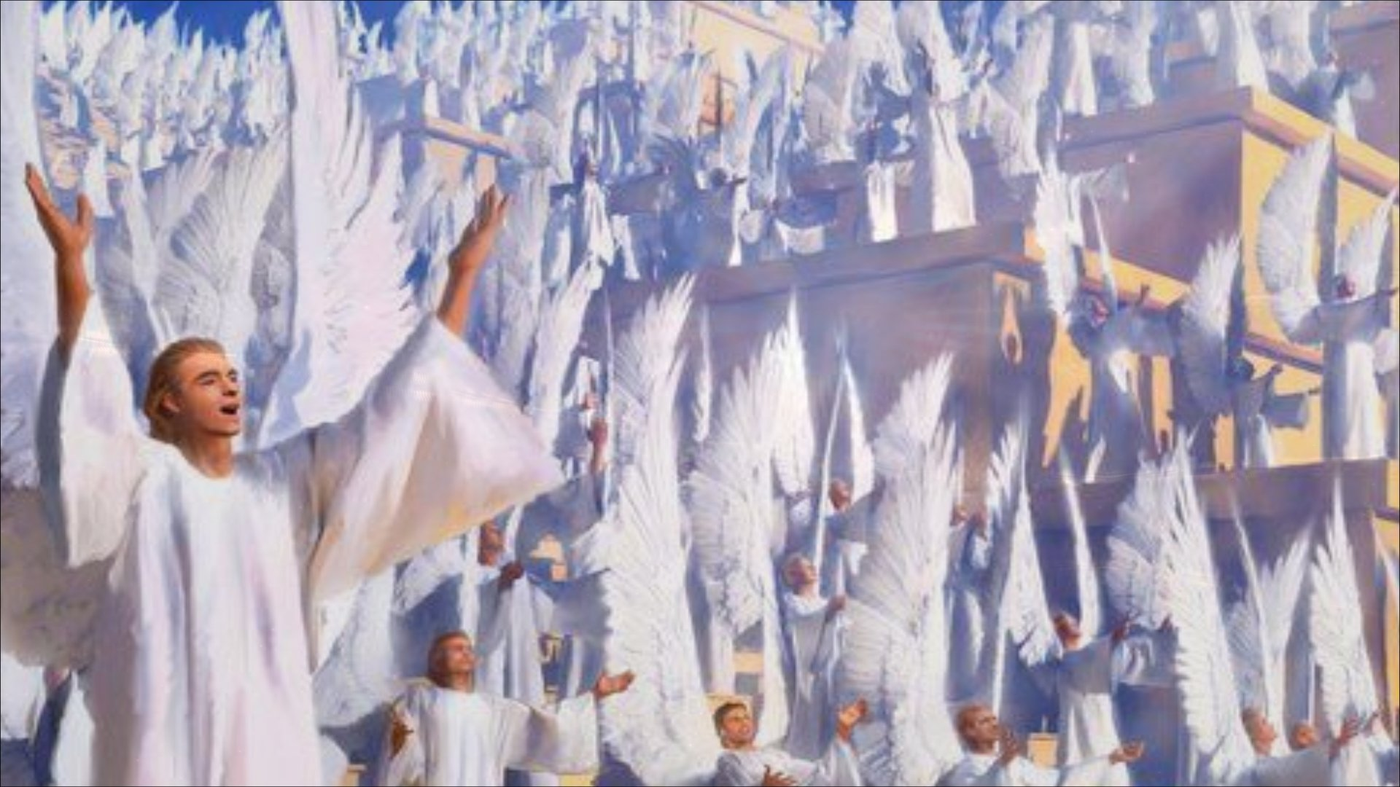
Luke 15:3-4
Lost Sheep
⁷ In the same way, I tell you there is much joy in heaven when 1 sinner changes his heart.
There is more joy for that 1 sinner than there is for 99 good people who don’t need to change.

Slide 9
Luke 15:10
Everyone rejoices
I tell you, it is the same in heaven. There is joy in heaven over one sinner who turns away from sin.”
Be happy! Rejoice! Celebrate! Jump for joy!
Wahoo! The lost is found!
DO
IT

Slide 10
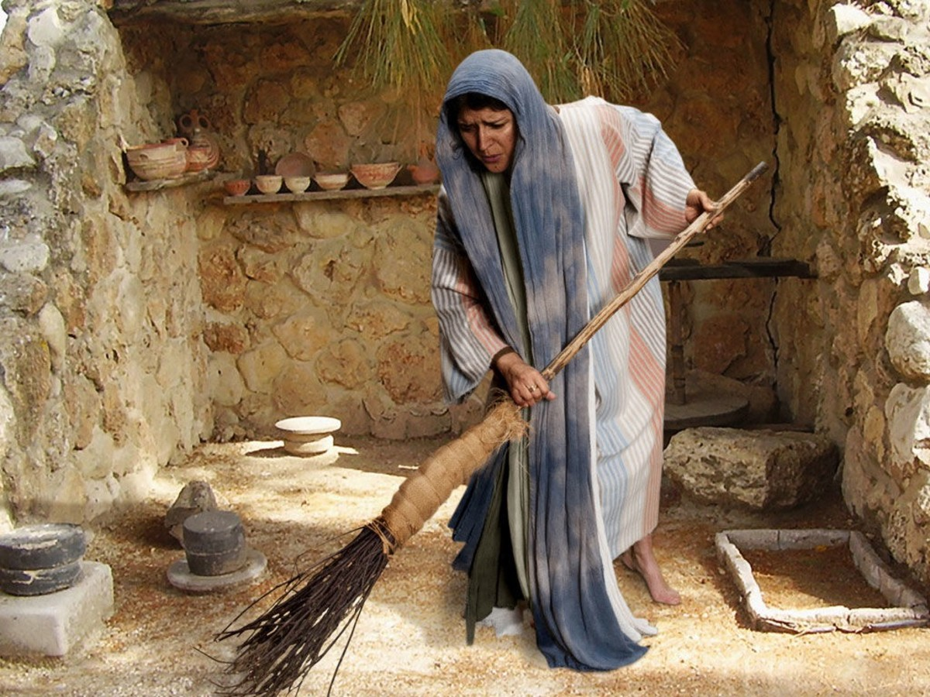
Luke 15
⁸ “Suppose a woman has ten silver coins,^{[a]} but she loses one of them.
She will light a lamp and clean the house. She will look carefully for the coin until she finds it.
Choose 1 person to hide a coin.
Then everyone else look for the coin.
DO
IT

Slide 11
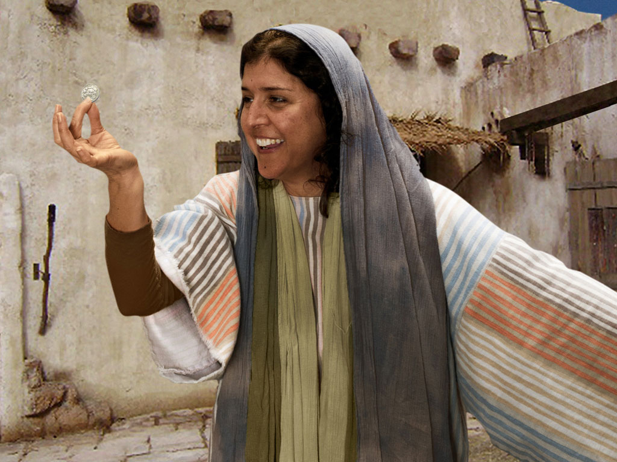
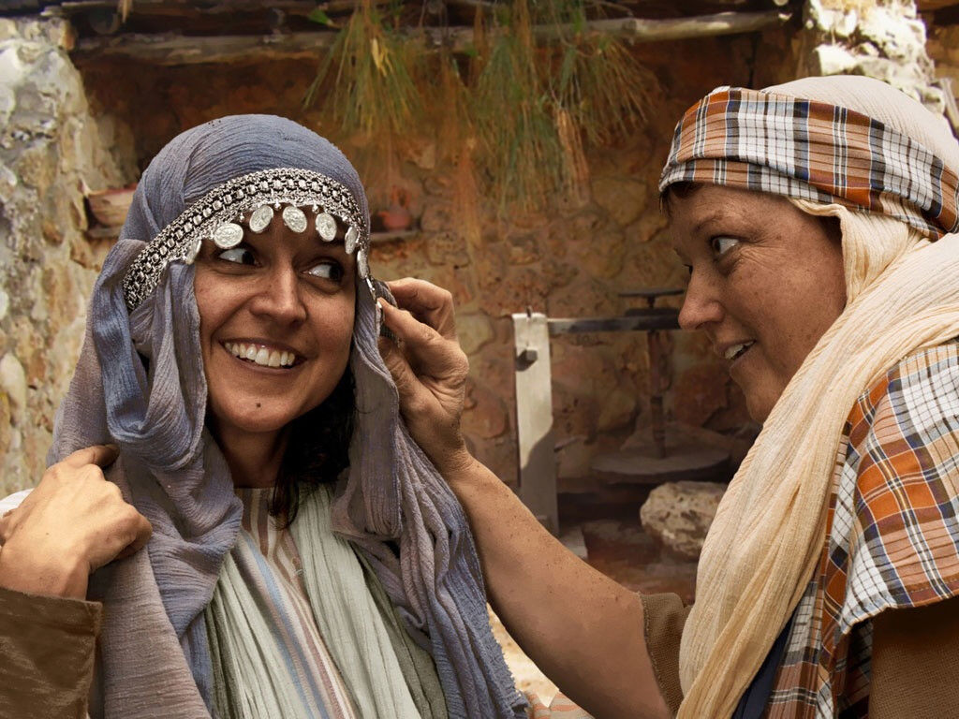
Luke 15
⁹ And when she finds it, she will call her friends and neighbors and say, ‘Be happy with me because I have found the coin that I lost!’
¹⁰ I tell you, it is the same in heaven. There is joy in heaven over one sinner who turns away from sin.”
Be happy! Rejoice! Celebrate! Jump for joy!
Wahoo! The lost is found!
DO
IT

Slide 12
Luke 15:10
Everyone rejoices
I tell you, it is the same in heaven. There is joy in heaven over one sinner who turns away from sin.”
Be happy! Rejoice! Celebrate! Jump for joy!
Wahoo! The lost is found!
DO
IT

Slide 13
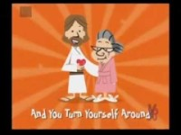
Let’s Celebrate!

Slide 14
Jesus told another story.
God is like this father.
Jesus wants everyone to know
that God definitely welcomes sinners.
He saves them from their sin.
He wants us to know that we
Are God’s children and He loves us!
God is our compassionate Heavenly Father.

Slide 15
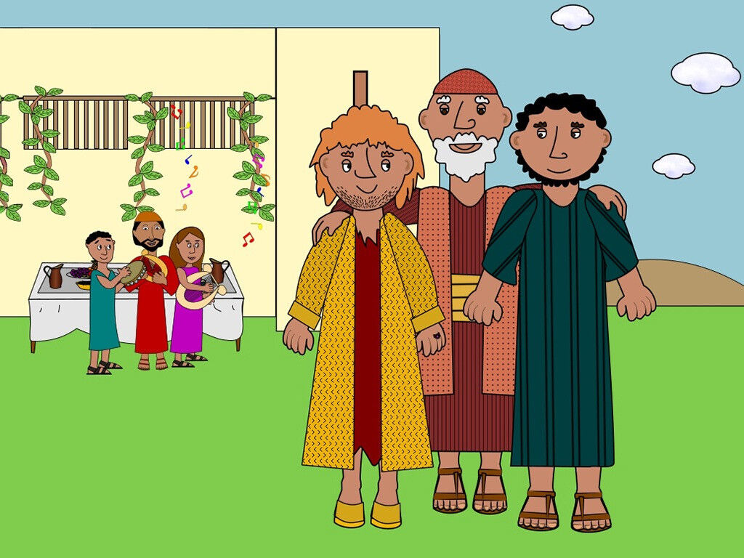
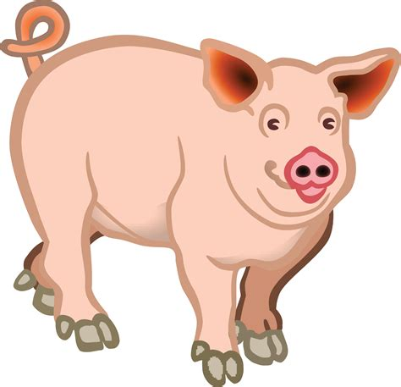
Let’s act out the story.
I’m Father.
I love my children!
I’m the youngest son.
Let’s play!
I’m the oldest son.
Let’s get to work!
Who would you like to be?
Father
Older son
Younger son
Servant
Friend(s)
Pig(s)
Yes sir!
I’m the servant.
We are friends.
Let’s party!
Oink Oink! I’m a hungry pig

Slide 16
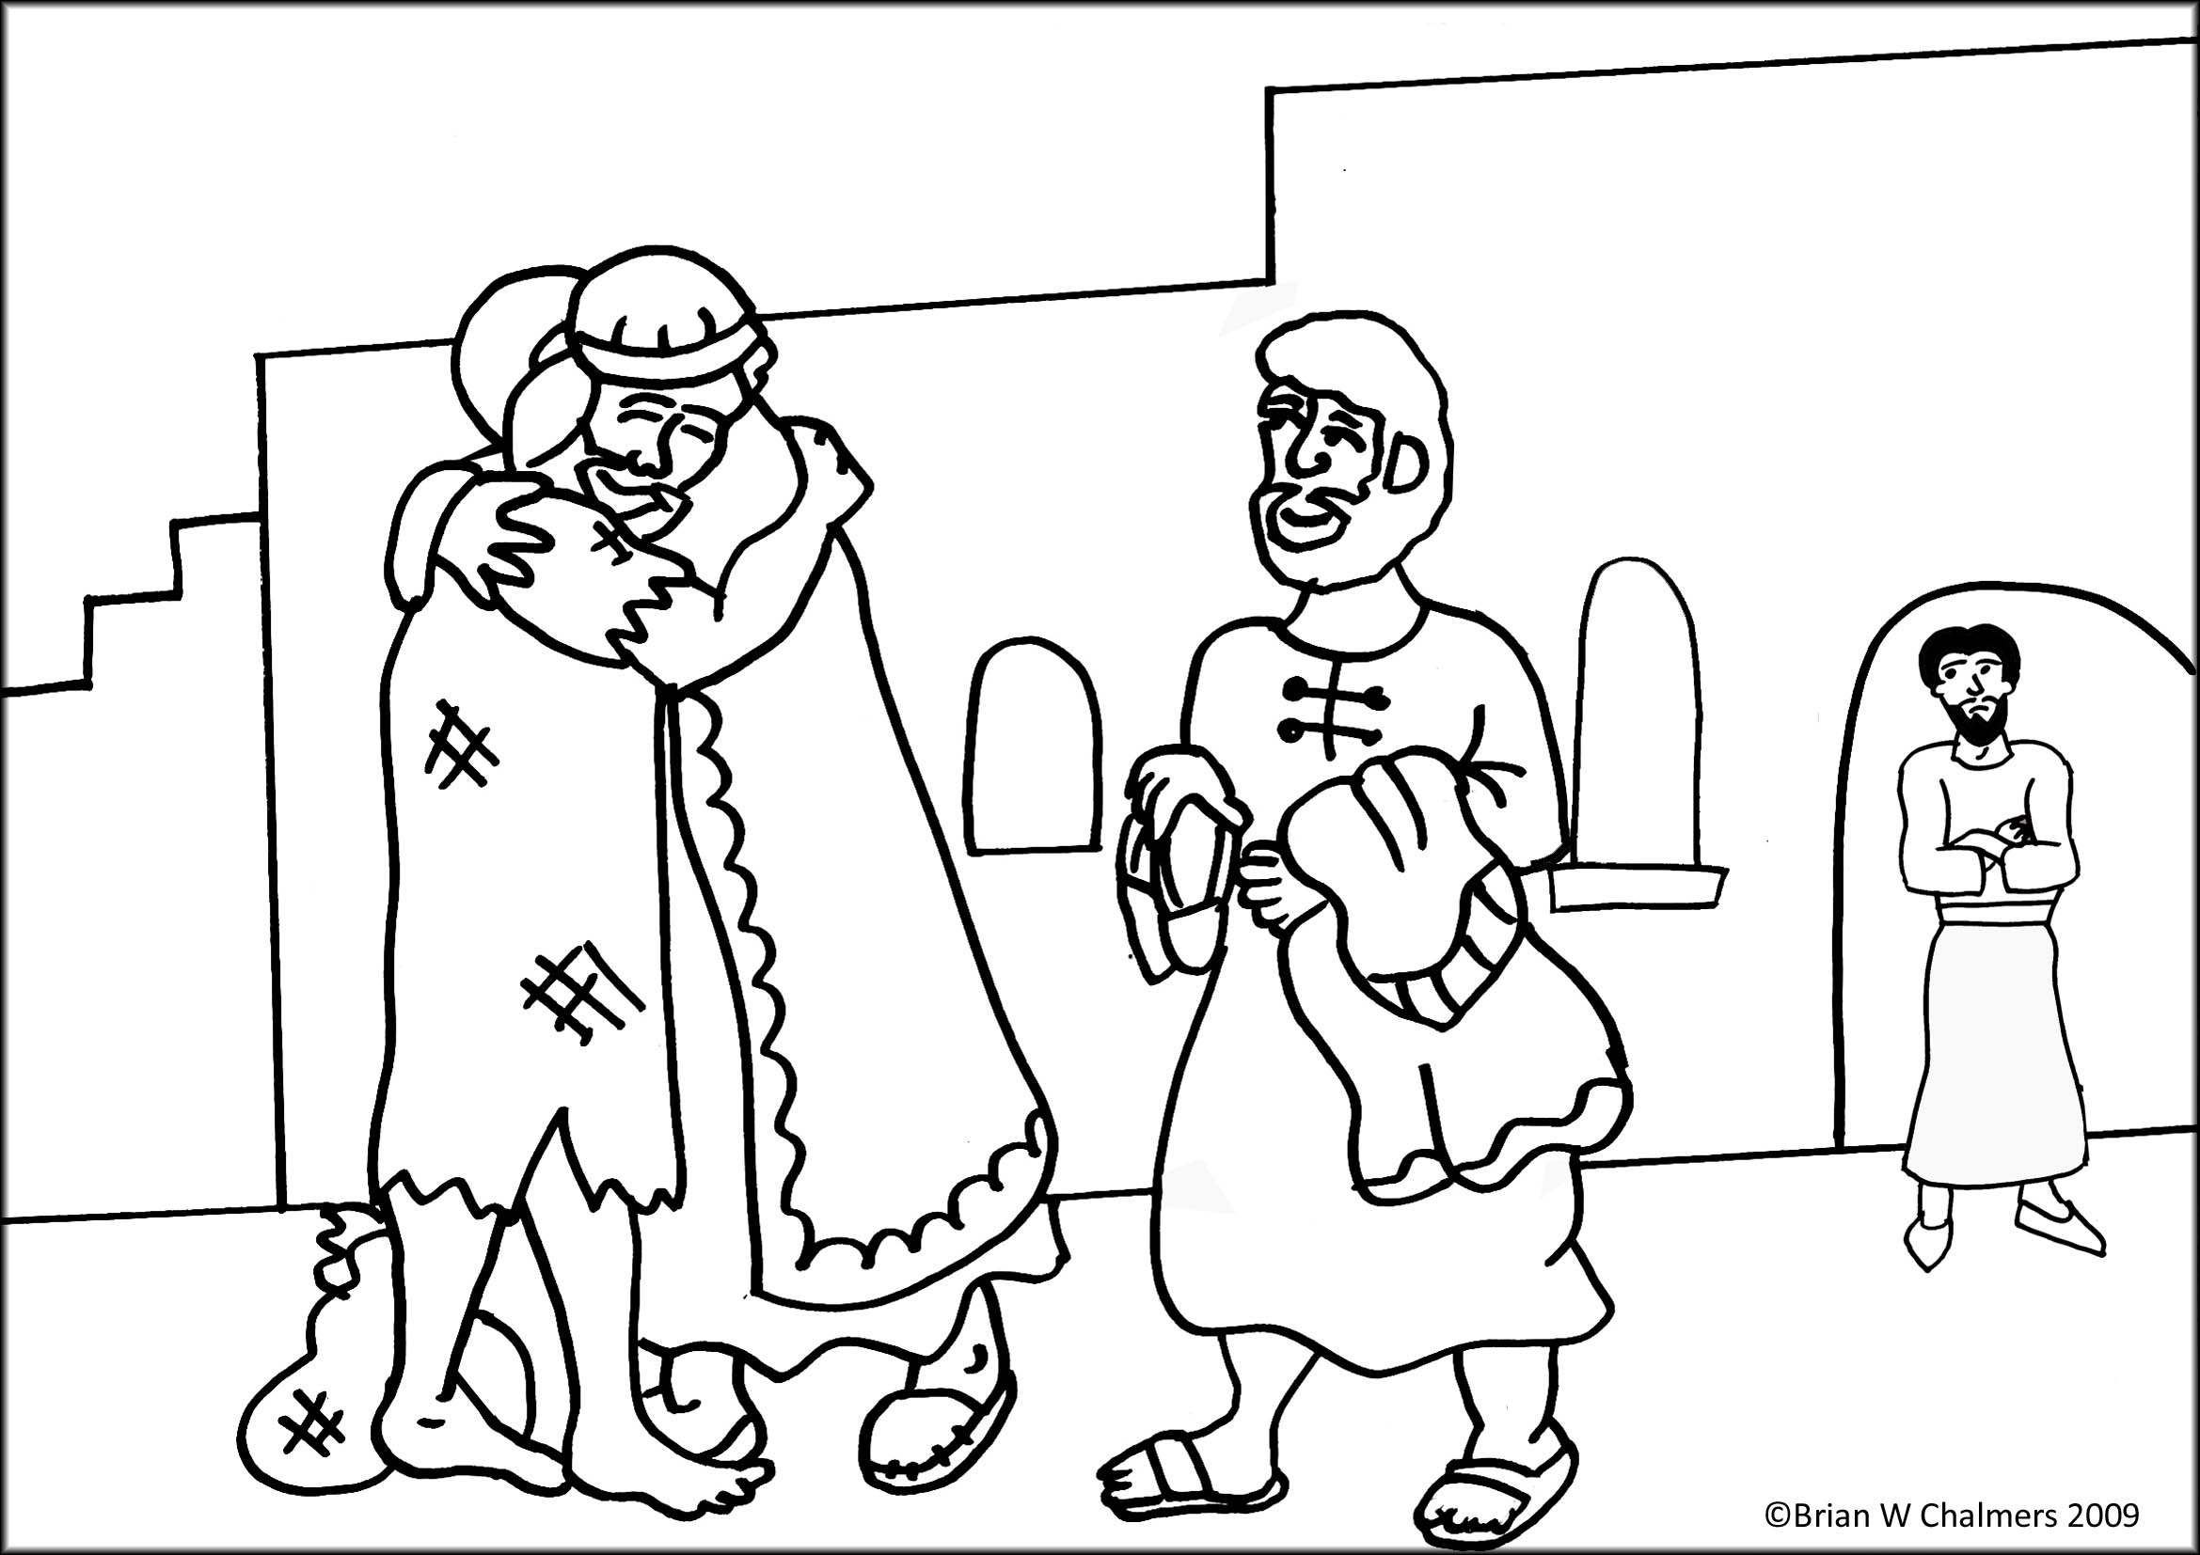
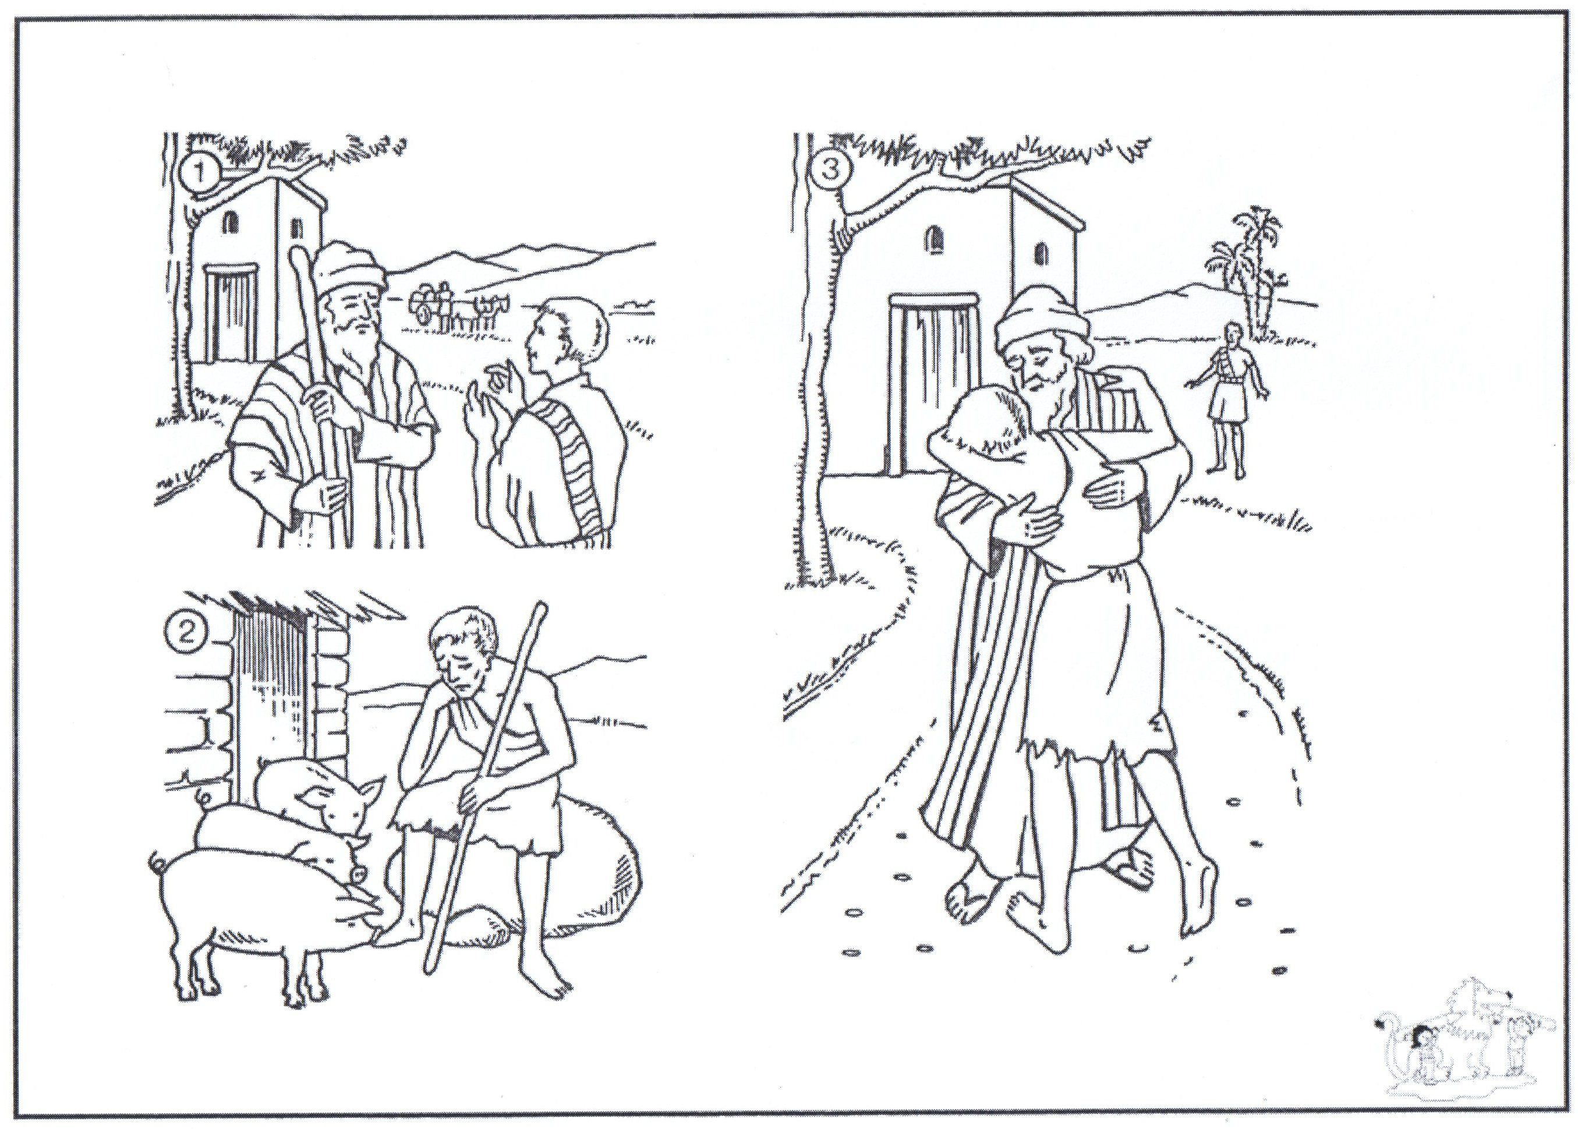
Option 2
You may color while I tell the story of the Lost Prodigal Son.

Slide 17
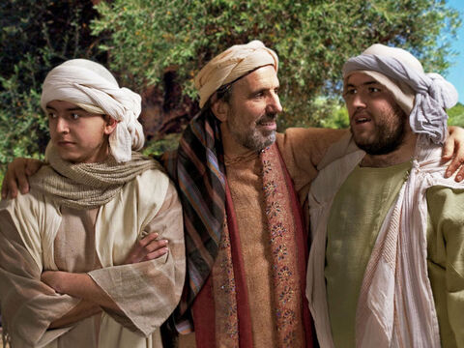
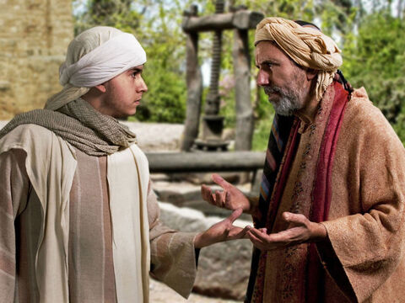
Luke 15:11-32
He could have said.
But he didn’t
I’m Father.
I love my children!
Father,
Give me my share of the property!
Son, I’m not dead yet. Our property is providing for us.
¹¹ Then Jesus said,
“A man had two sons.
¹² The younger son said to his father, ‘Give me my share of the property.’ So the father divided the property between his two sons.
I’m the youngest son.
Let’s play!
I’m the oldest son.
Let’s get to work!
I will divide the property and give you your portion.
God lets us make choices.

Slide 18
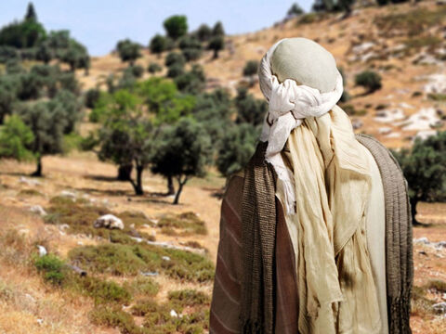




Luke 15
I’m going on an adventure!
No more rules!
I’m tired of working at home!
I’m leaving!
¹³ Then the younger son gathered up all that was his and left.
No more work!
He packed his bags.
  Clothes
  Food
  Your money bag

Slide 19
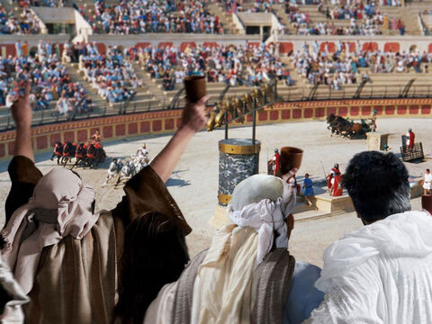
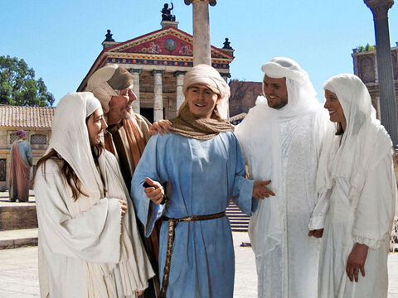
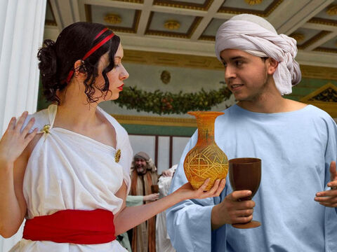
Luke 15
Let’s have fun!
He traveled far away to another country. There he wasted his money in foolish living.
I have money!
Show me what is fun to do.
Gamble foolishly.
Maybe you will win.
I didn’t win.
I lost a lot of money!
Oh well!
Awesome!
Let’s go have fun!
This is the best drink.
(And the most expensive.)
No worries.
I have money to spend!

Slide 20
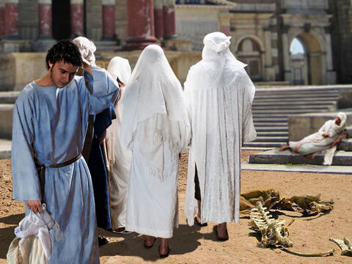

Luke 15
Oh no! My money is GONE!
No way. If your money is gone, we are out of here.
¹⁴ He spent everything that he had.
My money is gone!
Can you buy us some food. Let’s go party!

Slide 21
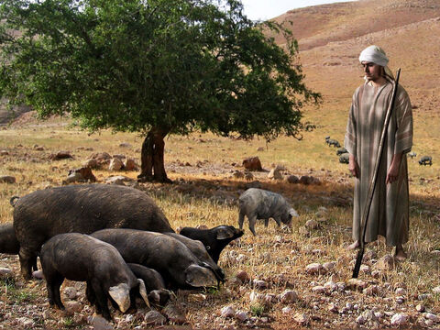
Luke 15
I’m so hungry!
I’m so hungry!
No one has given me food for days!
I would eat the pig food!
Soon after that, the land became very dry, and there was no rain.
There was not enough food to eat anywhere in the country.
The son was hungry and needed money.
¹⁵ So he got a job with one of the citizens there. The man sent the son into the fields to feed pigs.
¹⁶ The son was so hungry that he was willing to eat the food the pigs were eating. But no one gave him anything.
Get away!
You can’t have our food!
Oink Oink!
I’m a hungry pig

Slide 22
This place really stinks!
I’m leaving!
God used this hard time
To help the son stop and think.
Are you calling us stinky?
Oink Oink!

Slide 23
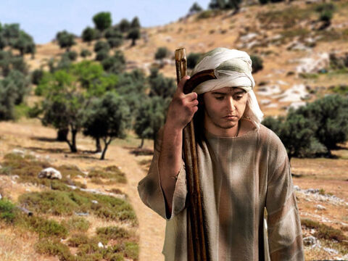
Luke 15
I have been foolish!
I have been very foolish!
¹⁷ The son realized that he had been very foolish.
He thought, ‘All of my father’s servants have plenty of food. But I am here, almost dying with hunger.
¹⁸ I will leave and return to my father.
I’ll say to him: Father, I have sinned against God and against you. ¹⁹ I am not good enough to be called your son. But let me be like one of your servants.’
My father’s servants have plenty of food.
I will serve my Father.

Slide 24
Luke 15
I’ll go home
I’ll say to him: Father, I have sinned against God and against you. ¹⁹ I am not good enough to be called your son. But let me be like one of your servants.’
²⁰ So the son left and went to his father.

Slide 25
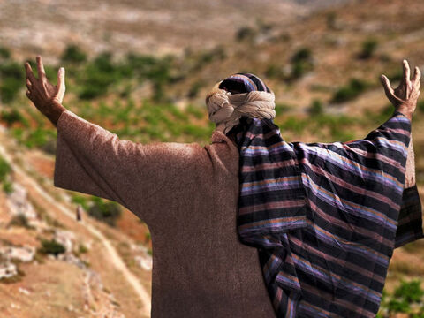
Luke 15
There’s my son!
There’s my son!
He’s coming to me!
“While the son was still a long way off, his father saw him coming. He felt sorry for his son. So the father ran to him, …
This is God’s response
when we decide to come to Him.

Slide 26
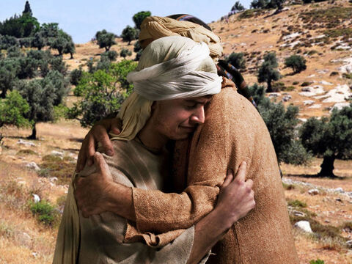
Luke 15
There’s my son!
My son!
I’ve been looking and
watching for you
I’ve missed you so much!
the father ran to him, and hugged and kissed him.

Slide 27
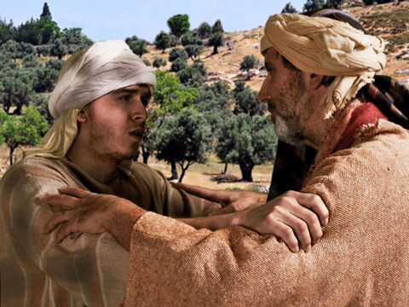
Luke 15
Father I have sinned!
²¹ The son said, ‘Father, I have sinned against God and against you. I am not good enough to be called your son.
²² But the father said to his servants, ‘Hurry!
‘Father,
I have sinned against God and against you.
I am not good enough
to be called your son….
Let me just be your servant.
Servant come here!
Hurry!
Yes sir!

Slide 28
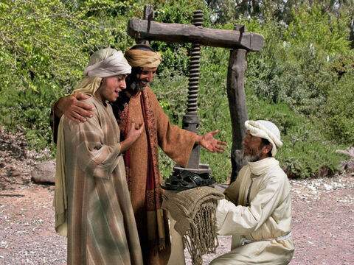
Luke 15
Hurry bring my son the best clothes.
I forgive him
Here is the special robe.
²² But the father said to his servants, ‘Hurry!
Bring the best clothes and put them on him….
God covers us with
His righteousness like a robe.

Slide 29

Luke 15
Here is our family ring.
You are my son!
Put sandals on his feet.
He is not a servant.
Oh Father I’m not worthy.
²² ….
Also, put a ring on his finger and sandals on his feet.
²³ And get our fat calf and kill it. Then we can have a feast and celebrate! ²⁴ My son was dead, but now he is alive again! He was lost, but now he is found!’
And get food ready for a party!
My son was lost
And now is found!
Here are sandals for your tired feet.

Slide 30
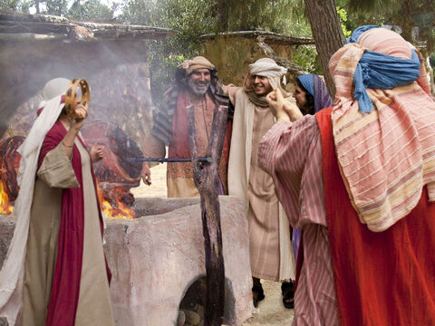




Luke 15
Let’s Party!
I did not expect this from Father!
He really does LOVE me!
I’m glad to be home!
So, they began to celebrate.

Slide 31


Luke 15
Let’s Party!
While the celebrated…..
²⁵ “The older son was in the field. As he came closer to the house, he heard the sound of music and dancing.
Pause Party after song

Slide 32
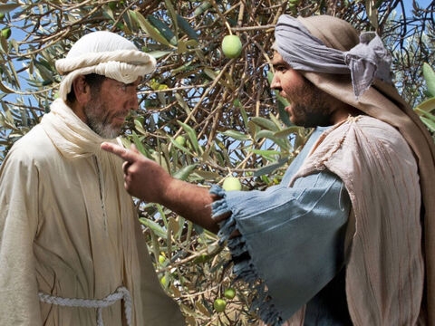
Luke 15
What is going on?
Your brother is home!
Your father is celebrating!
Come! There’s a feast with all the best food!
²⁵ “The older son was in the field.
As he came closer to the house, he heard the sound of music and dancing.
²⁶ So he called to one of the servants and asked, ‘What does all this mean?’
²⁷ The servant said, ‘Your brother has come back. Your father killed the fat calf to eat because your brother came home safely!’ ²⁸ The older son was angry and would not go in to the feast.
What!?!
I’m not going in there!

Slide 33
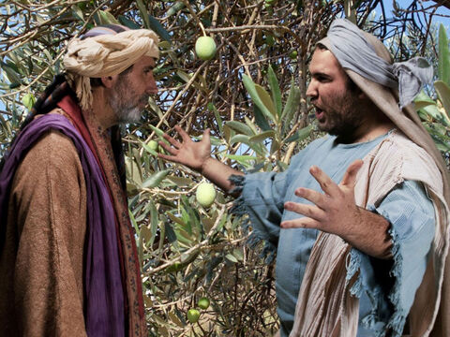
Luke 15
This is not fair!
Please join us.
You are invited!
I’m the oldest son.
I have worked and worked for you!
You never had a party for me!
So his father went out and begged him to come in. ²⁹ The son said to his father, ‘I have served you like a slave for many years! I have always obeyed your commands. But you never even killed a young goat for me to have a feast with my friends. ³⁰ But your other son has wasted all your money on prostitutes. Then he comes home, and you kill the fat calf for him!’ ³¹ The father said to him, ‘Son, you are always with me. All that I have is yours. ³² We had to celebrate and be happy because your brother was dead, but now he is alive. He was lost, but now he is found.’”
Son, all I have is yours.
Your brother was lost and now he is found.
We have to celebrate!
My brother sold half the property, wasted ALL the money
on sinful living, comes begging for mercy and you throw a party!?!

Slide 34
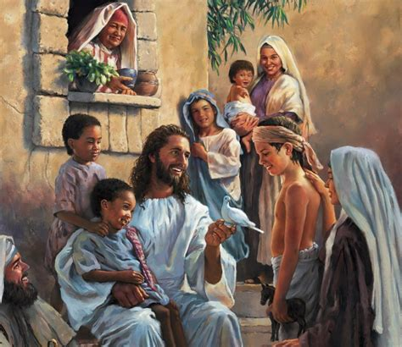
The older brother was working like a slave,
but he was a SON.
The younger brother was willing to be a slave, but he was a SON.
We are God’s children, not His slaves.
We work with Him not for Him to get his love..
He is our Father. He loves us. He guides us.
He wants to be with us.
He helps us! He forgives us!
His rules are there to protect us.
He gives us all that we need.
He wants us to have fun!

Slide 35
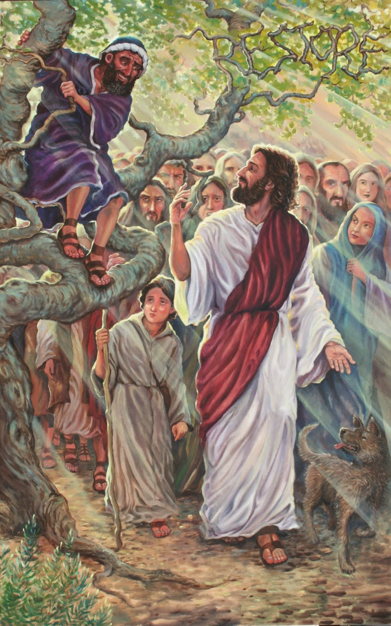
REMEMBER
Jesus said,
“’For the Son of Man came to
seek and to save the lost.’”
Luke 19:20
Can you find the lost sheep, coin, & boy in the picture?

Slide 36
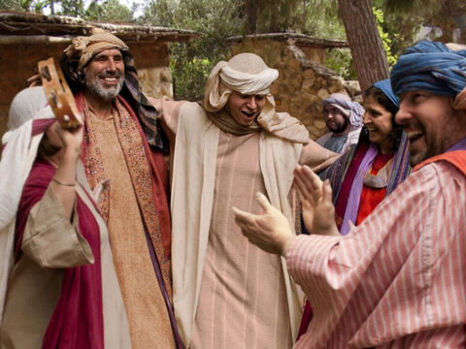
Come!
Let’s celebrate!
I tell you, it is the same in heaven. There is joy in heaven over one sinner who turns away from sin.”
Luke 15:10

Slide 37
Luke 15
Let’s Party!
Continue to celebrate!

Slide 38

SING I’ve Got the Joy Joy Joy Down in my Heart

Slide 39


SING

Slide 40

https://activity-array.com/

