Slide 1
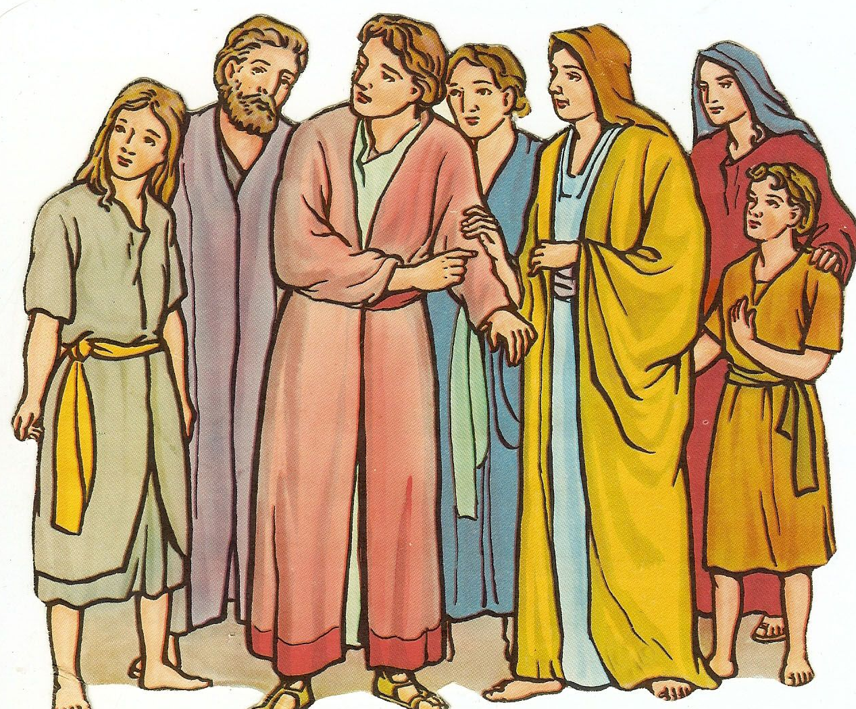
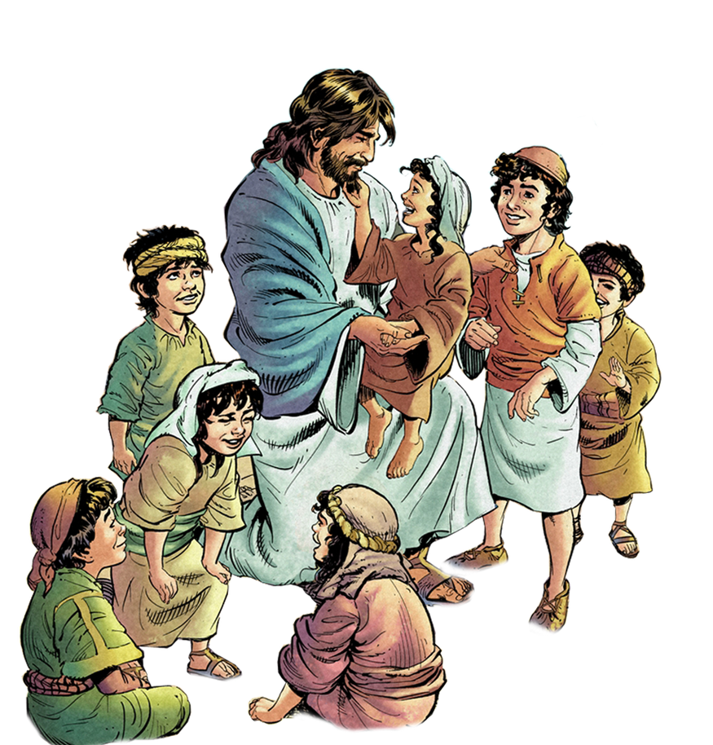
The Golden Rule
Generosity
Judge Not
Jesus teaches on the mountain
Parts of
Matthew 6-8

Slide 2
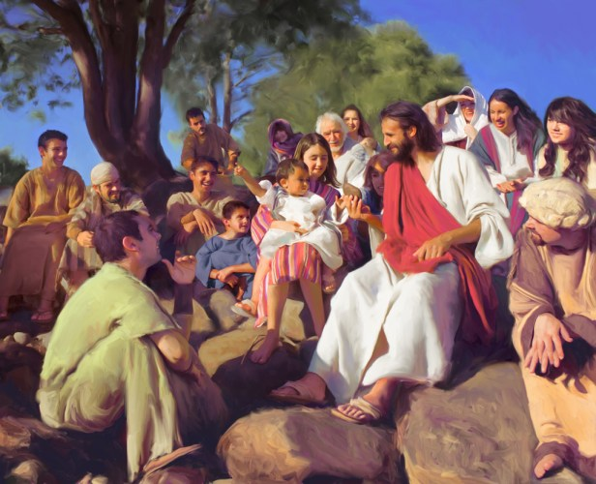
Jesus sat down and taught the people
Jesus wanted everyone to know more about
how much God loves us
and how He expects his children to act.

Slide 3


God’s love
God loves you so much!
He is generous and kind!
He will take care of you.
You can trust Him.
You can cut out some little hearts.
God wants you to love others
like He loves you.

Slide 4
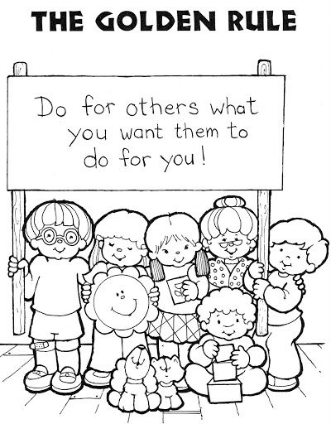
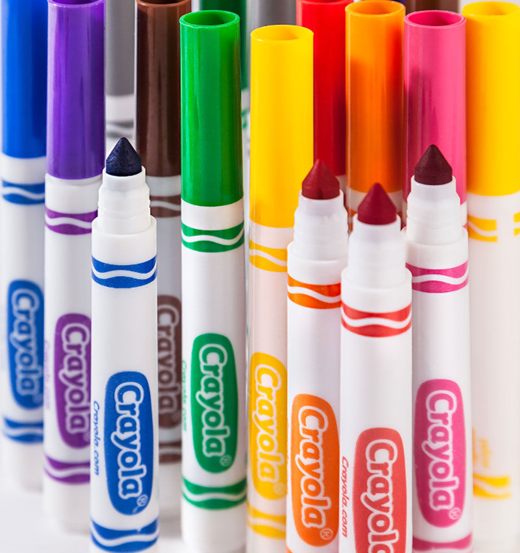
The Golden Rule
^{Matthew 7:12} In everything,
do to others
what you would want them
to do to you.
This is what is written in the law and in the prophets.

Slide 5
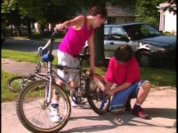

Slide 6
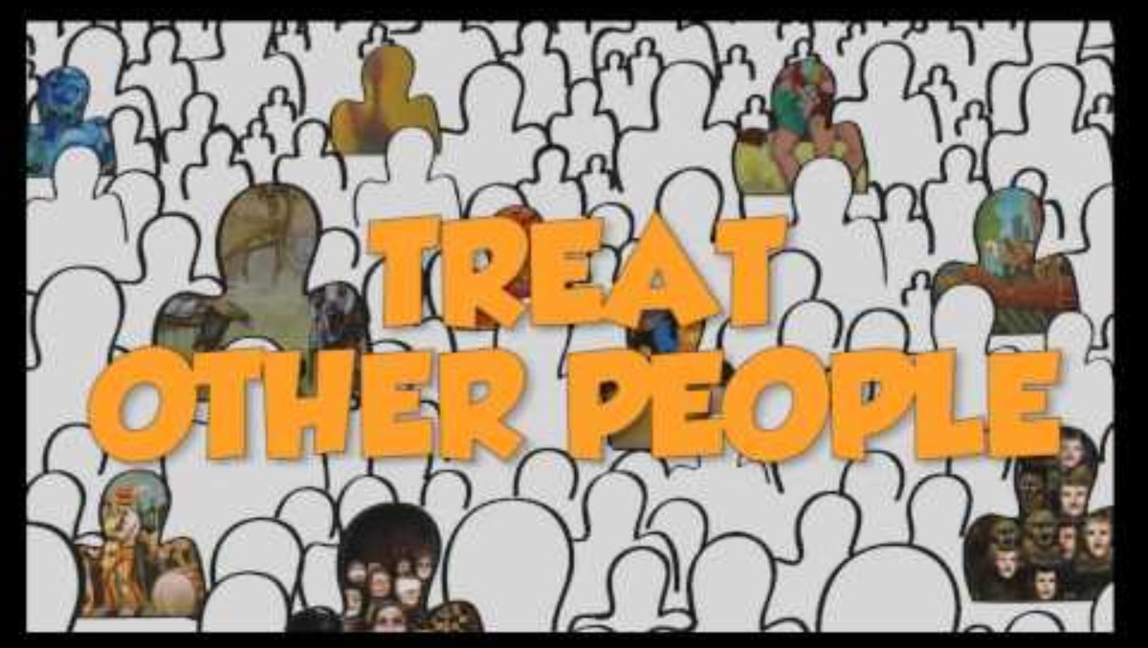

Slide 7

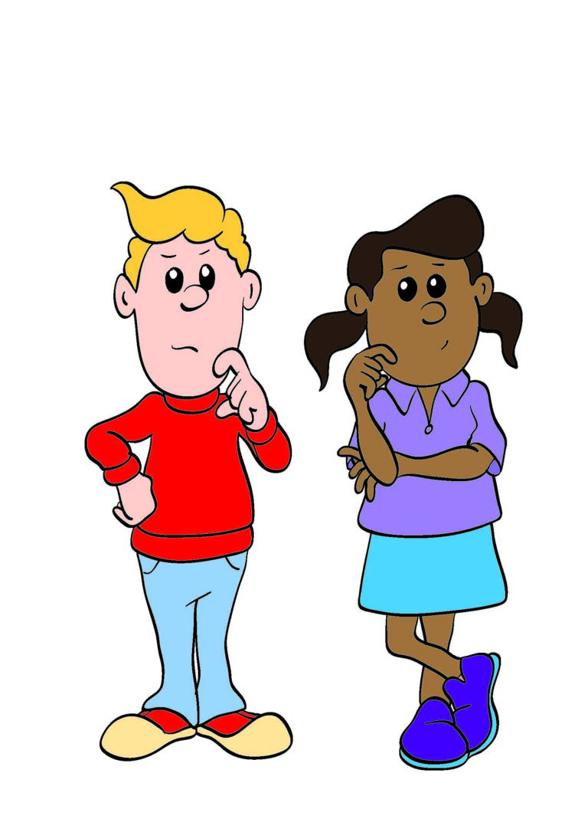

Shall I
demand to be first
Or
let you go first?
How would you like to be treated?

Slide 8
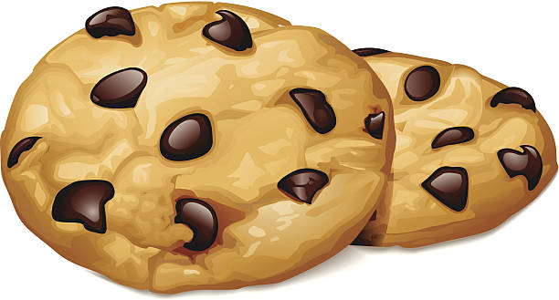
Shall I
give or take
the biggest treat?
How would you like to be treated?

Slide 9
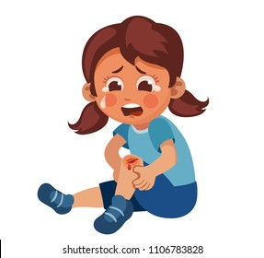
Shall I
Ignore her
Or
Comfort her?
How would you like to be treated?

Slide 10
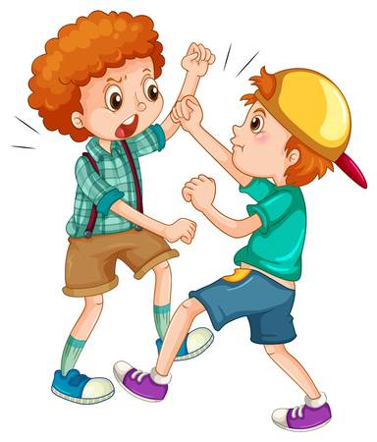
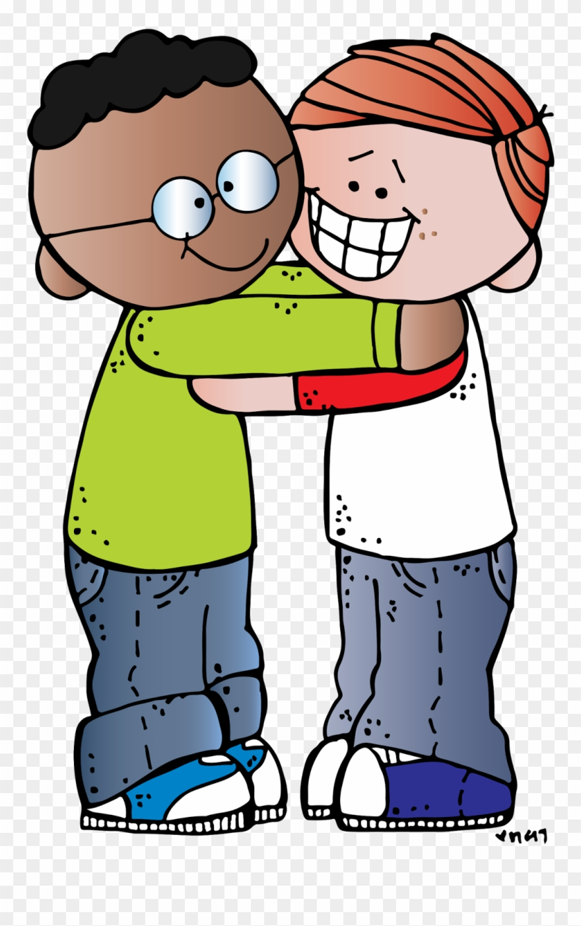
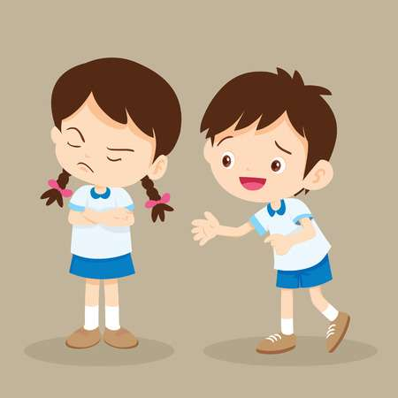
You were mean. Shall I
ignore you, fight back, or forgive you and be kind?
How would you like to be treated?

Slide 11
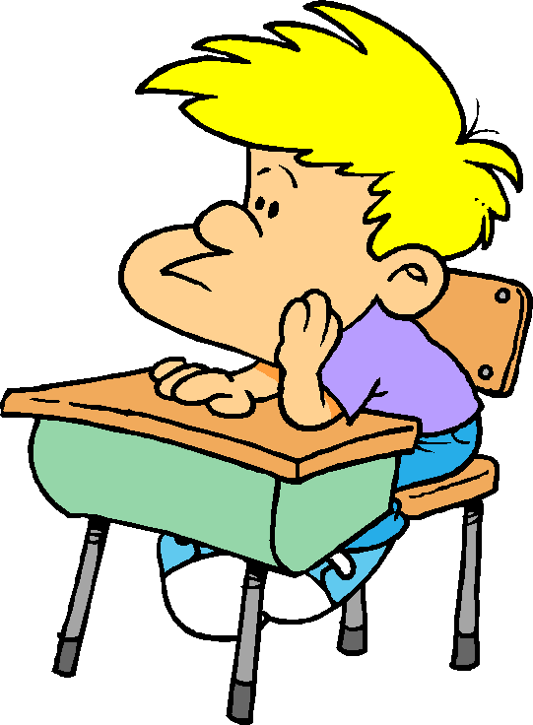
He doesn’t understand. Shall I
call him stupid
Or
go help him?
How would you like to be treated?

Slide 12

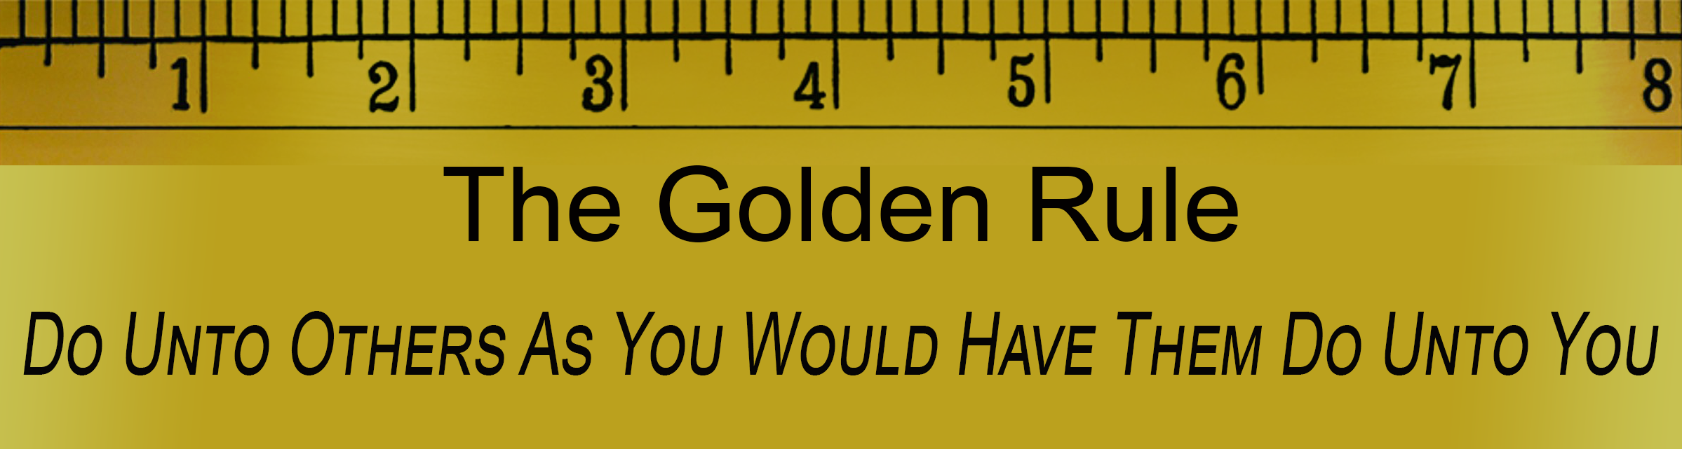
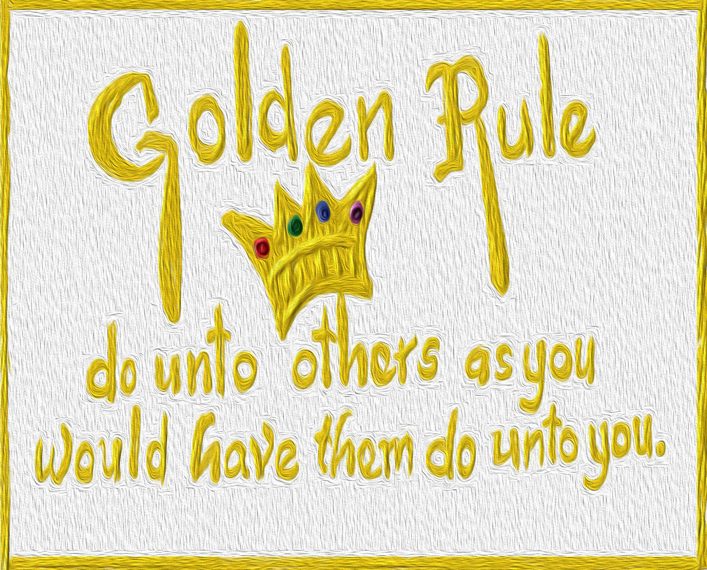
Love one another as Jesus loves you

Slide 13
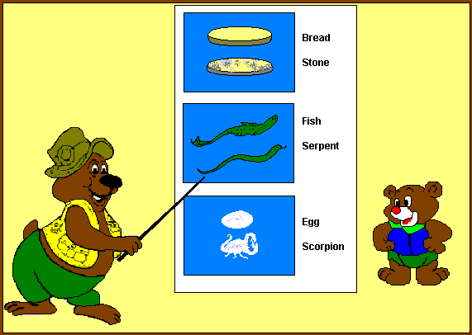
God is generous and gives great gifts
– will you be generous?
⁹ “Suppose your son asks for bread. Which of you will give him a stone?
¹⁰ or suppose he asks for a fish. Which of you will give him a snake?
¹¹ Even though you are evil, you know how to give good gifts to your children.
How much more will your father who is in heaven give good gifts to those who ask him!
Which one would you like?

Slide 14
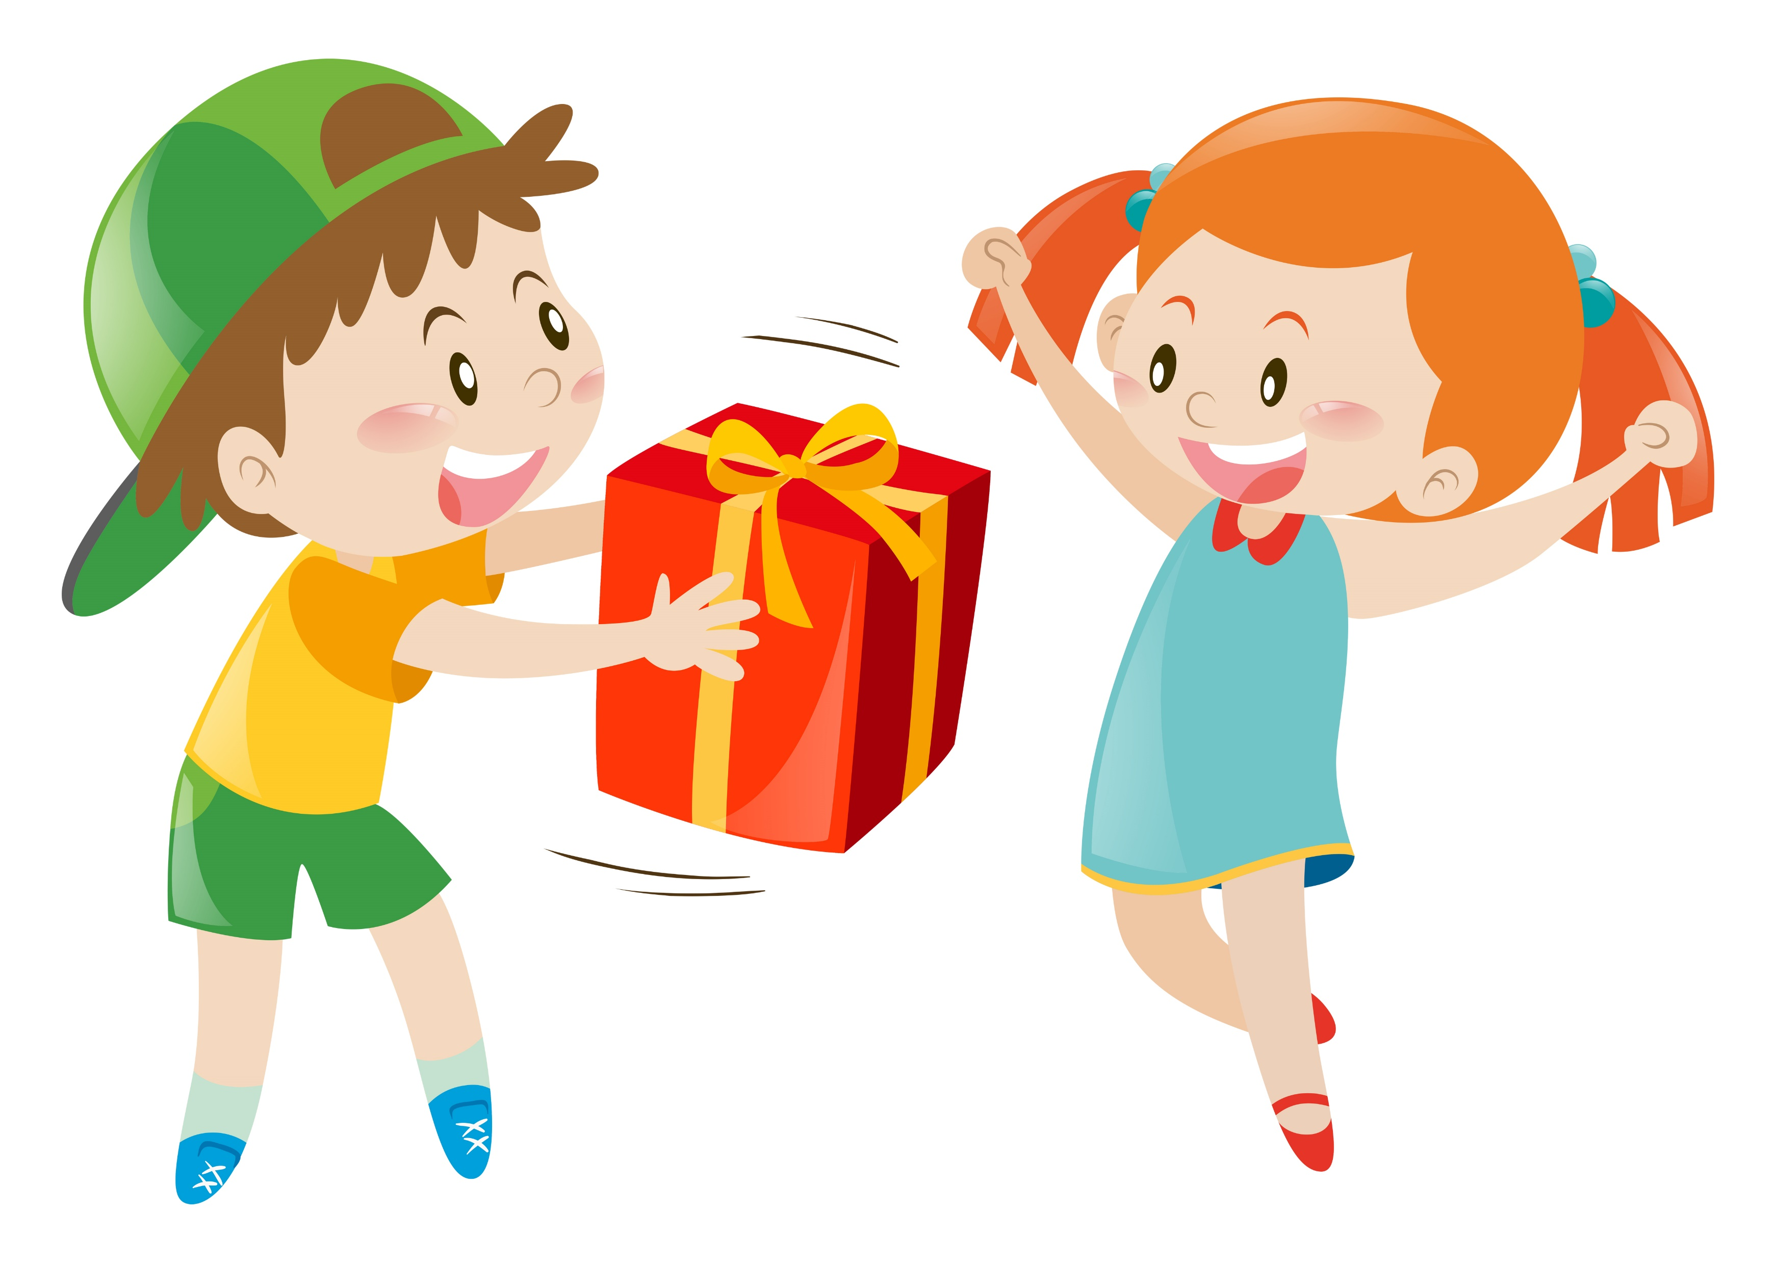
Give a gift or a snack

Slide 15


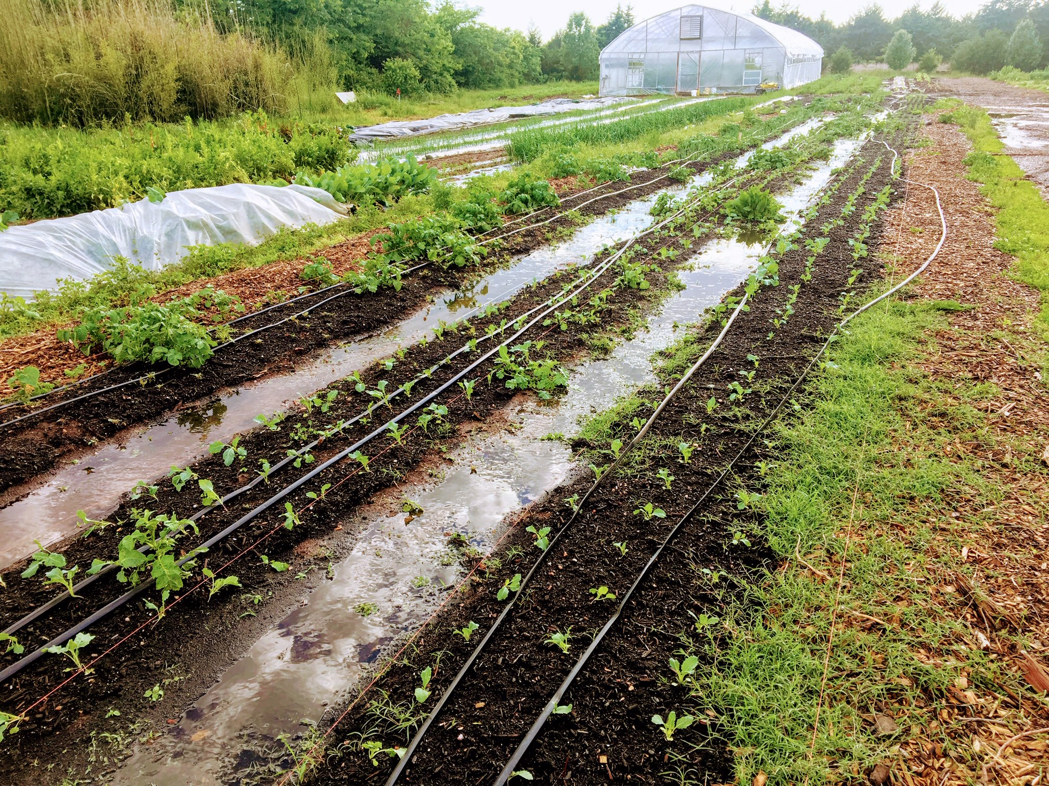
God gives good gifts to good and bad people
You’ve heard others say,
“love your neighbor
and hate your enemy.
That’s not God’s way.
God sends rain and sunshine to everyone so everyone can have food.

Slide 16
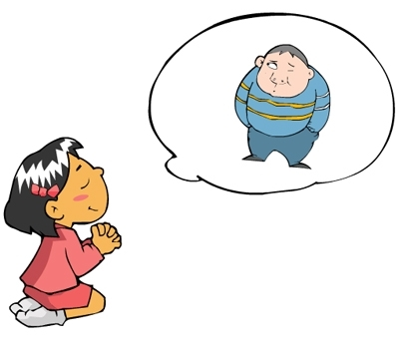
Pray for those who hurt you – Jesus prays for you
God loves everyone.
He is willing to help and save each one!
So, you should
Love your enemies.
Pray for those who hurt you.
Be kind to everyone.
That is what I do.

Slide 17
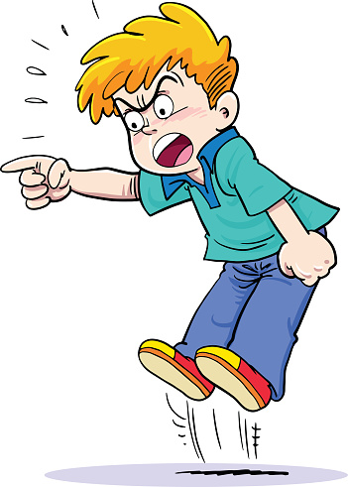
God is kind to everyone – You should be too
You have heard it said,
“Do not murder”
If you do, you’ll be judged in court
But I tell you,
Anyone who is angry with a brother or sister may be judged.
Scorning or despising someone or saying, “you fool!”
is also a sin and brings death.
(Matthew 5:21-22)
For this is the way the devil acts.
He scorns and despises God, His rules, and His creation.
He brings death and destruction.
Do not be like him.
Choose God’s way of love and compassion.

Slide 18
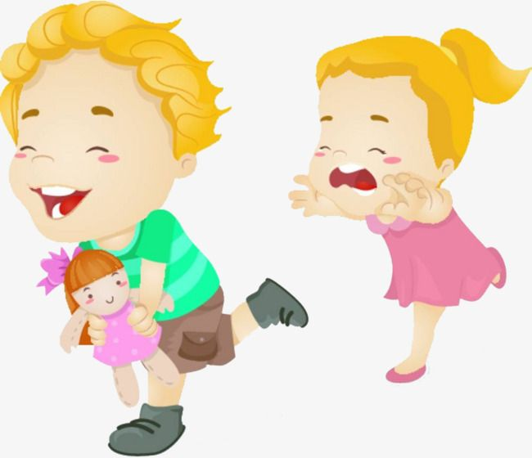
Matthew 5:38-48
You have heard some say
“eye for eye, tooth for tooth”
But I say,
Do not resist them.
If someone strikes you,
Offer them the other cheek.
Hey it’s OK
You can have that doll. I’ll get my other one and we can play together.
Mommy!
Wow!
That would be hard!

Slide 19
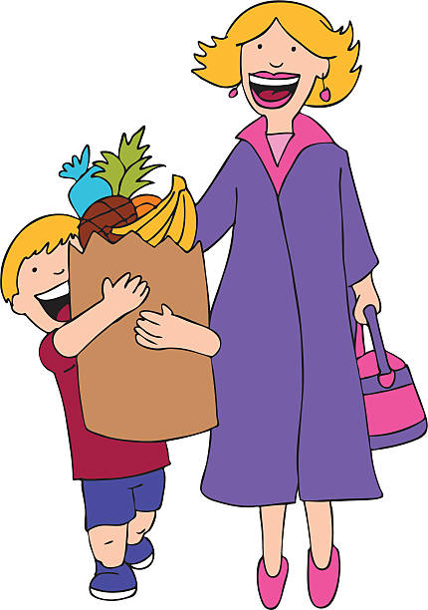
Matthew 5:38-48
If someone sues you
or takes your shirt,
give him your coat too.
If someone forces you
to carry something a mile,
carry it 2 miles.
Give to the one who asks.
Just like Your Father does.
I’m happy to help you!

Slide 20


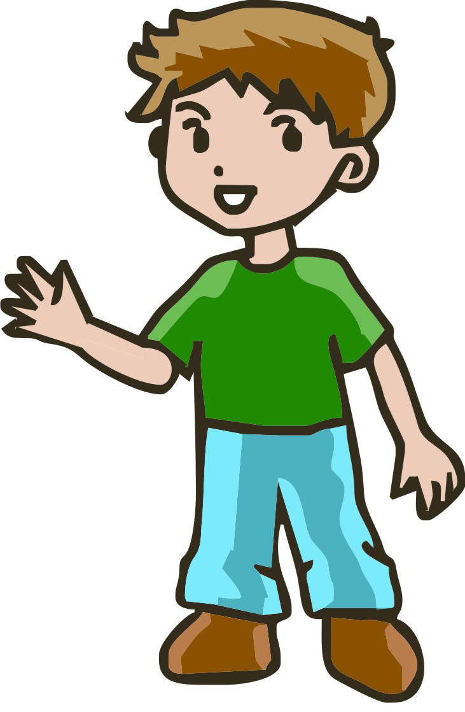
Being kind can make a friend. A friend is no longer an enemy.
Sure!
You can have my bat, too.
Umm.
That’s very generous.
We could play ball together.
Hey! Give me your mitt!

Slide 21
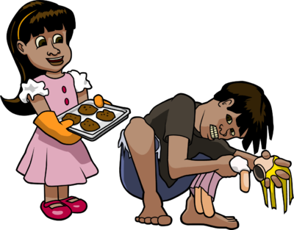
Being kind can make a friend. A friend is no longer an enemy.
That wasn’t nice.
But I forgive you.
Ha ha ha
I broke your doll.
Serves you right
Umm.
I made some cookies.
Would you like one?

Slide 22
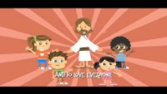
Love one another

Slide 23
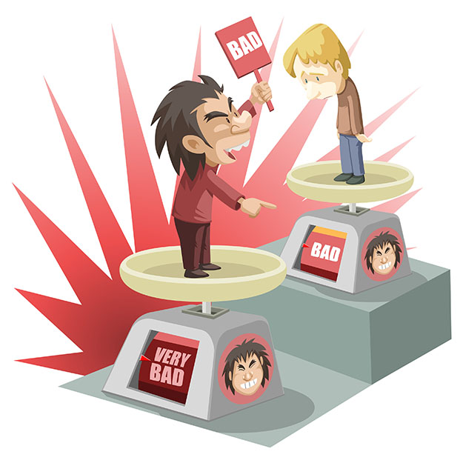
Jesus did not come to judge. He came to save.
“Do not judge other people.
Then you will not be judged.
Matthew 7:1-2

Slide 24
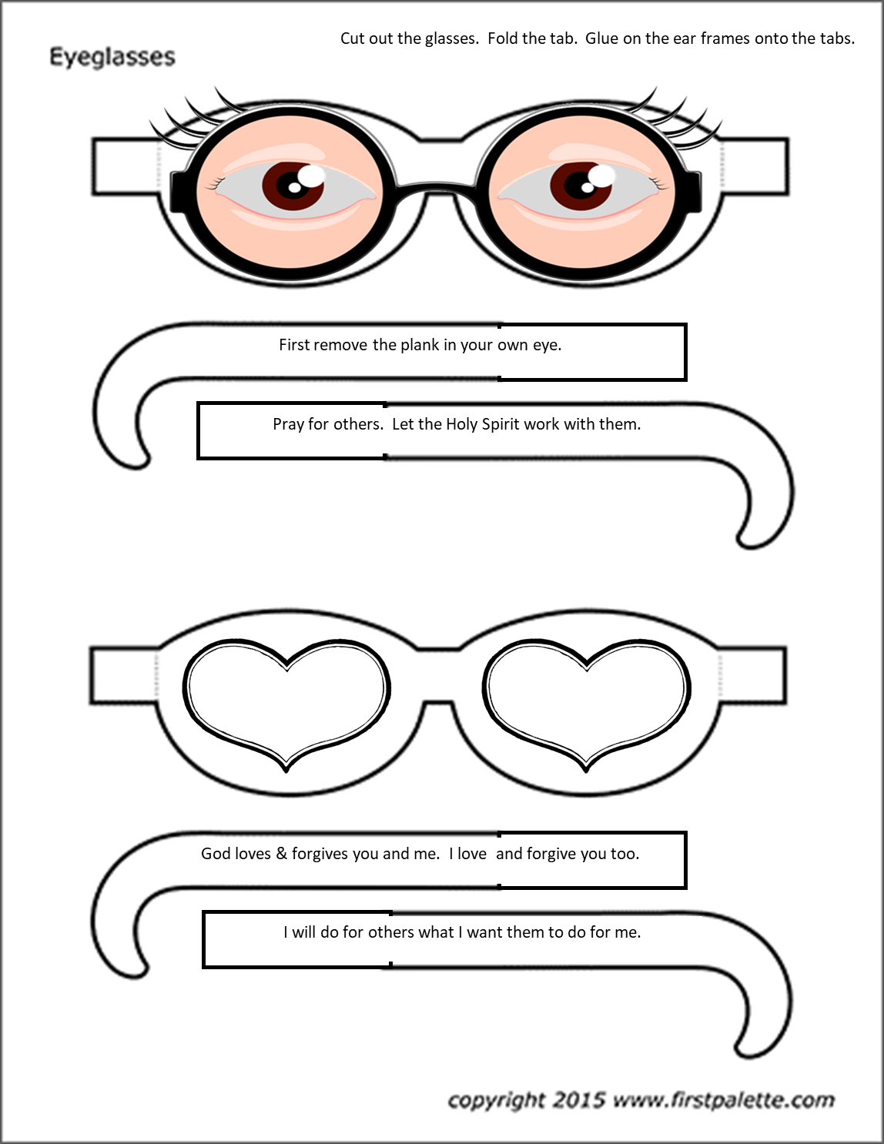

Slide 25
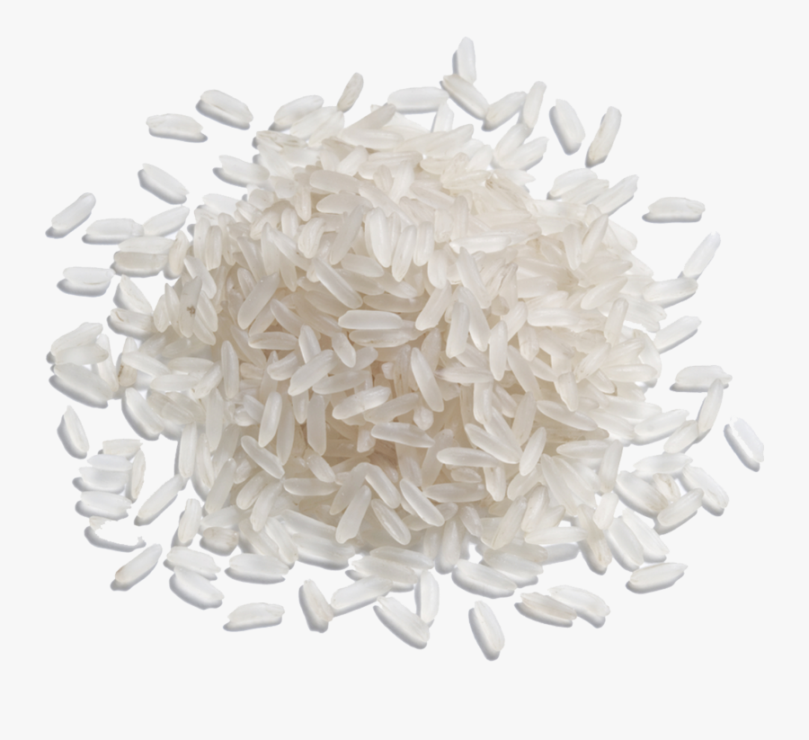


Jesus told a funny story
I need a volunteer
I have some special glasses for you to wear.
While wearing these glasses, can you find the colored rice in the white rice.

Slide 26
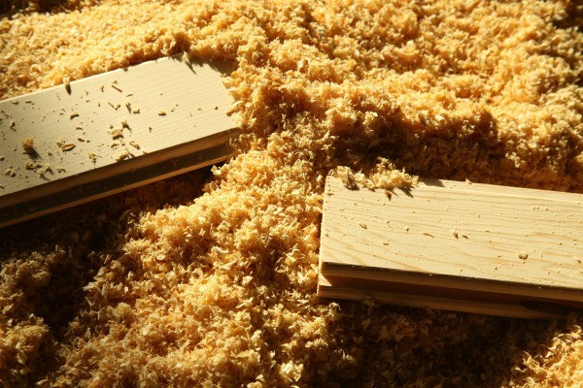
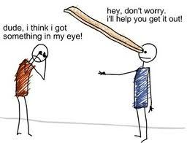
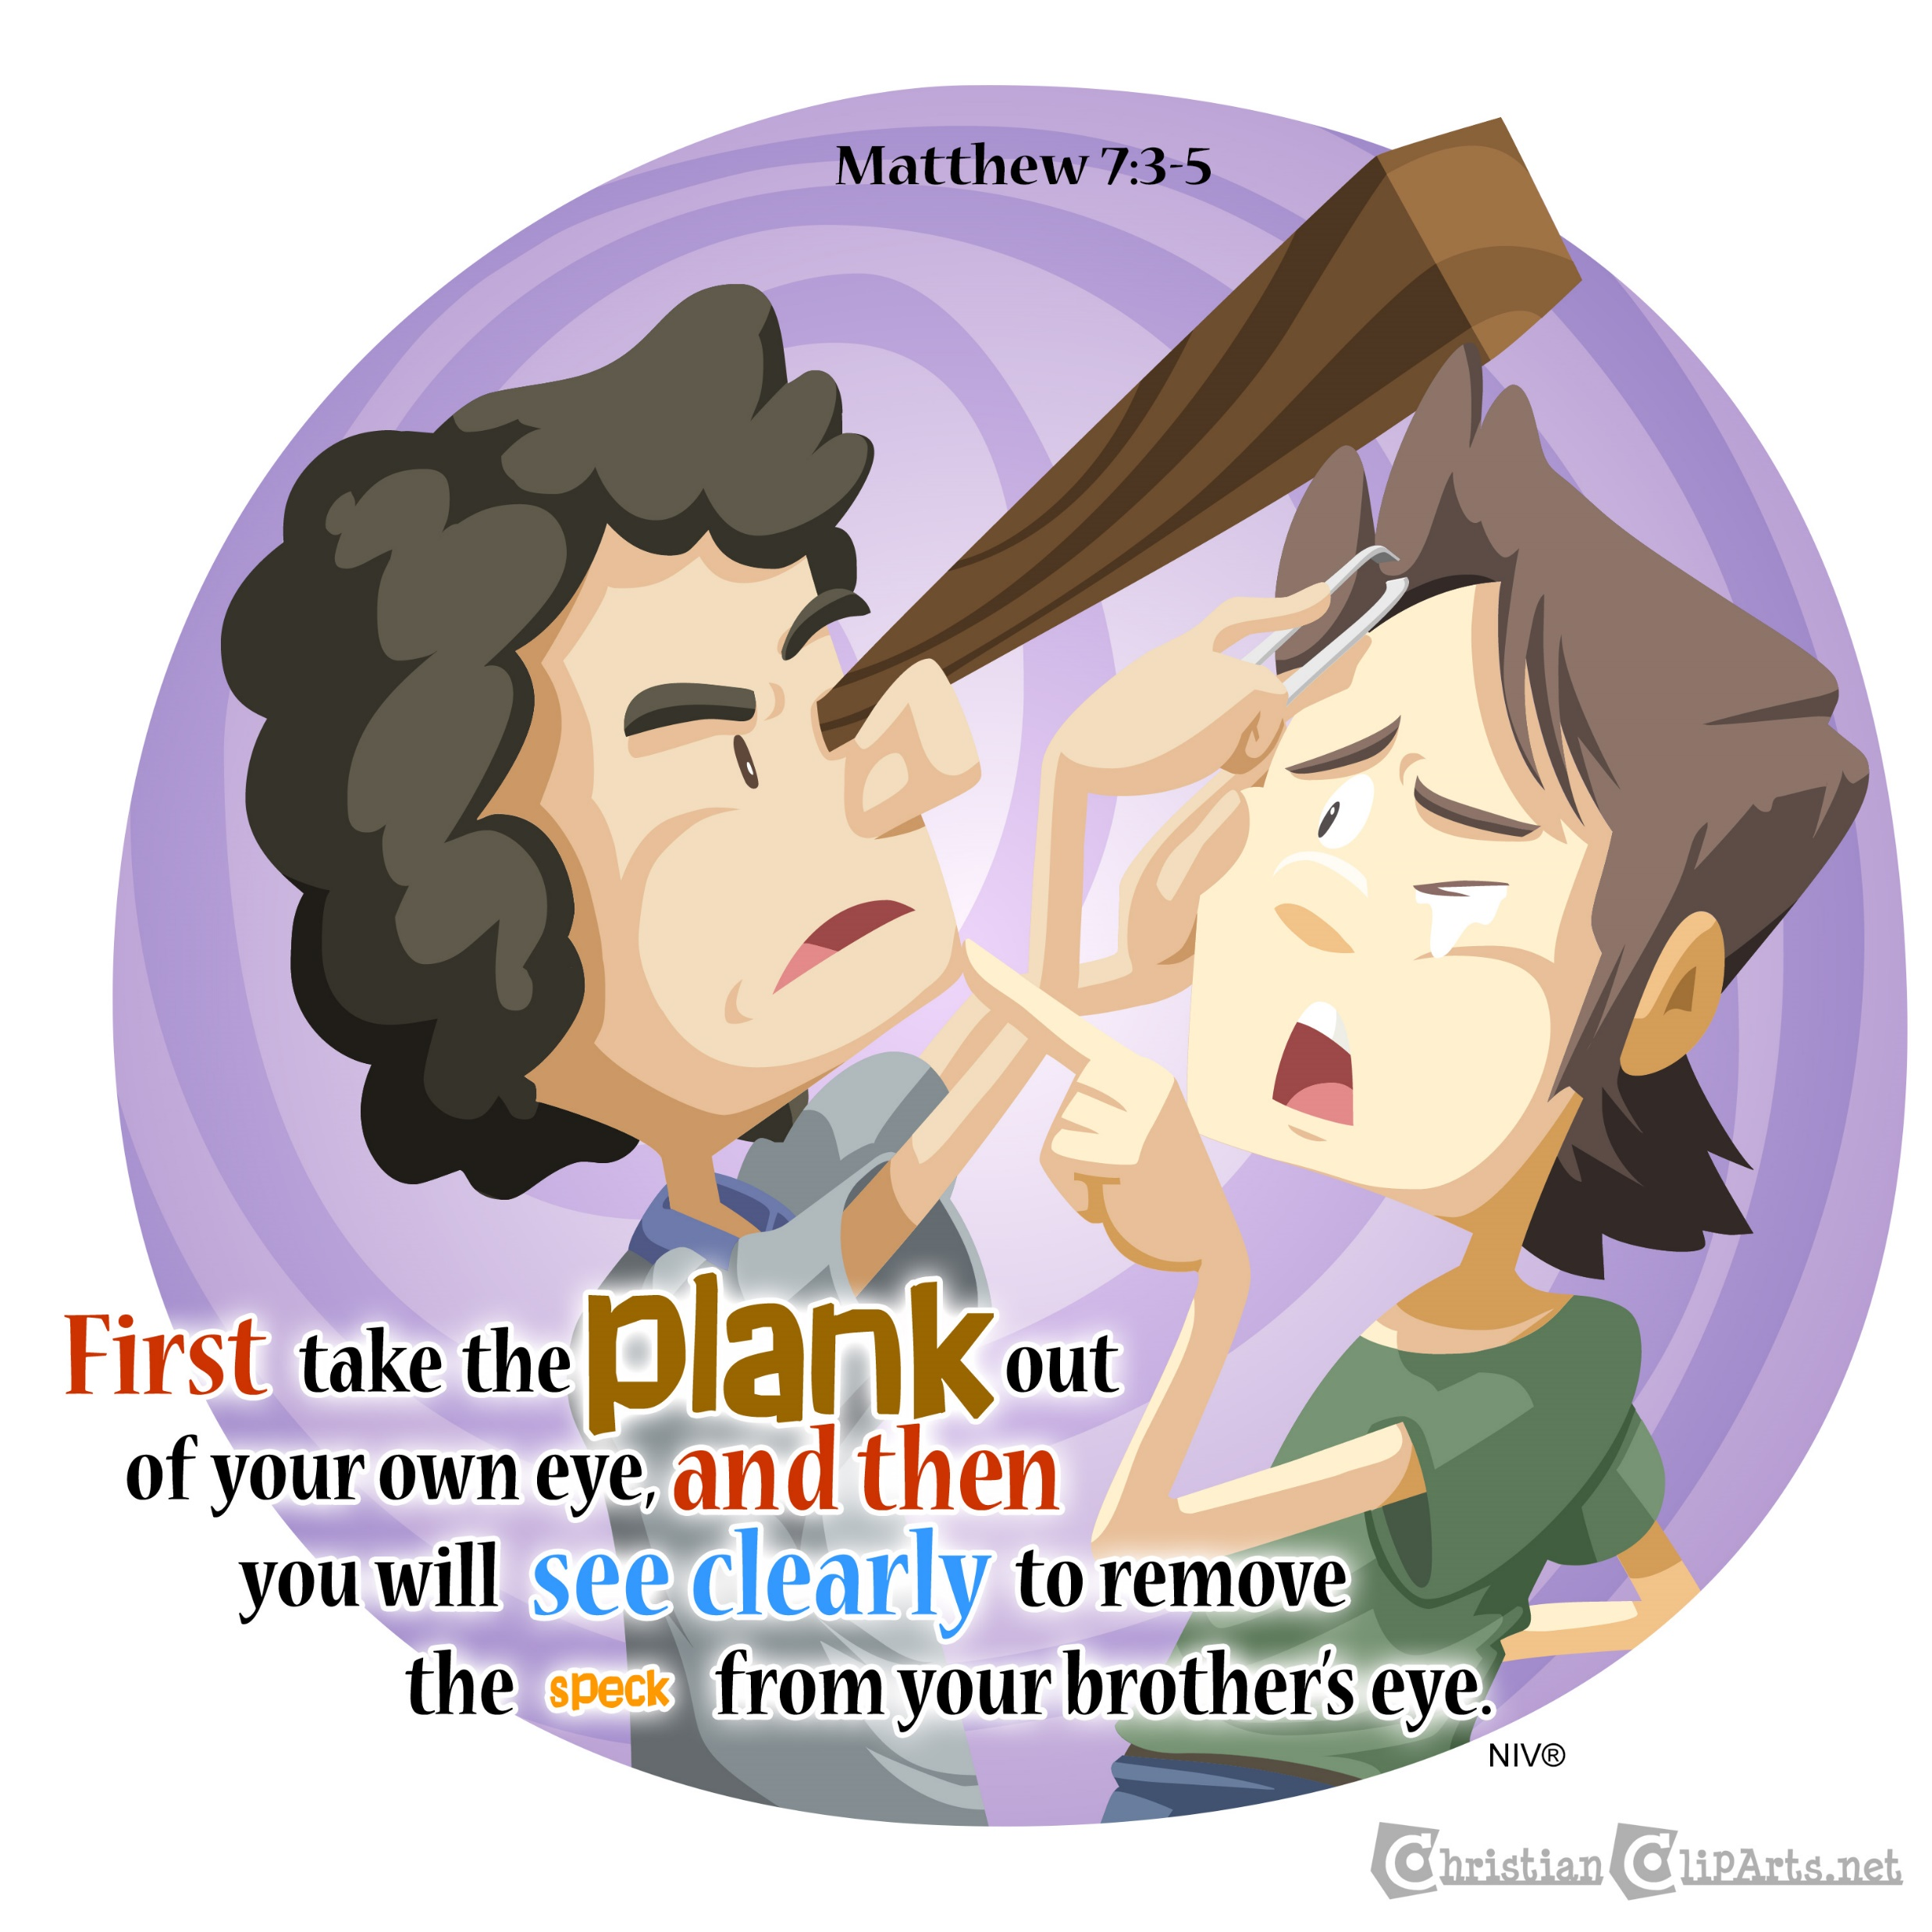
Matthew 7:1-5
³ “You look at the bit of sawdust
in your friend’s eye.
But you pay no attention to the piece of wood in your own eye.
⁴ How can you say to your friend, ‘let me take the bit of sawdust out of your eye’?
How can you say this while there is a piece of wood in your own eye?
⁵ you pretender! First take the piece of wood out of your own eye.
Then you will be able to see clearly to take the bit of sawdust out of your friend’s eye.

Slide 27
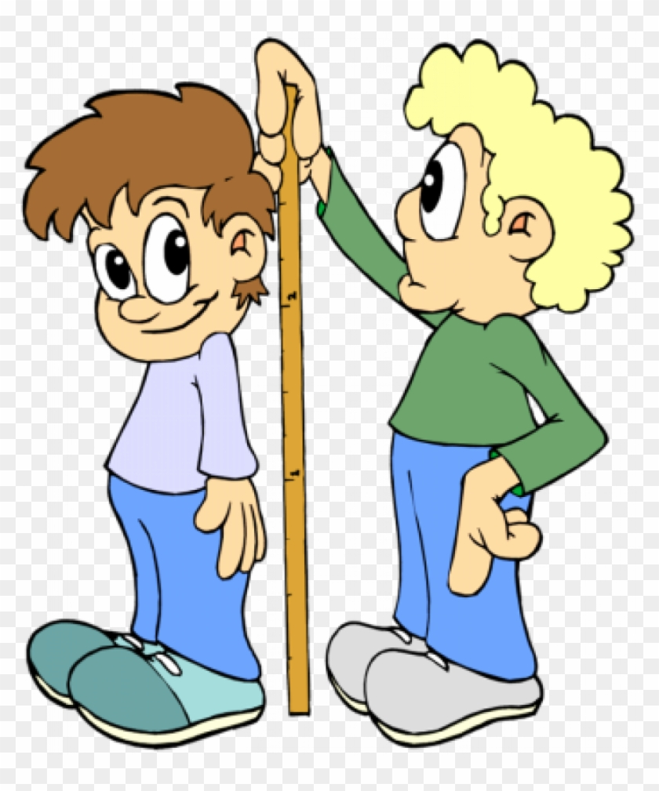
How do you want others to look at you and your actions?
You will be judged in the same way you judge others.
You will be measured in the same way you measure others.

Slide 28
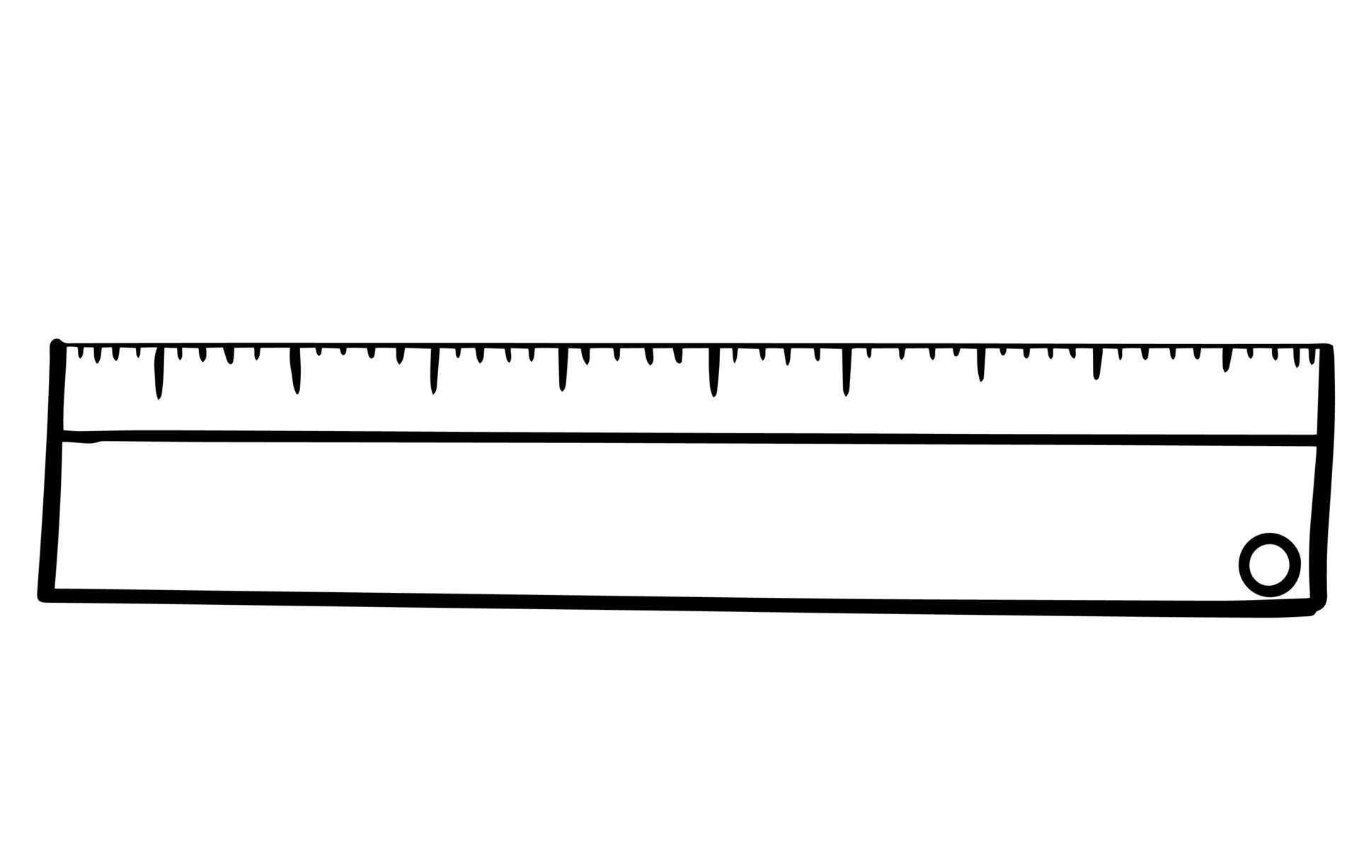
What measure will you use?
Forgiven – Growing with Jesus by the Holy Spirit
Evil not good Perfect
Not as good as you Better than you

Slide 29
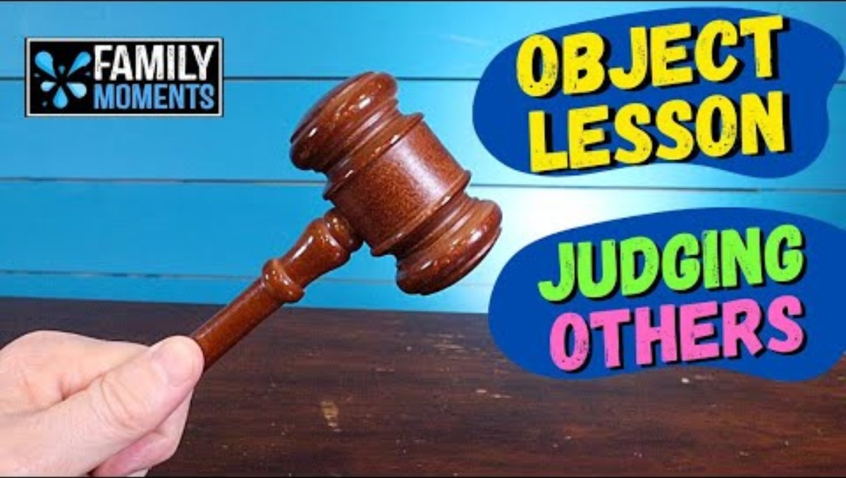

Slide 30
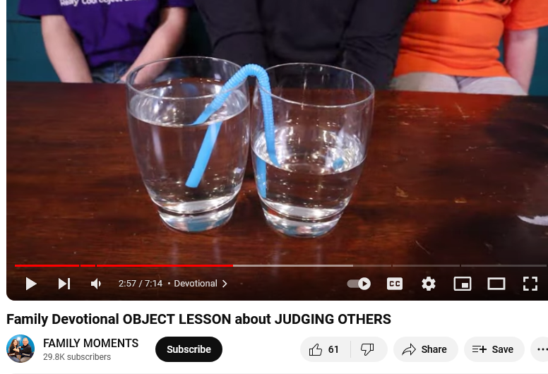
It’s your turn
Get two glasses
And a bendy straw
Cut the straw’s long end so that it’s the same length as the end you drink from with the bendy part in the middle.
Fill one glass up half way – this person doesn’t have much. Sometimes they try to get more by stealing. Sometimes they try to put others down so that they look better.
Fill one glass up – This person thinks they are the BEST!
Put the straw completely in this glass and let it fill with water. Put a finger over each end of the straw and keep them there while you…
Put one end of the straw in one cup and the other end in the other cup. Remove your fingers.
Does the water in the cups equal out?
God sees us equally. God is fair.
God helps everyone improve.

Slide 31

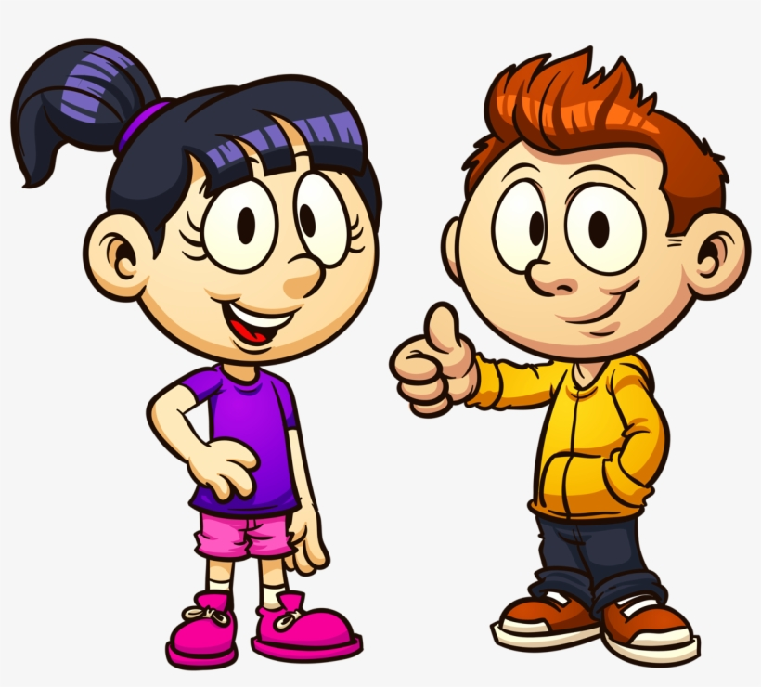
So, then we pursue the things which make for peace and the building up of one another.
Romans 14:19
He has shown you, O mortal, what is good.
And what does the Lord require of you?
To act justly and to love mercy
and to walk humbly
with your God.
Micah 6:8
Romans 14:19
Micah 6:8
We all mistakes
and we can all learn.
Let’s try this.

Slide 32


Slide 33
The Golden Rule
^{Matthew 7:12} In everything,
do to others
what you would want them
to do to you.
This is what is written in the law and in the prophets.

Slide 34

https://activity-array.com/

