Slide 1
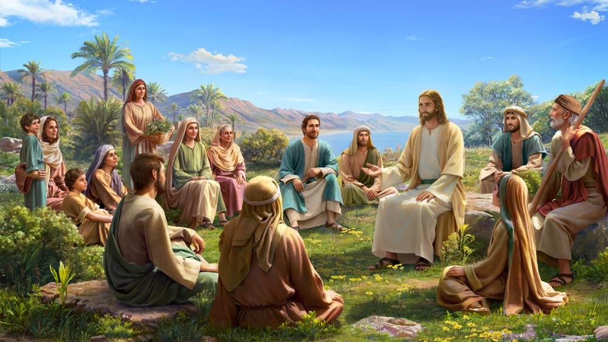
Sermon on the Mount part 1 – The Beatitudes
Matthew

Slide 2
Intro to Jesus’ ministry
Matthew 3 & 4 in review

Slide 3
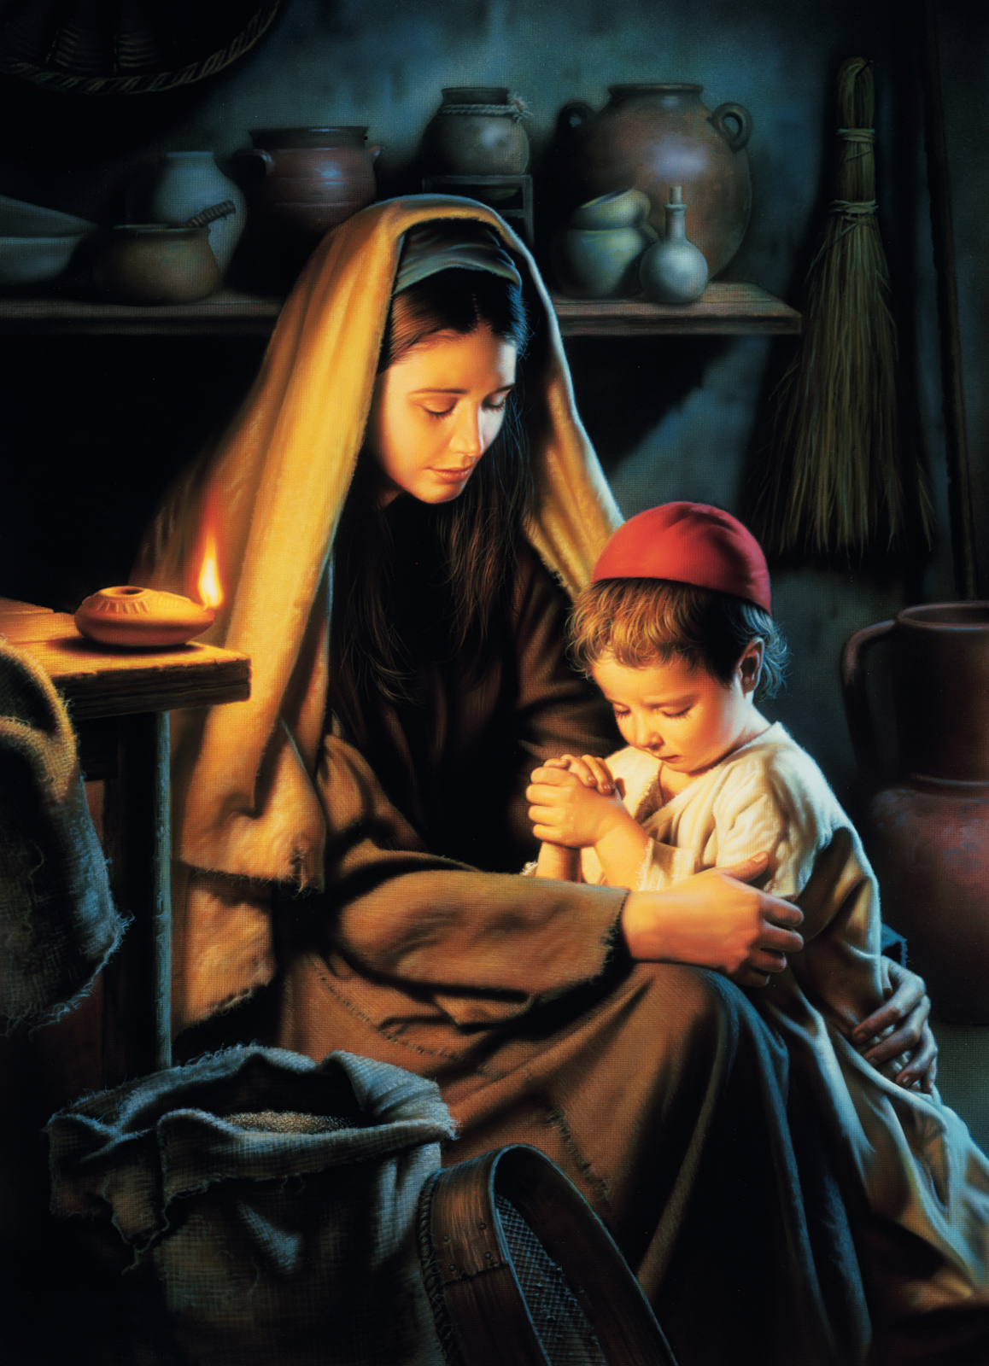
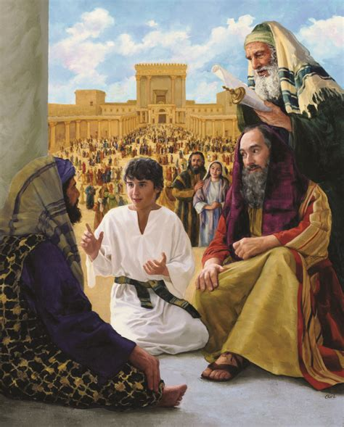
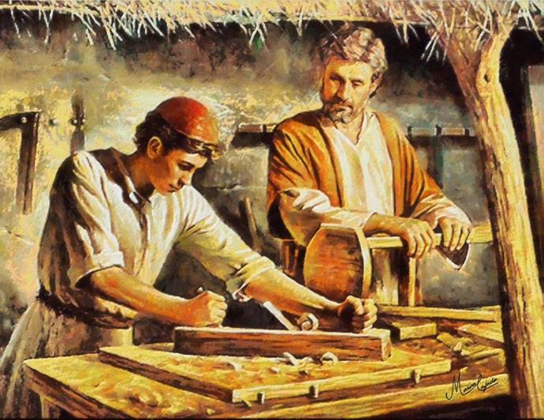
Jesus grew just like you
Jesus learned about God and went to church. He spent time talking with the minister priests.
Luke 2
Jesus grew in wisdom and in stature and in favor with God and man. He was humble, helpful , respectful, and obedient.

Slide 4
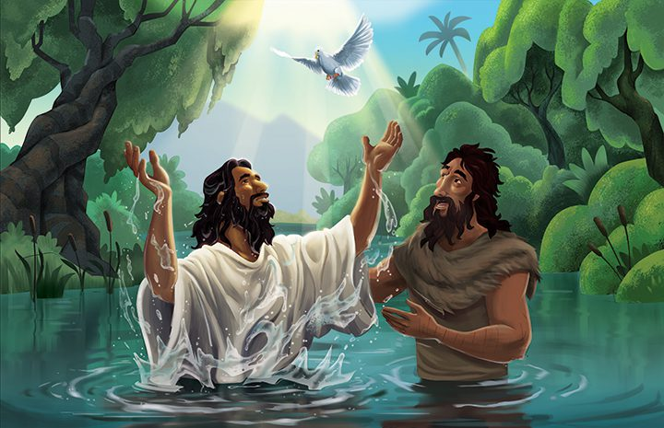
Jesus was baptised
This is my beloved Son, with whom I am well pleased.
Matthew 3
¹³ Then Jesus came from Galilee to the Jordan to John, to be baptized by him…. ¹⁶ And when Jesus was baptized, immediately he went up from the water, and behold, the heavens were opened to him, and he saw the Spirit of God descending like a dove and coming to rest on him; ¹⁷ and behold, a voice from heaven said, “This is my beloved Son,^{[d]} with whom I am well pleased.”

Slide 5
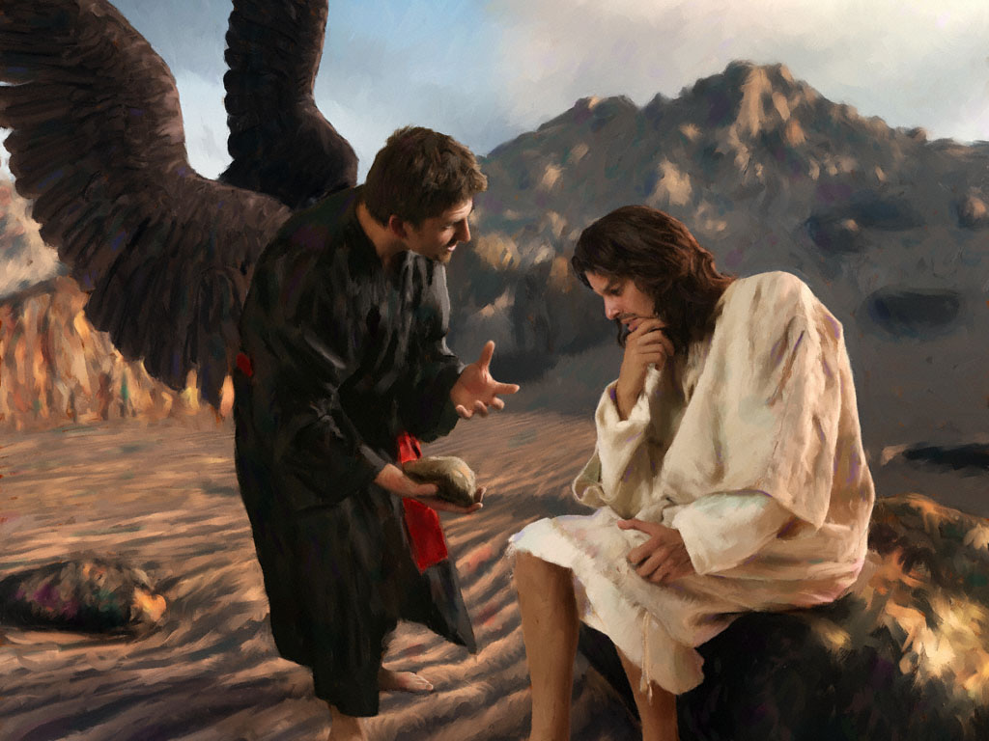
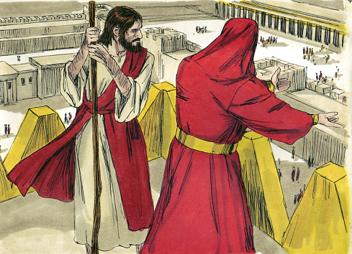
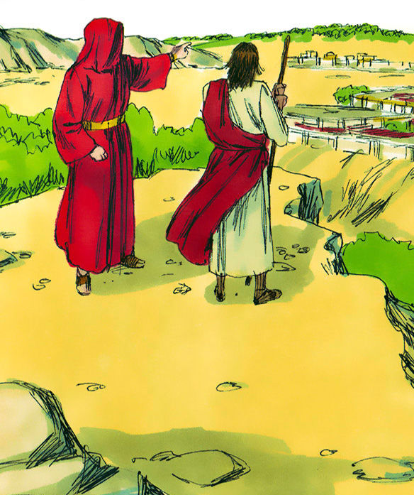
Jesus went to the desert. The devil met him there.
Turn these rocks to bread.
It is written, man doesn’t live by bread alone, but by every word that comes from God.
Matthew 4
Then Jesus was led up by the Spirit into the wilderness to be tempted by the devil. ² And after fasting forty days and forty nights, he was hungry. ³ And the tempter came and said to him, “If you are the Son of God, command these stones to become loaves of bread.” ⁴ But he answered, “It is written,
“‘Man shall not live by bread alone,
but by every word that comes from the mouth of God.’”
⁵ Then the devil took him to the holy city and set him on the pinnacle of the temple ⁶ and said to him, “If you are the Son of God, throw yourself down, for it is written,
“‘He will command his angels concerning you,’
and
“‘On their hands they will bear you up,
lest you strike your foot against a stone.’”
⁷ Jesus said to him, “Again it is written, ‘You shall not put the Lord your God to the test.’” ⁸ Again, the devil took him to a very high mountain and showed him all the kingdoms of the world and their glory. ⁹ And he said to him, “All these I will give you, if you will fall down and worship me.” ¹⁰ Then Jesus said to him, “Be gone, Satan! For it is written,
“‘You shall worship the Lord your God
and him only shall you serve.’”
¹¹ Then the devil left him, and behold, angels came and were ministering to him.
Jump. Let the angels catch you.
Bow to me. I’ll give all kingdoms to you.
It is written, don’t test God.
Be gone Satan. It is written, worship only the Lord your God. Serve Him only.

Slide 6
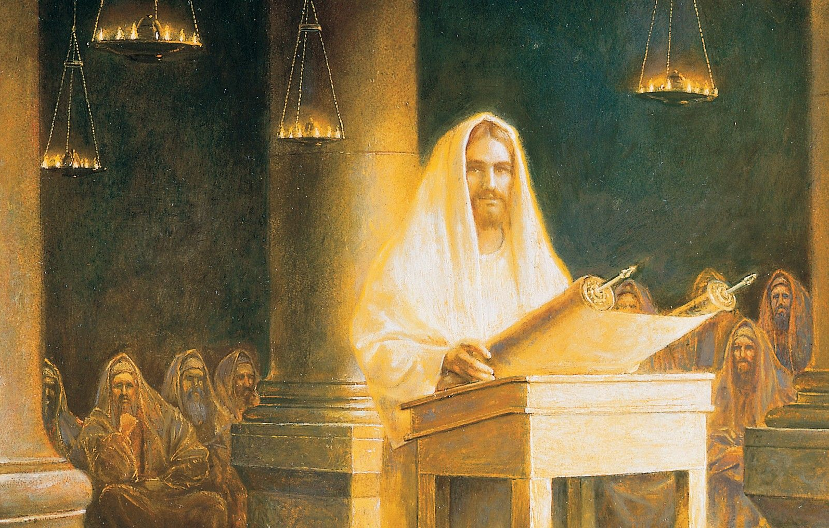
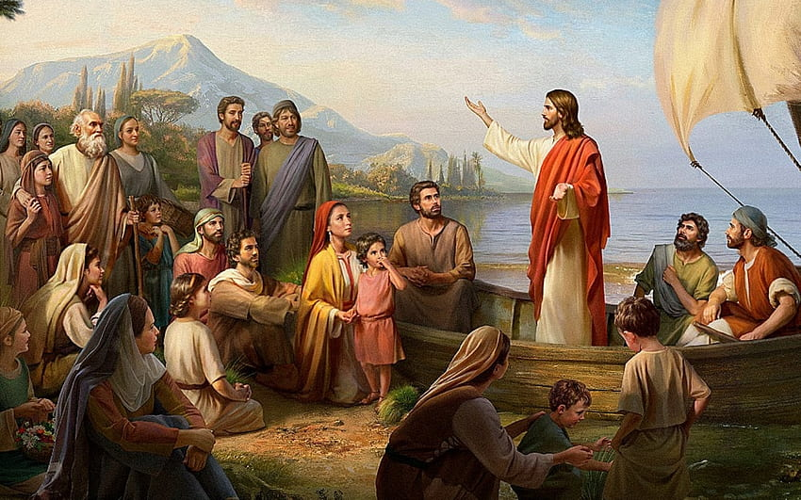
Jesus started preaching
The Holy Spirit is on me.
I have come to tell the good news to the poor;
to proclaim liberty to captives; give sight to the blind
Matthew 3
¹² Now when he heard that John had been arrested, he withdrew into Galilee. …
¹⁷ From that time Jesus began to preach, saying, “Repent, for the kingdom of heaven is at hand.”
Luke 4
¹⁶ And he came to Nazareth, where he had been brought up. And as was his custom, he went to the synagogue on the Sabbath day, and he stood up to read. ¹⁷ And the scroll of the prophet Isaiah was given to him. He unrolled the scroll and found the place where it was written,
¹⁸ “The Spirit of the Lord is upon me,
because he has anointed me
to proclaim good news to the poor.
He has sent me to proclaim liberty to the captives
and recovering of sight to the blind,
to set at liberty those who are oppressed,
¹⁹ to proclaim the year of the Lord's favor.”
Repent. The kingdom of God is near.

Slide 7
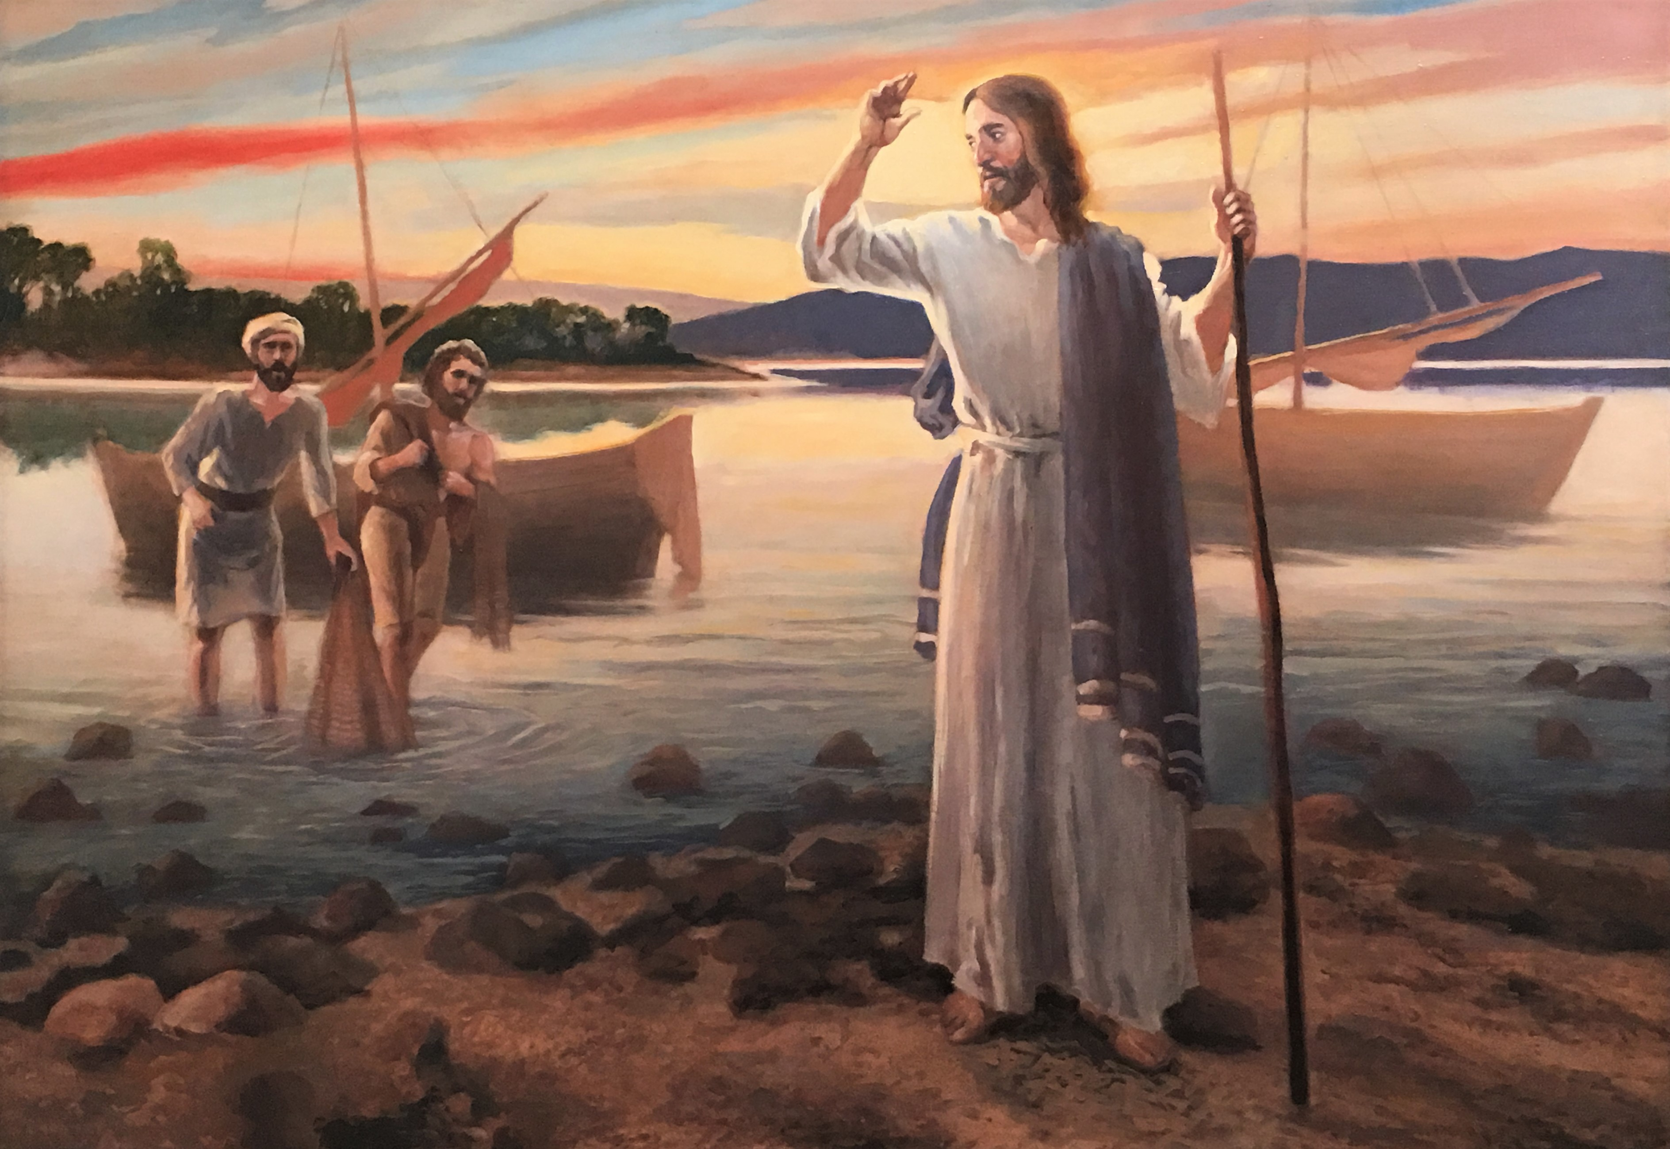
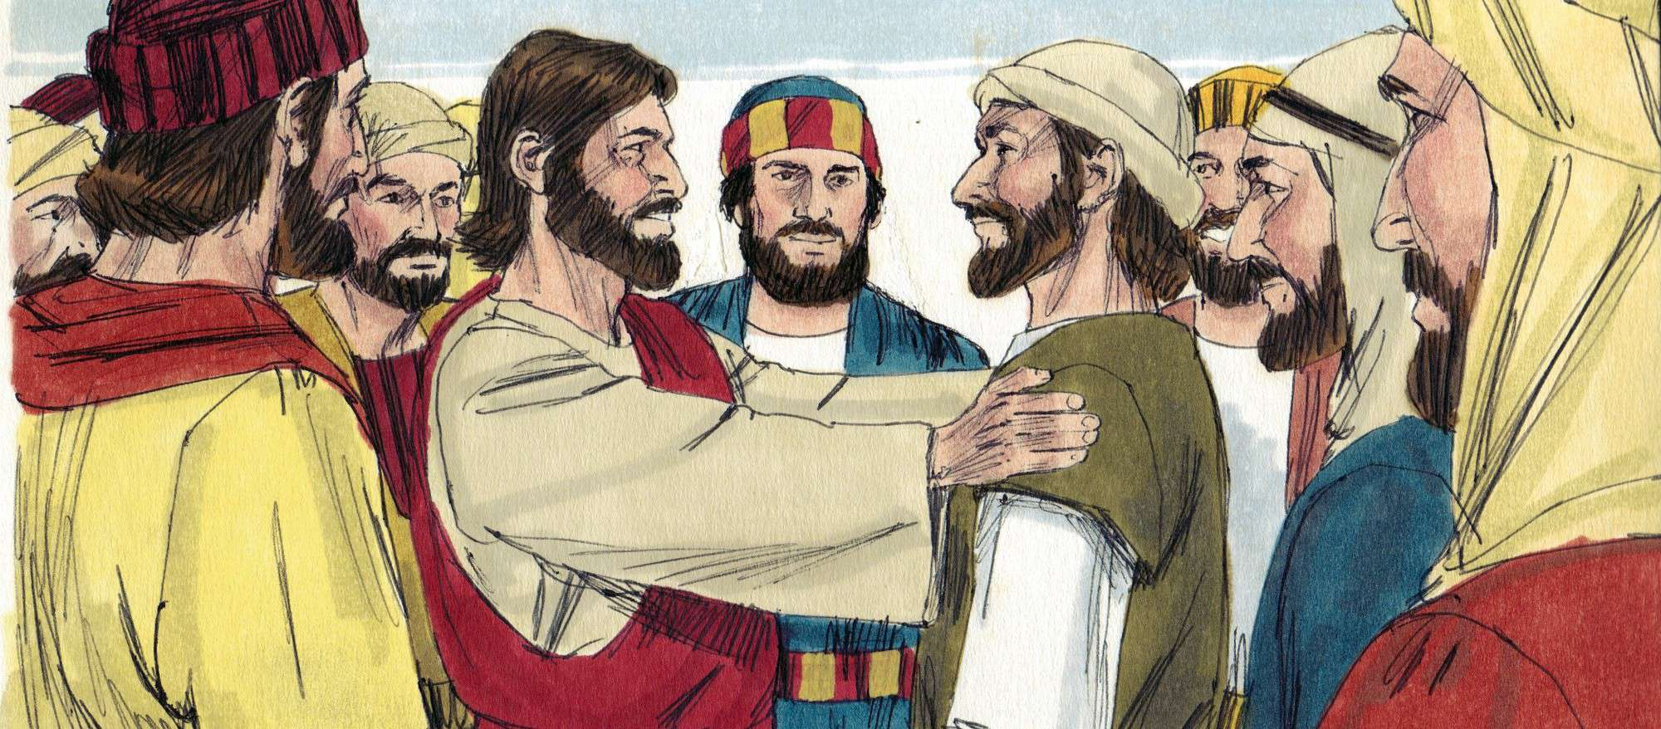
Jesus called His disciples
Come follow me.
I will make you fisher’s of men
Matthew 4
¹⁸ While walking by the Sea of Galilee, he saw two brothers, Simon (who is called Peter) and Andrew his brother, casting a net into the sea, for they were fishermen. ¹⁹ And he said to them, “Follow me, and I will make you fishers of men.”^{[b]} ²⁰ Immediately they left their nets and followed him. ²¹ And going on from there he saw two other brothers, James the son of Zebedee and John his brother, in the boat with Zebedee their father, mending their nets, and he called them. ²² Immediately they left the boat and their father and followed him.
Come. Follow me.
Be my disciple.

Slide 8
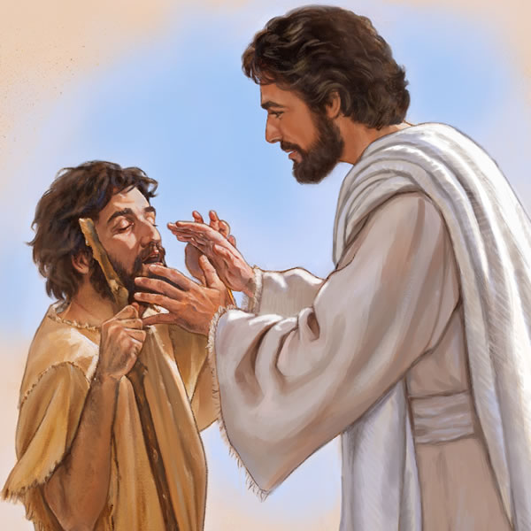
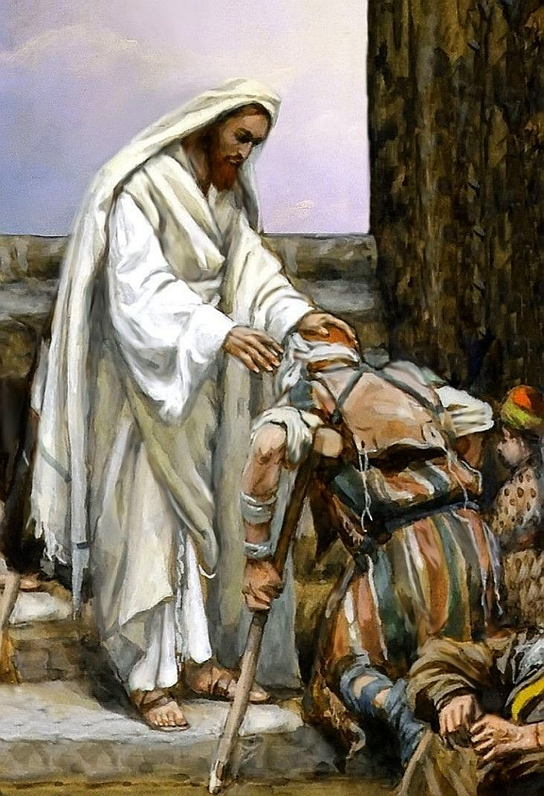
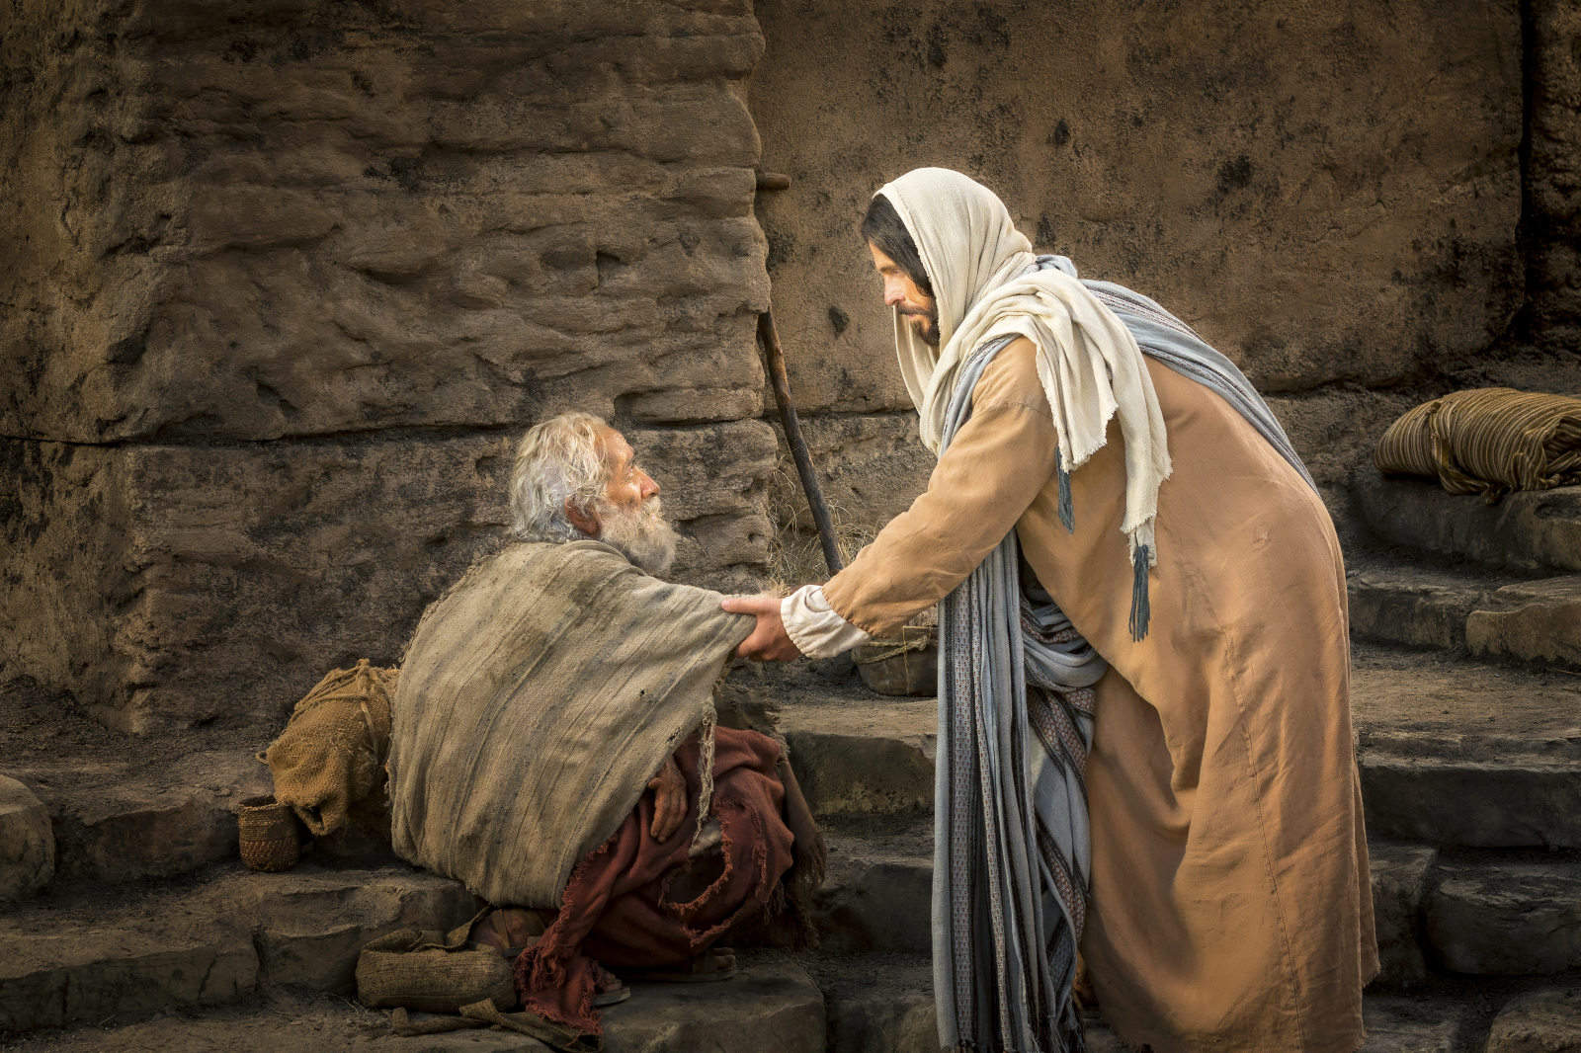
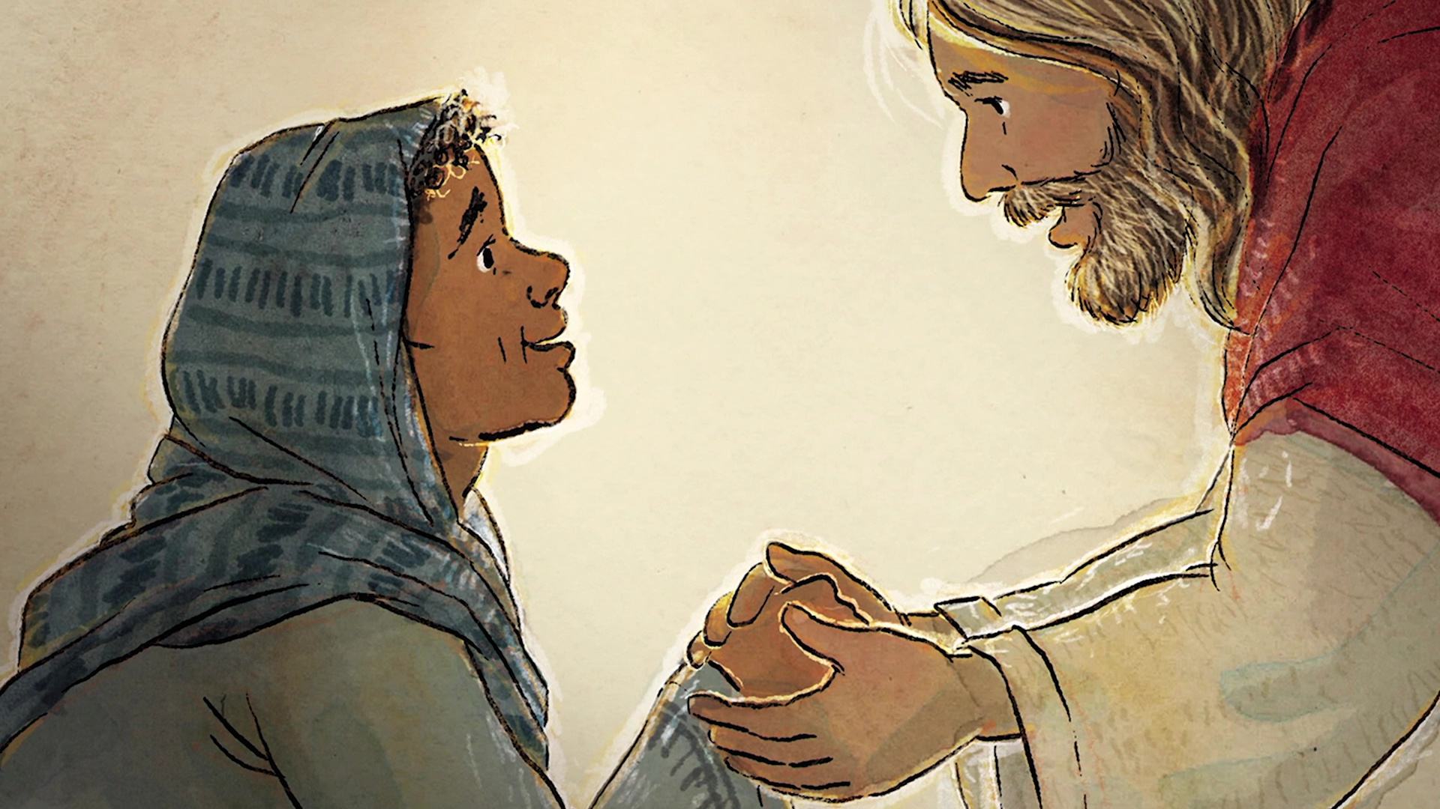
Jesus healed the sick
Matthew 4
²³ And he went throughout all Galilee, teaching in their synagogues and proclaiming the gospel of the kingdom and healing every disease and every affliction among the people.
²⁴ So his fame spread throughout all Syria, and they brought him all the sick, those afflicted with various diseases and pains, those oppressed by demons, those having seizures, and paralytics, and he healed them.

Slide 9
The Beatitudes
Matthew 5
Jesus begins the Sermon on the Mount

Slide 10
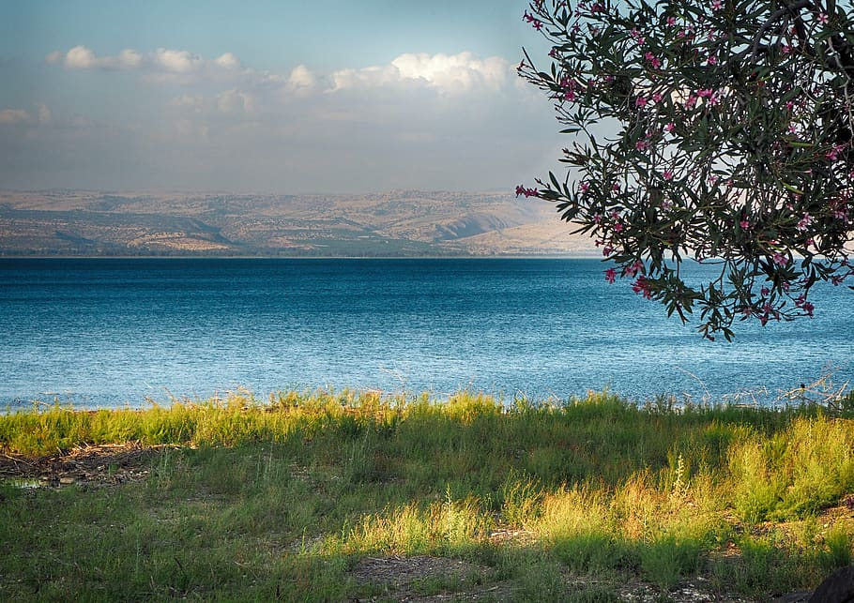
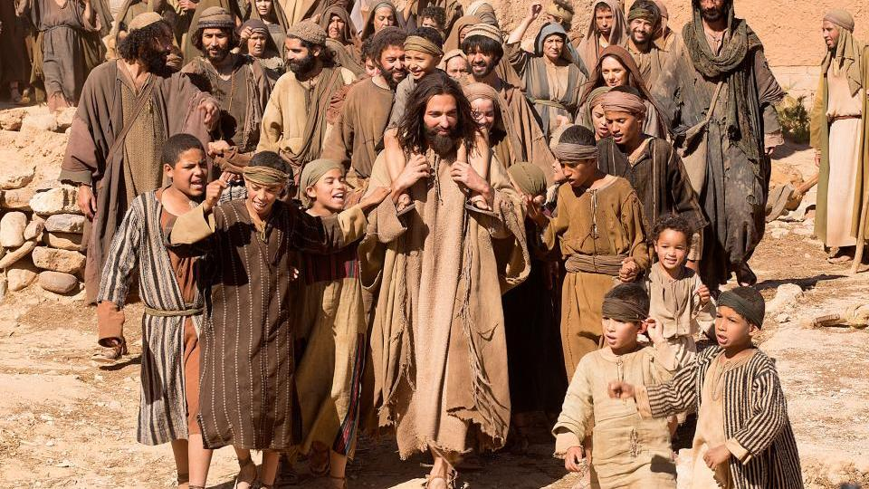
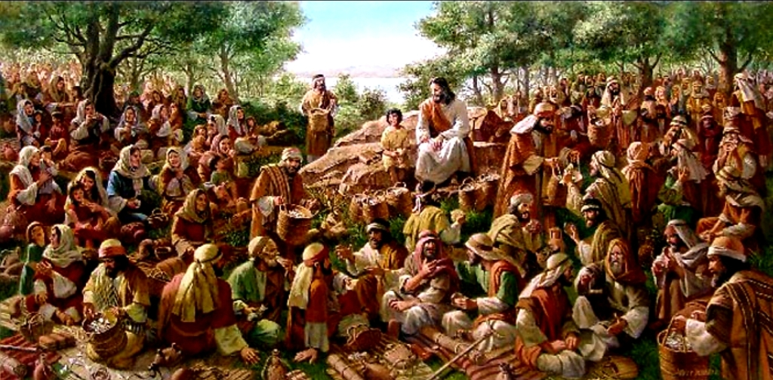
People followed Jesus
Matthew 4
²⁵ And great crowds followed him from Galilee and the Decapolis, and from Jerusalem and Judea, and from beyond the Jordan.
Matthew 5
Seeing the crowds, he went up on the mountain, and when he sat down, his disciples came to him.
² And he opened his mouth and taught them, saying:

Slide 11
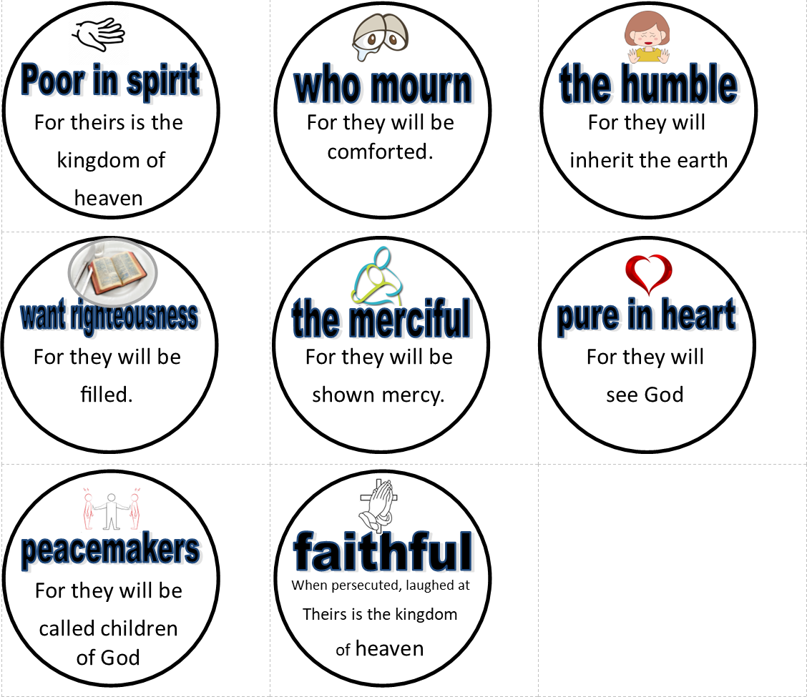

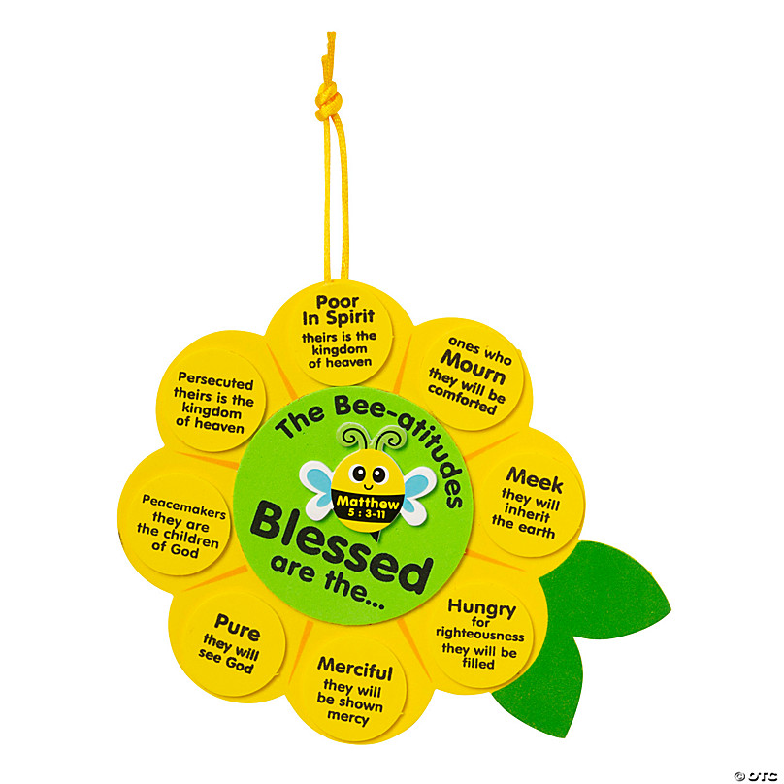
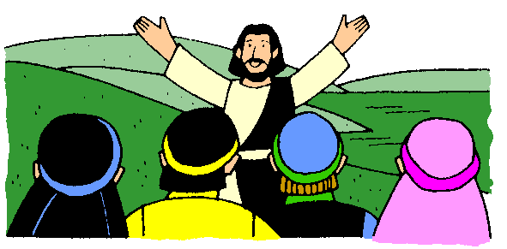
CRAFT TIME
As we talk about each of the Beatitudes, add a petal to the sunflower OR circle to the snowflake with that beatitude and blessing.
Think about how snowflakes come quietly down and, together, make such beauty.
Think about how a sunflower grows so tall with God’s blessing of sun and rain.
https://www.orientaltrading.com/the-bee-atitudes-sign-craft-kit-makes-12-a2-14194665.fltr

Slide 12
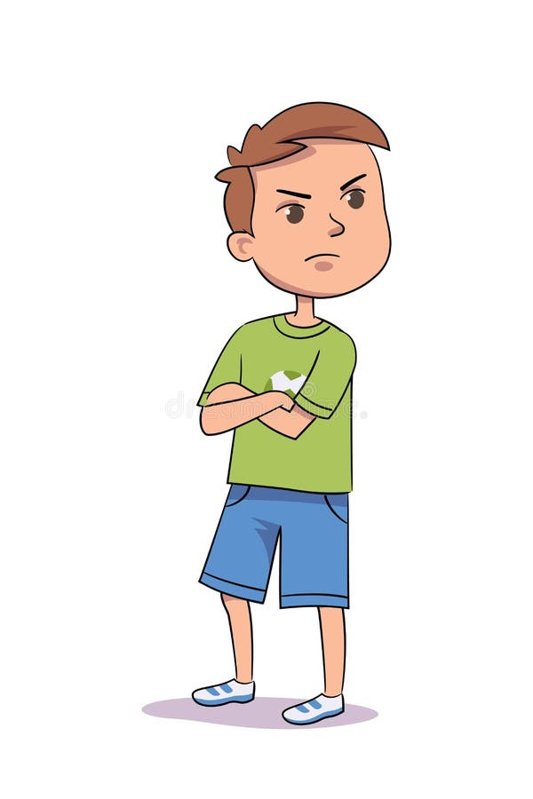
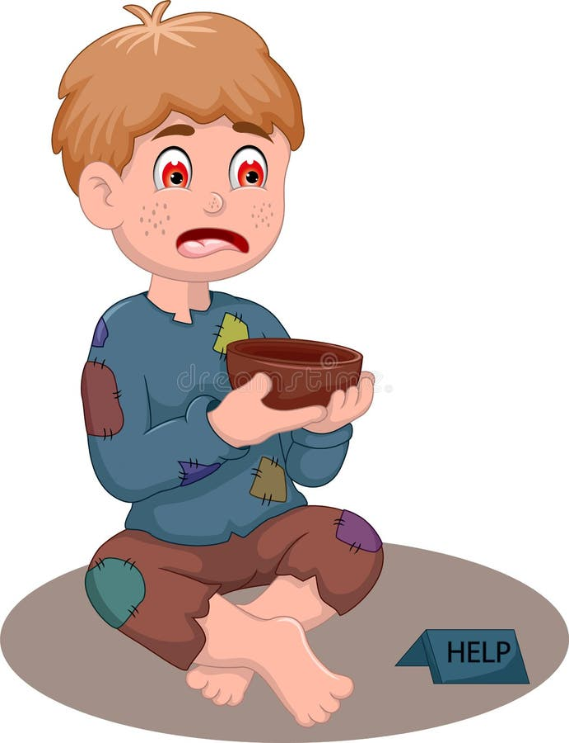
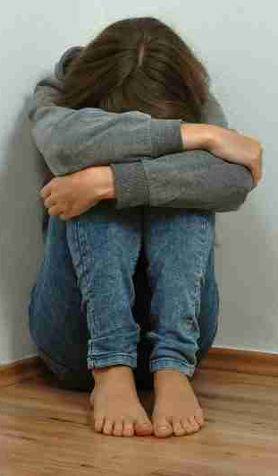
What kind of attitude should a child of God have?
Who can I bless today with my gifts?
I don’t need none of your
no good blessings.
I can do everything by myself!
No one loves me. I’m a terrible no good for nothing.
Jesus wants us all to know the answer to that question. He started his sermon by talking about the type of attitude we should have.
I need 3 volunteers to mimic the 3 in the pictures (or everyone choose 1 to mimic).
Be a statue and stay that way until I tell you can move.
Please give me a little.
I really need a little help, actually, a lot of help!
Proud
conceited
Low self esteem
Humble
In Want

Slide 13




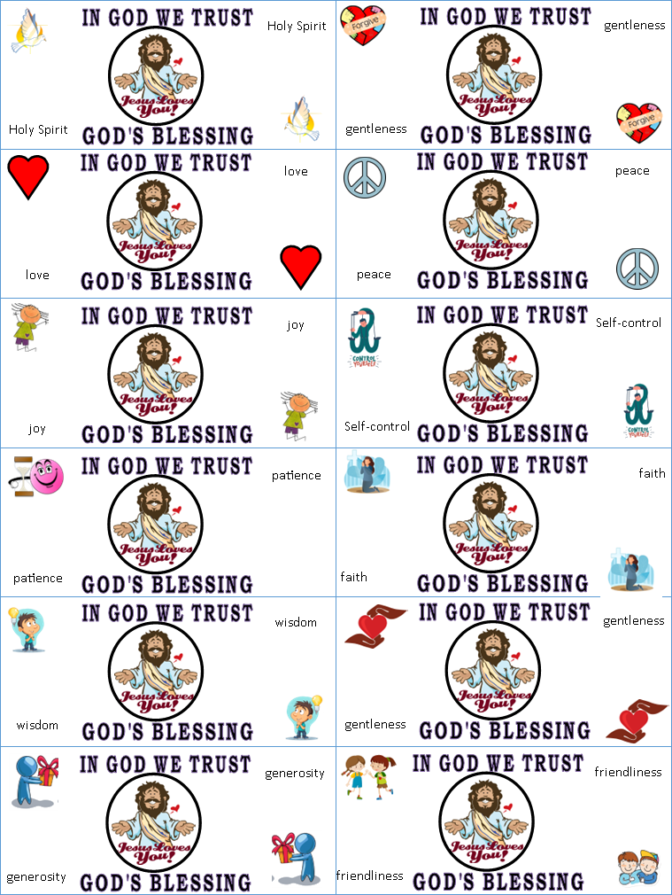
Who is ready to catch and receive the gifts?
What blessings did you receive?
Being poor in spirit means we want God’s blessings and are ready to receive it. God is anxious to give!
Teacher: Print blessing ‘money’ on green paper and cut out. Throw money in the air and see who, without changing their pose can catch it.

Slide 14

Jesus taught the people
I have so much for you!
Thanks for asking!
You will receive.
BEE
³ “Blessed are the poor in spirit,
for theirs is the kingdom of heaven.
“Great blessings belong to
those who know they are spiritually in need.
contrite
I need…..
What DO you NEED?

Slide 15

Lord, I need YOU!
Everyone be ready to receive blessings!

Slide 16
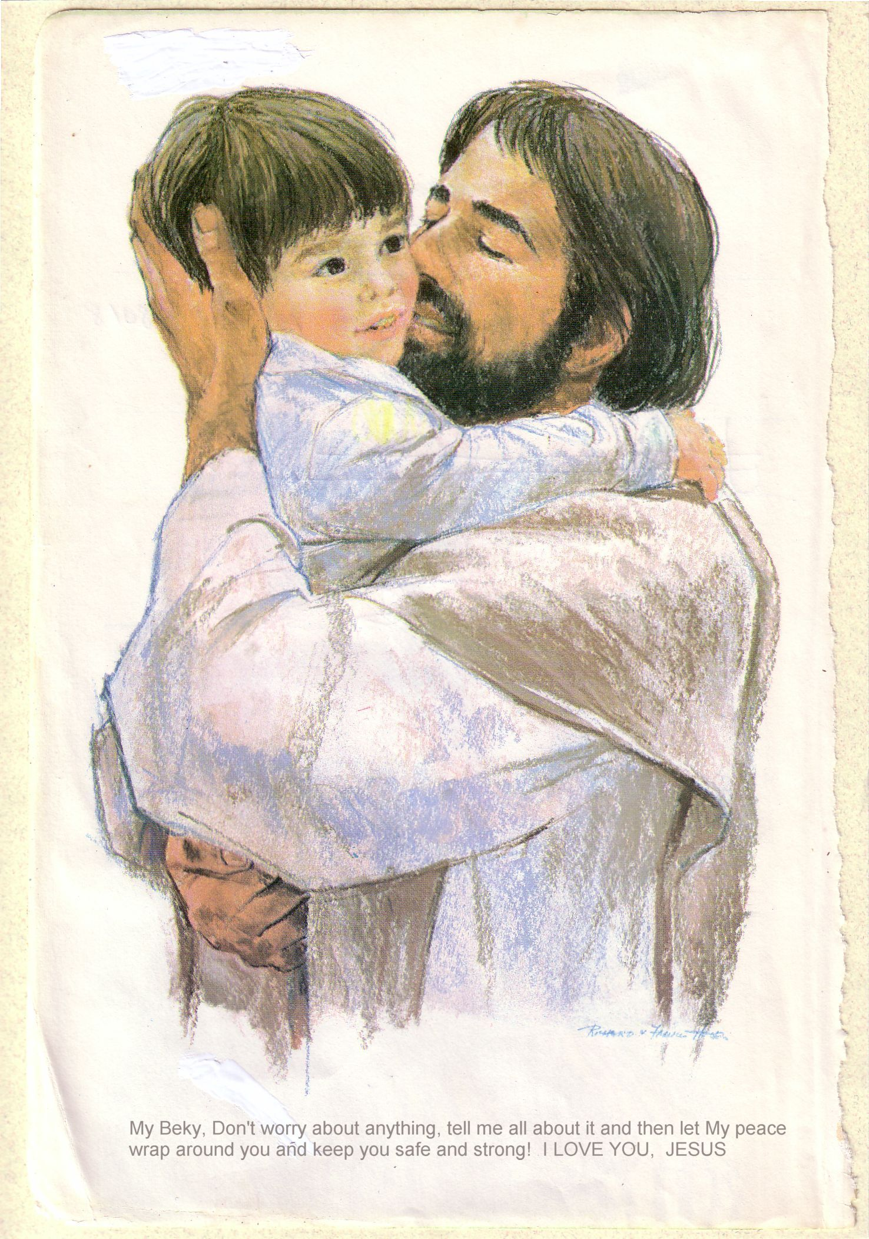
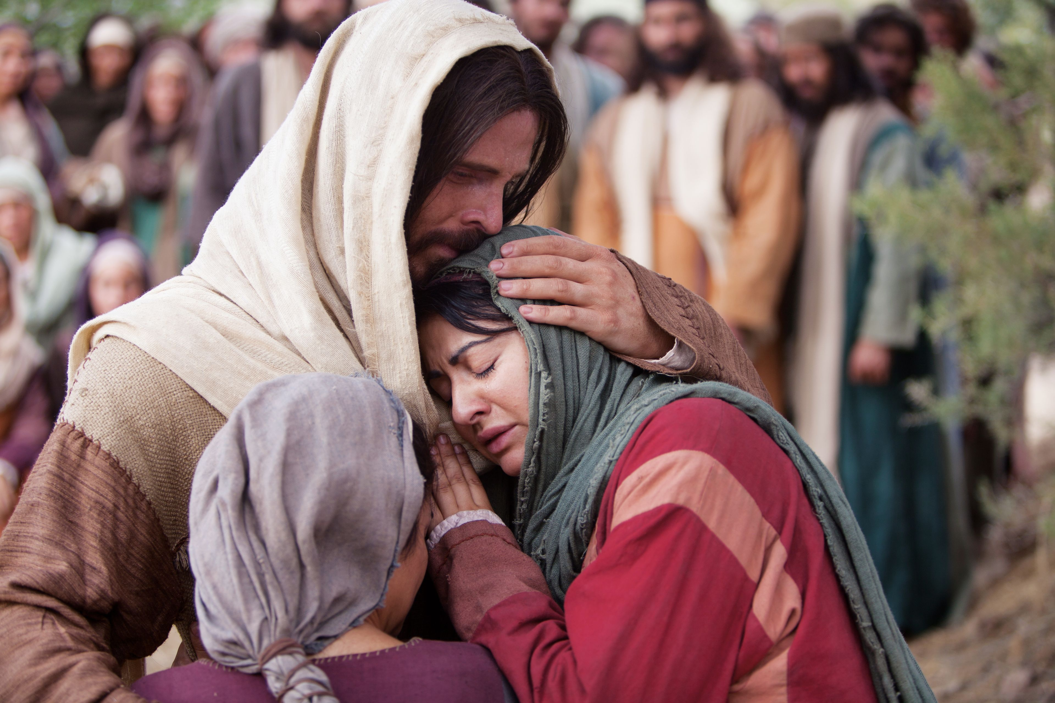
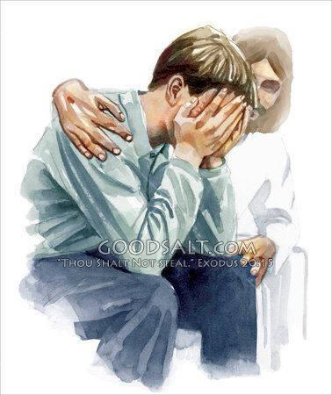
Beatitudes
BEE
⁴ “Blessed are those who mourn,
for they shall be comforted.
Great blessings belong to those who are sad now.
God will comfort them.
Be comforted

Slide 17
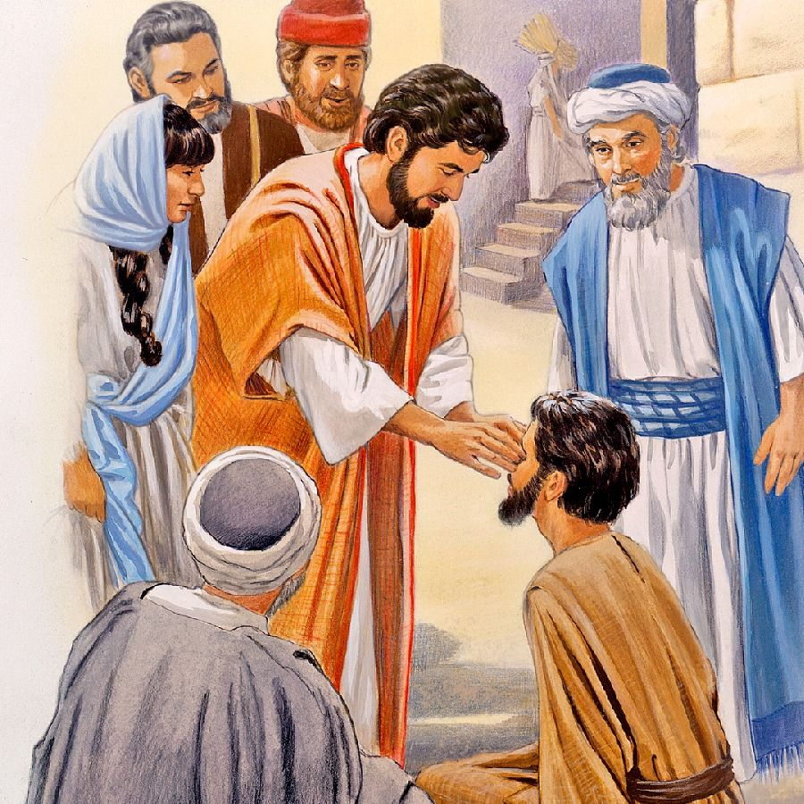
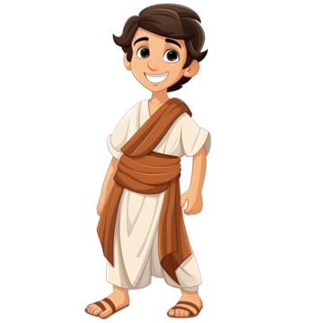
Why is there sadness?
Neither. This happened so that you can see God’s works. I have come to do God’s work.
Go wash in the Pool of Siloam.
Teacher, who sinned: this man or his parents so that he was born blind?
People thought if something bad happened, it was because they did something wrong or God was mad at them.
But this happened:
John 9
As he went along, he saw a man blind from birth. ² His disciples asked him, “Rabbi, who sinned, this man or his parents, that he was born blind?”
³ “Neither this man nor his parents sinned,” said Jesus, “but this happened so that the works of God might be displayed in him. ⁴ As long as it is day, we must do the works of him who sent me. Night is coming, when no one can work. ⁵ While I am in the world, I am the light of the world.”
⁶ After saying this, he spit on the ground, made some mud with the saliva, and put it on the man’s eyes. ⁷ “Go,” he told him, “wash in the Pool of Siloam” (this word means “Sent”). So the man went and washed, and came home seeing.
I was blind.
Now I can see!
Praise God!

Slide 18

Why is there sadness? So that you come to Jesus for comfort.
Another time Jesus’ friend Lazarus was sick and then he died. Jesus came to their village. When Martha heard Jesus was near, she came to him.
When we are sad and have questions, we need to come to Jesus. He will comfort us and give us hope.
Jesus cries with us too.
Listen to the story:

Slide 19
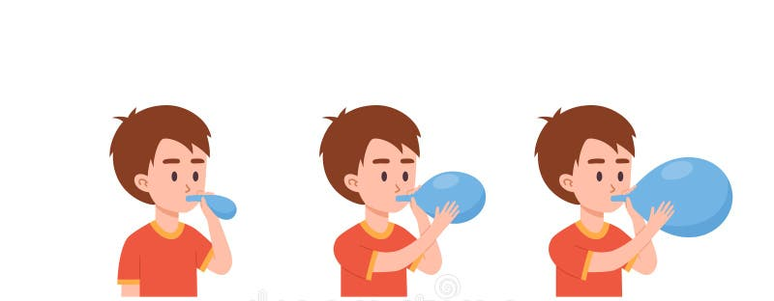

Beatitudes
BEE
⁵ “Blessed are the meek,
for they shall inherit the earth.
Great blessings belong to those who are humble.
They will be given the land God promised
humble
Pride ruins you.
What is pride? It is the opposite of being humble.
It’s thinking – I’m better than you. I’m the best!
You get puffed up – like this balloon.
What are some prideful thoughts?
I’m the best student. ….. You’re dumb.
I’m the strongest …. You’re so weak!

Slide 20
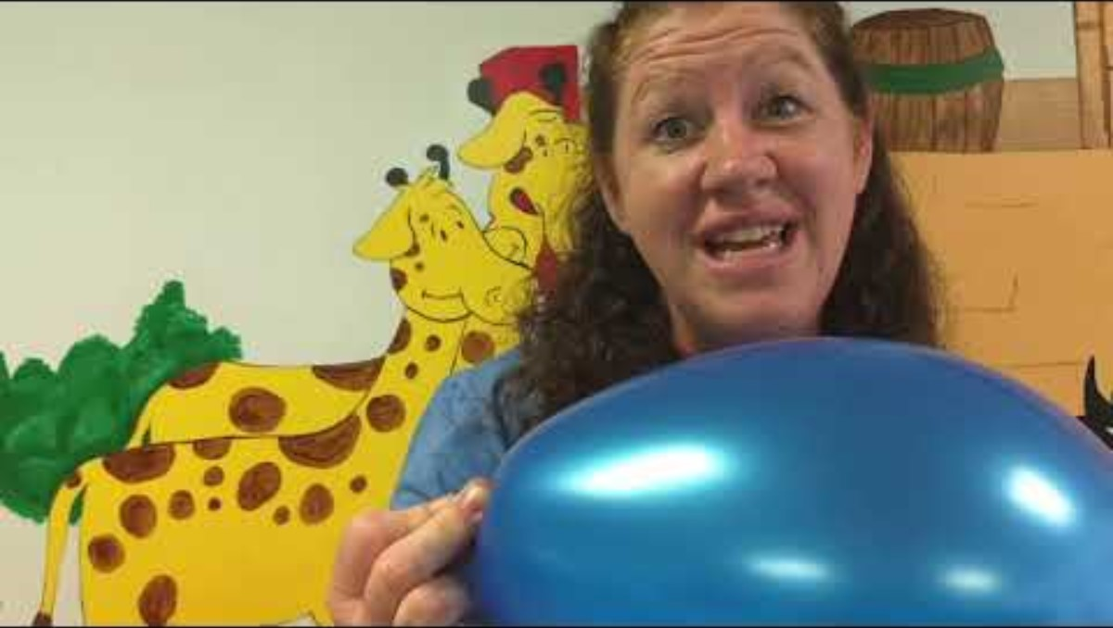
Pride puffs up – but that is dangerous
Teacher note: Watch this video beforehand for the best explanation: https://www.youtube.com/watch?v=imSkNSlPY1A

Slide 21
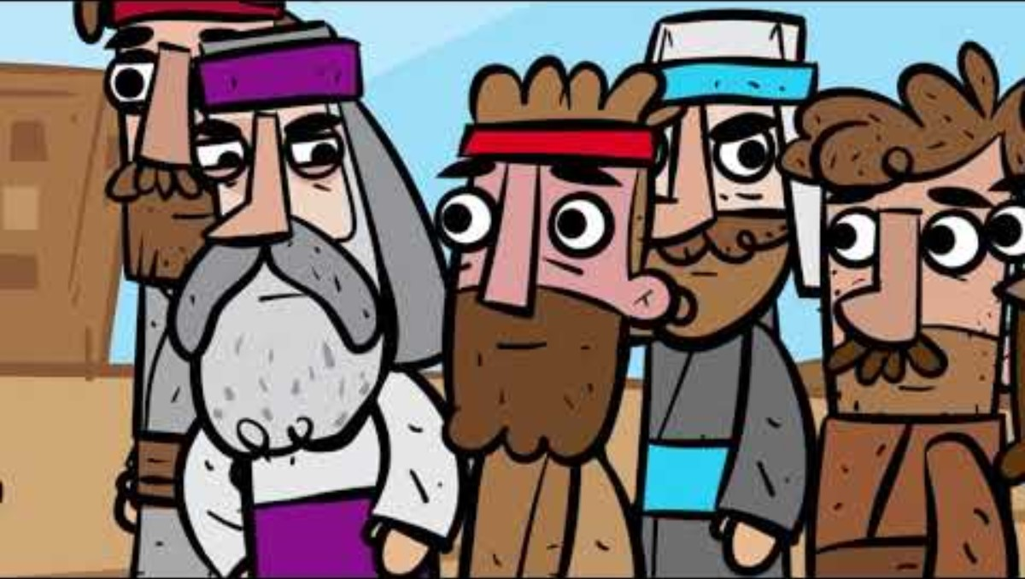

Humility and meekness
Jesus told a story that gives us an example of pride and humility. When we are humble, God is pleased!.
He lifts us up

Slide 22
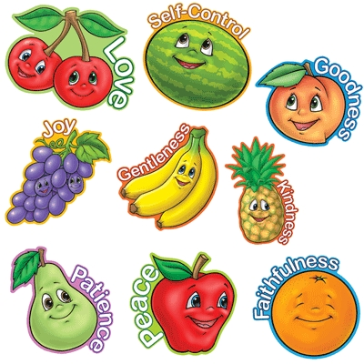

Beatitudes
BEE
⁶ “Blessed are those who hunger and thirst for righteousness, for they shall be satisfied
Great blessings belong to those who want to do right more than anything else.
God will fully satisfy them..
Truth seeker
What good things
should we be hungry for?

Slide 23
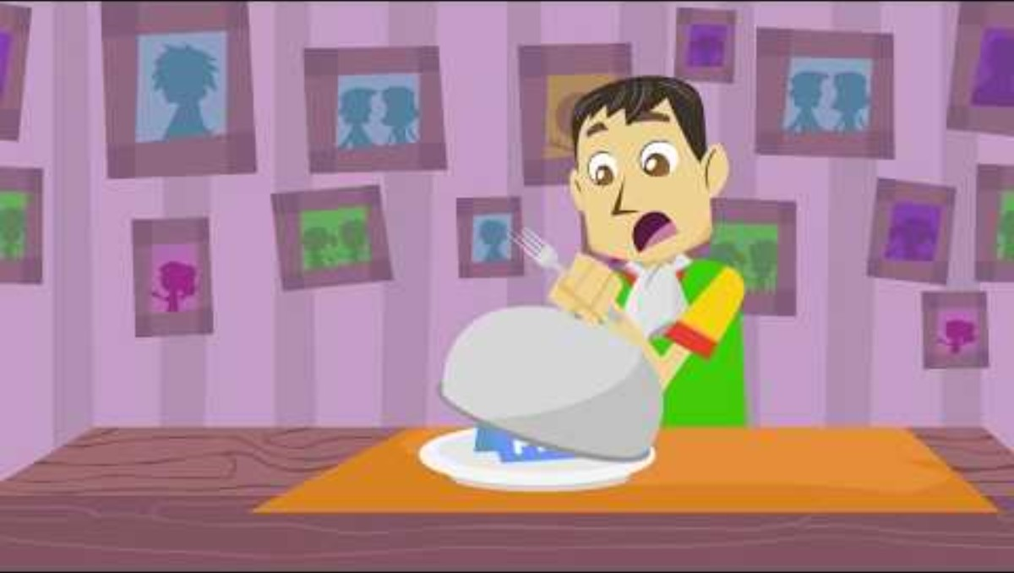
I get hungry for more of you God

Slide 24

Hungry for Righteousness

Slide 25
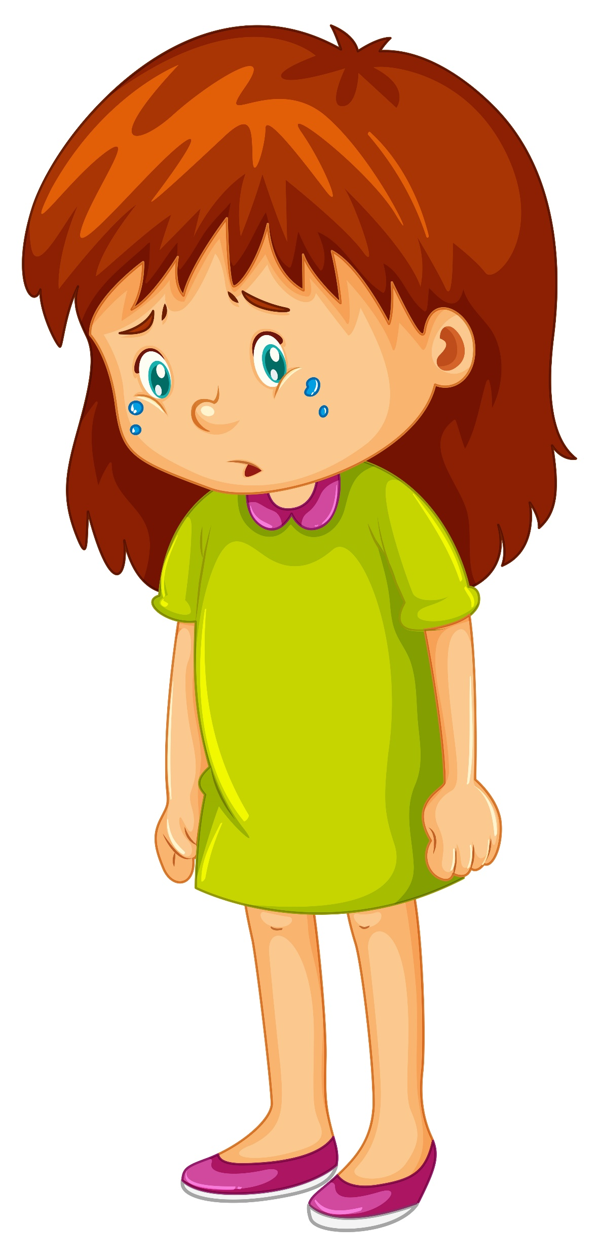
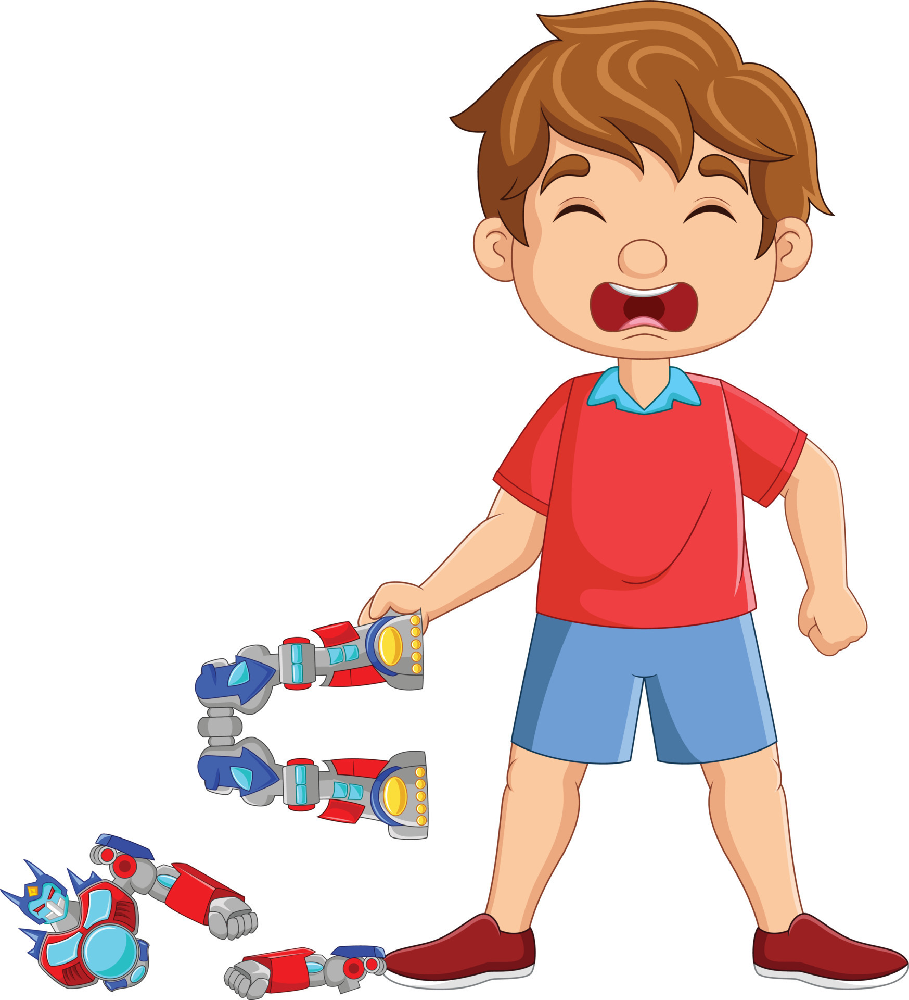



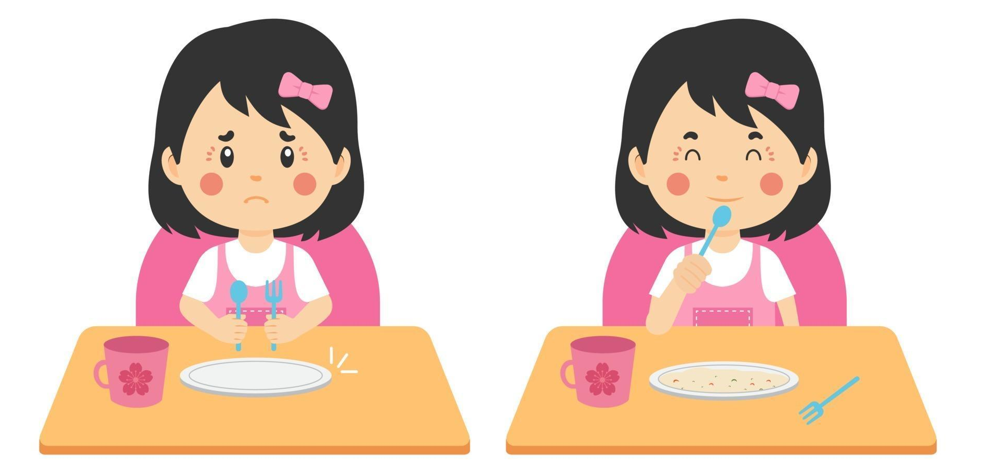
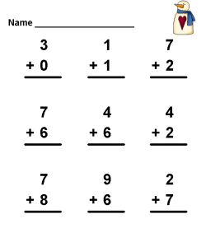
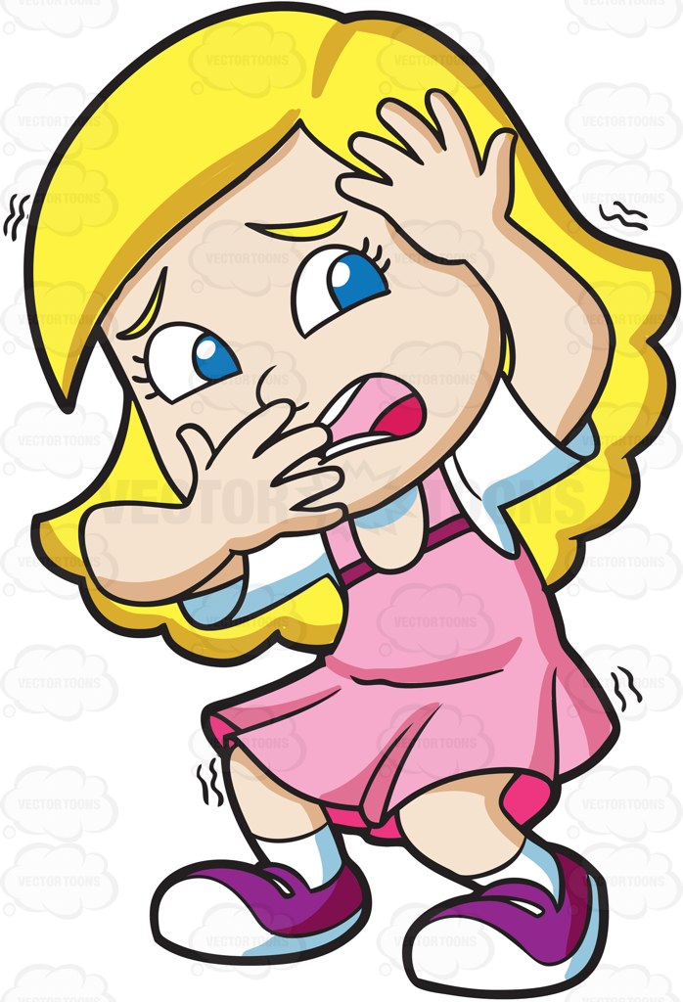

Beatitudes
BEE
Help others;
Give to others;
Forgive others
⁷ “Blessed are the merciful,
for they shall receive mercy.
Great blessings belong to those who show mercy to others.
Mercy will be given to them.
merciful
How can you be merciful to this person?
It broke!
No one wants to play with me.

Slide 26
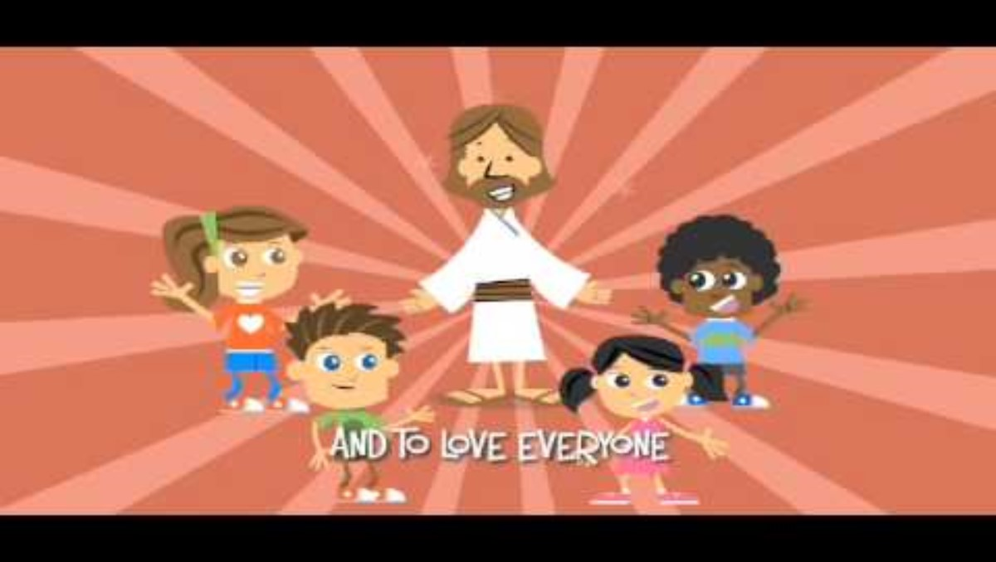
Love One Another

Slide 27


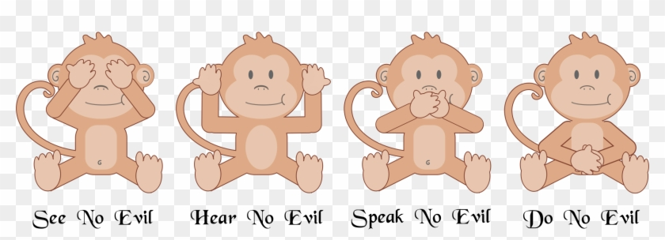
Beatitudes
BEE
I see good things
I think about good things
I do good things
⁸ “Blessed are the pure in heart,
for they shall see God.
Great blessings belong to those whose thoughts are pure.
They will be with God.
pure

Slide 28
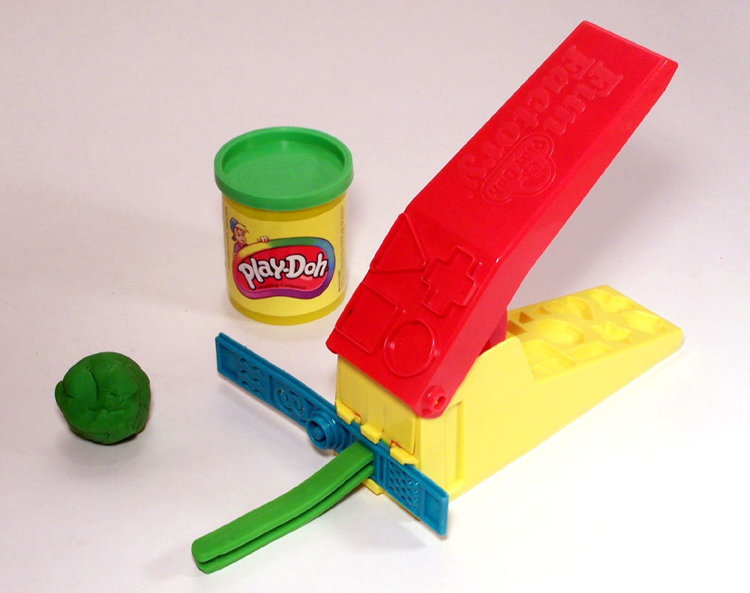
What goes in, comes out
Finally, brothers and sisters, whatever is true,
whatever is noble,
whatever is right,
whatever is pure,
whatever is lovely,
whatever is admirable
—if anything is
excellent or praiseworthy
—think about such things.
Philippians 4:8
I need some helpers. Let’s put some playdough in here and then you press the red lever. See it come out…
If I put green playdough in here. What will come out?
So, let’s say the green playdough is envy and jealousy. Advertisements can make us want a lot of unnecessary things. If we focus on that, we aren’t satisfied with what we have. That’s not excellent or praiseworthy.
This red playdough represents anger. What if we watch movies where people get mad or kill each other. Is that lovely? NO!
If we watch or listen to bad things, bad things are being remembered by our brain. They will come out in our words and actions. If we watch or listen to good things, it’s easier to think about good things.

Slide 29
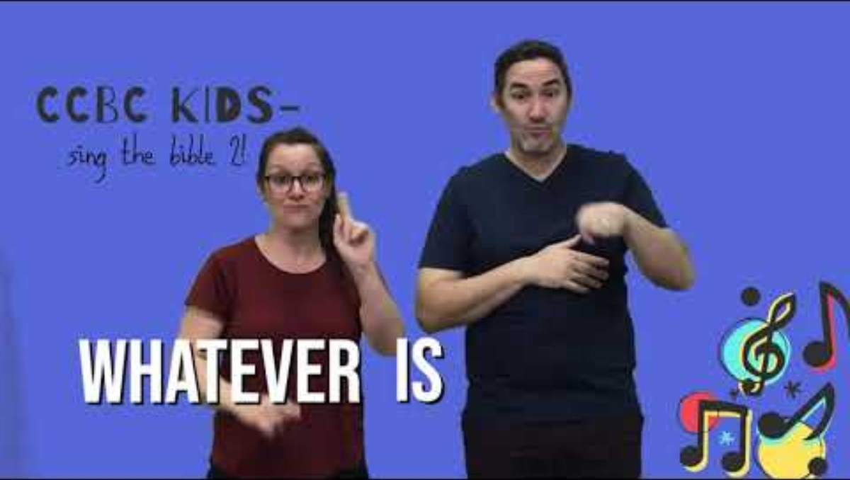
Read Philippians 4:8 and sing it

Slide 30


Beatitudes
BEE
“Blessed are the peacemakers,
for they shall be called sons of God.
Great blessings belong to those who work to bring peace.
God will call them his sons and daughters.
A peacemaker
Like snowflakes falling peacefully to the ground all together.
Look at all those sunflower seeds growing so close together, living at peace with each other.
https://www.daniellesplace.com/html/bible-crafts-beatitudes-peacemakers.html

Slide 31

How to be a Peacemaker

Slide 32
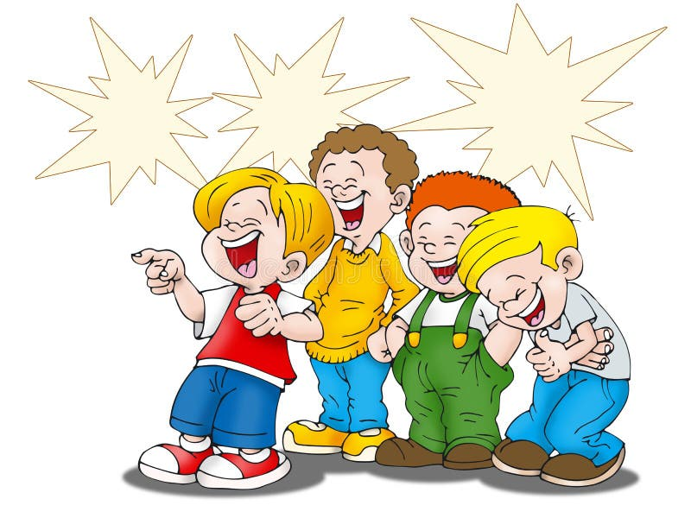
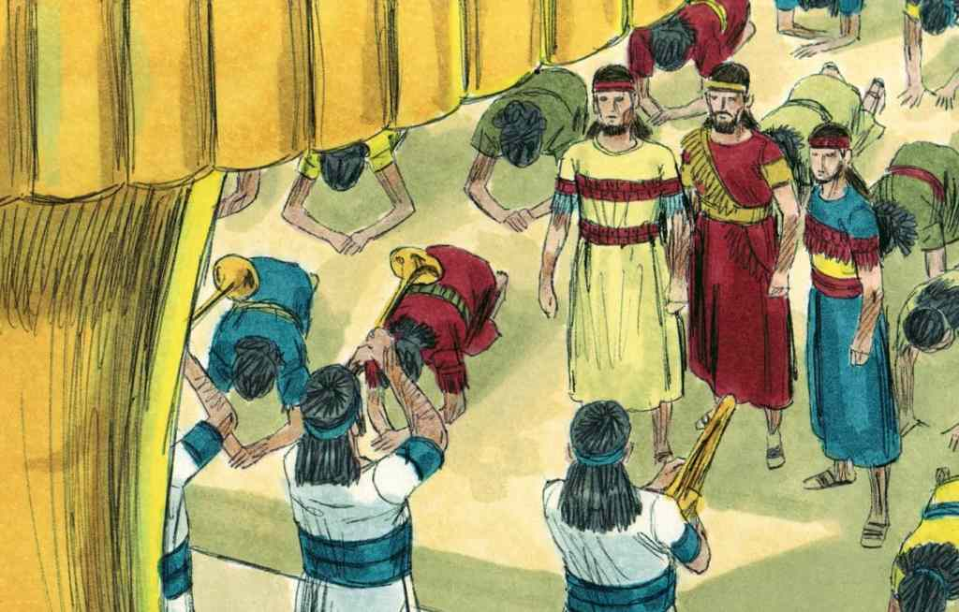
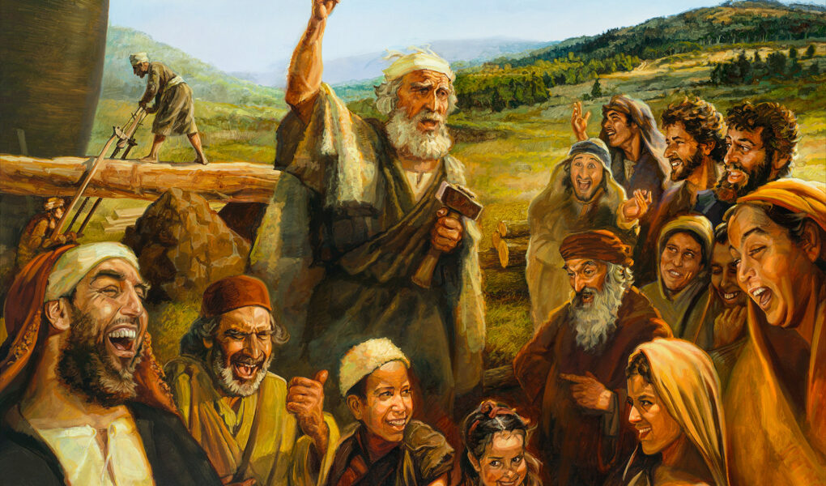
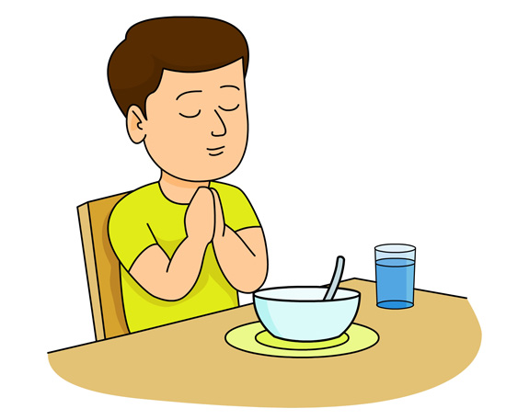
Beatitudes
BEE
¹⁰ “Blessed are those who are persecuted for righteousness' sake,
for theirs is the kingdom of heaven.
¹¹ “People will insult you and hurt you.
They will lie and say all kinds of evil things about you because you follow me. But when they do that, know that great blessings belong to you.
¹² Be happy about it. Be very glad because you have a great reward waiting for you in heaven.
People did these same bad things to the prophets who lived before you.
For example:
faithful
We will not bow to the statue idol.
We worship God.
There will be a flood. I’m building an ark.
I hope you come in to be safe.
Ha ha ha
You will die!

Slide 33

The Beatitudes – Review in Song

Slide 34

Jesus gives you a
Abunda-wonderful life!

Slide 35

https://activity-array.com/

Slide 36
EXTRA IDEAS

Slide 37
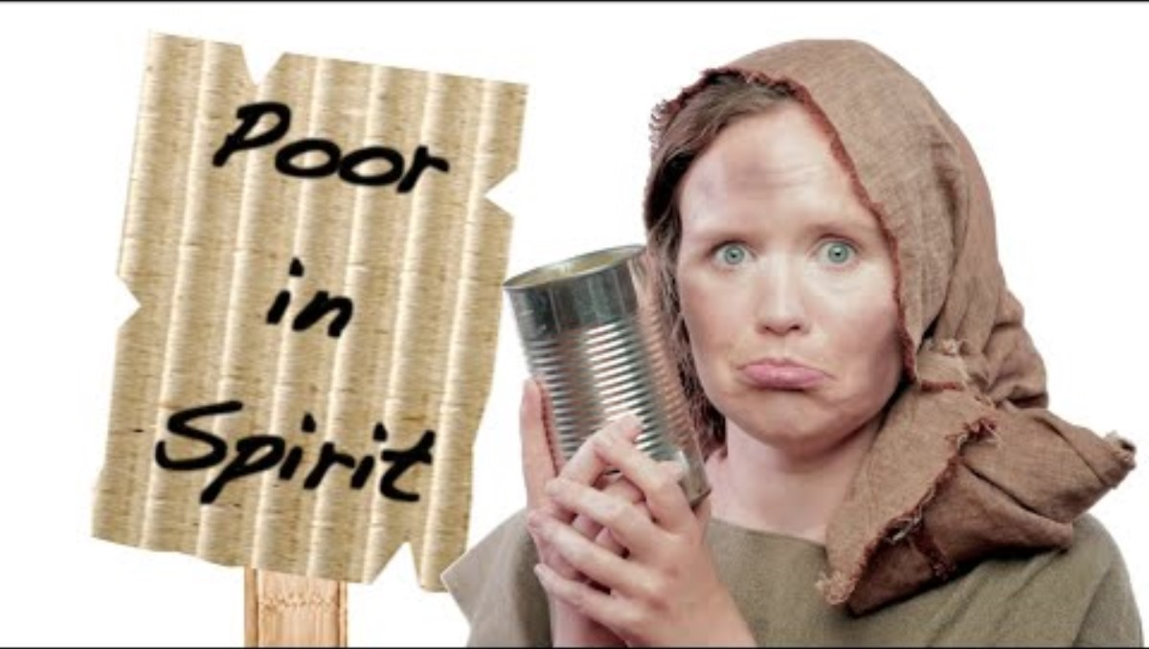
What does poor in spirit mean?
https://ministry-to-children.com/lesson-blessed-are-the-poor-in-spirit/ or watch the above video

Slide 38



Poor in Spirit
Is the attitude of realizing that you are poor in spiritual things and need God and His blessings!
Which blessings did you receive?
Look for and collect more of God’s blessings.
I need…..
Choose which spiritual blessing you need…
Paste them on the paper

Slide 39

How to be a Peacemaker

