Slide 1
Parable of the Sower
Matthew 13

Slide 2
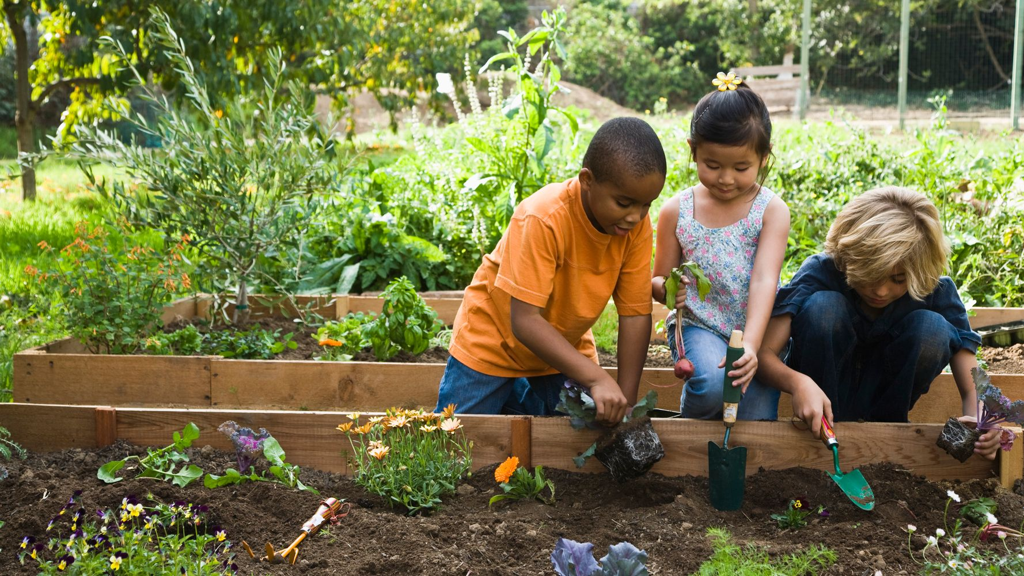
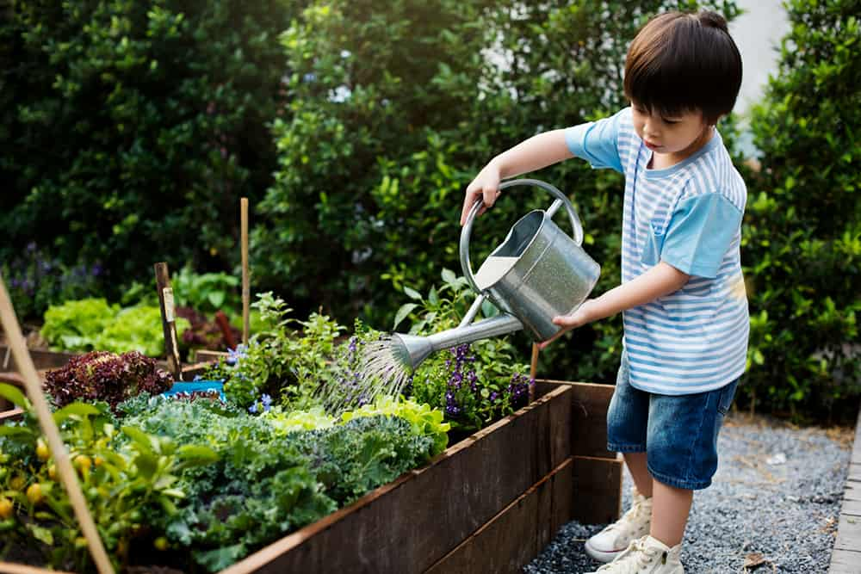
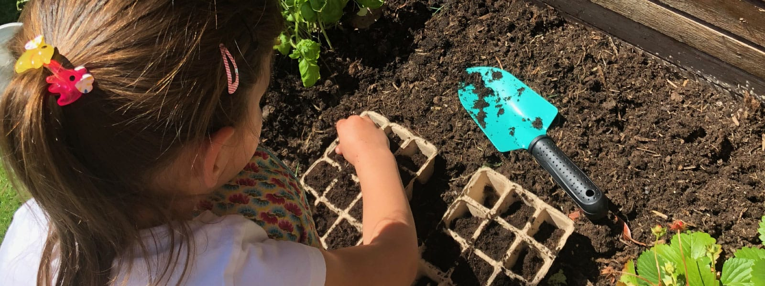
Have you ever planted a garden? Tell me about it.

Slide 3
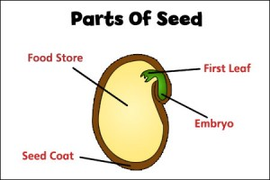
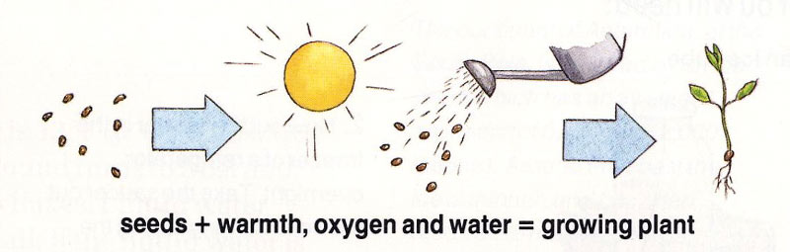
What do you know about seeds?
What do seeds need to grow?
What are the parts of a seed?

Slide 4
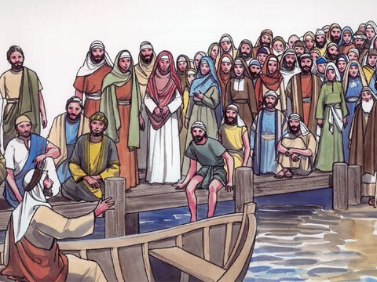
Matthew 13
13 That same day Jesus went out of the house and sat by the lake. ² Such large crowds gathered around him that he got into a boat and sat in it, while all the people stood on the shore. ³ Then he told them many things in parables, saying:

Slide 5
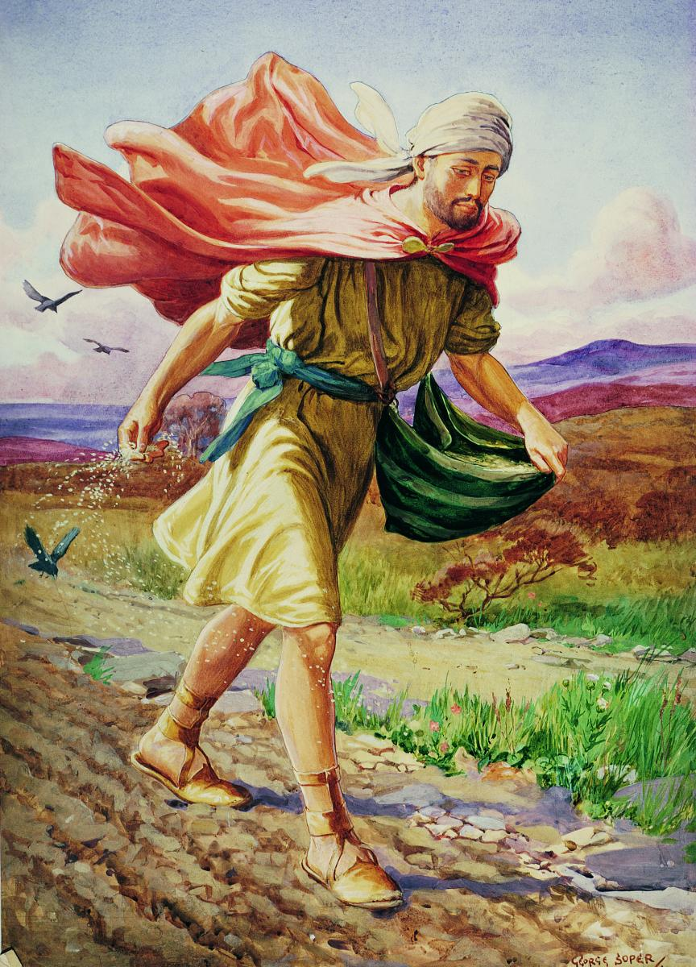
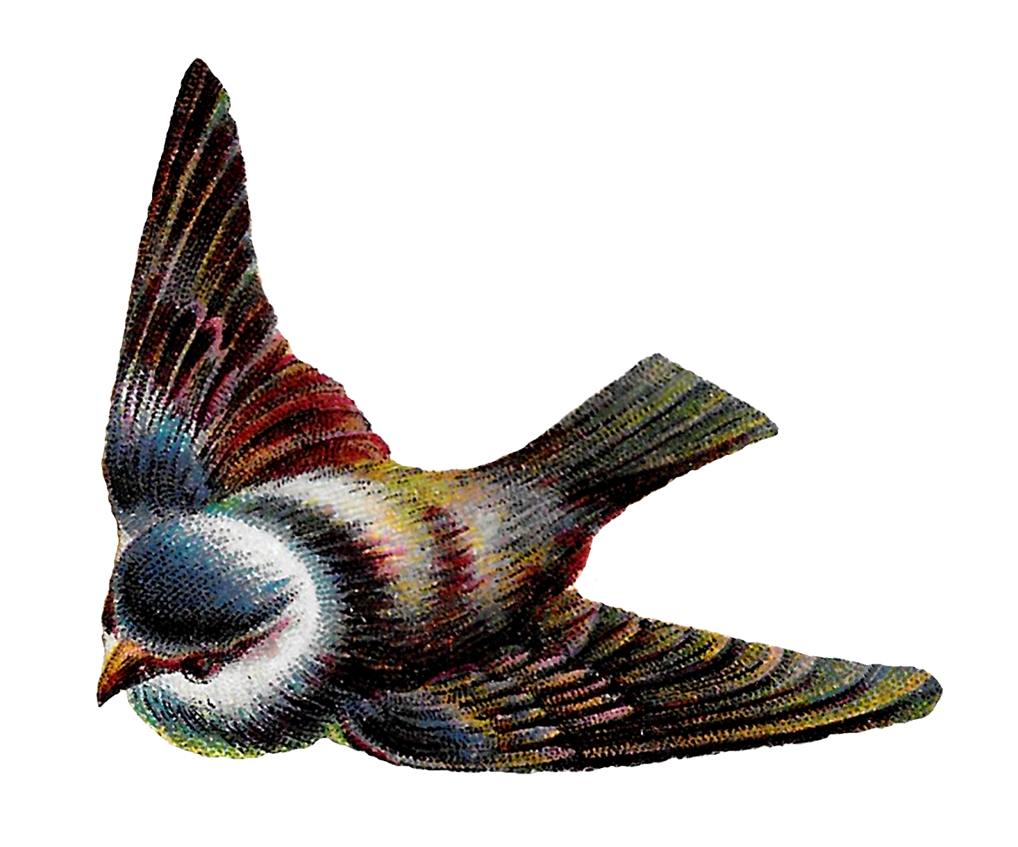
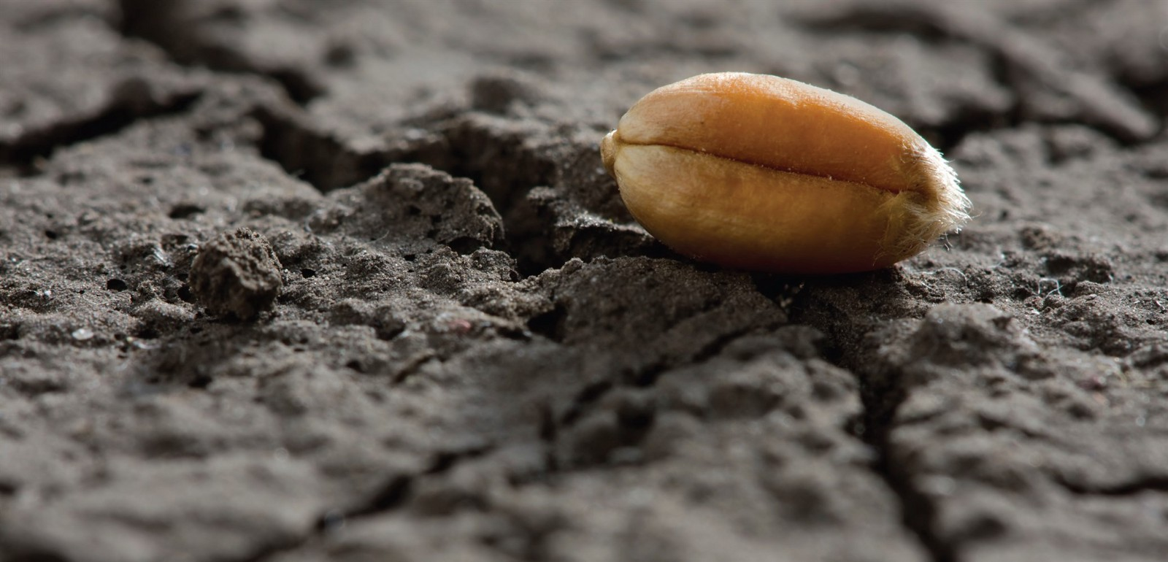
Seed on the Path
“A farmer went out to sow his seed.
⁴ As he was scattering the seed, some fell along the path, and the birds came and ate it up.

Slide 6


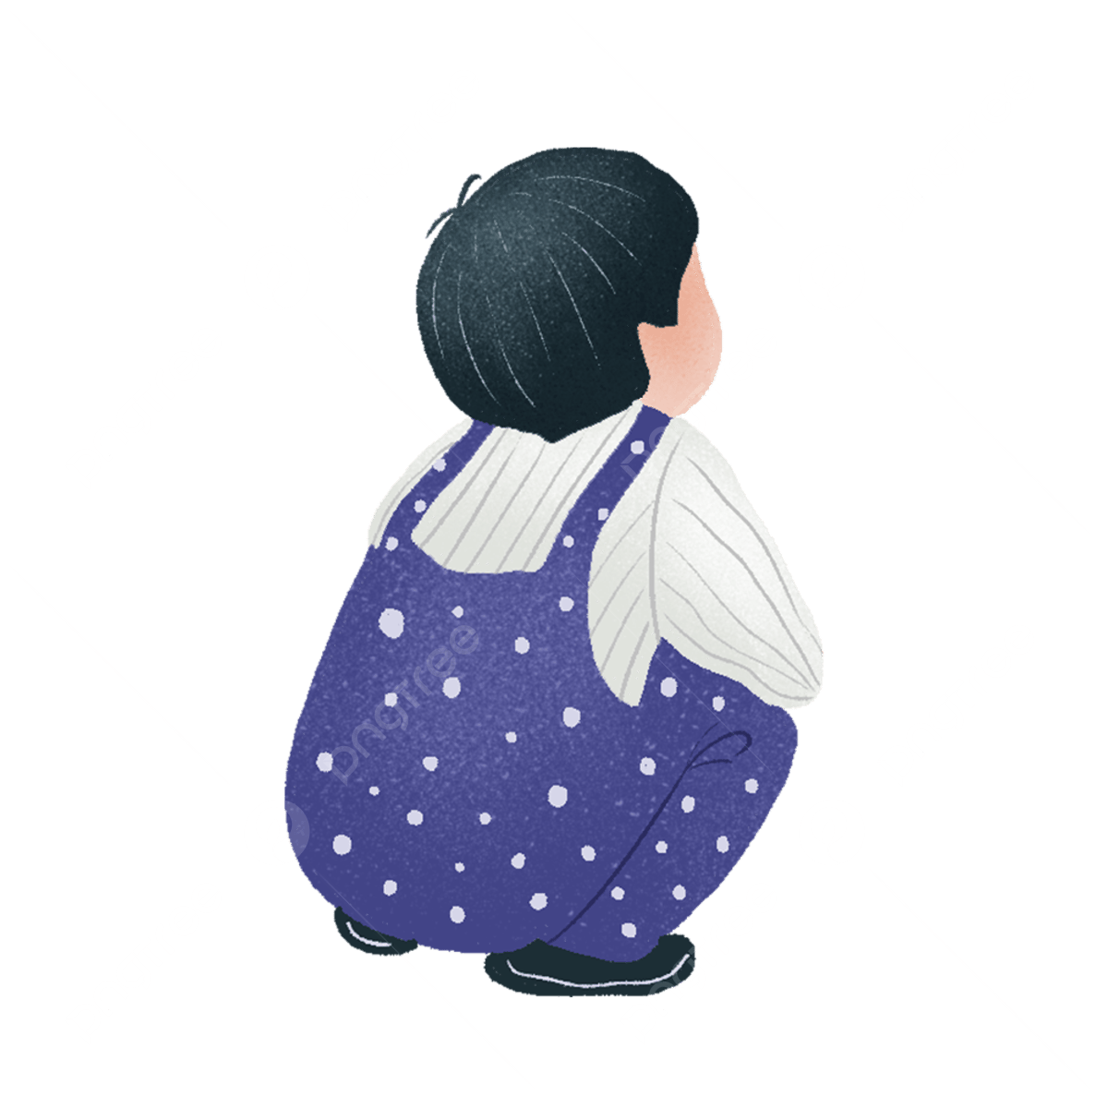
DO IT – CHARADES
Choose: Will you be a seed or a bird?
While I read the text again:
Seeds: squat down on the floor. & look like a seed
Birds: fly to a seed, touch them & say “yum!”
Seeds: Go back to your seat.
Birds: fly back to your seat
Yum
“A farmer went out to sow his seed.
⁴ As he was scattering the seed, some fell along the path, and the birds came and ate it up.

Slide 7
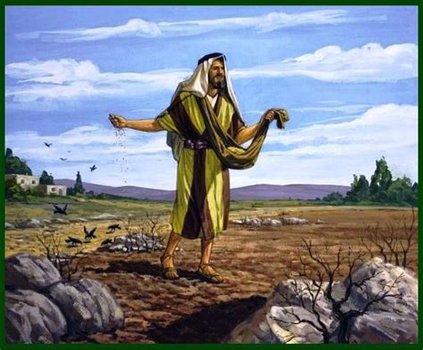
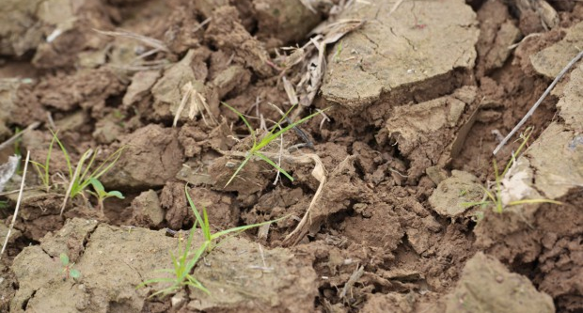

Seeds on the rocky places
⁵ Some fell on rocky places, where it did not have much soil. It sprang up quickly, because the soil was shallow. ⁶ But when the sun came up, the plants were scorched, and they withered because they had no root.

Slide 8


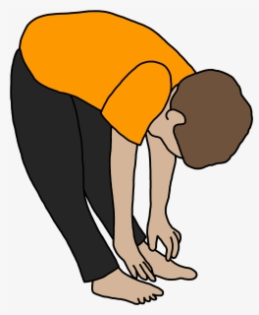
DO IT – CHARADES
Get 2 chairs to be like rocks; then pretend to be a seed.
While I read the text again:
Seeds: Between the 2 chairs, squat down on the floor. & look like a seed
Seeds: Grow quickly – stand up quickly; lift up your arms like leaves.
Seeds: Wilt – crop your arms, stoop down and then flop down on the ground.
⁵ Some fell on rocky places, where it did not have much soil.
It sprang up quickly, because the soil was shallow.
⁶ But when the sun came up, the plants were scorched, and they withered because they had no root.

Slide 9
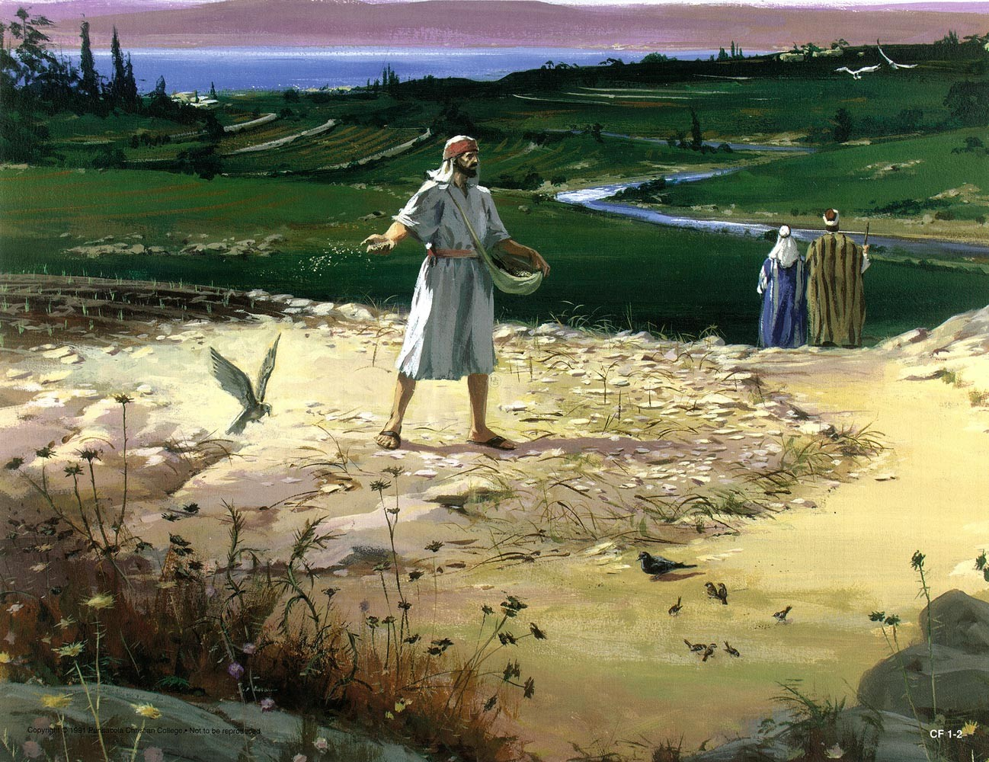
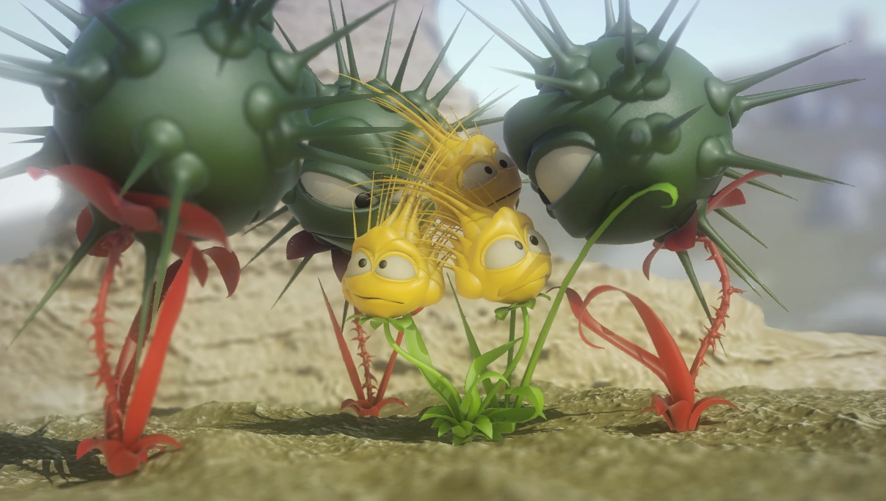
Seeds among thorns and weeds
⁷ Other seed fell among thorns, which grew up and choked the plants.

Slide 10
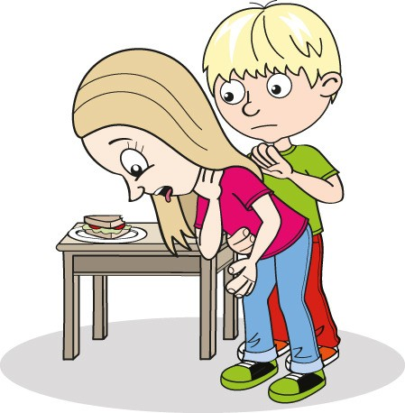
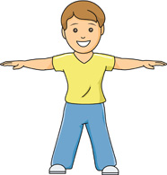
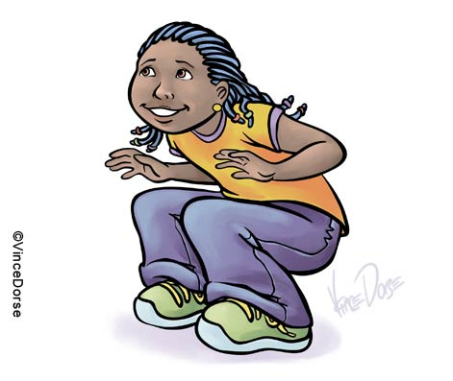
DO IT – CHARADES
Choose: Will you be a seed or a weed?
While I read the text again:
Seeds: squat down on the floor. & look like a seed
Weeds: squat down on the floor. & look like a seed
Seeds: Grow -- lift up your arms like leaves.
Weeds: Grow -- lift up your arms like leaves.
Weeds: Pretend to choke the seed plants
Seeds: Wilt – crop your arms, stoop down and then flop down on the ground.
⁷ Other seed fell among thorns,
which grew up
and choked the plants.

Slide 11
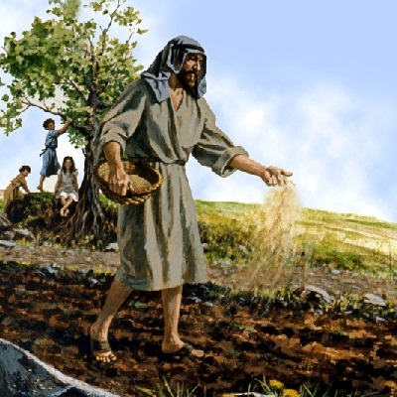
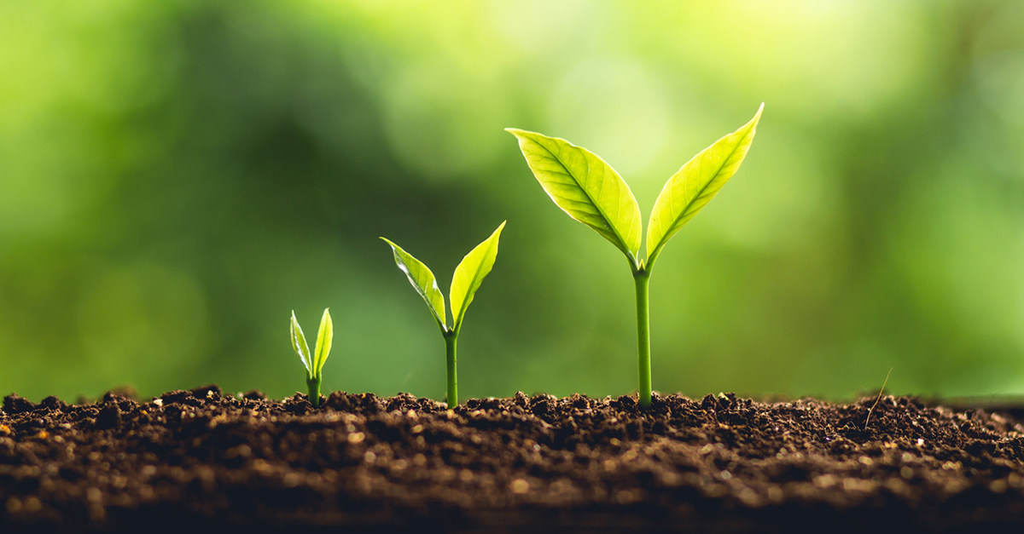
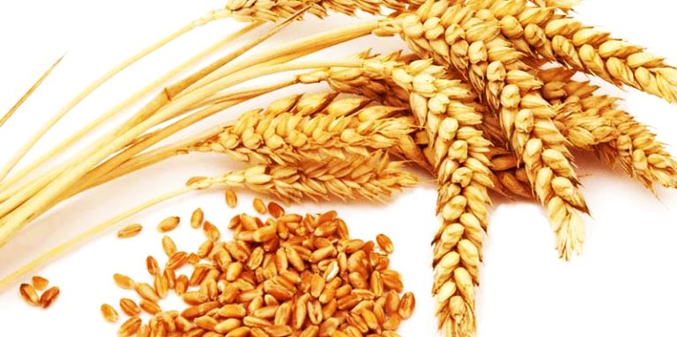
Seed on the good soil
⁸ Still other seed fell on good soil, where it produced a crop—a hundred, sixty or thirty times what was sown. ⁹ Whoever has ears, let them hear.”

Slide 12
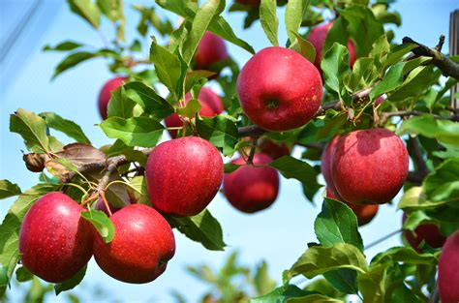
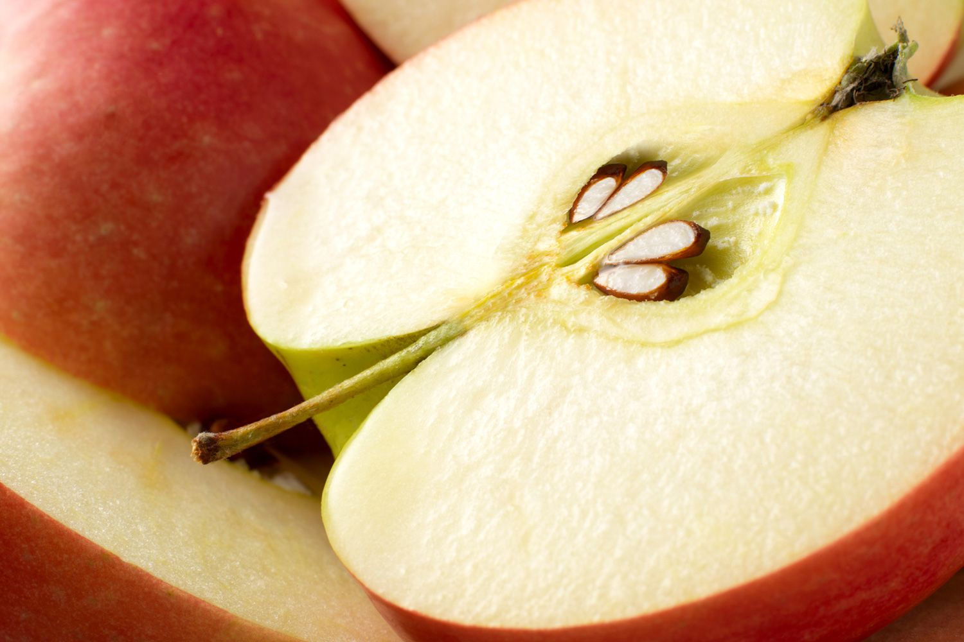
One seed produces many
⁸ Still other seed fell on good soil, where it produced a crop—a hundred, sixty or thirty times what was sown.
For example
1 seed grows into an apple tree that produces many, many apples which may each have 3-10 seeds.
1 seed will grow a wheat plant that produces many kernels

Slide 13



DO IT – CHARADES
Everyone be a seed
While I read the text again:
Seeds: squat down on the floor. & look like a seed
Seeds: Grow -- lift up your arms like leaves.
Seeds: Grow taller – stand on tip-toe and hold a fruit
⁸ Still other seed fell on good soil,
where it grew
and produced a crop—a hundred, sixty or thirty times what was sown.

Slide 14
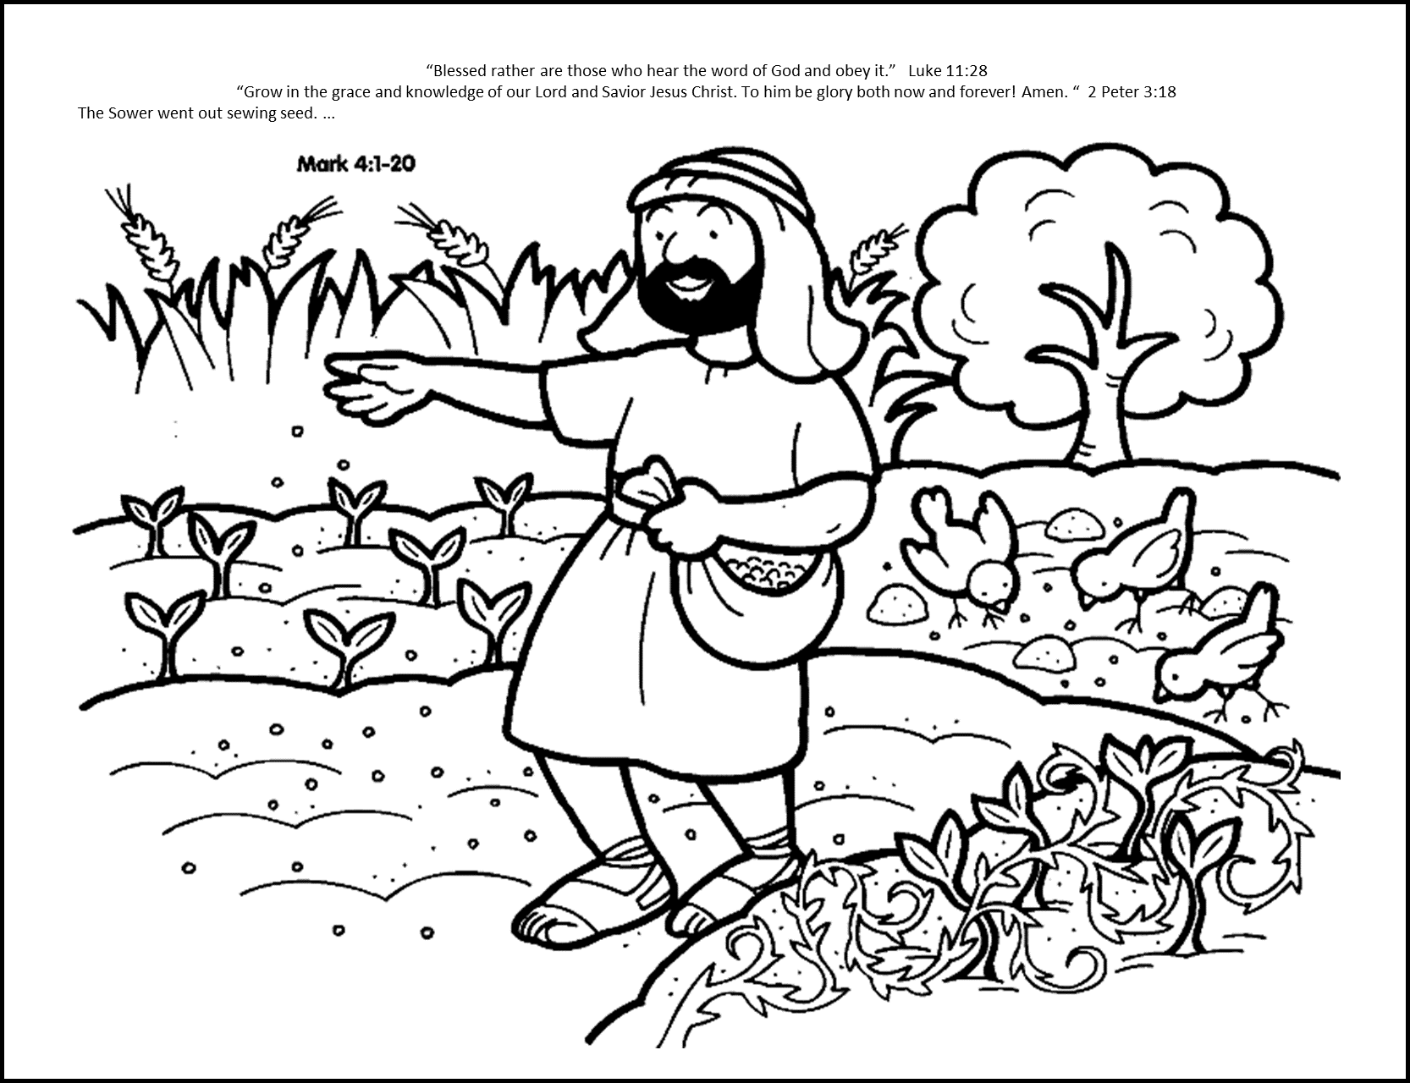

Coloring Time
You can color the picture while we continue the story.

Slide 15
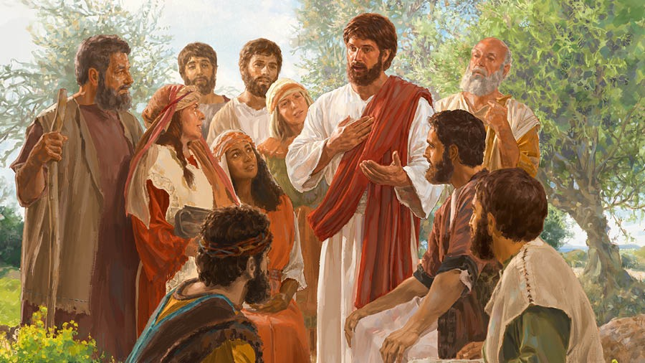
It’s like Isaiah said
Some people don’t want to really understand the truth, but I know that you do.
God can help you understand the truth.
Let me explain it to you….
¹⁰ The disciples came to him and asked, “Why do you speak to the people in parables?”
¹¹ He replied, “Because the knowledge of the secrets of the kingdom of heaven has been given to you, but not to them. ¹² Whoever has will be given more, and they will have an abundance. Whoever does not have, even what they have will be taken from them. ¹³ This is why I speak to them in parables:
“Though seeing, they do not see;
though hearing, they do not hear or understand.
¹⁴ In them is fulfilled the prophecy of Isaiah:
“‘You will be ever hearing but never understanding;
you will be ever seeing but never perceiving.
¹⁵ For this people’s heart has become calloused;
they hardly hear with their ears,
and they have closed their eyes.
Otherwise they might see with their eyes,
hear with their ears,
understand with their hearts
and turn, and I would heal them.’^{[a]}
¹⁶ But blessed are your eyes because they see, and your ears because they hear. ¹⁷ For truly I tell you, many prophets and righteous people longed to see what you see but did not see it, and to hear what you hear but did not hear it.
¹⁸ “Listen then to what the parable of the sower means:
Why do you speak in parables?
What does the parable mean?

Slide 16
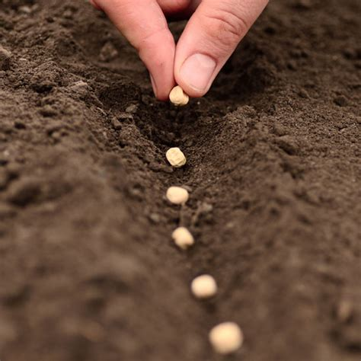


Luke 8
The seed is the Word of God.
Many hear the Word of God,
but not all are willing or ready to receive it.
¹¹ “This is the meaning of the parable:
The seed is the word of God.

Slide 17
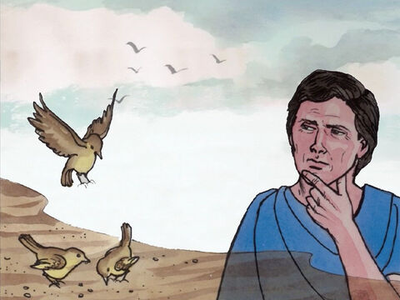
What does it mean?
I know it may seem like a waste and not worth it to sow on a hard path, but maybe some day someone will stop to listen to my words and believe them.
That sounds ridiculous.
Whatever – I don’t care what the Bible says. I’ve got places to go…
¹⁹ When anyone hears the message about the kingdom and does not understand it, the evil one comes and snatches away what was sown in their heart. This is the seed sown along the path.
Remember Jesus had said:
“A farmer went out to sow his seed.
⁴ As he was scattering the seed, some fell along the path, and the birds came and ate it up.

Slide 18
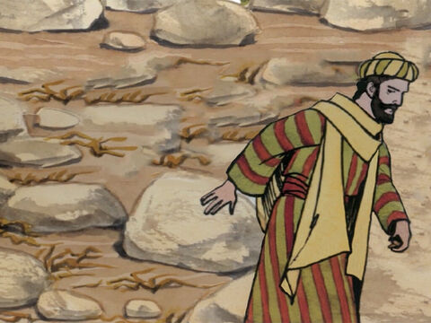
What does it mean?
But I do love you! Hold on.
I will help you through this hard time, if you let me.
It sounded good then, but now….
Life is too hard.
God must not love me.
²⁰ The seed falling on rocky ground refers to someone who hears the word and at once receives it with joy. ²¹ But since they have no root, they last only a short time. When trouble or persecution comes because of the word, they quickly fall away.
Remember Jesus had said:
⁵ Some fell on rocky places, where it did not have much soil. It sprang up quickly, because the soil was shallow. ⁶ But when the sun came up, the plants were scorched, and they withered because they had no root.

Slide 19
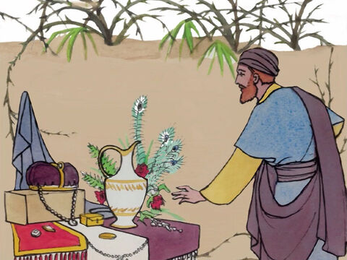
What does it mean?
Wow look! I want that!
I want to party, not go to church.
I’m too busy to spend time with God.
²² The seed falling among the thorns refers to someone who hears the word, but the worries of this life and the deceitfulness of wealth choke the word, making it unfruitful.
Remember Jesus had said:
⁷ Other seed fell among thorns, which grew up and choked the plants.

Slide 20
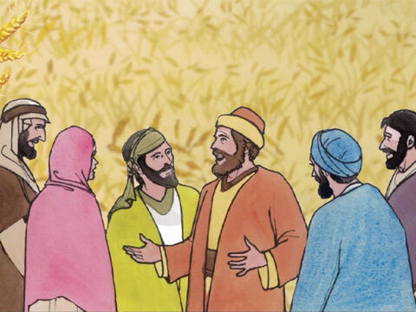
What does it mean?
I wonder what the truth is.
What does the Bible mean?
God has done so much for me!
I want to tell you the good news!
²³ But the seed falling on good soil refers to someone who hears the word and understands it. This is the one who produces a crop, yielding a hundred, sixty or thirty times what was sown.”
Remember Jesus had said:
⁸ Still other seed fell on good soil, where it produced a crop—a hundred, sixty or thirty times what was sown.
⁹ Whoever has ears, let them hear.”
How can I be a better person?
Who is Jesus?

Slide 21
“Blessed rather are those who hear the word of God and obey it.”
Luke 11:28

Slide 22
What does it mean?
I trust God. He gives me strength during hard times.
I enjoy spending time with God.
Praise God!
I’m so glad you love and trust Him too!
²³ But the seed falling on good soil refers to someone who hears the word and understands it. This is the one who produces a crop, yielding a hundred, sixty or thirty times what was sown.”
Remember Jesus had said:
⁸ Still other seed fell on good soil, where it produced a crop—a hundred, sixty or thirty times what was sown.
⁹ Whoever has ears, let them hear.”
God helps me make good choices.
God has given me lots to share.

Slide 23
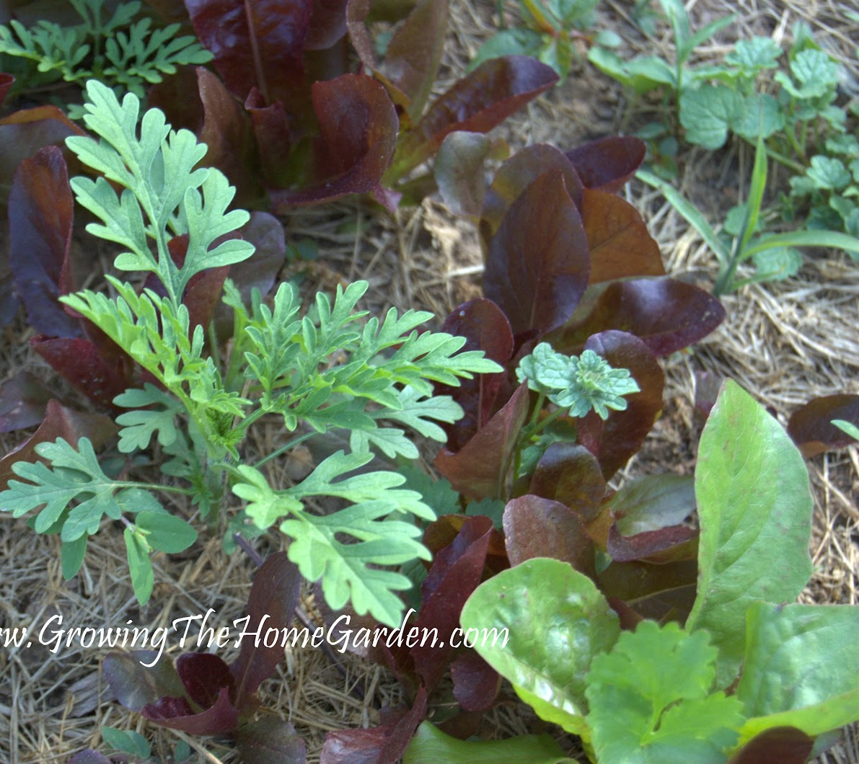
So what kind of soil do you want your heart be?
I want a soft heart, willing to learn!

Slide 24

“But grow
in the grace
and knowledge
of our Lord and Savior
Jesus Christ.
To him be glory
both now and forever!
Amen.
2 Peter 3:18
2 Peter 3:18

Slide 25
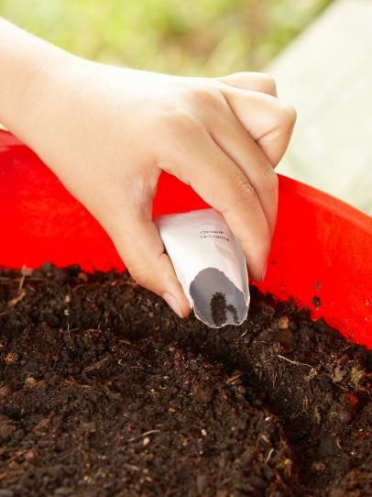
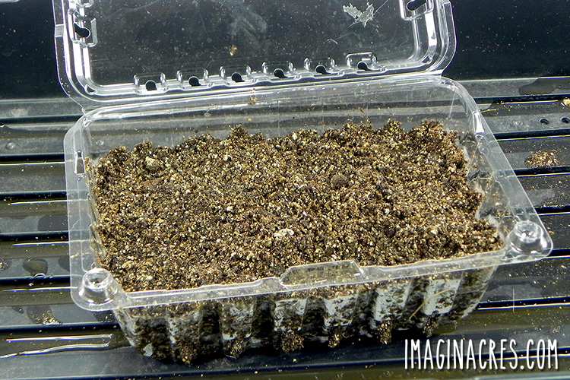
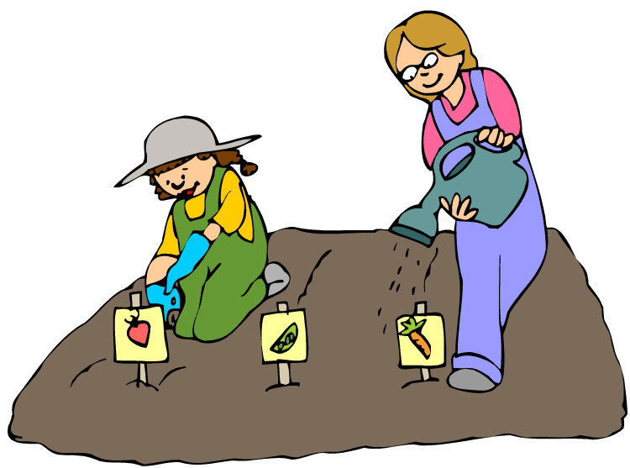
Activity Time
We want to be like the good soil and be ready to hear and understand God’s Word.
Let’s prepare to plant some seeds.
In an empty salad container:
Put in some soil and press it down
Prepare the soil:
  Loosen it up with a rake or fork
  Make a line or hole in the soil for seeds
Plant some seeds
Water your seeds to keep the soil moist, but don’t flood it.

Slide 26

Read your Bible Pray everyday

Slide 27
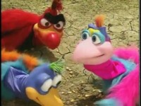
The Sower by the Donut man

Slide 28
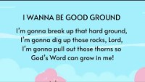
I Wanna Be Good Ground

Slide 29

https://activity-array.com/

