Slide 1

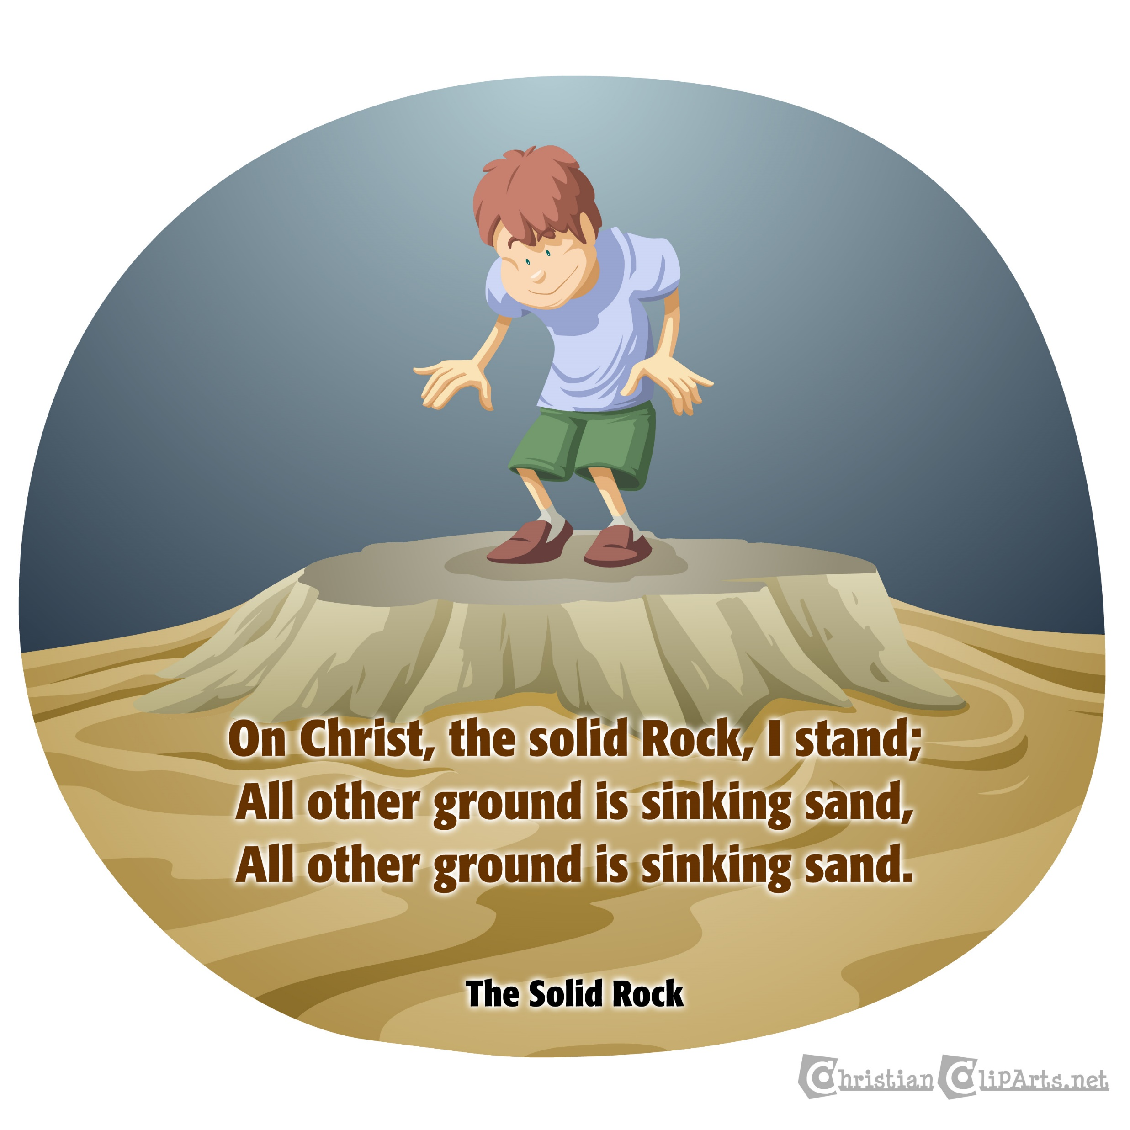
Wise build on the rock
Matthew 7:24-27 Luke 6:46-49

Slide 2
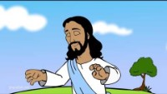


Slide 3
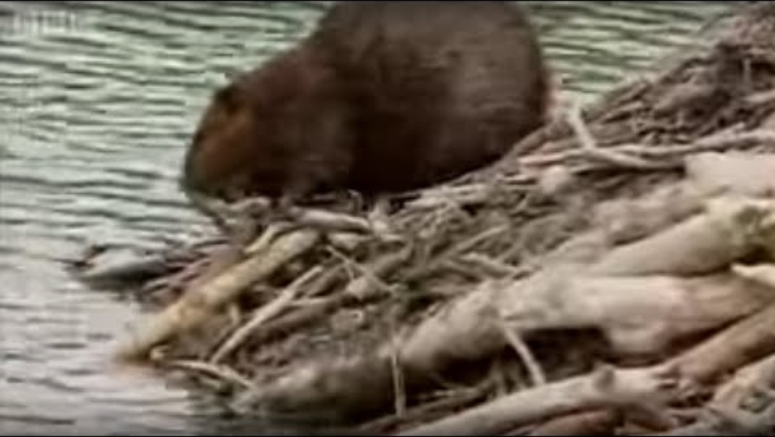
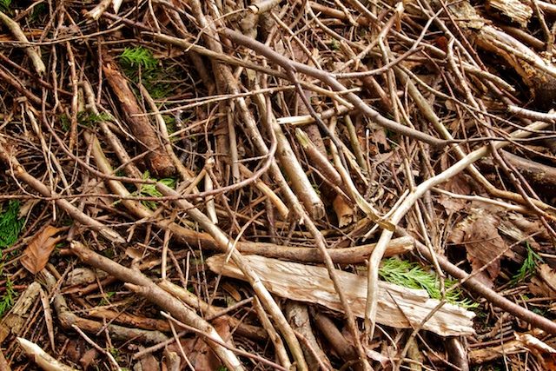
4 minutes

Slide 4
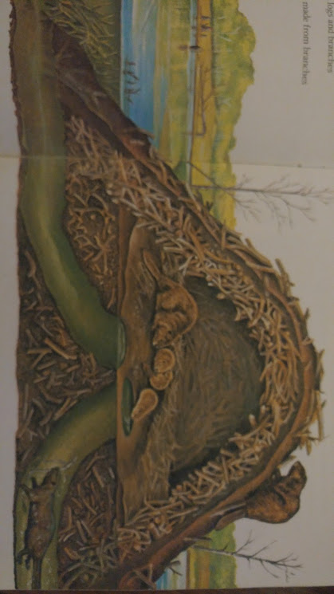
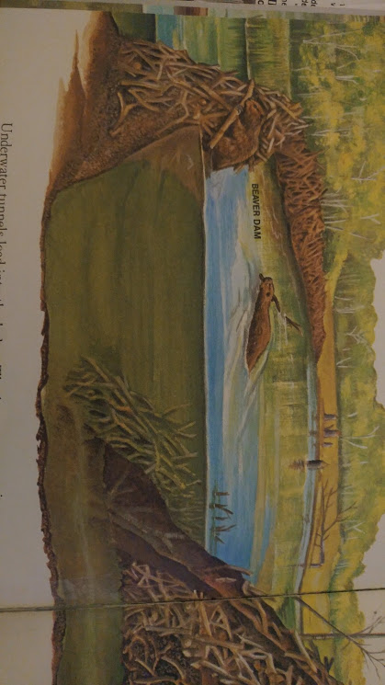
Beavers build a very strong dam to withstand the waters.
Then they build a strong lodge.
They put the sticks firm in the bottom of the river
And add rocks and mud to make it stronger.
They continue to add more and more sticks.
Beaver Architects

Slide 5
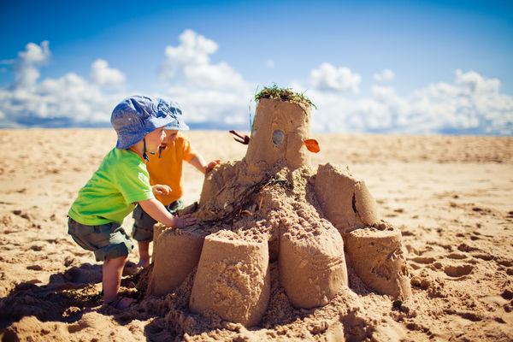
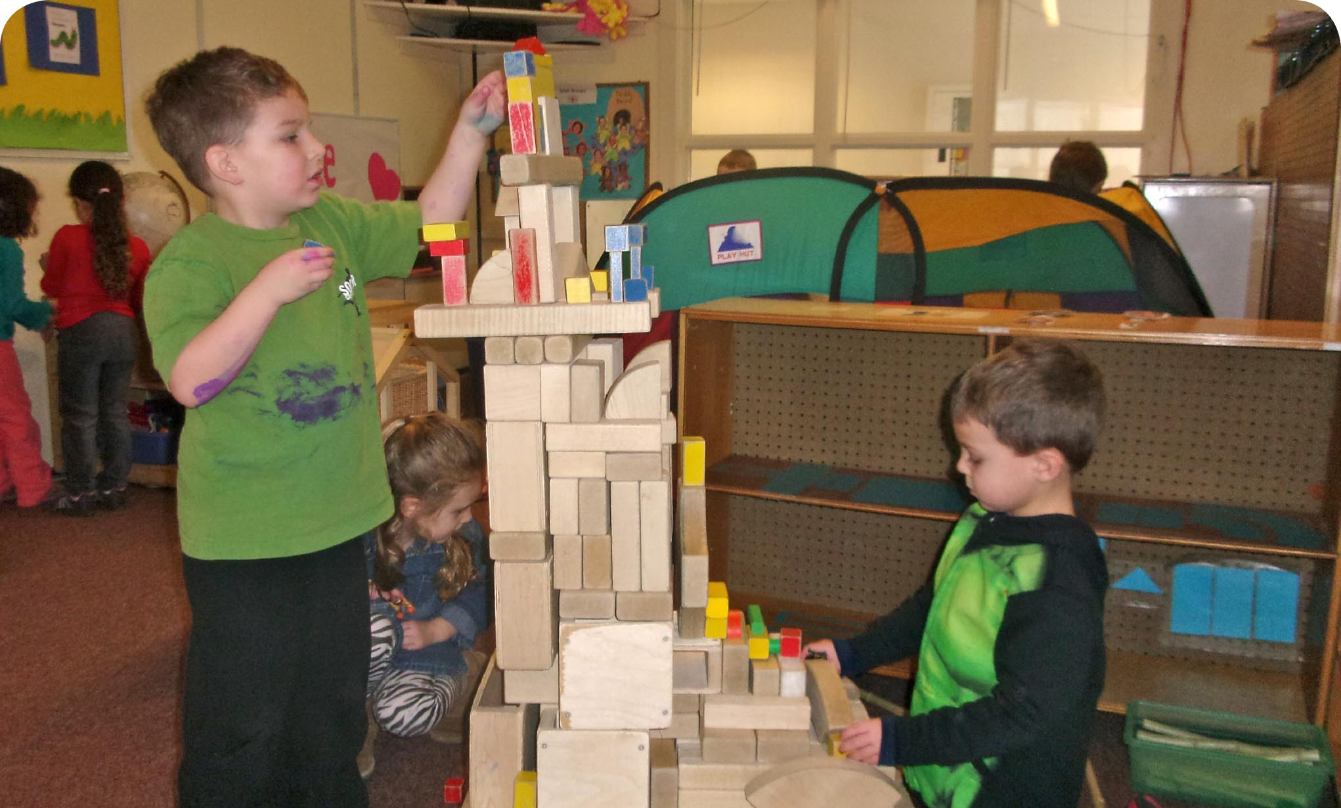

Do you like to build?
What do you like to use?
Let’s build a house

Slide 6
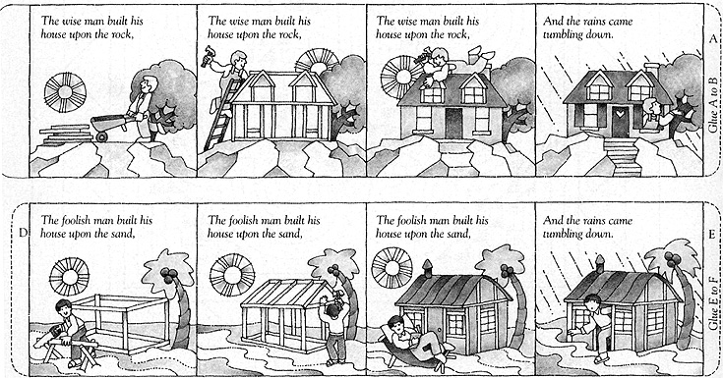
Build
FOOLISH MAN — BLUE FRAME
Cut out the blue frame above. Fold the blue frame on each section and glue the ends together to make a house.
Cut out the blue roof and fold on the dotted line. Put on the roof on the house.
WISE MAN — BROWN FRAME
Cut out the brown frame above. Fold the brown frame on each section and glue the ends together to make a house.
Cut out the brown roof and fold on the dotted line. Put on the roof on the house.

Slide 7
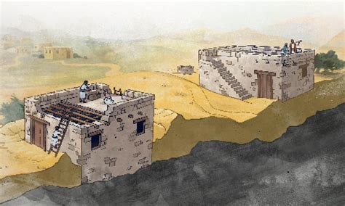
Matthew 7:24-28
²⁴ “So then, everyone who hears my words and puts them into practice is like a wise man.
He builds his house on the rock.
²⁶ But everyone who hears my words and does not put them into practice is like a foolish man.
He builds his house on sand.

Slide 8
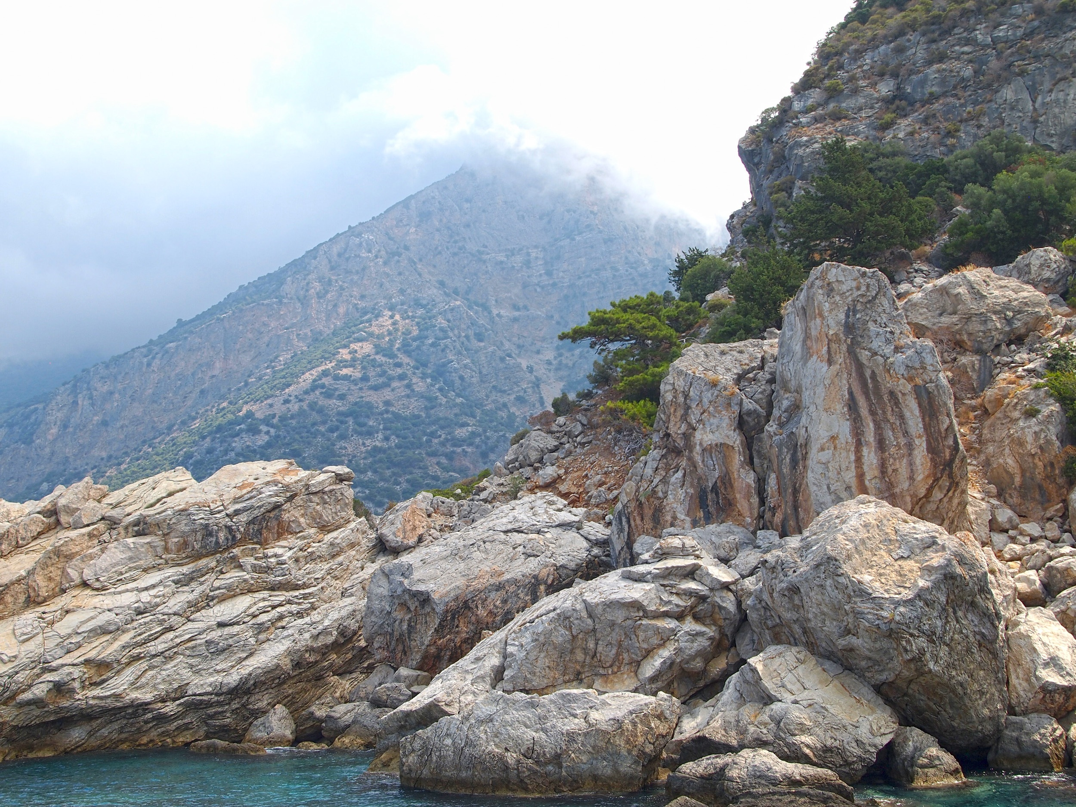
Jesus is the rock
He doesn’t change
His word is always true
It is a firm place to stand
He is strong
My God is my rock
In whom I take refuge.
Psalms 18:2
The Lord is my rock and my place of safety. He is the God who saves me.
My God is my rock. I go to him for safety.

Slide 9
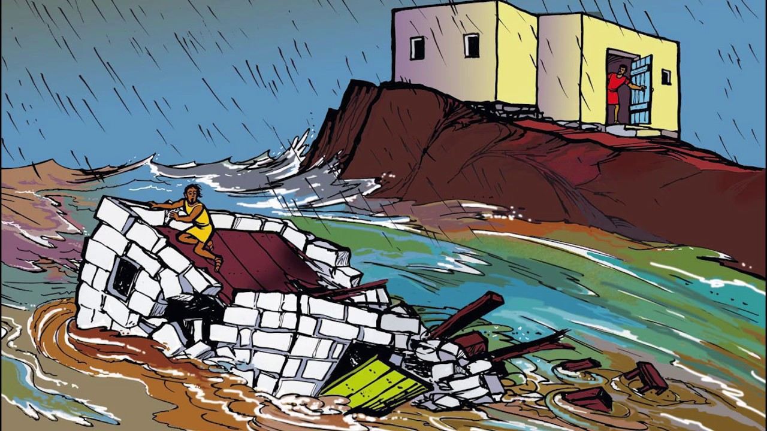
Matthew 7:24-28
²⁴ “So then, everyone who hears my words and puts them into practice is like a wise man.
He builds his house on the rock. ²⁵ the rain comes down. The water rises. The winds blow and beat against that house. But it does not fall.
It is built on the rock.
²⁶ But everyone who hears my words and does not put them into practice is like a foolish man.
He builds his house on sand.
²⁷ The rain comes down. The water rises. The winds blow and beat against that house. And it falls with a loud crash.”

Slide 10
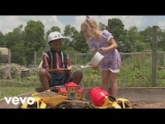
Wise man and foolish man

Slide 11
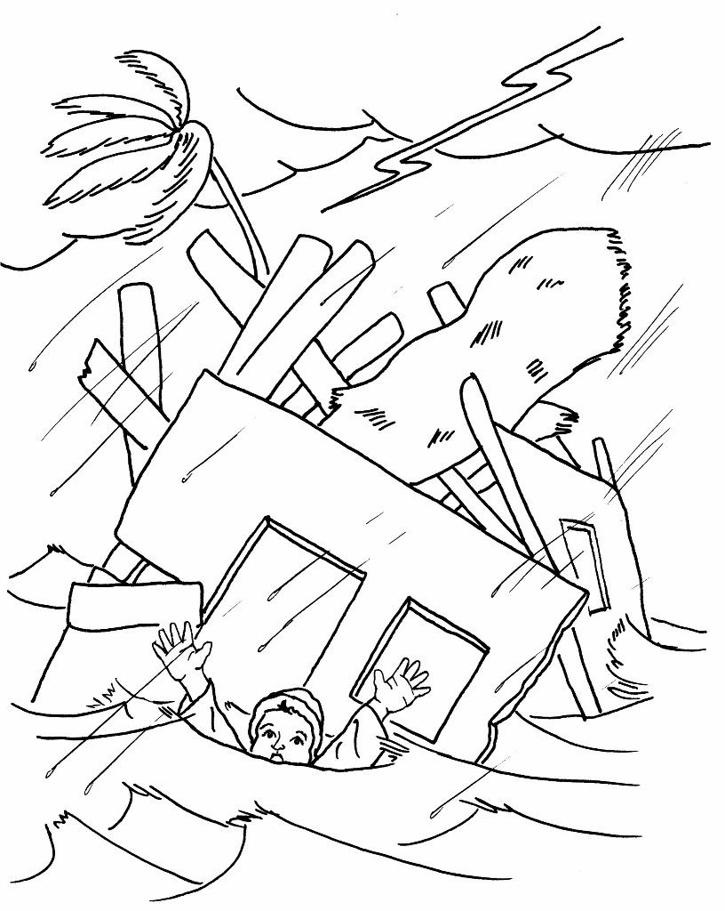
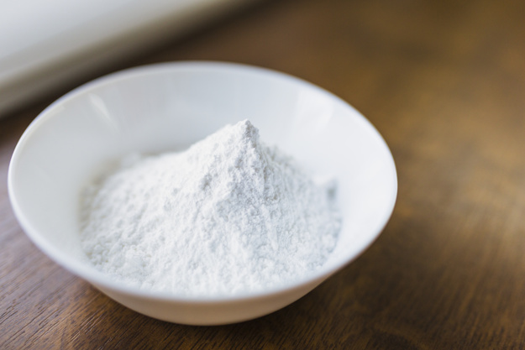
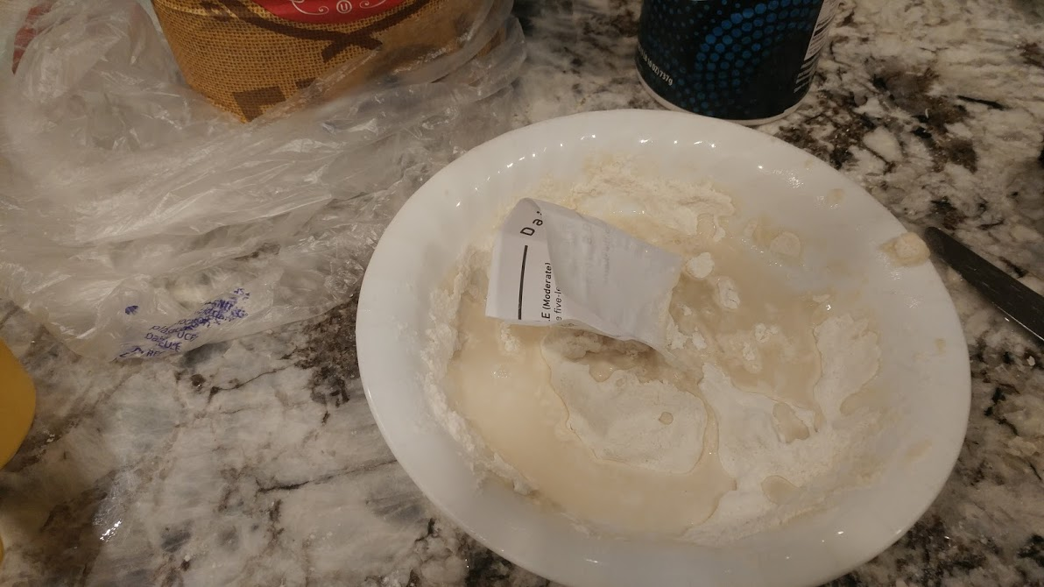
action
ACTION
In a bowl mix 1/4 cup flour & 1 tsp salt
Place the Foolish man house (blue) on the mix
Pour 1/4 cup water towards the house to knock it down.

Slide 12

Wise man and foolish man

Slide 13
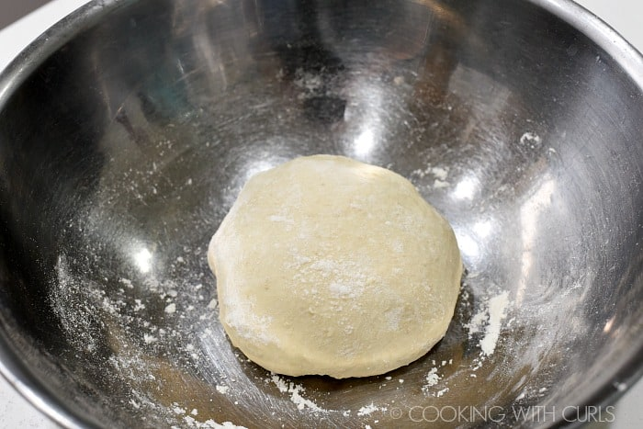
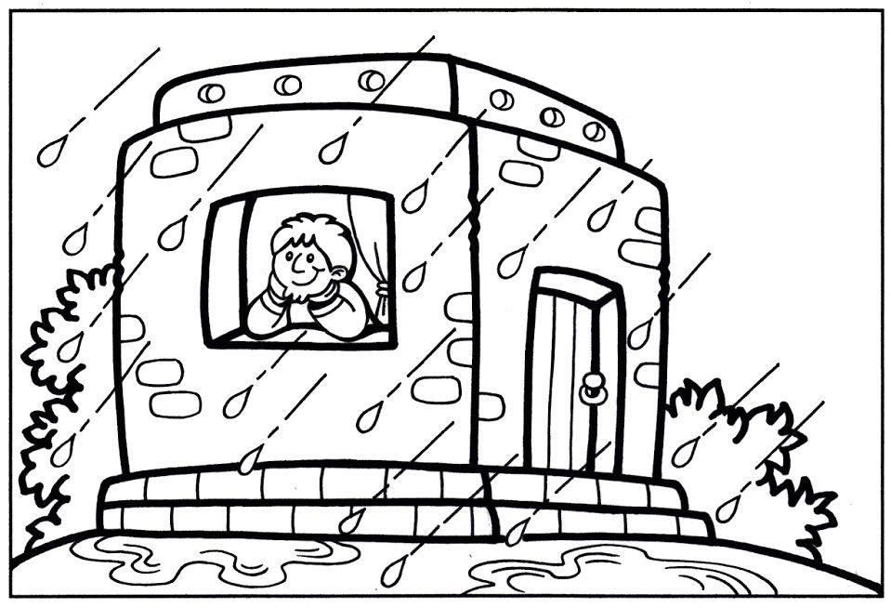
action
ACTION
Remove the house. Add 1/4 cup flour. Mix the water and flour to make a firm dough “rock”
Press the brown Wise man house firmly into the dough.
Again pour water on the house. Did it stay firm?
Add more flour to make a dough and form a heart. Those who remember God’s words to love & honor God and to love others are like the wise man.

Slide 14

Wise mand foolish man

Slide 15
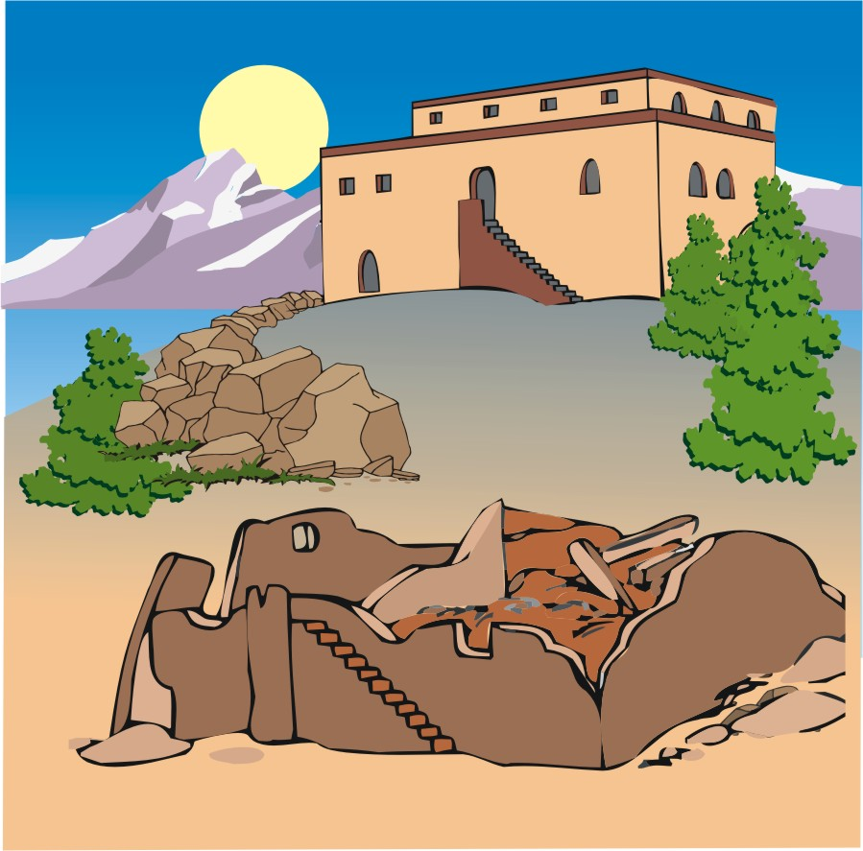
Luke 6:46-49
⁴⁷ Some people come and listen to me and do what I say. I will show you what they are like. ⁴⁸ They are like a man who builds a house. He digs down deep and sets it on solid rock. When a flood comes, the river rushes against the house. But the water can’t shake it. The house is well built.
⁴⁹ But here is what happens when people listen to my words and do not obey them. They are like a man who builds a house on soft ground instead of solid rock. The moment the river rushes against that house, it falls down. It is completely destroyed.”

Slide 16

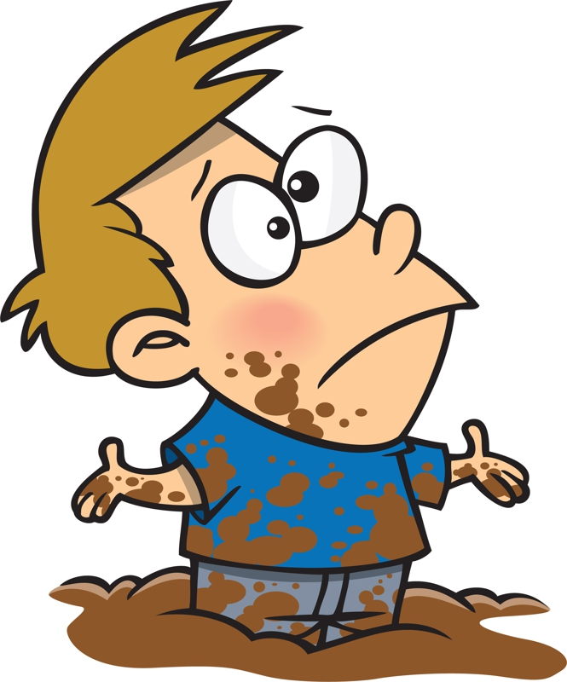





Compare scripture
Look up and read
James 1:22-25

Slide 17


What words should I remember?
What did Jesus say?
Love God – He loves you and gives you so much!
Love others because God loves them too!

Slide 18



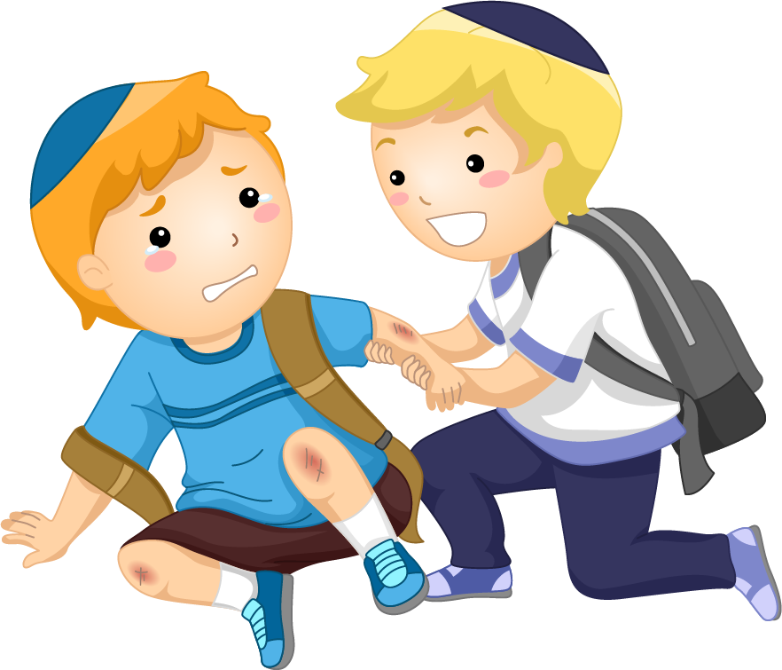

Slide 19




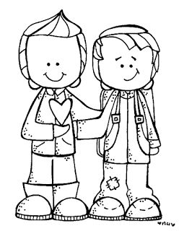
Be a Peacemaker

Slide 20
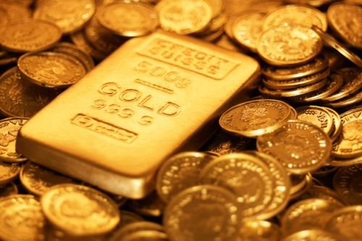
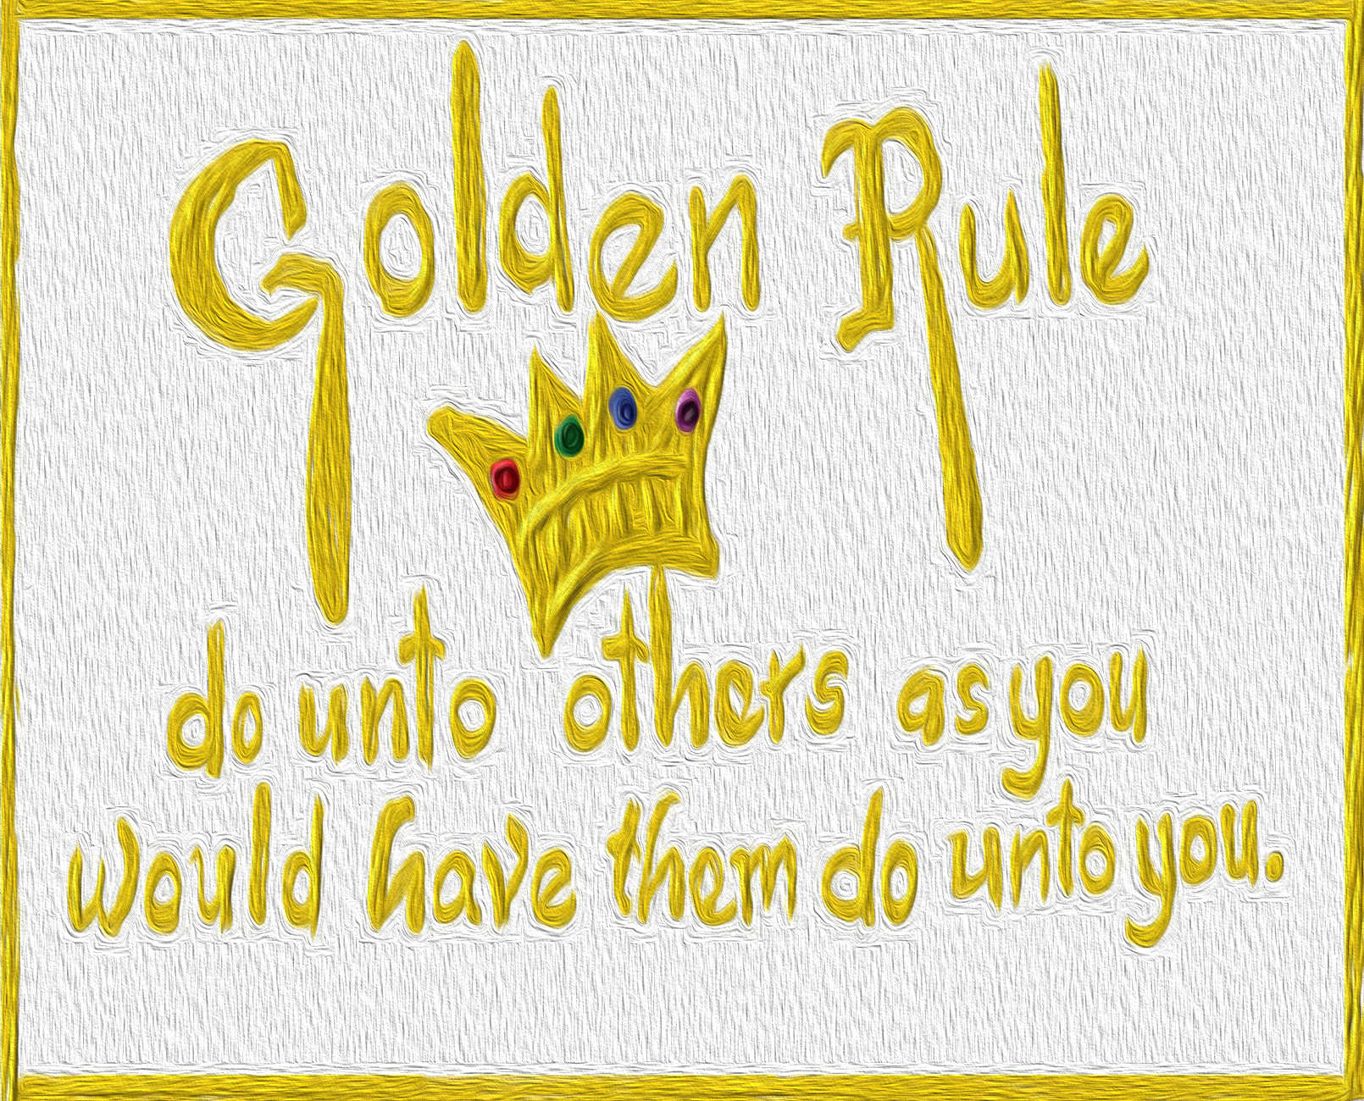
Matthew 7:12
¹² In everything,
do to others
what you would want them
to do to you.
This is what is written in the law and in the prophets.

Slide 21

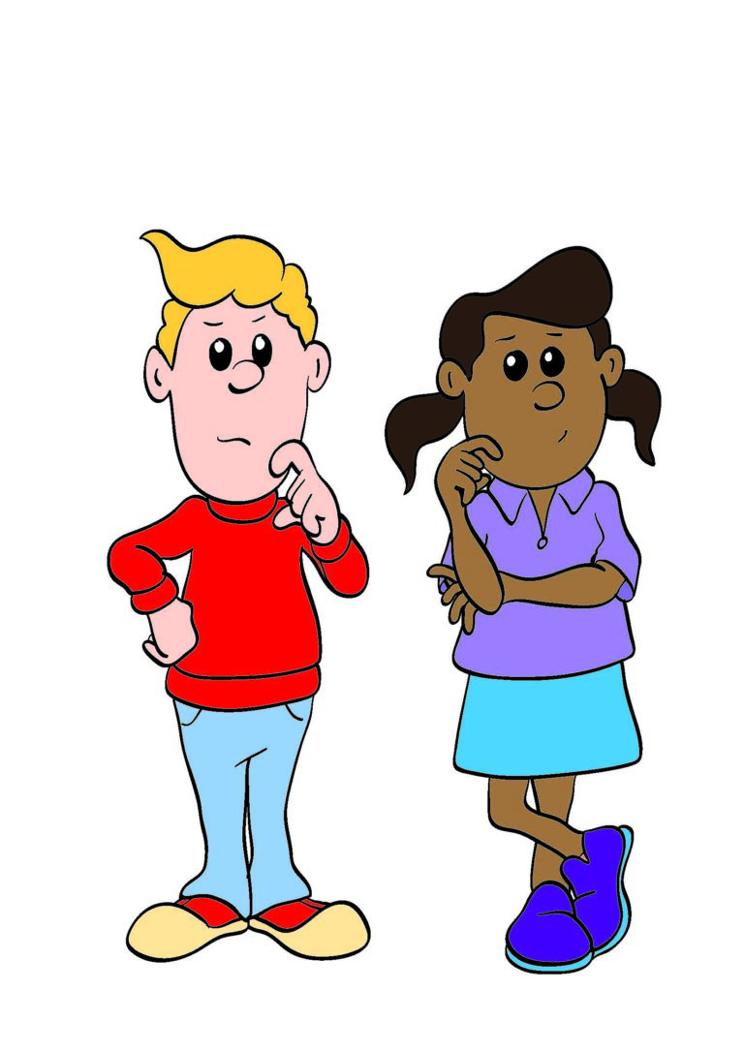

Shall I
demand to be first
Or let you go first?
How would you like to be treated?

Slide 22
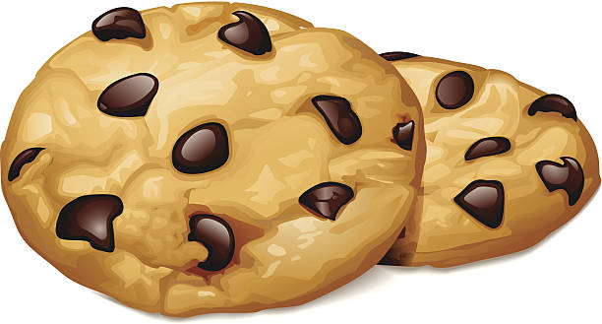
Shall I
give or take
the biggest treat?
How would you like to be treated?

Slide 23

Shall I
Ignore her
Or
Comfort her?
How would you like to be treated?

Slide 24
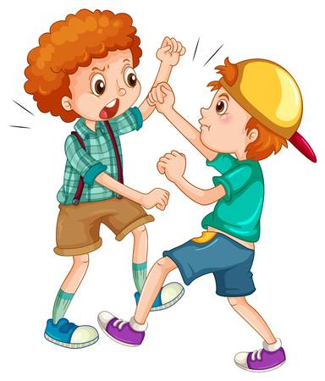
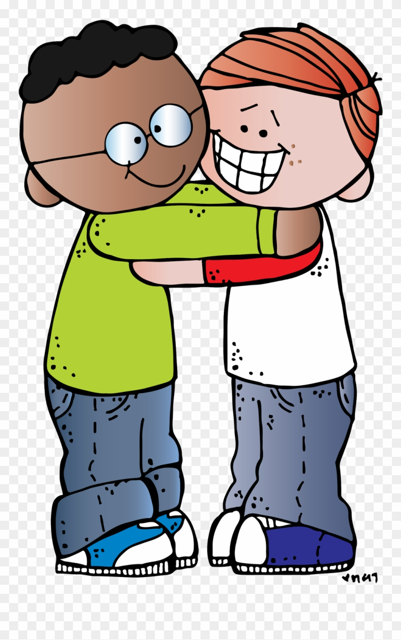

Someone was mean.
Should you
ignore them, fight, or forgive?
How would you like to be treated?

Slide 25
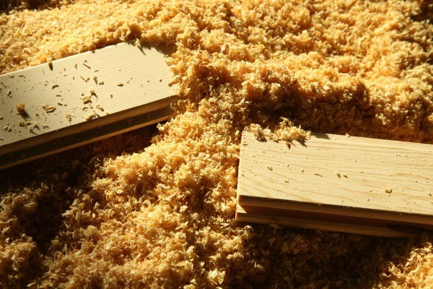
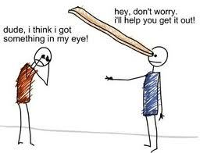
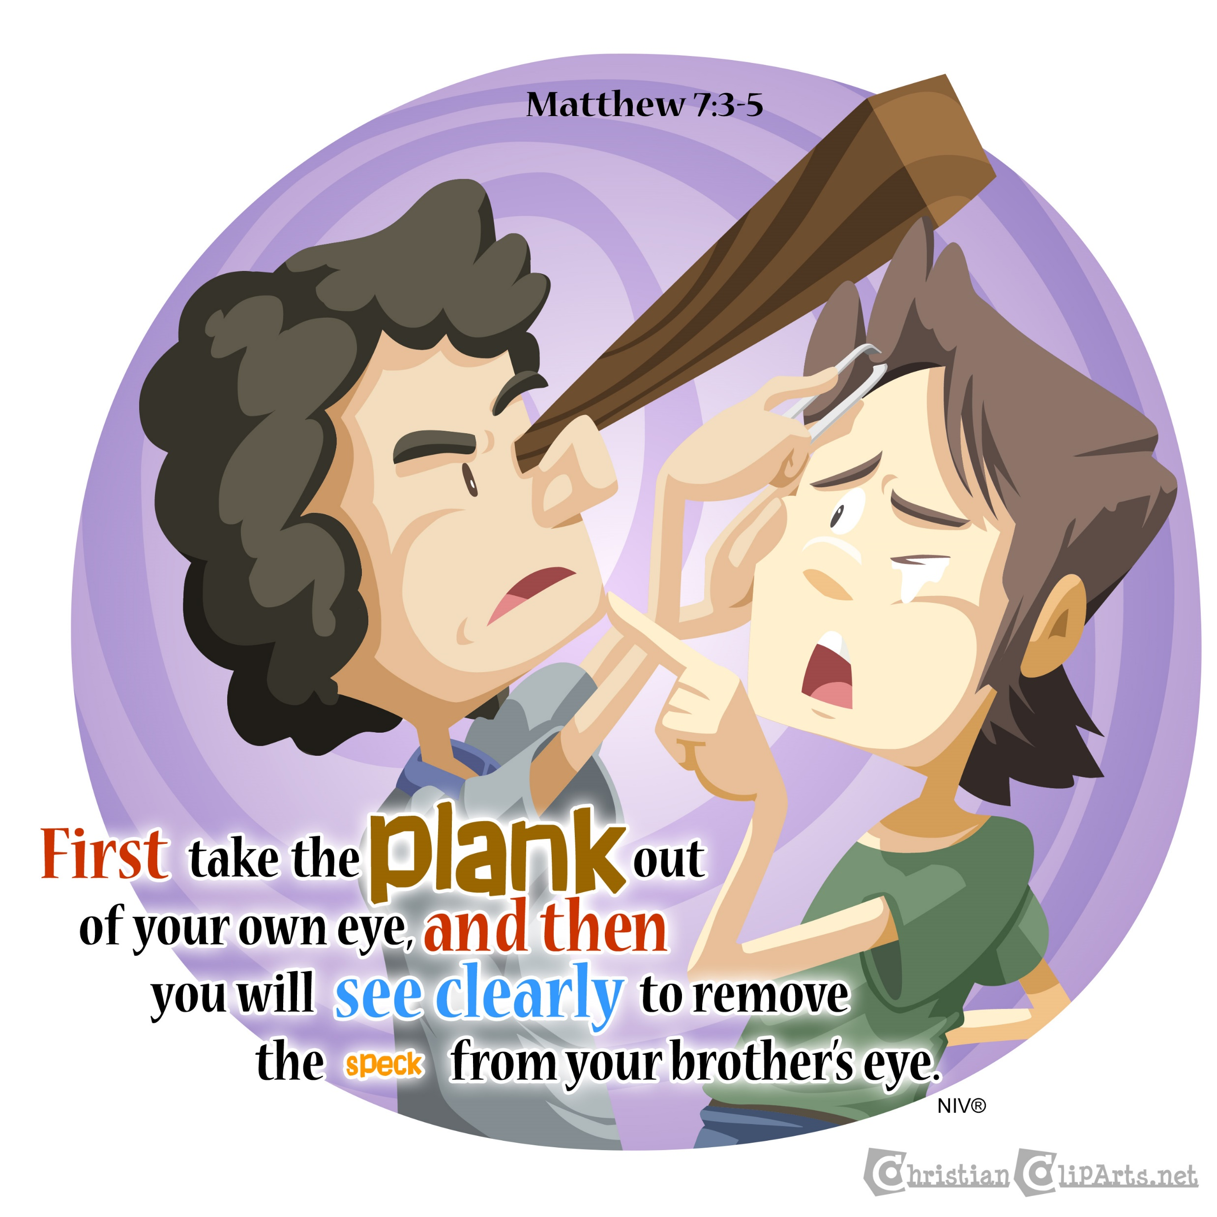
Matthew 7:1-5
“Do not judge other people. Then you will not be judged. ² you will be judged in the same way you judge others. You will be measured in the same way you measure others.
³ “You look at the bit of sawdust in your friend’s eye. But you pay no attention to the piece of wood in your own eye. ⁴ How can you say to your friend, ‘let me take the bit of sawdust out of your eye’? How can you say this while there is a piece of wood in your own eye? ⁵ you pretender! First take the piece of wood out of your own eye. Then you will be able to see clearly to take the bit of sawdust out of your friend’s eye.

Slide 26

Someone doesn’t understand our school work
Should you
call him stupid
or
go help him?
How would you like to be treated?

Slide 27
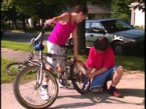
Do to others

Slide 28
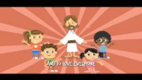
Love one another

Slide 29

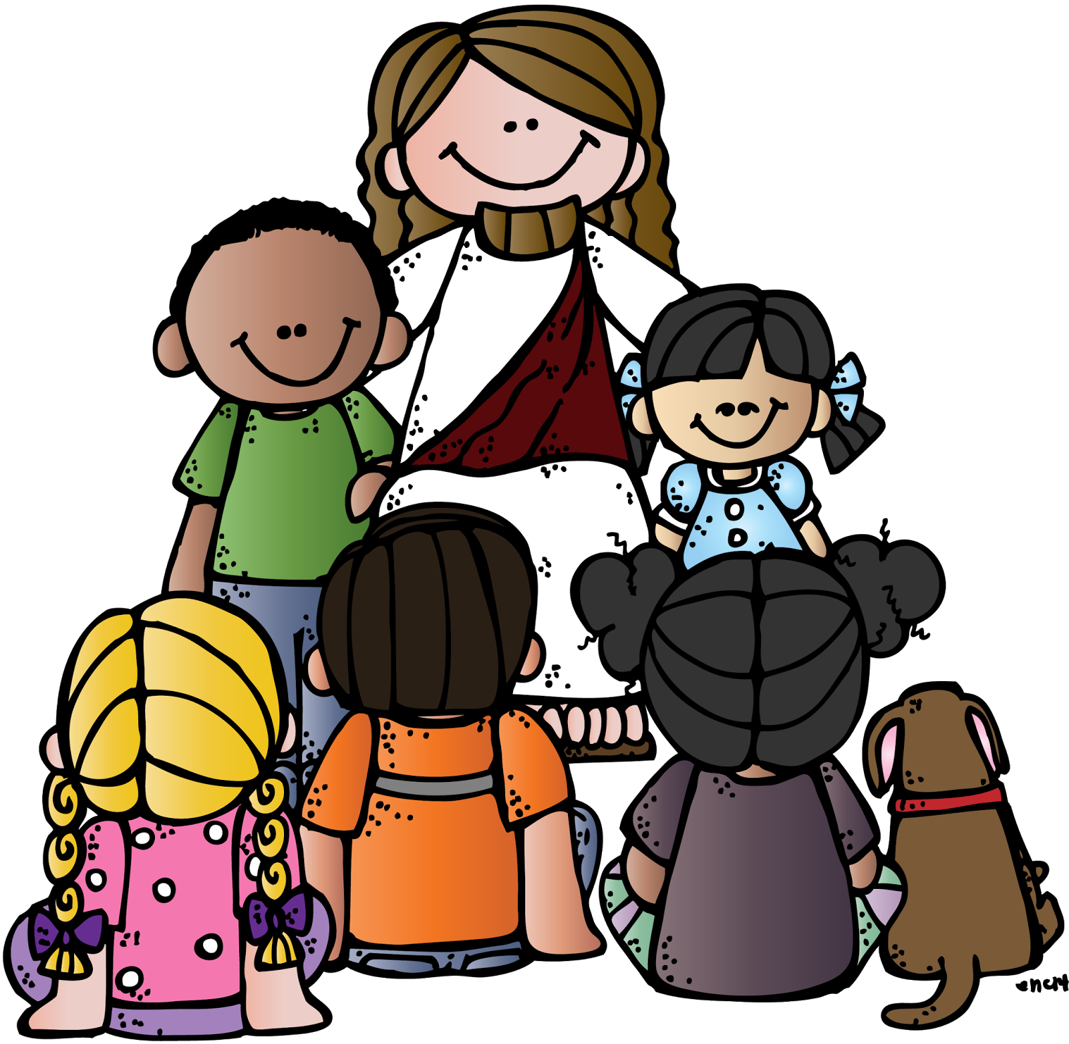
love
Love God
Love one another
Because God Loves every one
And that includes you!

Slide 30
God is a generous giver we should be too
Ask seek knock

Slide 31

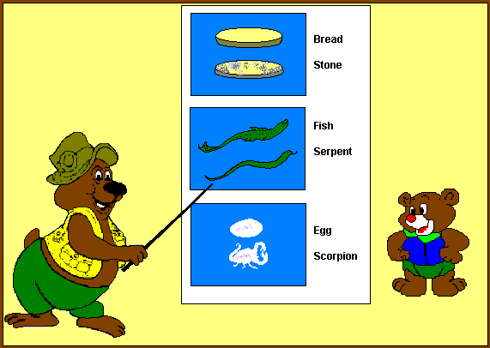
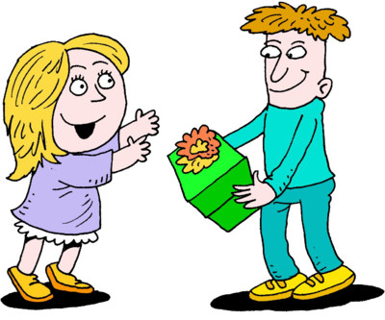
Matthew 7:9-11
⁹ “Suppose your son asks for bread. Which of you will give him a stone?
¹⁰ or suppose he asks for a fish. Which of you will give him a snake?
¹¹ Even though you are evil, you know how to give good gifts to your children.
How much more will your father who is in heaven give good gifts to those who ask him!

Slide 32
Optional slides

Slide 33
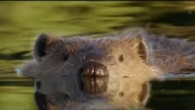
Wise experienced beaver

Slide 34
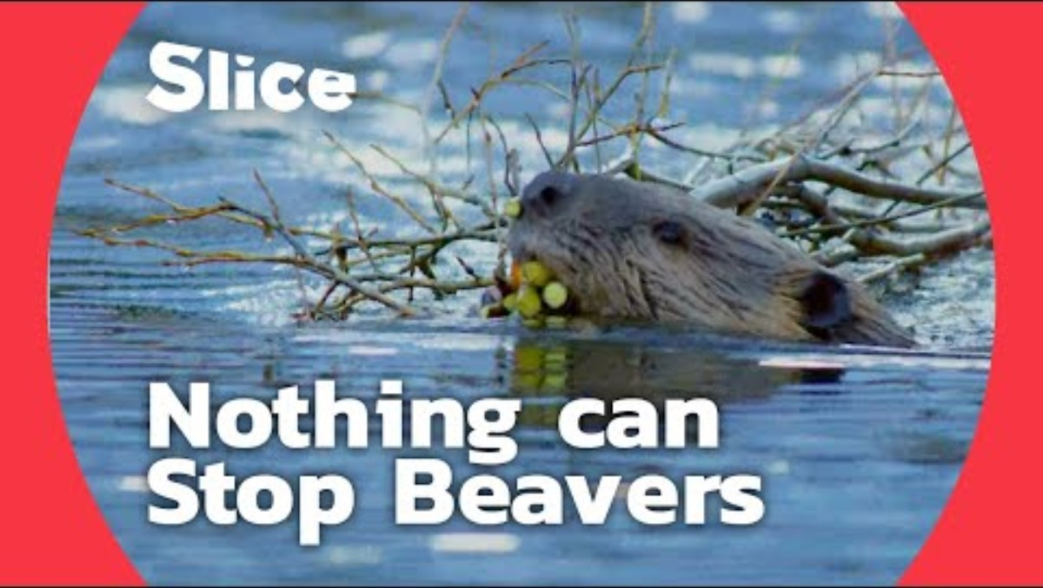
Young in experienced “foolish” beaver

Slide 35

https://activity-array.com/

