Slide 1

Mary visits Elizabeth
John is born
Joseph’s dream
You are chosen
You are blessed
Praise God

Slide 2

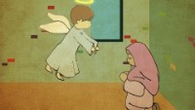
Short version of Story

Slide 3
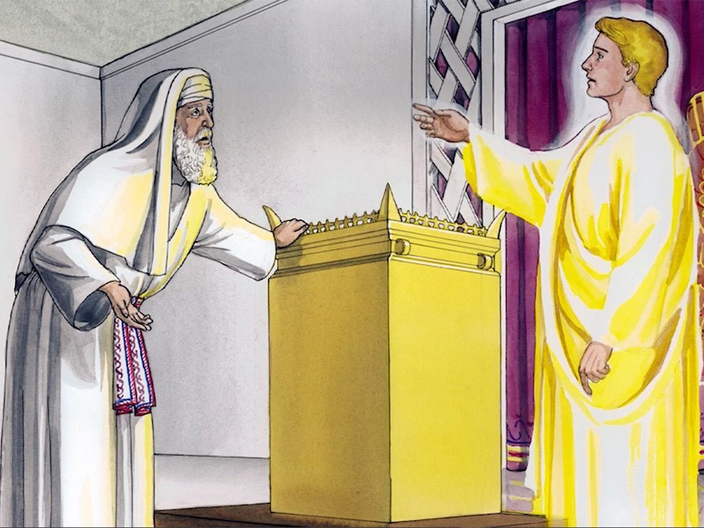
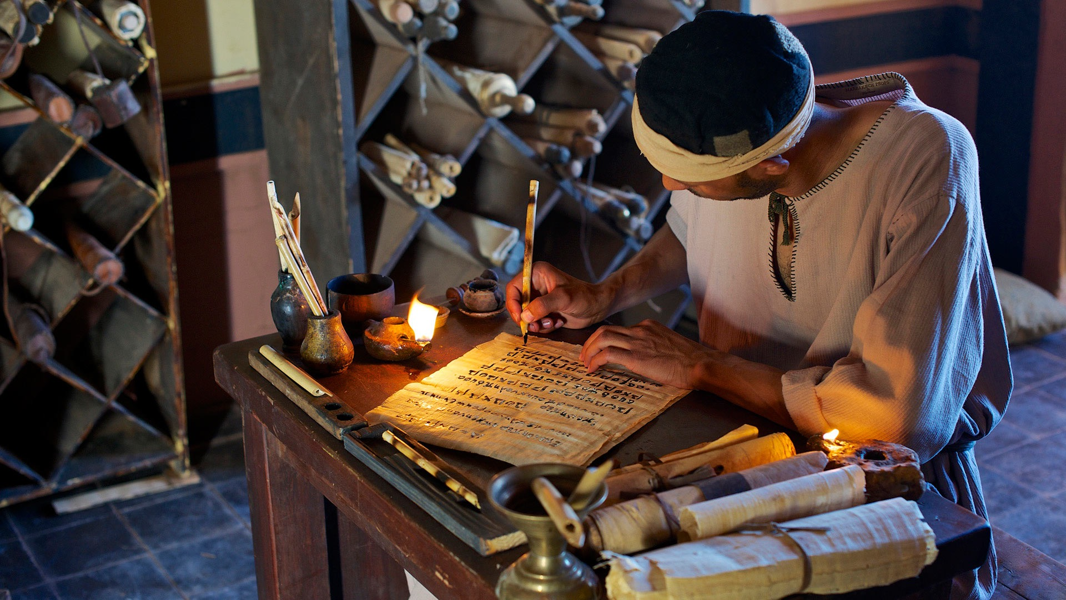
Luke continued with the story of Jesus.
Last week we read how the angel Gabriel came to Zechariah and announced that he and Elizabeth would have a son! They were to name him “John.” He would help people get ready for Jesus.
Six months later, the angel went to Mary. She would be the mother of Jesus, the Son of God.
What happens next?
Find Luke 1:39

Slide 4

Then Jesus told him,
“Because you have seen me, you have believed; blessed are those who have not seen and yet have believed.”
John 20:29
We too are blessed
Because we believe.

Slide 5
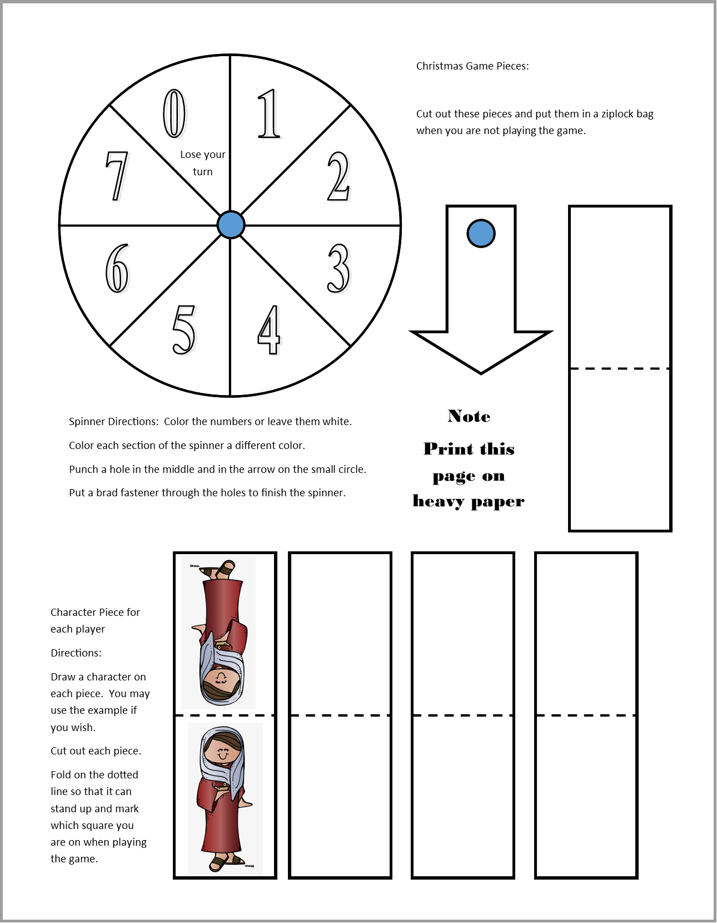
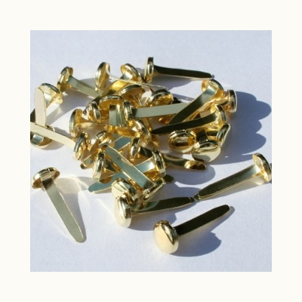
CRAFT TIME
1 - Spinner
DIRECTIONS
Color each spinner section a different color.
Cut out the game pieces and follow the directions on the page.
  Spinner
  Arrow
Attach the arrow onto the center of the spinner with a brad through the little blue circles.

Slide 6
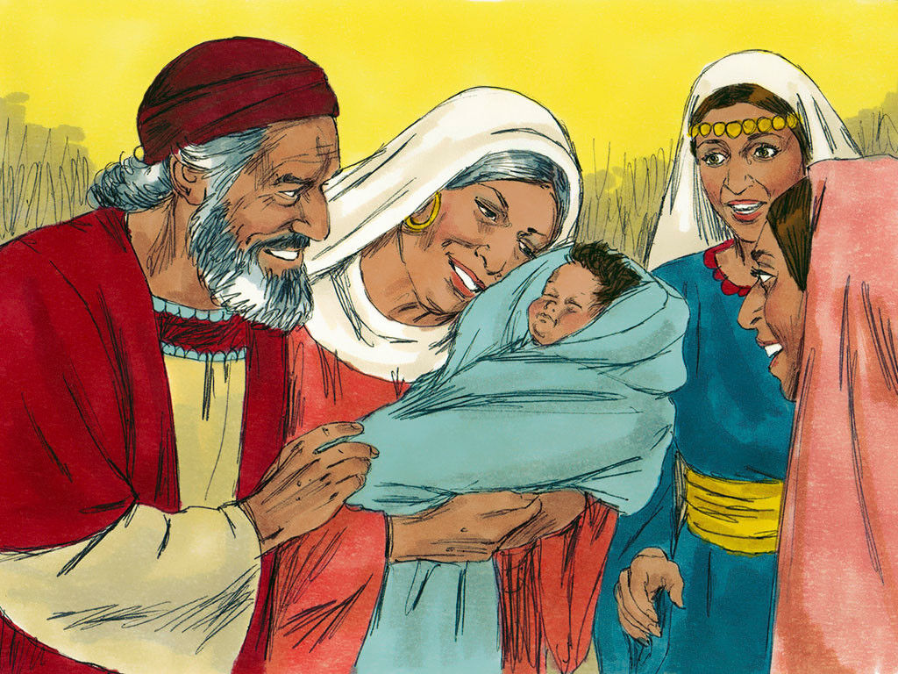
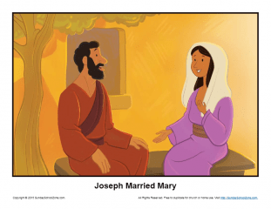
I need 4 volunteers
I’m Elizabeth
I’m Zechariah.
I’m Mary
I’m Joseph
Are you willing to be characters in our story and act it out?
We need:
Mary
Elizabeth
Zechariah
Joseph
Who will you be?

Slide 7
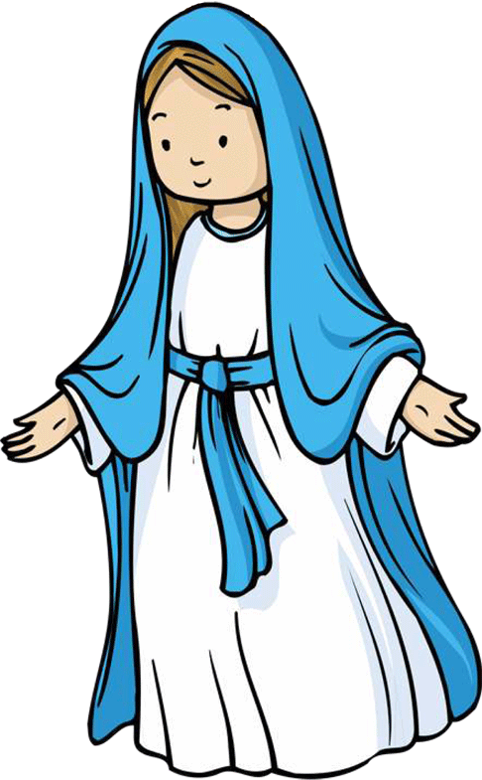
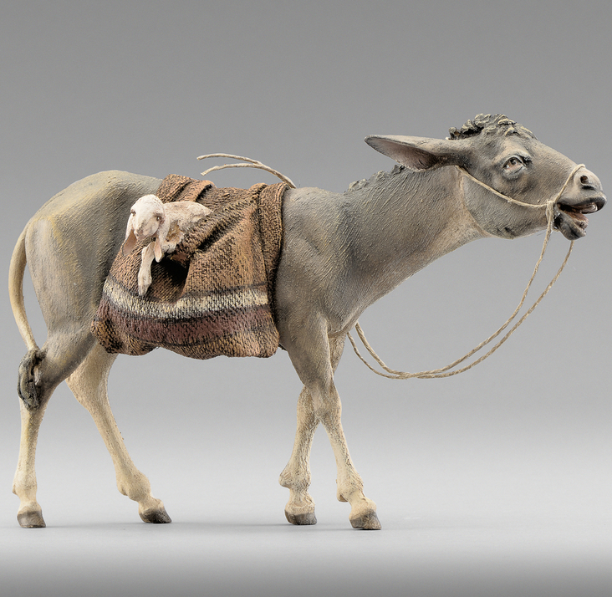
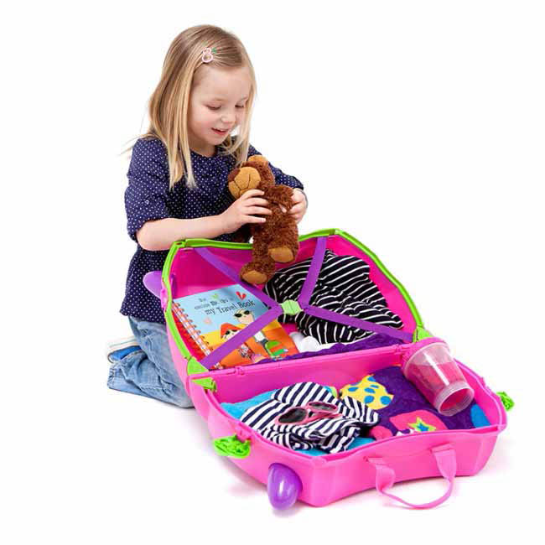
Pack your bags
What would you pack?
Mary packed her bags and went to visit Elizabeth.
Luke 1:39-
³⁹ At that time Mary got ready and hurried to a town in Judea’s hill country.
Let’s answer the question and play a game.
First, we’ll make a rhythm: Slap legs, clap, clap
Then we’ll say a chant while we do the rhythm.
Slap legs, clap, clap, slap legs, clap, clap
I’m going to my cousins
Slap legs, clap, clap, slap legs, clap, clap (repeat)
I will take _______________
We will all do the rhythm together and say the chant. Everyone will have a turn to finish the sentence.
Extra Challenge: Repeat what everyone has said, in order, and then finish the sentence.

Slide 8
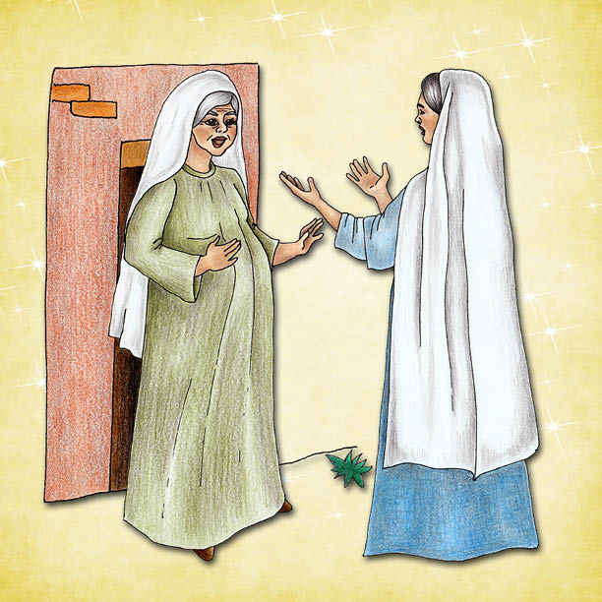
Mary visits Elizabeth
Hello Elizabeth!
Mary! God has blessed you! Blessed is the child you will have! As soon as I heard you my baby jumped for joy!
Luke 1:39-
³⁹ At that time Mary got ready and hurried to a town in Judea’s hill country.
⁴⁰ There she entered Zechariah’s home and greeted Elizabeth. ⁴¹ When Elizabeth heard Mary’s greeting, the baby inside her jumped.
And Elizabeth was filled with the Holy Spirit. ⁴² In a loud voice she called out, “God has blessed you more than other women. And blessed is the child you will have! ⁴³ But why is God so kind to me? Why has the mother of my Lord come to me? ⁴⁴ As soon as I heard the sound of your voice, the baby inside me jumped for joy.
⁴⁵ You are a woman God has blessed. You have believed that the Lord would keep his promises to you!”

Slide 9


Mary sings
Praise God!
He is holy!
He has done great things!
Luke 1:46
⁴⁶ Mary said,
“My soul gives glory to the Lord.
⁴⁷ My spirit delights in God my Savior.
⁴⁸ He has taken note of me
even though I am not considered important.
From now on all people will call me blessed.
⁴⁹ The Mighty One has done great things for me.
His name is holy.
⁵⁰ He shows his mercy to those who have respect for him,
from parent to child down through the years.
⁵¹ He has done mighty things with his powerful arm.
He has scattered those who are proud in their deepest thoughts.
⁵² He has brought down rulers from their thrones.
But he has lifted up people who are not considered important.
⁵³ He has filled with good things those who are hungry.
But he has sent away empty those who are rich.
⁵⁴ He has helped the people of Israel, who serve him.
He has always remembered to be kind
⁵⁵ to Abraham and his children down through the years.
He has done it just as he promised to our people of long ago.”

Slide 10
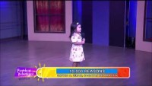
SING
Praise the Lord

Slide 11
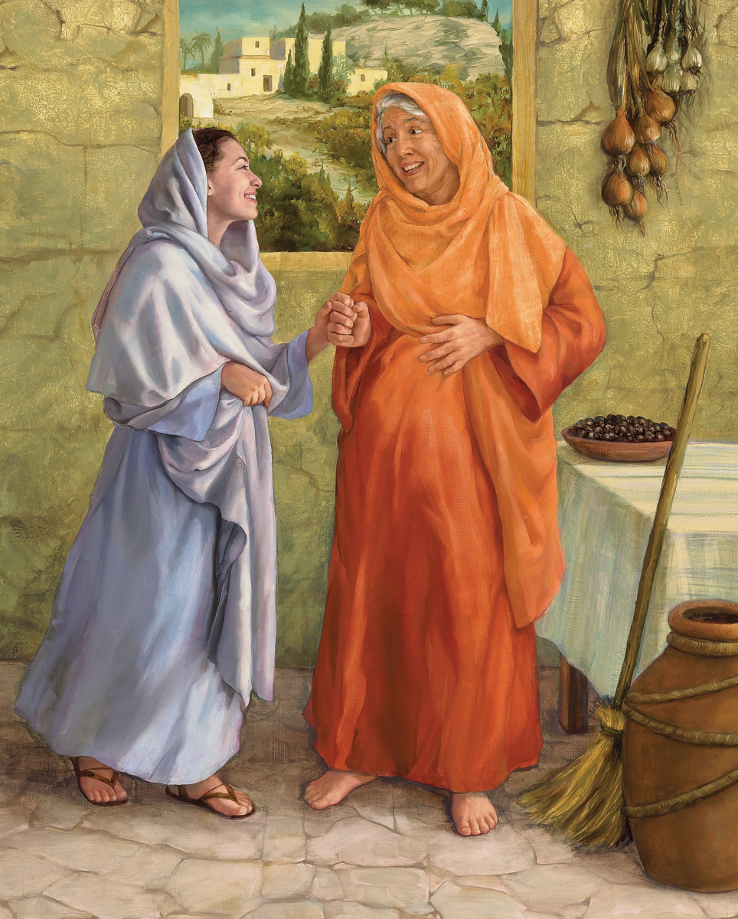
Mary stayed with Elizabeth for 3 months.
At the end of the 3 months……
An angel came to me and said I would have baby Jesus
The angel Gabriel, came to Zechariah when he served at the temple.
Sadly, he didn’t believe the angel, so now he can’t talk.

Slide 12
CRAFT TIME
2 - Game Pieces
DIRECTIONS
Look at the sample play piece. See the lady is right side up on the bottom and upside down on the top.
When you cut it out and fold it, she’ll be right side up on both sides.
See the head is on either side of the dotted line. Draw a circle on either side of the dotted line of the other pieces. These will be the heads.
Draw other people as more game pieces.
  Angel
  Man
  Baby

Slide 13
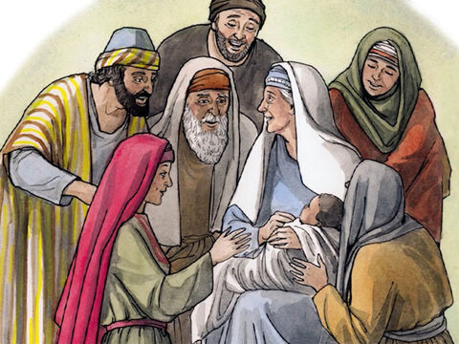

I’m so happy!
We have a baby boy!
God is good
I’m so happy for you!
God is good!
⁵⁷ The time came for Elizabeth to have her baby. She gave birth to a son.
⁵⁸ Her neighbors and relatives heard that the Lord had been very kind to her. They shared her joy.

Slide 14
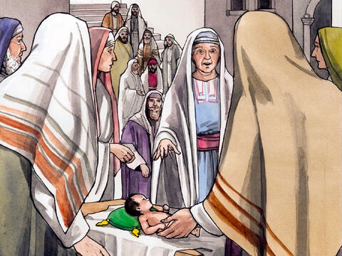
We’ll name him Zechariah, like his father.
No!
He must be called John.
But no one in your family has that name.
⁵⁹ On the eighth day, they came to have the child circumcised. They were going to name him Zechariah, like his father.
⁶⁰ But his mother spoke up. “No!” she said. “He must be called John.”
⁶¹ They said to her, “No one among your relatives has that name.”

Slide 15

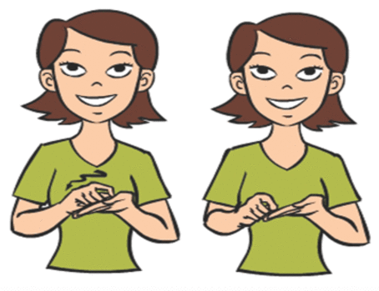
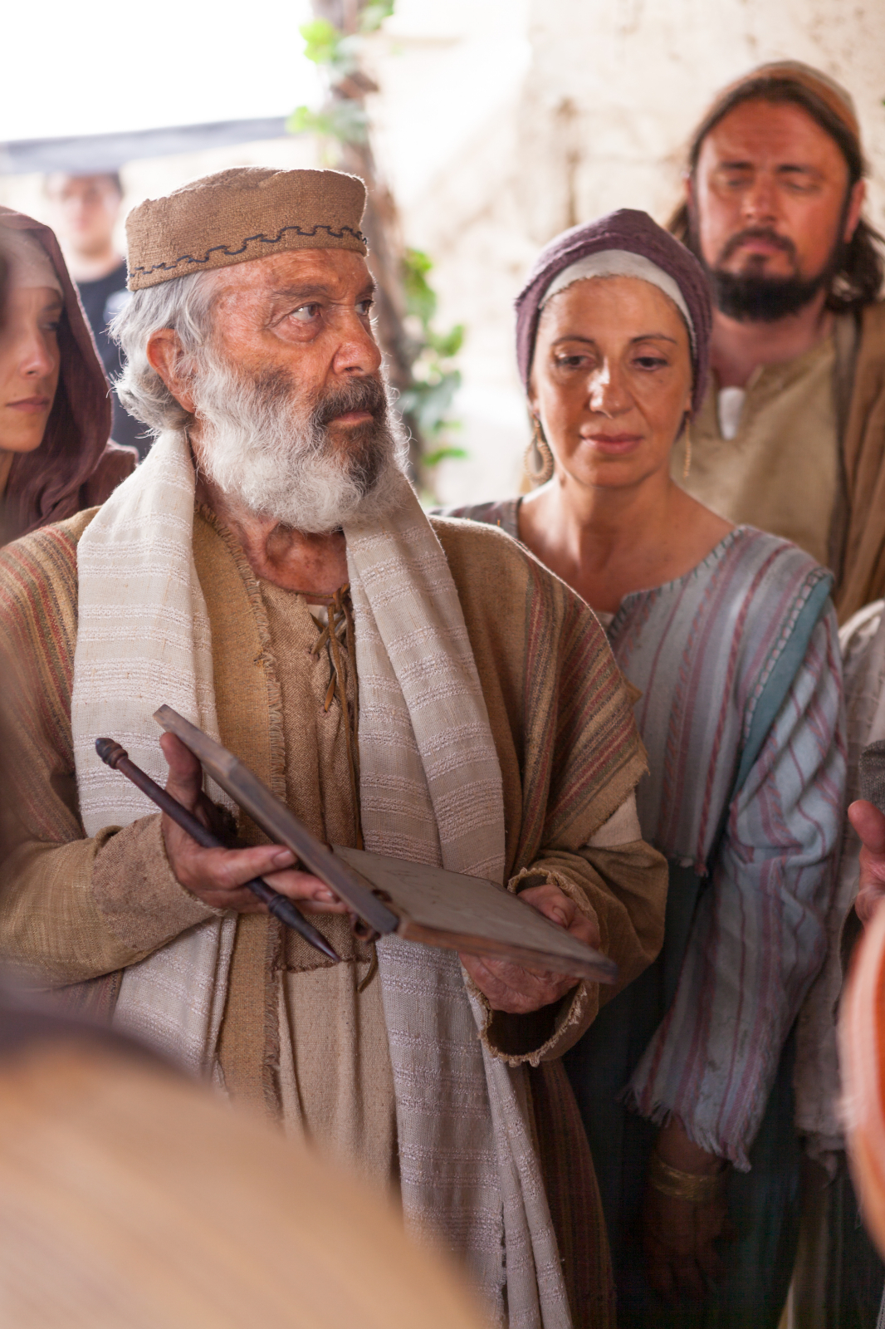

(Motion for come)
(motion for paper and pencil)
⁶² Then they motioned to his father.
They wanted to find out what he would like to name the child.
⁶³ He asked for something
to write on.
How would you motion for someone to come?
(motion for name & baby_
How would you motion for someone to name a baby?
How would you motion for someone to bring paper and pencil?

Slide 16

His name is JOHN
Wow!
Praise God!
Then he wrote,
“His name is John.”
Everyone was amazed.
⁶⁴ Right away Zechariah could speak again.
Right away he praised God.
⁶⁵ All his neighbors were filled with fear and wonder.
Throughout Judea’s hill country, people were talking about all these things.
⁶⁶ Everyone who heard this wondered about it. And because the Lord was with John, they asked, “What is this child going to be?”
His name is JOHN
What is
this child
going to be?
Praise God!
He has answered our prayer!
We are blessed!

Slide 17
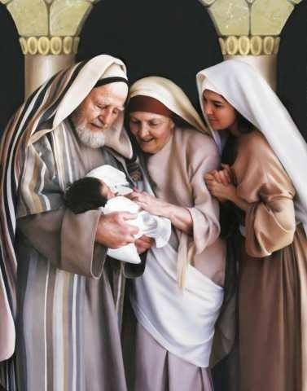
.
Our Savior will be a light in the darkness.
Praise God!
⁶⁷ John’s father Zechariah was filled with the Holy Spirit. He prophesied,
⁶⁸ “Give praise to the Lord, the God of Israel!
He has come to his people and purchased their freedom.
⁶⁹ He has acted with great power and has saved us.
He did it for those who are from the family line of his servant David.
⁷⁰ Long ago holy prophets said he would do it.
⁷¹ He has saved us from our enemies.
We are rescued from all who hate us.
⁷² He has been kind to our people of long ago.
He has remembered his holy covenant.
⁷³ He made a promise to our father Abraham.
⁷⁴ He promised to save us from our enemies.
Then we could serve him without fear.
⁷⁵ He wants us to be holy and godly as long as we live.
⁷⁶ “And you, my child, will be called a prophet of the Most High God.
You will go ahead of the Lord to prepare the way for him.
⁷⁷ You will tell his people how they can be saved.
You will tell them that their sins can be forgiven.
⁷⁸ All of that will happen because our God is tender and caring.
His kindness will bring the rising sun to us from heaven.
⁷⁹ It will shine on those living in darkness
and in the shadow of death.
God has kept his promises.
Praise God!
He promised our Savior would come from the family of David.
You my child will be called a prophet of the Most High God.
.
You will prepare people for the Lord.
You will tell them how their sins will be forgiven.

Slide 18
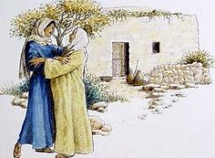
Mary went home
Good-bye Elizabeth.
It was nice visiting you.
Good-bye Mary
Luke 1:56-
⁵⁶ Mary stayed with Elizabeth about three months. Then she returned home.

Slide 19
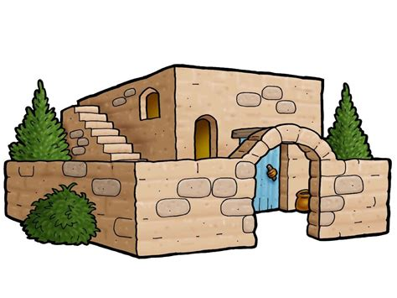
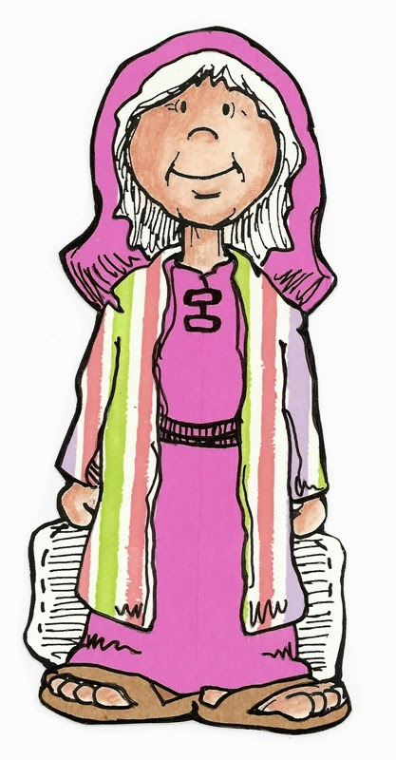
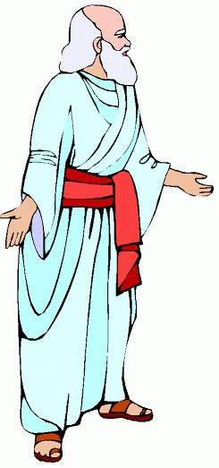
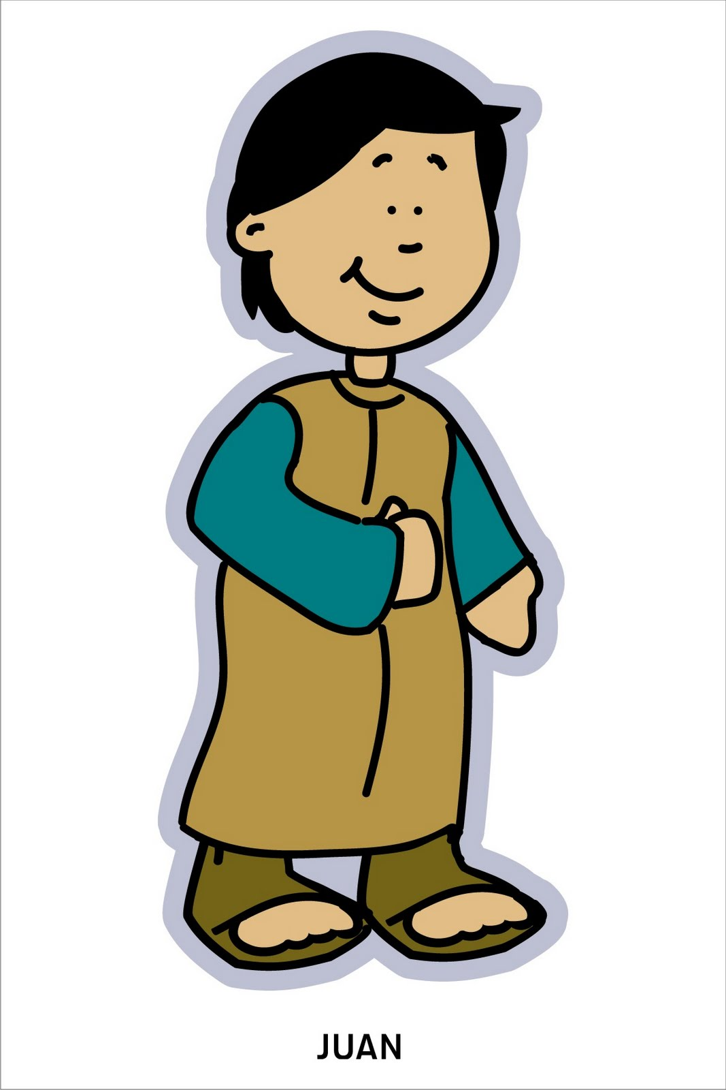
You are a blessing indeed!
You love God
and faithfully follow Him
John, you are such a delight!
You are obedient and kind.
You are an answer to prayer.
I love you!
God loves you too!
⁸⁰ The child grew up, and his spirit became strong.
He lived in the desert until he appeared openly to Israel.
I love you!
God loves you too!

Slide 20
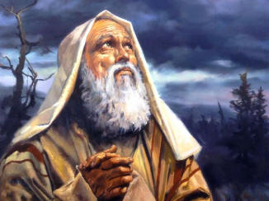
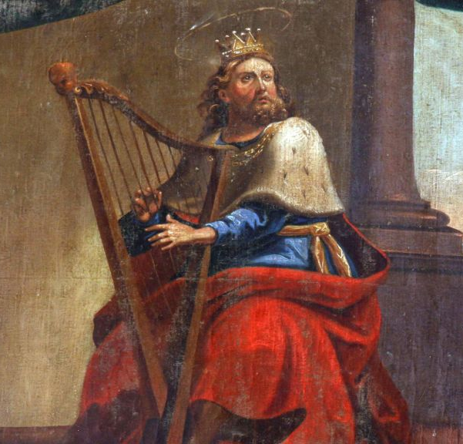
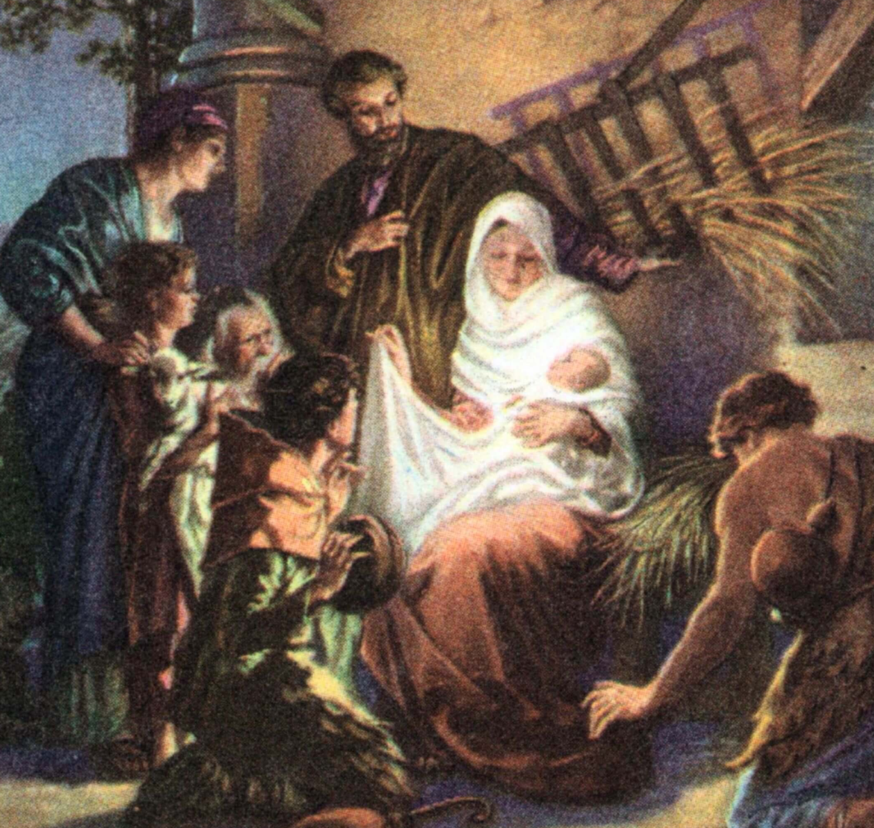

Matthew tells Joseph’s part of the story.
Joseph, who married Mary, was the great, great (28 greats) grandson of King David and a great⁴² grandson of Abraham
Read about it in Matthew 1
⁷ So there were 14 generations from Abraham to David. There were 14 from David until the Jewish people were forced to go away to Babylon. And there were 14 from that time to the Messiah.
I’ll write a book about Jesus.

Slide 21
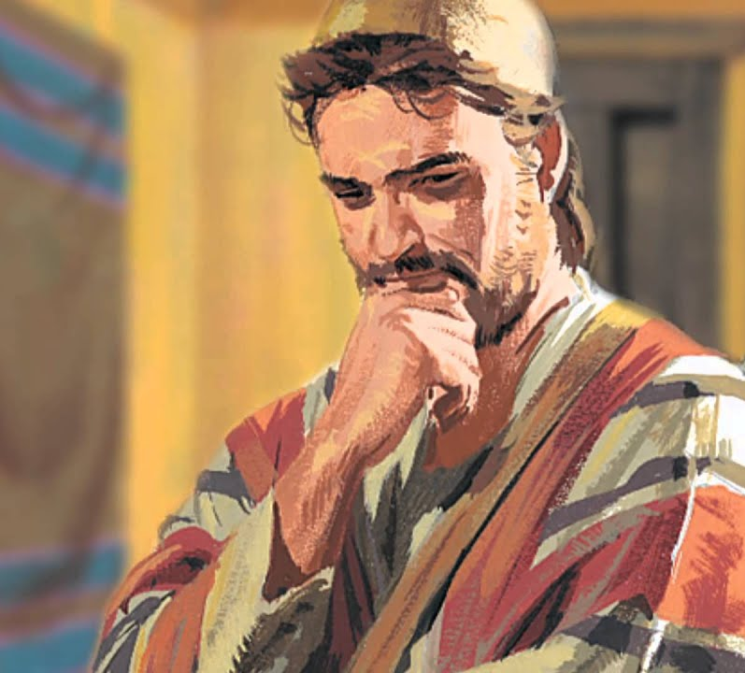
Joseph thinks about what to do
Mary is pregnant.
I’m not the father.
Who is? What will people think?
Matthew 1:
¹⁸ This is how the birth of Jesus the Messiah came about. His mother Mary and Joseph had promised to get married.
But before they started to live together, it became clear that she was going to have a baby. She became pregnant by the power of the Holy Spirit.
¹⁹ Her husband Joseph was faithful to the law. But he did not want to put her to shame in public. So he planned to divorce her quietly.
²⁰ But as Joseph was thinking about this,
What shall I do?
I don’t want to shame her.
I want to keep the law.
I will divorce her quietly.

Slide 22
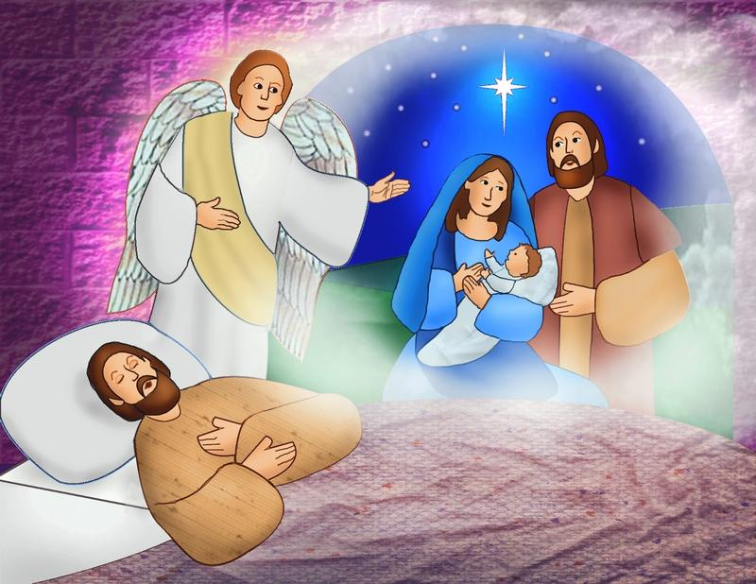
Joseph has a dream
Joseph, Son of David,
Don’t be afraid to take Mary home as your wife.
The baby is from the Holy Spirit.
Matthew 1
²⁰ But as Joseph was thinking about this, an angel of the Lord appeared to him in a dream.
The angel said, “Joseph, son of David, don’t be afraid to take Mary home as your wife. The baby inside her is from the Holy Spirit. ²¹ She is going to have a son. You must give him the name Jesus. That’s because he will save his people from their sins.”
Name the baby “Jesus”
He will save people from their sins.

Slide 23
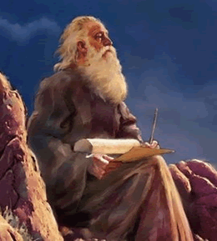
Joseph married Mary
“The virgin is going to have a baby. She will give birth to a son. And he will be called Immanuel.” (Isaiah 7:14)
Matthew 1
²² All this took place to bring about what the Lord had said would happen. He had said through the prophet, ²³ “The virgin is going to have a baby. She will give birth to a son. And he will be called Immanuel.” (Isaiah 7:14) The name Immanuel means “God with us.”

Slide 24
Joseph married Mary
Come, be my wife.
I will take care of you.
I’m so happy Joseph!
Our baby is Immanuel,
God is with us!
Matthew 1
²⁴ Joseph woke up. He did what the angel of the Lord commanded him to do. He took Mary home as his wife. ²⁵ But he did not sleep with her until she gave birth to a son. And Joseph gave him the name Jesus.
That is amazing!
God is willing to come be with us, as our baby!
I want to be a good daddy to him!
His name will be Jesus and He will save us from our sins. What a honor to be his parents!

Slide 25
“Praise be to the Lord, the God of Israel, because He has come to His people and redeemed them.
Luke 1:68
Praise the Lord
He has come!

Slide 26

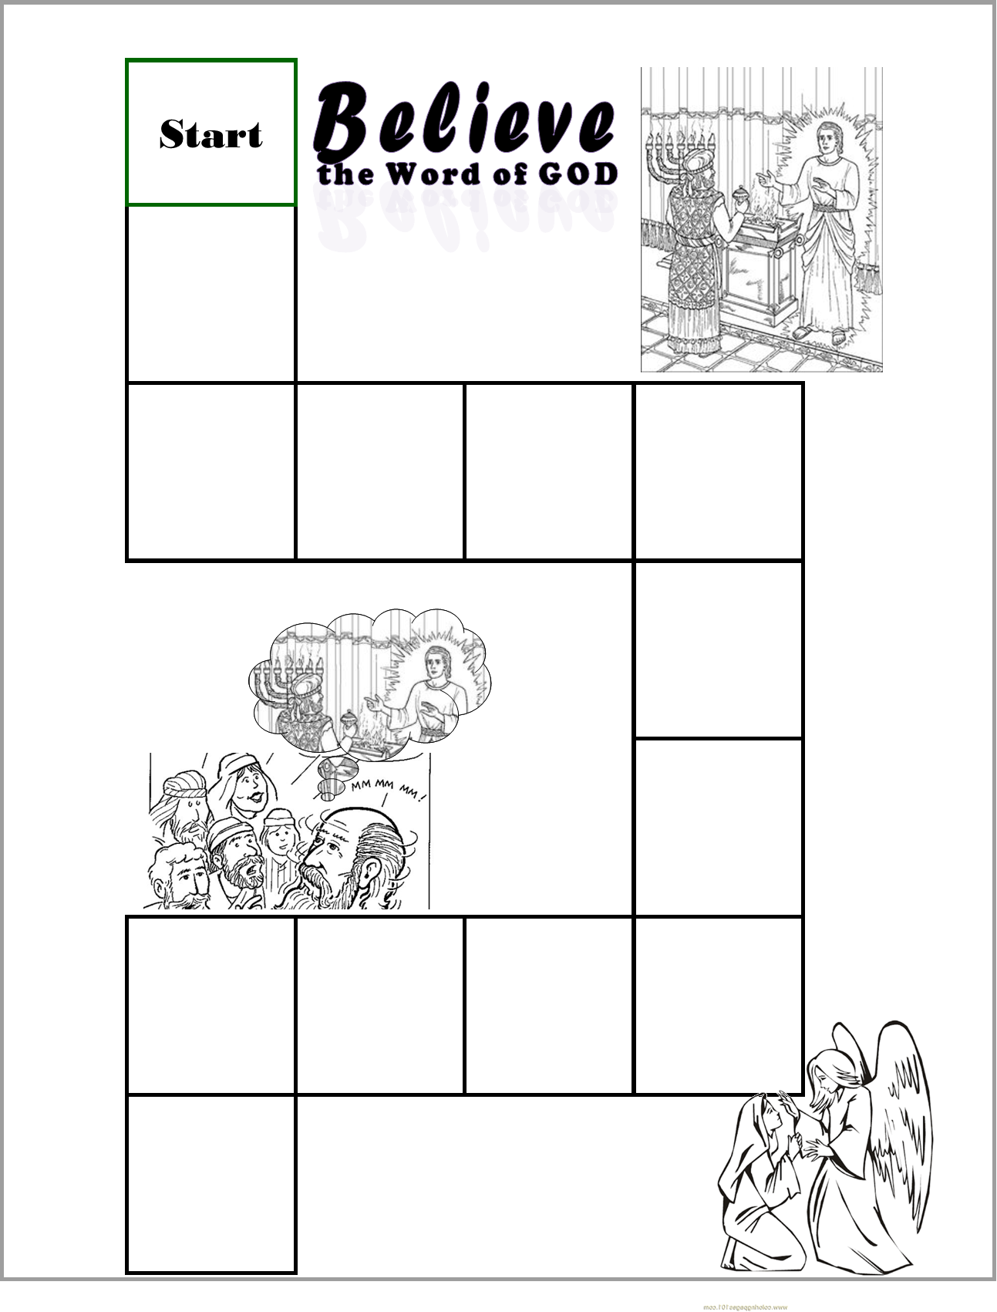
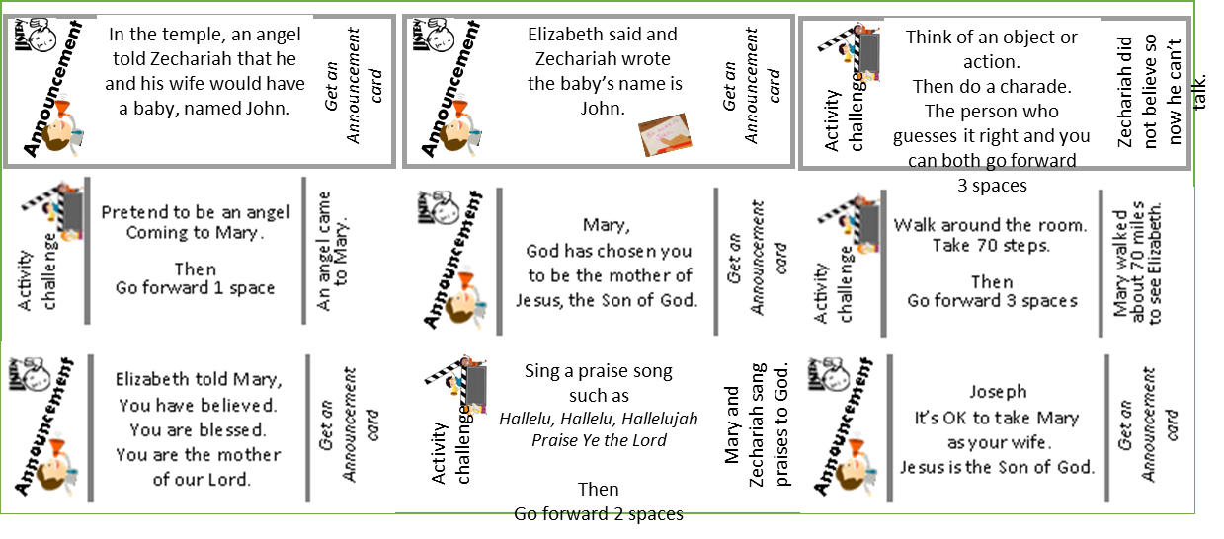
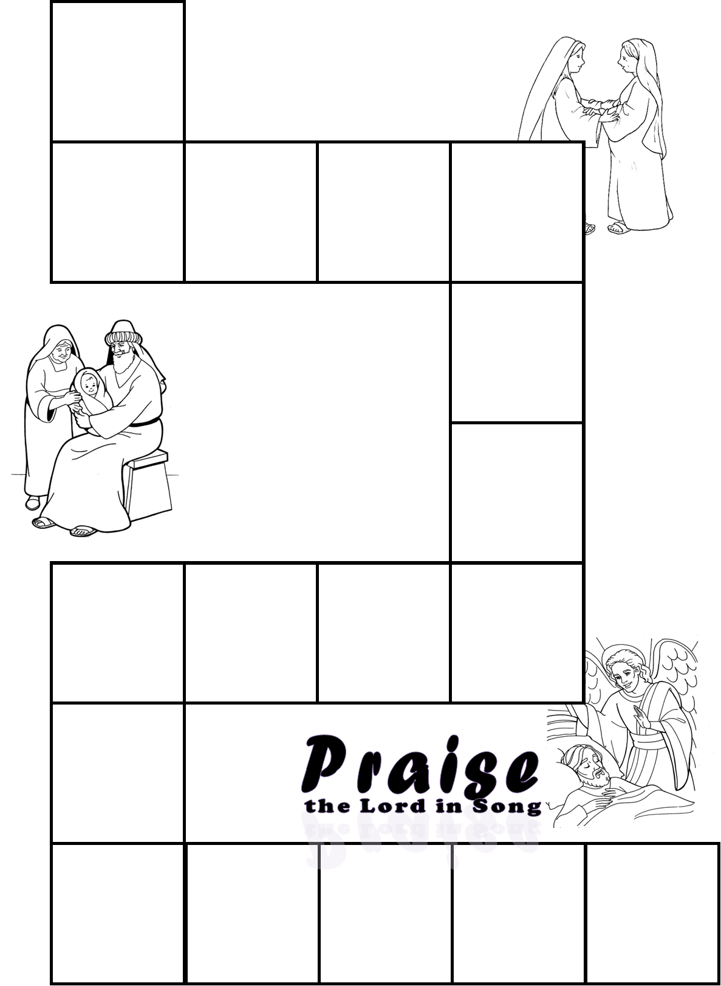
CRAFT TIME
3 – Game Board
DIRECTIONS
Prepare the playing board part 1:
  Put on the Announcement card and Activity Challenge stickers.
  Write in your own directions on 2 squares if you wish.
  Glue this page on the left side of a manila folder so that the bottom right corner is near the bottom right corner of the left side of the folder.
Put on the activity stickers like this: (click to see where)
Note: We will be adding pages of the game each week.

Slide 27

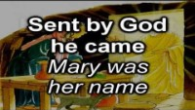
SING Christmas Carols
The Angel Gabriel

Slide 28


CRAFT TIME
4 – Announcement Cards
DIRECTIONS
Cut out the Announcement Cards
We will be adding new cards each week.
Tell everyone: Who Jesus is. Then go forward ____ spaces | Tell everyone: What your name means. (Look it up online.) Then go forward ____ spaces | Tell everyone: Zechariah and Elizabeth Are going to have a baby! Then go forward ____ spaces | Tell everyone: Jesus is coming! Then go forward ____ spaces
Tell everyone Your mom’s name. Then go forward ____ spaces | Tell everyone What you would pack For a long trip. Then go forward ____ spaces | Tell everyone the name of the person to your left. Then go forward ____ spaces | Tell everyone what you wish you had. Then go forward ____ spaces
Tell everyone: I am chosen, so are you! I am blessed, so are you! Then go forward ____ spaces | Tell everyone: God is awesome! Why do you think so? Then go forward ____ spaces | PRINT THESE CARDS ON HEAVY PAPER CUT THEM OUT USE THEM FOR YOUR GAME YOU WILL DRAW ONE WHEN YOU LAND ON THE DRAW AN ANNOUNCEMENT CARD SPACE.

Slide 29

SING Christmas Carols
NEW Joy to the World

Slide 30
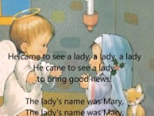
SING Christmas Carols
An Angel Came From Heaven

Slide 31
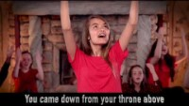
SING Christmas Carols
Emanuel God is with Us All Year Long

Slide 32

SING Christmas Carols
Angels We Have Heard on High

Slide 33
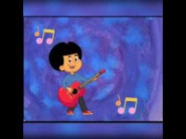
SING Christmas Carols
Emanuel – Advent Song for kids

Slide 34

SING Christmas Carols
Joy to the World

Slide 35

SING Christmas Carols
Emanuel God is with Us All Year Long

Slide 36

SING Christmas Carols
Go Tell It On the Mountain

Slide 37

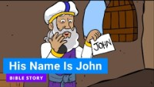

Slide 38
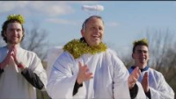
The rest of the story

Slide 39

https://activity-array.com/

