Slide 1
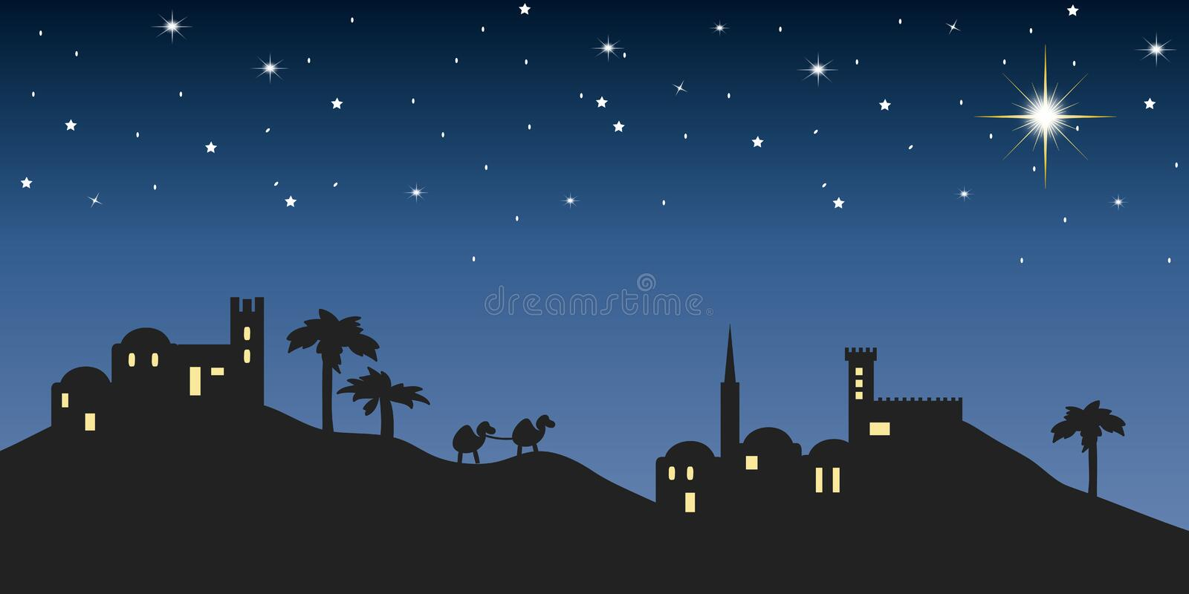
Baby born in Bethlehem
Angels announce
Baby Jesus is born!
Luke 2
Our Savior is here!

Slide 2


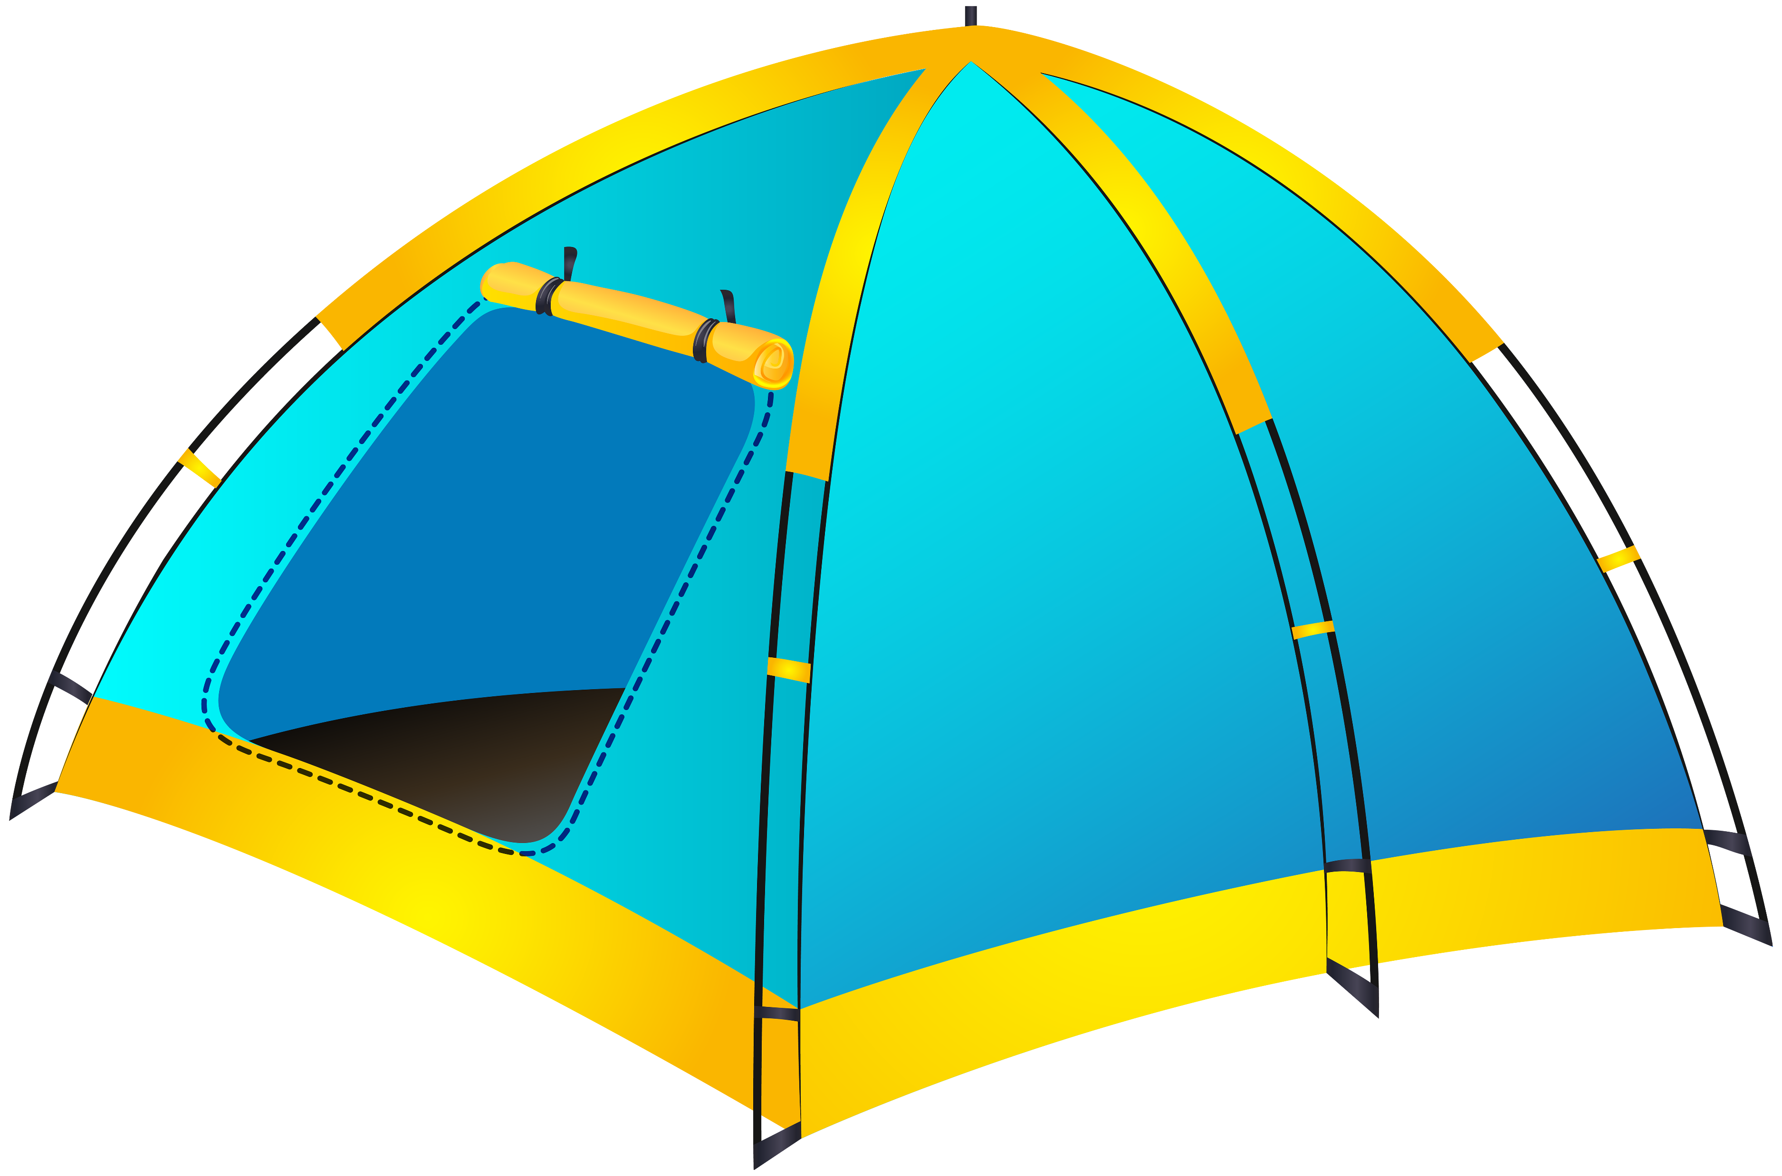
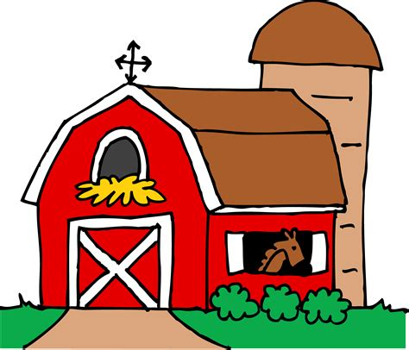
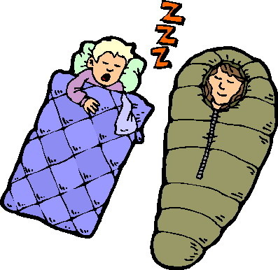
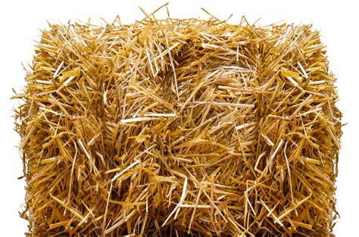
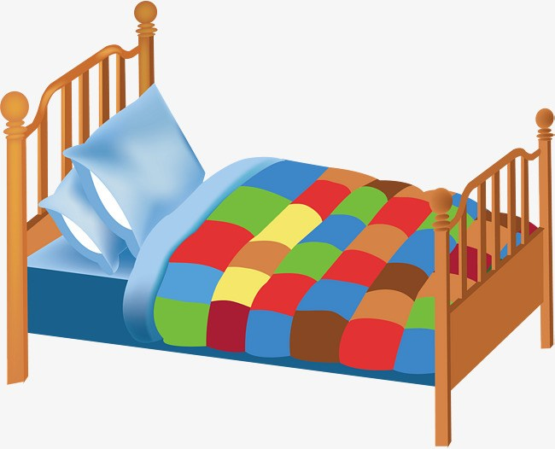
Have you ever slept in _____________

Slide 3
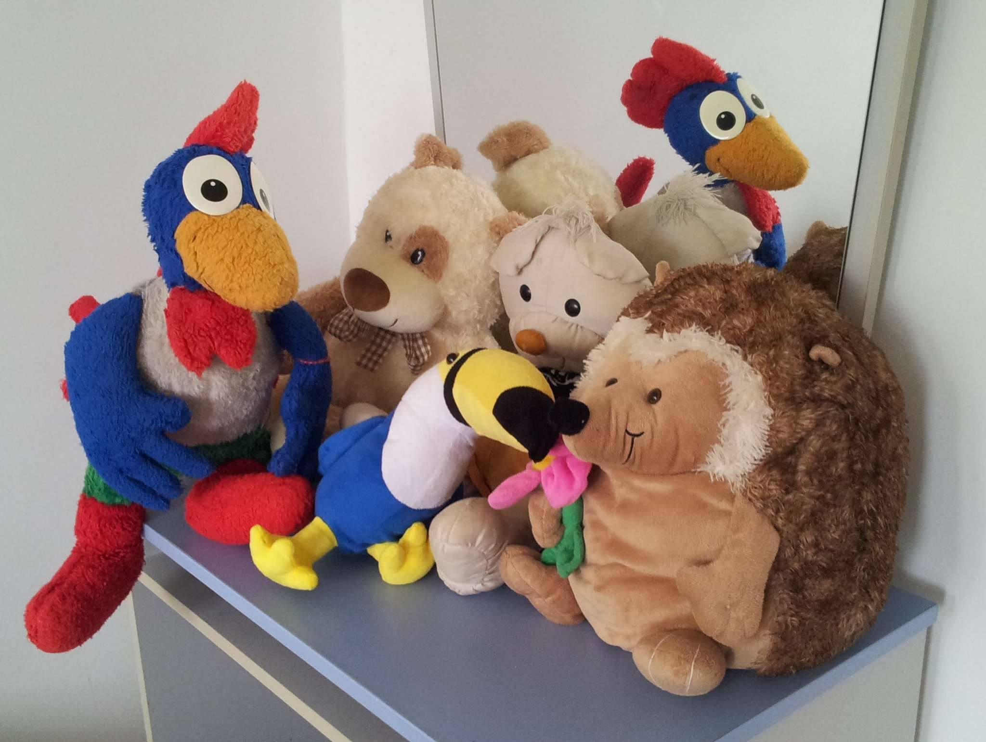
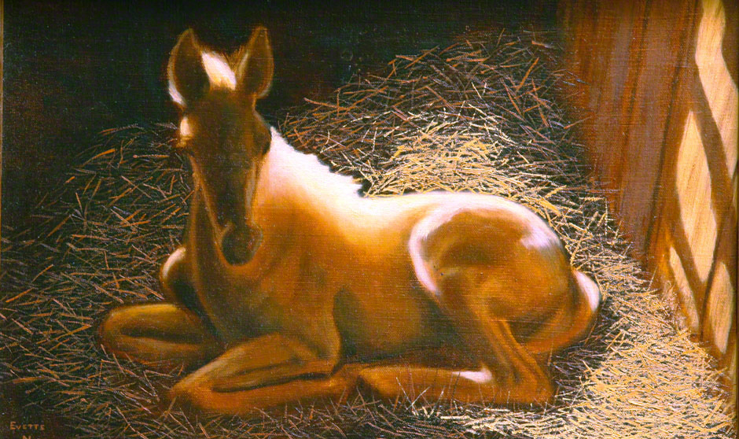

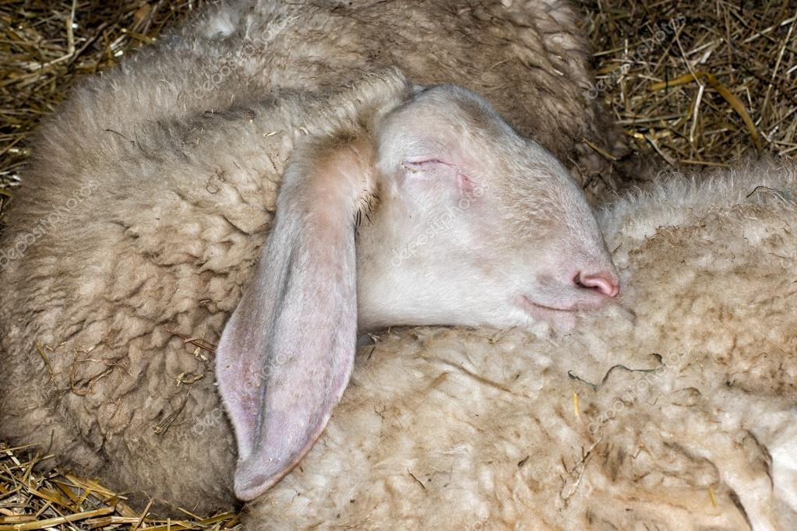
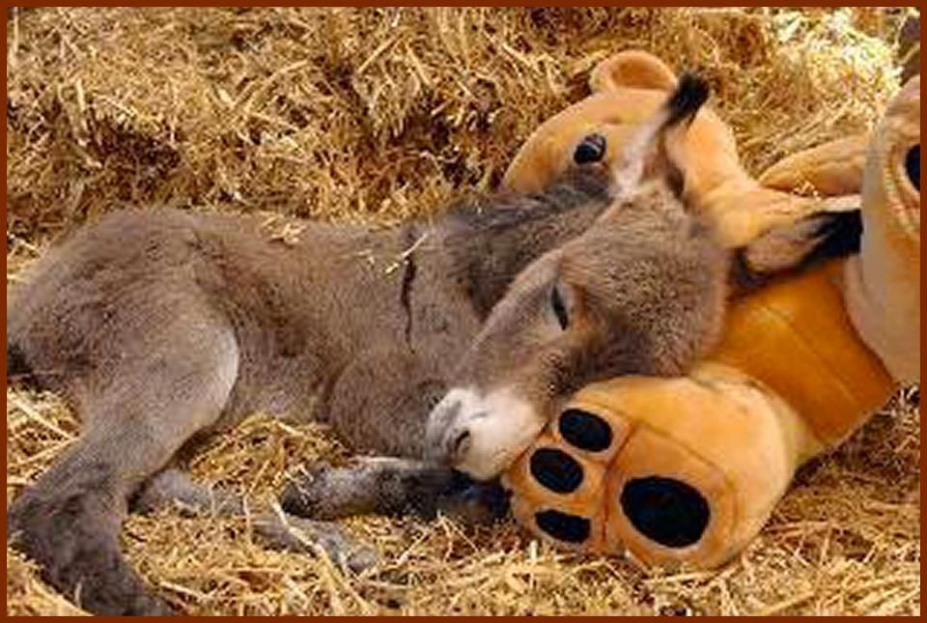

Have you ever slept with __________

Slide 4

¹ Give praise to the Lord, proclaim His name;
make known among the nations what He has done.
² Sing to him, sing praise to Him;
tell of all His wonderful acts.
³ Glory in His holy name;
let the hearts of those who seek the Lord rejoice.
⁴ Look to the Lord and His strength;
seek His face always.
Psalms 105
Psalms 105:1-2
You can find our story in Luke 2

Slide 5
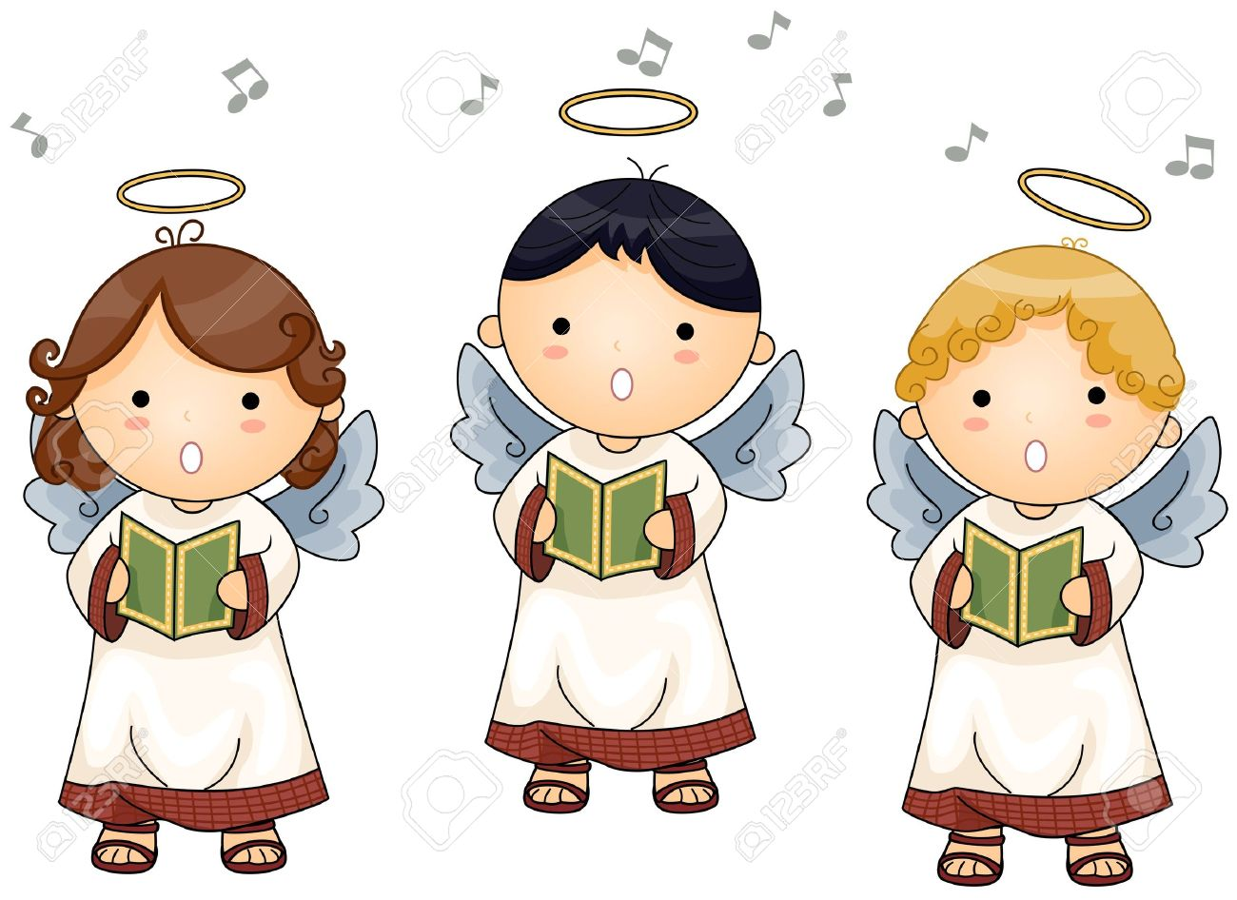
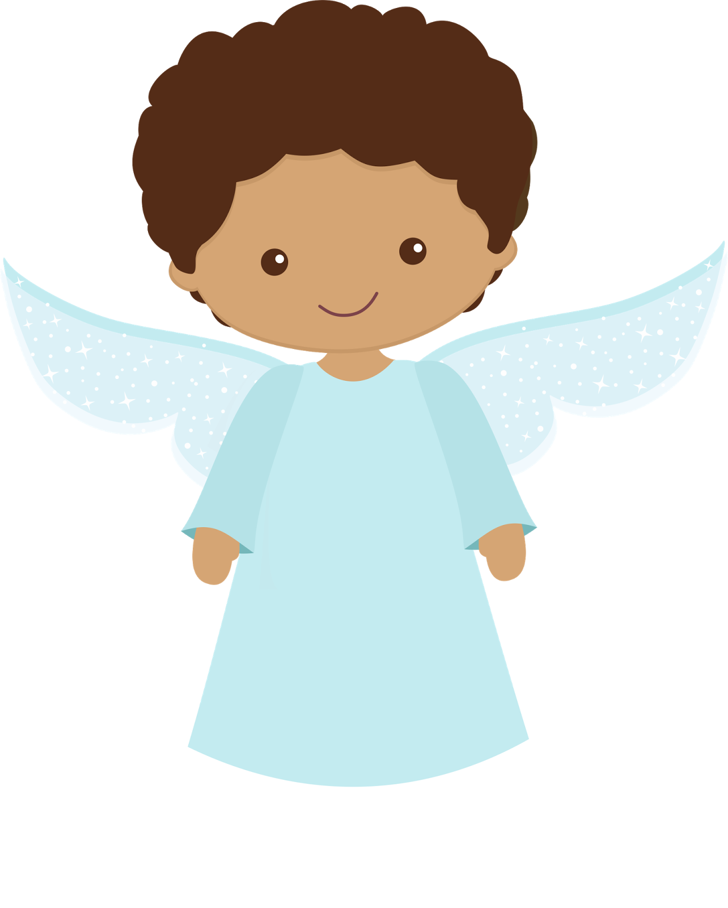
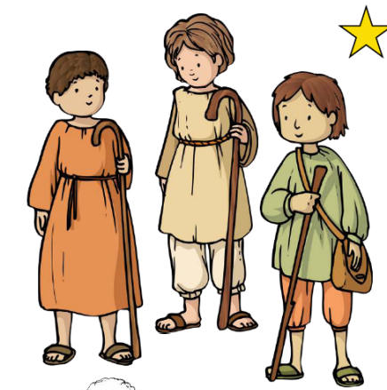
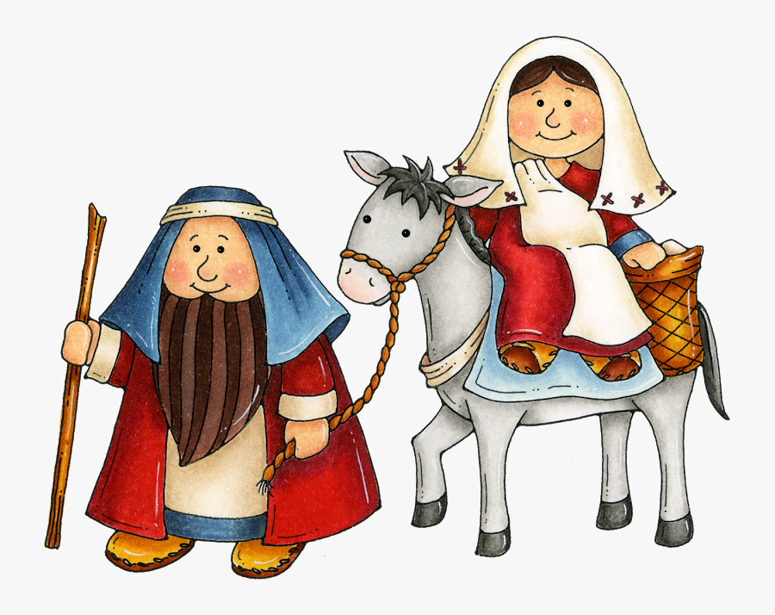
You can be part of our story today
Choose a part to act out:
Joseph
Mary (& doll)
3 Innkeepers/villagers
Shepherd (& sheep) [1+ more]
Angel [1 +many]

Slide 6
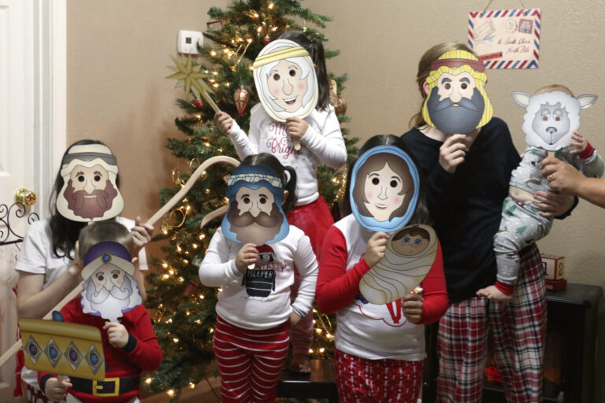
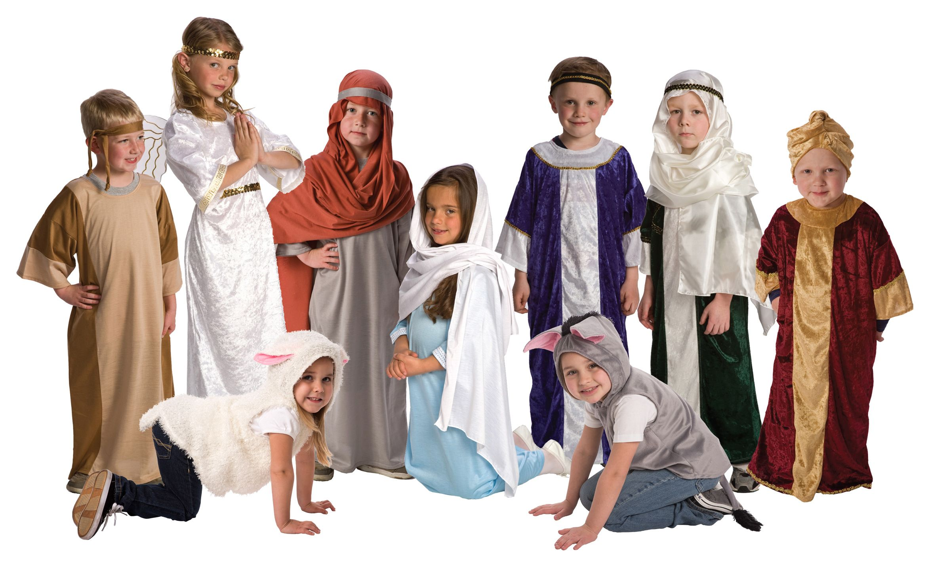
Characters Get Ready
Put on a costume or mask
Print free masks from the dating divas.

Slide 7
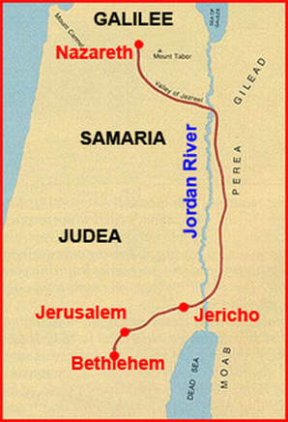
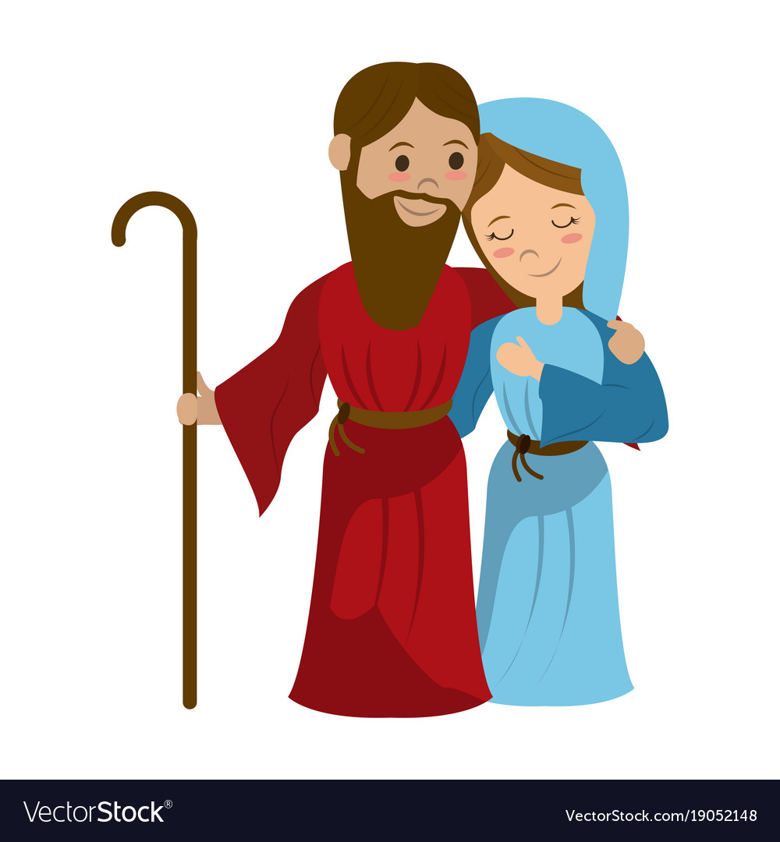
Luke 2
Our ancestor is David; King David.
He was born in Bethlehem, so that is where we must go.
Caesar Augustus says we have to go to our ancestor’s town to pay taxes and be counted.
That is such a long way!
90 miles!
I will get our things ready.
2 In those days, Caesar Augustus made a law. It required that a list be made of everyone in the whole Roman world. ² It was the first time a list was made of the people while Quirinius was governor of Syria. ³ Everyone went to their own town to be listed.
⁴ So Joseph went also. He went from the town of Nazareth in Galilee to Judea. That is where Bethlehem, the town of David, was. Joseph went there because he belonged to the family line of David. ⁵ He went there with Mary to be listed. Mary was engaged to him. She was expecting a baby.

Slide 8
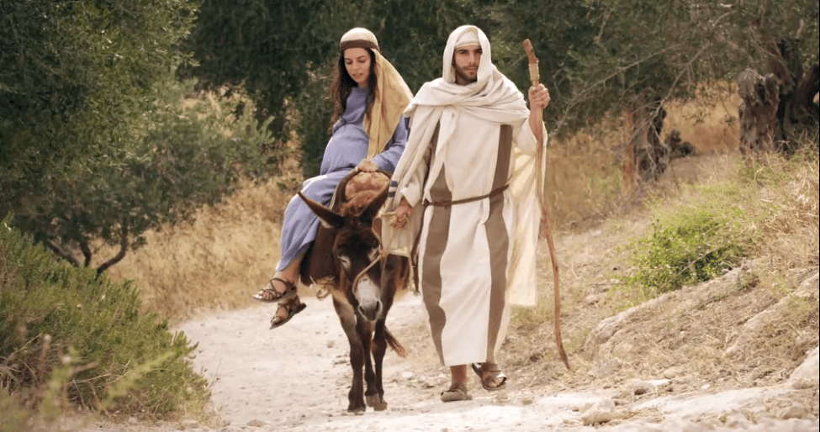
Luke 2
⁴ So Joseph went also. He went from the town of Nazareth in Galilee to Judea. That is where Bethlehem, the town of David, was. Joseph went there because he belonged to the family line of David. ⁵ He went there with Mary to be listed. Mary was engaged to him. She was expecting a baby.
Mary and Joseph walk around room and to the Bethlehem stable.

Slide 9
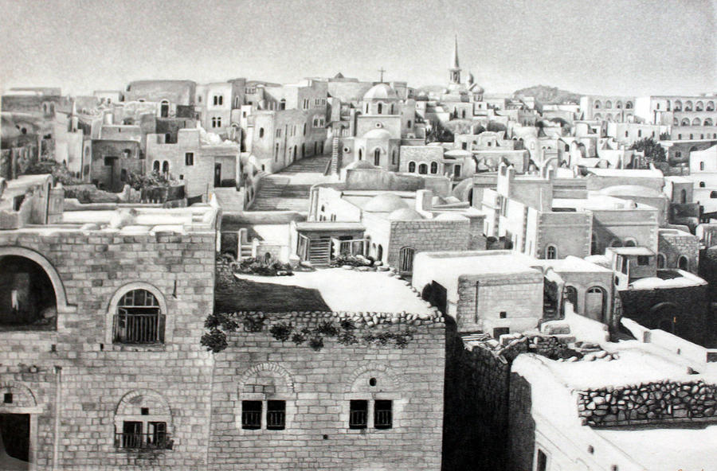
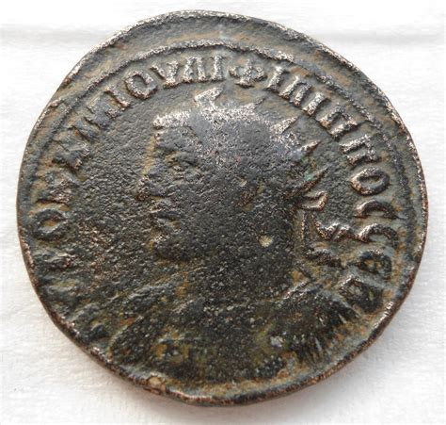
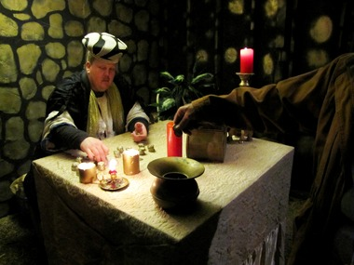
First you must pay your taxes and be counted.

Slide 10
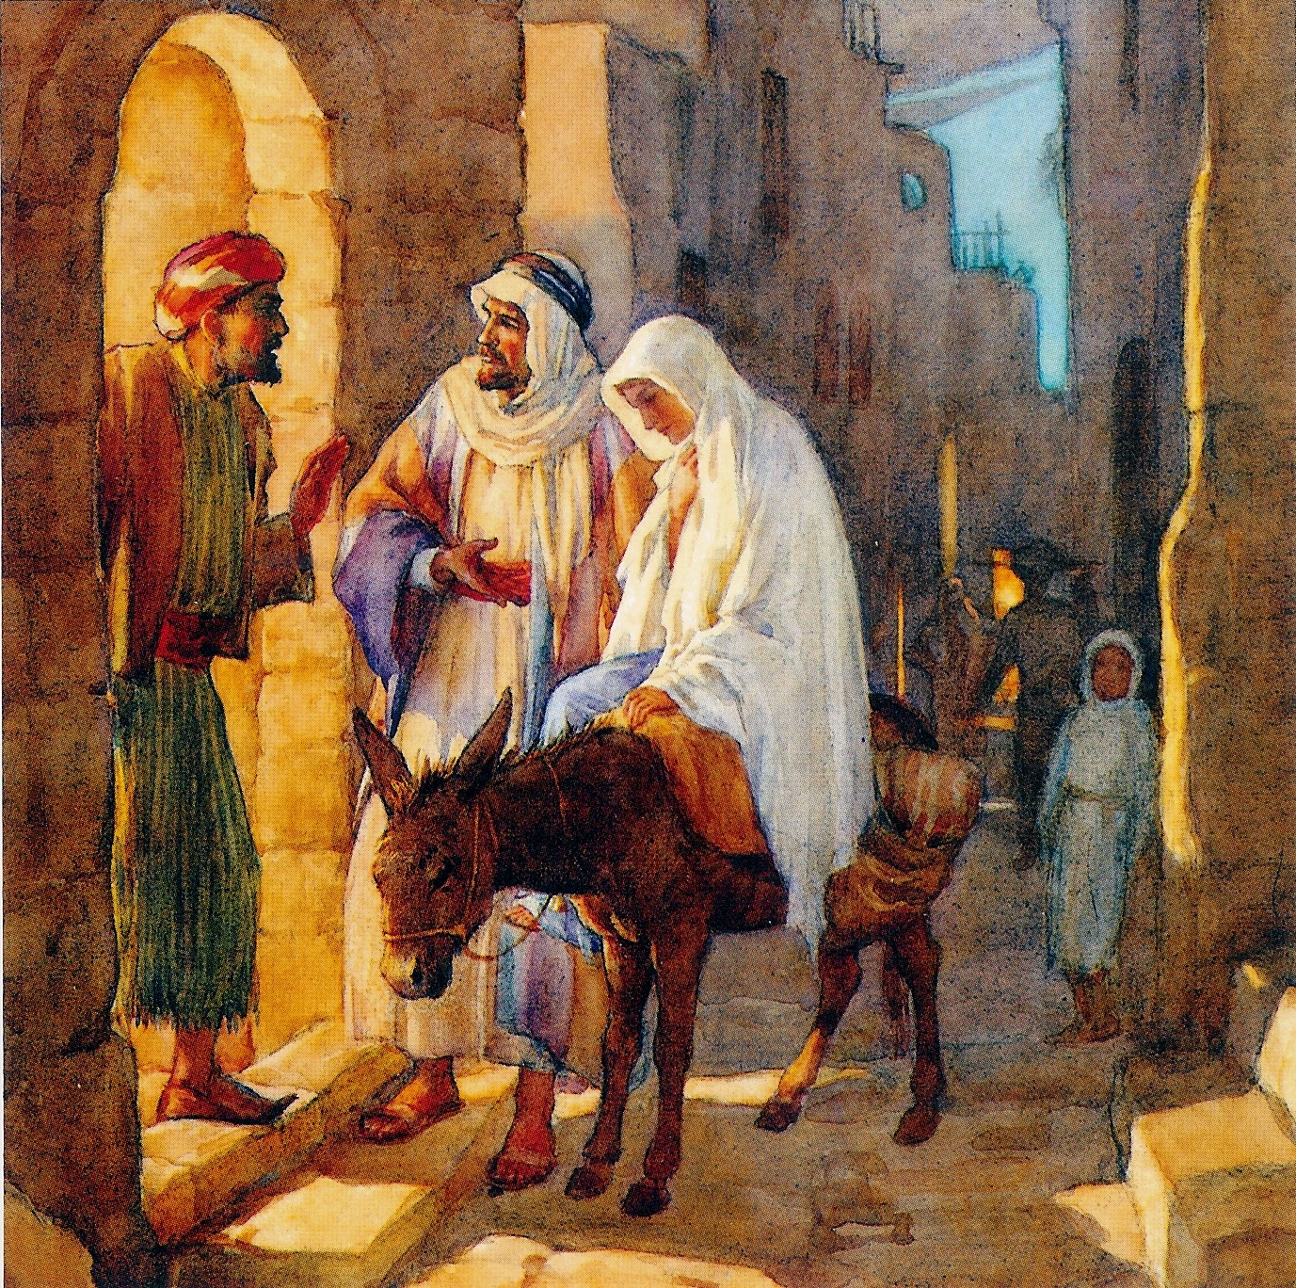
Now we must find a place to sleep.
We need a place to sleep.
Do you have a room?
No. I don’t have a room. We are full!

Slide 11
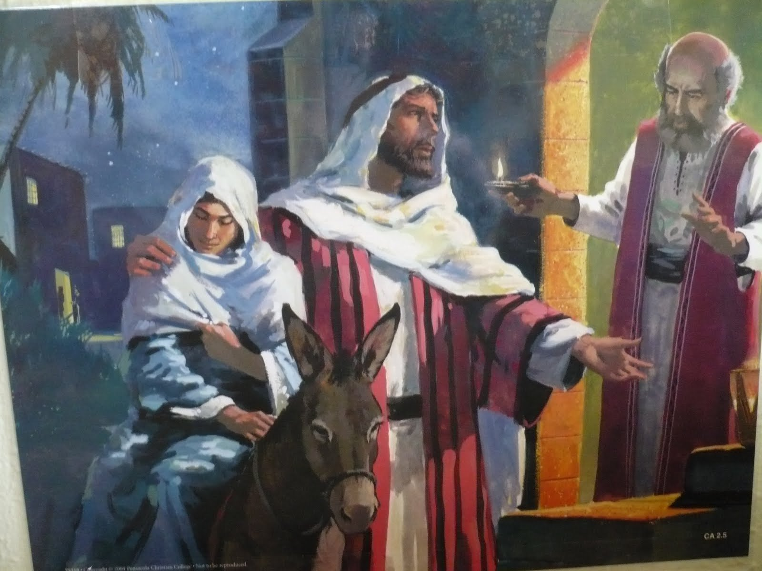
No room in the inn
No. I don’t have a room. We are full!
We need a place to sleep.
Do you have a room?

Slide 12
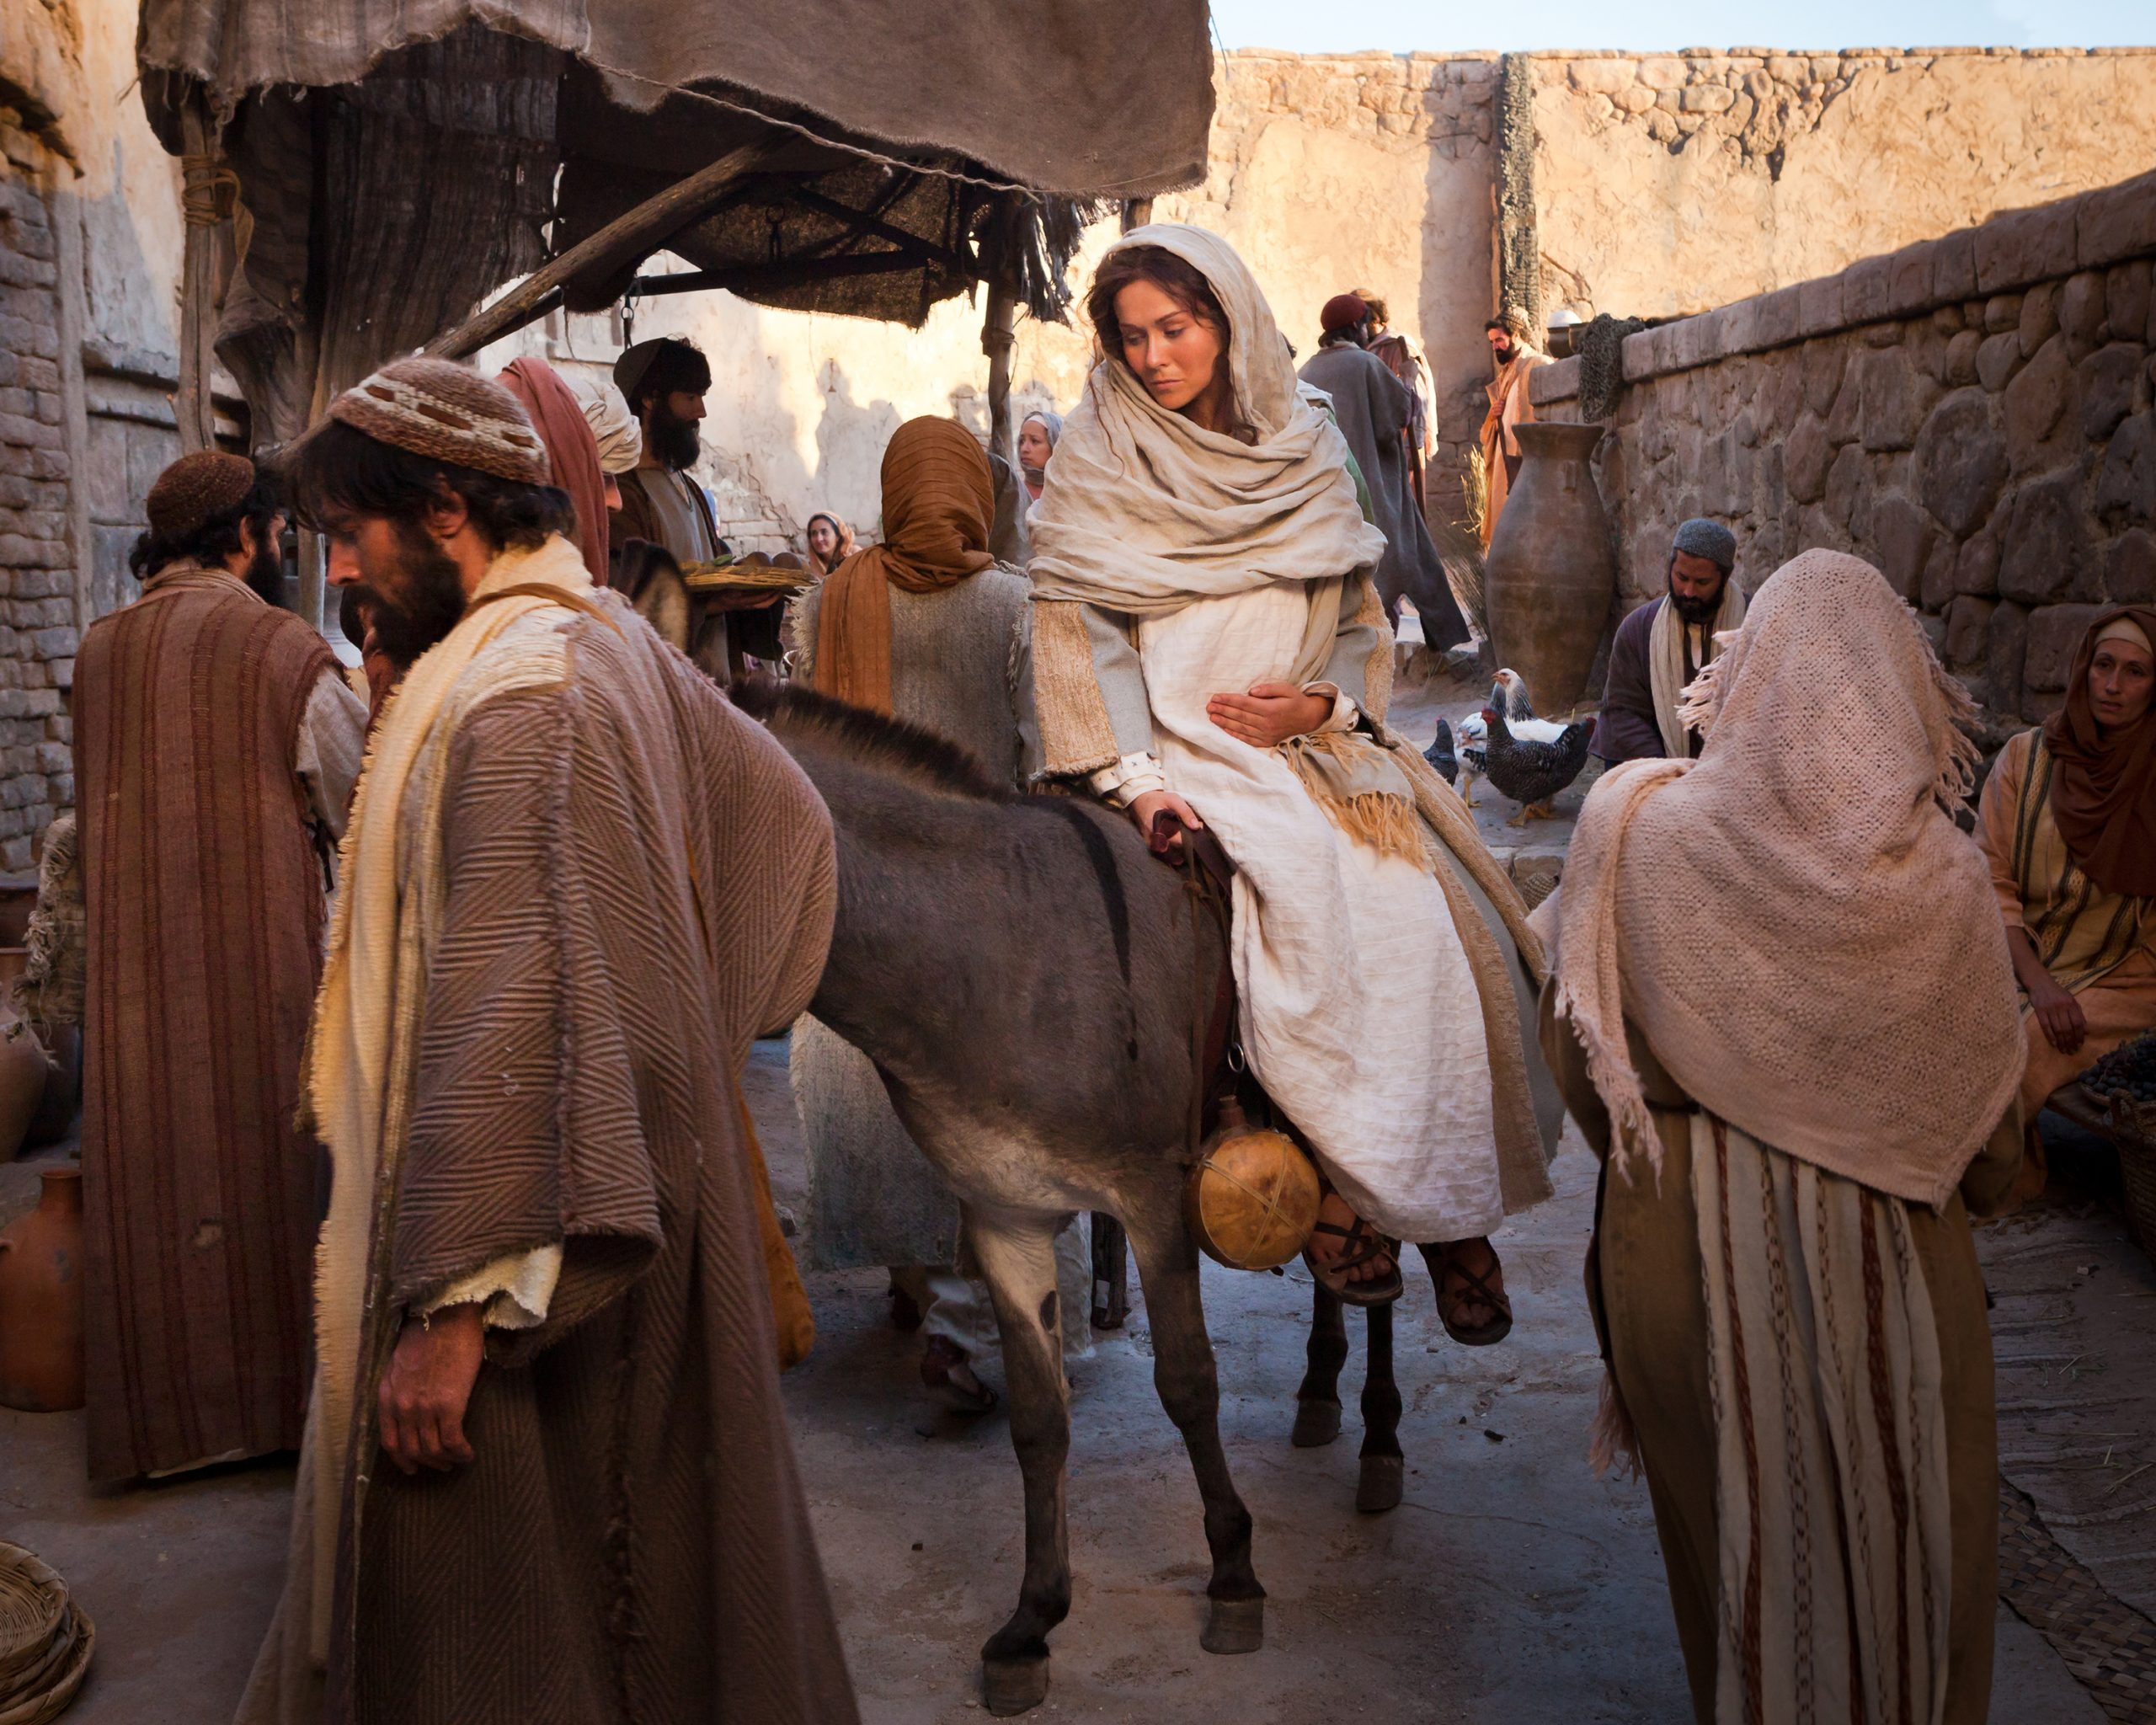
The city is full.
Many people are here for the census.
There are so many people!
All the places are full!
Where shall we sleep?
We will keep looking.
God will provide.

Slide 13
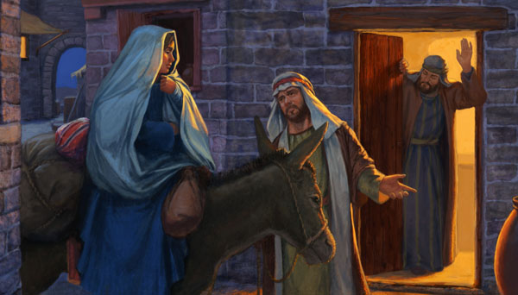
Room only in the stable
Shall we stay in the stable?
No. But you can stay in the stable
It is better than nothing

Slide 14
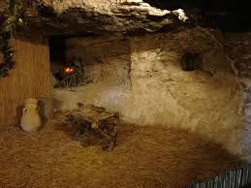
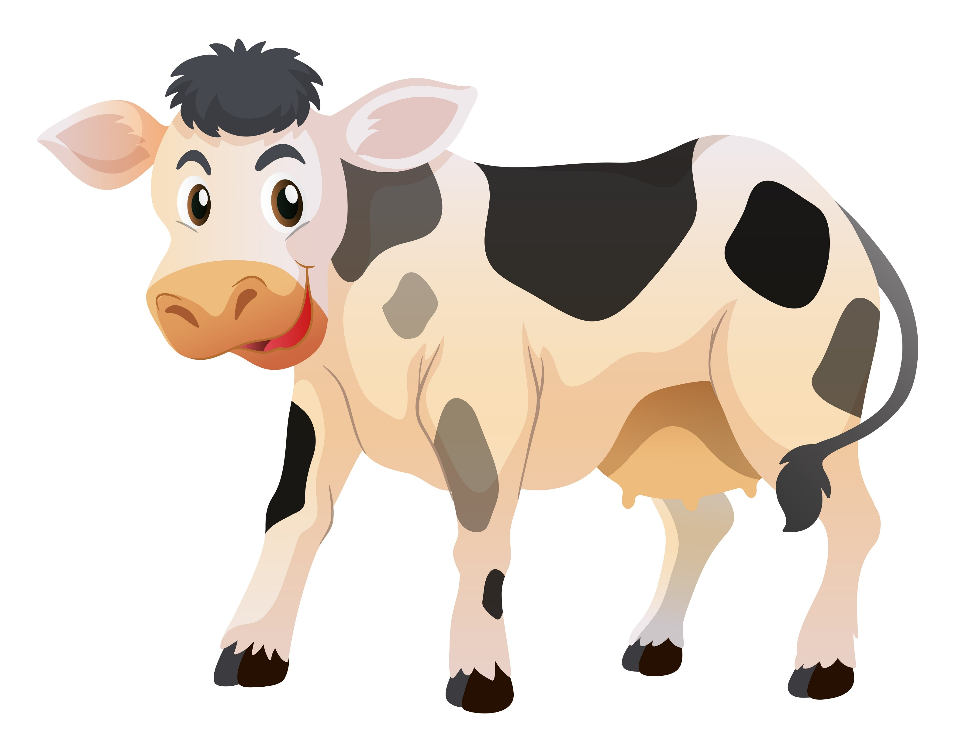
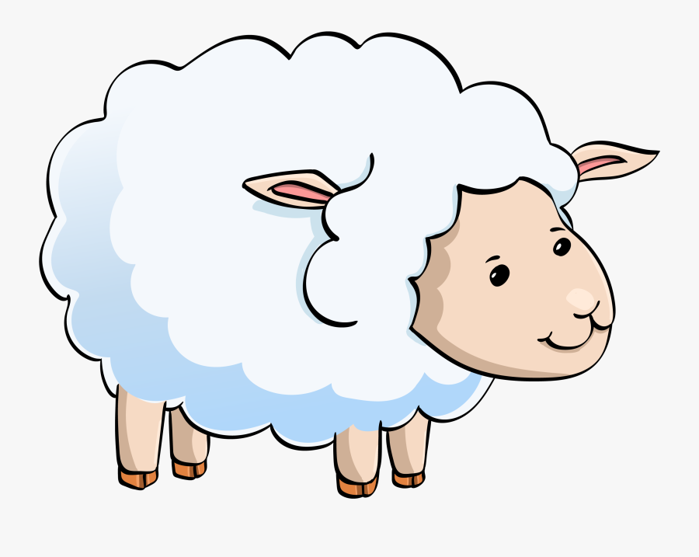
Here is the stable.
At least it is warm and dry.

Slide 15

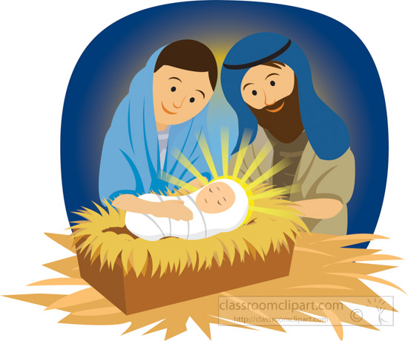
Sing Away in the Manger

Slide 16
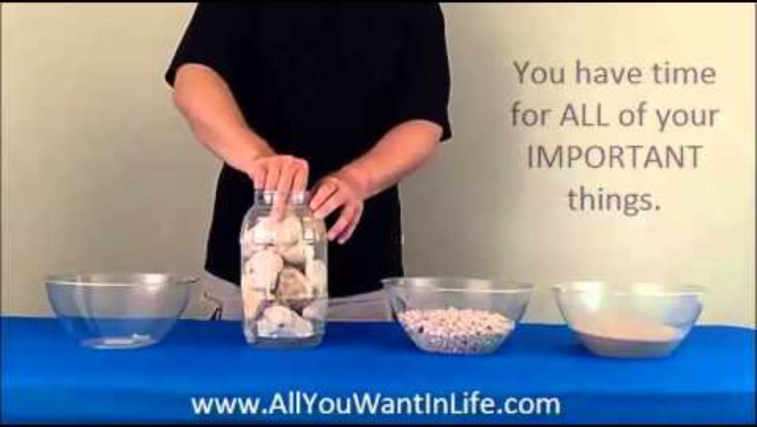
Object Lesson
Is there room inn your heart for Jesus?

Slide 17
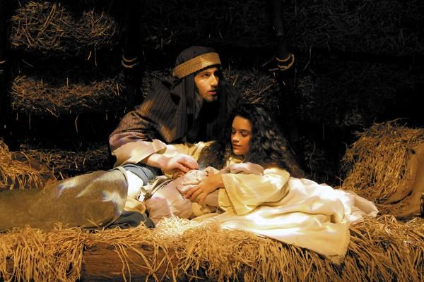
Luke 2
.Can you imagine.
God’s Son born in a stable?
Jesus
He is so precious!
A special gift from God!
⁶ While Joseph and Mary were there, the time came for the child to be born. ⁷ She gave birth to her first baby. It was a boy. She wrapped him in large strips of cloth. Then she placed him in a manger. That’s because there was no guest room where they could stay.

Slide 18
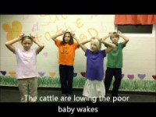
Sing Away in the Manger

Slide 19
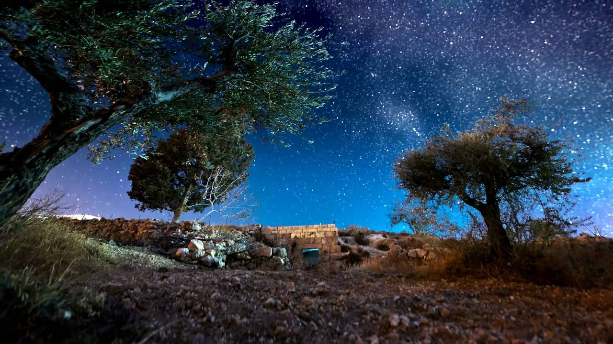
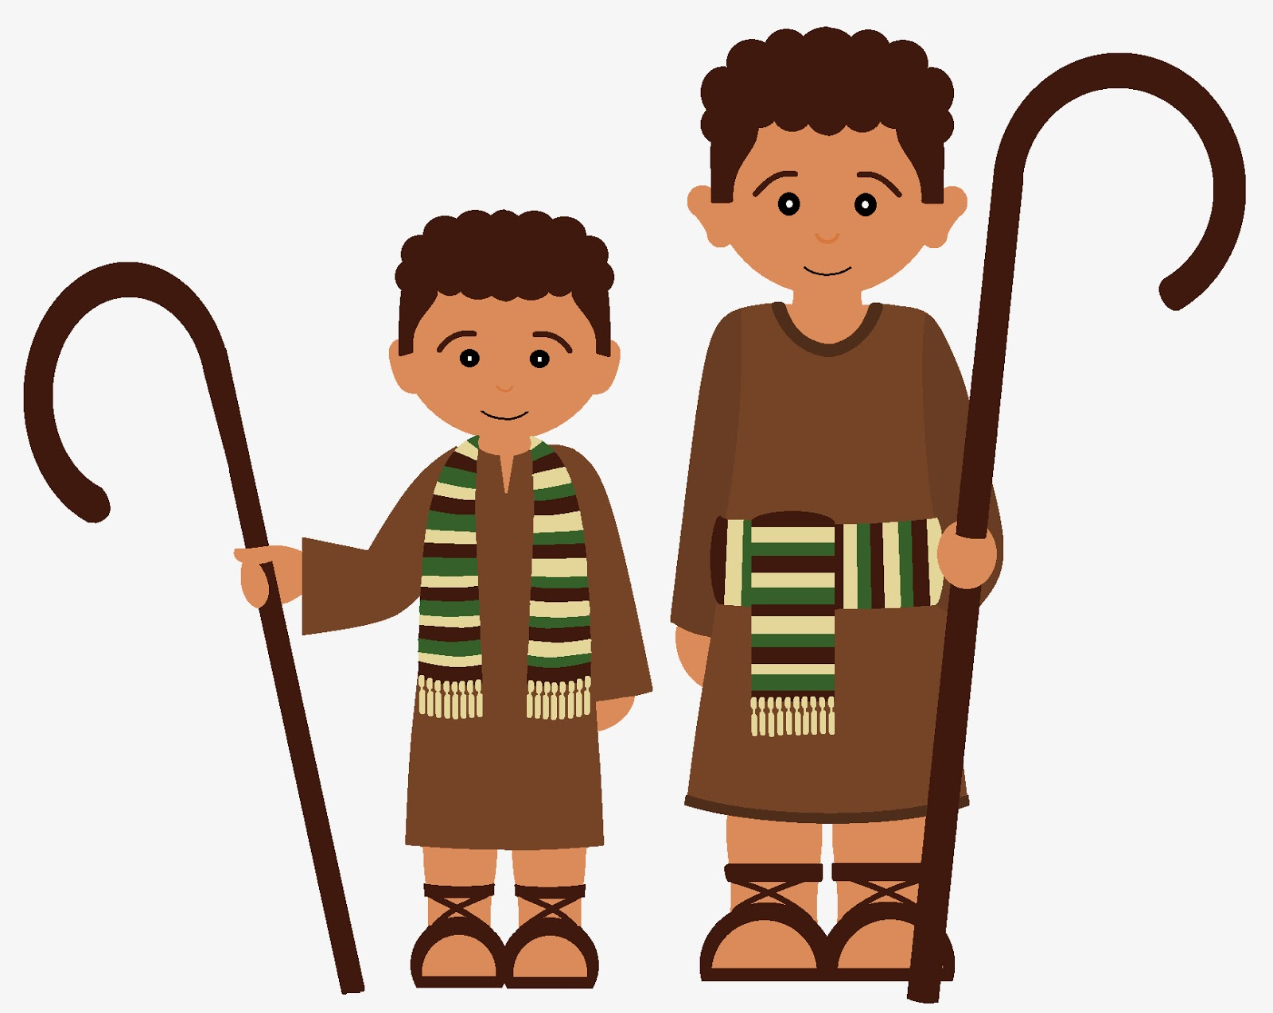

Part 2 from
Luke 2
⁸ There were shepherds living out in the fields nearby. It was night, and they were taking care of their sheep
I’ve been wondering when the Messiah will come.
The sheep are all counted and safe in the sheep pen.
It’s a beautiful night!

Slide 20
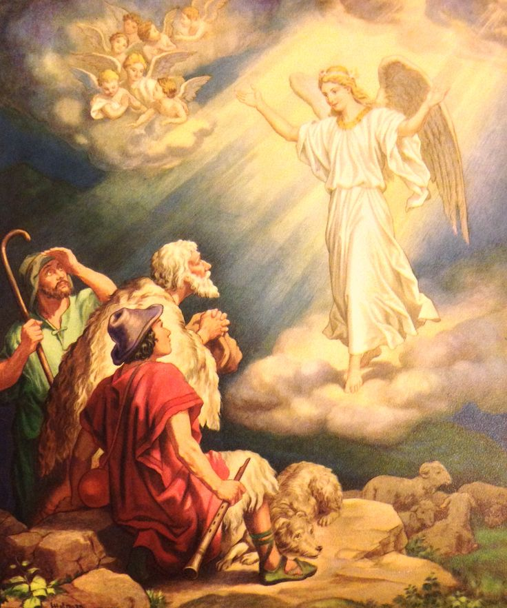
Luke 2
Do not be afraid.
I bring you good news!
It will bring joy to everyone!
⁹ An angel of the Lord appeared to them. And the glory of the Lord shone around them. They were terrified.
¹⁰ But the angel said to them, “Do not be afraid. I bring you good news. It will bring great joy for all the people. ¹¹ Today in the town of David a Savior has been born to you. He is the Messiah, the Lord.
¹² Here is how you will know I am telling you the truth. You will find a baby wrapped in strips of cloth and lying in a manger.”
Today in the town of David, Bethlehem,
a baby has been born.
He is the Savior!
You will find him wrapped in strips of cloth, lying in a manger.

Slide 21
Gory to God
in the highest heaven!
Peace. Goodwill to all!
Gloria! Praise God!
¹³ Suddenly a large group of angels from heaven also appeared. They were praising God. They said,
¹⁴ “May glory be given to God in the highest heaven!
And may peace be given to those he is pleased with on earth!”

Slide 22
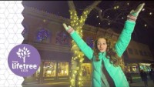
Sing Hark the Heralds Angels Sing

Slide 23
Luke 2
⁸¹⁵ The angels left and went into heaven. Then the shepherds said to one another, “Let’s go to Bethlehem. Let’s see this thing that has happened, which the Lord has told us about.”
Let’s go find the baby!
The Messiah Savior
has come!
WOW!

Slide 24
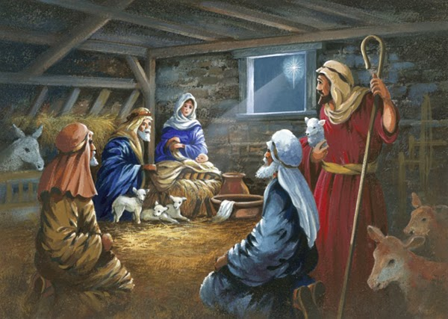
Luke 2
This is Jesus.
¹⁶ So they hurried off and found Mary and Joseph and the baby. The baby was lying in the manger.
Come in.
Jesus!
Our Savior!
Praise God!
The Savior!
Praise God!
Angels told us that He was born and where to find Him!

Slide 25
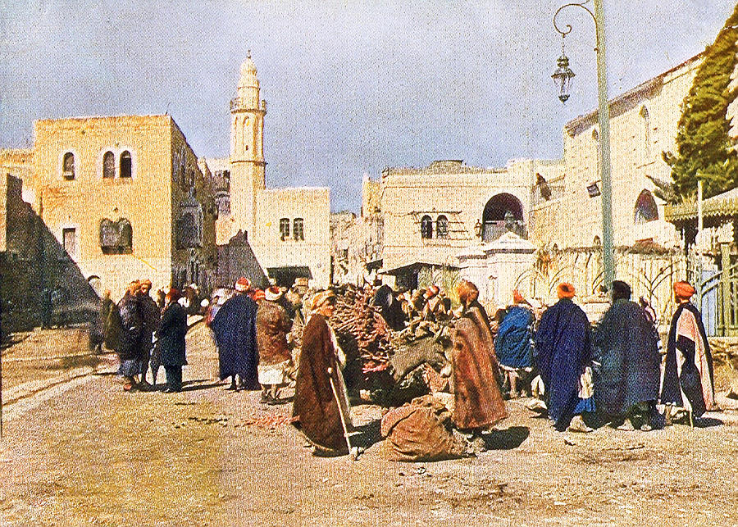
Luke 2
¹⁷ After the shepherds had seen him, they told everyone. They reported what the angel had said about this child. ¹⁸ All who heard it were amazed at what the shepherds said to them. ¹⁹ But Mary kept all these things like a secret treasure in her heart. She thought about them over and over. ²⁰ The shepherds returned. They gave glory and praise to God. Everything they had seen and heard was just as they had been told.
The Savior has been born.
His name is Jesus.
The angels told us last night!
Have you heard?
Did you see the angel choir?
The Savior has been born!

Slide 26
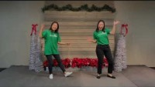
Sing Go Tell It on The Mountain

Slide 27

Sing Joy to the World

Slide 28
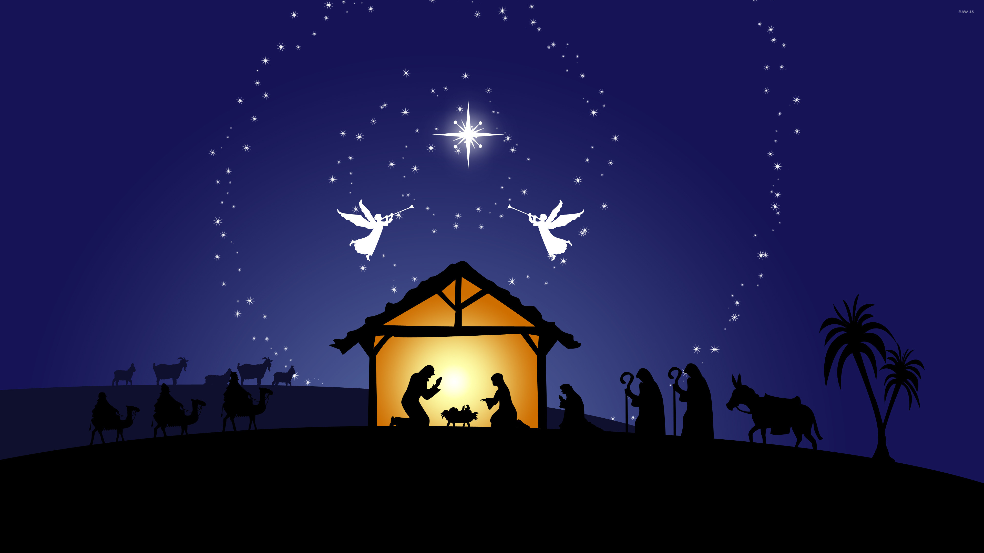
The shepherds were ready to receive Jesus as their Savior.
Are you?
The shepherds were excited to go tell others about Jesus!
Are you?

Slide 29

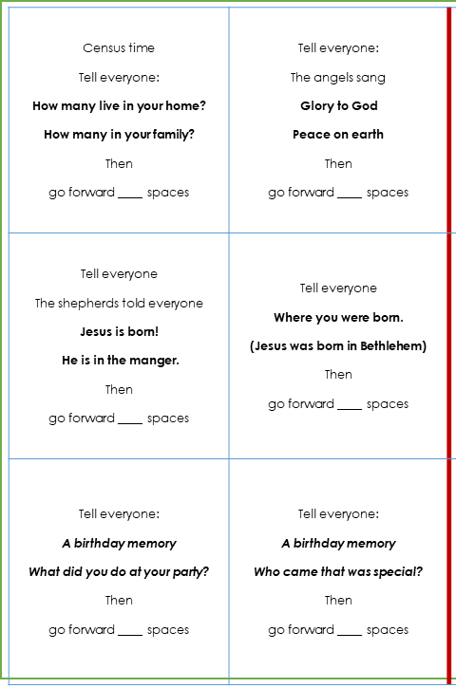
Game Craft PART 1
DIRECTIONS
Cut out the Announcement Cards
Write in how many spaces to move forward. Choose 1, 2, or 3
We will be adding new cards each week.

Slide 30
Sing Go Tell It on The Mountain

Slide 31

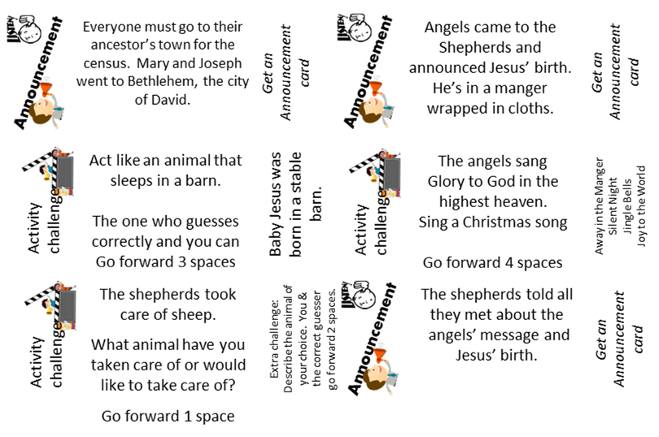
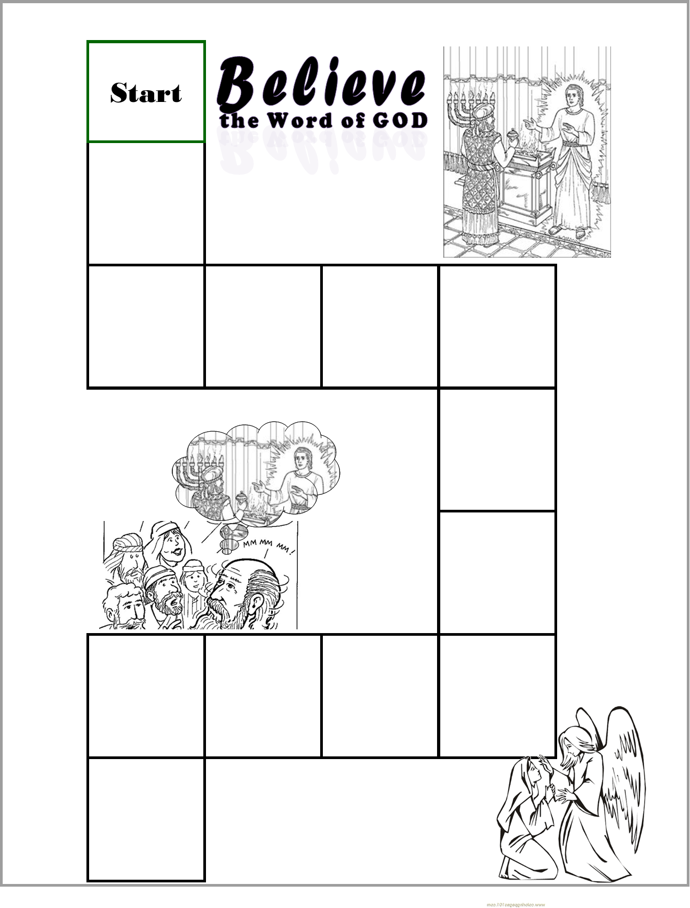
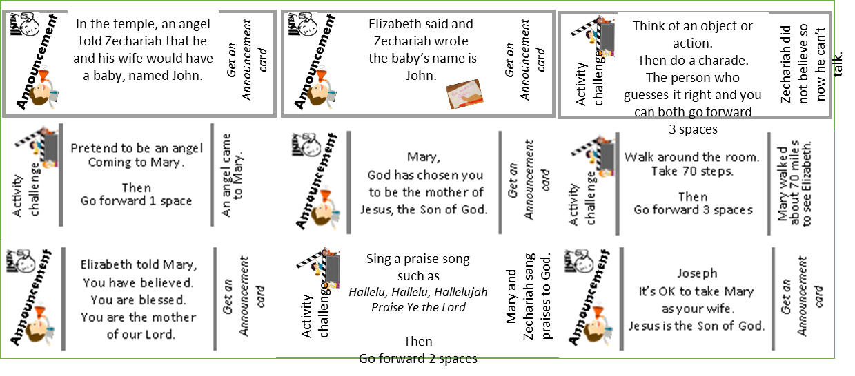
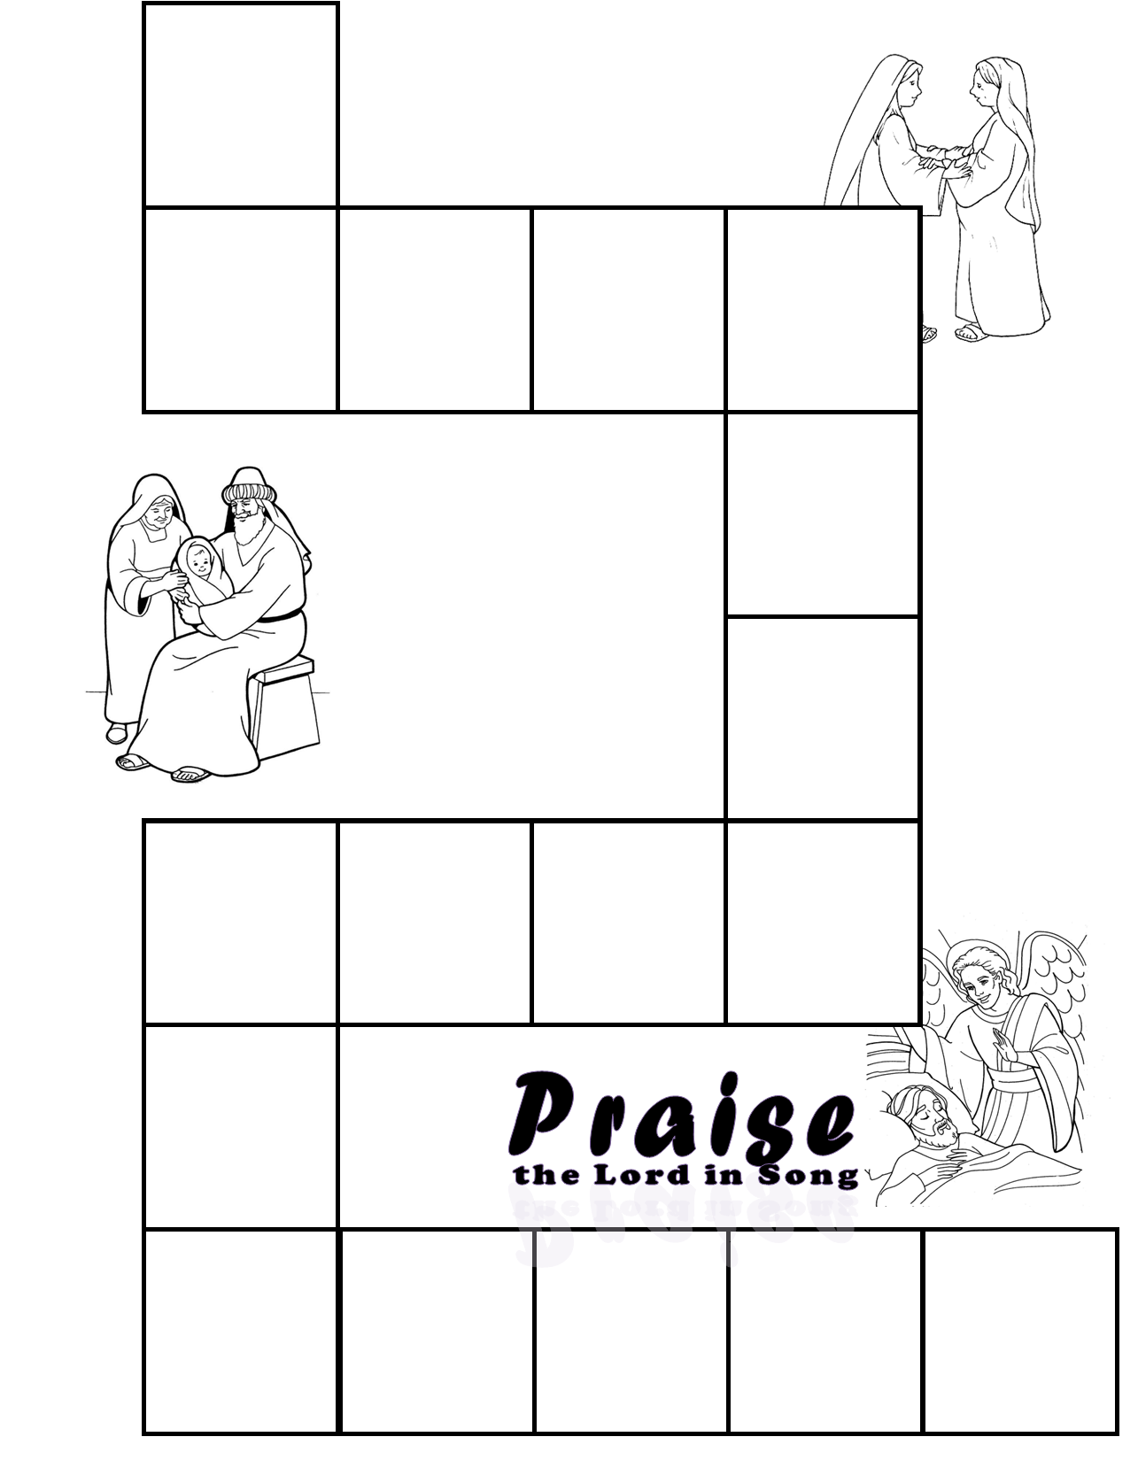
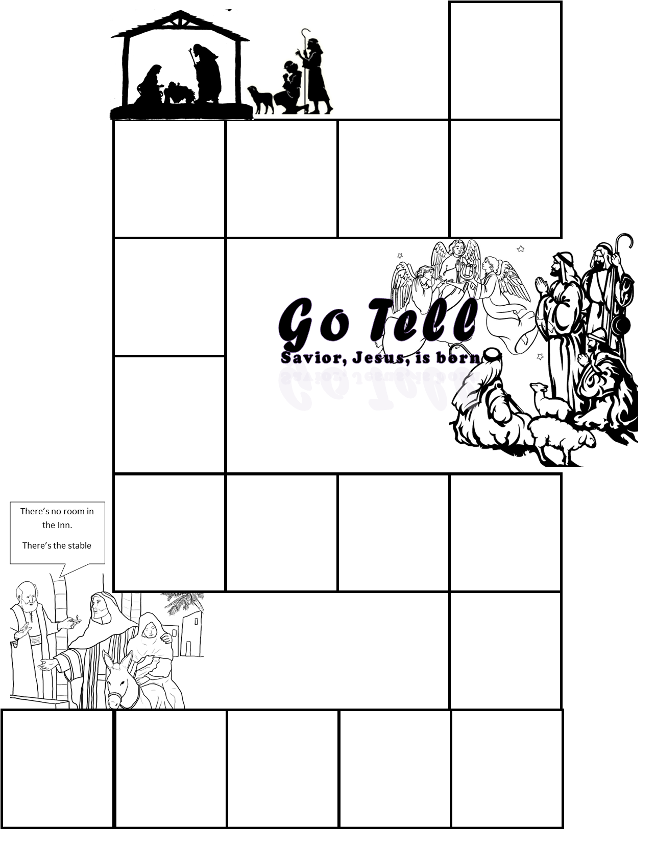
Craft PART 2
DIRECTIONS
Prepare the playing board part 3: Glue this page on the left side of a manila folder so that the bottom right corner is near the bottom right corner of the left side of the folder.
Put on the activity stickers like this: (click to see where)
Write in your own directions on 2 squares if you wish.
Note: We will be adding the final page of the game next week.

Slide 32
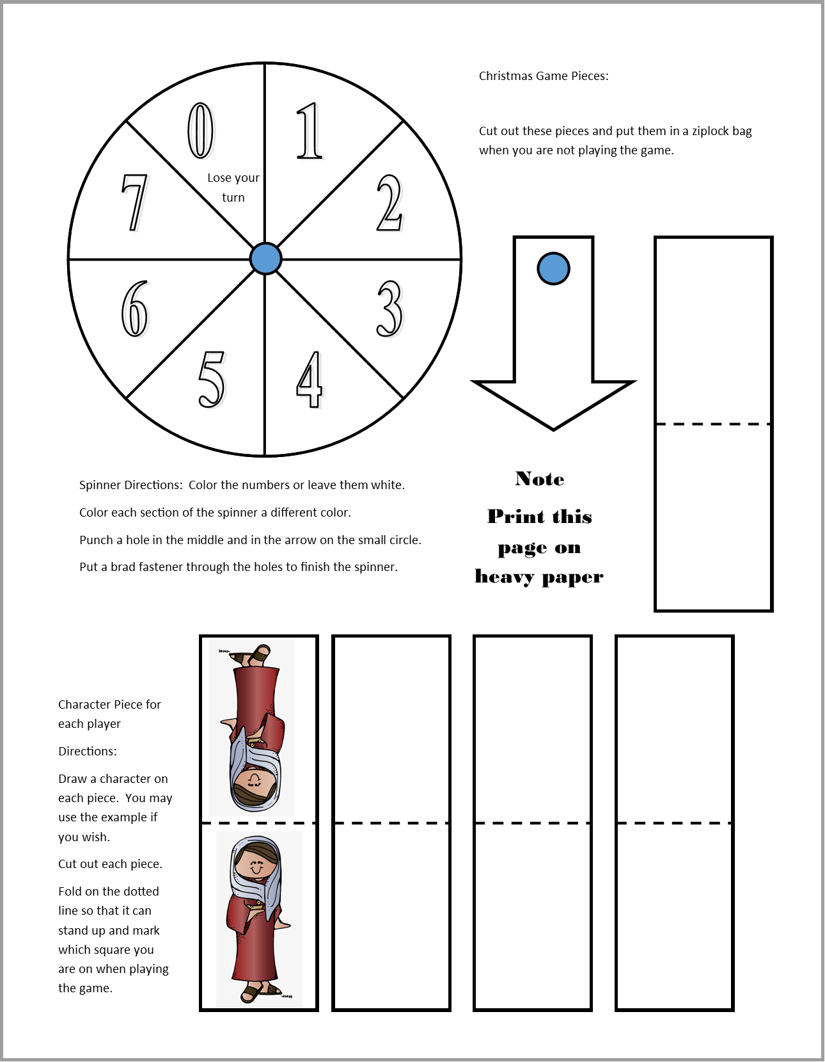

Play the game
DIRECTIONS
All players: choose a game piece and place it on the start square.
Place the Announcement Cards in a pile, picture side up.
On your turn, spin the spinner
Go that many spaces.
Follow the directions on the space you land on, if there are any.

Slide 33
Sing Away in the Manger

Slide 34
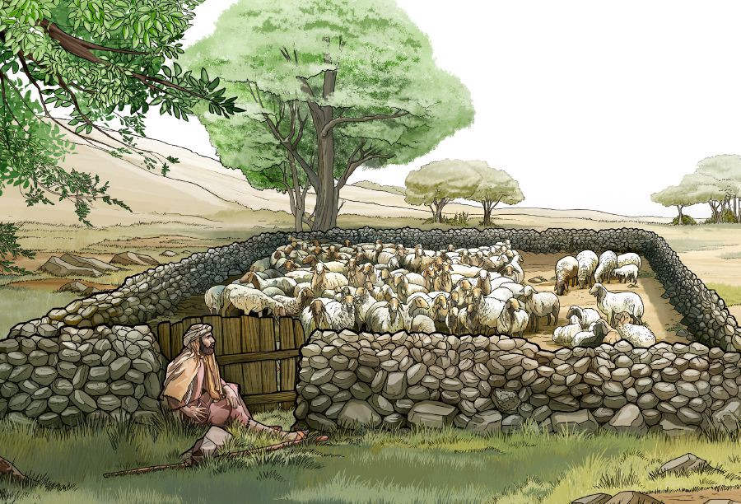
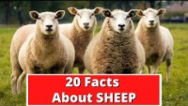
The shepherds took care of sheep. What do you know about sheep?

Slide 35
Sing Hark the Heralds Angels Sing

Slide 36
Sing Joy to the World

Slide 37

Have you ever gone camping?
Tell me about it.
Have you seen the stars?
There are so many!

Slide 38

Have you ever sat around a fire?
Tell me about it.

Slide 39
Remember in our story there were shepherds camping outside.
They were probably sitting around a campfire talking.
Do you know what shepherds do?
They take care of sheep!
Let’s learn a little bit about sheep.

Slide 40

Sing Joy to the World

Slide 41

https://activity-array.com/

