Slide 1
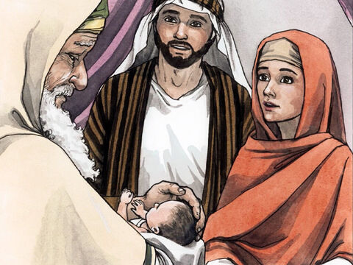
Baby Dedication
Simeon and Anna meet Jesus

Slide 2
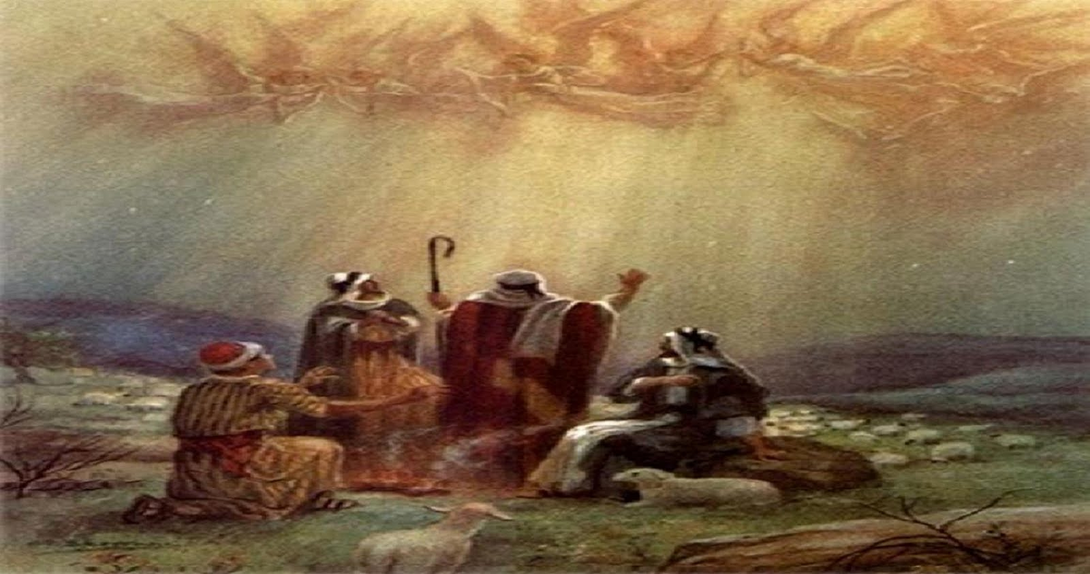
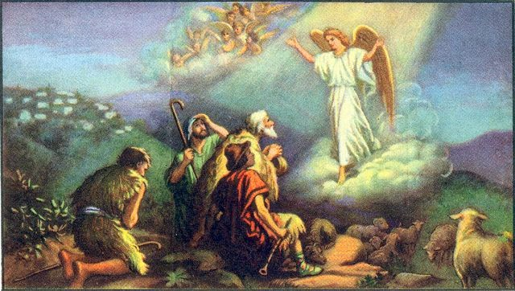
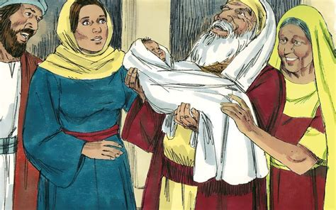
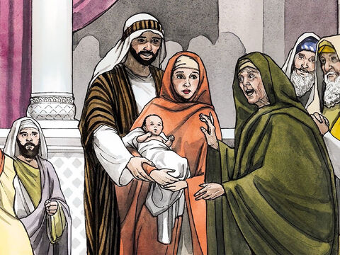
Last week’s story was:
Jesus’ birth was announced to shepherds by angels who shared the good news with people in Bethlehem.
This week’s story is:
Jesus’ birth announced to an old man & woman by the Holy Spirit who shared the good news with people in Jerusalem.

Slide 3
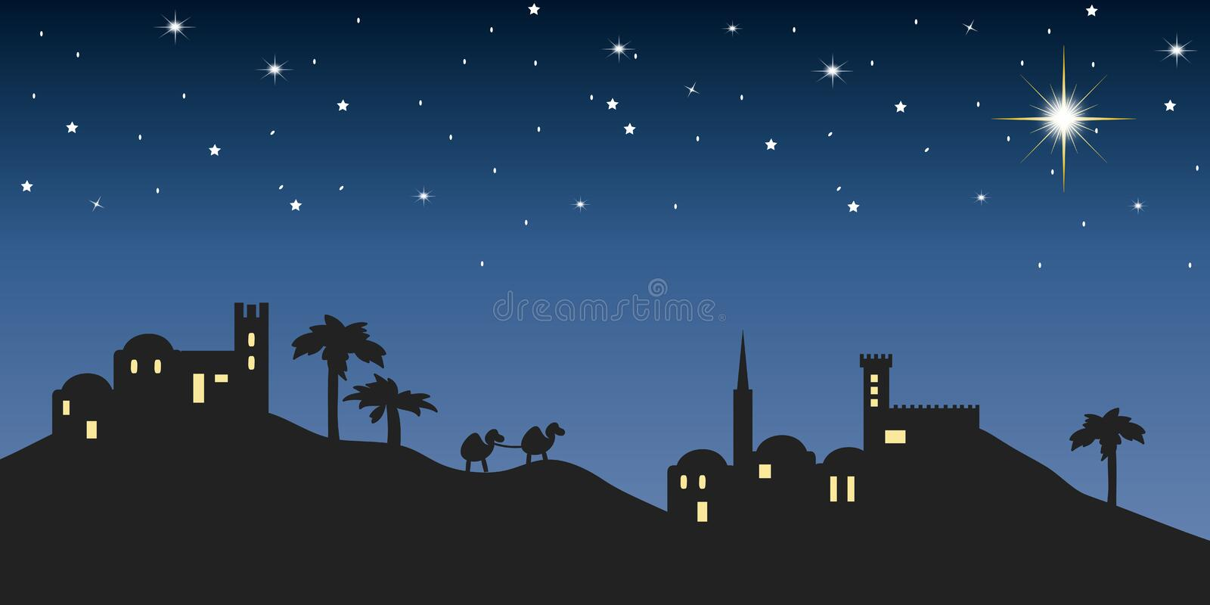
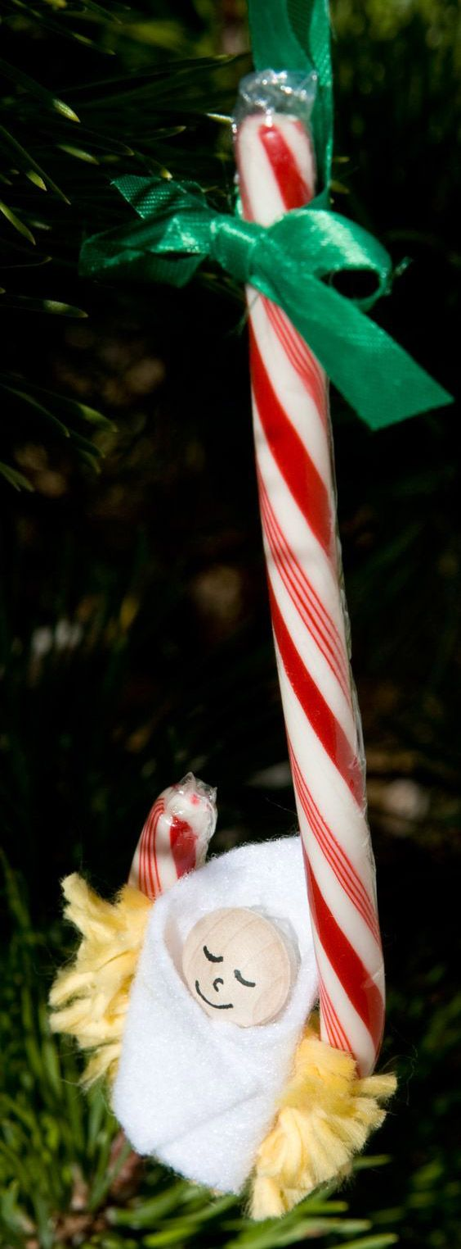
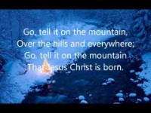
Go Tell It On The Mountain

Slide 4

¹ Give praise to the Lord, proclaim His name;
make known among the nations what He has done.
² Sing to him, sing praise to Him;
tell of all His wonderful acts.
³ Glory in His holy name;
let the hearts of those who seek the Lord rejoice.
⁴ Look to the Lord and His strength;
seek His face always.
Psalms 105
Psalms 105:1-2
Psalms 84 also speaks what I think Simeon and Anna desired.
You can find our story in Luke 2

Slide 5
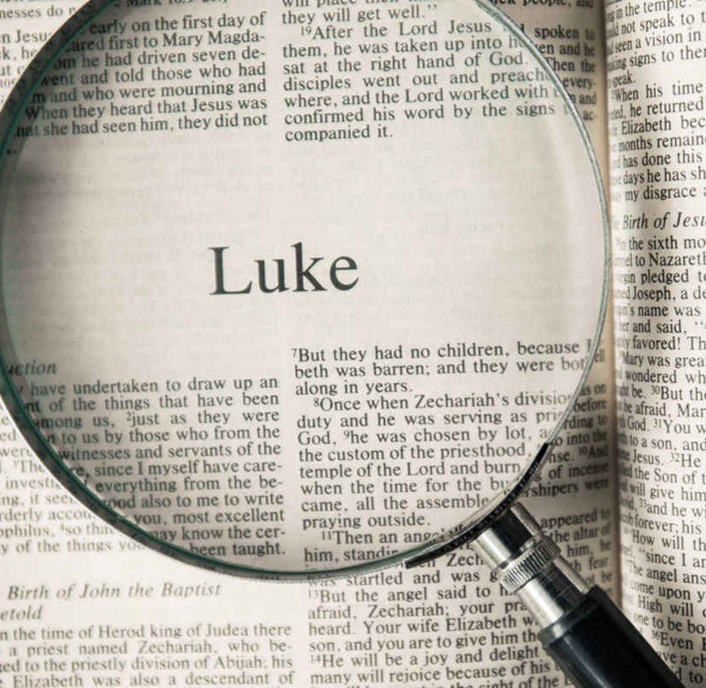
Our story is found in Luke 2:21-40 read verse 30-31 together

Slide 6
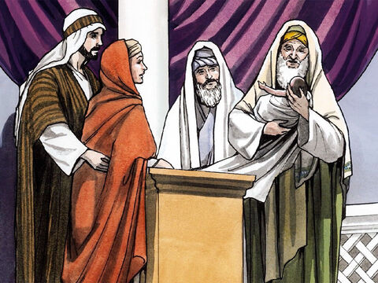
Eight days old
8
Name him…
His name is Jesus
²¹ And when eight days were completed ^{[g]}for the circumcision of the Child, His name was called Jesus, the name given by the angel before He was conceived in the womb.

Slide 7
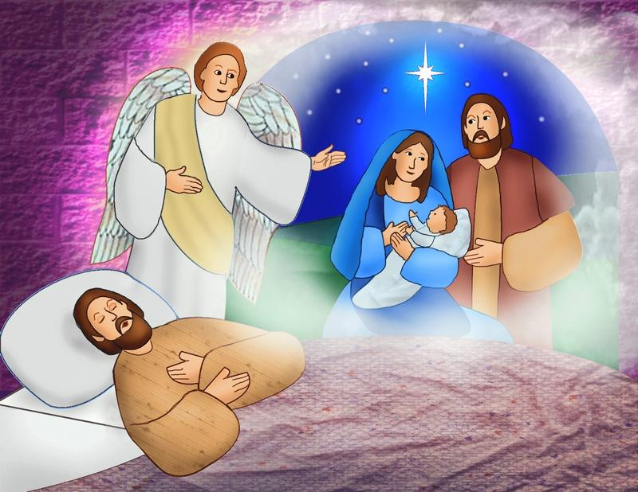
^{Matthew 1:21}
She is going to have a son. You must give him the name Jesus. That’s because he will save his people from their sins.”
Joseph
remembered

Slide 8
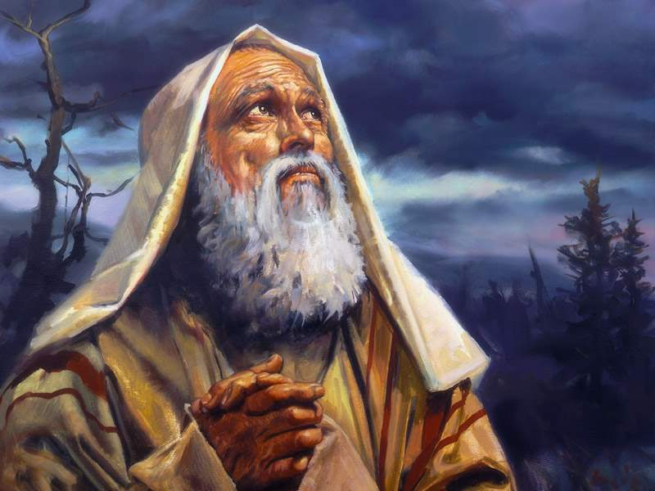
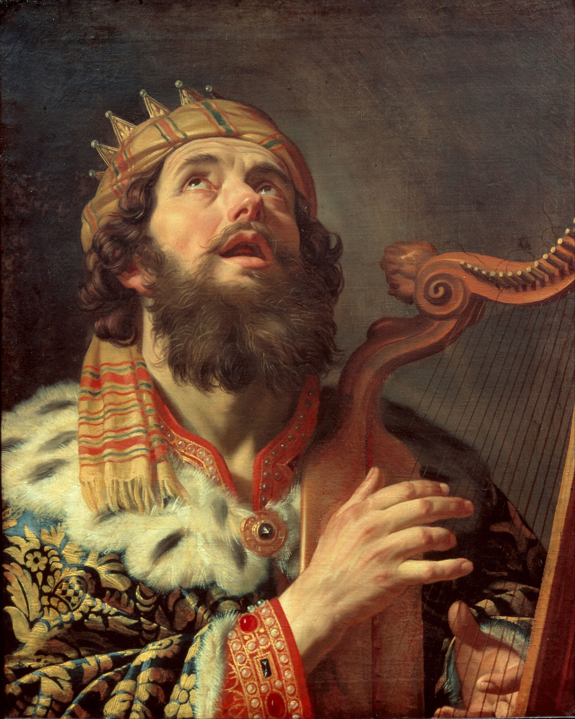

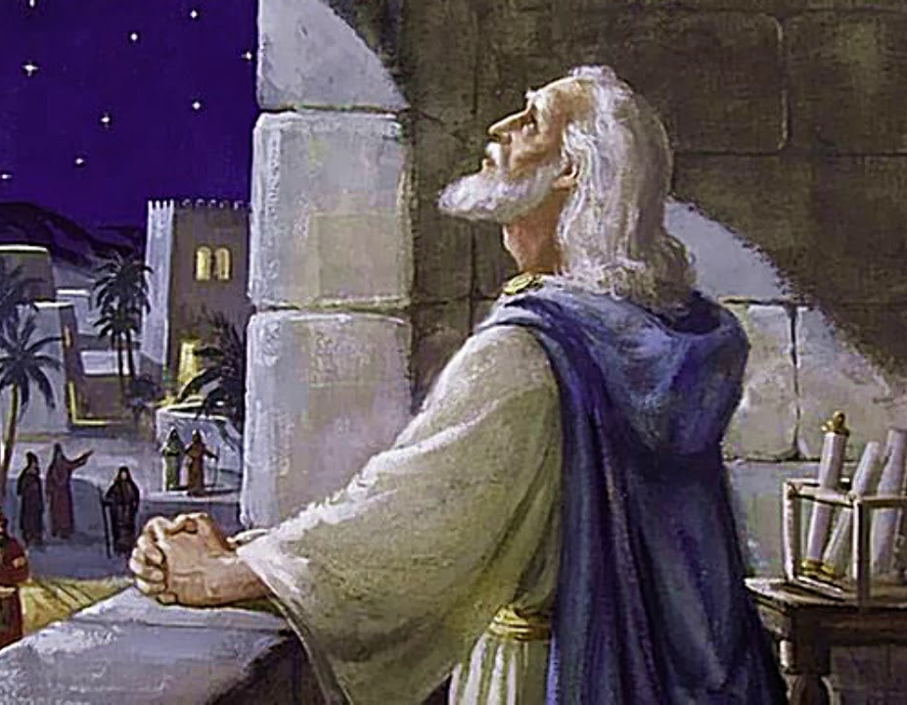
They kept the law of God
The Messiah will come.
He will save all people from their sins.
Mary and Joseph kept the law of God.
They were faithful.
God is faithful.
God kept His promises.
He had promised Adam & Eve,
Abraham, Isaac, Jacob…
King David,
Isaiah, Daniel, ….
And many others that the Messiah would come.
He would be a blessing.
He would save people from their sins.
He would sit on David’s throne.
He would be our High Priest and King.
The Messiah was born!
Through your offspring
all nations will be blessed.
He will be the Messiah.

Slide 9
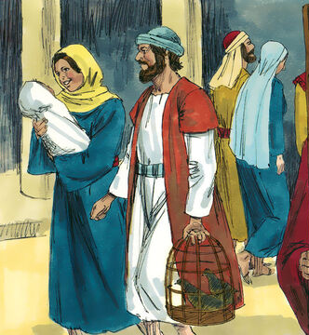
Forty-one days old
41
Purification & Dedication
God will make me clean
We have our offering, 2 pigeons
²² The time came for making Mary “clean” as required by the Law of Moses. So Joseph and Mary took Jesus to Jerusalem. There they presented him to the Lord. ²³ In the Law of the Lord it says, “The first boy born in every family must be set apart for the Lord.” (Exodus 13:2,12) ²⁴ They also offered a sacrifice. They did it in keeping with the Law, which says, “a pair of doves or two young pigeons.” (Leviticus 12:8)
.
You are God’s Son.
We will dedicate you today.

Slide 10

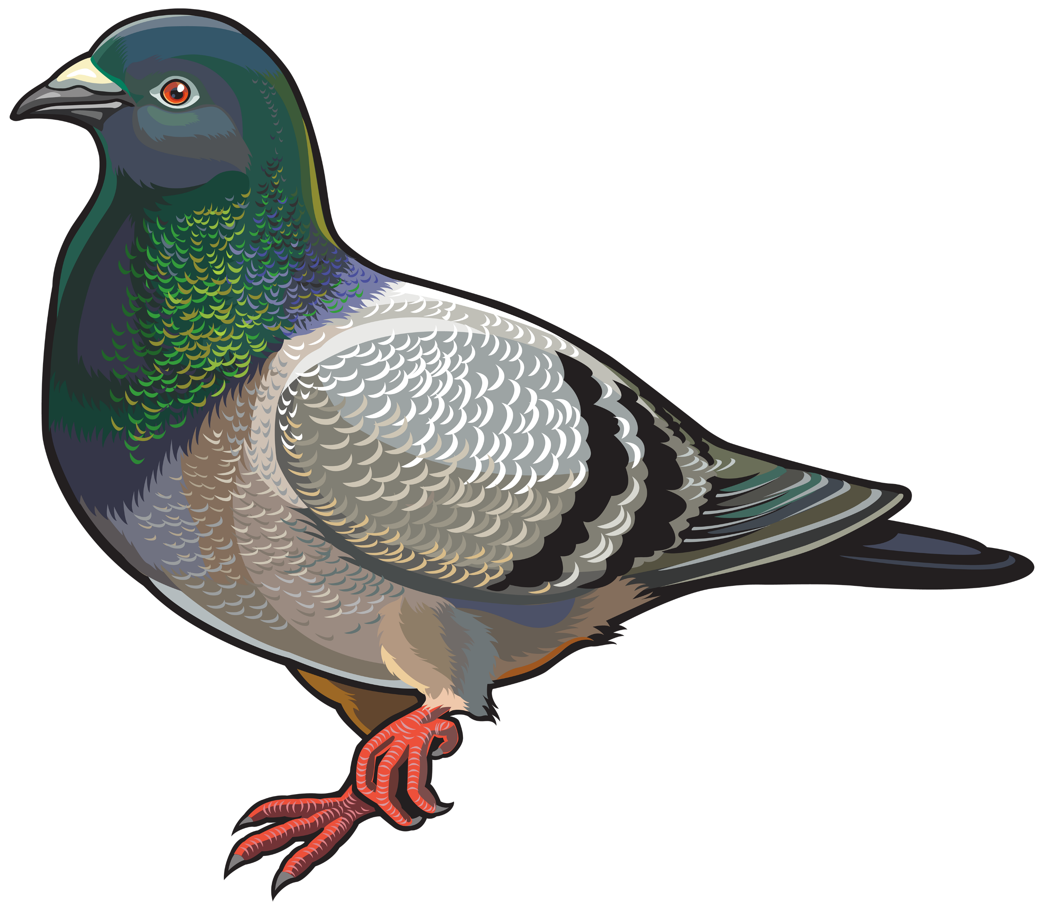
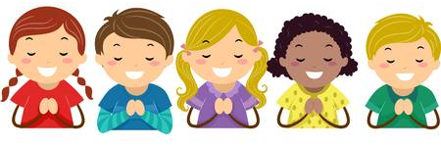

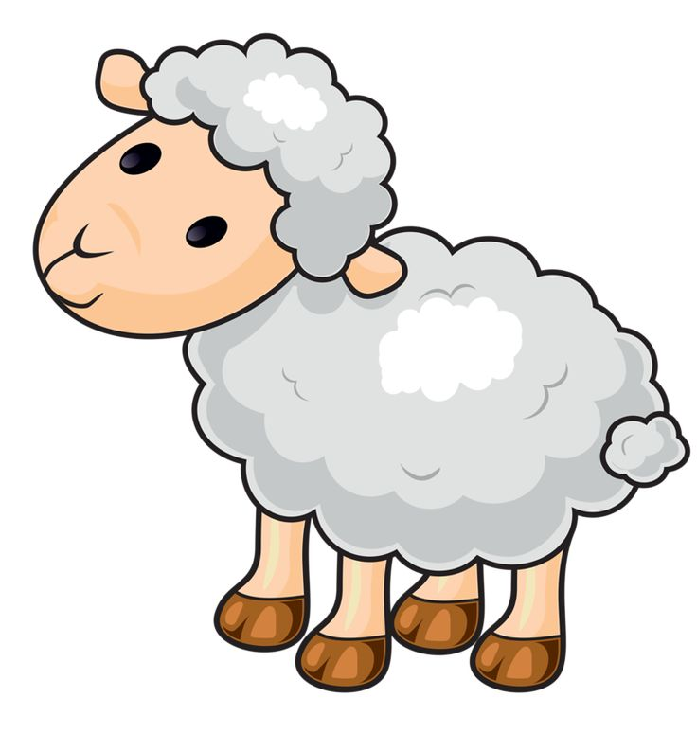
Prayer of Repentance
Dear Heavenly Father,
Please forgive me for my sins. I know you don’t like lying, greed, selfishness, nor harming others.
Please help me to be generous, loving, kind, and true. Help me to be faithful to You. Thank you for forgiving me. Thank you for loving me! Amen.
God will make me clean

Slide 11
Prayer of Thankfulness
Dear Heavenly Father,
Thank you for your generosity. Thank you for family, friends, home, health,…. Thank you for Jesus who came so that we can have forgiveness and eternal life!
Thank you for _______________.
God is good

Slide 12
Jesus was dedicated to the Lord
May God bless this child.

Slide 13
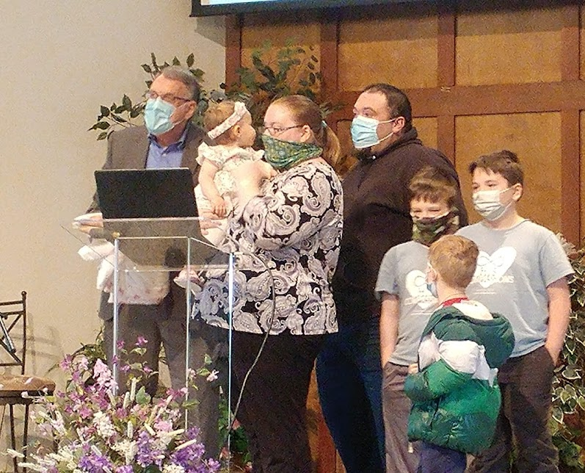
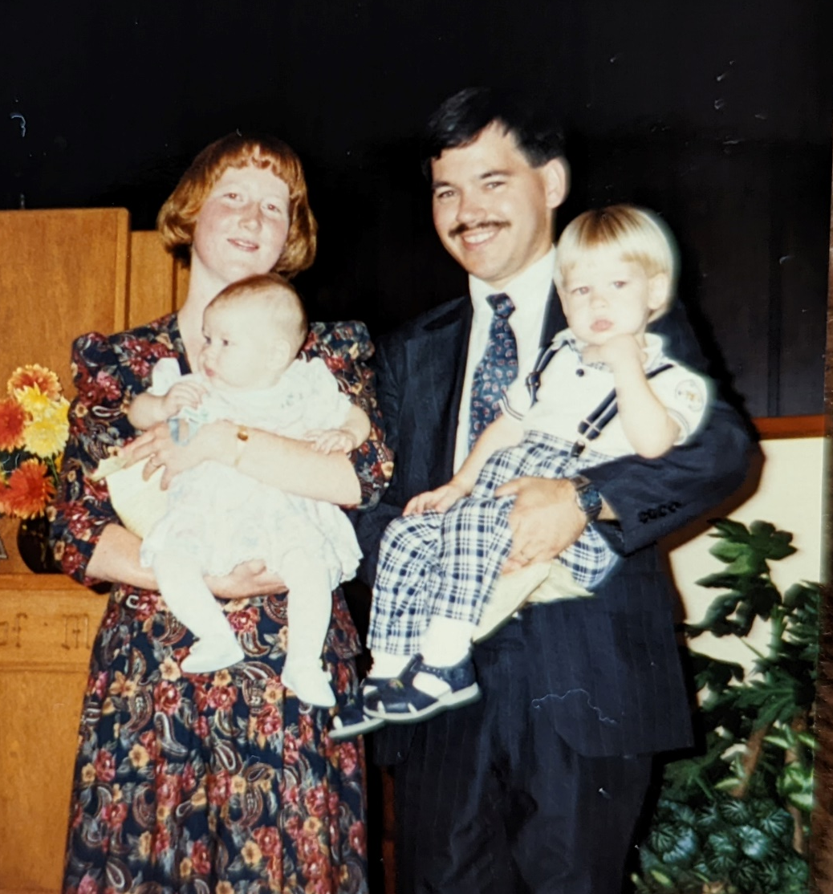
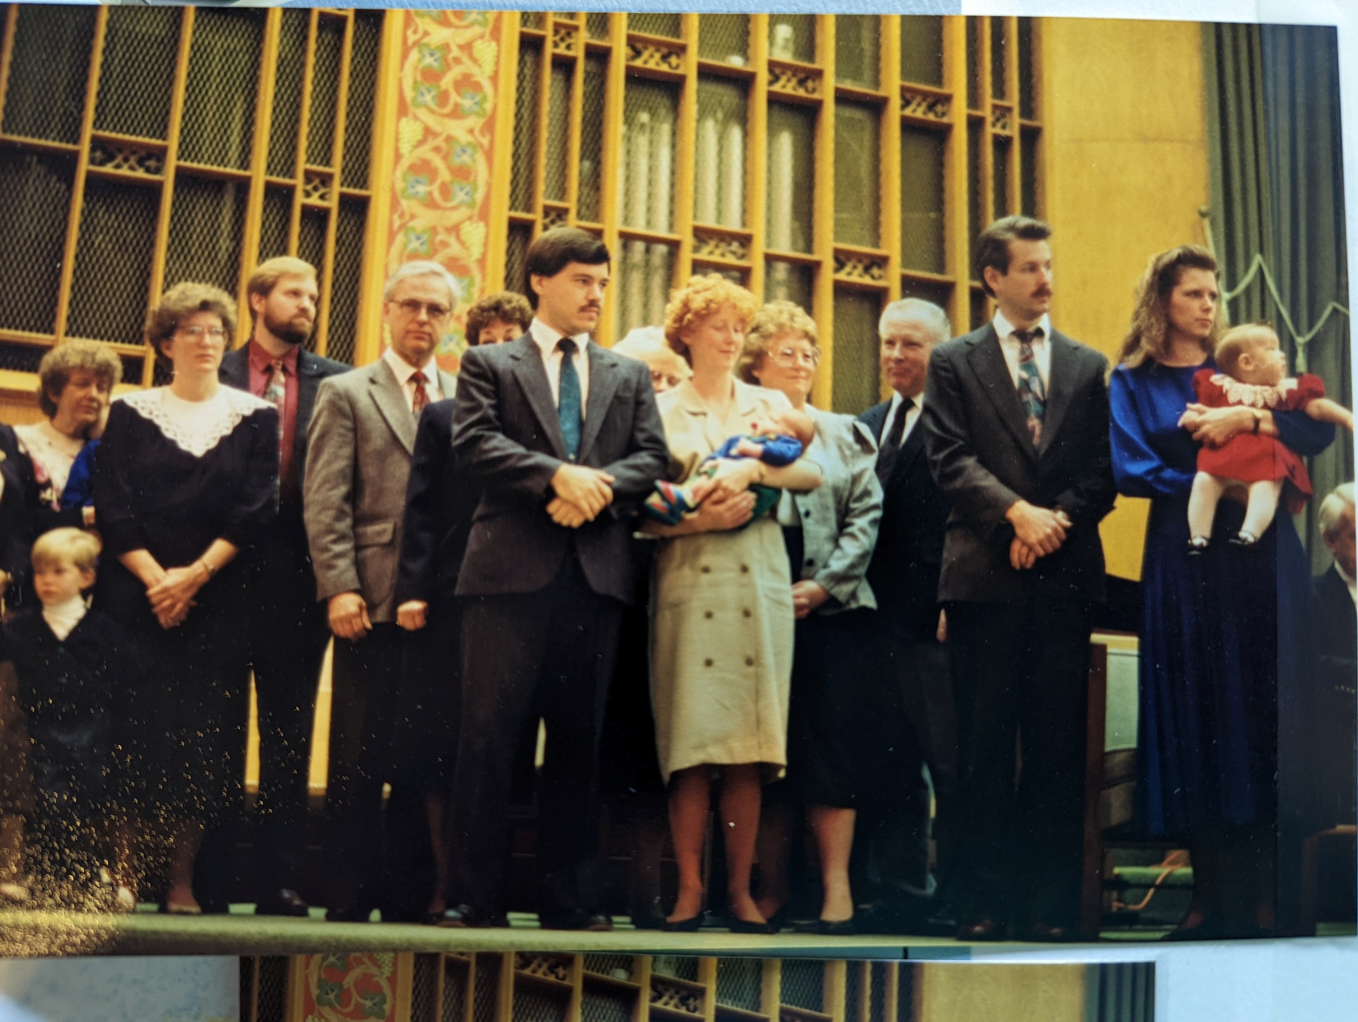
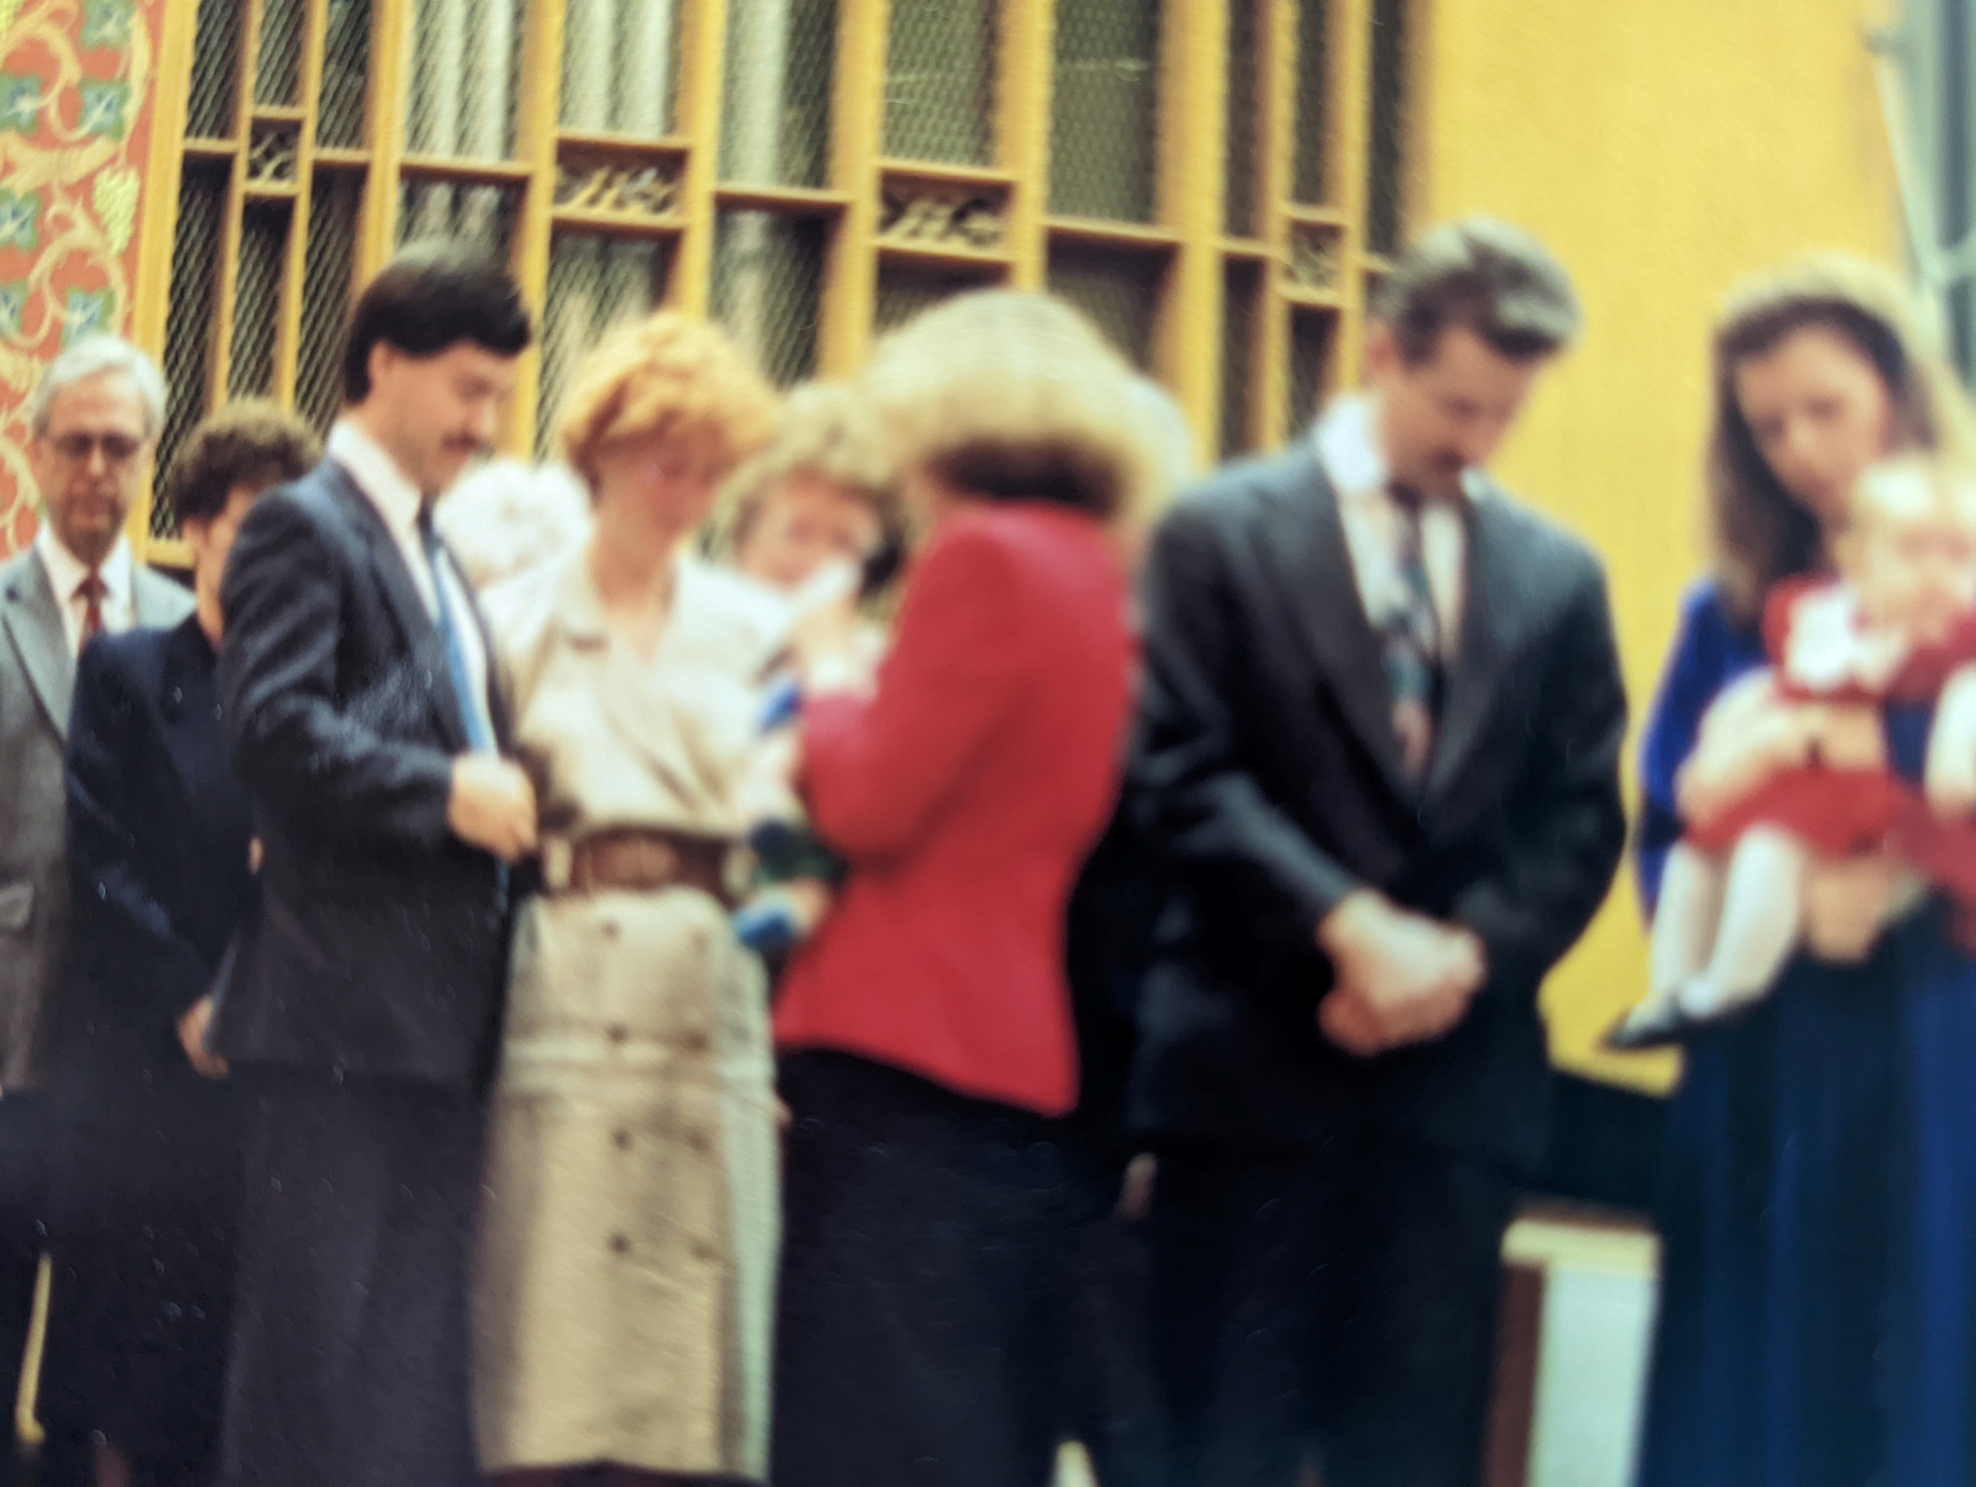
They dedicated their child to God
Have you been dedicated to God?
Even now parents dedicate their children to God. They want God to be with their child.
They dedicated themselves to God to be good parents and teach their children about God.

Slide 14
Let’s have a dedication prayer.
May God bless this child.
Parents and Teachers
Let’s pray for the children and bless them.
Heavenly Father,
Thank you for _______, this child is a special gift from you.
Bless (him/her) with:
Wisdom and understanding;
Patience and kindness;
Self control;
Love and care for others.
Give __________ abilities to serve you and bless others.
We thank you for giving all these things. You are good.
In Jesus’ name we pray, Amen.

Slide 15
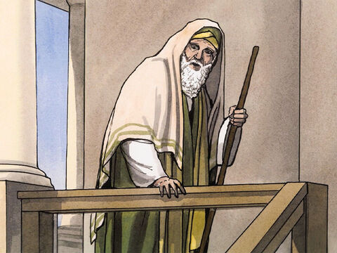
Simeon knows who Jesus is.
Go look who’s here.
It is the Messiah.
²⁵ In Jerusalem there was a man named Simeon. He was a good and godly man. He was waiting for God’s promise to Israel to come true.
The Holy Spirit was with him. ²⁶ The Spirit had told Simeon that he would not die before he had seen the Lord’s Messiah. ²⁷ The Spirit led him into the temple courtyard.
Then Jesus’ parents brought the child in. They came to do for him what the Law required..

Slide 16
Simeon
Praised God
²⁸ Simeon took Jesus in his arms and praised God. He said,
²⁹ “Lord, you are the King over all.
Now let me, your servant, go in peace.
That is what you promised.
³⁰ My eyes have seen your salvation.
³¹ You have prepared it in the sight of all nations.
³² It is a light to be given to the Gentiles.
It will be the glory of your people Israel.”
Lord, you are King over all.
I have seen your salvation.
Here is the Messiah.
He is a light to all people.
He is the glory of your people.

Slide 17
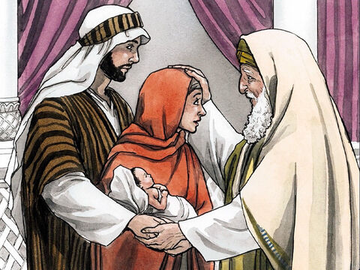
Simeon
Praised God
³³ The child’s father and mother were amazed at what was said about him.
³⁴ Then Simeon blessed them.
He said to Mary, Jesus’ mother, “This child is going to cause many people in Israel to fall and to rise. God has sent him. But many will speak against him. ³⁵ The thoughts of many hearts will be known. A sword will wound your own soul too.”
God bless you.
God has sent this child.
Some will love him.
Some will hate him.
You, too, will suffer.
The thoughts of many will be made known.

Slide 18
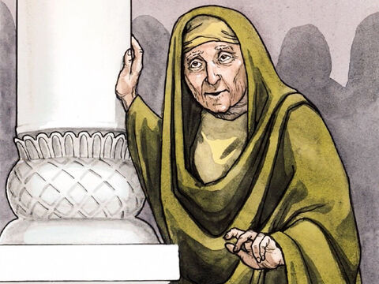
Anna was waiting for Jesus, too
He is here.
³⁶ There was also a prophet named Anna. She was the daughter of Penuel from the tribe of Asher.
Anna was very old. After getting married, she lived with her husband seven years. ³⁷ Then she was a widow until she was 84.
She never left the temple. She worshiped night and day, praying and going without food.
There He is!

Slide 19
Anna was waiting for Jesus, too
³⁸ Anna came up to Jesus’ family at that moment.
She gave thanks to God.
And she spoke about the child to all who were looking forward to the time when Jerusalem would be set free.
Thank you God!
Look everyone!
Our Savior, the Messiah is here!

Slide 20
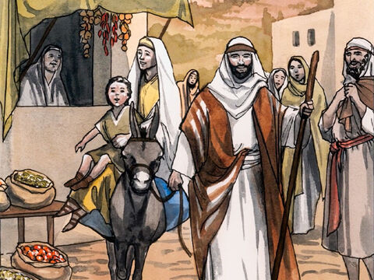
Jesus grew and became strong
Hello friends!
³⁹ Joseph and Mary did everything the Law of the Lord required.
When they returned to Galilee. They went to their own town of Nazareth.
⁴⁰ And the child grew and became strong. He was very wise. He was blessed by God’s grace.

Slide 21

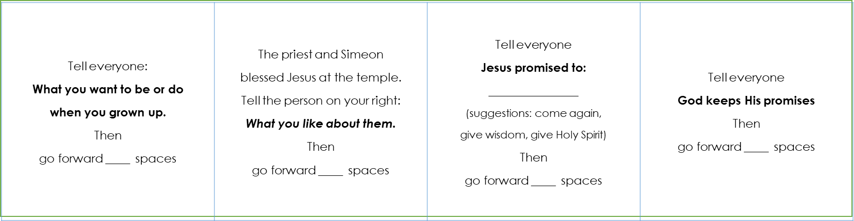
Craft PART 1
DIRECTIONS
Cut out the Announcement Cards
Write in how many spaces to move forward. Choose 1, 2, or 3
We will be adding new cards each week.

Slide 22

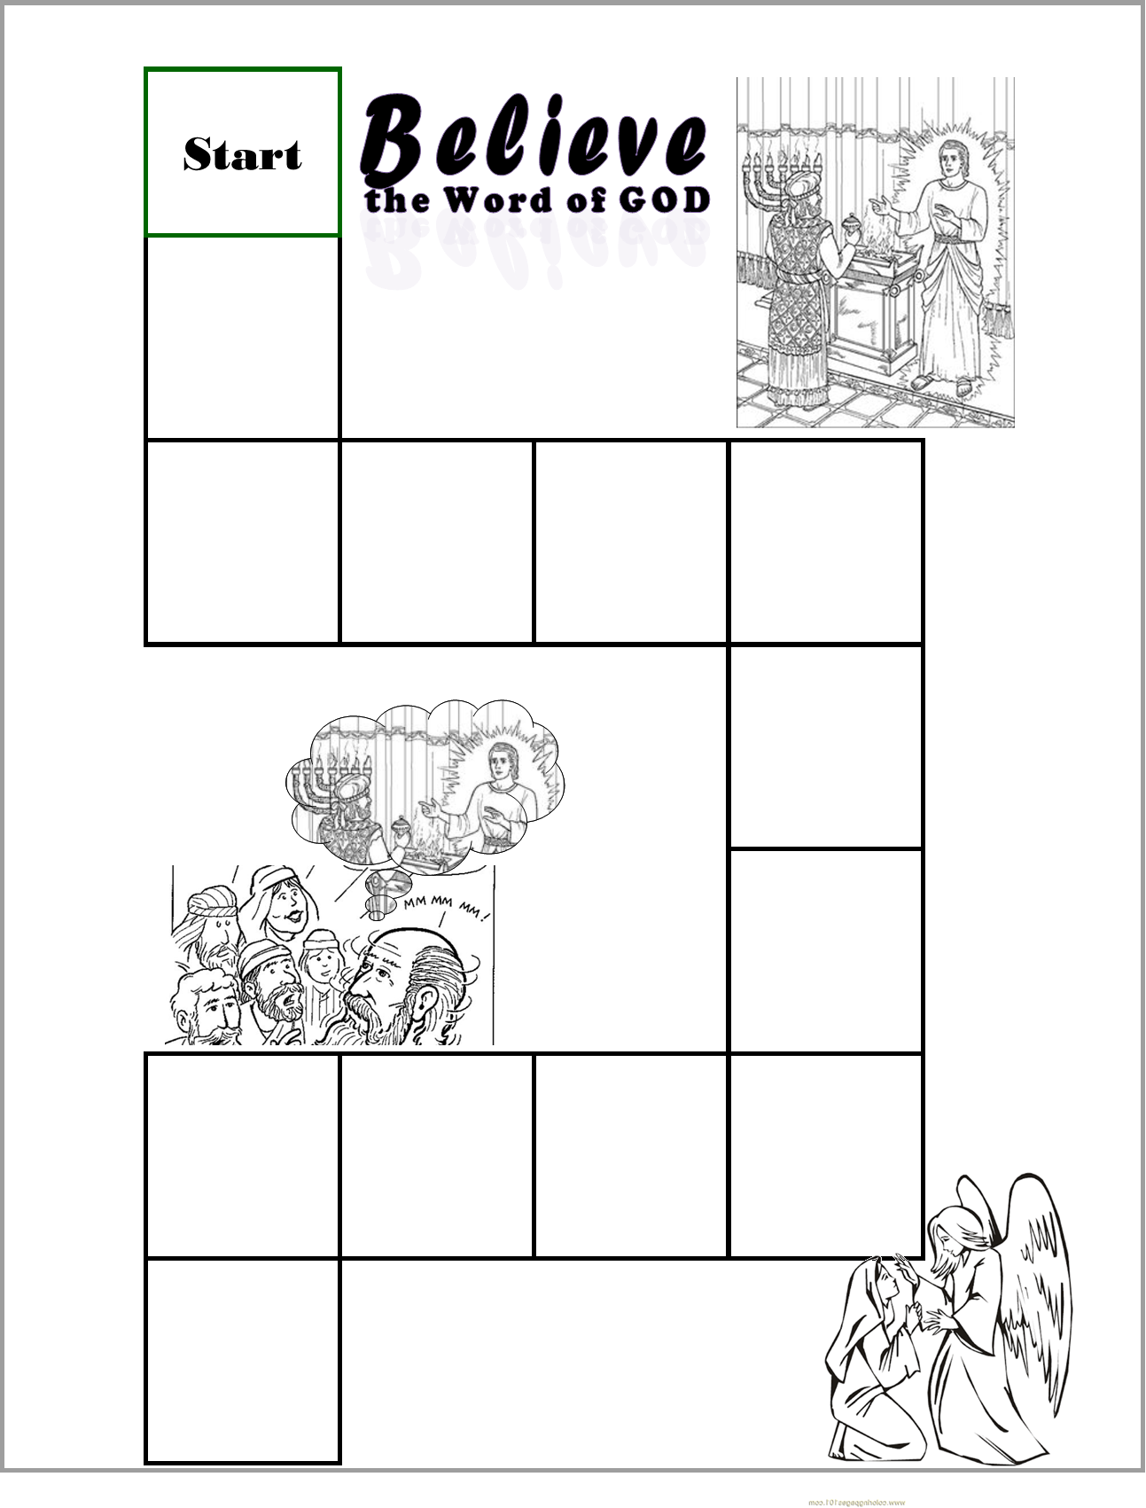
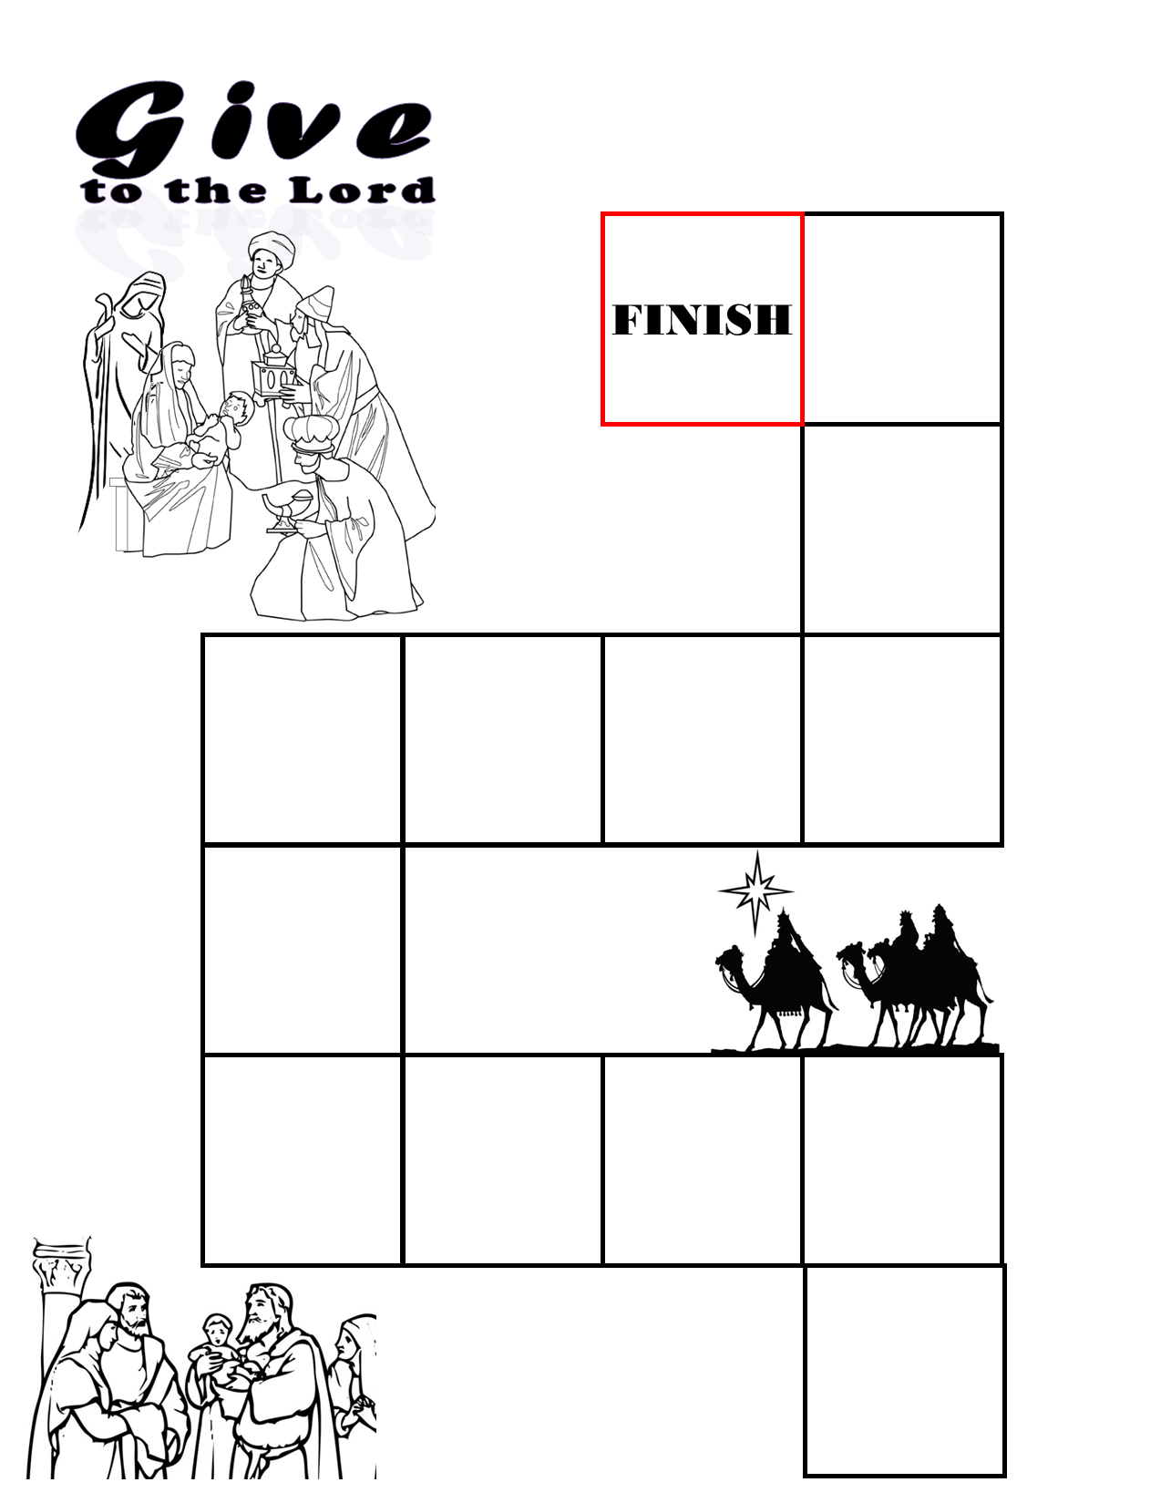
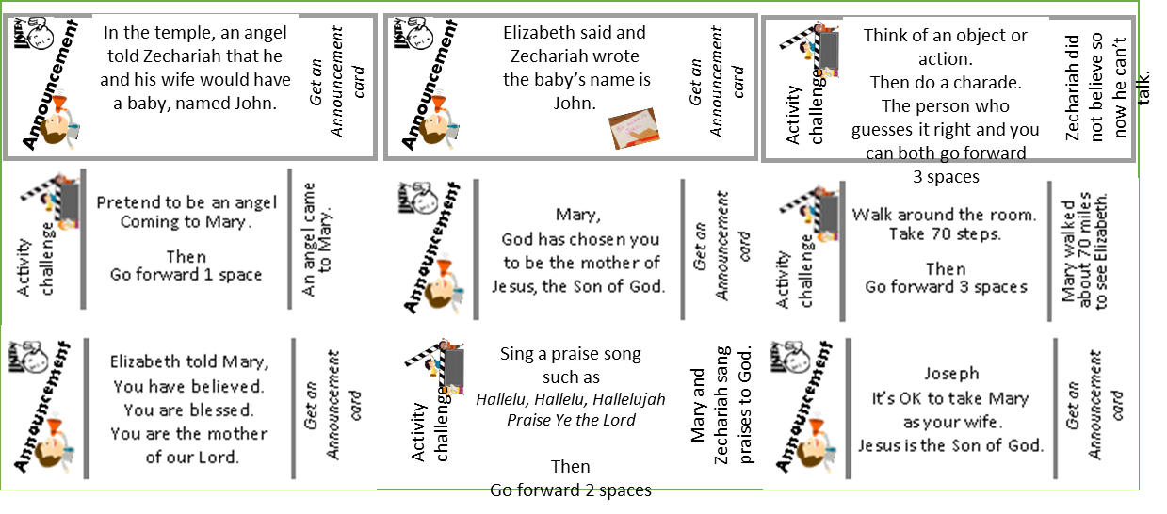
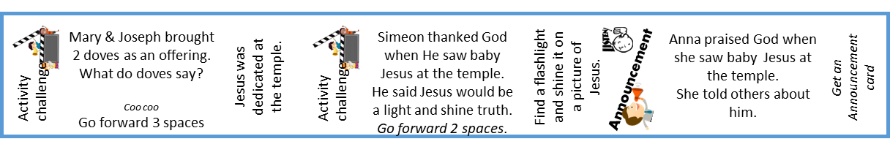
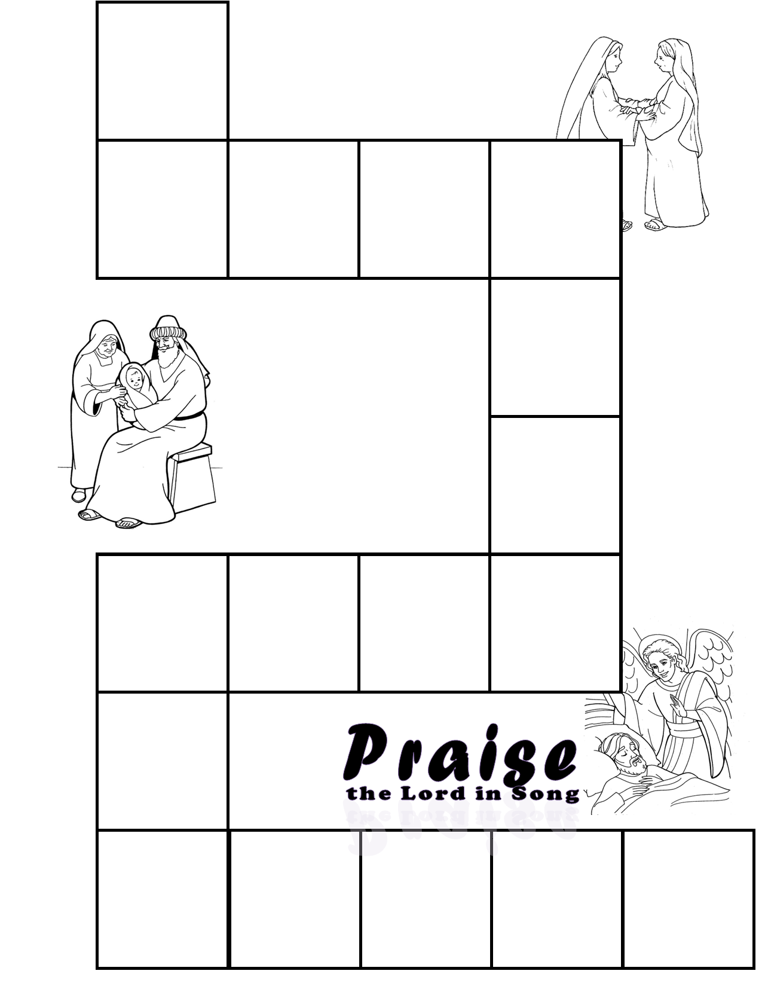
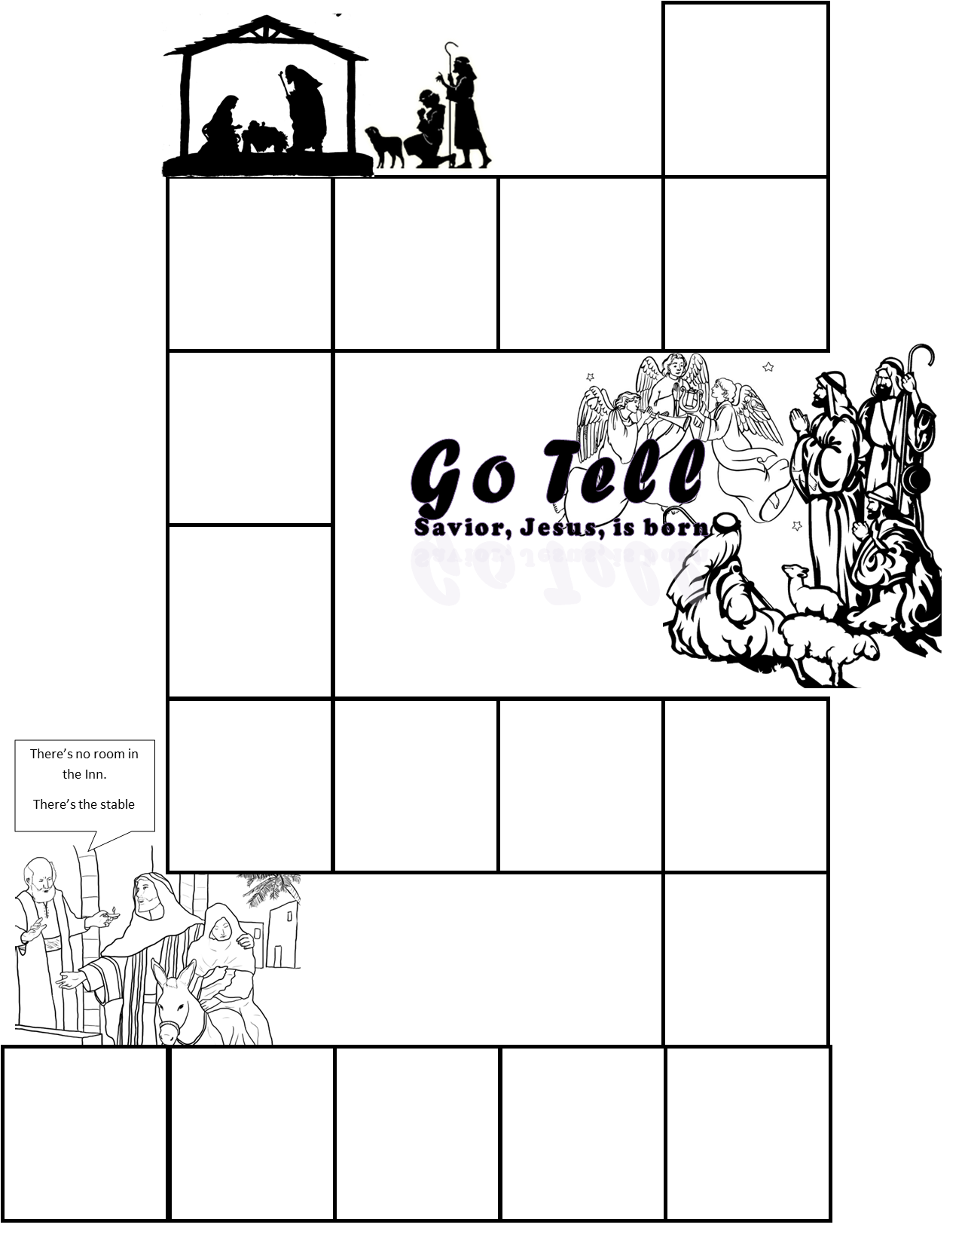
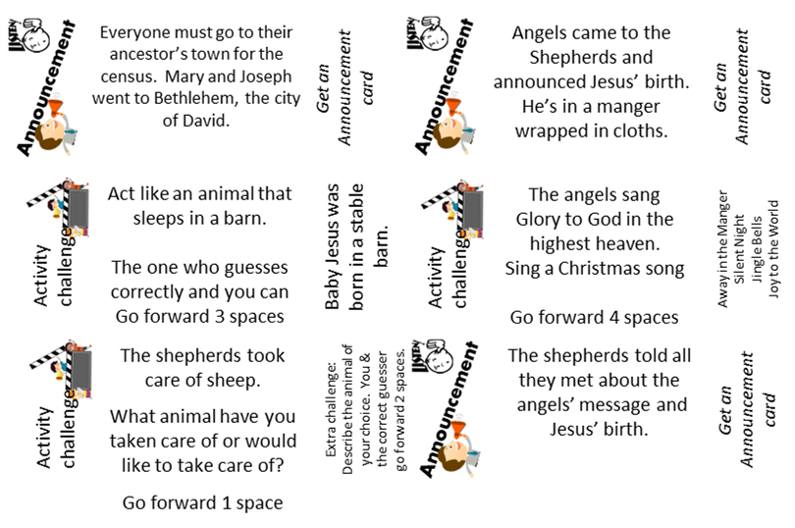
Craft PART 2
DIRECTIONS
Prepare the playing board part 3: Glue this page on the left side of a manila folder so that the bottom right corner is near the bottom right corner of the left side of the folder.
Put on the activity stickers like this: (click to see where)
Write in your own directions on 2 squares if you wish.
Note: We will be adding the final stickers and cards of the game next week.

Slide 23

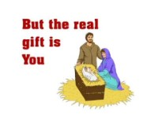
Let’s have a birthday party!

Slide 24

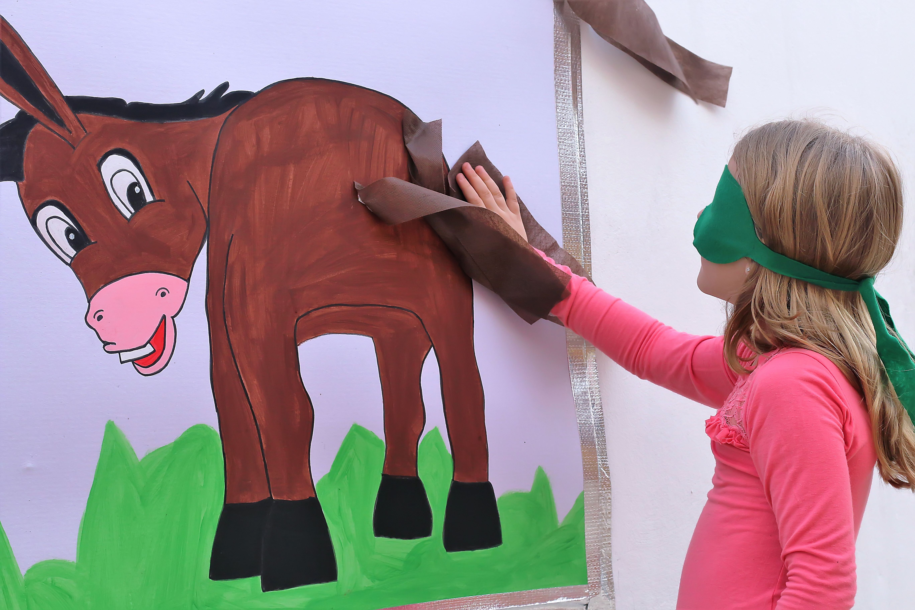
Pin the tail on the donkey
Game
Time
Zoom option:
Use your annotation.
Close your eyes and try to draw a tail on the donkey.
Can you get it in the right place.?

Slide 25
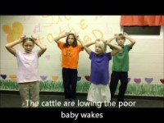
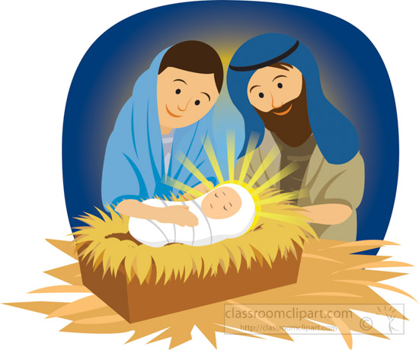
Sing Away in the Manger

Slide 26
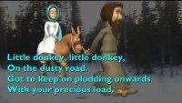
Sing Little Donkey

Slide 27
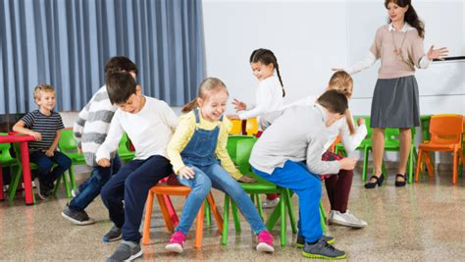
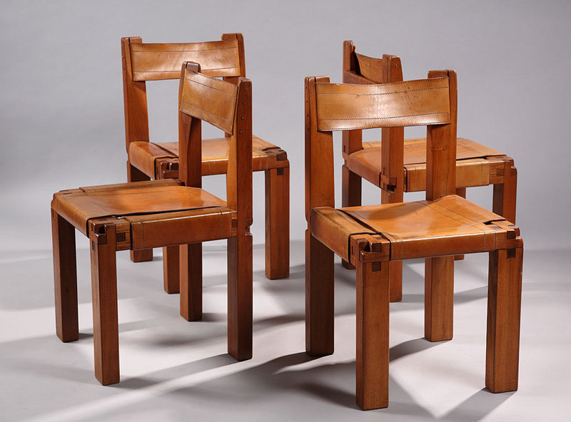
Musical Chairs
Play following music
Pause intermittently
If child has no chair, they are out and can: signal when to stop the music next then sing with music
Game Time

Slide 28

Sing Joy to the World

Slide 29
Go Tell It On The Mountain

Slide 30
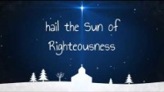
Hark the Herald Angels Sing

Slide 31
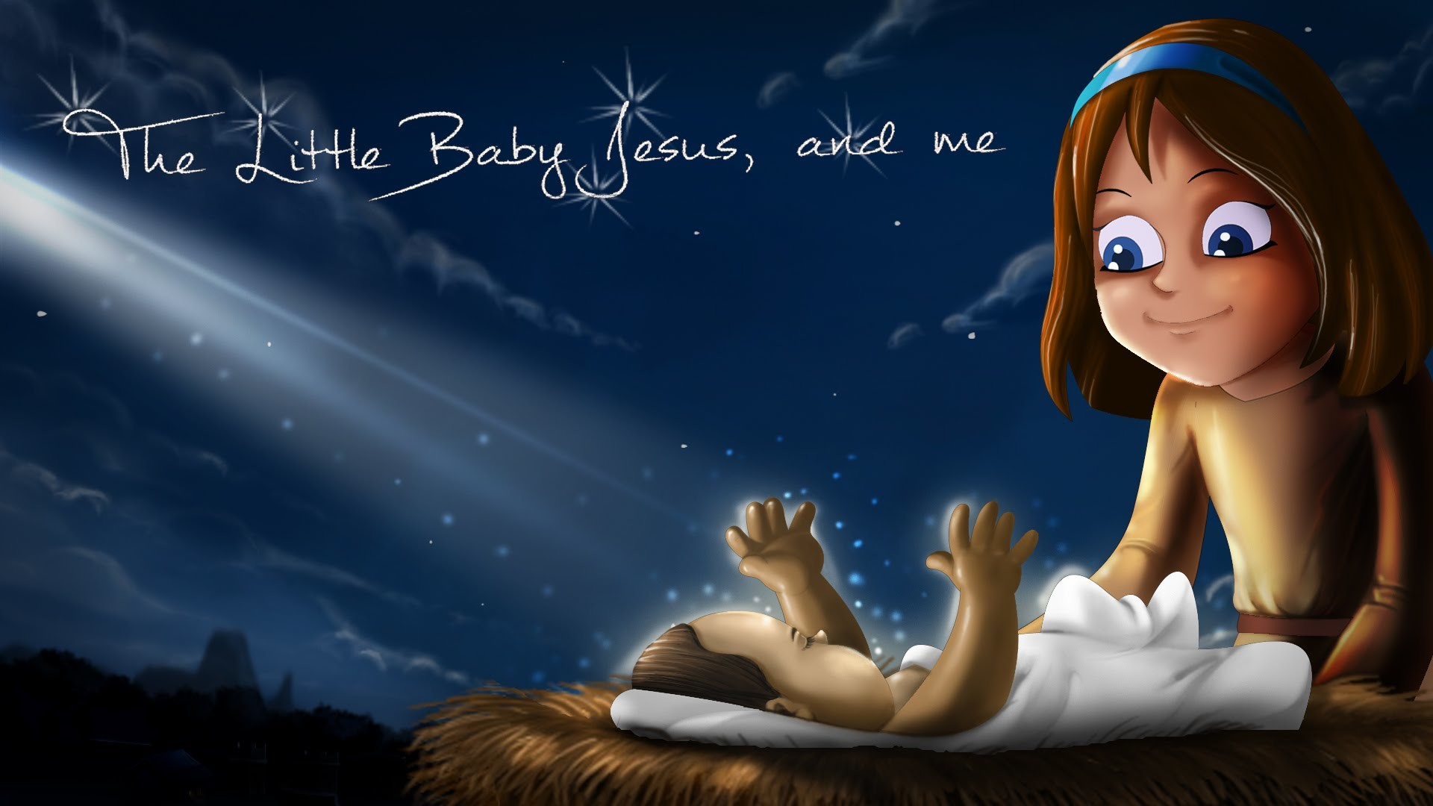

Open Gifts

Slide 32
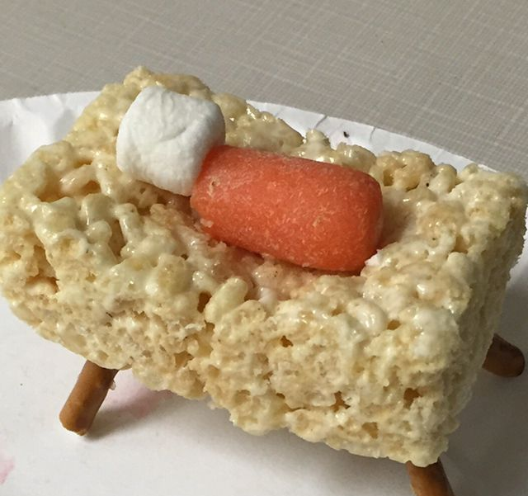

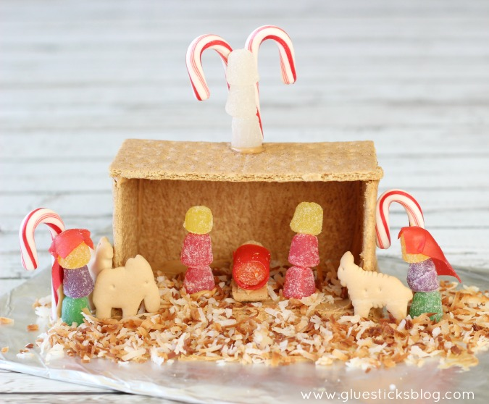
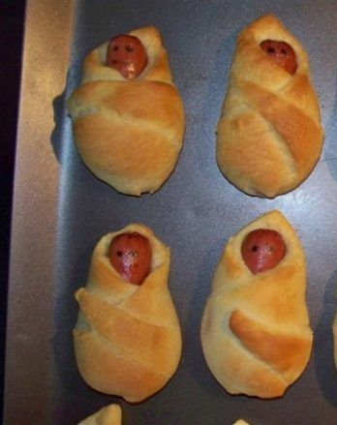
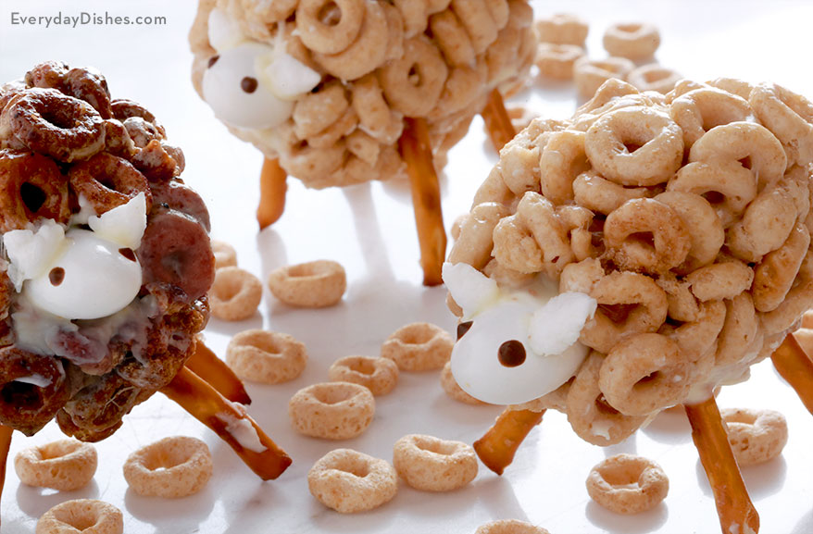
Ideas
Snack Time
https://gluesticksblog.com/honey-maid-graham-cracker-nativity-scene

Slide 33
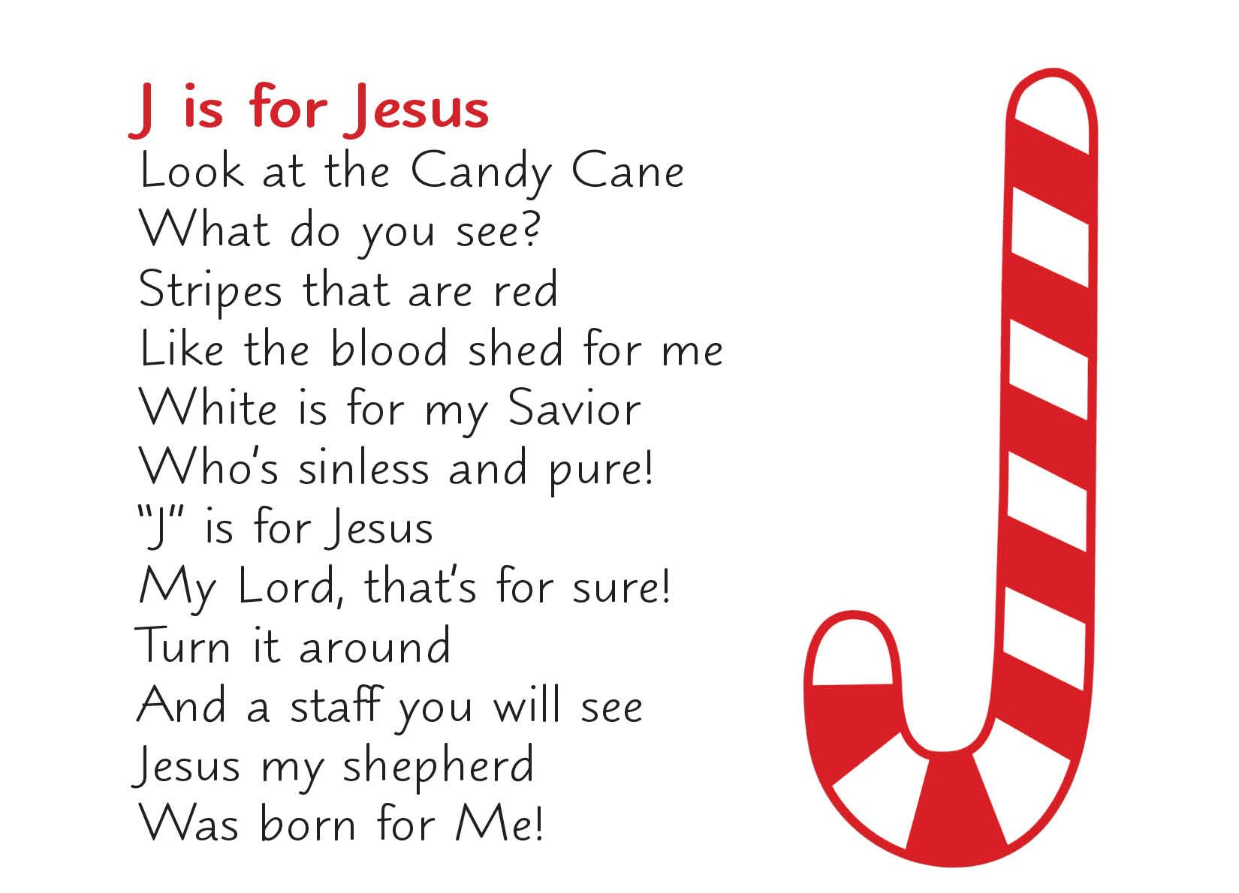
CRAFT TIME
DIRECTIONS:
Turn a candy cane to look like a J.
Cut yellow yarn into many 2-inch pieces
Glue them on the crook of the candy cane
Wrap a cut out or a peanut with a little piece of fabric
Glue the baby on the yarn
Add a bow or a star at the top of the candy cane
Make some to share

Slide 34
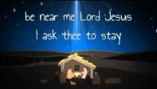
Away in the Manger

Slide 35
Go Tell It On The Mountain

Slide 36
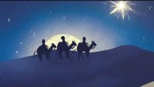
In Review

Slide 37

O Come, O Come Emmanuel

Slide 38

Silent Night

Slide 39

https://activity-array.com/

