Slide 1
Wise men still seek Him
Led by His light
Matthew 2

Slide 2

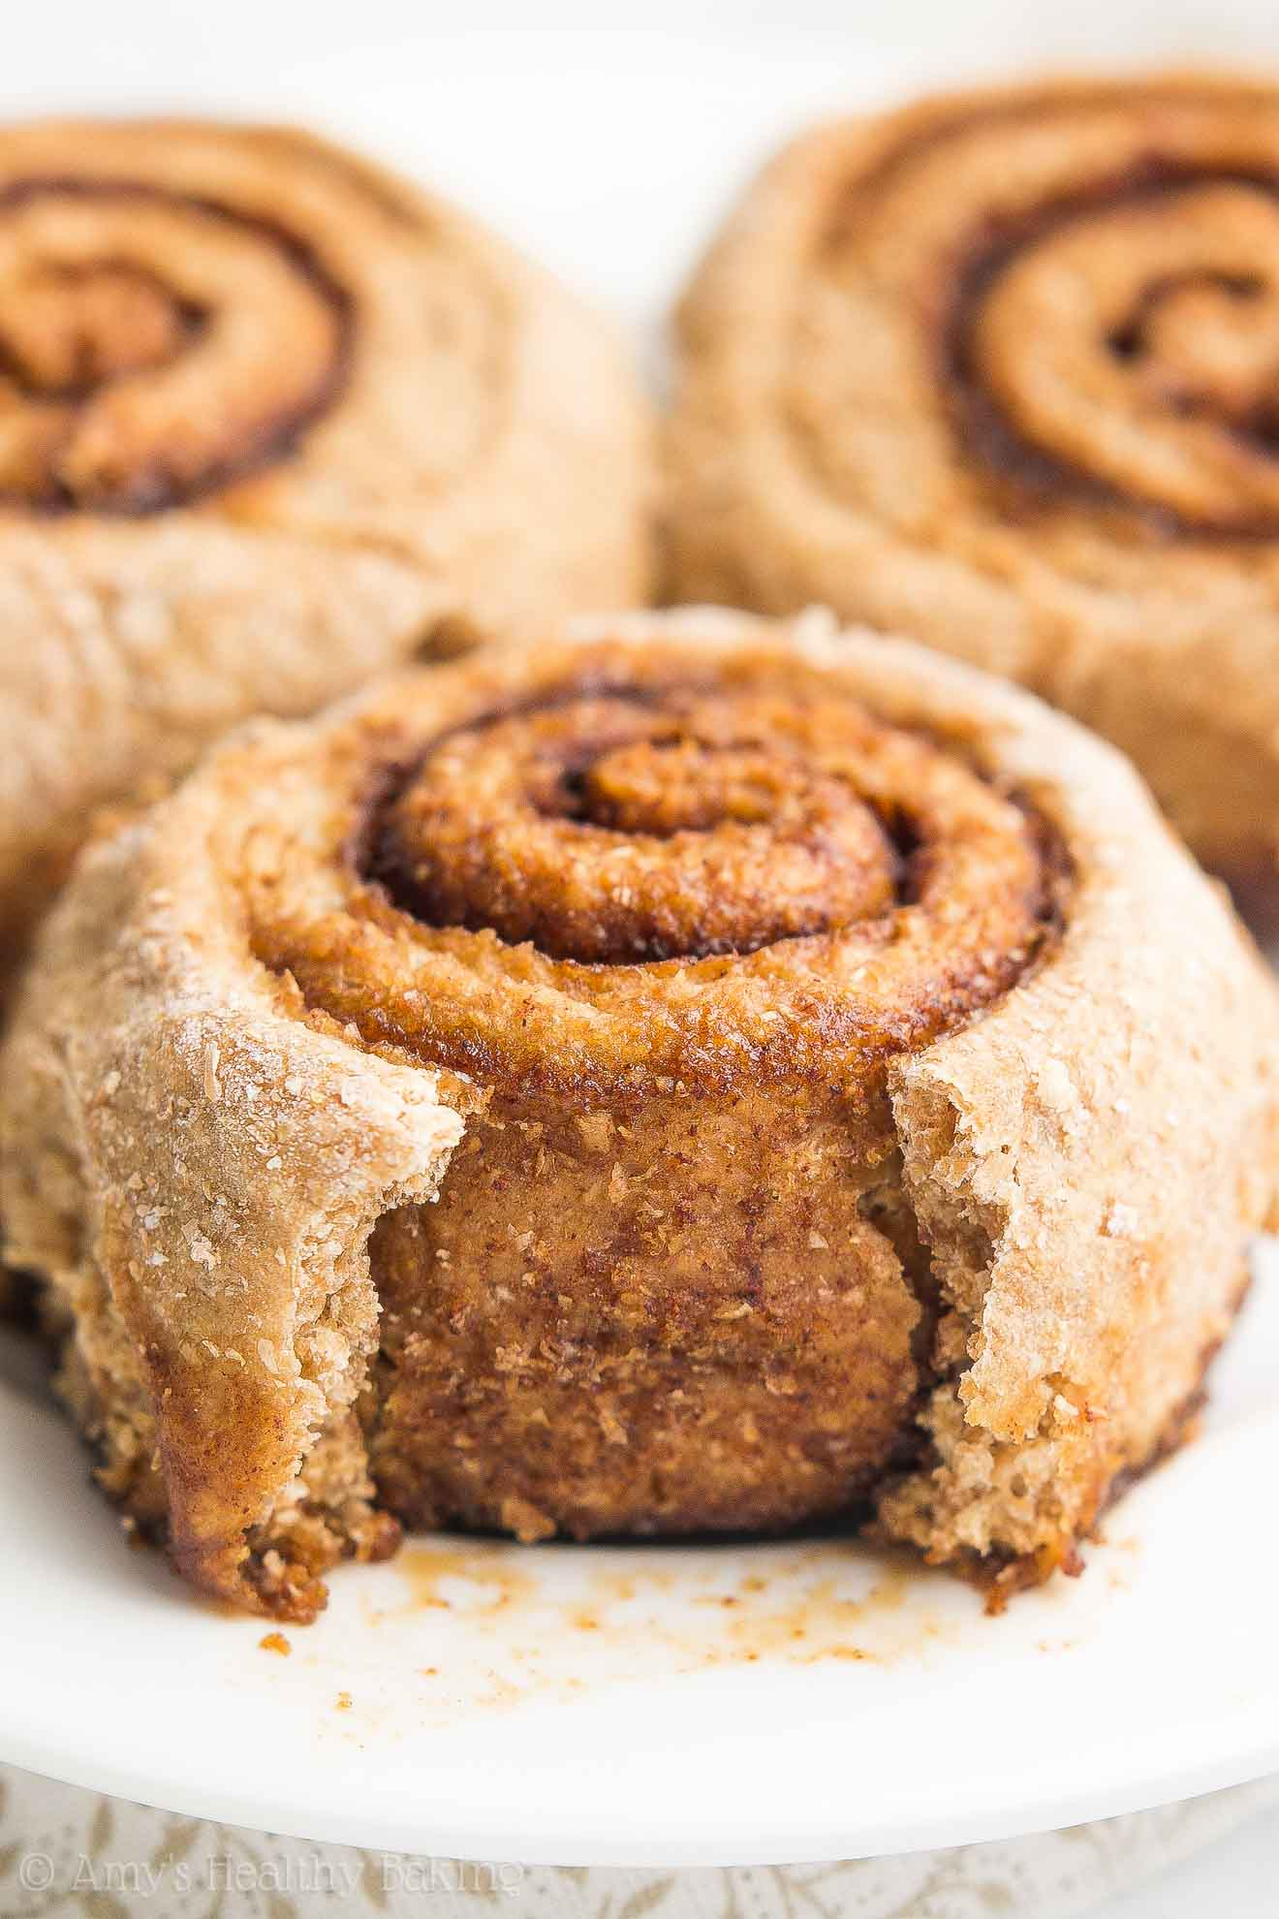
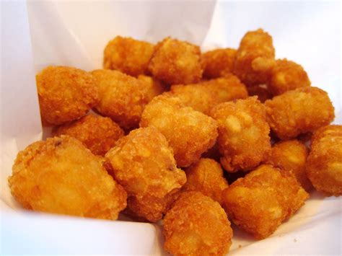
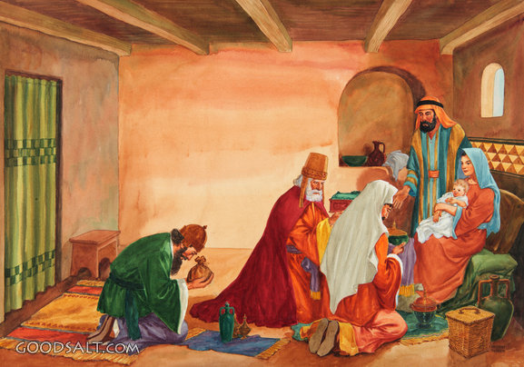
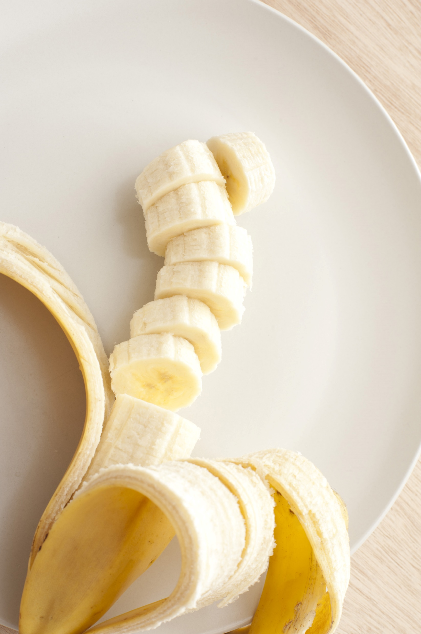
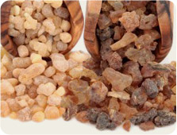
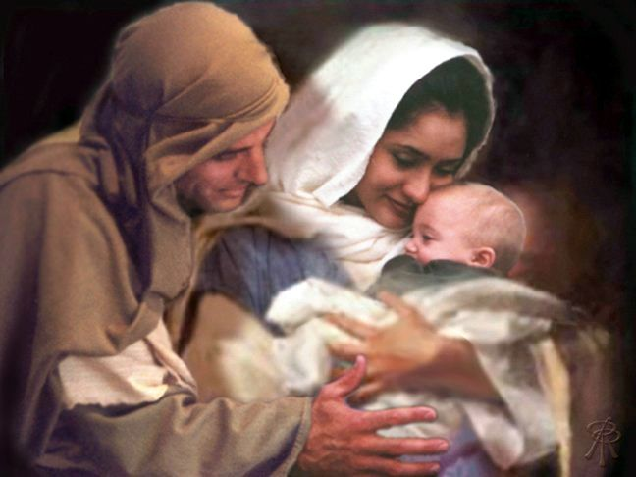
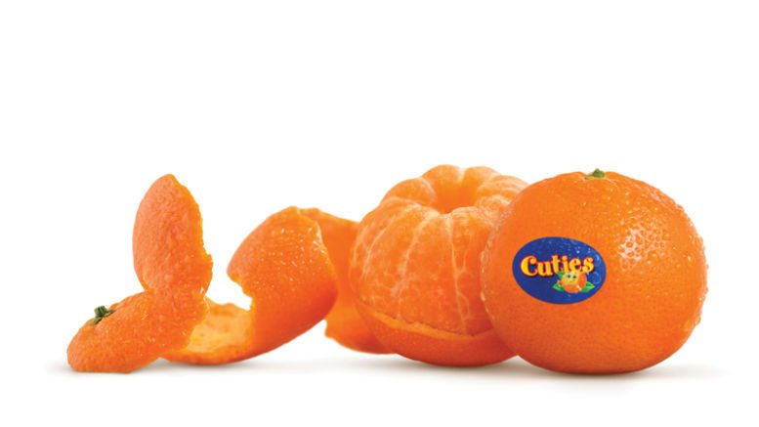
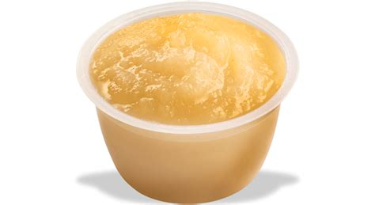
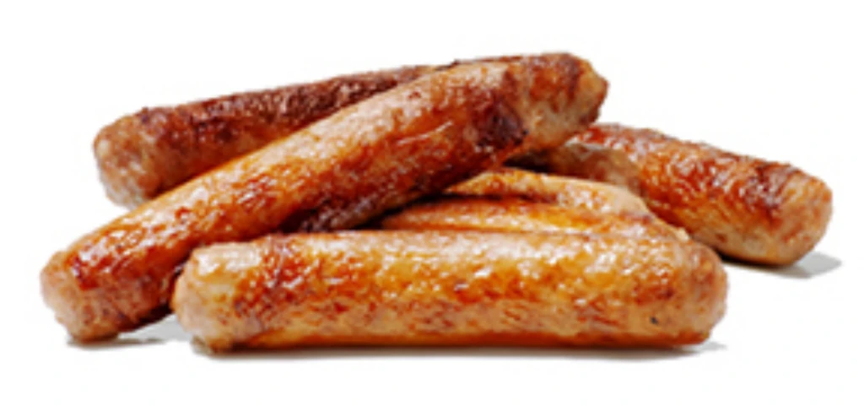
Breakfast
Just like the wisemen,
We wrapped up some spices for you.
They found Him very
a-pealing.
They worshiped Jesus.
The little tot the wisemen sought, was baby Jesus.
Orange you glad that Jesus came!
Link up to Him. He wants to be with you forever!
No sauce
about it, you are the apple of HIS eye.
He loves YOU!

Slide 3
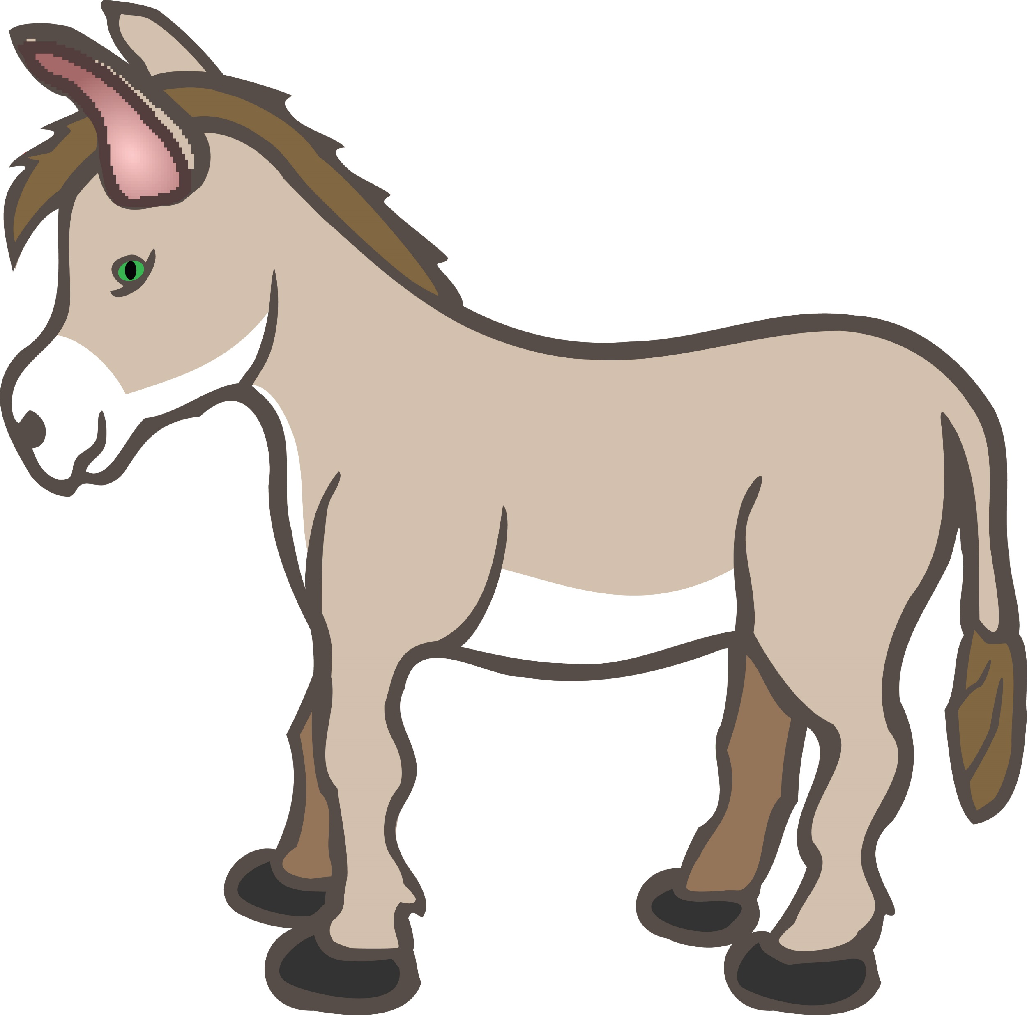
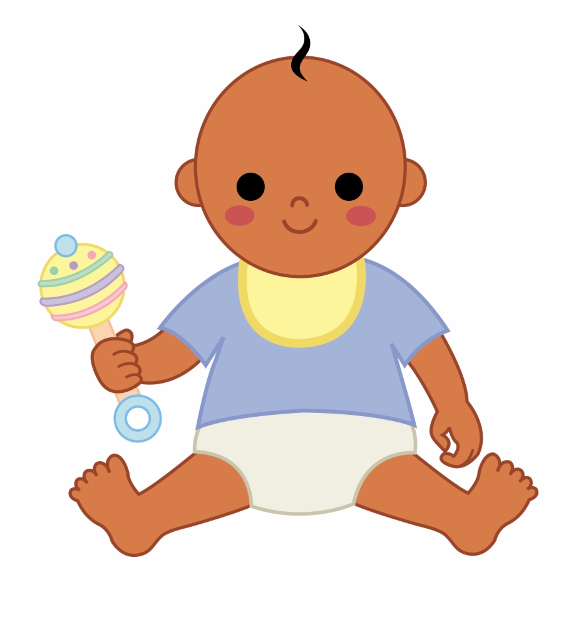
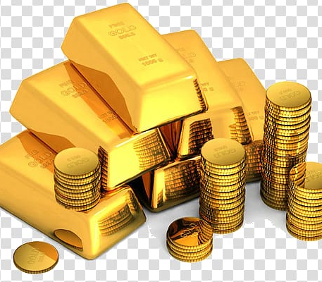
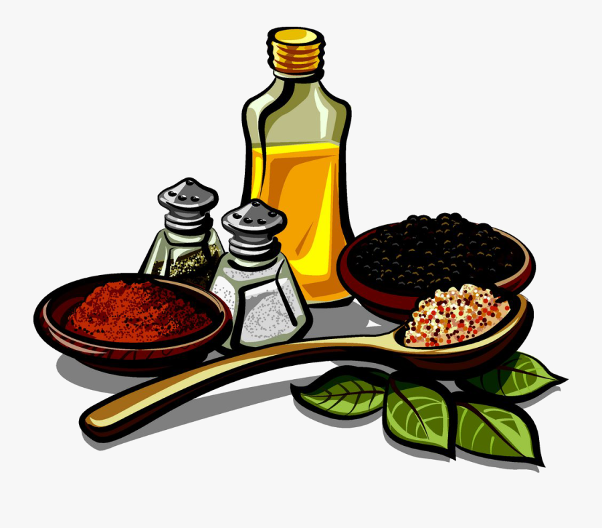

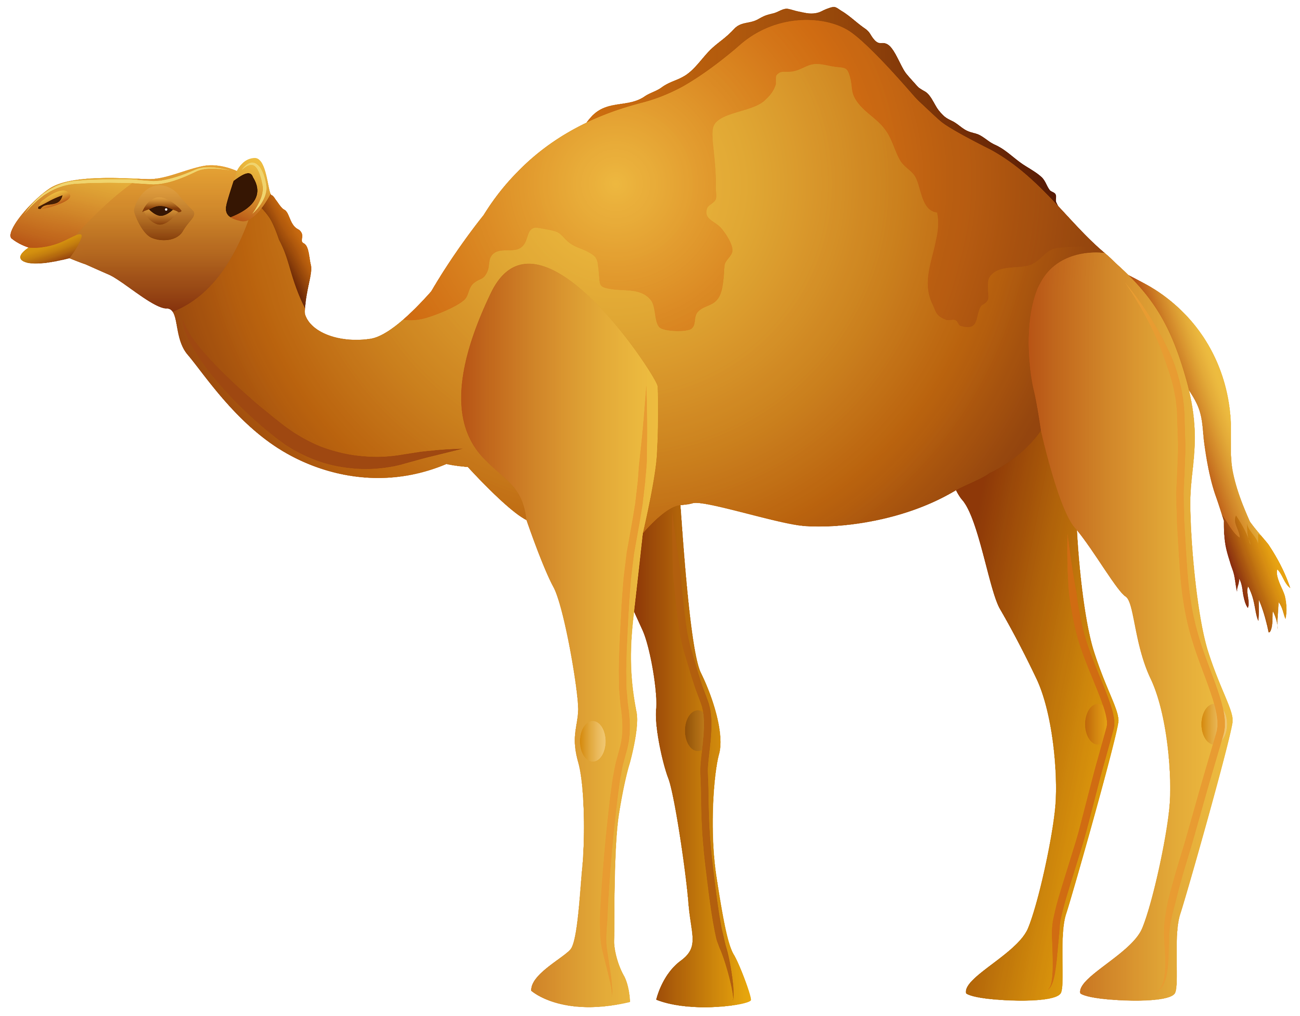

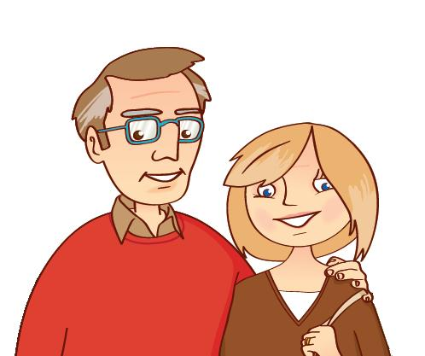
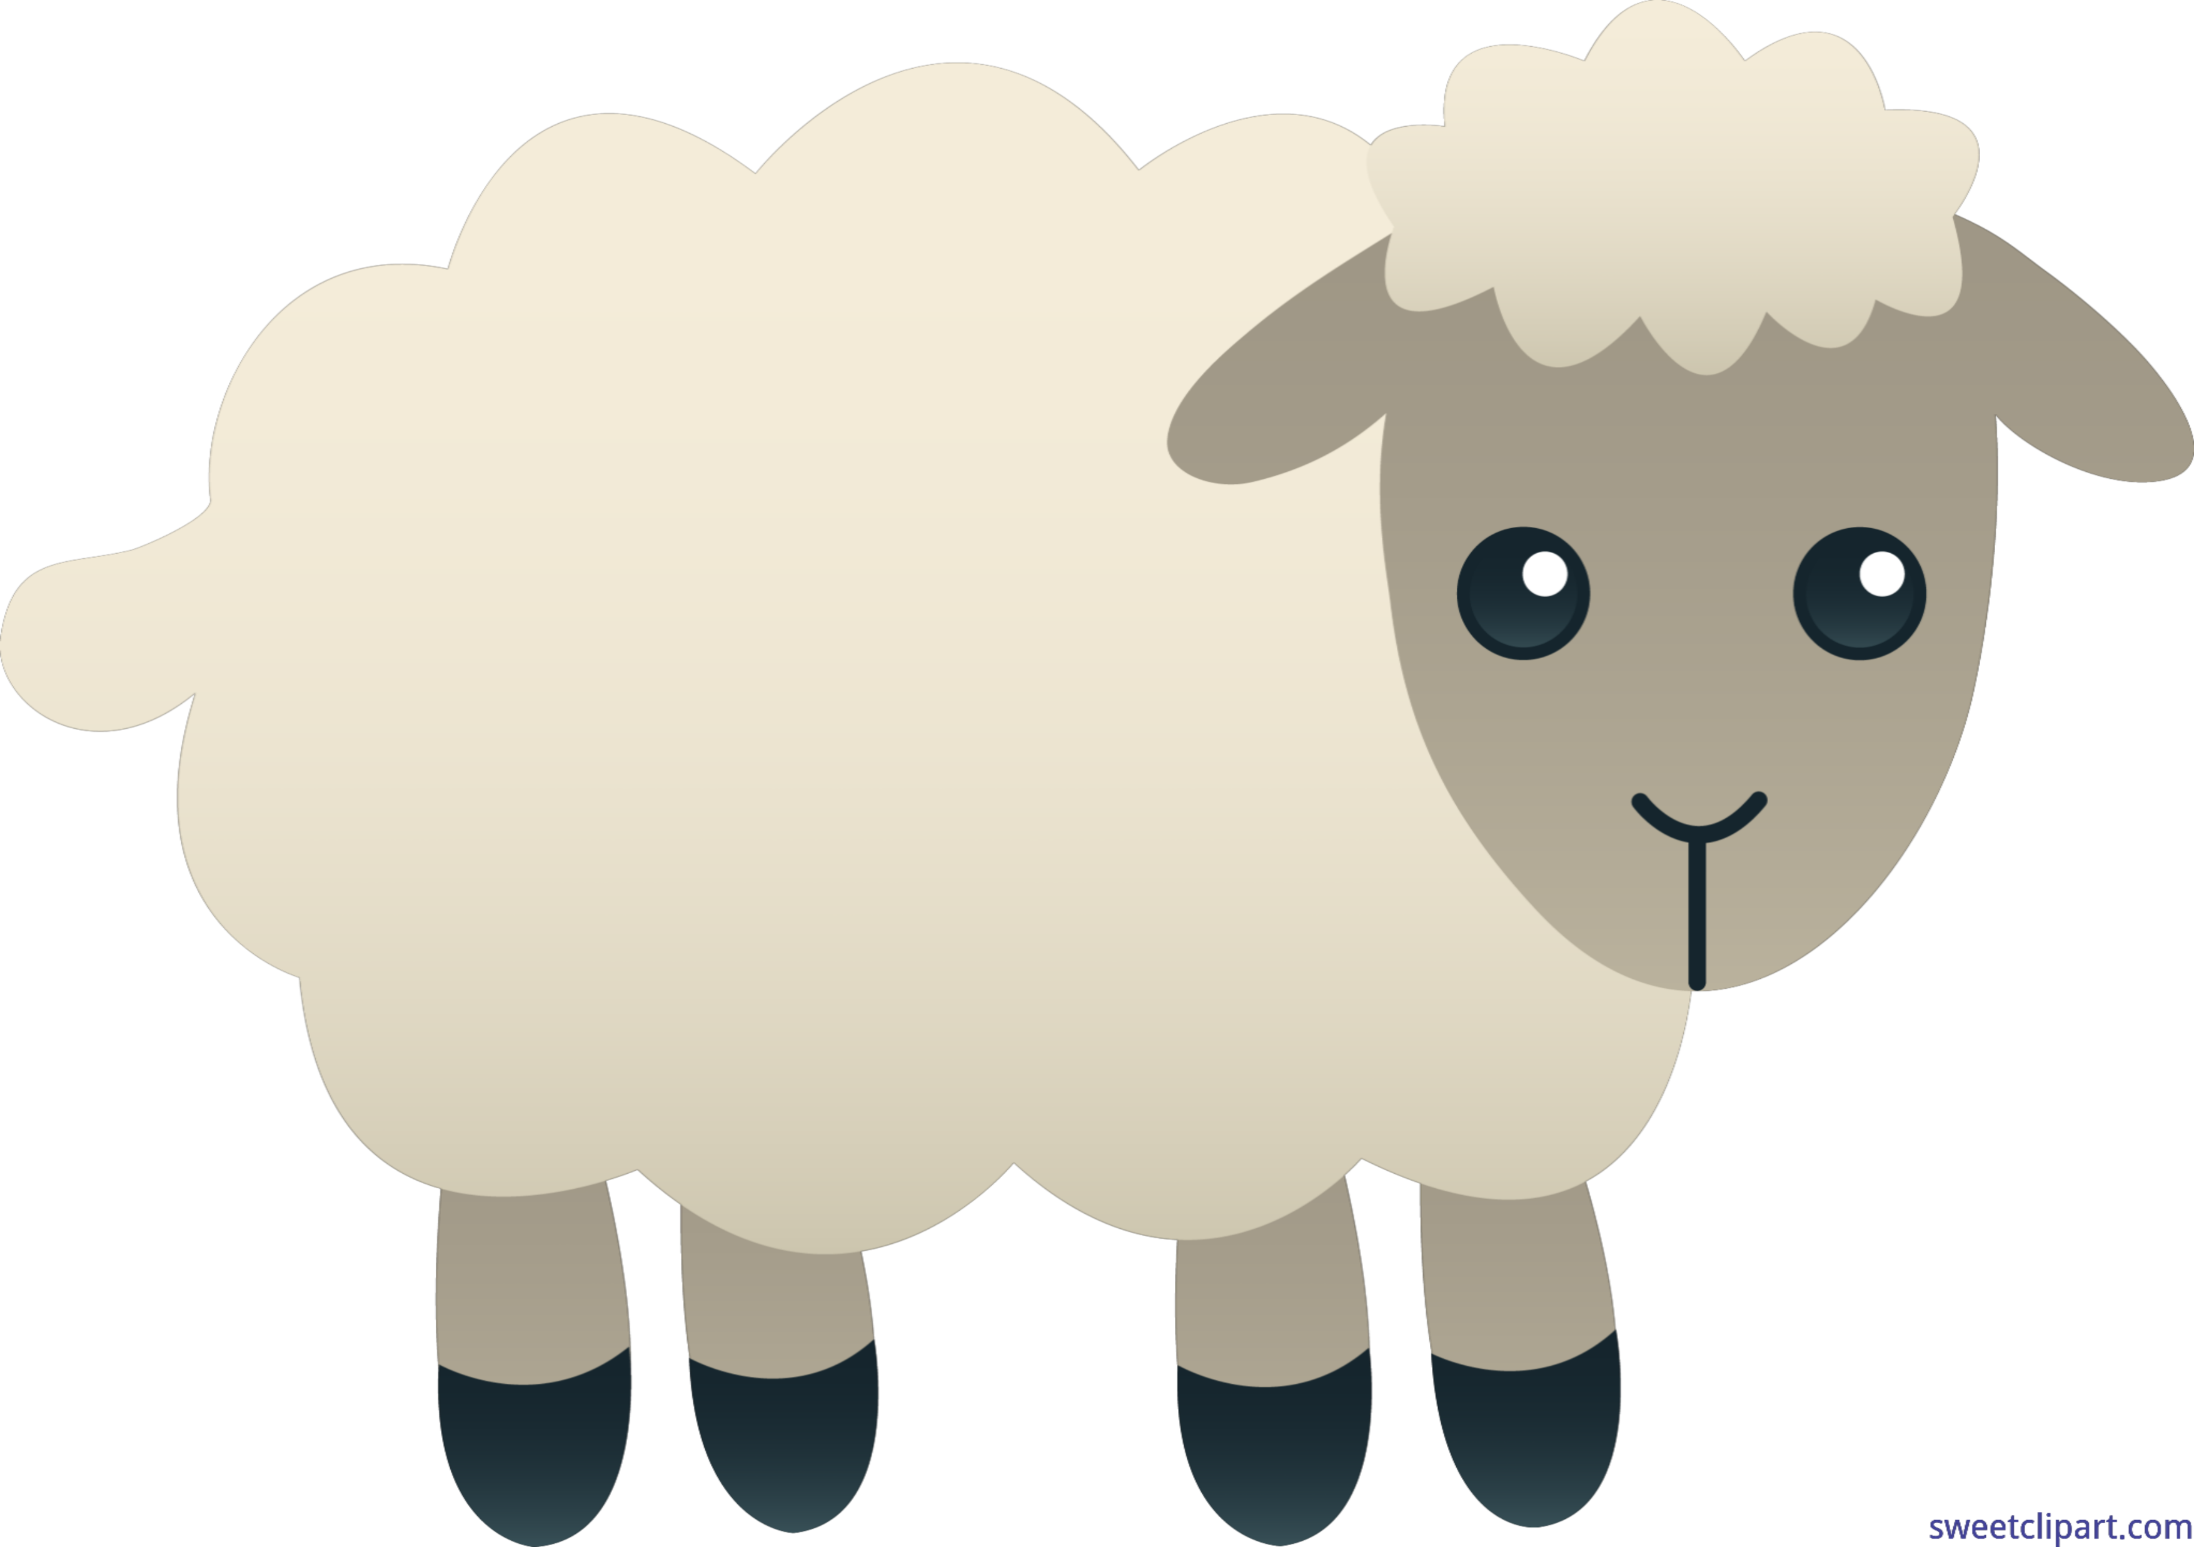
Look around you. Can you find:
Star
Baby
Camel
Mom
Dad
Sheep
Donkey
Gold
Spices
A pyramid
Gift
How many can you find?

Slide 4
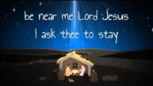
Away in the Manger

Slide 5
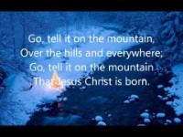
Go Tell It On The Mountain

Slide 6
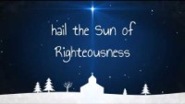
Hark the Herald Angels Sing

Slide 7
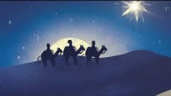
In Review

Slide 8
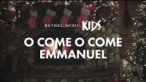
O Come, O Come Emmanuel

Slide 9

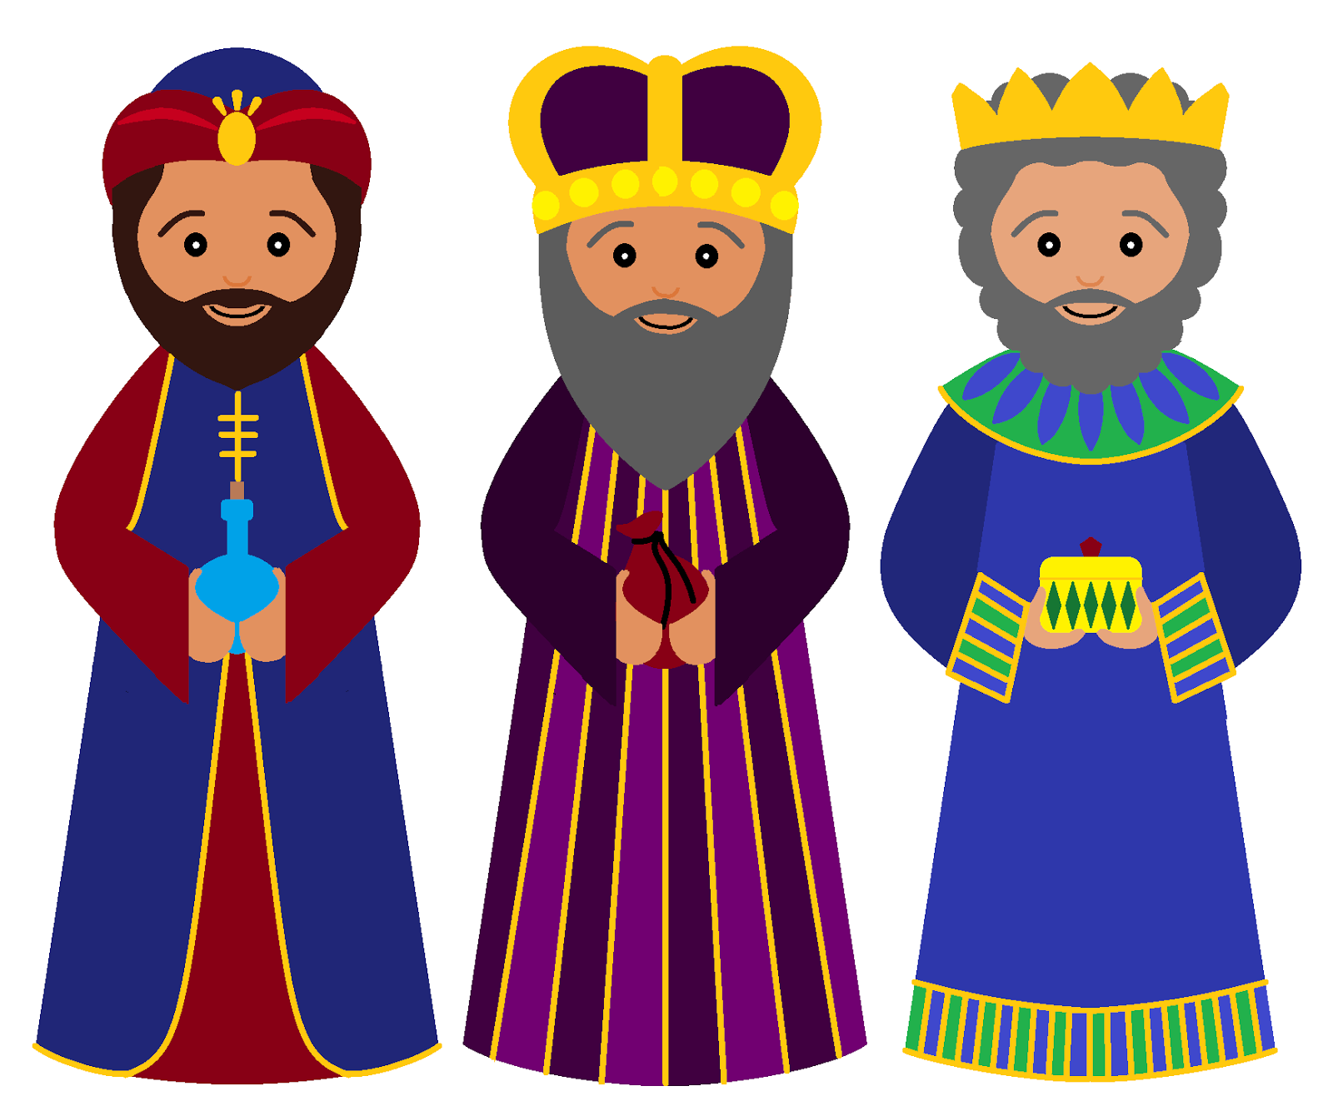
In what book of the Bible can we find the story of the wise men?
CLUES:
It’s not in Luke, though he tells the rest of the story about Jesus’ birth. He wanted everyone to know that God loves each of us and is near to even the ordinary and unloved.
It’s not in John, though he tells how God’s Word became flesh, Jesus. Jesus is God. Jesus tells us God’s truth.
It’s in the first Gospel book.
It starts with “M”
Matthew wanted to make sure that you know that Jesus is the King of kings! Even the wise kings of the east worshipped Him!

Slide 10
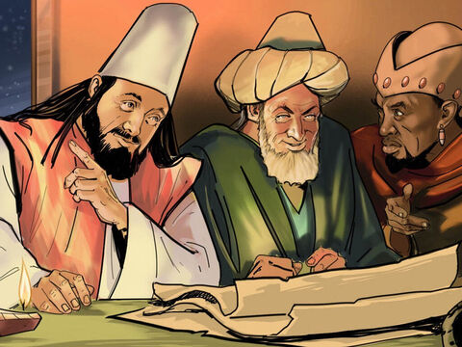
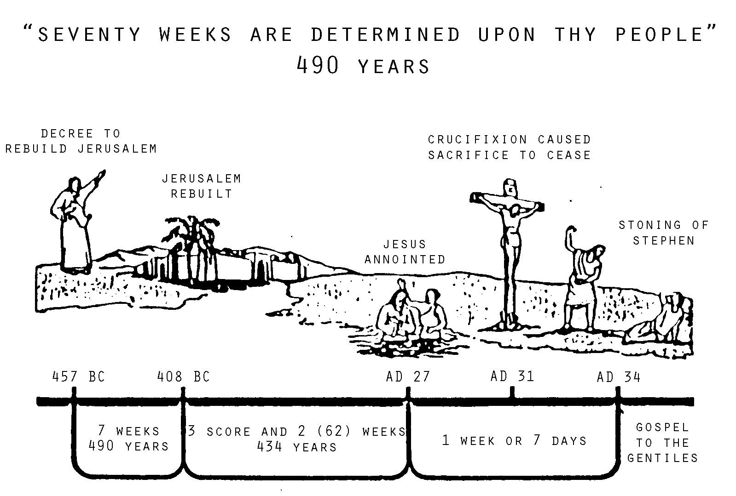
There is a NEW STAR.
A king is born
According to Daniel’s prophecies it is time for the king to be born in Israel.
Let’s go see him!
Read more about it
in Daniel 9:22-27

Slide 11
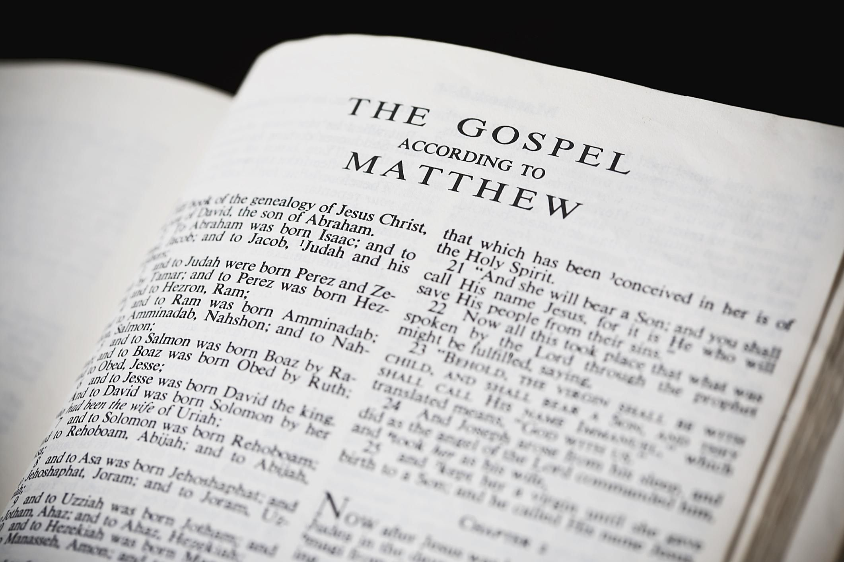
Let’s find the book of Matthew read Matthew 2:1-2

Slide 12

Sing Joy to the World

Slide 13
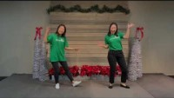
Sing Go Tell It on The Mountain

Slide 14
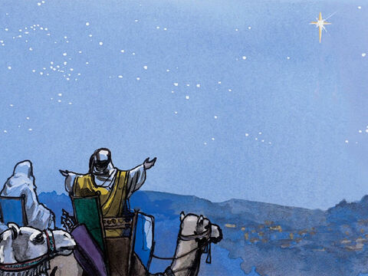
There’s Jerusalem
The Wise Men Visit Jesus
2 Jesus was born in Bethlehem in Judea. This happened while Herod was king of Judea. After Jesus’ birth, Wise Men from the east came to Jerusalem.

Slide 15
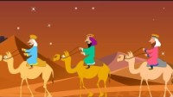
We Three Kings

Slide 16
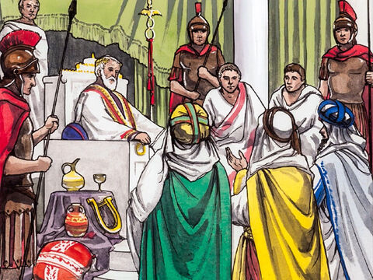
Where is the King?
Wise Men from the east came to Jerusalem. ² They asked, “Where is the child who has been born to be king of the Jews? We saw his star when it rose. Now we have come to worship him.”
³ When King Herod heard about it, he was very upset. Everyone in Jerusalem was troubled too.
Where is the new born King?
We followed his star
We have come to worship Him..

Slide 17
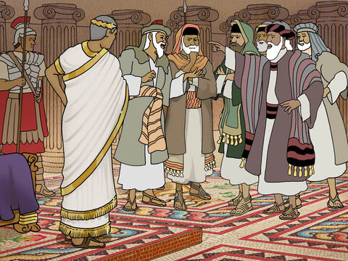
Where is the Messiah to be born?
Where is the Messiah to be born?
Micah wrote
He will be born
In Bethlehem.
⁴ So Herod called together all the chief priests of the people. He also called the teachers of the law. He asked them where the Messiah was going to be born. ⁵ “In Bethlehem in Judea,” they replied. “This is what the prophet has written. He said,
⁶ “ ‘But you, Bethlehem, in the land of Judah,
are certainly not the least important among the towns of Judah.
A ruler will come out of you.
He will rule my people Israel like a shepherd.’ ” (Micah 5:2)

Slide 18
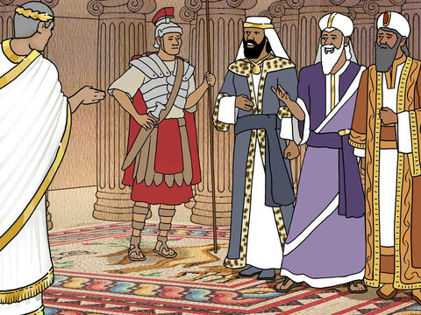
Go search
Go search carefully for the babe and tell me where to find him so I can worship him.
⁷ Then Herod secretly called for the Wise Men.
He found out from them exactly when the star had appeared.
⁸ He sent them to Bethlehem. He said, “Go and search carefully for the child. As soon as you find him, report it to me. Then I can go and worship him too.”

Slide 19
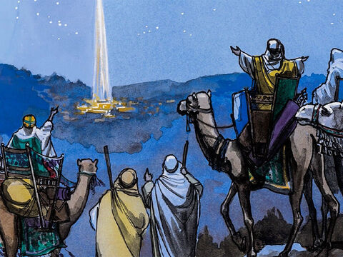
Look! Follow the star!
The star has shown us the way.
Hallelujah!
We are almost there
to worship the promised One!
⁹ After the Wise Men had listened to the king, they went on their way.
The star they had seen when it rose went ahead of them.
It finally stopped over the place where the child was. ¹⁰ When they saw the star, they were filled with joy. ¹¹ The Wise Men went to the house.

Slide 20
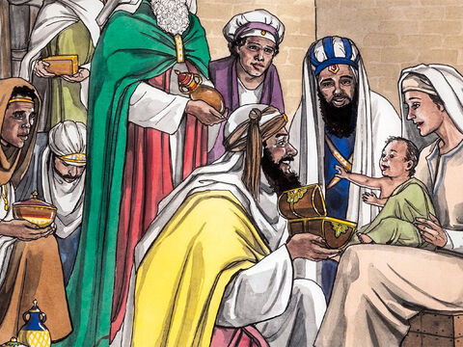
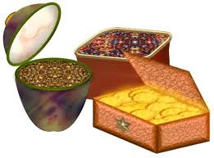
Oh precious Baby!
¹¹ The Wise Men went to the house.
There they saw the child with his mother Mary. They bowed down and worshiped him.
Then they opened their treasures. They gave him gold, frankincense and myrrh.
My Lord and King,
We brought you gold
Frankincense
And myrrh.

Slide 21
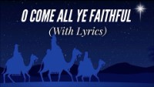
O Come Let Us Adore Him

Slide 22
GOLD
GIFTS FIT FOR A KING
FRANKINCENSE
MYRRH
Riches – Money of greatest value
Incense used in the sanctuary for worship.
Fragrant resin used in perfumes, medicine, and incense, and embalming
Jesus is
King
God
Savior

Slide 23
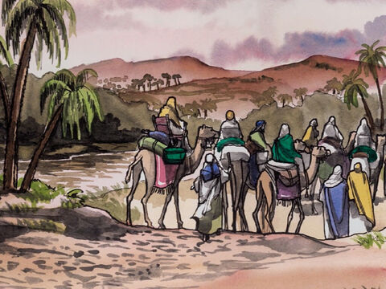
Let’s go home
Praise God!
We saw our Savior!
¹² But God warned them in a dream not to go back to Herod. So they returned to their country on a different road.

Slide 24
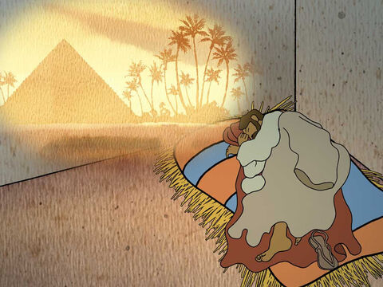
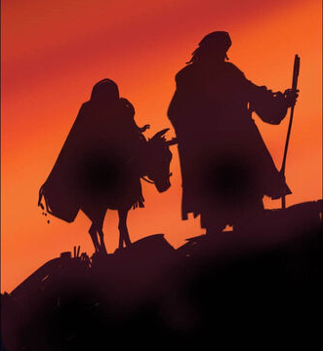
G0!
¹³ When the Wise Men had left, Joseph had a dream. In the dream an angel of the Lord appeared to Joseph. “Get up!” the angel said. “Take the child and his mother and escape to Egypt. Stay there until I tell you to come back. Herod is going to search for the child. He wants to kill him.”
¹⁴ So Joseph got up. During the night, he left for Egypt with the child and his mother Mary. ¹⁵ They stayed there until King Herod died. So the words the Lord had spoken through the prophet came true. He had said, “I brought my son out of Egypt.” (Hosea 11:1)
HURRY!
GET UP!

Slide 25
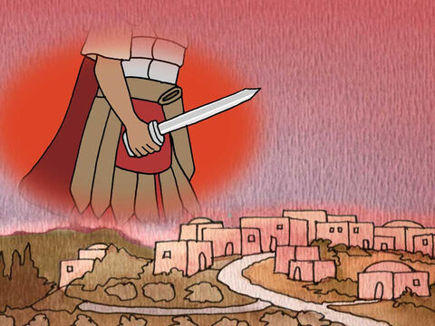
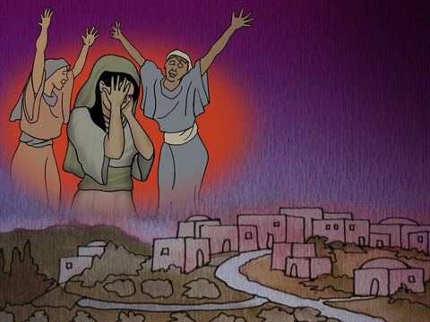
Oh No!
¹⁶ Herod realized that the Wise Men had tricked him. So he became very angry. He gave orders about Bethlehem and the area around it. He ordered all the boys two years old and under to be killed. This agreed with the time when the Wise Men had seen the star. ¹⁷ In this way, the words Jeremiah the prophet spoke came true. He had said,
¹⁸ “A voice is heard in Ramah.
It’s the sound of crying and deep sadness.
Rachel is crying over her children.
She refuses to be comforted,
because they are gone.” (Jeremiah 31:15)
That’s
horrible!
So Sad!
Waaa

Slide 26
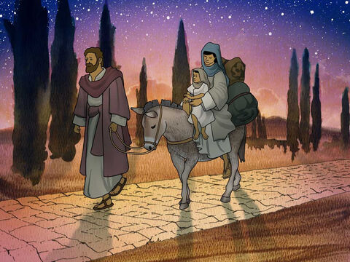
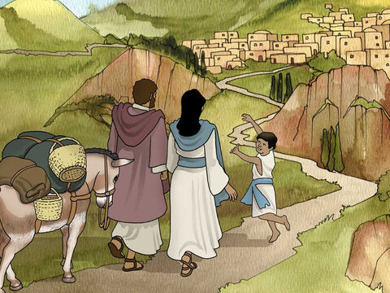
There’s our home!
Nazareth!
God has kept us safe! Praise Him
¹⁹ After Herod died, Joseph had a dream while he was still in Egypt. In the dream an angel of the Lord appeared to him. ²⁰ The angel said, “Get up! Take the child and his mother. Go to the land of Israel. The people who were trying to kill the child are dead.”
²¹ So Joseph got up. He took the child and his mother Mary back to the land of Israel. ²² But then he heard that Archelaus was king of Judea. Archelaus was ruling in place of his father Herod. This made Joseph afraid to go there. Joseph had been warned in a dream. So he went back to the land of Galilee instead. ²³ There he lived in a town called Nazareth. So what the prophets had said about Jesus came true. They had said that he would be called a Nazarene.

Slide 27
Sing Joy to the World

Slide 28

https://activity-array.com/

