Slide 1

Zechariah & Elizabeth
Prayer is Answered
John the Baptist is Born
The Promised Messiah is Coming!

Slide 2
Object Lesson
Do you believe
This or that

Slide 3

But these are written that you may believe that Jesus is the Messiah, the Son of God, and that by believing you may have life in His name.
John 20:31

Slide 4
Jesus said,
“Do not let your hearts be troubled. You believe in God; believe also in me.
John 14:1

Slide 5
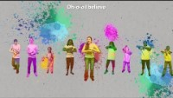
I Believe in Jesus

Slide 6
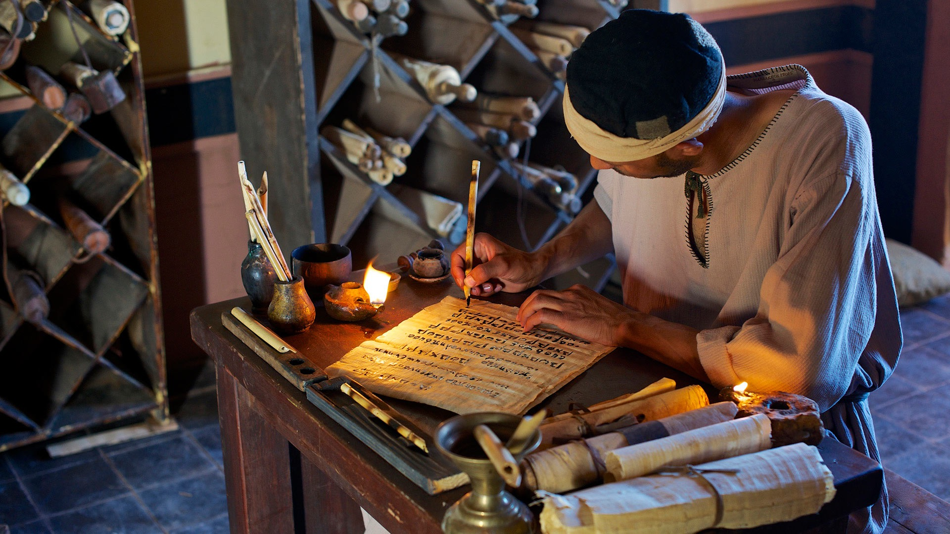
Find Luke 1
Luke Writes an Orderly Report
1 Many people have attempted to write about the things that have taken place among us. ² Reports of these things were handed down to us. There were people who saw these things for themselves from the beginning. They saw them and then passed the word on. ³ With this in mind, I myself have carefully looked into everything from the beginning. So I also decided to write down an orderly report of exactly what happened. I am doing this for you, most excellent Theophilus. ⁴ I want you to know that the things you have been taught are true.

Slide 7
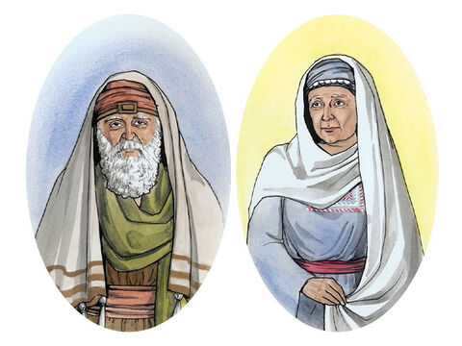
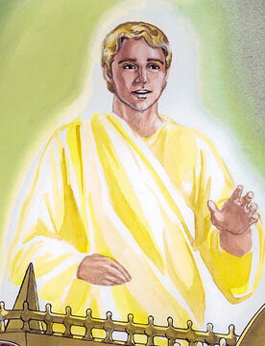
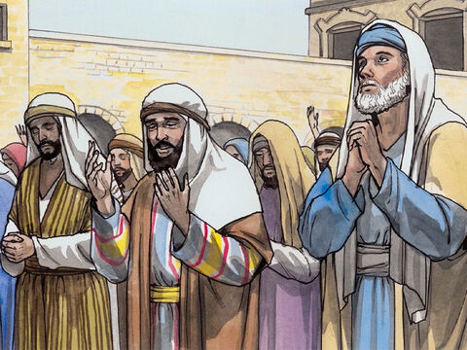
Be the Characters
Hi! I’m Zechariah.
I’m a priest.
Hi! I’m Gabriel.
I’m an angel.
Hi! We are friends.
We worship God.
Hi! I’m Elizabeth.
I’m Zechariah’s wife.
I need your help to act out our story today.
Who woud you like to be?
Zechariah
Elizabeth
Angel
Worshipers/Friends

Slide 8
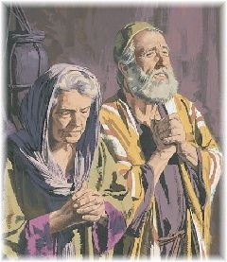
For the past many years…
Dear Holy God,
We love you. You are awesome!
We look forward to the Messiah’s coming.
If it is your will, we would love to have a baby.
⁵ Herod was king of Judea.
During the time he was ruling, there was a priest named Zechariah. He belonged to a group of priests named after Abijah. His wife Elizabeth also came from the family line of Aaron.
⁶ Both of them did what was right in the sight of God. They obeyed all the Lord’s commands and rules faithfully.
⁷ But they had no children, because Elizabeth was not able to have any. And they were both very old.

Slide 9
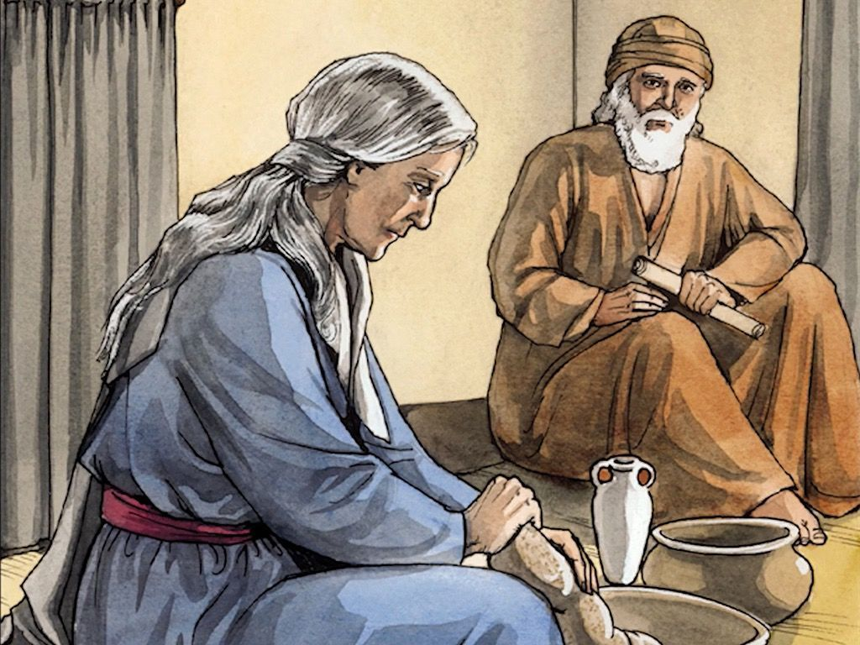
Feast of Weeks – Pentecost – 50 days after Passover
⁵ Herod was king of Judea.
During the time he was ruling, there was a priest named Zechariah. He belonged to a group of priests named after Abijah….
Abijah was Samuel’s youngest son. The priests in Abijah’s group had been serving on the 8th week after Passover for many, many years – many generations.
(1 Chronicles 24)
They served during the time of Pentecost.
(Leviticus 23:15-21)
I’m looking forward to it Zechariah! I will make extra bread for the trip.
Soon it will be 50 days after the Passover.
It is my turn to serve at the temple, too.
We must get ready to go to Jerusalem.
Yes, it is a special time to remember when God spoke from Mount Sinai and reminded us that we are His people and He is our King.
God gave us the 10 Commandments
and the plan of the sanctuary temple.

Slide 10
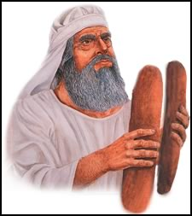
It was a special time.
¹⁶ Count off fifty days up to the day after the seventh Sabbath, and then present an offering of new grain to the Lord. ¹⁷ From wherever you live, bring two loaves made of two-tenths of an ephah of the finest flour, baked with yeast, as a wave offering of firstfruits to the Lord.
Thank you, LORD
for giving us a good harvest.
You are our Provider
and give us all good things.

Slide 11

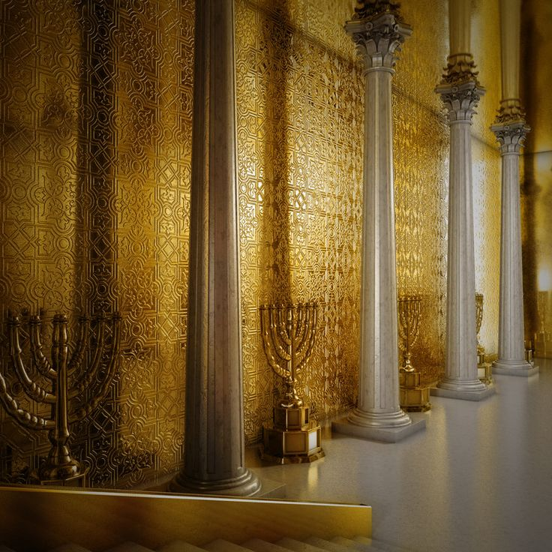

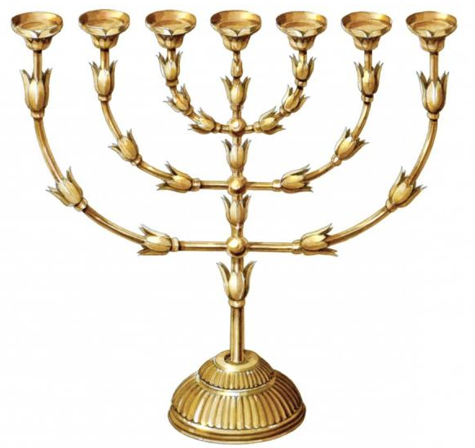
Let’s set the Setting
You can
READ
MORE
About it in
Exodus
25:31-40
1 Kings
7:48-49
I will send the Messiah, your Savior. He will be a light to all.
Inside the temple there were seven tall golden candlesticks on the left. Let’s light some candles over here.
The priest made sure that the candles had plenty of oil to burn all day and all night.
The candelabra had 7 candle stick branches.
Remember God is the light that guides us and shows us truth.

Slide 12

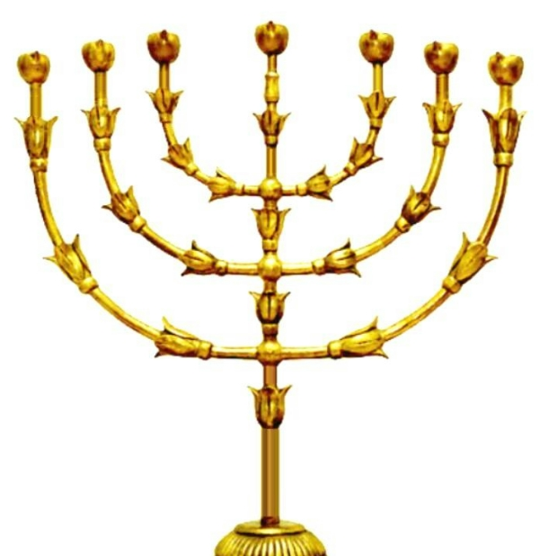
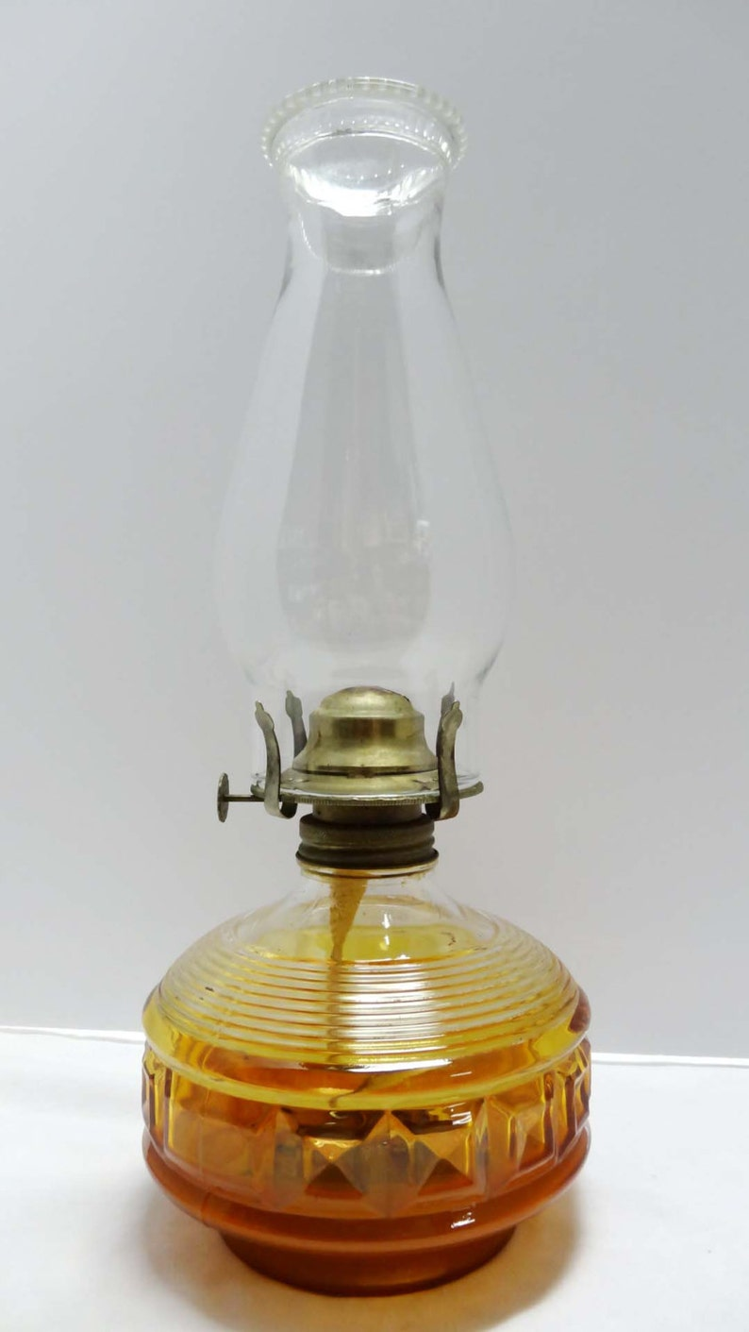

How would they tend the lamps?
You can
READ
MORE
About it in
Exodus
25:31-40
1 Kings
7:48-49
A candle burns the wick and wax and then you must replace it.
An oil lamp burns the wick and oil. You must put in new oil and trim and raise the wick.
We want God’s light to shine in us always. How do we tend our lamp each morning and evening? We read the Bible and pray.
The Holy Spirit is the ‘oil’ that keeps us shining for Jesus and sharing His love.

Slide 13

I Believe in Jesus

Slide 14
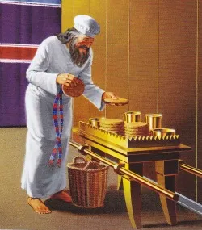
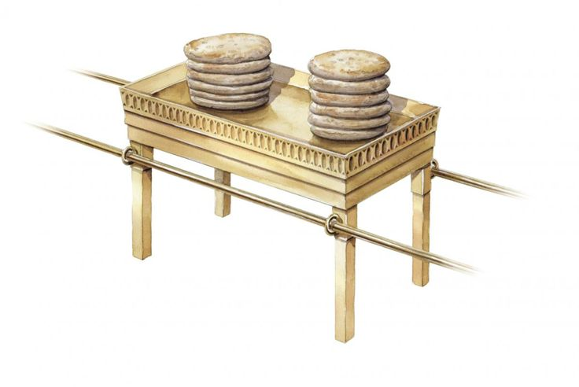
Let’s set the Setting
The Messiah will be like the bread and give you life.
You can
READ
MORE
About it in
Exodus
25:23-30
There was a table of holy bread on the right. We’ll put some bread over on this side of our room.
There were 12 loaves of bread for the 12 tribes of Israel.
Remember that God nourishes us. He gives us life and energy. He is called the bread of life.
You can have some crackers for snack. Can you stack them up like this bread?
Other Suggestion: make pancakes and then let the kids eat them.

Slide 15
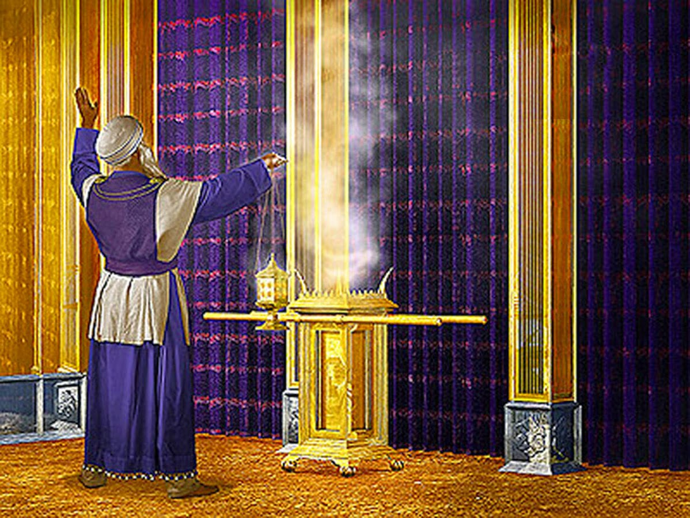
Let’s set the Setting
You can
READ
MORE
About it in
Exodus 30:1-9
30:34-37
26:31-35
The Messiah will intercede and pray for you, as your High Priest.
In the middle on the far side of the room there was a special gold altar where the priest would put special type incense used only for this holy purpose. Let’s light some incense on the table over here.
The altar was in front of a beautiful purple, red, and blue curtain with angels on it.
The incense wafted up and over the curtain. It represented the prayers going to God in heaven.
God hears our prayers. He gives us all that we need.

Slide 16
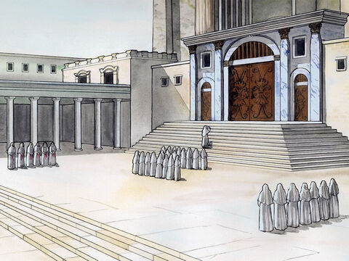
Our story today starts at the temple
You can
READ
MORE
About it in
1 Kings
6:36
Lord, Please send the Messiah.
In the temple, there was a large courtyard for the people to pray.
Every morning and evening there was a special time to pray.
Let’s pray together.

Slide 17
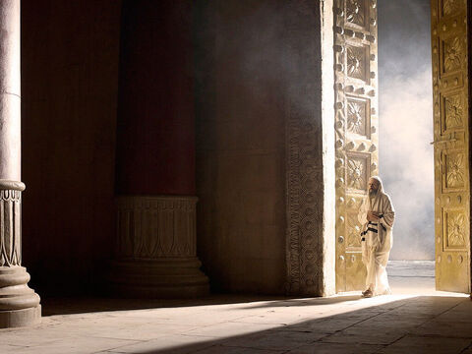
Time for prayer
⁸ One day Zechariah’s group was on duty. He was serving as a priest in God’s temple. ⁹ He happened to be chosen, in the usual way, to go into the temple of the Lord. There he was supposed to burn incense. ¹⁰ The time came for this to be done. All who had gathered to worship were praying outside.

Slide 18

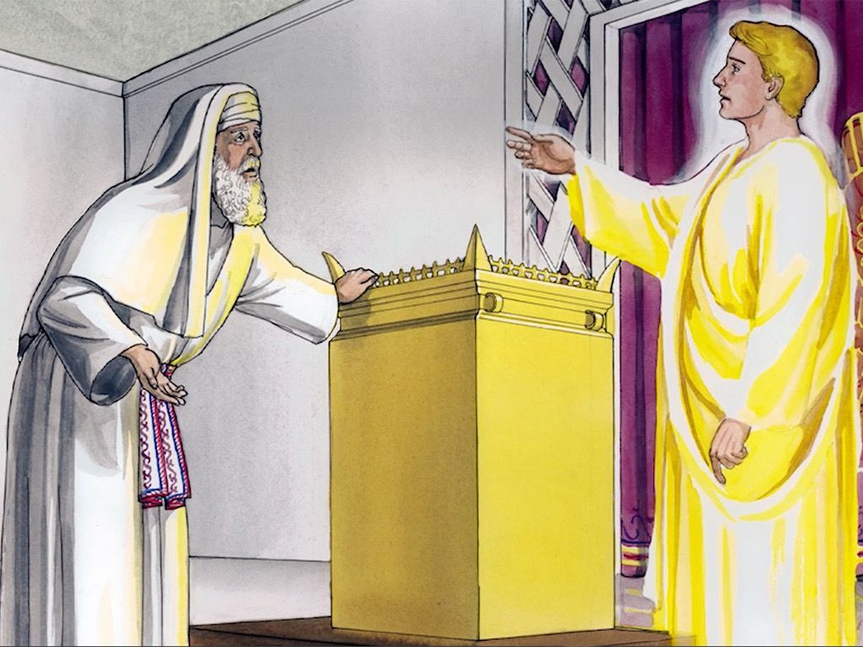
Do not be afraid Zechariah.
God has heard your prayer.
¹¹ Then an angel of the Lord appeared to Zechariah. The angel was standing at the right side of the incense altar.
¹² When Zechariah saw him, he was amazed and terrified.
¹³ But the angel said to him, “Do not be afraid, Zechariah. Your prayer has been heard.

Slide 19
Your wife Elizabeth will have a son!
Name him “John”
He will bring you much joy.
He will have an important job.
Your wife Elizabeth will have a child. It will be a boy, and you must call him John. ¹⁴ He will be a joy and delight to you. His birth will make many people very glad.
¹⁵ He will be important in the sight of the Lord. He must never drink wine or other such drinks. He will be filled with the Holy Spirit even before he is born.

Slide 20
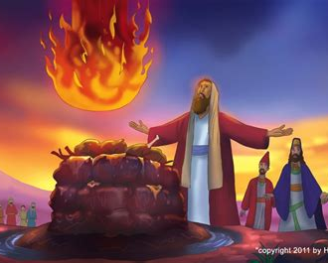
Just like Elijah turned the hearts of the people to the Lord with mighty power, so will John.
He will prepare people for Jesus, the Messiah who will soon come.
¹⁶ He will bring back many of the people of Israel to the Lord their God. ¹⁷ And he will prepare the way for the Lord. He will have the same spirit and power that Elijah had. He will bring peace between parents and their children. He will teach people who don’t obey to be wise and do what is right. In this way, he will prepare a people who are ready for the Lord.”

Slide 21
How can I be sure?
I’m old.
My wife is old, tool
I’m Gabriel. God sent me to tell you this. Because you do not believe me, you will be silent and unable to talk..
¹⁸ Zechariah asked the angel, “How can I be sure of this? I am an old man, and my wife is old too.”
¹⁹ The angel said to him, “I am Gabriel. I serve God. I have been sent to speak to you and to tell you this good news. ²⁰ And now you will have to be silent. You will not be able to speak until after John is born. That’s because you did not believe my words. They will come true at the time God has chosen.”

Slide 22
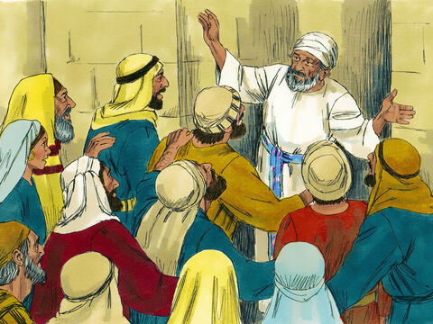
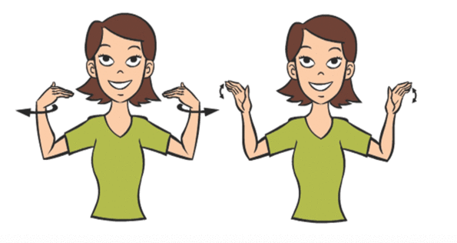
Out in the temple courtyard
²¹ During that time, the people were waiting for Zechariah to come out of the temple. They wondered why he stayed there so long.
²² When he came out, he could not speak to them. They realized he had seen a vision in the temple. They knew this because he kept gesturing to them. He still could not speak.
Zechariah is taking a long long time.
I wonder why.
What motions would you make to try to help someone guess that an angel spoke to you?
(sign for angel)

Slide 23
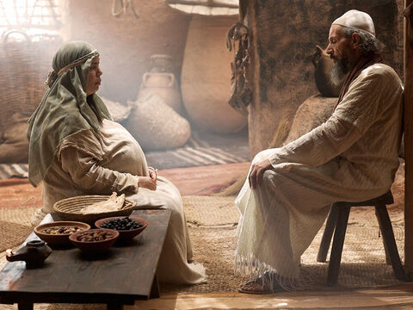
Later at home
The Lord has been kind to me. He has done this for me!
Thank you, Lord!
²³ When his time of service was over, he returned home. ²⁴ After that, his wife Elizabeth became pregnant. She stayed at home for five months.
²⁵ “The Lord has done this for me,” she said. “In these days, he has been kind to me. He has taken away my shame among the people.”

Slide 24
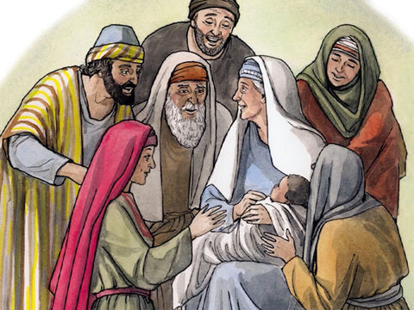

I’m so happy!
We have a baby boy!
God is good!
I’m so happy for you!
God is good!
⁵⁷ The time came for Elizabeth to have her baby. She gave birth to a son.
⁵⁸ Her neighbors and relatives heard that the Lord had been very kind to her. They shared her joy.

Slide 25
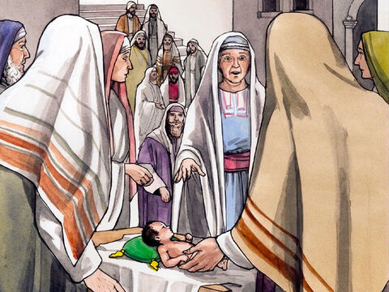
We’ll name him Zechariah, like his father.
No!
He must be called John.
But no one in your family has that name.
⁵⁹ On the eighth day, they came to have the child circumcised. They were going to name him Zechariah, like his father.
⁶⁰ But his mother spoke up. “No!” she said. “He must be called John.”
⁶¹ They said to her, “No one among your relatives has that name.”

Slide 26
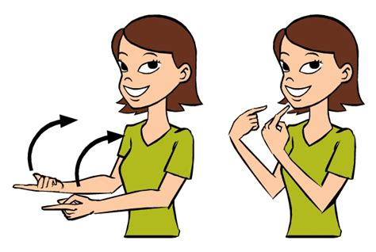
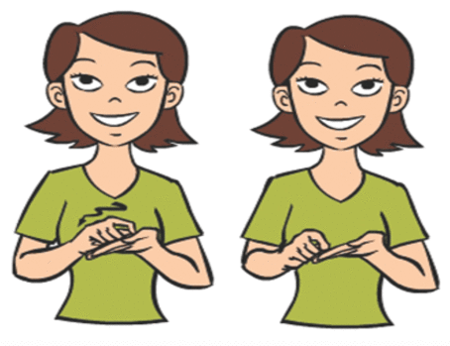
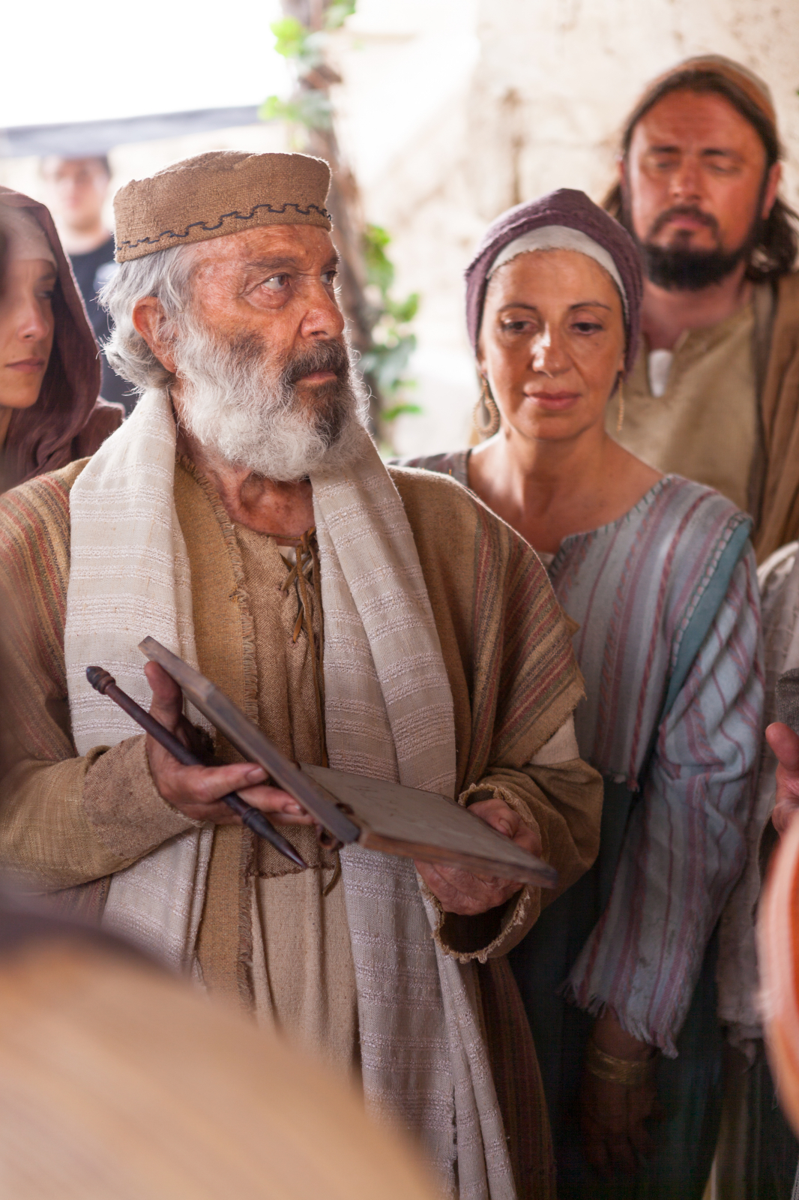
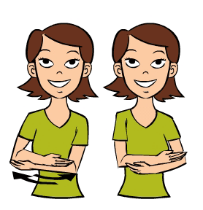
(Motion for come)
(motion for paper and pencil)
⁶² Then they motioned to his father.
They wanted to find out what he would like to name the child.
⁶³ He asked for something
to write on.
How would you motion for someone to come?
(motion for name & baby_
How would you motion for someone to name a baby?
How would you motion for someone to bring paper and pencil?

Slide 27

His name is JOHN
Wow!
Praise God!
Then he wrote,
“His name is John.”
Everyone was amazed.
⁶⁴ Right away Zechariah could speak again.
Right away he praised God.
⁶⁵ All his neighbors were filled with fear and wonder.
Throughout Judea’s hill country, people were talking about all these things.
⁶⁶ Everyone who heard this wondered about it. And because the Lord was with John, they asked, “What is this child going to be?”
His name is JOHN
What is
this child
going to be?
Praise God!
He has answered our prayer!
We are blessed!

Slide 28
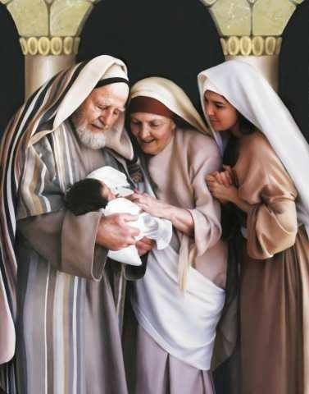
.
Our Savior will be a light in the darkness.
Praise God!
⁶⁷ John’s father Zechariah was filled with the Holy Spirit. He prophesied,
⁶⁸ “Give praise to the Lord, the God of Israel!
He has come to his people and purchased their freedom.
⁶⁹ He has acted with great power and has saved us.
He did it for those who are from the family line of his servant David.
⁷⁰ Long ago holy prophets said he would do it.
⁷¹ He has saved us from our enemies.
We are rescued from all who hate us.
⁷² He has been kind to our people of long ago.
He has remembered his holy covenant.
⁷³ He made a promise to our father Abraham.
⁷⁴ He promised to save us from our enemies.
Then we could serve him without fear.
⁷⁵ He wants us to be holy and godly as long as we live.
⁷⁶ “And you, my child, will be called a prophet of the Most High God.
You will go ahead of the Lord to prepare the way for him.
⁷⁷ You will tell his people how they can be saved.
You will tell them that their sins can be forgiven.
⁷⁸ All of that will happen because our God is tender and caring.
His kindness will bring the rising sun to us from heaven.
⁷⁹ It will shine on those living in darkness
and in the shadow of death.
God has kept his promises.
Praise God!
He promised our Savior would come from the family of David.
You my child will be called a prophet of the Most High God.
.
You will prepare people for the Lord.
You will tell them how their sins will be forgiven.

Slide 29
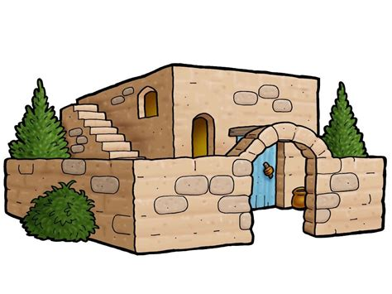
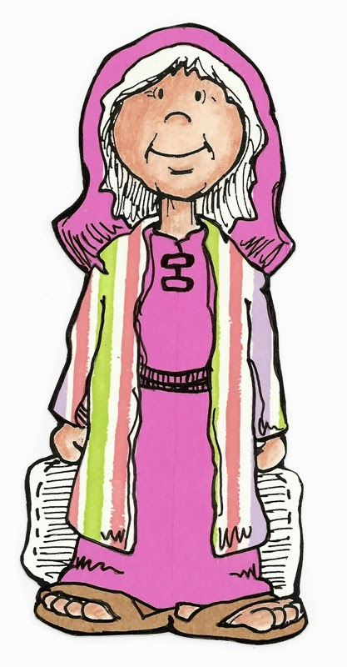
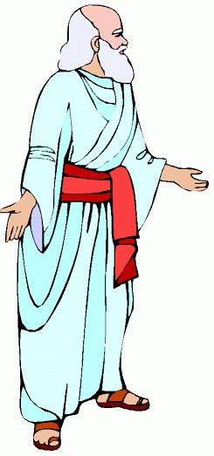
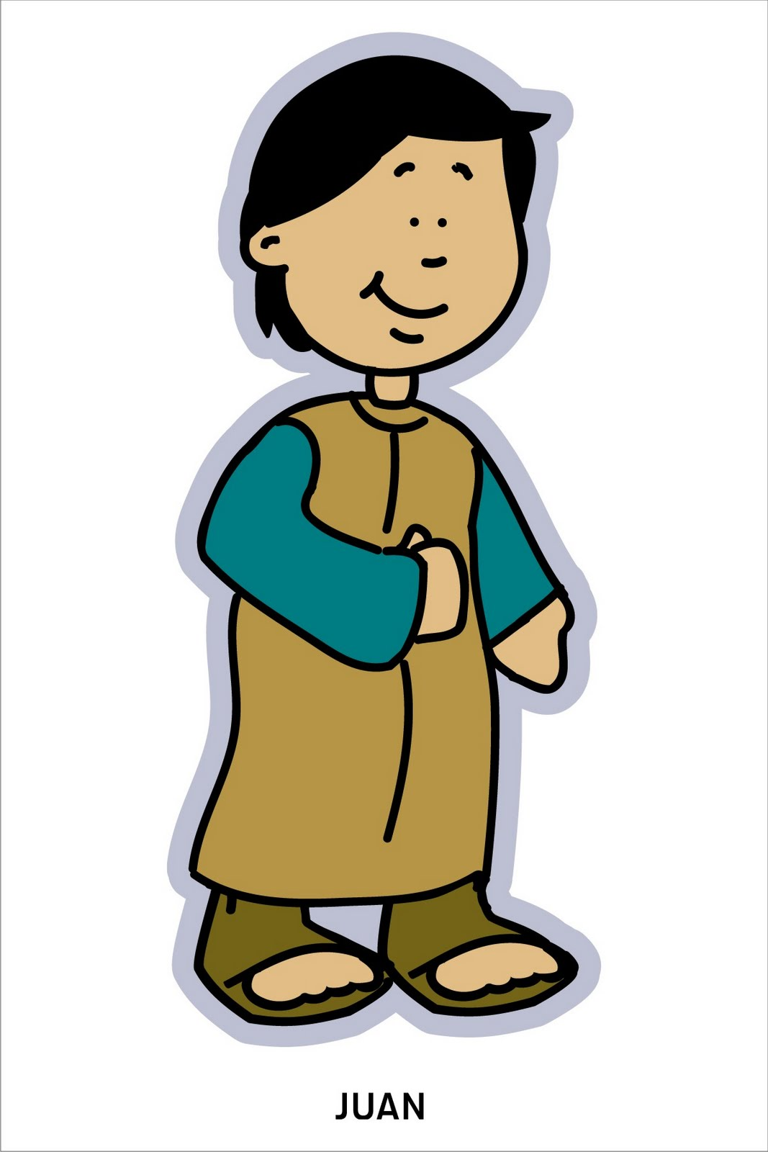
You are a blessing indeed!
You love God
and faithfully follow Him
John, you are such a delight!
You are obedient and kind.
You are an answer to prayer.
I love you!
God loves you too!
⁸⁰ The child grew up, and his spirit became strong.
He lived in the desert until he appeared openly to Israel.
I love you!
God loves you too!

Slide 30
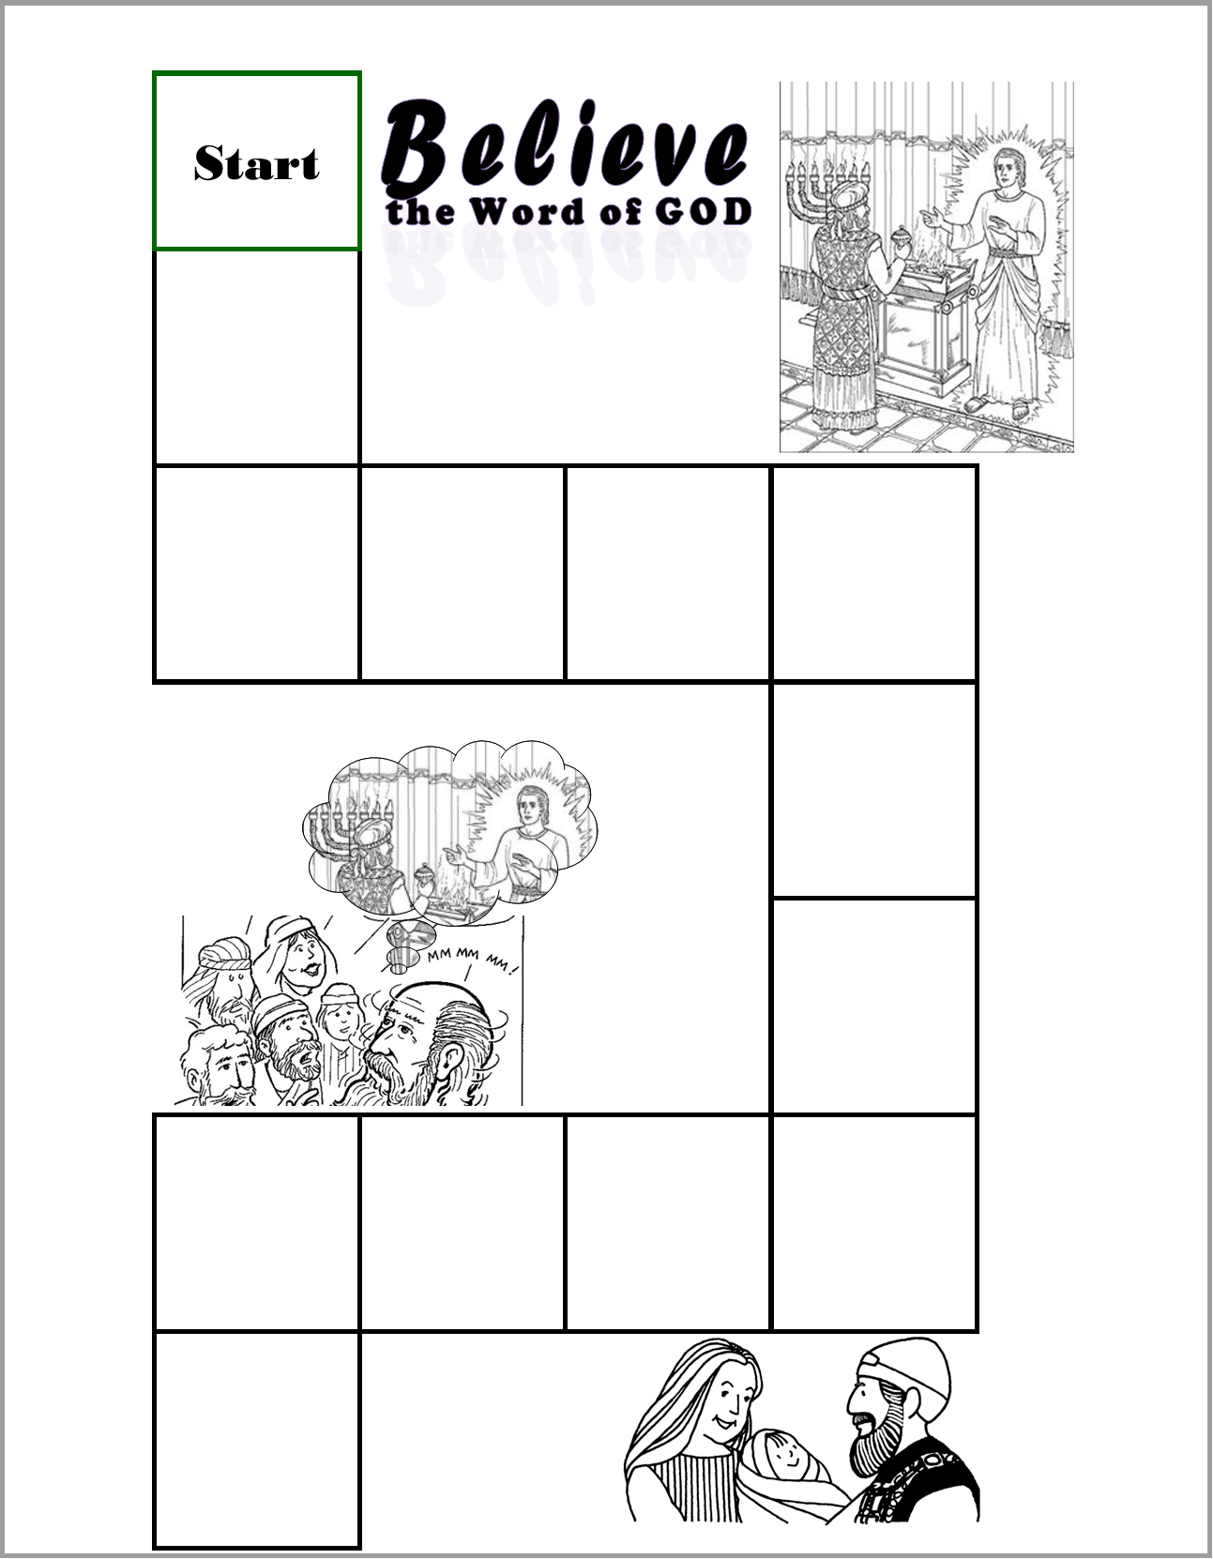
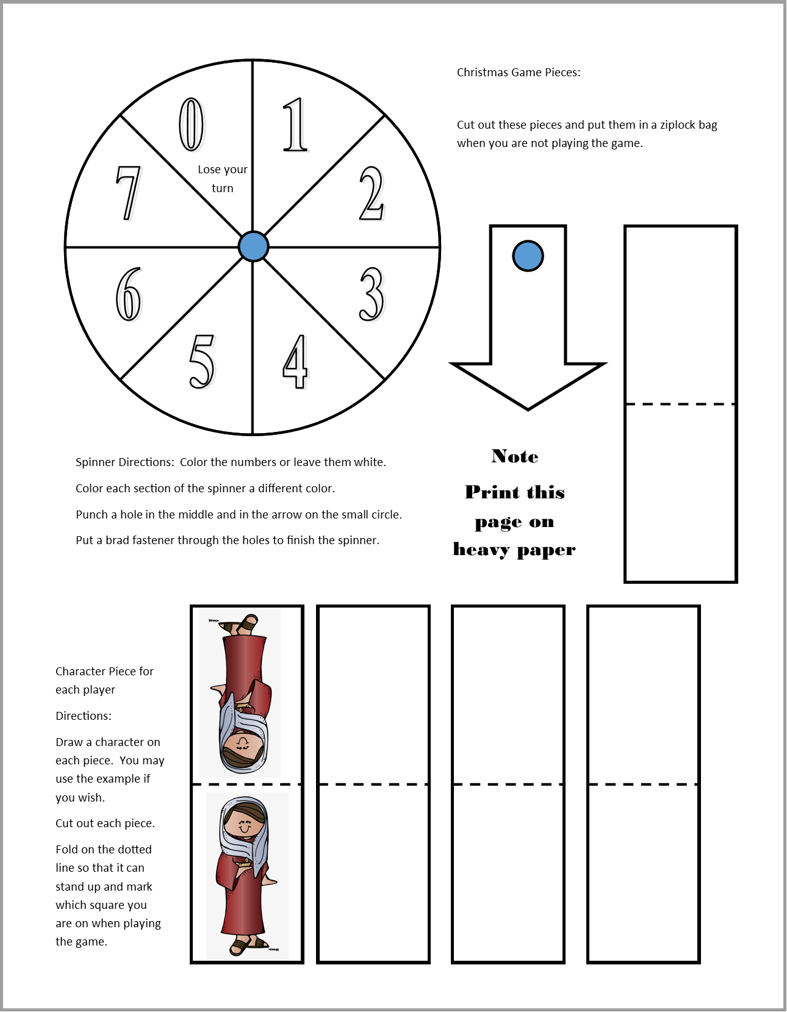
CRAFT TIME option 1
DIRECTIONS
Cut out the game pieces and follow the directions on the page.
  Spinner
  Playing pieces
Prepare the playing board part 1:
  Put on the Announcement card and Activity Challenge stickers.
  Write in your own directions on 2 squares if you wish.
  Glue this page on the left side of a manila folder so that the bottom right corner is near the bottom right corner of the left side of the folder.
Prepare the Announcement Cards by cutting them out.
Note: We will be adding pages of the game each week.

Slide 31
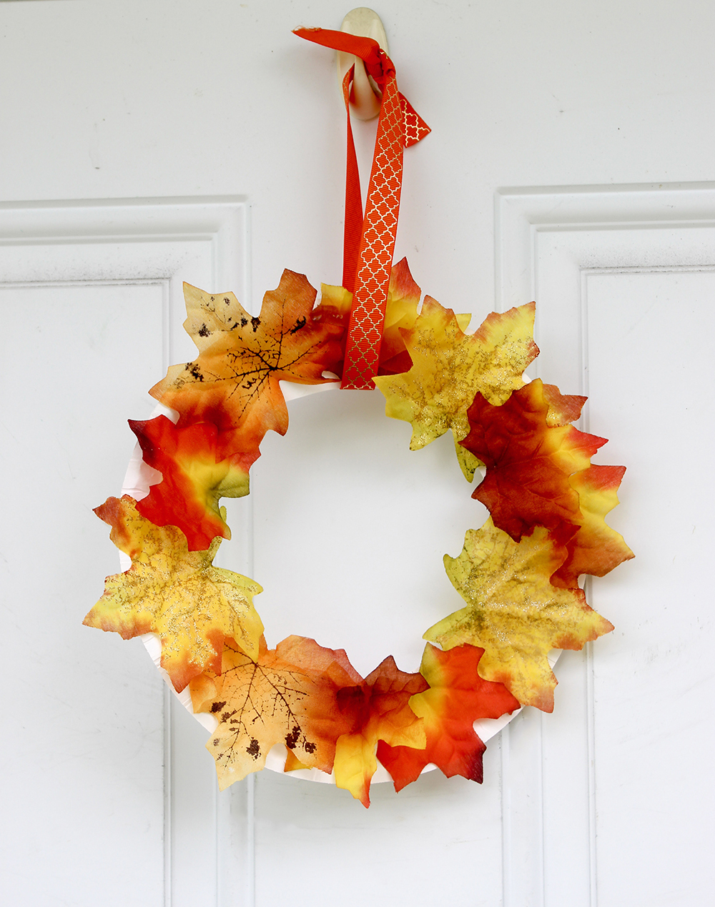
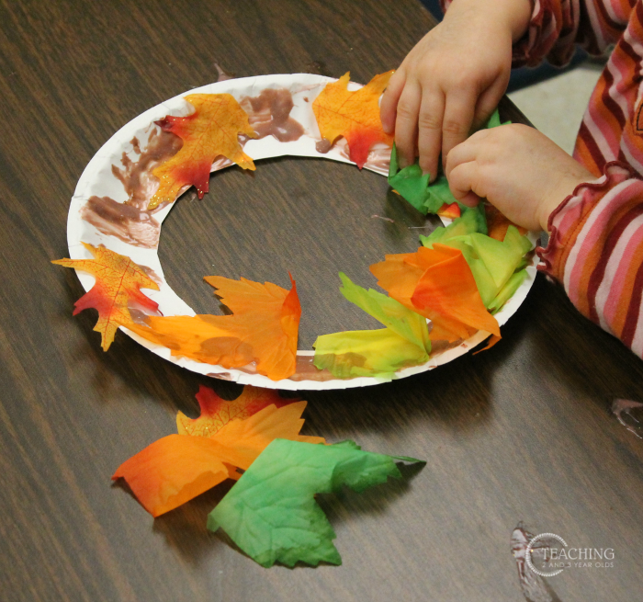

CRAFT TIME option 2
DIRECTIONS
Cut the middle out of a paper plate
Glue Fall leaves all around the edge of the plate. You can use real leaves or make some with paper or purchased leaves. Overlap them so that you do not see the plate.
Cut a rectangle for the candle.
Glue the bottom of the rectangle to the back of the plate so that the candle is in the middle as shown.
Make a flame either on paper and color or on construction paper or crinkle some tissue paper.
Add a message on the front such as
  HAPPY THANKSGIVING
  THANK YOU, GOD
  PRAISE GOD
Thank You God!

Slide 32

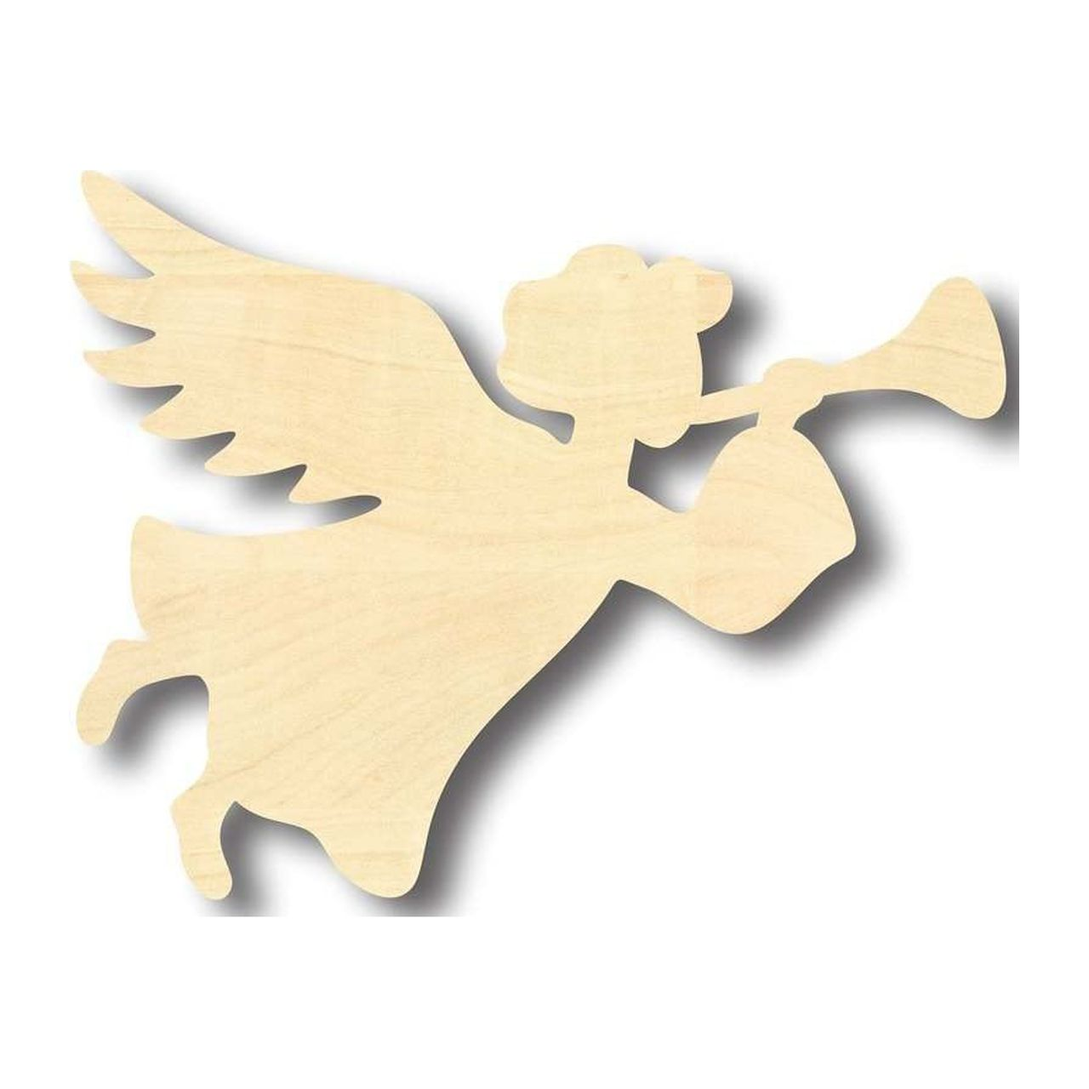
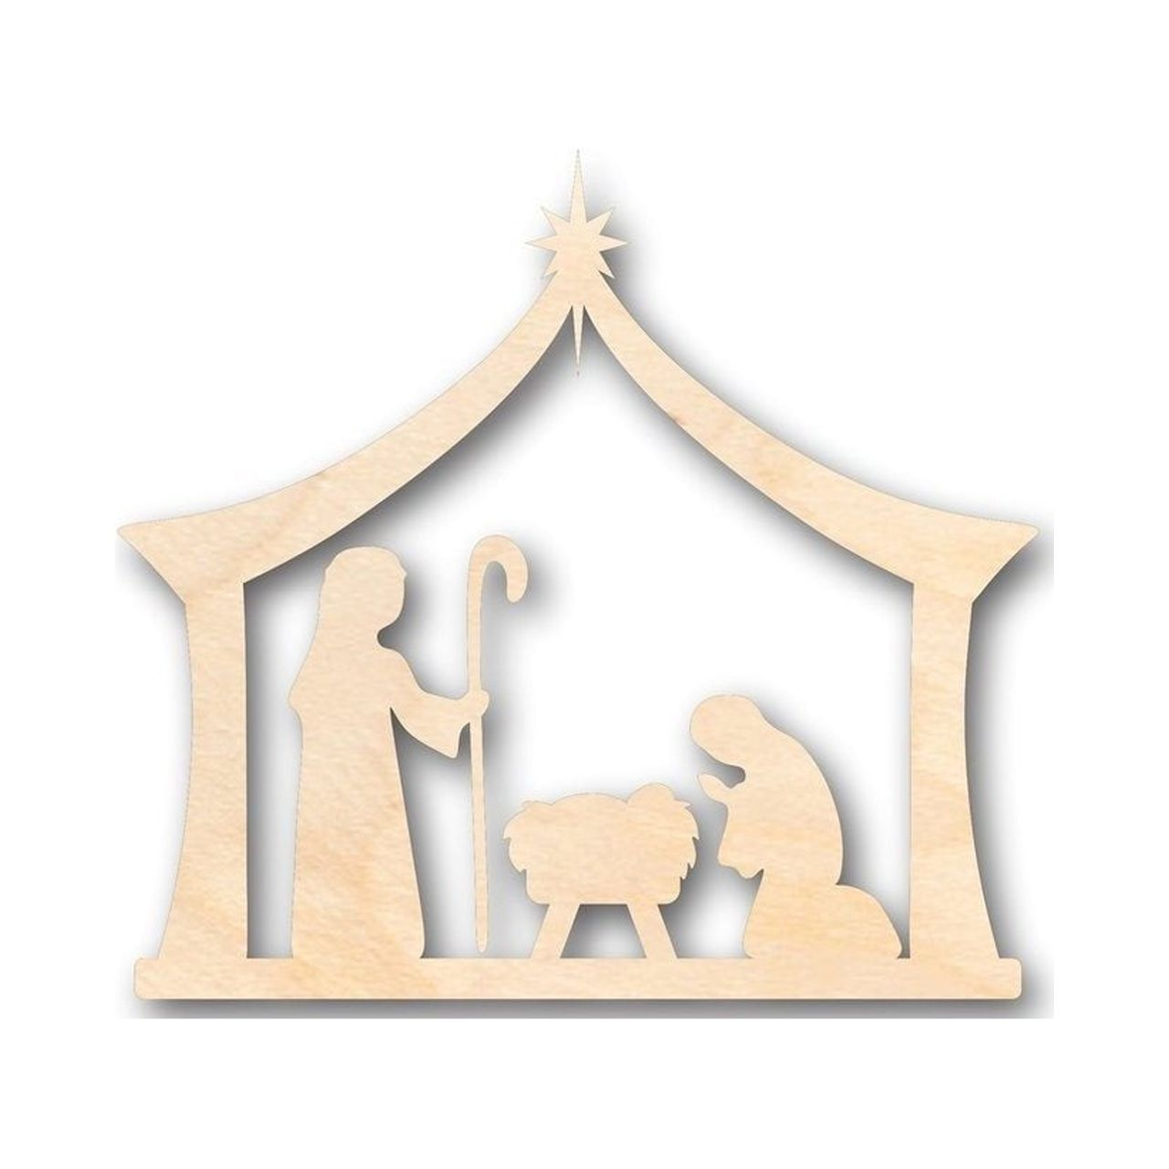
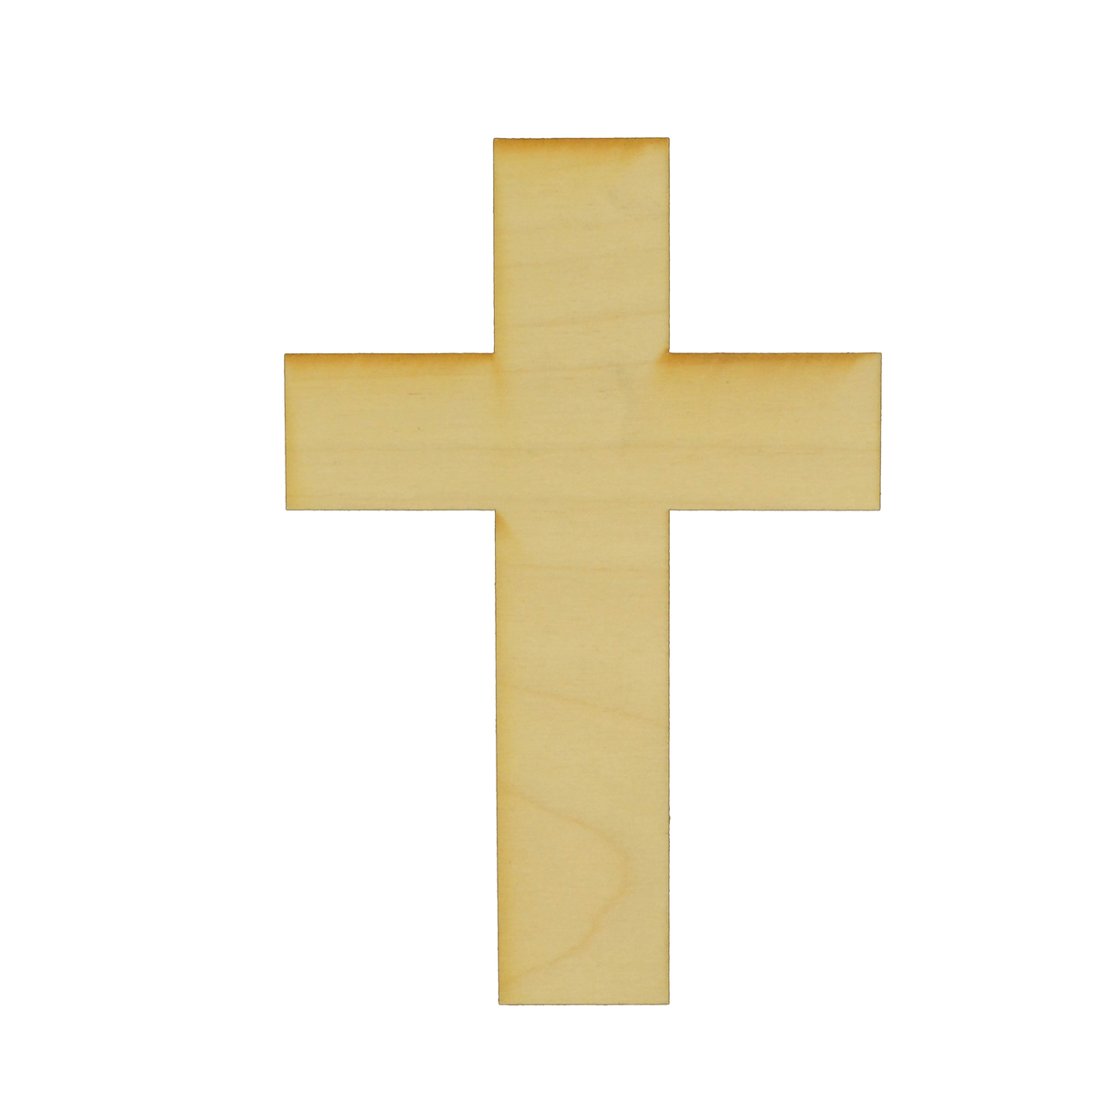
CRAFT TIME option 3
DIRECTIONS
Paint the wood word ‘BELIEVE’ word a bright color (We will glue it to the background next week)
Paint the background wood a dark blue (blue + black + purple paint) like a night sky.
Glue the BELIEVE onto the background. Add foam or wood nativity pictures, an angel, cross, crown, and star
  I believe the angel’s message
  I believe that Jesus came as a baby. He lived to show and tell God’s love
  I believe that Jesus died for our sins and rose again that we all may have eternal life.

Slide 33
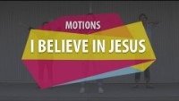
I Believe in Jesus
Saddleback kids

Slide 34
I Believe in Jesus

Slide 35
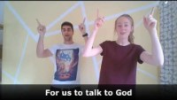

Slide 36
I Believe in Jesus
Saddleback kids

Slide 37
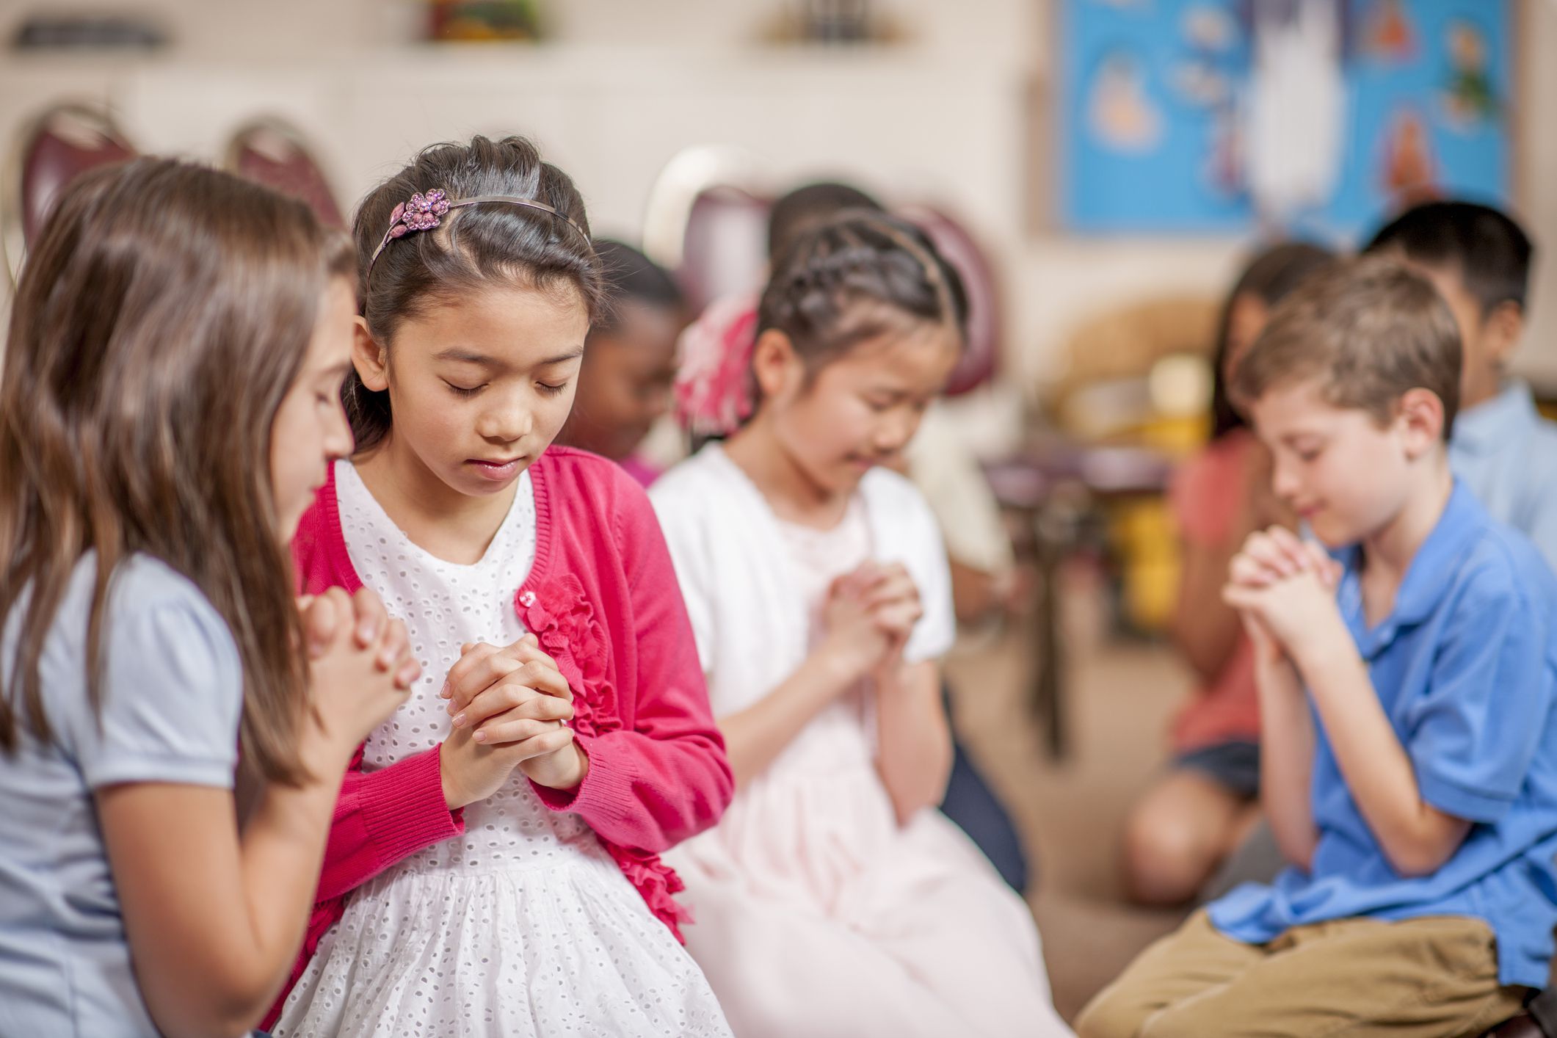
Pray
Adoration: First, tell God how much you love and adore him.
Confession: Next, tell God about what you have done wrong and tell him you are sorry. He will forgive you.
Thanksgiving: Think about all the positive things in your life and thank God for these blessings.
Supplication: Pray for something you need help with, and for other people who need God's help.

Slide 38
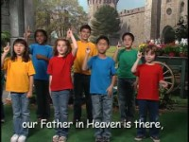
G

Slide 39

Pray about everything

Slide 40
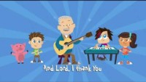

Slide 41
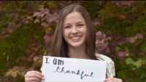

Slide 42
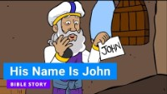

Slide 43
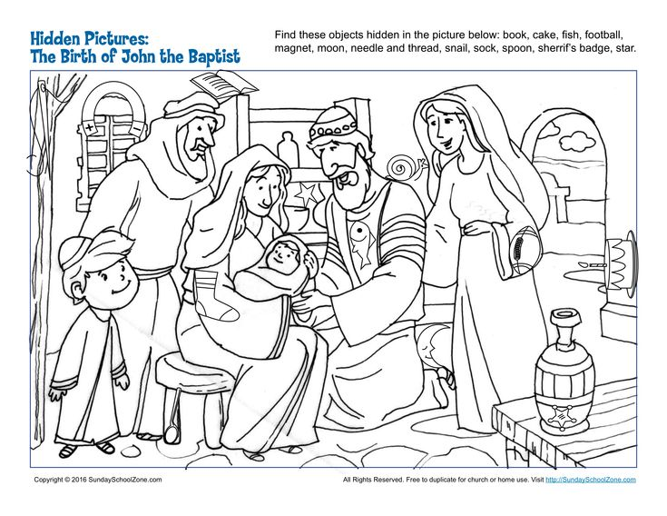

Slide 44


Slide 45
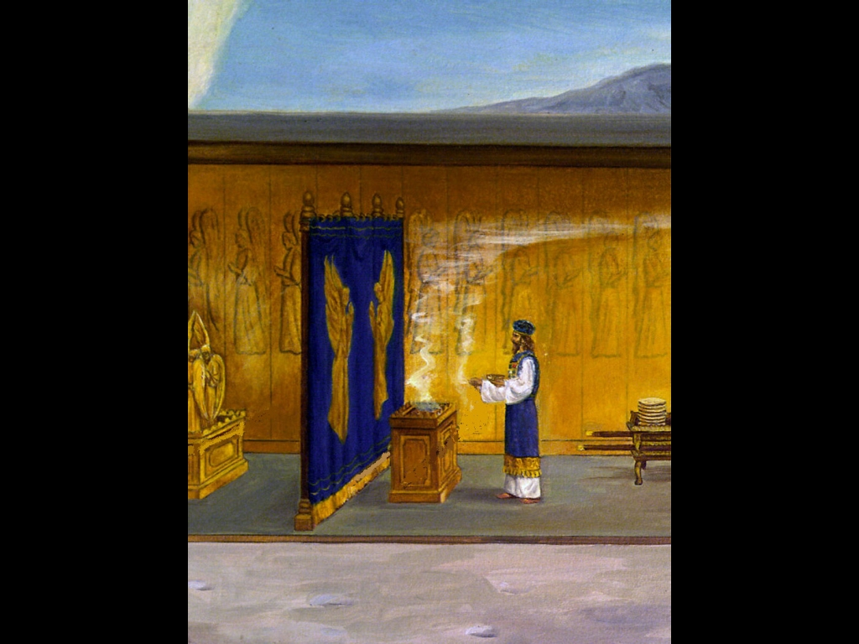
Incense for God
30 “Make an altar for burning incense. Make it out of acacia wood. ² It must be one and a half feet square and three feet high. Make a horn stick out from each of its upper four corners. ³ Cover the top, sides and horns with pure gold. Put a strip of gold around it. ⁴ Make two gold rings for the altar below the strip. Put the rings across from each other. They will hold the poles that are used to carry it. ⁵ Make the poles out of acacia wood. Cover them with gold. ⁶ Put the altar in front of the curtain that hangs in front of the ark. The ark is where the tablets of the covenant law are kept. The ark will have a cover. It will be the place where sin is paid for. There I will meet with you.
⁷ “Aaron must burn sweet-smelling incense on the altar. He must do it every morning when he takes care of the lamps. ⁸ He must burn incense again when he lights the lamps at sunset. Incense must be burned regularly in front of the Lord. Do it for all time to come. ⁹ Do not burn any other incense on the altar. Do not use the altar for burnt offerings or grain offerings. And do not pour drink offerings on it. ¹⁰ Once a year Aaron must put the blood of a sin offering on the horns of the altar. He must do this to make the altar pure. He must do this on the day Israel’s sin is paid for. Do this for all time to come. The altar is a very holy place to me.”…
³⁴ Then the Lord said to Moses, “Get some sweet-smelling spices. Get some gum resin, onycha and galbanum. Also get some pure frankincense. Make sure everything is in equal amounts. ³⁵ Have a person who makes perfume mix it all up into a sweet-smelling incense. It must have salt in it. It will be pure and sacred. ³⁶ Grind some of it into powder. Place it in front of the ark of the covenant law in the tent of meeting. There I will meet with you. The incense will be very holy to you. ³⁷ Do not make any incense for yourselves in the same way. Think of it as holy to the Lord. ³⁸ Whoever makes incense in the same way to enjoy its sweet smell must be separated from their people.”

Slide 46

https://activity-array.com/

