Slide 1

Gabriel visits
Mary and Joseph
Your Will Be Done

Slide 2
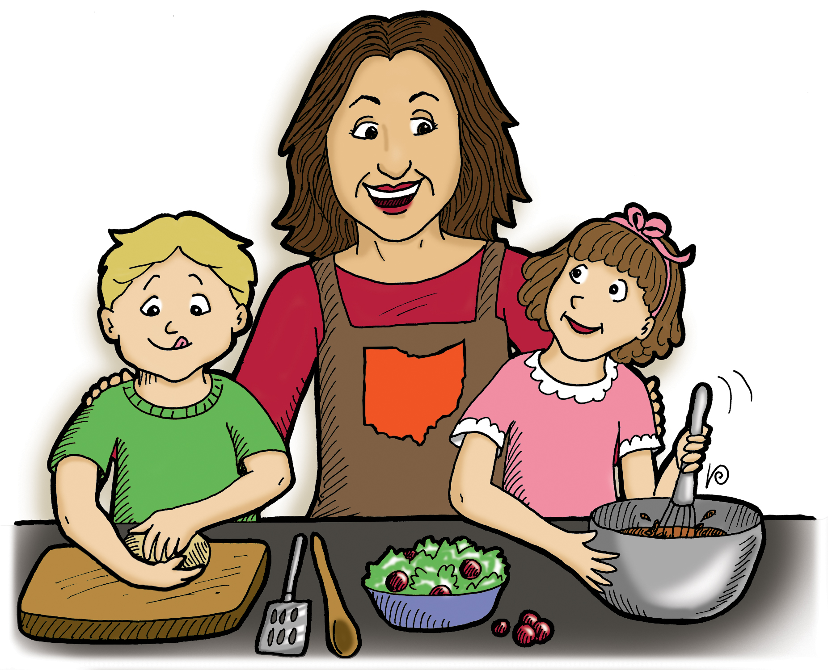

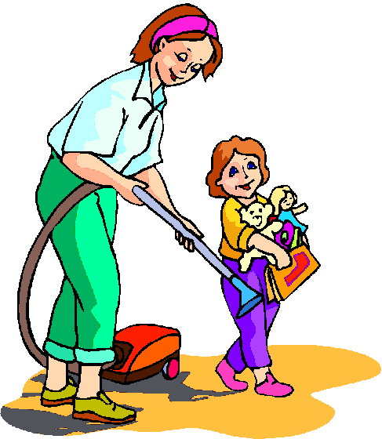


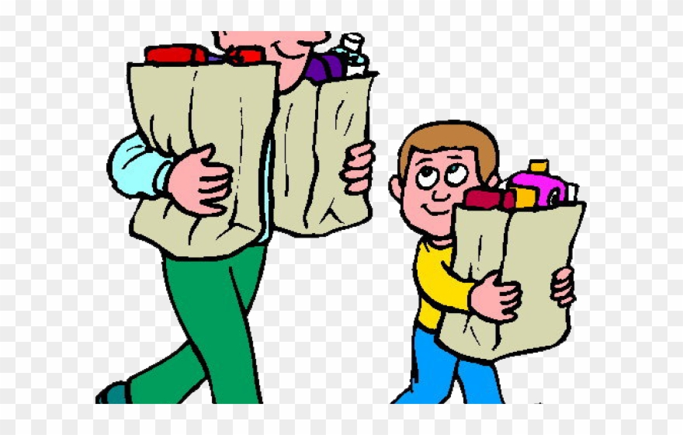


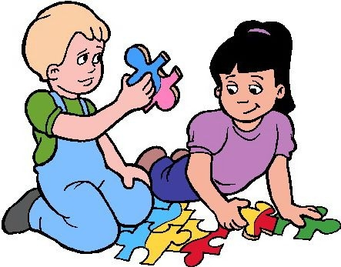

Are you willing?
How are you willing to help?
Choose one. Give a clue:
Do a charade (pretend you’re doing it}
Draw a picture
Describe it
We’ll try to guess it

Slide 3



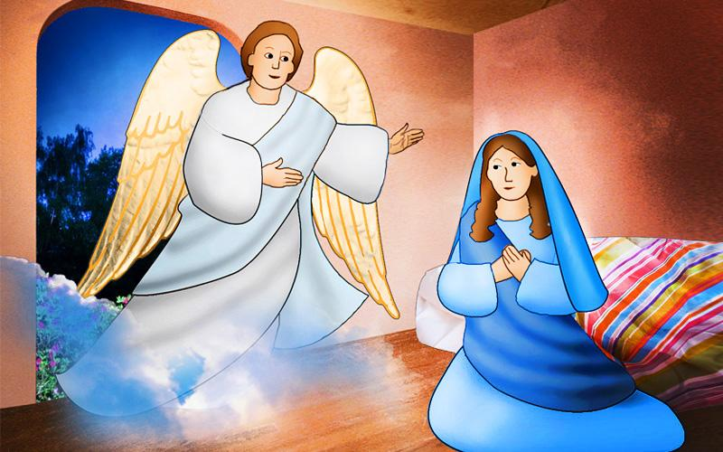
^{Luke 1:38}
“I serve the Lord,”
Mary answered.
“May it happen to me just as you said it would.”

Slide 4


SING
The Books of the Bible

Slide 5
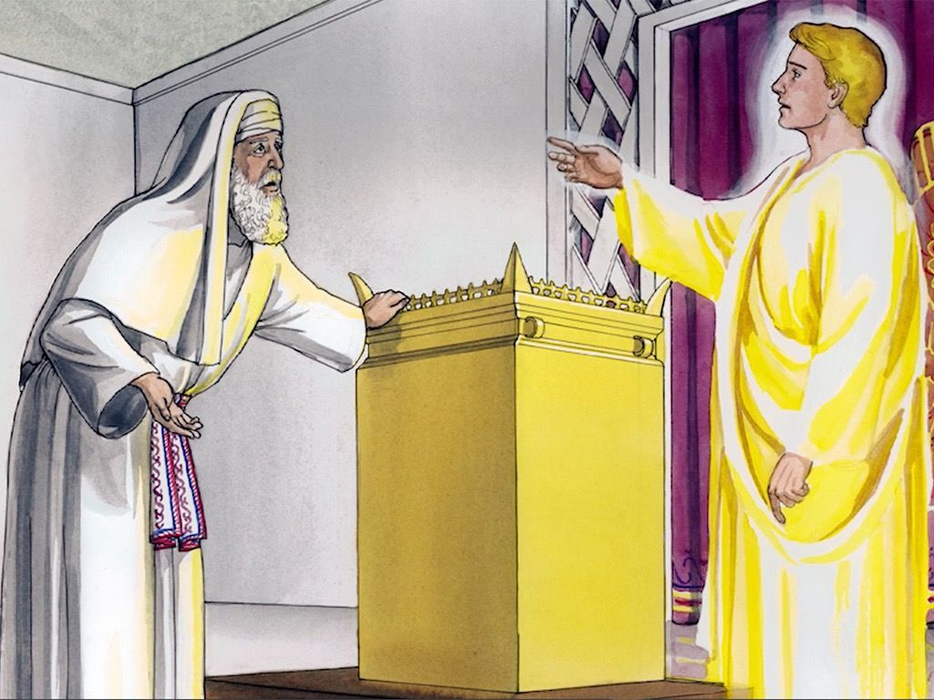
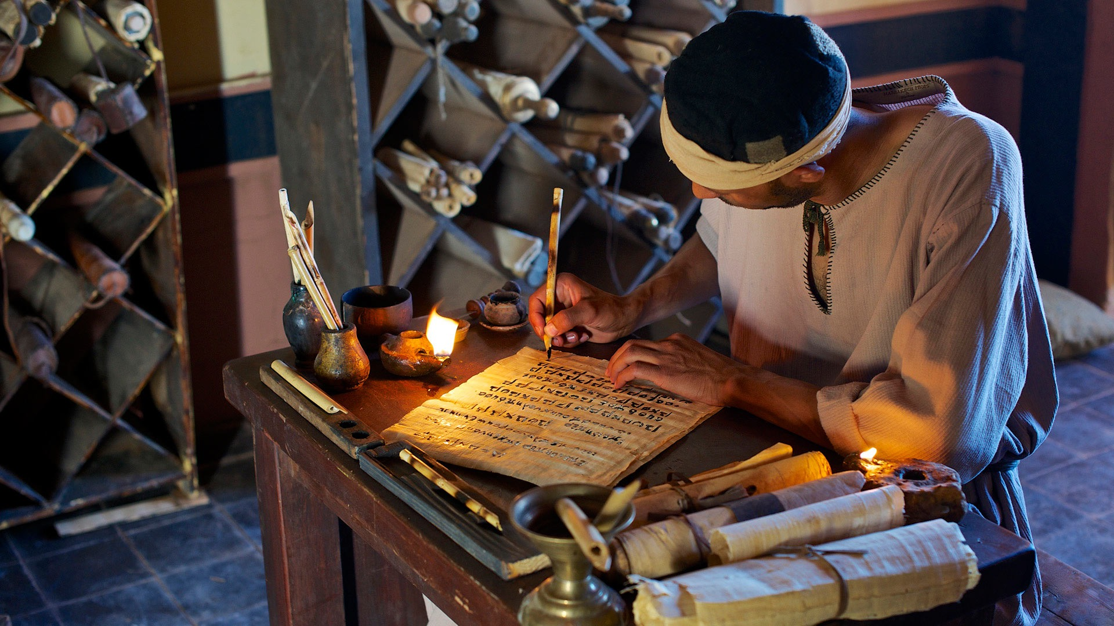
Luke continued with the story of Jesus.
Last week we read how the angel Gabriel came to Zechariah and announced that he and Elizabeth would have a son! They were to name him “John.” He would help people get ready for Jesus.
Now the angel Gabriel has a couple other people to visit.
Find Luke 1:26

Slide 6
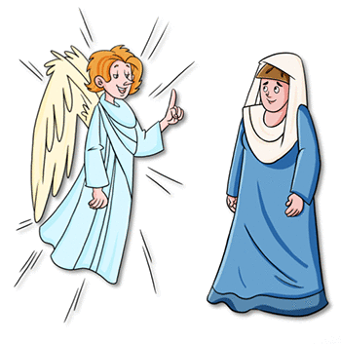
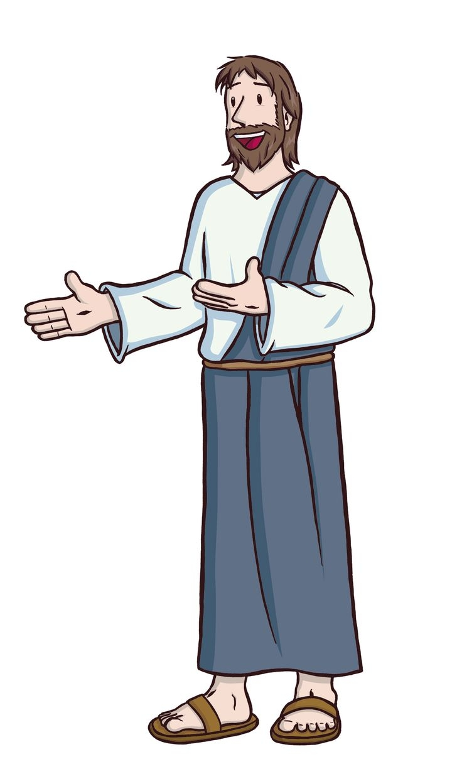
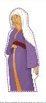
I need 4 volunteers
I’m Gabriel
I’m Joseph
Are you willing to be characters in our story and act it out?
We need:
Angel Gabriel
Mary
Elizabeth
Joseph
Who will you be?
I’m Mary
I’m Elizabeth

Slide 7

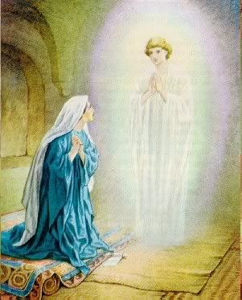
Mary, You are favored
The Lord has blessed you.
He is with you.
Luke 1:26-
²⁶ In the sixth month after Elizabeth had become pregnant, God sent the angel Gabriel to Nazareth, a town in Galilee. ²⁷ He was sent to a virgin. The girl was engaged to a man named Joseph. He came from the family line of David. The virgin’s name was Mary. ²⁸ The angel greeted her and said, “The Lord has blessed you in a special way. He is with you.”
²⁹ Mary was very troubled because of his words. She wondered what kind of greeting this could be. ³⁰ But the angel said to her, “Do not be afraid, Mary. God is very pleased with you.
Do not be afraid, Mary.
God is very pleased with you.

Slide 8

Mary, You will be the mother of God’s Son
You will have a baby.
Name Him Jesus.
He will be the Son of God.
Luke 1:26-
³¹ You will become pregnant and give birth to a son. You must call him Jesus. ³² He will be great and will be called the Son of the Most High God. The Lord God will make him a king like his father David of long ago. ³³ The Son of the Most High God will rule forever over his people. They are from the family line of Jacob. That kingdom will never end.”
God will make him King like his (grand)father David.
He will rule forever.

Slide 9
Mary was willing
How can this happen
since I’m a virgin.
Luke 1:34-
³⁴ “How can this happen?” Mary asked the angel. “I am a virgin.”
³⁵ The angel answered, “The Holy Spirit will come to you. The power of the Most High God will cover you. So the holy one that is born will be called the Son of God.
³⁶ Your relative Elizabeth will have a child even though she is old. People thought she could not have children. But she has been pregnant for six months now. ³⁷ That’s because what God says will always come true.”
The Holy Spirit will come over you. The holy one that is born will be called the Son of God.
Even Elizabeth will have a child even though she is old.
She has been pregnant for 6 months now.

Slide 10
Mary was willing
I serve the Lord.
May God’s will be done.
Luke 1:38
³⁸ “I serve the Lord,”
Mary answered.
“May it happen to me
just as you said it would.”

Slide 11
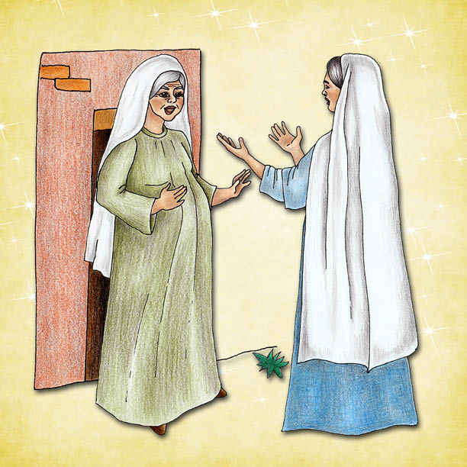
Mary visits Elizabeth
Hello Elizabeth!
Mary! God has blessed you! Blessed is the child you will have! As soon as I heard you my baby jumped for joy!
Luke 1:39-
³⁹ At that time Mary got ready and hurried to a town in Judea’s hill country.
⁴⁰ There she entered Zechariah’s home and greeted Elizabeth. ⁴¹ When Elizabeth heard Mary’s greeting, the baby inside her jumped.
And Elizabeth was filled with the Holy Spirit. ⁴² In a loud voice she called out, “God has blessed you more than other women. And blessed is the child you will have! ⁴³ But why is God so kind to me? Why has the mother of my Lord come to me? ⁴⁴ As soon as I heard the sound of your voice, the baby inside me jumped for joy.
⁴⁵ You are a woman God has blessed. You have believed that the Lord would keep his promises to you!”

Slide 12
Mary visits Elizabeth
You have believed that the Lord will keep His promises to you!
Luke 1:39-
⁴⁵ You are a woman God has blessed.
You have believed that the Lord would keep his promises to you!”

Slide 13


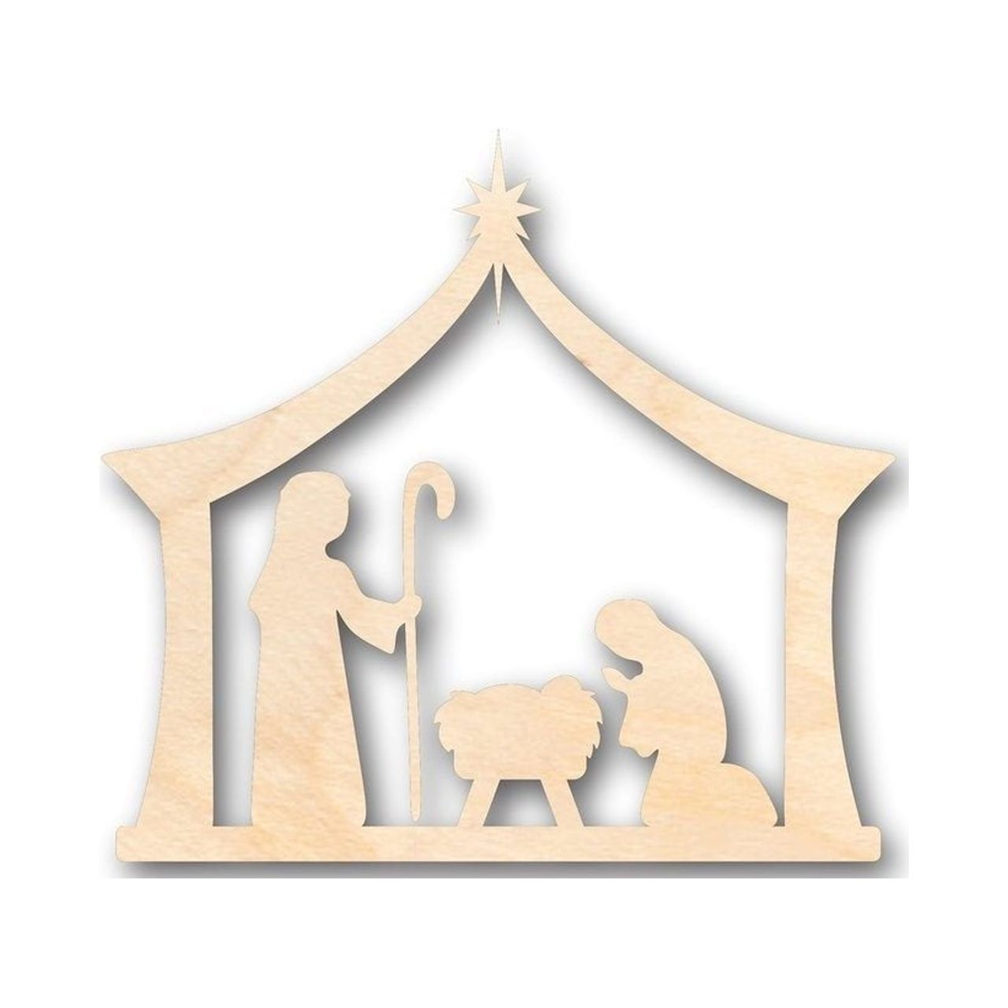

CRAFT TIME option 3
DIRECTIONS
Paint the wood word ‘BELIEVE’ word a bright color (We will glue it to the background next week)
Paint the background wood a dark blue (blue + black + purple paint) like a night sky.
Glue the BELIEVE onto the background. Add foam or wood nativity pictures, an angel, cross, crown, and star
  I believe the angel’s message
  I believe that Jesus came as a baby. He lived to show and tell God’s love
  I believe that Jesus died for our sins and rose again that we all may have eternal life.

Slide 14


Mary sings
Praise God!
He is holy!
He has done great things!
Luke 1:46
⁴⁶ Mary said,
“My soul gives glory to the Lord.
⁴⁷ My spirit delights in God my Savior.
⁴⁸ He has taken note of me
even though I am not considered important.
From now on all people will call me blessed.
⁴⁹ The Mighty One has done great things for me.
His name is holy.
⁵⁰ He shows his mercy to those who have respect for him,
from parent to child down through the years.
⁵¹ He has done mighty things with his powerful arm.
He has scattered those who are proud in their deepest thoughts.
⁵² He has brought down rulers from their thrones.
But he has lifted up people who are not considered important.
⁵³ He has filled with good things those who are hungry.
But he has sent away empty those who are rich.
⁵⁴ He has helped the people of Israel, who serve him.
He has always remembered to be kind
⁵⁵ to Abraham and his children down through the years.
He has done it just as he promised to our people of long ago.”

Slide 15

SING
God You Do Great Things

Slide 16
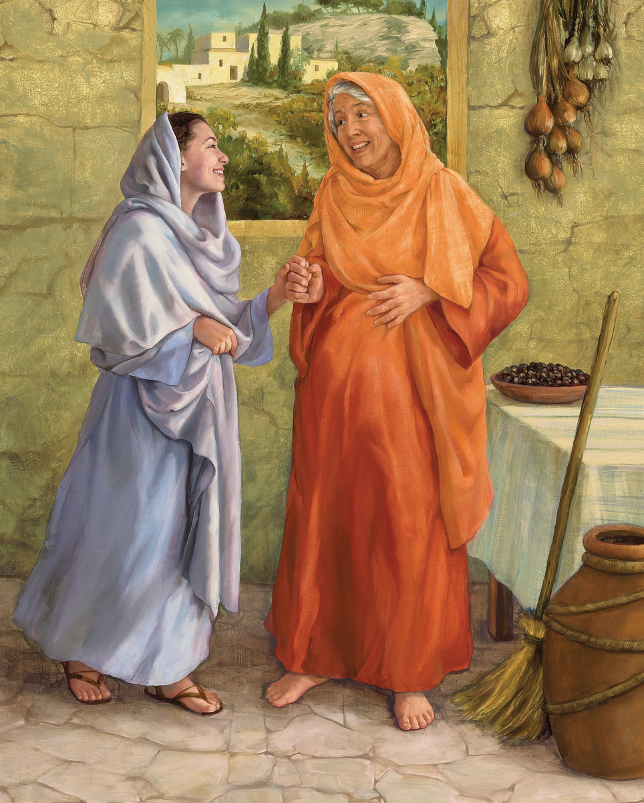
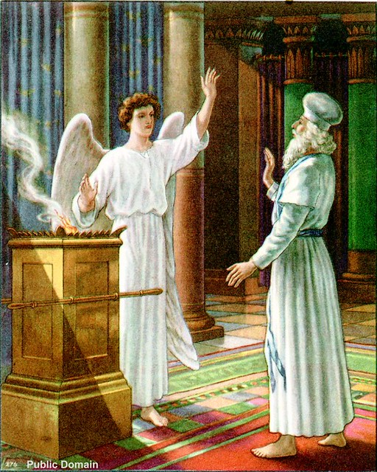
Mary and Elizabeth visit
Tell me more about your baby announcement.
Did an angel come to you?
The angel Gabriel, came to Zechariah when he served at the temple.
Luke 1:56-
⁵⁶ Mary stayed with Elizabeth about three months.
(Elizabeth probably told Mary how an angel came to Zechariah)
Sadly, he didn’t believe the angel, so now he can’t talk.
He wrote the story down tho.
The angel told him that our prayer was answered and that I would have a baby, whom we should name John
He will bring back many people of Israel to the Lord their God and will prepare the way for the Messiah.
He instructed that John should never drink wine or fermented drink.

Slide 17
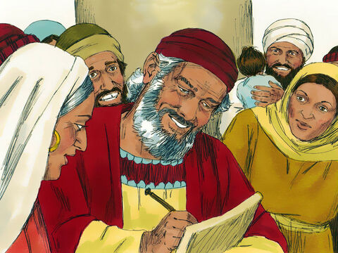
Baby John was born
His name is John!
Praise God!
Luke 1:56-
⁵⁶ Mary stayed with Elizabeth about three months.
(Mary probably was there when Elizabeth had baby John. She probably witnessed Zechariah write “His name is John” and heard his song of praise)

Slide 18
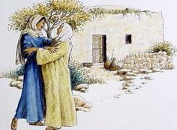
Mary went home
Good-bye Elizabeth.
It was nice visiting you.
Good-bye Mary
Luke 1:56-
⁵⁶ Mary stayed with Elizabeth about three months. Then she returned home.

Slide 19
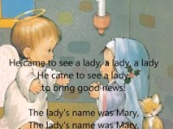
SING Christmas Carols
An Angel Came From Heaven

Slide 20
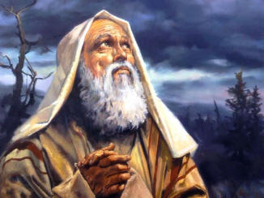
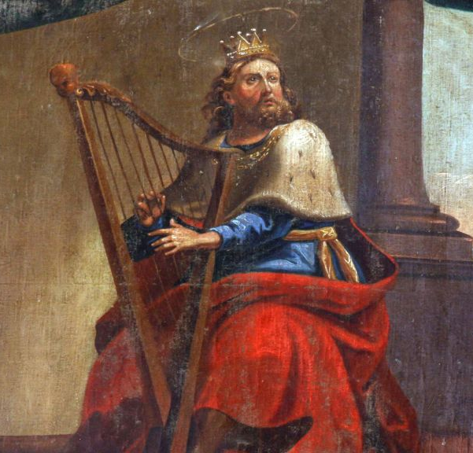
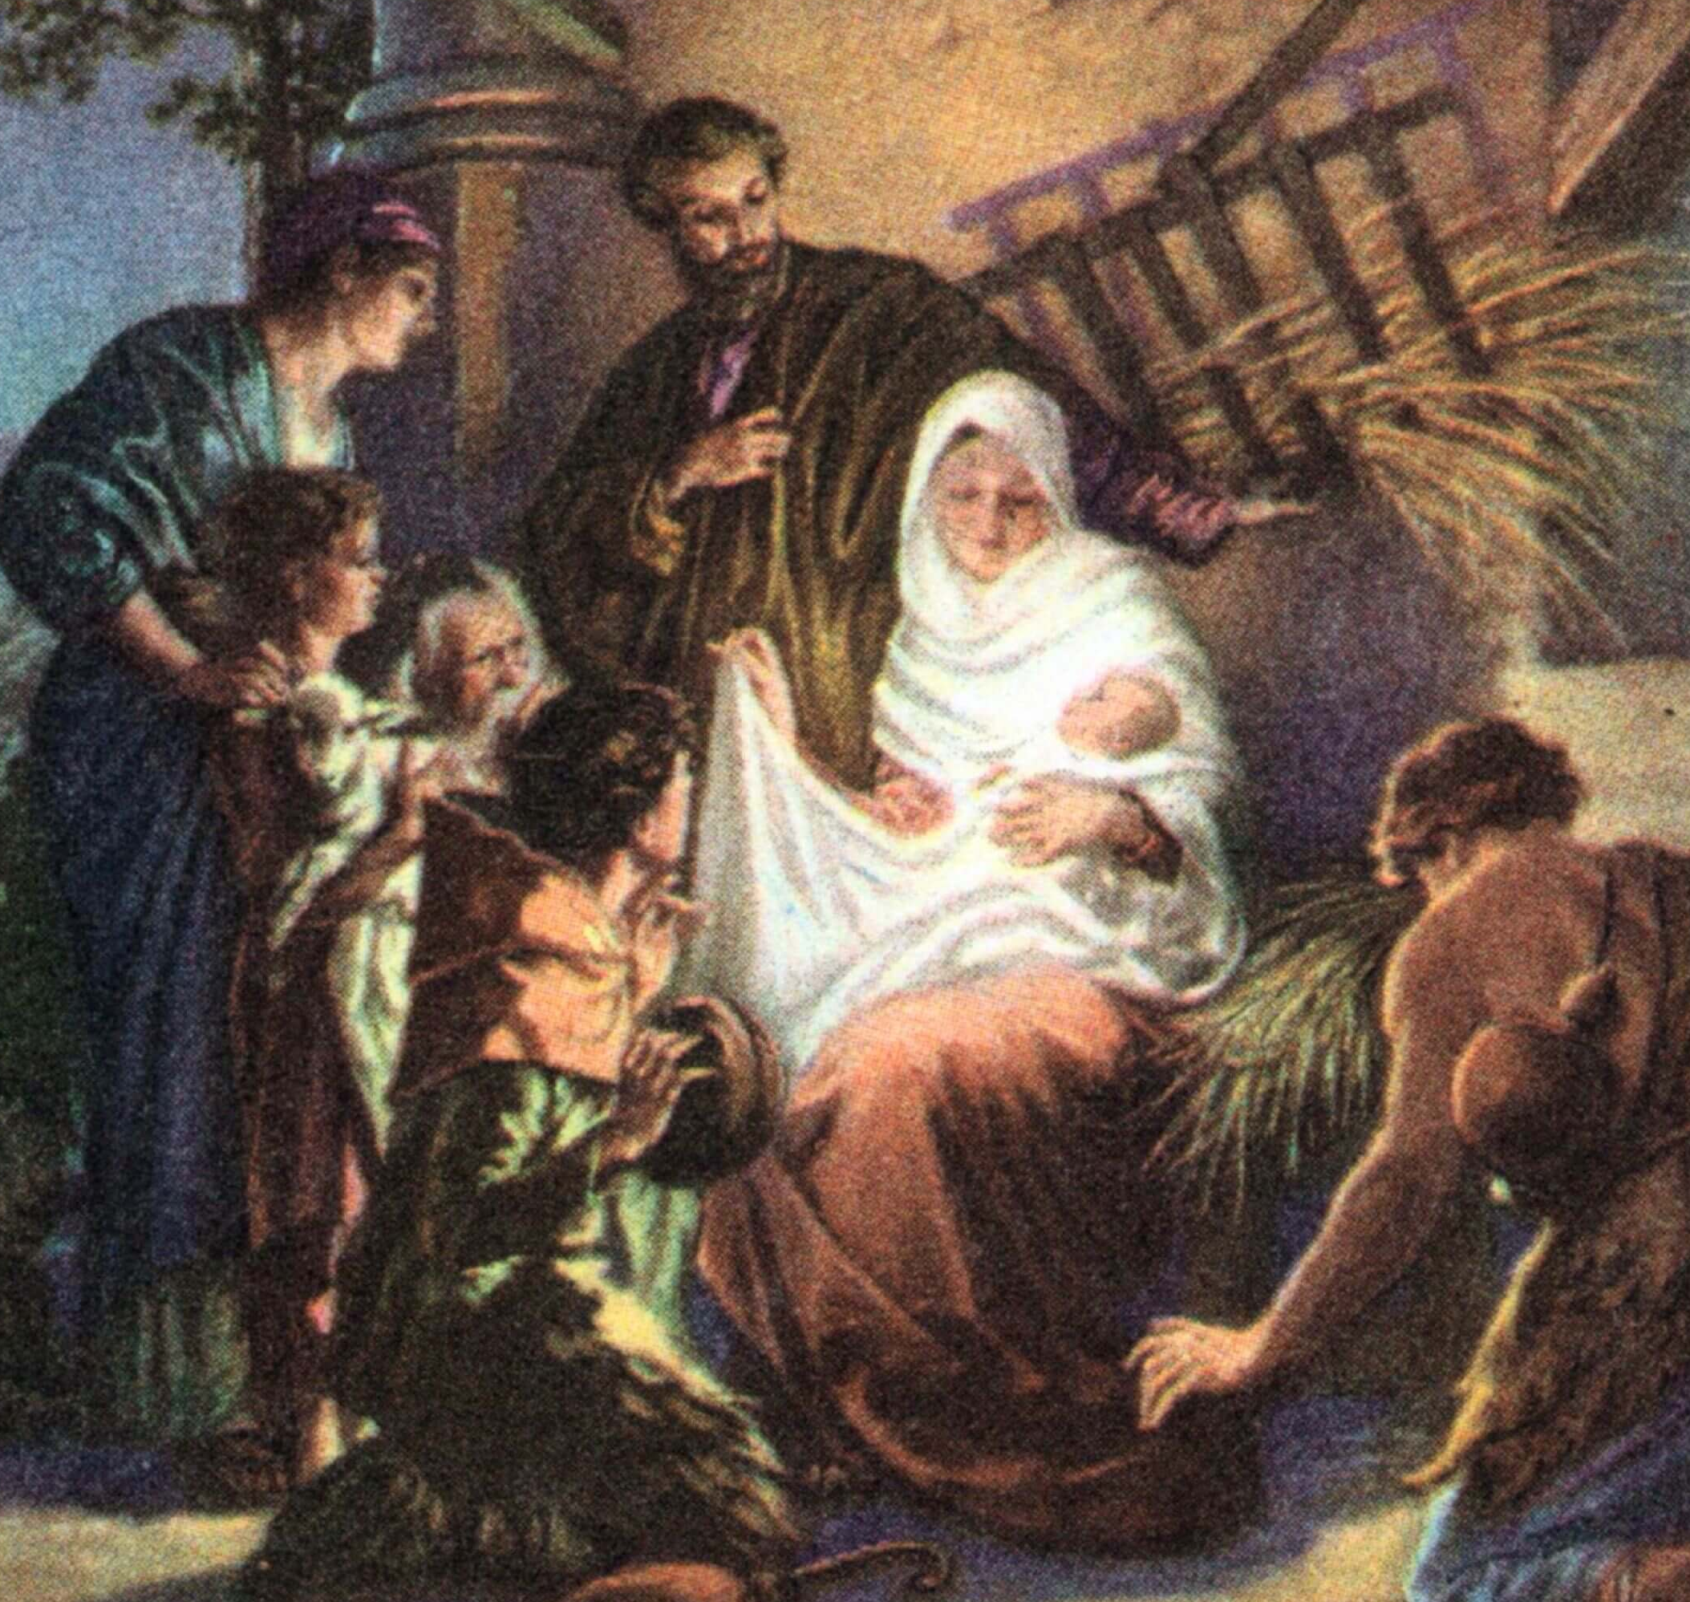

Matthew tells Joseph’s part of the story.
Joseph, who married Mary, was the great, great (28 greats) grandson of King David and a great⁴² grandson of Abraham
Read about it in Matthew 1
⁷ So there were 14 generations from Abraham to David. There were 14 from David until the Jewish people were forced to go away to Babylon. And there were 14 from that time to the Messiah.
I’ll write a book about Jesus.

Slide 21
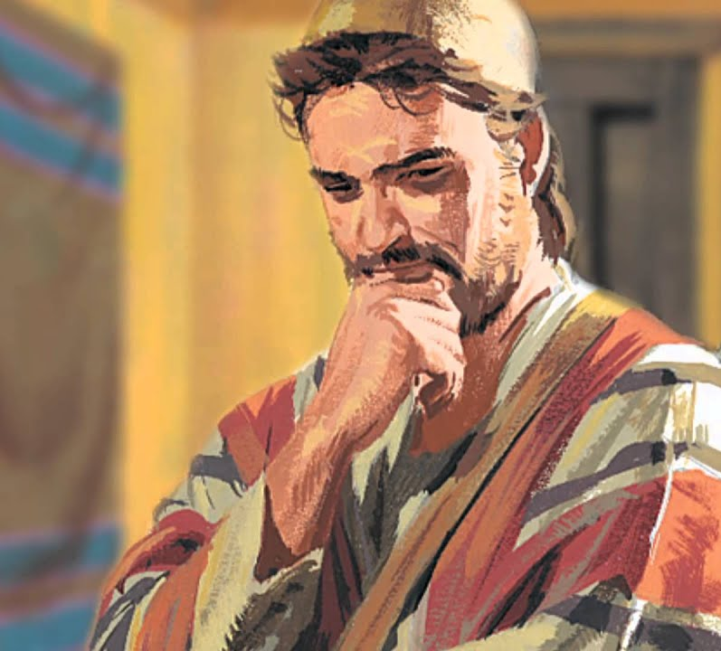
Joseph thinks about what to do
I’m so glad Mary is back!
She has been gone 3 long months,
and now she is pregnant. Who is the father?
It wasn’t me. It looks like Mary broke our promise.
Matthew 1:
¹⁸ This is how the birth of Jesus the Messiah came about. His mother Mary and Joseph had promised to get married.
But before they started to live together, it became clear that she was going to have a baby. She became pregnant by the power of the Holy Spirit.
¹⁹ Her husband Joseph was faithful to the law. But he did not want to put her to shame in public. So he planned to divorce her quietly.
²⁰ But as Joseph was thinking about this,
What shall I do?
I don’t want to shame her.
But, I want to keep the law.
I will divorce her quietly.

Slide 22
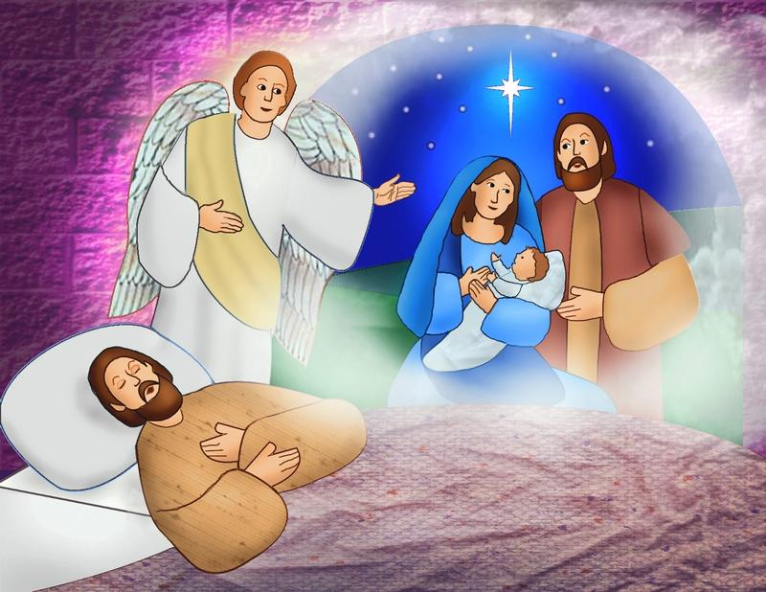
Joseph has a dream
Son of David,
Don’t be afraid to take Mary home as your wife.
The baby is from the Holy Spirit.
Matthew 1
²⁰ But as Joseph was thinking about this, an angel of the Lord appeared to him in a dream.
The angel said, “Joseph, son of David, don’t be afraid to take Mary home as your wife. The baby inside her is from the Holy Spirit. ²¹ She is going to have a son. You must give him the name Jesus. That’s because he will save his people from their sins.”
Name the baby “Jesus”
He will save people from their sins.

Slide 23
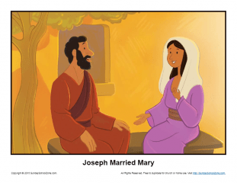
Joseph married Mary
Come, be my wife.
I will take care of you.
I’m so happy Joseph!
Our baby is Immanuel,
God is with us!
Matthew 1
²² All this took place to bring about what the Lord had said would happen. He had said through the prophet, ²³ “The virgin is going to have a baby. She will give birth to a son. And he will be called Immanuel.” (Isaiah 7:14) The name Immanuel means “God with us.”
²⁴ Joseph woke up. He did what the angel of the Lord commanded him to do. He took Mary home as his wife. ²⁵ But he did not sleep with her until she gave birth to a son. And Joseph gave him the name Jesus.
That is amazing!
God is willing to come be with us, as our baby!
I want to be a good daddy to him!
His name will be Jesus and He will save us from our sins. What a honor to be his parents!

Slide 24

^{Luke 1:38}
“I serve the Lord,”
Mary answered.
“May it happen to me just as you said it would.”

Slide 25
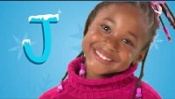
SING Christmas Carols
NEW Joy to the World

Slide 26

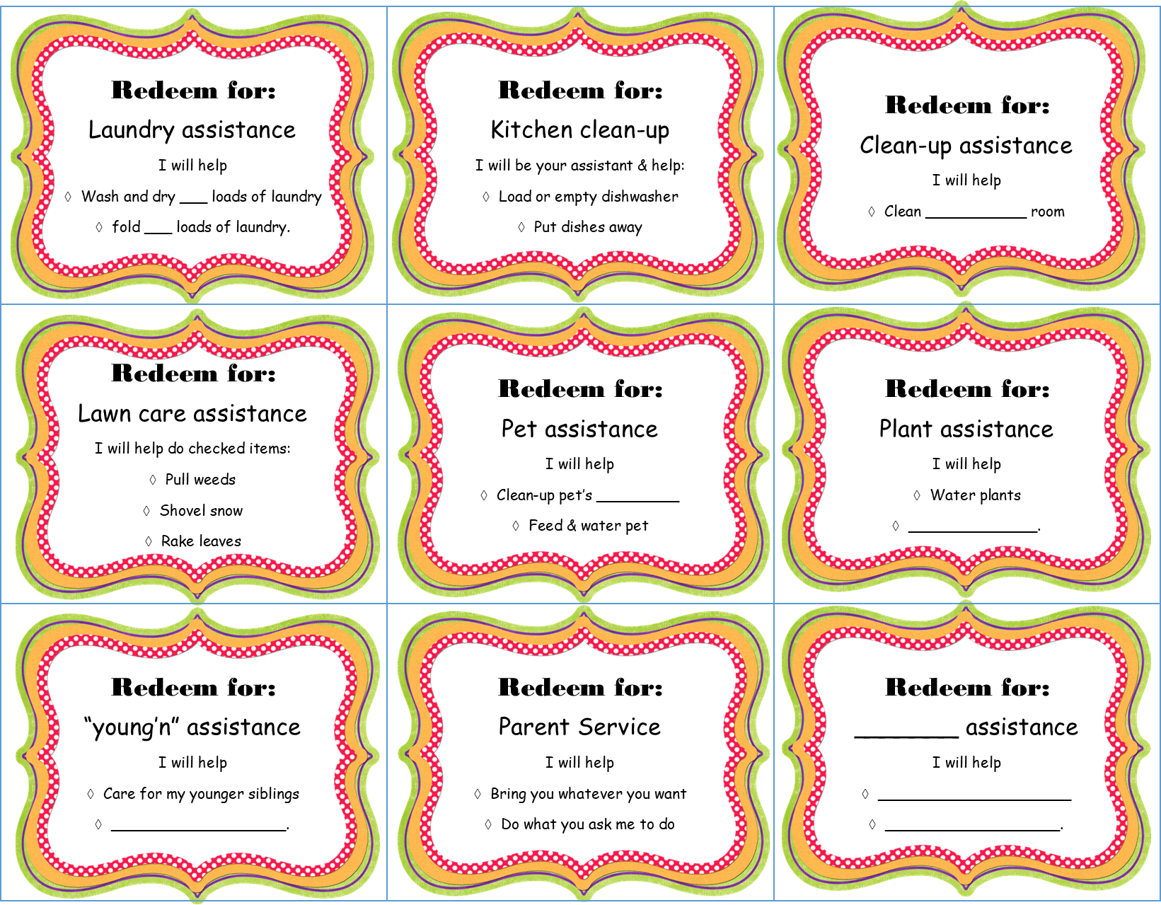
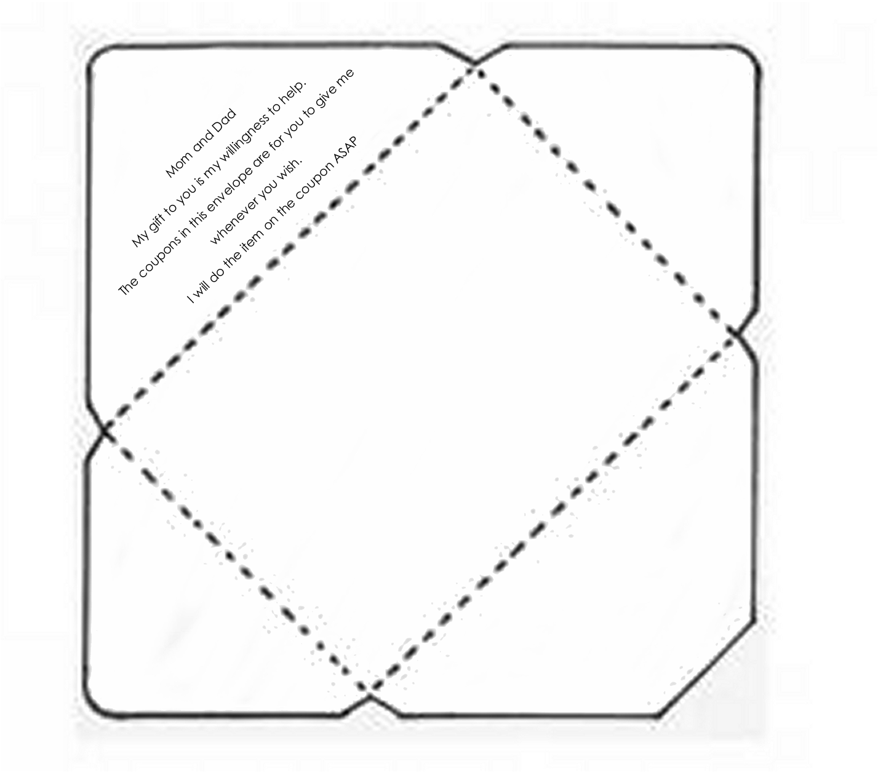
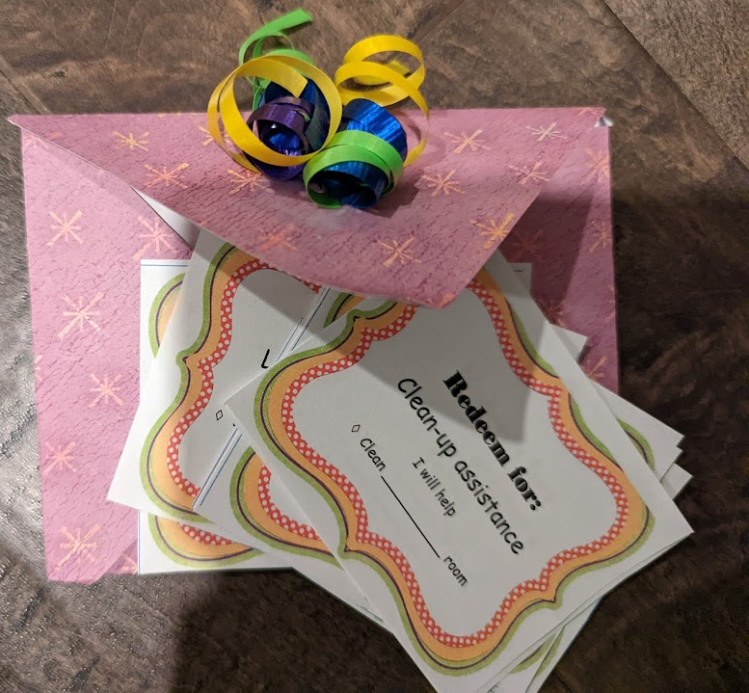
CRAFT TiME option 2
My gift to you
Is my willingness
We’re going to decorate a coupon envelope.
In it you can place coupons
of things that you are willing to do.
Someone can draw out a coupon.
It will be a special gift to them
for you to do what it says on the coupon.

Slide 27


Mary and Joseph were willing.
They said yes to being Jesus’ parents.
Are you willing?
My gift
to you

Slide 28
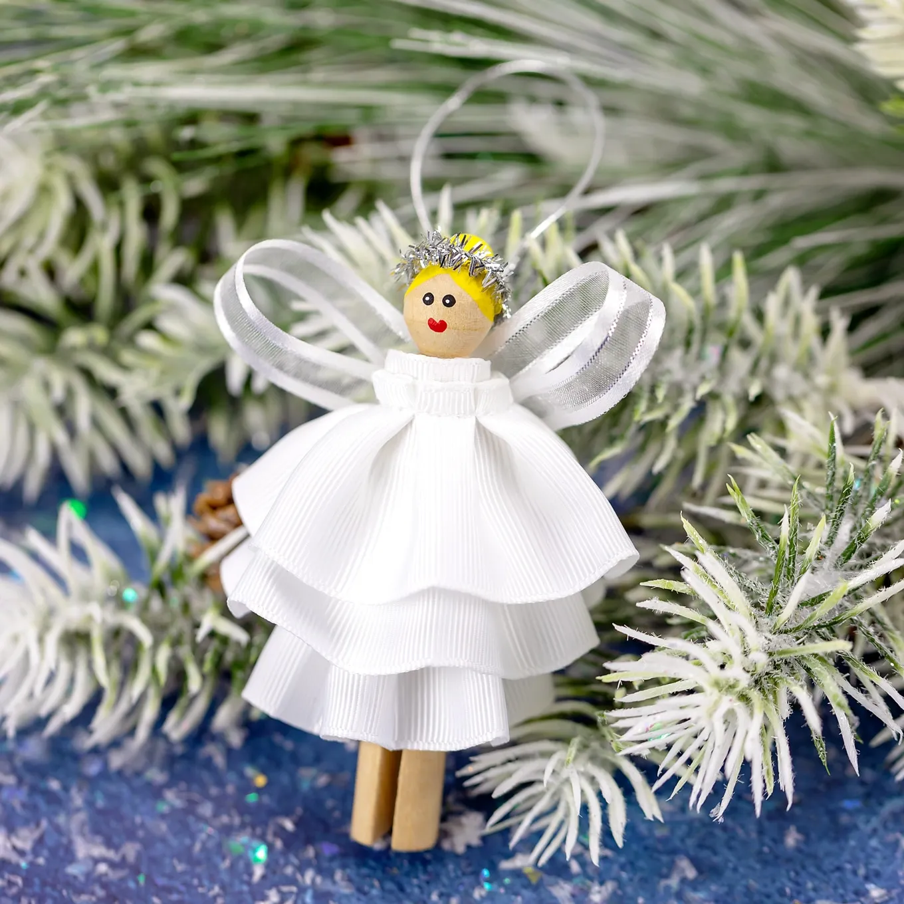
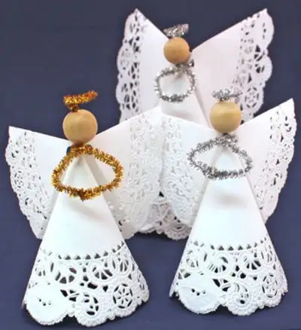


Craft Time
Additional or optional craft: An angel
Click on the picture for directions on how to make the angel.
Or color an angel and use it to decorate a box or envelope for the coupons.
https://discover.hubpages.com/art/how-to-make-christmas-angel-crafts

Slide 29
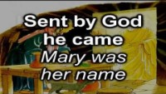
SING Christmas Carols
The Angel Gabriel

Slide 30

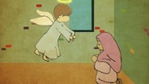
Short version of Story

Slide 31
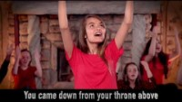
SING Christmas Carols
Emanuel God is with Us All Year Long

Slide 32
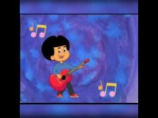
SING Christmas Carols
Emanuel – Advent Song for kids

Slide 33
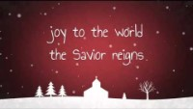
SING Christmas Carols
Joy to the World

Slide 34

SING Christmas Carols
Angels We Have Heard on High

Slide 35

SING Christmas Carols
Emanuel God is with Us All Year Long

Slide 36

SING Christmas Carols
Go Tell It On the Mountain

Slide 37
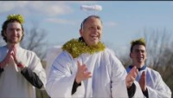
The rest of the story

Slide 38

https://activity-array.com/

