Slide 1
Baby born in Bethlehem
Angels announce
Baby Jesus is born!
Luke 2
Our Savior is here!

Slide 2

Ready to GO
What do you do to get ready to go somewhere?

Slide 3
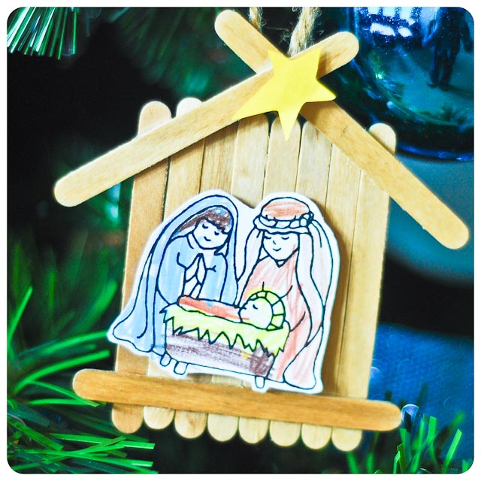
Craft PART 1
Line up 8 sticks side by side
Glue 1 stick across the bottom
Glue 2 sticks for the roof

Slide 4
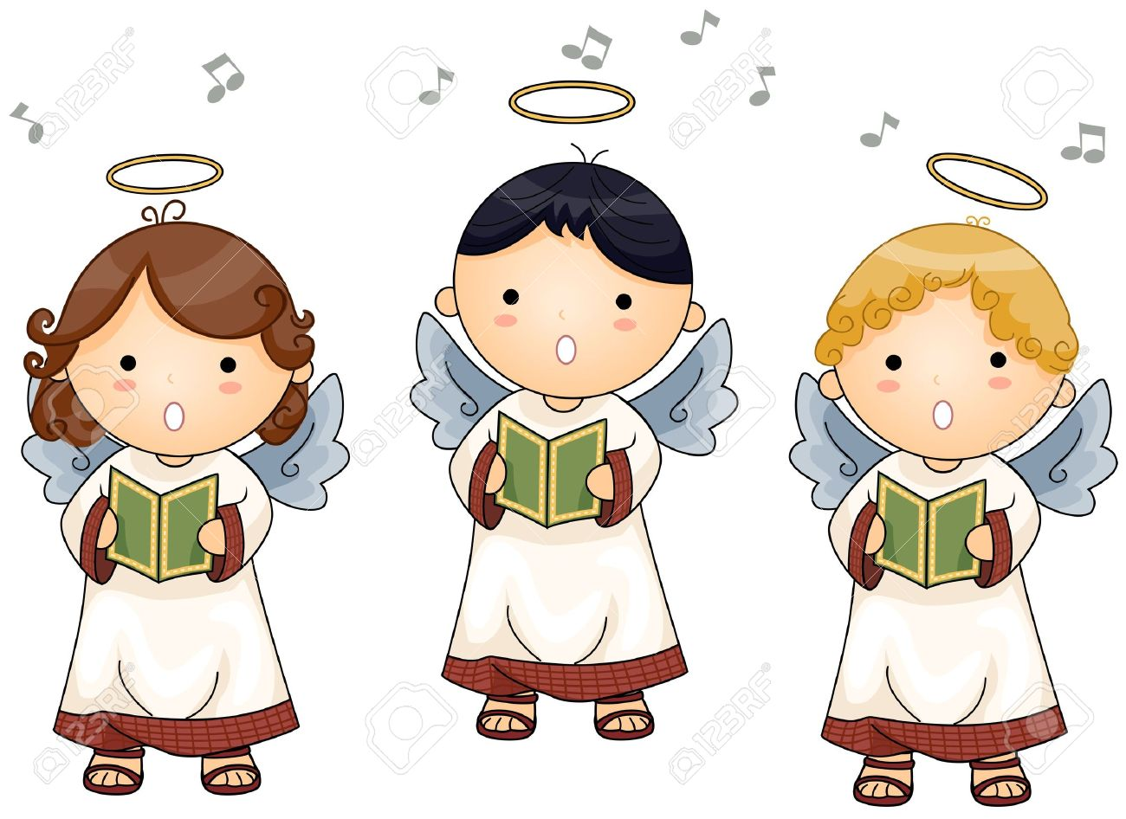

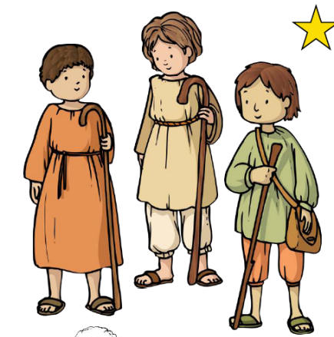
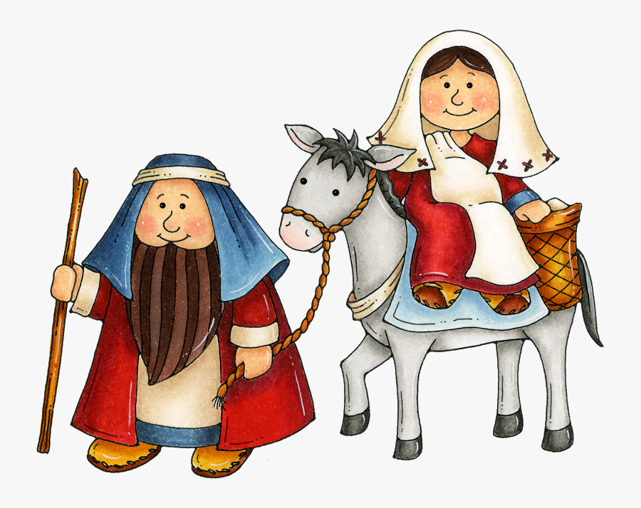
You can be part of our story today
Choose a part to act out:
Joseph
Mary (& doll)
Innkeeper/villagers
Shepherd (& sheep) [1+ more]
Angel [1 +many]

Slide 5
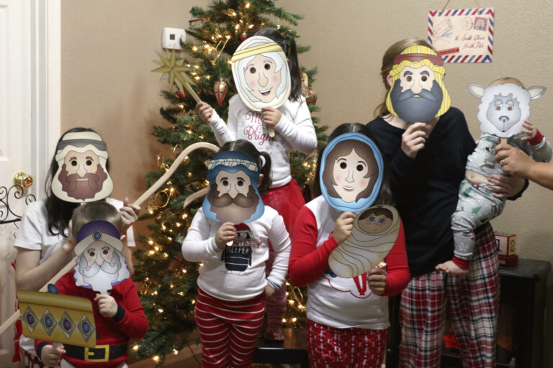
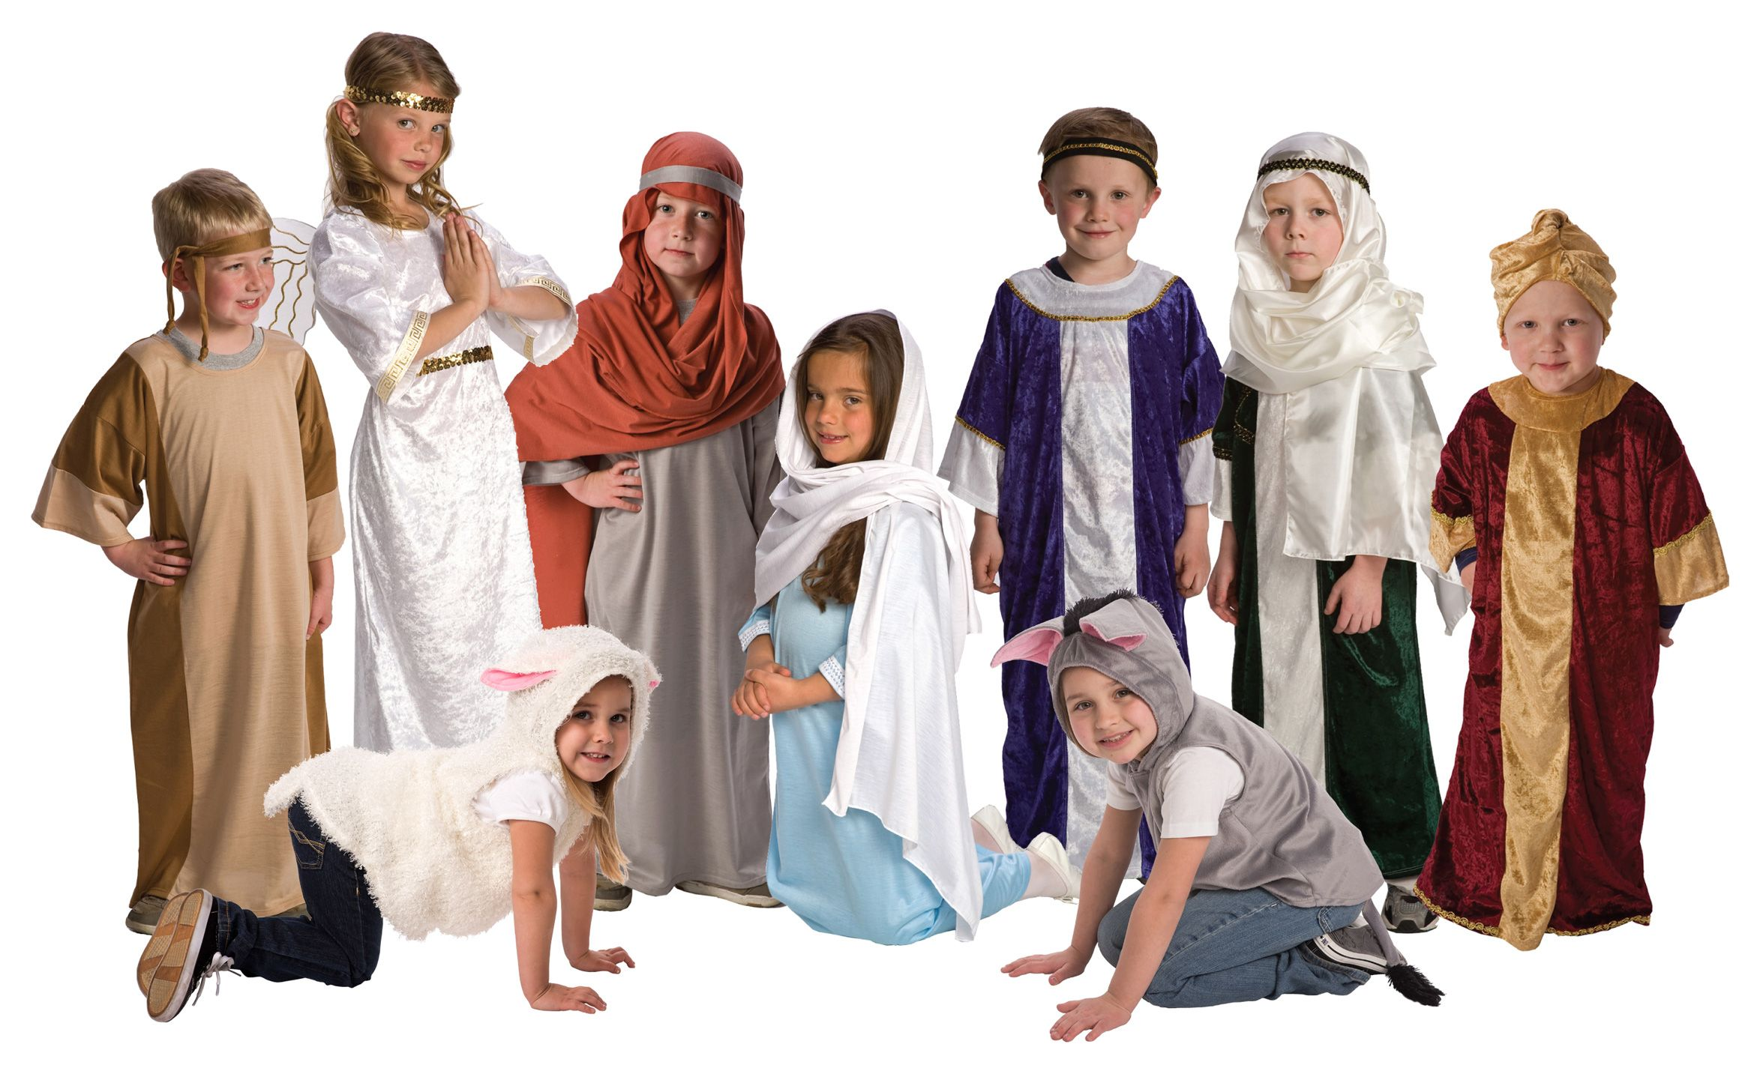
Characters Get Ready
Put on a costume or mask
Print free masks from the dating divas.

Slide 6
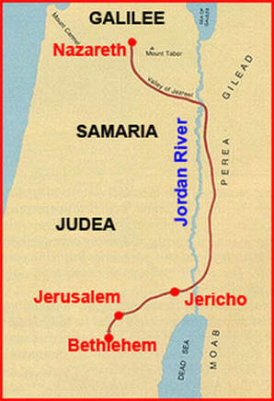
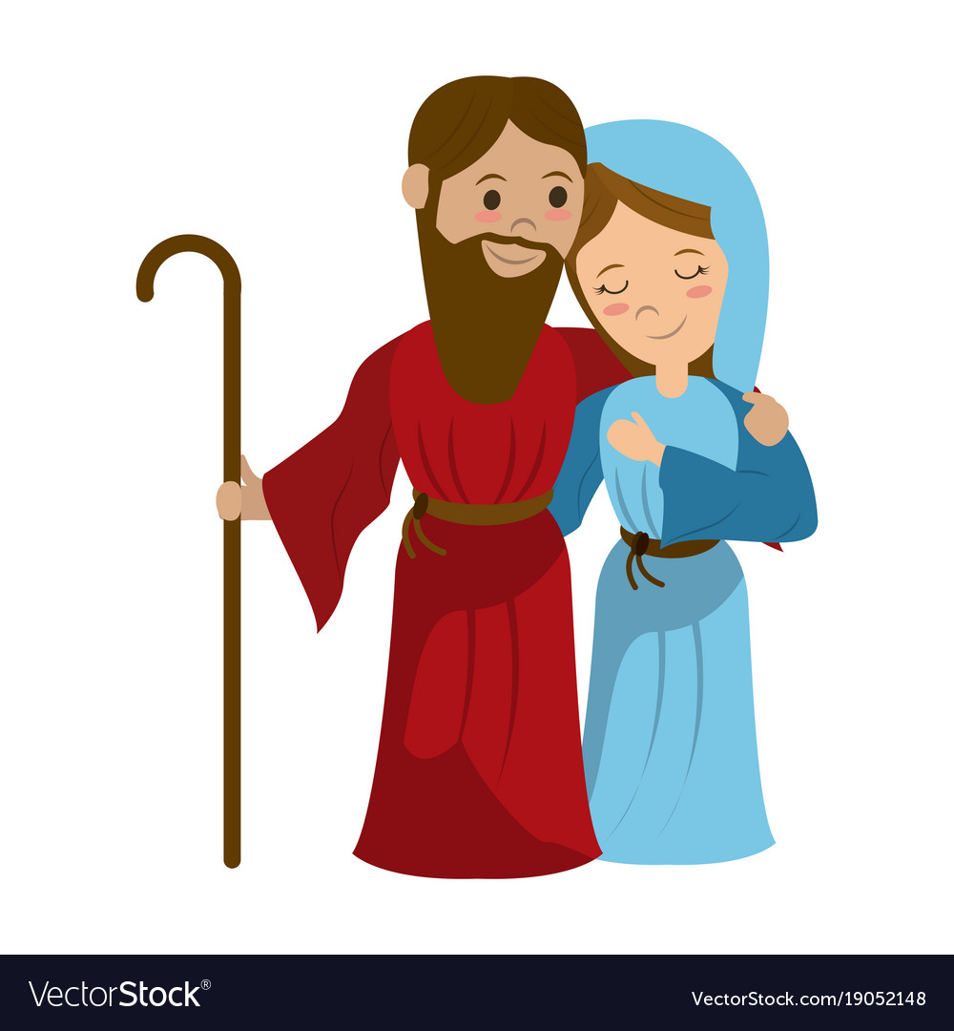
Luke 2
The governor says we have to go to Bethlehem to pay taxes.
That is such a long way!
90 miles!
I will get our things ready.
2 In those days, Caesar Augustus made a law. It required that a list be made of everyone in the whole Roman world. ² It was the first time a list was made of the people while Quirinius was governor of Syria. ³ Everyone went to their own town to be listed.
⁴ So Joseph went also. He went from the town of Nazareth in Galilee to Judea. That is where Bethlehem, the town of David, was. Joseph went there because he belonged to the family line of David. ⁵ He went there with Mary to be listed. Mary was engaged to him. She was expecting a baby.

Slide 7
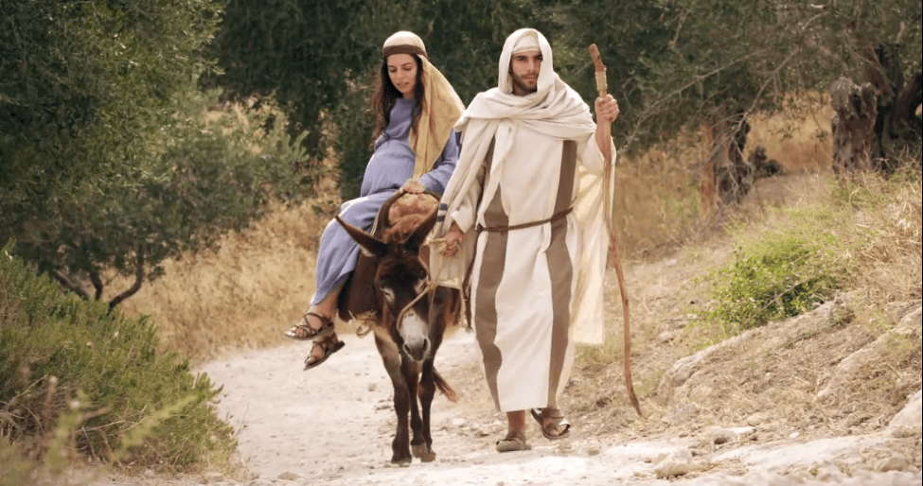
Luke 2
⁴ So Joseph went also. He went from the town of Nazareth in Galilee to Judea. That is where Bethlehem, the town of David, was. Joseph went there because he belonged to the family line of David. ⁵ He went there with Mary to be listed. Mary was engaged to him. She was expecting a baby.

Slide 8
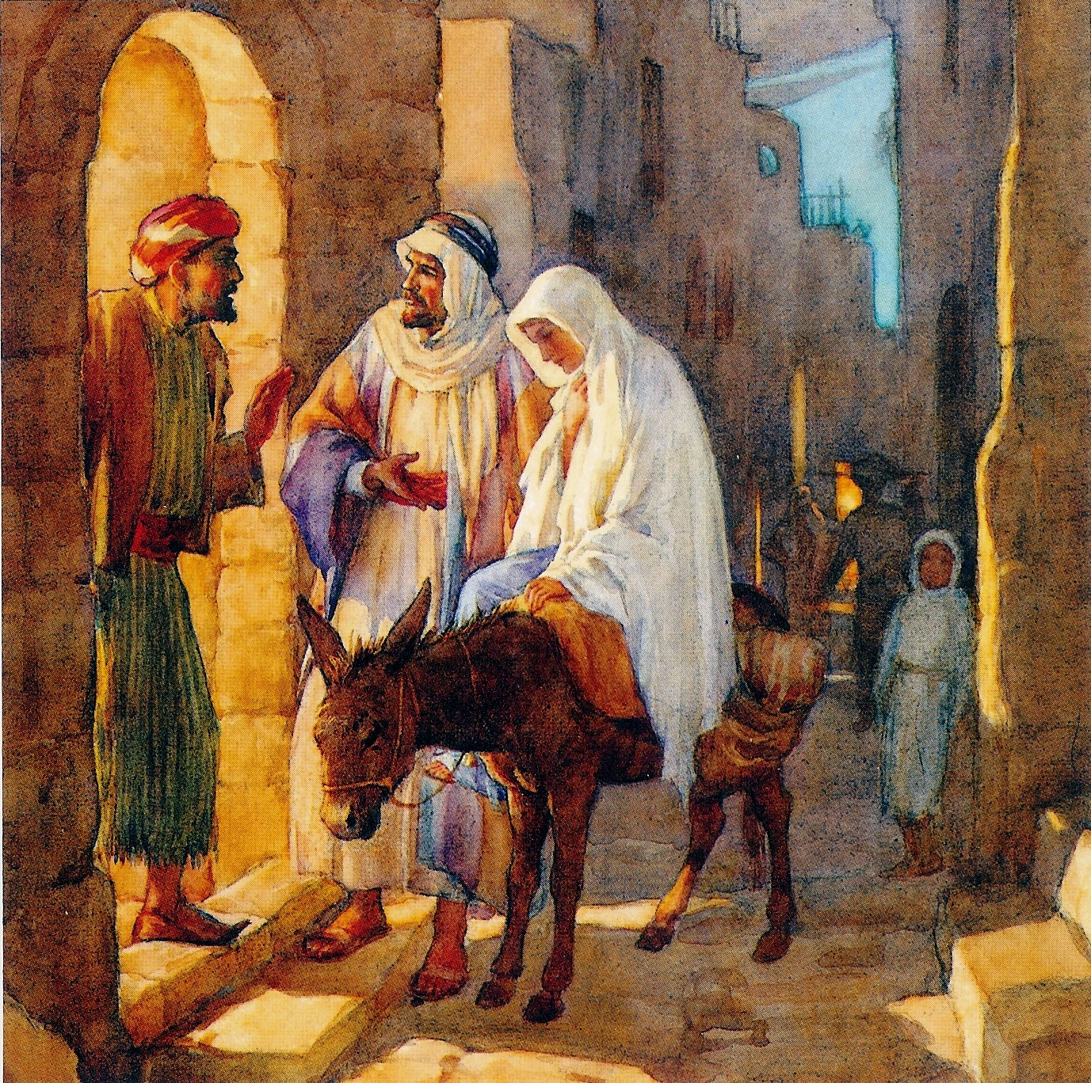
No room in the inn
We need a place to sleep.
Do you have a room?
No. I don’t have a room. We are full!

Slide 9
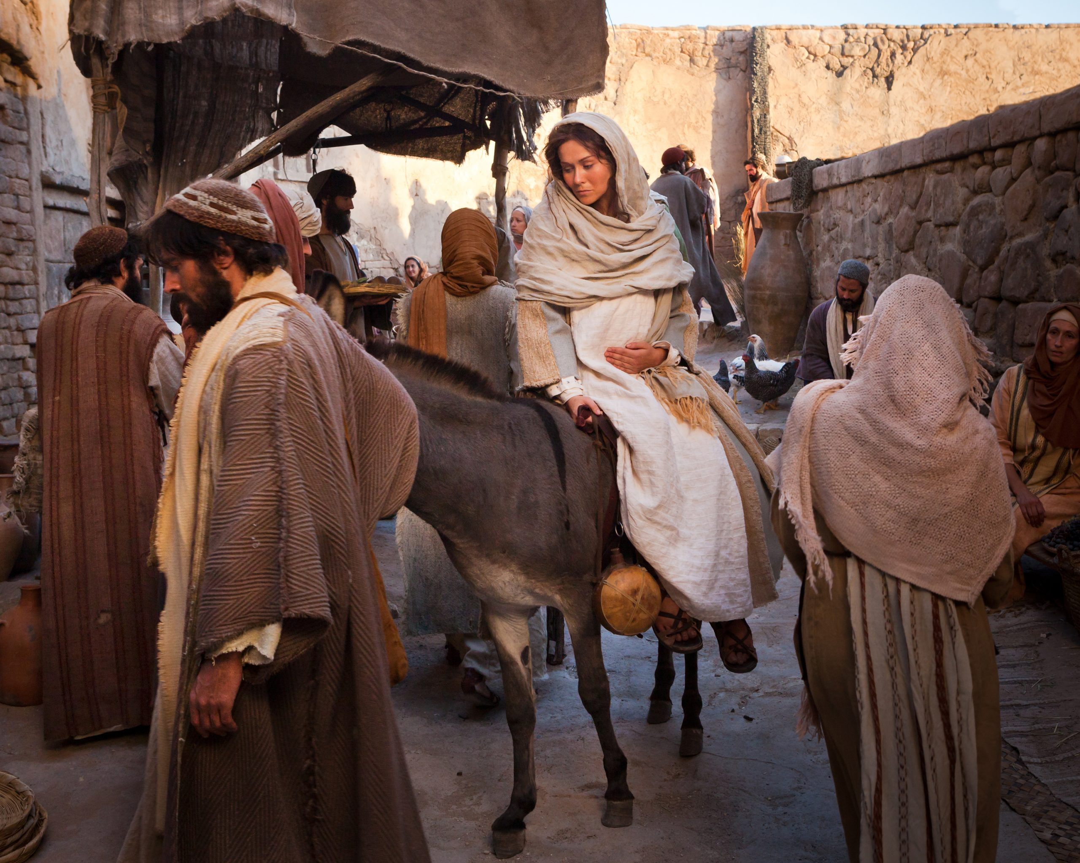
No room in the inn
There are so many people!
All the places are full!
Where shall we sleep?
We will keep looking.
God will provide.

Slide 10
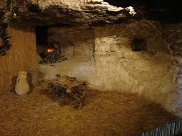
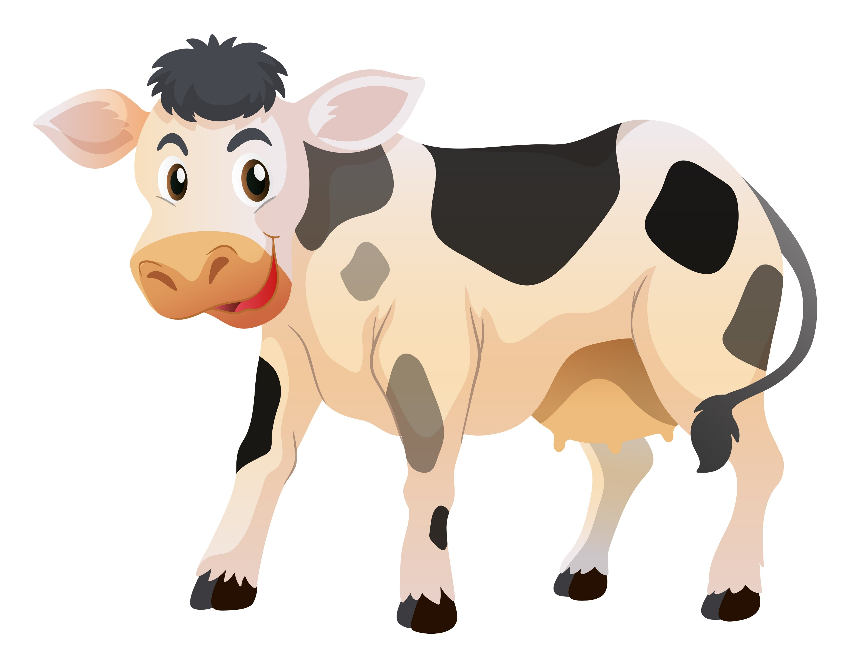
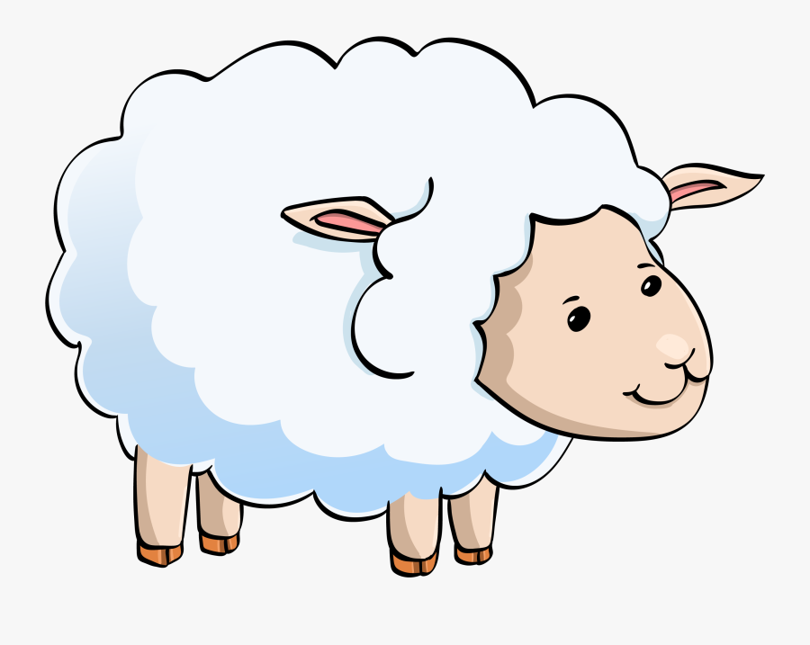
Here is a stable.
At least it is warm and dry.

Slide 11
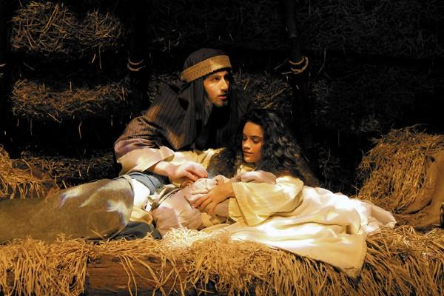
Luke 2
.Can you imagine.
God’s Son born in a stable?
Jesus
He is so precious!
A special gift from God!
⁶ While Joseph and Mary were there, the time came for the child to be born. ⁷ She gave birth to her first baby. It was a boy. She wrapped him in large strips of cloth. Then she placed him in a manger. That’s because there was no guest room where they could stay.

Slide 12
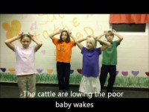
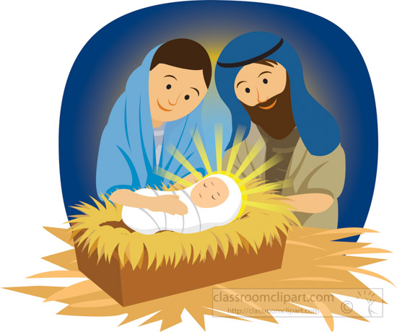
Sing Away in the Manger

Slide 13
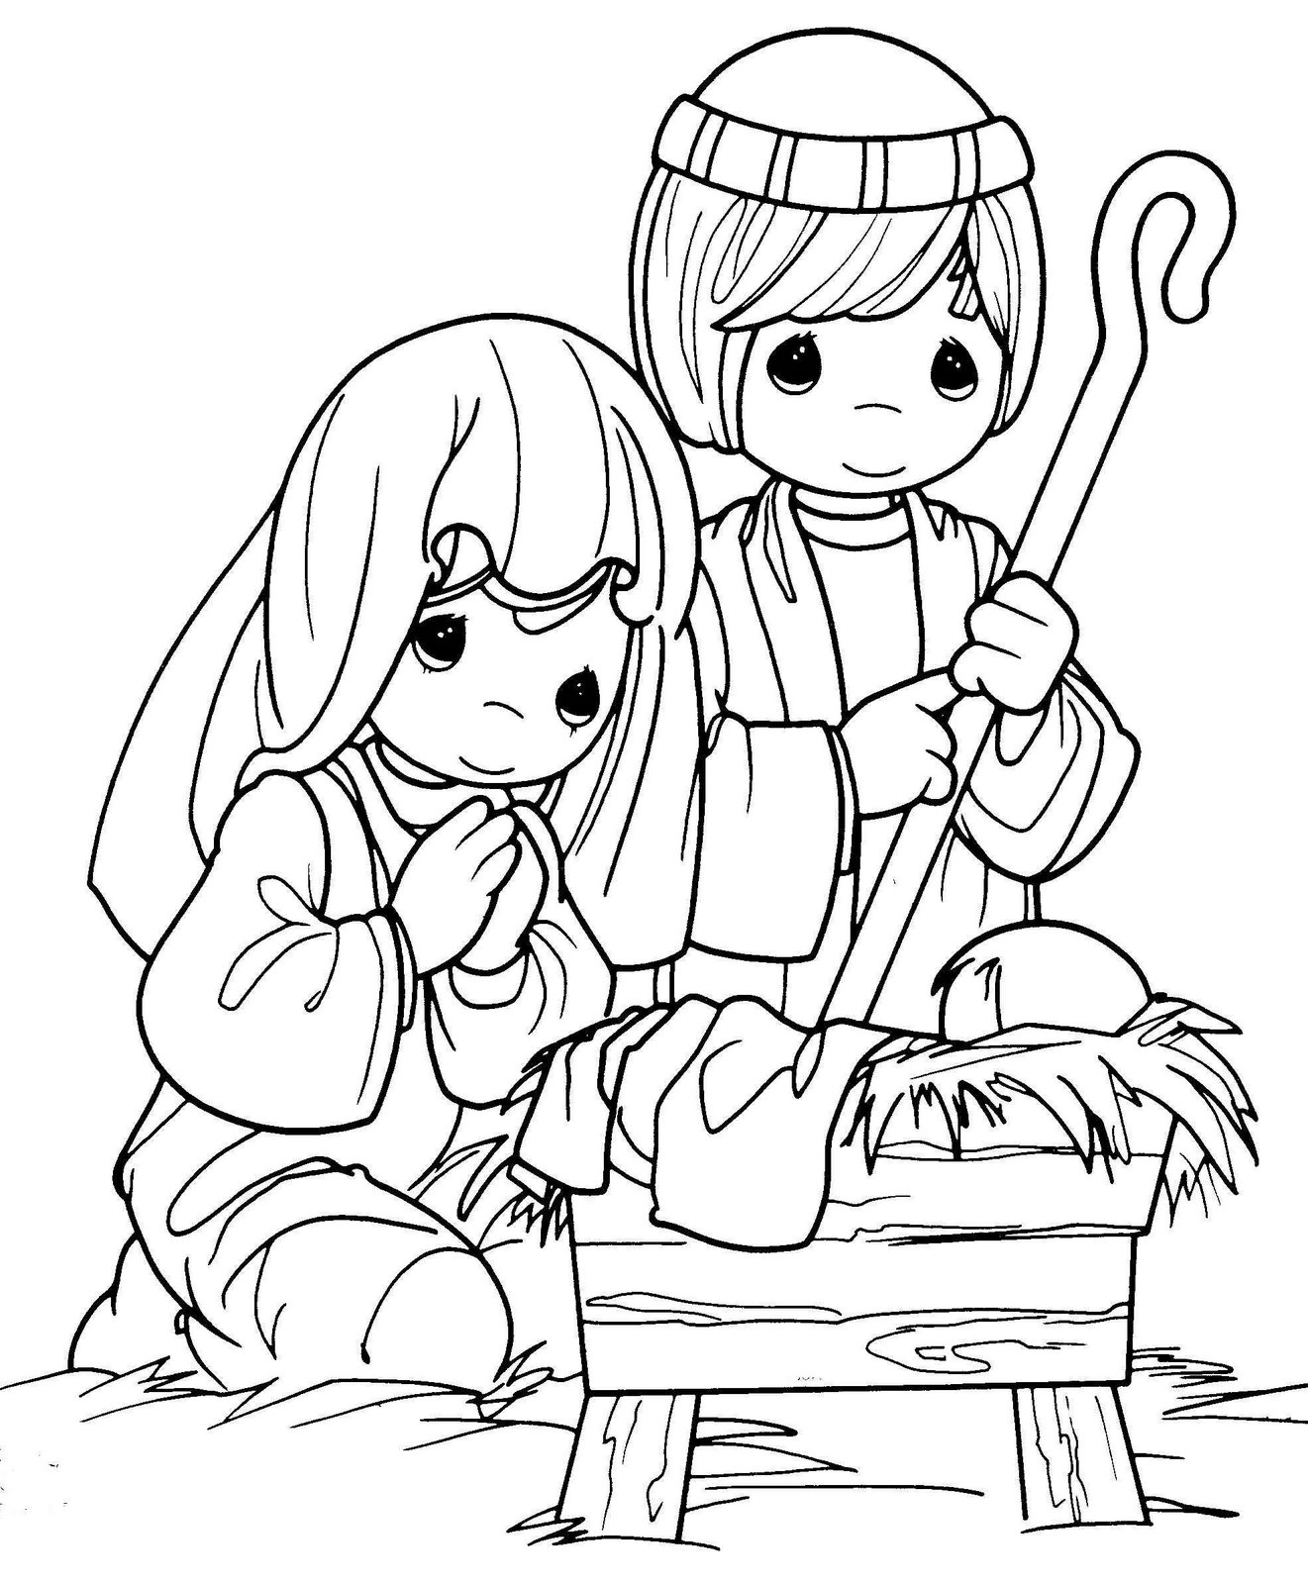
Craft PART 2
Color and cut out a nativity picture.
Glue on a picture of Mary, Joseph, and Baby Jesus
Glue on a star

Slide 14
Sing Away in the Manger

Slide 15
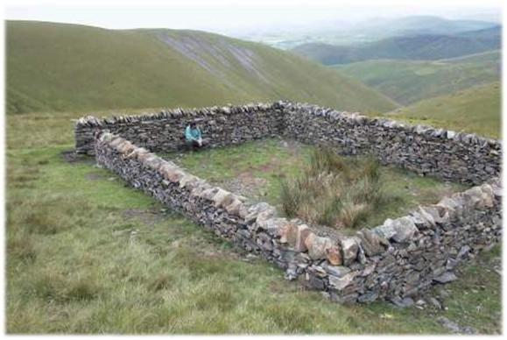
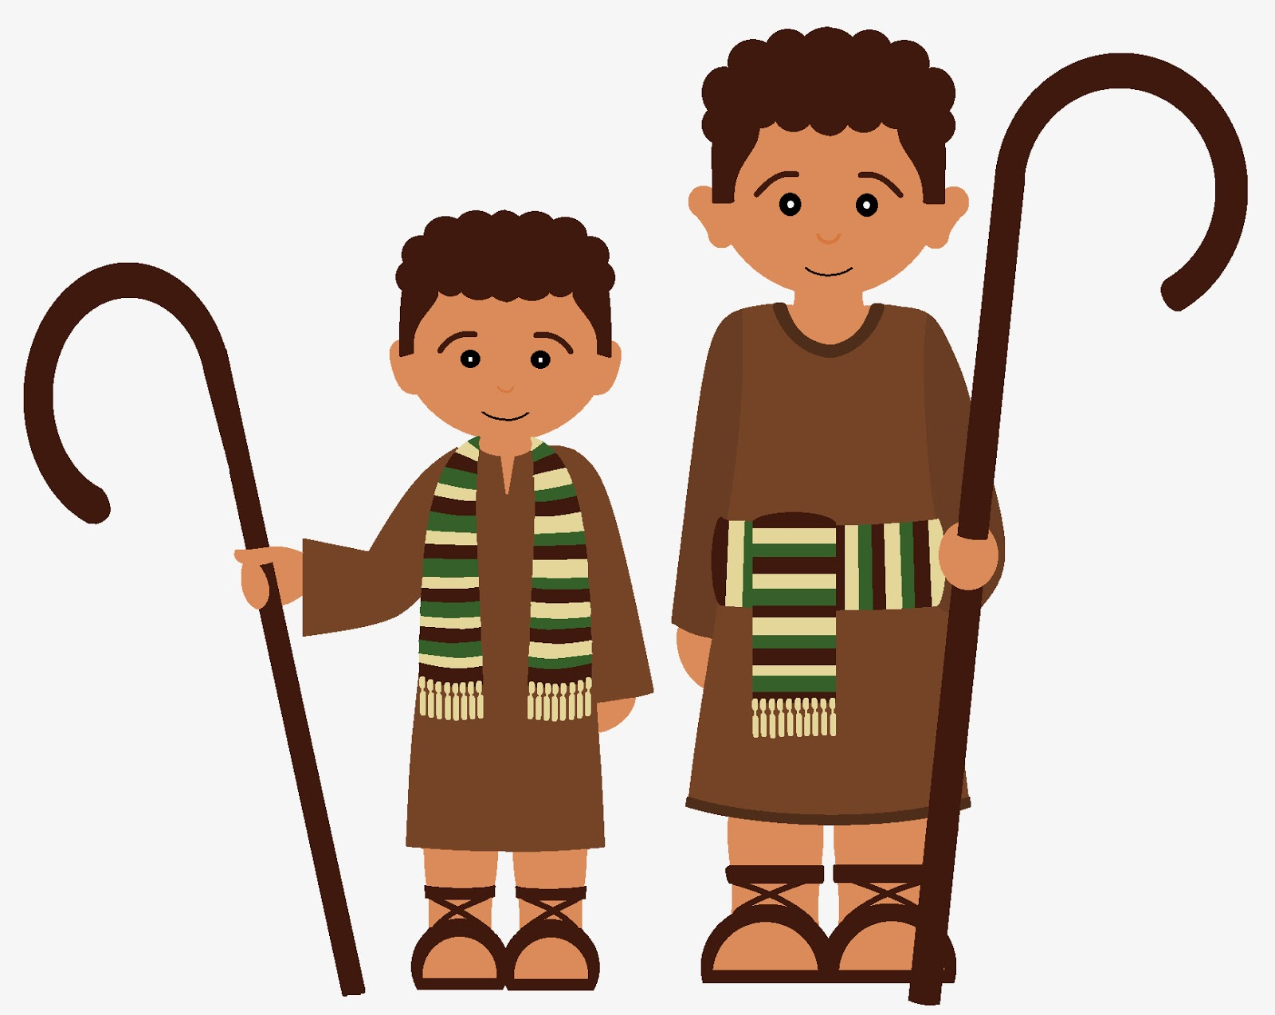
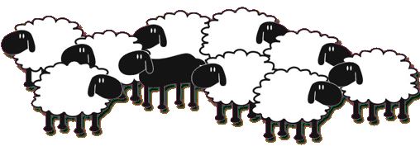

Luke 2
⁸ There were shepherds living out in the fields nearby. It was night, and they were taking care of their sheep
I’ve been wondering when the Messiah will come.
The sheep are all counted and safe in the sheep pen.
It’s a beautiful night!

Slide 16
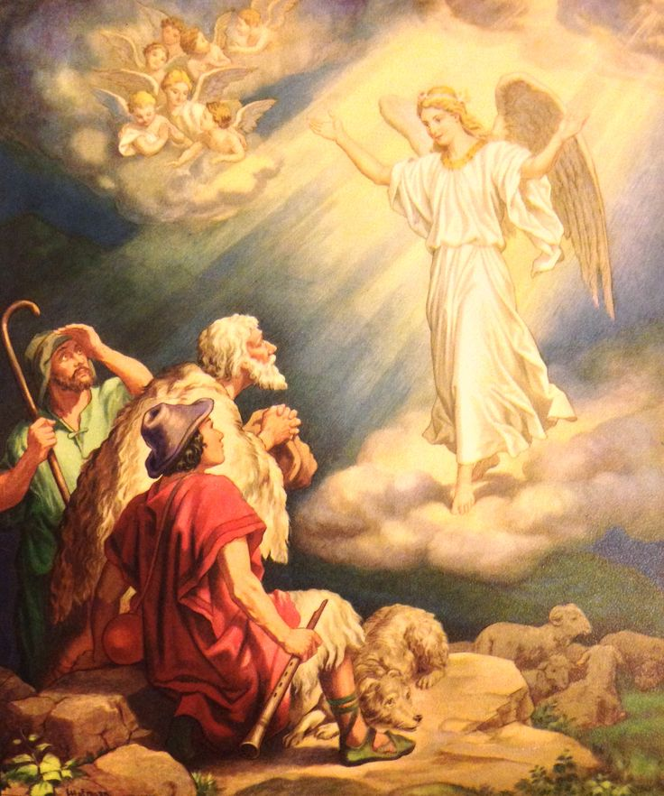
Luke 2
Do not be afraid.
I bring you good news!
It will bring joy to everyone!
⁹ An angel of the Lord appeared to them. And the glory of the Lord shone around them. They were terrified.
¹⁰ But the angel said to them, “Do not be afraid. I bring you good news. It will bring great joy for all the people. ¹¹ Today in the town of David a Savior has been born to you. He is the Messiah, the Lord.
¹² Here is how you will know I am telling you the truth. You will find a baby wrapped in strips of cloth and lying in a manger.”
Today in the town of David, Bethlehem,
a baby has been born.
He is the Savior!
You will find him wrapped in strips of cloth, lying in a manger.

Slide 17
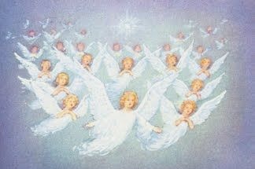
Gloria! Praise God!
Gory to God
in the highest heaven!
Peace. Goodwill to all!
¹³ Suddenly a large group of angels from heaven also appeared. They were praising God. They said,
¹⁴ “May glory be given to God in the highest heaven!
And may peace be given to those he is pleased with on earth!”

Slide 18
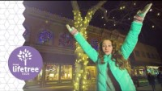
Sing Hark the Heralds Angels Sing

Slide 19

Sing Joy to the World

Slide 20
Luke 2
⁸¹⁵ The angels left and went into heaven. Then the shepherds said to one another, “Let’s go to Bethlehem. Let’s see this thing that has happened, which the Lord has told us about.”
Let’s go find the baby!
The Messiah Savior
has come!
WOW!

Slide 21
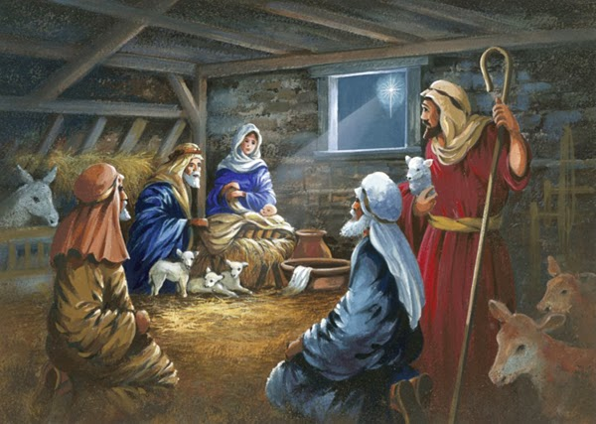
Luke 2
¹⁶ So they hurried off and found Mary and Joseph and the baby. The baby was lying in the manger.
This is Jesus.
Come in.
Jesus!
Our Savior!
Praise God!
The Savior!
Praise God!
Angels told us that He was born and where to find Him!

Slide 22
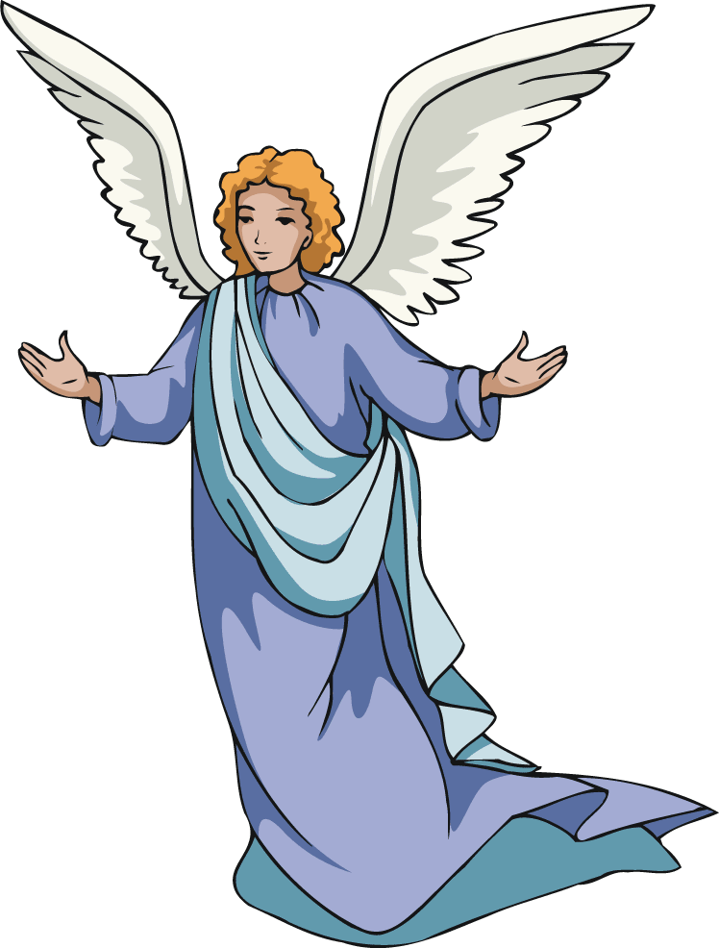
Craft PART 3
Turn it over and glue an angel on the back
Add a piece of string to hang your ornament.

Slide 23
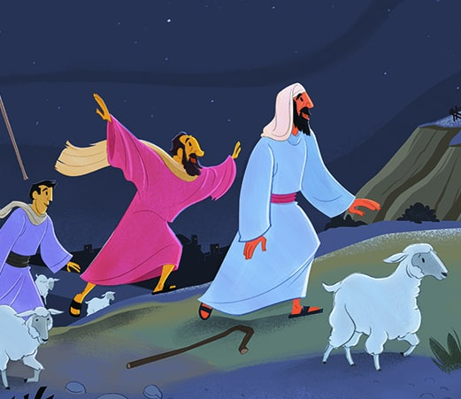
Luke 2
¹⁷ After the shepherds had seen him, they told everyone. They reported what the angel had said about this child. ¹⁸ All who heard it were amazed at what the shepherds said to them. ¹⁹ But Mary kept all these things like a secret treasure in her heart. She thought about them over and over. ²⁰ The shepherds returned. They gave glory and praise to God. Everything they had seen and heard was just as they had been told.
Have you heard?
Did you see the angel choir?
The Savior has been born!
The Savior has been born.
His name is Jesus.
The angels told us last night!

Slide 24
The shepherds were ready to receive Jesus as their Savior.
Are you?
The shepherds were excited to go tell others about Jesus!
Are you?

Slide 25
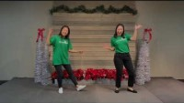
Sing Go Tell It on The Mountain

Slide 26

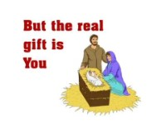
Let’s have a birthday party!

Slide 27
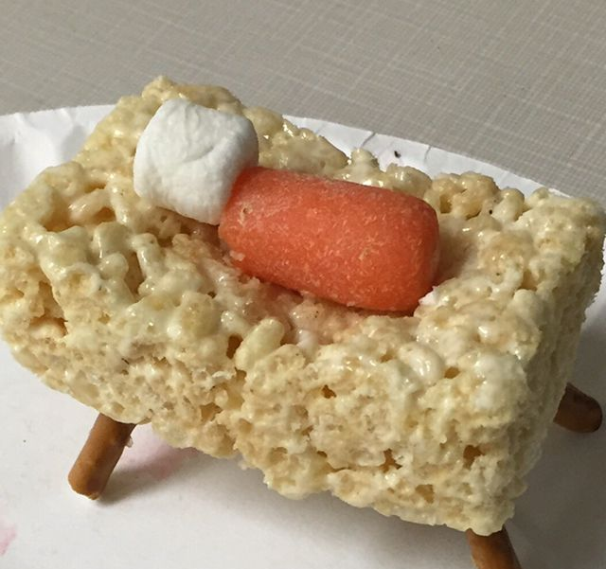

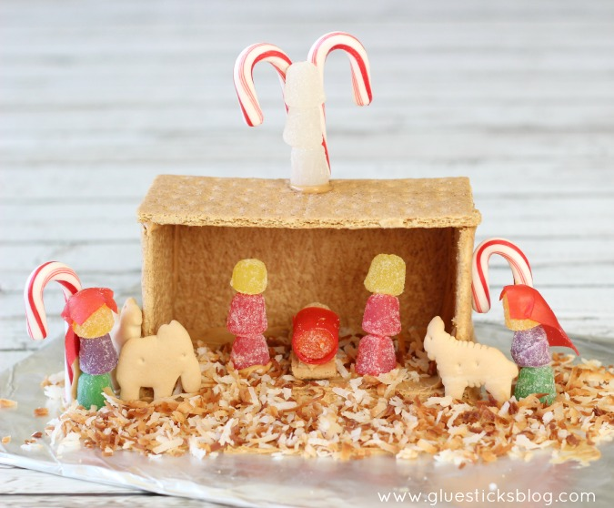
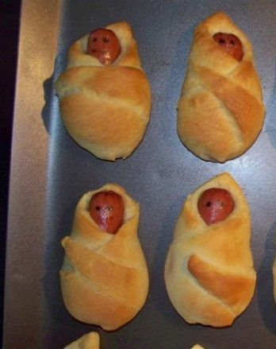
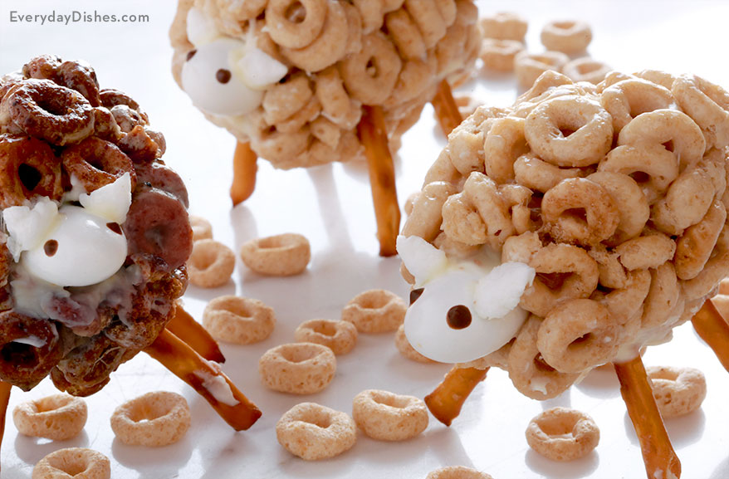
Ideas
Snack Time
https://gluesticksblog.com/honey-maid-graham-cracker-nativity-scene

Slide 28

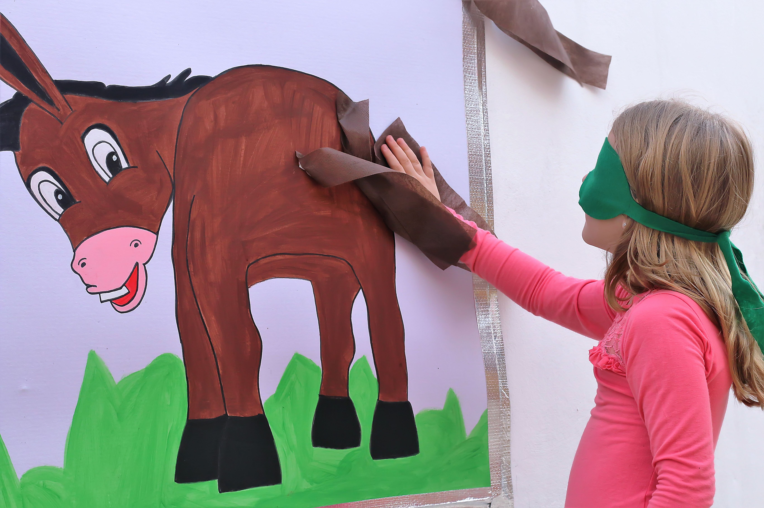
Pin the tail on the donkey
Game
Time
Zoom option:
Use your annotation.
Close your eyes and try to draw a tail on the donkey.
Can you get it in the right place.?
Play next 2 song during the game

Slide 29
Sing Away in the Manger

Slide 30
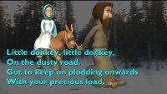
Sing Little Donkey

Slide 31
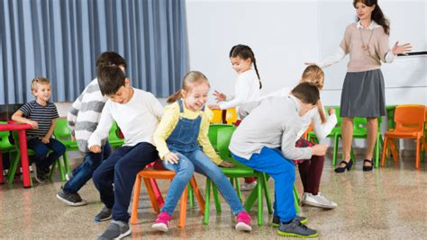
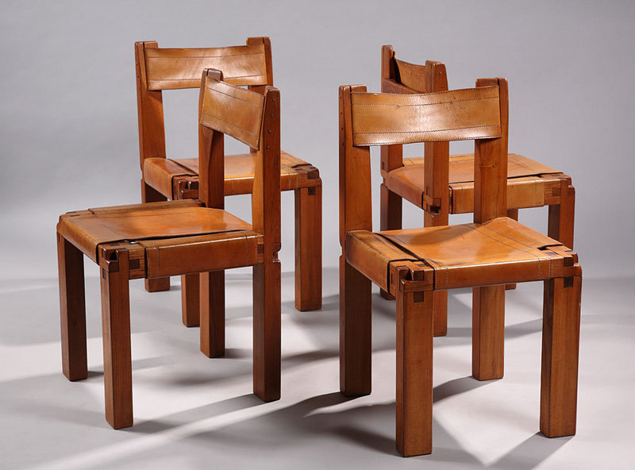
Musical Chairs
Play following music
Pause intermittently
If child has no chair, they are out and can: signal when to stop the music next then sing with music
Game Time

Slide 32
Sing Joy to the World

Slide 33
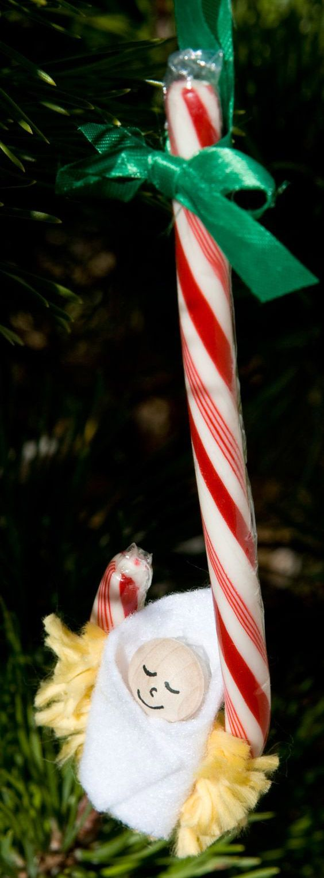
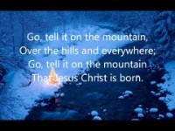
Go Tell It On The Mountain

Slide 34

Hark the Herald Angels Sing

Slide 35
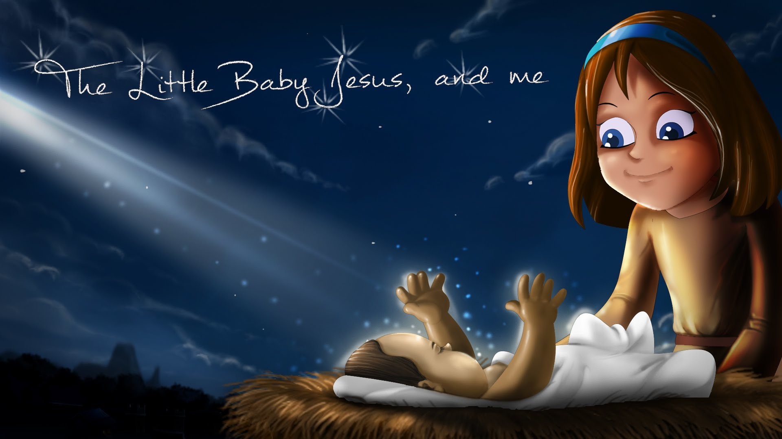

Open Gifts

Slide 36
Sing Away in the Manger

Slide 37
Sing Joy to the World

Slide 38
Sing Go Tell It on The Mountain

Slide 39

https://activity-array.com/

