Slide 1
WIDOW OF NAIN
Luke 7:11-17

Slide 2
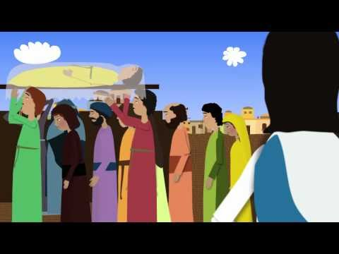
Young man,
Get up!

Slide 3
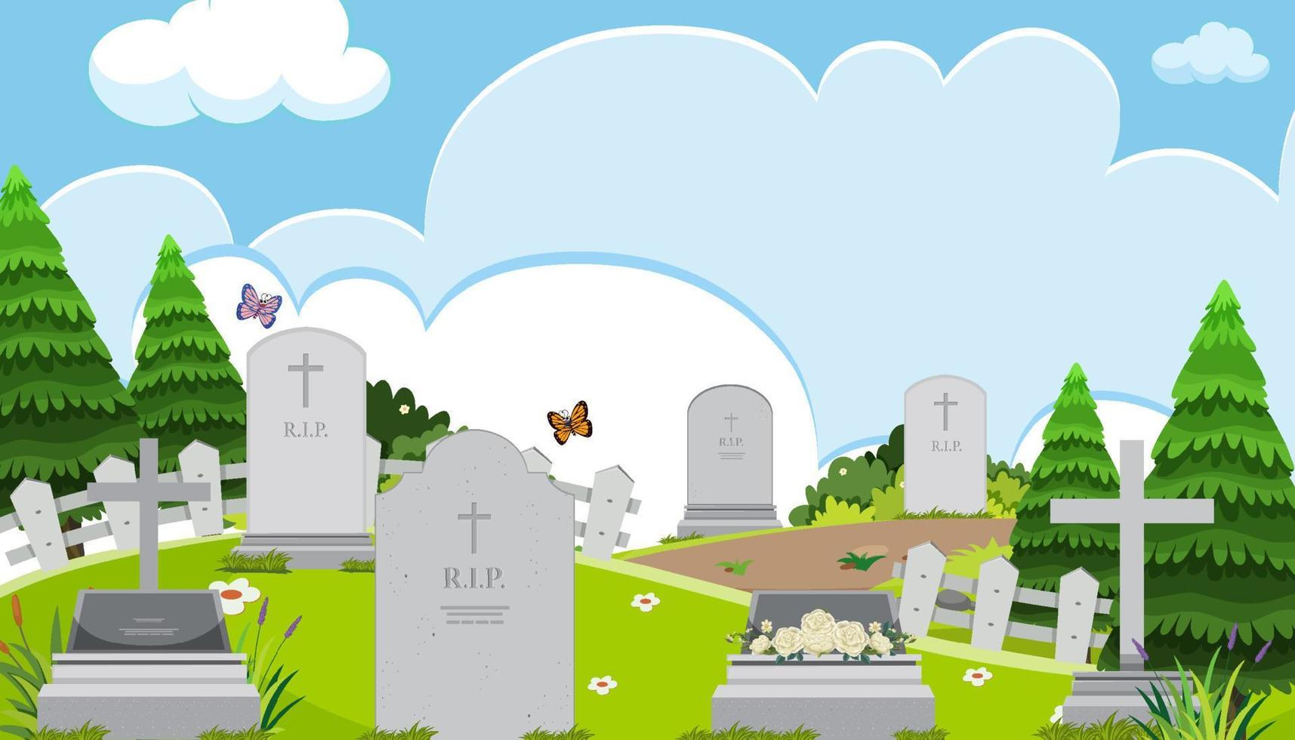
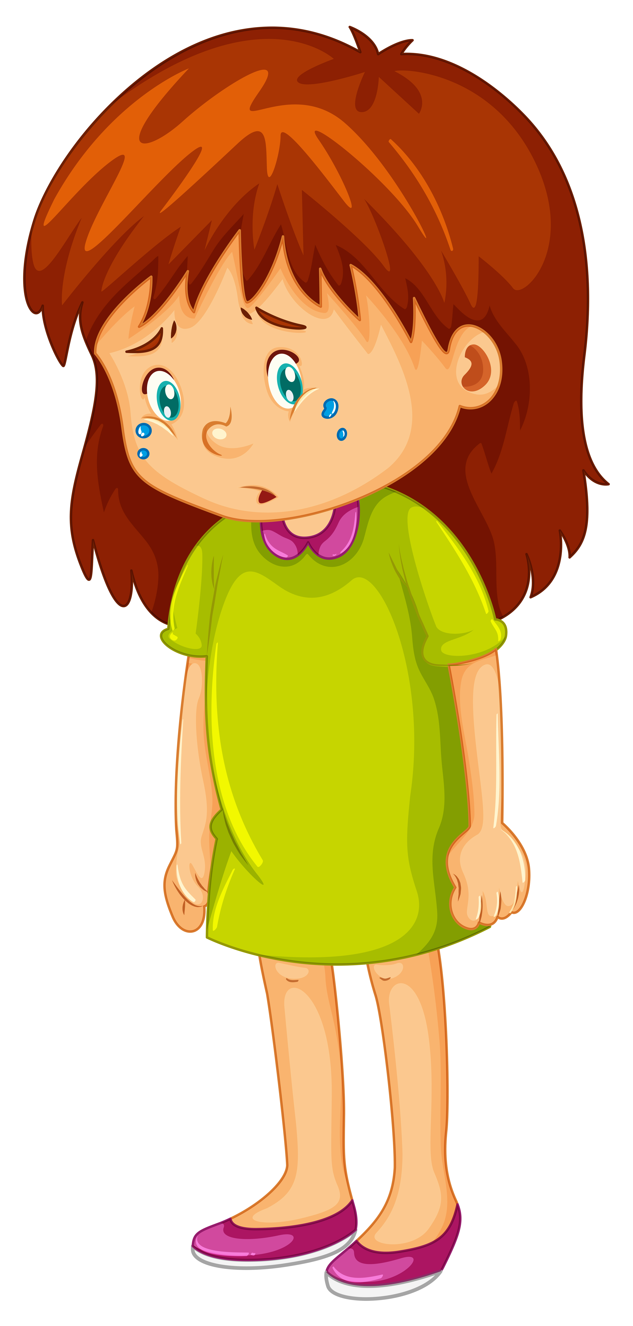
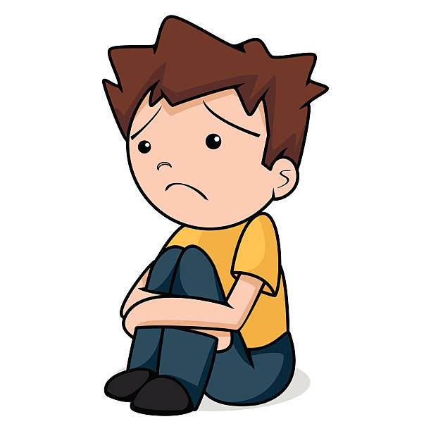
Has someone died that you loved?

Slide 4
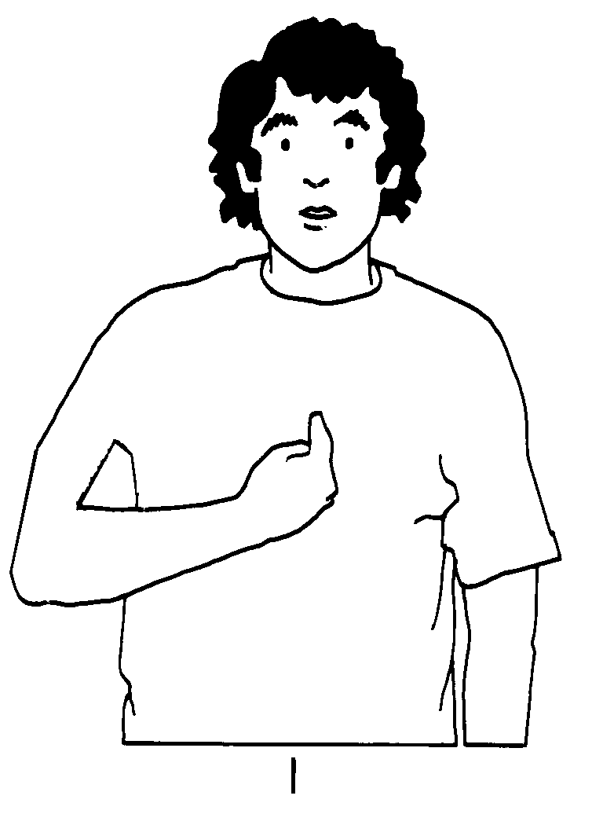

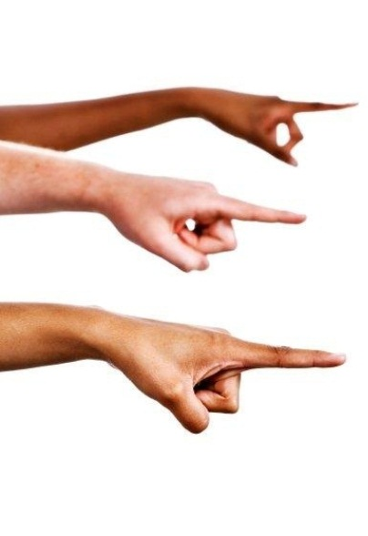
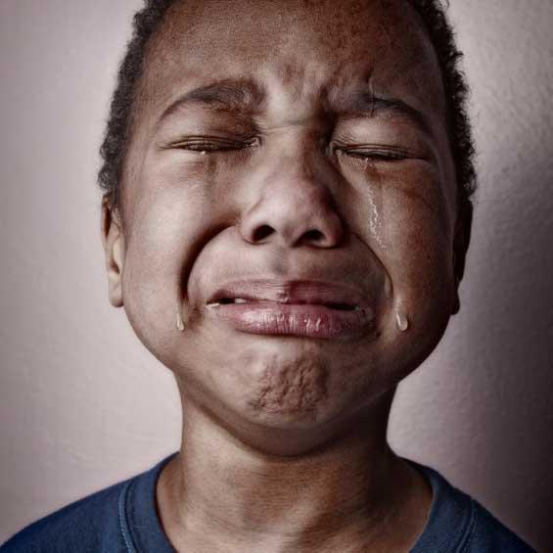
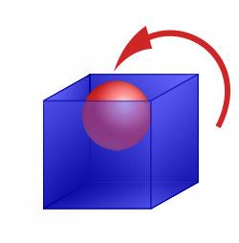

_ WILL _ _ _ _ _ _ _ _ _ _ _ _ _ _ _ _ _ _ _ _ _ _ _ _ _ _ _ _ _
I
TURN
THEIR
MOURNING
INTO
GLADNESS
I will give them comfort and joy instead of sorrow.
Jeremiah 31:13 Decipher the code above

Slide 5
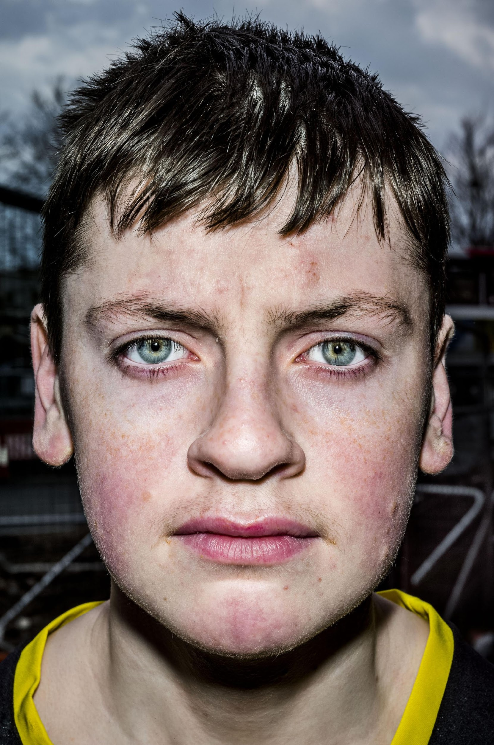
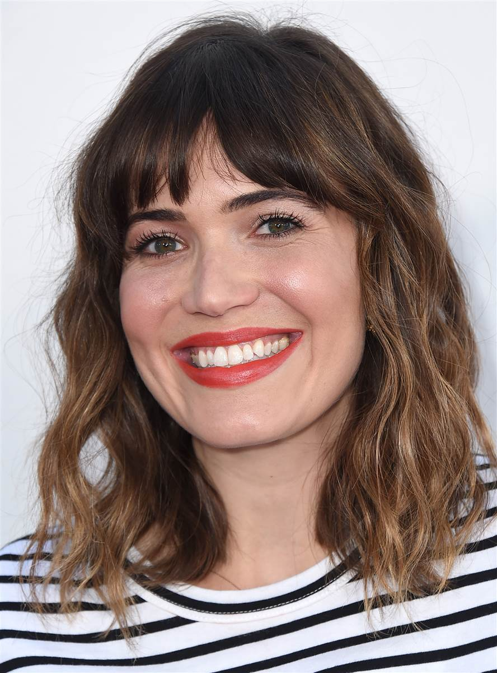
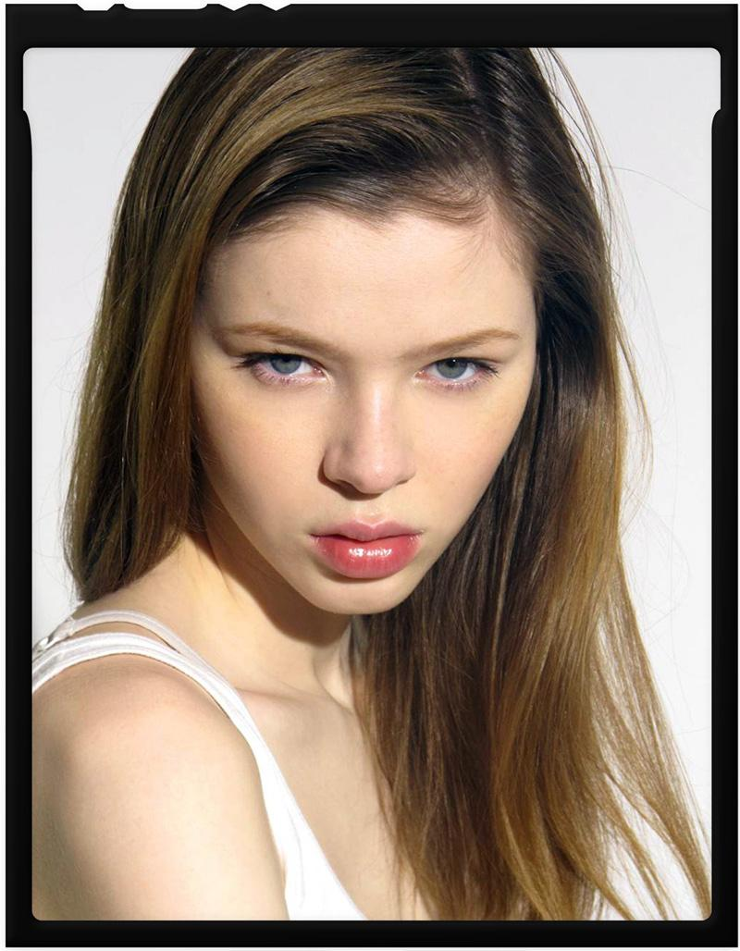
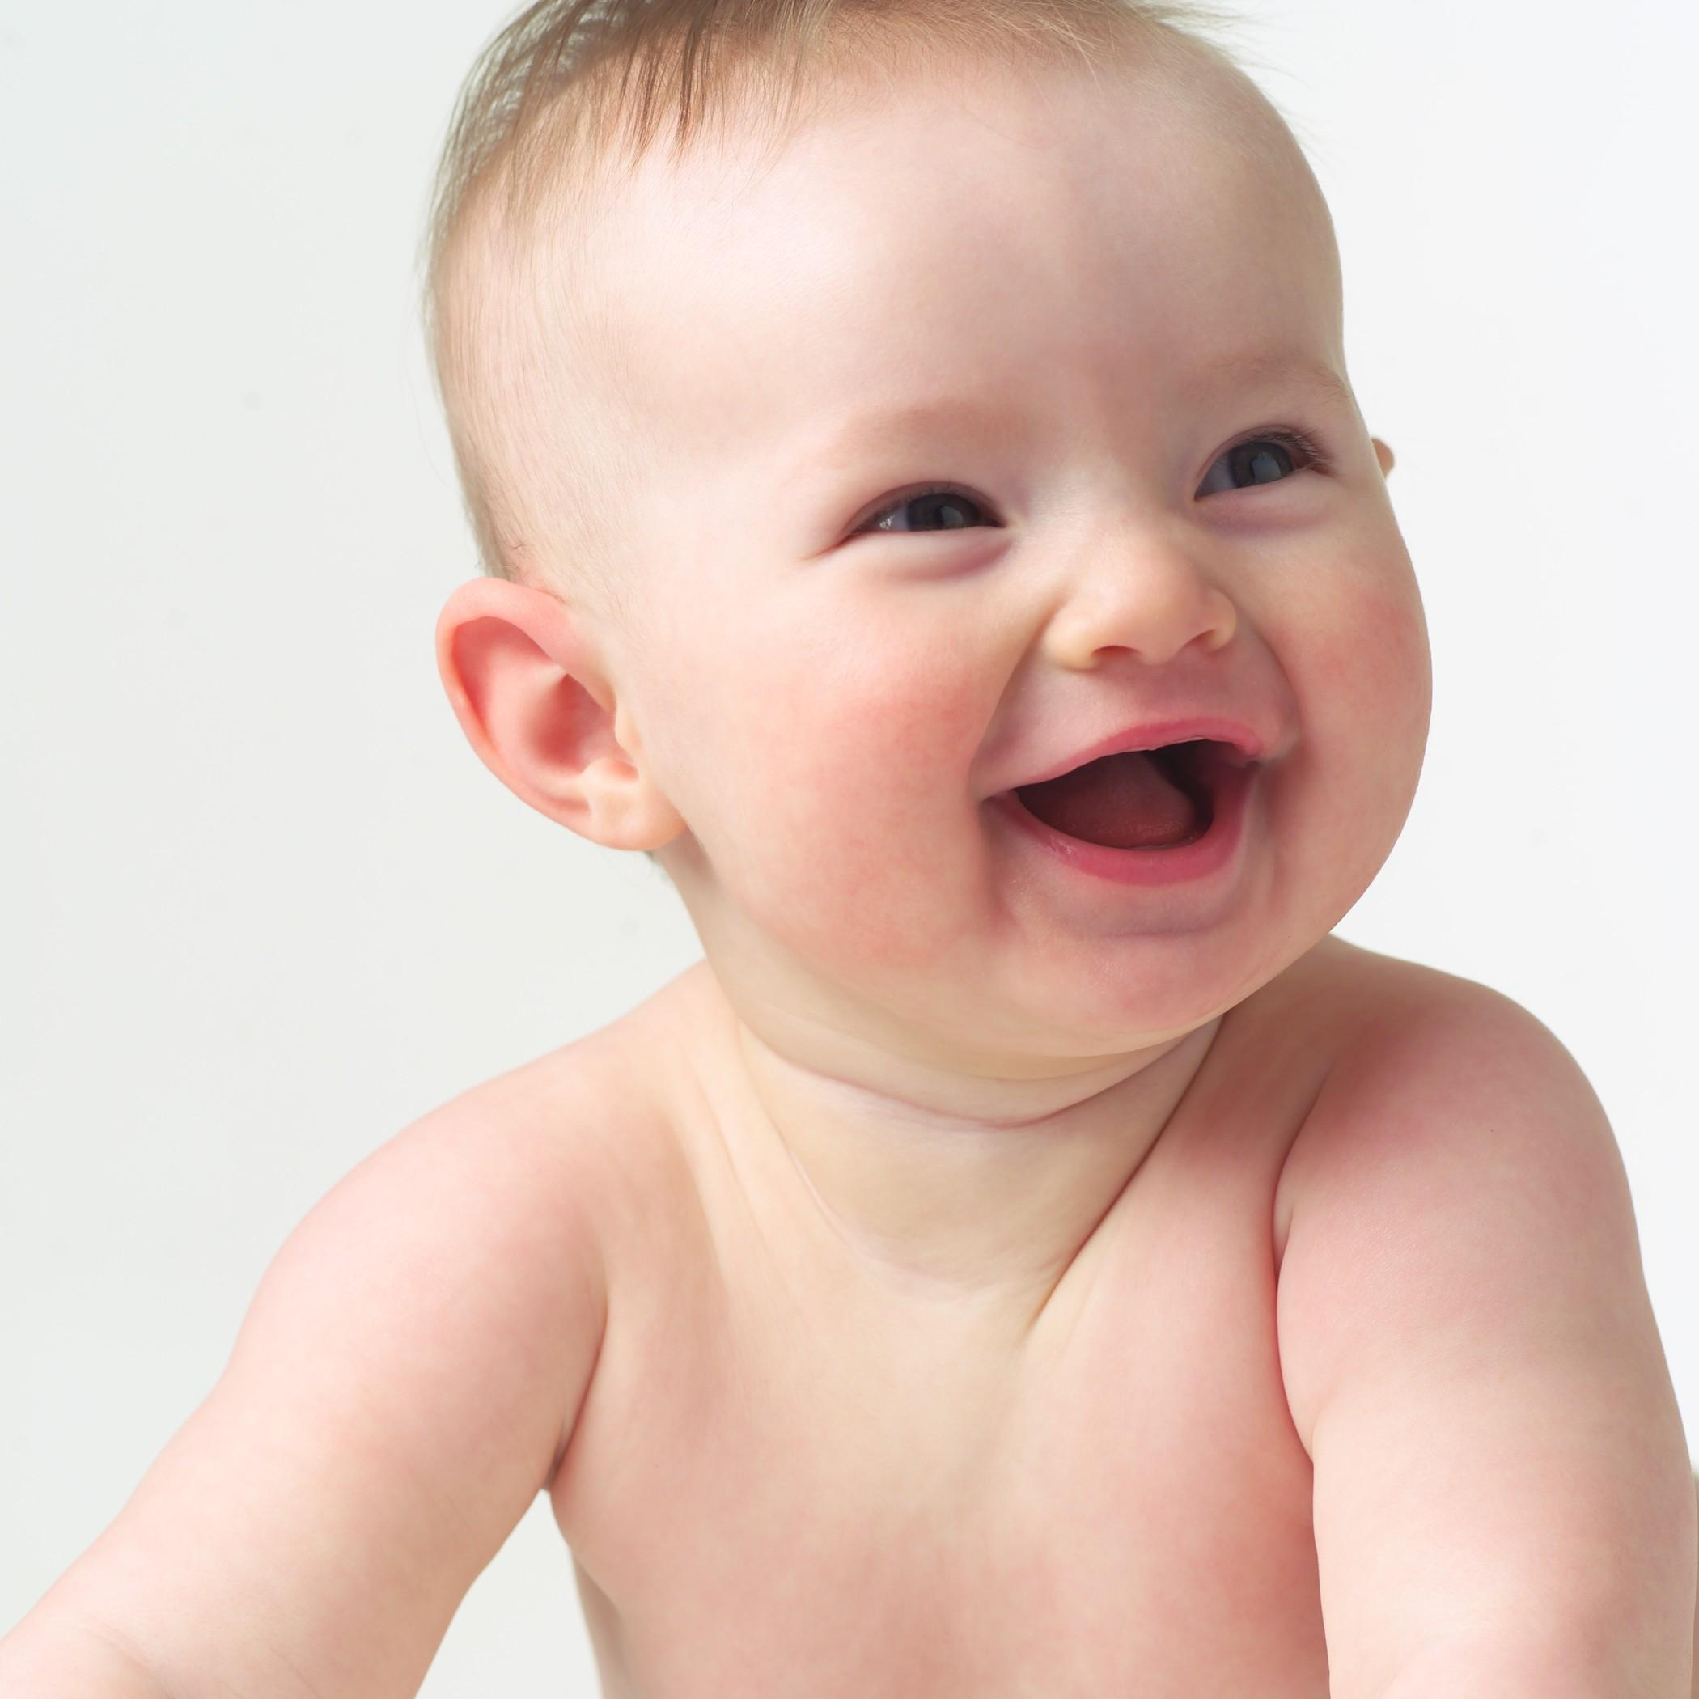
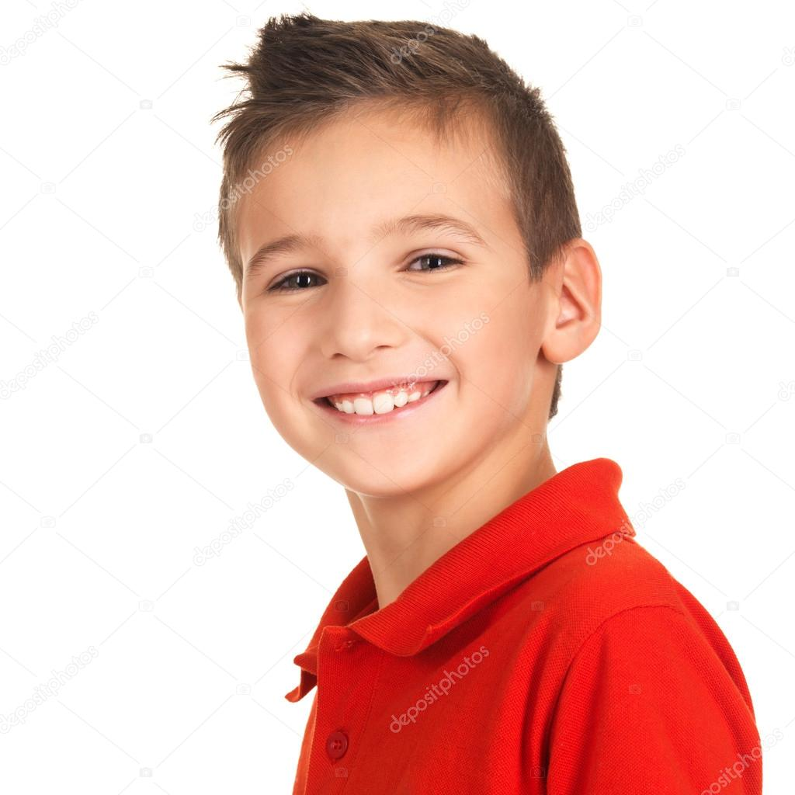
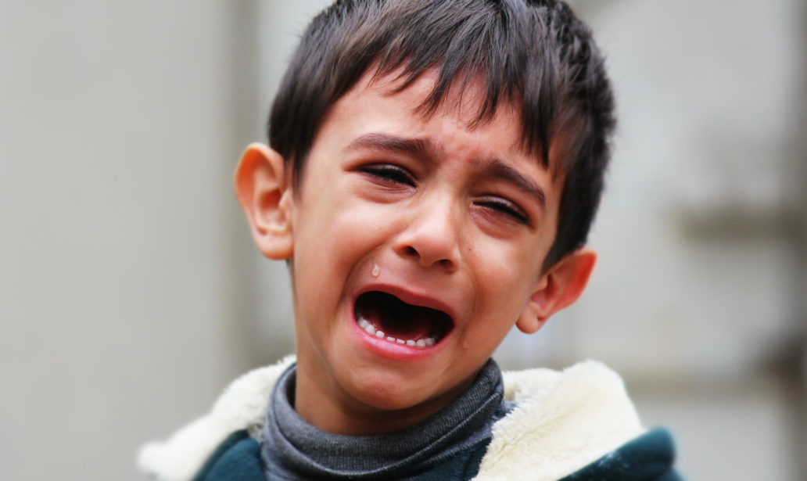
HAPPY OR SAD?

Slide 6
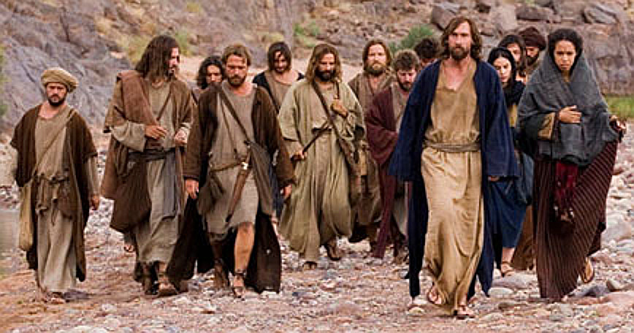
Crowds follow
^{Luke 7:11}
Soon afterward, Jesus went to a town called Nain, and his disciples and a large crowd went along with him.
This Photo by Unknown Author is licensed under CC BY-SA

Slide 7
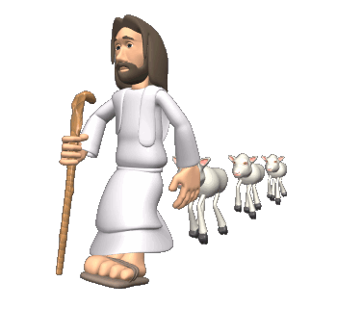
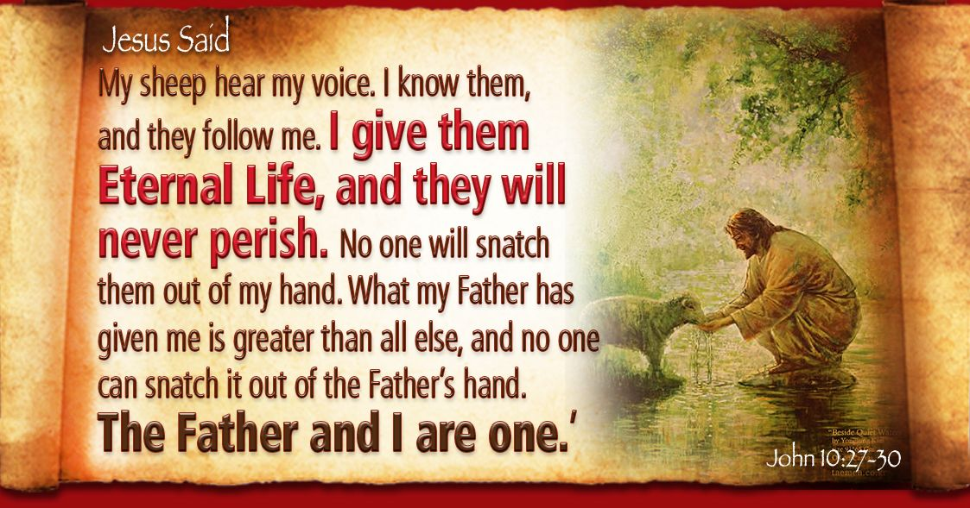
WHY DID THE CROWDS
FOLLOW JESUS?
He healed those who were sick
He was fun to be around.
He told great stories!
He is the Good Shepherd, our leader
This Photo by Unknown Author is licensed under CC BY-SA-NC

Slide 8

PRAISE GOD
IN SONG

Slide 9
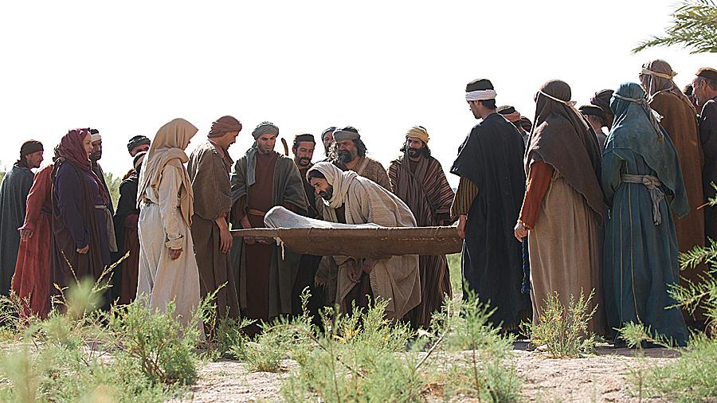
Once dead …
^{Luke 7:12} As He approached the town gate, a dead person was being carried out—the only son of his mother, and she was a widow. And a large crowd from the town was with her.
This Photo by Unknown Author is licensed under CC BY-NC-ND

Slide 10
Once dead …
^{Luke 7:13} When the Lord saw her, his heart went out to her and he said, “Don’t cry.”
¹⁴ Then he went up and touched the bier they were carrying him on, and the bearers stood still.
He said, “Young man, I say to you, get up!”
Young man
I say to you,
Get up!
Don’t cry
This Photo by Unknown Author is licensed under CC BY-NC-ND

Slide 11
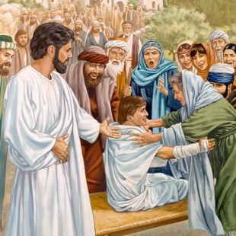
… Now alive!
A great prophet has appeared among us!
God has come to help His people!
¹⁵ The dead man sat up and began to talk, and Jesus gave him back to his mother.
¹⁶ They were all filled with awe and praised God.
“A great prophet has appeared among us,” they said. “God has come to help his people.”
¹⁷ This news about Jesus spread throughout Judea and the surrounding country.
Jesus has raised you to life!
Mom!
Did I die?
How am I alive?

Slide 12

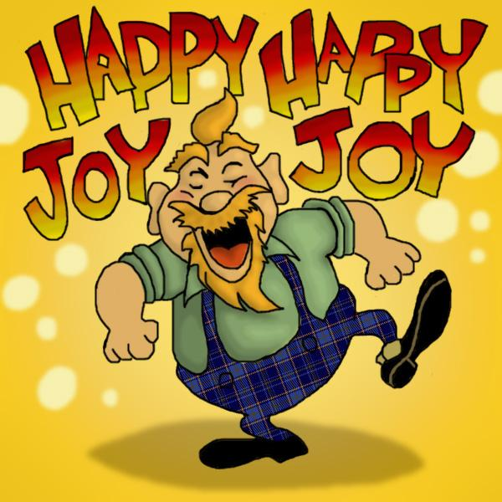
I will turn their mourning into gladness;
I will give them comfort and joy instead of sorrow.
Jeremiah 31:13

Slide 13

PRAISE GOD
IN SONG

Slide 14
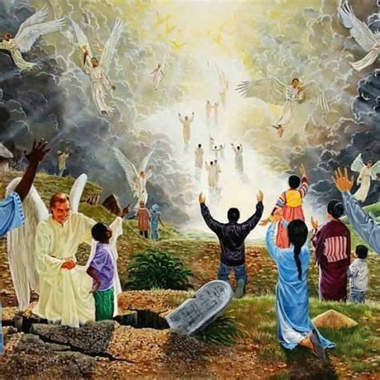
JESUS IS THE RESURRECTION AND THE LIFE
When He comes again,
Jesus will raise us up
from the dead, too,
and we will live with Him.

Slide 15

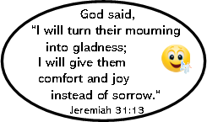

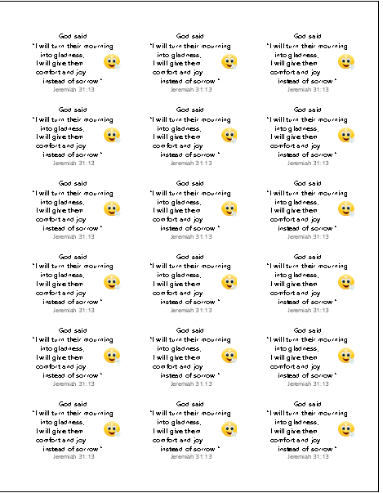
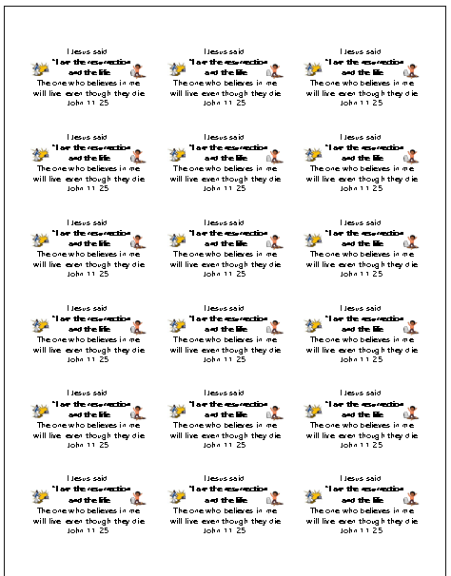
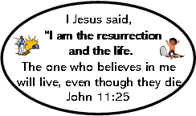
CRAFT TIME
I will turn their mourning
into gladness;
I will give them
comfort and joy
instead of sorrow.
Jeremiah 31:13
Put the sticker on the pot
Add soil to the pot
Plant a seed – bury it in the soil
Water the seed & place the pot in a sunny area. Remember: Jesus is called the water of life and He is the Son of God. It is He who gives us life and eternal life!
Watch your seed grow!
Jesus said, “I am the resurrection and the life. The one who believes
in me will live,
even though they die
John 11:25
Jesus said, “I am the resurrection and the life. The one who believes
in me will live,
even though they die
John 11:25
This Photo by Unknown Author is licensed under CC BY

Slide 16
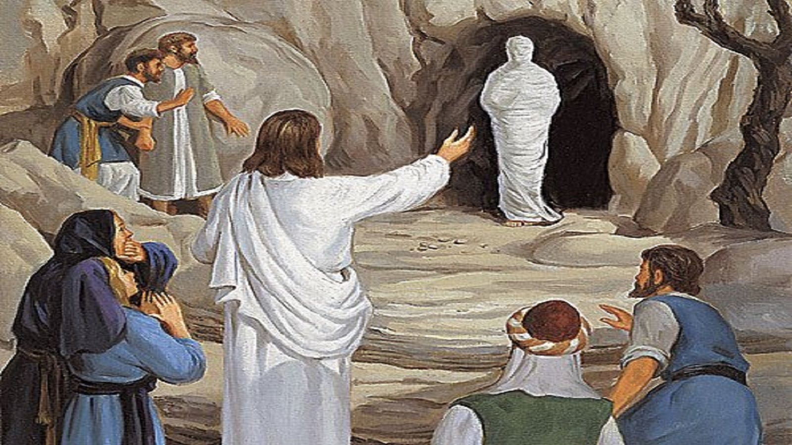
Jesus said to her,
“I am the resurrection and the life. The one who believes in me will live, even though they die;
John 11:25

Slide 17
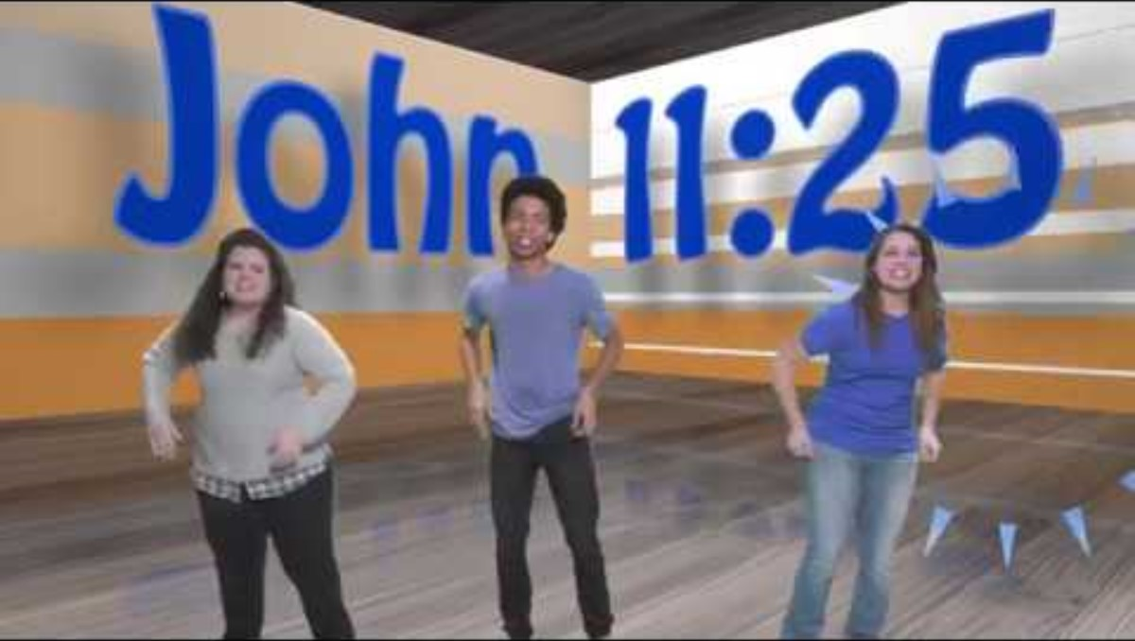
PRAISE GOD
IN SONG

Slide 18
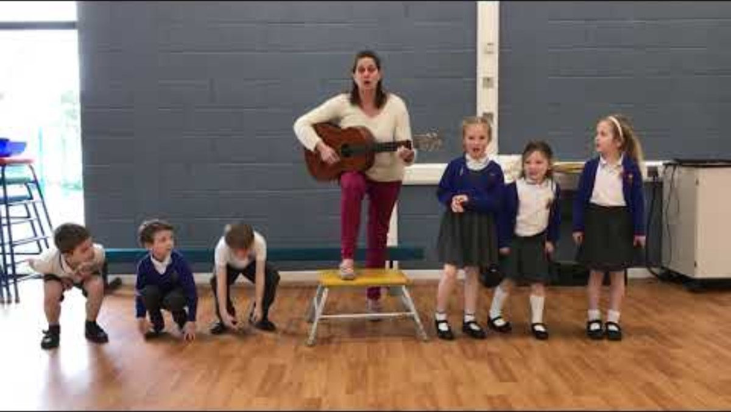
PRAISE GOD
IN SONG

Slide 19
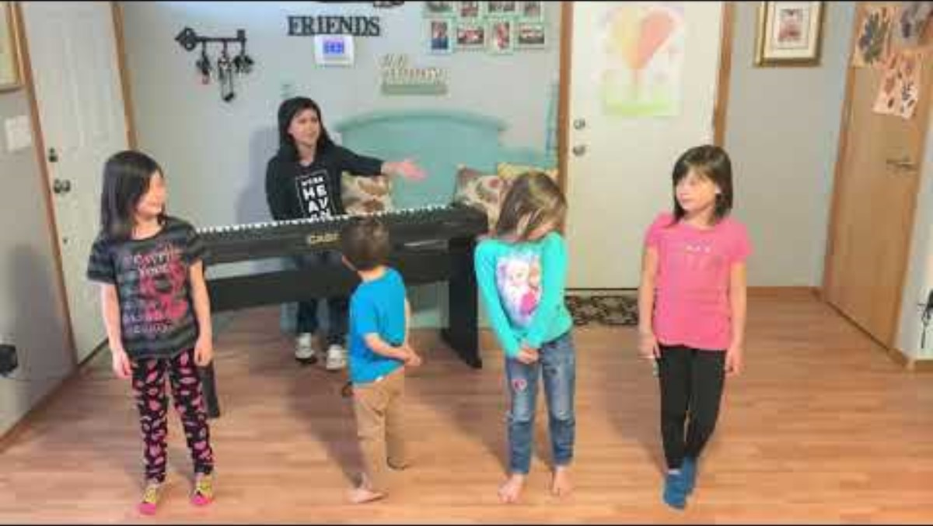
PRAISE GOD
IN SONG

Slide 20

https://activity-array.com/

