Slide 1
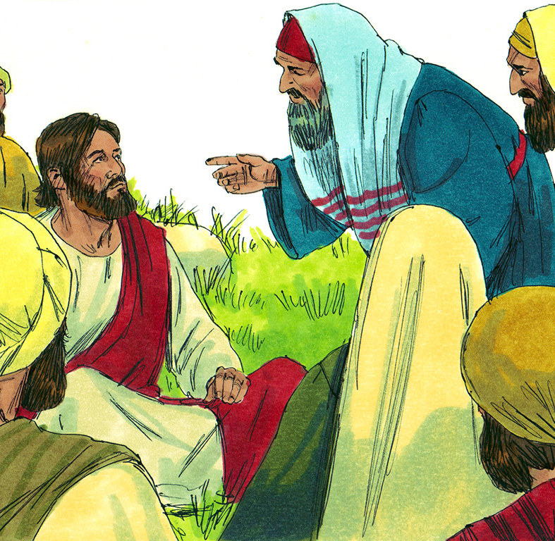
Go
He is well
Jesus heals official’s son – John 4:43-53
Jesus heals centurion’s son – Luke 7:1-10

Slide 2
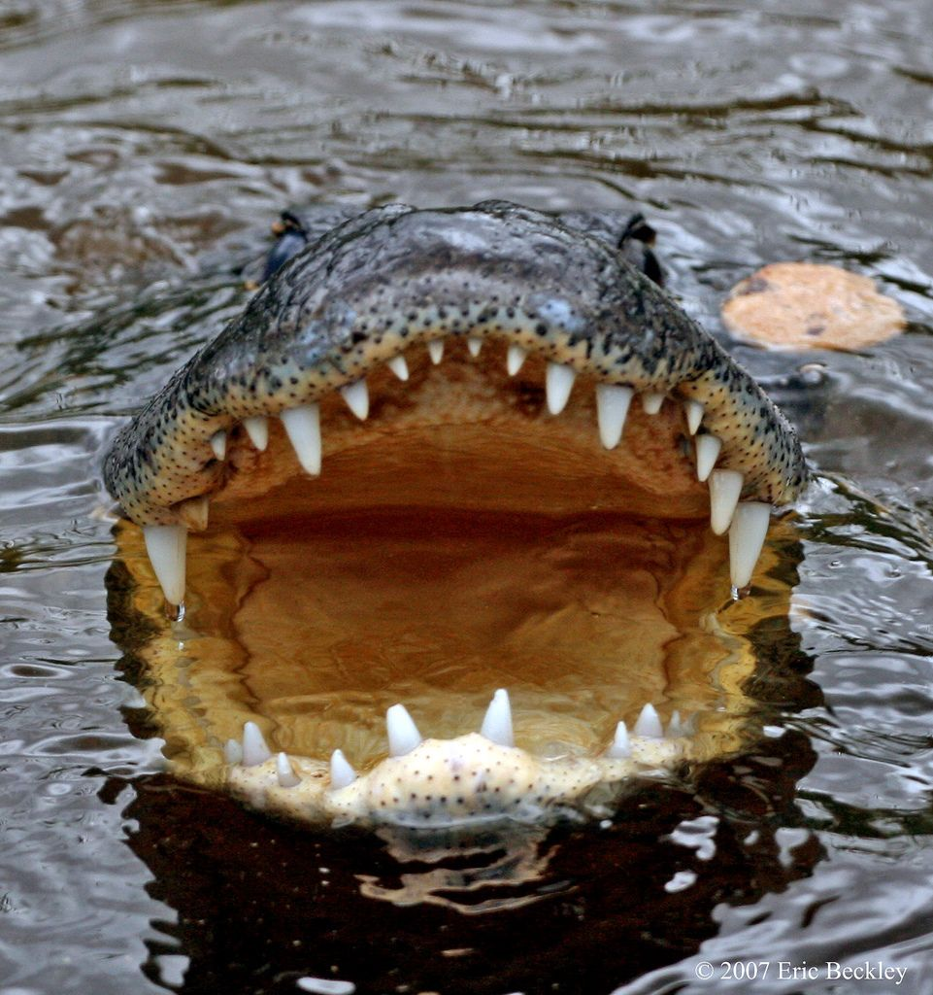
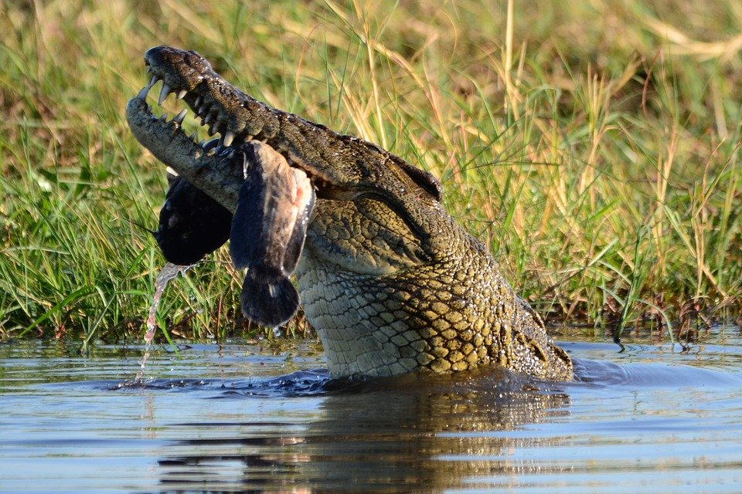
Alligators and Crocodiles
are strong
Crocodile

Slide 3
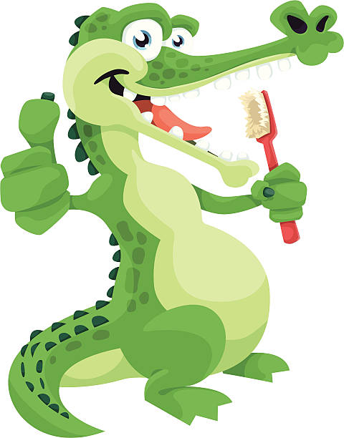
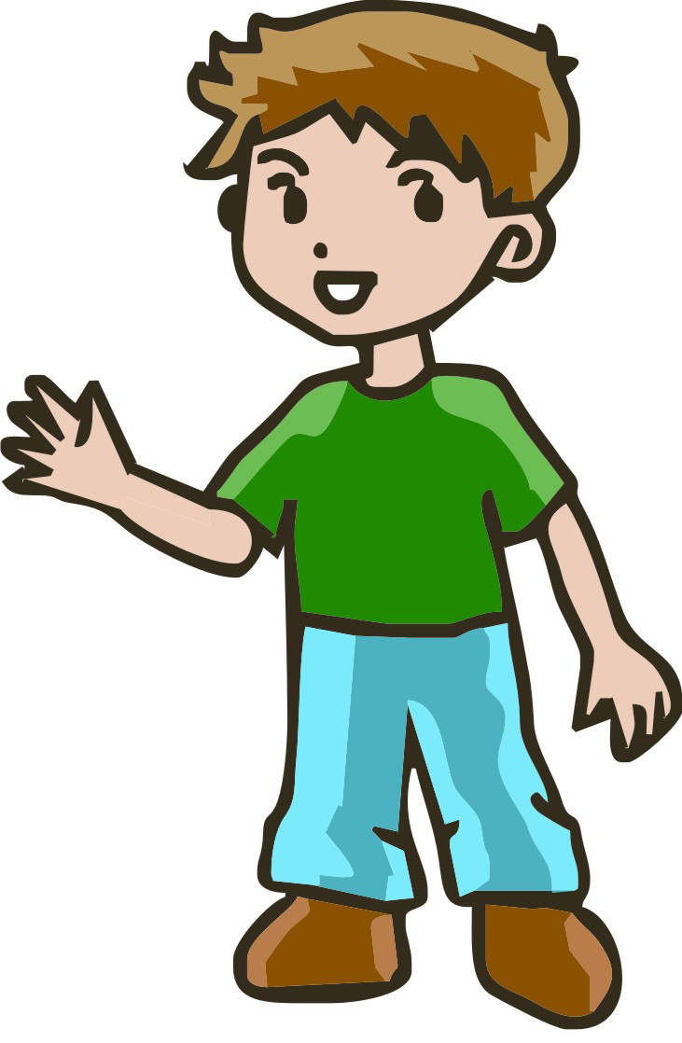
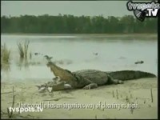

Would you do this?
Why do the
Plovers
Trust the crocodile?

Slide 4
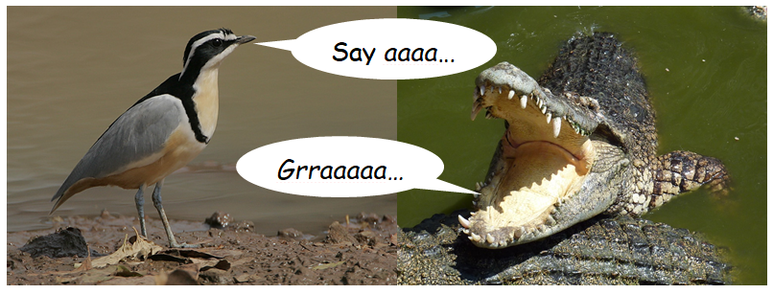
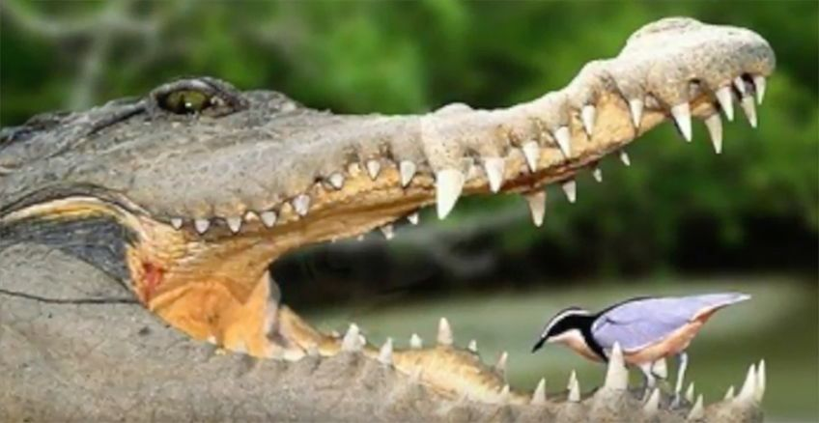
Is this FAITH?
Faith is:
Confidence or trust in a person or thing

Slide 5
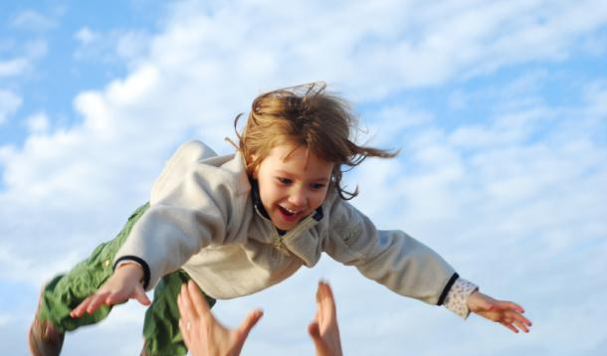
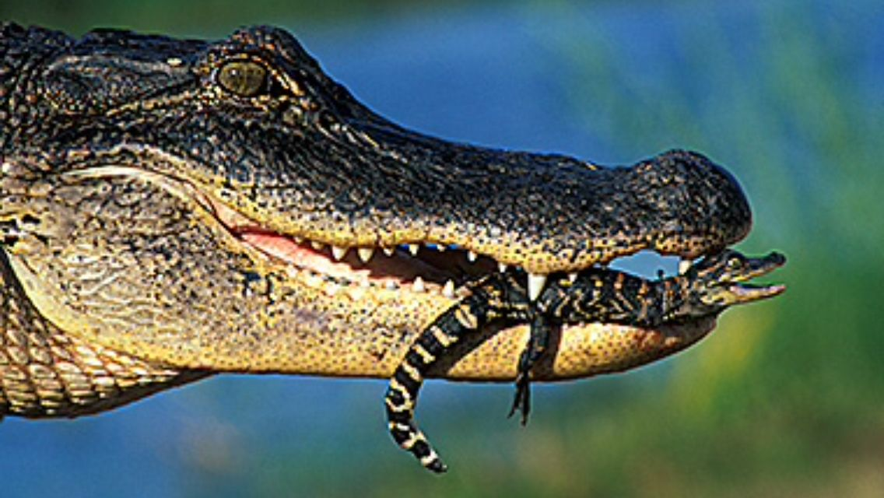
Babies trust their parents.
Her mouth is a safe place for them.
Trust
Faith

Slide 6
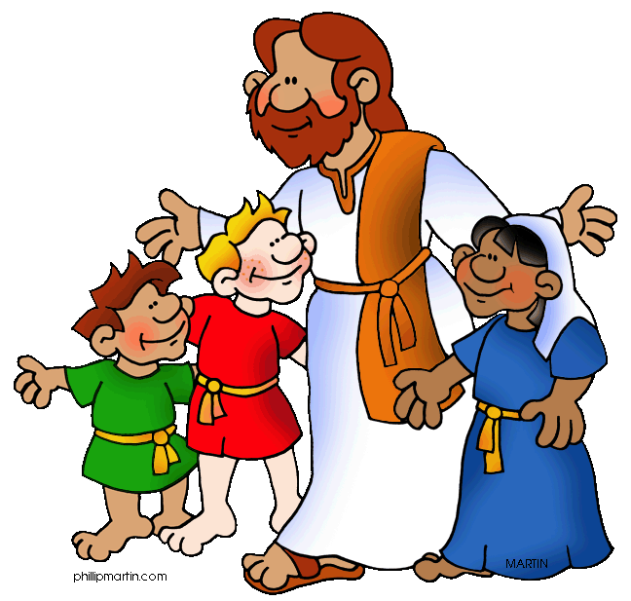
I love Him
God loves me!
God knows me
God knows what I need
God has everything
He gives me what I need
God is STRONG
He takes care of me
I have faith
in Him
I know Him
I trust Him

Slide 7


Hebrews 11:1
Faith is the confidence that what we hope for will actually happen

Slide 8
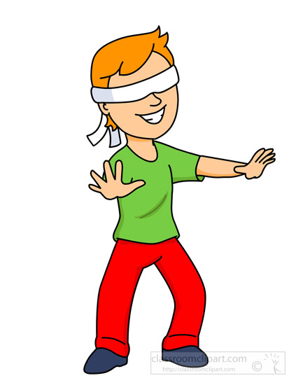
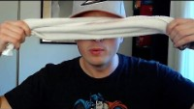
Object Lesson --- FAITH
Teacher – do a lesson live. Here are some ideas
Do you have faith?
I need a volunteer
The volunteer will be blind-folded.
They need to follow directions.
Teacher Prep:

Slide 9
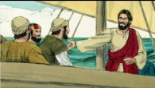
He’s Able

Slide 10
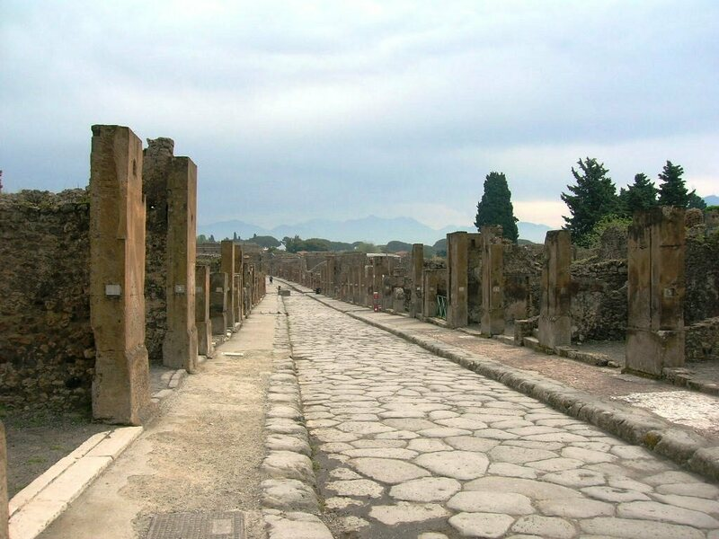

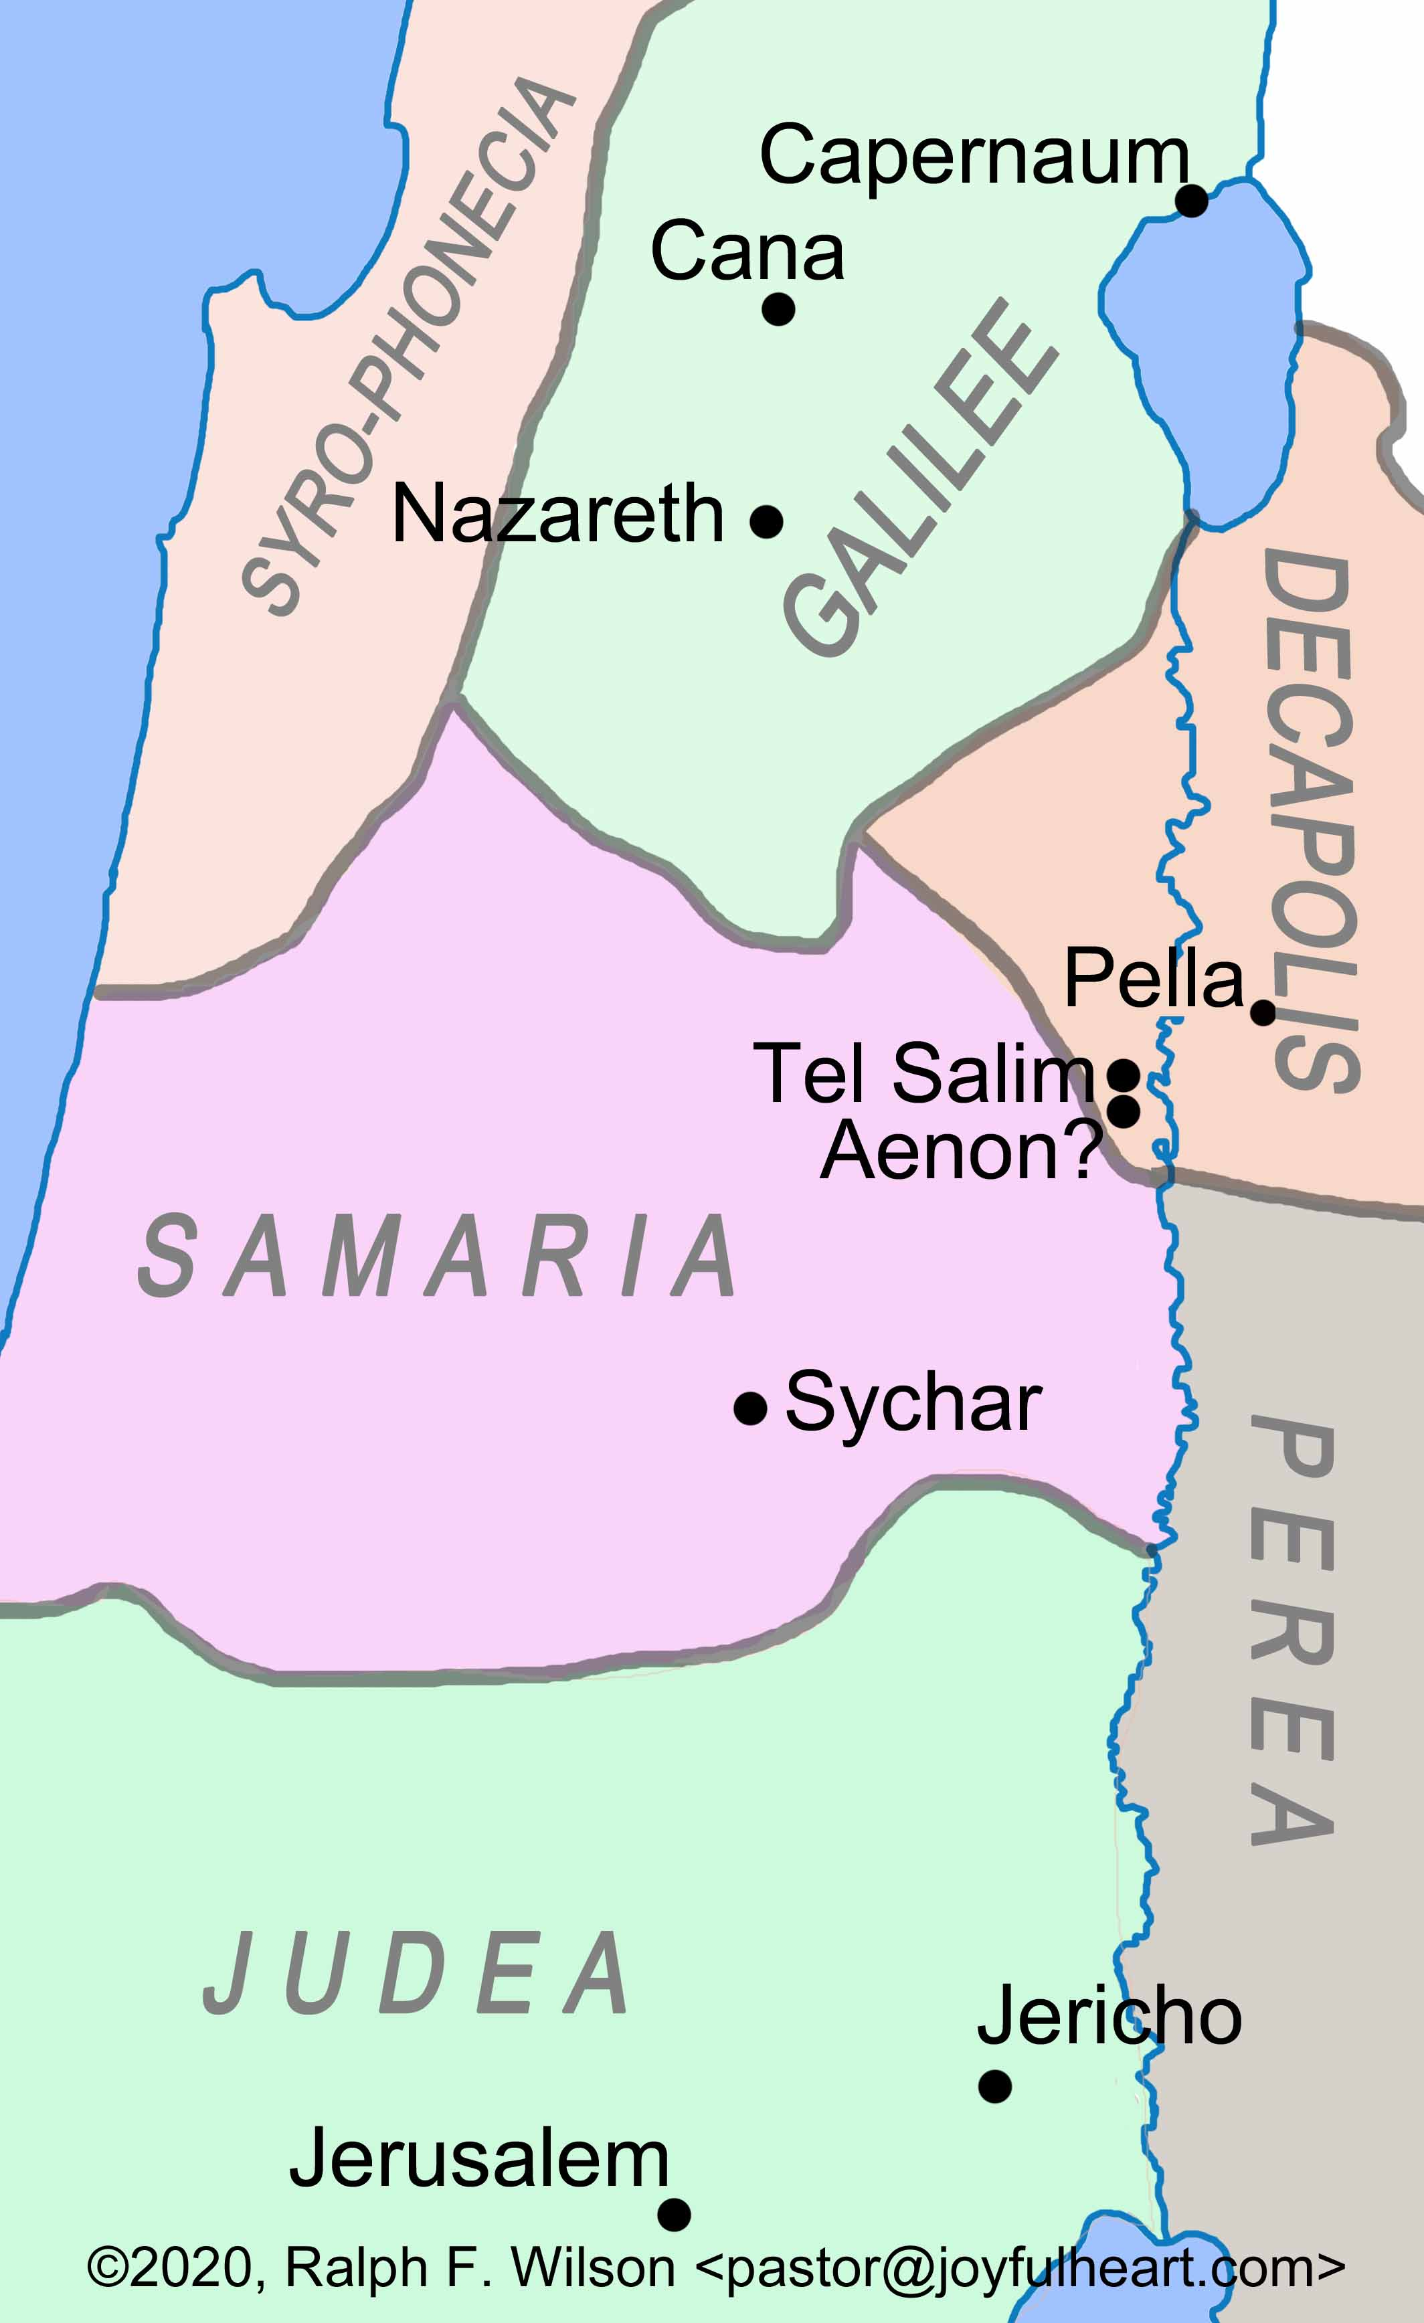
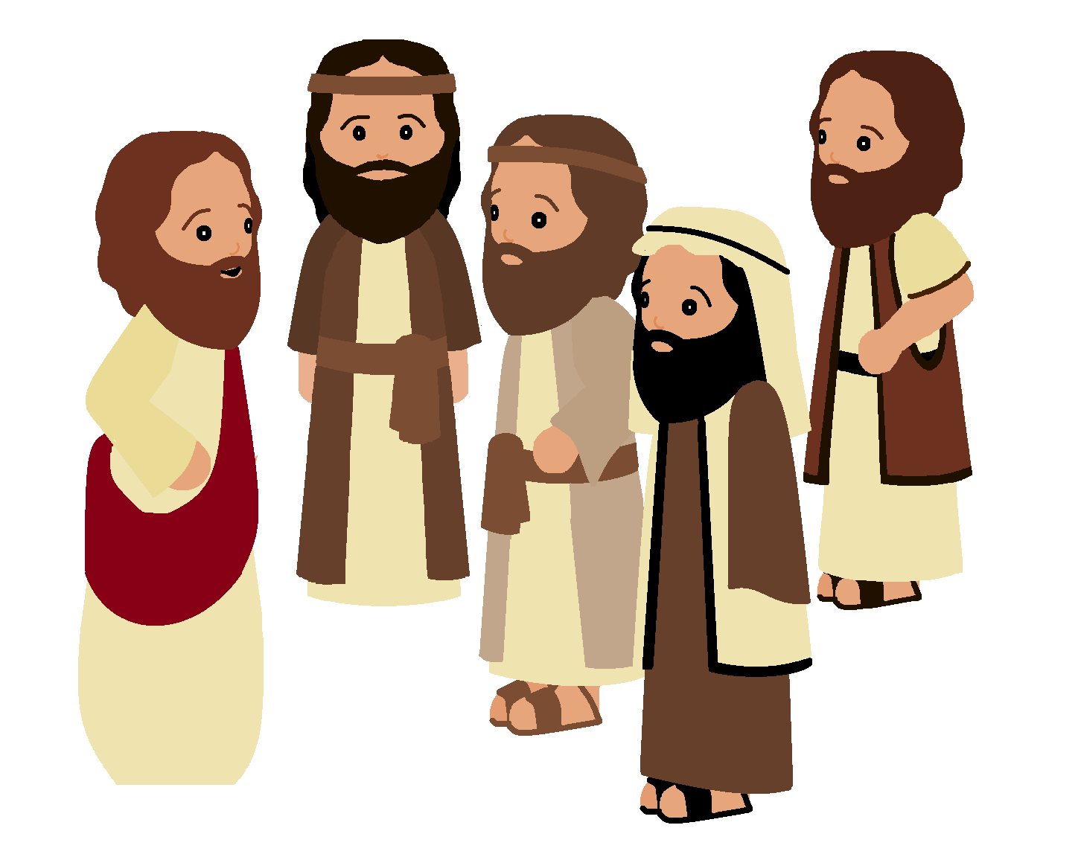

Find
John 4:43-53
  Can you find:
  Sychar
  Cana
  Capernaum
  Jesus traveled from Sychar
  To Cana.
Do you remember Jesus talking to the Samaritan woman beside the well?
She got to know Jesus, the Messiah, our Savior.
Because she told the people the people in her village of Jesus, the people wanted to hear more. Jesus stayed there in Sychar in Samaria for 2 days.
In our story today, Jesus goes to Cana.
A man comes from Capernaum.

Slide 11
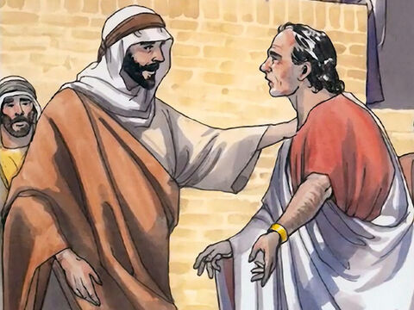
Come to Capernaum PLEASE
John 4
One of the king’s important officers lived in the city of Capernaum. This man’s son was sick. ⁴⁷ The man heard that Jesus had come from Judea and was now in Galilee. He went to Jesus and begged him to come to Capernaum and heal his son. His son was almost dead.

Slide 12
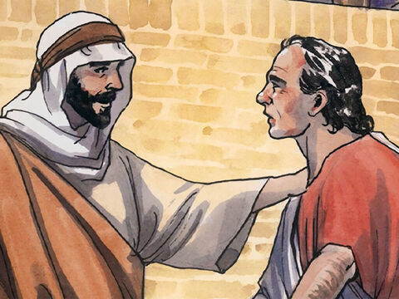
GO
Your son will live
Jesus, Sir
Come before my child dies!
⁴⁸ Jesus said to him, “You people must see signs and miracles before you will believe in me.”
⁴⁹ The officer said, “Sir, come before my child dies.”
⁵⁰ Jesus answered, “Go. Your son will live.”
The man believed what Jesus told him and went home.
Go, Your son will live!

Slide 13
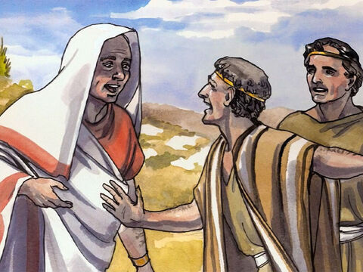
Your son is well!
What time did my son begin to get well?
That was the exact time Jesus said that he would be well! Remarkable!
Sir, your son is well!
It was about 1:00 when the fever left him.
⁵¹ On the way the man’s servants came and met him. They told him, “Your son is well.”
⁵² The man asked, “What time did my son begin to get well?”
They answered, “It was about one o’clock yesterday when the fever left him.”
⁵³ The father knew that one o’clock was the exact time that Jesus had said, “Your son will live.” So the man and all the people of his house believed in Jesus.

Slide 14

Find Romans 15:13
We trust in God
We have FAITH in Him
May the God of hope
Fill you with all joy and peace
As you trust in Him
So that you may overflow
With hope
By the power of the Holy Spirit.

Slide 15
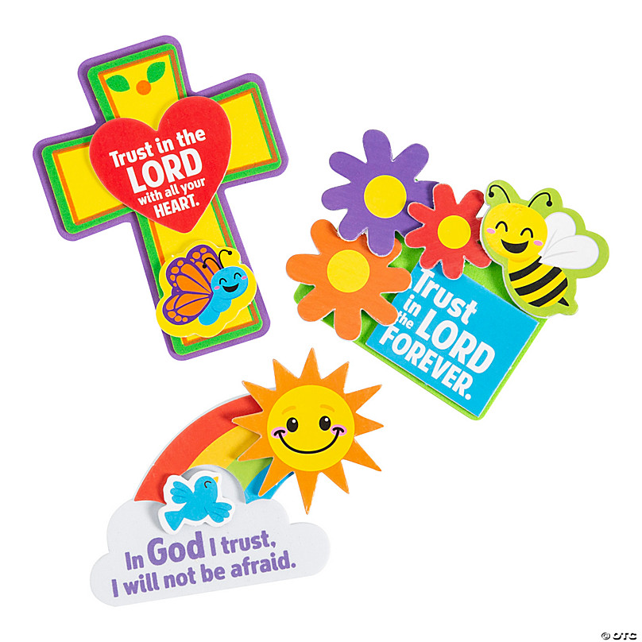
CRAFT TIME
May the God of hope
Fill you with all joy and peace
As you trust in Him
So that you may overflow
With hope
By the power of the Holy Spirit.

Slide 16

My God is Great

Slide 17
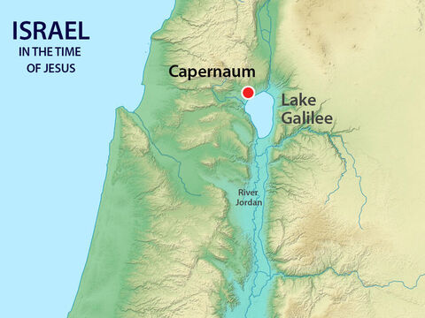
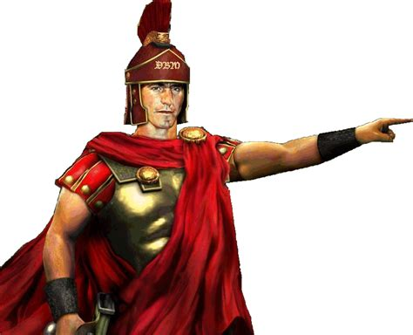
Find Luke 7:1-10
Another time
From the same place
Luke tells a similar story about a Centurion. That’s a soldier who is in charge of 100 soldiers.
He lived in Capernaum too.

Slide 18

Soldier Says
Forward march
Left face (turn)
Right face (turn)
Halt! (stop)
March to ___________
Pick up something _____
Take it to _________

Slide 19

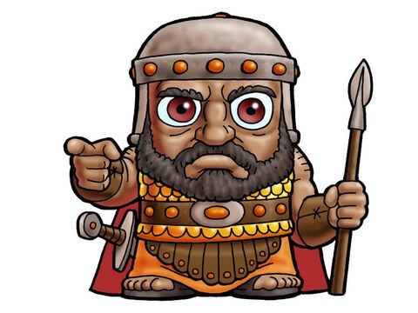
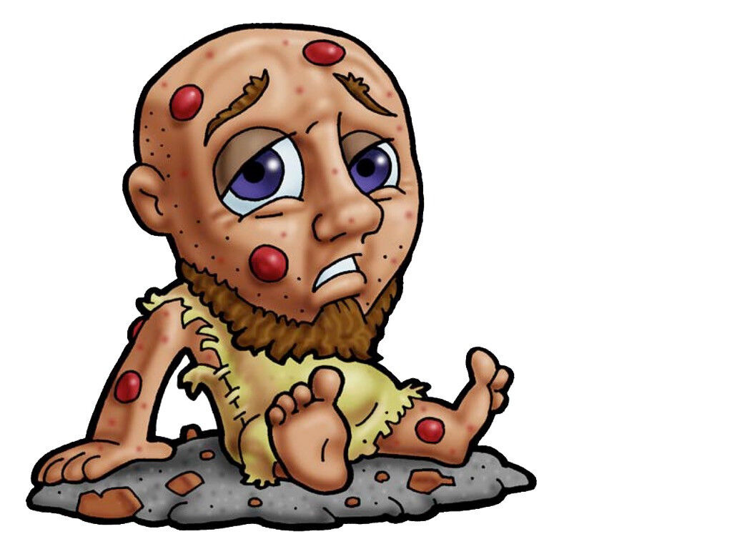
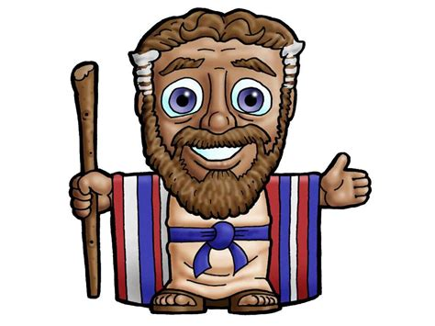
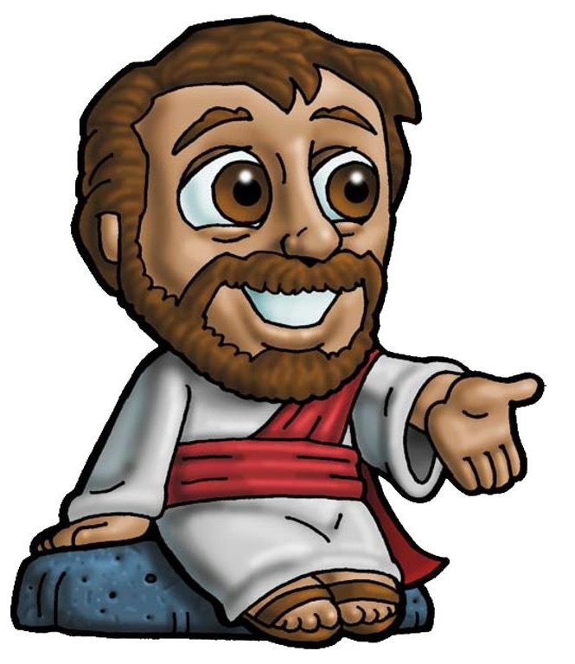
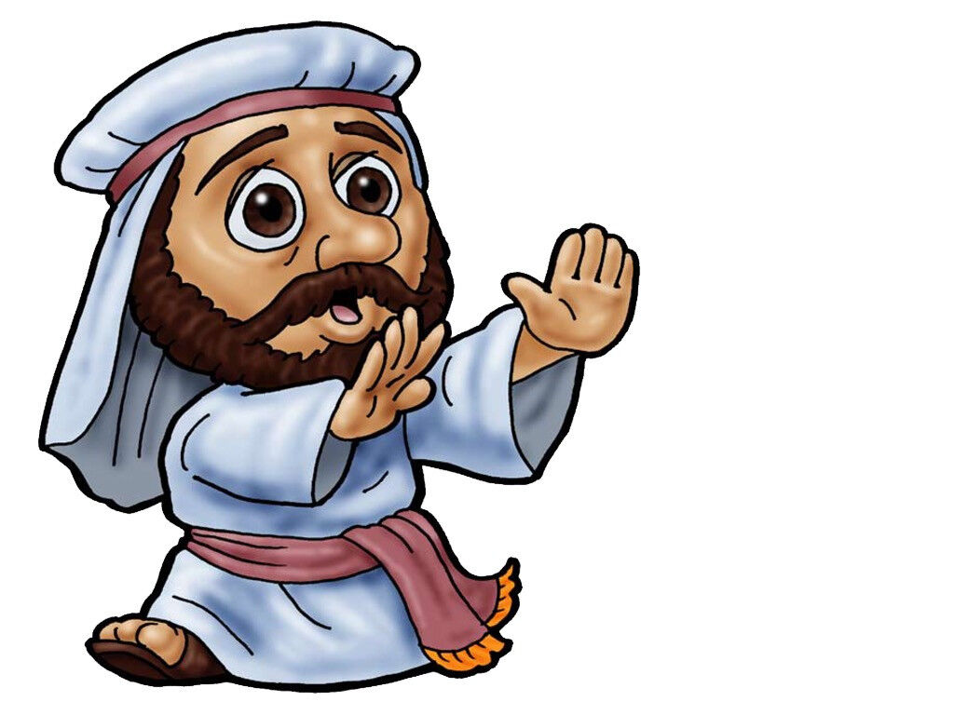
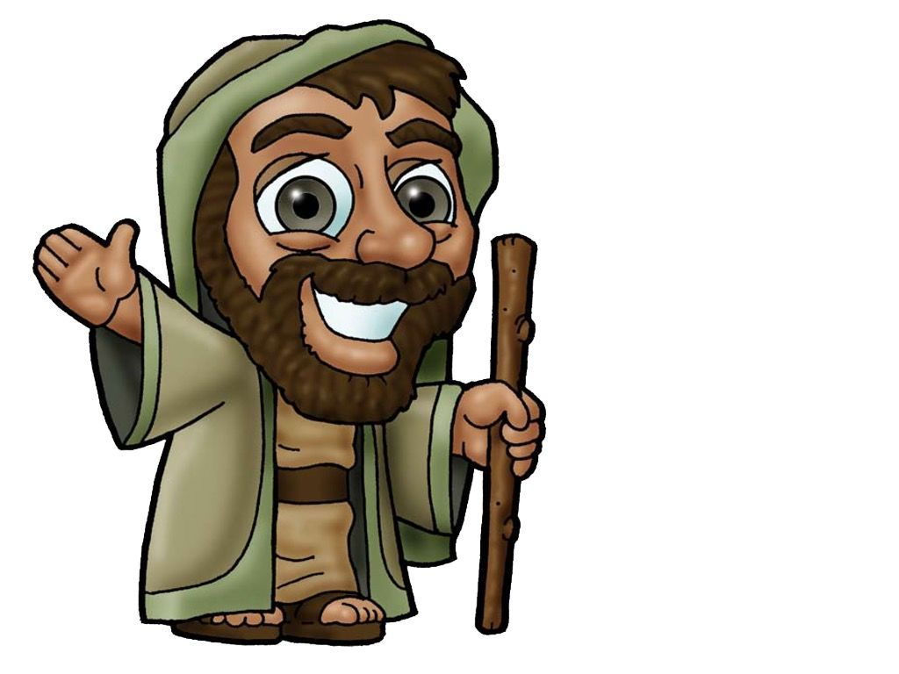
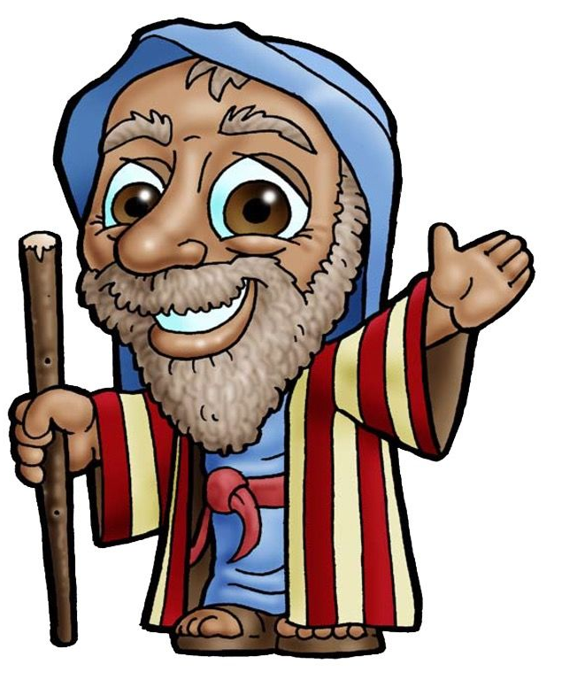
I need some volunteers to help act out our story. Who wants to be:
An Centurion Soldier (humble & commanding)
His servant (sick) no talking
Jesus
Jewish Leaders
Friends

Slide 20
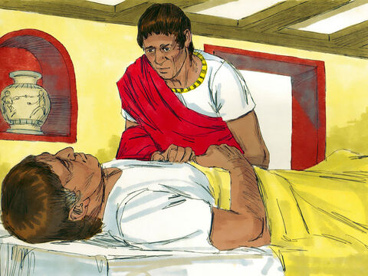
Oh, my servant!
What can I do?
When Jesus finished saying all these things to the people, he went to Capernaum. ² In Capernaum there was an army officer. He had a servant who was so sick he was nearly dead. The officer loved the servant very much.

Slide 21
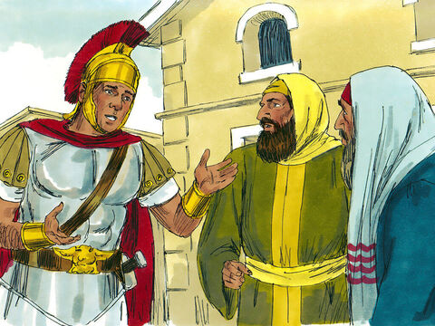
Please go get Jesus
³ When the officer heard about Jesus, he sent some Jewish elders to him. The officer wanted the leaders to ask Jesus to come and heal his servant.

Slide 22

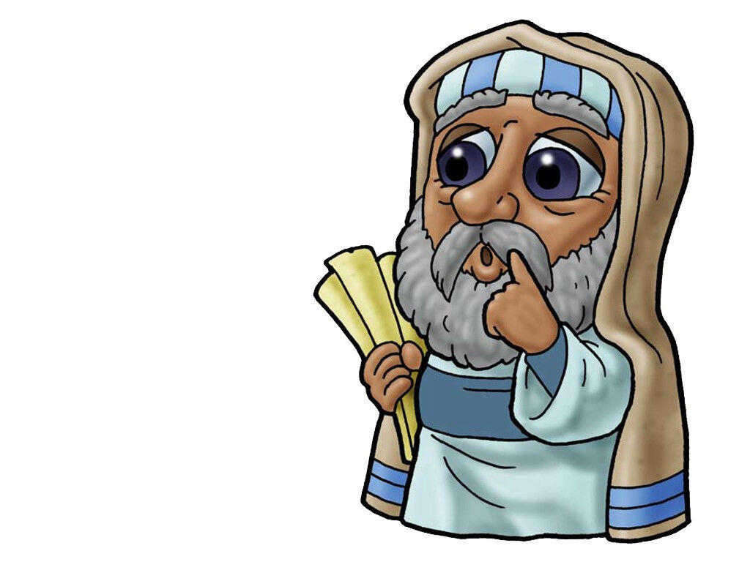
Yes sir!
What can we do for you.
Temple leader Tyrus, come here please.
Yes sir!
Right away sir!
Go get Jesus.
My servant Syril is sick.

Slide 23

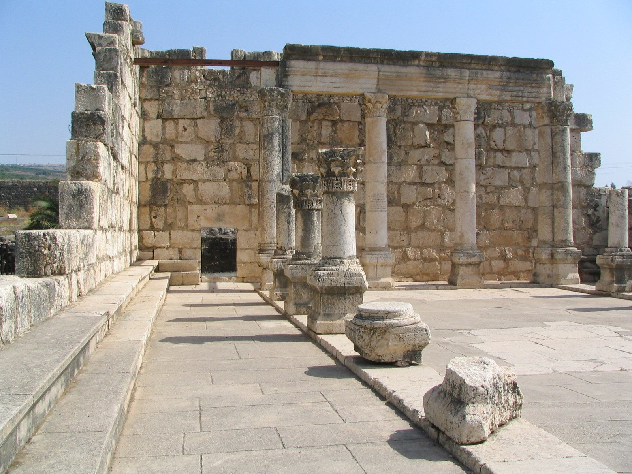
Please come.
He is a good man.
⁴ The men went to Jesus and begged him saying, “This officer is worthy of your help. ⁵ He loves our people, and he built us a synagogue.”
⁶ So Jesus went with the men.

Slide 24
Centurion Caleb has asked us to come and get you.
His trusted servant is very, very sick.
He loves our people and is worthy of your help. He helped us build our synagogue.
Alright. I will go.

Slide 25
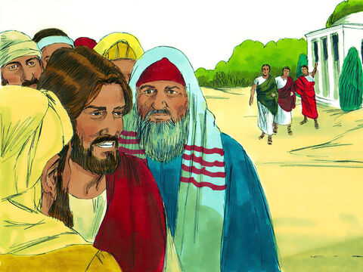
Jesus went
⁶ So Jesus went with the men.
He was getting near the officer’s house when the officer sent friends to say, “Lord, you don’t need to come into my house.

Slide 26
Yes sir!
What can we do for you.
My friends come here please.
Yes sir!
Right away sir!
Go to Jesus.
Tell him that he can just say the word and my servant will be well. I am not worthy for Him to come to my house.

Slide 27
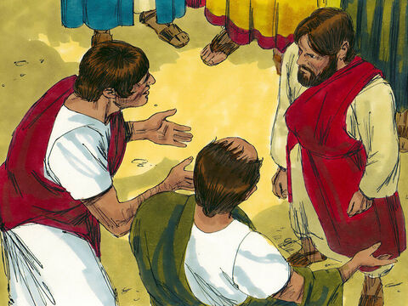
Wait Jesus
Just speak
“Lord, you don’t need to come into my house. I am not good enough for you to be under my roof. ⁷ That is why I did not come to you myself. You only need to say the word, and my servant will be healed. ⁸ I, too, am a man under the authority of other men. And I have soldiers under my command. I tell one soldier, ‘Go,’ and he goes. And I tell another soldier, ‘Come,’ and he comes. And I say to my servant, ‘Do this,’ and my servant obeys me.”
⁹ When Jesus heard this, he was amazed. He turned to the crowd following him and said, “I tell you, this is the greatest faith I have seen anywhere, even in Israel.”

Slide 28
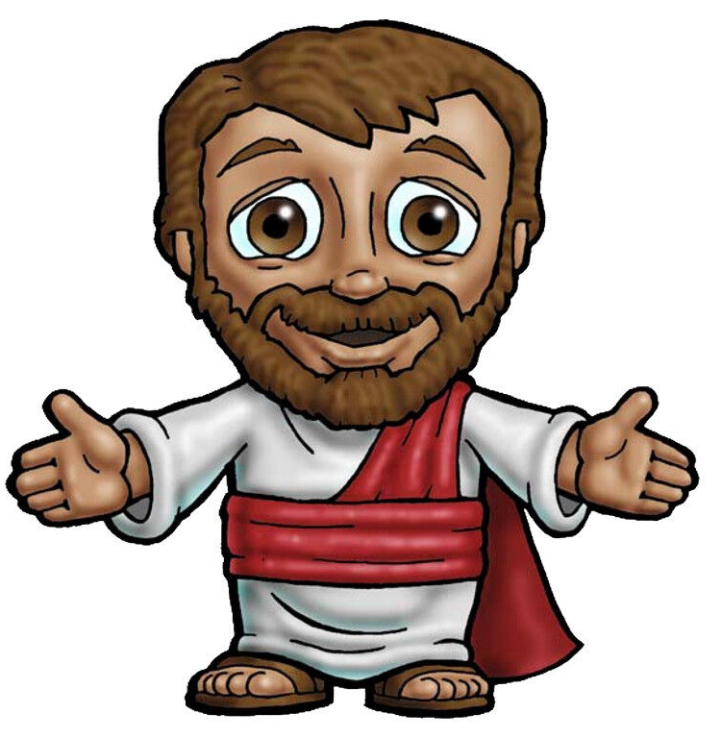
Centurion Caleb has asked us tell you that you should not come.
He said, just say the word and his servant will be well.
Like he said,
what he says to do, we do.
Yet he is a very humble man.
He has great faith!

Slide 29
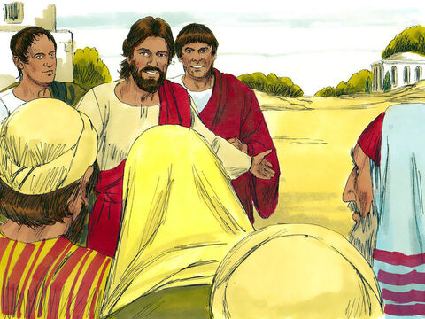
Go
He is well
Matthew (8:13) tells us that Jesus said:
“Go home. Your servant will be healed just as you believed he would.” And at that same time his servant was healed.

Slide 30
Go home.
He is well!
Yes sir!
Thank you sir!
Hmmm

Slide 31
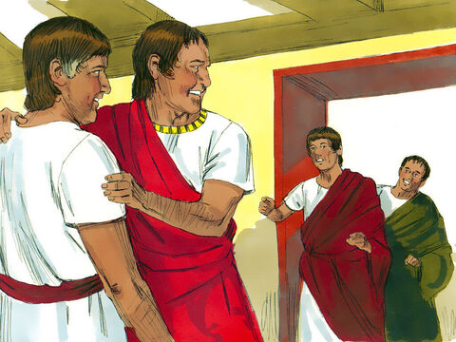
He is well!
Luke 7:¹⁰
The men who had been sent to Jesus went back to the house. There they found that the servant was healed.

Slide 32
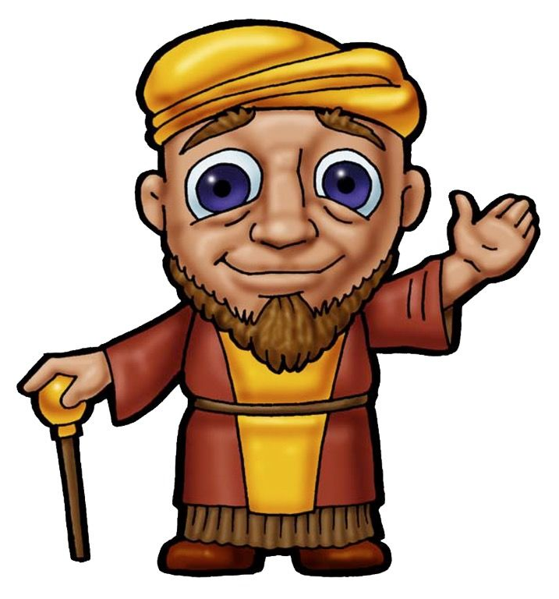
Praise God! My servant is well!
Wow! It is true!
Praise God!

Slide 33
Find Romans 15:13
We trust in God
We have FAITH in Him
May the God of hope
Fill you with all joy and peace
As you trust in Him
So that you may overflow
With hope
By the power of the Holy Spirit.

Slide 34
Do you have faith?
Fearlessly
Ask
Implicitly
Trust
HIM
We can boldly pray to God
We can ask for things we and others need
Because He told us to & promised to provide.
We can absolutely know, without a doubt,
That God loves us & will do what is best for us.
We can trust Him!

Slide 35

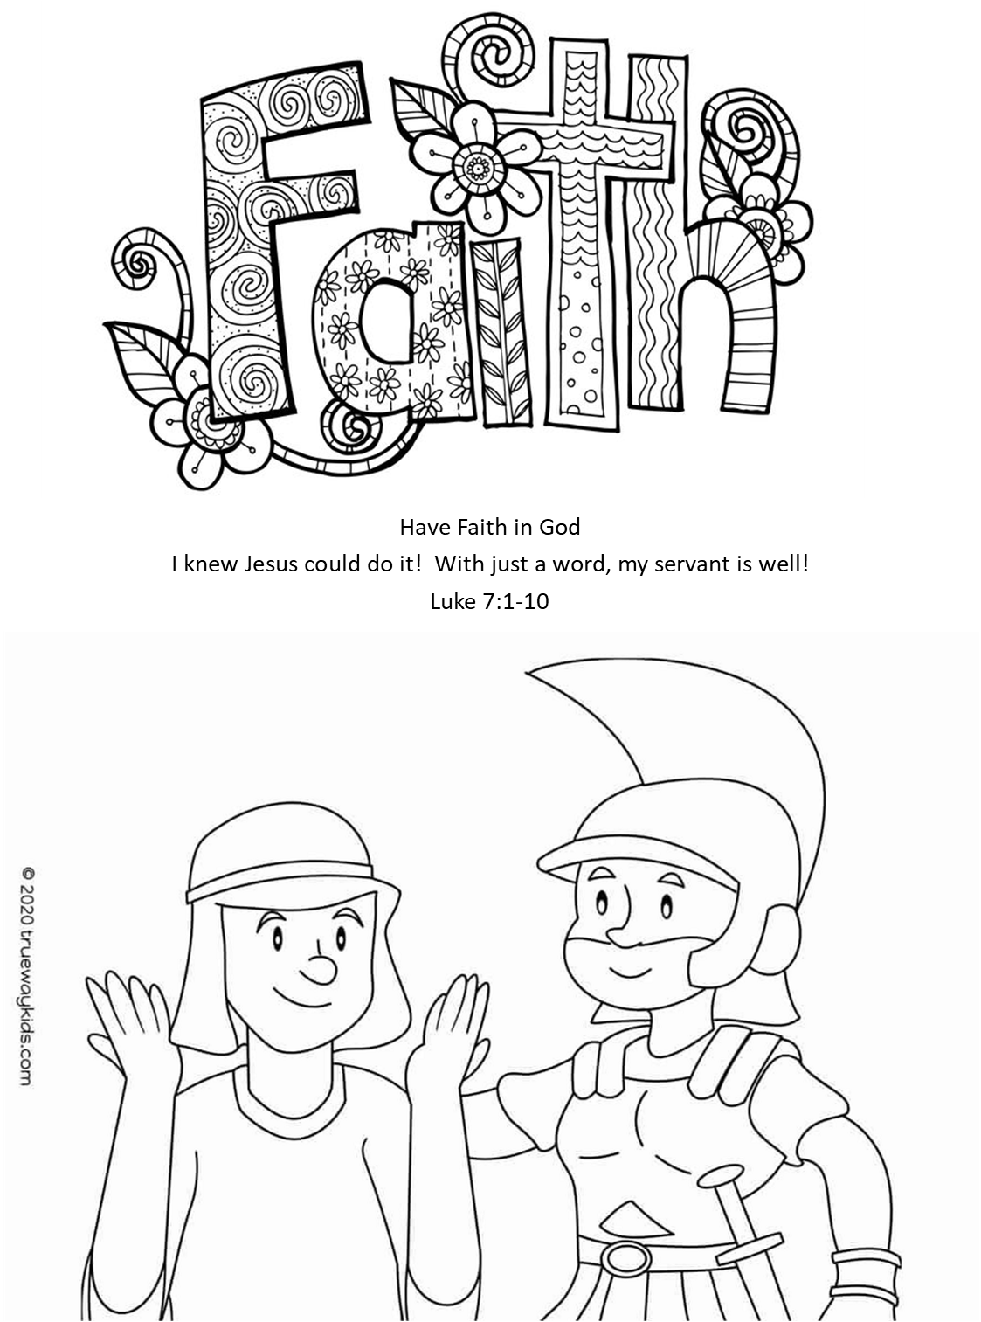
CRAFT
& COLOR
?
?

Slide 36
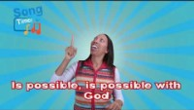
All Things are Possible with GodSing

Slide 37
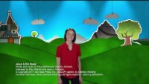
Jesus is the Healering

Slide 38
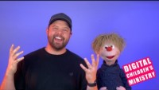

Example:

Slide 39

https://activity-array.com/

Slide 40
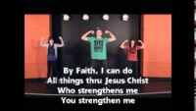
By FAITHSing

