Slide 1
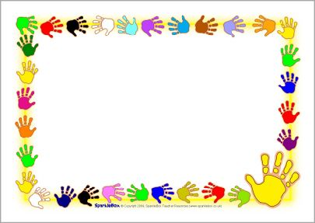
God Made the Sabbath for you and me!
Mark 2:23-28 Eating in the Field on Sabbath
Mark 3:1-6 Healing a Hand on the Sabbath

Slide 2

Remember the Sabbath Day
REMEMBER
God made all things good, very good!
He will make all things good, very good again.
So do what is good and rest in our Good God’s Care.

Slide 3
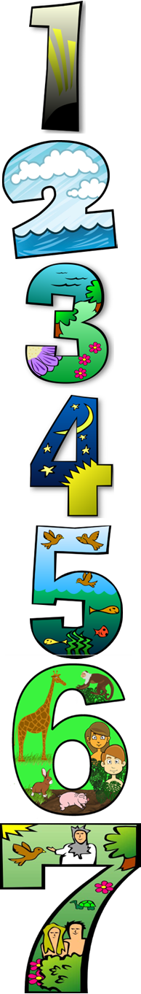
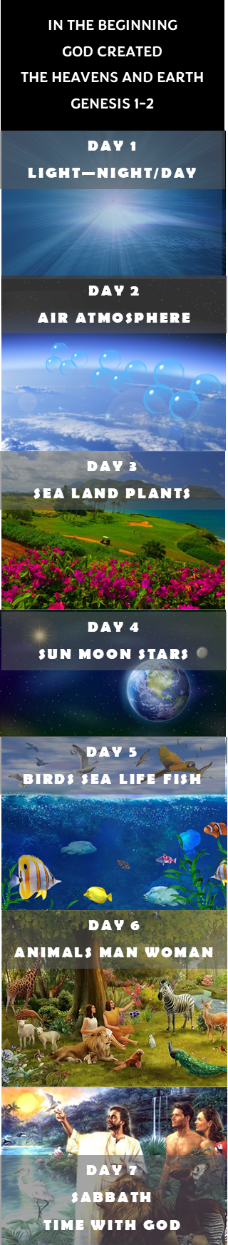
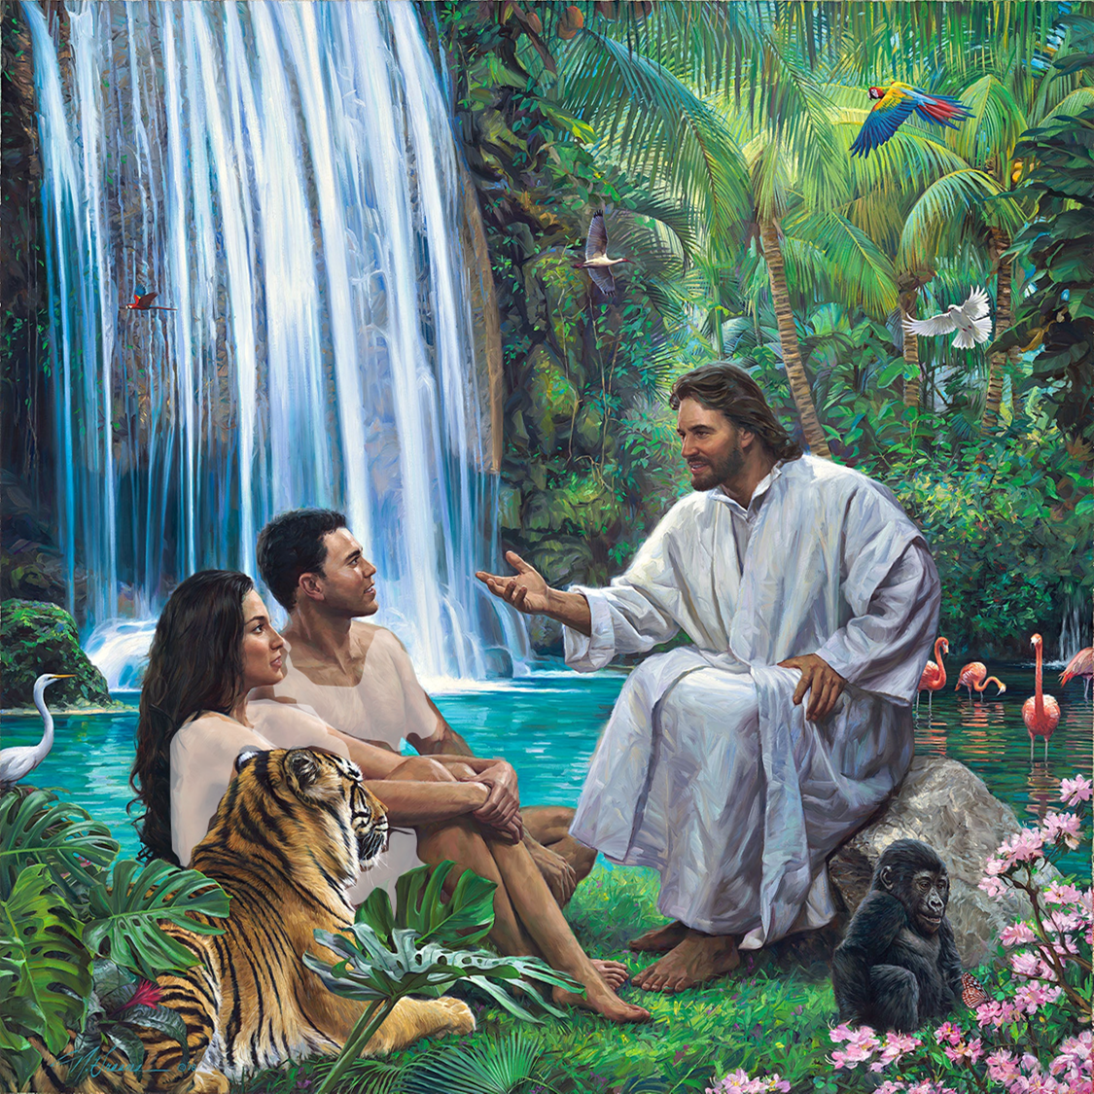
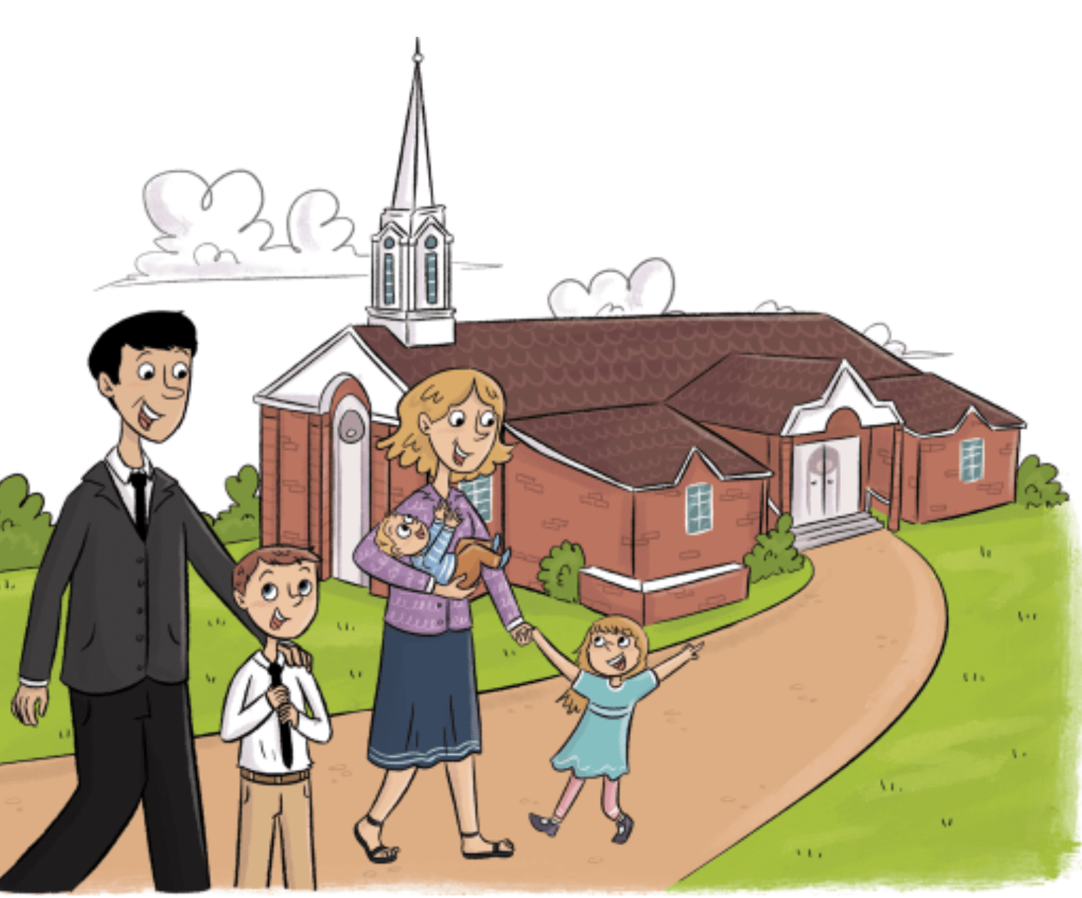
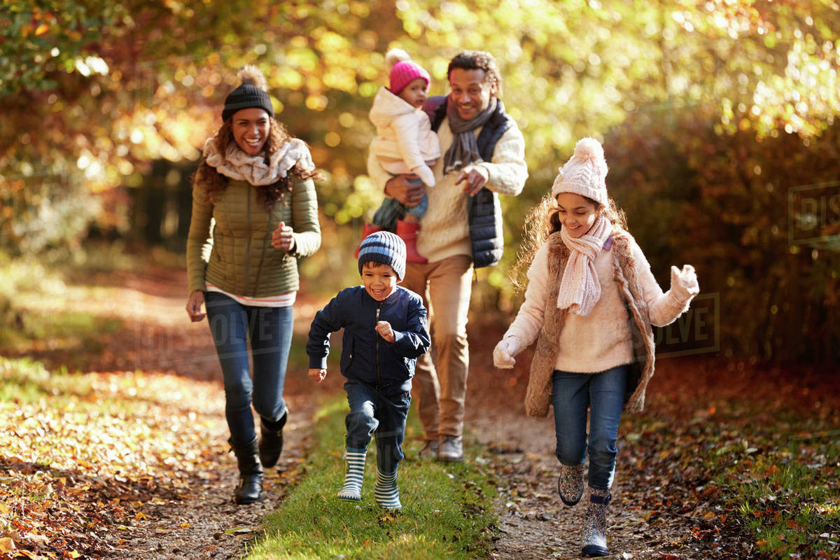
God Created then Rested
He blessed the Seventh day – Sabbath – a holy day
Genesis 1
In 6 days, God made a perfect world for you and me.
Genesis 2:1-3
“Thus, the heavens and the earth, and all the host of them, were finished. ² And on the seventh day God ended His work which He had done, and He rested on the seventh day from all His work which He had done.
³ Then God blessed the seventh day and sanctified it, because in it He rested from all His work which God had created and made.”

Slide 4
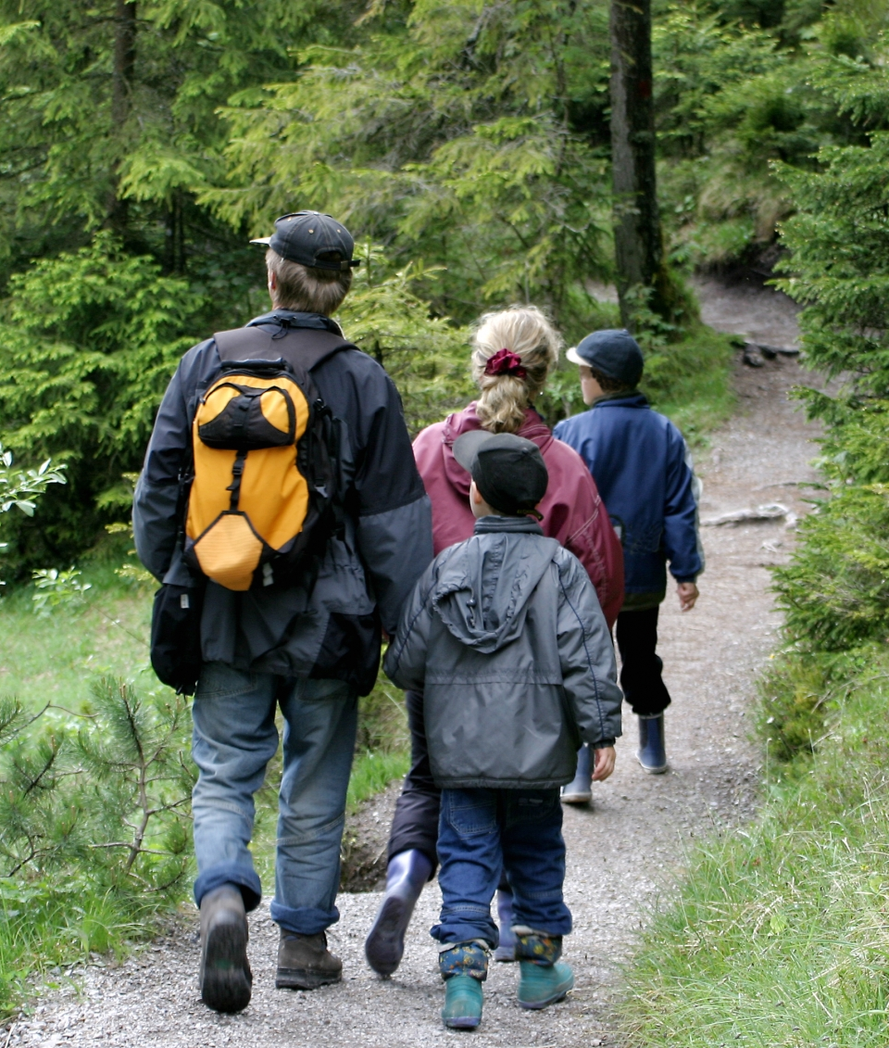
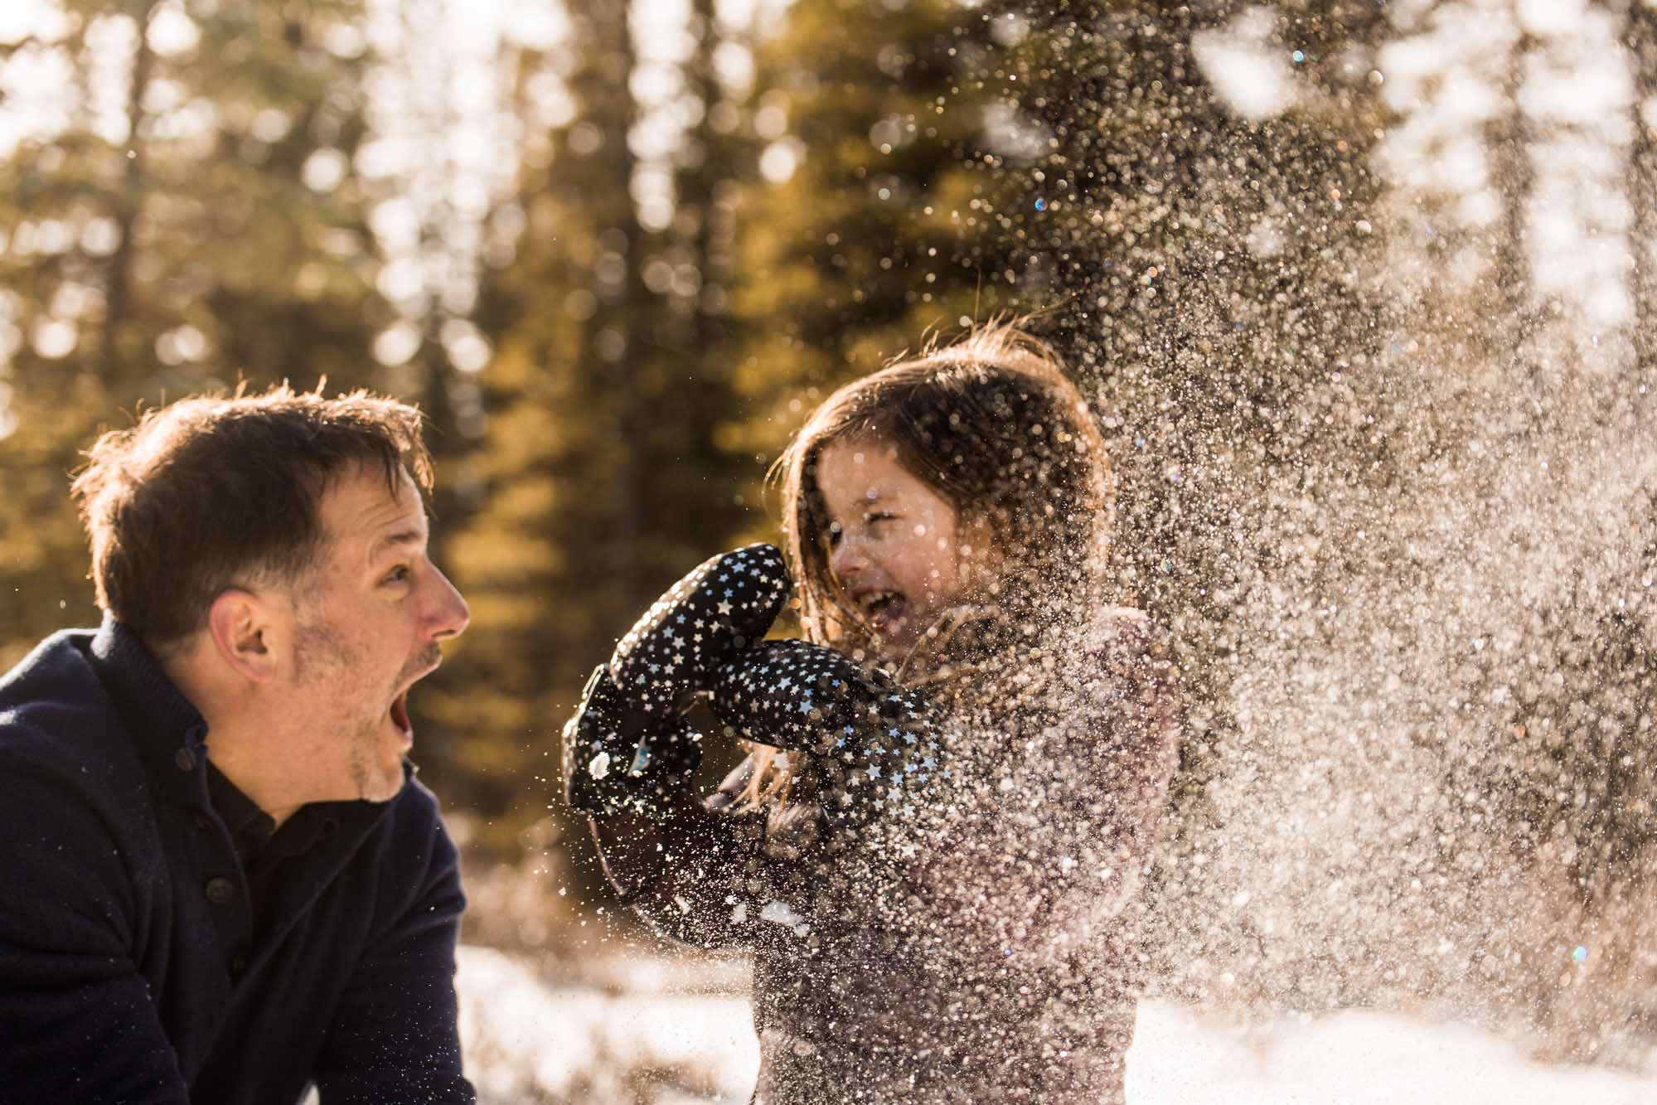

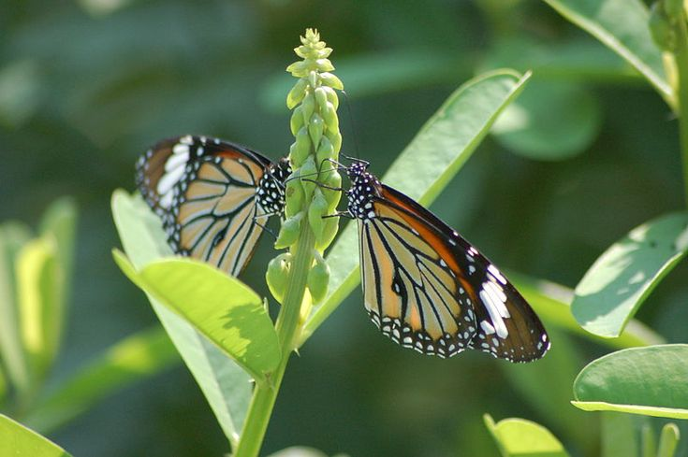
REMEMBER
God is our Creator – He made all things
On Sabbath it is fun to
Go exploring
Go for a walk
Go for a ride
And see what God has made.
Look around the room.
What can you find that
God has made?

Slide 5
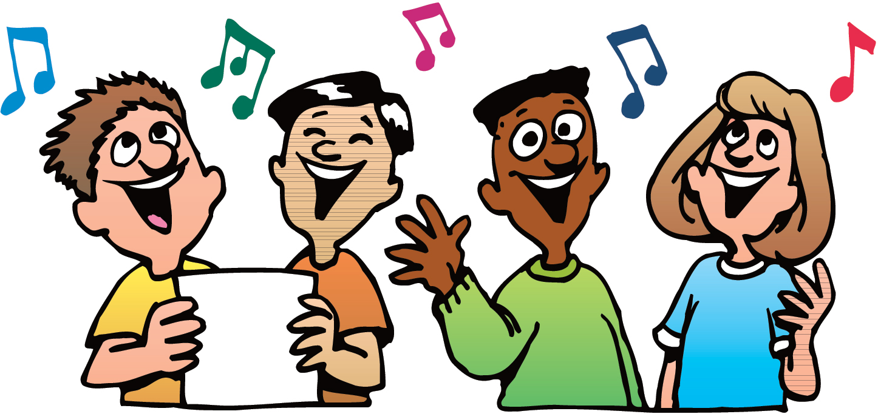
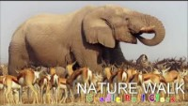
Shall We Go for a Walk Today
SING

Slide 6
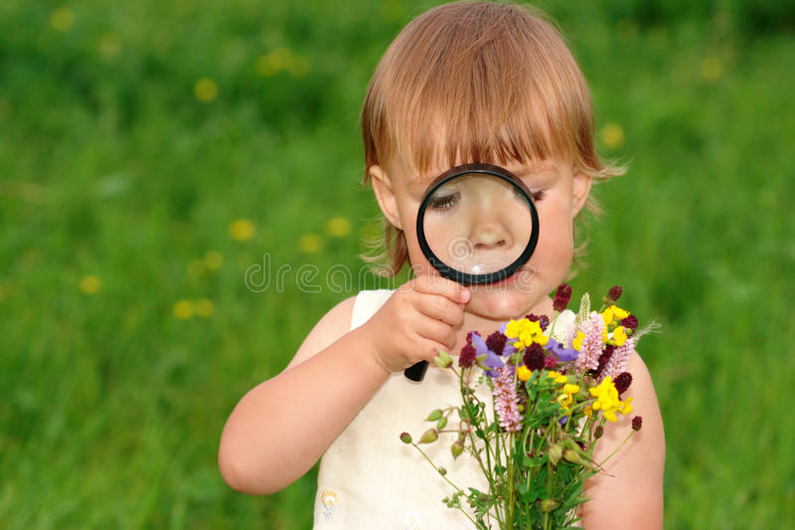
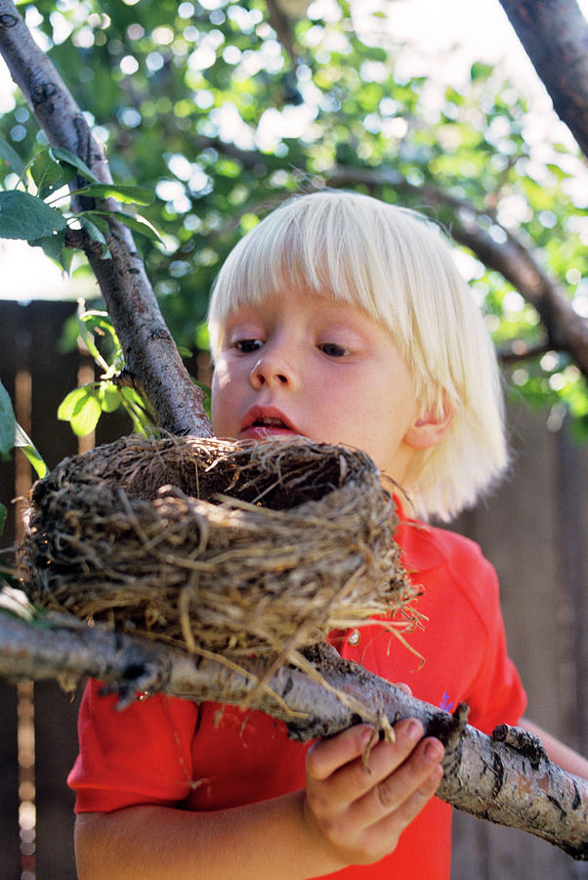
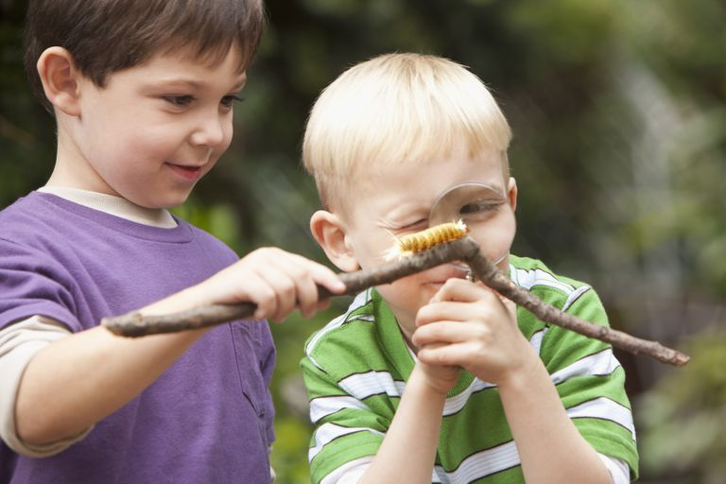
What do you notice about the nature object that you found?
Going out in nature relaxes us. Seeing God’s wonderful creation reminds us about how great He is!
God made us too! We are unique and wonderful. He loves us and takes care of us!

Slide 7
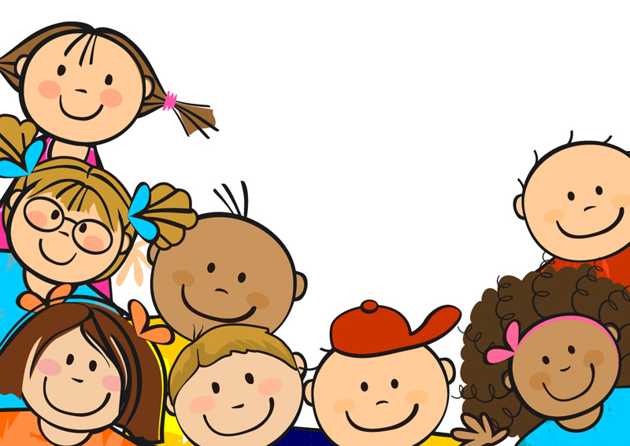
What do you enjoy doing on the Sabbath?

Slide 8
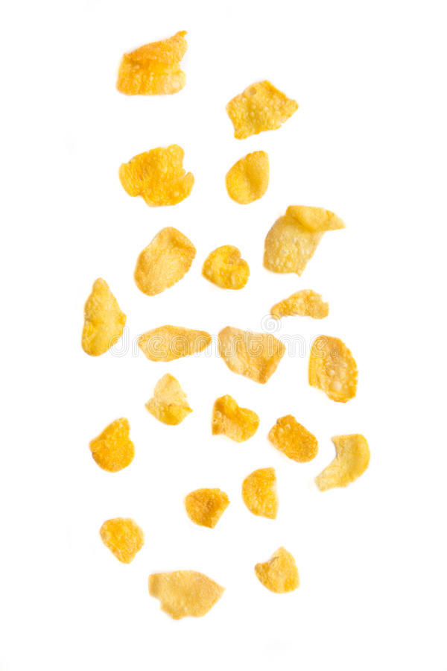
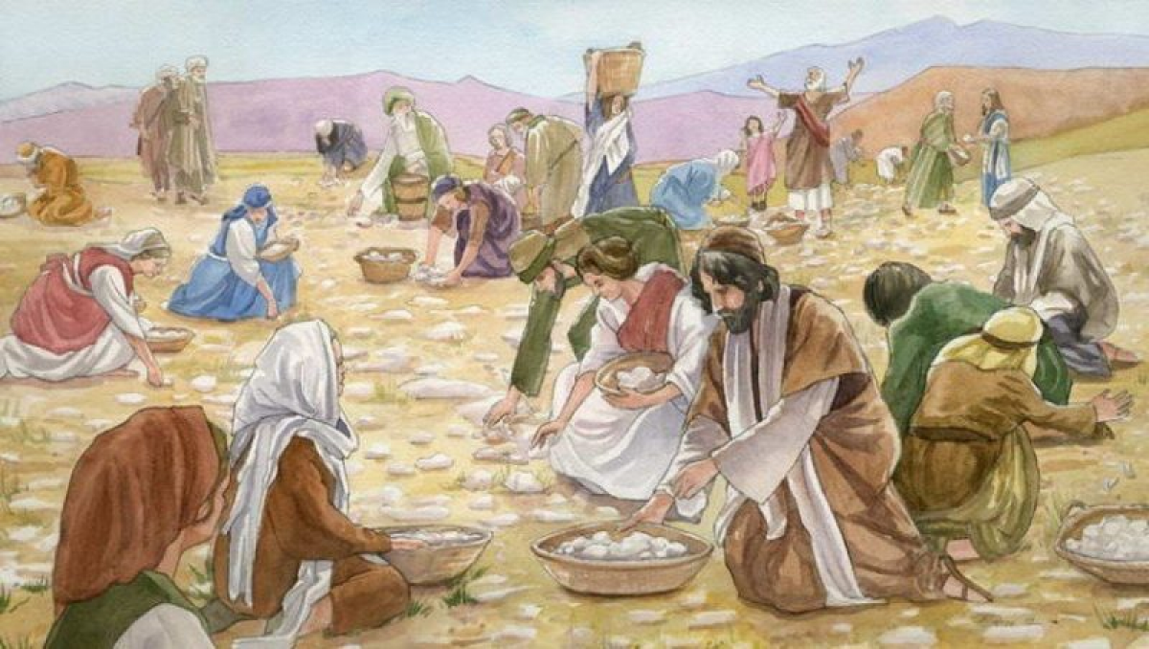
God rescued the Israelites from slavery in Egypt
Remember God provided food - manna
Exodus 16
²¹ Each morning everyone gathered as much as they needed, and when the sun grew hot, it melted away. ²² On the sixth day, they gathered twice as much—two omers^{[b]} for each person—and the leaders of the community came and reported this to Moses. ²³ He said to them, “This is what the Lord commanded: ‘Tomorrow is to be a day of sabbath rest, a holy sabbath to the Lord. So bake what you want to bake and boil what you want to boil. Save whatever is left and keep it until morning.’”
²⁴ So they saved it until morning, as Moses commanded, and it did not stink or get maggots in it. ²⁵ “Eat it today,” Moses said, “because today is a sabbath to the Lord. You will not find any of it on the ground today. ²⁶ Six days you are to gather it, but on the seventh day, the Sabbath, there will not be any.”
On Friday, gather enough for Sabbath too.
I will keep it from spoiling. I care for you.

Slide 9
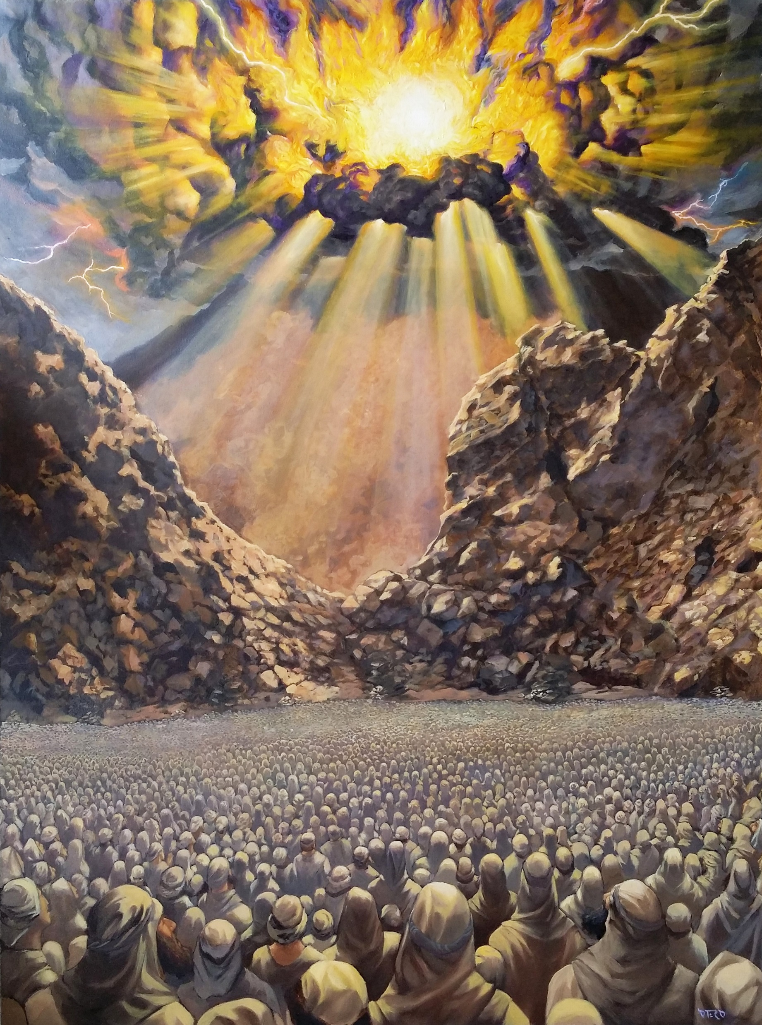
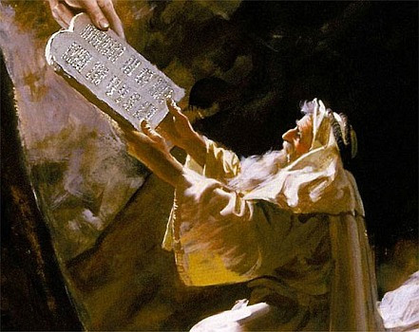
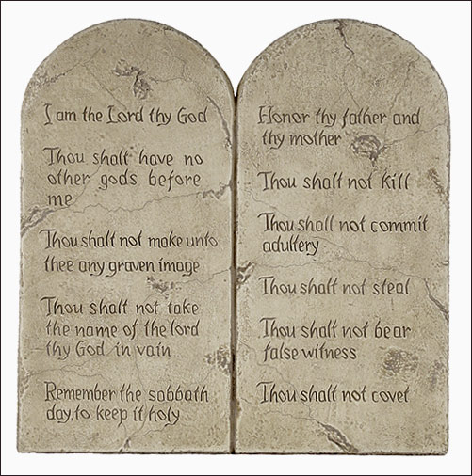
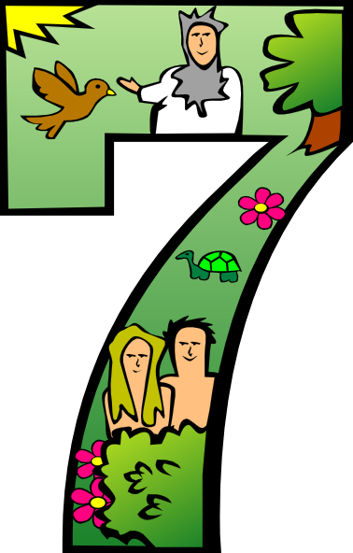
God gave a covenant of 10 commandments
#4 – Remember the Sabbath Day and keep it Holy
Remember that I am your Creator. I give you rest.
Exodus 20
⁸ “Remember the Sabbath day by keeping it holy. ⁹ Six days you shall labor and do all your work, ¹⁰ but the seventh day is a sabbath to the Lord your God. On it you shall not do any work, neither you, nor your son or daughter, nor your male or female servant, nor your animals, nor any foreigner residing in your towns.
¹¹ For in six days the Lord made the heavens and the earth, the sea, and all that is in them, but he rested on the seventh day.
Therefore, the Lord blessed the Sabbath day and made it holy.

Slide 10
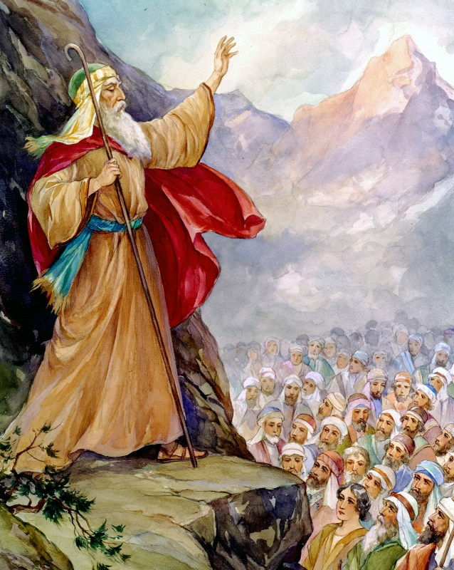
Again, Moses reminded the people
#4 – Remember the Sabbath Day and keep it Holy
Deuteronomy 6
Hear, Israel, the decrees and laws I declare in your hearing today. Learn them and be sure to follow them. ….
¹² “Observe the Sabbath day by keeping it holy, as the Lord your God has commanded you. ¹³ Six days you shall labor and do all your work, ¹⁴ but the seventh day is a sabbath to the Lord your God. On it you shall not do any work, neither you, nor your son or daughter, nor your male or female servant, nor your ox, your donkey or any of your animals, nor any foreigner residing in your towns, so that your male and female servants may rest, as you do. ¹⁵ Remember that you were slaves in Egypt and that the Lord your God brought you out of there with a mighty hand and an outstretched arm. Therefore, the Lord your God has commanded you to observe the Sabbath day.
Remember that you used to be slaves and God delivered you.
Let others rest, too.

Slide 11


Slide 12
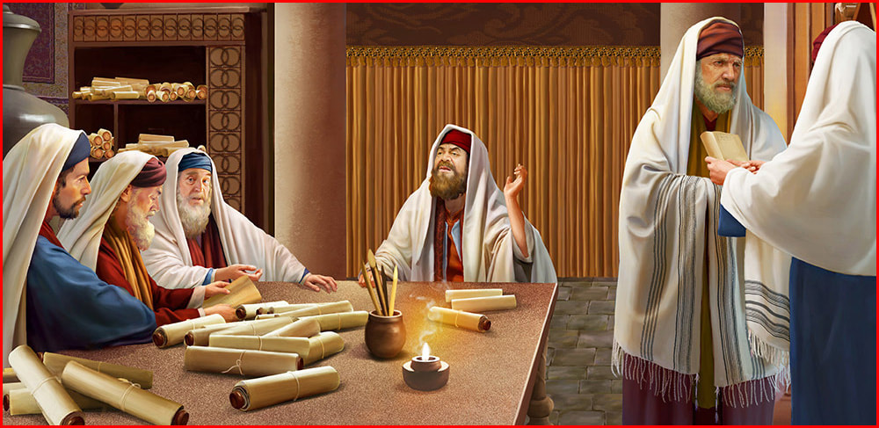
More and More Laws
People need to know what work is.
No one should work!
The Pharisees made many, many laws about the Sabbath.
  Don’t carry anything – not even a tissue!
  Don’t build a fire
  Don’t even harvest – Not 1 little thing
  Don’t walk more than a mile
  Don’t…. Don’t….. Don’t…..
Sabbath was no longer a delightful day.

Slide 13

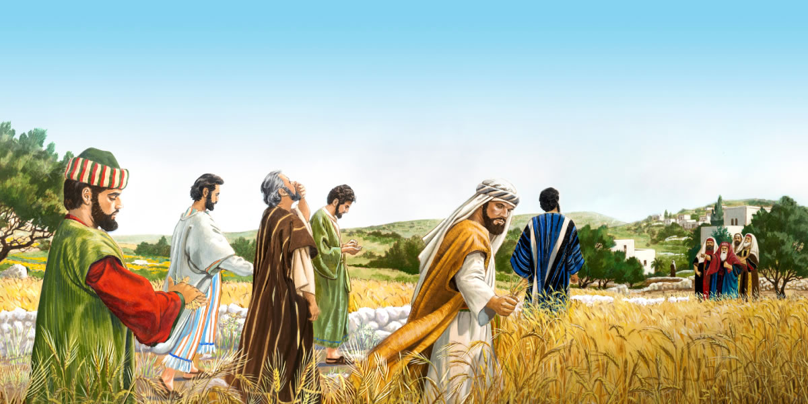
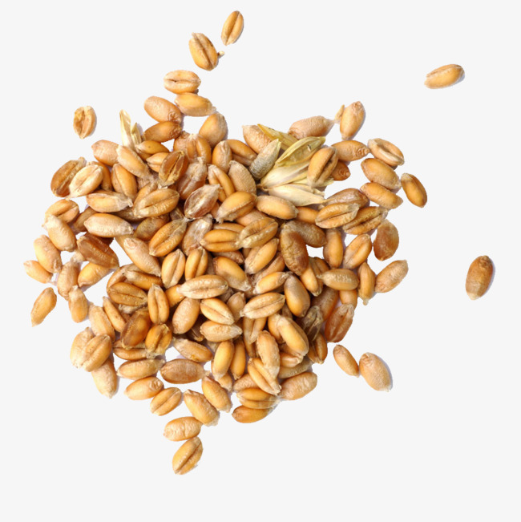
Enjoy God’s Provisions
Mark 2:23-28
²³ Now it happened that He went through the grainfields on the Sabbath; and as they went His disciples began to pluck the heads of grain.
²⁴ And the Pharisees said to Him, “Look, why do they do what is not lawful on the Sabbath?”
Look. Why are they not keeping our laws?

Slide 14
Harvesting or Eating God’s Provisions?
Mark 2:23-28
²⁵ But He said to them, “Have you never read what David did when he was in need and hungry, he and those with him: ²⁶ how he went into the house of God in the days of Abiathar the high priest, and ate the showbread, which is not lawful to eat except for the priests, and also gave some to those who were with him?”
²⁷ And He said to them, “The Sabbath was made for man, and not man for the Sabbath. ²⁸ Therefore the Son of Man is also Lord of the Sabbath.”
They are keeping the Sabbath.
The Sabbath was made for man.

Slide 15


Snack Time
Choose a snack
Enjoy what God has given.

Slide 16
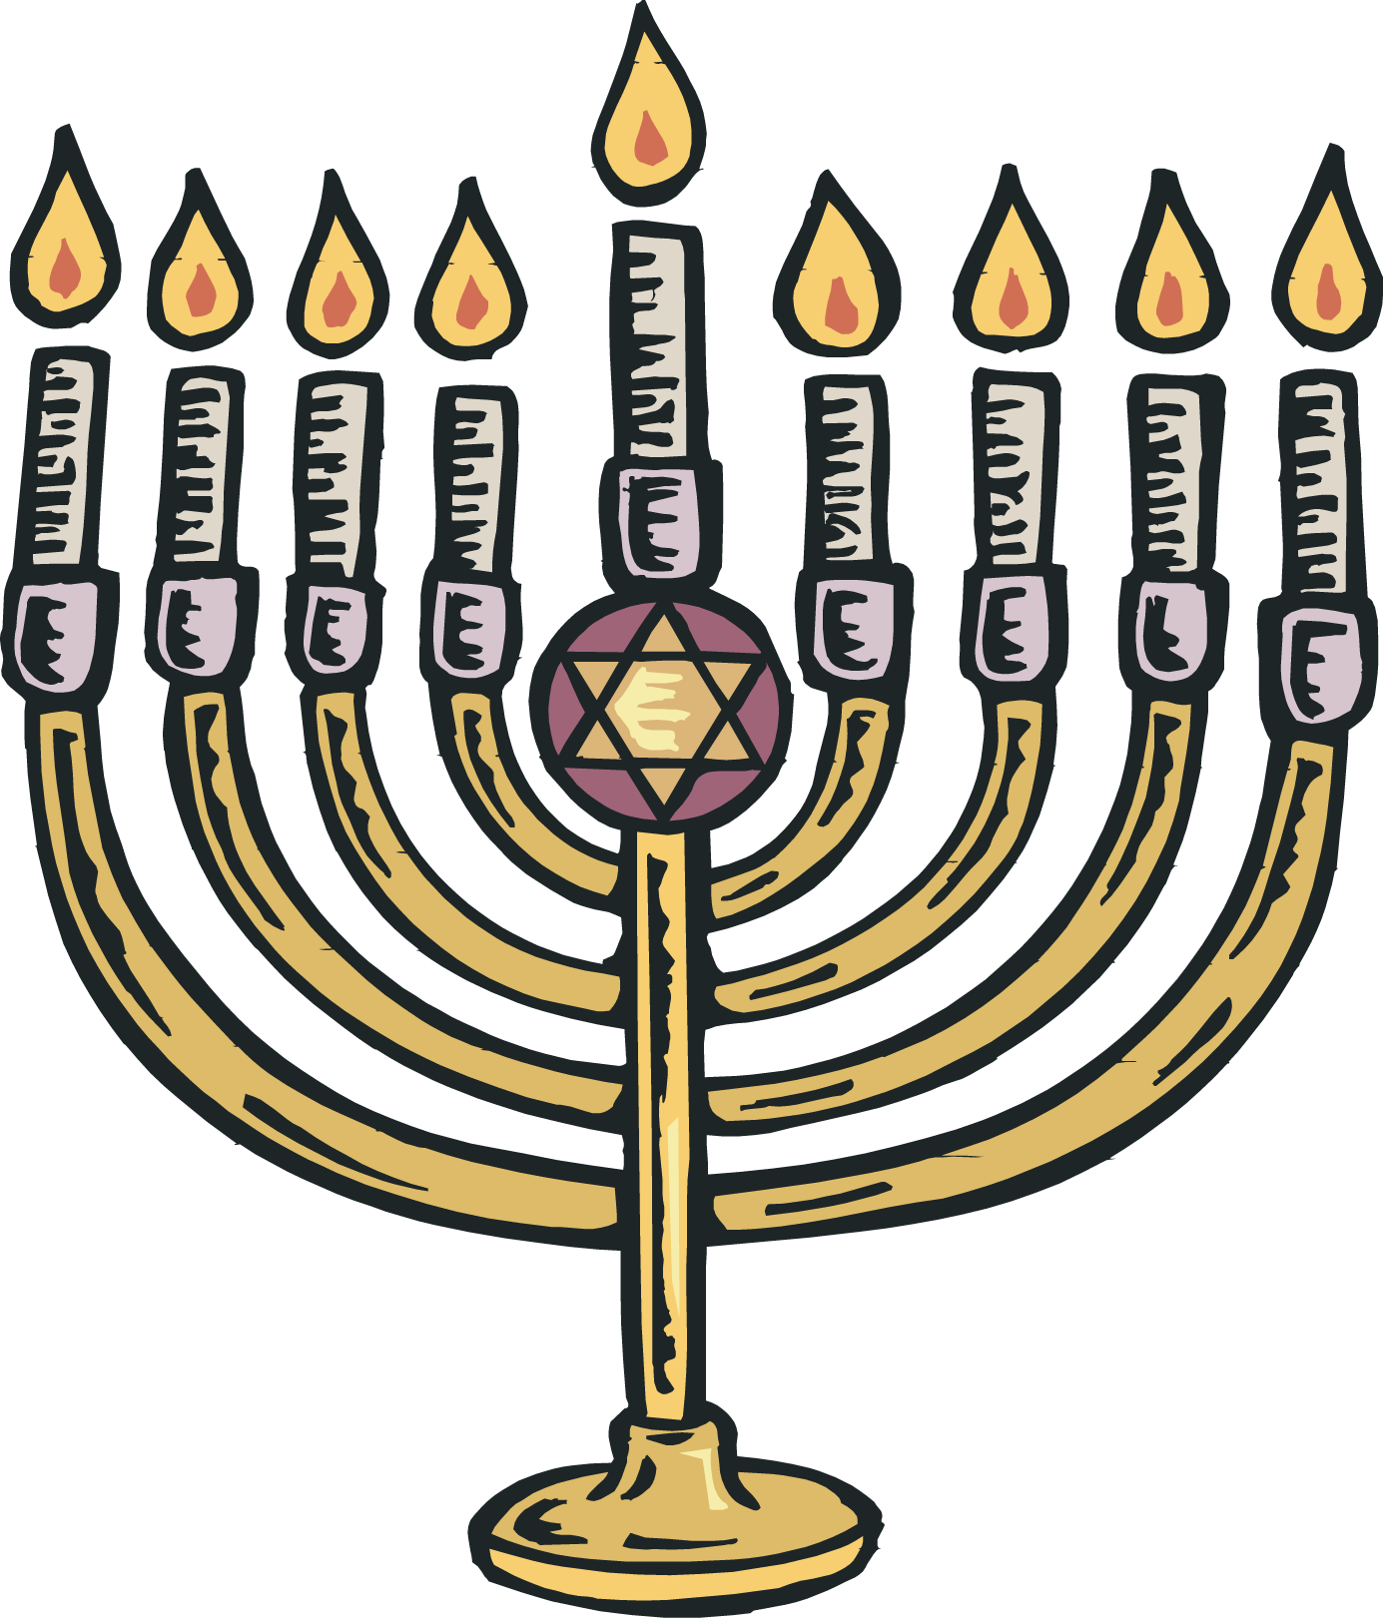
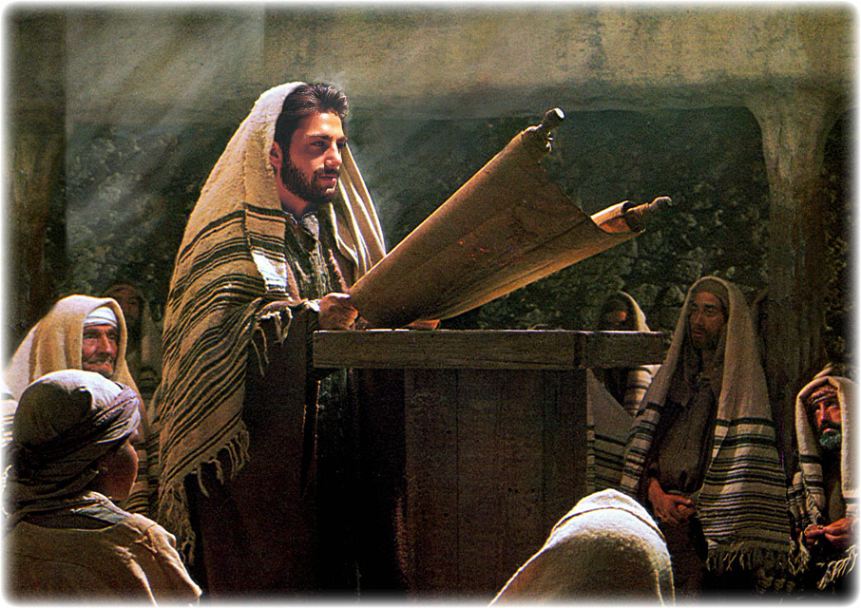
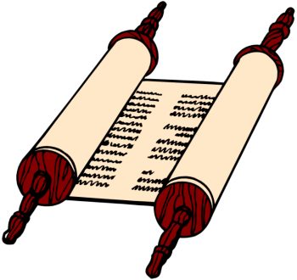
Each Sabbath Jesus went to church at the synagogue and taught the people.
Luke 4
¹⁴ Jesus returned to Galilee in the power of the Spirit, and news about him spread through the whole countryside. ¹⁵ He was teaching in their synagogues, and everyone praised him.
¹⁶ He went to Nazareth, where he had been brought up, and on the Sabbath day he went into the synagogue, as was his custom. He stood up to read,

Slide 17
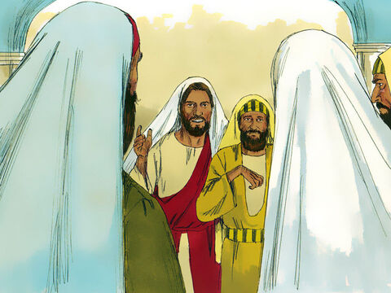
Each Sabbath Jesus went to church at the synagogue
Will Jesus heal on Sabbath?
Isn’t that work?
Mark 3:1-6
3 Another time when Jesus went into a synagogue, a man with a crippled hand was there.
² Some people there wanted to see Jesus do something wrong so they could accuse him. They watched him closely to see if he would heal the man on the Sabbath day.
How terrible would that be?
Try it. Hold your hand in a crooked way.
What could you not do?

Slide 18

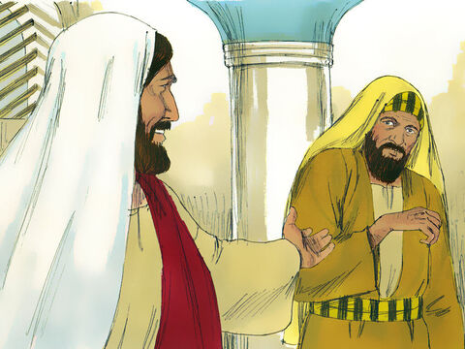

Each Sabbath Jesus went to church at the synagogue
Which is right to do on the Sabbath? Is it better to do good or to do evil?
Mark 3:1-6
³ Jesus said to the man with the crippled hand, “Stand up here in front of everyone.”
⁴ Then Jesus asked the people, “Which is right on the Sabbath day: to do good, or to do evil? Is it right to save a life or to destroy one?” But they said nothing to answer him.
⁵ Jesus was angry as he looked at the people. But he felt very sad because they were stubborn.

Slide 19
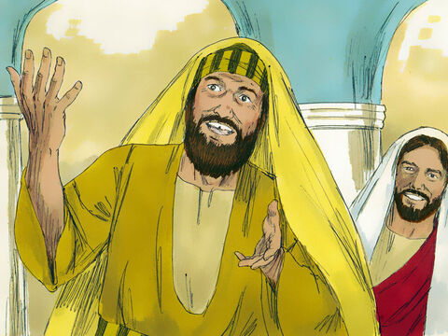
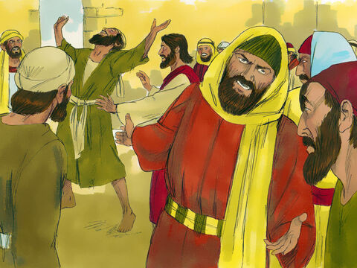

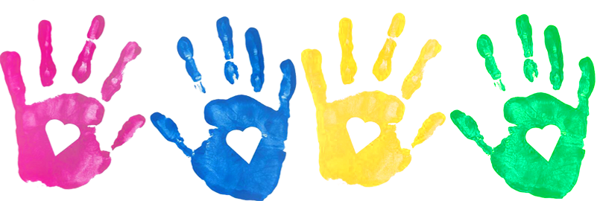
Do good on the Sabbath. Care for others.
Jesus healed the sick even on the Sabbath.
Mark 3:1-6
Then he said to the man, “Let me see your hand.” The man put his hand out for Jesus, and it was healed.
⁶ Then the Pharisees left and began making plans with the Herodians^{[c]} about a way to kill Jesus.
How sad that they didn’t rejoice with the man and praise God. How sad that they wanted to kill Jesus!

Slide 20
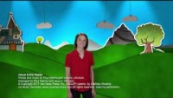
Jesus is the Healer
SING

Slide 21
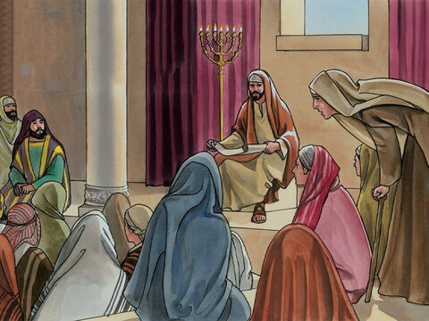
Each Sabbath Jesus went to church at the synagogue He taught the people and healed the sick.
Luke 13:10-17
¹⁰ On a Sabbath Jesus was teaching in one of the synagogues, ¹¹ and a woman was there who had been crippled by a spirit for eighteen years. She was bent over and could not straighten up at all.
How terrible would that be?
Try it. Walk around stooped over.
What could you not do?

Slide 22
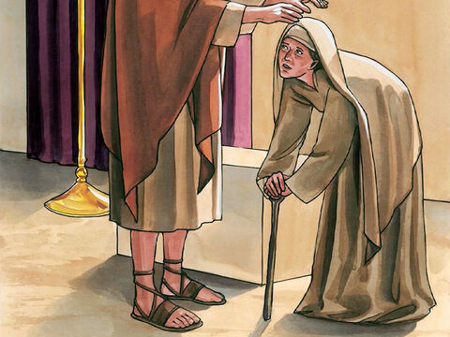
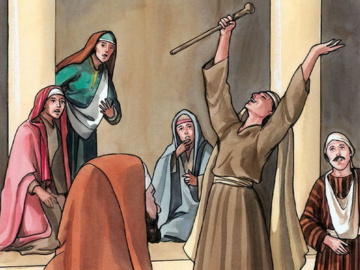
Each Sabbath Jesus taught the people and healed the sick.
He set them FREE!
Hallelujah!
Praise God!
Luke 13:10-17
¹² When Jesus saw her, he called her forward and said to her, “Woman, you are set free from your infirmity.” ¹³ Then he put his hands on her, and immediately she straightened up and praised God.
Stand up
and
Praise God!
PRAISE GOD!

Slide 23
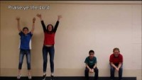
Praise Ye the LORD
SING

Slide 24
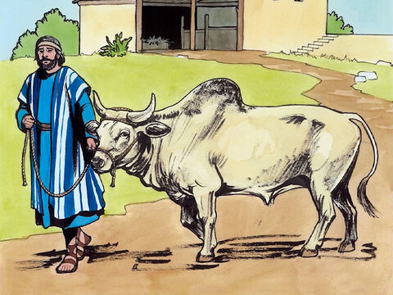
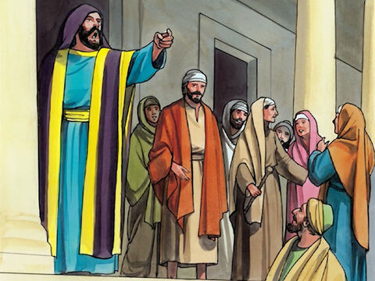
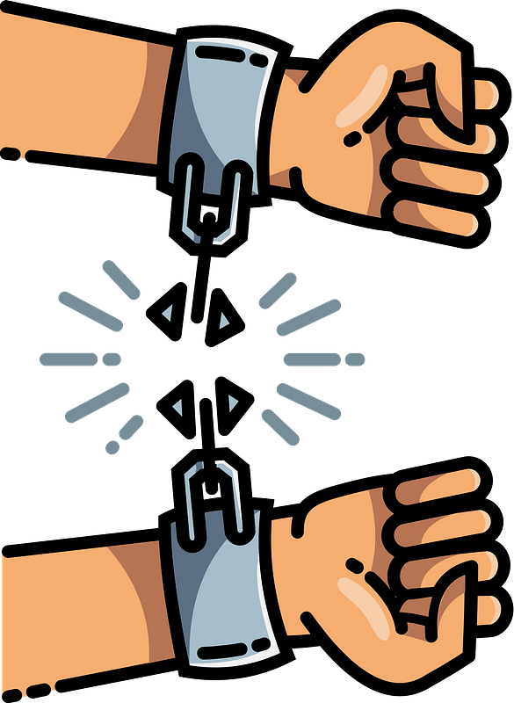

Do good on the Sabbath!
Offer people freedom.
There are 6 days to be healed. Come to Jesus on those days.
Luke 13:10-17
¹⁴ Indignant because Jesus had healed on the Sabbath, the synagogue leader said to the people, “There are six days for work. So come and be healed on those days, not on the Sabbath.”
¹⁵ The Lord answered him, “You hypocrites! Doesn’t each of you on the Sabbath untie your ox or donkey from the stall and lead it out to give it water? ¹⁶ Then should not this woman, a daughter of Abraham, whom Satan has kept bound for eighteen long years, be set free on the Sabbath day from what bound her?”
¹⁷ When he said this, all his opponents were humiliated, but the people were delighted with all the wonderful things he was doing.
That is not right!
There are 6 days to work.
You untie your oxen so it can drink.
It is right to give freedom!

Slide 25
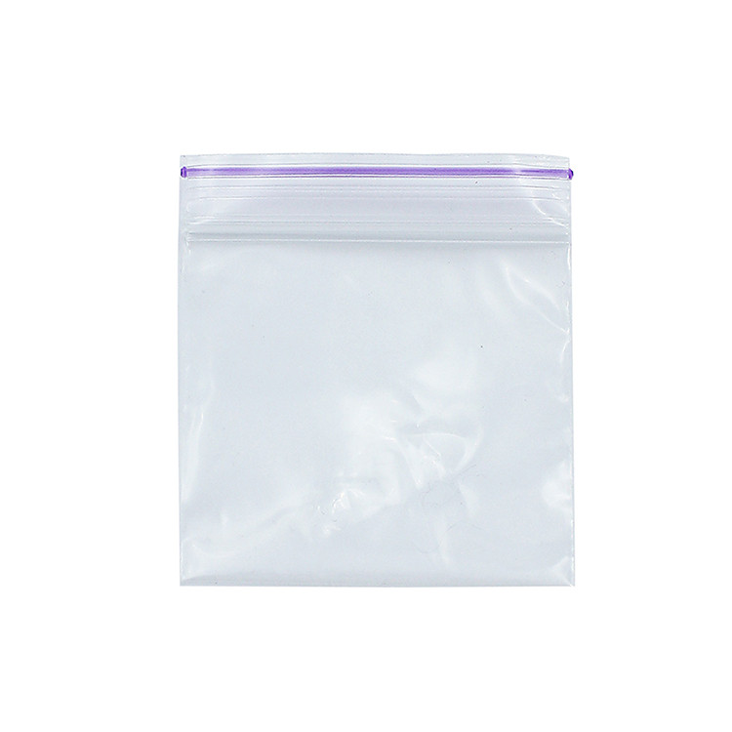
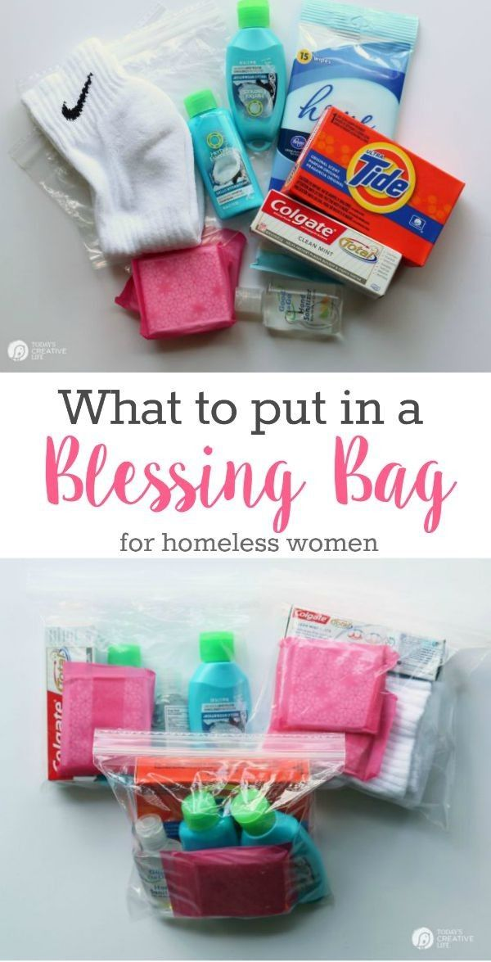
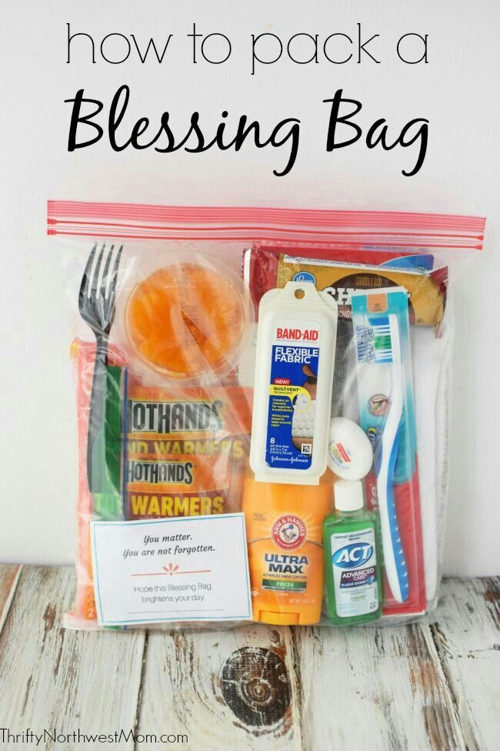
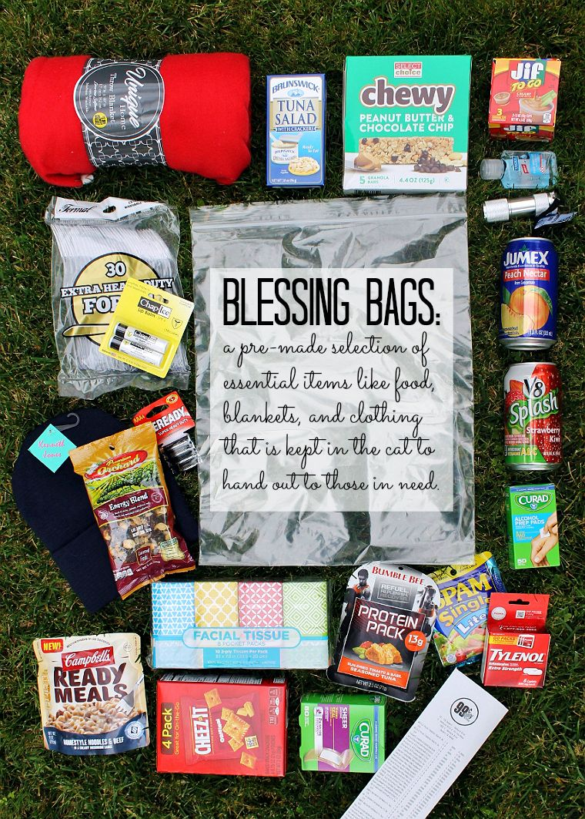
Do Good – Care for One Another
Project Time -- Blessing Bag
What would you put inside a Blessing bag?

Slide 26
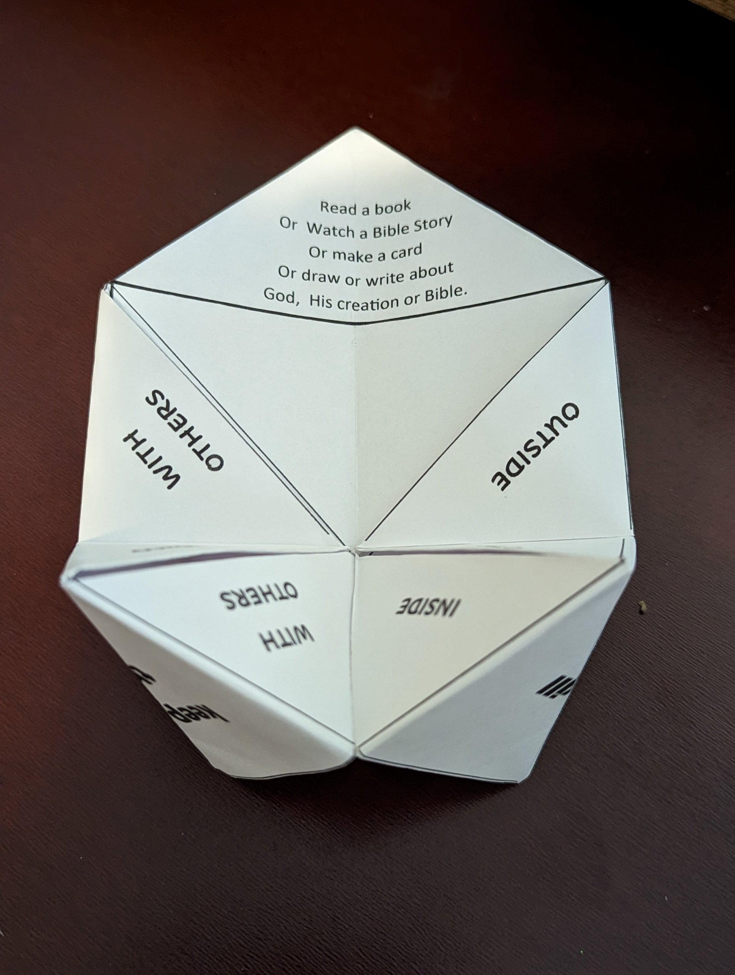
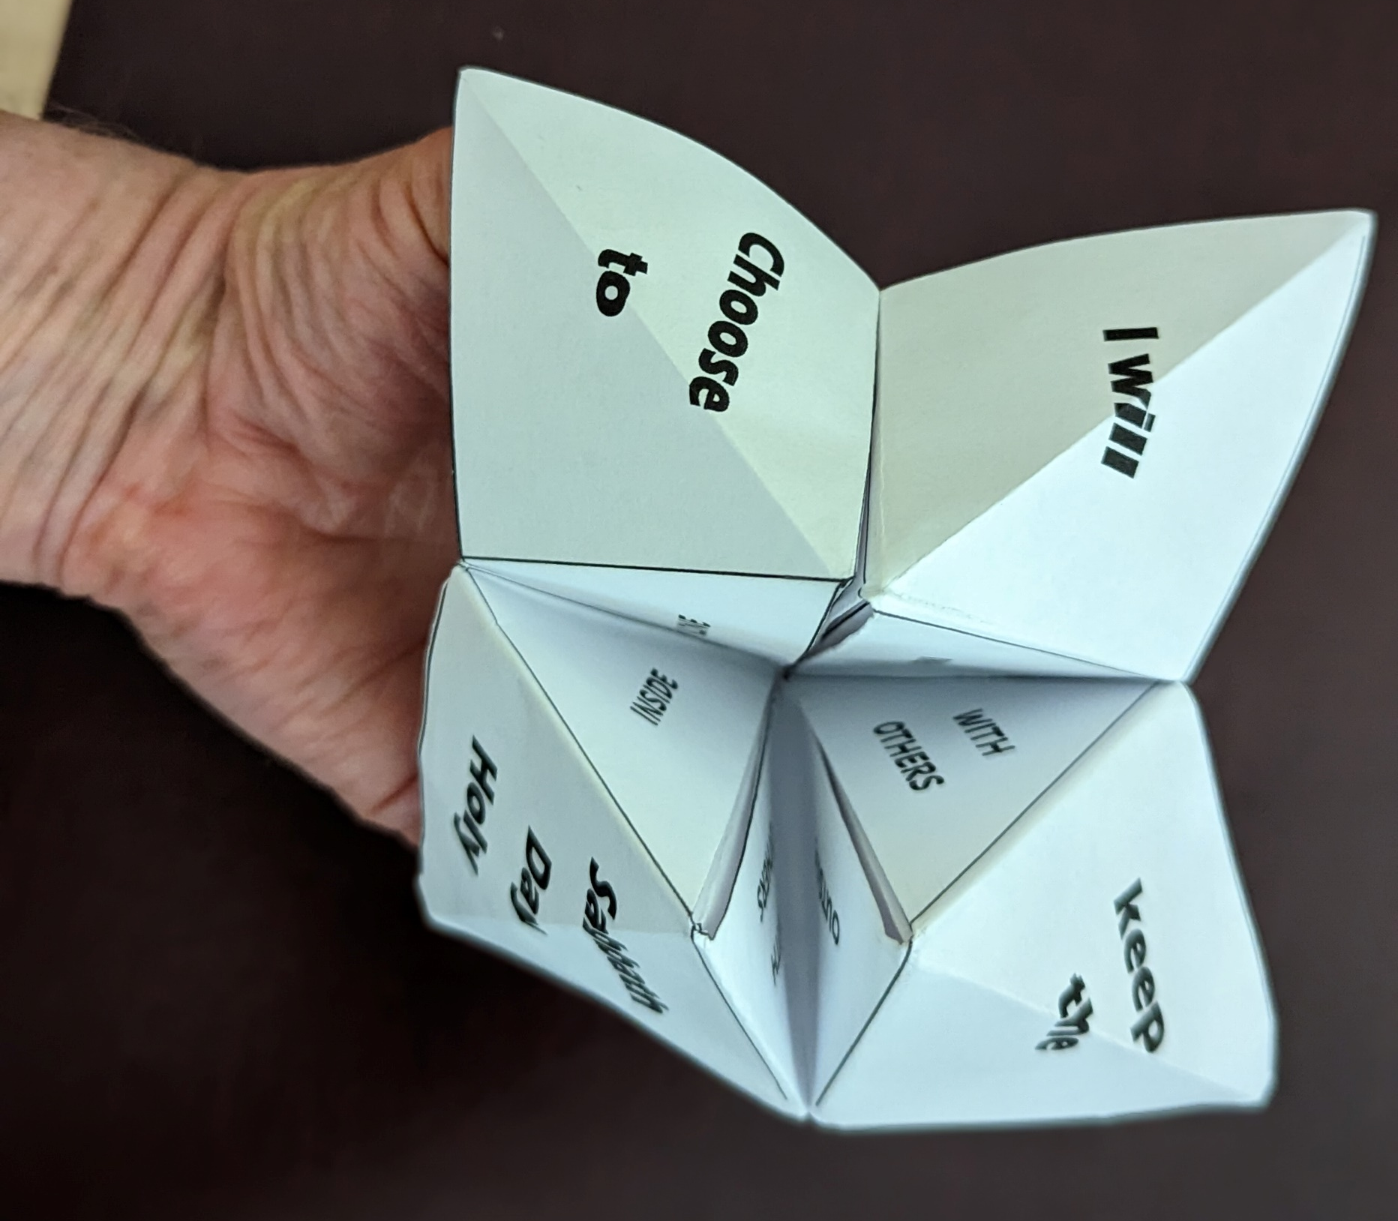
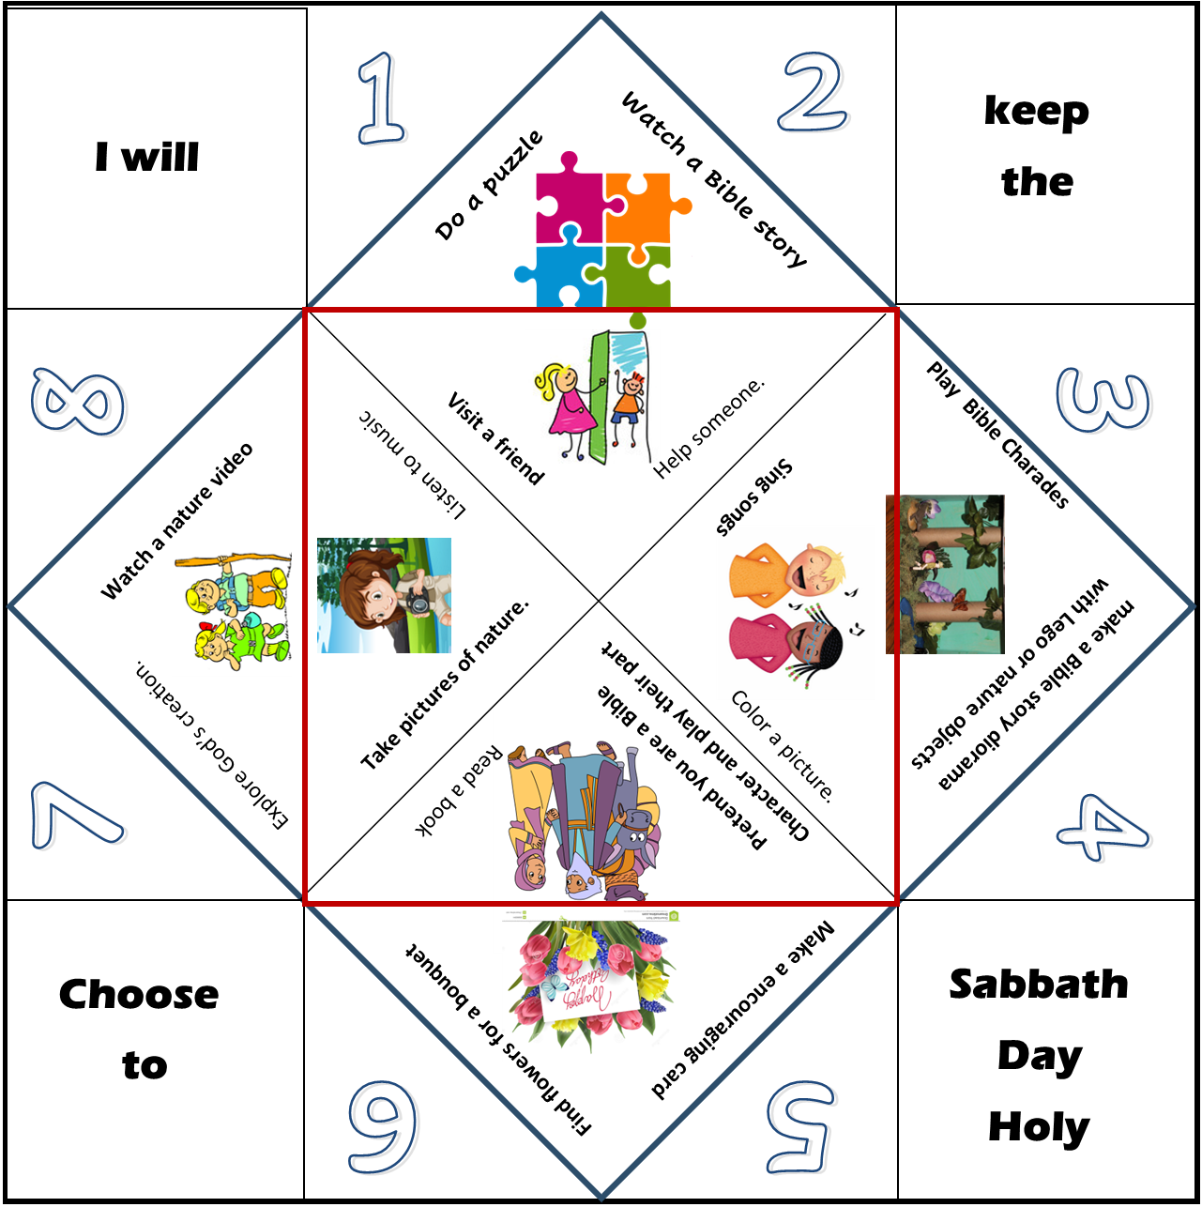

Sabbath Activity Suggestions (Fortune Teller)
Craft Time
Directions: Cut the top and bottom black lines to make a square.
Turn the paper printed side down
Fold a tip of the square towards the center. Fold on the blue line. Repeat for each of the corners.
Flip the paper over. Fold the tips of the now smaller square into the center and fold on the red line. Repeat for each of the corners.
Fold in half. Open. Fold in half the other way.

Slide 27
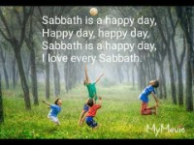

Slide 28


Slide 30
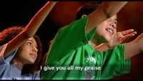

Slide 31


Slide 32

https://activity-array.com/

