Slide 1
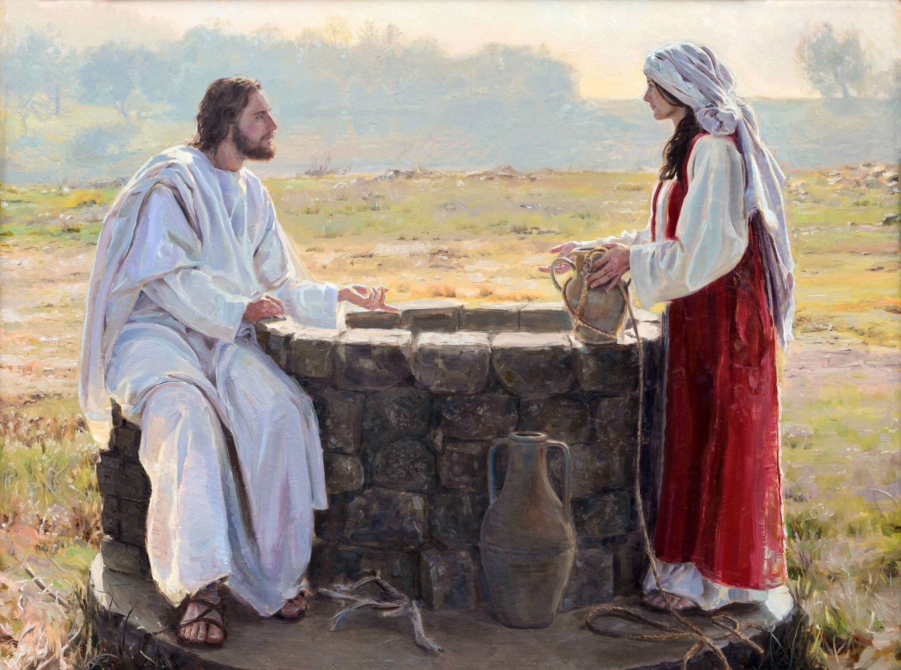
Woman at the Well
John 4:1-42

Slide 2
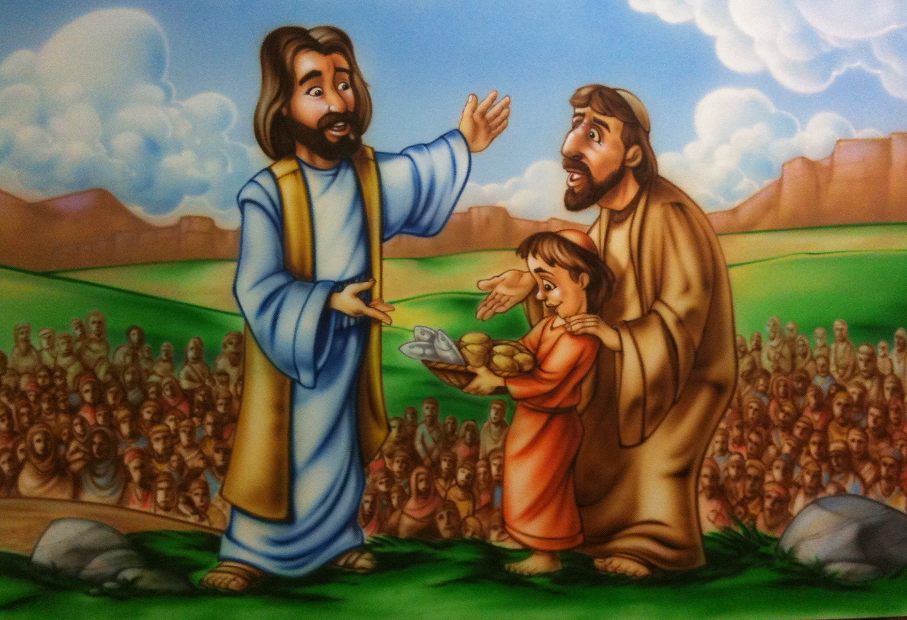
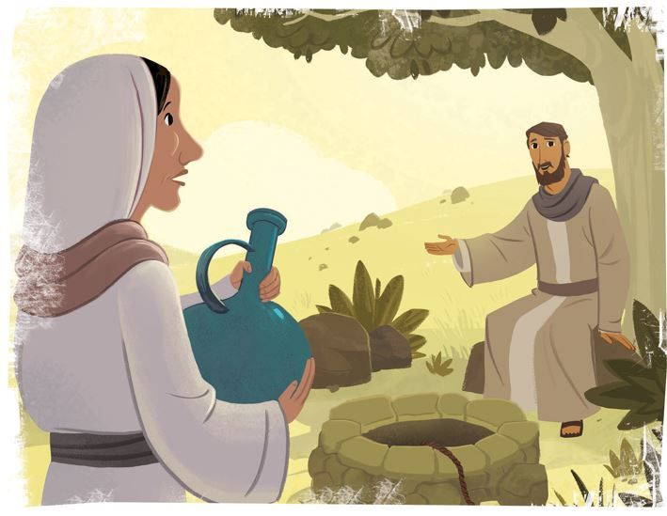
Jesus feeds the hungry
Jesus said:
“Blessed are those who hunger and thirst for righteousness,
for they will be filled.”
Matthew 5:6
Jesus satisfies the thirsty

Slide 3


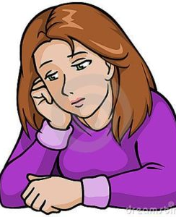

Our story today is about a very sad lady.
z
Have you ever felt sad?
Why might you be sad?
Lonely
Bad
Hurt
Unloved

Slide 4
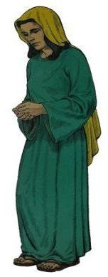

She had a lot of questions.
z
Does anybody love me?
Does God love me?
Where should I pray? How should I pray?
Would God even listen to me?
Will somebody save me?

Slide 5
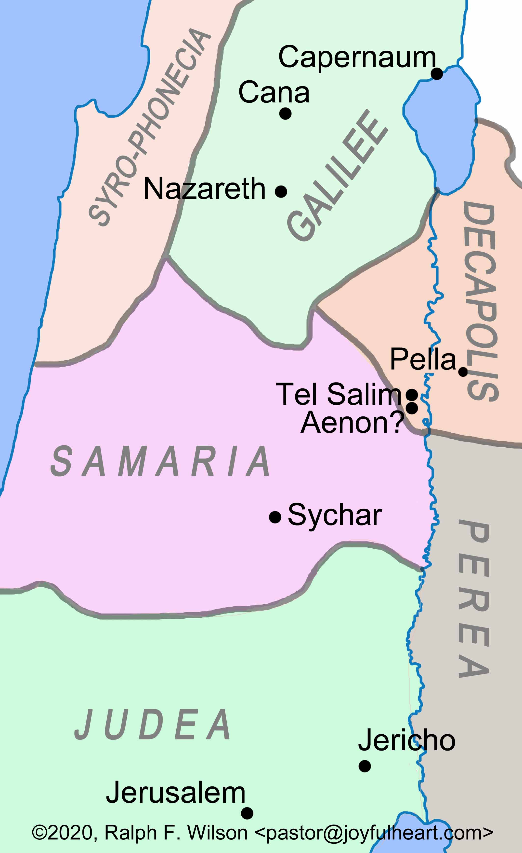
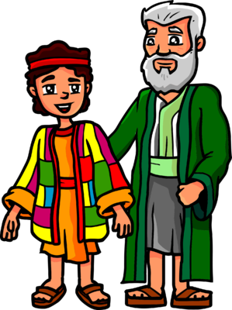

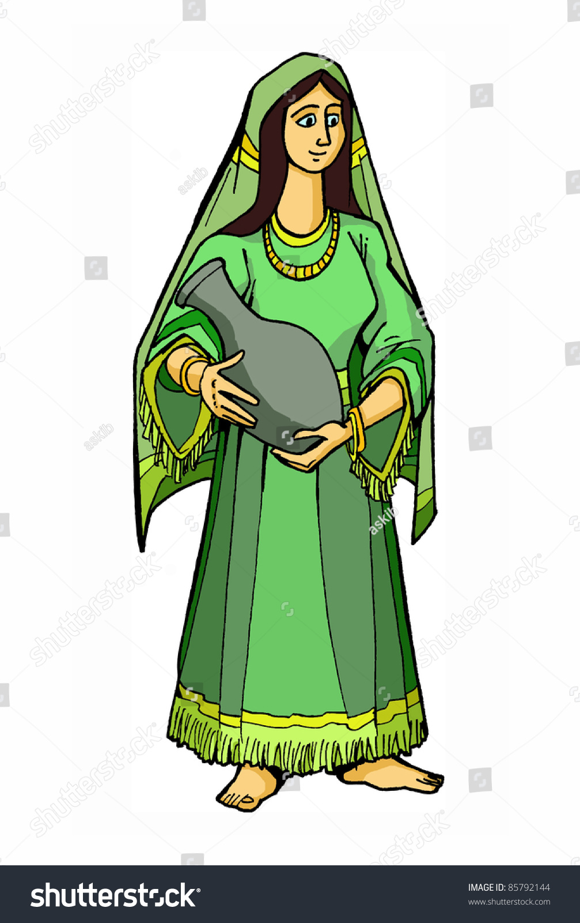
She lived in Sychar in the area of Samaria.
z
That was near the land that Jacob gave to Joseph a long time before.
It was where Jacob had dug a very deep well.
Every day the ladies would go get water from the well.
But this lady didn’t go when the other ladies went. Maybe they made fun of her.
Men didn’t love her either! She had been rejected and divorced 5 times!

Slide 6
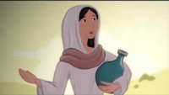
Let’s watch our story.
You can find it in John 4

Slide 7
Now do you know the answers to her questions.
z
Does anybody love me?
Does God love me?
Where should I pray?
How should I pray?
Would God even listen to me?
Will somebody save me?
It didn’t feel like it.
YES!
Pray anywhere
In spirit and truth.
Be honest with God
YES!
YES! Jesus!

Slide 8
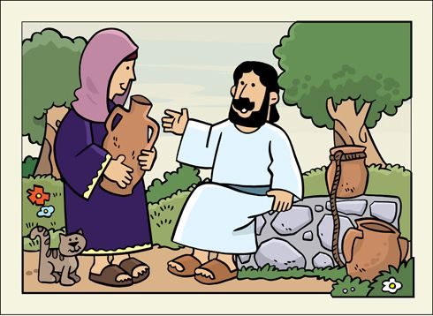
Jesus was thirsty
She gave him a drink
She was thirsty for truth and love
Jesus was friendly and showed his love for her. He told her truth that gave her joy!
Are you thirsty?

Slide 9
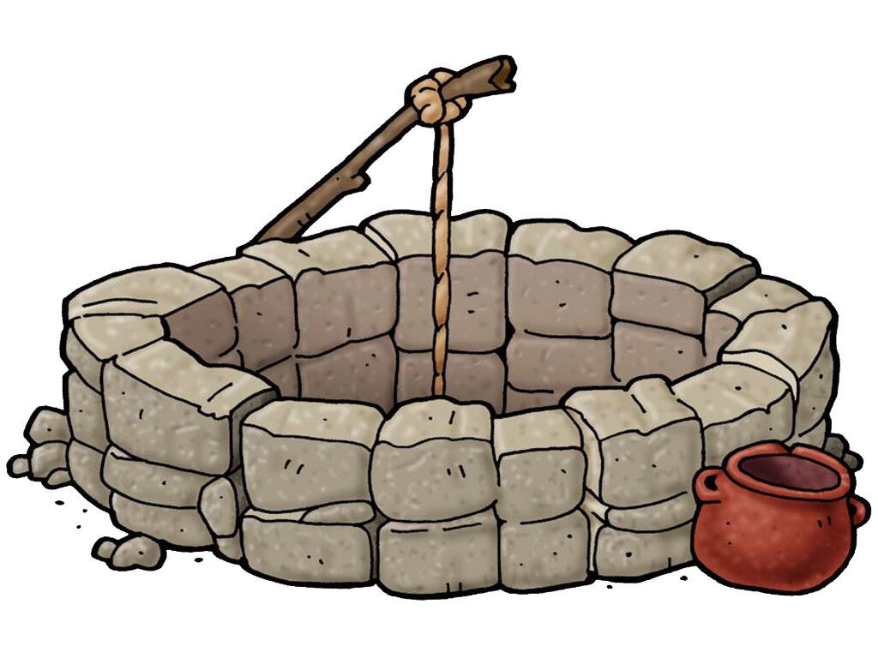

Pull up some water from our well.
God loves you
He forgives
He gives LIFE!

Slide 10
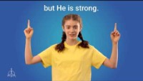
Jesus Love Me
I know you.
You are important to me.
Jesus knows me and
loves me!
Come hear him!

Slide 11
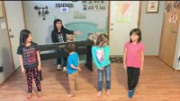
I’ve Got a River of Life
I’ve got a river of life flowing out of me
May it spring up in me and make me whole

Slide 12
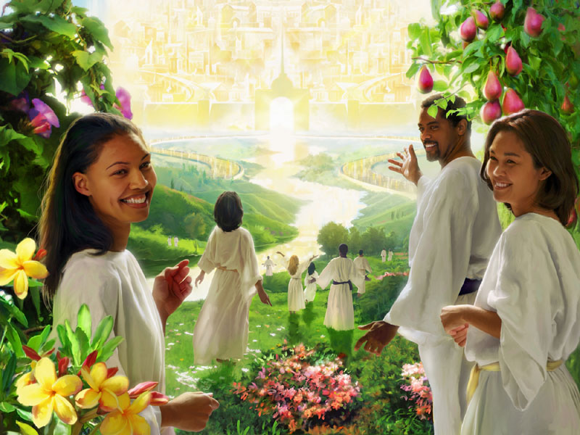
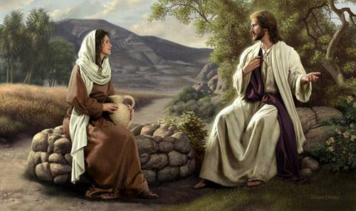
¹³ Jesus answered,
“Everyone who drinks this water will be thirsty again,
¹⁴ but whoever drinks the water I give them will never thirst.
Indeed, the water I give them will become in them a spring of water welling up to eternal life.”

Slide 13
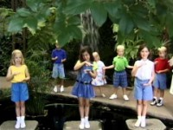
Deep and Wide

Slide 14
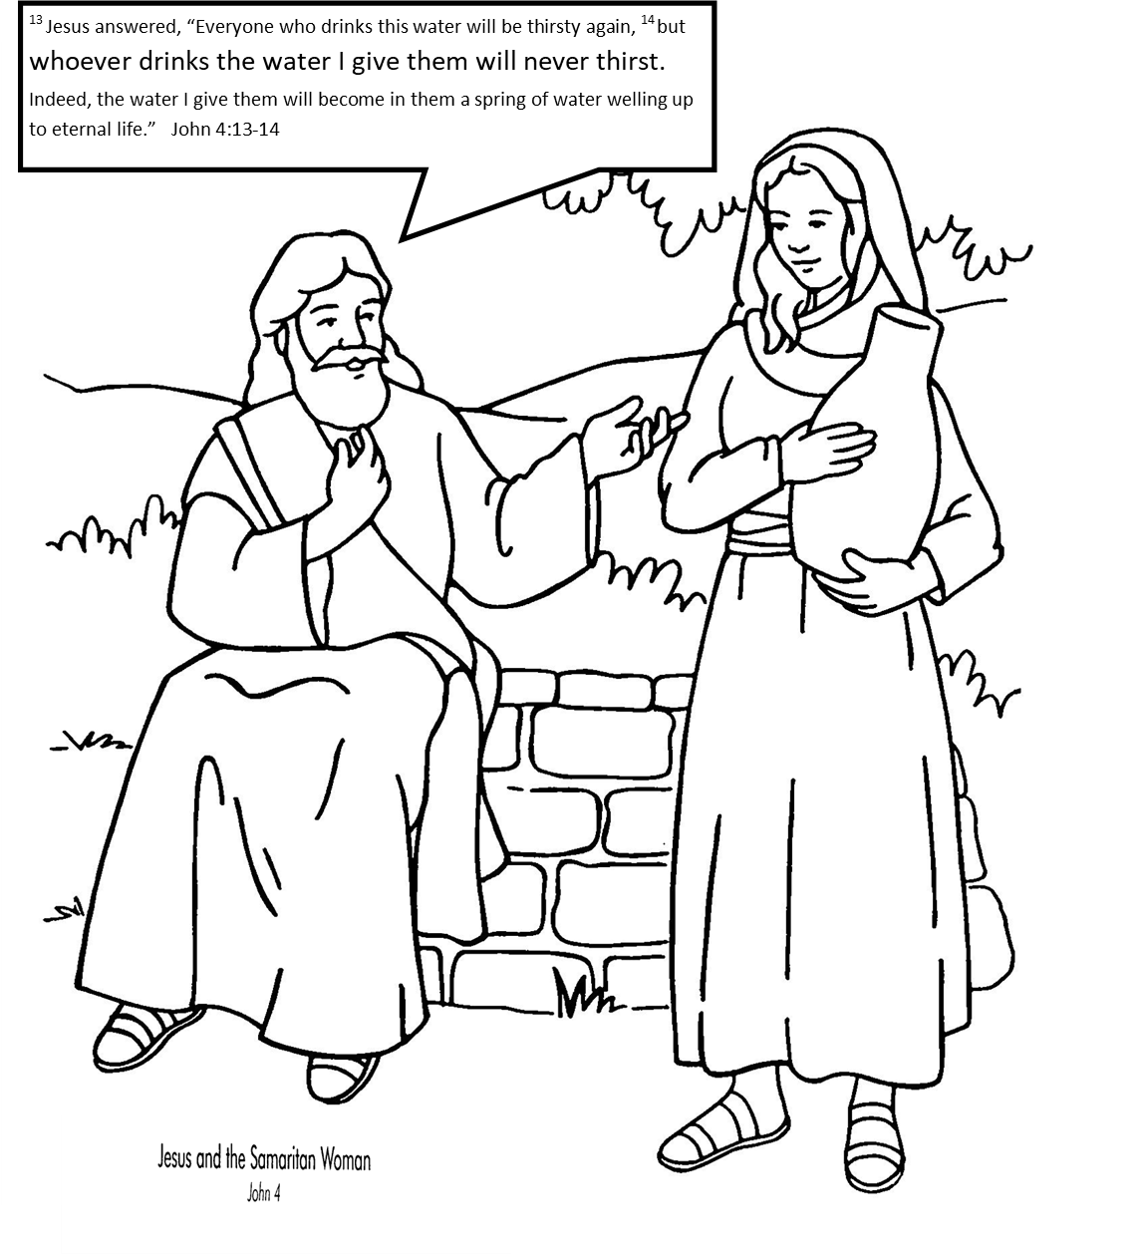
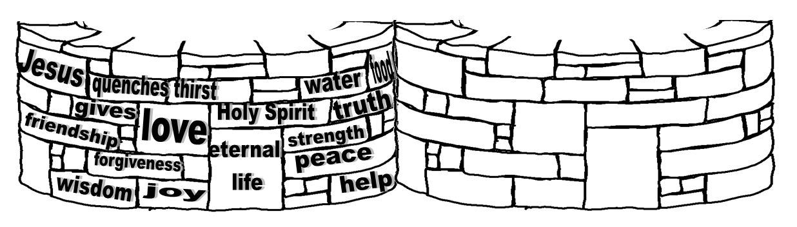
CRAFT TIME option 1
Color the picture
Fold where the dotted line is – at the feet
Cut out the well.
Tape the ends together to make a well and put it in front of Jesus and the woman.
What does Jesus give us?

Slide 15
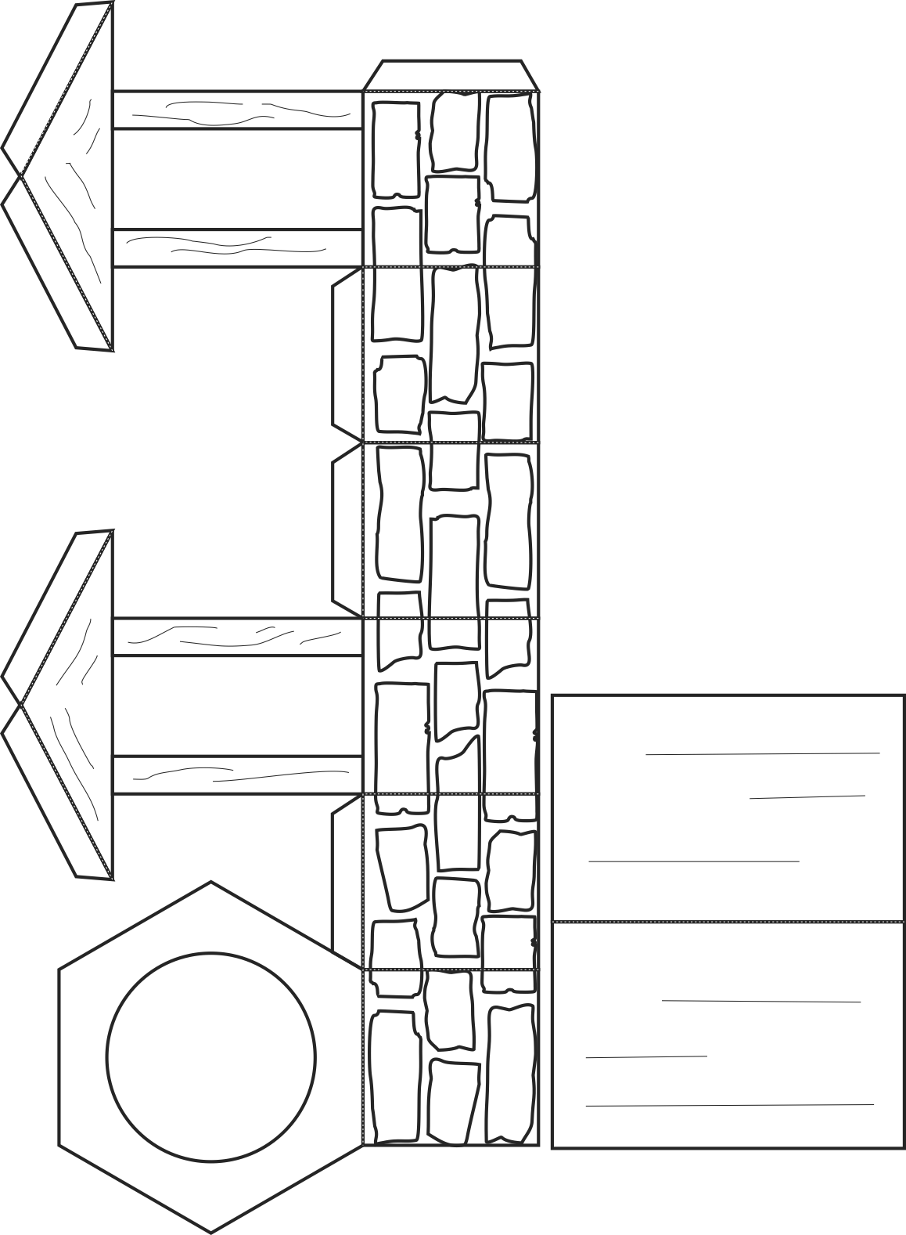
CRAFT TIME option 2
Craft from my children’s curriculum
Color the picture
Cut it out.
Fold on the dotted lines to make a well.
Glue the top of the well down onto the tabs.
Glue the roof on top of the triangles.

Slide 16


Jesus told the lady to ask for living water. What is this living water?
Israelites cherished fresh water. They called fresh water, living water. It was water from God.
Rain
Springs
River
Well
It makes things grow! It gives them life!
Experience it:
Spray water
Pour water
Drink water

Slide 17
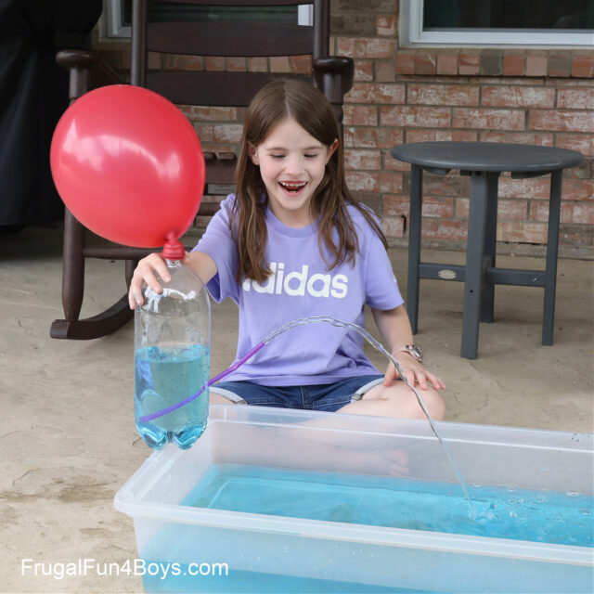
Object Lesson
Jesus is like the water – He fills us up.
The Holy Spirit is like the balloon – When we have the Holy Spirit in our lives, God’s living water, His love will overflow to others.
https://frugalfun4boys.com/water-fountain-science-experiment/

Slide 18
God loves you! He gives you life!
Isaiah wrote that just like God sends living water which gives life to plants, animals, and us; He would send His Holy Spirit to help us know God and receive eternal life.
For I will pour water on the thirsty land,
and streams on the dry ground;
I will pour out my Spirit on your offspring,
and my blessing on your descendants.
Isaiah 44:3

Slide 19
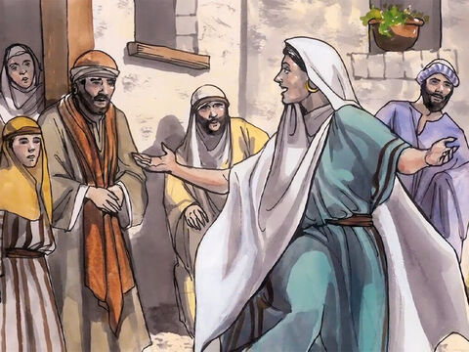
Thank you God for eternal life!
Isaiah wrote that then people would praise God and tell all nations about God’s love.
Surely God is my salvation;
I will trust and not be afraid….
³ With joy you will draw water
from the wells of salvation.
In that day you will say:
“Give praise to the Lord, proclaim his name;
make known among the nations what he has done,
Isaiah 12:2-4

Slide 20
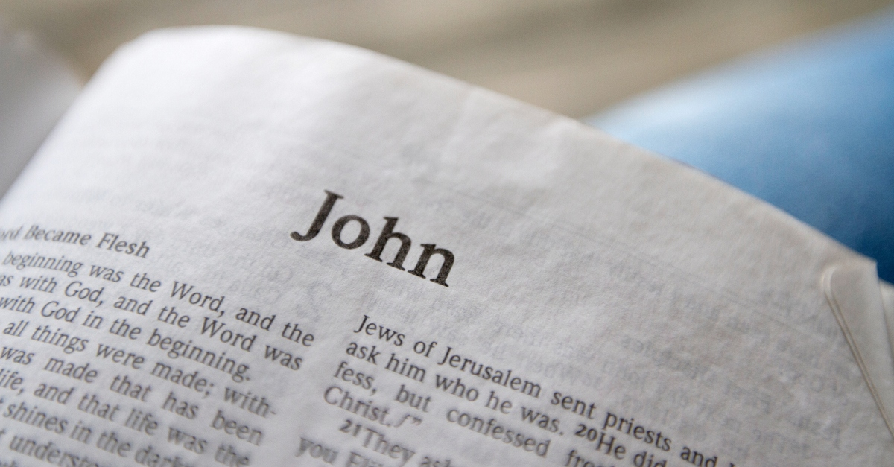
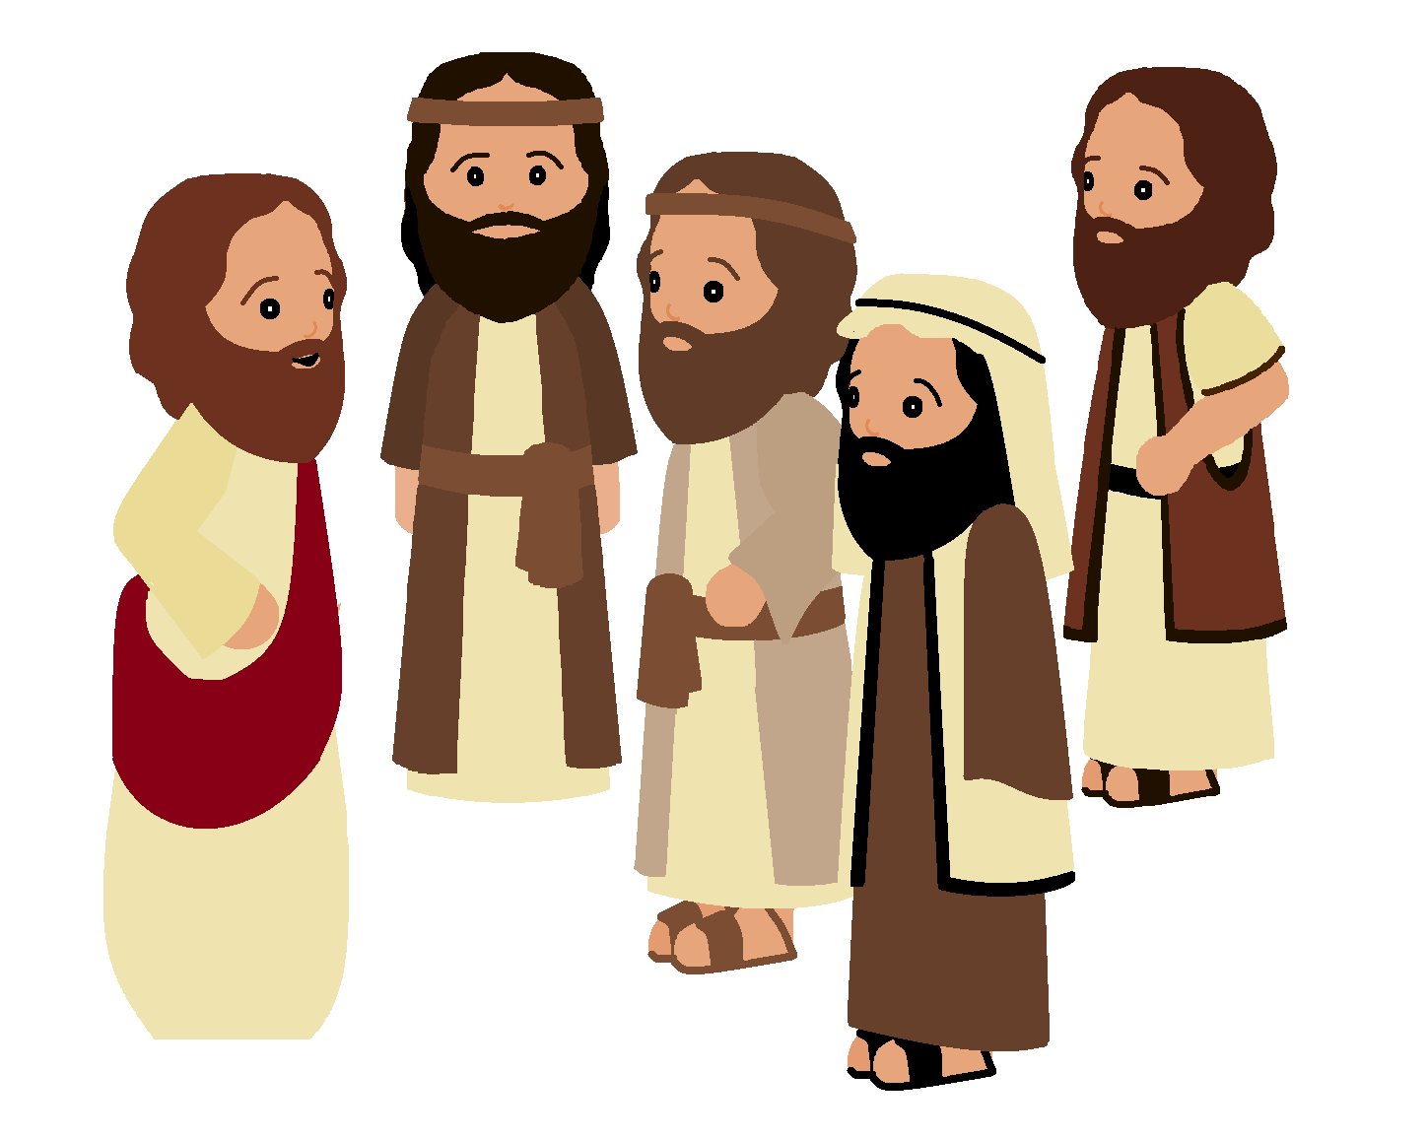
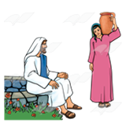
Let’s take a look at the disciples’ part of the story.
Find the book of John and follow along with the slides.

Slide 21
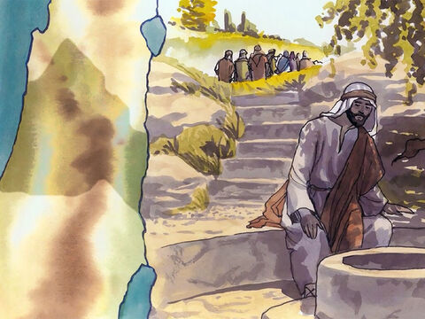
Read John 4:8
Let’s go get some food.
I will wait here.
⁵ In Samaria Jesus came to the town called Sychar. This town is near the field that Jacob gave to his son Joseph. ⁶ Jacob’s well was there. Jesus was tired from his long trip. So he sat down beside the well. It was about noon. ⁷ A Samaritan woman came to the well to get some water. Jesus said to her, “Please give me a drink.” ⁸ (This happened while Jesus’ followers were in town buying some food.)

Slide 22
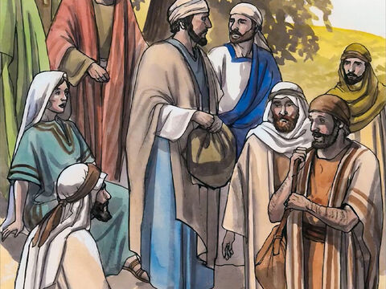
Read John 4:27
Jesus is talking to a Samaritan woman!
This man said he was the Messiah!
²⁵ The woman said, “I know that the Messiah is coming.” (Messiah is the One called Christ.) “When the Messiah comes, he will explain everything to us.”
²⁶ Then Jesus said, “He is talking to you now. I am he.”
²⁷ Just then his followers came back from town. They were surprised because they saw Jesus talking with a woman. But none of them asked, “What do you want?” or “Why are you talking with her?”
My disciples don’t know that this lady and the whole town are ready to hear the gospel.

Slide 23
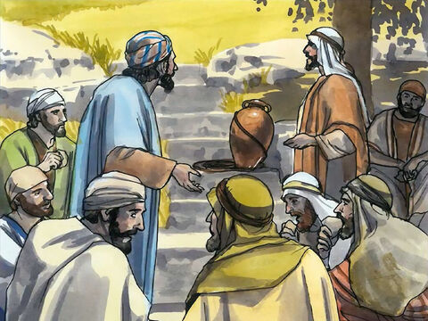
John 4:28, 31-33
Did somebody already bring Jesus some food?
²⁸ Then the woman left her water jar and went back to town…..
³¹ While the woman was away, the followers were begging him, “Teacher, eat something!”
³² But Jesus answered, “I have food to eat that you know nothing about.”
³³ So the followers asked themselves, “Did somebody already bring Jesus some food?”
Teacher (Jesus) eat something.
I have food to eat that you know nothing about.
Snack Time

Slide 24
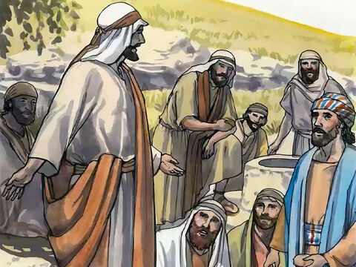
John 4:34
My food is to do what God wants me to do.
Finishing his work gives me energy.
³⁴ Jesus said, “My food is to do what the One who sent me wants me to do. My food is to finish the work that he gave me to do.

Slide 25
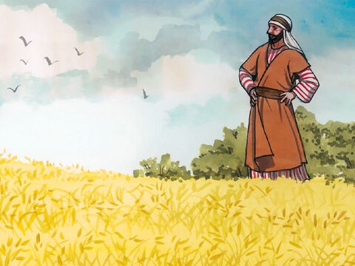
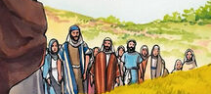
John 4:34
Open your eyes.
Look the fields are ready to be harvested.
³⁵ You say, ‘Four more months to wait before we gather the grain.’ But I tell you, open your eyes. Look at the fields that are ready for harvesting now.
The people are ready and coming to hear the gospel now!

Slide 26
John 4:34
I am gathering crops for eternal life.
Others are helping.
³⁶ Even now, the one who harvests the crop is being paid. He is gathering crops for eternal life. So now the one who plants can be happy along with the one who harvests. ³⁷ It is true when we say, ‘One person plants, but another harvests the crop.’ ³⁸ I sent you to harvest a crop that you did not work for. Others did the work, and you get the profit from their work.”^{[b]}
This lady is participating in the harvest.

Slide 27
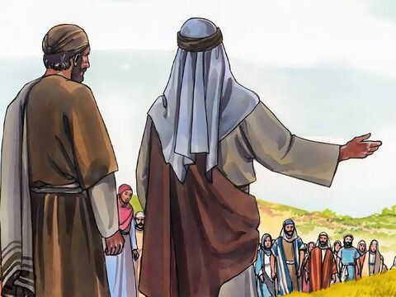
John 4:39-40
³⁹ Many of the Samaritans in that town believed in Jesus. They believed because of what the woman said: “He told me everything I have ever done.” ⁴⁰ The Samaritans came to Jesus and begged him to stay with them.
They were thirsty
for God and eternal life too.
They wanted to know our Savior.
.Please stay with us!

Slide 28
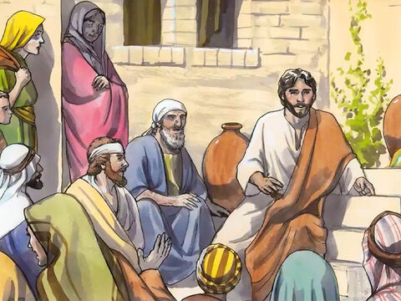
John 4:40-42
.God loves you!
I have come to save you
and bring forgiveness.
Worship God in spirit and truth.
I have come to give you eternal life.
So he stayed there two days. ⁴¹ Many more believed because of the things he said.
⁴² They said to the woman, “First we believed in Jesus because of what you told us. But now we believe because we heard him ourselves. We know that this man really is the Savior of the world.”
You are the Savior of the world!

Slide 29
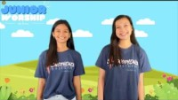
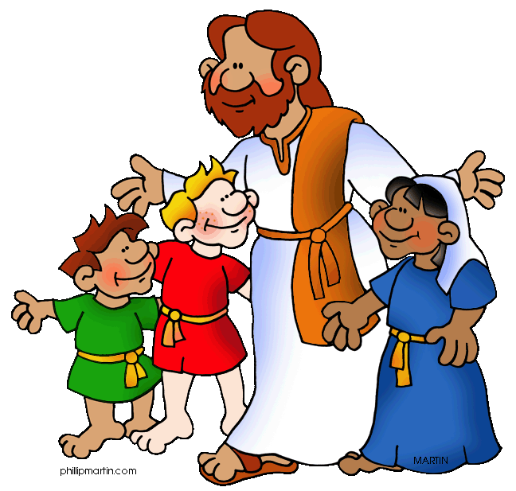
Jesus is my Best Friend

Slide 30

Alternative Presentation slides follow…..
Thanks for checking out this presentation
https://activity-array.com/

Slide 31
Let’s watch our story.
You can find it in John 4

Slide 32
¹³ Jesus answered, “Everyone who drinks this water will be thirsty again, ¹⁴ but whoever drinks the water I give them will never thirst. Indeed, the water I give them will become in them a spring of water welling up to eternal life.”

Slide 33
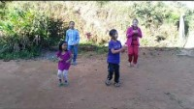
Love the Lord Your God

Slide 34
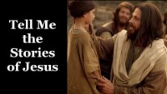
Tell me the Stories of Jesus

Slide 35
READ THE STORY
EXTRA
John 4:1-42
Follow along through the slides---

Slide 36
John 4
4 Now Jesus learned that the Pharisees had heard that he was gaining and baptizing more disciples than John— ² although in fact it was not Jesus who baptized, but his disciples. ³ So he left Judea and went back once more to Galilee.
⁴ Now he had to go through Samaria. ⁵ So he came to a town in Samaria called Sychar, near the plot of ground Jacob had given to his son Joseph. ⁶ Jacob’s well was there.
Jesus, tired as he was from the journey, sat down by the well. It was about noon.

Slide 37
May I have a drink?
Will you give me a drink?
How can you ask me for a drink?
⁷ When a Samaritan woman came to draw water, Jesus said to her, “Will you give me a drink?” ⁸ (His disciples had gone into the town to buy food.)
⁹ The Samaritan woman said to him, “You are a Jew and I am a Samaritan woman. How can you ask me for a drink?” (For Jews do not associate with Samaritans.^{[a]})

Slide 38
Ask for Living Water
If you knew me, you would ask for living water.
Sir, how and where can you get this living water?
¹⁰ Jesus answered her, “If you knew the gift of God and who it is that asks you for a drink, you would have asked him and he would have given you living water.”
¹¹ “Sir,” the woman said, “you have nothing to draw with and the well is deep. Where can you get this living water? ¹² Are you greater than our father Jacob, who gave us the well and drank from it himself, as did also his sons and his livestock?”
Are you greater than Jacob?

Slide 39
Quench my thirst
Everyone who drinks this water will be thirsty again.
Sir, I want living water.
¹³ Jesus answered, “Everyone who drinks this water will be thirsty again, ¹⁴ but whoever drinks the water I give them will never thirst. Indeed, the water I give them will become in them a spring of water welling up to eternal life.”
¹⁵ The woman said to him, “Sir, give me this water so that I won’t get thirsty and have to keep coming here to draw water.”
I will quench your thirst and give you eternal life.

Slide 40
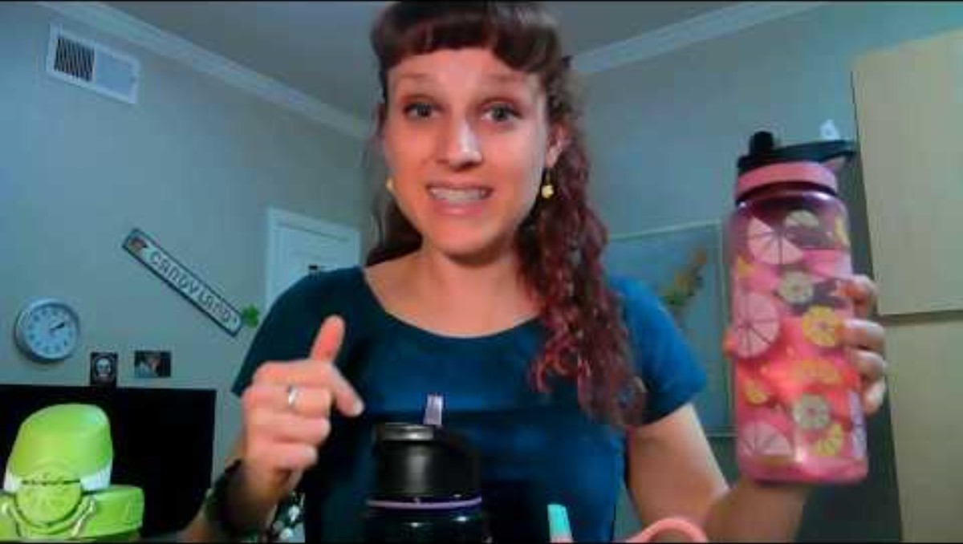

Slide 41
Go
I have no husband.
Go get your husband.
¹⁶ He told her, “Go, call your husband and come back.”
¹⁷ “I have no husband,” she replied.
Jesus said to her, “You are right when you say you have no husband. ¹⁸ The fact is, you have had five husbands, and the man you now have is not your husband. What you have just said is quite true.”
¹⁹ “Sir,” the woman said, “I can see that you are a prophet.
I see you are a prophet.
True. You have had 5 husbands & 5 divorces and you are not married.

Slide 42
Go
Now it’s not important where you worship.
Worship God in spirit and in truth..
Where should we worship?
²⁰ Our ancestors worshiped on this mountain, but you Jews claim that the place where we must worship is in Jerusalem.”
²¹ “Woman,” Jesus replied, “believe me, a time is coming when you will worship the Father neither on this mountain nor in Jerusalem. ²² You Samaritans worship what you do not know; we worship what we do know, for salvation is from the Jews. ²³ Yet a time is coming and has now come when the true worshipers will worship the Father in the Spirit and in truth, for they are the kind of worshipers the Father seeks. ²⁴ God is spirit, and his worshipers must worship in the Spirit and in truth.”
²⁵ The woman said, “I know that Messiah” (called Christ) “is coming. When he comes, he will explain everything to us.”
²⁶ Then Jesus declared, “I, the one speaking to you—I am he.”
I am he.
I know the Messiah will explain everything to us.

Slide 43
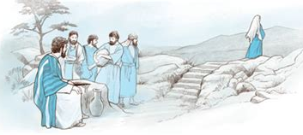
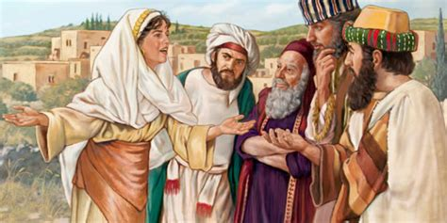
Go
²⁷ Just then his disciples returned and were surprised to find him talking with a woman. But no one asked, “What do you want?” or “Why are you talking with her?”
²⁸ Then, leaving her water jar, the woman went back to the town and said to the people, ²⁹ “Come, see a man who told me everything I ever did. Could this be the Messiah?” ³⁰ They came out of the town and made their way toward him.
Come see a man who told me everything I did. Could he be the Messiah?

Slide 44
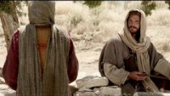
Our story

