Slide 1


Jesus heals
Jairus’ daughter and
A bleeding woman
Mark 5:21-42

Slide 2
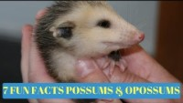
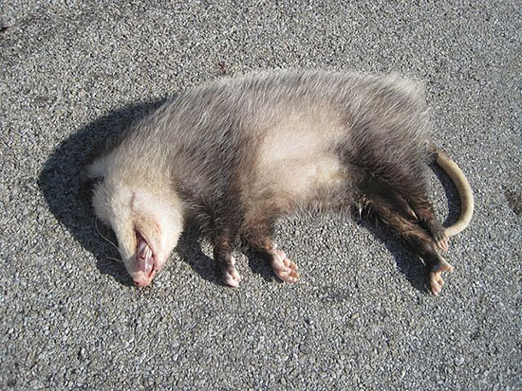
Opossums
Do they play dead?

Slide 3
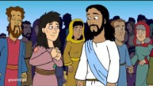
Dead or Alive

Slide 4


What is faith?
Object Lesson
Faith is being sure
of what we hope for.
It is being sure
of what we do not see.
Hebrews 11:1
BELIEVE
GOD’S
PROMISES

Slide 5
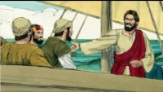
He’s Able

Slide 6
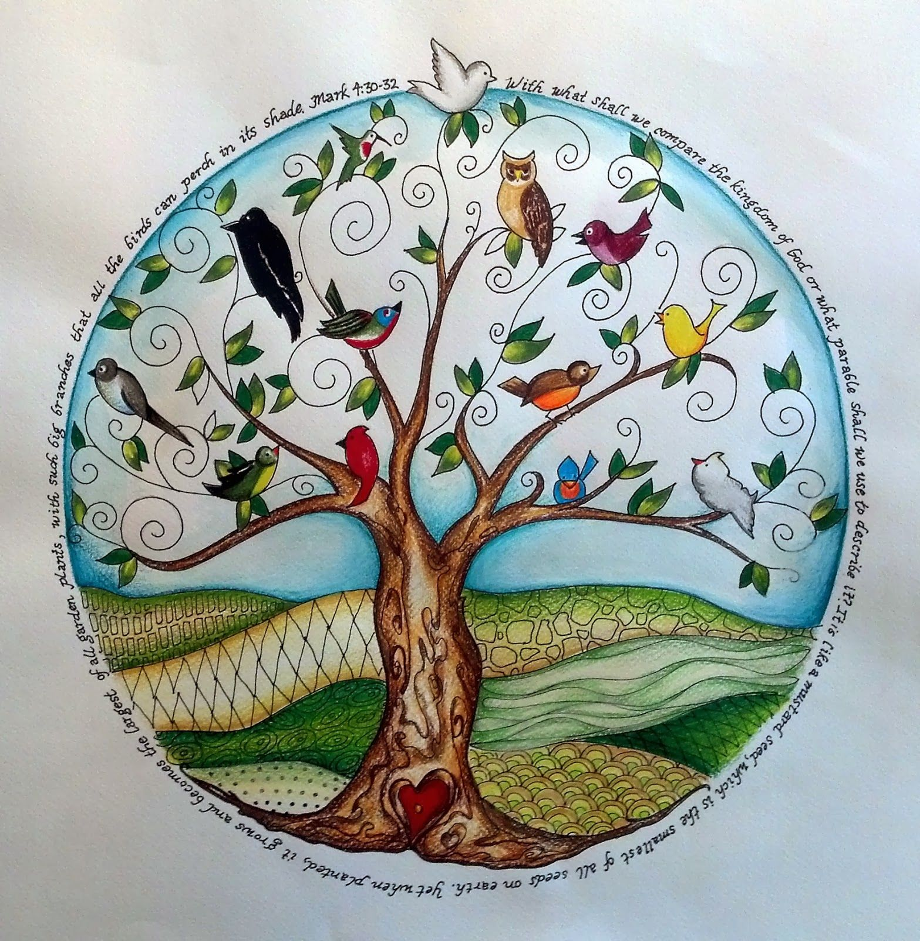
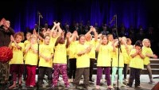

Faith As Small as a Mustard Seed

Slide 7
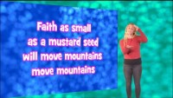
Faith As Small as a Mustard Seed

Slide 8
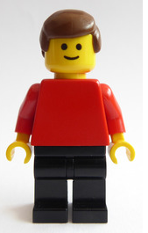
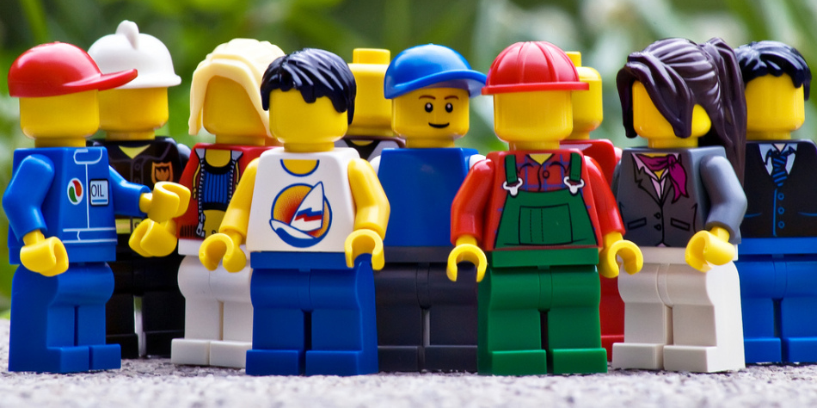
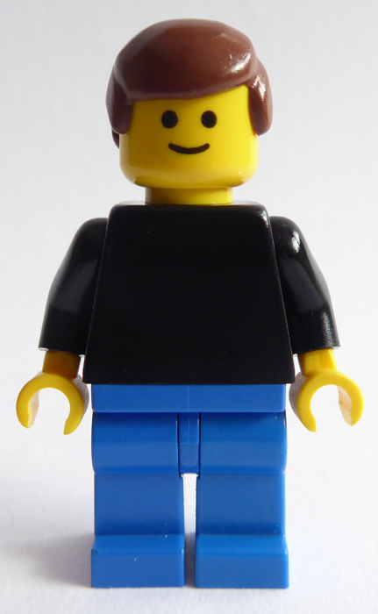

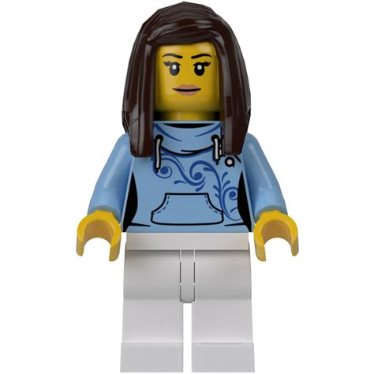
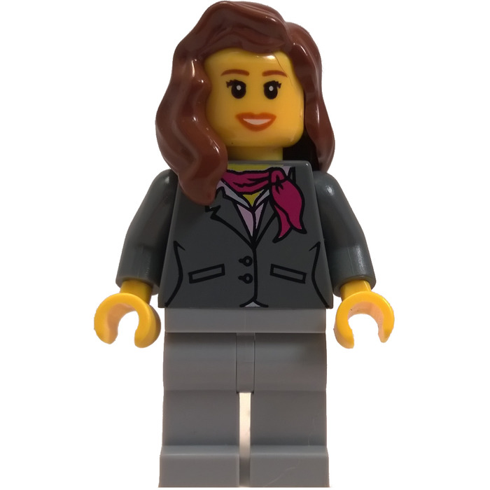
You can Retell the Story with me
You and your family can get some Lego people, action figures or dolls to act out the story.
Your family will need
3 men, 2 women, & a crowd:
Jairus (dad)
Jairus’ servant
Jesus
Crowd
Woman
Jairus’ daughter
Extras:
Jairus’ wife (mom)
Peter
James
John
Hi! I’m Jesus
Hi! I’m Jairus
I’m Jairus’ servant
Hi! I’m the woman
I’m 12

Slide 9
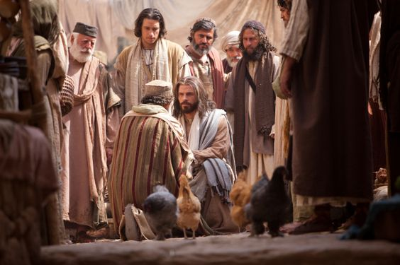
Mark 6
A father’s plea
²¹ Jesus went across the Sea of Galilee in a boat. It landed at the other side. There a large crowd gathered around him. ²² Then a man named Jairus came. He was a synagogue leader. When he saw Jesus, he fell at his feet. ²³ He begged Jesus, “Please come. My little daughter is dying. Place your hands on her to heal her. Then she will live.” ²⁴ So Jesus went with him.
“Please come.
My little daughter is dying.
Place your hands on her to heal her. Then she will live.”
Ask

Slide 10
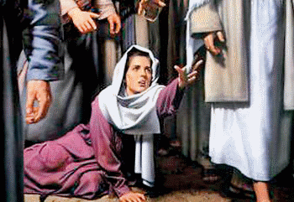
An important interruption
“I just need to touch his clothes. Then I will be healed.”
A large group of people followed. They crowded around him. ²⁵ A woman was there who had a sickness that made her bleed. It had lasted for 12 years. ²⁶ She had suffered a great deal, even though she had gone to many doctors. She had spent all the money she had. But she was getting worse, not better. ²⁷ Then she heard about Jesus. She came up behind him in the crowd and touched his clothes. ²⁸ She thought, “I just need to touch his clothes. Then I will be healed.” ²⁹ Right away her bleeding stopped. She felt in her body that her suffering was over.
Reach out

Slide 11
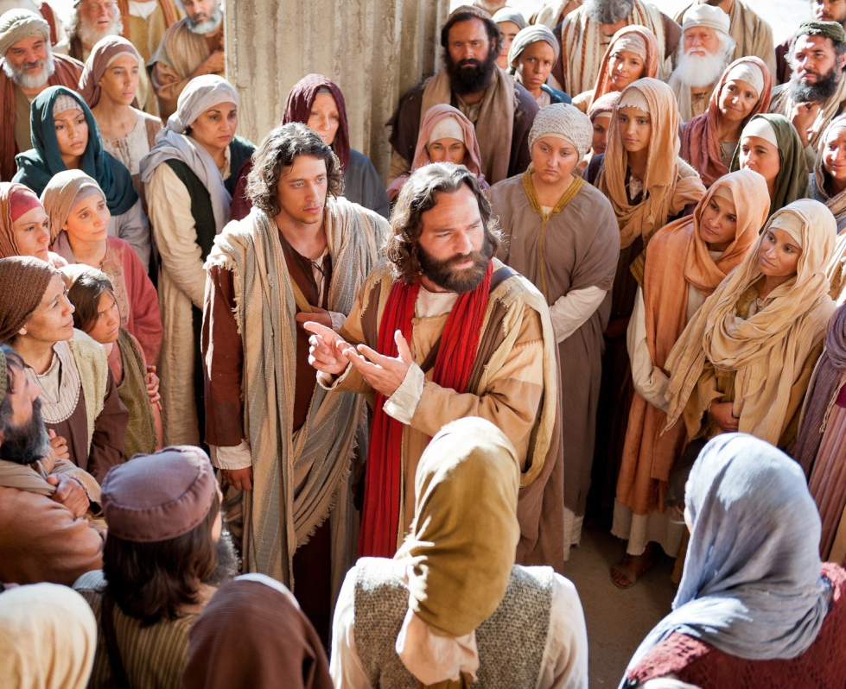
Someone touched me
Who touched me?
³⁰ At once Jesus knew that power had gone out from him. He turned around in the crowd. He asked, “Who touched my clothes?”
³¹ “You see the people,” his disciples answered. “They are crowding against you. And you still ask, ‘Who touched me?’ ”
³² But Jesus kept looking around. He wanted to see who had touched him.
There are a lot of people crowding around you. And still you ask, Who touched me?”
Yes. Power to heal went from me.

Slide 12
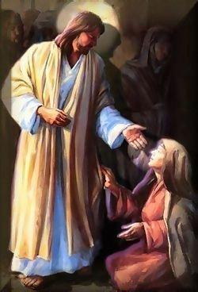
Someone touched me
“Dear woman, your faith has healed you. Go in peace.
You are free from your suffering.”
^{Mark 6:33} Then the woman came and fell at his feet. She knew what had happened to her. She was shaking with fear. But she told him the whole truth. ³⁴ He said to her, “Dear woman, your faith has healed you. Go in peace. You are free from your suffering.”
Forgive me Lord,
I’ve been bleeding for 12 years.
Have FAITH

Slide 13
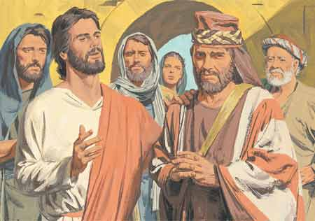
It’s too late!
…. or is it?
The woman was healed.
I will have faith.
I believe Jesus gives life and health.
“Your daughter is dead,” “Why bother the teacher anymore?”
³⁵ While Jesus was still speaking, some people came from the house of Jairus. He was the synagogue leader. “Your daughter is dead,” they said. “Why bother the teacher anymore?”
³⁶ Jesus heard what they were saying. He told the synagogue leader, “Don’t be afraid. Just believe.”
“Don’t be afraid. Just believe.”

Slide 14
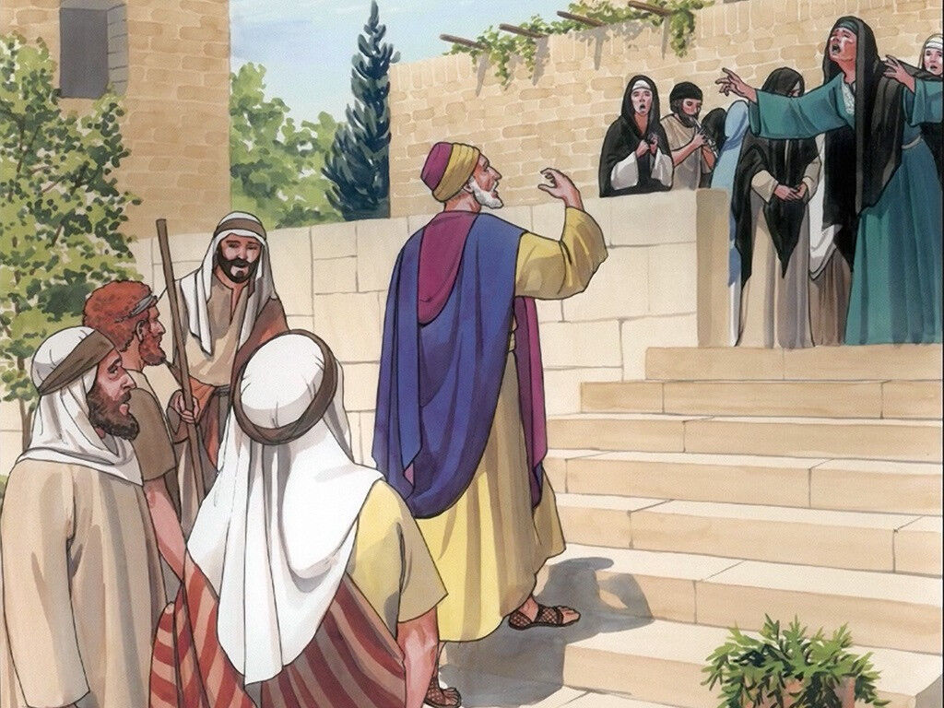
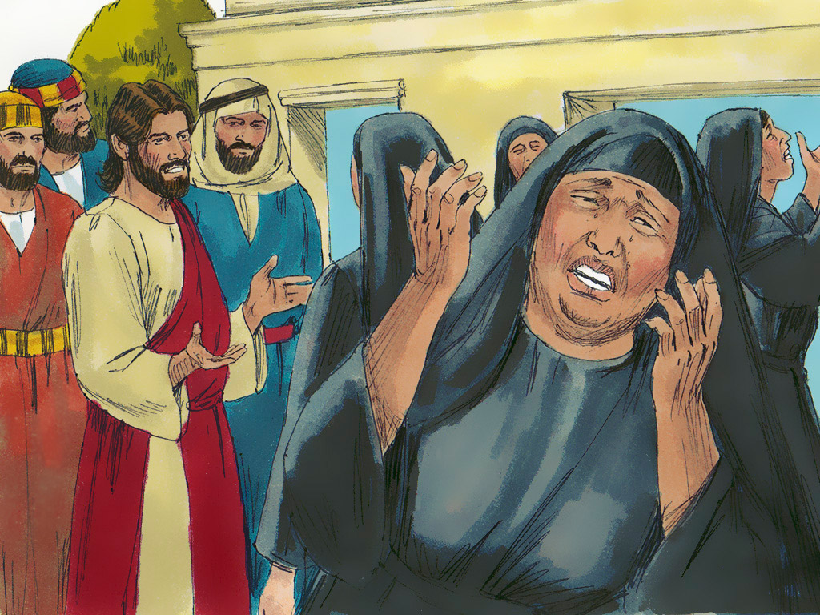
Stop wailing
She’s only sleeping
Boo hoo hoo
Waaaaa
³⁷ He let only Peter, James, and John, the brother of James, follow him. ³⁸ They came to the home of the synagogue leader. There Jesus saw a lot of confusion. People were crying and sobbing loudly. ³⁹ He went inside. Then he said to them, “Why all this confusion and sobbing? The child is not dead. She is only sleeping.” ⁴⁰ But they laughed at him.
He made them all go outside.
“Why all this confusion and sobbing? The child is not dead. She is only sleeping.”

Slide 15
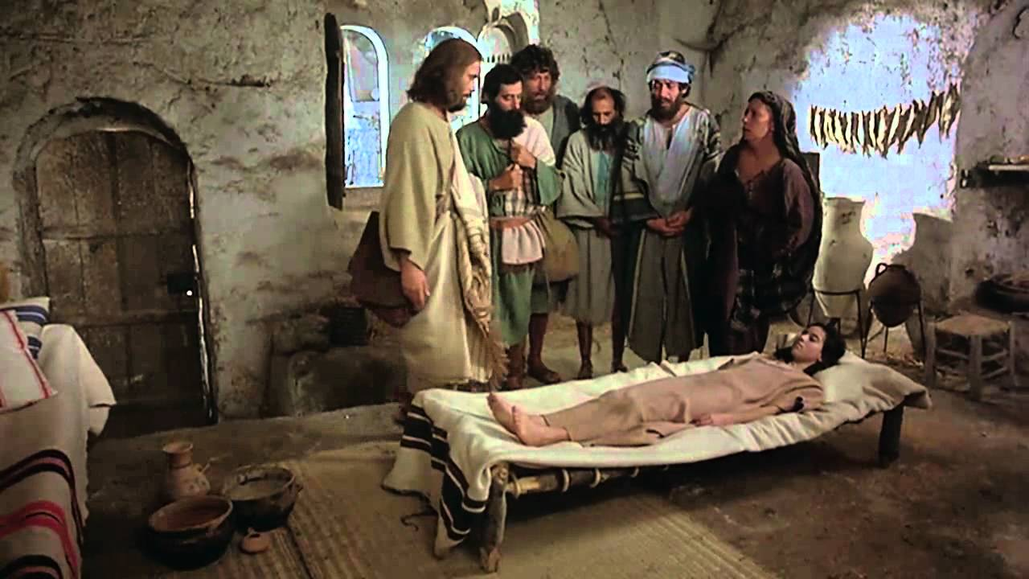
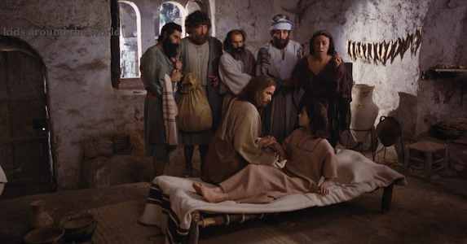
Get up!
He took only the child’s father and mother and the disciples who were with him. And he went in where the child was. ⁴¹ He took her by the hand. Then he said to her, “Talitha koum!” This means, “Little girl, I say to you, get up!” ⁴² The girl was 12 years old. Right away she stood up and began to walk around. They were totally amazed at this. ⁴³ Jesus gave strict orders not to let anyone know what had happened. And he told them to give her something to eat.
“Little girl,
I say to you, get up!”
Oh WOW!
Get her something to eat.

Slide 16
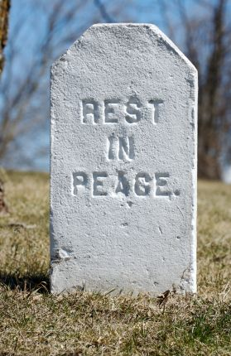
Just wait
Jesus is coming!
“Those who walk uprightly
enter into peace;
they find rest as they lie in death.”
Isaiah 57:2
Just like this Lego, a dead person
Can not hear nor talk
Does not have feelings
Can’t think nor plan
Can’t do anything!
They’re just lying there, waiting
For the living know that they will die,
but the dead know nothing.
Ecclesiastes 9:5
You will rest, and then at the end of the days you will rise to receive your allotted inheritance.”
Daniel 12:12

Slide 17
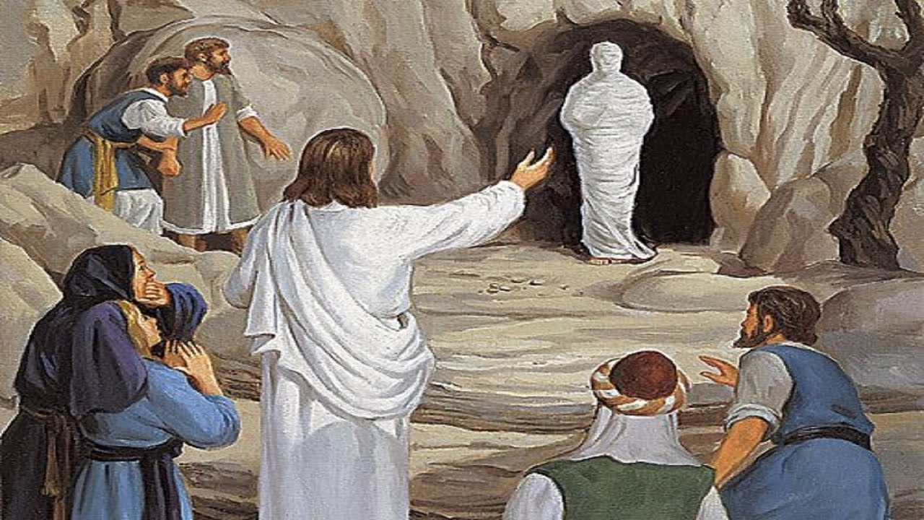
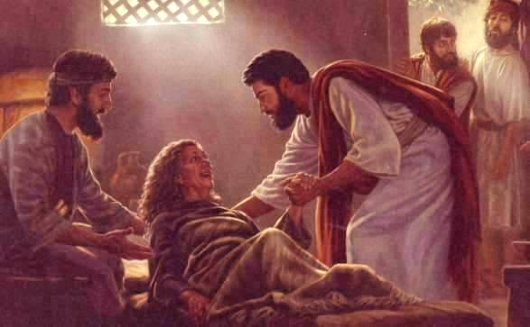
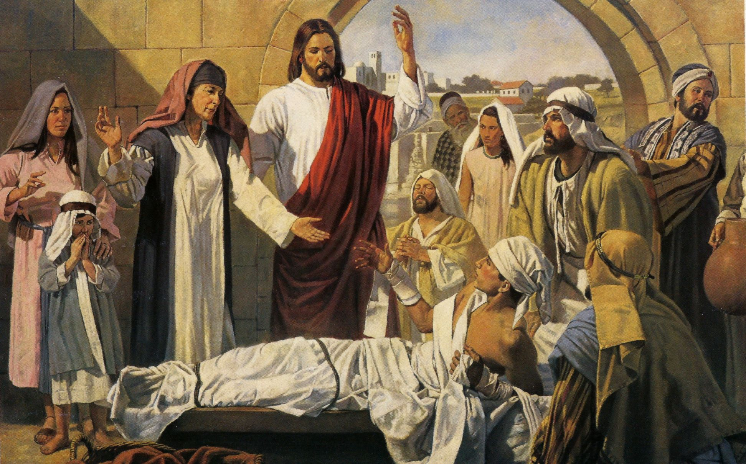

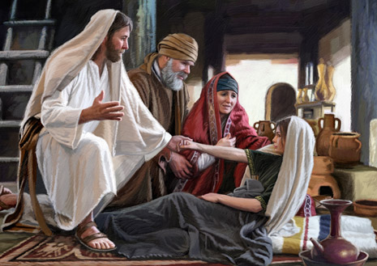
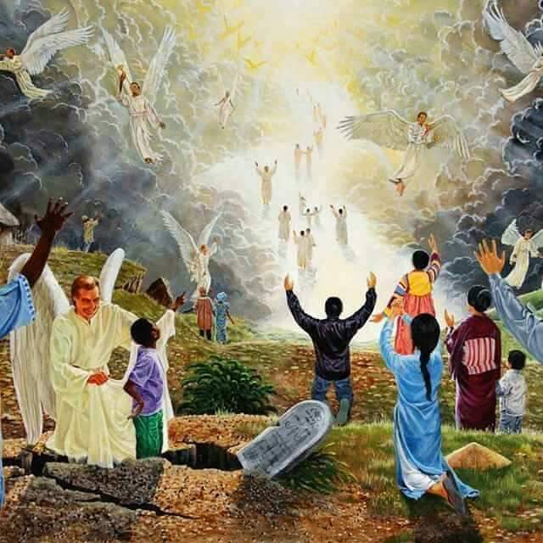

Slide 18
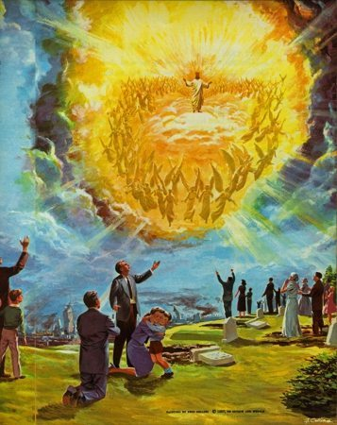
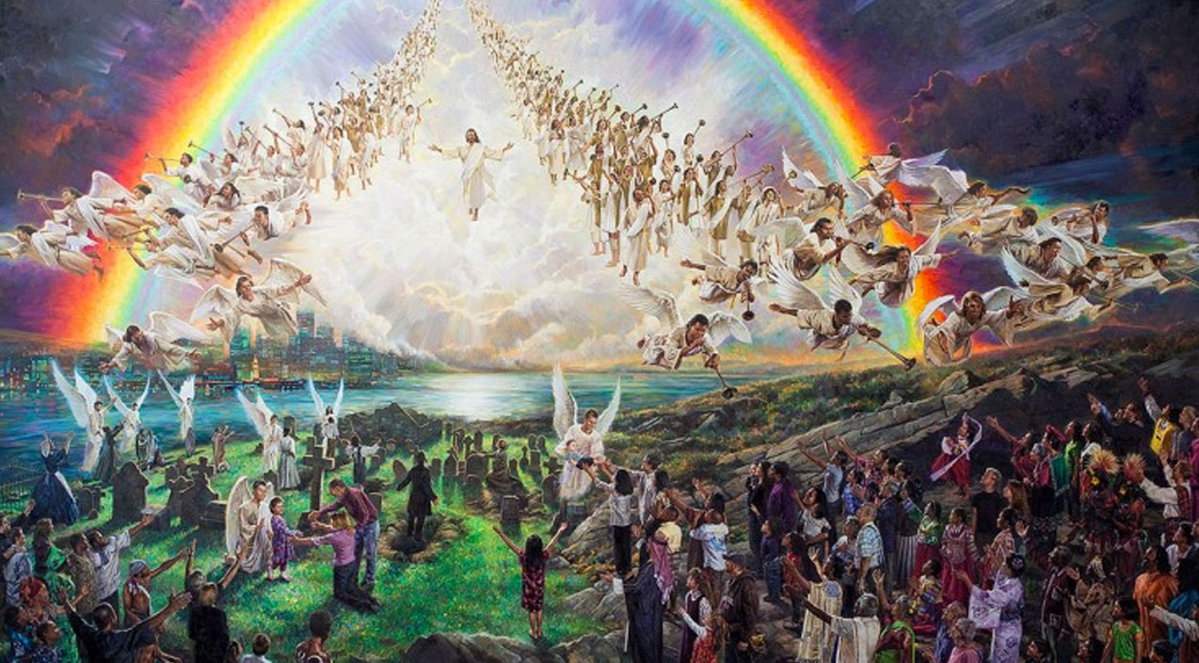
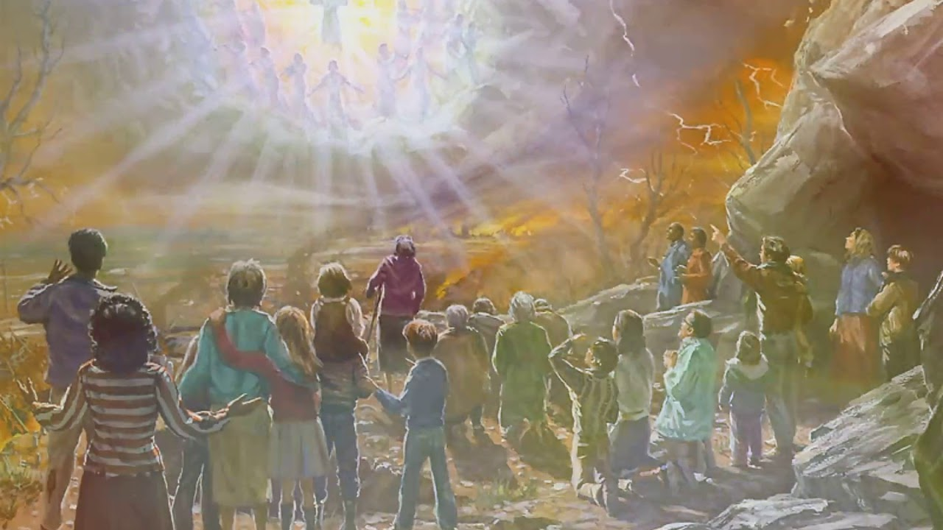
Arise!
For the Lord himself will come down from heaven, with a loud command, with the voice of the archangel and with the trumpet call of God, and the dead in Christ will rise first. After that, we who are still alive and are left will be caught up together with them in the clouds to meet the Lord in the air. And so we will be with the Lord forever.
1 Thessalonians 4:16-17

Slide 19
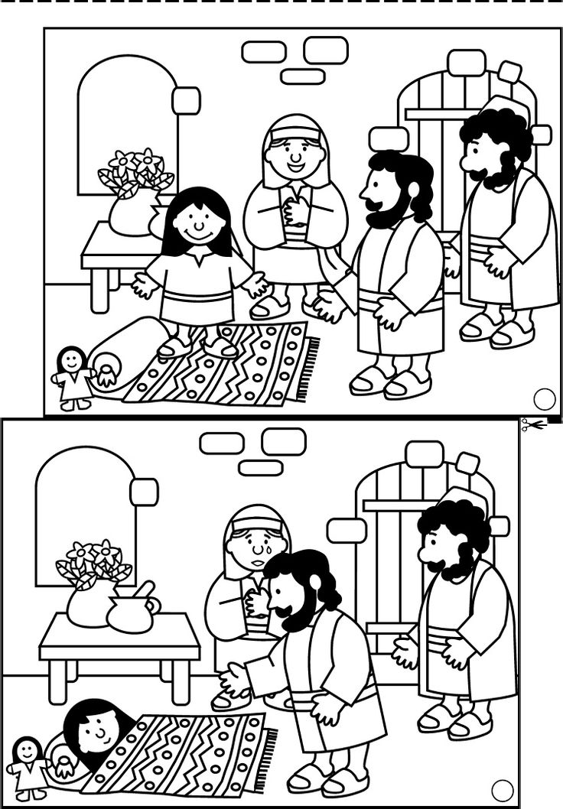
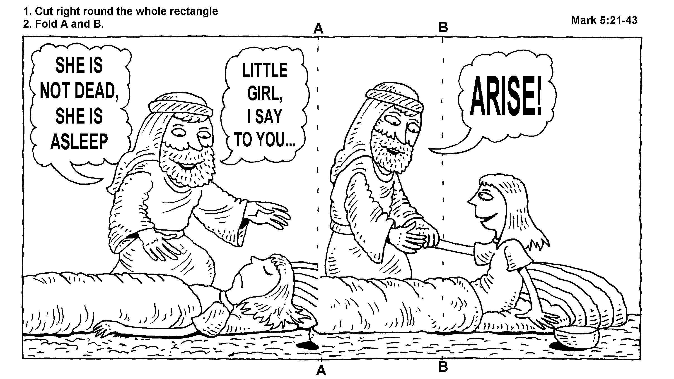


Craft Time --- Color

Slide 20
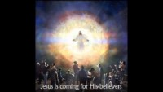
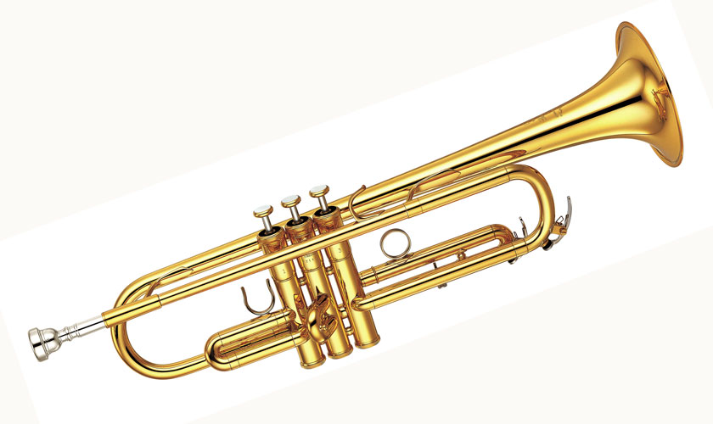
Lift up the trumpet, and loud let it ring:
Jesus is coming again!
Cheer up, ye pilgrims, be joyful and sing:
Jesus is coming again!
Coming again, coming again,
Jesus is coming again!

Slide 21
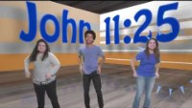

Slide 22
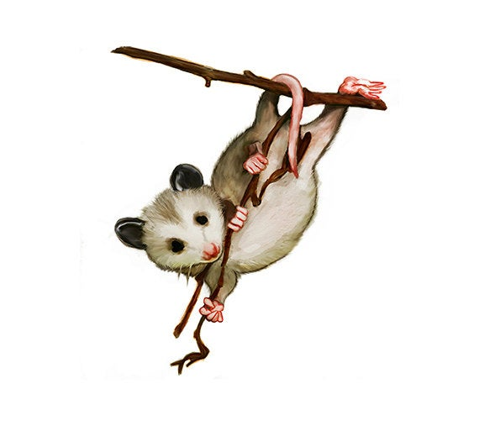
GAME TIME
Team A
Who was the little girl’s daddy?
Jacob
Jairus
Able

Slide 23

GAME TIME
Team B
What did Jairus want Jesus to do?
Come heal his daughter

Slide 24
GAME TIME
Team A
What did a lady do to be healed?
Touch Jesus’ robe
As an act of faith

Slide 25
GAME TIME
Team B
Jesus said, “your _____
has healed you.
faith

Slide 26
GAME TIME
Team A
What is faith?
Trusting in God
Believing God’s promises
Being certain of what we can’t see
All the above

Slide 27
GAME TIME
Team B
Did Jairus’ daughter die?
Yes

Slide 28
GAME TIME
Team A
What was all the noise at Jairus’ house?
Lots of people
were crying and wailing.

Slide 29
GAME TIME
Team B
Which disciples went with Jesus into Jairus’ house?
Peter, James, John
Andrew, James, Judas
Matthew, Mark, Luke

Slide 30
GAME TIME
Team A
When Jesus told the girl to arise, what happened?
She came alive
Sat up
Stood up

Slide 31
GAME TIME
Team B
What did Jesus tell her parents to give their daughter?
food

Slide 32
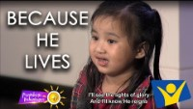

Slide 33

https://activity-array.com/

