Slide 1
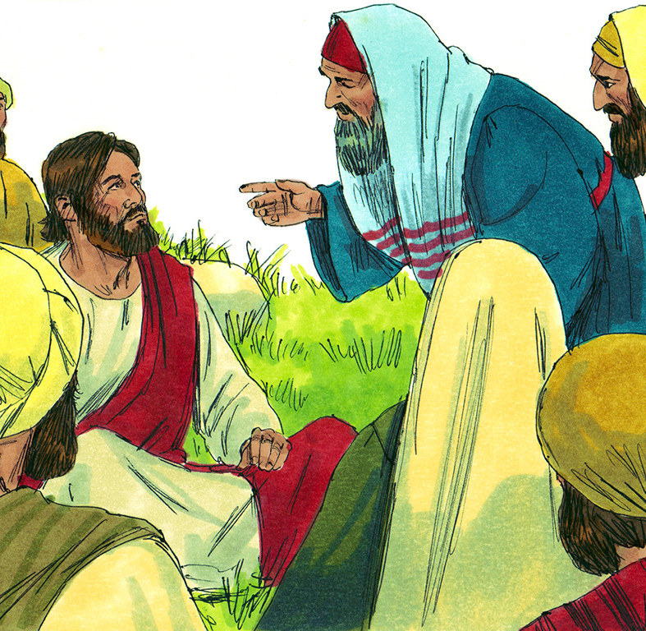
Go
He is well
Jesus heals official’s son – John 4:43-53
Jesus heals centurion’s son – Luke 7:1-10

Slide 2
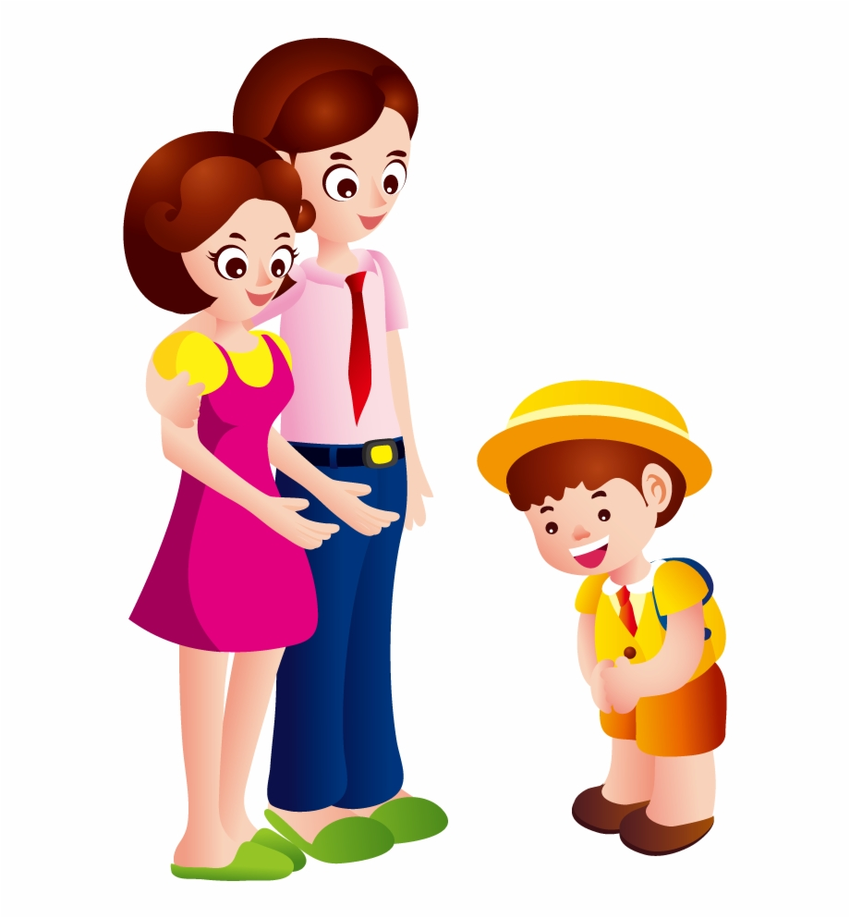
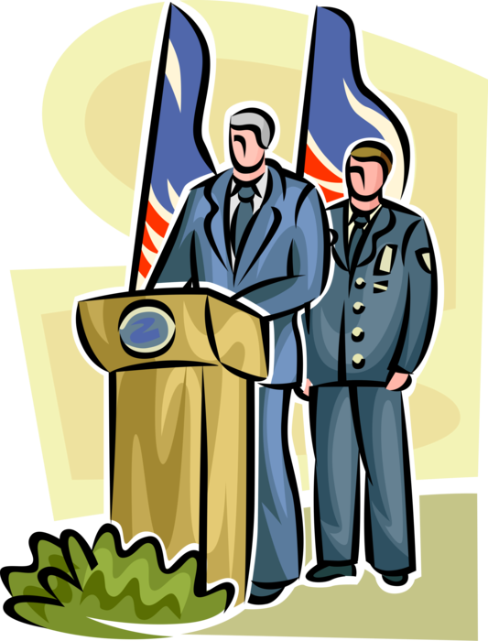
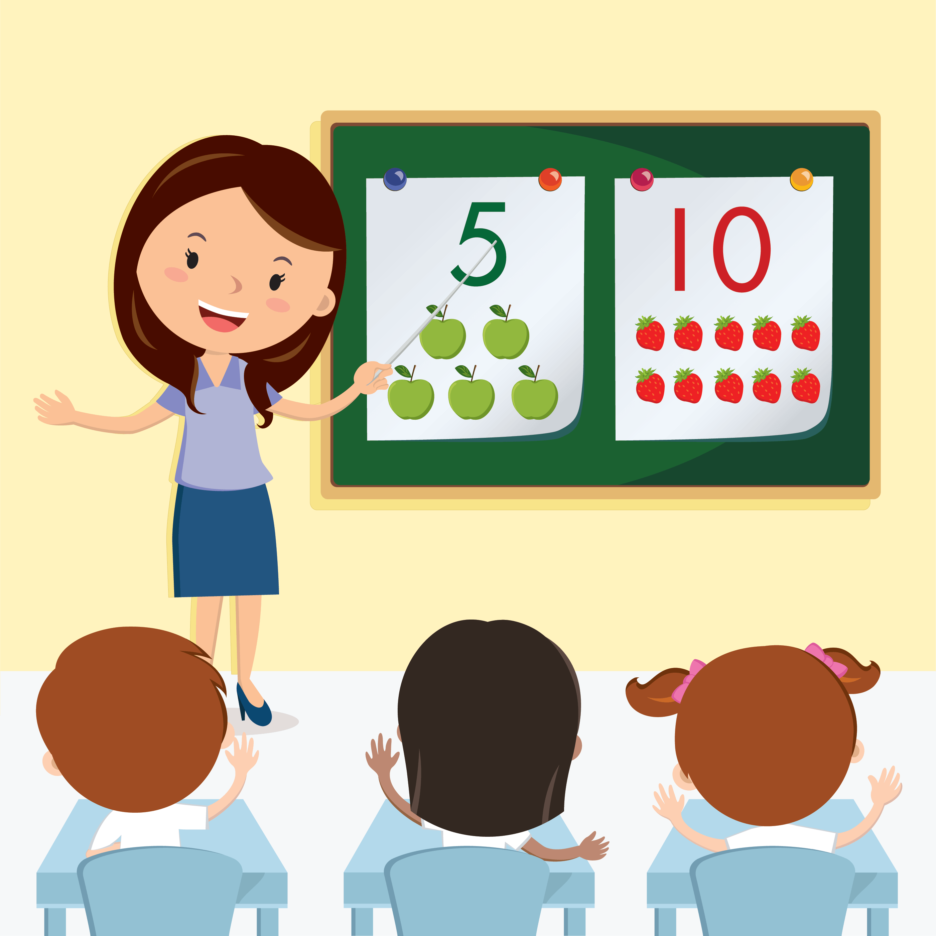
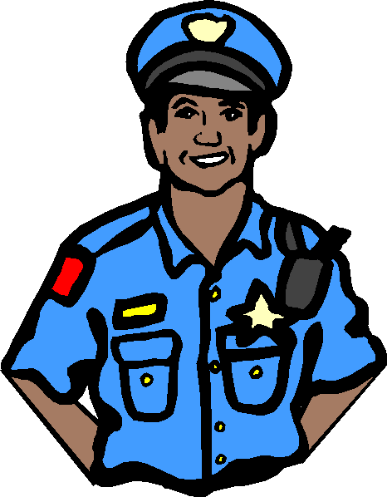
What does it mean to have AUTHORITY?
A person with AUTHORITY is in charge.
They can make things happen. They choose what will happen.
They have the authority to tell someone to do something.
We should obey someone who is in AUTHORITY.

Slide 3
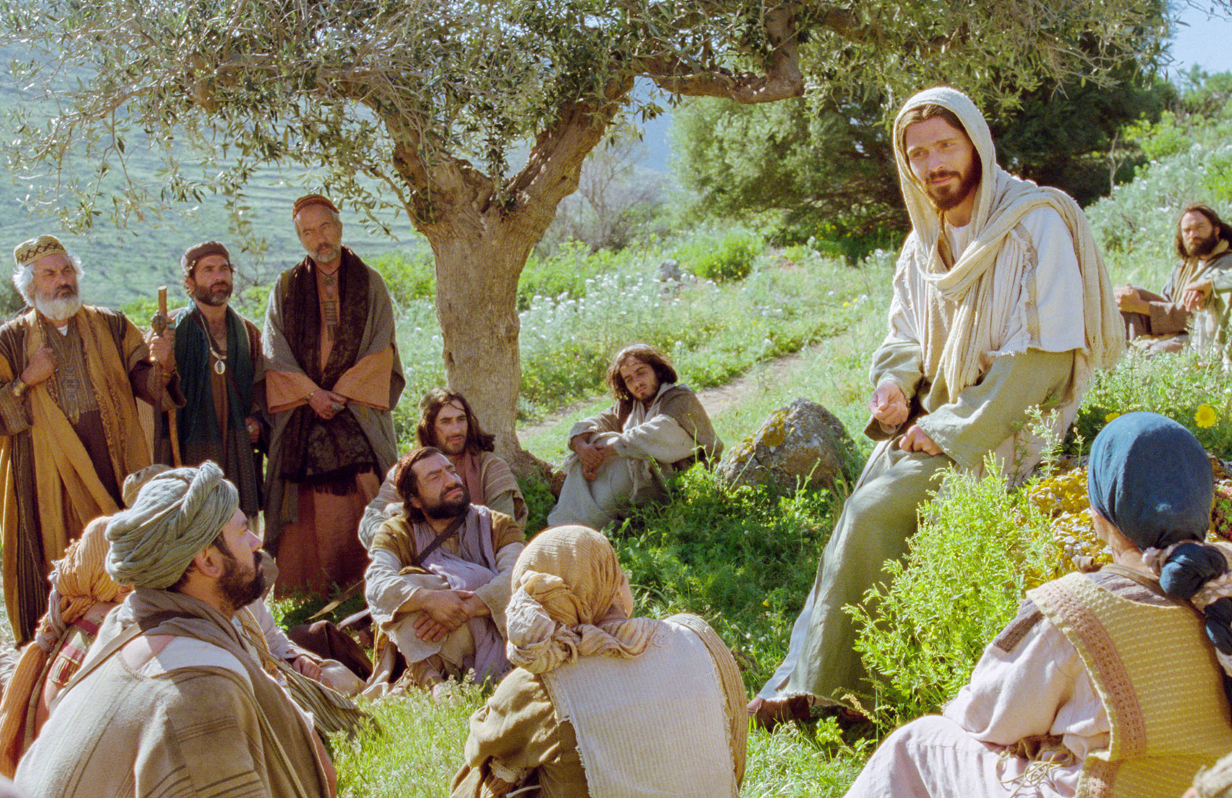
Jesus taught the people to obey
God’s law
I have not come to get rid of the law.
I have come to fulfill what the prophets have said.
Not until heaven and earth disappear and everything is accomplished, will even the smallest letter of the law change.
Be sure to obey God’s law.
¹⁷ “Do not think that I have come to abolish the Law or the Prophets; I have not come to abolish them but to fulfill them. ¹⁸ For truly I tell you, until heaven and earth disappear, not the smallest letter, not the least stroke of a pen, will by any means disappear from the Law until everything is accomplished. ¹⁹ Therefore anyone who sets aside one of the least of these commands and teaches others accordingly will be called least in the kingdom of heaven, but whoever practices and teaches these commands will be called great in the kingdom of heaven. ²⁰ For I tell you that unless your righteousness surpasses that of the Pharisees and the teachers of the law, you will certainly not enter the kingdom of heaven.

Slide 4
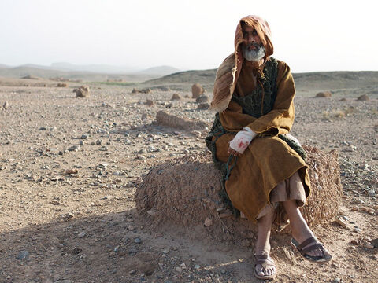
Jesus came to teach, to heal, and to save
Unclean
Unclean
Jesus could heal me.
I must go to him.
When Jesus came down from the mountainside, large crowds followed him.
But there was one who could not be near the crowds. He had leprosy.
This disease eats away the skin.
It is contagious. If someone touches it, they would get leprosy.
The man had to say, “unclean, unclean” so that no one would come near.

Slide 5
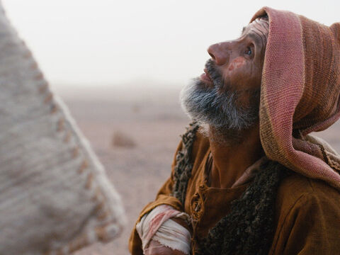
The leper showed respect
Lord, if you are willing,
You can make me clean.”
² A man with leprosy^{[a]} came and knelt before Jesus and said, “Lord, if you are willing, you can make me clean.”
The leper showed respect
by kneeling before Jesus and
by asking Jesus if He was willing.
Do you think Jesus was willing to make him well?

Slide 6
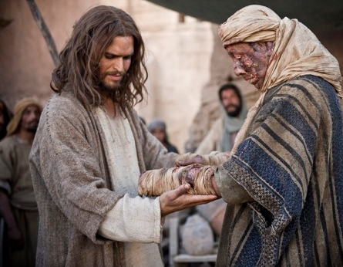
I am willing
I am willing
Be clean!
³ Jesus reached out his hand and touched the man.
Jesus touched him!
Did Jesus get leprosy? NO
“I am willing,” he said. “Be clean!” Immediately he was cleansed of his leprosy.
⁴ Then Jesus said to him, “See that you don’t tell anyone. But go, show yourself to the priest and offer the gift Moses commanded, as a testimony to them.”
Remember the law says that you must go show yourself to the priest. They will see that you are clean.
Then you can be with people, see your family, go to work, and go to church.
Go show yourself to the priest.

Slide 7
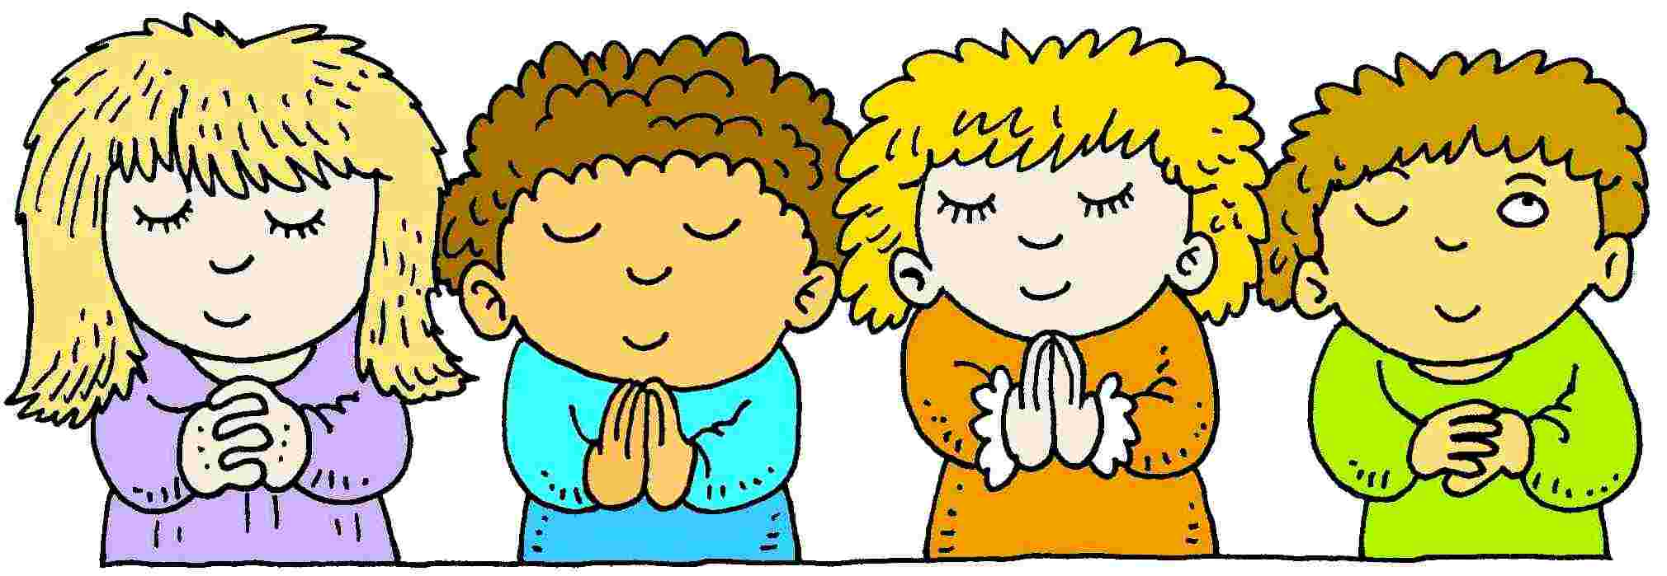
Recognize uncleanness know that
Jesus forgives & cleans us
Unclean
Unclean
Jesus could heal me.
I must go to him.
This man recognized that he was unclean.
He recognized that Jesus was the only One who could ‘clean’ him.
We, too, are unclean with sin of one kind or another and that sin eats at our heart. It can make us sad, discouraged, and even sick.
  Disobey
  Dis respectful
  selfishness
  hate
  judgmental
Jesus, I’ve been disobedient. Please forgive me.
I want to be generous
like you.
Jesus, haven’t been kind. Please forgive me.
I want to love others
like you do.

Slide 8
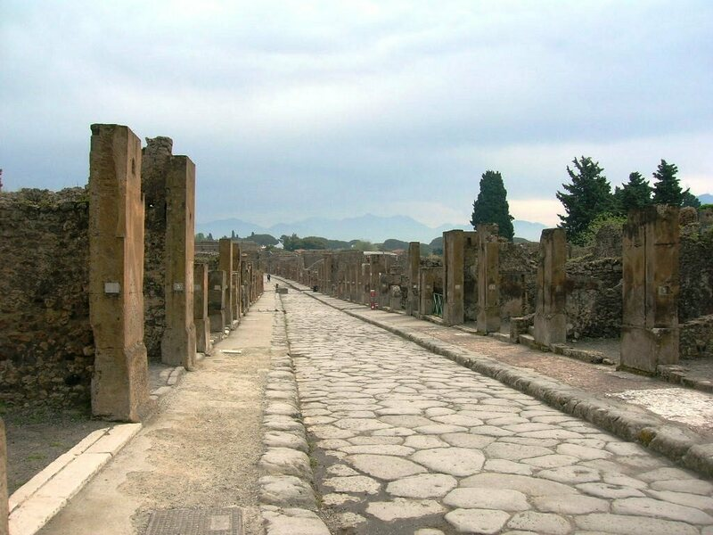
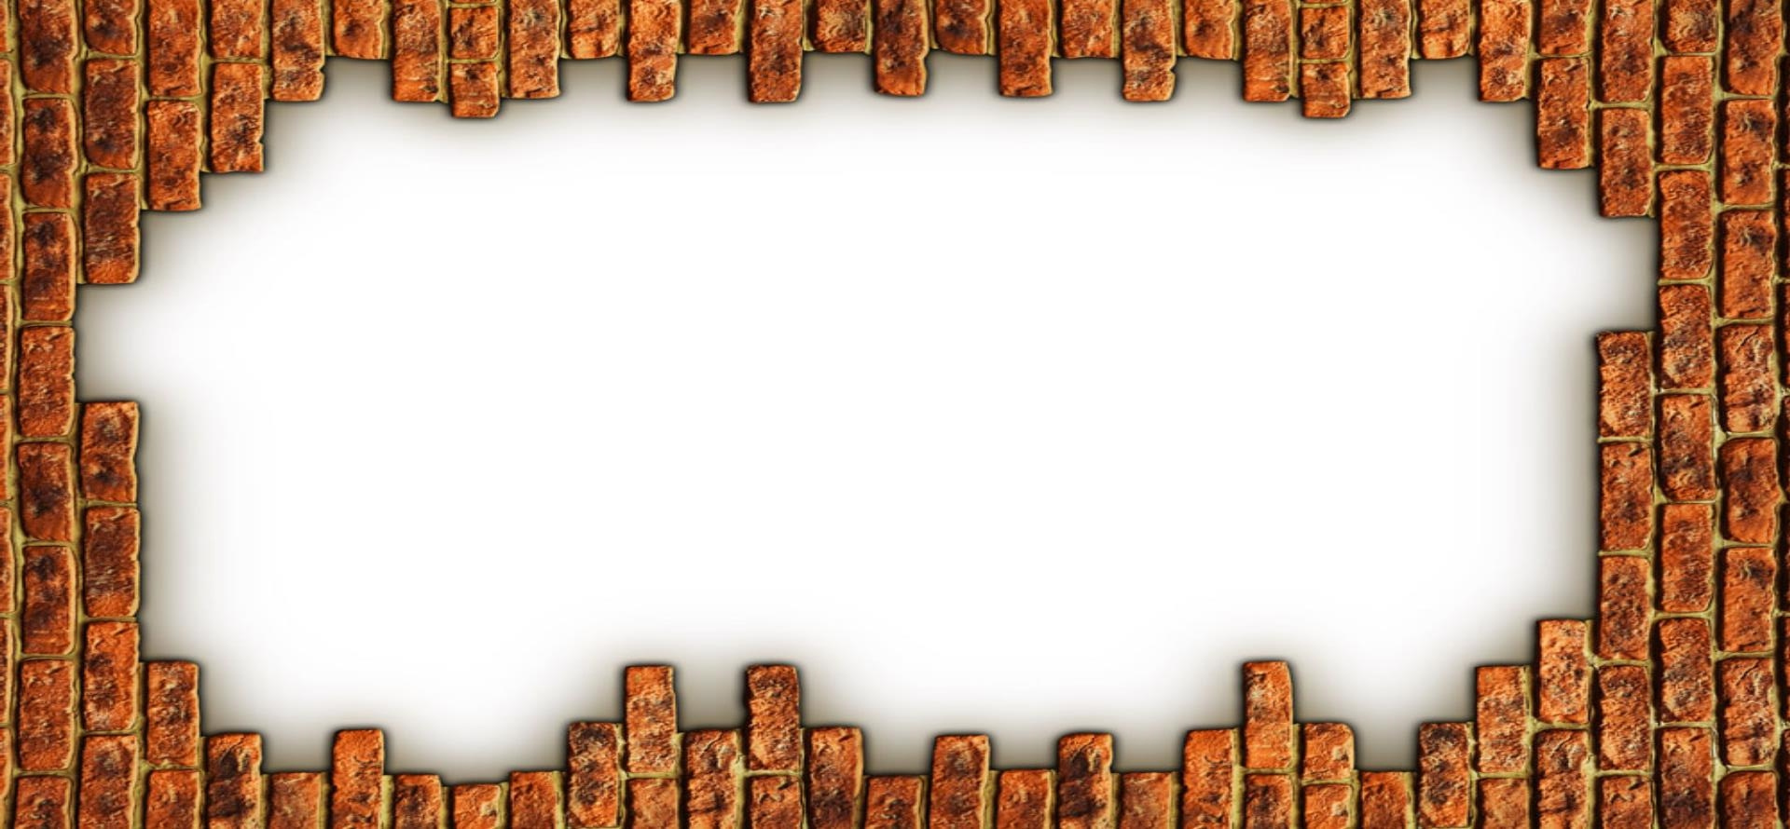
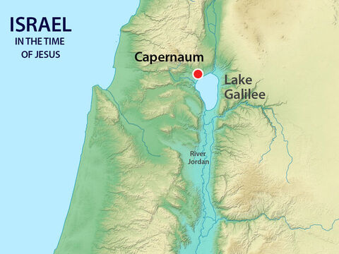
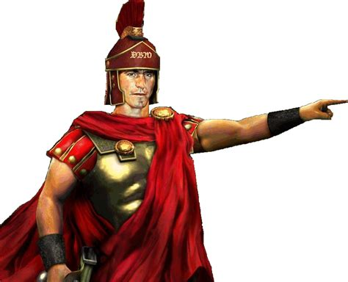
Matthew 8:5-13
⁵ When Jesus had entered Capernaum, a centurion came to him, asking for help.
A Centurion is in charge of 100 soldiers.

Slide 9

Soldier Says
Forward march
Left face (turn)
Right face (turn)
Halt! (stop)
March to ___________
Pick up something green
Take it to _________

Slide 10
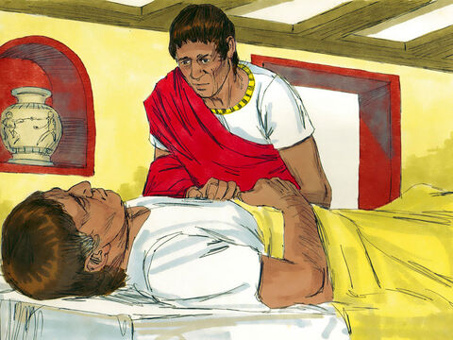
Oh, my servant!
What can I do?
Matthew 8
⁵ When Jesus had entered Capernaum, a centurion came to him, asking for help. ⁶ “Lord,” he said, “my servant lies at home paralyzed, suffering terribly.”
Luke 7
When Jesus finished saying all these things to the people, he went to Capernaum. ² In Capernaum there was an army officer. He had a servant who was so sick he was nearly dead. The officer loved the servant very much.

Slide 11
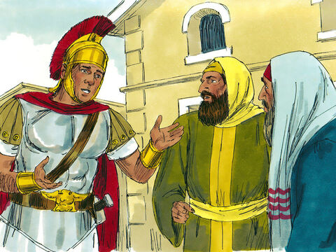
Please go get Jesus
Jesus can heal my servant.
Please ask Jesus to heal him.
Luke 7
³ When the officer heard about Jesus, he sent some Jewish elders to him. The officer wanted the leaders to ask Jesus to come and heal his servant.

Slide 12

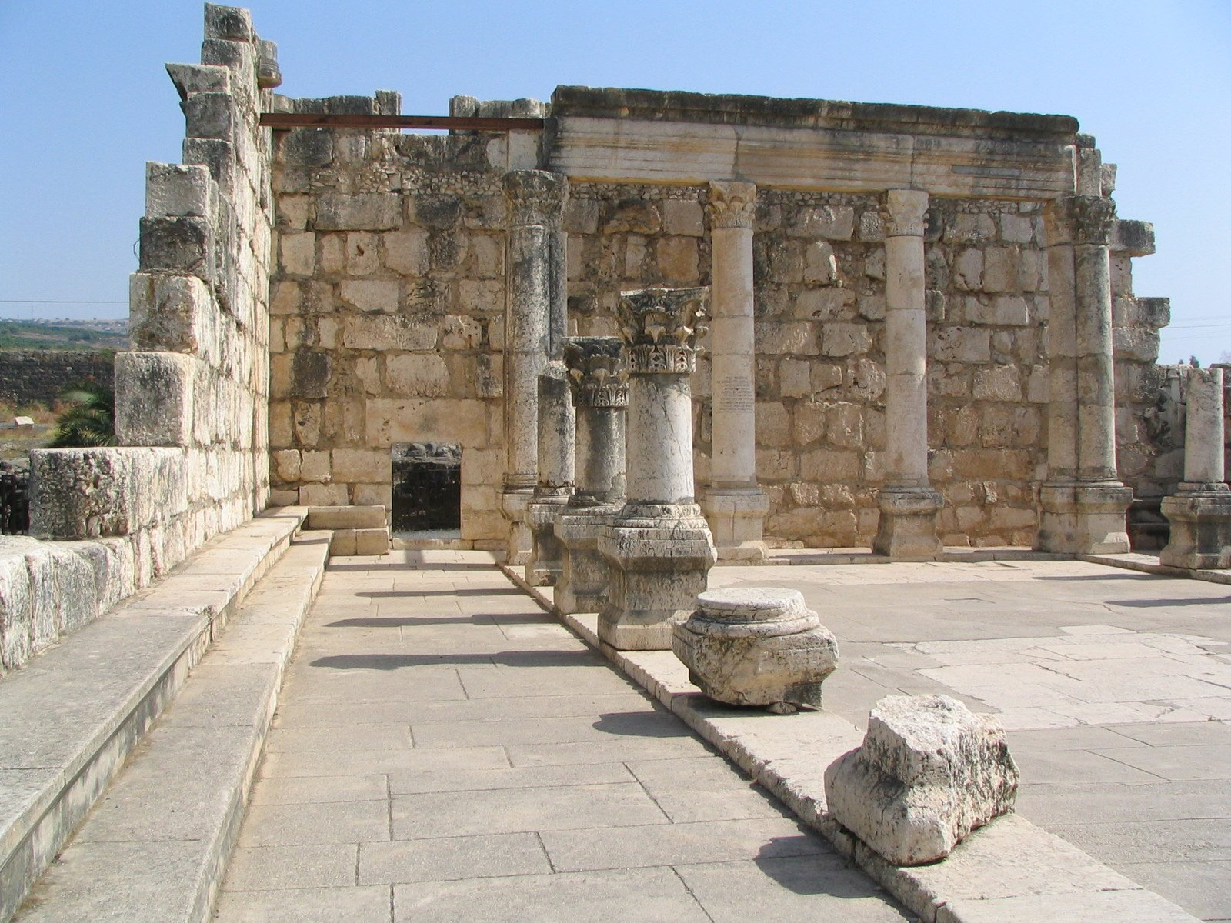
Please come.
He is a good man.
Jesus, Please heal this officer’s servant.
He loves our people and helped to build us a synagogue church.
⁴ The men went to Jesus and begged him saying, “This officer is worthy of your help. ⁵ He loves our people, and he built us a synagogue.”
⁶ So Jesus went with the men.

Slide 13
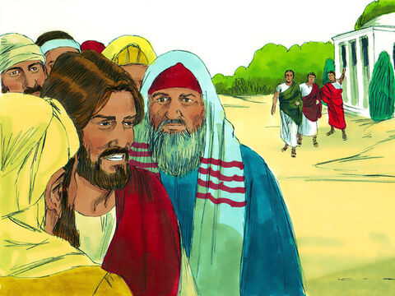
Jesus went
Go tell Jesus to stop.
Lord, The officer says you don’t need to come into his house.
⁶ So Jesus went with the men.
He was getting near the officer’s house when the officer sent friends to say, “Lord, you don’t need to come into my house.

Slide 14
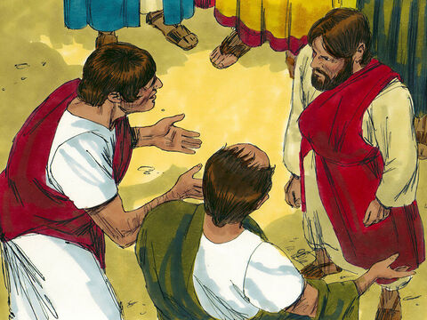
Jesus, just say the word and my servant will be well.
I, too, am a man under authority.
I obey my commander.
I also have authority. I tell my soldiers and servants what to do that they do it.
Just say the word,
and my servant will be well.
“Lord, you don’t need to come into my house. I am not good enough for you to be under my roof. ⁷ That is why I did not come to you myself. You only need to say the word, and my servant will be healed. ⁸ I, too, am a man under the authority of other men. And I have soldiers under my command. I tell one soldier, ‘Go,’ and he goes. And I tell another soldier, ‘Come,’ and he comes. And I say to my servant, ‘Do this,’ and my servant obeys me.”
⁹ When Jesus heard this, he was amazed. He turned to the crowd following him and said, “I tell you, this is the greatest faith I have seen anywhere, even in Israel.”
I have not seen such great faith anywhere in Israel.

Slide 15
Go
He is well
Matthew (8:13) tells us that Jesus said:
“Go home. Your servant will be healed just as you believed he would.” And at that same time his servant was healed.
Go home.
Your servant is well.

Slide 16
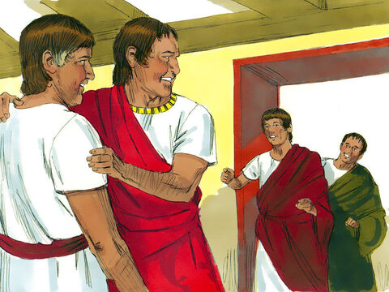

He is well!
Luke 7:¹⁰
The men who had been sent to Jesus went back to the house. There they found that the servant was healed.

Slide 17
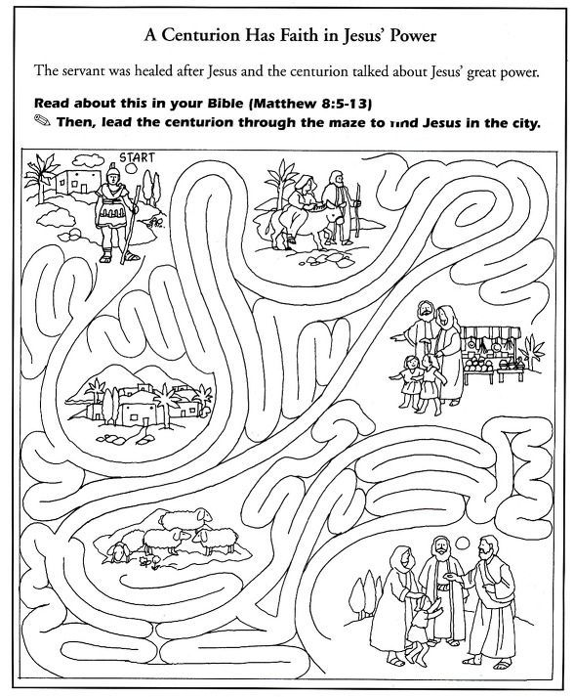
Jesus is A-maze-ing!
Can you help the centurion go through Jerusalem?

Slide 18
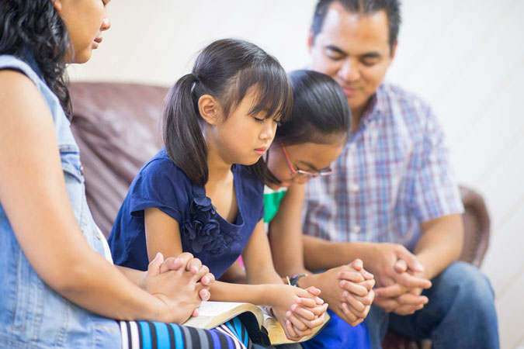
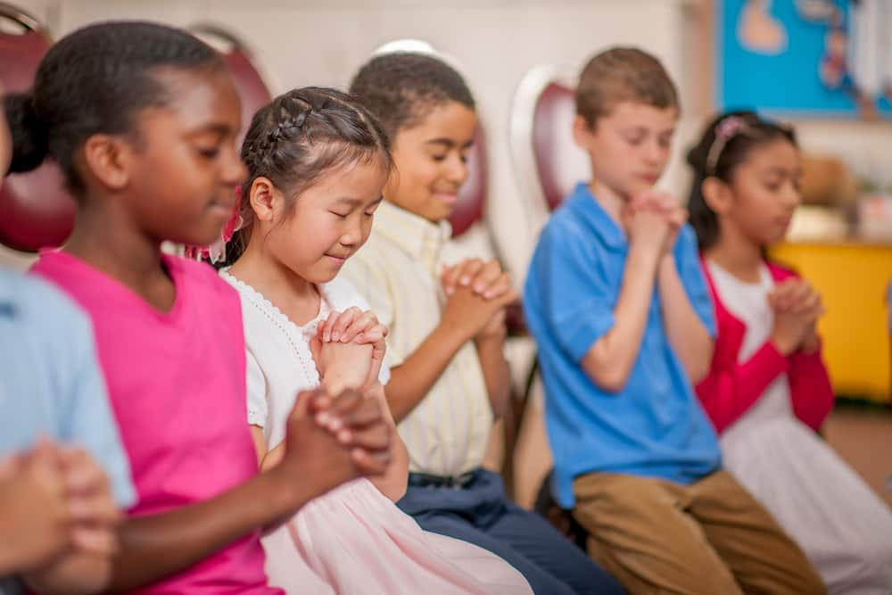
Jesus healed many people with a word or a touch.
We, too, can pray that Jesus will heal us.
If He is knows that that is what is best, He will do it.

Slide 19
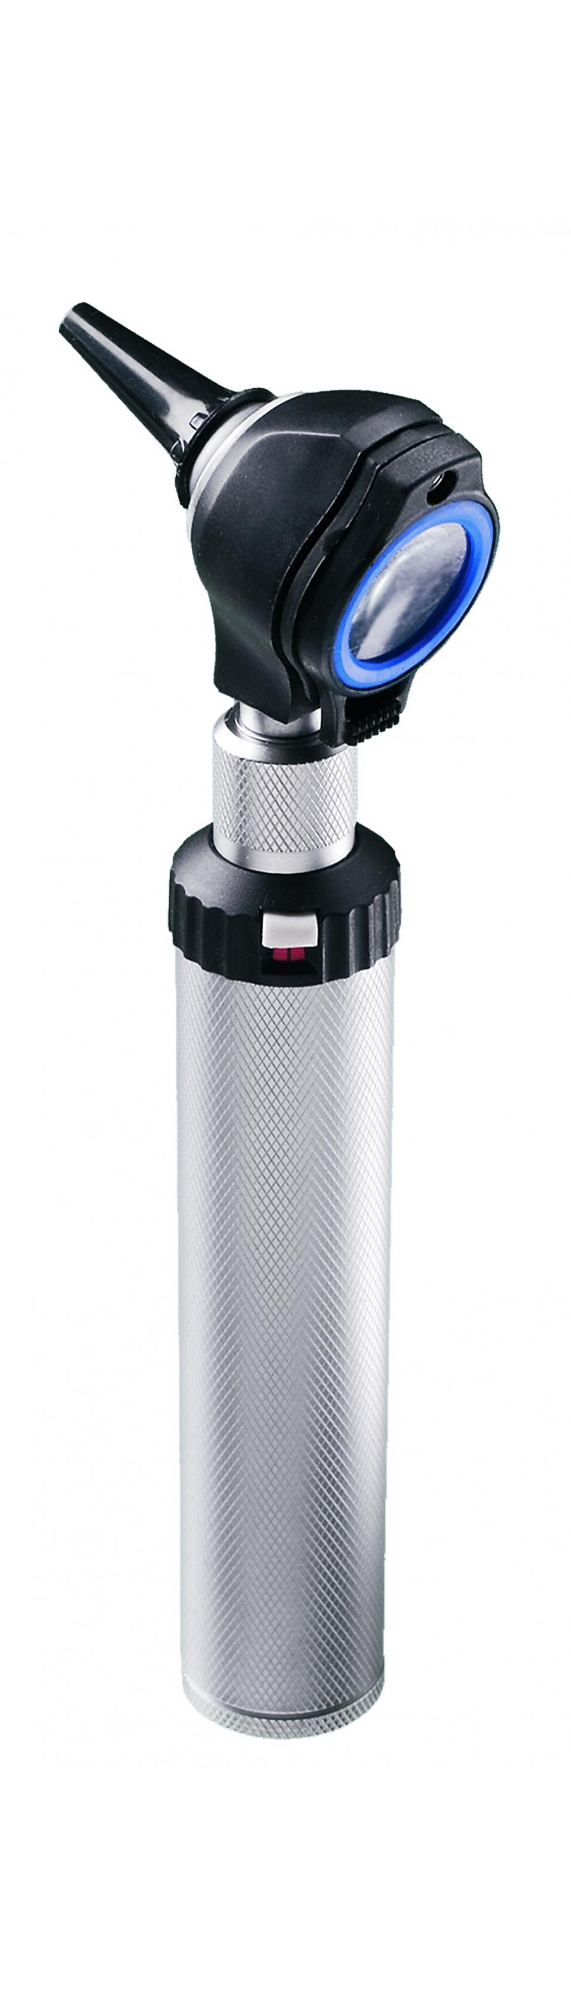
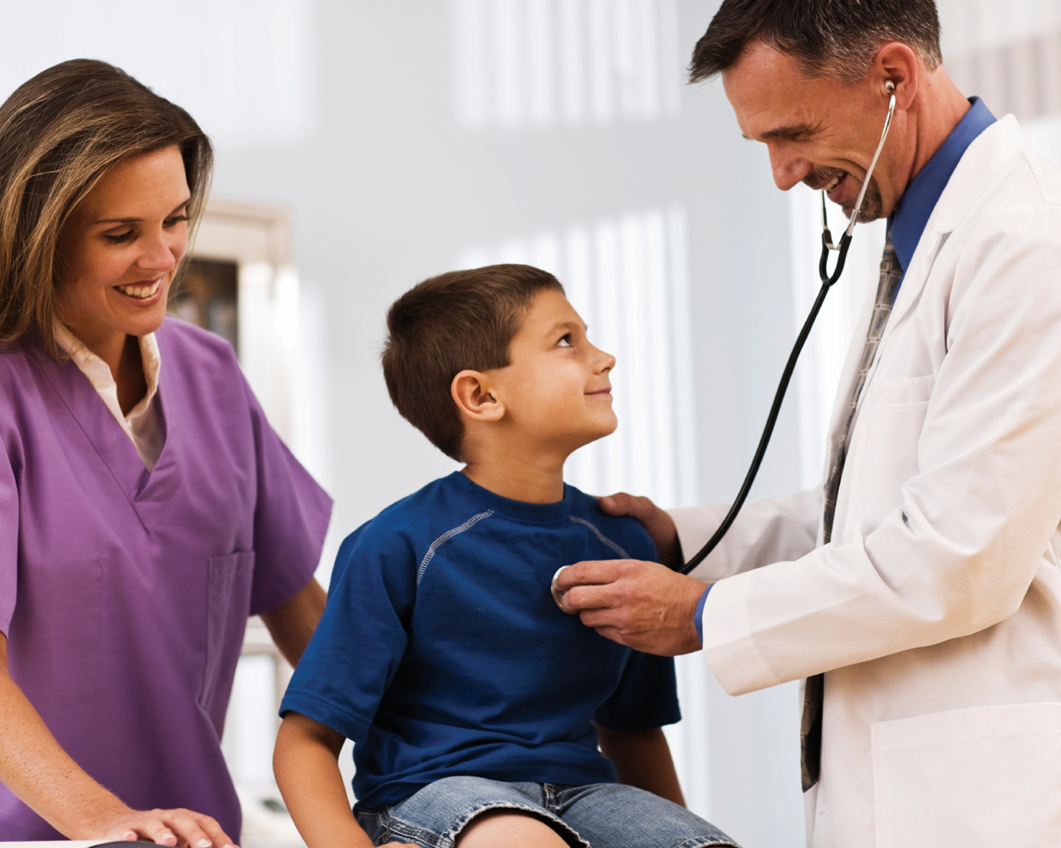

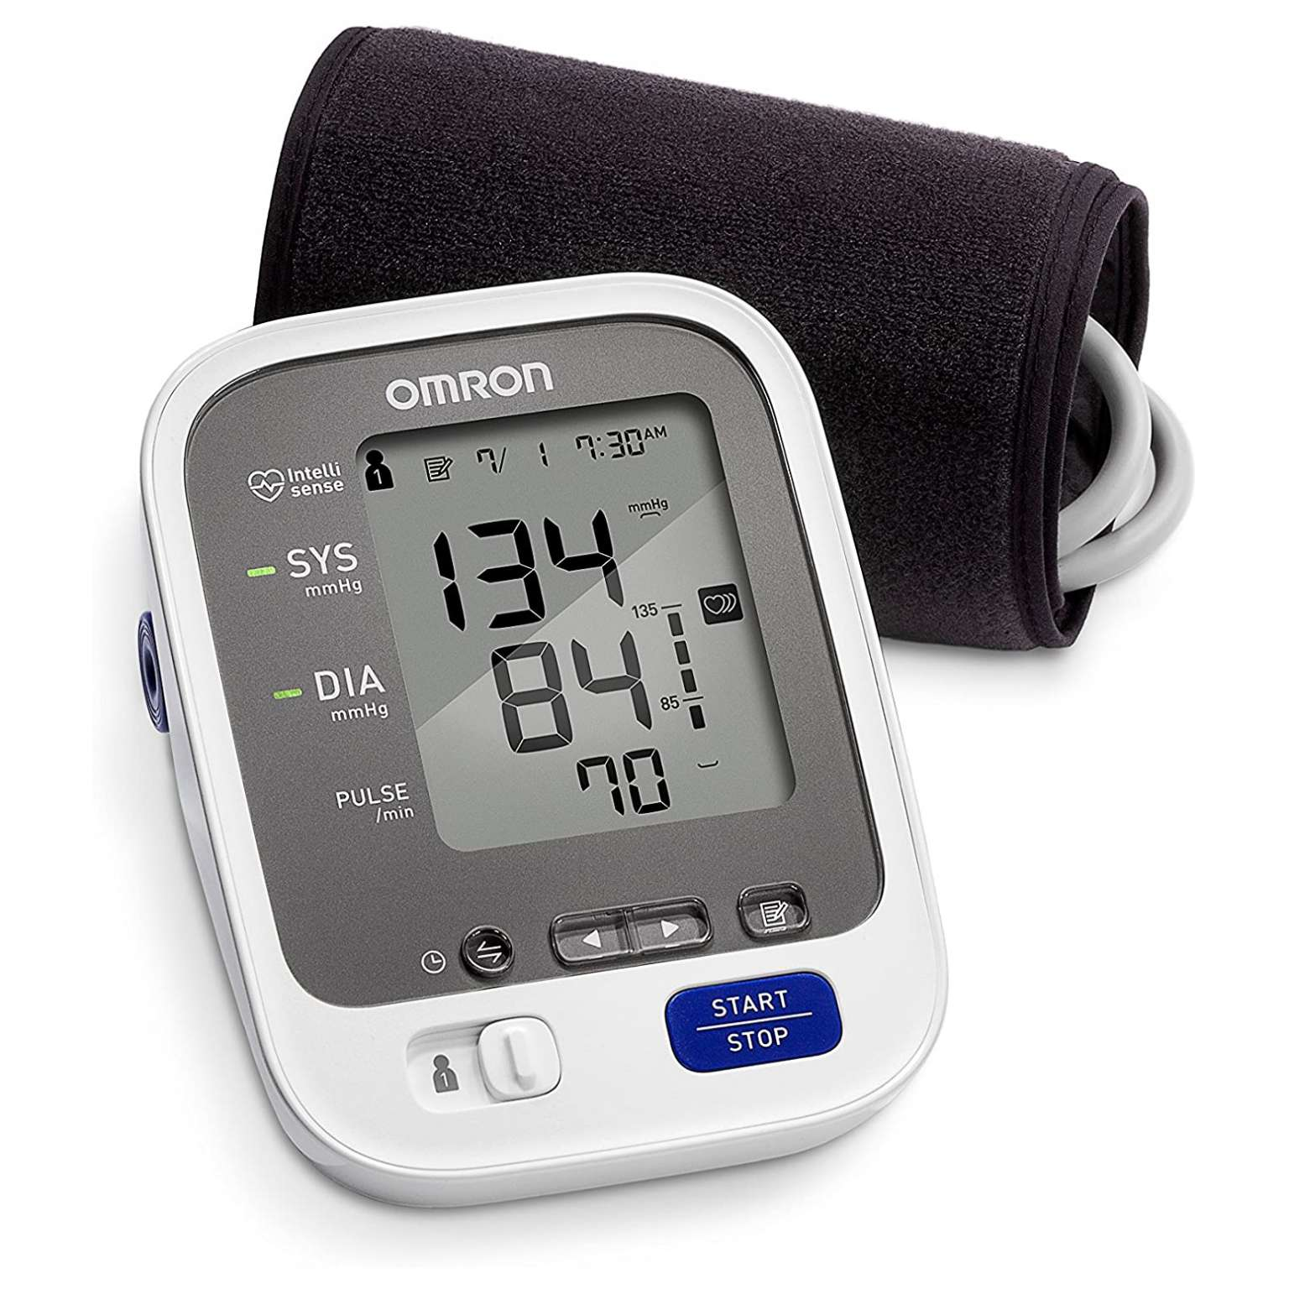
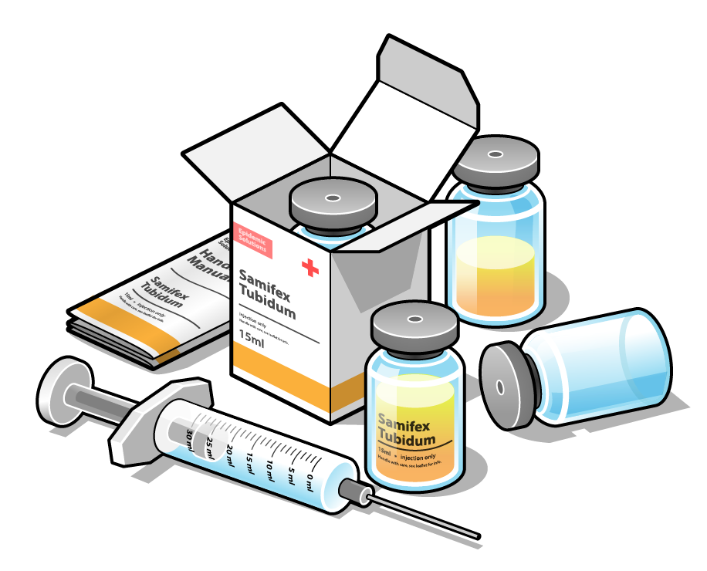

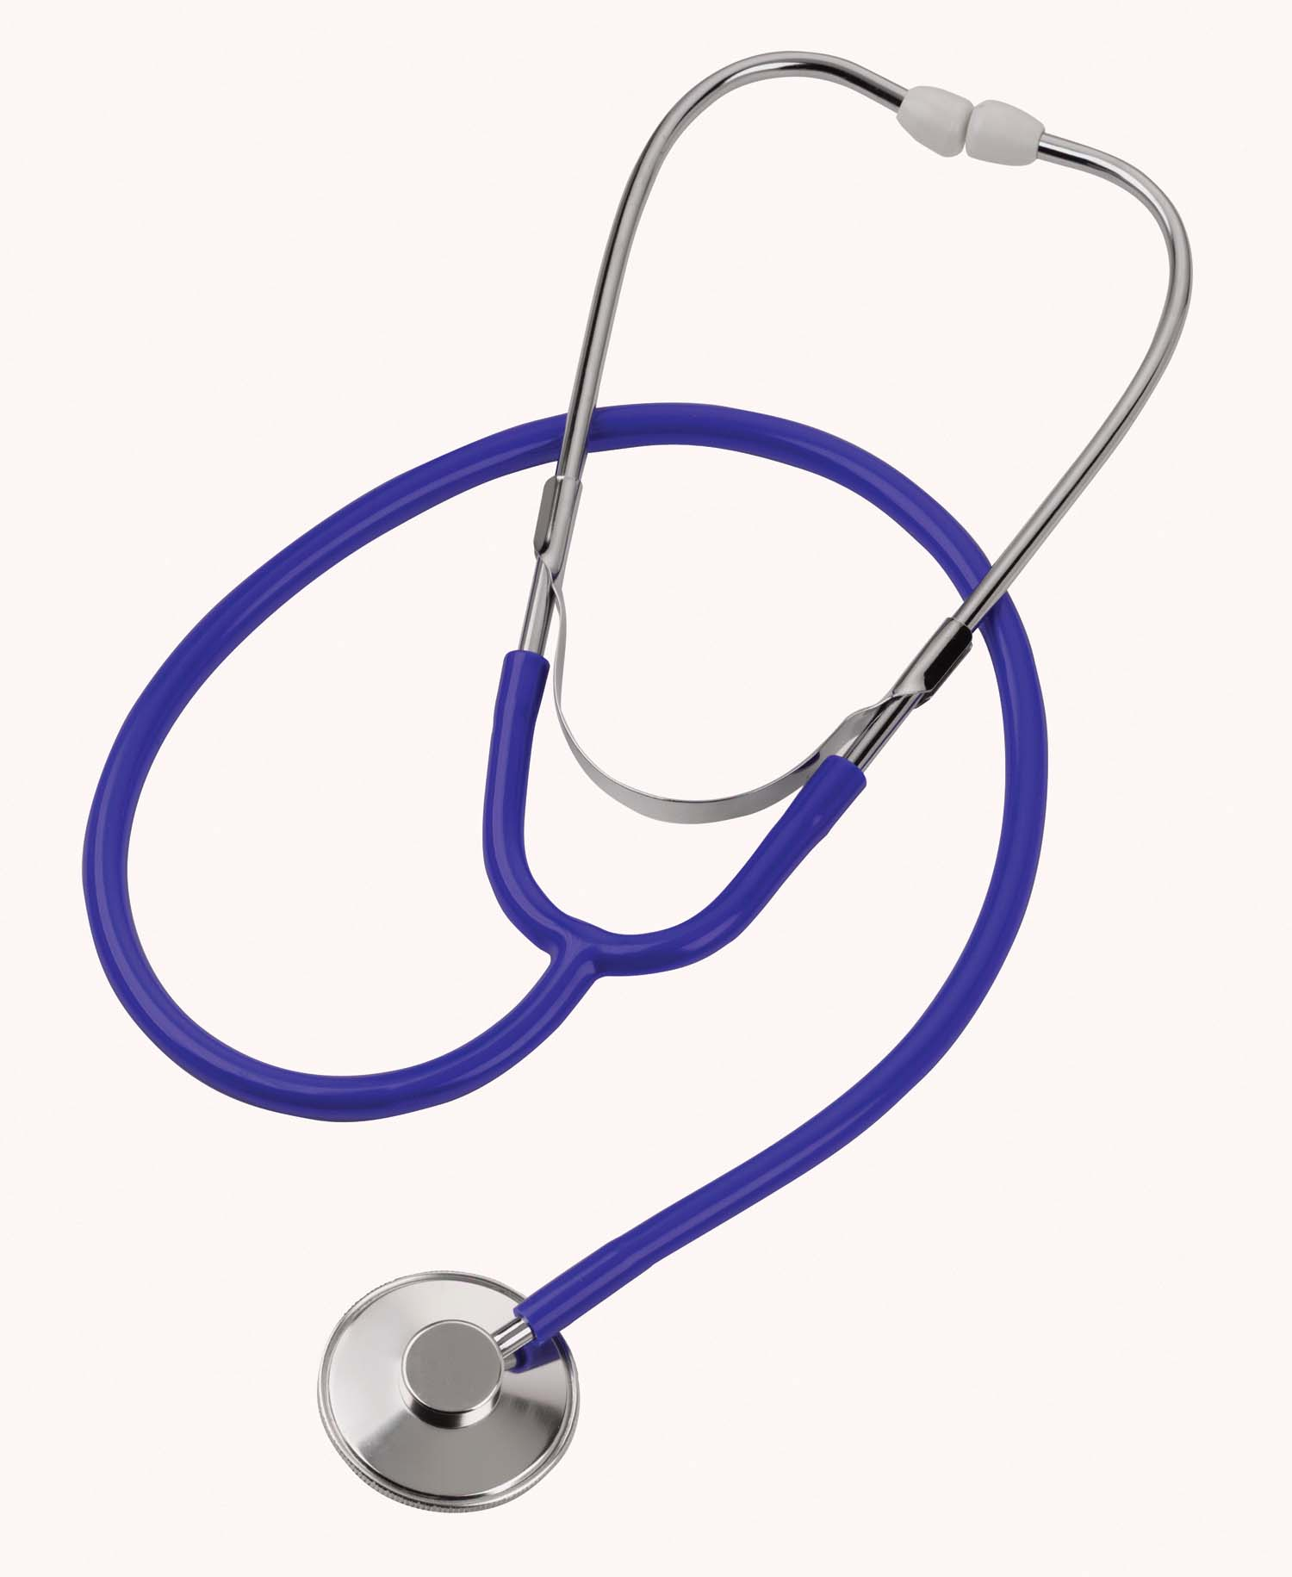
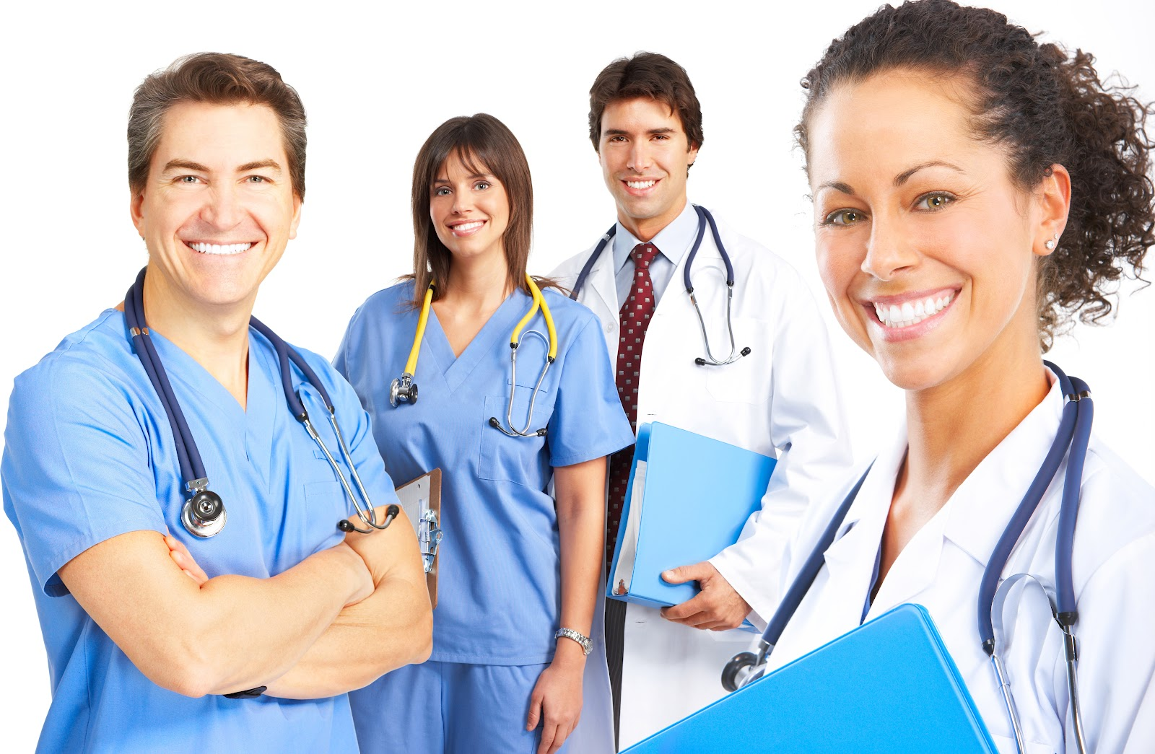
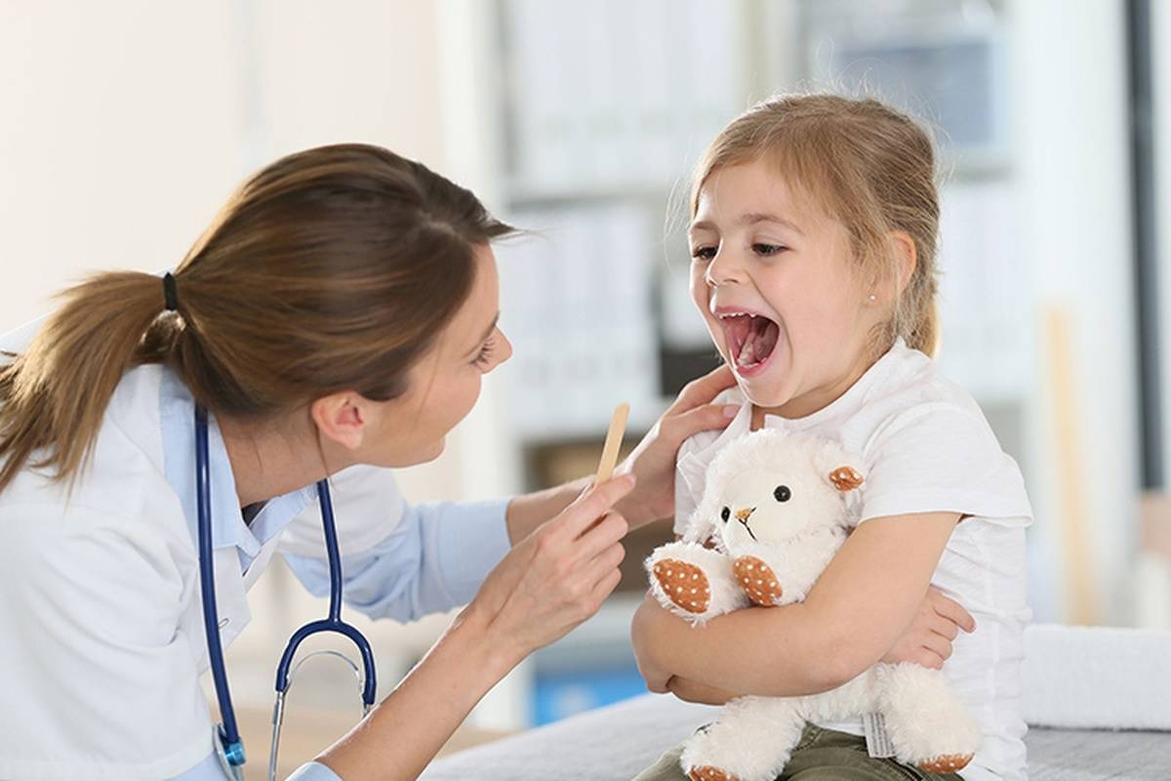
God gives us doctors and nurses that help us get well too. We should do what they say is best for us.

Slide 20

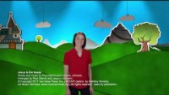
Jesus is the Healering

Slide 21

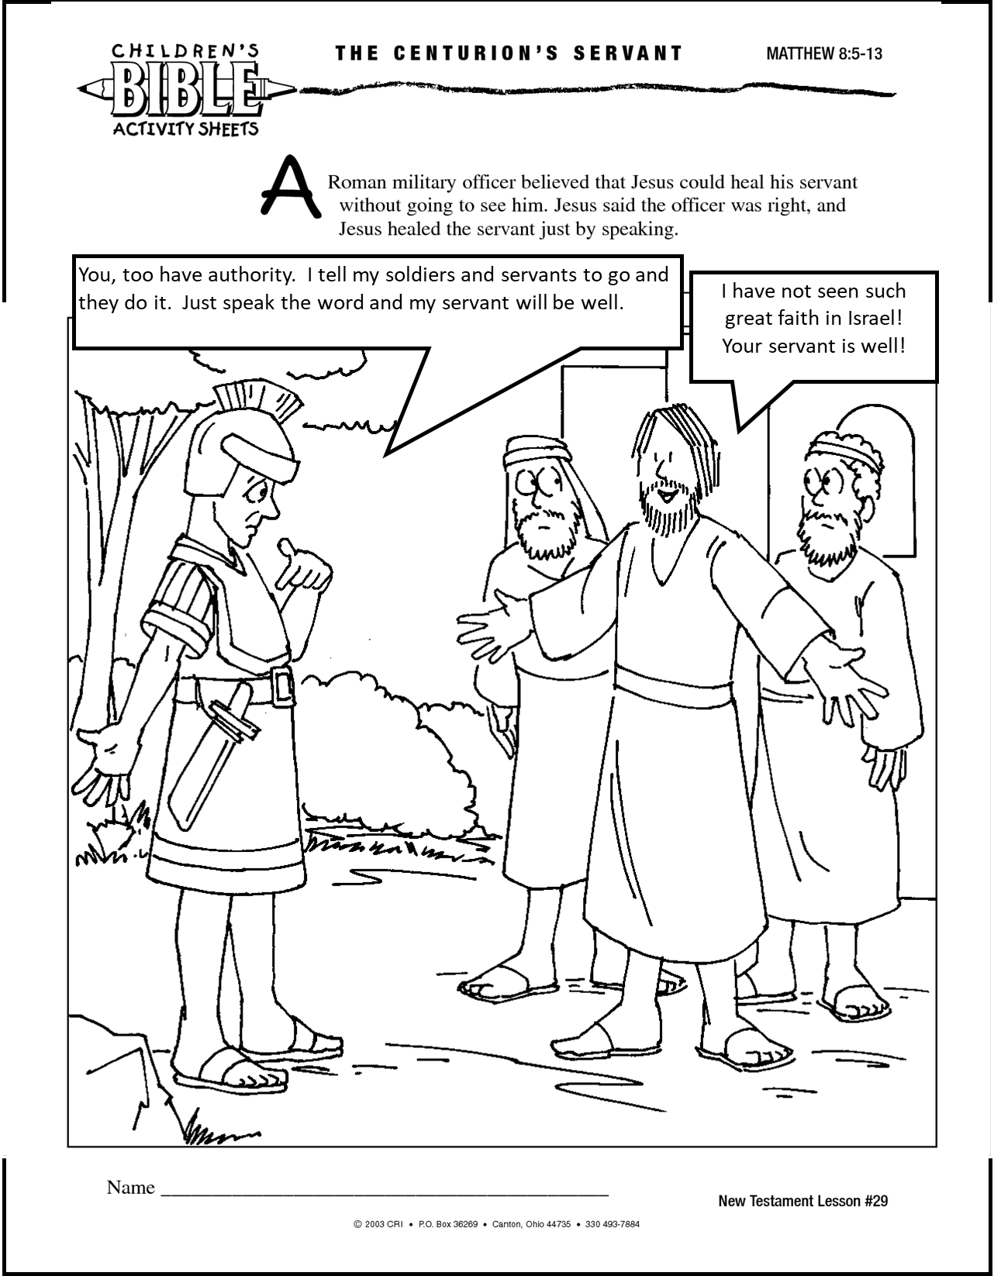
CRAFT
& COLOR
?

Slide 22

Hebrews 11:1
Faith is the confidence that what we hope for will actually happen

Slide 23
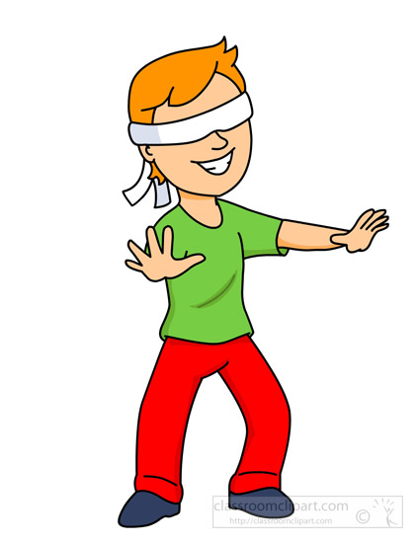
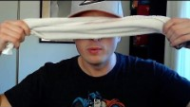
Object Lesson --- FAITH
Teacher – do a lesson live. Here are some ideas
Do you have faith?
I need a volunteer
The volunteer will be blind-folded.
They need to follow directions.
Teacher Prep:

Slide 24

My God is Great

Slide 25
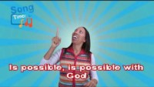
All Things are Possible with GodSing

Slide 26

Find Romans 15:13
We trust in God
We have FAITH in Him
May the God of hope
Fill you with all joy and peace
As you trust in Him
So that you may overflow
With hope
By the power of the Holy Spirit.

Slide 27

EXTRA
https://activity-array.com/

Slide 28
Find John 4
Another time
From the same place
John tells a similar story that happened regarding an official from Capernaum.
Let’s act it out.

Slide 29
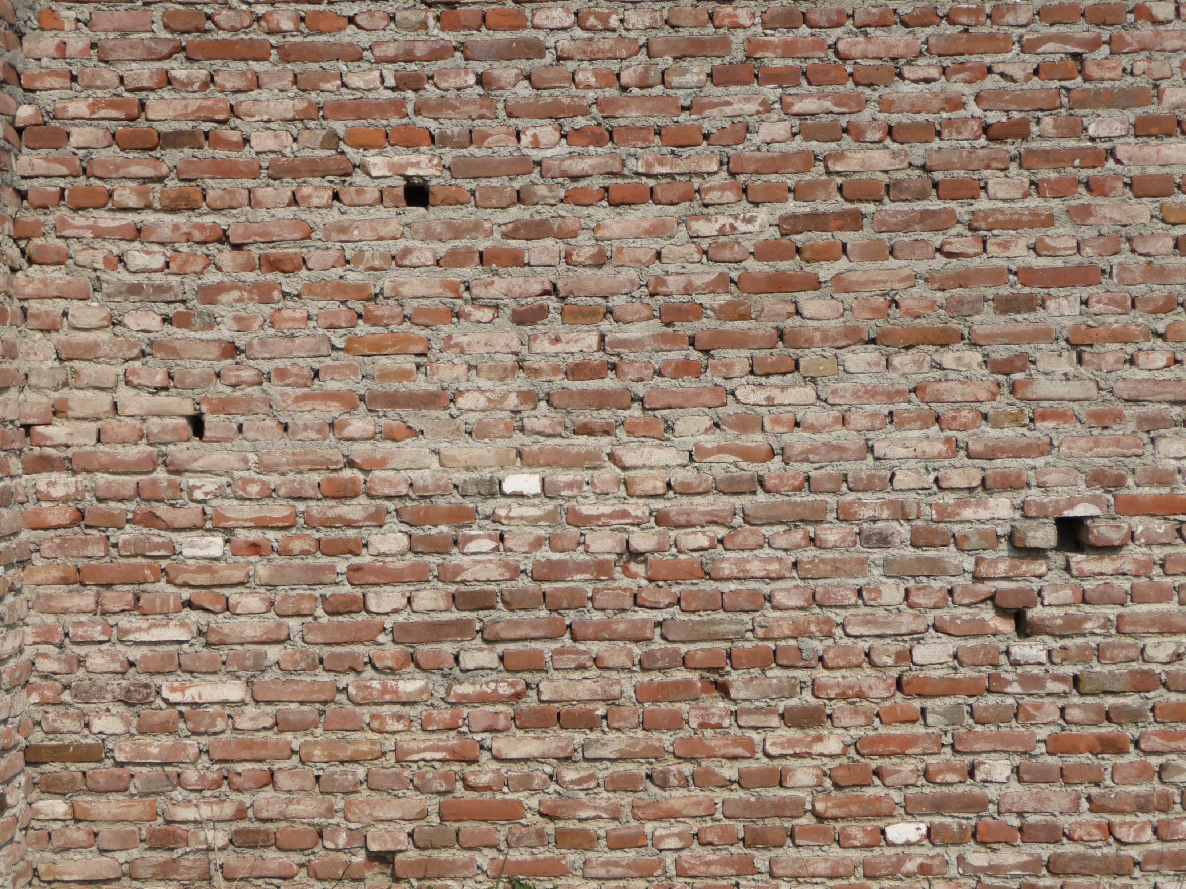
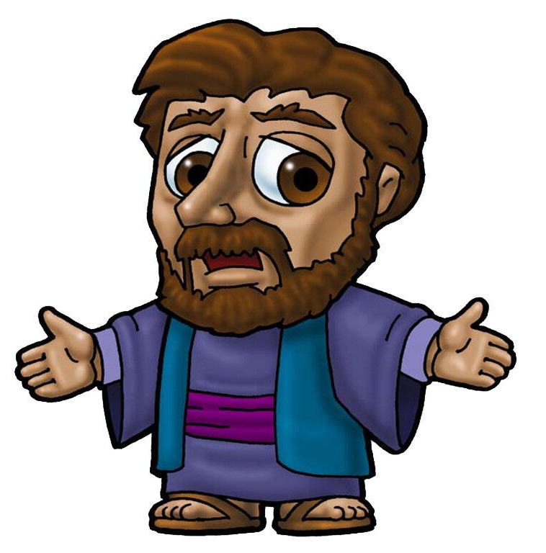
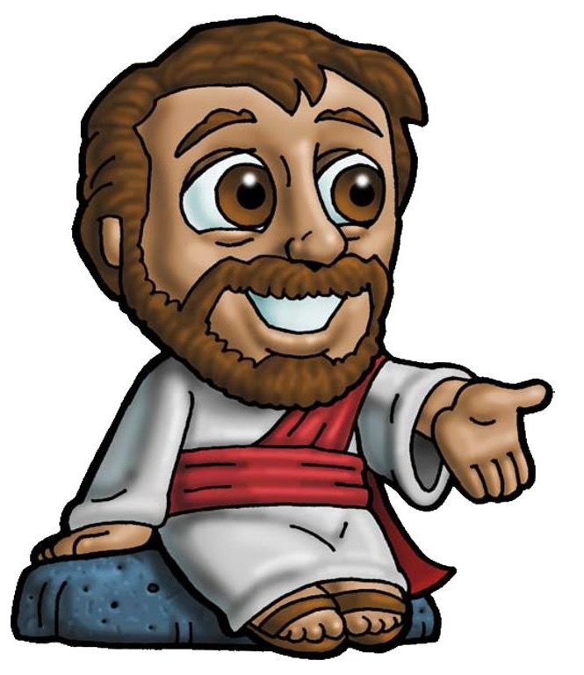
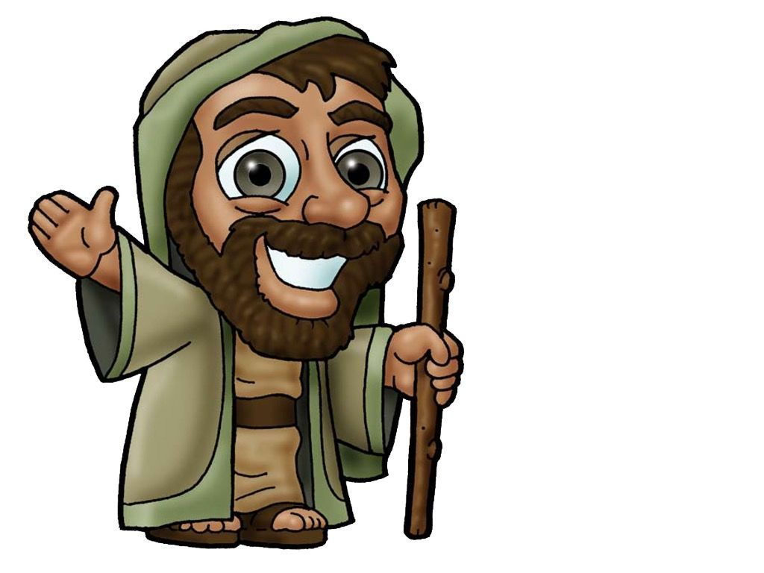
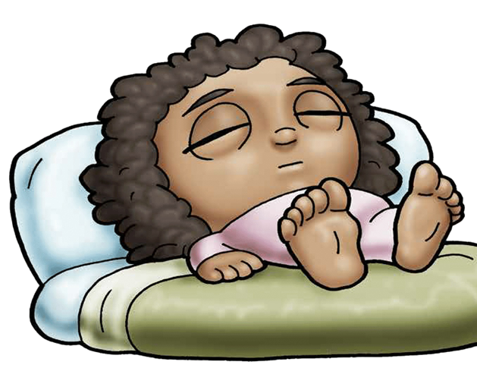
I need some volunteers to help act out our story. Who wants to be:
An Official/Officer (great at begging)
His son (sick) no talking
Jesus
Servant

Slide 30
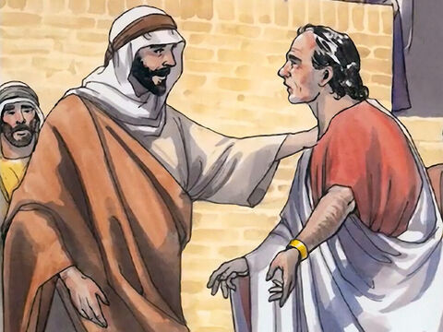
Come to Capernaum PLEASE
John 4
One of the king’s important officers lived in the city of Capernaum. This man’s son was sick. ⁴⁷ The man heard that Jesus had come from Judea and was now in Galilee. He went to Jesus and begged him to come to Capernaum and heal his son. His son was almost dead.

Slide 31

Jesus, Please
Come to Capernaum
Heal my son!

Slide 32
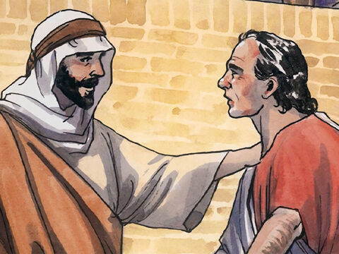
GO
Your son will live
Jesus, Sir
Come before my child dies!
⁴⁸ Jesus said to him, “You people must see signs and miracles before you will believe in me.”
⁴⁹ The officer said, “Sir, come before my child dies.”
⁵⁰ Jesus answered, “Go. Your son will live.”
The man believed what Jesus told him and went home.
Go, Your son will live!

Slide 33
Please come before my son dies!
Unless you see signs you won’t believe.
I believe you.
Go. You son will live.

Slide 34
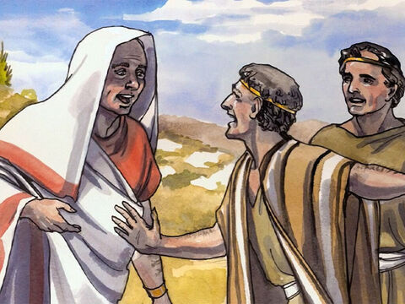
Your son is well!
⁵¹ On the way the man’s servants came and met him. They told him, “Your son is well.”
⁵² The man asked, “What time did my son begin to get well?”
They answered, “It was about one o’clock yesterday when the fever left him.”
⁵³ The father knew that one o’clock was the exact time that Jesus had said, “Your son will live.” So the man and all the people of his house believed in Jesus.

Slide 35
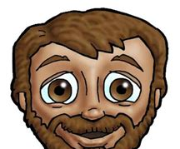
What time did he get well?
Your son is well!
That’s the same time Jesus said, “He will live.”.
1:00

Slide 36
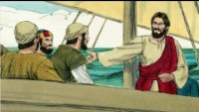
He’s Able

Slide 37
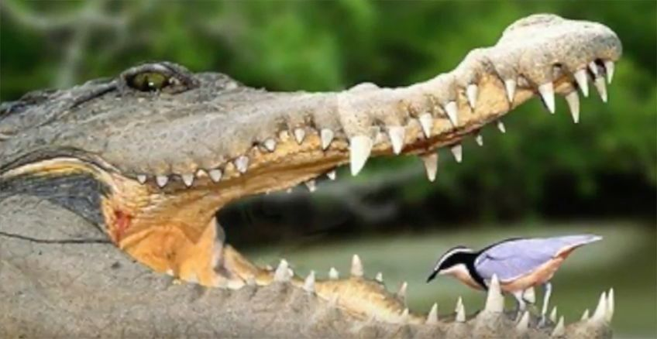
Do you have faith?
Fearlessly
Ask
Implicitly
Trust
HIM
We can boldly pray to God
We can ask for things we and others need
Because He told us to & promised to provide.
We can absolutely know, without a doubt,
That God loves us & will do what is best for us.
We can trust Him!

Slide 38
EXTRA NATURE NUGGET

Slide 39
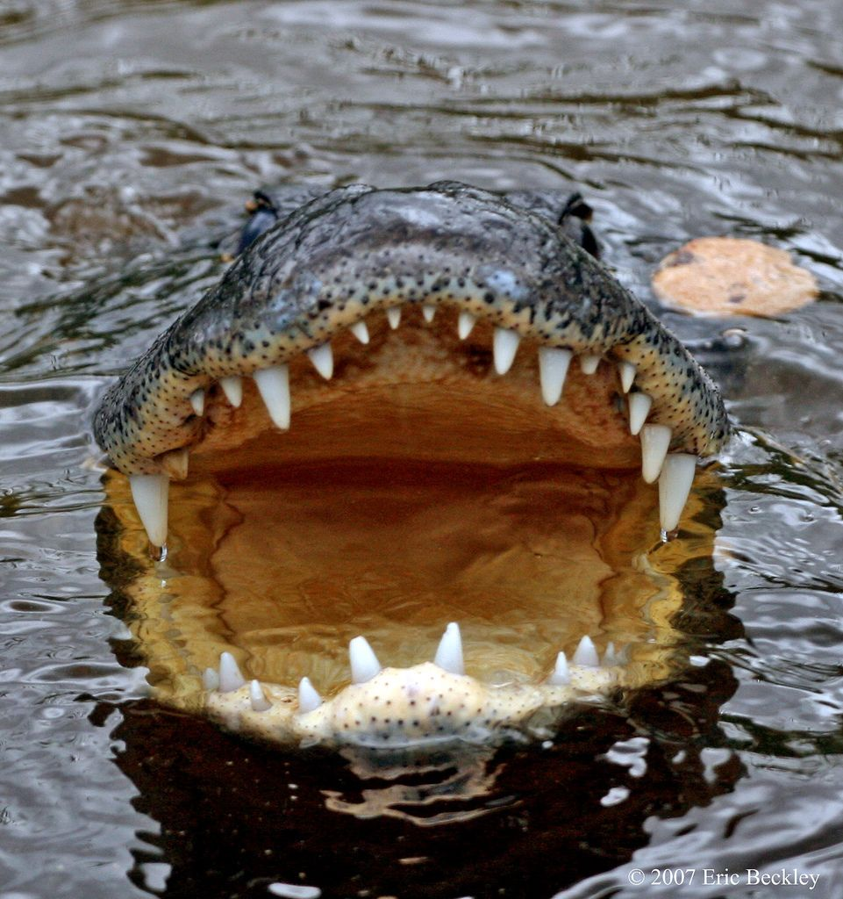
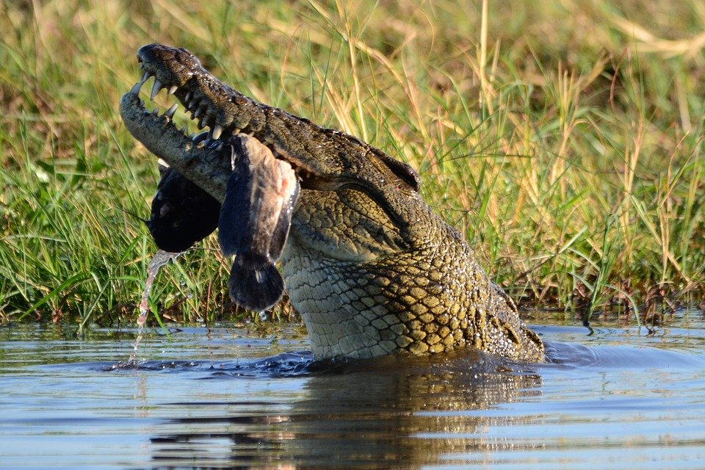
Alligators and Crocodiles
are strong
Crocodile

Slide 40
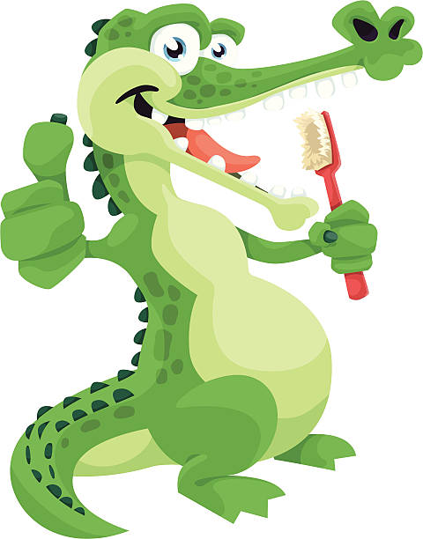
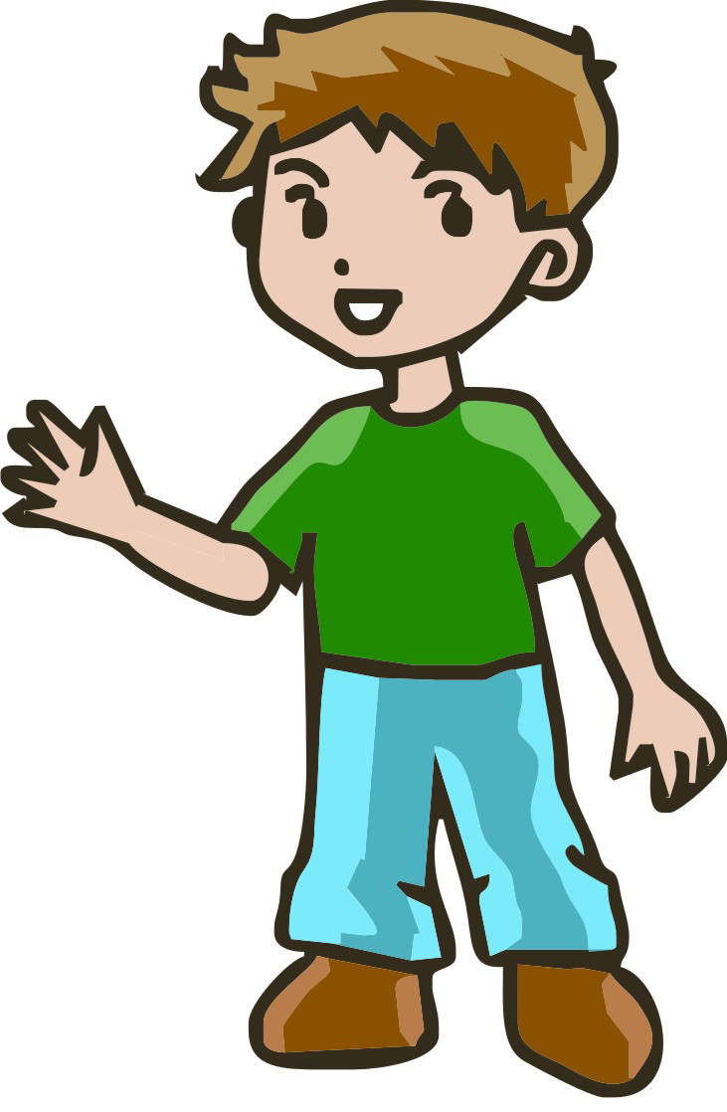


Would you do this?
Why do the
Plovers
Trust the crocodile?

Slide 41

Is this FAITH?
Faith is:
Confidence or trust in a person or thing

Slide 42


Babies trust their parents.
Her mouth is a safe place for them.
Trust
Faith

Slide 43


Example:

Slide 44

By FAITHSing

