Slide 1
Anointed with perfume and tears
Luke 7:36-50

Slide 2
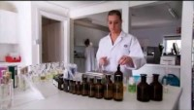
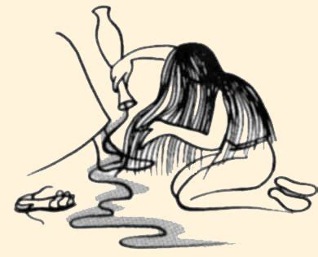
our story is about a lady who gave a gift of Perfume

Slide 3
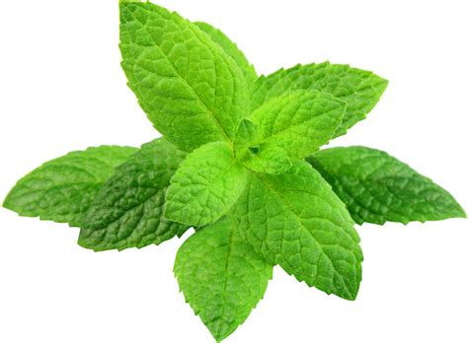
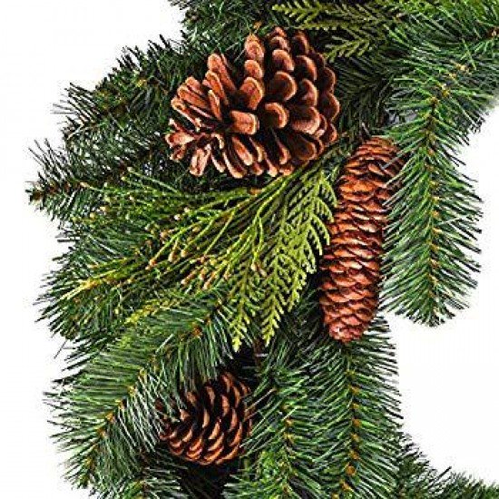
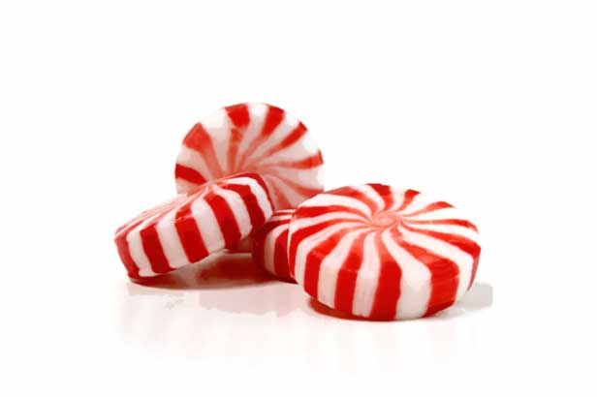
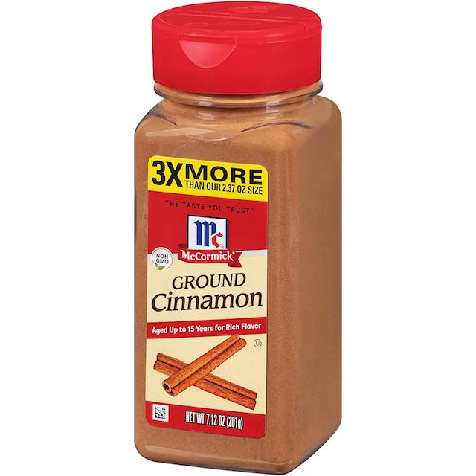
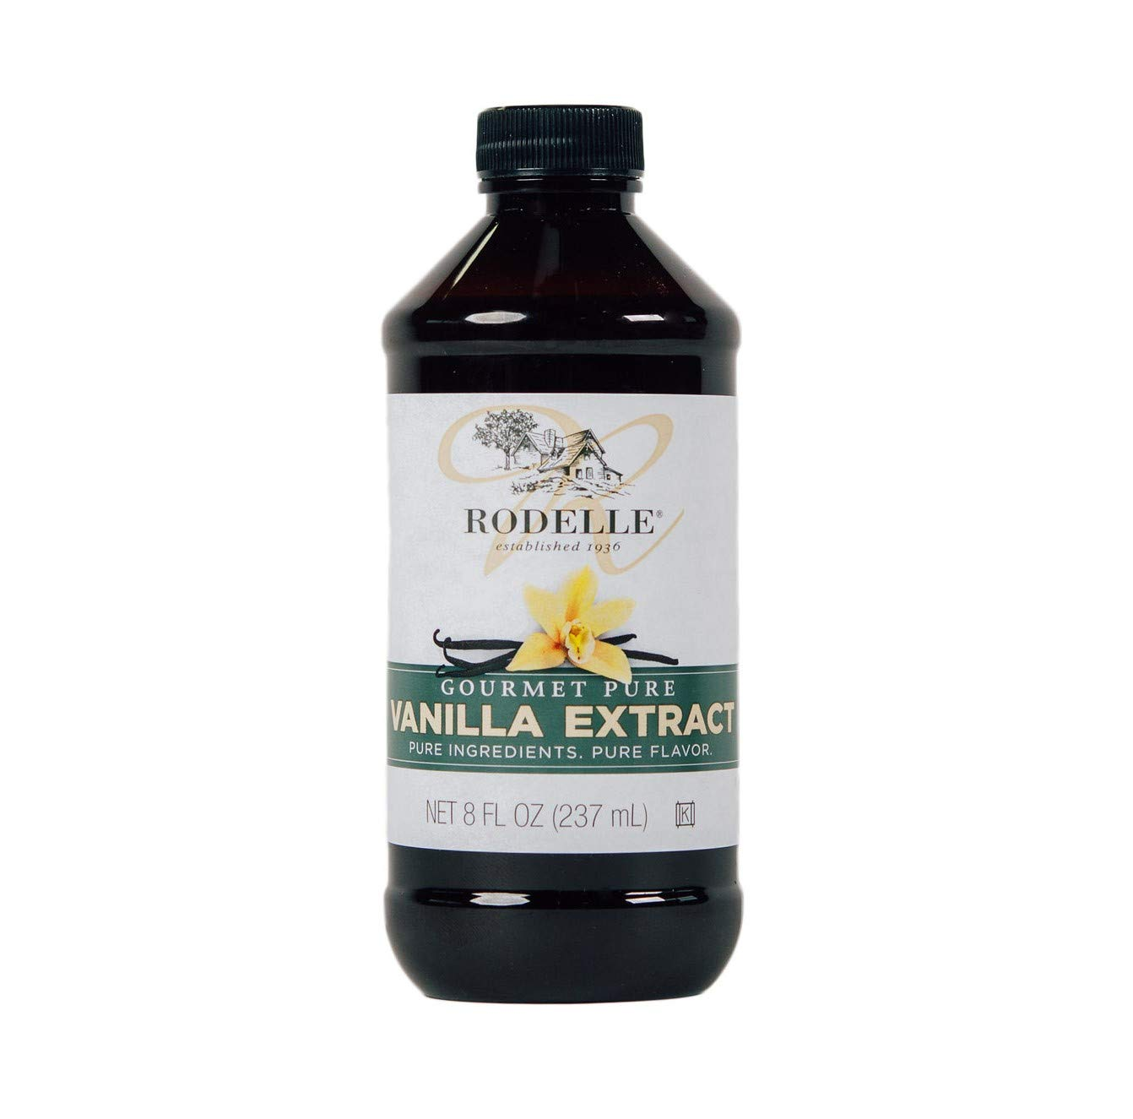
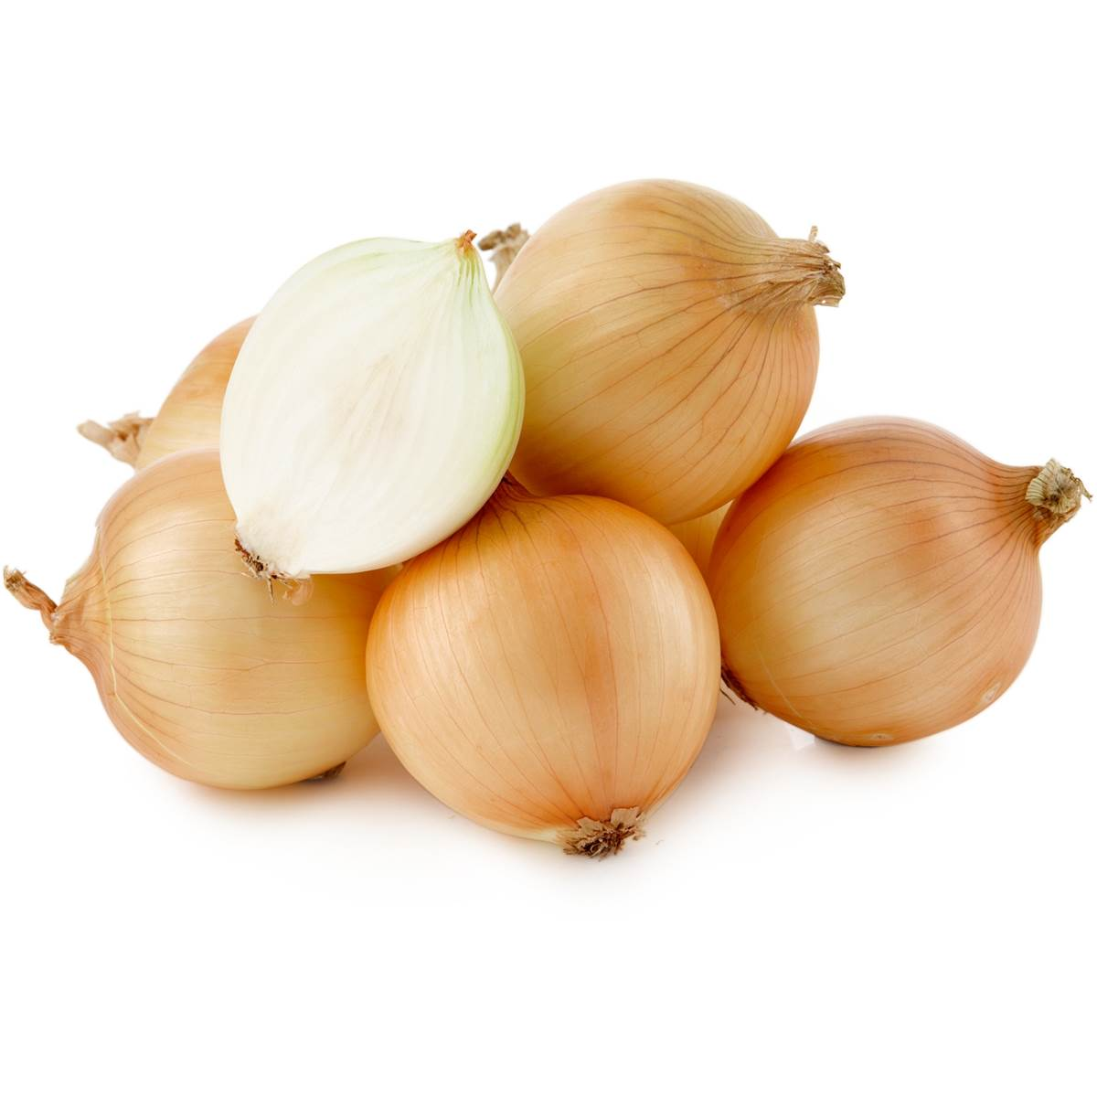
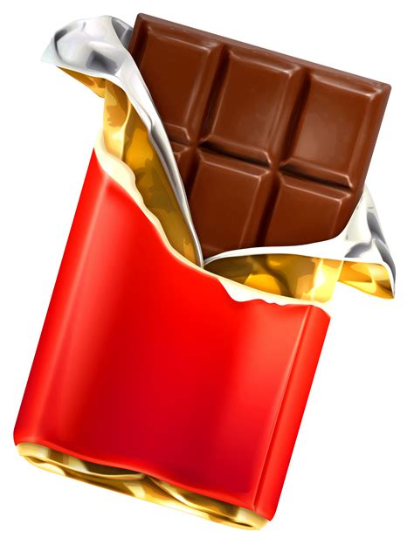
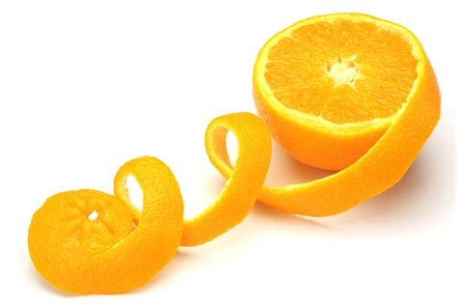


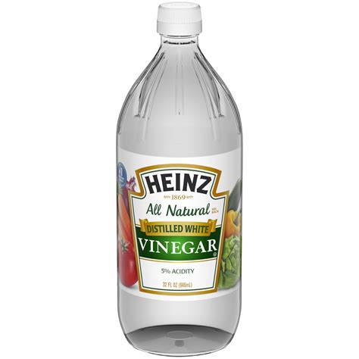

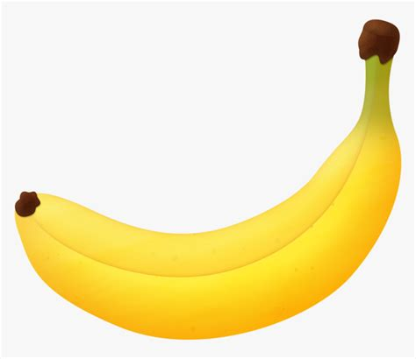
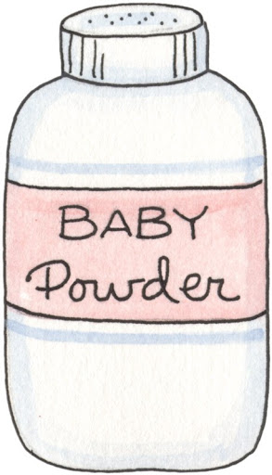
What is that smell?
Which smell do you like best?

Slide 4
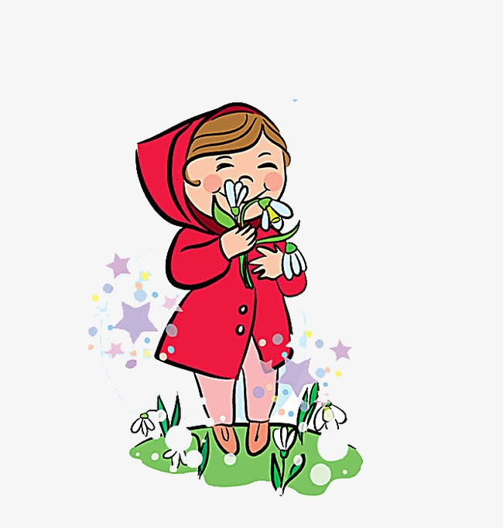
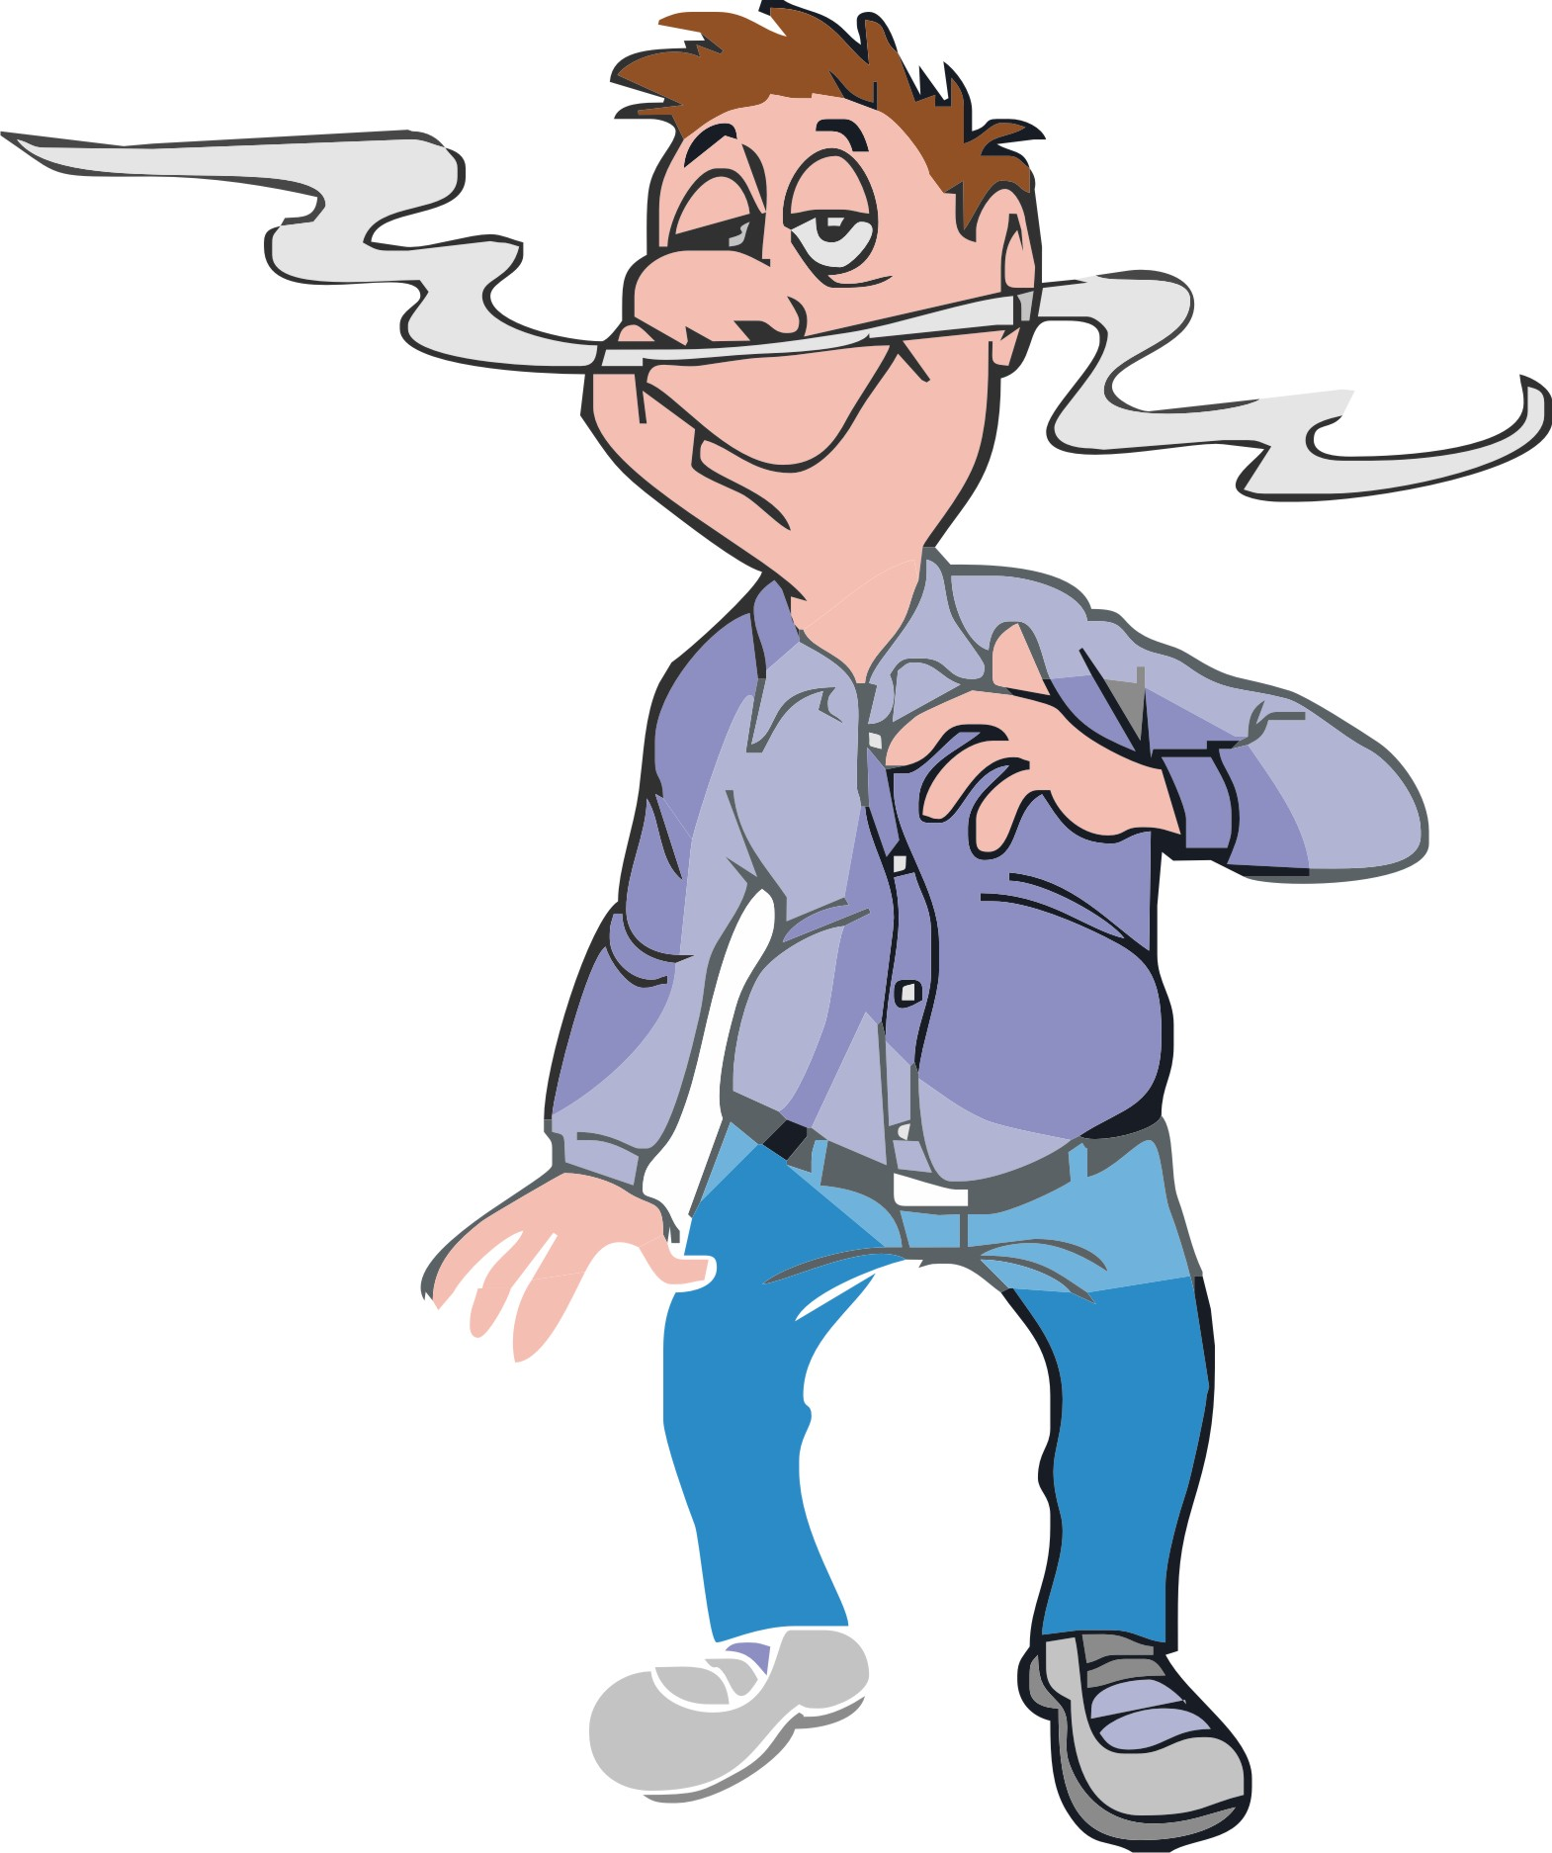
^{1 Peter2:17}
Show respect for all people.
Love your brothers and sisters in God’s family. Respect God, and honor the king.
You can be like a sweet smell
Spread your sweet smell
everywhere you go

Slide 5


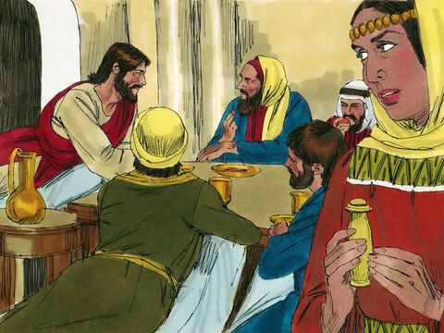
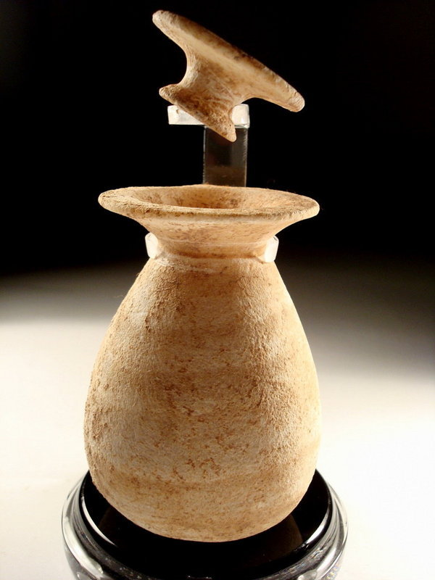
In you honor jesus
Luke 7:36 & 37
One of the pharisees asked Jesus to eat with him. Jesus went into the pharisee’s house and took a place at the table.
There was a sinful woman in that town. She knew that Jesus was eating at the pharisee’s house. So the woman brought some expensive perfume in an alabaster jar.

Slide 6
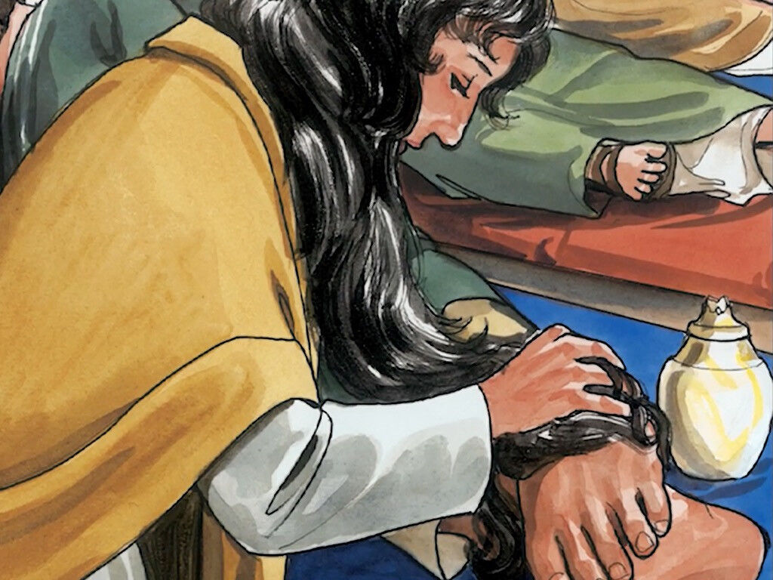

In you honor jesus
Luke 7:38
She stood at Jesus’ feet, crying. Then she began to wash his feet with her tears. She dried his feet with her hair. She kissed his feet many times and rubbed them with the perfume.

Slide 7
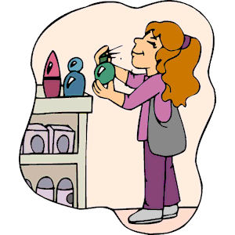

^{2 Corinthians 2:14-15}
But thanks be to God, who always leads us in victory through Christ.
God uses us to spread his knowledge everywhere like a sweet-smelling perfume.
Our offering to God is to be the perfume of Christ that goes out to those who are being saved and to those who are being lost.
I have some perfumes.
I’ll put some on a cotton ball
See which perfume you like better.
You can put your favorite on your feet.

Slide 8
Luke 7:38
39 When the Pharisee who asked Jesus to come to his house saw this, he thought to himself, “If this man were a prophet,[a] he would know that the woman who is touching him is a sinner!”
40 In response, Jesus said to the Pharisee, “Simon, I have something to say to you.”
If this man were a prophet,
he would know that woman is a sinner.
He wouldn’t let her touch him!
Simon, I have something to tell you.

Slide 9
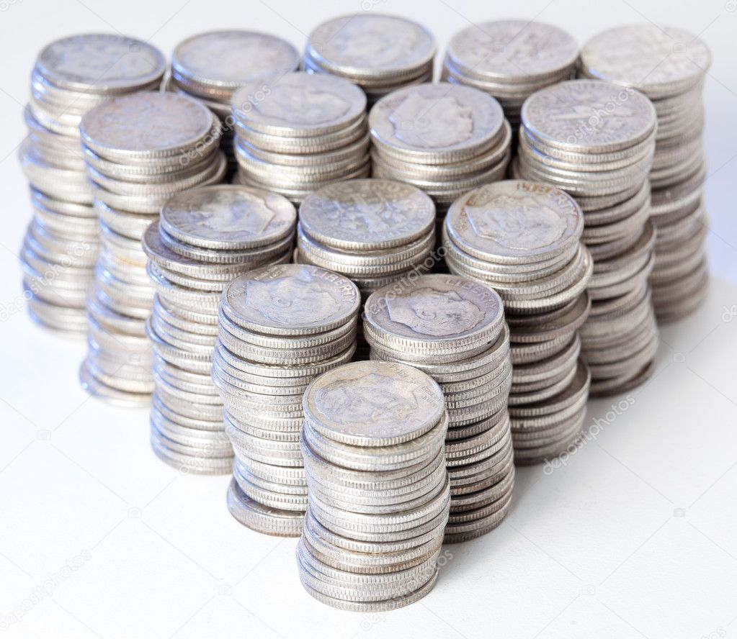
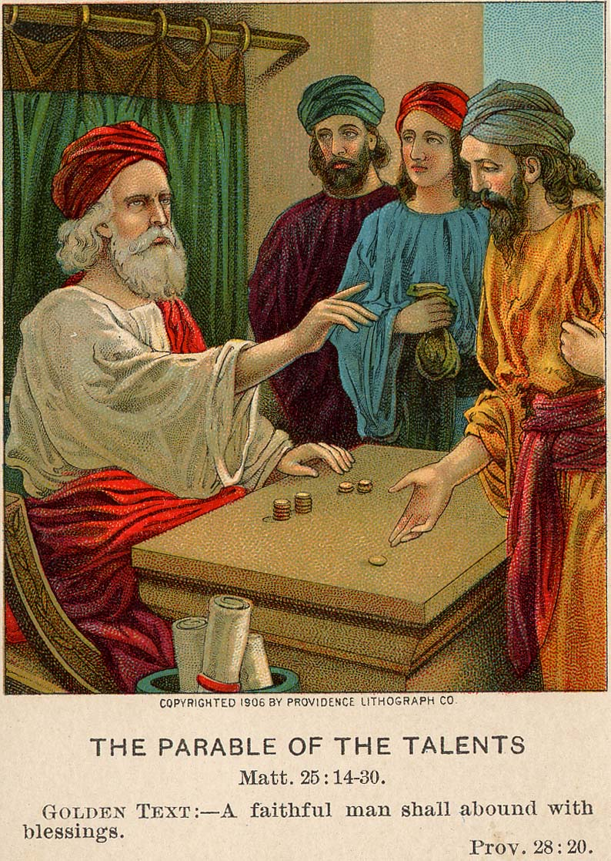
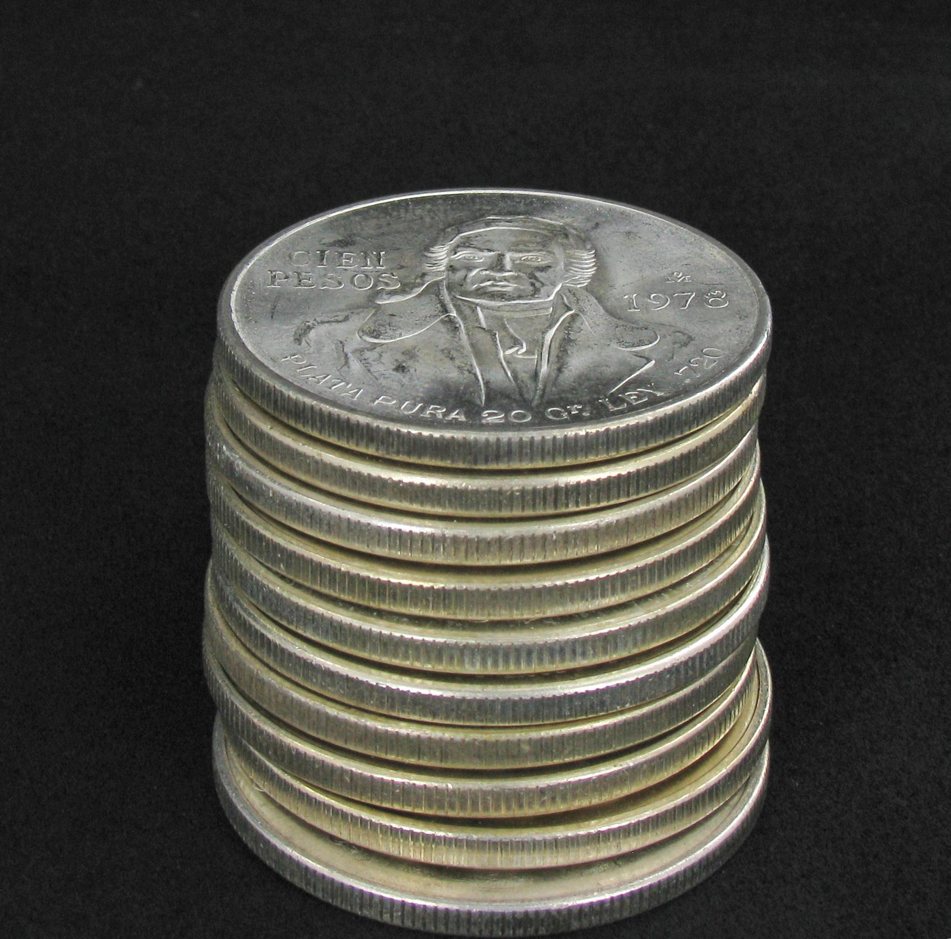
Luke 7:41
41 Jesus said, “There were two men. Both men owed money to the same banker. One man owed him 500 silver coins. The other man owed him 50 silver coins.
You owe 500 silver coins.
You owe 50 silver coins.
However, I forgive both your debts. You don’t have to pay me.
150
150
150
+50
500
150 coins
150 coins
150 coins
50 coins
42 The men had no money, so they could not pay their debt. But the banker told the men that they did not have to pay him. Which one of those two men will love him more?”
43 Simon answered, “I think it would be the one who owed him the most money.”
Jesus said to him, “You are right.”

Slide 10
Luke 7:42
…Which one of those two men will love him more?”
43 Simon answered, “I think it would be the one who owed him the most money.”
Jesus said to him, “You are right.”
You
owe!
coins
Which one of those 2 men will love him more?
You are right.
I think it would be the one who owed him the most money.

Slide 11
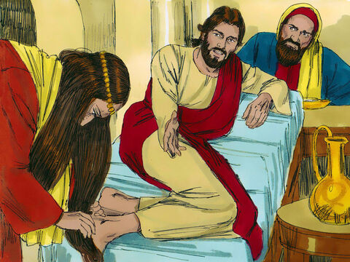
She loves and honors me
Do you see this woman.
You didn’t give me water to wash my feet, but she is washing my feet with her tears!
You did not greet me with a friendly kiss.
She has been kissing my feet since I came in.
You did not honor me with oil on my head, but she rubbed my feet with her sweet smelling oil.
Luke 7:44-50
44 Then he turned to the woman and said to Simon, “Do you see this woman? When I came into your house, you gave me no water for my feet. But she washed my feet with her tears and dried my feet with her hair. 45 You did not greet me with a kiss, but she has been kissing my feet since I came in. 46 You did not honor me with oil for my head, but she rubbed my feet with her sweet-smelling oil.

Slide 12
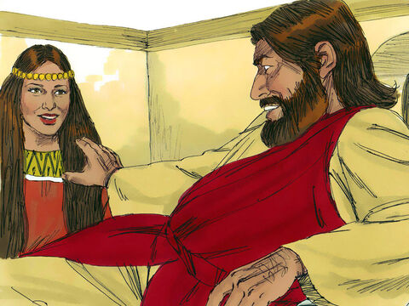
forgiven
Your sins are forgiven.
Go in peace
Luke 7:44-50
47 I tell you that her many sins are forgiven. This is clear, because she showed great love. People who are forgiven only a little will love only a little.”
48 Then Jesus said to her, “Your sins are forgiven.”
49 The people sitting at the table began to think to themselves, “Who does this man think he is? How can he forgive sins?”
50 Jesus said to the woman, “Because you believed, you are saved from your sins. Go in peace.”

Slide 13

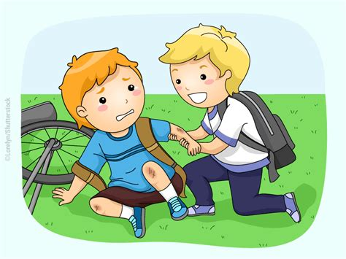

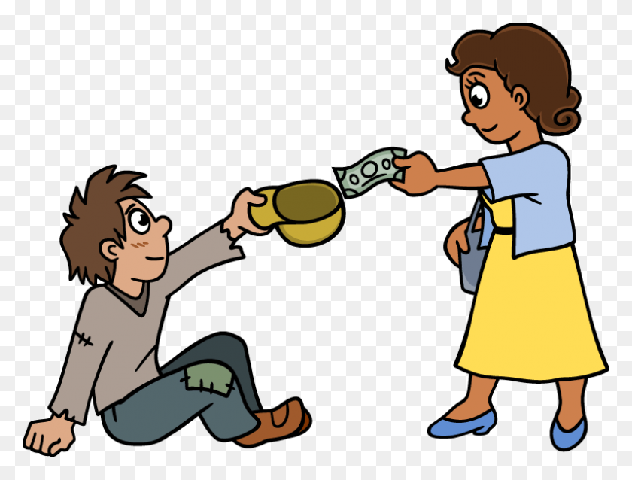

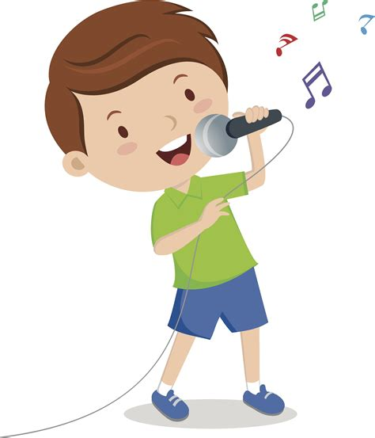
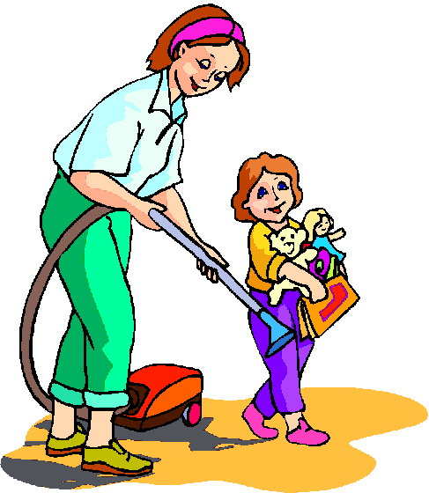

Jesus loves you!
He forgives you!
How do you show jesus
that
you love him?

Slide 14


Slide 15

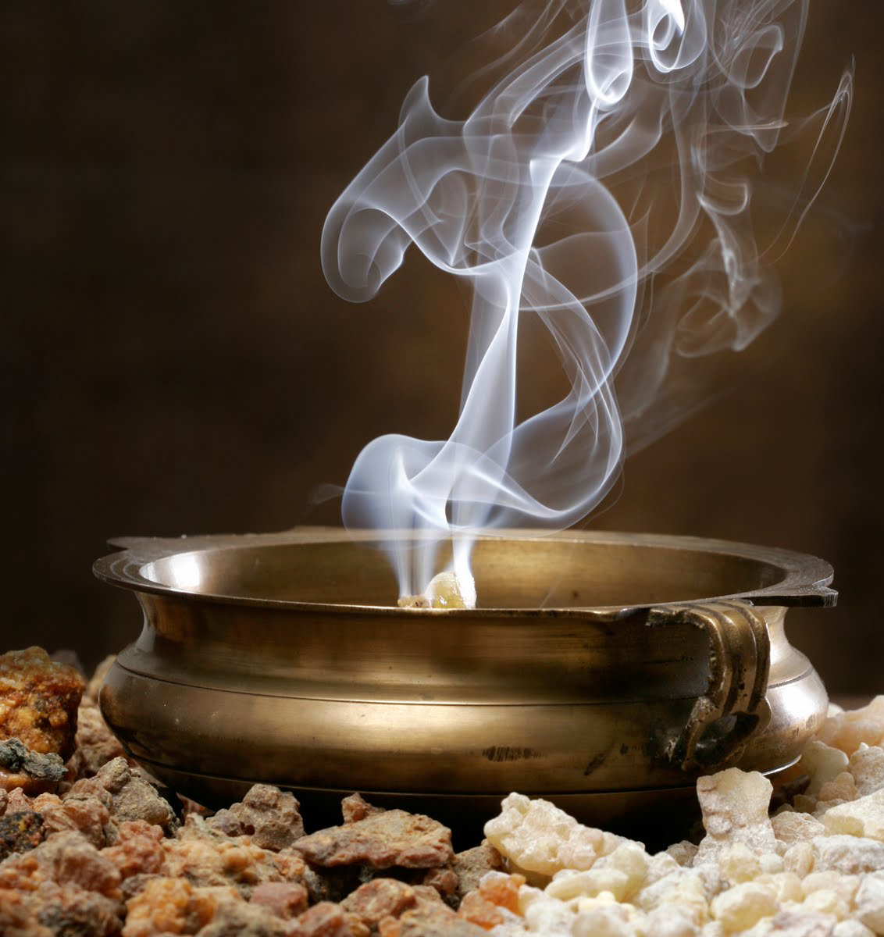
^{Ephesians 5:1-2}
You are God’s dear children, so try to be like him.
Live a life of love. Love others just as Christ loved us.
He gave himself for us—a sweet-smelling offering and sacrifice to God.
You can be like a sweet smell
Spread the sweet smell of God’s love
And your love
everywhere you go

Slide 16


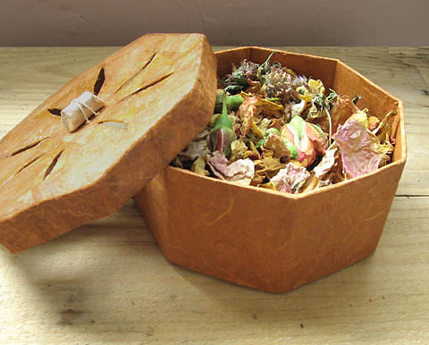
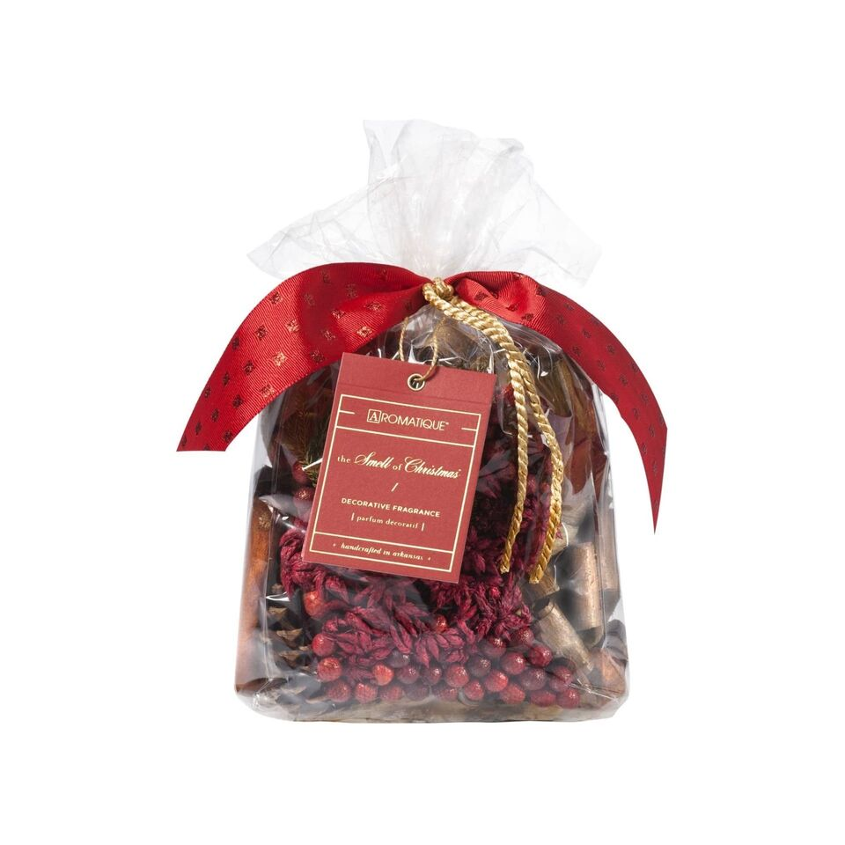
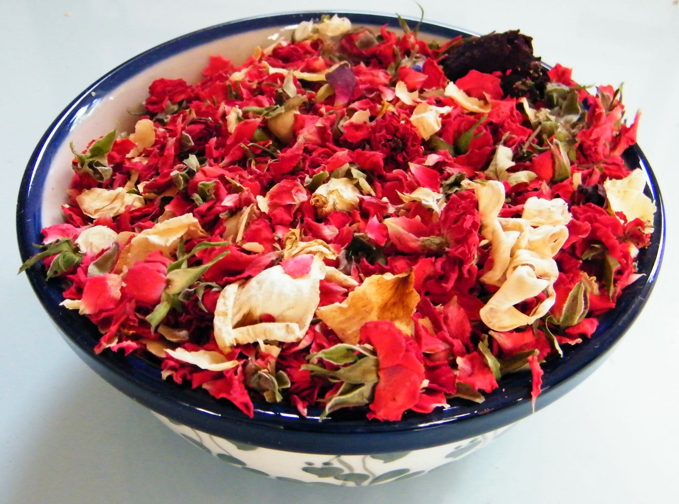
Let’s make something that smells good for others to honor God
Decorate a box.
Put some potpourri in it:
flower petals, spices, orange peels, etc.
Give it to someone you love
Or
Someone who looks like they need love
This Photo by Unknown Author is licensed under CC BY-NC-ND

Slide 17
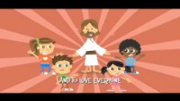

Slide 18
^{1 Peter2:17}
Show respect for all people.
Love your brothers and sisters in God’s family. Respect God, and honor the king.
You can be like a sweet smell
Spread your sweet smell of love
everywhere you go

Slide 19
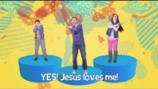

Slide 20
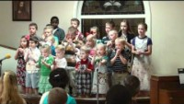

Slide 21
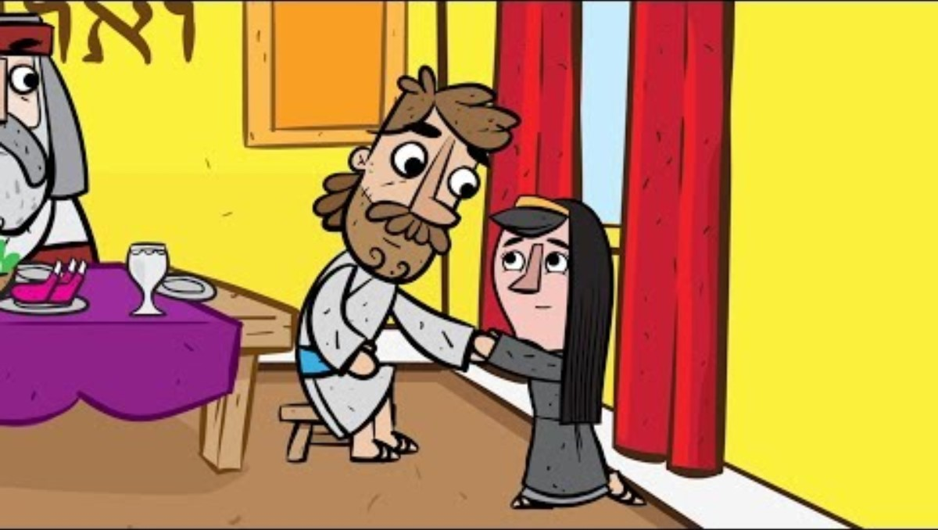

Slide 22

https://activity-array.com/

