Slide 1
John the Baptist Baptizes Jesus, too
I Choose to Follow Jesus – Mark 1:1-11; Matthew 3

Slide 2

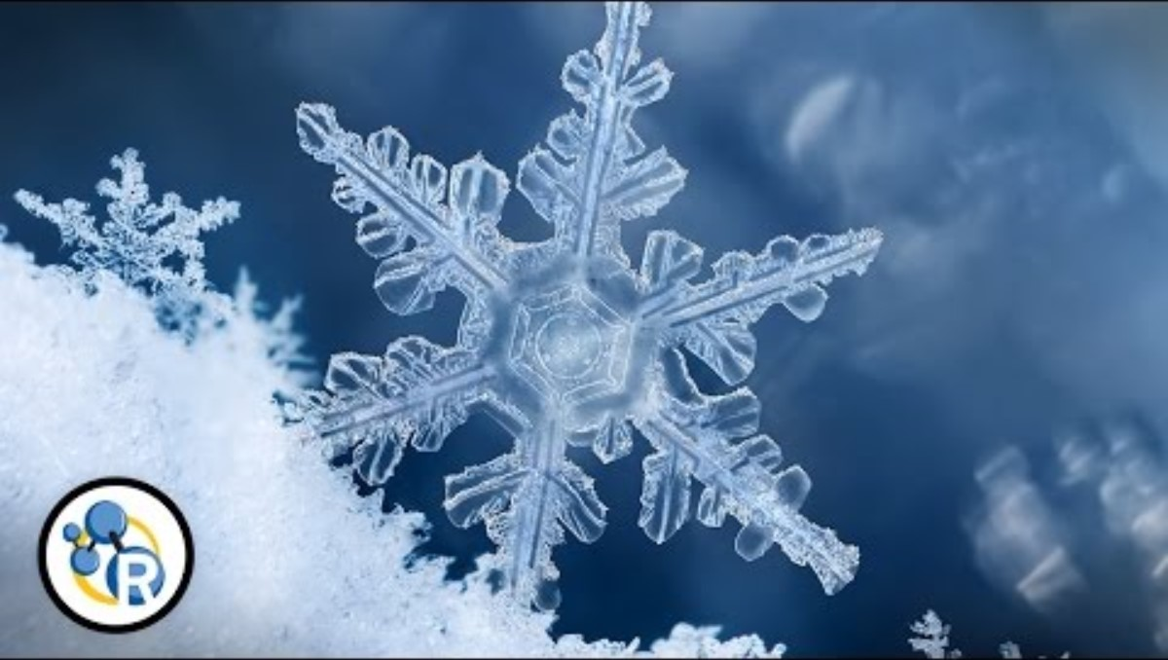
Have you seen a snowflake? How are they formed?
God makes a speck of dirty dust into a beautiful sparkling snowflake.
Together, with many others, they clothe our world in glistening white!
Jesus washes our sins away and makes us whiter than snow.
Together, we can tell others the good news about Jesus!

Slide 3
God made it possible for a speck of dirty dust to become a beautiful sparkling snowflake.
Together, with many others, they clothe our world in glistening white!
Jesus made it possible for us to be forgiven. He washes our sins away and makes us whiter than snow.
Together, we can tell others the good news about Jesus!

Slide 4
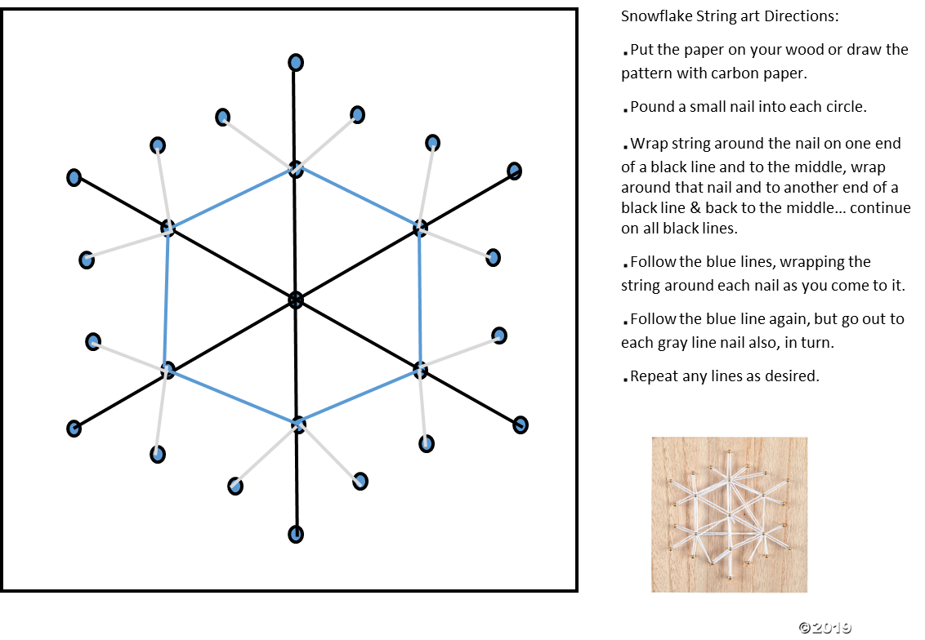
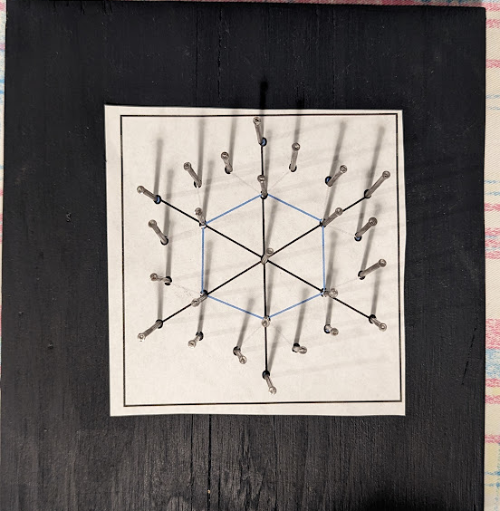
He will wash me and I will be whiter than snow

Slide 5
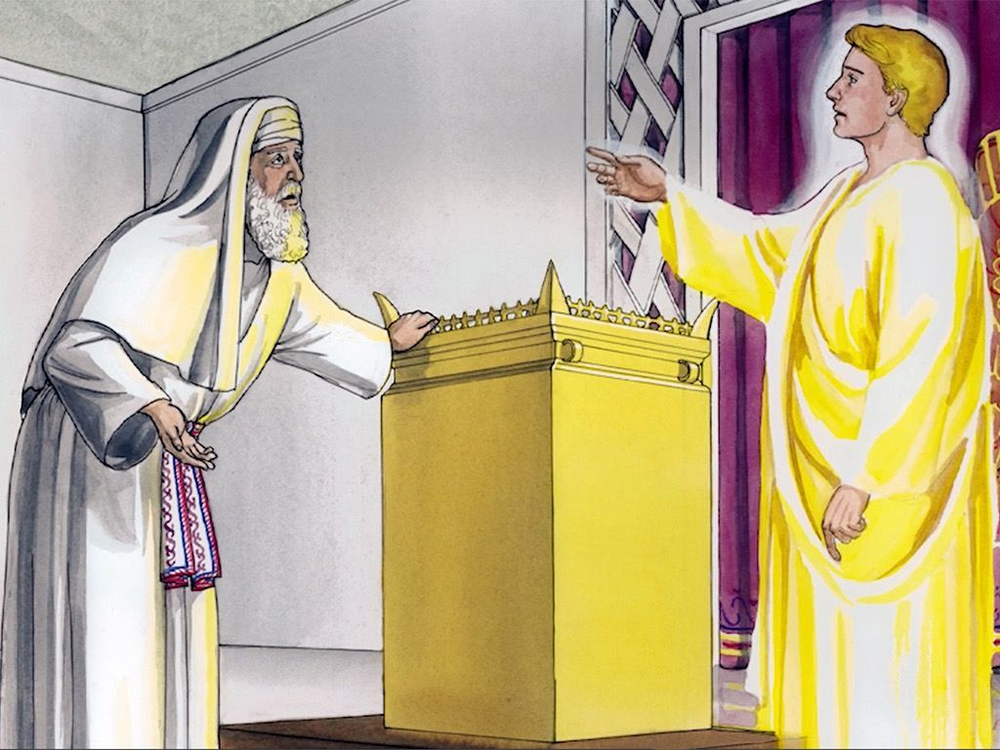
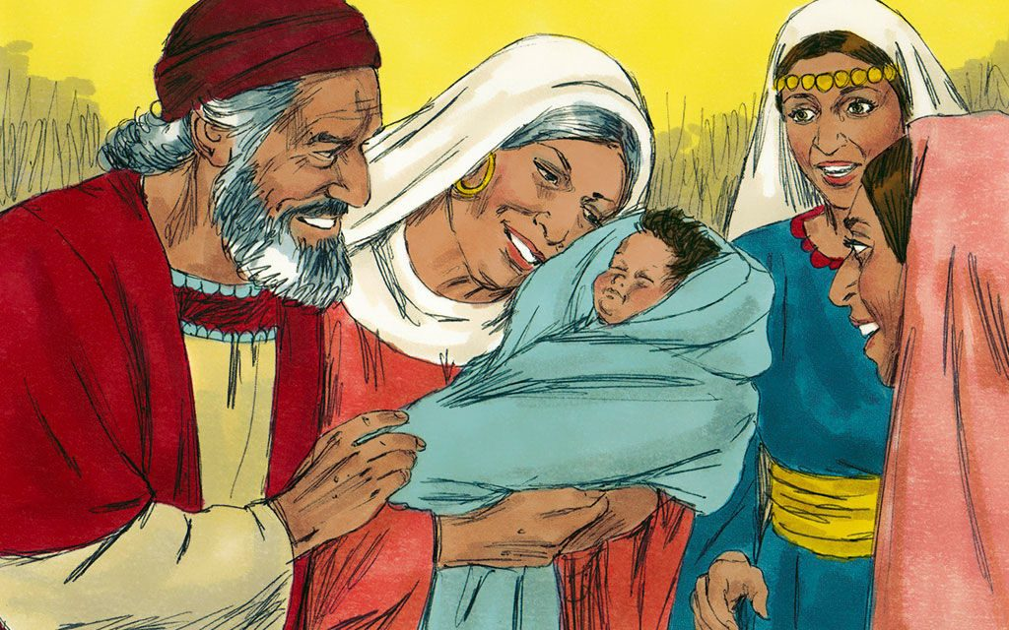
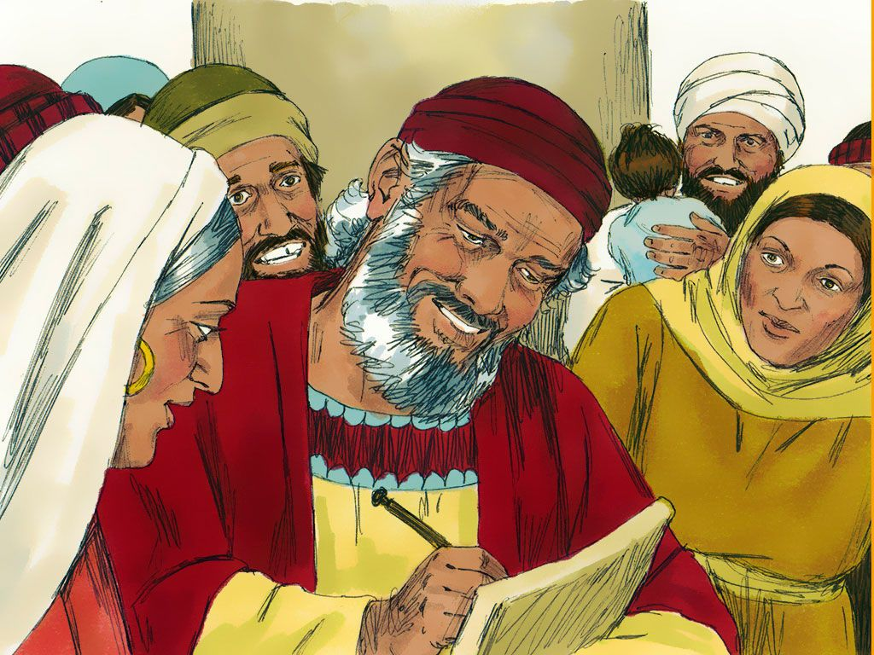
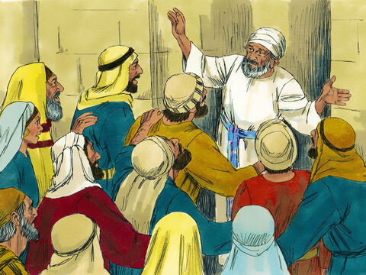
Do you remember about the angel coming to Zechariah and telling him that he and Elizabeth would have a baby? They were to name him John.
It happened just like that.
Who can tell me more? You can find the story in Luke 1:5-25

Slide 6
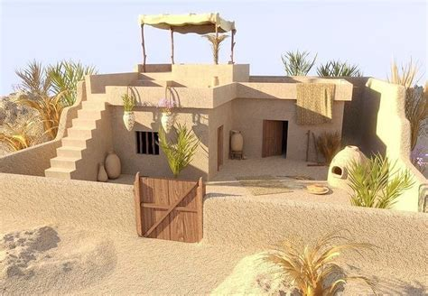
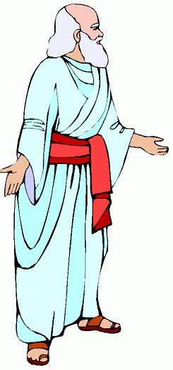
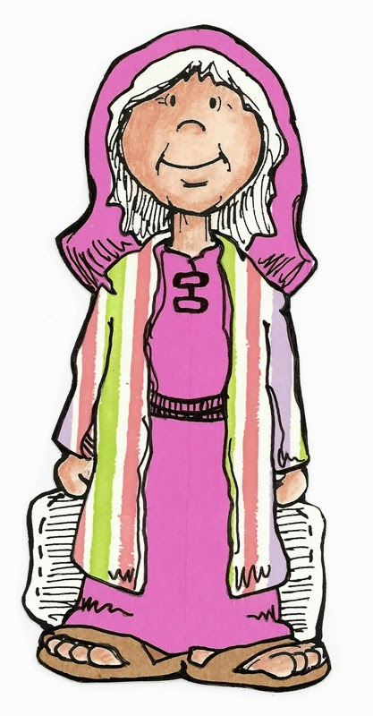
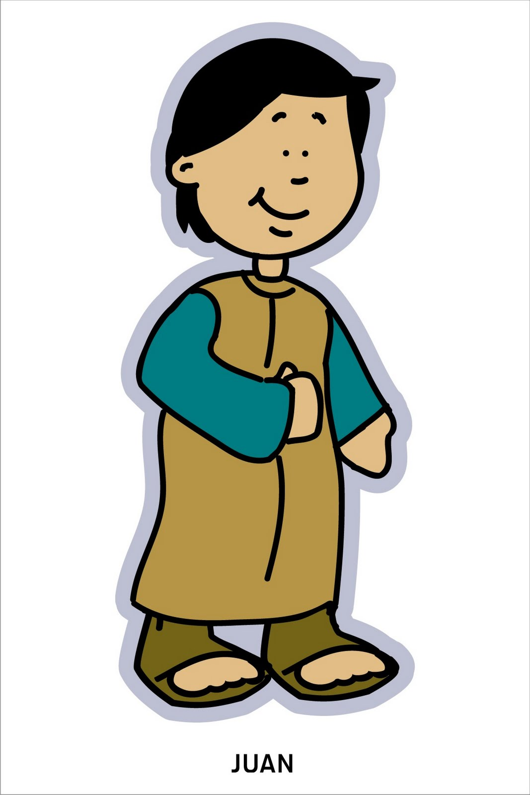
John. It is time to tell people to get ready for Jesus to come.
Baby John grew up. He lived in the desert.
Our story is about when he was a grown man.
God had a special job for him to do.
⁸⁰ The child grew up, and his spirit became strong.
He lived in the desert until he appeared openly to Israel.

Slide 7

You can find the story of John the Baptist in each of the four Gospels. Can you find it?
Matthew 3:1-12
Mark 1:1-8
Luke 3:1-20
John 1:15-39
Mark likes to tell short stories.
Let’s read what Mark says about John.

Slide 8

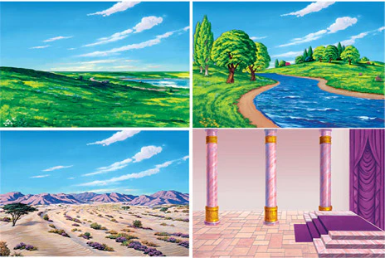

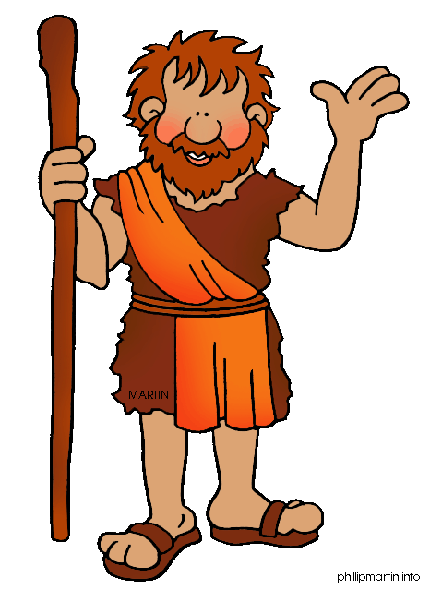
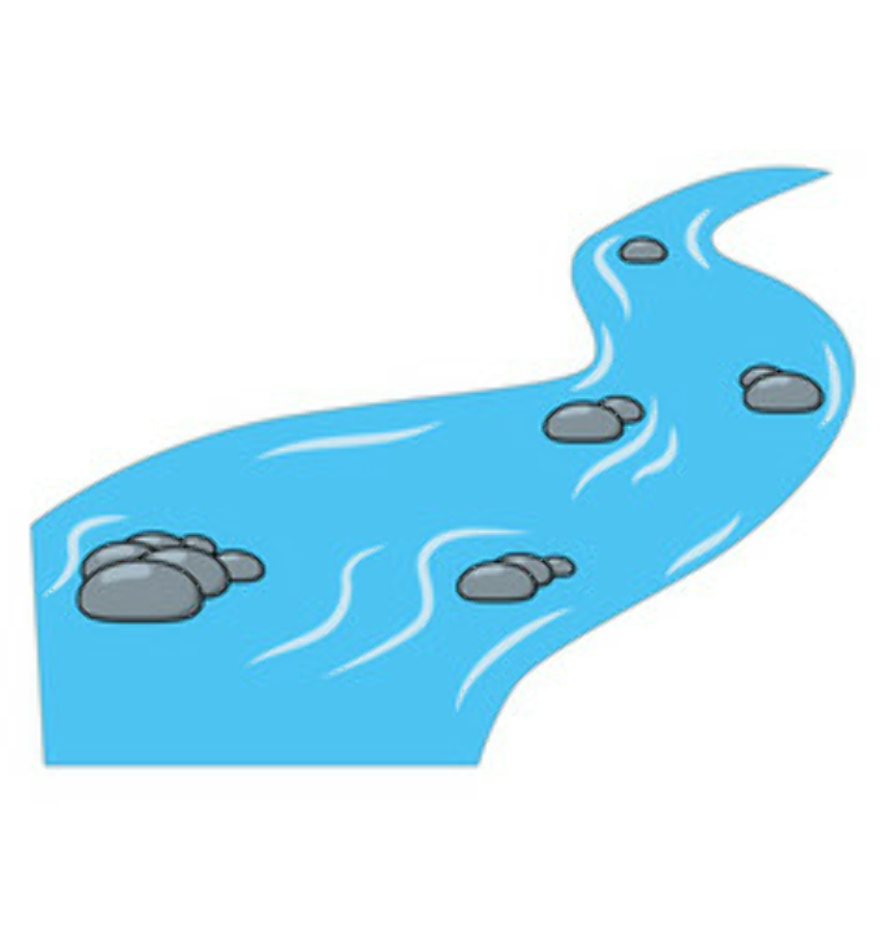
Take turns reading Mark 1:1-8 and putting up felts for the story.
1 This is the beginning of the good news about Jesus the Messiah, the Son of God. ² Long ago Isaiah the prophet wrote,
“I will send my messenger ahead of you.
He will prepare your way.” (Malachi 3:1)
³ “A messenger is calling out in the desert,
‘Prepare the way for the Lord.
Make straight paths for him.’ ” (Isaiah 40:3)
⁴ And so John the Baptist appeared in the desert. He preached that people should be baptized and turn away from their sins. Then God would forgive them.
⁵ All the people from the countryside of Judea went out to him. All the people from Jerusalem went too
. When they admitted they had sinned, John baptized them in the Jordan River.
⁶ John wore clothes made out of camel’s hair. He had a leather belt around his waist. And he ate locusts and wild honey.
⁷ Here is what John was preaching. “After me, there is someone coming who is more powerful than I am. I’m not good enough to bend down and untie his sandals. ⁸ I baptize you with water. But he will baptize you with the Holy Spirit.”

Slide 9
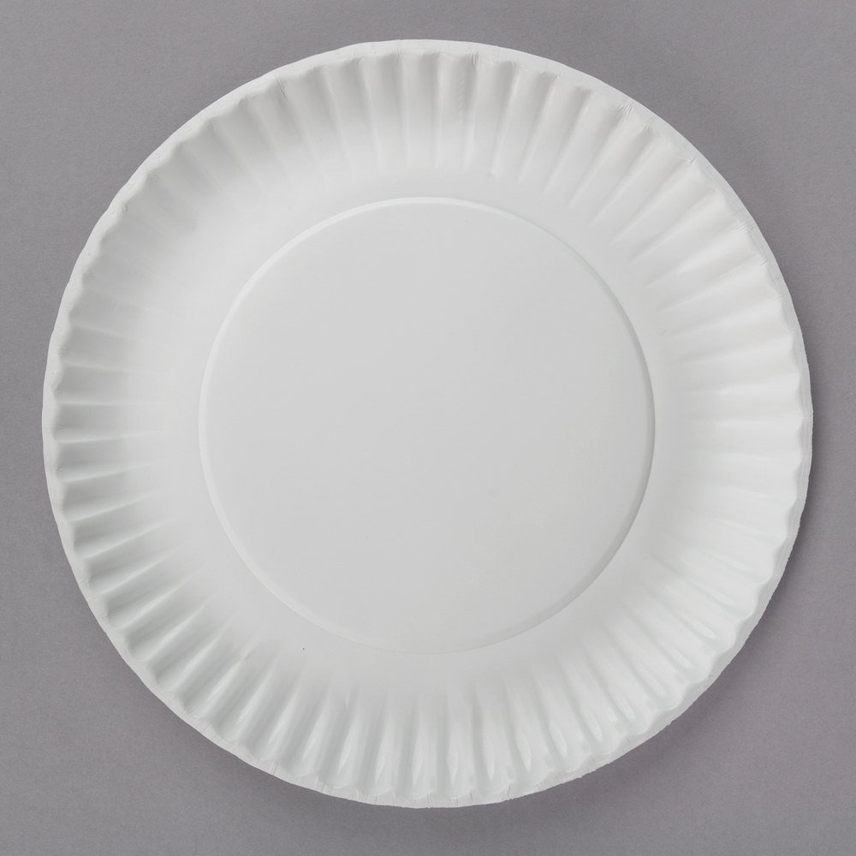
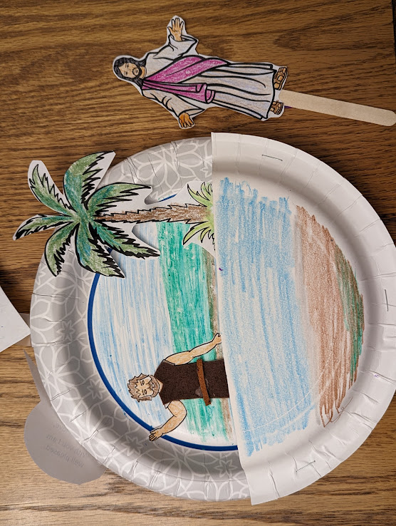
Craft Time
Part 1
Directions part 1
Get 2 paper plates.
On the upper part of the whole plate; plate #1, draw and color some ground and sky.
On the lower part, color blue for the river Jordan.
Color and glue the tree to the ground.

Slide 10
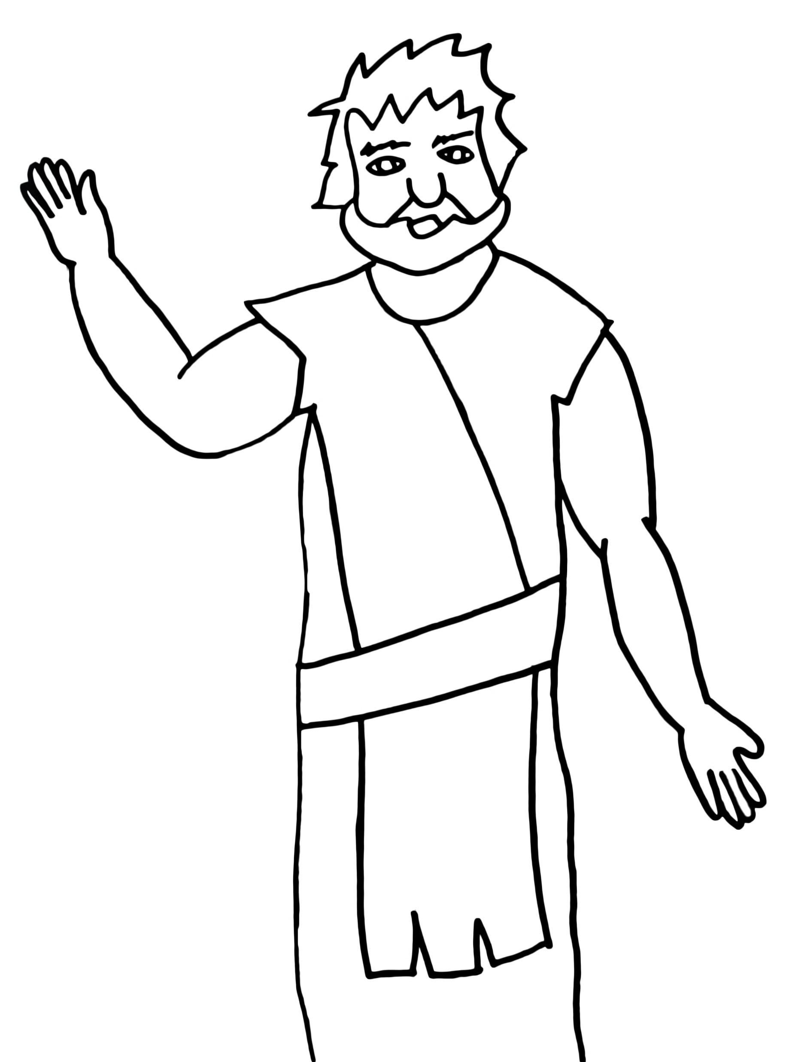
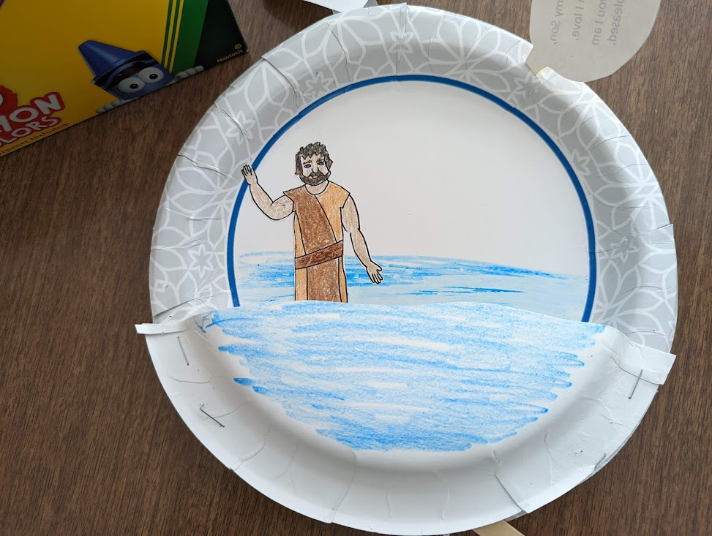
Craft Time
Part 2
Color John the Baptist’s arms and face.
Cut him out
Glue John the Baptist on plate 1 so that he is just barely in the water.
Cut out the square with the story.
Tape the story to the back of the plate.
Use the pattern to cut out brown felt for John’s coat of camel hair… Glue it over the drawn coat.
Measure his belt and cut a strip of leather for his belt. A piece of leather shoe lace works great.

Slide 11
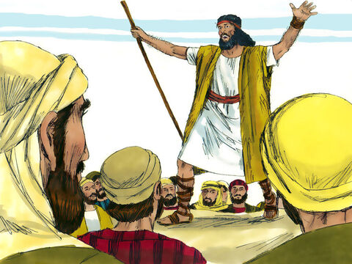
Be sorry for your sins!
Repent!
Matthew 3
⁵ People went out to him from Jerusalem and all Judea and the whole region of the Jordan. ⁶ Confessing their sins, they were baptized by him in the Jordan River.
⁷ But when he saw many of the Pharisees and Sadducees coming to where he was baptizing, he said to them: “You brood of vipers! Who warned you to flee from the coming wrath? ⁸ Produce fruit in keeping with repentance. ⁹ And do not think you can say to yourselves, ‘We have Abraham as our father.’ I tell you that out of these stones God can raise up children for Abraham. ¹⁰ The ax is already at the root of the trees, and every tree that does not produce good fruit will be cut down and thrown into the fire.
Live in a way that shows you have decided to be good not bad.
Produce good fruit!
What should we do?

Slide 12
What should we do?
Share your clothes
and your food.
Luke 3:7-14
¹⁰ “Then what should we do?” the crowd asked.
¹¹ John answered, “Anyone who has extra clothes should share with the one who has none. And anyone who has extra food should do the same.”

Slide 13

SNACK TIME
I need a volunteer(s) to pass out the snacks.
You can share the food like John told the people to do.
Share your clothes
and your food.

Slide 14
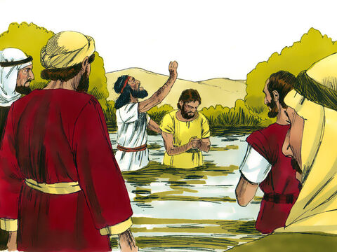
What should we tax collectors do?
Don’t collect any more money than what you are supposed to.
Luke 3:7-14
¹² Even tax collectors came to be baptized. “Teacher,” they asked, “what should we do?”
¹³ “Don’t collect any more than you are required to,” John told them.

Slide 15
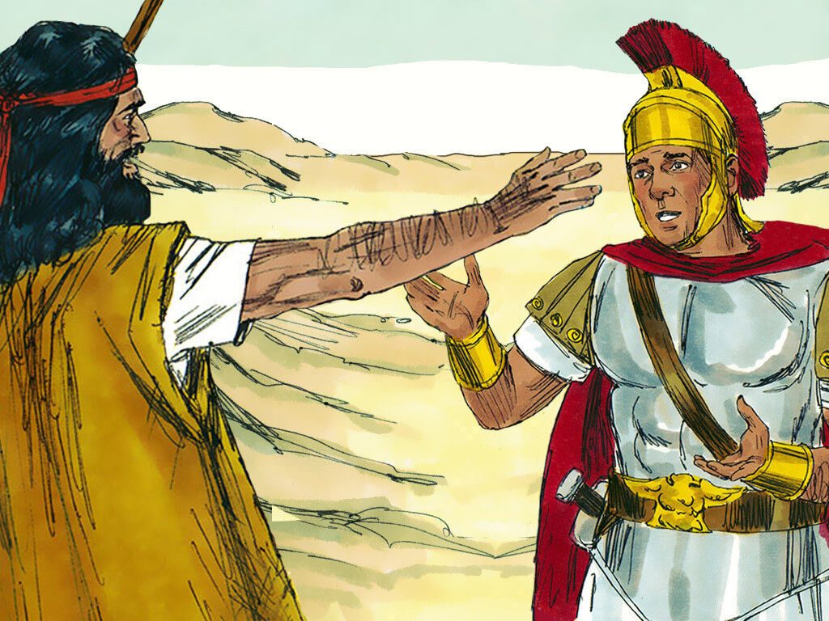
Don’t force people to give you money.
Don’t accuse people falsely.
Be happy with your pay.
What should we soldiers do?
Luke 3:7-14
¹⁴ Then some soldiers asked him, “And what should we do?”
John replied, “Don’t force people to give you money. Don’t bring false charges against people. Be happy with your pay.”

Slide 16

Because you are sorry for your sins and want to do what is right,
I baptize you….
I’m sorry for my sins too.
I want to do what is right!
Do you?

Slide 17

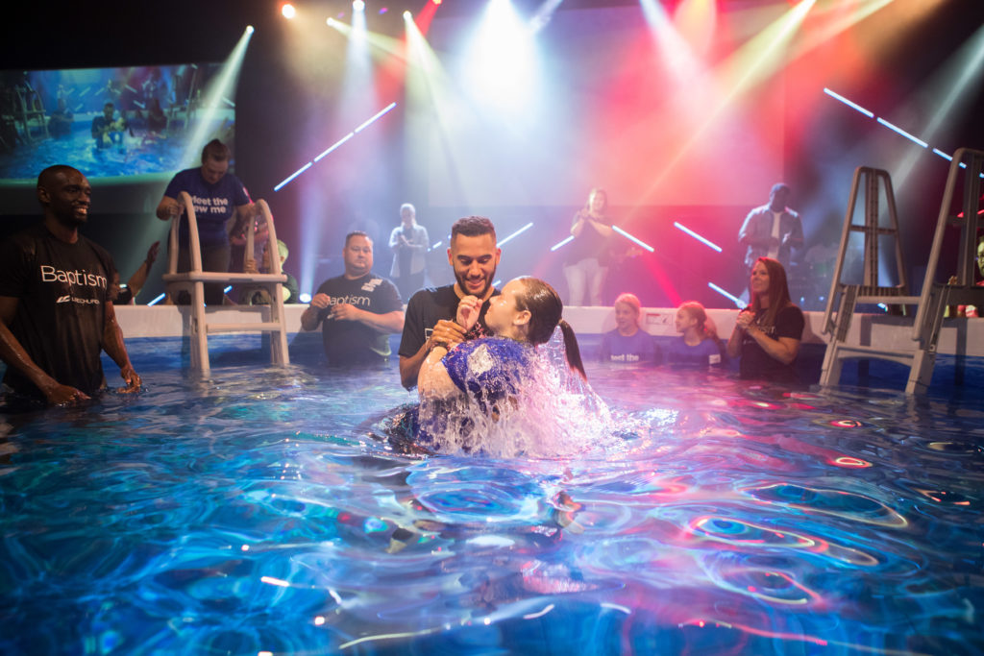
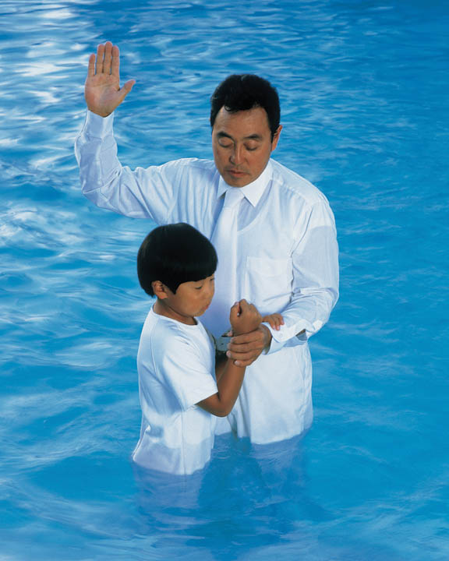
What does it mean to be baptized?
What happens?
We choose to follow Jesus.
The pastor studies with us.
We go to the pastor in the water. We dunk in the water, and he helps us up.
It shows that Jesus washes our sins away.

Slide 18
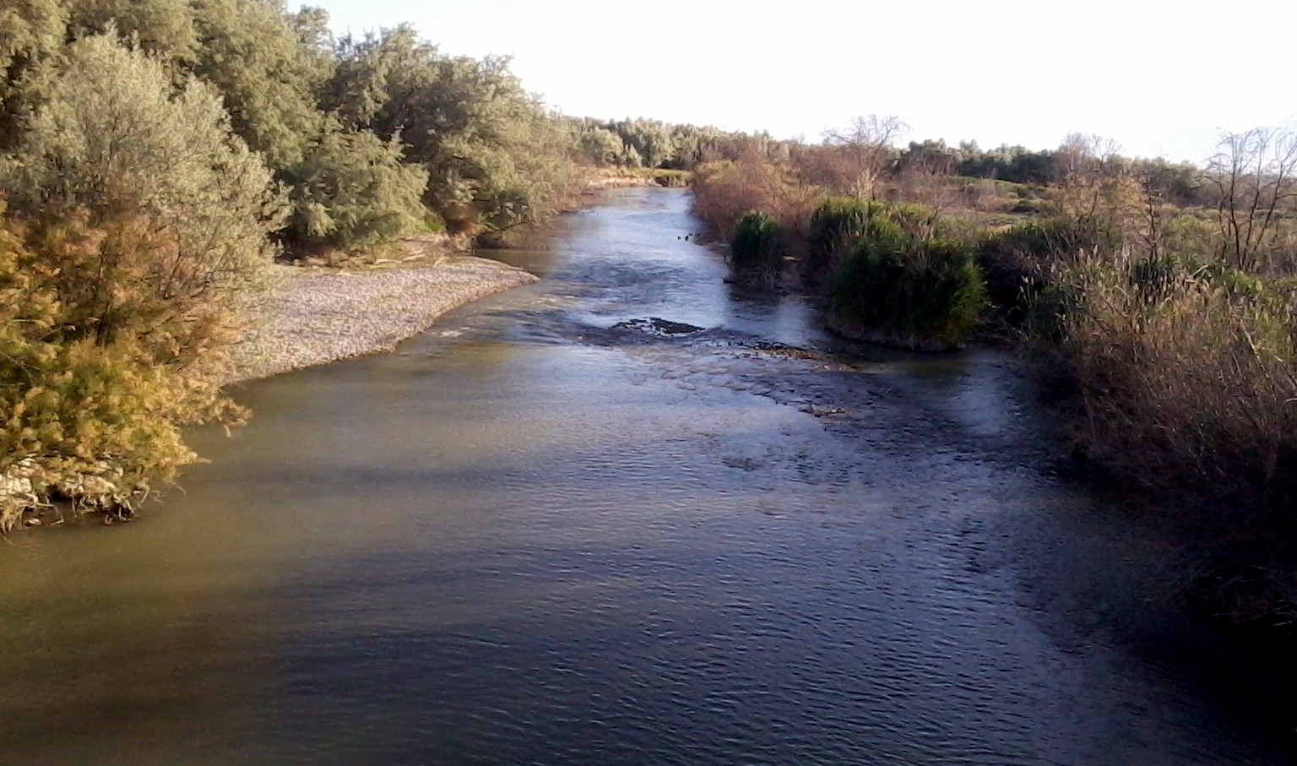
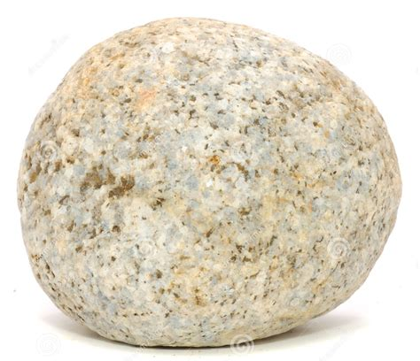
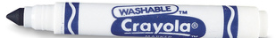
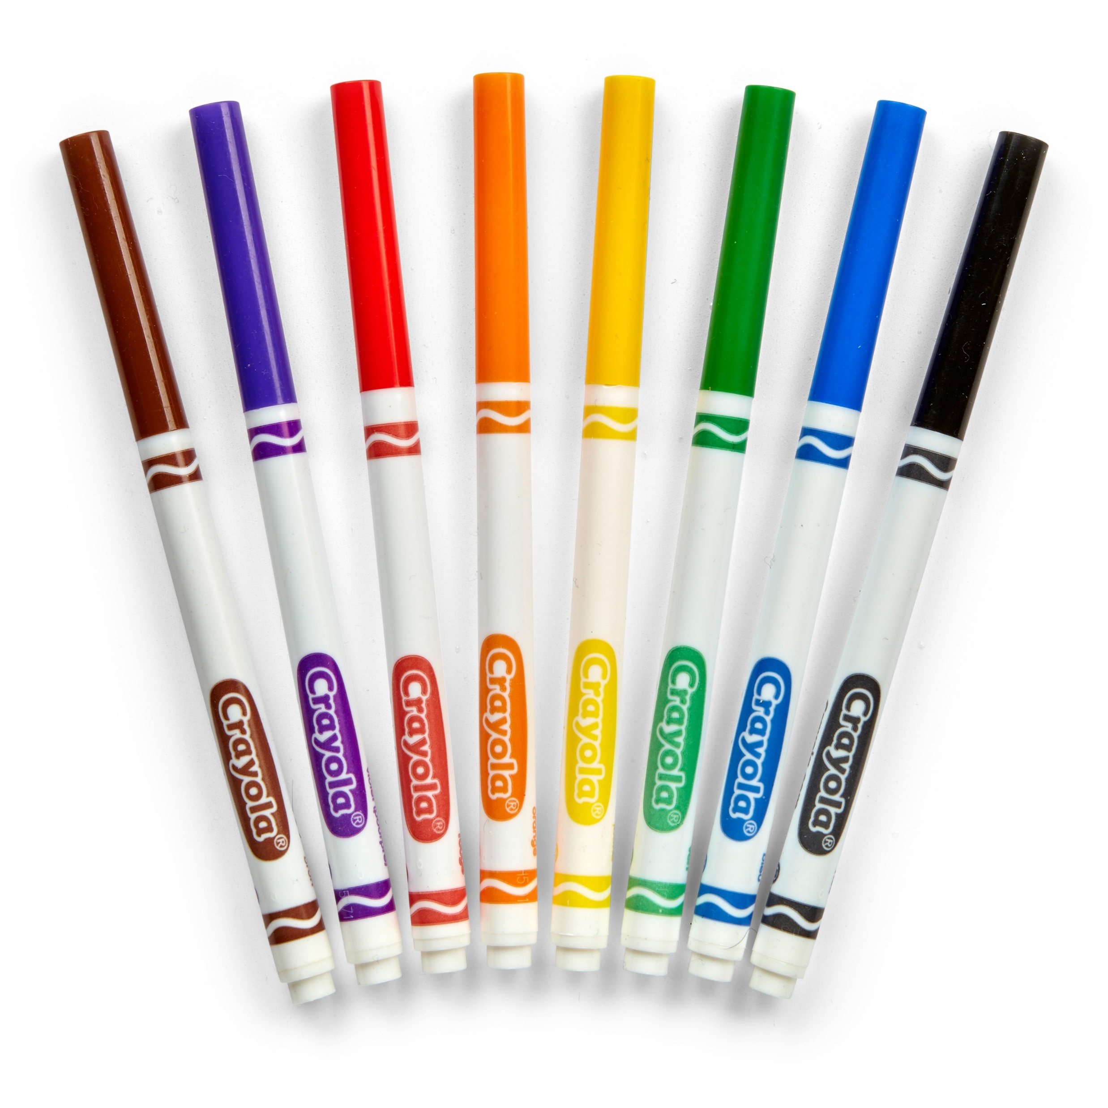

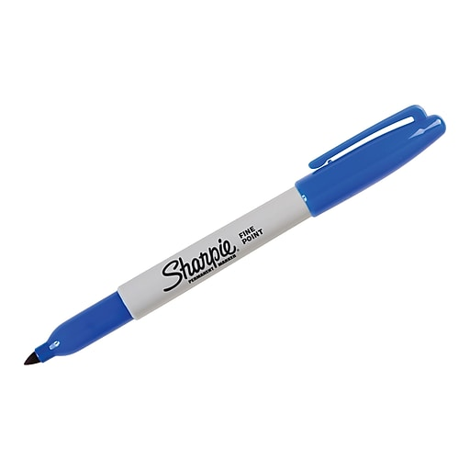
Object Lesson Baptism is like…
Choose a big flat rock
With a WASHABLE MARKER write some bad things you have done or a person might do.
lie
steal
mean
disobey

Slide 19
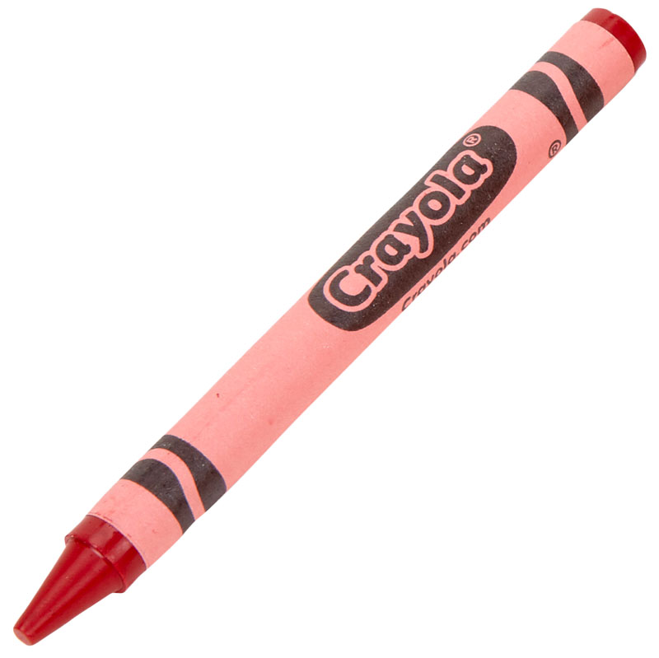
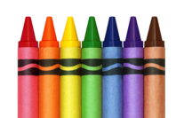
Sometimes we are bad
Sometimes we are good
Turn your rock over
With a CRAYON write some GOOD things you have done or a person might do.
truth
give
kind
obey

Slide 20

Sing I have Decided

Slide 21
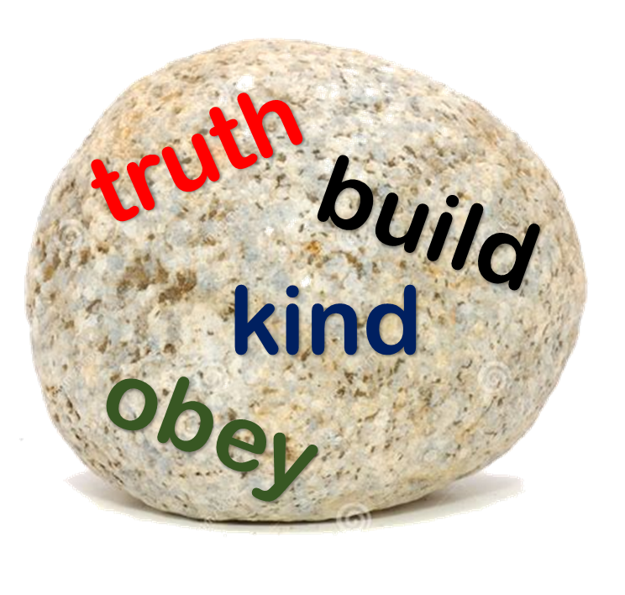
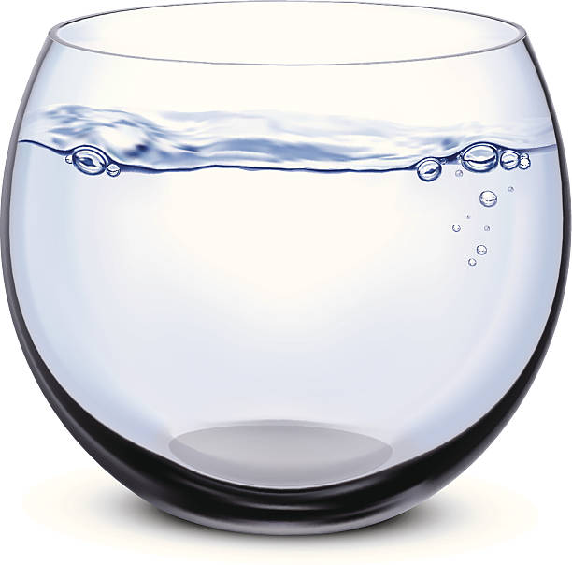
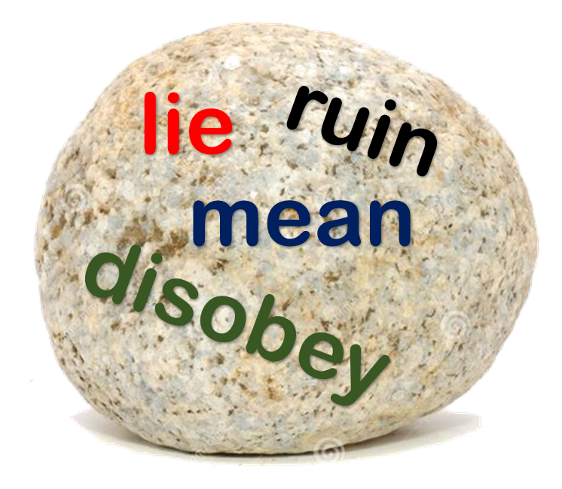
Baptism shows others we choose to follow Jesus
Jesus wants to forgive us
The Bible tells us:
“If we confess our sins, He is faithful and just to forgive us and cleanse us from all unrighteousness.”
Get a big bowl or bucket of water or go to a sink.
Put your rock in the water and scrub it with your hands. You don’t need soap.
Now look at it. Do you see the bad things? Do you see the good things?
God washes all our badness; all our sins away! They are gone!
He helps us do what is right and good.

Slide 22

Sing 1 John 1:9

Slide 23
If we confess our sins
He is faithful and just to forgive us our sins and cleanse us from all unrighteousness.
1 John 1:9
Confess
forgive
cleanse
Abcdefghijklmnopqrstuvwxyz
A b c d e f g h I j k l m n o p q r s t u v w x y z

Slide 24
Are you the Messiah?
No, He will be much greater than me!
I’m not even worthy to tie his sandals.
Luke 3:15-18
¹⁵ The people were waiting. They were expecting something. They were all wondering in their hearts if John might be the Messiah. ¹⁶ John answered them all, “I baptize you with water. But one who is more powerful than I am will come. I’m not good enough to untie the straps of his sandals. He will baptize you with the Holy Spirit and fire. ¹⁷ His pitchfork is in his hand to toss the straw away from his threshing floor. He will gather the wheat into his barn. But he will burn up the husks with fire that can’t be put out.” ¹⁸ John said many other things to warn the people. He also announced the good news to them.
Are you
our Savior?
Get ready!
He is coming!

Slide 25
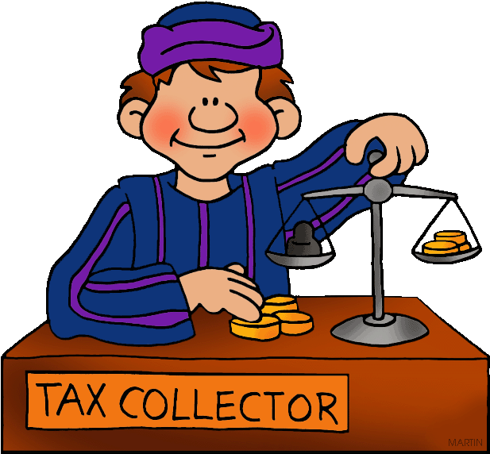
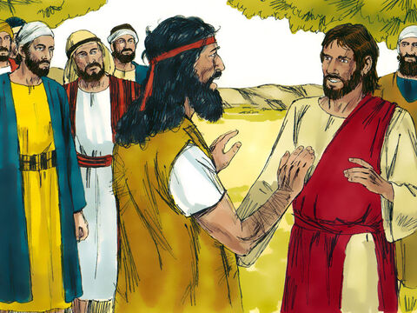
Matthew 3:13-15
I need to be baptized by you.
So why do you come to me?
This is the way God
wants us to do it.
¹³ Jesus came from Galilee to the Jordan River. He wanted to be baptized by John. ¹⁴ But John tried to stop him. So he told Jesus, “I need to be baptized by you. So why do you come to me?”
¹⁵ Jesus replied, “Let it be this way for now. It is right for us to do this. It carries out God’s holy plan.” Then John agreed.

Slide 26
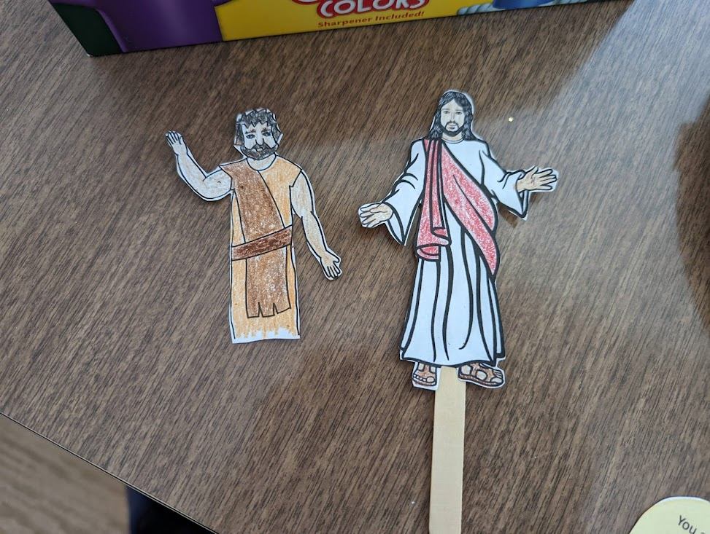
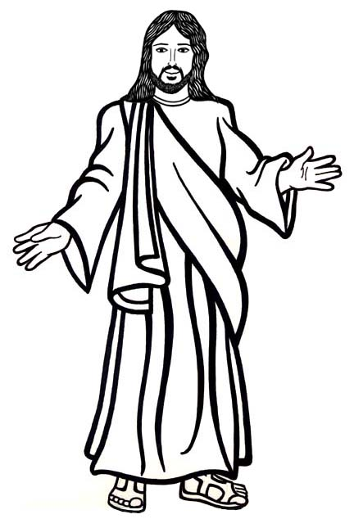
Craft Time
Part 3
Color and Cut out Jesus.
Glue him onto a popsicle stick.
Have Jesus come to John the Baptist

Slide 27
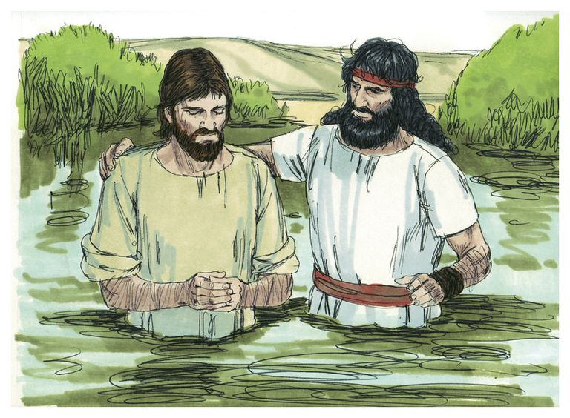
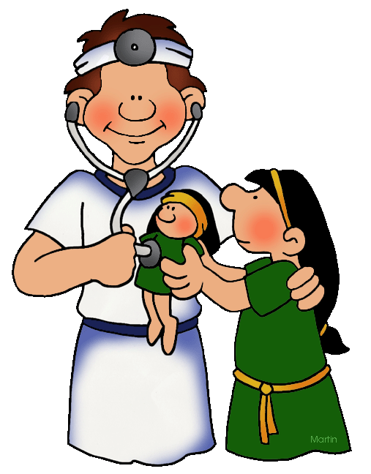
John baptized Jesus
Luke writes:
²¹ When all the people were being baptized, Jesus was baptized too. And as he was praying, heaven was opened.
…
²³ Jesus was about 30 years old when he began his special work for God and others.

Slide 28
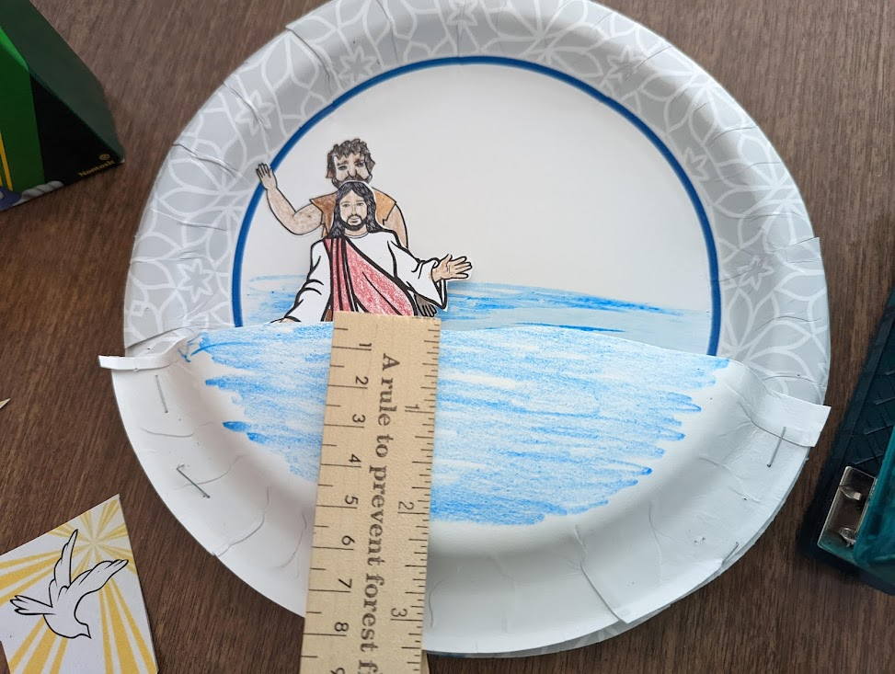
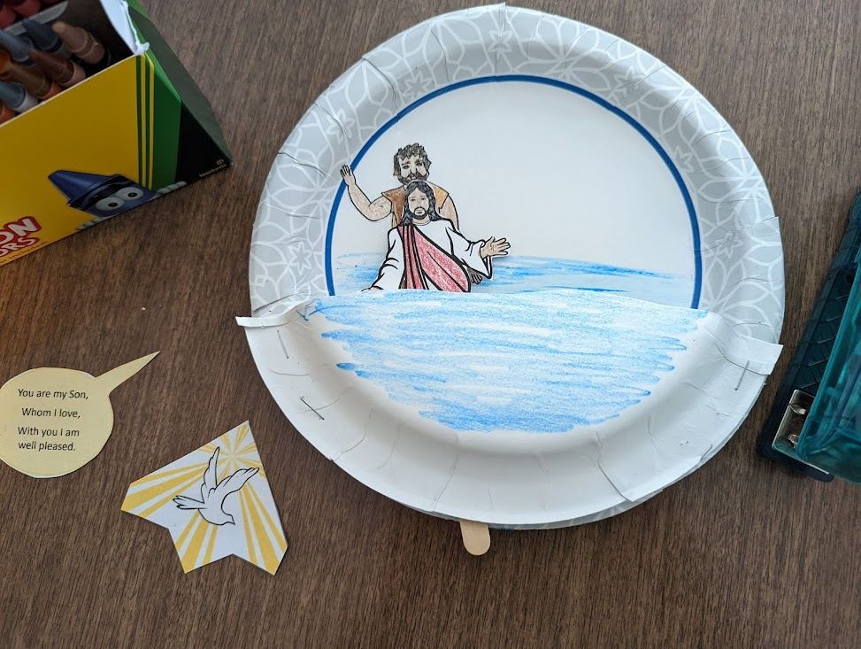
Craft Time
Part 4
Staple the 3rd of a plate onto the bottom of the full plate so that it make a little pocket.
Staple 2 times on each side where the arrows are. Leave a space for a stick to go through.
Put him in the pocket and push the stick through the little space that you left between the 2 plates.
Now you can show Jesus getting baptized. Just pull down on the stick.

Slide 29
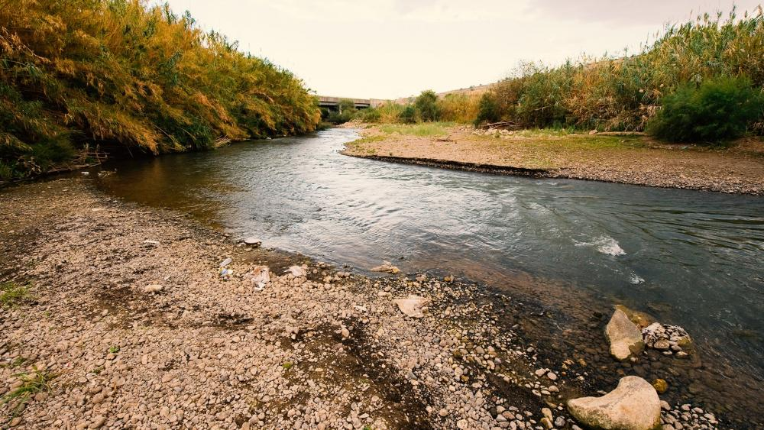
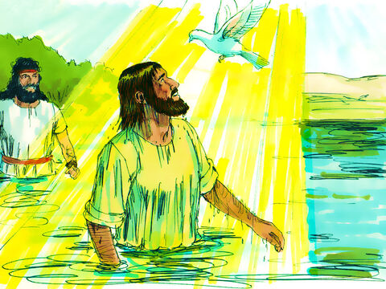
Jesus was baptized
This is my Son.
I love Him.
I am very pleased with Him.
¹⁶ As soon as Jesus was baptized, he came up out of the water. At that moment heaven was opened. Jesus saw the Spirit of God coming down on him like a dove. ¹⁷ A voice from heaven said, “This is my Son, and I love him. I am very pleased with him.”

Slide 30
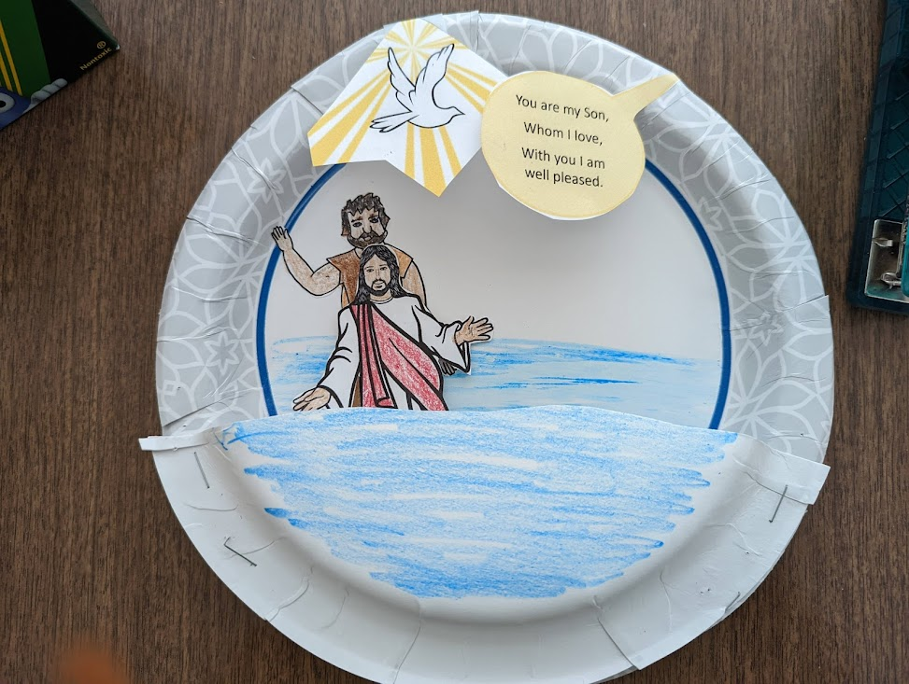


Craft Time
Part 6
Cut out the dove and light.
Cut out the conversation bubble.
Tape them to the top of the plate.
You can fold them over after Jesus is baptized.
You are my Son,
Whom I love,
With you I am well pleased.

Slide 31
EXTRA story video
Tic-Tac-Toe game

Slide 32
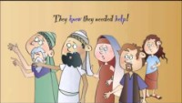
Our Story – John the Baptist

Slide 33
GAME TIME
TIC TAC TOE
Optional game
Review the story with a Tic Tac Toe game.
2 teams: Orange and Green
Use the annotation function of Zoom to make your team’s x or o.

Slide 34
GAME TIME
TIC TAC TOE
QUESTION:
Who baptized Jesus?
FIND IT IN THE BIBLE: Matthew 3:13
PICTURE HINT:
John the Baptist

Slide 35
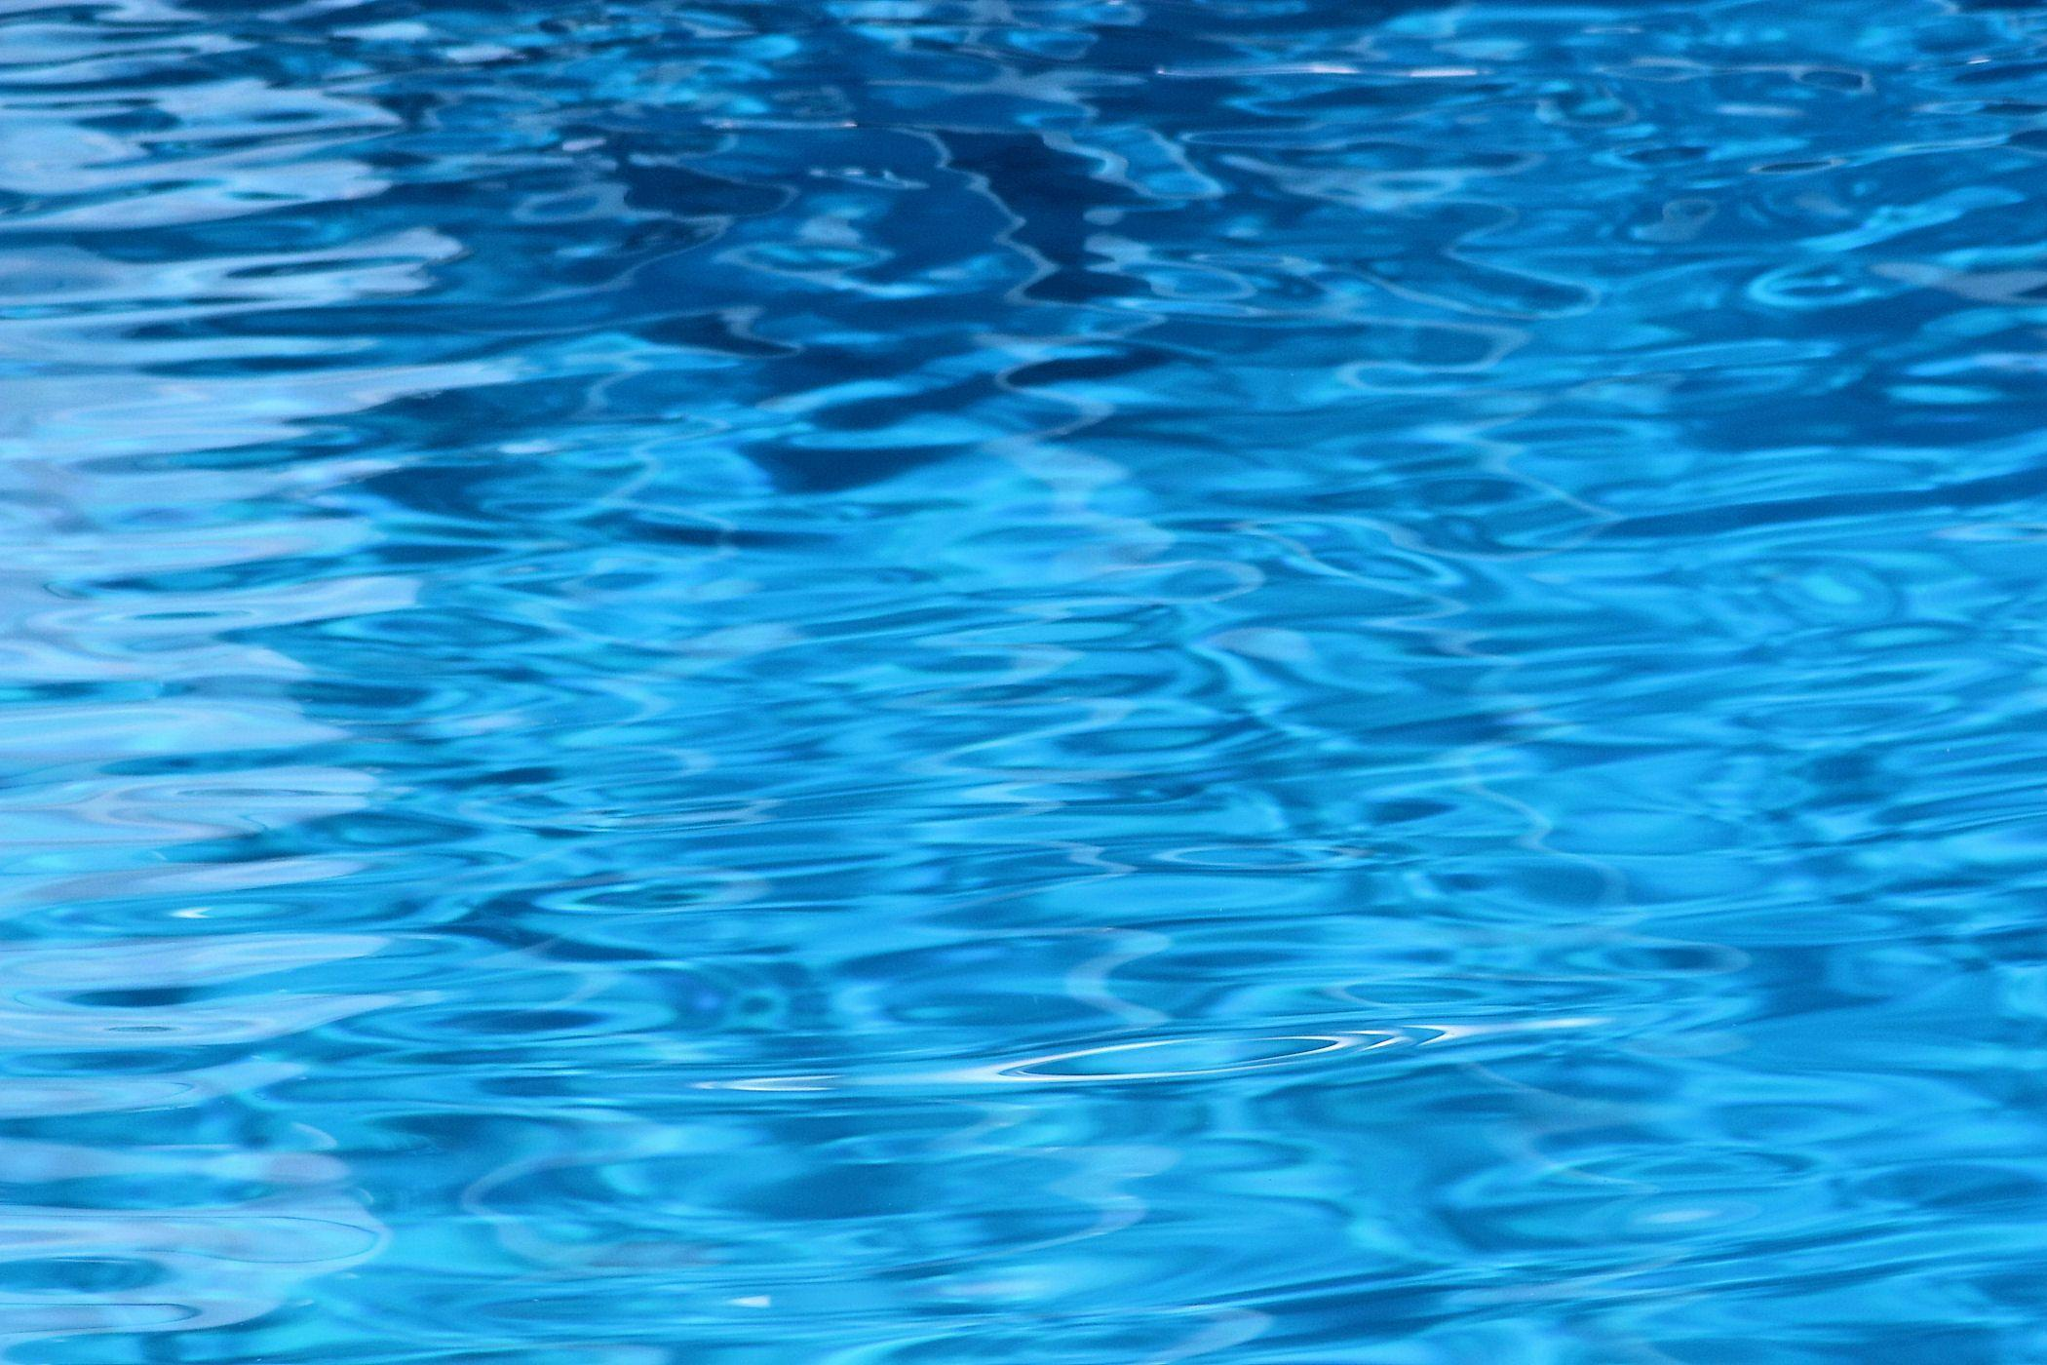
GAME TIME
TIC TAC TOE
QUESTION:
Who did John baptize in our story today?
FIND IT IN THE BIBLE: Matthew 3:13
PICTURE HINT:
Jesus

Slide 36
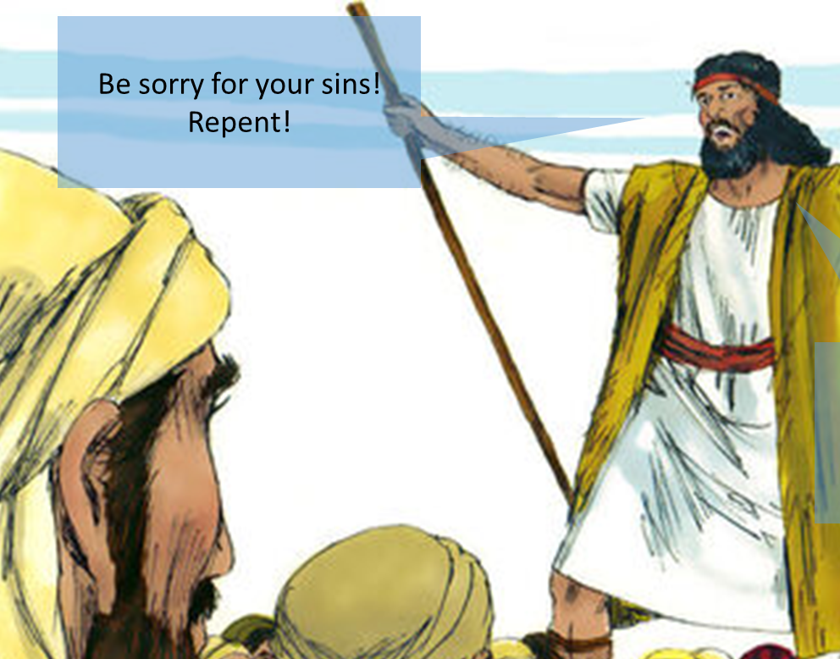
GAME TIME
TIC TAC TOE
QUESTION: John told the people to “R _ _ _ _ _ !” This means to be sorry for your sins. What did he tell the people to do?
FIND IT IN THE BIBLE: Matthew 3:2
PICTURE HINT:
Repent

Slide 37
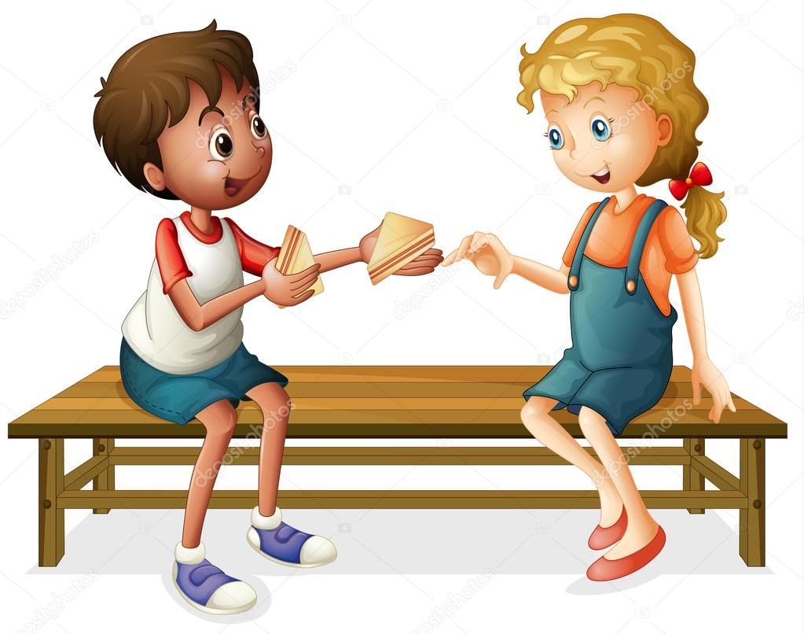
GAME TIME
TIC TAC TOE
QUESTION: John said to live in a way that shows that you are sorry for your sins. He said if you have extra, you should _ _ a _ e .
FIND IT IN THE BIBLE: Luke 3:11
PICTURE HINT:
Share

Slide 38
GAME TIME
TIC TAC TOE
QUESTION:
After Jesus was baptized, what came down onto Jesus? It looked like a d _ _ _.
FIND IT IN THE BIBLE: Luke 3:22
PICTURE HINT:
BONUS
FIRST TEAM TO ANSWER
GETS IT
The Holy Spirit
Looked like dove

Slide 39
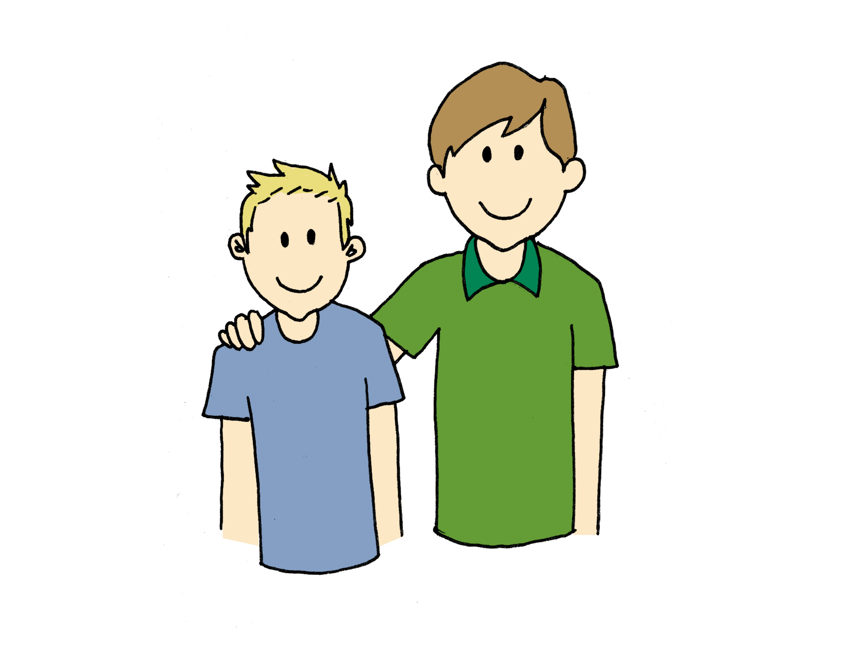
GAME TIME
TIC TAC TOE
QUESTION:
God said, “This is my _ _ _. ….
FIND IT IN THE BIBLE: Luke 3:22
PICTURE HINT:
Son

Slide 40
GAME TIME
TIC TAC TOE
QUESTION:
God continued. “This is my Son, whom I _ _ _ _. With you I am well pleased.
FIND IT IN THE BIBLE: Luke 3:22
PICTURE HINT:
You are my Son,
Whom I love,
With you I am well pleased.
love

Slide 41
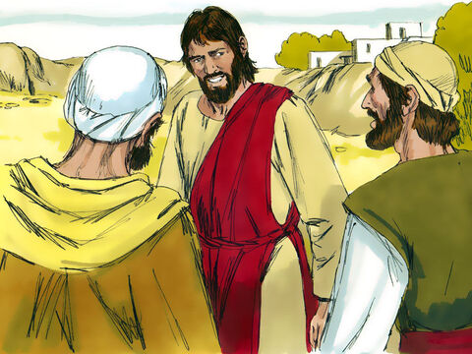
GAME TIME
TIC TAC TOE
QUESTION:
John the Baptist told his disciples about Jesus. How many disciples went to follow Jesus?
FIND IT IN THE BIBLE: John 1:37
PICTURE HINT:
two

Slide 42


GAME TIME
TIC TAC TOE
QUESTION:
One of the disciples was Andrew.
Who did he tell about Jesus?
FIND IT IN THE BIBLE: John 1:40-43
PICTURE HINT:
His brother,
Simon Peter

Slide 43

Take turns reading Mark 1:1-8
1 This is the beginning of the good news about Jesus the Messiah, the Son of God. ² Long ago Isaiah the prophet wrote,
“I will send my messenger ahead of you.
He will prepare your way.” (Malachi 3:1)
³ “A messenger is calling out in the desert,
‘Prepare the way for the Lord.
Make straight paths for him.’ ” (Isaiah 40:3)
⁴ And so John the Baptist appeared in the desert. He preached that people should be baptized and turn away from their sins. Then God would forgive them. ⁵ All the people from the countryside of Judea went out to him. All the people from Jerusalem went too. When they admitted they had sinned, John baptized them in the Jordan River. ⁶ John wore clothes made out of camel’s hair. He had a leather belt around his waist. And he ate locusts and wild honey. ⁷ Here is what John was preaching. “After me, there is someone coming who is more powerful than I am. I’m not good enough to bend down and untie his sandals. ⁸ I baptize you with water. But he will baptize you with the Holy Spirit.”

Slide 44

https://activity-array.com/

