Slide 1
Fishers of Men
Jesus Spreads the Good News
And
Chooses Disciples

Slide 2
What is a fisherman?
How do they catch fish?

Slide 3
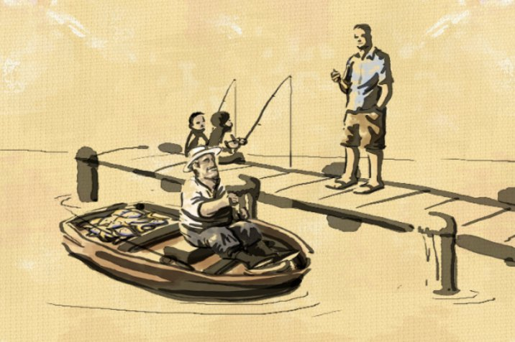
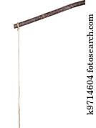
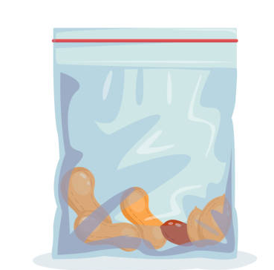
Take a turn to be a fish and a turn to be a fisherman.
FISHERMAN
Get a stick and string to make a pole
Put a snack in a ziplock bag.
Clip the bag to your string.
Go see who will take the bait.
Then give it to them
FISH
Look around and see which snack you like.
Gently tug on the bag of your choice and say, “I would like your snack.”

Slide 4
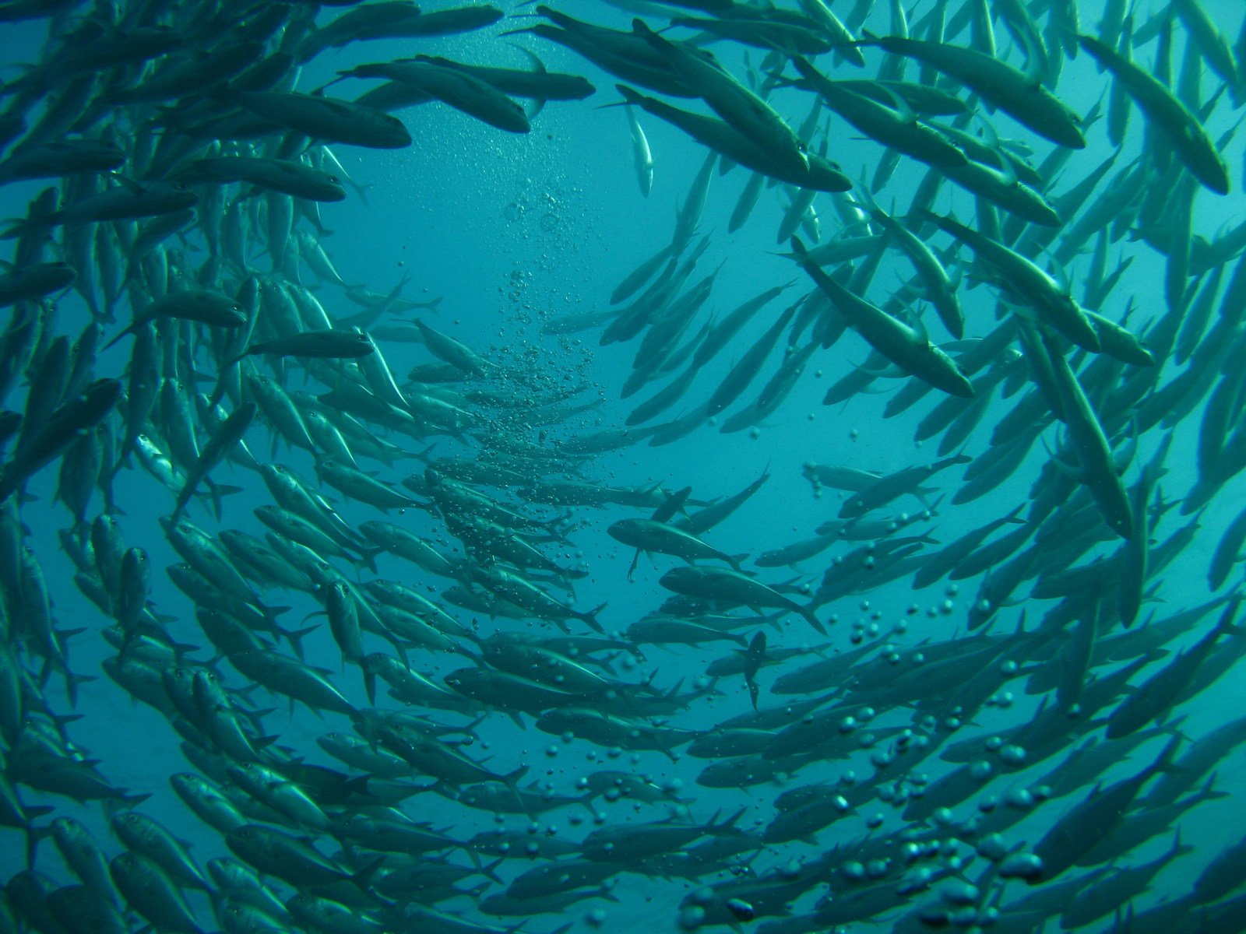
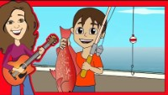
What do fishermen do?

Slide 5
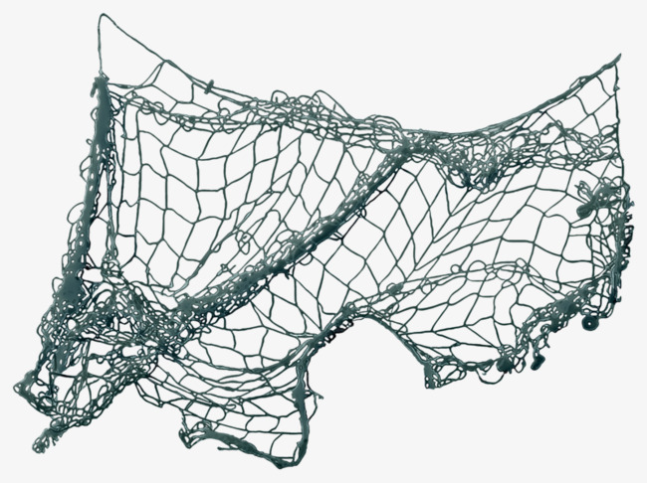
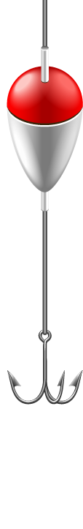

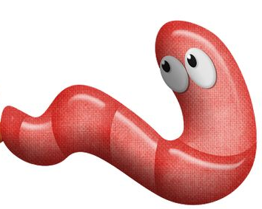
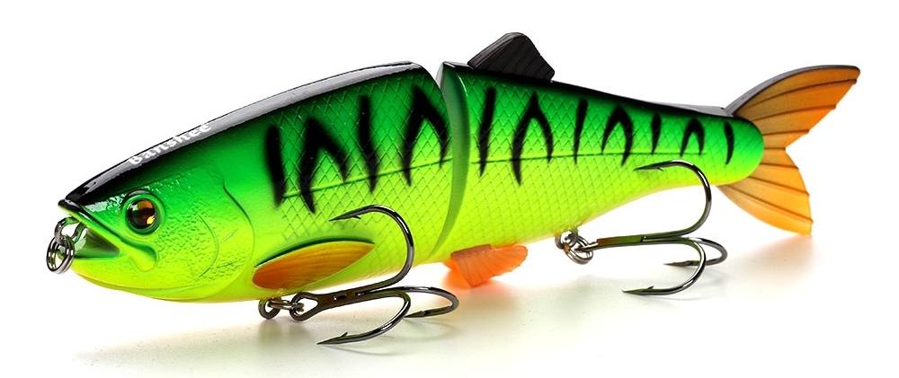
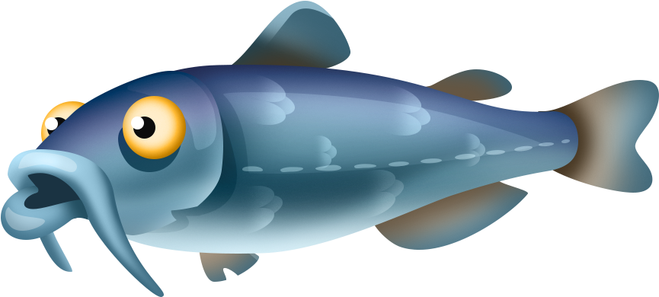
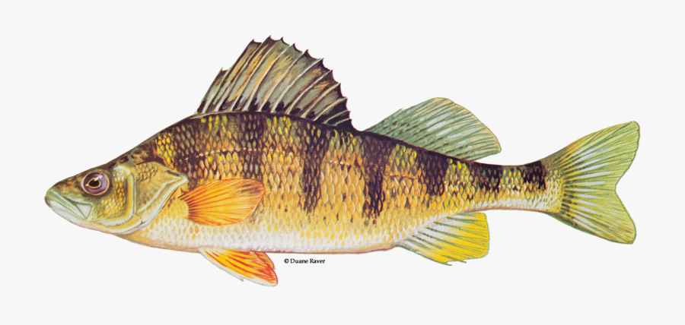

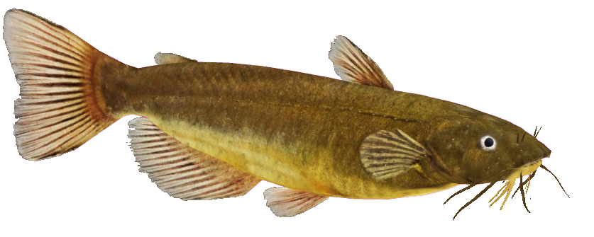
Find which fish enjoys which bait.

Slide 6
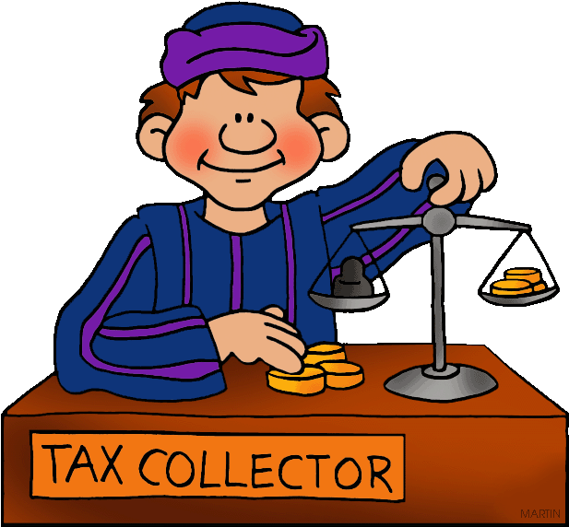
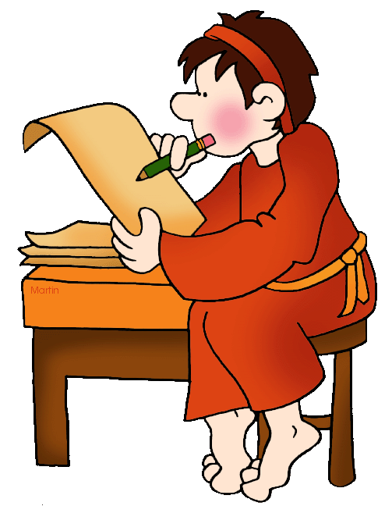
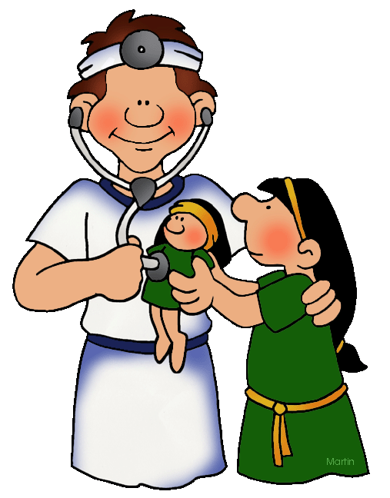
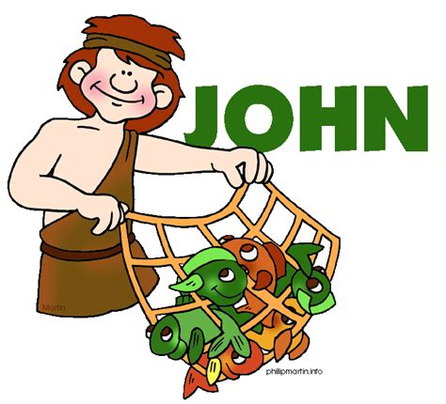
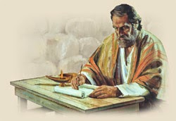
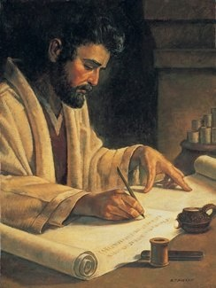
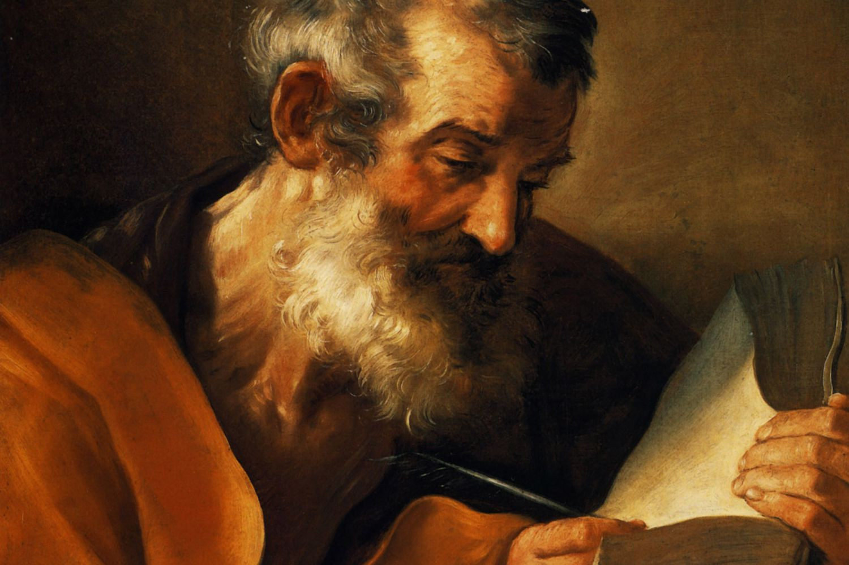
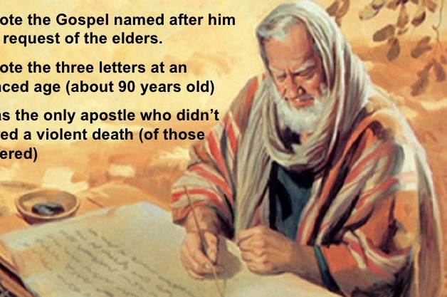
The Gospel of Jesus Christ
Matthew Wrote
Mark Wrote
Luke Wrote
John Wrote
To the Jews
About the Kingdom of God
Jesus is the Promised One
To everyone
Listen! Good News!
Jesus is our Savior
To you who love God
The rest of the story
Jesus gives Truth
He is Son of God and Son of man
To everyone
Believe it Here’s proof
Jesus is the Son of God

Slide 7
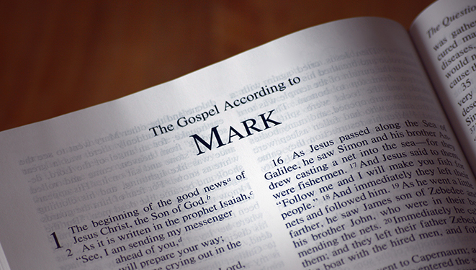
Let’s read our Bible story.
FIND Mark 1:14-20

Slide 8

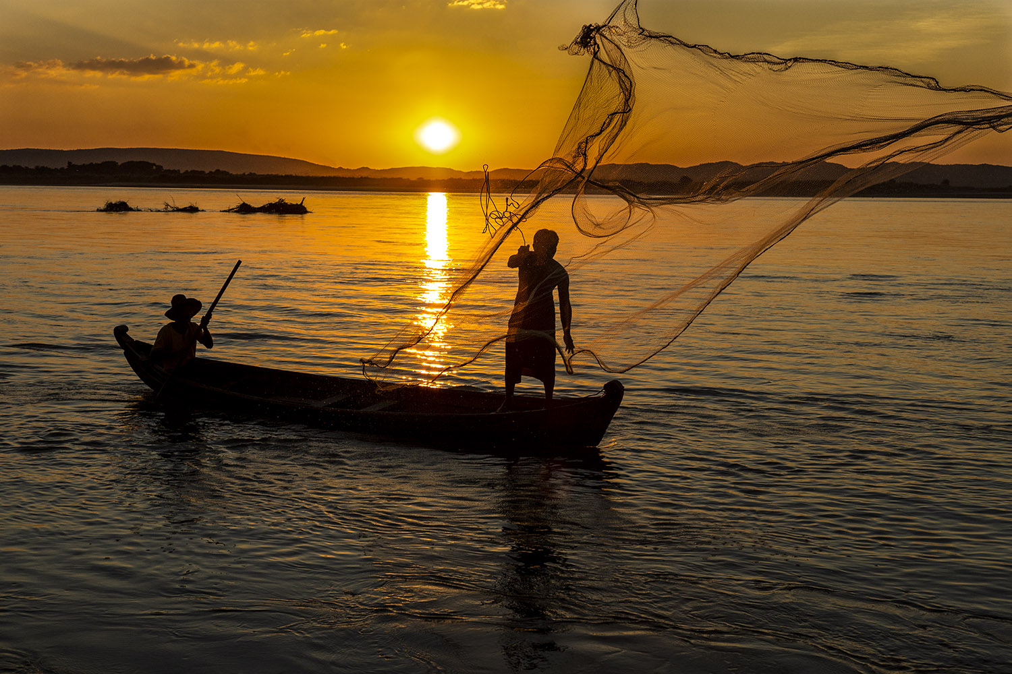
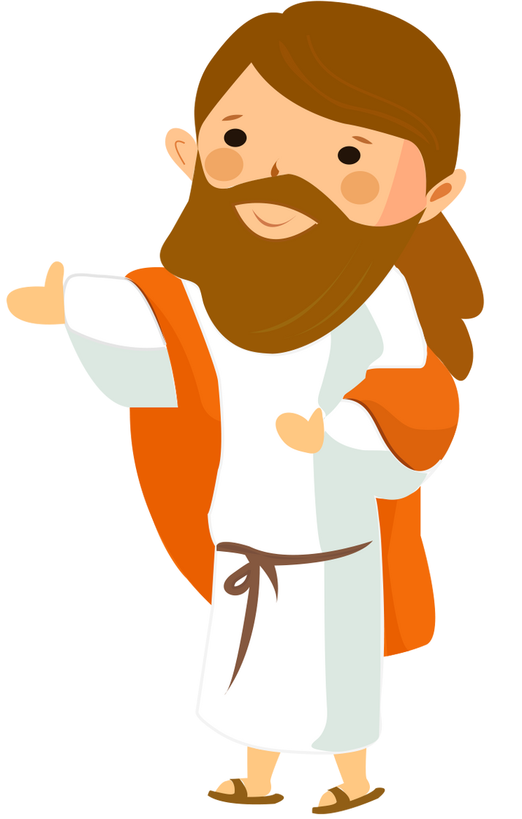

Mark 1: 14-18
¹⁶ As Jesus walked beside the Sea of Galilee, he saw Simon and his brother Andrew casting a net into the lake, for they were fishermen. ¹⁷ “Come, follow me,” Jesus said, “and I will send you out to fish for people.” ¹⁸ At once they left their nets and followed him.
Try it – throw a net
Come Follow me.
You will fish for people.

Slide 9
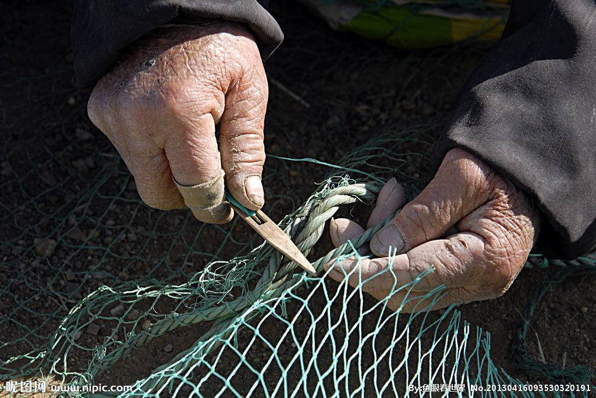
Mark 1: 19-20
¹⁹ When he had gone a little farther, he saw James son of Zebedee and his brother John in a boat, preparing their nets. ²⁰ Without delay he called them, and they left their father Zebedee in the boat with the hired men and followed him.
James and John were fixing their nets.
Why?
Try it – fix a net -- tie a string from one side of a hole to the other.
Come Follow me.
You will fish for people.

Slide 10

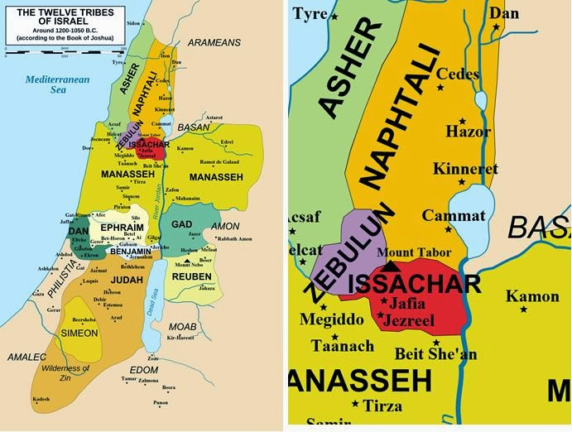
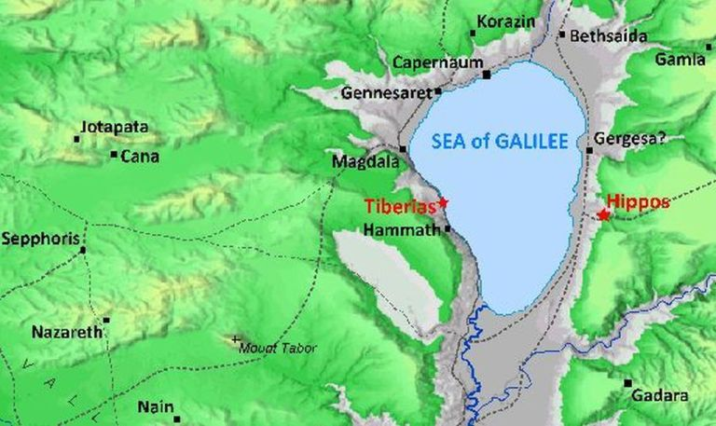
Matthew 4:12-13
¹² When Jesus heard that John had been put in prison, he withdrew to Galilee.
¹³ Leaving Nazareth, he went and lived in Capernaum, which was by the lake in the area of Zebulun and Naphtali—
Sea of Galilee
Sea of Galilee
Sea of Galilee

Slide 11
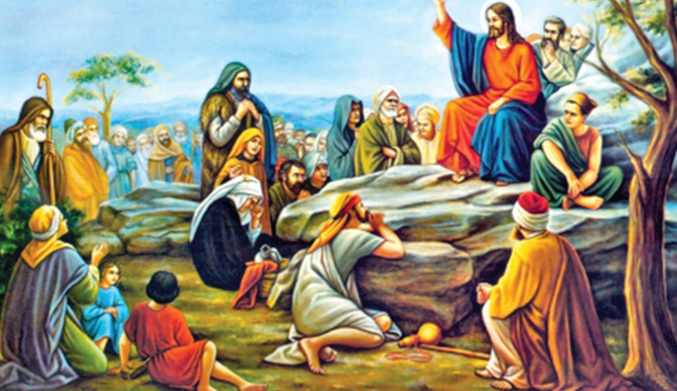
Matthew 4:17
Repent, for the kingdom of heaven is near.
¹⁷ From that time on Jesus began to preach, “Repent, for the kingdom of heaven has come near.”
Is Jesus fishing for people?

Slide 12
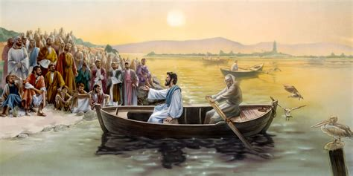
Luke 5:1-3 Jesus spoke the word of God
Yes, Jesus is fishing for people.
5
One day as Jesus was standing by the Lake of Gennesaret,^{[a]} the people were crowding around him and listening to the word of God.
² He saw at the water’s edge two boats, left there by the fishermen, who were washing their nets.
³ He got into one of the boats, the one belonging to Simon, and asked him to put out a little from shore.
Then he sat down and taught the people from the boat.
Do not worry about what you eat, drink, or what you will wear. Is not life more important.
Look at the birds. God provides food for them.
God knows your needs. He will provide for you.
Seek first His kingdom and His righteousness.
(Matthew 6:25-33)

Slide 13
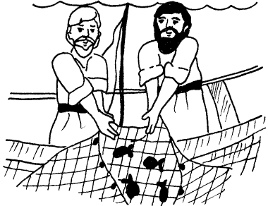

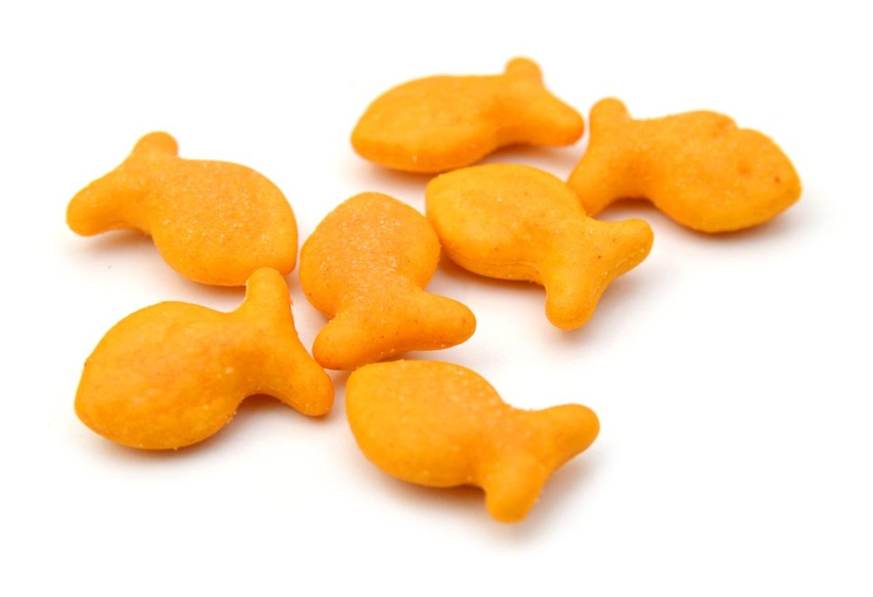
CRAFT TIME
“Come and Follow Me.’ Jesus said,
‘I will make you fishers of men.”
DIRECTIONS:
Color the picture
Add a net above. You can use the netting that oranges, avocadoes, onions, etc. come in.
Put little plastic, gummy, or cracker fish in the net.

Slide 14
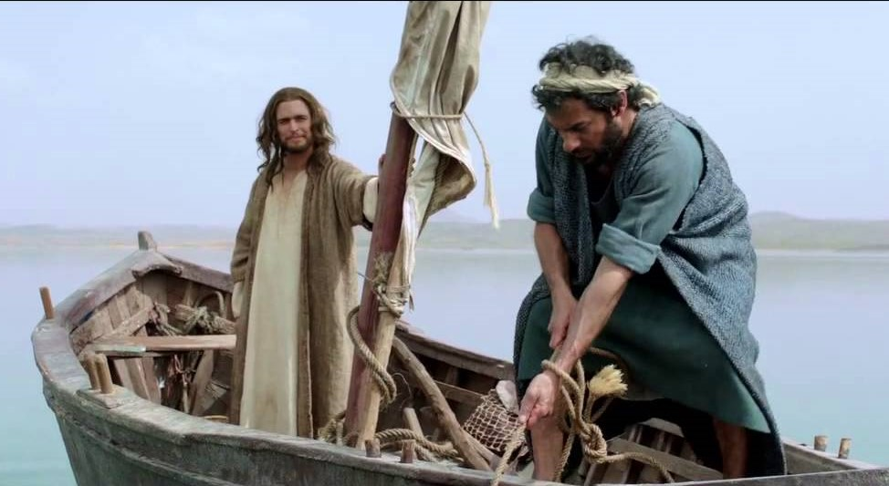
Catch some fish
Simon Peter,
Row out to deep water.
Let down your nets for a catch.
Master, we fished all night and didn’t catch anything!
⁴ When he had finished speaking, he said to Simon, “Put out into deep water, and let down the nets for a catch.”
⁵ Simon answered, “Master, we’ve worked hard all night and haven’t caught anything. But because you say so, I will let down the nets.”
But because you said so,
I will do it!

Slide 15
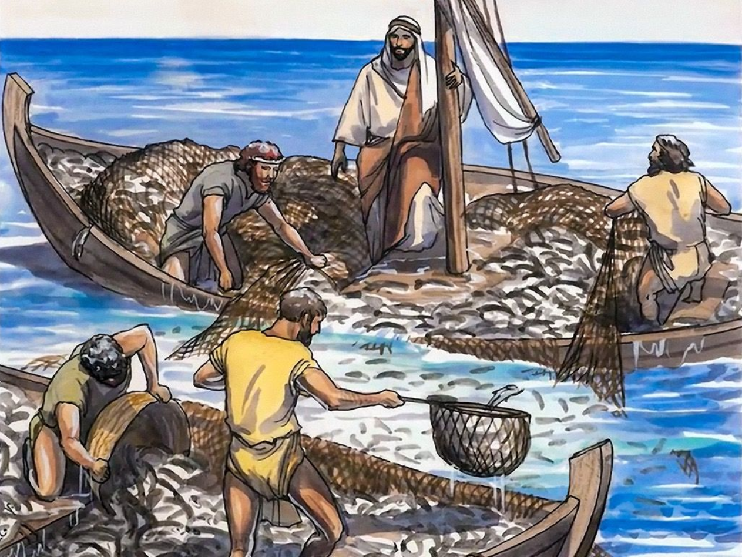
So MANY Fish!
WOW!
⁶ When they had done so, they caught such a large number of fish that their nets began to break.
⁷ So they signaled their partners in the other boat to come and help them, and they came and filled both boats so full that they began to sink.

Slide 16
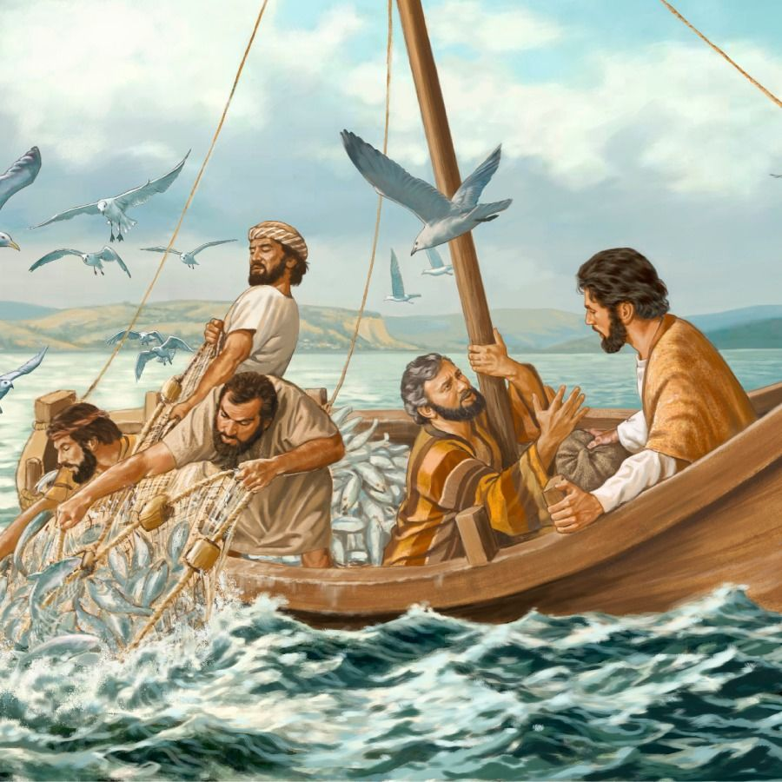
Come follow me
Be fishers of men!
Don’t be afraid.
From now on you will be a fisher of men.
Go away from me Lord; I am a sinful man!
⁸ When Simon Peter saw this, he fell at Jesus’ knees and said, “Go away from me, Lord; I am a sinful man!” ⁹ For he and all his companions were astonished at the catch of fish they had taken, ¹⁰ and so were James and John, the sons of Zebedee, Simon’s partners.
Then Jesus said to Simon, “Don’t be afraid; from now on you will fish for people.” ¹¹ So they pulled their boats up on shore, left everything and followed him.
Even fish do what their Creator tells them to do!

Slide 17
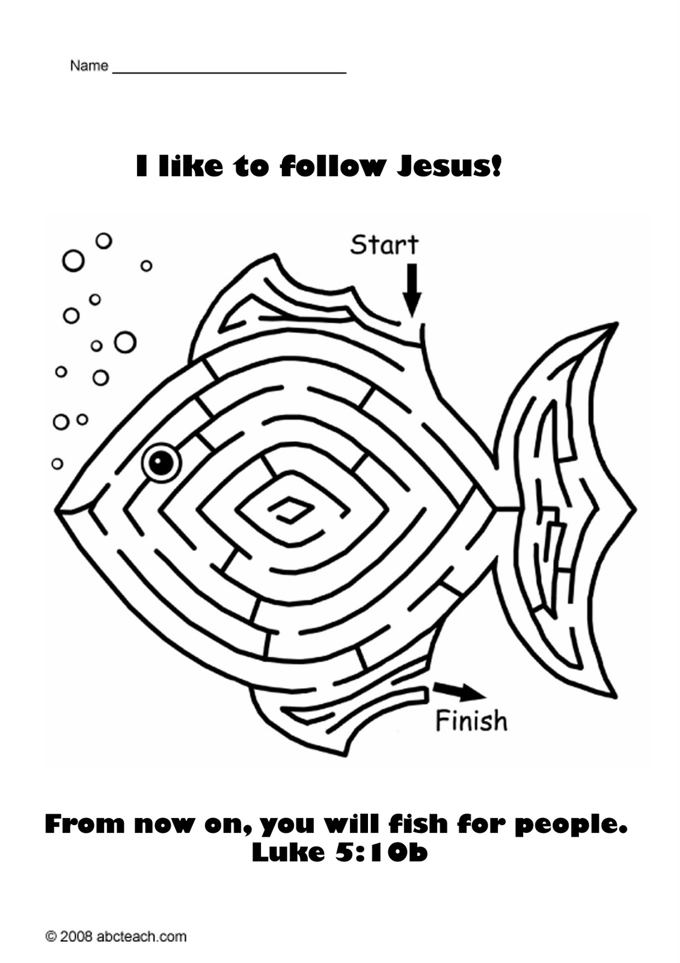
Can you find a way?

Slide 18
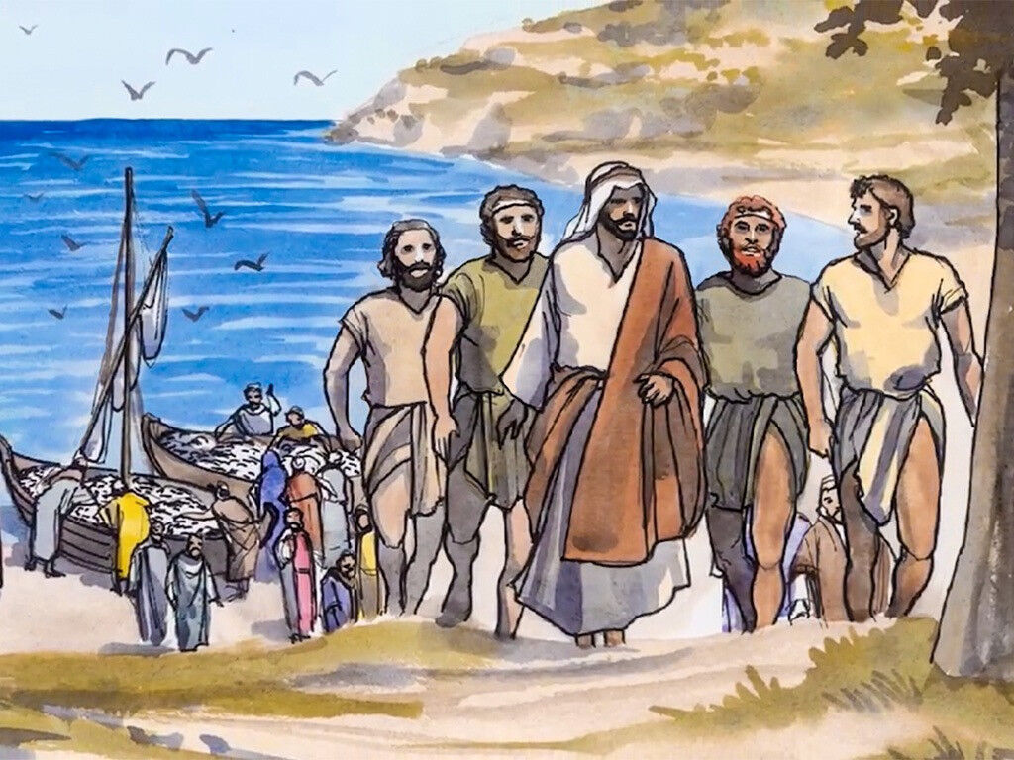
They followed Jesus
^{Matthew 4:19} “Come, follow me,” Jesus said, “and I will send you out to fish for people.” ²⁰ At once they left their nets and followed him.

Slide 19

Follow Me

Slide 20
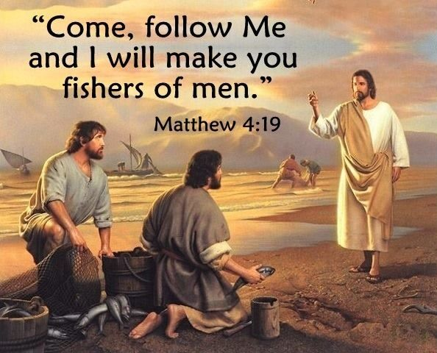
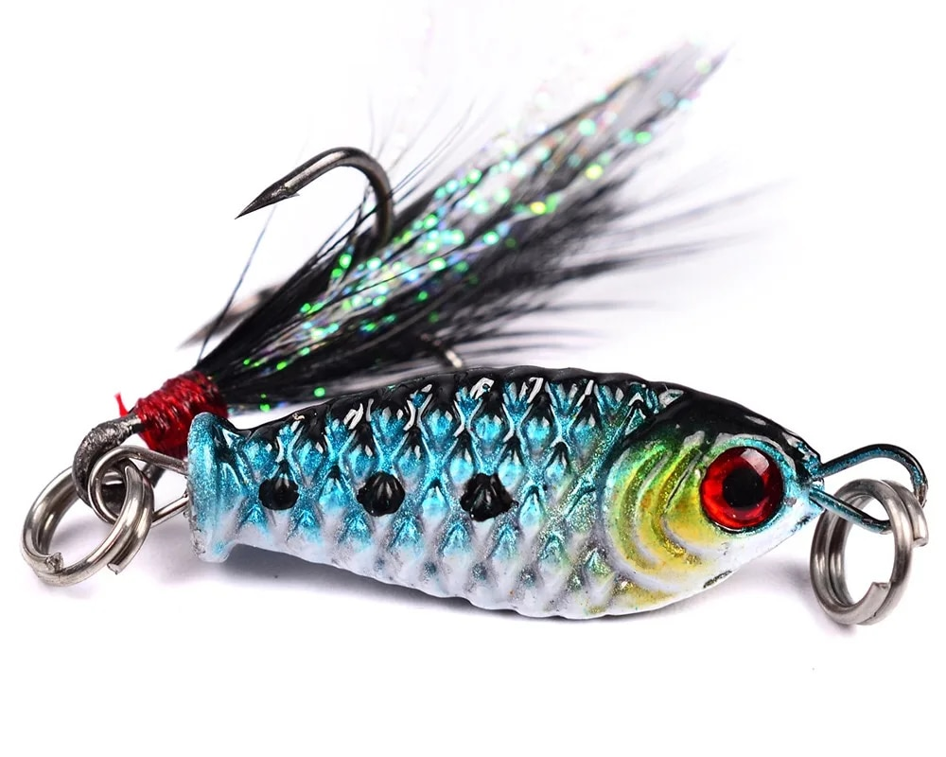
What does that mean to catch people?
Is it like a big tag game?
Should we catch people in a net?
Do we want to hook people?
Do we lure them towards Jesus?
I wouldn’t want to be caught that way!
I want to be free.
I heard Jesus say that He came to make people free!

Slide 21
How can we attract people to Jesus so that they can be free?
Give them food
Help them __________
Love them
Tell them that Jesus forgives them.
Tell them that Jesus LOVES them
______________________

Slide 22

I will make you fishers of men

Slide 23
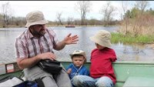
How do you catch fish?
How are we a fisher of men?

Slide 24
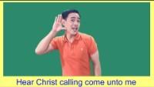
I will make you fishers of men

Slide 25
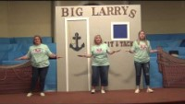
I Have Decided to Follow Jesus

Slide 26
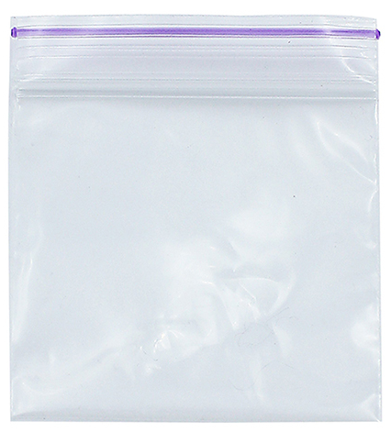


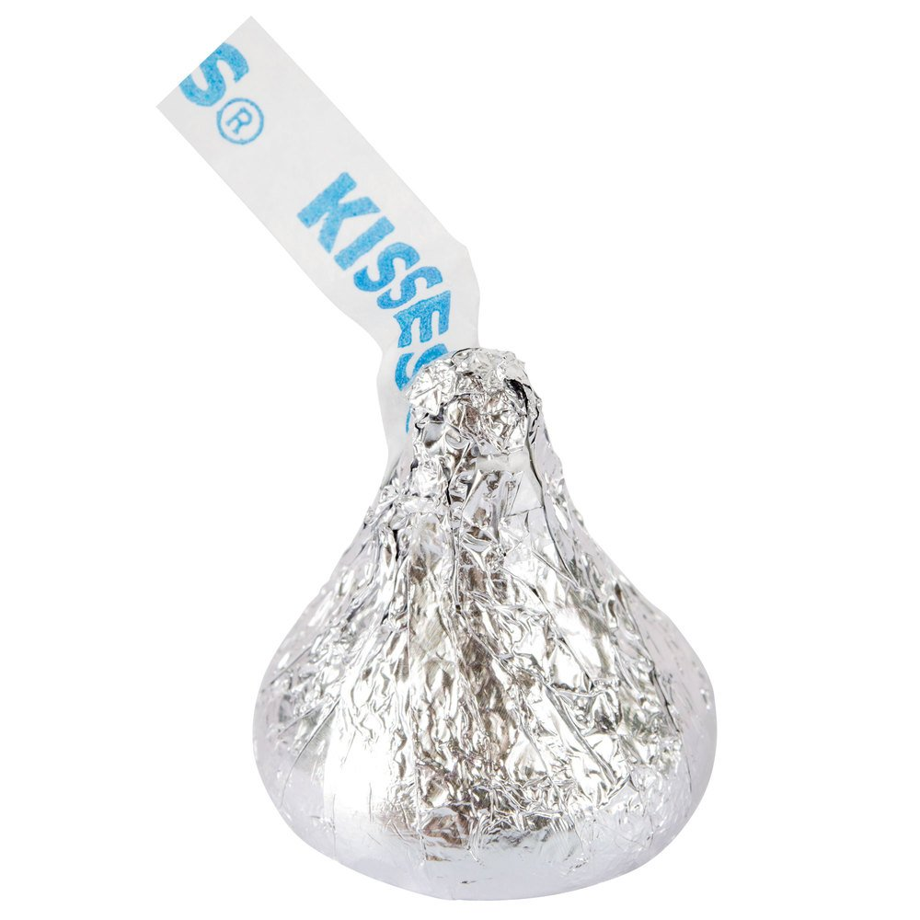
Let’s be fisher of men
Deliver a gift to someone
FISHERMAN
Get a stick and string to make a pole
Choose a gift ziplock bag for a neighbor
Clip the bag to your string.
Offer it to someone in church or to a neighbor.
Gift bag ideas
Tea bag
Bookmark
Snack bar
_______

Slide 27

Step by Step

Slide 28
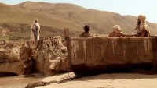
I will make you fishers of men

Slide 29

https://activity-array.com/

