Slide 1
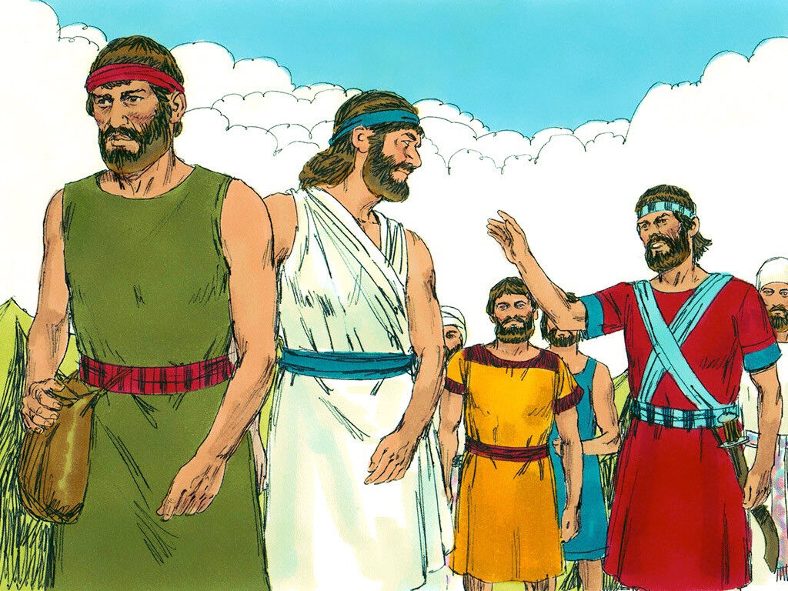
JOSHUA
Leads Israel into the promised land
PART 1
Joshua chapter 1-2
GO SEE
&
BE STRONG

Slide 2

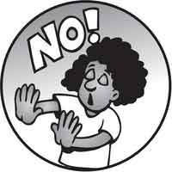

How strong are you?

Slide 3
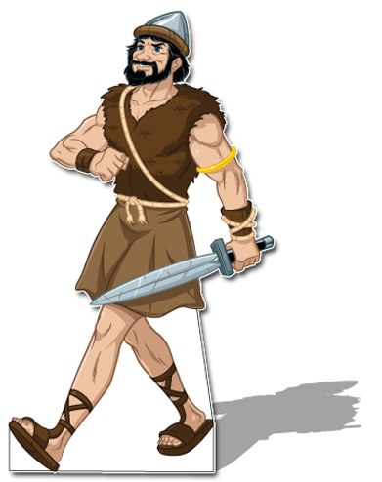
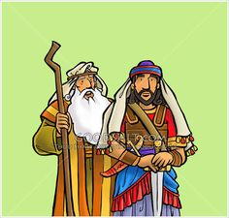
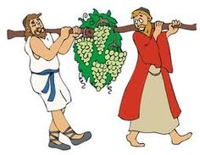
Meet Joshua
Moses’ helper
Brave spy that trusted in God
Commander of the army

Slide 4
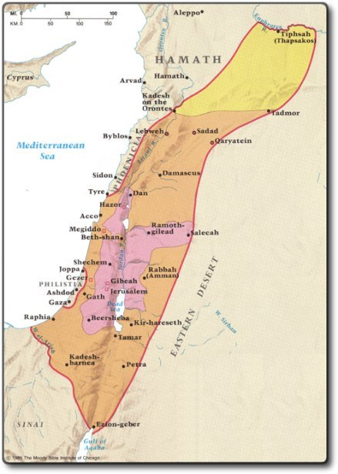
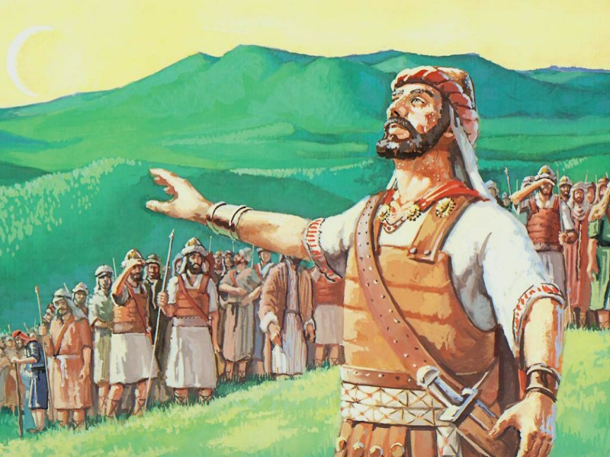
Joshua chapter 1
1 Moses, the servant of the Lord, died. After that, the Lord spoke to Joshua, the son of Nun. Joshua was Moses’ helper. The Lord said to Joshua, ² “My servant Moses is dead. Now then, I want you and all these people to get ready to go across the Jordan River. I want all of you to go into the land I am about to give to the Israelites. ³ I will give all of you every place you walk on, just as I promised Moses.
⁴ Your territory will reach from the Negev Desert all the way to Lebanon. The great Euphrates River will be to the east. The Mediterranean Sea will be to the west. Your territory will include all the Hittite country.
⁵ Joshua, no one will be able to oppose you as long as you live. I will be with you, just as I was with Moses. I will never leave you. I will never desert you. ⁶ Be strong and brave. You will lead these people. They will take the land as their very own. It is the land I promised to give their people of long ago.
Joshua, get ready to lead my people to the promised land.
Be strong! I will be with you!

Slide 5
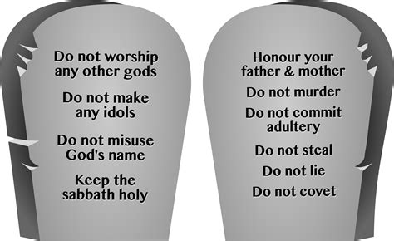
Love God
Be strong and brave!
Joshua, read my law and obey it.
Be strong and brave. Do not be afraid.
I will be with you wherever you go!
Love others
⁷ “Be strong and very brave. Make sure you obey the whole law my servant Moses gave you. Do not turn away from it to the right or the left. Then you will have success everywhere you go. ⁸ Never stop reading this Book of the Law. Day and night you must think about what it says. Make sure you do everything written in it. Then things will go well with you. And you will have great success.
⁹ Here is what I am commanding you to do. Be strong and brave. Do not be afraid. Do not lose hope. I am the Lord your God. I will be with you everywhere you go.”

Slide 6


Be Strong

Slide 7

“Here is what I am commanding you to do.
Be strong and brave.
Do not be afraid.
Do not lose hope.
I am the Lord your God.
I will be with you everywhere you go.”
Joshua 1:9

Slide 8

Be Strong

Slide 9
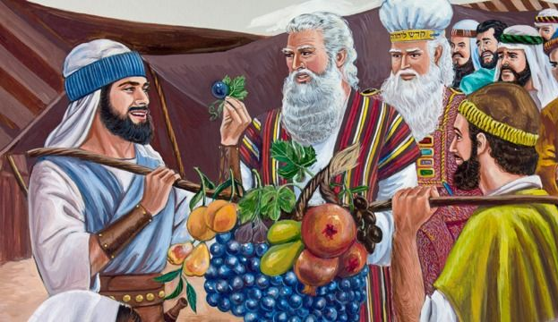
40 years before this…
The Israelites had come to Canaan.
Moses sent 12 spies to look at the land.
They saw big cities, big people, and big produce!
10 were scared.
2 were excited and trusted God.
The people believed the 10. They were scared!
NOW are the people going to be scared or brave?

Slide 10

In the next part of our story,
Joshua sends 2 spies to look at the land.
Let’s see how good you are at spying something.

Slide 11
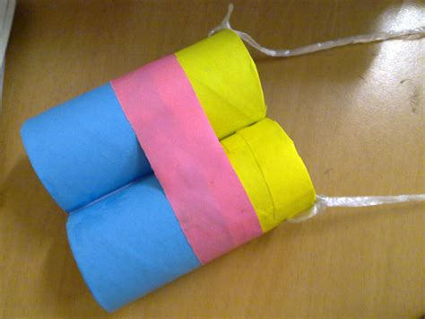

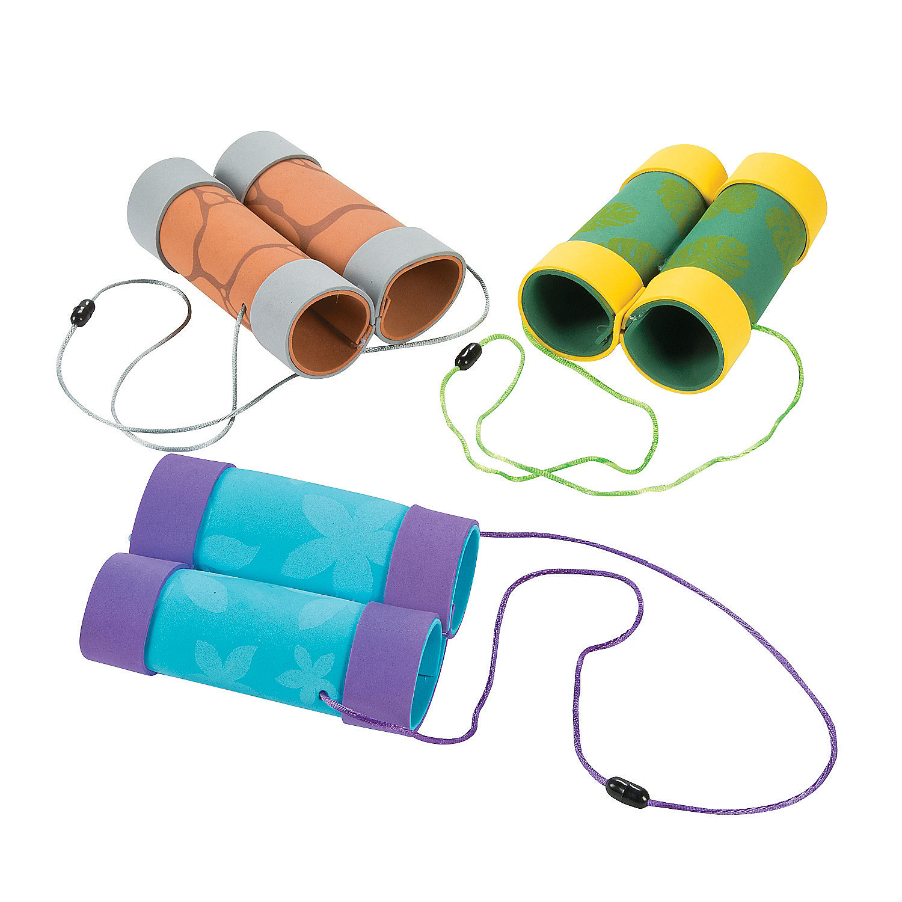
First you need some binoculars.

Slide 12
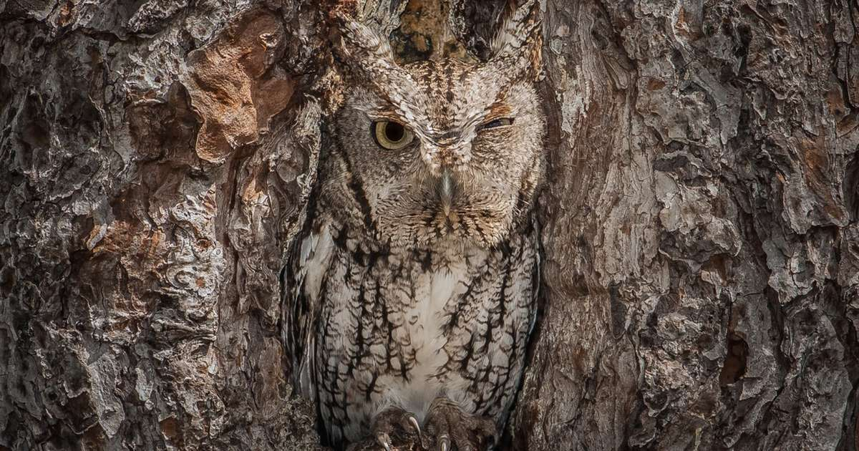
NATURE NUGGET
Can you find the animal?
Animals Hide I SPY

Slide 13
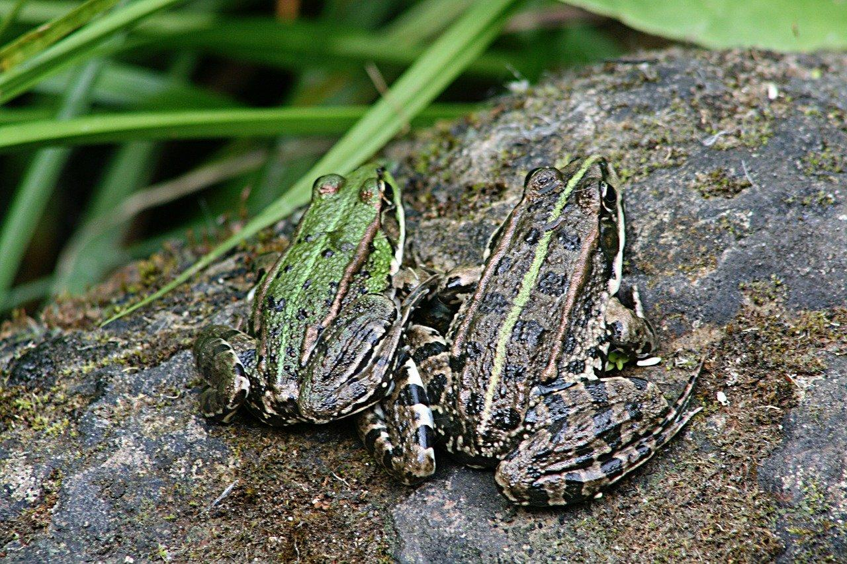
NATURE NUGGET
Can you find the animal?
Animals Hide I SPY

Slide 14
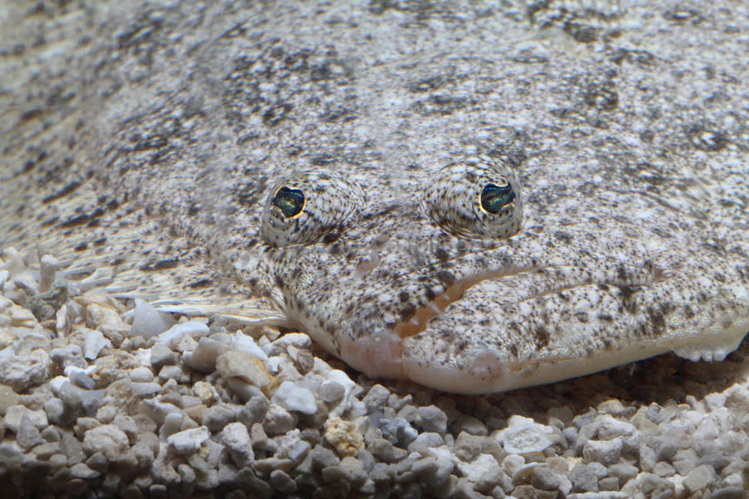
NATURE NUGGET
Can you find the animal?
Animals Hide I SPY
Stonefish

Slide 15
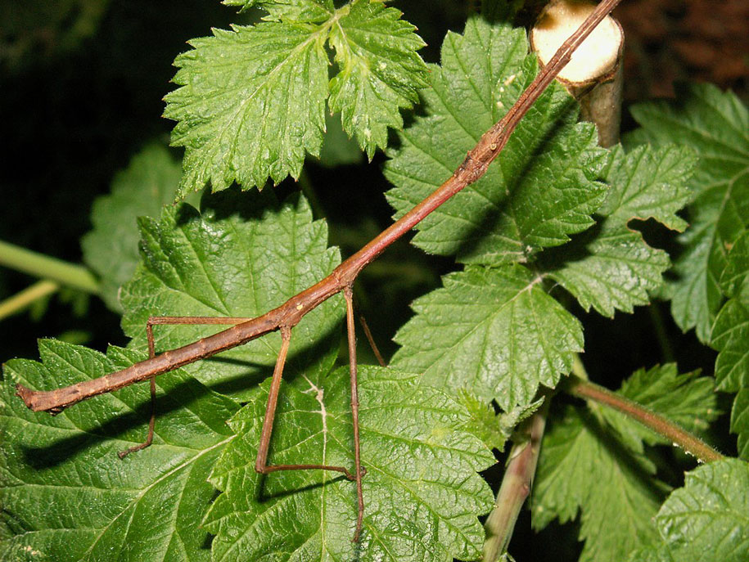
NATURE NUGGET
Can you find the animal?
Animals Hide I SPY

Slide 16
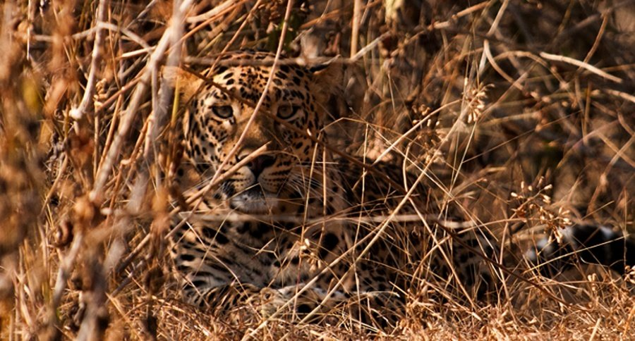
NATURE NUGGET
Can you find the animal?
Animals Hide I SPY

Slide 17
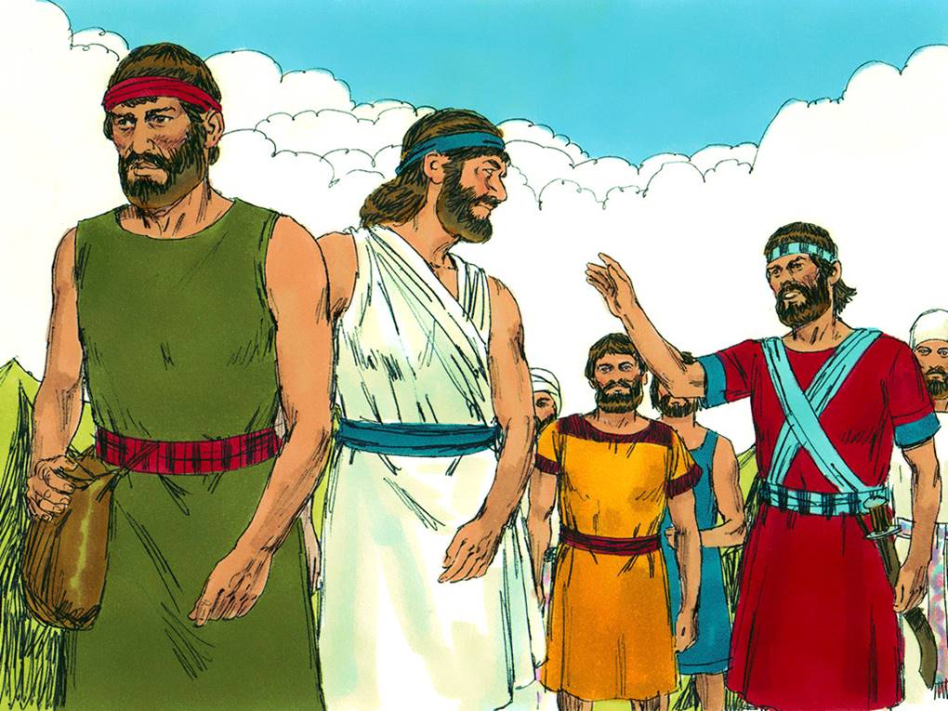

Rahab Helps the Spies
Joshua chapter 2
2 Joshua, the son of Nun, sent two spies from Shittim. He sent them in secret. He said to them, “Go and look over the land. Most of all, check out Jericho.”
Remember
Be strong and courageous
God will be with you.
Can you find
I
spy

Slide 18
Let’s do it!
As we walk around the room, pretend to do this:
Go through the tall grass – frip, frip – peek here
Go over the river Jordan – splash, splash!
Climb up a mountain – uh uh – it’s hard work!
Sneak down the other side – crouch – Shh!
Sneak to a tree, climb it – peek there
Look over there is Jericho! -- It’s big!
How will we get in? Where are the guards?

Slide 19
Let’s do it!
Continue….
Ok no one is around, sneak inside
Look there is the market. The food looks good!
Oh no! There’s the guard! Hide in this doorway!
A lady opened the door, pulls us in, shuts the door and locks it!
She tells us to sit quietly over there.

Slide 20
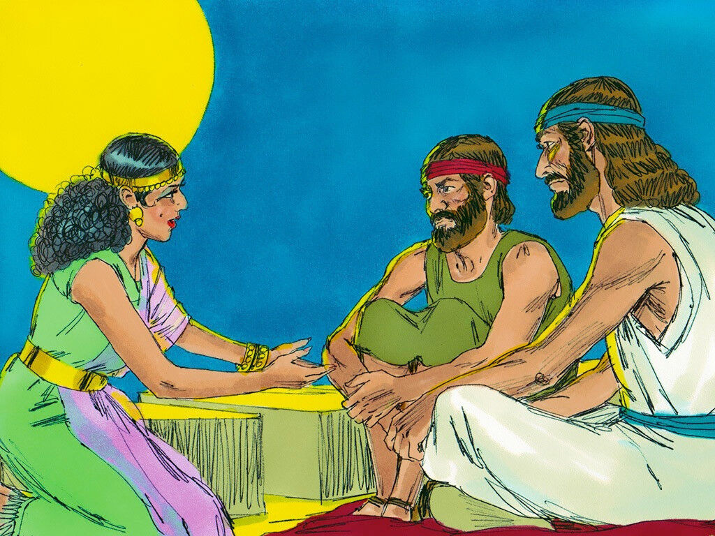

We have heard how strong you’re God is.
Tell me more!
Rahab Helps the Spies
Joshua chapter 2
2 Joshua, the son of Nun, sent two spies from Shittim. He sent them in secret. He said to them, “Go and look over the land. Most of all, check out Jericho.” So they went to Jericho. They stayed at the house of a prostitute. Her name was Rahab.
Can you find
I
spy

Slide 21
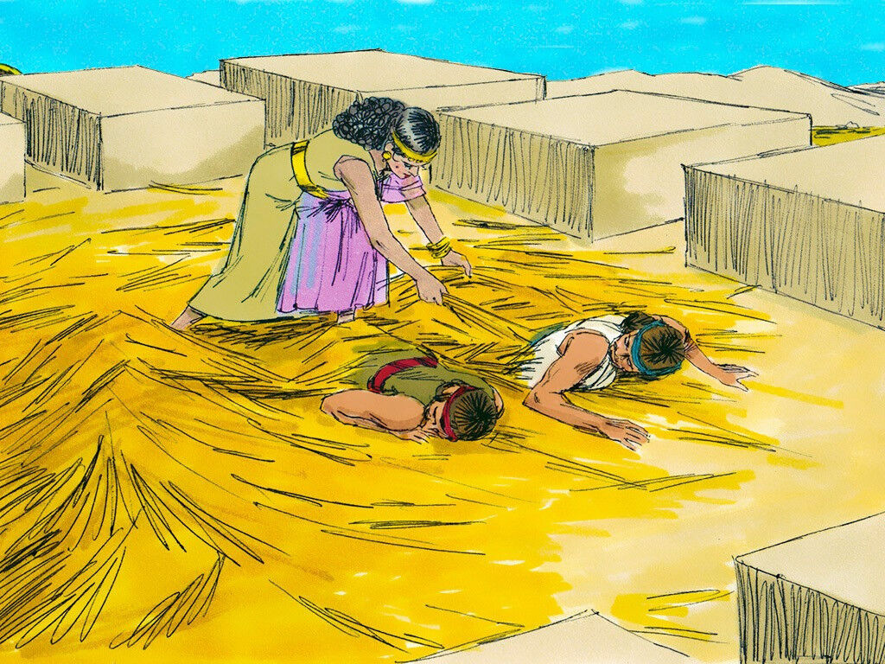

² The king of Jericho was told, “Look! Some of the Israelites have come here tonight. They’ve come to check out the land.” ³ So the king sent a message to Rahab. It said, “Bring out the men who came into your house. They’ve come to check out the whole land.”
⁴ But the woman had hidden the two men.
I
spy

Slide 22
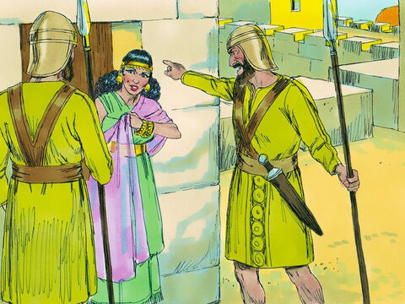

She said, “It’s true that the men came here. But I didn’t know where they had come from. ⁵ They left at sunset, when it was time to close the city gate. I don’t know which way they went. Go after them quickly. You might catch up with them.” ⁶ But in fact she had taken them up on the roof. There she had hidden them under some flax she had piled up. ⁷ The king’s men left to hunt down the spies. They took the road that leads to where the Jordan River can be crossed. As soon as they had gone out of the city, the gate was shut.
I
spy

Slide 23

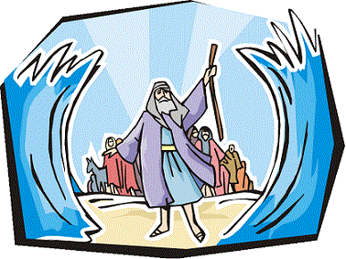
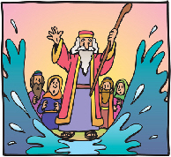

Joshua 2
⁸ Rahab went up on the roof before the spies settled down for the night. ⁹ She said to them, “I know that the Lord has given you this land. We are very much afraid of you. Everyone who lives in this country is weak with fear because of you. ¹⁰ We’ve heard how the Lord dried up the Red Sea for you when you came out of Egypt. We’ve heard what you did to Sihon and Og, the two Amorite kings. They ruled east of the Jordan River. You completely destroyed them. ¹¹ When we heard about it, we were terrified. Because of you, we aren’t brave anymore. The Lord your God is the God who rules in heaven above and on the earth below.
She believes in God!
I
spy

Slide 24

Joshua 2
¹² “Now then, please give me your word. Promise me in the name of the Lord that you will be kind to my family. I’ve been kind to you. Promise me ¹³ that you will spare the lives of my father and mother. Spare my brothers and sisters. Also spare everyone in their families. Promise that you won’t put any of us to death.”
¹⁴ So the men made a promise to her. “If you save our lives, we’ll save yours,” they said. “Just don’t tell anyone what we’re doing. Then we’ll be kind and faithful to you when the Lord gives us the land.”
I
spy

Slide 25
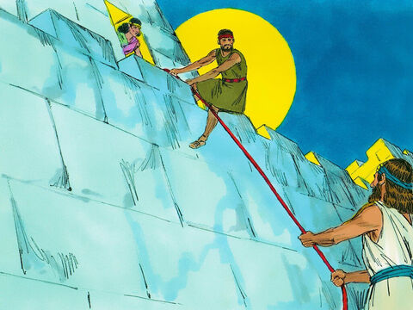

¹⁵ The house Rahab lived in was part of the city wall. So she let the spies down by a rope through the window. ¹⁶ She said to them, “Go up into the hills. The men chasing you won’t be able to find you. Hide yourselves there for three days until they return. Then you can go on your way.”
¹⁷ The spies had said to her, “You made us give our word. But we won’t keep our promise ¹⁸ unless you do what we say. When we enter the land, you must tie this bright red rope in the window. Tie it in the window you let us down through. Bring your father and mother into your house. Also bring in your brothers and everyone else in your family. ¹⁹ None of you must go out into the street. If you do, anything that happens to you will be your own fault. We won’t be responsible. But if anyone hurts someone who is inside the house with you, it will be our fault. We will be responsible. ²⁰ Don’t tell anyone what we’re doing. If you do, we won’t have to keep the promise you asked us to make.”
²¹ “I agree,” Rahab replied. “I’ll do as you say.”
So she sent them away, and they left. Then she tied the bright red rope in the window.
I
spy

Slide 26
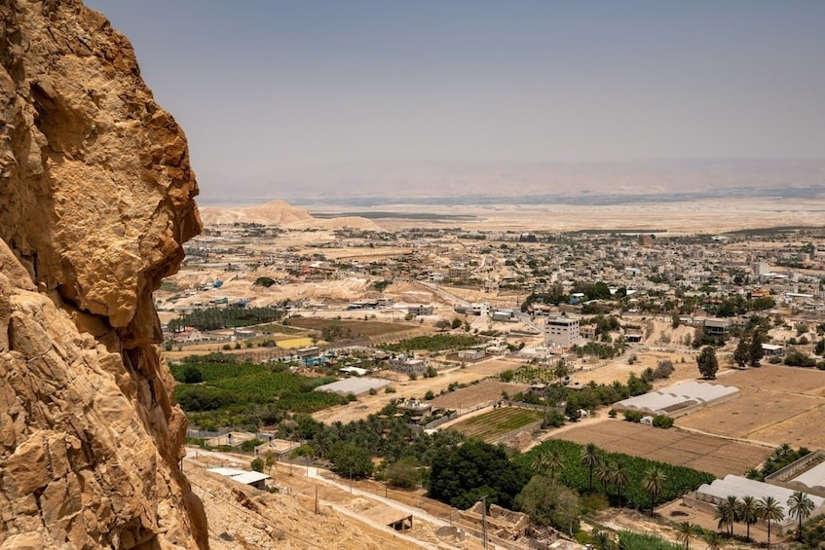
Let’s do it!
As we walk around the room, pretend to do this:
Run to the tree, hide behind it.
Climb up a mountain – uh uh – it’s hard work!
We better hide here awhile. -- wait quietly.
Sneak down the other side – crouch – Shh!
Go through the tall grass – frip, frip – peek here
Go over the river Jordan – splash, splash!
There’s camp! Let’s find Joshua!

Slide 27
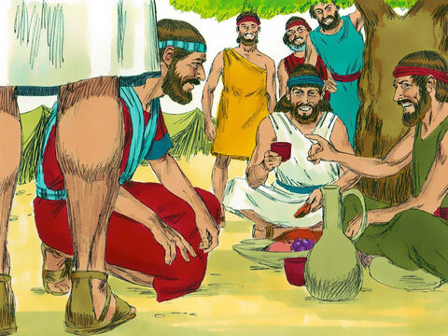

Joshua 2
²² When the spies left, they went up into the hills. They stayed there for three days. By that time the men chasing them had searched all along the road. They couldn’t find them. So they returned. ²³ Then the two spies started back. They went down out of the hills. They went across the Jordan River. They came to Joshua, the son of Nun. They told him everything that had happened to them. ²⁴ They said, “We’re sure the Lord has given the whole land over to us. All the people there are weak with fear because of us.”
I
spy

Slide 28
“Here is what I am commanding you to do.
Be strong and brave.
Do not be afraid.
Do not lose hope.
I am the Lord your God.
I will be with you everywhere you go.”
Joshua 1:9

Slide 29



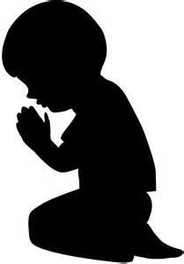
Dear Lord,
Help us to be strong and courageous.
Thank you for always being with us.
Thank you that You are strong!

Slide 30
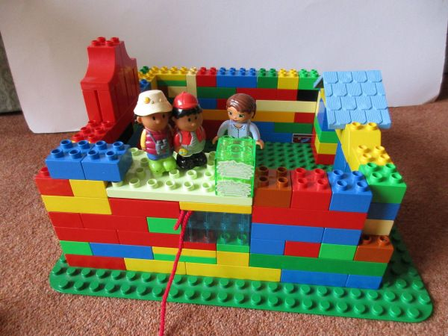
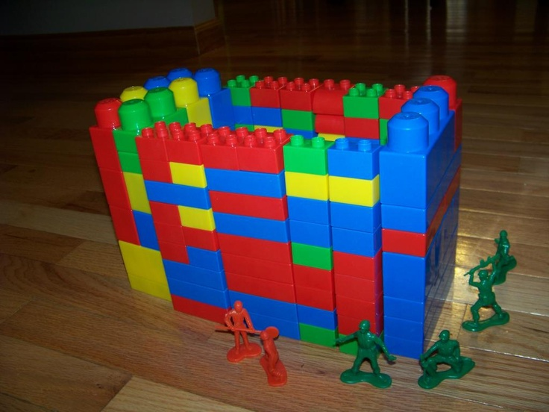
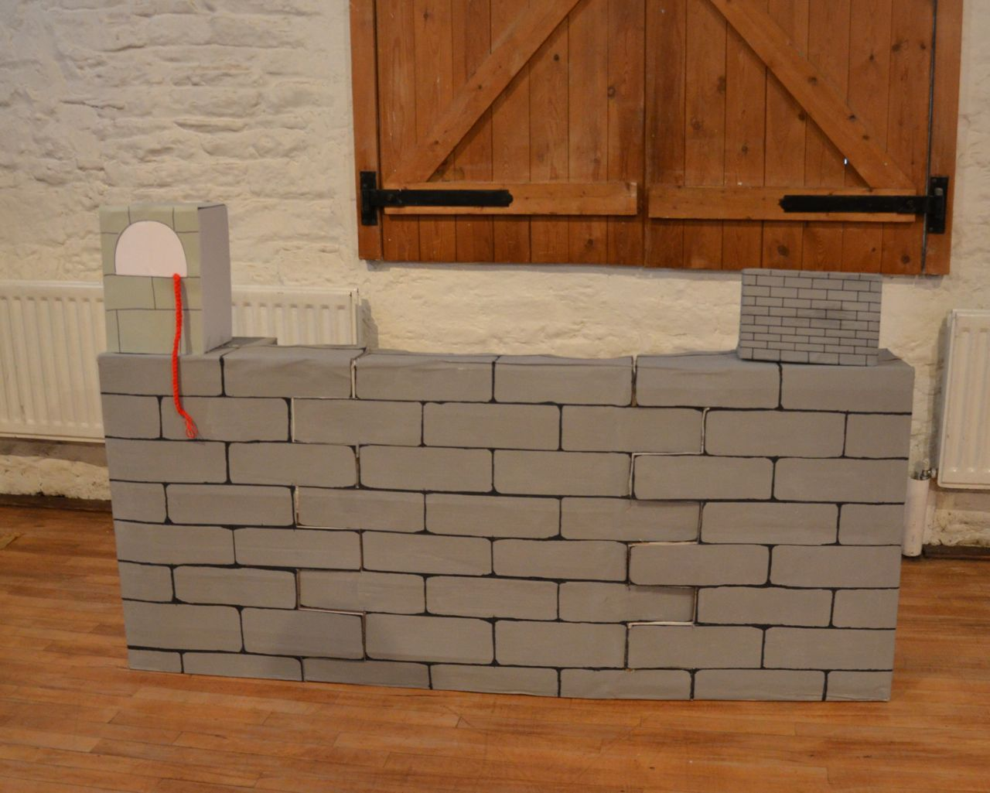
Activity – Let’s build Jericho
Let’s put a red cord from Rahab’s window.
We’ll leave Jericho here. We’ll use it in a couple weeks.

Slide 31
Be Strong

Slide 32
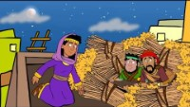

Slide 33
Be Strong

Slide 34
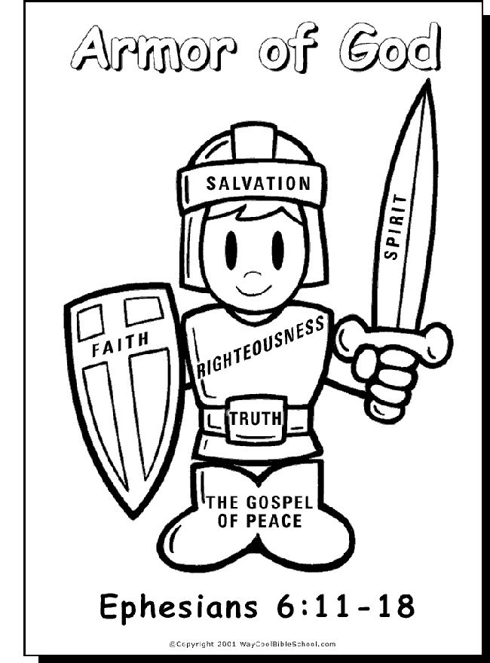

Full Armor of God

Slide 35

Joshua Fought the Battle of Jericho

Slide 36

Joshua Fought the Battle of Jericho

