Slide 1
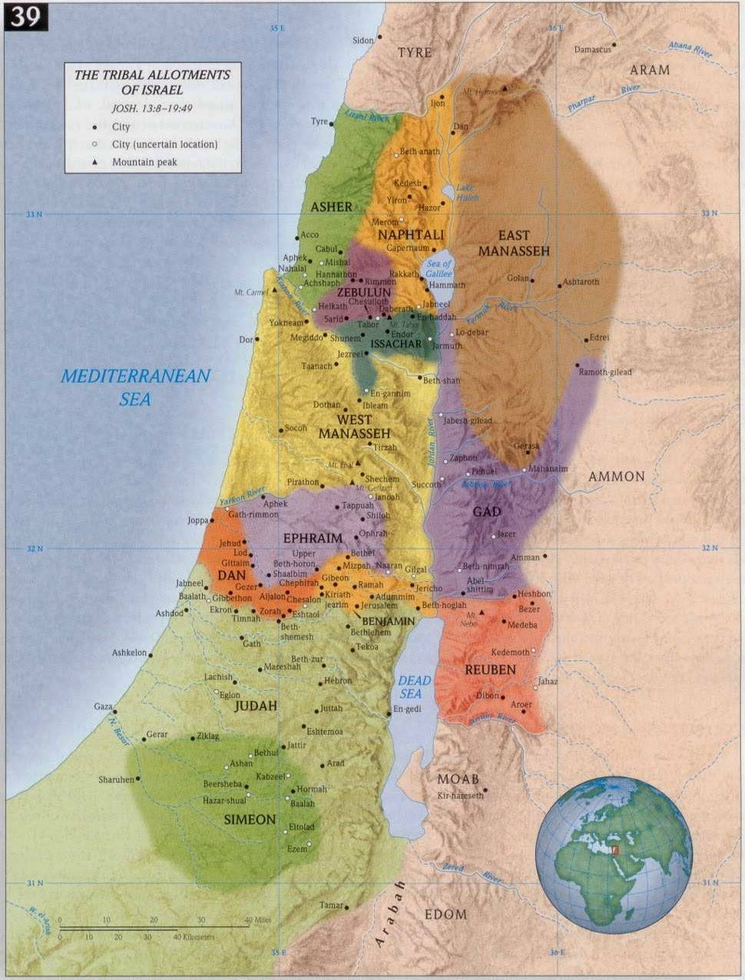
The Promised Land
Conquered and Given to each Tribe
Cities of Refuge
Joshua 20

Slide 2

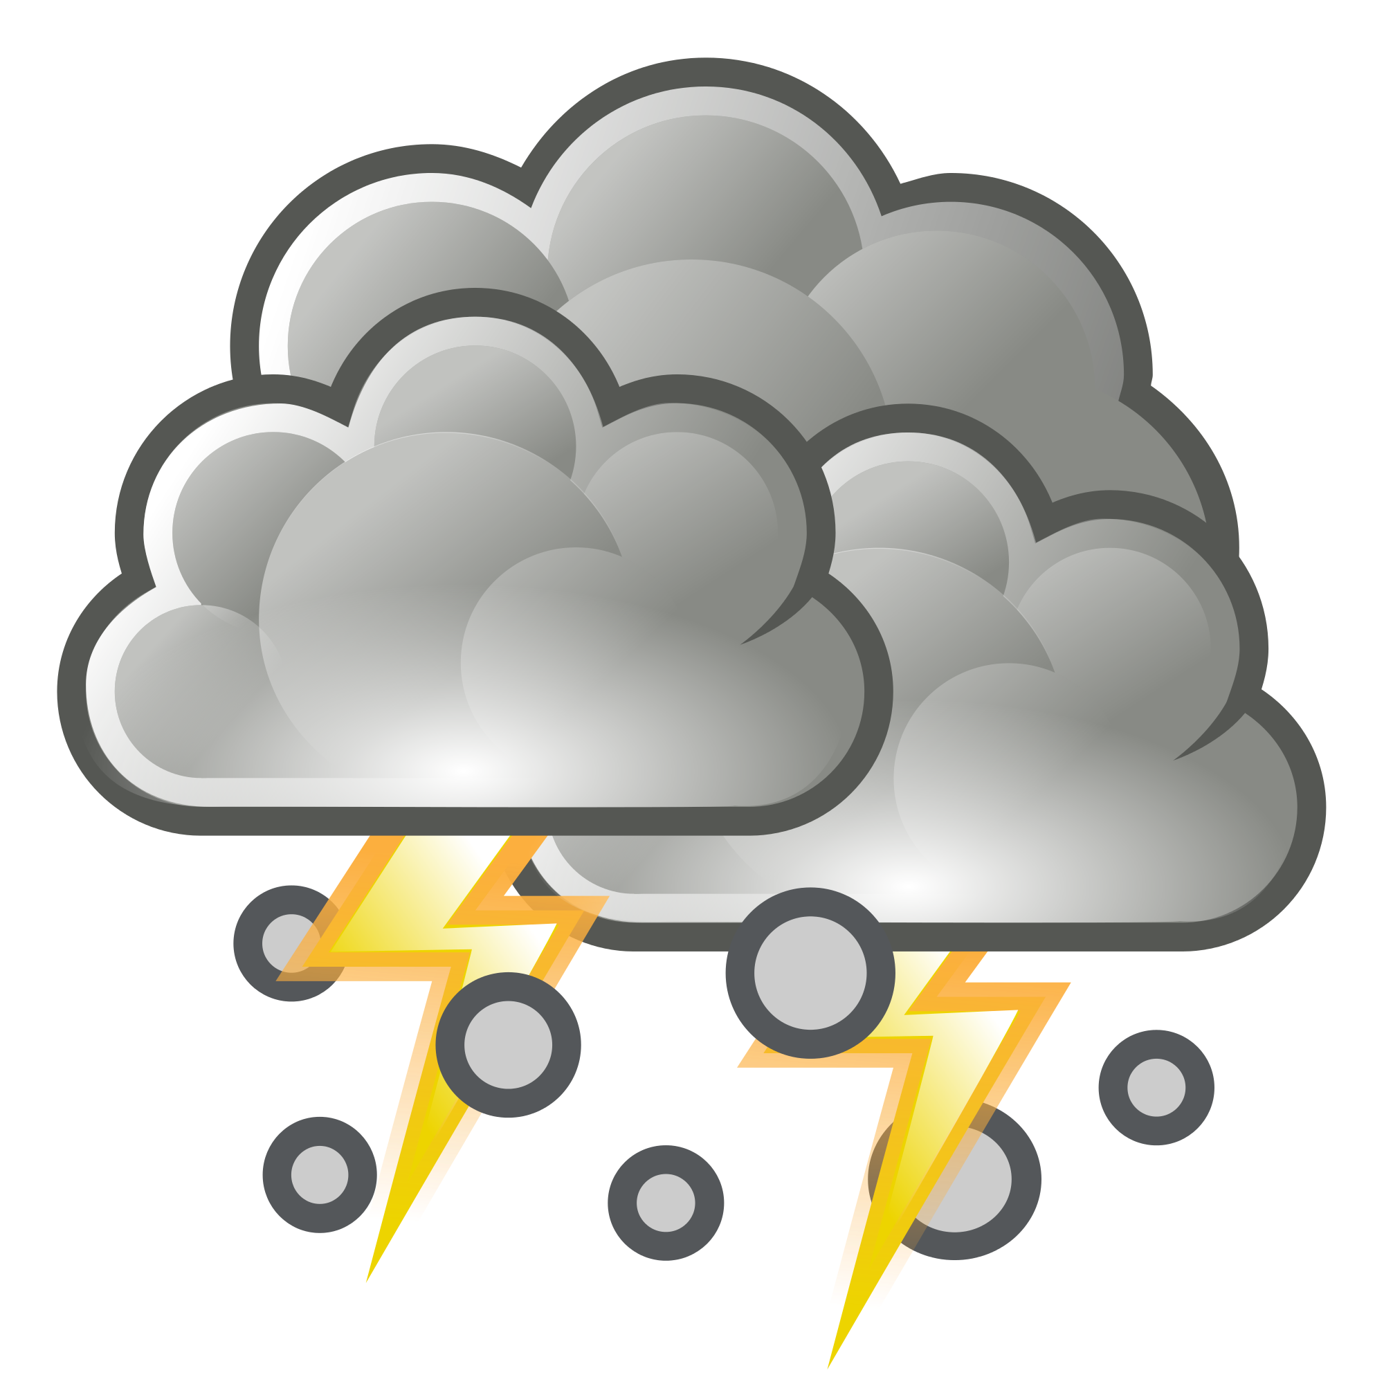

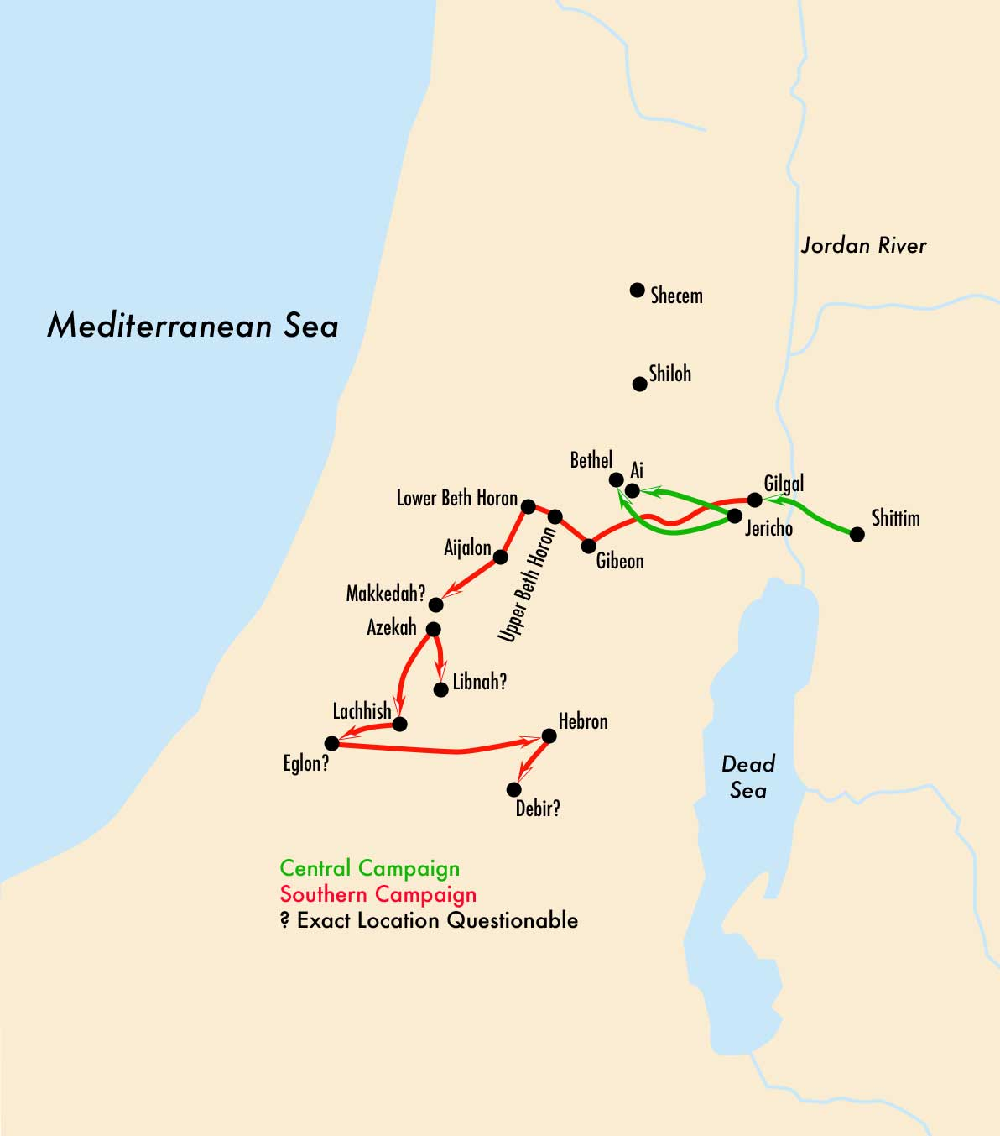
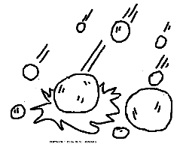
God helped Israel win many battles!
The Israelites fought many battles with God’s help as they took the land which God promised them.
One battle was against 5 kings.
God was helping the Israelites. The battle was going well.
Hailstones came down on the enemy.
Joshua said to God, may the sun and moon stand still.
The sun and moon stood still! It was a long day of battle!
God fought for Israel. They won!

Slide 3
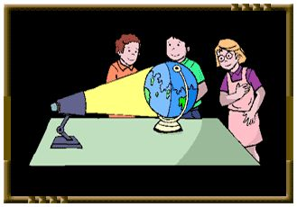
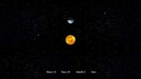
How can the sun stand still?
WAIT!
Do it
The sun is the center of our solar system.
The earth revolves. It goes around the sun.
The moon revolves. It goes around the earth.
The moon also spins. It rotates around and around.
The earth spins, too. It rotates, around and around.
It is day time and night time as the earth spins or rotates around and around the sun.
When the sun shines on our side of the earth,
it is day time.
When it is dark on our side of the earth,
it is night time.
If the earth stops spinning, time will stand still.
WOW! God stopped the earth’s spin!?!

Slide 4



Slide 5
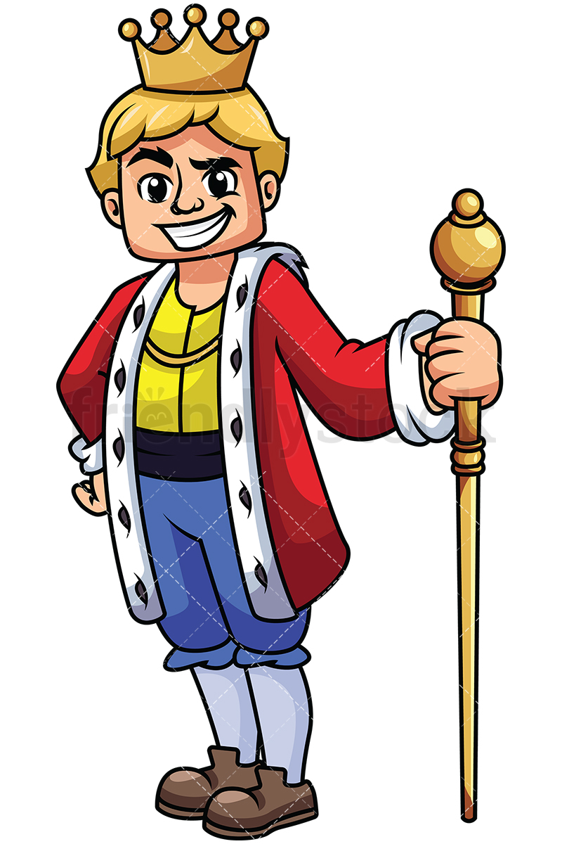
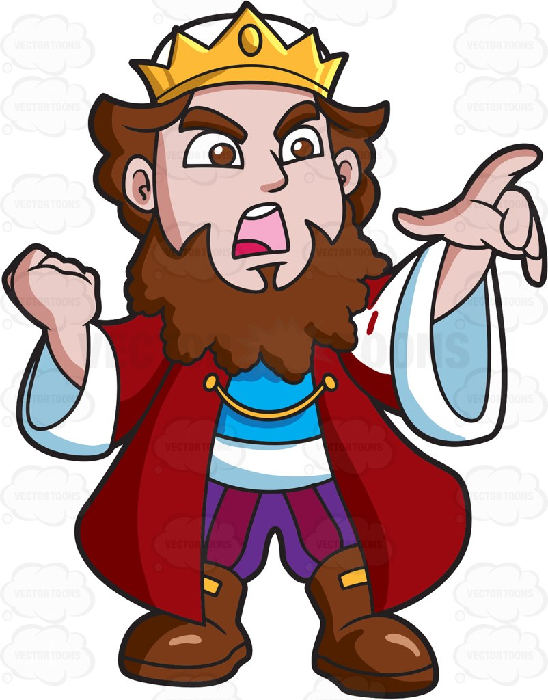
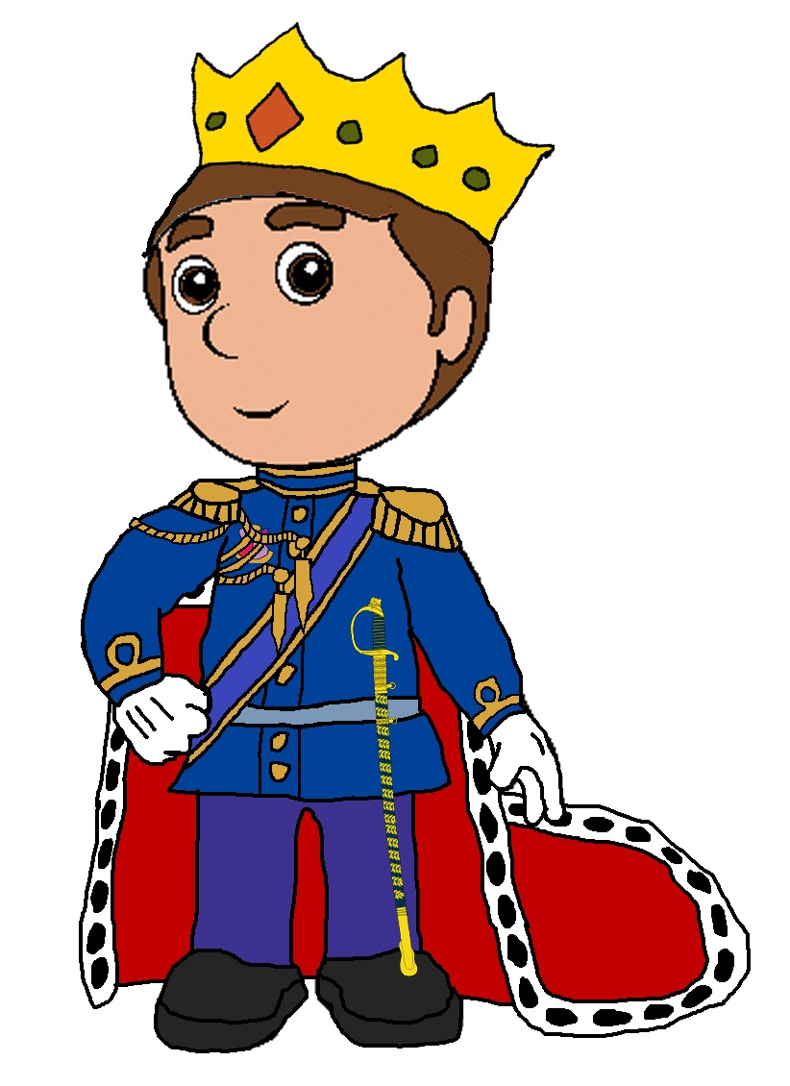
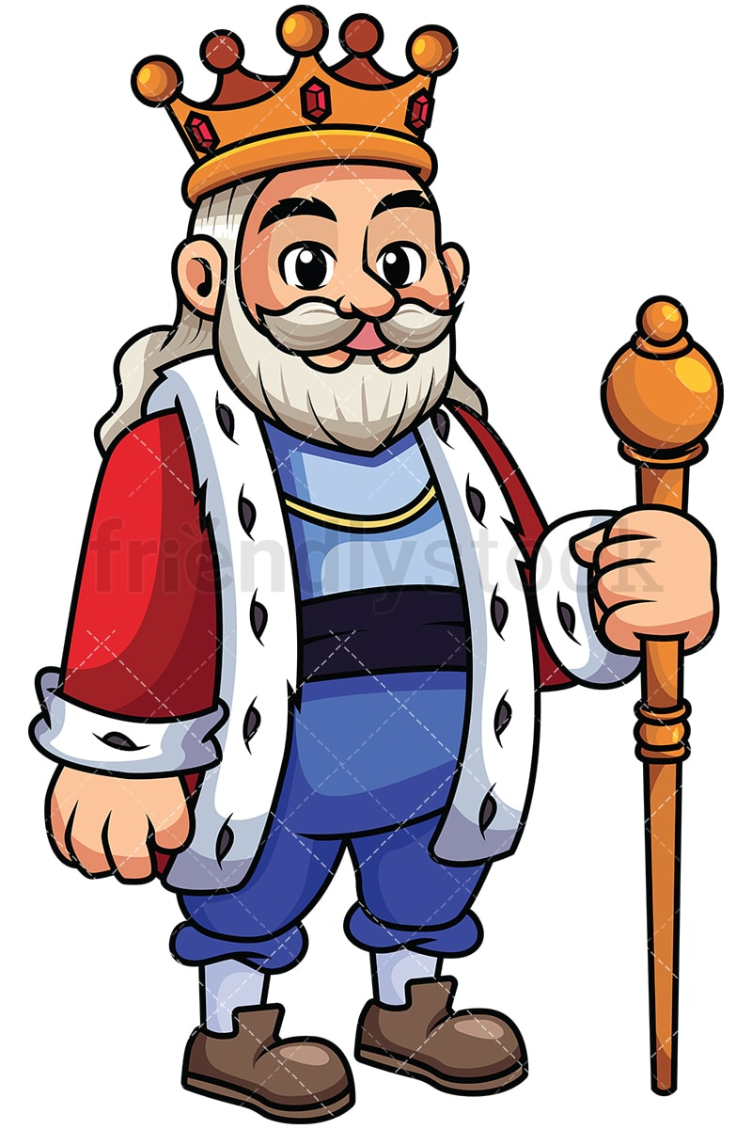
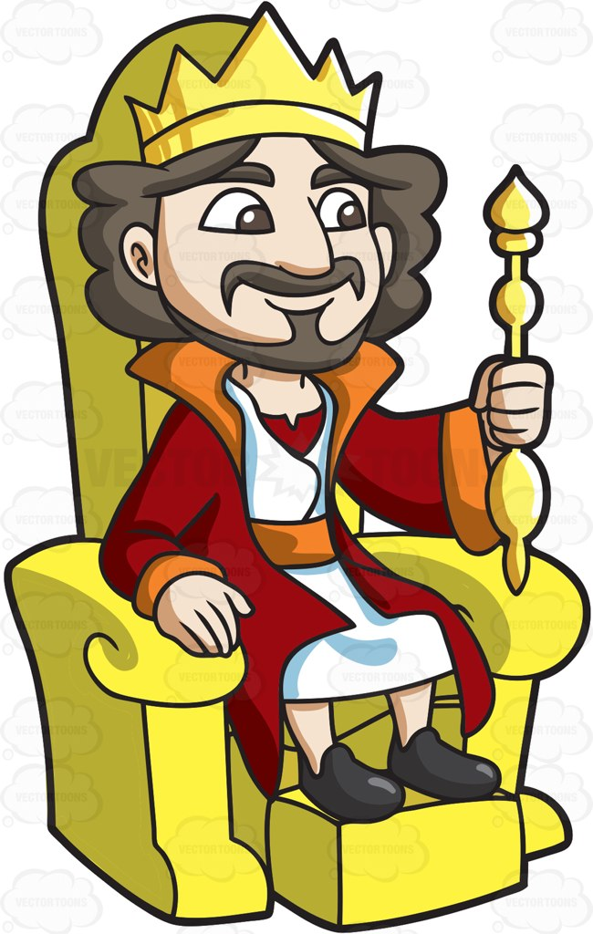
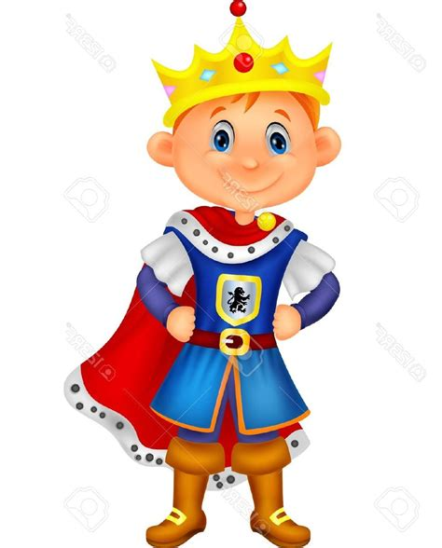
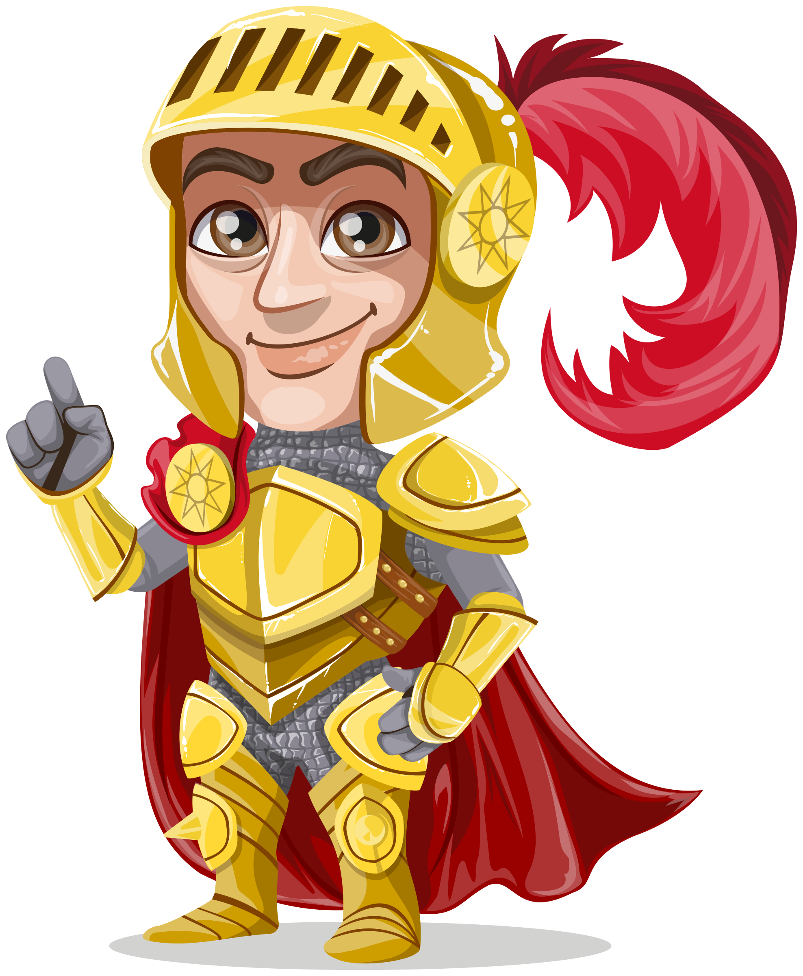
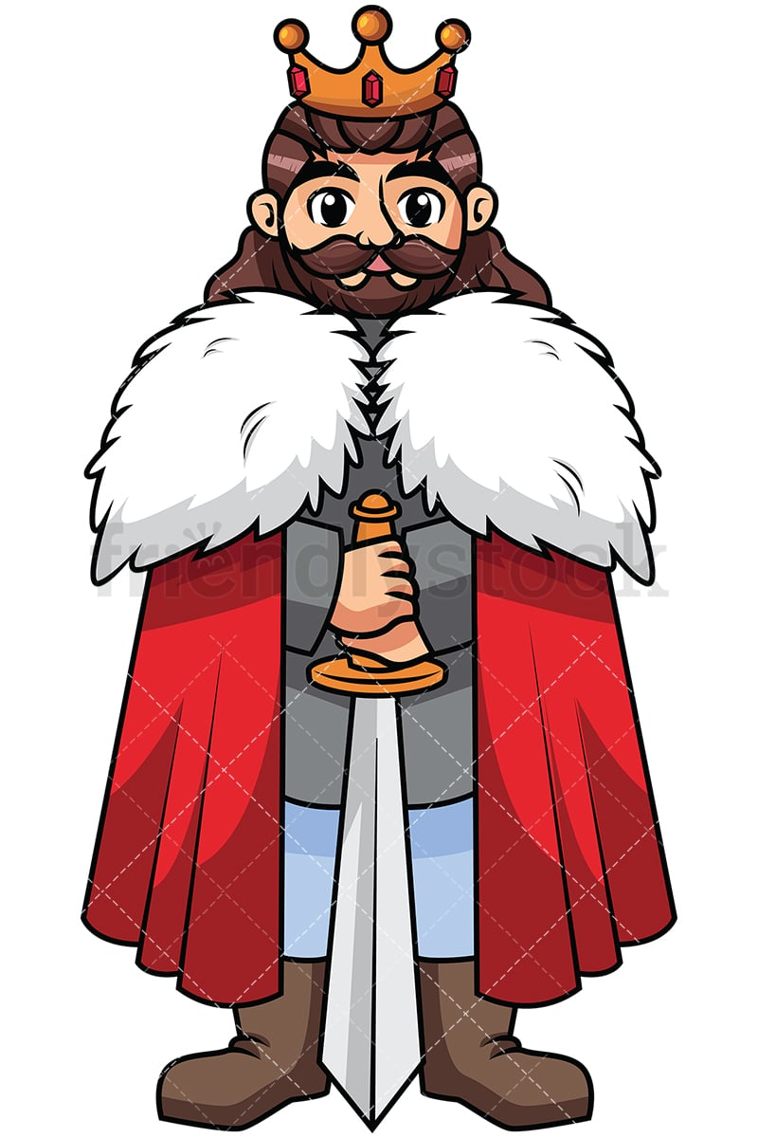
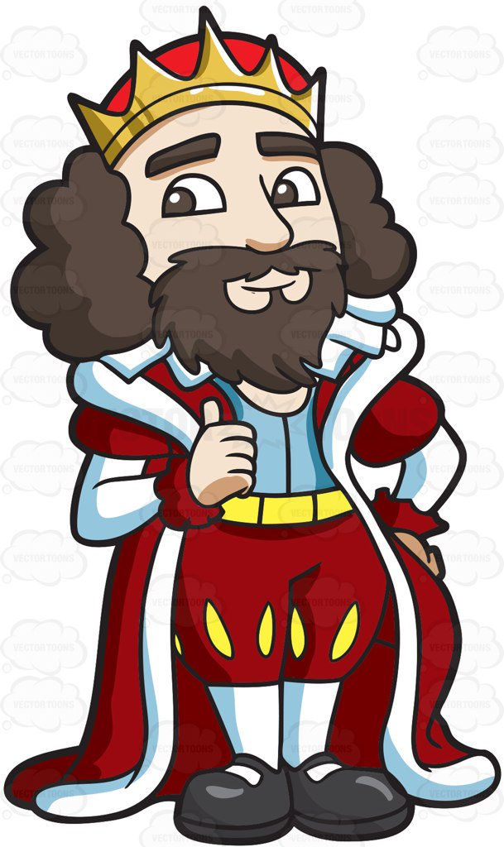
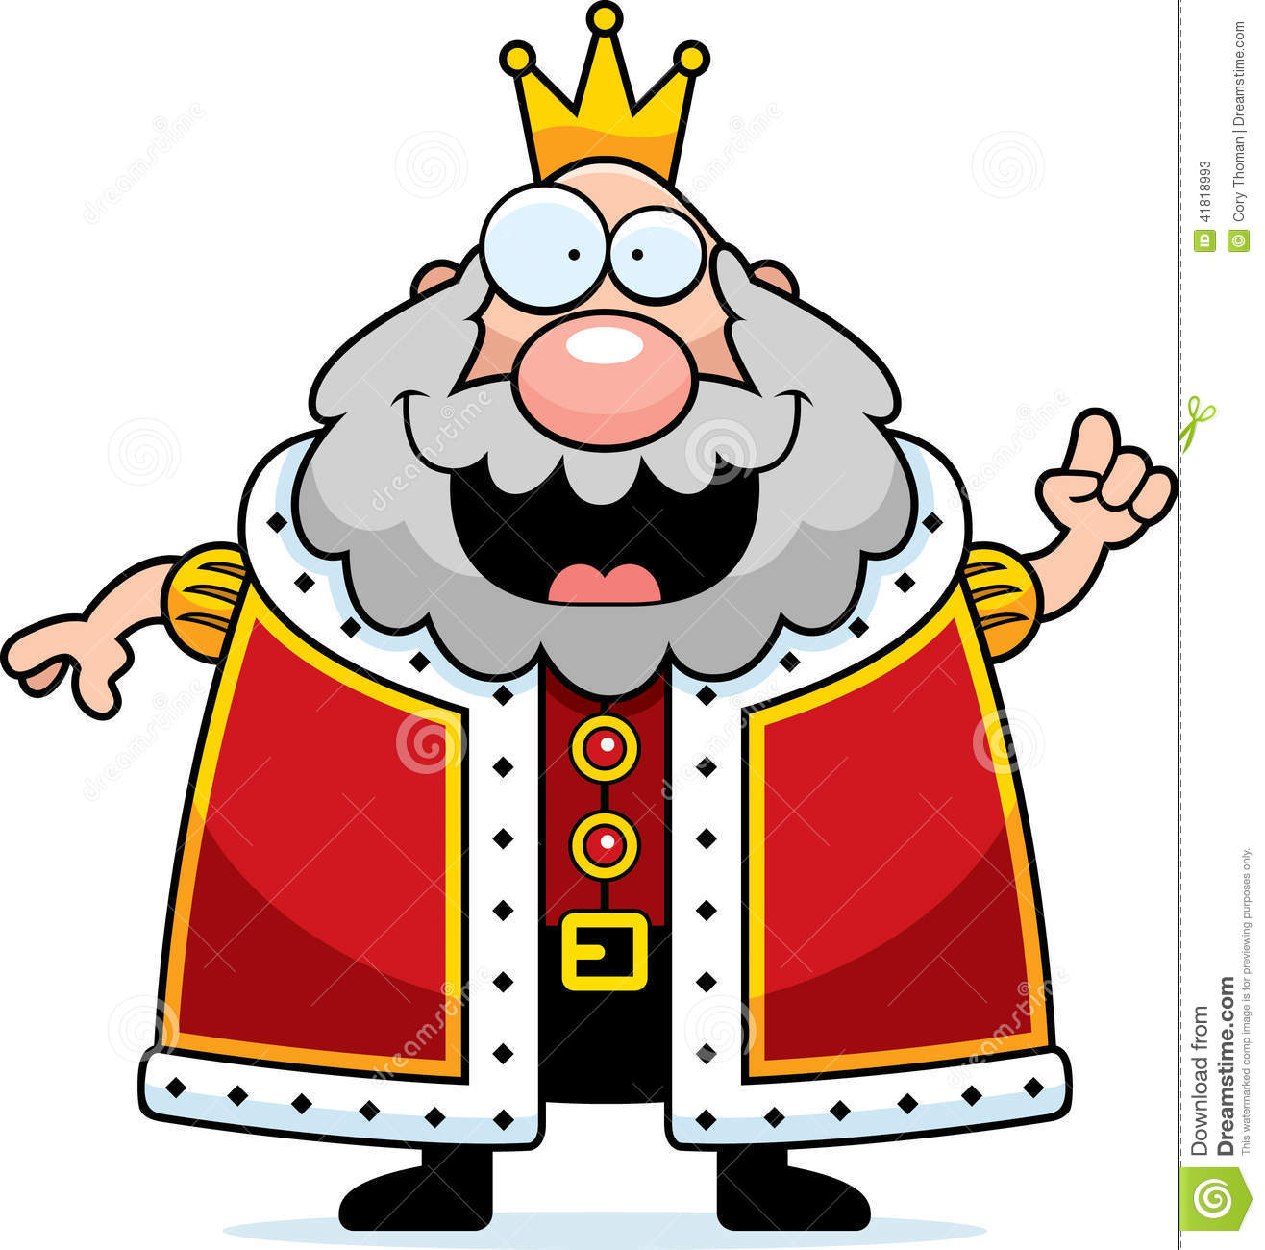
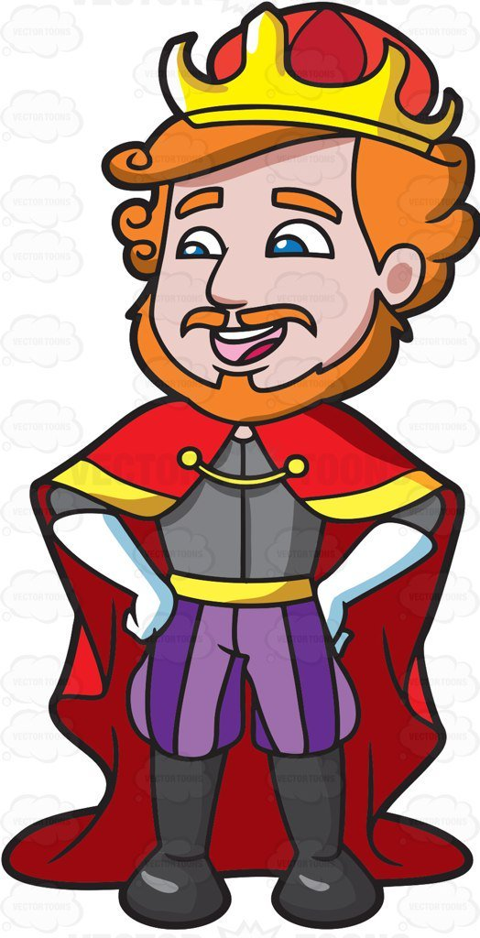
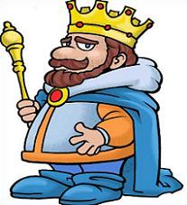
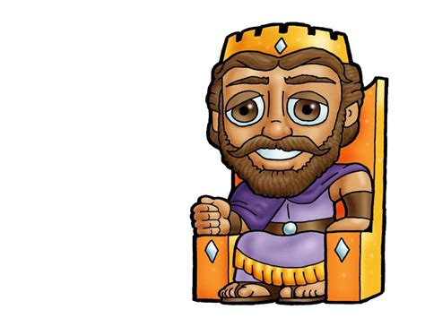
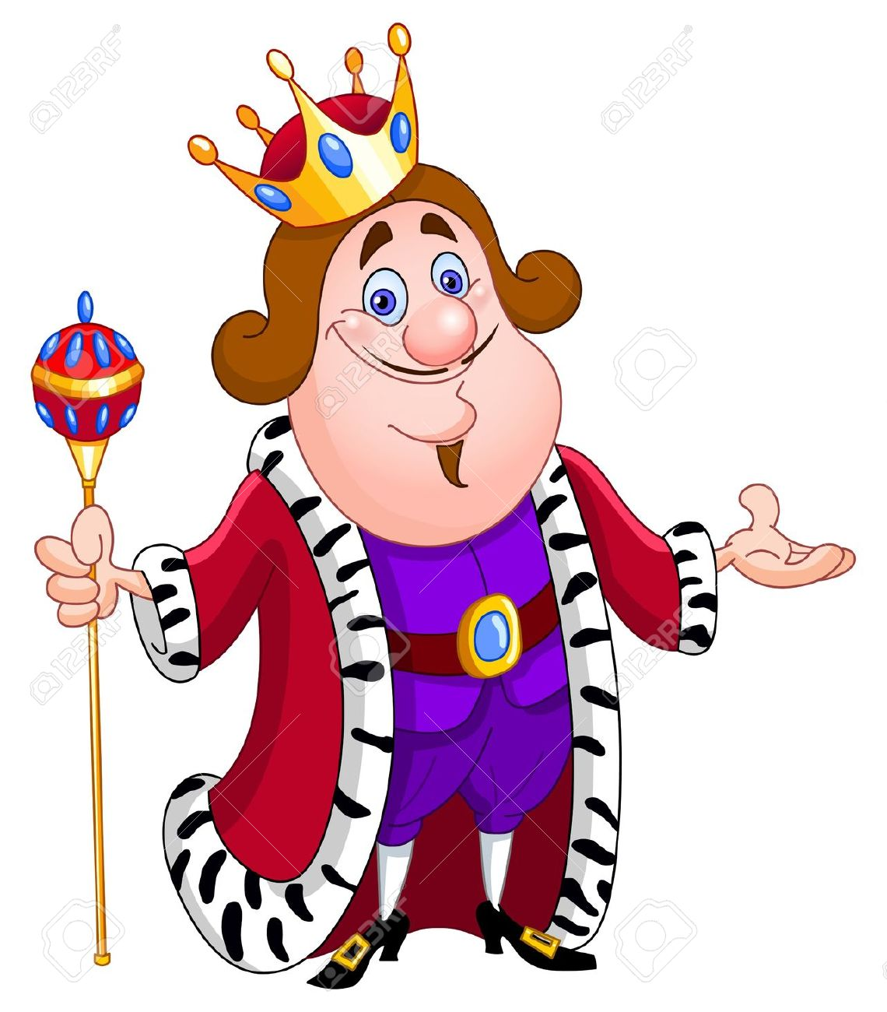
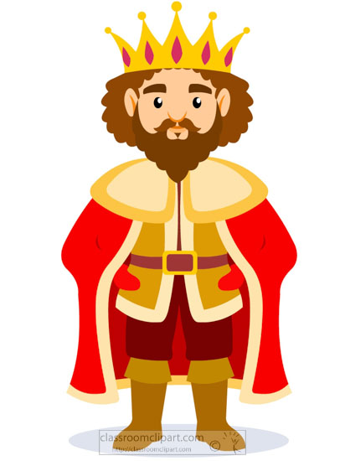
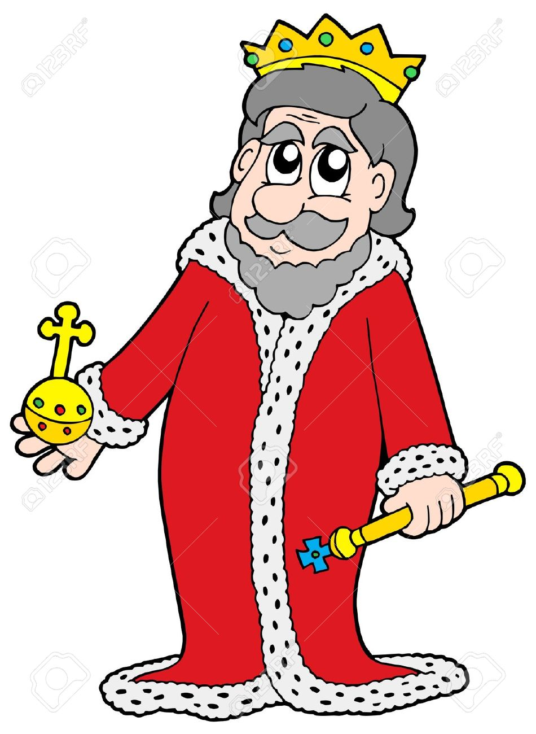
God helped Joshua and the Israelites win.
They defeated 31 kings! They were evil and disregarded God.
Joshua 12:9-24 lists their cities:
⁹ the king of Jericho | one
the king of Ai, which is near Bethel | one
¹⁰ the king of Jerusalem | one
the king of Hebron | one
¹¹ the king of Jarmuth | one
the king of Lachish | one
¹² the king of Eglon | one
the king of Gezer | one
¹³ the king of Debir | one
the king of Geder | one
¹⁴ the king of Hormah | one
the king of Arad | one
¹⁵ the king of Libnah | one
the king of Adullam | one
¹⁶ the king of Makkedah | one
the king of Bethel | one
¹⁷ the king of Tappuah | one
the king of Hepher | one
¹⁸ the king of Aphek | one
the king of Lasharon | one
¹⁹ the king of Madon | one
the king of Hazor | one
²⁰ the king of Shimron Meron | one
the king of Akshaph | one
²¹ the king of Taanach | one
the king of Megiddo | one
²² the king of Kedesh | one
the king of Jokneam in Carmel | one
²³ the king of Dor in Naphoth Dor | one
the king of Goyim in Gilgal | one
²⁴ the king of Tirzah | one

Slide 6

God is our Refuge and Strength

Slide 7
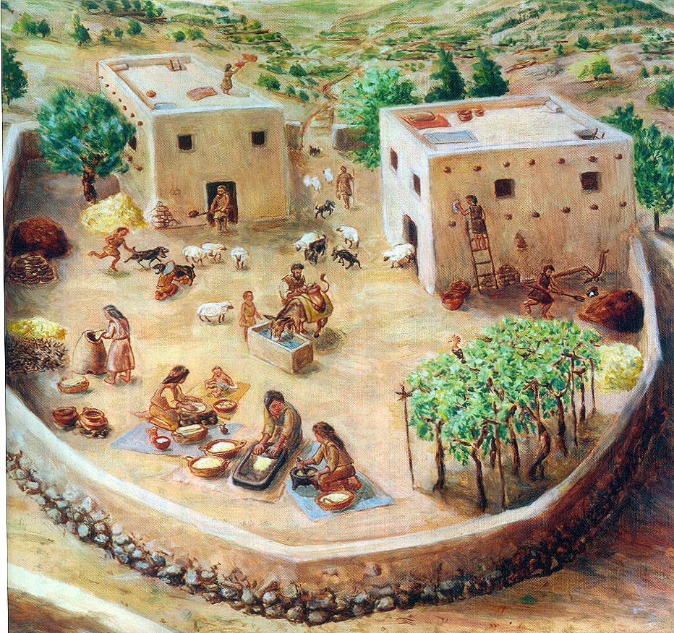
A place to rest!
^{Joshua 11:23} So Joshua captured the whole land, just as the Lord had directed Moses.
Joshua gave the land to Israel as their very own.
He divided it up and gave each tribe its share.
Then the land had peace and rest.

Slide 8
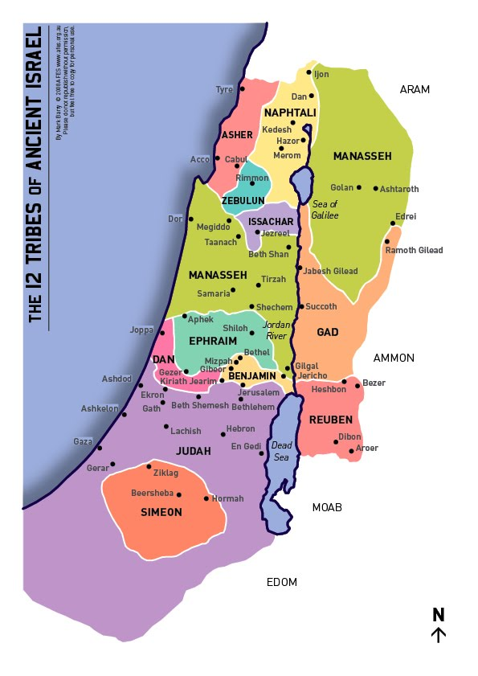
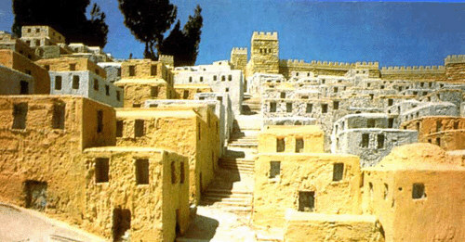
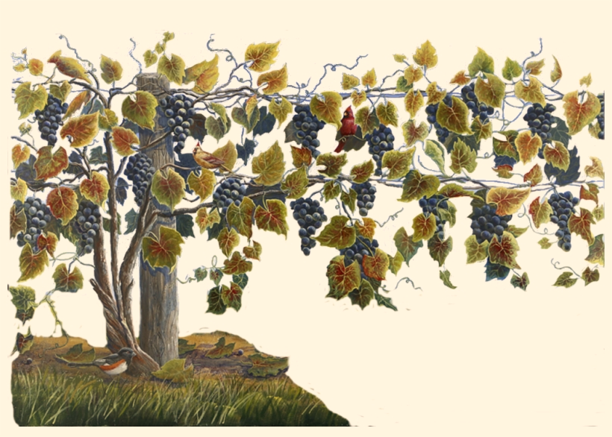
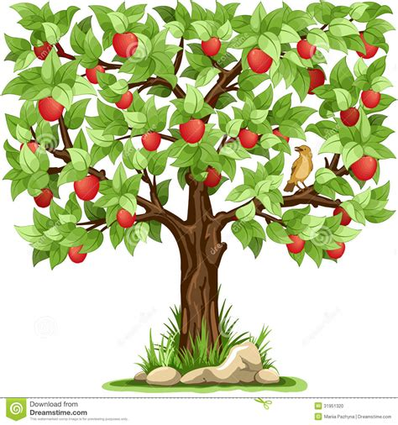
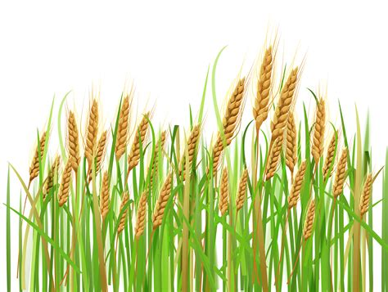
Now Israel had land to build homes & cities.
They had land for gardens and orchards.

Slide 9
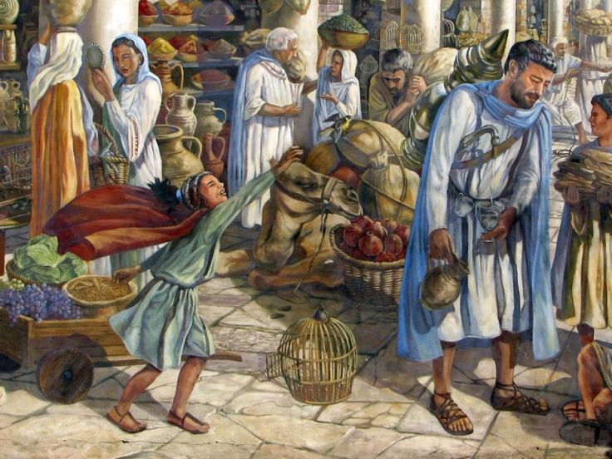
God wanted the land to be a safe place.
God gave the Israelites laws to help them:
Be healthy
Care for one another
Solve problems
Live peacefully
What rules do you have at home to make it a safe place?

Slide 10
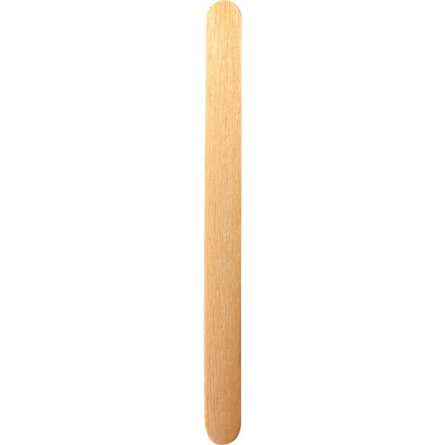

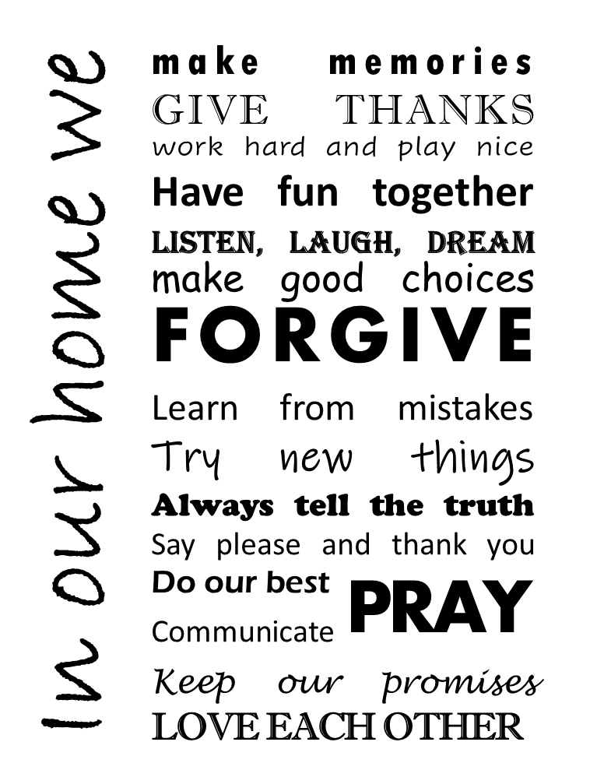
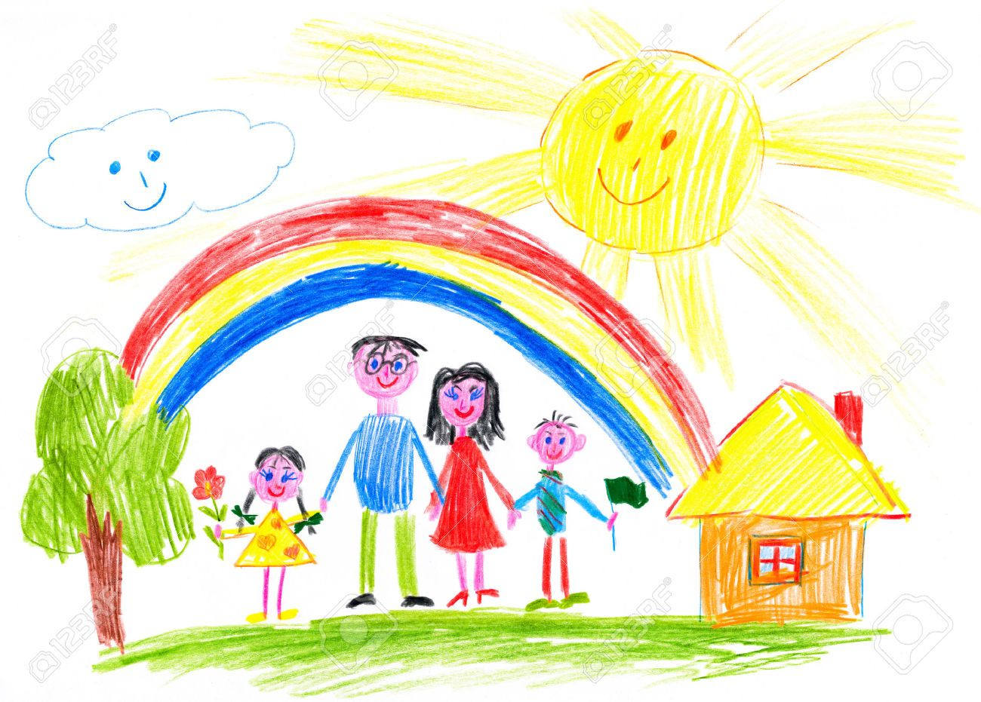
CRAFT TIME – Part 1
You can start to draw a house and your family on the small square.
We’ll finish the rest later

Slide 11
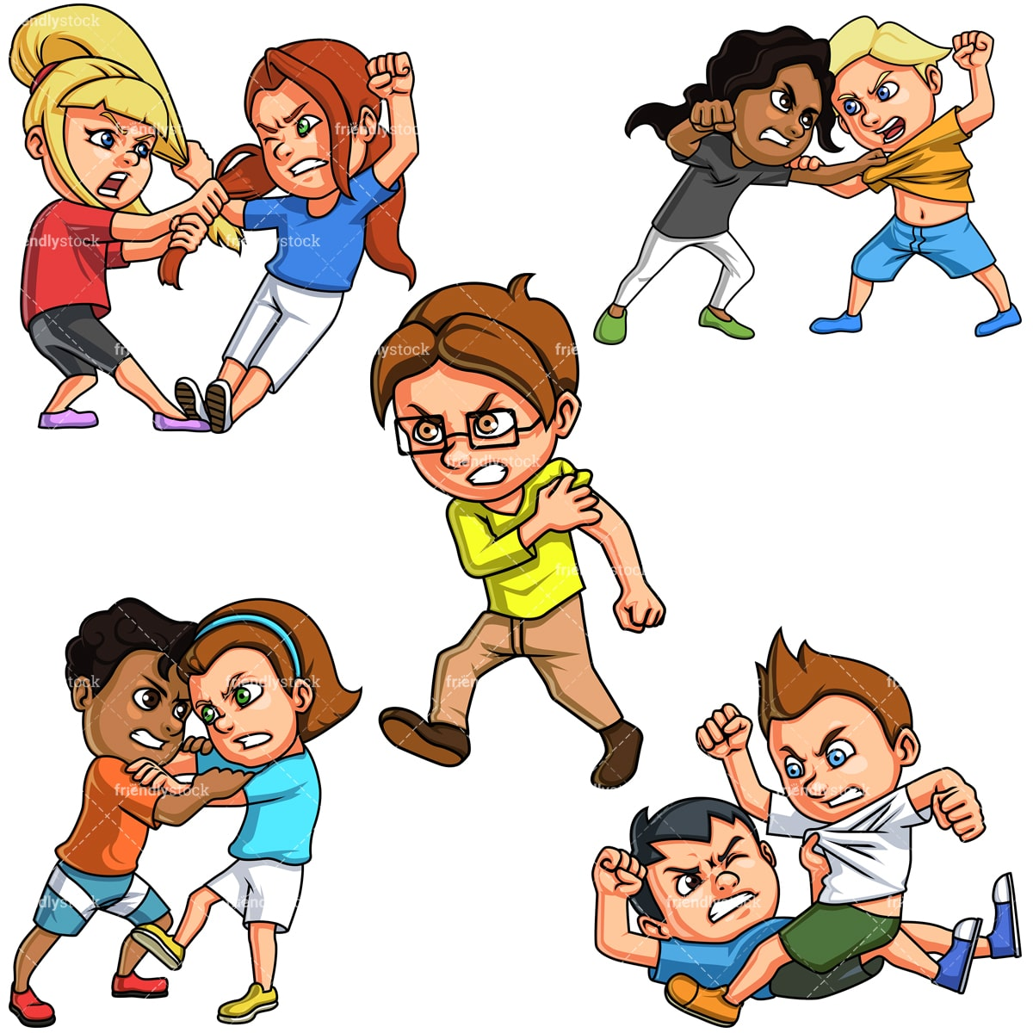
Do not murder.
God wants to save as many lives as possible.
Murderers want to kill.
Numbers 35 God said:
¹⁶ “ ‘Suppose a person uses an iron object to hit and kill someone. Then that person is a murderer and must be put to death.
¹⁷ Or suppose a person is holding a stone that could kill. And they use it to hit and kill someone. Then that person is a murderer and must be put to death.
¹⁸ Or suppose a person is holding a wooden object that could kill. And they use it to hit and kill someone. Then that person is a murderer and must be put to death. …

Slide 12
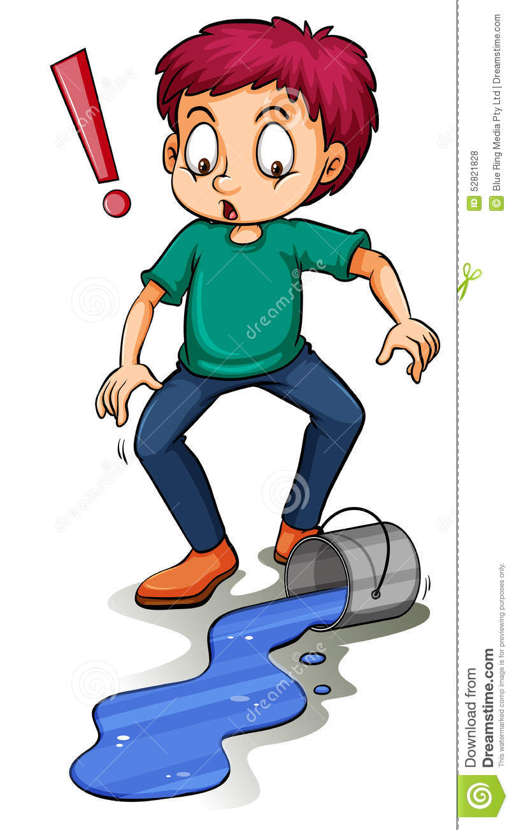
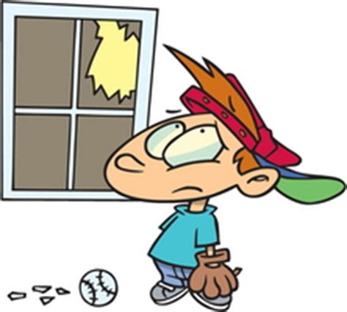
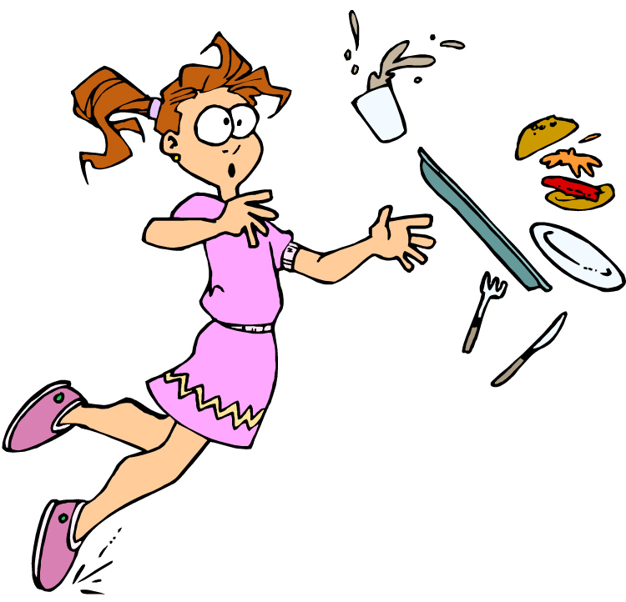
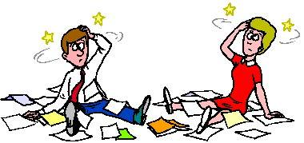
One of the rules had to do with people who accidently did something terrible.
Have you ever done something accidently?
Maybe something broke or someone got hurt.
Oops!

Slide 13
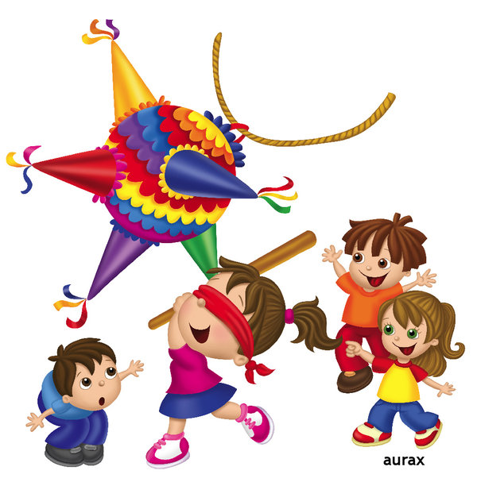
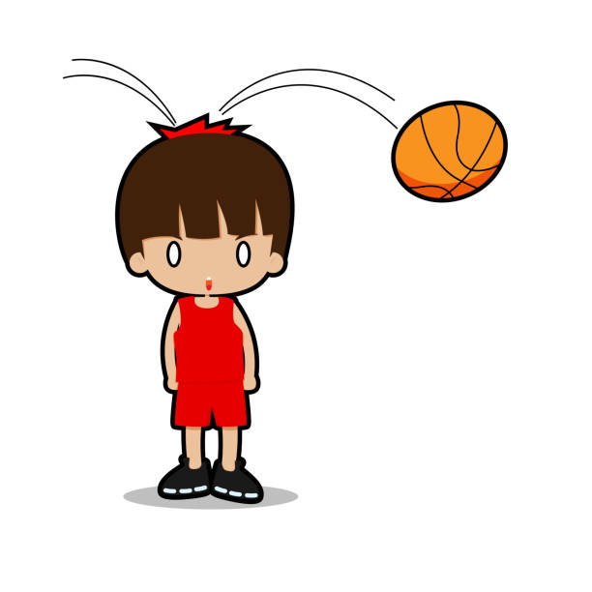
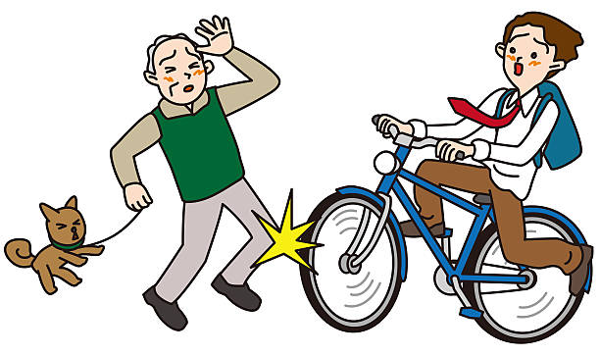
What if … it was an accident
Numbers 35
²² “ ‘But what if a person suddenly pushes someone else without being angry?
Or what if that person throws something at someone else without meaning to?
²³ Or what if that person does not see the other person and drops a stone on them that kills them?
He was not the dead person’s enemy.
He did not mean to harm them.

Slide 14
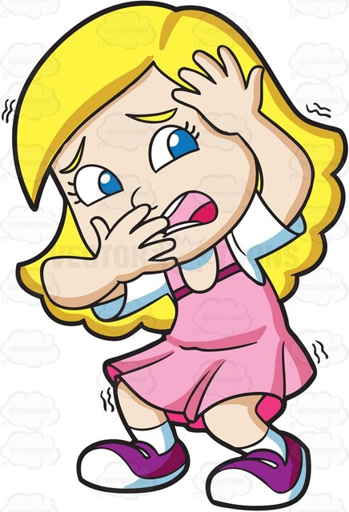
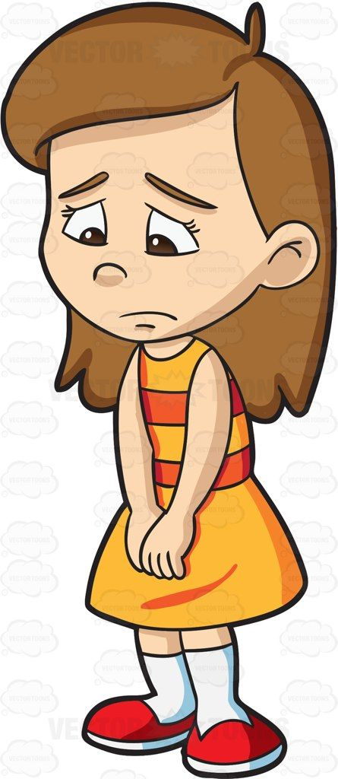
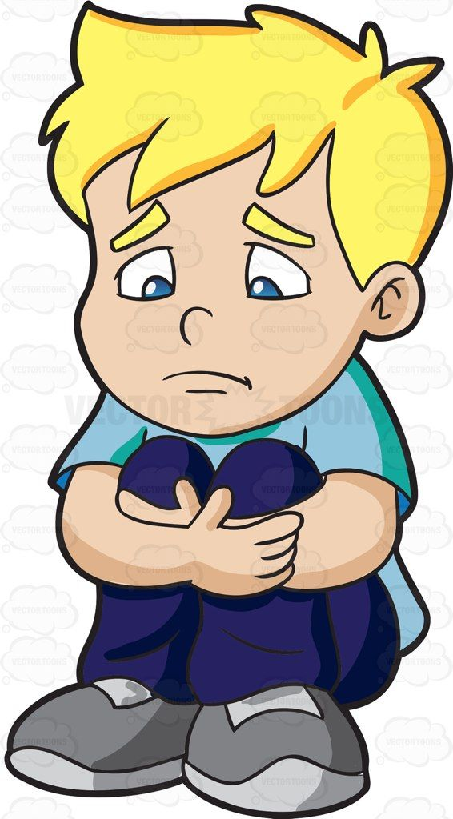
If you accidently hurt someone
You feel terrible!
You want compassion and a safe place.

Slide 15

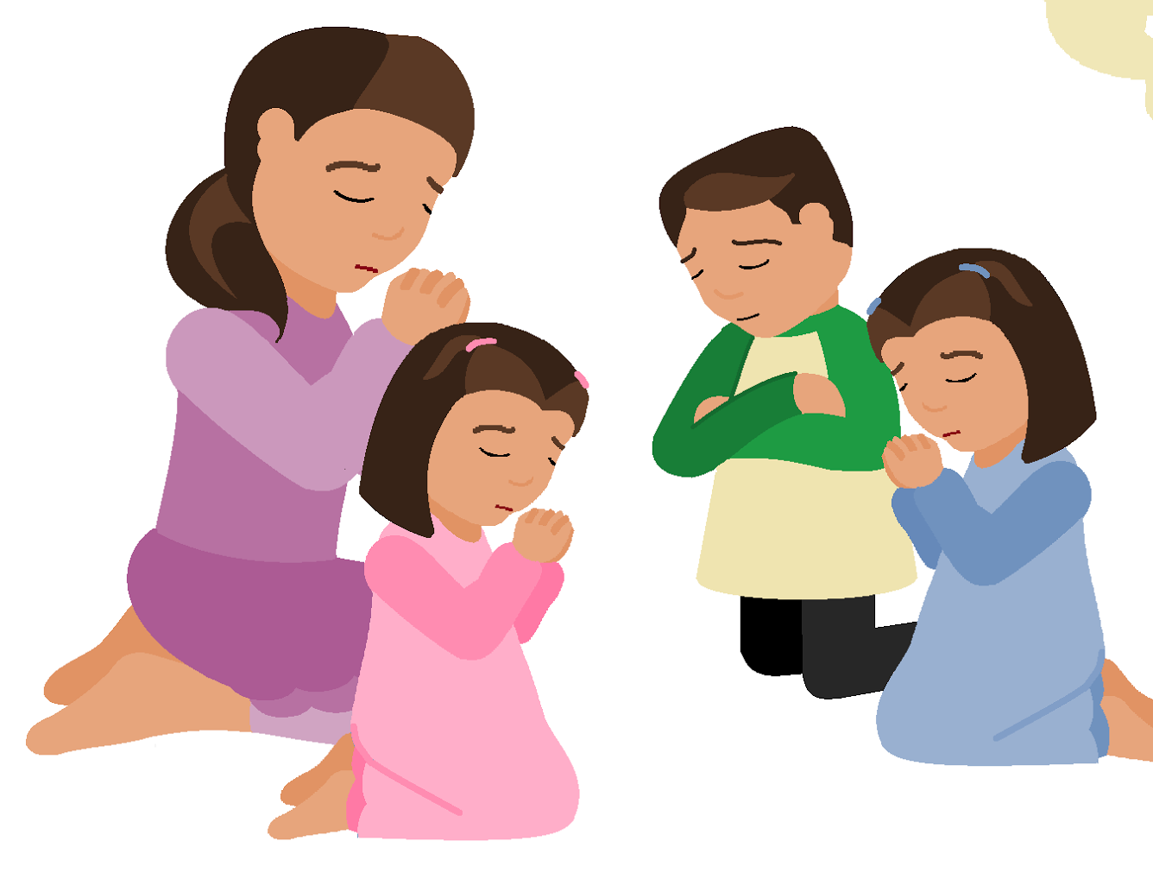
Jesus died so that we can be forgiven.
His salvation gives us safety.
Psalms 62:8
Trust in him at all times,
you people.
Tell him all your troubles.
God is our place of safety.

Slide 16
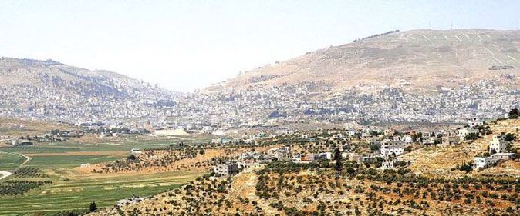
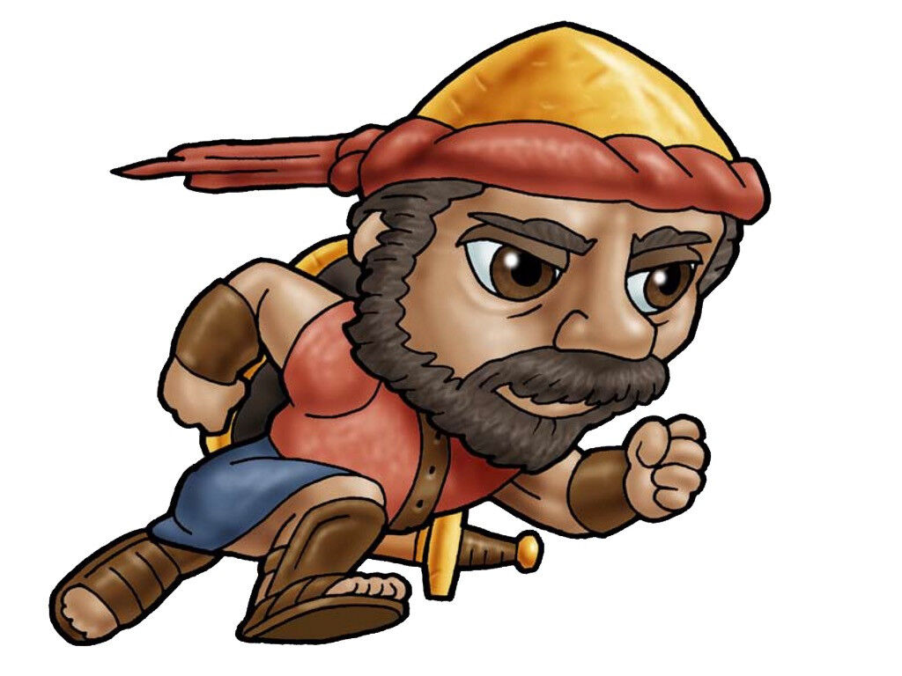
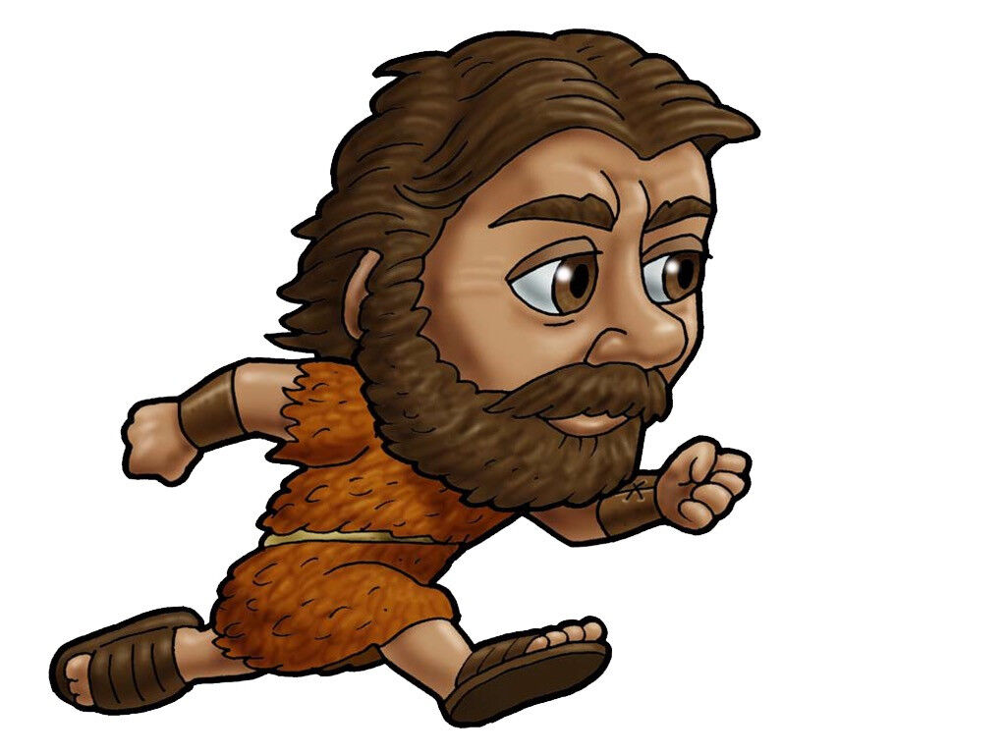
Sometimes accidents happen.
God didn’t want someone to get hurt if they caused an accident.
He made a safe place. He gives us second chances.
Cities to Run to for Safety
Joshua 20
Then the Lord spoke to Joshua. He said, ² “Tell the Israelites to choose the cities to go to for safety, just as I directed you through Moses. ³ Anyone who kills a person by accident can run there for safety. So can anyone who kills a person without meaning to. The one charged with murder will be kept safe from the nearest male relative of the person killed.
Shechem
City of Refuge

Slide 17
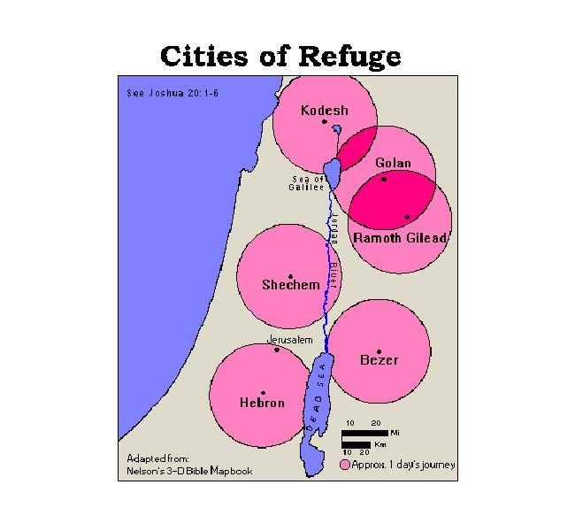
Choose 6 cities to be safe places.
Numbers 35:11-
….choose the cities to go to for safety. People who have killed someone by accident can run to one of those cities. ¹² They will be places of safety for them. People will be safe there from those who want to kill them. Then anyone charged with murder will not die before their case has been brought to the community court. ¹³ Six towns will be the cities you can go to for safety. ¹⁴ Three will be east of the Jordan River. The other three will be in Canaan. ¹⁵ Those six towns will be places where the Israelites can go for safety. Outsiders living in Israel can also go to them for safety. So anyone who has killed another person by accident can run there.

Slide 18
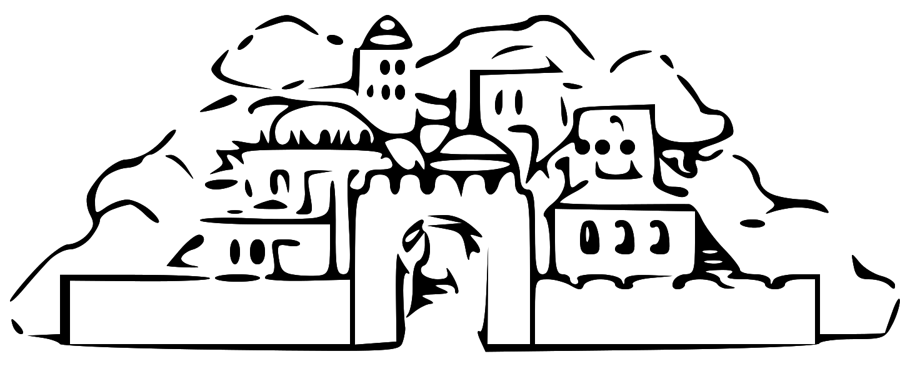
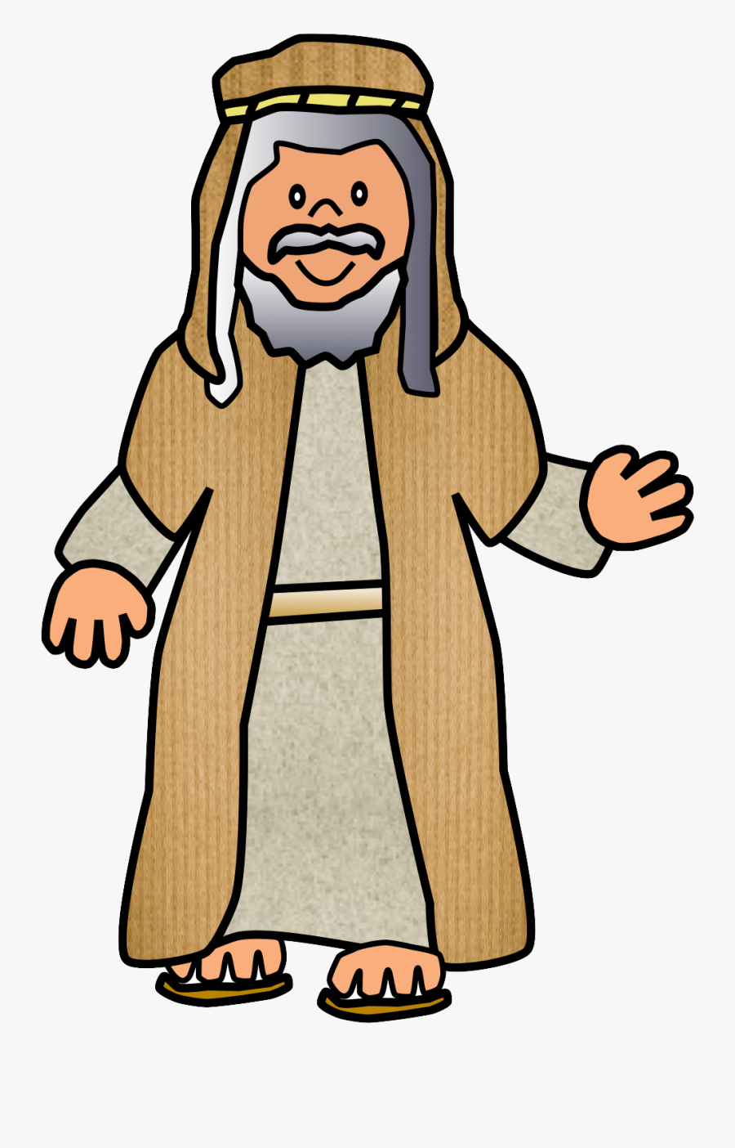


You may come here and be safe.
We will listen and make a fair judgement.
Cities to Run to for Safety
⁴ Suppose those who are charged with murder run for safety to one of these cities. Then they must stand in the entrance of the city gate. They must state their case in front of the elders of that city. The elders must let them come into their city. The elders must provide a place for them to live in their city. ⁵ Suppose the nearest male relative of the person killed chases the one charged with murder.
Then the elders must not hand them over to that relative. That’s because that person didn’t mean to kill their neighbor. They didn’t make evil plans to do it.
Shechem
City of Refuge

Slide 19


Court in Shechem
⁶ They must stay in that city until their case has been brought to the community court. They must stay there until the high priest serving at that time dies. Then they can go back to their own home. They can return to the town they ran away from.”
It was an accident.
This man is innocent.
He is free to go home after the High Priest dies.

Slide 20




Nature Nugget

Slide 21
CRAFT TIME
Finish Drawing a house and your family on the small square.
Cut out a heart
Glue the saying, picture and heart on a nice piece of paper.
Add 2 popsicle sticks at the top and a 3rd across them in the middle for stability.
Add a ribbon or other décor. at the top it you wish.
While you finish up, let’s listen to a song, story, and snack.

Slide 22


God made a way for second chances even for very bad accidents that caused death.
We want our homes and churches to be safe places, too, where we experience forgiveness and second chances.
Jesus is our refuge, our Savior, who gives second chances!

Slide 23
God is our Refuge and Strength

Slide 24

Story time & Snack time – Safe at last

Slide 25



GAME TIME
Let’s play tag.
If you are touched, you are “it” and get to try to touch someone else.
If you are running away, you can go to the base, which is ___________. If you are there, you are safe!
Base – safe place

Slide 26
Jesus died so that we can be forgiven.
His salvation gives us safety.
Psalms 62:8
Trust in him at all times,
you people.
Tell him all your troubles.
God is our place of safety.

Slide 27


Read about it
God lives forever! You can run to him for safety.
His powerful arms are always there to carry you.
He will drive out your enemies to make room for you.
Deuteronomy 33:27
He said,
“The Lord is my rock and my fort. He is the God who saves me.
2 Samuel 22:2
Deuteronomy 33:27 2 Samuel 22:2, 3
Psalm 5:11 Psalm 16:1
Psalm 46:10 Nahum 1:7

Slide 28

THE END

