Slide 1
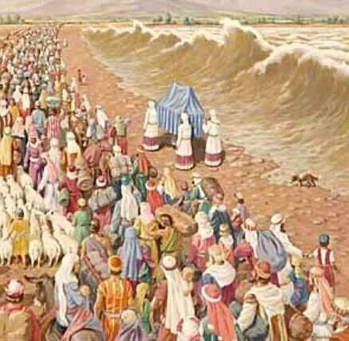
Israel crossed the
Jordan
Joshua 3 and 4

Slide 2


Do you remember a time when something really awesome happened?
Tell us about it.

Slide 3

I will remember
I will remember the deeds
of the Lord;
yes, I will remember Your miracles of long ago.
You are the God
who performs miracles;
You display your power among the peoples.
Psalms 77:11 & 14
Psalms
77: 11-14

Slide 4
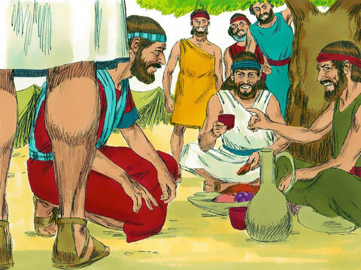
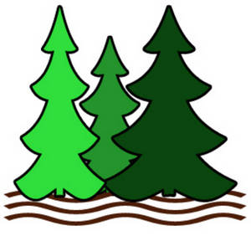
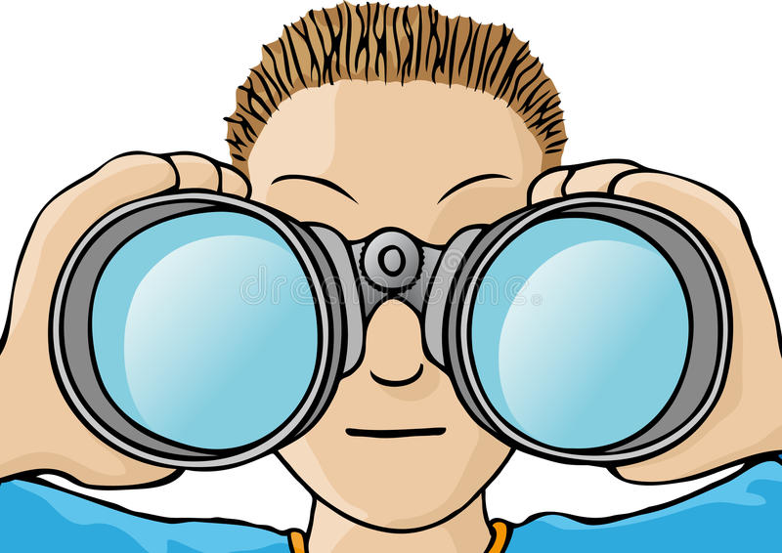
Remember --
We must not wait. Let’s go tomorrow!
Joshua 2
²² When the spies left, they went up into the hills. They stayed there for three days. By that time the men chasing them had searched all along the road. They couldn’t find them. So they returned. ²³ Then the two spies started back. They went down out of the hills. They went across the Jordan River. They came to Joshua, the son of Nun. They told him everything that had happened to them. ²⁴ They said, “We’re sure the Lord has given the whole land over to us. All the people there are weak with fear because of us.”
I
spy

Slide 5
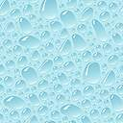


Strong and Courageous

Slide 6
Remember
the deeds of the LORD
Psalms 77:11

Slide 7
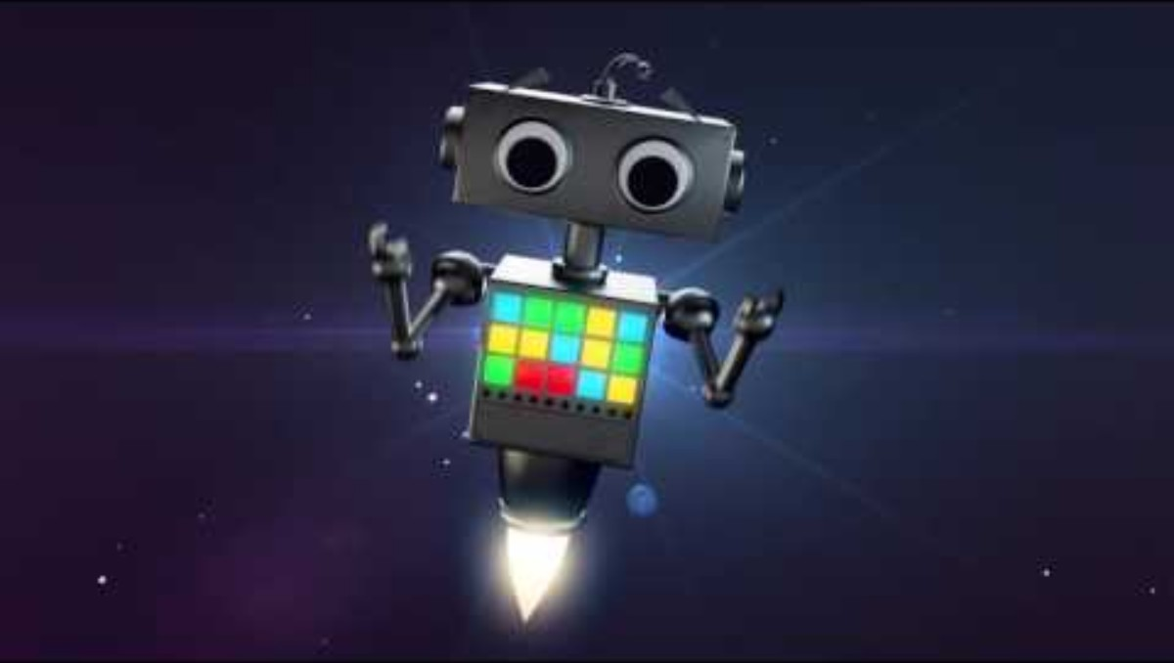
What a Mighty God we Serve

Slide 8
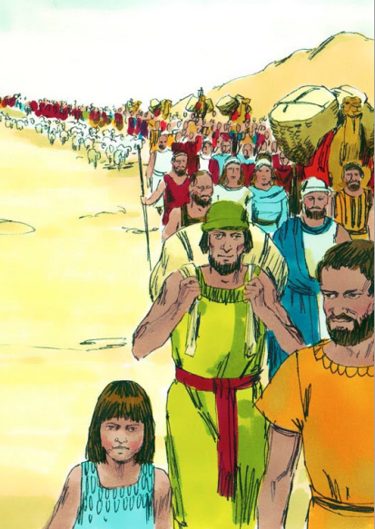
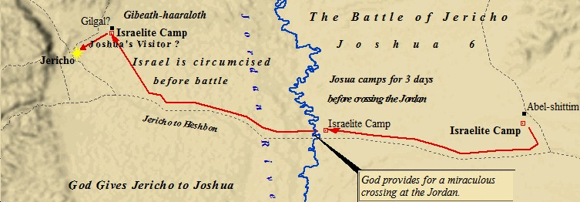
Joshua 3
Early the next morning Joshua and all the Israelites started out from Shittim. They went down to the Jordan River.
They camped there before they went across it.

Slide 9
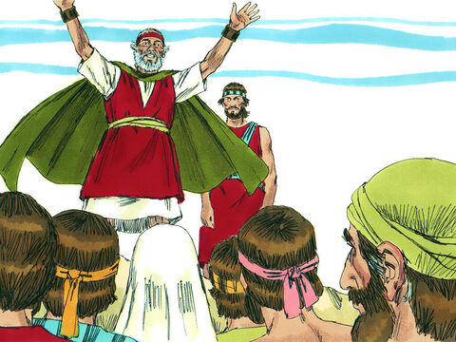
Here’s the plan
Get ready to move.
In a couple days,
when you see the
Levite priests carrying
the Ark of the Covenant, move out and follow it.
But stay back about 1,000 yards.
² After three days the officers went all through the camp. ³ They gave orders to the people. They said, “Watch for the ark of the covenant of the Lord your God. The priests, who are Levites, will be carrying it. When you see it, you must move out from where you are and follow it. ⁴ Then you will know which way to go. You have never gone this way before. But don’t go near the ark. Stay about 1,000 yards away from it.”

Slide 10
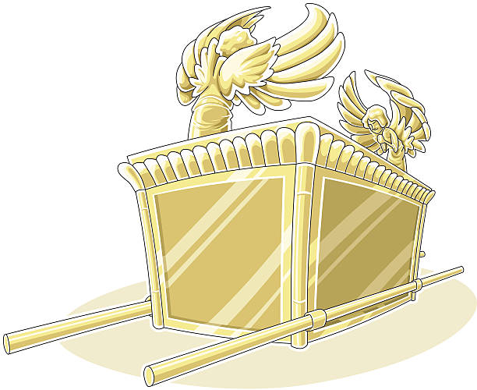
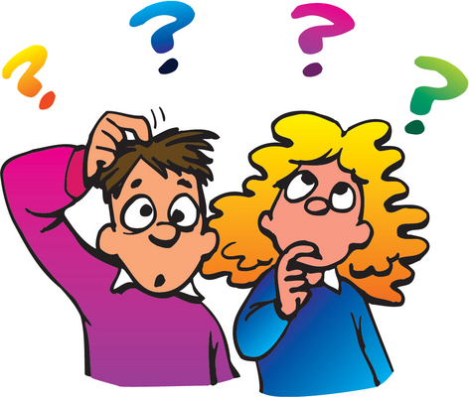
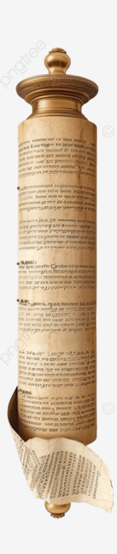
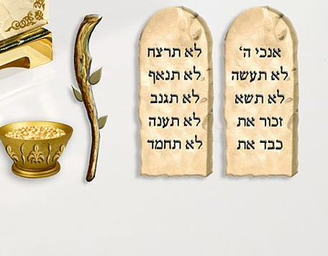
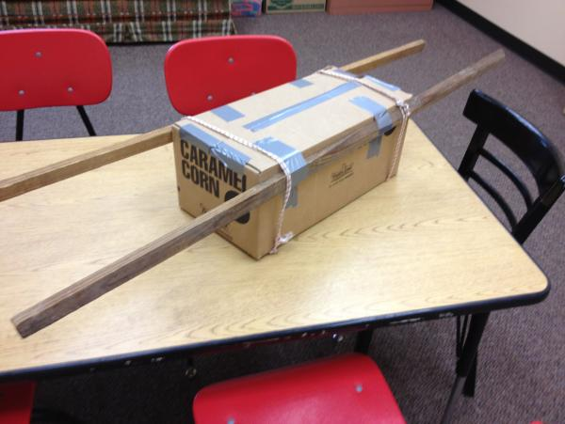
Wait!
What was the ark of the covenant?
The ark was a special gold box
Designed by God, made by Israel
For the tabernacle’s Most Holy Place
Where God’s Holy Presence was.
Cheribum Angels
Mercy seat
10 commandments
Aaron’s budded rod
A covenant is an agreement or contract
Carrying rods
Book of laws
Optional: make an ark of cardboard & have kids put the items inside & cover it with blue cloth.
DIY instructions 1 or idea 2
angel stencils
Bowl of manna

Slide 11
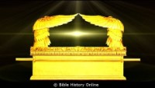
Ark of the covenant
Teachers – this may be more appropriate to listen to ahead of time and use in describing the ark of the covenant to the kids.

Slide 12
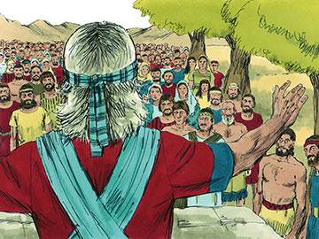
Get ready
Get ready for the Lord to do amazing things.
Pray, wash your clothes, and bathe. Be clean for the Lord.
⁵ Joshua said to the people, “Consecrate yourselves -- set yourselves apart to the Lord. Tomorrow he’ll do amazing things among you.”

Slide 13
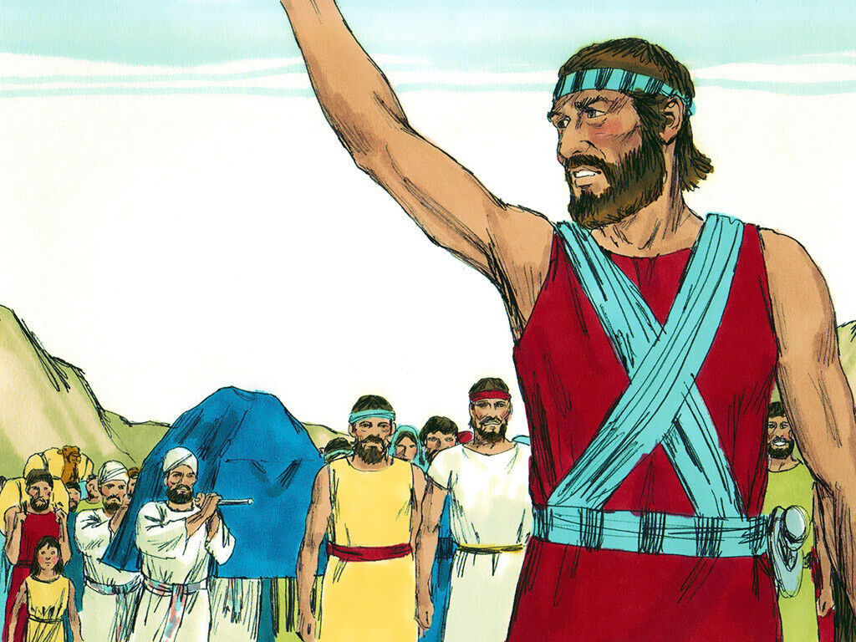
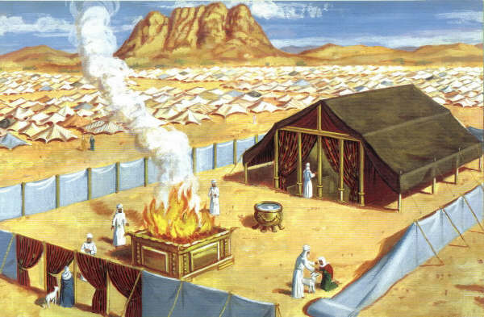

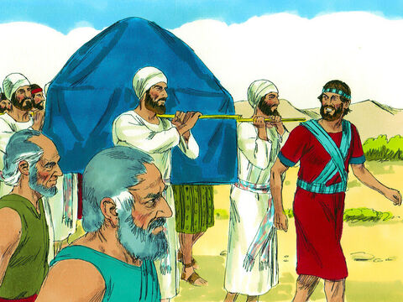
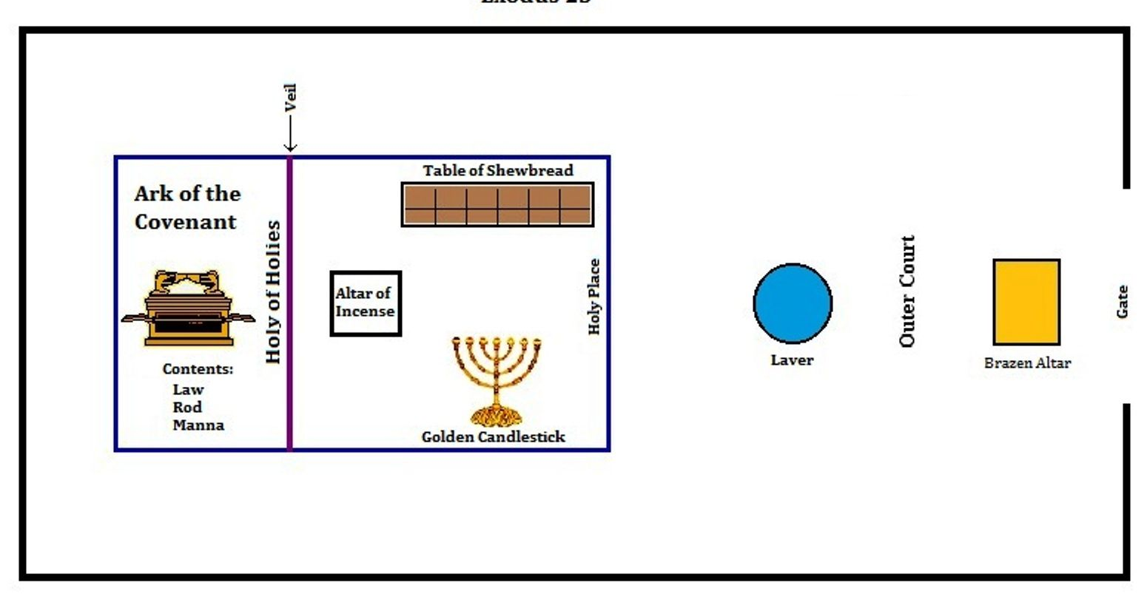
Get set
⁶ Joshua said to the priests, “Go and get the ark of the covenant. Walk on ahead of the people.”
So, they went and got it.
Then they walked on ahead of them.
They packed up the tabernacle:
They covered the furniture with blue cloth and leather.
They folded up the curtains.
Everything was put on carts except the ark of the covenant, which the priests carried.
Let’s get ready: We’ll put a blue cover over our ark of the covenant. Later 4 of you can carry it.

Slide 14
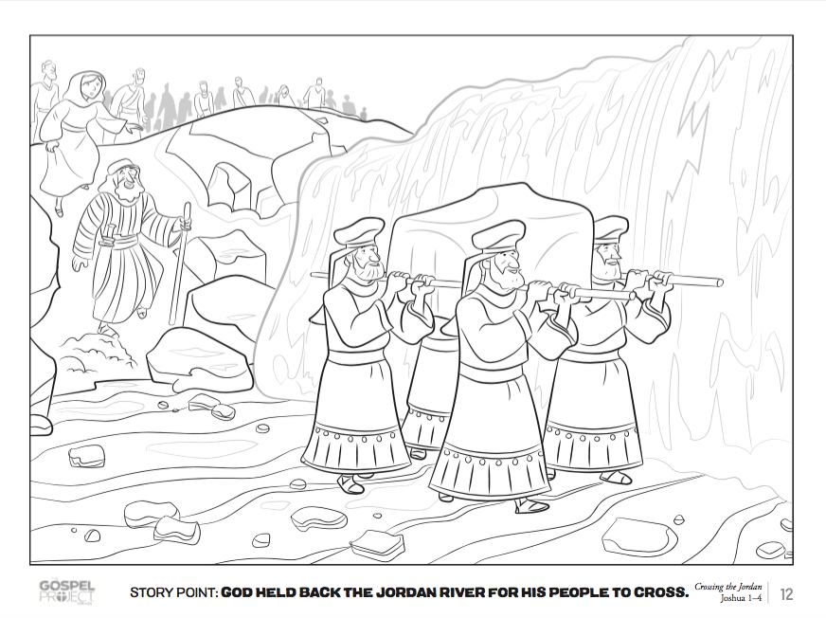
COLORING TIME

Slide 15
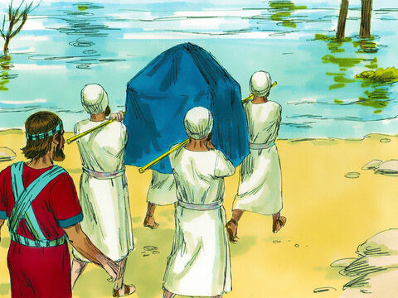
LISTEN
Joshua, today I will honor you in the eyes of the people.
The priests with the ark of the covenant should stand in the river and the river will stop flowing. The water will pile up in one place.
Choose a man from each tribe to get a stone from the middle of the river and take it to the other side.
⁷ The Lord said to Joshua, “Today I will begin to honor you in the eyes of all the Israelites. Then they will know that I am with you, just as I was with Moses. ⁸ Speak to the priests who carry the ark of the covenant. Tell them, ‘When you reach the edge of the Jordan River, go into the water and stand there.’ ”
⁹ Joshua said to the Israelites, “Come here. Listen to what the Lord your God is saying. ¹⁰ You will soon know that the living God is among you. He will certainly drive out the people now living in the land. He’ll do it to make room for you. He’ll drive out the Canaanites, Hittites, Hivites, Perizzites, Girgashites, Amorites and Jebusites.
¹¹ The ark will go into the Jordan River ahead of you. It’s the ark of the covenant of the Lord of the whole earth. ¹² Choose 12 men from the tribes of Israel. Choose one from each tribe. ¹³ The priests will carry the ark of the Lord. He’s the Lord of the whole earth. As soon as the priests step into the Jordan, it will stop flowing. The water that’s coming down the river will pile up in one place. That’s how you will know that the living God is among you.”

Slide 16
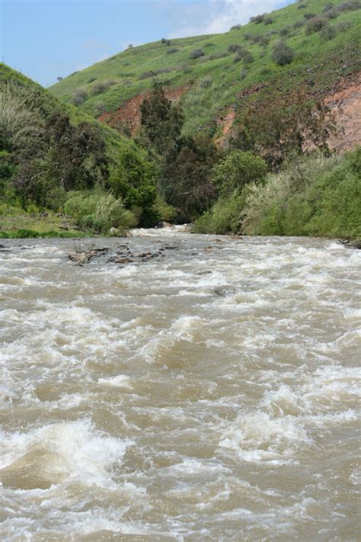
Do it
¹⁴ So the people took their tents down. They prepared to go across the Jordan River.
The priests carrying the ark of the covenant went ahead of them.
¹⁵ The water of the Jordan was going over its banks. It always does that at the time the crops are being gathered.

Slide 17
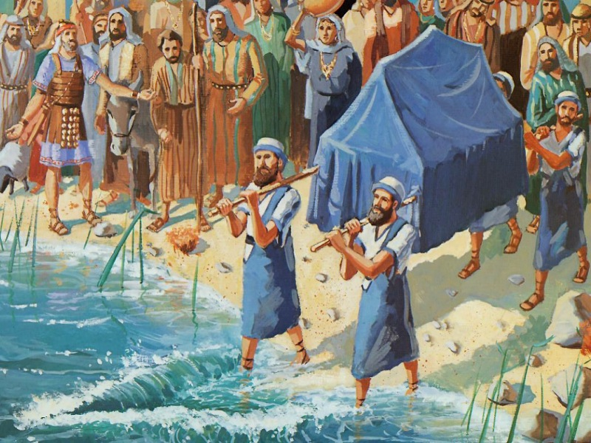
Go
The priests came to the river. Their feet touched the water’s edge.
¹⁶ Right away the water coming down the river stopped flowing. It piled up far away at a town called Adam near Zarethan. The water flowing down to the Dead Sea was completely cut off. So, the people went across the Jordan River opposite Jericho.
ACT IT OUT
Priests go to the ‘Jordan’ (blue cloth).
Lift up blue cloth. ‘water’ and put it over a table.

Slide 18
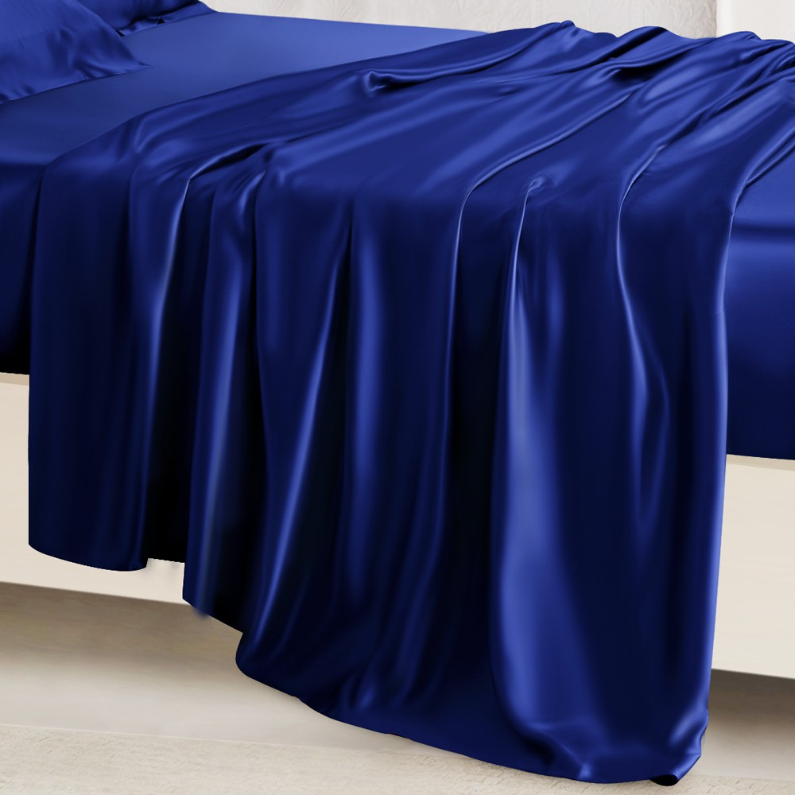
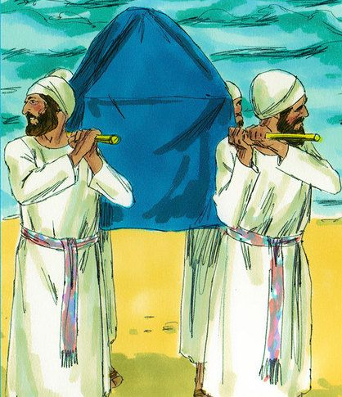
ACT IT OUT
Put blue cloth over a table to be the water separating.
4 kids – priests carry the ‘ark of the covenant’ (cover a box)
into the middle of the ‘Jordan’

Slide 19
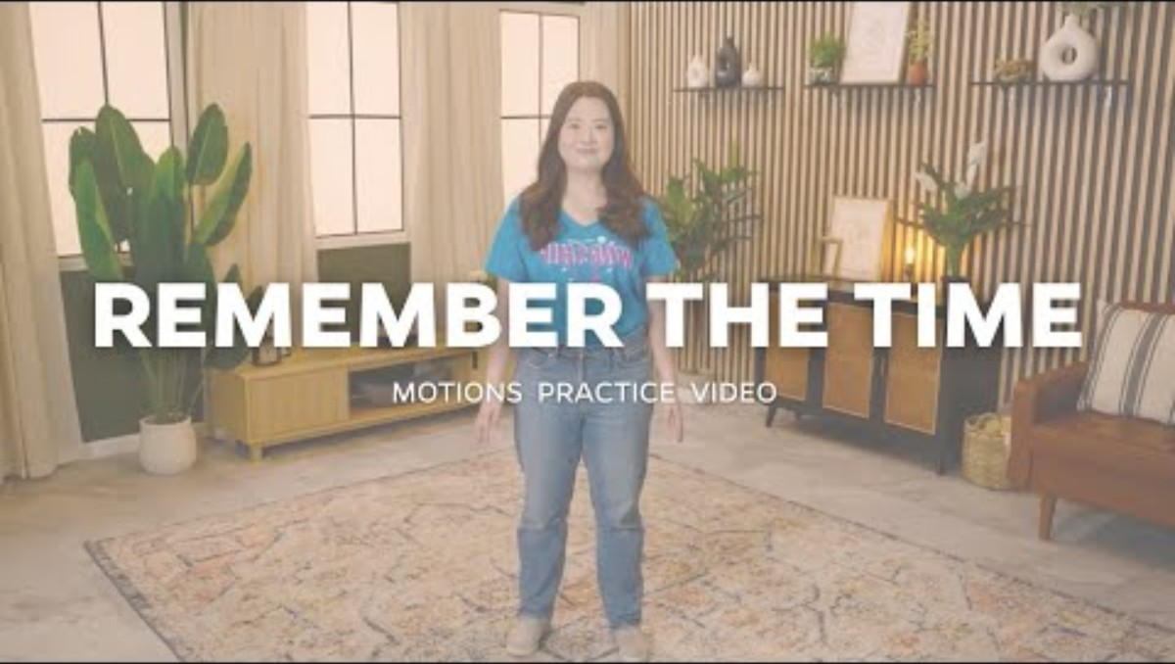
Remember the Time

Slide 20
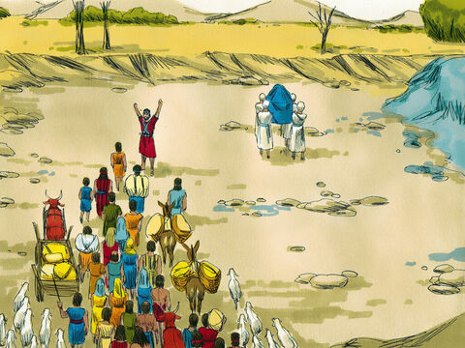
Go
¹⁷ The priests carried the ark of the covenant of the Lord. They stopped in the middle of the river and stood on dry ground. They stayed there until the whole nation of Israel had gone across on dry ground.
ACT IT OUT
Everyone go through the ‘Jordan’

Slide 21

Our God is So Great

Slide 22
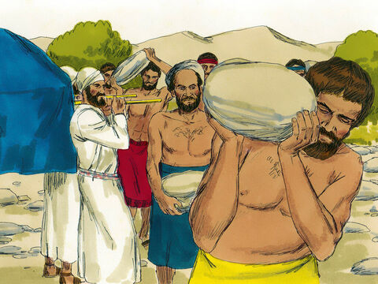
Remember this day
OK. It’s time for the 12 leaders to each get a stone
from where the priests are with the Ark of the Covenant.
Take the stone to where we will camp tonight.
We will build an altar there to remind everyone what God did today.
Joshua 4
After the whole nation had gone across the Jordan River, the Lord spoke to Joshua. He said, ² “Choose 12 men from among the people. Choose one from each tribe. ³ Tell them to get 12 stones from the middle of the river. They must pick them up from right where the priests stood. They must carry the stones over with all of you. And they must put them down at the place where you will stay tonight.”
⁴ So Joshua called together the 12 men he had appointed from among the Israelites. There was one man from each tribe. ⁵ He said to them, “Go back to the middle of the Jordan River. Go to where the ark of the Lord your God is. Each one of you must pick up a stone. You must carry it on your shoulder. There will be as many stones as there are tribes in Israel. ⁶ The stones will serve as a reminder to you. In days to come, your children will ask you, ‘What do these stones mean?’ ⁷ Tell them that the Lord cut off the flow of water in the Jordan River. Tell them its water stopped flowing when the ark of the covenant of the Lord went across. The stones will always remind the Israelites of what happened there.”
ACT IT OUT
Get 12 stones. Carry one on your shoulder.

Slide 23
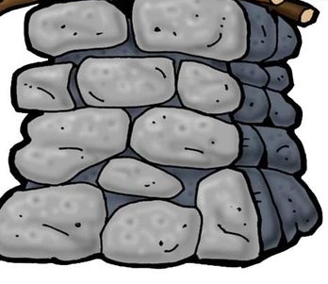
Remember this day
⁸ So the Israelites did as Joshua commanded them. They took 12 stones from the middle of the Jordan River. There was one stone for each of the tribes of Israel. It was just as the Lord had told Joshua.
The people carried the stones with them to their camp. There they put them down.
⁹ Joshua also piled up 12 stones in the middle of the river. He piled them up right where the priests who carried the ark of the covenant had stood. And they are still there to this very day.
¹⁰ The priests who carried the ark remained standing in the middle of the Jordan River. They stayed there until the people had done everything the Lord had commanded Joshua.
ACT IT OUT
Stack 12 stones in the middle of the river.

Slide 24

Come out
Joshua, command the priests to come out of the river.
Look the river is flowing back at flood stage!
Come out of the river.
…
¹⁵ Then the Lord spoke to Joshua. He said, ¹⁶ “Command the priests to come up out of the Jordan River. They are carrying the ark where the tablets of the covenant law are kept.”
¹⁷ So Joshua gave a command to the priests. He said, “Come up out of the Jordan River.”
¹⁸ Then the priests came up out of the river. They were carrying the ark of the covenant of the Lord. As soon as they stepped out on dry ground, the water of the Jordan began to flow again. It went over its banks, just as it had done before.
¹⁹ On the tenth day of the first month the people went up out of the Jordan River. They camped at Gilgal on the eastern border of Jericho.
ACT IT OUT
Priests come out. Put the blue sheet ‘water’ down on the floor – river flows as normal.

Slide 25
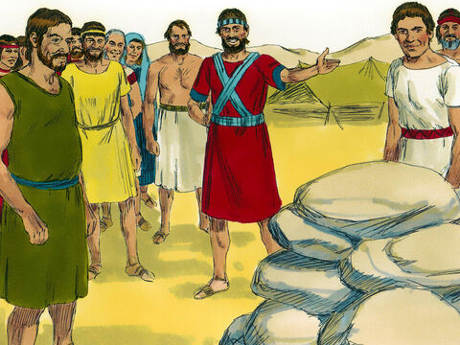
Tell your children
²⁰ Joshua set up the 12 stones at Gilgal. They were the ones the people had taken out of the Jordan. ²¹ Then he spoke to the Israelites. He said, “In days to come, your children after you will ask their parents, ‘What do these stones mean?’ ²² Their parents must tell them, ‘Israel went across the Jordan River on dry ground.’ ²³ The Lord your God dried up the Jordan for you until you had gone across it. He did to the Jordan River the same thing he had done to the Red Sea. He dried up the Red Sea ahead of us until we had gone across it. ²⁴ He did it so that all the nations on earth would know that he is powerful. He did it so that you would always have respect for the Lord your God.”
When you’re children see this pile of stones and ask you why they are there. Tell them what the LORD did today, so that they will know how powerful He is.
RETELL THE STORY
Stack 12 stones beside the river.
Tell someone what they remind us of (retell story)

Slide 26
I will remember
I will remember the deeds
of the Lord;
yes, I will remember Your miracles of long ago.
You are the God
who performs miracles;
You display your power among the peoples.
Psalms 77:11 & 14
Psalms
77: 11-14

Slide 27
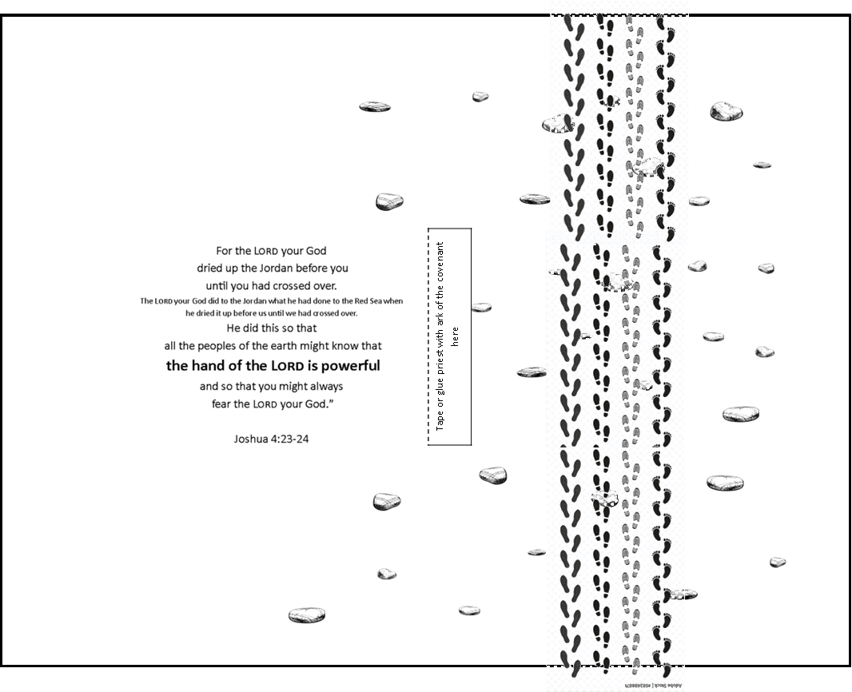
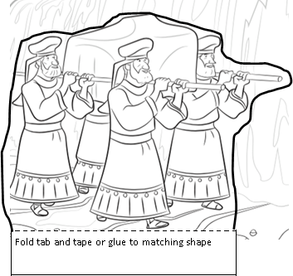
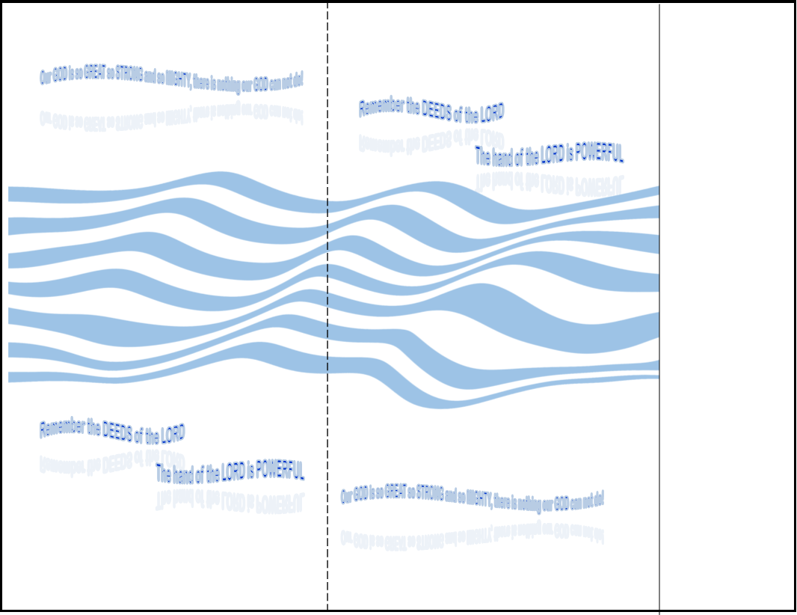
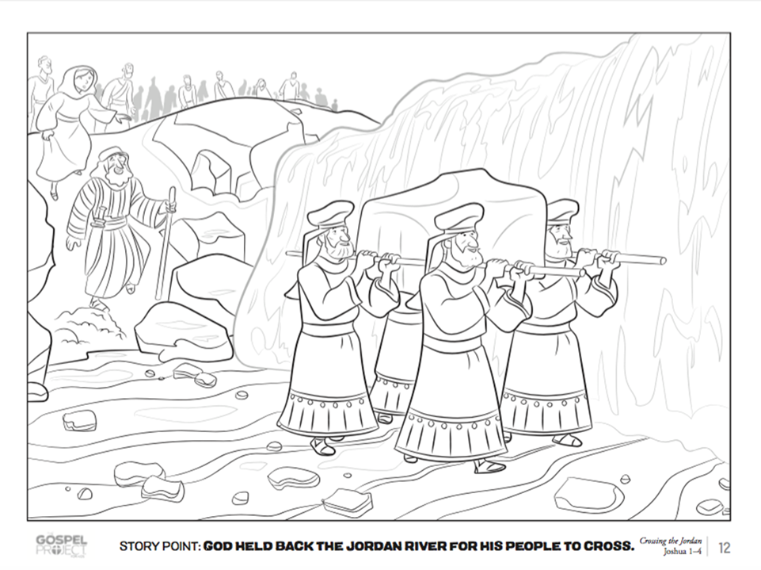
CRAFT TIME
Directions:
Take a half piece of brown paper or color white paper brown like the bottom of a river.
Take a half sheet of blue paper or color it blue like water.
Put the blue page on top of the brown page and tape the short ends together.
Cut the blue paper on the line. Fold on the dotted line.

Slide 28
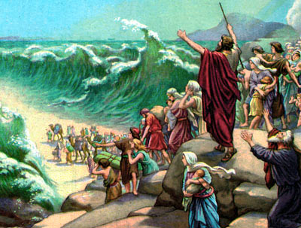
Just like God opened the Red Sea,
God opened the river Jordan, at flood stage, so that the people could walk through on dry ground.
Red Sea crossing
40 years later – Jordan River crossing

Slide 29
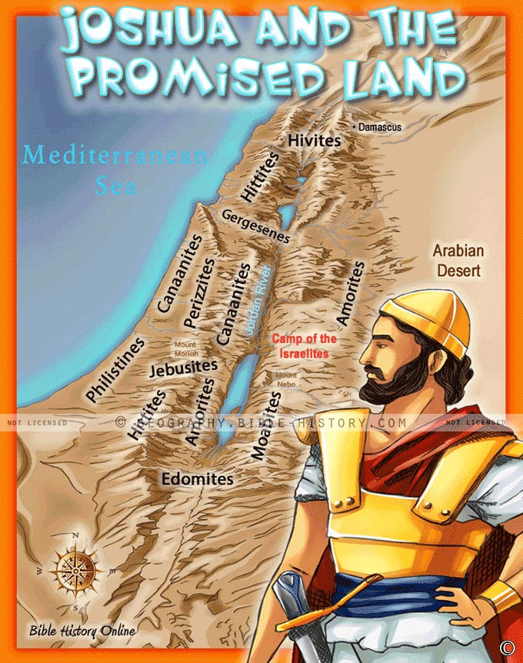
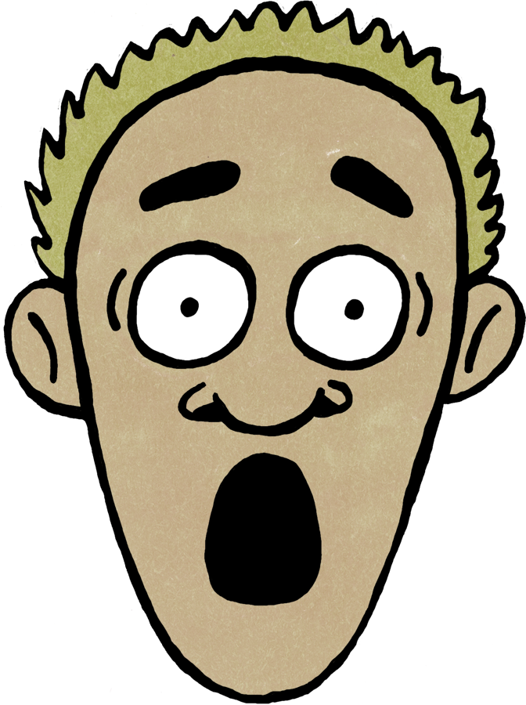
THEY ARE SCARED!
Joshua 5
All the Amorite and Canaanite kings heard how the Lord had dried up the Jordan River. They heard how he had dried it up for the Israelites until they had gone across it. The Amorite kings lived west of the Jordan. The kings of Canaan lived along the Mediterranean Sea. When all those kings heard what the Lord had done, they were terrified. They weren’t brave enough to face the Israelites anymore.

Slide 30
Remember
the deeds of the LORD
Psalms 77:11

Slide 31
I will remember the deeds
of the Lord;
yes, I will remember
Your miracles of long ago.
Psalms 77:11

Slide 32
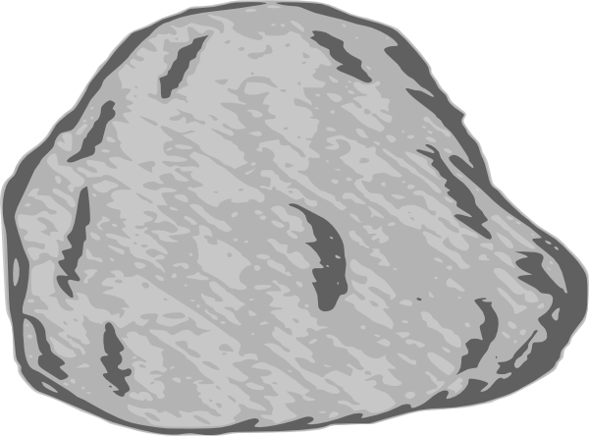
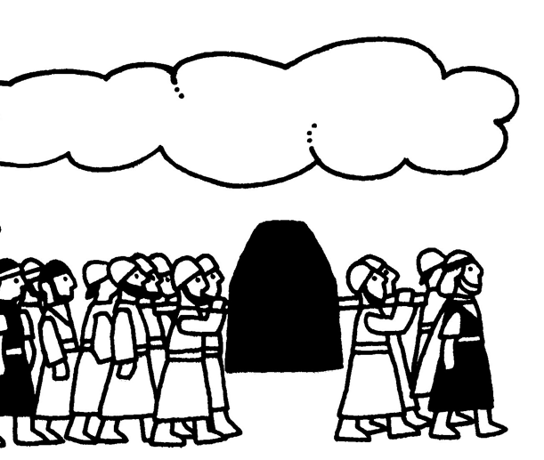
Craft Time
Decorate a rock with a drawing of our story.
Remember
the deeds of the LORD
Psalms 77:11

Slide 33


