Slide 1
Joshua and Jericho
Commander of the Lord tells the plan – Joshua 5
Israel follows the plan – Joshua 6
Jericho falls!

Slide 2
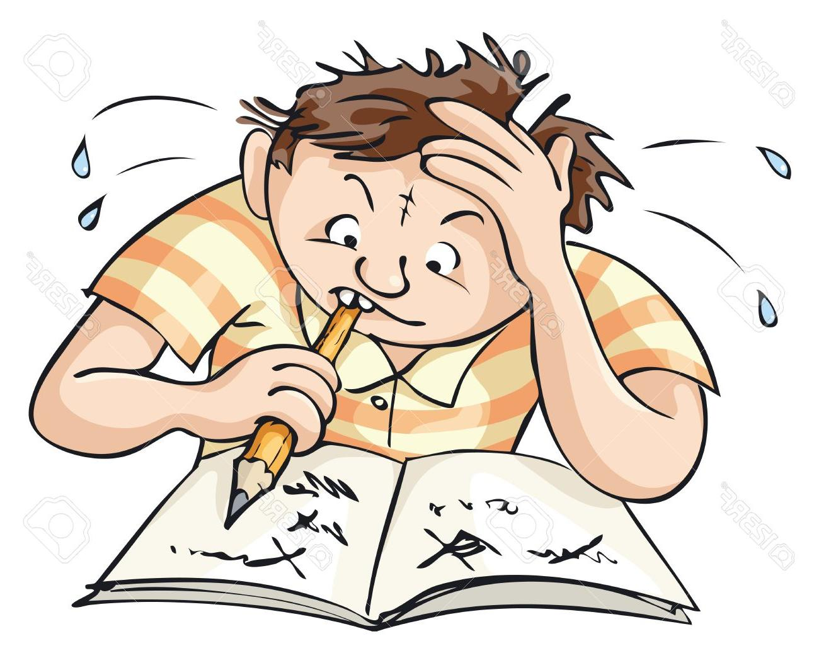
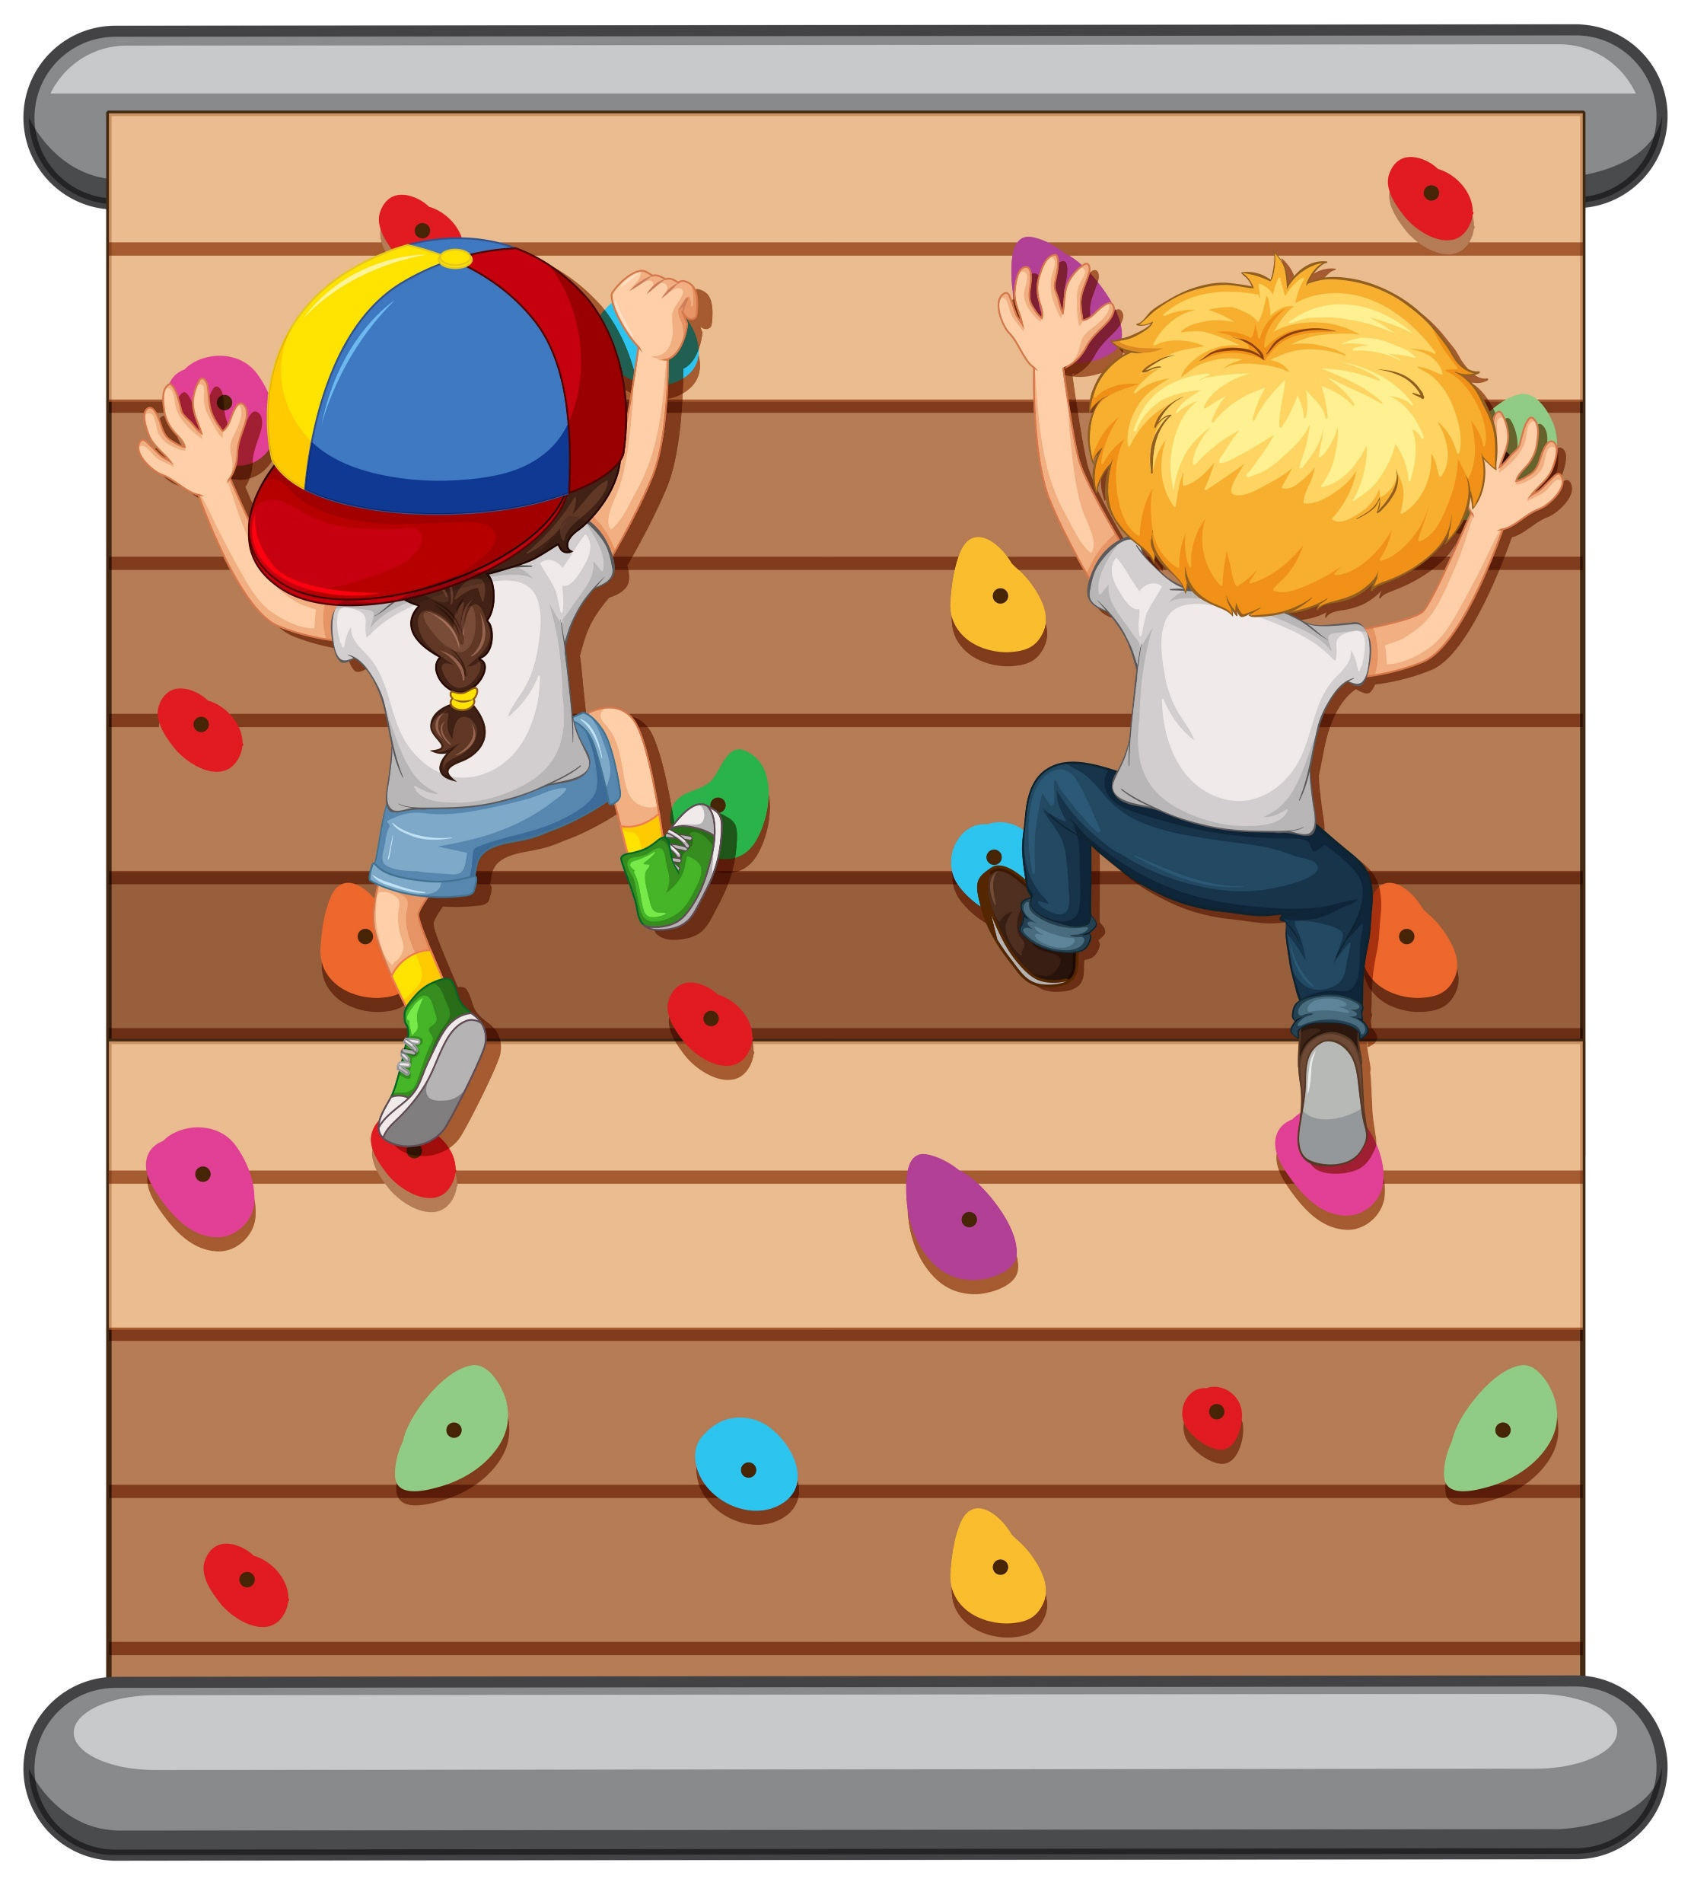
Have you ever had to do something that was really difficult -- it seemed impossible?
What was it?

Slide 3
“Do not let your hearts be troubled.
Trust in God…”
John 14:1
“The Lord your God will go ahead of you. He will fight for you.”
Deuteronomy 1:30

Slide 4
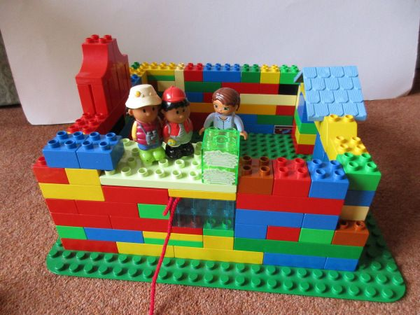
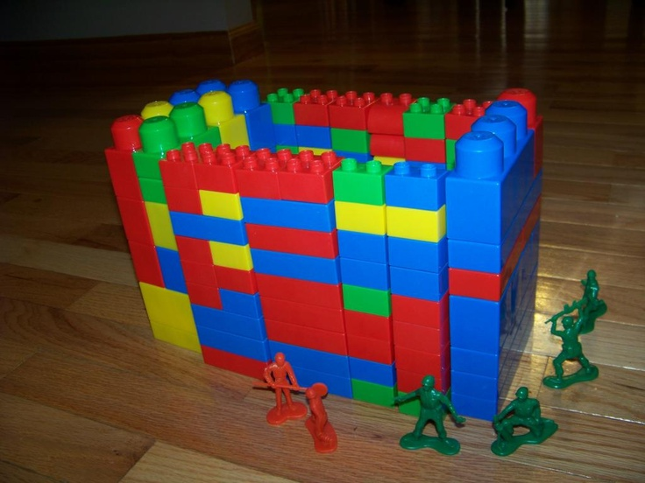
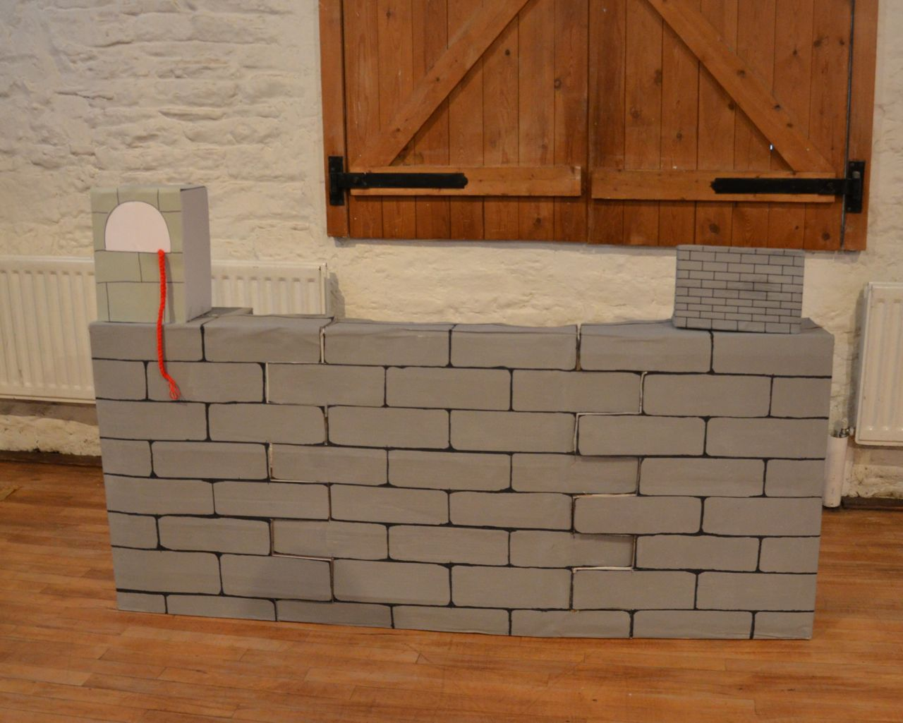
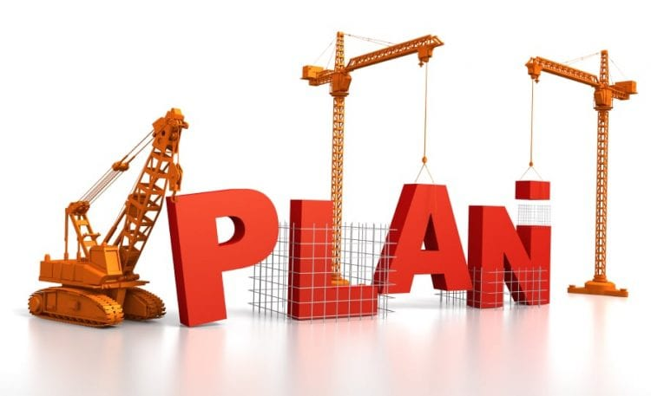
Activity – Let’s build Jericho
First we’ll build the corner wall with a house for Rahab.
Let’s put a red cord from Rahab’s window.

Slide 5
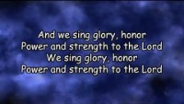
The Battle Belongs to the Lord

Slide 6
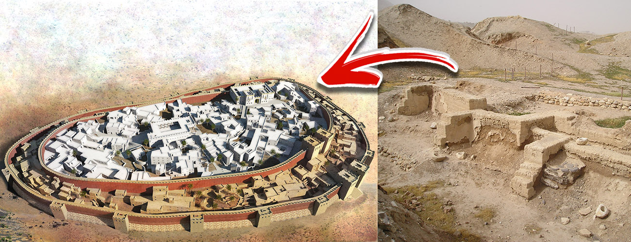

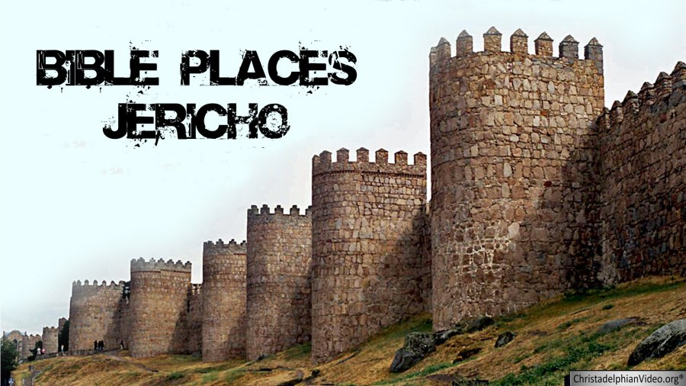
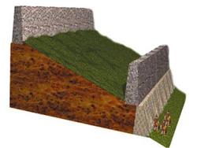
Ancient Jericho – City of BIG walls
Ancient Jericho was firmly established in the Jordan River valley. The ancient site of this time covered 6 acres, and was heavily fortified by a wall with immense round towers made of stone. (See Ancient Jericho, Israel History)
It was built on a hill with a 6 foot embankment and a strong wall above.

Slide 7
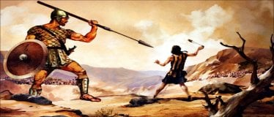
Ancient Jericho – City of the Giants
In ancient times, Jericho was known as the City of Giants, because it was inhabited by giants known as Gibborim.
The “Gibborim”, “heroes of old, men of renown”, who are mentioned in Genesis 6, were not as tall and powerful as the Nephilim, but they were nevertheless a dangerous warrior race. (See Ancient pages)

Slide 8
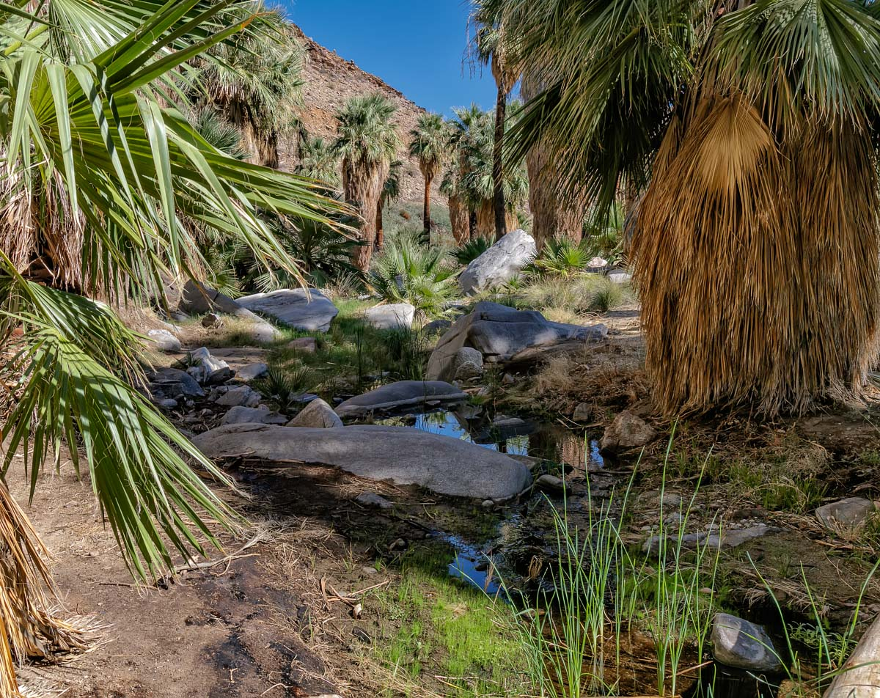
Ancient Jericho – City of Palm Trees
Jericho means City of Palm Trees. It had many springs and palm trees
Inside was a spring, too, giving plenty of water.
The people grew much grain. In fact, as we learned last week, this was the time of the harvest & flooding of the Jordan river
The people had just filled their jars with much grain and could live a long time in their strong town even with the gates closed.

Slide 9
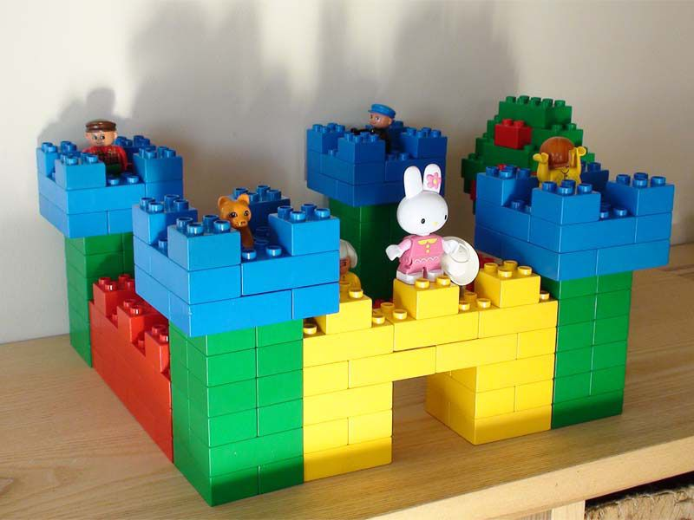
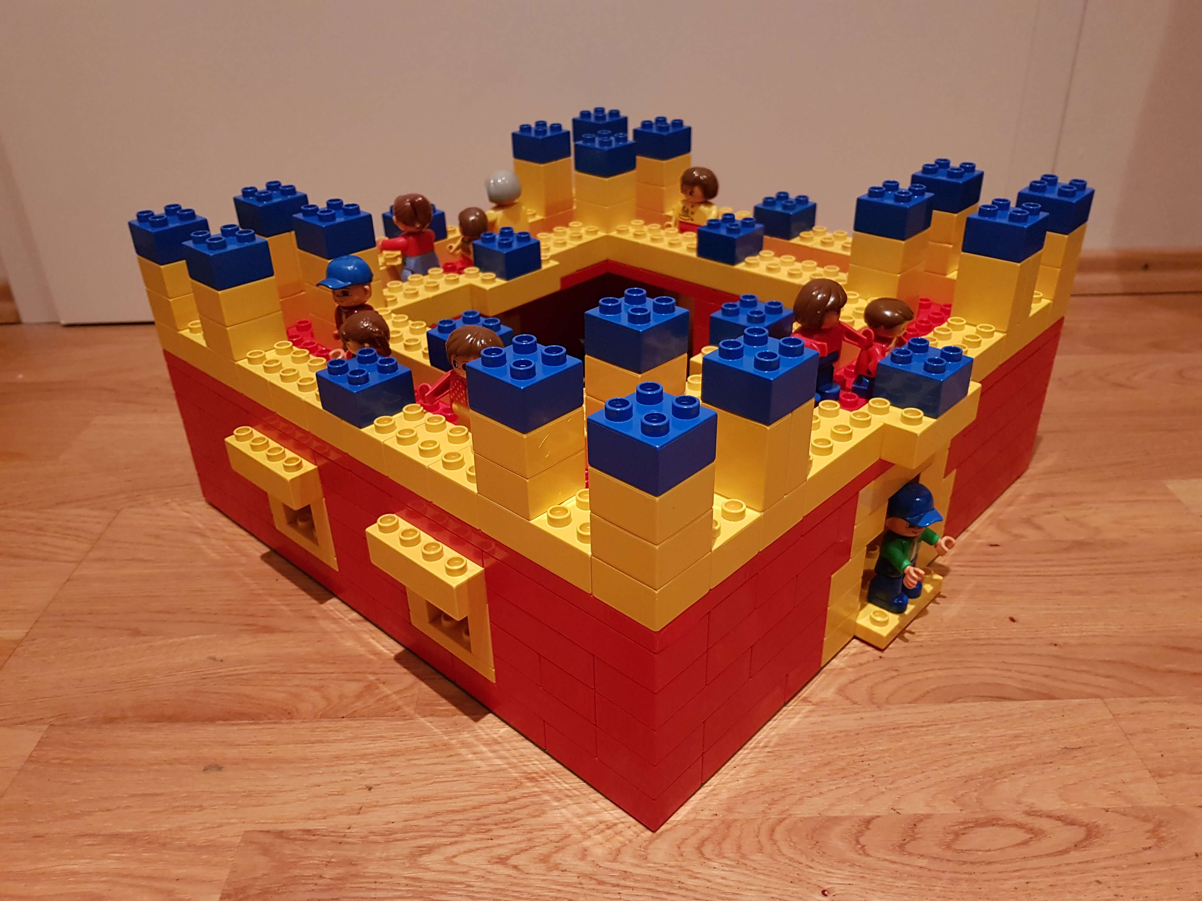
Are you done?
Good job working together to build a fort. This is the mighty fortress, Jericho!

Slide 10
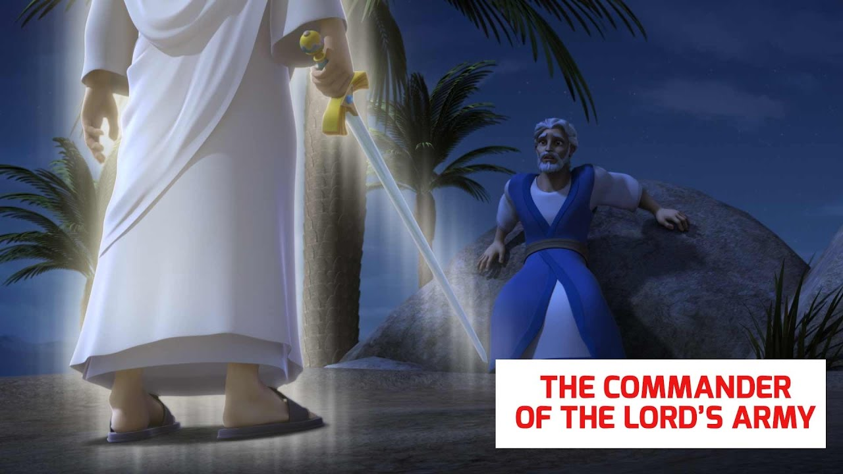
Joshua 5
Friend or Foe?
Well, are you on my side or against me?
I love you.
I hope you are on my side.
Are you for us or against us?
I have come as the commander of the Lord’s army.
¹³ When Joshua was near Jericho, he looked up and saw a man standing in front of him. The man was holding a sword. He was ready for battle. Joshua went up to him. He asked, “Are you on our side? Or are you on the side of our enemies?”
¹⁴ “I am not on either side,” he replied. “I have come as the commander of the Lord’s army.”

Slide 11
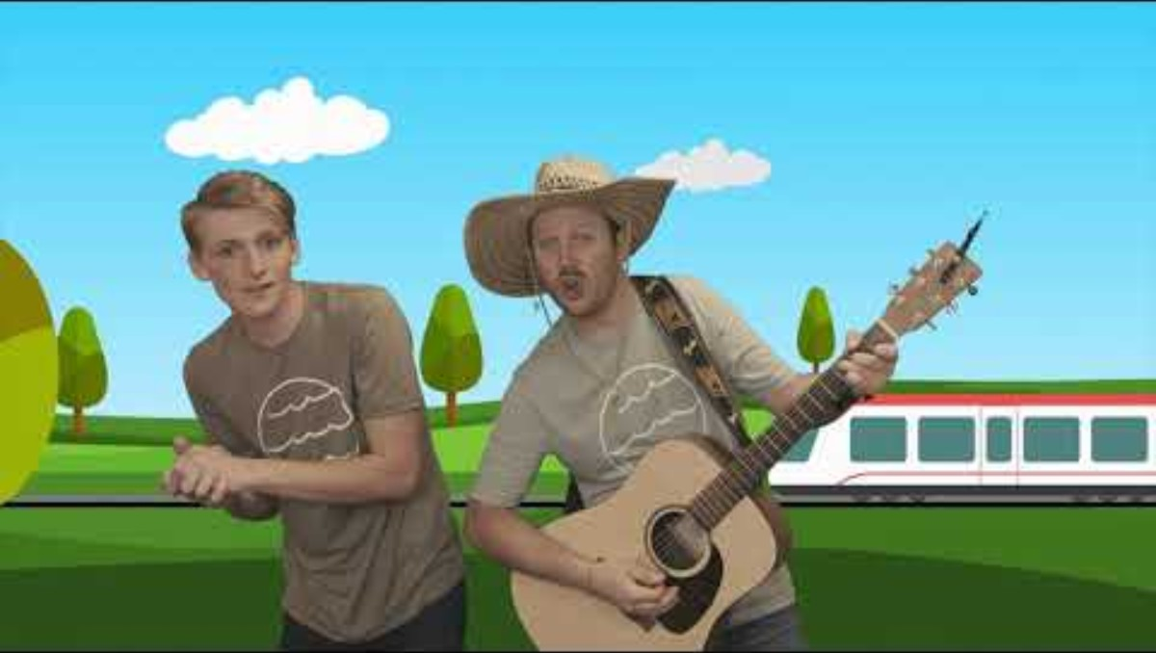
If we want God to be for us, we need to choose to be on His side.
Leaning On the Lord’s Side

Slide 12
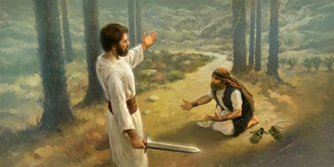
Then Joshua fell with his face to the ground. He asked the man, “What message does my Lord have for me?”
¹⁵ The commander of the Lord’s army replied, “Take off your sandals. The place you are standing on is holy ground.” So, Joshua took them off.
What message do you have for me?
Take off your sandals.
You’re on holy ground.

Slide 13
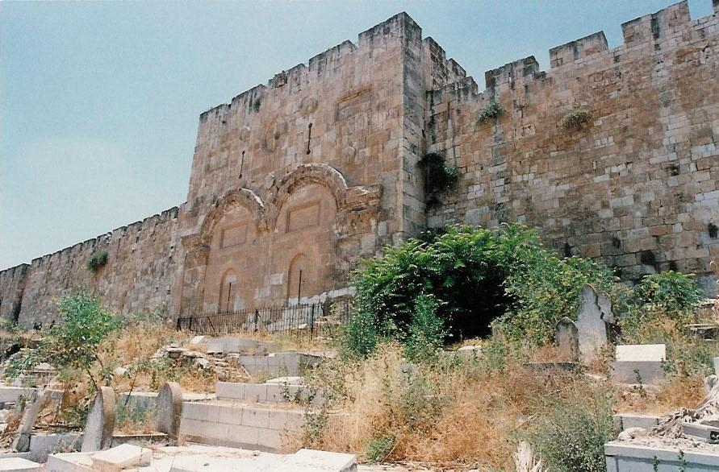
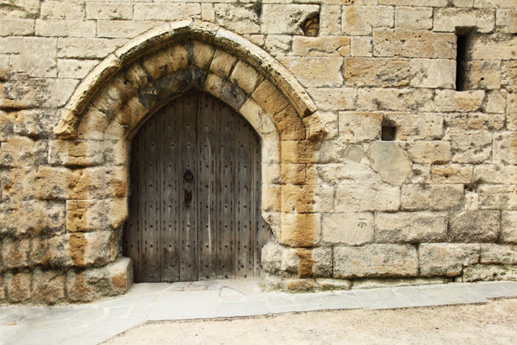
Meanwhile …
Joshua 6
The gates of Jericho were shut tight and guarded closely because of the Israelites.
No one went out. No one came in.

Slide 14
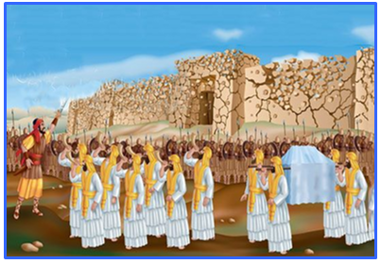
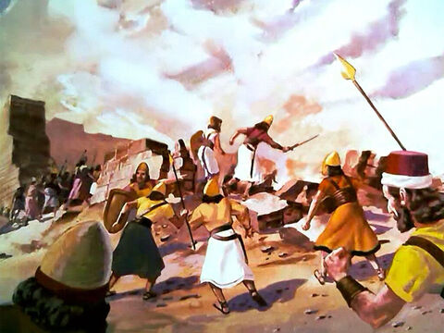
The plan from the
Commander of the Lord
² Then the Lord said to Joshua, “I have handed Jericho over to you. I have also handed over to you its king and its fighting men.
³ March around the city once with all your fighting men. In fact, do it for six days. ⁴ Have seven priests get trumpets made out of rams’ horns. They must carry them in front of the ark.
On the seventh day, march around the city seven times. Tell the priests to blow the trumpets as you march. ⁵ You will hear them blow a long blast on the trumpets. When you do, tell the whole army to give a loud shout.
The wall of the city will fall down. Then the whole army will march up to the city. Everyone will go straight in.”
Listen.
The battle is the Lord’s.
Here is my plan….

Slide 15
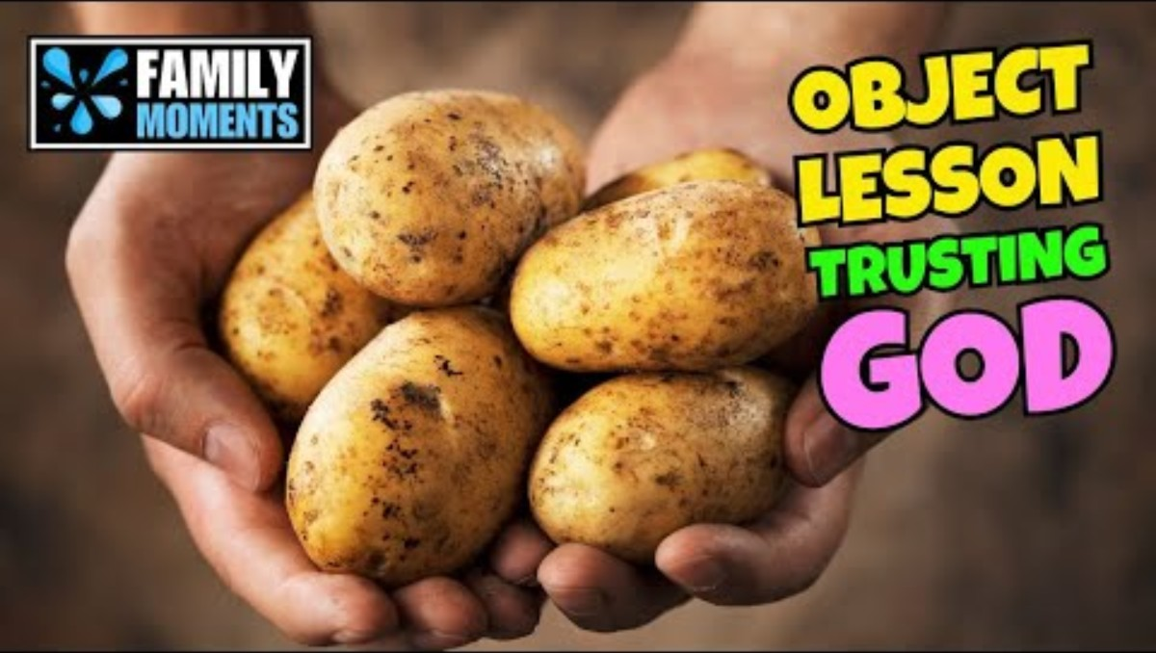


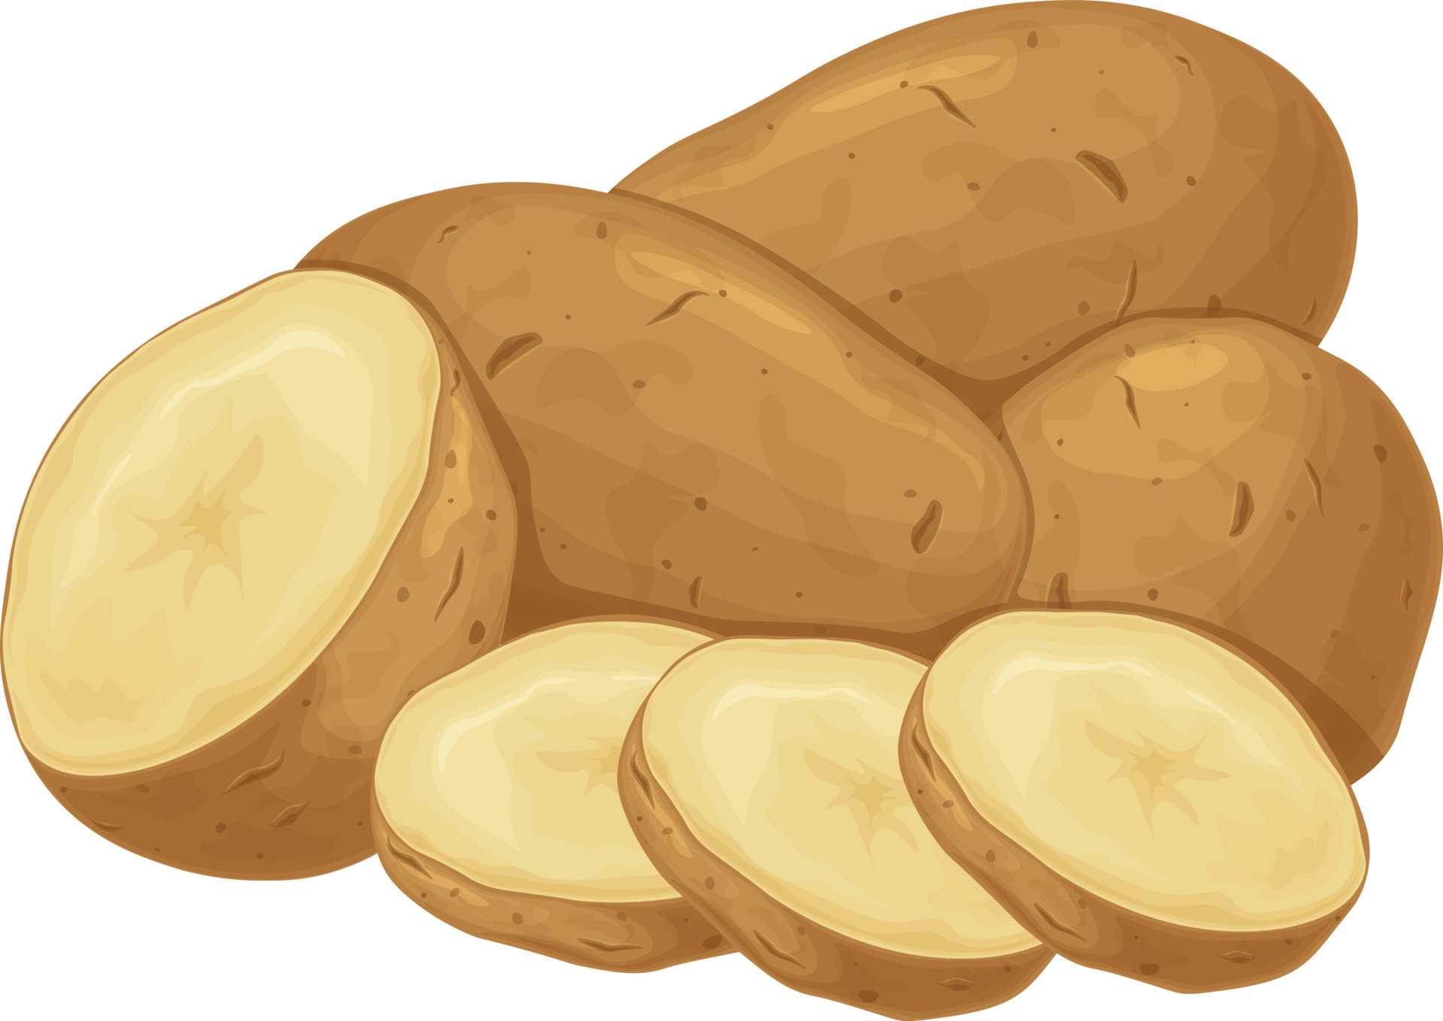
What kind of plan is that? That’s strange! Shall we trust God’s plan?
Watch the object lesson with the kids or before them and do it live.

Slide 16
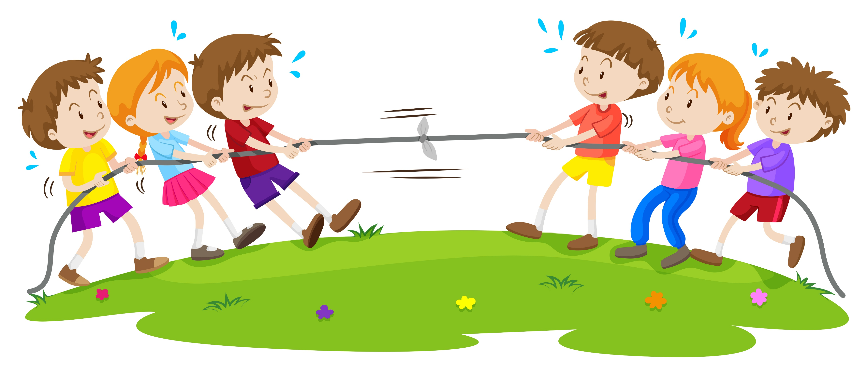
OBJECT LESSONS
If we want God to be FOR US, we need to choose to BE ON HIS SIDE and DO HIS PLAN.
TUG OF WAR
Adults all be on one side (God’s side), except one playing (enemy).
Kids, do you want to be on the winning side? Who’s side do you want to be on?
Point: God’s side should win.

Slide 17
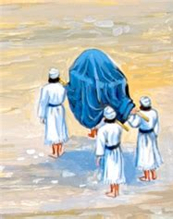
When it was time to move, the Ark of the Covenant was covered with a blue cloth.
Blue represents loyalty and faithfulness.
It reminds us that God is faithful.
We can be loyal and faithful to Him and obey His commandments and directions.
Four priests would carry it, by its poles, on their shoulders. They could not touch the Ark.
It was Holy because God is Holy.
They Ark of Covenant reminded them that God was with them.
God is with us.
He is faithful.

Slide 18
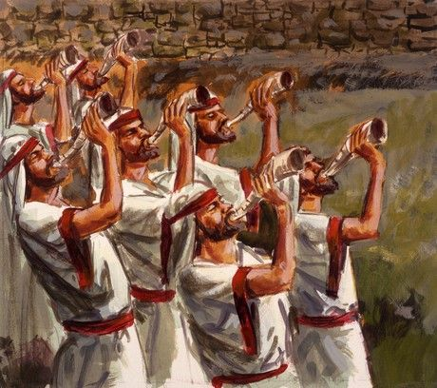
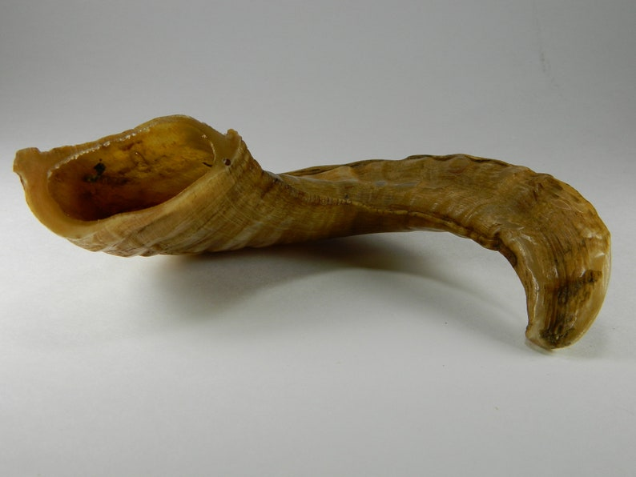
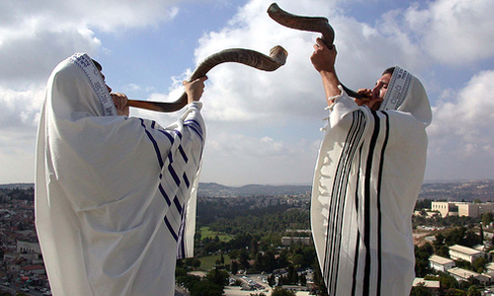
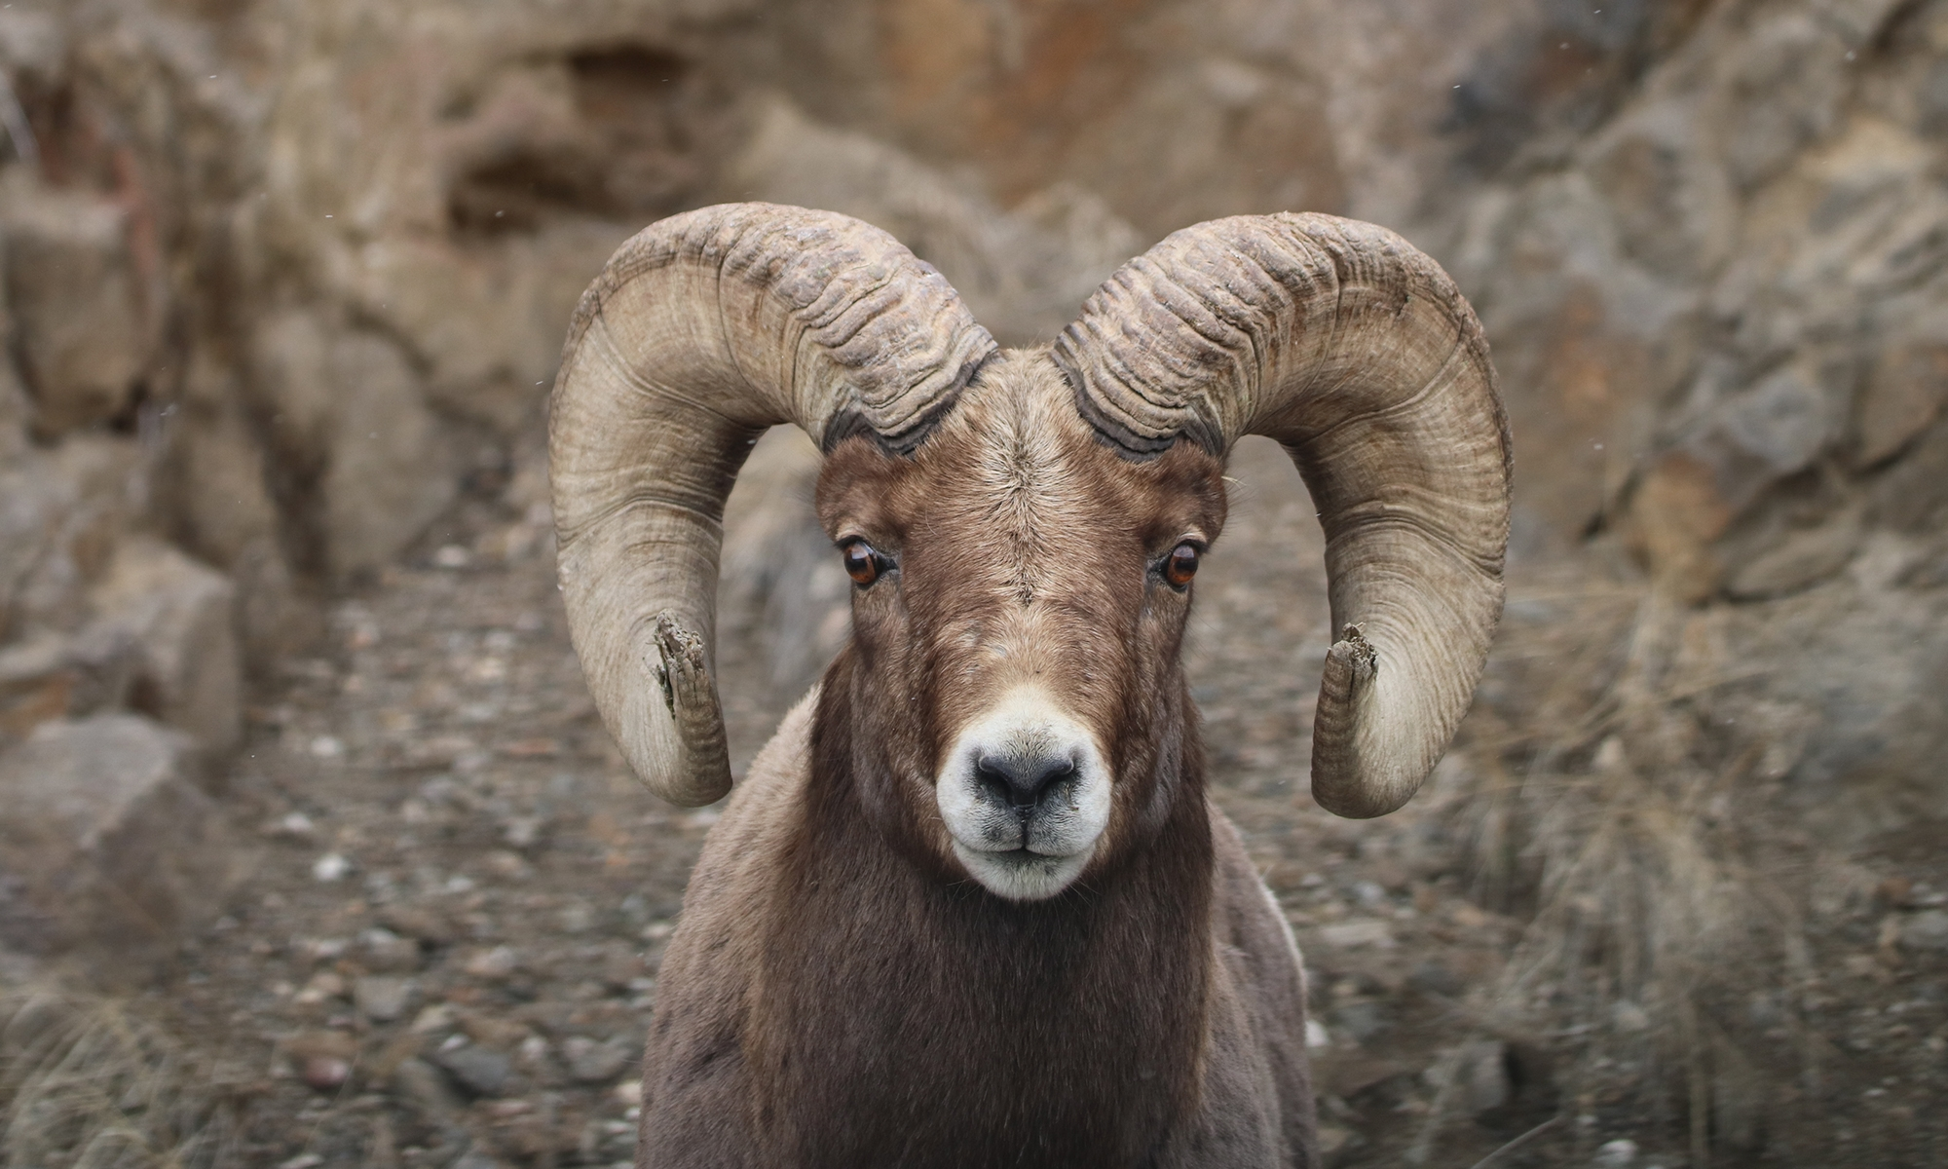
They were to blow the rams horns.
Announcing the King is coming
  Our God is with us.
Sound the battle cry
  Our God will fight for us & with us.
Ram horns came from rams.

Slide 19
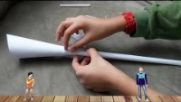
Let’s make a horn.

Slide 20
“Do not let your hearts be troubled.
Trust in God…”
John 14:1
“The Lord your God will go ahead of you. He will fight for you.”
Deuteronomy 1:30

Slide 21
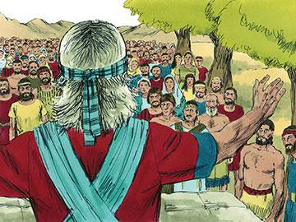
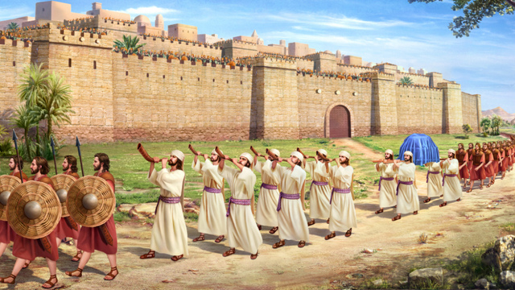
God has given us His battle plan.
He said, “March around the city once with all your fighting men. In fact, do it for six days. ⁴ Have seven priests get trumpets made out of rams’ horns. They must carry them in front of the ark.

Slide 22
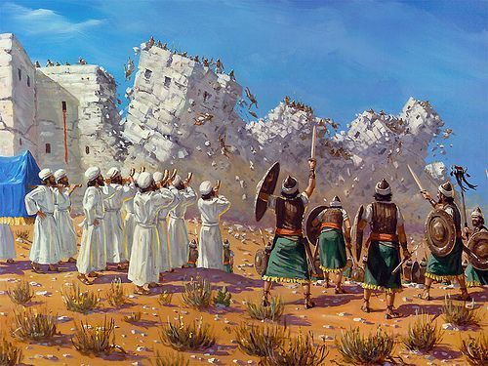
God will do battle on the 7th day.
On the seventh day, march around the city seven times. Tell the priests to blow the trumpets as you march.
⁵ You will hear them blow a long blast on the trumpets. When you do, tell the whole army to give a loud shout.
The wall of the city will fall down. Then the whole army will march up to the city. Everyone will go straight in.”

Slide 23
We must follow God’s battle plan.
He promised, ““I have handed Jericho over to you. I have also handed over to you its king and its fighting men.”
The battle is the Lord’s!
The spoils of war are the Lord’s.
He has commanded:
“The city and everything in it must be set apart to the Lord to be destroyed. But the prostitute Rahab and all those with her in her house must be spared. That’s because she hid the spies we sent. “

Slide 24
Joshua 6-7
⁶ So Joshua, the son of Nun, called for the priests. He said to them, “Go and get the ark of the covenant of the Lord. I want seven of you to carry trumpets in front of it.” ⁷ He gave an order to the army. He said, “Move out! March around the city. Some of the fighting men must march in front of the ark of the Lord.”
⁸ When Joshua had spoken to the men, the seven priests went forward. They were carrying the seven trumpets as they marched in front of the ark of the Lord. They were blowing the trumpets. The ark of the Lord’s covenant was carried behind the priests. ⁹ Some of the fighting men marched ahead of the priests who were blowing the trumpets. The others followed behind the ark and guarded all the priests. That whole time the priests were blowing the trumpets.
¹⁰ But Joshua had given an order to the army. He had said, “Don’t give a war cry. Don’t raise your voices. Don’t say a word until the day I tell you to shout. Then shout!” ¹¹ So he had the ark of the Lord carried around the city once. Then the army returned to camp. They spent the night there.

Slide 25
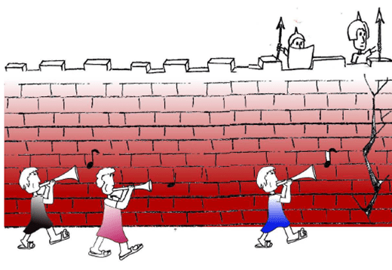
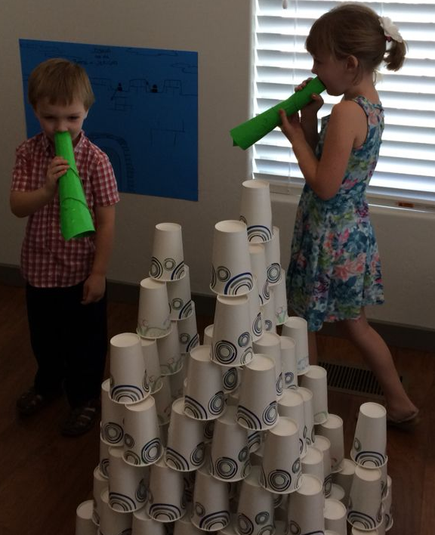
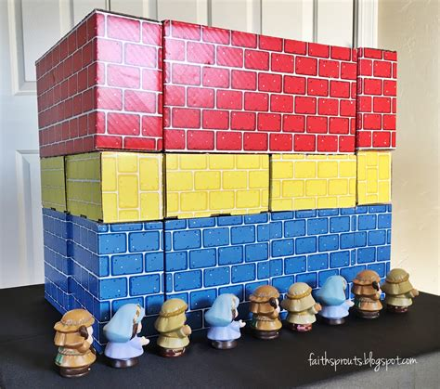
Let’s do it
Army forward guard, priests with ram’s horns, priests with the ark of the covenant, Army rear guard – march around the city once and then return to camp.
Let’s do it again!
--5 more times

Slide 26
Tomorrow is the 7th day. Remember --
God said, ““I have handed Jericho over to you. I have also handed over to you its king and its fighting men.”
The battle is the Lord’s!
The spoils of war are the Lord’s.
He has commanded:
“The city and everything in it must be set apart to the Lord to be destroyed. But the prostitute Rahab and all those with her in her house must be spared. That’s because she hid the spies we sent. “

Slide 27
Let’s do it
Army forward guard, priests with ram’s horns, priests with the ark of the covenant, Army rear guard – march around the city 7 times and then SHOUT!
Let’s sing while we march….

Slide 28
The Battle Belongs to the Lord
March around the city once, twice, three times…..

Slide 29
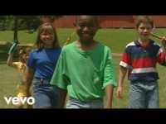
When we do what God says, we too are in the Lord’s Army
March around the city four times, five times, six times …..

Slide 30
On the 7th day
Blow a long blast!
SHOUT!!!
¹⁵ On the seventh day, they got up at sunrise. They marched around the city, just as they had done before. But on that day they went around it seven times. ¹⁶ On the seventh time around, the priests blew a long blast on the trumpets. Then Joshua gave a command to the army. He said, “Shout! The Lord has given you the city! …
²⁰ The priests blew the trumpets. As soon as the army heard the sound, they gave a loud shout. Then the wall fell down.
Everyone charged straight in. So they took the city.

Slide 31
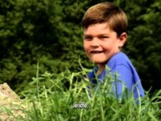
Joshua Fought the Battle of Jericho – by Cedarmont kids

Slide 32
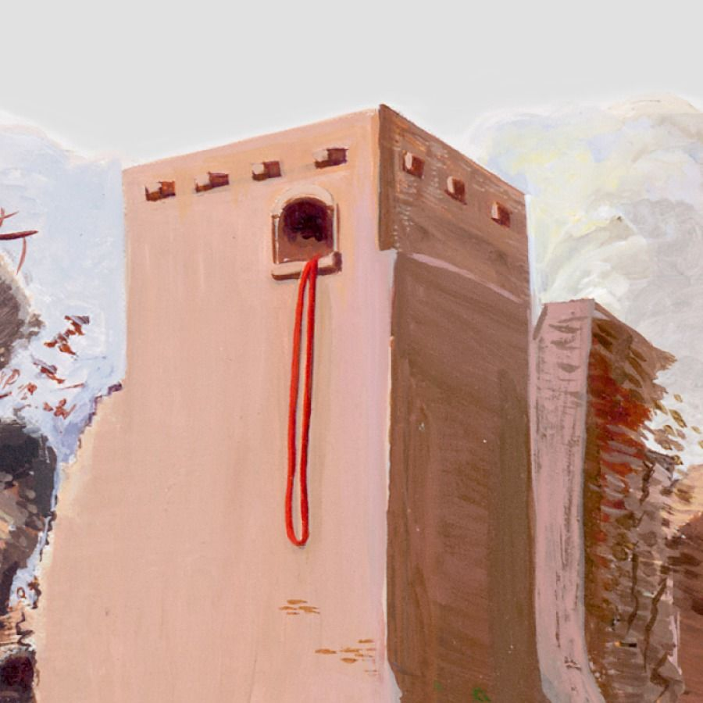
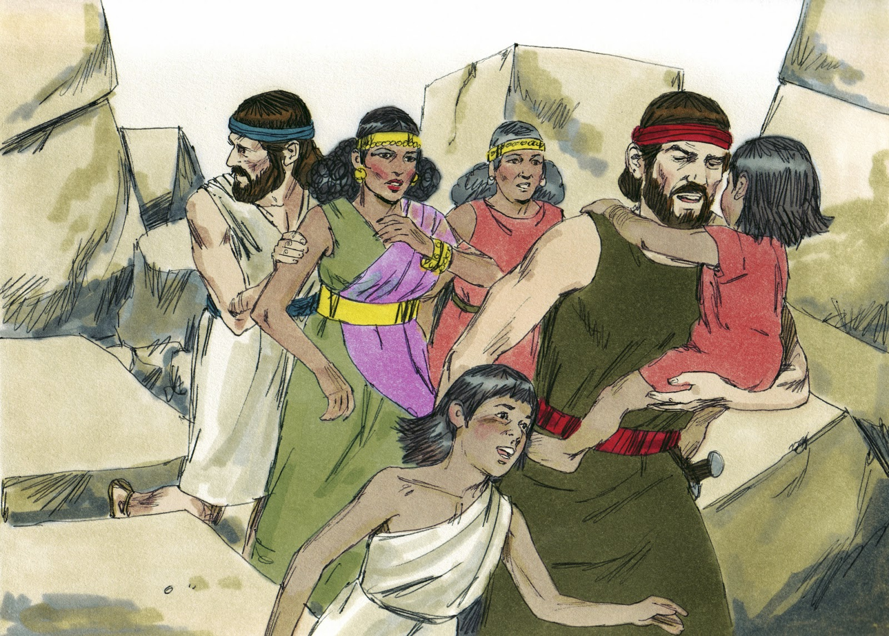
Go get Rahab
God showed mercy
to those who believed.
²² Then Joshua spoke to the two men who had gone in to check out the land. He said, “Go into the prostitute’s house. Bring her out. Also bring out everyone with her. That’s what you promised her you would do.” ²³ So the young men who had checked out the land went into Rahab’s house. They brought her out along with her parents and brothers and sisters. They brought out everyone else there with her. They put them in a place outside the camp of Israel.

Slide 33
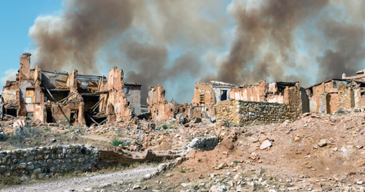
Jericho was destroyed
²¹ They set it apart to the Lord to be destroyed. They destroyed every living thing in it with their swords. They killed men and women. They wiped out young people and old people. They destroyed cattle, sheep and donkeys….
²⁴ Then they burned the whole city and everything in it. But they added the silver and gold to the treasures kept in the Lord’s house. They also put there the things made out of bronze and iron. ²⁵ But Joshua spared the prostitute Rahab. He spared her family. He also spared everyone else in the house with her. He did it because she hid the spies he had sent to Jericho. Rahab lives among the Israelites to this day.
²⁶ At that time Joshua made a promise and called down a curse. He said, “May the person who tries to rebuild this city of Jericho be under the Lord’s curse.
“If that person lays its foundations,
it will cost the life of his oldest son.
If he sets up its gates,
it will cost the life of his youngest son.”
²⁷ So the Lord was with Joshua.
And Joshua became famous everywhere in the land.
God’s judgement fell
on those who were evil.

Slide 34
“Faith is being sure of what we hope for.
It is being sure of what we do not see.”
Hebrews 11:1
“Israel’s army had faith. So, the walls of Jericho fell down. It happened after they had marched around the city for seven days.
Rahab, the prostitute, had faith. So, she welcomed the spies. That’s why she wasn’t killed with those who didn’t obey God.”
Hebrews 11:30-31

Slide 35
“Do not let your hearts be troubled.
Trust in God…”
John 14:1
“The Lord your God will go ahead of you. He will fight for you.”
Deuteronomy 1:30

Slide 36
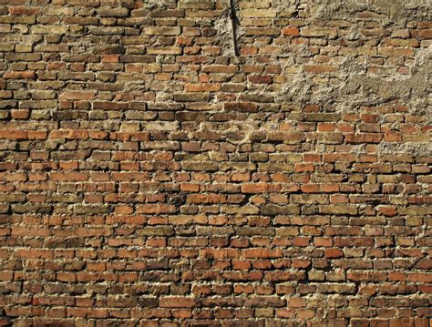
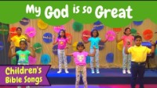

Slide 37
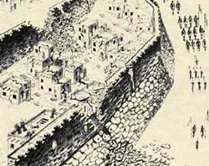
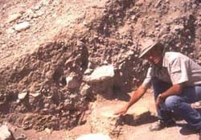
Did it happen that way?
Yes! Excavations at the site have found:
Bricks at the bottom of the embankment wall from the fallen fortress walls. – Which made a ramp for the Israelites to go “straight up” into the city.
The bricks are burned showing evidence of a fire.
There is evidence of an earthquake. God sent and earthquake at this precise time to break the walls and give the victory.
They found jars full of grain. The Israelites didn’t take this as spoils. It was devoted to the Lord. It helps confirm the story.
Read more about it at Answers to Genesis

Slide 38

https://activity-array.com/

