Slide 1
A TOWER PROBLEM
Resolve Assumptions
Talk & Listen
Tribes of Reuben, Gad, and half tribe of Manasseh Return Home
Joshua 22

Slide 2
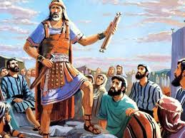
Mission Completed
You have helped us conquer the land.
Thank you! You can go home now.
Love the Lord your God.
Serve Him with all your heart and soul.
Joshua 22
Joshua sent for the tribes of Reuben and Gad and half of the tribe of Manasseh. ² He said to them,
“You have done everything that Moses, the servant of the Lord, commanded. You have also obeyed everything I commanded. ³ For a long time now you haven’t deserted the other Israelites. Instead, you have done what the Lord your God sent you to do. You have obeyed him right up to this day.
⁴ Now the Lord your God has given the other tribes peace and rest. That’s what he promised to do. So return to your homes. They are in the land that Moses, the servant of the Lord, gave you. It’s on the east side of the Jordan River.
⁵ Be very careful to obey the law that Moses, the servant of the Lord, gave you. He commanded you to love the Lord your God. He told you to live exactly as the Lord wants you to. He told you to obey the Lord’s commands. He told you to remain faithful to the Lord. And he told you to serve the Lord with all your heart and with all your soul.”

Slide 3

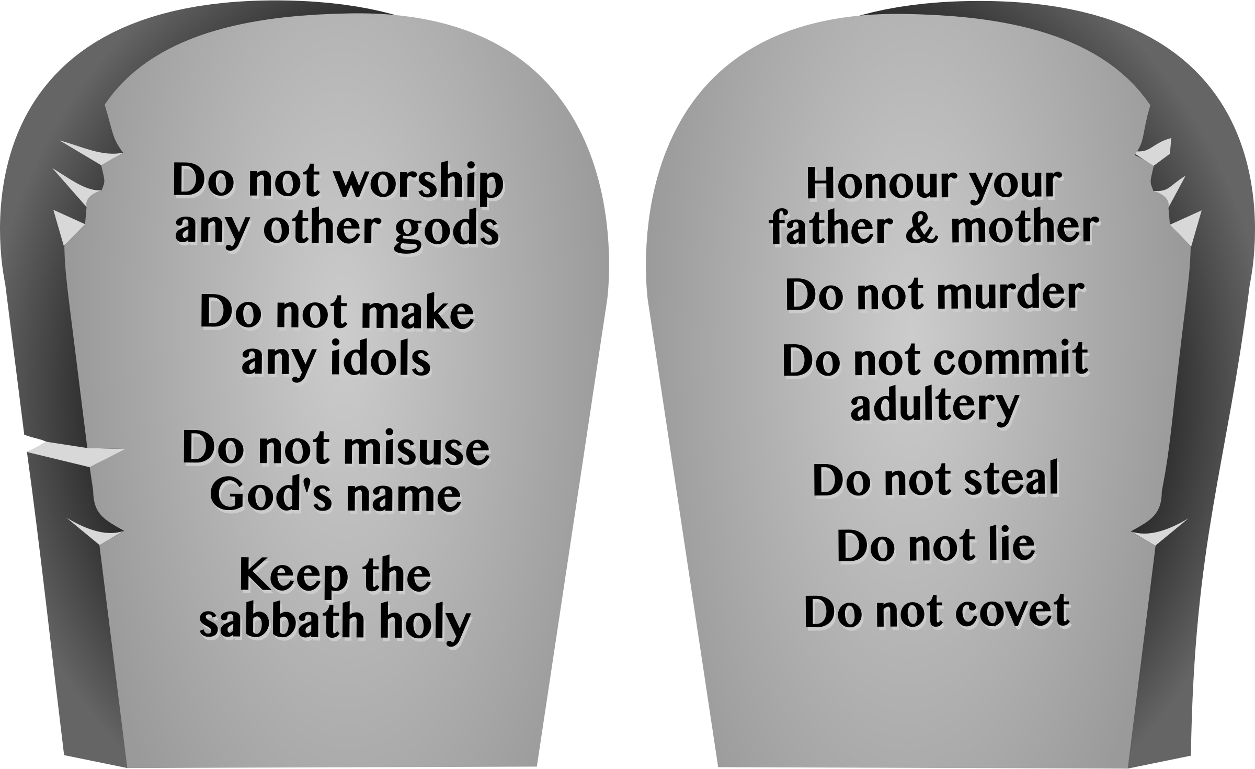

⁵ but be very careful to keep the commandment and the law that Moses the servant of the lord gave you:
To love the lord your God, to walk in obedience to him, to keep his commands, to hold fast to him and to serve him with all your heart and with all your soul.”
Joshua 22:5
Obey
God
Serve
God

Slide 4

Let’s sing

Slide 5
Mission Completed
God has blessed you with great wealth. Take your herds of livestock, silver, gold, bronze, iron, & clothes. Share them with your families.
Joshua 22
⁶ Joshua gave the eastern tribes his blessing. Then he sent them home. So they went.
⁷ Moses had given land in Bashan to half of the tribe of Manasseh. Joshua had given land to the other half of the tribe. He had given it to them along with the other tribes on the west side of the Jordan River.
When Joshua sent them home, he blessed them. ⁸ He said, “Return to your homes. Take your great wealth with you. Return with your large herds of livestock. Take your silver, gold, bronze and iron with you. Return with all the extra clothes you acquired. Divide up the things you have taken from your enemies. Share them with your people.”
May God continue to bless you!

Slide 6
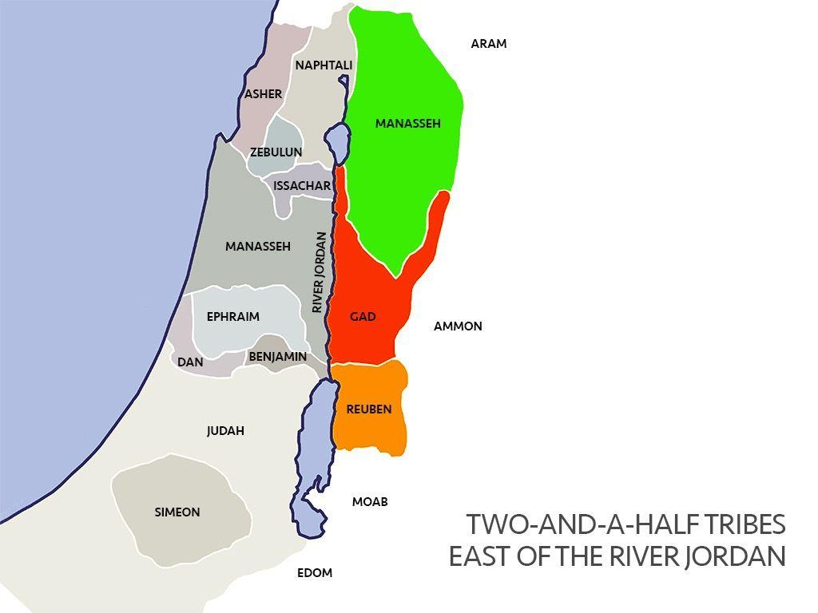
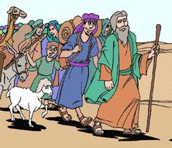
Going home
Joshua 22
⁹ So the tribes of Reuben and Gad and half of the tribe of Manasseh went home. They left the other Israelites at Shiloh in Canaan. They returned to Gilead. That was their own land. They had acquired it according to the Lord’s command through Moses.
We are going home!
DO IT
Pretend you are walking home
And sing….

Slide 7

Let’s sing
It’s a great thing to praise the Lord
Walk in the light of the Lord
It’s a great thing to love the Lord
Walk in the light of the Lord.
It’s a great thing to serve the Lord
Walk in the light of the Lord.

Slide 8

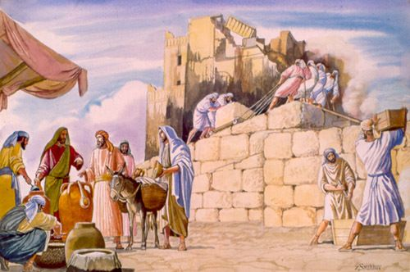
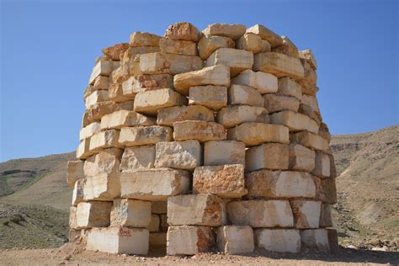
Altar Built
¹⁰ The tribes of Reuben and Gad and half of the tribe of Manasseh came to Geliloth. It was near the Jordan River in the land of Canaan. They built a large altar there by the Jordan.
DO IT
Build a tower
And listen….

Slide 9
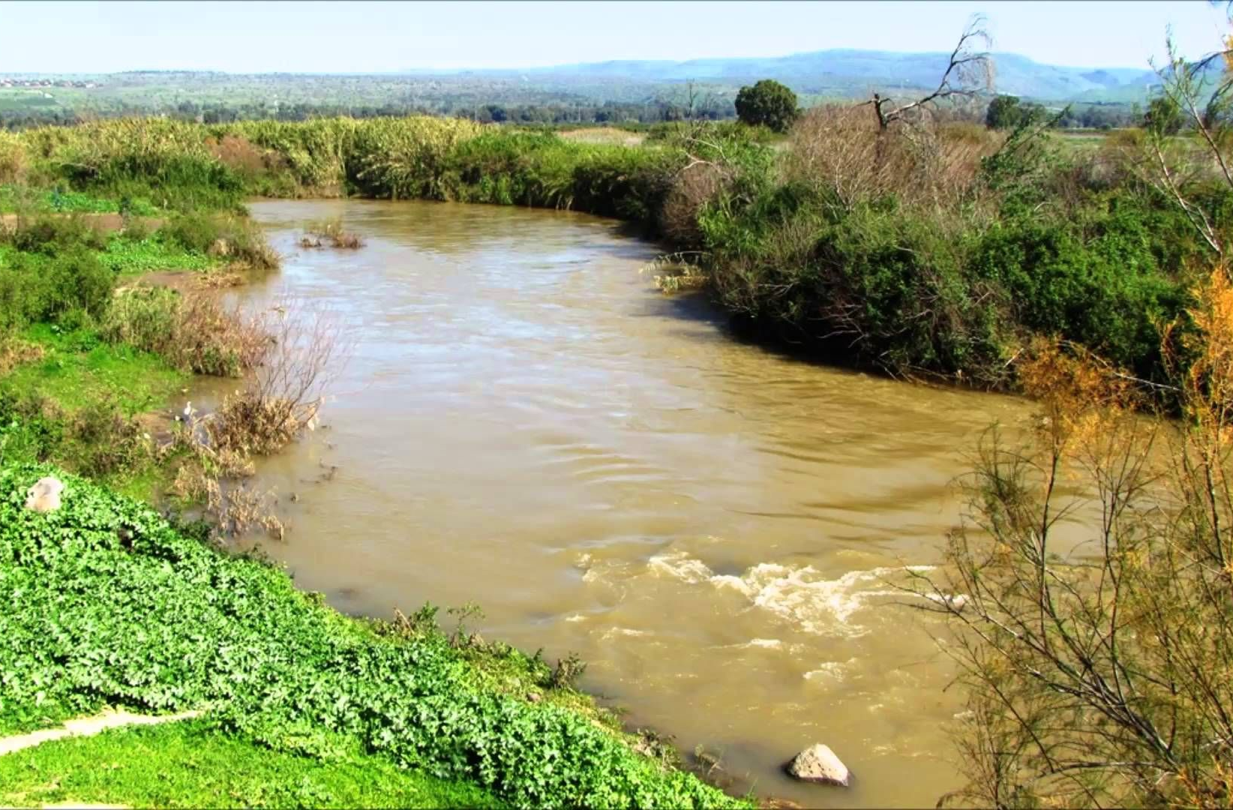
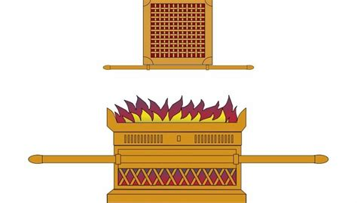
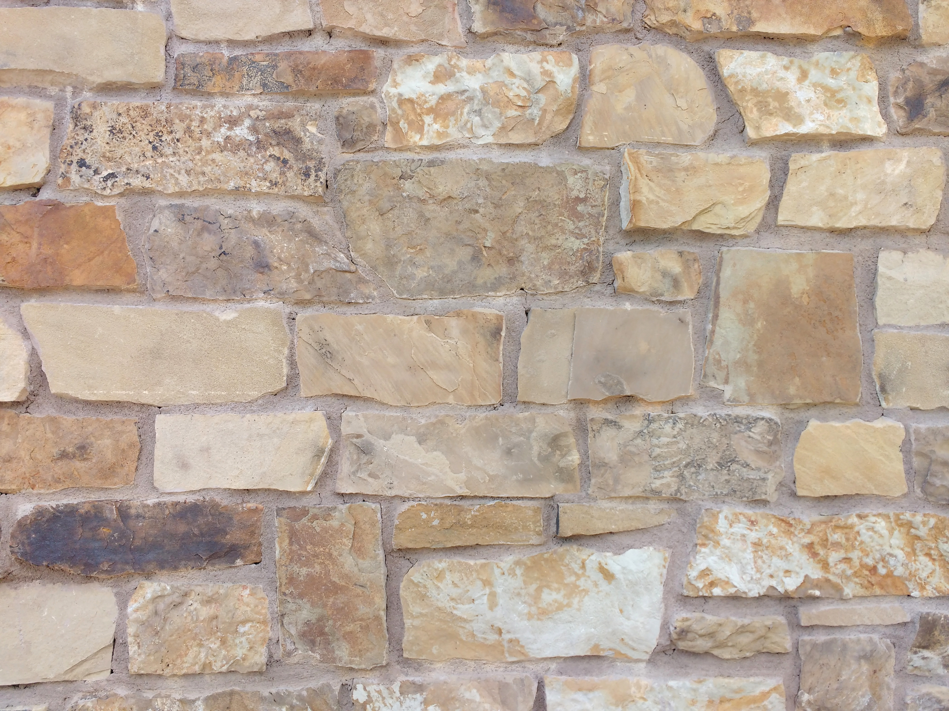
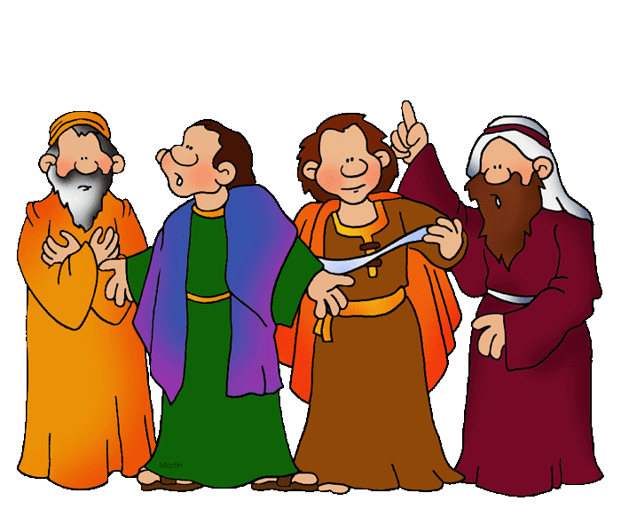
What is that?
That is wrong!
¹¹ The rest of the Israelites heard that the eastern tribes had built the altar. They heard that it had been built on the border of Canaan at Geliloth. It was near the Jordan River on the west side. ¹² So the whole community of Israel gathered together at Shiloh. They decided to go to war against the eastern tribes.
¹³ The Israelites sent Phinehas the priest to the land of Gilead. Phinehas was the son of Eleazar. They sent him to the tribes of Reuben and Gad and half of the tribe of Manasseh. ¹⁴ They sent ten of their leaders with him. There was one from each of the tribes of Israel. Each man was the leader of a family group among the larger family groups of Israel.
What is that?!
It must be an altar for another God
We must get rid of it!
We can’t have that!

Slide 10
We see a problem
¹⁵ Those leaders went to the tribes of Reuben and Gad and half of the tribe of Manasseh. Those tribes were in the land of Gilead. The leaders said to them,
¹⁶ “We’re speaking for the Lord’s whole community. How could you disobey the God of Israel like this? How could you turn away from the Lord? How could you disobey him by building an altar for yourselves? ¹⁷ Don’t you remember how we sinned at Peor? The Lord struck us with a plague because of what we did. Up to this day we’re still suffering because of that sin. ¹⁸ Are you turning away from the Lord now?
“Suppose you disobey the Lord today. If you do, he’ll be angry with the whole community of Israel tomorrow. ¹⁹ If your own land is ‘unclean,’ come over to the Lord’s land. It’s where his holy tent stands. Share our land with us. But don’t disobey the Lord. Don’t turn against us by building an altar for yourselves. Don’t build any altar other than the altar of the Lord our God. ²⁰ Remember what happened to Achan, the son of Zerah. Achan wasn’t faithful to the Lord. He took the things that had been set apart to the Lord in a special way to be destroyed. Didn’t the whole community of Israel experience the Lord’s anger? Achan wasn’t the only one who died because of his sin.”
We can’t have that!
What is that?!
Remember when we worshipped idols at Peor!
Remember the plagues!
We mustn’t sin against God!
Remember when Achen took God’s devoted things!

Slide 11
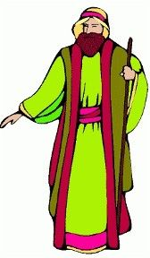
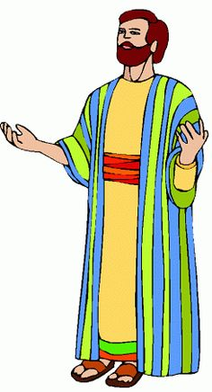
That’s not true
We built this altar because we don’t want to be separated!
²¹ Then the tribes of Reuben and Gad and half of the tribe of Manasseh replied. They answered the leaders of the family groups of Israel. ²² They said, “The Mighty One, God, the Lord! The Mighty One, God, the Lord! He knows! And we want Israel to know! Have we opposed the Lord? Have we refused to obey him? If we have, don’t spare us today. ²³ Have we built our own altar so we can turn away from the Lord? Have we built it to offer burnt offerings and grain offerings on it? Have we built it to sacrifice friendship offerings on it? If we have, may the Lord himself hold us accountable.
²⁴ “No! We built it because we were afraid. Someday your children might speak to our children. We were afraid they might say, ‘What do you have to do with the Lord? What do you have to do with the God of Israel? ²⁵ The Lord has made the Jordan River a border between us and you. You people of Reuben! You people of Gad! You don’t have anything to do with the Lord.’ If your children say that, they might cause our children to stop worshiping the Lord.
The Mighty One, God is Lord!

Slide 12
The opposite is true
We built this altar because we want to remember God!
²⁶ “That’s why we said to ourselves, ‘Let’s get ready and build an altar. But let’s not build it to offer burnt offerings or sacrifices on it.’ ²⁷ So just the opposite is true. The altar will be a witness between us and you. It will be a witness between our children and yours after us. It will also be a witness that we will worship the Lord at his sacred tent. We’ll worship him there with our burnt offerings, sacrifices and friendship offerings. Then in days to come your children won’t be able to say to ours, ‘You don’t have anything to do with the Lord.’
²⁸ “So we said to ourselves, ‘Suppose they say that to us sometime. Or suppose they say it to our children after us. Then we’ll answer, “Look at this altar. It’s exactly like the Lord’s altar. Our people built it. They didn’t build it to offer burnt offerings and sacrifices on it. Instead, they built it to be a witness between us and you.” ’
²⁹ “We would never refuse to obey the Lord. We would never turn away from him now. We wouldn’t build an altar to offer burnt offerings, grain offerings and sacrifices on it. We wouldn’t use any altar other than the altar of the Lord our God. That altar stands in front of his holy tent.”
We want to worship God forever!
We will worship at the tabernacle.

Slide 13
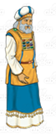
There’s no problem
Now we know that you have been faithful to God.
³⁰ Phinehas the priest heard what the tribes of Reuben, Gad and Manasseh had to say. The leaders of the family groups of the community of Israel heard it too. All of them were pleased with what they heard. ³¹ Phinehas the priest spoke to the tribes of Reuben, Gad and Manasseh. Phinehas was the son of Eleazar. He said, “Today we know that the Lord is with us. That’s because you have been faithful to him in this matter. Now you have saved the Israelites from the Lord’s anger against them.”
³² Then Phinehas the priest, the son of Eleazar, returned to Canaan. So did the leaders. All of them went back from their meeting with the tribes of Reuben and Gad in Gilead. They brought a report back to the Israelites. ³³ The people were glad to hear the report. They praised God. They didn’t talk anymore about going to war against the eastern tribes. And they didn’t talk anymore about destroying the country where the tribes of Reuben and Gad lived.

Slide 14
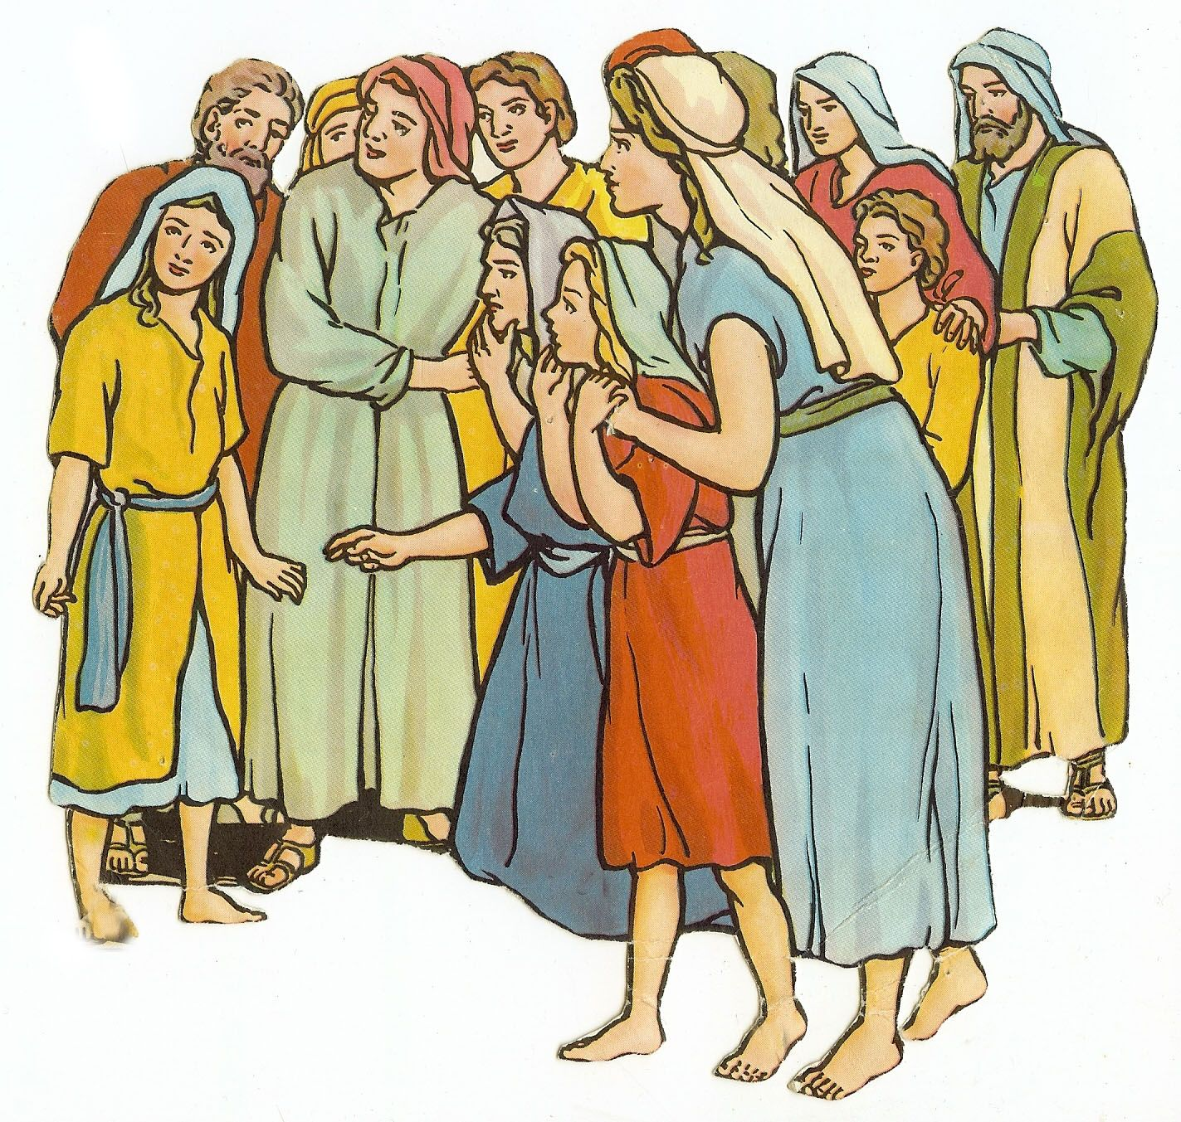
A witness – the Lord is god
Yes, we will
Love the Lord your God.
Serve Him with all your heart and soul.
Love the Lord your God.
Serve Him with all your heart and soul.
³⁴ The tribes of Reuben and Gad gave the altar a name. They called it A Witness Between Us that the Lord is God.
A witness
The Lord is God

Slide 15
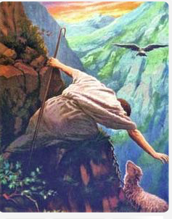
“ My dear brothers and sisters,
pay attention to what I say.
Everyone should be quick to listen. But they should be slow to speak.
They should be slow to get angry.”
James 1:19
Jesus seeks
and saves
the lost
“ Moreover, if your brother sins against you,
go and tell him his fault between you and him alone. If he hears you, you have gained your brother. ”
Matthew 18:15
Blessed are those who make peace.
They will be called children of God.
Matthew 5:9

Slide 16



To resolve conflict to solve a problem before there’s a fight
GO
The Israelites noticed the altar on the other side of the river. They assumed it was an idol. They thought it was a sin. But before a fight broke out, they went to talk to those who built it -- the tribes of Reuben, Gad, and Manasseh, They told them their concern. Then they listened. The problem was solved.

Slide 17
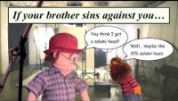

Slide 18


Slide 19
It’s time for charades role-play the given scenarios
Have 2 papers for each number, numbered 1-5.
Everyone gets a slip of paper with a number on it.
When your number comes up on the scenario slide, you get to choose to be the “someone” who did it or the “your” who it was done to.
The “someone” pretends to do the thing mentioned in the scenario.
Then the “you or your” should tell:
    How you feel or would feel and why you think it was wrong.
The “someone” should tell:
    Why they did it or apologize.
Then they should:
    Talk about a solution to the problem
    Apologize and forgive.

Slide 20

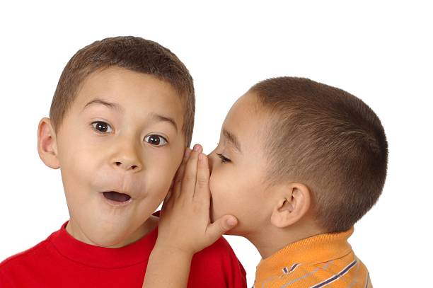
Role play conflict resolution
GO
# 3
To you, saw someone whispering to a friend.
You think they are saying mean things.
What will you say to them?
Later you find out they were planning a surprise birthday party for you.

Slide 21
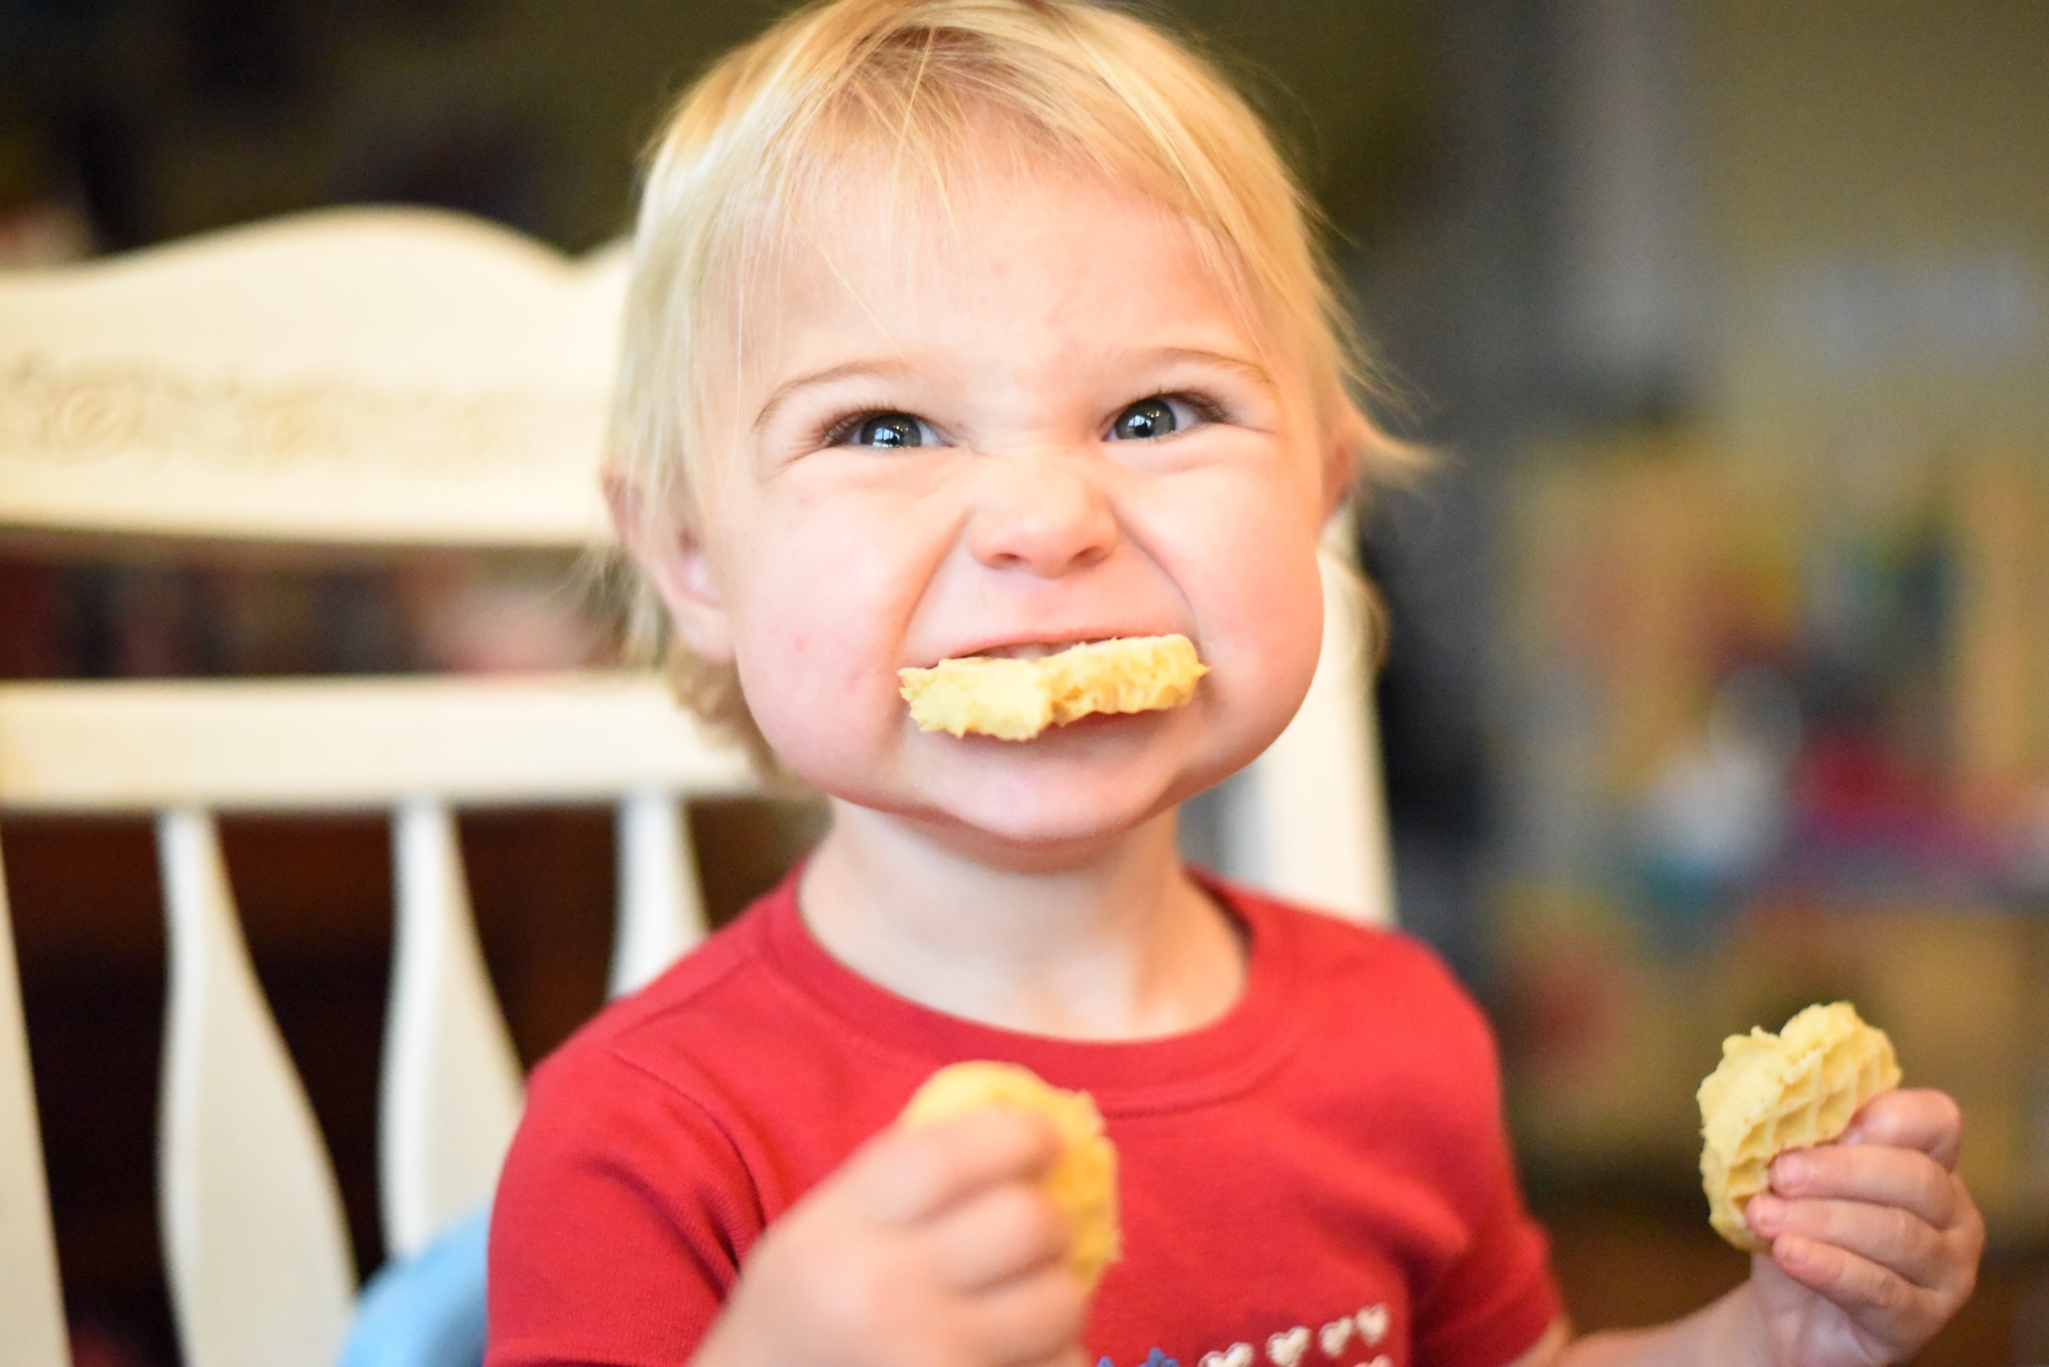
Role play conflict resolution
GO
# 5
To you, it looked like someone took your snack!
You got mad at them.
But then you found your snack on the floor!

Slide 22
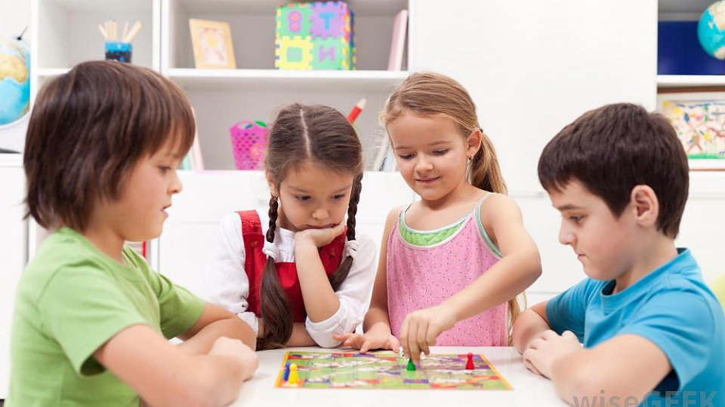
Role play conflict resolution
GO
# 1
During a game,
Someone didn’t follow the rules.

Slide 23
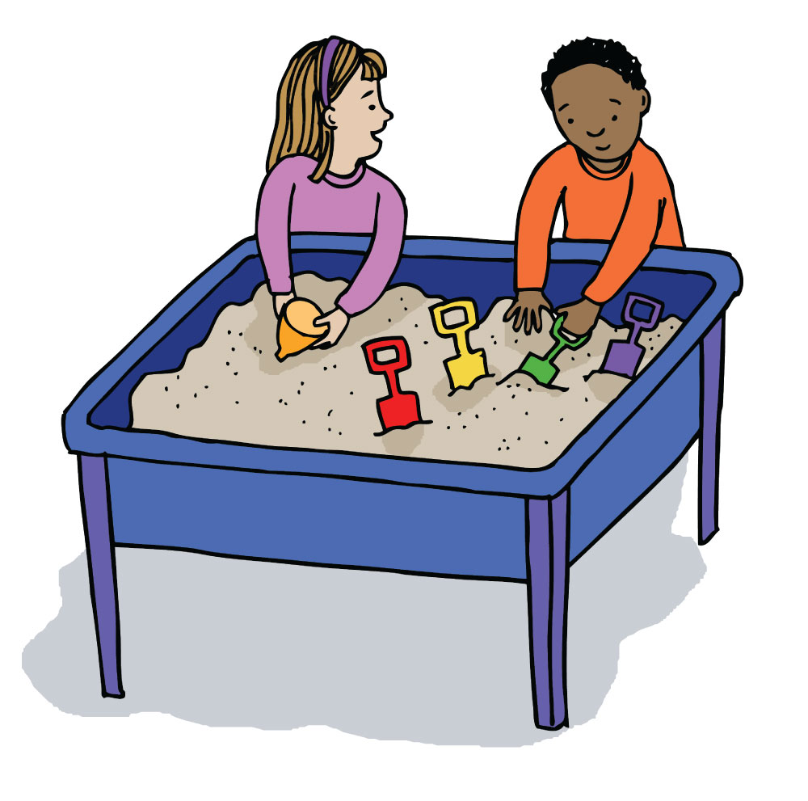
Role play conflict resolution
GO
# 4
Someone won’t share
Or
Won’t give you a turn.

Slide 24

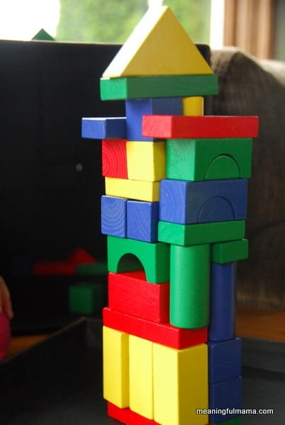
Role play conflict resolution
GO
# 2
peace
maker
Someone ran into your tower and broke it.

Slide 25
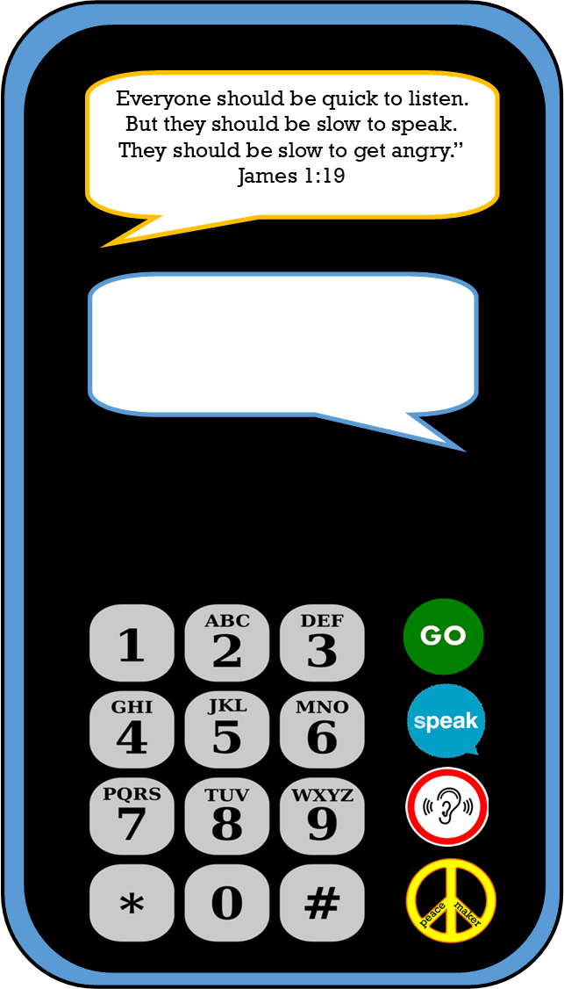
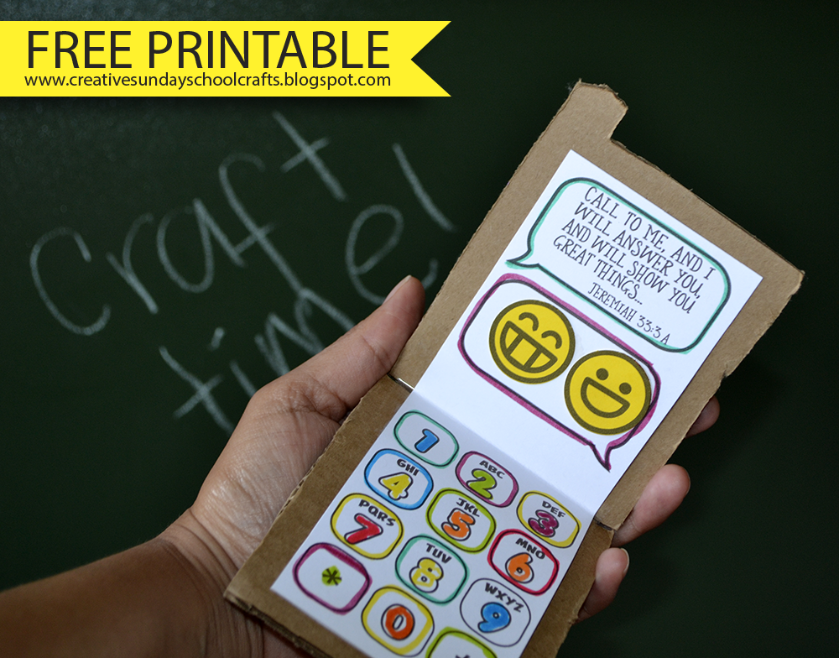
Craft time
Get craft at Creative Sunday School Crafts

Slide 26
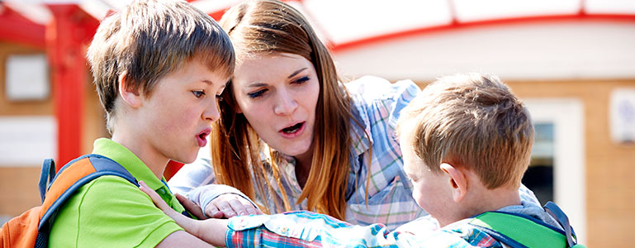
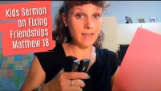
Object lesson –
Friendships are important!
If broken, fix it.
If you need help, get help to fix it

Slide 27
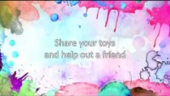
Let’s sing

Slide 28


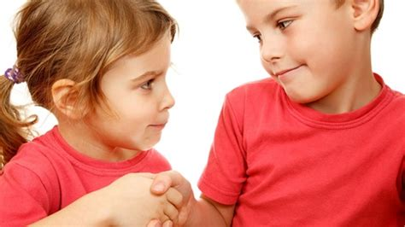
Let’s sing
Blessed Are The Peacemakers (Click here to print this page) From the album 365: My Every Day Bible Song Collection BLESSED ARE THE PEACEMAKERS Words & Music by Stephen Elkins Chorus Bicker, bicker, bicker Ringing in my ear Bicker, bicker, bicker It’s all I ever hear Bicker, bicker, bicker No good it ever brings And Jesus said a lot About our bickering Blessed are the peacemakers For they shall be called The sons of God Blessed are the peacemakers For they shall be called The sons of God repeat
Copyright Wonder Workshop, a division of Stephen's Group, Inc.

Slide 29

THE END

