Slide 1
Let My People Go!
Pharaoh and Plagues
Exodus 5-10

Slide 2
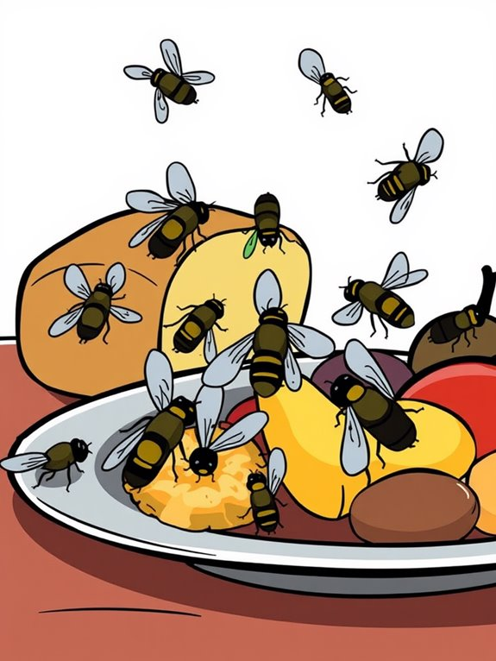
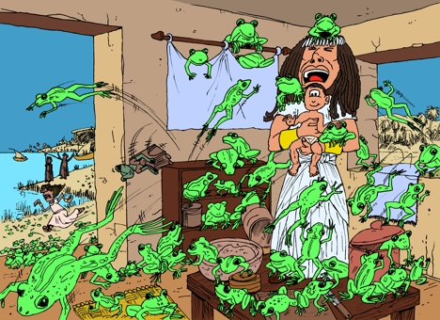

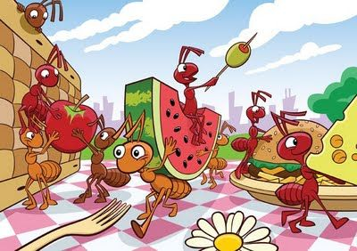
Have you ever had so many of something that it bugged you? Tell me… …about it

Slide 3
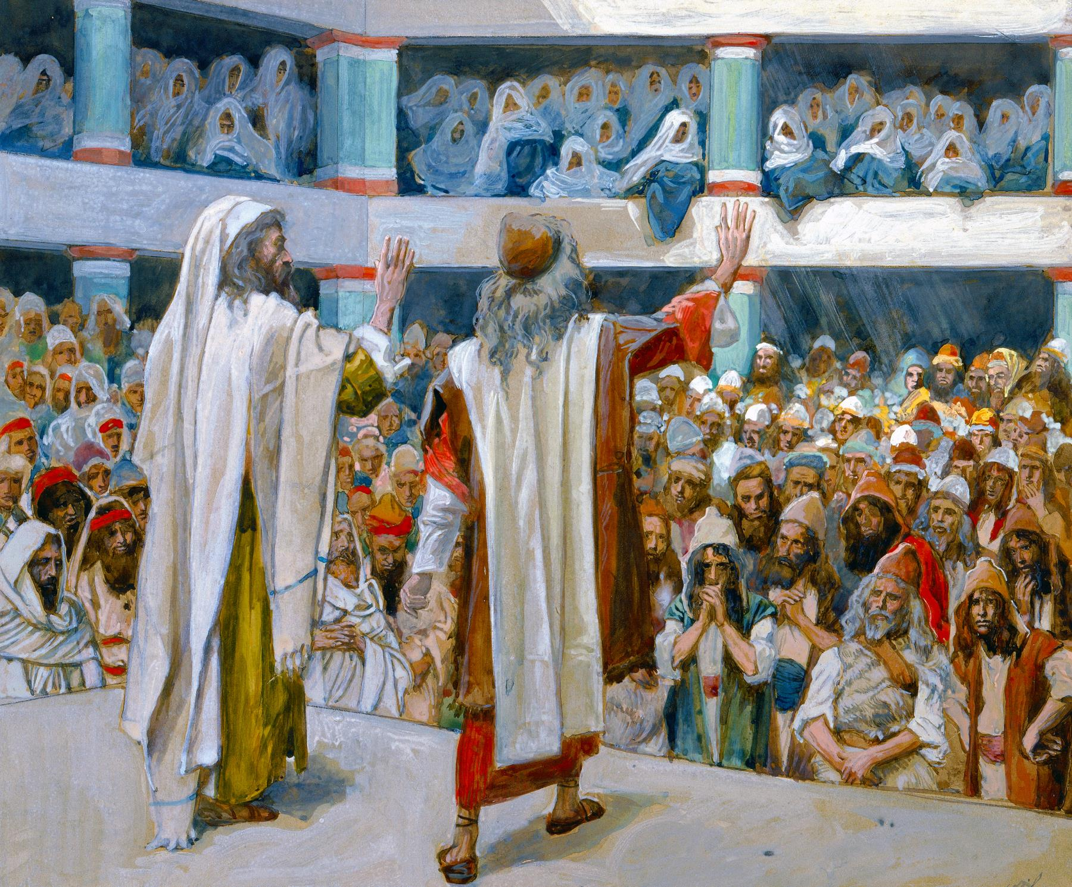



Exodus 4
God sees your pain. He has heard you cry out to Him. He has met with me. Yahweh is His name. He will deliver you!
²⁹ Moses and Aaron brought together all the elders of the Israelites, ³⁰ and Aaron told them everything the Lord had said to Moses.
He also performed the signs before the people, ³¹ and they believed.
And when they heard that the Lord was concerned about them and had seen their misery, they bowed down and worshiped.
Praise the LORD!
You, YAHWEH, have heard and answered.
You are our God!
During this first part you can illustrate the story with playdough.
Act it out: Have ‘Moses’ throw down a stick. Replace it with a fake snake. Have him pick it up by the tail and then give him back the staff.

Slide 4
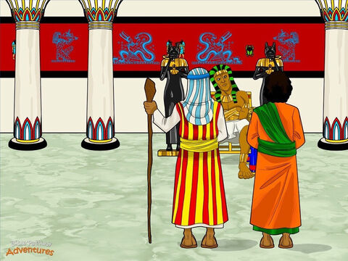
Exodus 4
NO! Get back to work!
Now you must make the same number of bricks, but get your own straw.
We won’t provide the straw!
Get back to work!
Who is this lord that I should obey him and let Israel go?
I don’t know him.
I won’t let Israel go!
The God of the Hebrews has met with us.
Let us take a 3 day journey into the wilderness and hold a festival to the LORD our God and offer sacrifices to Him or He may strike with plagues or with the sword.
This is what the LORD, God of Israel, says:
“Let my people go
so that they may hold a festival to me in the wilderness.
Afterward Moses and Aaron went to Pharaoh and said, “This is what the Lord, the God of Israel, says: ‘Let my people go, so that they may hold a festival to me in the wilderness.’”
² Pharaoh said, “Who is the Lord, that I should obey him and let Israel go? I do not know the Lord and I will not let Israel go.”
³ Then they said, “The God of the Hebrews has met with us. Now let us take a three-day journey into the wilderness to offer sacrifices to the Lord our God, or he may strike us with plagues or with the sword.”
⁴ But the king of Egypt said, “Moses and Aaron, why are you taking the people away from their labor? Get back to your work!” ⁵ Then Pharaoh said, “Look, the people of the land are now numerous, and you are stopping them from working.”
⁶ That same day Pharaoh gave this order to the slave drivers and overseers in charge of the people: ⁷ “You are no longer to supply the people with straw for making bricks; let them go and gather their own straw. ⁸ But require them to make the same number of bricks as before; don’t reduce the quota. They are lazy; that is why they are crying out, ‘Let us go and sacrifice to our God.’ ⁹ Make the work harder for the people so that they keep working and pay no attention to lies.
Act it out: Have ‘Moses’ throw down a stick. Replace it with a fake snake. Have him pick it up by the tail and then give him back the staff.

Slide 5
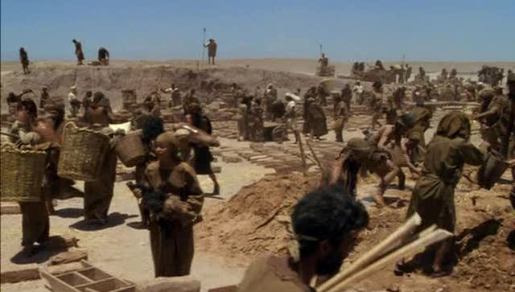
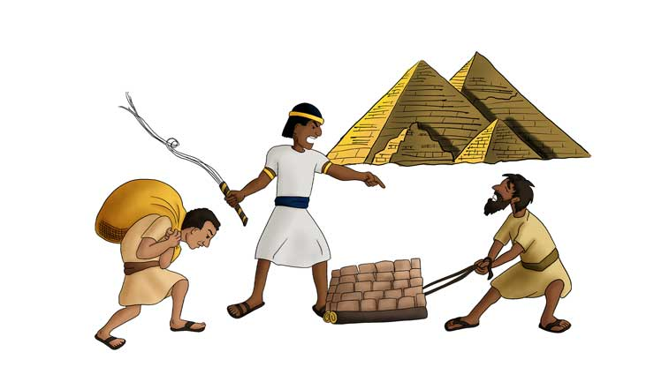

Bricks without Straw
Don’t talk to me that way!
Don’t be a slacker!
Make just as many bricks as you did before!
¹⁰ Then the slave drivers and the overseers went out and said to the people, “This is what Pharaoh says: ‘I will not give you any more straw. ¹¹ Go and get your own straw wherever you can find it, but your work will not be reduced at all.’” ¹² So the people scattered all over Egypt to gather stubble to use for straw. ¹³ The slave drivers kept pressing them, saying, “Complete the work required of you for each day, just as when you had straw.” ¹⁴ And Pharaoh’s slave drivers beat the Israelite overseers they had appointed, demanding, “Why haven’t you met your quota of bricks yesterday or today, as before?”
¹⁵ Then the Israelite overseers went and appealed to Pharaoh: “Why have you treated your servants this way? ¹⁶ Your servants are given no straw, yet we are told, ‘Make bricks!’ Your servants are being beaten, but the fault is with your own people.”
¹⁷ Pharaoh said, “Lazy, that’s what you are—lazy! That is why you keep saying, ‘Let us go and sacrifice to the Lord.’ ¹⁸ Now get to work. You will not be given any straw, yet you must produce your full quota of bricks.”
¹⁹ The Israelite overseers realized they were in trouble when they were told, “You are not to reduce the number of bricks required of you for each day.” ²⁰ When they left Pharaoh, they found Moses and Aaron waiting to meet them, ²¹ and they said, “May the Lord look on you and judge you! You have made us obnoxious to Pharaoh and his officials and have put a sword in their hand to kill us.”
This is too hard

Slide 6
Exodus 6
The LORD God Almighty, the God who appeared to Abraham, Isaac, and Jacob will rule with power, stretch out His hand, rescue you and be your God. He will keep His promises to Abraham, Isaac, and Jacob and bring you to the Promised Land .
He has made it so we have to gather our own straw and make as many bricks.
We aren’t listening.
hen the Lord said to Moses, “Now you will see what I will do to Pharaoh: Because of my mighty hand he will let them go; because of my mighty hand he will drive them out of his country.”
² God also said to Moses, “I am the Lord. ³ I appeared to Abraham, to Isaac and to Jacob as God Almighty,^{[a]} but by my name the Lord^{[b]} I did not make myself fully known to them. ⁴ I also established my covenant with them to give them the land of Canaan, where they resided as foreigners. ⁵ Moreover, I have heard the groaning of the Israelites, whom the Egyptians are enslaving, and I have remembered my covenant.
⁶ “Therefore, say to the Israelites: ‘I am the Lord, and I will bring you out from under the yoke of the Egyptians. I will free you from being slaves to them, and I will redeem you with an outstretched arm and with mighty acts of judgment. ⁷ I will take you as my own people, and I will be your God. Then you will know that I am the Lord your God, who brought you out from under the yoke of the Egyptians. ⁸ And I will bring you to the land I swore with uplifted hand to give to Abraham, to Isaac and to Jacob. I will give it to you as a possession. I am the Lord.’”
⁹ Moses reported this to the Israelites, but they did not listen to him because of their discouragement and harsh labor.

Slide 7
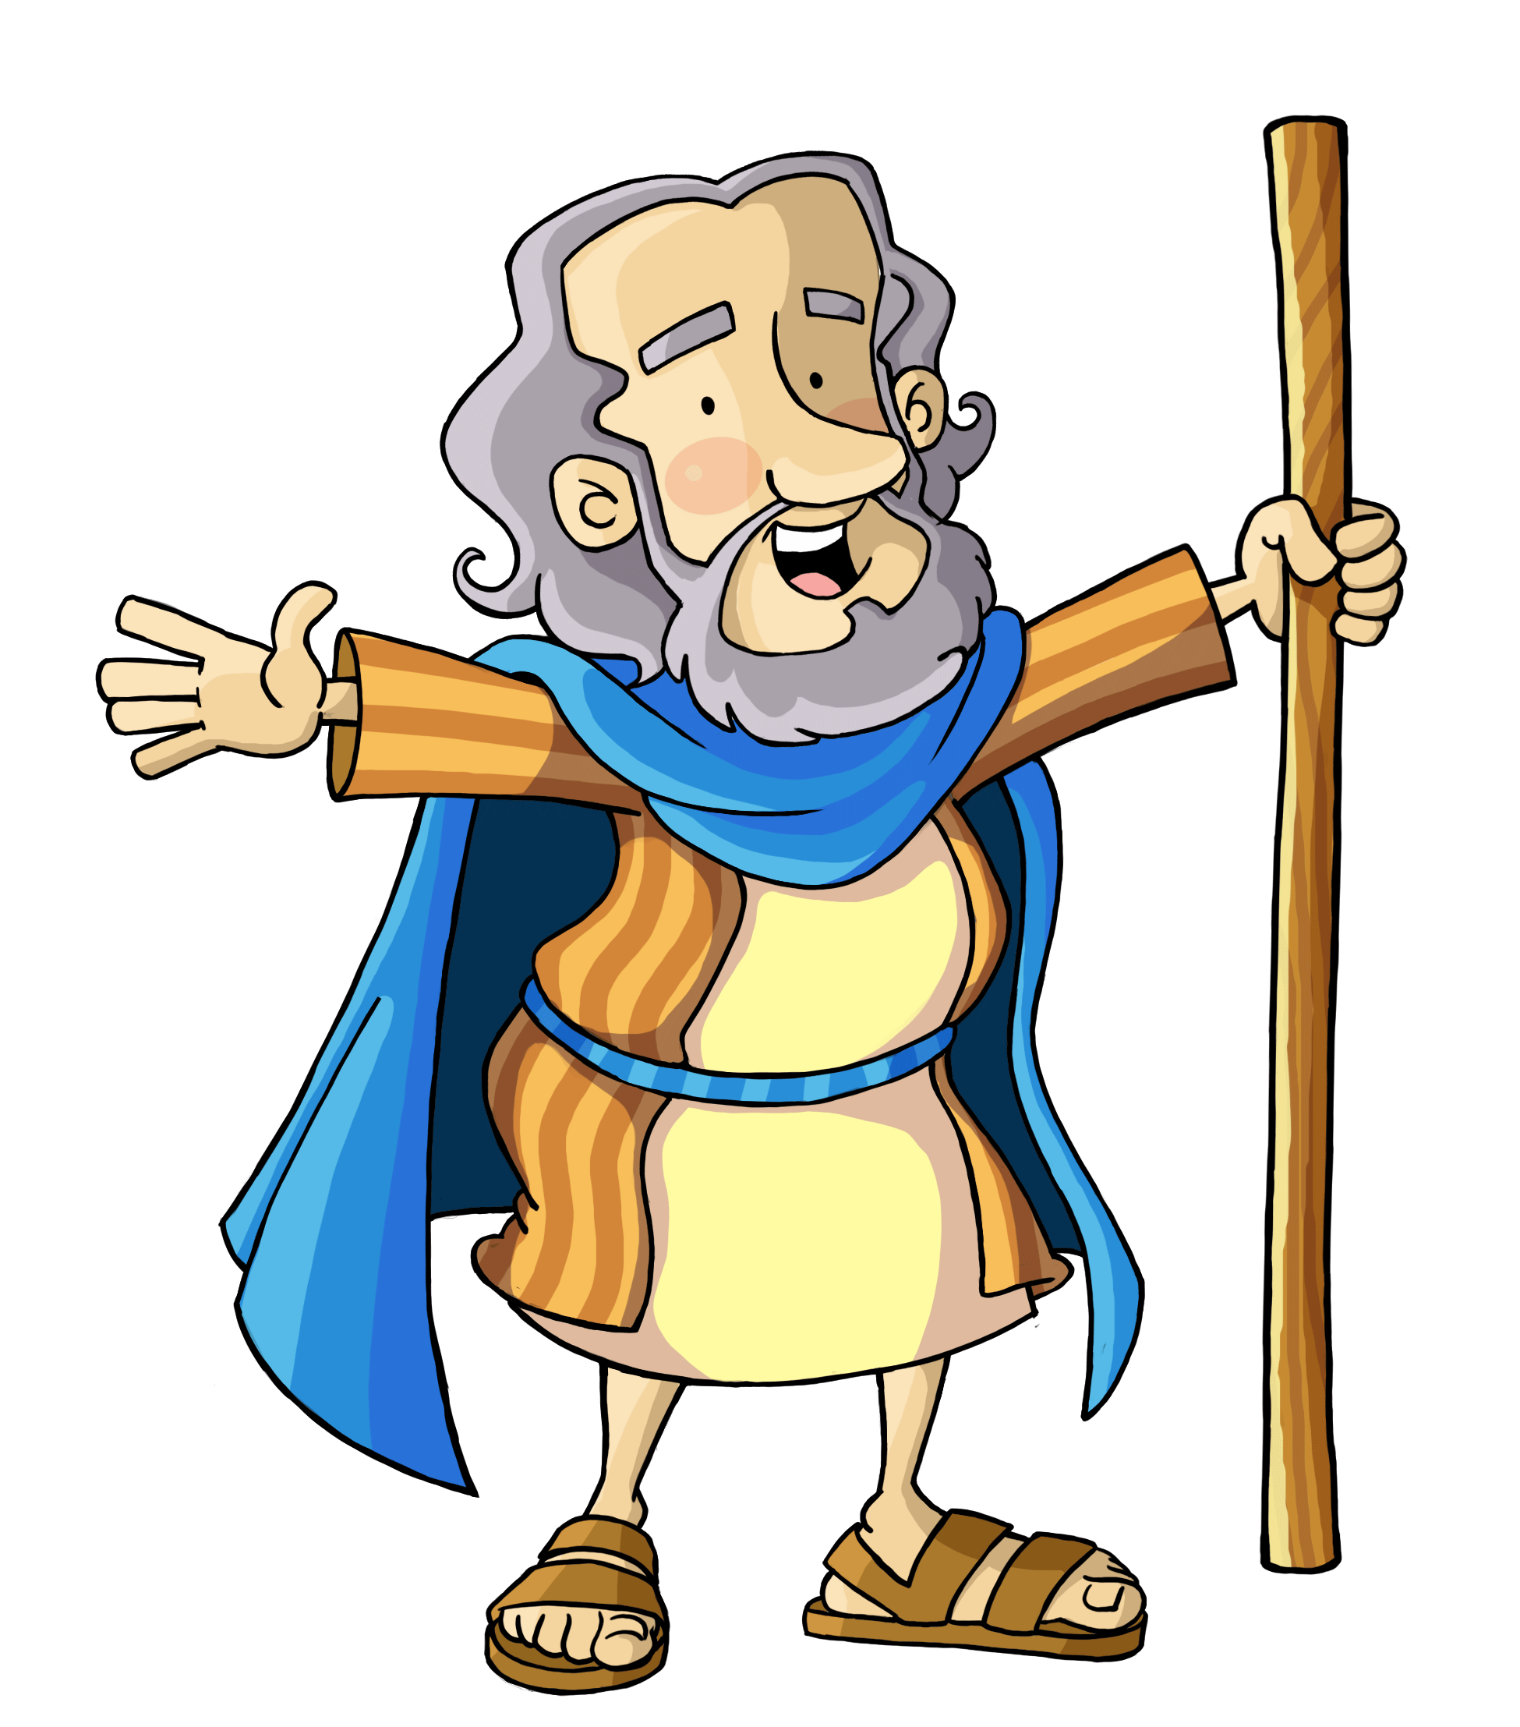
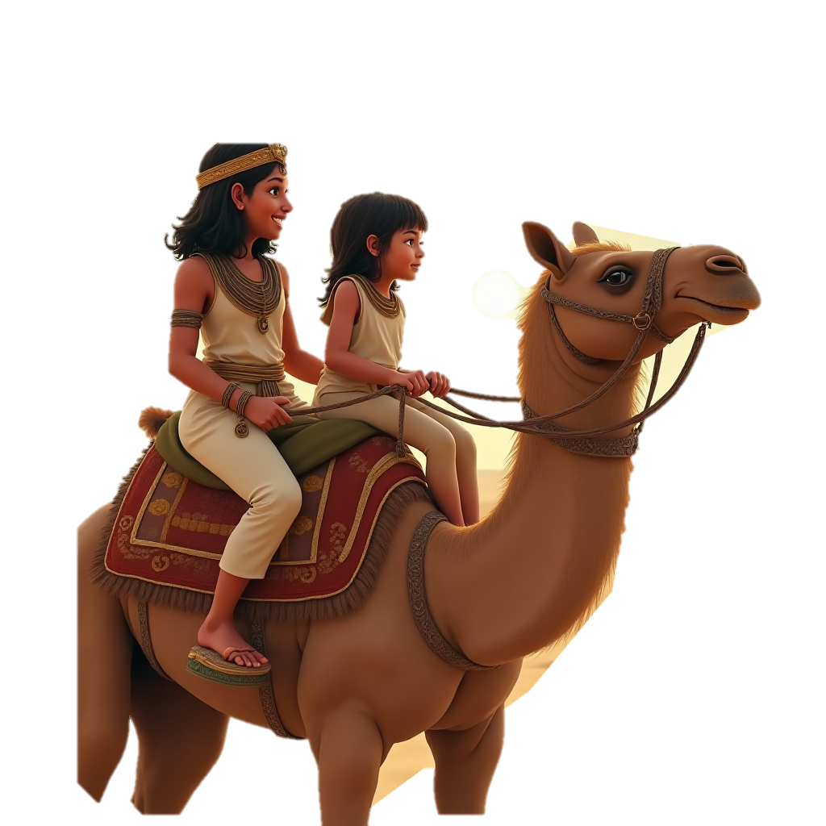
Moses talks with God
Because of my Mighty Hand, he will let them go.
Say what I tell you to say. Do what I tell you to do.
Pharaoh’s heart is hard and won’t let the people go until I show My mighty acts of judgement.
Exodus 5
²² Moses returned to the Lord and said, “Why, Lord, why have you brought trouble on this people? Is this why you sent me? ²³ Ever since I went to Pharaoh to speak in your name, he has brought trouble on this people, and you have not rescued your people at all.”
Exodus 6
Then the Lord said to Moses, “Now you will see what I will do to Pharaoh: Because of my mighty hand he will let them go; because of my mighty hand he will drive them out of his country.”…
¹⁰ Then the Lord said to Moses, ¹¹ “Go, tell Pharaoh king of Egypt to let the Israelites go out of his country.”
¹² But Moses said to the Lord, “If the Israelites will not listen to me, why would Pharaoh listen to me, since I speak with faltering lips^{[c]}?”
Exodus 7
Then the Lord said to Moses, “See, I have made you like God to Pharaoh, and your brother Aaron will be your prophet. ² You are to say everything I command you, and your brother Aaron is to tell Pharaoh to let the Israelites go out of his country. ³ But I will harden Pharaoh’s heart, and though I multiply my signs and wonders in Egypt, ⁴ he will not listen to you. Then I will lay my hand on Egypt and with mighty acts of judgment I will bring out my divisions, my people the Israelites. ⁵ And the Egyptians will know that I am the Lord when I stretch out my hand against Egypt and bring the Israelites out of it.”
⁶ Moses and Aaron did just as the Lord commanded them. ⁷ Moses was eighty years old and Aaron eighty-three when they spoke to Pharaoh.
Yahweh, Sovereign LORD, why have you brought trouble on your people? Ever since I obeyed you and told Pharaoh to let the people go, you have not rescued the people at all!
Did you know that Moses was 80 years old and Aaron was 83?

Slide 8
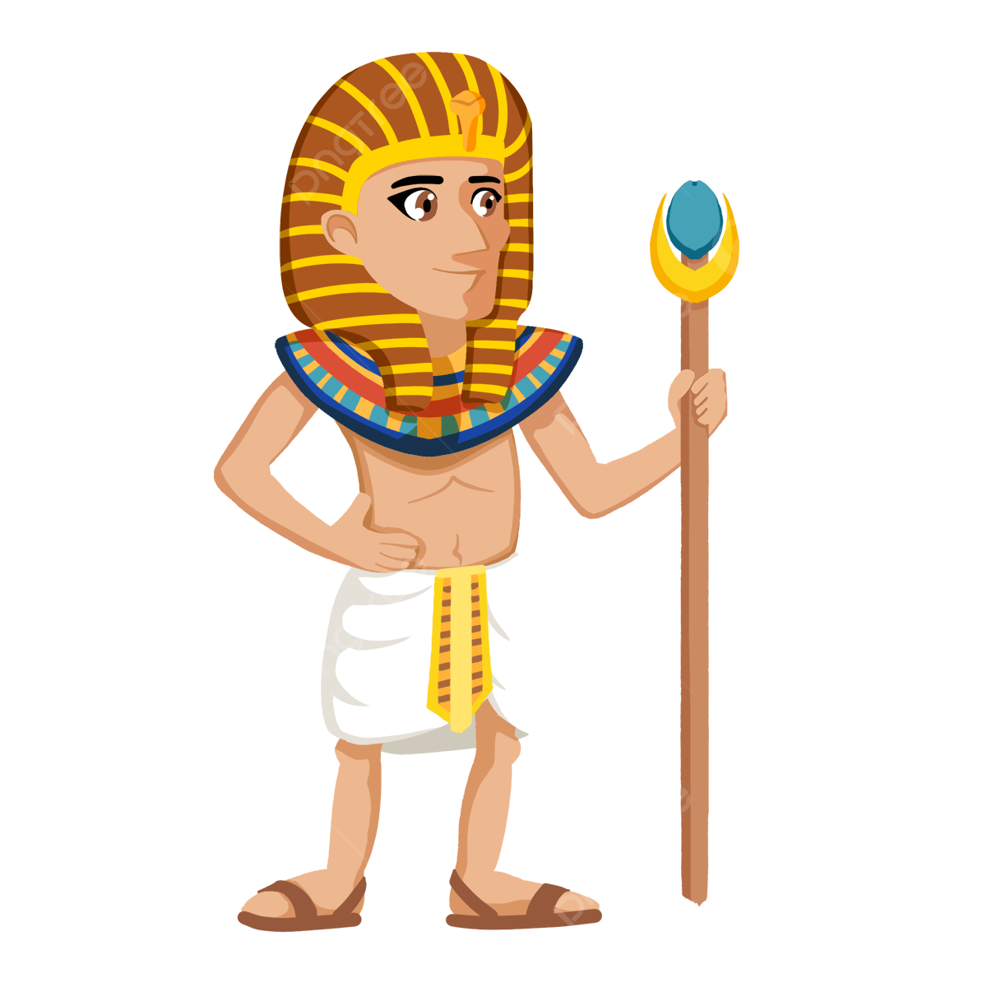
Exodus 8
Prove it.
So what.
My gods and their magicians can do wonders too.
The Sovereign LORD God Almighty, performs wonders and rules over all.
⁷ Moses was eighty years old and Aaron eighty-three when they spoke to Pharaoh.
Aaron’s Staff Becomes a Snake
⁸ The Lord said to Moses and Aaron, ⁹ “When Pharaoh says to you, ‘Perform a miracle,’ then say to Aaron, ‘Take your staff and throw it down before Pharaoh,’ and it will become a snake.”
¹⁰ So Moses and Aaron went to Pharaoh and did just as the Lord commanded. Aaron threw his staff down in front of Pharaoh and his officials, and it became a snake. ¹¹ Pharaoh then summoned wise men and sorcerers, and the Egyptian magicians also did the same things by their secret arts: ¹² Each one threw down his staff and it became a snake. But Aaron’s staff swallowed up their staffs. ¹³ Yet Pharaoh’s heart became hard and he would not listen to them, just as the Lord had said.
Our God is greater than your gods and stronger than their strength.
He is ready to prove it.
Hey it ate our snakes!
And our rods of authority!

Slide 9

They shall know
that I am
the Lord their God who brought them out of the land of Egypt, that I might dwell among them;
I am the Lord
their God.
Exodus
29:46

Slide 10

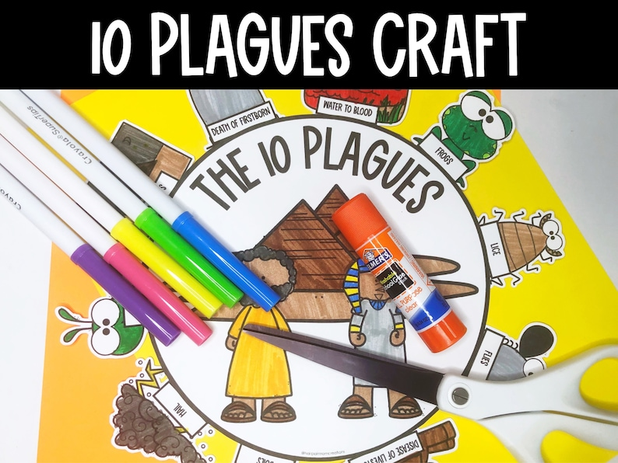
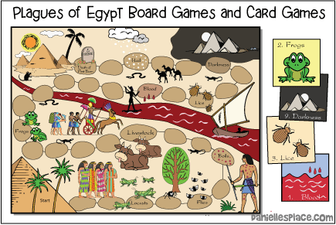
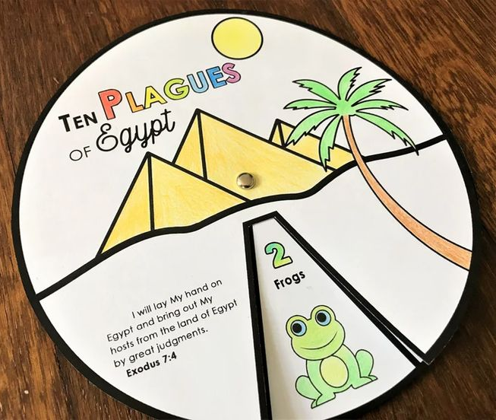
Craft Time
Throughout our story, we’ll work on the chosen craft. Color the picture that has to do with the plague we are talking about.
Free at donutsanddevos
Purchase From Etsy -- Link
Purchase From Danielle’s Place -- Link
Purchase from Etsy
Link

Slide 11
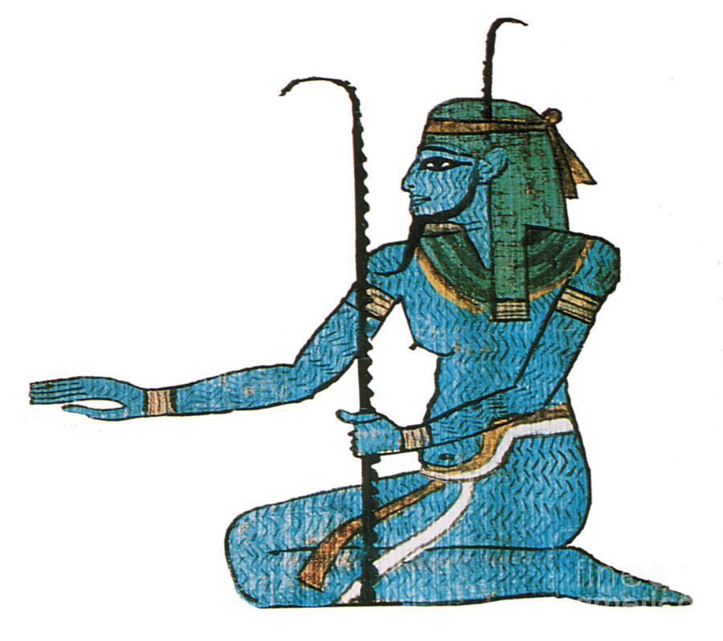
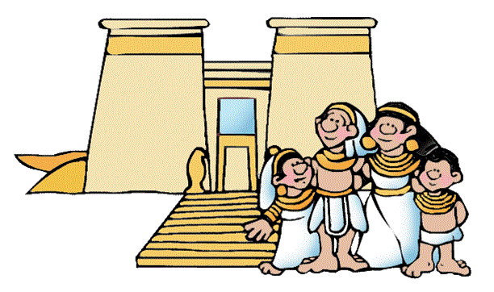
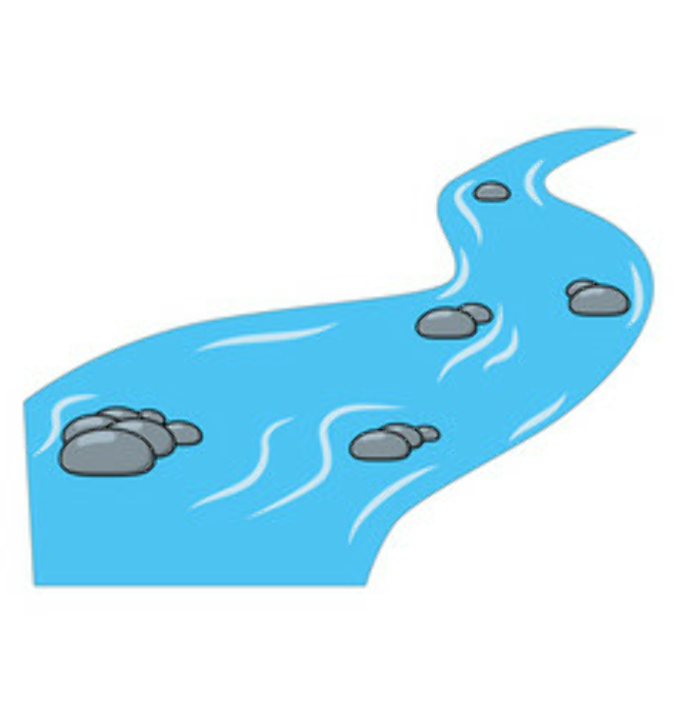
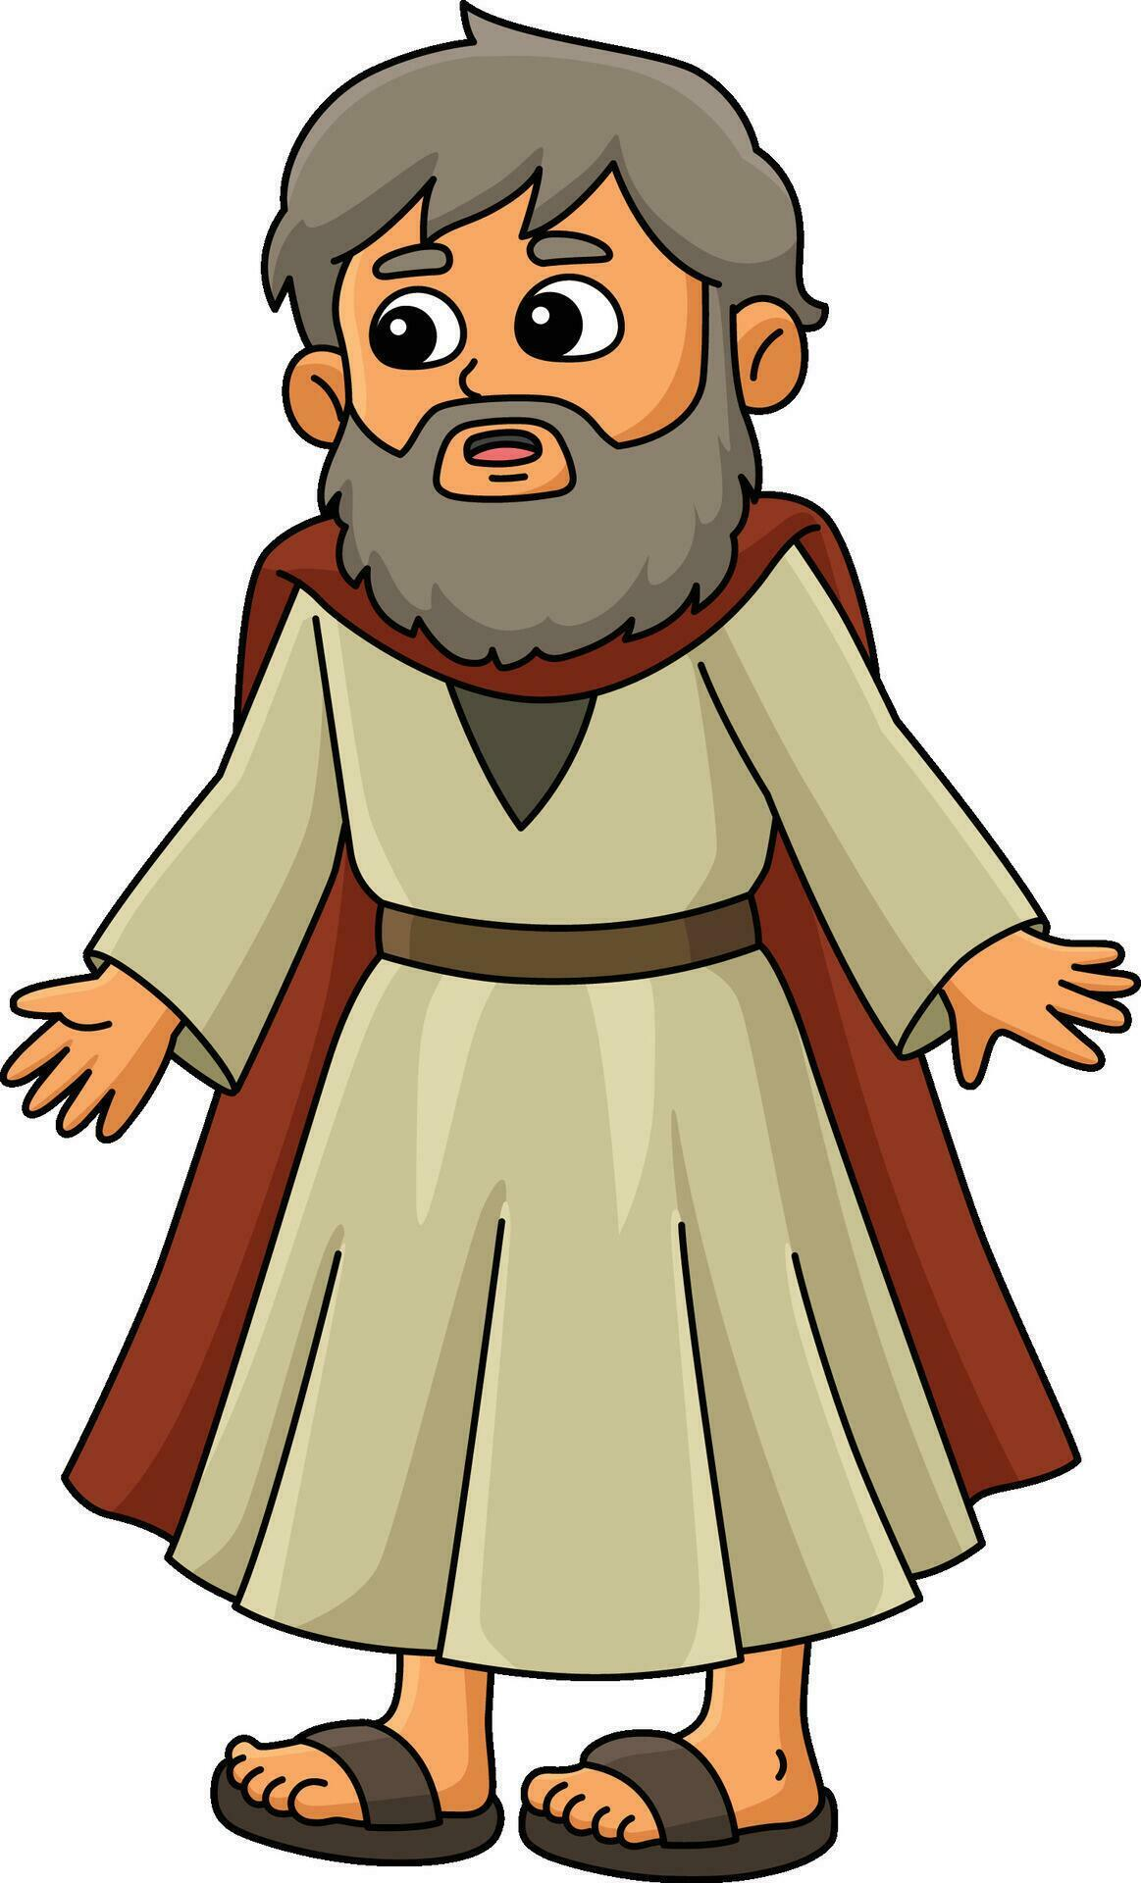
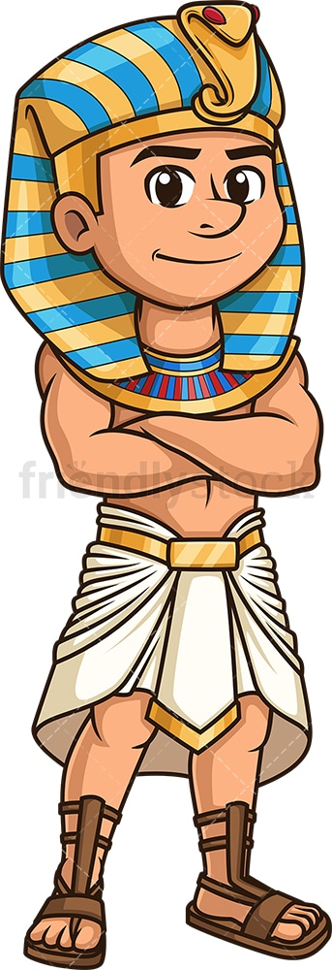
Plague #1
Bloody Nile
Act it out: Put red fabric, plastic, or cellophane over the blue fabric or plastic Nile on floor
¹⁴ Then the Lord said to Moses, “Pharaoh’s heart is unyielding; he refuses to let the people go. ¹⁵ Go to Pharaoh in the morning as he goes out to the river. Confront him on the bank of the Nile, and take in your hand the staff that was changed into a snake. ¹⁶ Then say to him, ‘The Lord, the God of the Hebrews, has sent me to say to you: Let my people go, so that they may worship me in the wilderness. But until now you have not listened. ¹⁷ This is what the Lord says: By this you will know that I am the Lord: With the staff that is in my hand I will strike the water of the Nile, and it will be changed into blood. ¹⁸ The fish in the Nile will die, and the river will stink; the Egyptians will not be able to drink its water.’”
¹⁹ The Lord said to Moses, “Tell Aaron, ‘Take your staff and stretch out your hand over the waters of Egypt—over the streams and canals, over the ponds and all the reservoirs—and they will turn to blood.’ Blood will be everywhere in Egypt, even in vessels^{[a]} of wood and stone.”
²⁰ Moses and Aaron did just as the Lord had commanded. He raised his staff in the presence of Pharaoh and his officials and struck the water of the Nile, and all the water was changed into blood. ²¹ The fish in the Nile died, and the river smelled so bad that the Egyptians could not drink its water. Blood was everywhere in Egypt.
²² But the Egyptian magicians did the same things by their secret arts, and Pharaoh’s heart became hard; he would not listen to Moses and Aaron, just as the Lord had said. ²³ Instead, he turned and went into his palace, and did not take even this to heart. ²⁴ And all the Egyptians dug along the Nile to get drinking water, because they could not drink the water of the river.
The Sovereign LORD has said,
“Let My people go!”
But you haven’t listened.
Now the LORD will change the river Nile to blood
The Hapi god is mad or bad.
Pew! That stinks!
Now what we are we going to drink?
Dig a well
So, what. My magicians can do that too.
Notes:
NIV Study Bible page 88
Our Sovereign LORD who rules over all things showed His sovereignty to Pharaoh, Egyptians, and the Israelites through the plages.
The water turning to blood was an attack on Hapi, the god of the Nile River

Slide 12




Plague #2
Frogs (Exodus 8)
²⁵ Seven days passed after the Lord struck the Nile.
^{1 [a]}Then the Lord said to Moses, “Go to Pharaoh and say to him, ‘This is what the Lord says: Let my people go, so that they may worship me. ² If you refuse to let them go, I will send a plague of frogs on your whole country. ³ The Nile will teem with frogs. They will come up into your palace and your bedroom and onto your bed, into the houses of your officials and on your people, and into your ovens and kneading troughs. ⁴ The frogs will come up on you and your people and all your officials.’”
⁵ Then the Lord said to Moses, “Tell Aaron, ‘Stretch out your hand with your staff over the streams and canals and ponds, and make frogs come up on the land of Egypt.’”
⁶ So Aaron stretched out his hand over the waters of Egypt, and the frogs came up and covered the land. ⁷ But the magicians did the same things by their secret arts; they also made frogs come up on the land of Egypt.
There will be frogs inside and outside,
in baskets, beds, ovens, kneeding troughs… everywhere!
The Sovereign LORD says.
“Let My people go!”
If you don’t there will be a plague of frogs.
Who cares!
My magicians can do that!
Act it out: Act like a frog or react to frogs hopping everywhere

Slide 13


Frog activity
What do you know about frogs?
Look
at a
frog

Slide 14
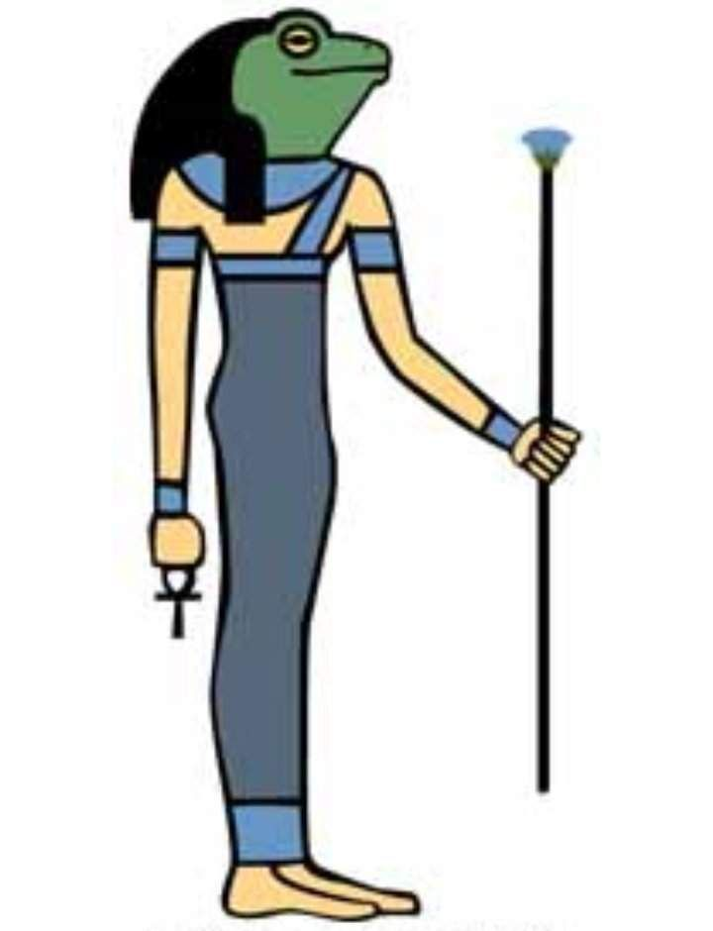
Please pray
⁸ Pharaoh summoned Moses and Aaron and said, “Pray to the Lord to take the frogs away from me and my people, and I will let your people go to offer sacrifices to the Lord.”
⁹ Moses said to Pharaoh, “I leave to you the honor of setting the time for me to pray for you and your officials and your people that you and your houses may be rid of the frogs, except for those that remain in the Nile.”
¹⁰ “Tomorrow,” Pharaoh said.
Moses replied, “It will be as you say, so that you may know there is no one like the Lord our God. ¹¹ The frogs will leave you and your houses, your officials and your people; they will remain only in the Nile.”
¹² After Moses and Aaron left Pharaoh, Moses cried out to the Lord about the frogs he had brought on Pharaoh. ¹³ And the Lord did what Moses asked. The frogs died in the houses, in the courtyards and in the fields. ¹⁴ They were piled into heaps, and the land reeked of them. ¹⁵ But when Pharaoh saw that there was relief, he hardened his heart and would not listen to Moses and Aaron, just as the Lord had said.
I will pray. And the frogs will leave.
Only the ones in the Nile will be left.
You may choose when.
My god Heqt can’t make them go away.
Tomorrow
Please pray that your God will take the frogs away.
Notes:
NIV Study Bible page 88
Our Sovereign LORD who rules over all things showed His sovereignty to Pharaoh, Egyptians, and the Israelites through the plages.
The plague of frogs mocked the goddess Heqt, a frog-headed goddess who supposedly helped women give birth.

Slide 15
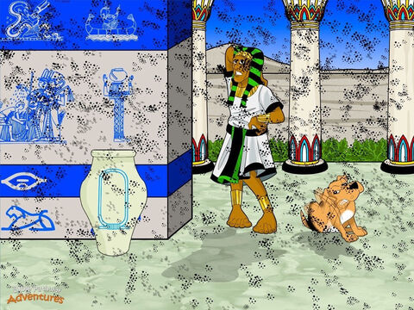
Plague #3
Gnats or Lice
NIV says gnats KJV says lice
Stretch out your hand and strike the dust of the ground
and throughout Egypt, the dust will become gnats (lice).
We can’t make
gnats (lice).
This is the finger of God.
Oo ooo These pesty gnats are everywhere! They’re even in
my nose!
¹⁶ Then the Lord said to Moses, “Tell Aaron, ‘Stretch out your staff and strike the dust of the ground,’ and throughout the land of Egypt the dust will become gnats.” ¹⁷ They did this, and when Aaron stretched out his hand with the staff and struck the dust of the ground, gnats came on people and animals. All the dust throughout the land of Egypt became gnats. ¹⁸ But when the magicians tried to produce gnats by their secret arts, they could not.
Since the gnats were on people and animals everywhere, ¹⁹ the magicians said to Pharaoh, “This is the finger of God.” But Pharaoh’s heart was hard and he would not listen, just as the Lord had said.
Look
at some
gnats
or lice
My magicians can do that…. Or not.
Notes:
NIV Study Bible page 88
Our Sovereign LORD who rules over all things showed His sovereignty to Pharaoh, Egyptians, and the Israelites through the plages.
The gnats rose from the dust, which ridiculed Osiris, the god of death and the underworld whose death and rebirth were celebrated each year.

Slide 16
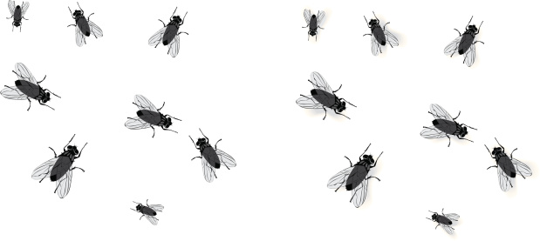

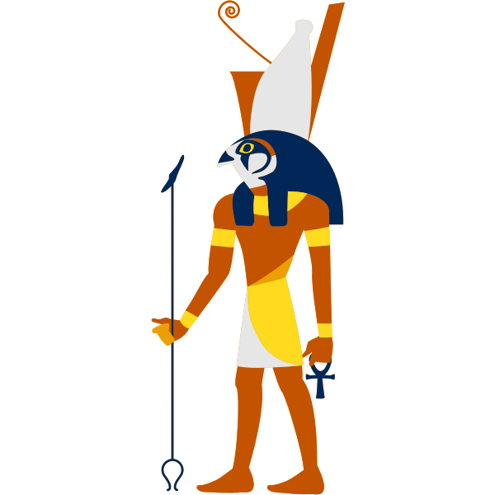
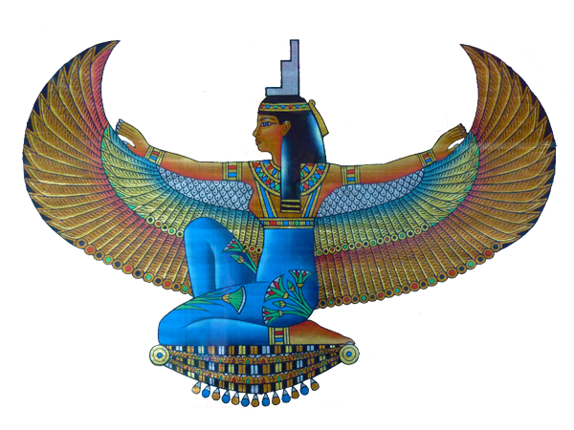
Plague #4
Flies
Look
at a
fly
²⁰ Then the Lord said to Moses, “Get up early in the morning and confront Pharaoh as he goes to the river and say to him, ‘This is what the Lord says: Let my people go, so that they may worship me. ²¹ If you do not let my people go, I will send swarms of flies on you and your officials, on your people and into your houses. The houses of the Egyptians will be full of flies; even the ground will be covered with them.
²² “‘But on that day I will deal differently with the land of Goshen, where my people live; no swarms of flies will be there, so that you will know that I, the Lord, am in this land. ²³ I will make a distinction^{[b]} between my people and your people. This sign will occur tomorrow.’”
²⁴ And the Lord did this. Dense swarms of flies poured into Pharaoh’s palace and into the houses of his officials; throughout Egypt the land was ruined by the flies.
If you don’t let my people go, Yahweh, the Sovereign LORD will send swarms of flies.
But there will not be flies in Goshen where my people live.
The LORD says,
Let my people go so that they can worship me.
Why can’t Isis and Horus control these bugs!
They may not go!
They are MY people.
Act it out: Buzz like a fly. Fly around the room and back to your chair.
Notes:
NIV Study Bible page 88
Our Sovereign LORD who rules over all things showed His sovereignty to Pharaoh, Egyptians, and the Israelites through the plages.
The flies of the 4th plague emphasized that just as God has power over the water and the earth, He also rules over the air, which showed God’s power over the sky-god Horus.

Slide 17
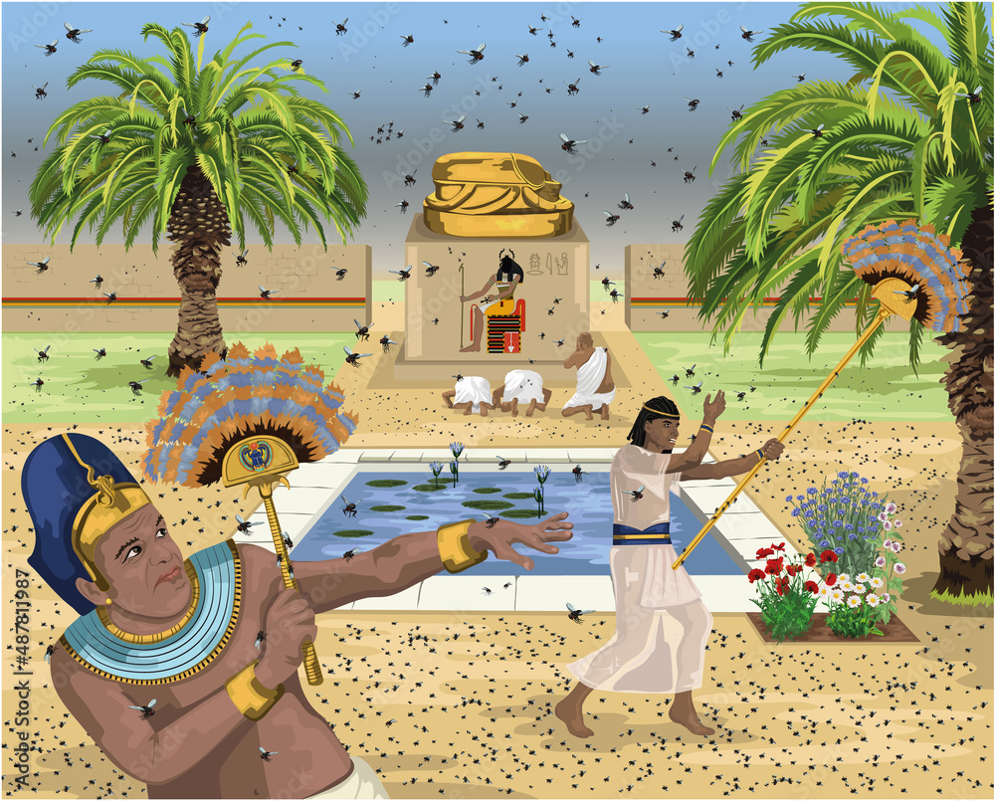
Make them leave!
²⁵ Then Pharaoh summoned Moses and Aaron and said, “Go, sacrifice to your God here in the land.”
²⁶ But Moses said, “That would not be right. The sacrifices we offer the Lord our God would be detestable to the Egyptians. And if we offer sacrifices that are detestable in their eyes, will they not stone us? ²⁷ We must take a three-day journey into the wilderness to offer sacrifices to the Lord our God, as he commands us.”
²⁸ Pharaoh said, “I will let you go to offer sacrifices to the Lord your God in the wilderness, but you must not go very far. Now pray for me.”
²⁹ Moses answered, “As soon as I leave you, I will pray to the Lord, and tomorrow the flies will leave Pharaoh and his officials and his people. Only let Pharaoh be sure that he does not act deceitfully again by not letting the people go to offer sacrifices to the Lord.”
³⁰ Then Moses left Pharaoh and prayed to the Lord, ³¹ and the Lord did what Moses asked. The flies left Pharaoh and his officials and his people; not a fly remained. ³² But this time also Pharaoh hardened his heart and would not let the people go.
No, that would not be right. The sacrifices we offer to the LORD would be detestable to the Egyptians.
I will pray and tomorrow the flies will leave.
We must make a 3 day journey into the wilderness just like He commanded us.
OK. I’ll let you go into the wilderness, but not very far.
OK. Go sacrifice to your God here in this land.
Now pray for me.
Remove the flies.

Slide 18
Plague #5
Livestock die
If you refuse and continue to hold back, there will be a plague on your livestock in the fields. Many horses, donkeys, camels, cattle, sheep, and goats will die.
But those belonging to the Israelites will not die.
Then the Lord said to Moses, “Go to Pharaoh and say to him, ‘This is what the Lord, the God of the Hebrews, says: “Let my people go, so that they may worship me.” ² If you refuse to let them go and continue to hold them back, ³ the hand of the Lord will bring a terrible plague on your livestock in the field—on your horses, donkeys and camels and on your cattle, sheep and goats. ⁴ But the Lord will make a distinction between the livestock of Israel and that of Egypt, so that no animal belonging to the Israelites will die.’”
The Sovereign LORD says,
“Let My people go!”
This is much nicer.
I changed my mind. You may not go.

Slide 19
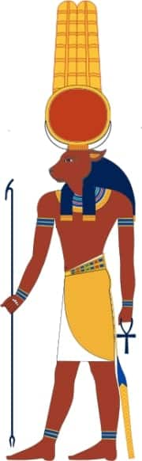
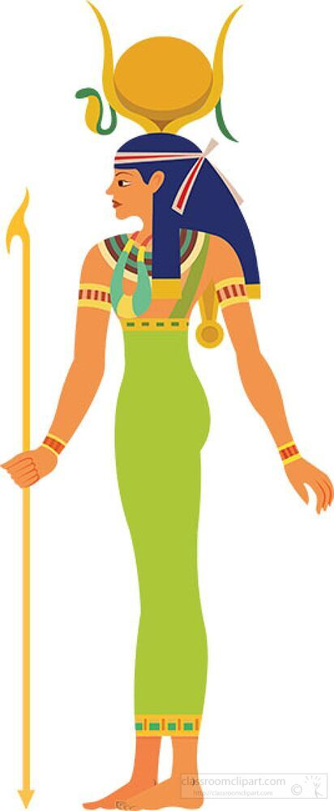
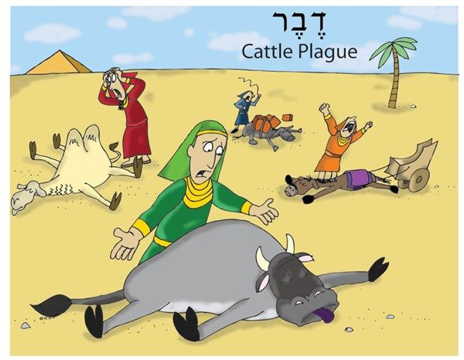
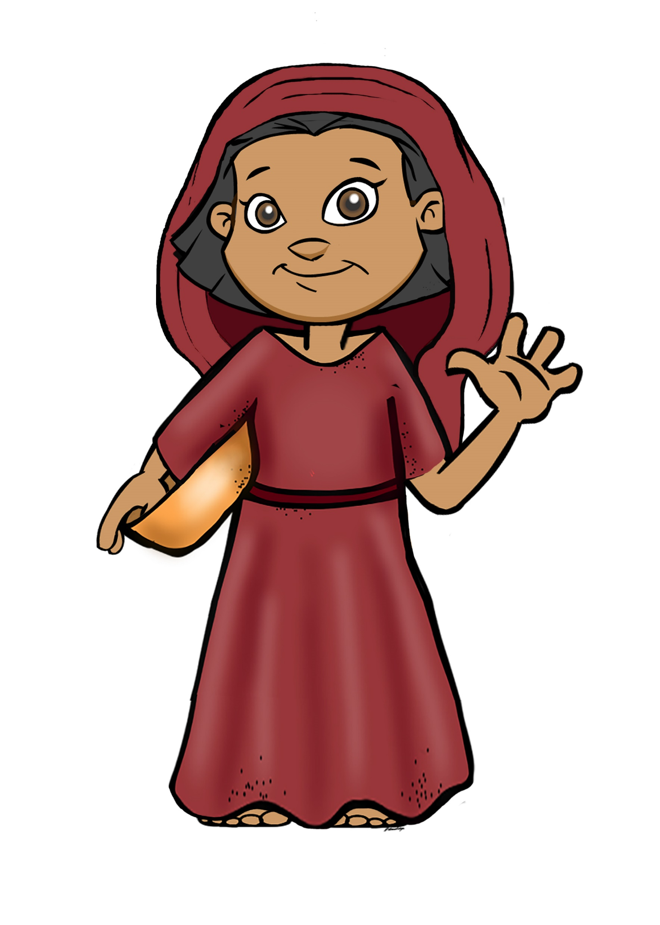
Hmm. It’s true.
Many Egyptian livestock died, but none of the Israelite livestock died.
My gods are weak.
But, I won’t let those people go!
⁵ The Lord set a time and said, “Tomorrow the Lord will do this in the land.” ⁶ And the next day the Lord did it: All the livestock of the Egyptians died, but not one animal belonging to the Israelites died. ⁷ Pharaoh investigated and found that not even one of the animals of the Israelites had died. Yet his heart was unyielding and he would not let the people go.
Your gods are false gods.
The LORD Yahweh is real!
Act it out: Act like a sheep/cow/camel…. and then die unless you live in Israel.
Notes:
NIV Study Bible page 88
Our Sovereign LORD who rules over all things showed His sovereignty to Pharaoh, Egyptians, and the Israelites through the plages.
In the plague on the livestock, God exalted himself over the cow-god, Hathor and the bull-gods A[is and Mnevis.

Slide 20
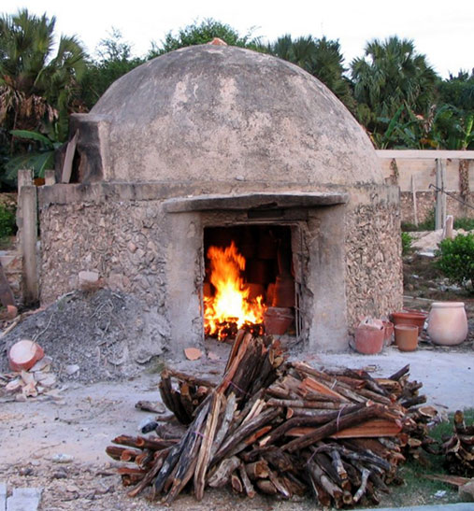

Plague #6
Boils
Take handfuls of soot from a furnace. Toss it into the air.
It will become a fine dust over the whole land of Egypt.
People and animals will break out with boils.
⁸ Then the Lord said to Moses and Aaron, “Take handfuls of soot from a furnace and have Moses toss it into the air in the presence of Pharaoh. ⁹ It will become fine dust over the whole land of Egypt, and festering boils will break out on people and animals throughout the land.”
¹⁰ So they took soot from a furnace and stood before Pharaoh. Moses tossed it into the air, and festering boils broke out on people and animals.
Now they’re using the brick-making furnace soot against me.
Act it out: Put red sticker dots on the kids.

Slide 21
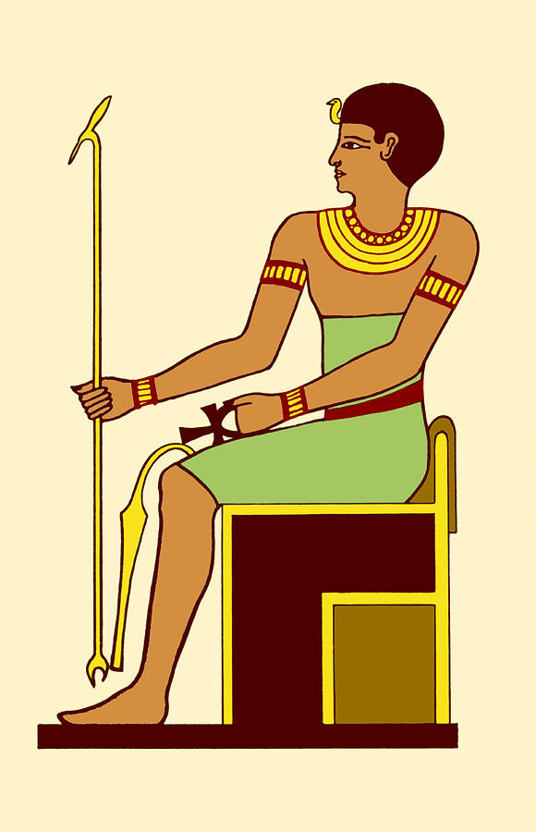
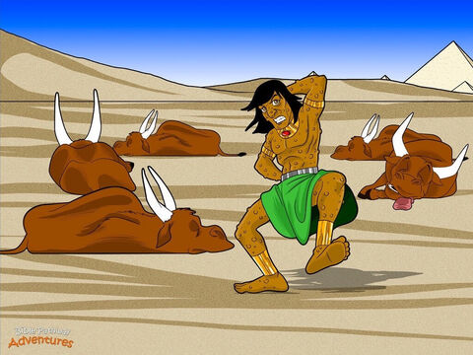
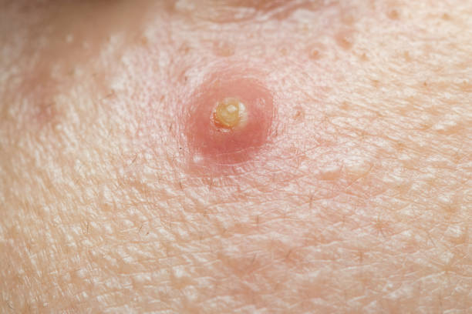
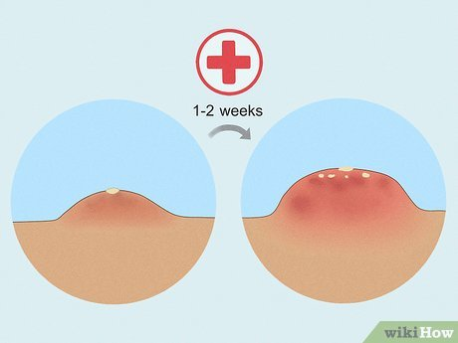
¹¹ The magicians could not stand before Moses because of the boils that were on them and on all the Egyptians. ¹² But the Lord hardened Pharaoh’s heart and he would not listen to Moses and Aaron, just as the Lord had said to Moses.
I can’t stand these boils!
Where is Imhotep who is supposed to heal?
I can’t even go to work!
Too bad!
My slaves are not leaving!
Act it out: Put red sticker dots on the kids.
Notes:
NIV Study Bible page 88
Our Sovereign LORD who rules over all things showed His sovereignty to Pharaoh, Egyptians, and the Israelites through the plages.
The boils of the 6th plague originated in the soot of kilns that fired bricks used to build the magnificent structures that were the glory of Egypt. God showed His power by using these kilns against the Egyptians, perhaps judging them for forcing the Israelites into slavery to make bricks. It also opposed Imhotep for medical cures.

Slide 22
Plague #7
Hail
Now I will send the full force of plagues against Egypt.
If you don’t there will be the worst hailstorm there has ever been.
Tell everyone to go inside – everyone and their animals or they will die.
God could have totally destroyed Egypt by now.
He made you Pharaoh now so He could show His power.
Again, Yahweh commands,
“let my people go and worship Me!”
¹³ Then the Lord said to Moses, “Get up early in the morning, confront Pharaoh and say to him, ‘This is what the Lord, the God of the Hebrews, says: Let my people go, so that they may worship me, ¹⁴ or this time I will send the full force of my plagues against you and against your officials and your people, so you may know that there is no one like me in all the earth. ¹⁵ For by now I could have stretched out my hand and struck you and your people with a plague that would have wiped you off the earth. ¹⁶ But I have raised you up^{[a]} for this very purpose, that I might show you my power and that my name might be proclaimed in all the earth. ¹⁷ You still set yourself against my people and will not let them go. ¹⁸ Therefore, at this time tomorrow I will send the worst hailstorm that has ever fallen on Egypt, from the day it was founded till now. ¹⁹ Give an order now to bring your livestock and everything you have in the field to a place of shelter, because the hail will fall on every person and animal that has not been brought in and is still out in the field, and they will die.’”
²⁰ Those officials of Pharaoh who feared the word of the Lord hurried to bring their slaves and their livestock inside. ²¹ But those who ignored the word of the Lord left their slaves and livestock in the field.
²² Then the Lord said to Moses, “Stretch out your hand toward the sky so that hail will fall all over Egypt—on people and animals and on everything growing in the fields of Egypt.” ²³ When Moses stretched out his staff toward the sky, the Lord sent thunder and hail, and lightning flashed down to the ground. So the Lord rained hail on the land of Egypt; ²⁴ hail fell and lightning flashed back and forth. It was the worst storm in all the land of Egypt since it had become a nation. ²⁵ Throughout Egypt hail struck everything in the fields—both people and animals; it beat down everything growing in the fields and stripped every tree. ²⁶ The only place it did not hail was the land of Goshen, where the Israelites were.
What is hail?
Ice balls.
Quick let’s get home!

Slide 23
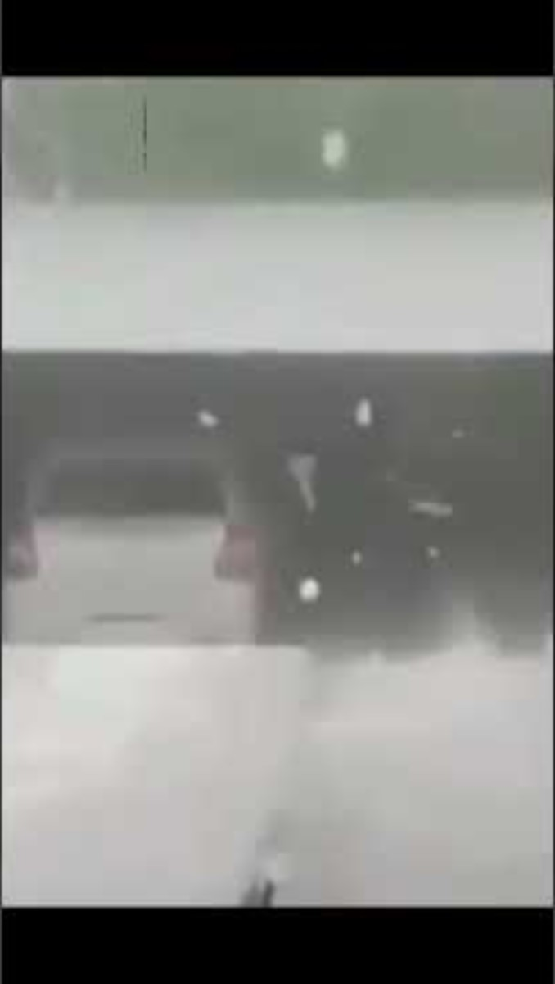
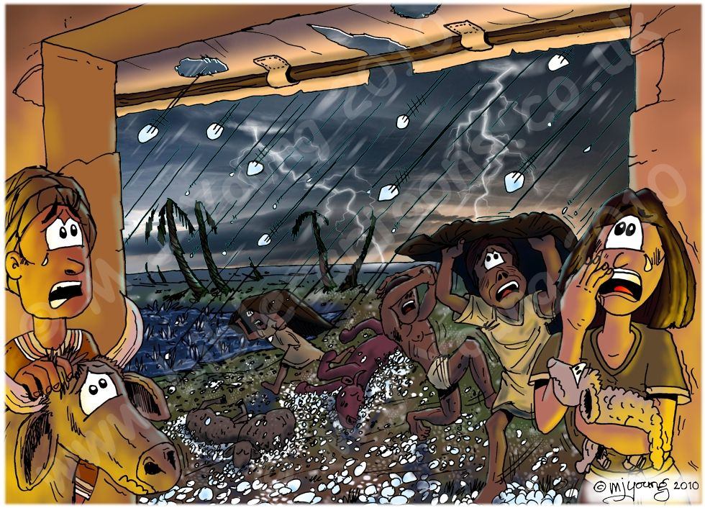
People and animals are dying.
The flax and barley fields are destroyed!
Oh! It is terrible!
I’m glad we obeyed and came inside with our animals!
Act it out: Hail is ice that bounces like ping pong balls
Feel some ice. Bounce some ping pong balls.

Slide 24
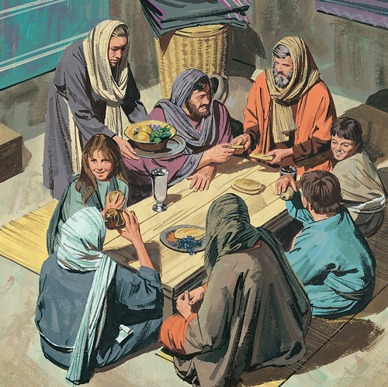
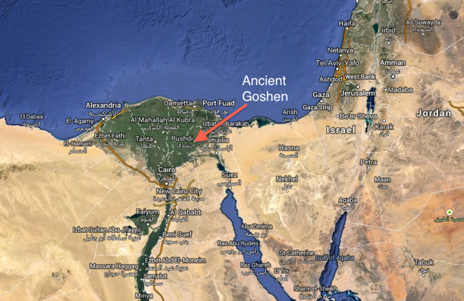
The Sovereign LORD is fighting for us now!
I see that He indeed rules over all things!
Amen!
Praise the Lord!
Like He said, Pharaoh’s heart is hard. He will only let us go if he sees how powerful our God is.
The Sovereign LORD is powerful! Did you see that the last plagues didn’t happen here, but they did in the rest of Egypt? It’s like God has put a protecting wall around us – an invisible wall!
The LORD is proving He is stronger than Egyptian’s gods.
Praise the LORD!
That’s true! They have had flies, boils, and hail. Their livestock have died and crops were ruined, but everything is fine here!

Slide 25

What a Might God We Serve

Slide 26
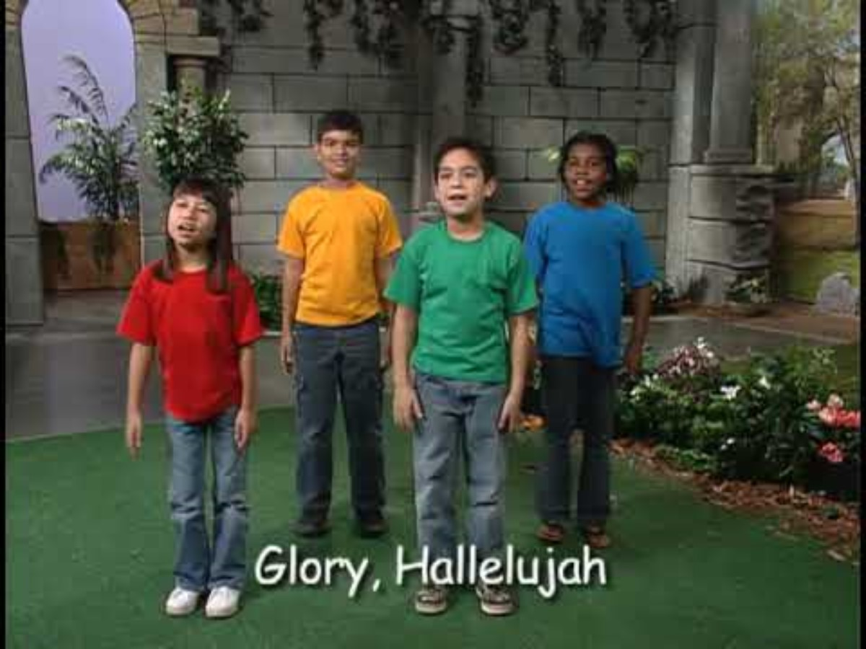
King of kings Lord of lords

Slide 27
Plague #8
Locusts
This is what the LORD, the God of the Hebrews says.
“Let my people go!”
If you don’t, tomorrow locusts will cover the ground and eat the little bit that survived the hailstorm.
The locusts will be everywhere – in the fields, your homes. No one has ever seen so many locusts!
Then the Lord said to Moses, “Go to Pharaoh, for I have hardened his heart and the hearts of his officials so that I may perform these signs of mine among them ² that you may tell your children and grandchildren how I dealt harshly with the Egyptians and how I performed my signs among them, and that you may know that I am the Lord.”
³ So Moses and Aaron went to Pharaoh and said to him, “This is what the Lord, the God of the Hebrews, says: ‘How long will you refuse to humble yourself before me? Let my people go, so that they may worship me. ⁴ If you refuse to let them go, I will bring locusts into your country tomorrow. ⁵ They will cover the face of the ground so that it cannot be seen. They will devour what little you have left after the hail, including every tree that is growing in your fields. ⁶ They will fill your houses and those of all your officials and all the Egyptians—something neither your parents nor your ancestors have ever seen from the day they settled in this land till now.’” Then Moses turned and left Pharaoh.

Slide 28
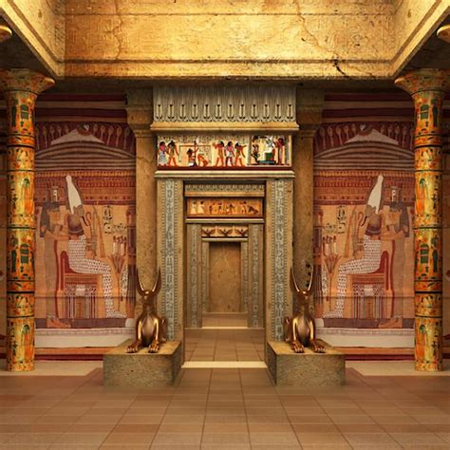
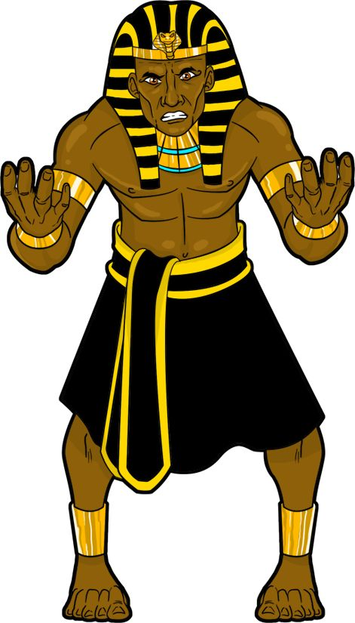
Pharaoh please
Pharaoh,
How long will you this man be a snare to us. Let the people go worship their god. Do you not realize that Egypt is ruined?
⁷ Pharaoh’s officials said to him, “How long will this man be a snare to us? Let the people go, so that they may worship the Lord their God. Do you not yet realize that Egypt is ruined?”
⁸ Then Moses and Aaron were brought back to Pharaoh. “Go, worship the Lord your God,” he said. “But tell me who will be going.”
⁹ Moses answered, “We will go with our young and our old, with our sons and our daughters, and with our flocks and herds, because we are to celebrate a festival to the Lord.”
¹⁰ Pharaoh said, “The Lord be with you—if I let you go, along with your women and children! Clearly you are bent on evil.^{[a]} ¹¹ No! Have only the men go and worship the Lord, since that’s what you have been asking for.” Then Moses and Aaron were driven out of Pharaoh’s presence.
Wait! If all of you go, clearly you are bent on evil.
No! Only the men may go.
Now leave this room!
Go worship your God.
But who all will be going?
We will go with our young and old, sons and daughters, flocks and herds because we will celebrate a festival to the LORD.

Slide 29
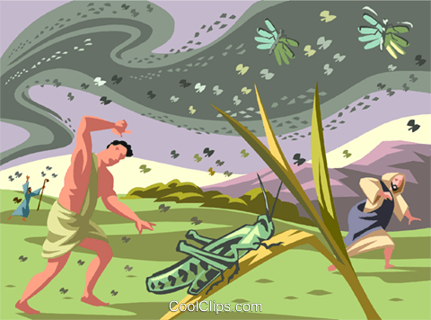
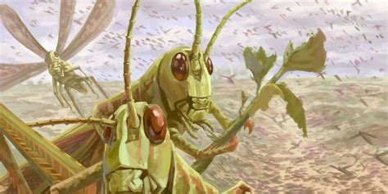
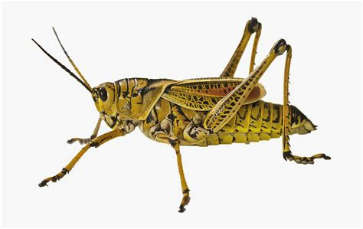

Stretch out your hand over Egypt so that locusts swarm over the land and devour everything growing in the fields, everything left by the hail.”
There’s so many locusts the ground is looking black!
Look
at a
grasshopper
or locusts
Act it out: Hop like locusts/grasshoppers and chomp noisily. – eat snack

Slide 30

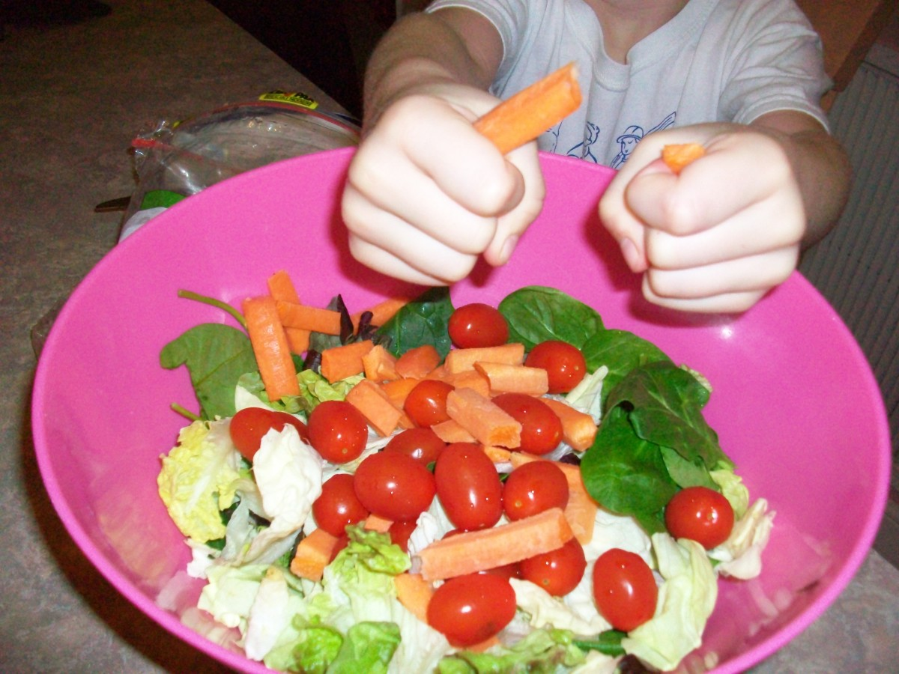

Snack Time
Grasshoppers ate up the crops.
They ate up the leaves on the trees.
They ate up everything green.
Today we have some
crunchy yummy
grasshopper food
salad for you.

Slide 31
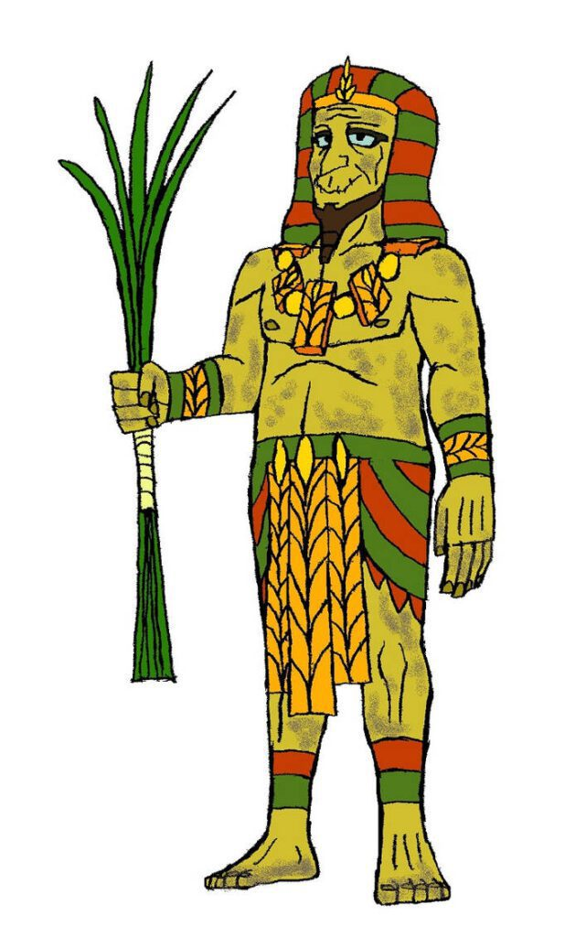
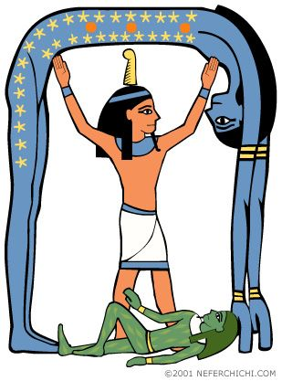
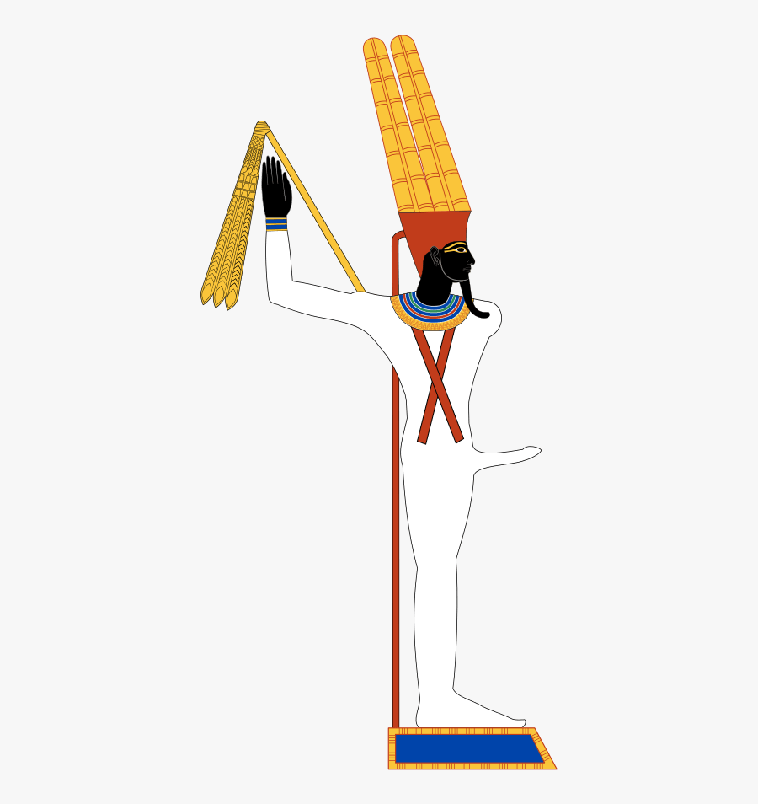
⁷¹⁶ Pharaoh quickly summoned Moses and Aaron and said, “I have sinned against the Lord your God and against you. ¹⁷ Now forgive my sin once more and pray to the Lord your God to take this deadly plague away from me.”
¹⁸ Moses then left Pharaoh and prayed to the Lord. ¹⁹ And the Lord changed the wind to a very strong west wind, which caught up the locusts and carried them into the Red Sea.^{[b]} Not a locust was left anywhere in Egypt. ²⁰ But the Lord hardened Pharaoh’s heart, and he would not let the Israelites go.
Moses and Aaron
I have sinned against the LORD and against you.
Now forgive my sin. Pray that the Lord will take away this deadly plague.
The LORD seems to rule over our gods
Notes:
NIV Study Bible page 88
Our Sovereign LORD who rules over all things showed His sovereignty to Pharaoh, Egyptians, and the Israelites through the plages.
The 7th and 8th plagues, hail and locusts scorned the gods Isis and Min, who were associated with harvest and fertility. These 2 plagues showed God’s total control over the Egy[tians food supply. Hail showed the weakness of Nut, the sky goddess. Locusts showed the weakness of Nepri, the grain god.

Slide 32
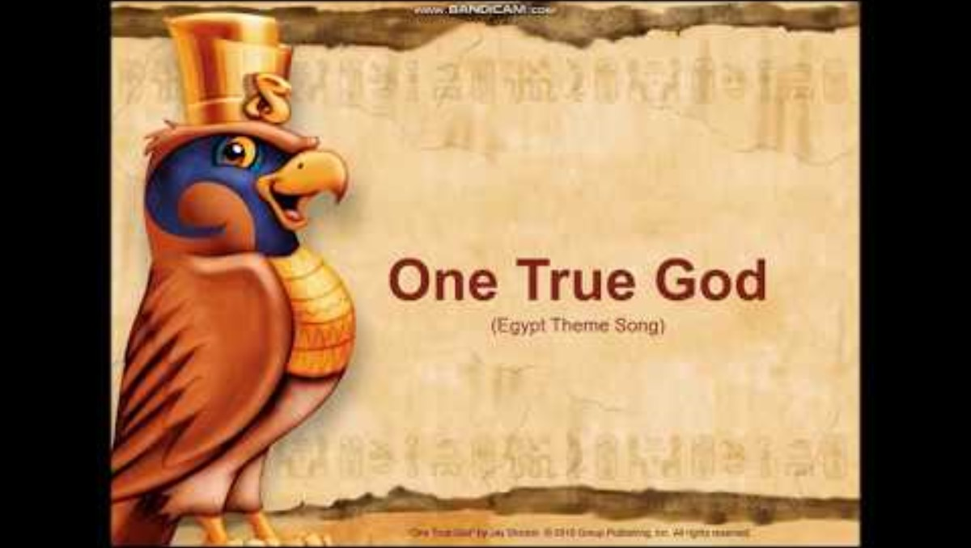

Slide 33
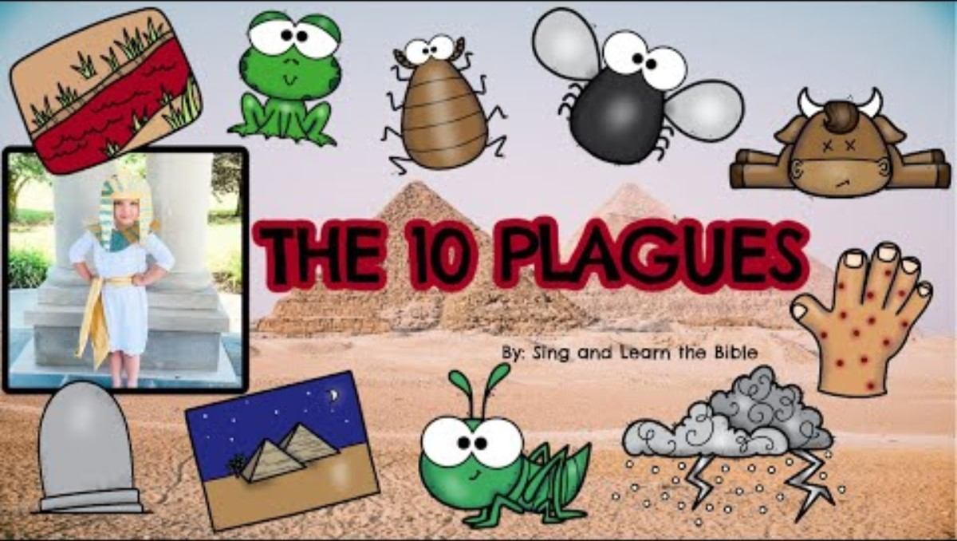

Slide 34
They shall know
that I am
the Lord their God who brought them out of the land of Egypt, that I might dwell among them;
I am the Lord
their God.
Exodus
29:46

Slide 35
Why did God send plagues in Egypt?
Now can you answer the questions?
What does SOVEREIGN LORD mean?
#1 To free His people, #2 To show His Power
#3 So that they could be together
What questions do you have?
God is the One True God; The supreme ruler over all things,
all ‘gods’, all people, and the whole universe!

Slide 36

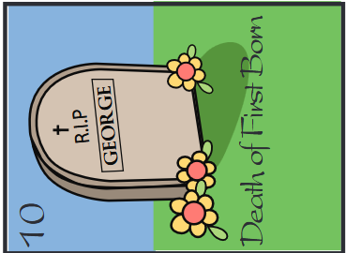
Will the Israelites get to leave Egypt?
What did He promise?
YES!
Next week we will find out.
It sounds like Pharaoh is almost ready to let them go.
There will be 2 more plagues.
Then Pharaoh will finally let them go.

Slide 37


Slide 38


https://activity-array.com/

