Slide 1
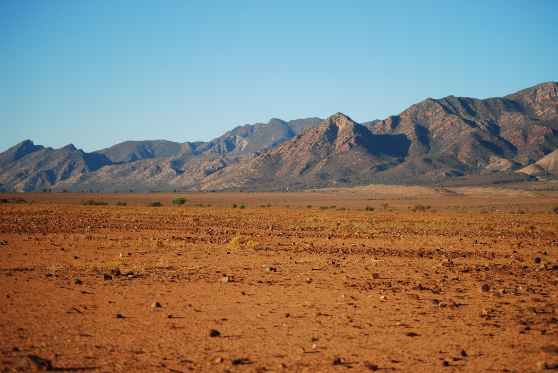
Manna in the Desert
God’s Holy Day

Slide 2
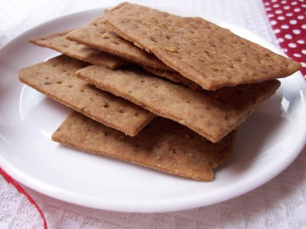
Cook up some manna
DIRECTIONS:
Preheat oven to 400 degrees
Put 1¼ cup of flour into a mixing bowl.
You can use any kind of flour or a variety of flours.
ADD ½ tsp salt and ½ tsp salt or other seasonings depending as desired then MIX
Sweet options: cinnamon, pumpkin pie spice
Savory options: garlic pwd., onion pwd., celery salt, tumeric, paprika
Optional: add ground nuts or seeds
CUT IN 4 T butter or other fat such as coconut oil or margarine
Cut in fat until fat in the flour is the size of peas.
ADD & MIX 1 T honey (or other sugar)
ADD & MIX ¼ cup water For savory wafers you can use some V-8 juice.
Make Dough into a ball and knead a couple times
Put dough on a cookie sheet and Roll with a rolling pin until ¼ inch thick.
Cut dough into wafer squares or other shape. Use a fork and poke holes all over.
Bake 10 min. until golden brown. Cool and enjoy!
Manna Wafers

Slide 3
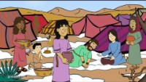
GraceLink story What is it?

Slide 4
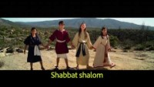
Shabbat Shalom Happy Sabbath!

Slide 5
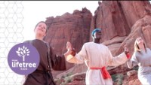
God Will Guide Us

Slide 6
Remember the Sabbath
Memory Text
Isaiah 58:13-14 New International Version (NIV)
¹³ “If you keep your feet from breaking the Sabbath
and from doing as you please on my holy day,
if you call the Sabbath a delight
and the Lord’s holy day honorable,
and if you honor it by not going your own way
and not doing as you please or speaking idle words,
¹⁴ then you will find your joy in the Lord,
and I will cause you to ride in triumph on the heights of the land
and to feast on the inheritance of your father Jacob.”
For the mouth of the Lord has spoken.

Slide 7
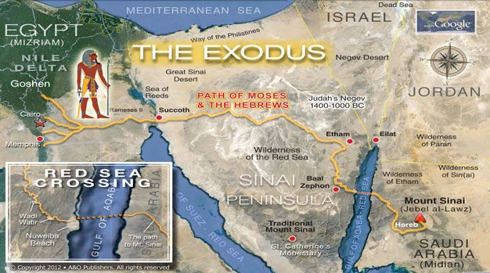






Then all the Israelites left Elim. They reached the western Sinai desert,^{[a]} between Elim and Mount Sinai, on the 15th day of the second month^{[b]} after leaving Egypt.
After Crossing the Red Sea, they continued towards Mt. Sinai, to worship God.

Slide 8
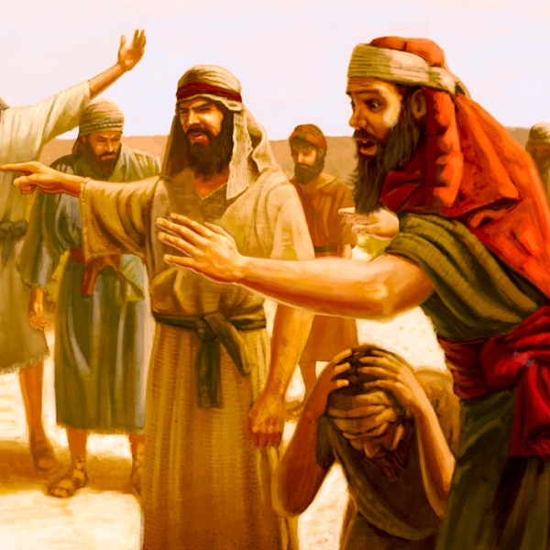


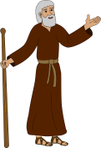

^{Exodus 16:2} Then the whole community of Israelites began complaining again. They complained to Moses and Aaron in the desert. ³ They said, “It would have been better if the Lord had just killed us in the land of Egypt. At least there we had plenty to eat. We had all the food we needed. But now you have brought us out here into this desert to make us all die from hunger.”
We are starving!

Slide 9
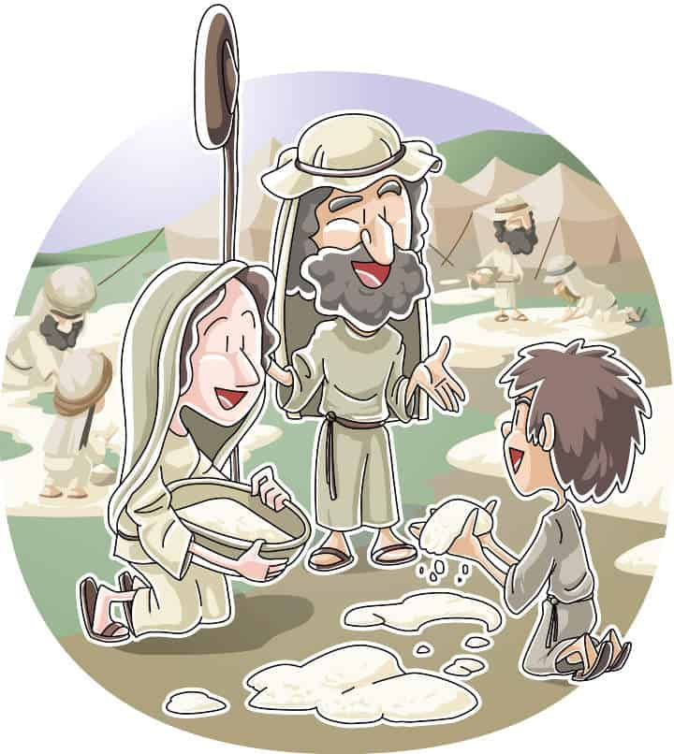
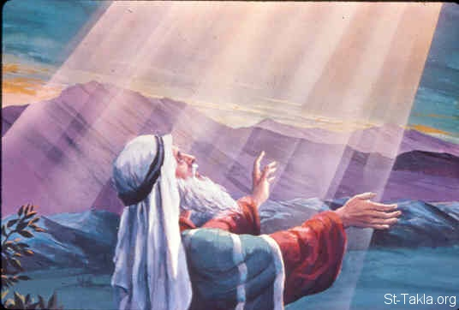


⁴ Then the Lord said to Moses, “I will cause food to fall from the sky. This food will be for you to eat. Every day the people should go out and gather the food they need that day. I will do this to see if they will do what I tell them. ⁵ Every day the people will gather only enough food for one day. But on Friday, when the people prepare their food, they will see that they have enough food for two days.”
God will provide!

Slide 10
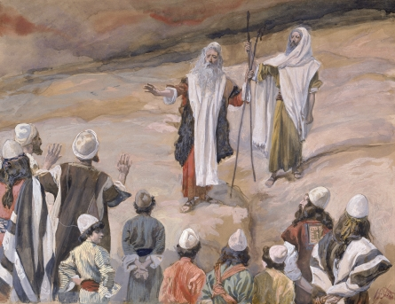


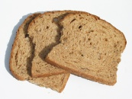

^{Exodus 16:6} So Moses and Aaron said to the Israelites, “Tonight you will see the power of the Lord. You will know that he is the one who brought you out of Egypt. ⁷ You have been complaining about the Lord, and he heard you. So tomorrow morning you will see the Glory of the Lord. You have been complaining and complaining about us. Maybe now we can have a little rest.”
God has heard you & answered your plea.

Slide 11



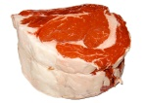
⁸ Then Moses said, “In the evening the Lord will give you meat to eat, and in the morning you will have all the bread you want. The Lord will do this because he has heard your complaining, which was against him, not us. What can we do? We do only what he tells us to do, so your complaints are really against the Lord.”
⁹ Then Moses said to Aaron, “Tell the whole community of Israelites to come together before the Lord, because he has heard their complaints.”
You have been complaining. Come listen to God.

Slide 12
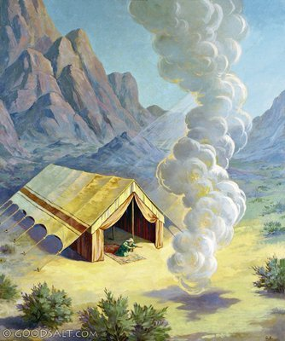



¹⁰ So Aaron spoke to all the Israelites. While he was talking, the people turned and looked into the desert. And they saw the Glory of the Lord appear in a cloud.
¹¹ The Lord said to Moses, ¹² “I have heard the complaints of the Israelites. So tell them, ‘Tonight you will eat meat. And in the morning you will have all the bread you want. Then you will know you can trust the Lord, your God.’”
Tell them again. I, the Lord, will provide. Trust me.

Slide 13
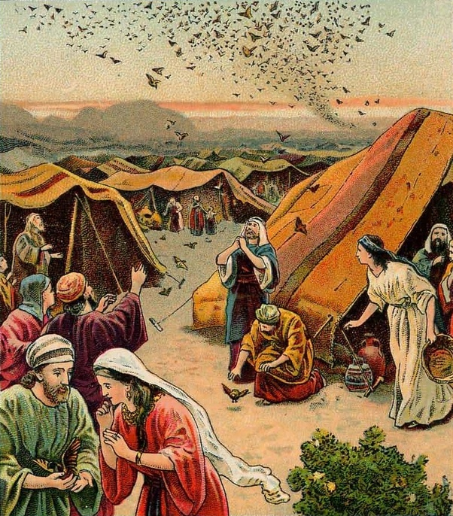
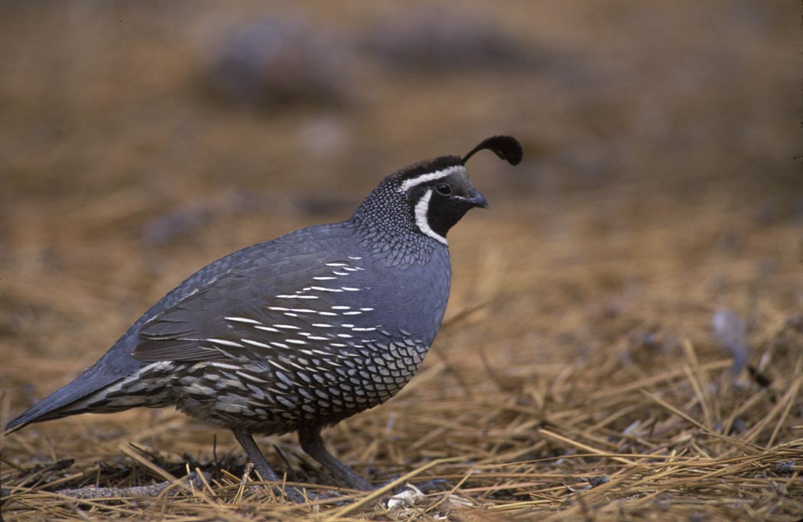


¹³ That evening, flocks of quail came and filled the camp,
Quail for meat.

Slide 14
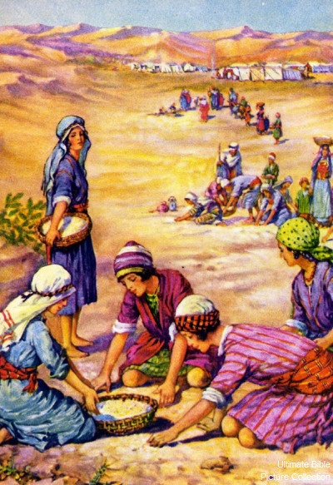


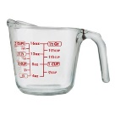

and in the morning dew lay on the ground all around it. ¹⁴ After the dew was gone, something like thin flakes of frost was on the ground. ¹⁵ When the Israelites saw it, they asked each other, “What is that?” because they did not know what it was. So Moses told them, “This is the food the Lord is giving you to eat. ¹⁶ The Lord says, ‘Each of you should gather what you need, a basket^{[e]} of manna for everyone in your family.’”
What is it?

Slide 15
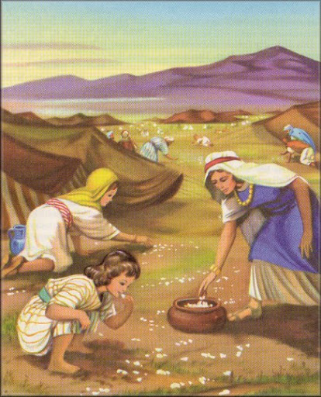


¹⁷ So that is what the Israelites did. Some people gathered a large amount, some people gathered a little. ¹⁸ But when they measured what they had gathered, there was no shortage and there was none left over. Everyone gathered just what they needed.
Jesus
Jesus
It is Manna, bread from heaven.

Slide 16
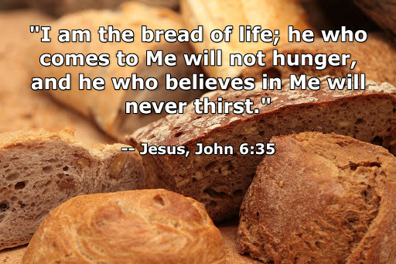

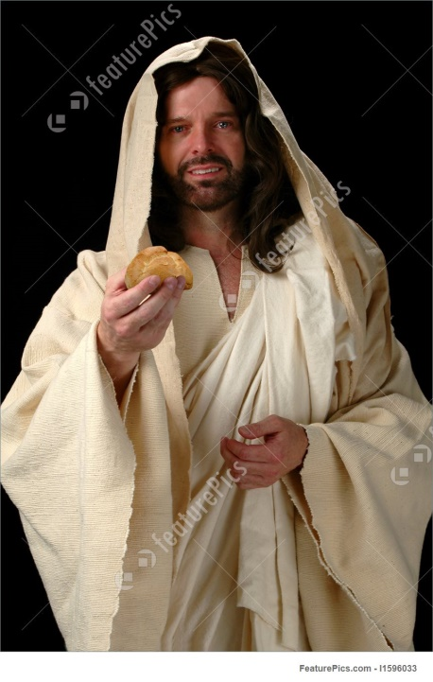
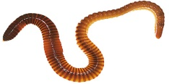


Jesus is the bread of life
He fill us. He sustains us. He gives us life.

Slide 17
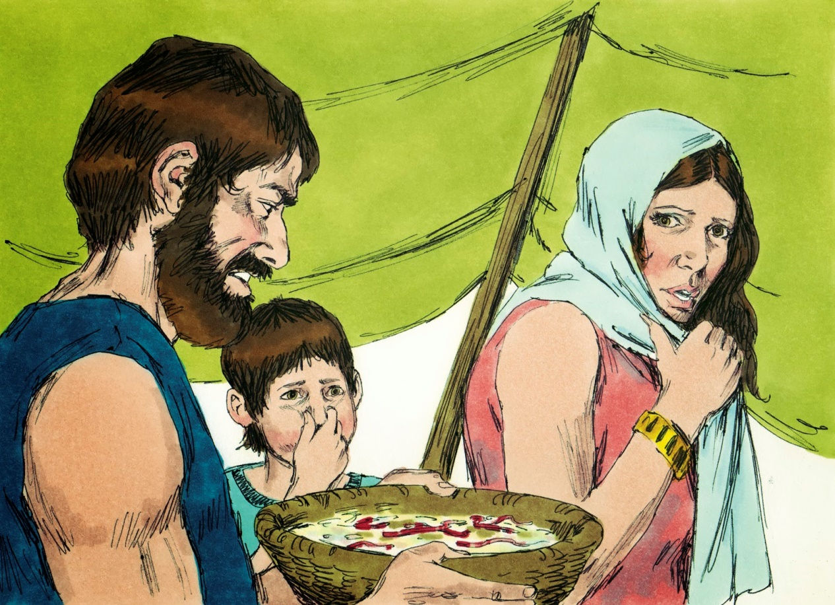



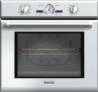
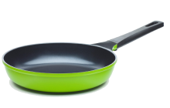
¹⁹ Moses told them, “Don’t save that food to eat the next day.” ²⁰ But some of the people did not obey Moses. They saved their food for the next day. But worms got into the food and it began to stink. Moses was angry with the people who did this.
²¹ Every morning the people gathered as much food as they could eat, but by noon^{[f]} the food melted and was gone.
Left overs SPOILED Sun.-Fri.

Slide 18
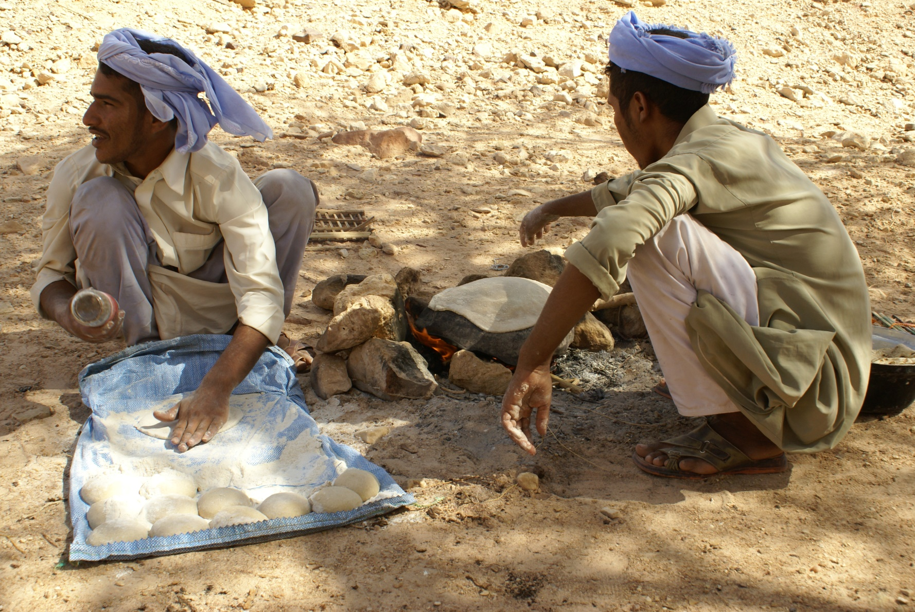


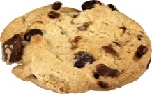
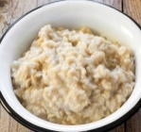
Exodus 16:23 NKJV
Bake what you will bake today, and boil what you will boil;
Left overs SPOILED Sun.-Fri.

Slide 19
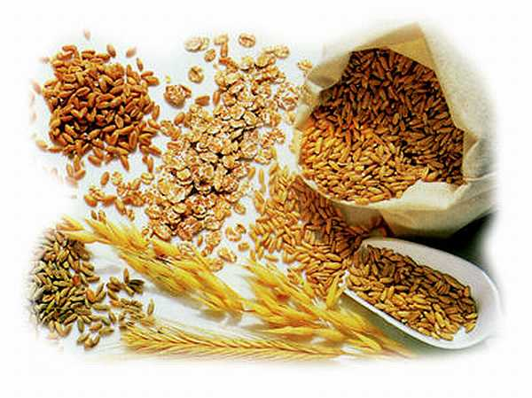
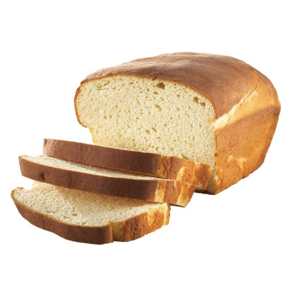
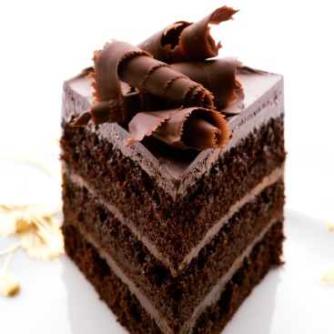

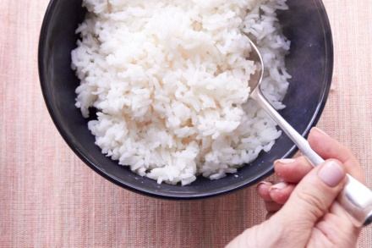
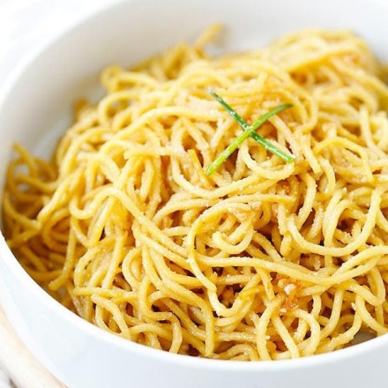
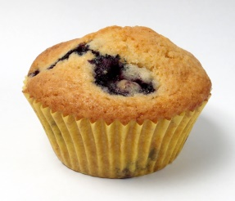
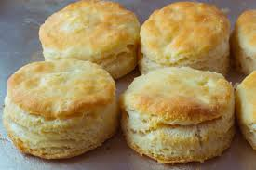

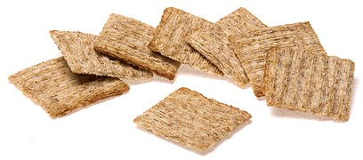
How do you eat grain?
BAKE IT
BOIL IT

Slide 20
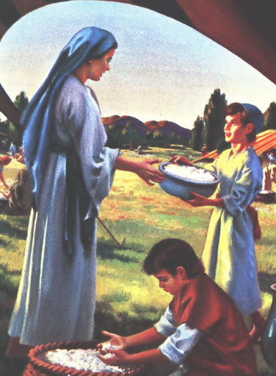

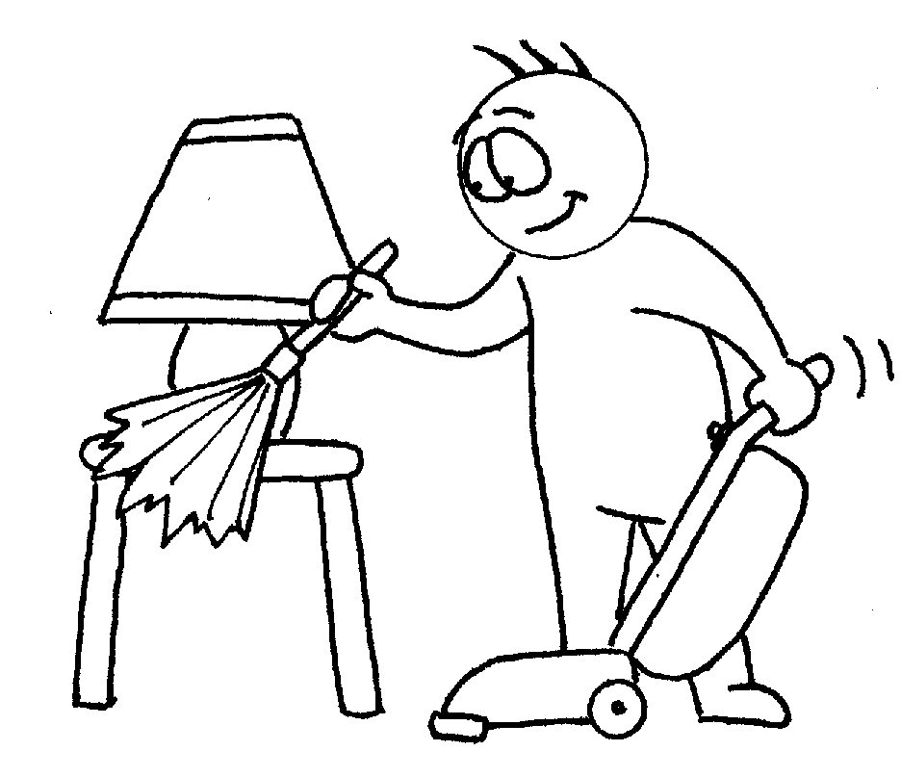
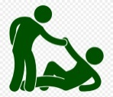
²² On Friday the people gathered twice as much food—two baskets^{[g]} for every person. So all the leaders of the people came and told this to Moses.
²³ Moses told them, “This is what the Lord said would happen. It happened because tomorrow is the Sabbath, the special day of rest to honor the Lord. You can cook all the food you need to cook for today, but save the rest of this food for tomorrow morning.”
²⁴ So the people saved the rest of the food for the next day, as Moses had commanded, and none of the food spoiled or had worms in it.
Sabbath Manna.

Slide 21
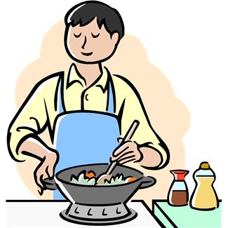


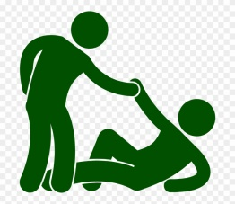
How did they prepare for Sabbath?
How do you prepare for Sabbath?
We have company coming. Our Lord and Creator is coming to spend the day with us!

Slide 22
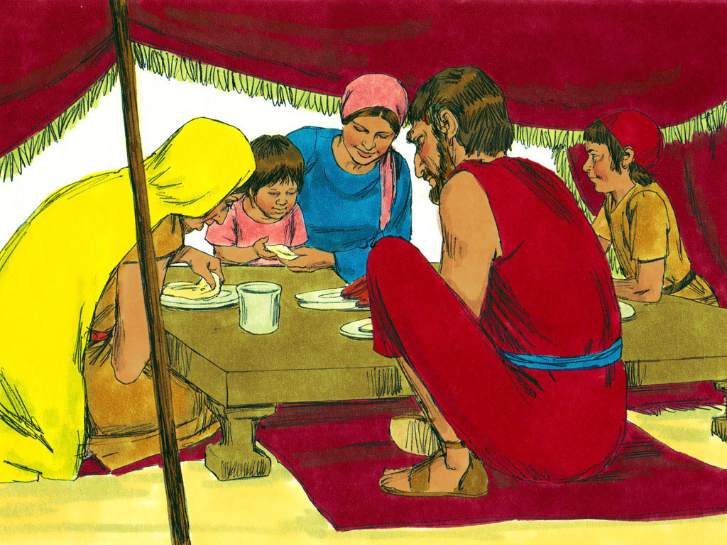



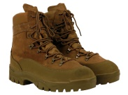
²⁵ On Saturday, Moses told the people, “Today is the Sabbath, the special day of rest to honor the Lord. So none of you should be out in the fields. Eat the food you gathered yesterday. ²⁶ You should gather the food for six days. But the seventh day of the week is a day of rest—so there will not be any of the special food on the ground.”
²⁷ On Saturday, some of the people went out to gather some of the food, but they could not find any. ²⁸ Then the Lord said to Moses, “How long will you people refuse to obey my commands and teachings?
²⁹ Look, the Lord has made the Sabbath a day of rest for you. So on Friday he will give you enough food for two days. Then, on the Sabbath, each of you should sit down and relax. Stay where you are.” ³⁰ So the people rested on the Sabbath.
Sabbath is a day of rest. Relax and enjoy it!

Slide 23


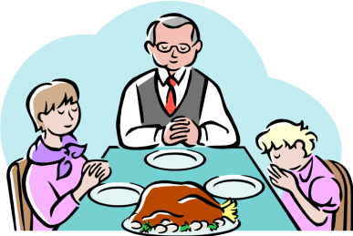



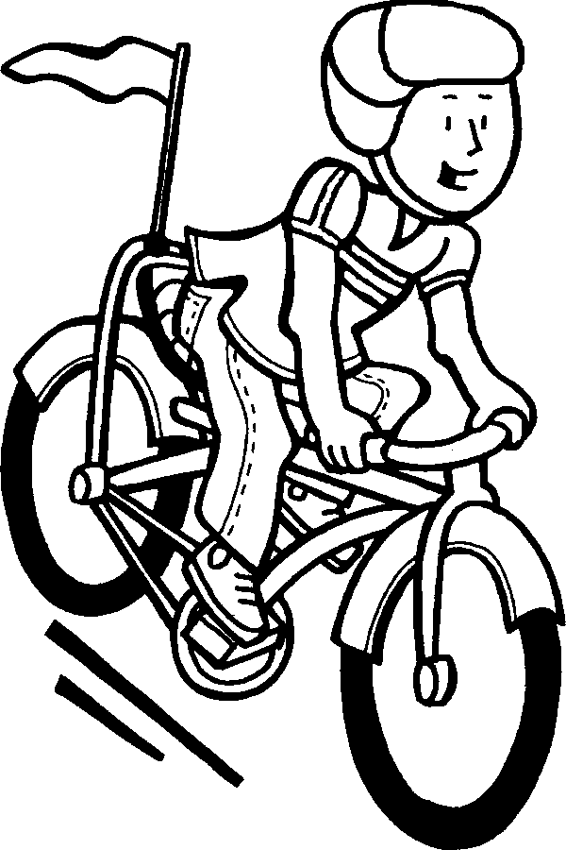
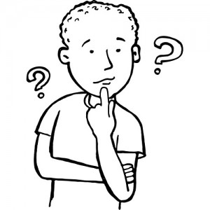
What do you like to do on Sabbath?

Slide 24

Keep the Sabbath Holy

Slide 25
Remember the Sabbath
7th day
Praise God
Psalm 92 Easy-to-Read Version (ERV)
A song of praise for the Sabbath.
It is good to praise the Lord.
God Most High, it is good to praise your name.
² It is good to sing about your love in the morning
and about your faithfulness at night.
³ It is good to play for you on the ten-stringed instrument and lyre
and to add the soft sounds of the harp to my praise.
⁴ Lord, you make us very happy because of what you did.
I gladly sing about it.
⁵ Lord, you did such great things…

Slide 26
Remember the Sabbath
7th day
Fourth Commandment
^{Exodus 20:8} “Remember the Sabbath day by keeping it holy. ⁹ Six days you shall labor and do all your work, ¹⁰ but the seventh day is a sabbath to the Lord your God. On it you shall not do any work, neither you, nor your son or daughter, nor your male or female servant, nor your animals, nor any foreigner residing in your towns. ¹¹ For in six days the Lord made the heavens and the earth, the sea, and all that is in them, but he rested on the seventh day. Therefore the Lord blessed the Sabbath day and made it holy.

Slide 27
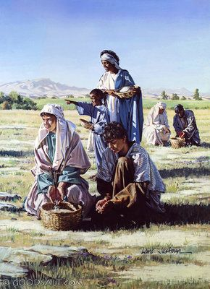
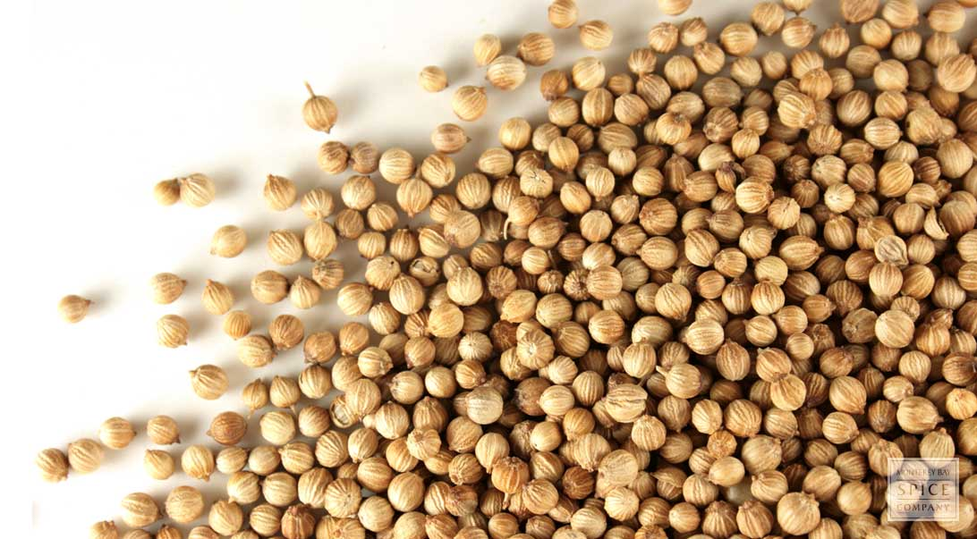


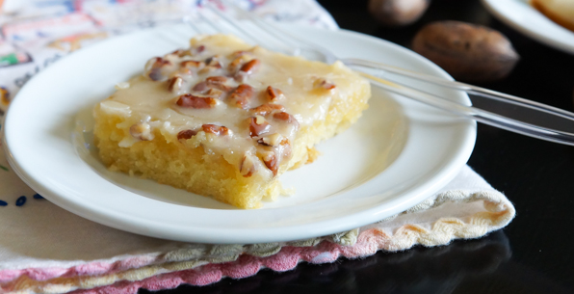

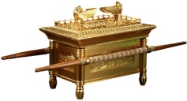
¹ The people called the special food “manna.^{[h]}” It was like small white coriander seeds and tasted like thin cakes made with honey. ³² Moses told the people what the Lord said: “Save a basket of this food for your descendants. Then they can see the food that I gave to you in the desert when I took you out of Egypt.”
Coriander seed is a staple seasoning in Middle Eastern and Mediterranean cuisines. In India, coriander seed is briefly pan roasted and eaten whole as a snack known as dhana dal. The seeds are also dry roasted to release aroma and flavor before it is ground and added to curries or other foods.
Delicious Manna!

Slide 28

³³ So Moses told Aaron, “Take a jar and fill it with a full basket of manna. Save this manna to put before the Lord. Save it for our descendants.”
³⁴ (Aaron did what the Lord had commanded Moses. Aaron put the jar of manna in front of the Ark of the Covenant.)
³⁵ The people ate the manna for 40 years, until they came to the land of rest, that is, until they came to the edge of the land of Canaan. ³⁶ (The measure they used for the manna was an omer. An omer was about 8 cups.^{[i]})
Save some Manna. It will be a reminder.

Slide 29
Remember the Sabbath
7th day
Sabbath Sign
Exodus 31:13 New King James Version (NKJV)
¹³ “Speak also to the children of Israel, saying: ‘Surely My Sabbaths you shall keep, for it is a sign between Me and you throughout your generations, that you may know that I am the Lord who sanctifies you.
Sanctified = set apart for a holy purpose; dedicated to God

Slide 30
Remember the Sabbath
Memory Text
Isaiah 58:13-14 New International Version (NIV)
¹³ “If you keep your feet from breaking the Sabbath
and from doing as you please on my holy day,
if you call the Sabbath a delight
and the Lord’s holy day honorable,
and if you honor it by not going your own way
and not doing as you please or speaking idle words,
¹⁴ then you will find your joy in the Lord,
and I will cause you to ride in triumph on the heights of the land
and to feast on the inheritance of your father Jacob.”
For the mouth of the Lord has spoken.

Slide 31

Vanilla Wafer Cookies
Vanilla Wafer Cookies4.6(34) · 35 min · Yield: about 3-1/2 dozen.
These buttery cookies bake up chewy and crispy at the same time. Sprinkle these vanilla wafers with ...
Ingredients1/2 cup butter, softened
1 cup sugar
1 egg
1 tablespoon vanilla extract
1-1/3 cups all-purpose flour
Manna Cookies

Slide 32

https://activity-array.com/

