Slide 1
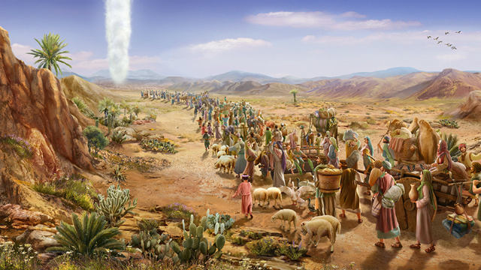
Led by God’s Glory
-- a pillar cloud
Exodus 13:20 – 14:31

Slide 2


Slide 3


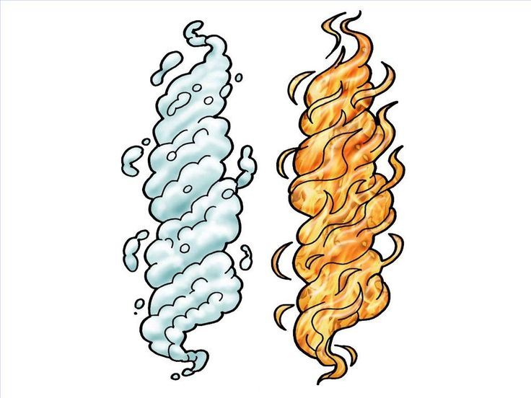

Slide 4
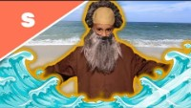

Slide 5
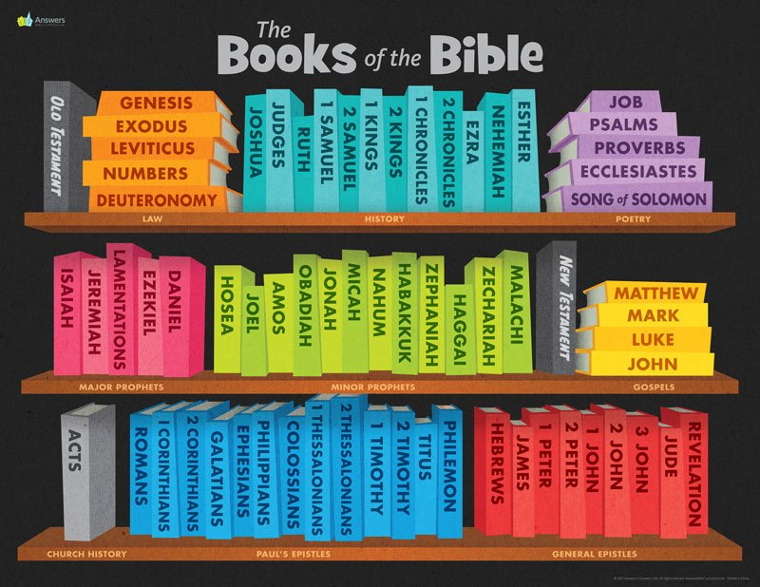
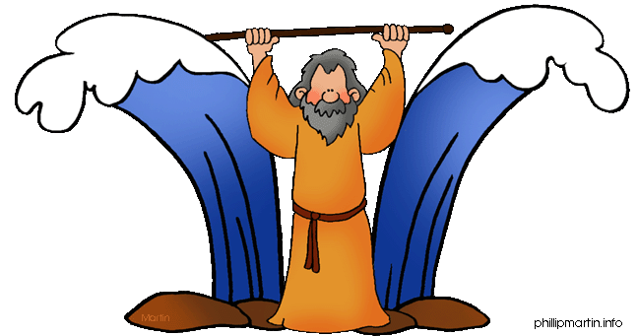
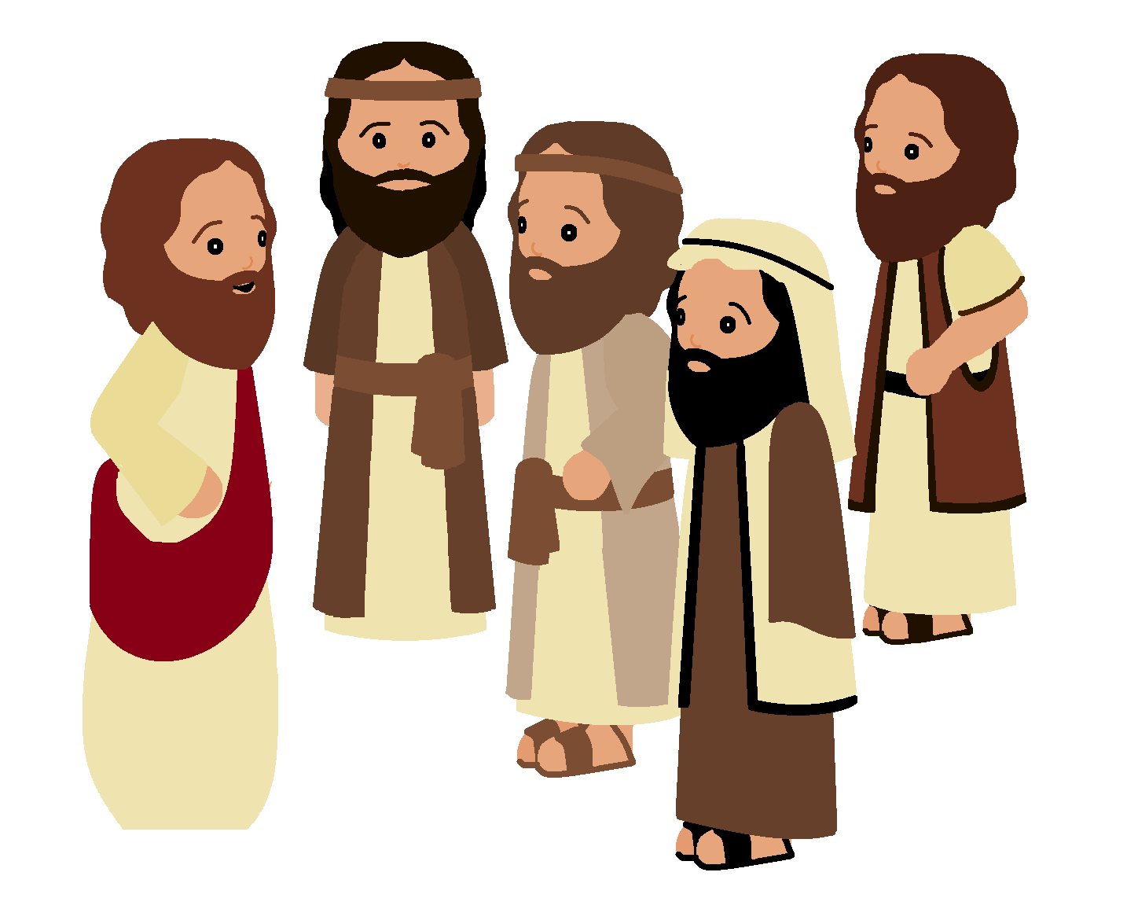

Slide 6
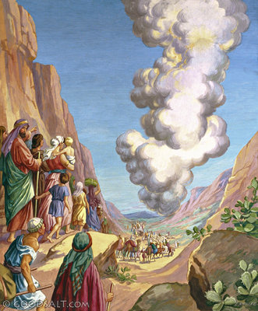
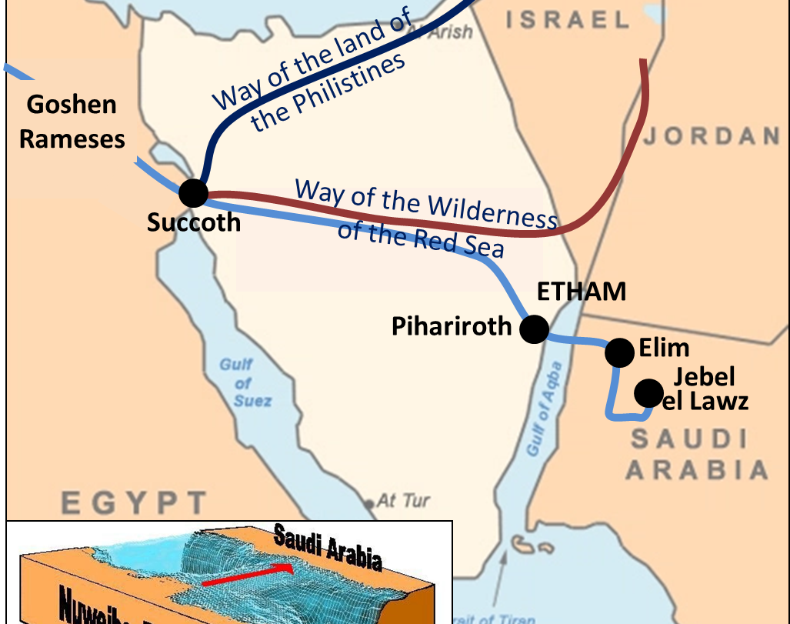
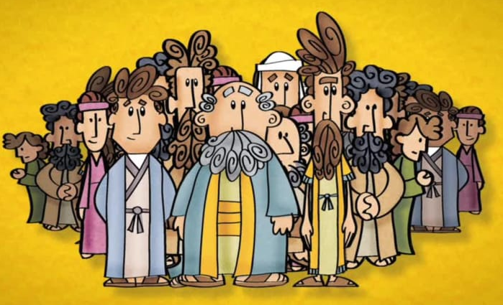
Exodus 13:20
²⁰ The Israelites left Succoth and camped at Etham. Etham was near the desert. ²¹ The Lord led the way.

Slide 7
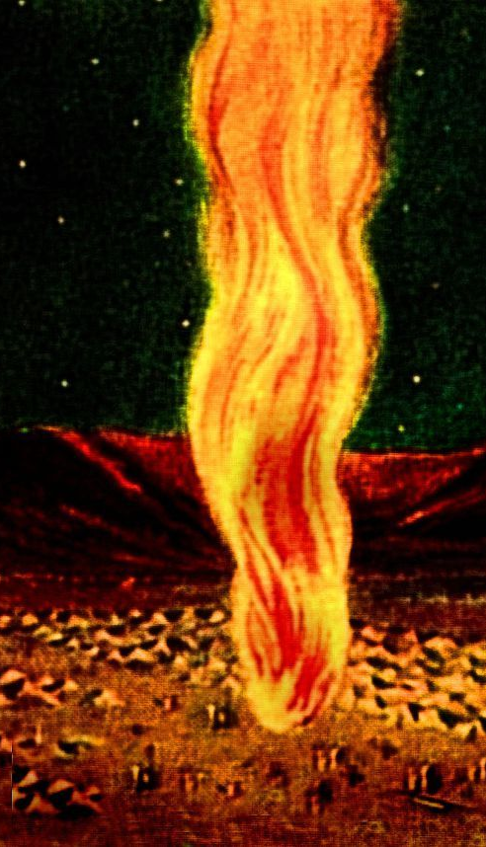
Exodus 13:20-22
During the day, he used a tall cloud to lead the people. And during the night, he used a tall column of fire to lead the way. This fire gave them light so that they could also travel at night. ²² The cloud was always with them during the day, and the column of fire was always with them at night.

Slide 8
God leads me
I will follow
Lord, “with your kindness
you led the people you saved.
And with your strength
you led them to your holy land. “
Exodus 15:13
I try with all my heart to serve you.
Help me obey your commands. “
Psalms 119:10

Slide 9


Slide 10
God told Moses His plan
EXODUS 14
Then the Lord said to Moses, ² “Tell the people to go back to Pi Hahiroth. Tell them to spend the night between Migdol and the Red Sea, near Baal Zephon. ³ Pharaoh will think that the Israelites are lost in the desert and that the people will have no place to go. ⁴ I will make Pharaoh brave, and he will chase you. But I will defeat Pharaoh and his army. This will bring honor to me. Then the people of Egypt will know that I am the Lord.” So the Israelites did what he told them.

Slide 11

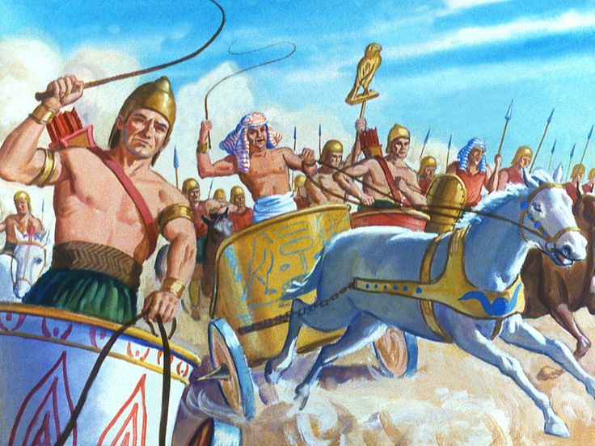
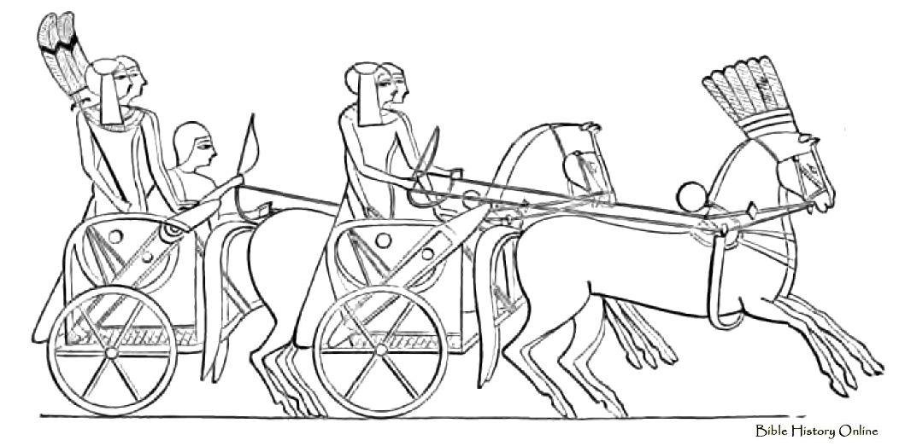
Pharaoh and all his army chased the Israelites.
⁵ Pharaoh received a report that the Israelites had escaped. When he heard this, he and his officials changed their minds about what they had done. Pharaoh said, “Why did we let the Israelites leave? Why did we let them run away? Now we have lost our slaves!”
⁶ So Pharaoh prepared his chariot and took his men with him. ⁷ He took 600 of his best men and all of his chariots. There was an officer in each chariot.^{[a]} ⁸ The Israelites were leaving with their arms raised in victory. But the Lord caused Pharaoh, the king of Egypt, to become brave. And Pharaoh chased the Israelites.
⁹ The Egyptian army had many horse soldiers and chariots. They chased the Israelites and caught up with them while they were camped near the Red Sea at Pi Hahiroth, east of Baal Zephon.
Color the chariots.
Fold the paper on the dotted line.

Slide 12
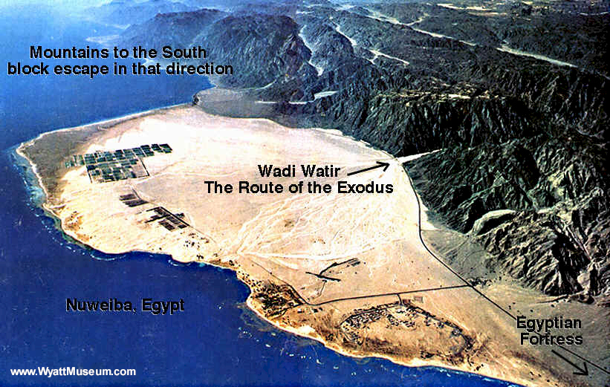
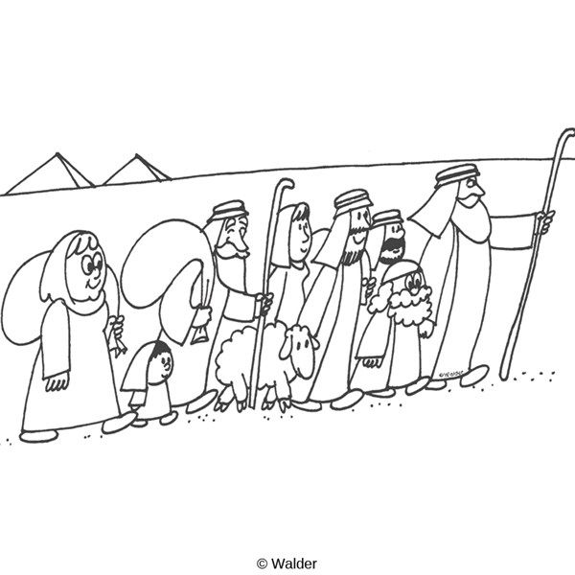
Do not be afraid.
God will fight for you.
¹⁰ When the Israelites saw Pharaoh and his army coming toward them, they were very frightened and cried to the Lord for help. ¹¹ They said to Moses, “Why did you bring us out of Egypt? Did you bring us out here in the desert to die? We could have died peacefully in Egypt; there were plenty of graves in Egypt. ¹² We told you this would happen! In Egypt we said, ‘Please don’t bother us. Let us stay and serve the Egyptians.’ It would have been better for us to stay and be slaves than to come out here and die in the desert.”
¹³ But Moses answered, “Don’t be afraid! Don’t run away! Stand where you are and watch the Lord save you today. You will never see these Egyptians again. ¹⁴ You will not have to do anything but stay calm. The Lord will do the fighting for you.”
Color the Israelites
Fold the paper on the dotted line.

Slide 13
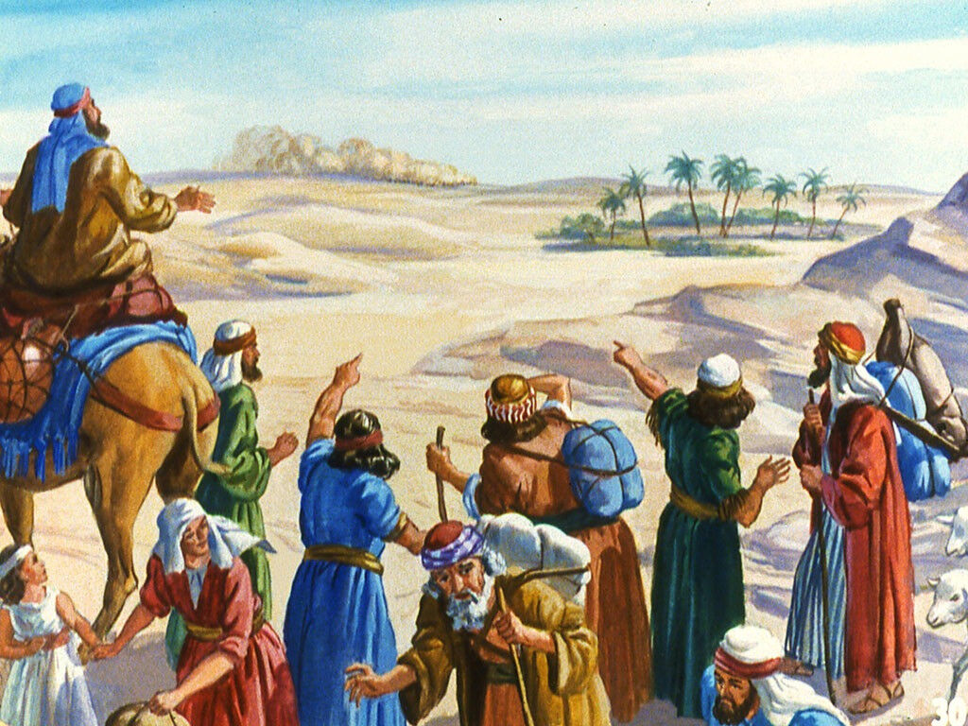
God protects His people.
Moses lift up your staff.
Everyone go forward!
¹⁵ Then the Lord said to Moses, “Why are you still crying to me? Tell the Israelites to start moving. ¹⁶ Raise the walking stick in your hand over the Red Sea, and the sea will split. Then the people can go across on dry land. ¹⁷ I have made the Egyptians brave, so they will chase you. But I will show you that I am more powerful than Pharaoh and all of his horses and chariots. ¹⁸ Then Egypt will know that I am the Lord. They will honor me when I defeat Pharaoh and his horse soldiers and chariots.”
The Lord Defeats the Egyptian Army
¹⁹ Then the angel of God moved to the back of the people. (The angel was usually in front of the people, leading them.) So the tall cloud moved from in front of the people and went to the back of the people. ²⁰ In this way the cloud stood between the Egyptians and the Israelites. There was light for the Israelites. But there was darkness for the Egyptians. So the Egyptians did not come any closer to the Israelites that night.

Slide 14
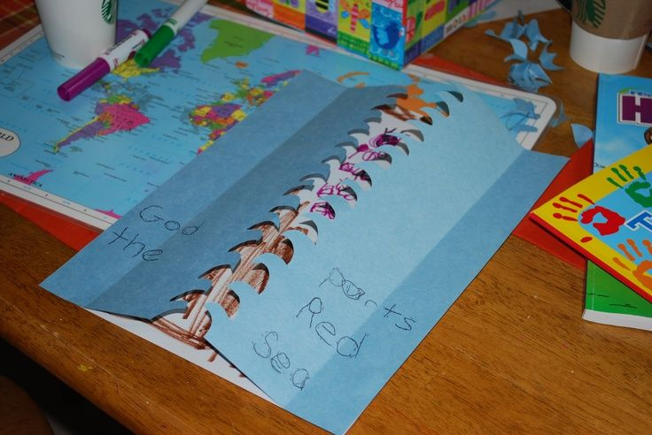
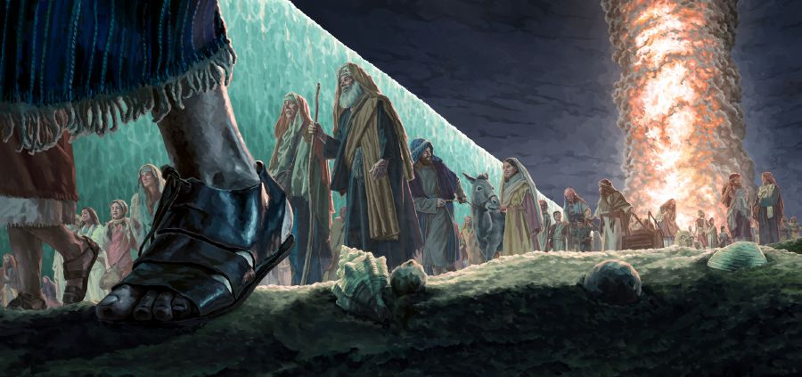
God made a way
²¹ Moses raised his hand over the Red Sea, and the Lord caused a strong wind to blow from the east. The wind blew all night long. The sea split, and the wind made the ground dry. ²² The Israelites went through the sea on dry land. The water was like a wall on their right and on their left.
Make your Red Sea by:
Cut out the blue paper on the zig zag wave line
Glue the left side to the left side of a brown piece of paper.
Glue the right side to the right side of the brown piece of paper.
Fold the blue papers so that you can lift up the unattached part like waves.
Now your Israelites can go through the Red Sea on dry ground.

Slide 15
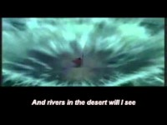

Slide 16
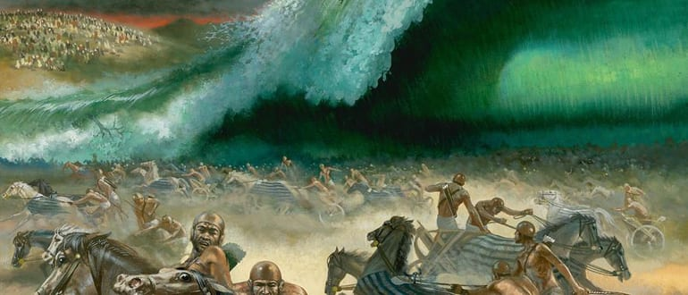
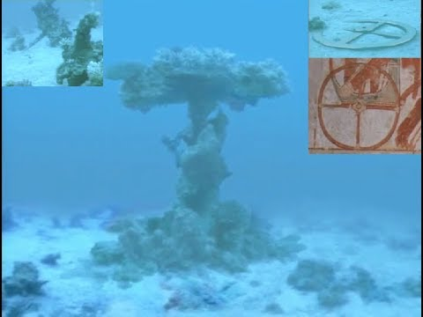
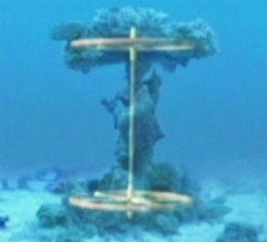
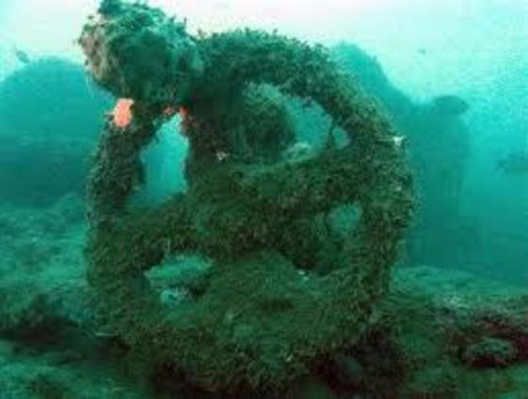
Here come the Egyptians.
They are stuck and sunk.
God won the victory!
²³ Then all of Pharaoh’s chariots and horse soldiers followed them into the sea. ²⁴ Early that morning the Lord looked down from the tall cloud and column of fire at the Egyptian army. Then he made them panic. ²⁵ The wheels of the chariots became stuck. It was very hard to control the chariots. The Egyptians shouted, “Let’s get out of here! The Lord is fighting against us. He is fighting for the Israelites.”
²⁶ Then the Lord told Moses, “Raise your hand over the sea to make the water fall and cover the Egyptian chariots and horse soldiers.”
²⁷ So just before daylight, Moses raised his hand over the sea. And the water rushed back to its proper level. The Egyptians were running as fast as they could from the water, but the Lord swept them away with the sea. ²⁸ The water returned to its normal level and covered the chariots and horse soldiers. Pharaoh’s army had been chasing the Israelites, but that army was destroyed. None of them survived!
²⁹ But the Israelites crossed the sea on dry land. The water was like a wall on their right and on their left. ³⁰ So that day the Lord saved the Israelites from the Egyptians. Later, the Israelites saw the dead bodies of the Egyptians on the shore of the Red Sea. ³¹ The Israelites saw the great power of the Lord when he defeated the Egyptians. So the people feared and respected the Lord, and they began to trust the Lord and his servant Moses.

Slide 17
God leads me
I will follow
Lord, “with your kindness
you led the people you saved.
And with your strength
you led them to your holy land. “
Exodus 15:13
I try with all my heart to serve you.
Help me obey your commands. “
Psalms 119:10

Slide 18

God is for me

Slide 19

Let’s act out the story.
Get ready
Get set
Choose Leader one -- The leader one will carry the cloud*.
Choose Leader two -- Leader two will carry a stick or rod like Moses
Make a ‘cloud’ – Hold up a white towel or attach balloons to a stick
Make the ‘Red Sea’ – Put 2 blue sheets/towels/blankets on the floor side by side; place chairs on the farthest edges of the blankets.
* Ideas for a cloud: balloons on a stick; towel over a broom; cotton balls on a paper

Slide 20
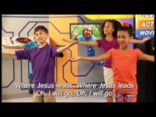
Let’s act out the story.
Go -- Follow the cloud
The Israelites followed God from Succoth across the desert to Etham and then to the beach Pi Hahiroth
The leader one will carry the cloud* and walk around the room and hall.
Leader two will carry a stick or rod like Moses
Everyone follow the cloud – follow leader one
* Ideas for a cloud: balloons on a stick; towel over a broom; cotton balls on a paper

Slide 21
Come to the Red Sea
What shall we do?
The Israelites saw the Egyptians coming after them.
They saw the Red Sea in front of them.
They saw the cliffs around them.
God’s glory cloud came between them and the Egyptians.
The leader and group stops by the Red Sea
The leader (cloud) moves behind the group
* Ideas for Red Sea: Put 2 blue blankets, sheets, to tablecloths on the floor with some chairs on either edge. When the Red Sea is parted, put the blue cloth over the chairs so everyone can walk on the floor between them.

Slide 22
Come to the Red Sea
How shall we get across?
Moses raised his staff stick.
God separated the Red Sea. He made a dry path for the Israelites to cross to the other side.
Leader two (Moses) raises staff
Helpers place cloth up and over chairs
Everyone walks through ‘Red Sea’
* Ideas for Red Sea: Put 2 blue blankets, sheets, to tablecloths on the floor with some chairs on either edge. When the Red Sea is parted, put the blue cloth over the chairs so everyone can walk on the floor between them.

Slide 23
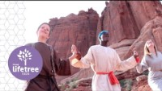
God Will Guide Us

Slide 24

I Won’t Worry

Slide 25
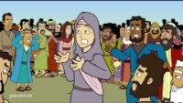
GraceLink

