Slide 1
Baby Moses
Drawn from the water – Saved for a purpose

Slide 2
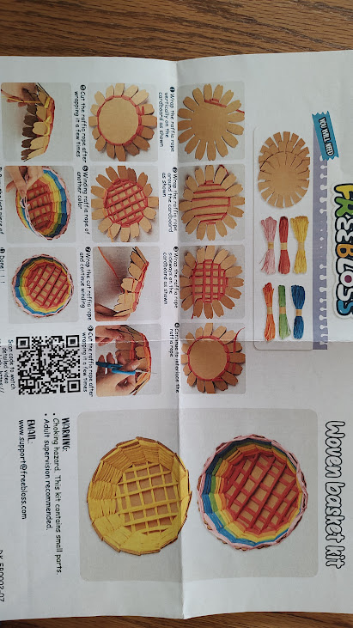
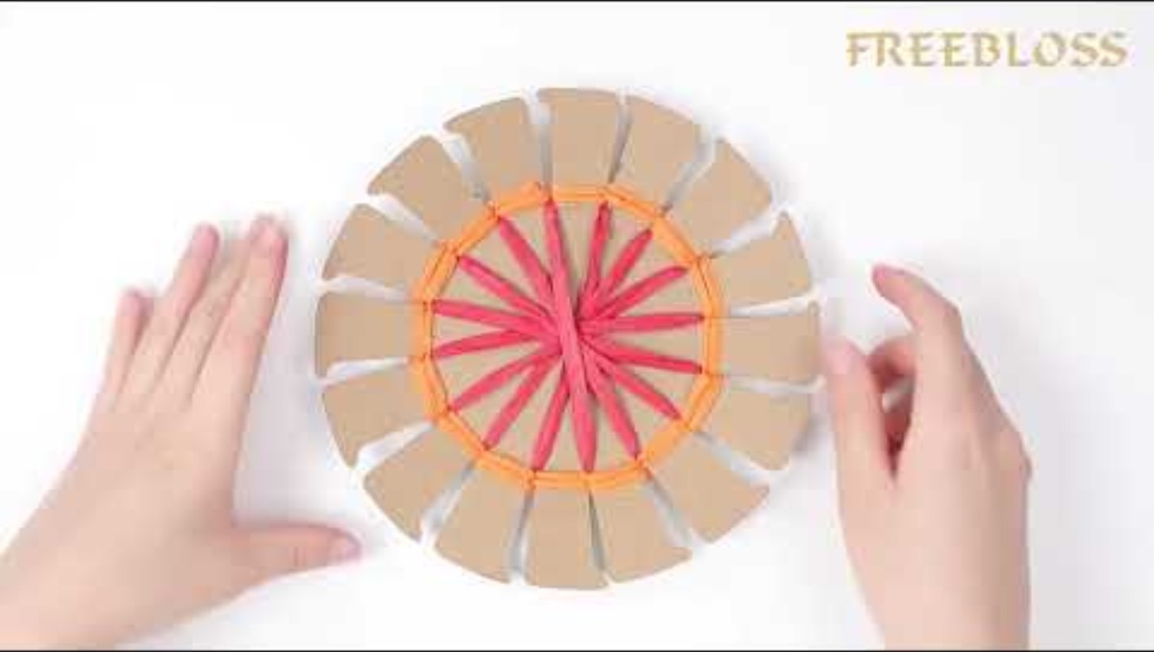
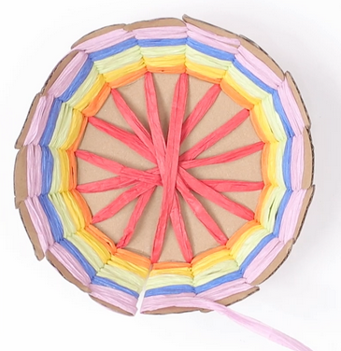
Our Bible story today has a basket in it. We’ll get you started on the craft now.

Slide 3



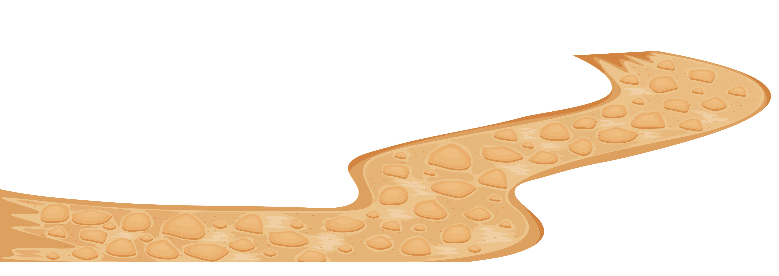
Have you ever been in danger? or
Has someone you love been in danger?

Slide 4

Psalms
25:1 & 20
Psalms 25
In you, Lord my God,
I put my trust.
²⁰ Guard my life and rescue me;
do not let me be put to shame,
for I take refuge in you.
⁴ Show me your ways, Lord,
teach me your paths.
⁵ Guide me in your truth and teach me,
for you are God my Savior,
and my hope is in you all day long.
⁶ Remember, Lord, your great mercy and love,
for they are from of old.

Slide 5
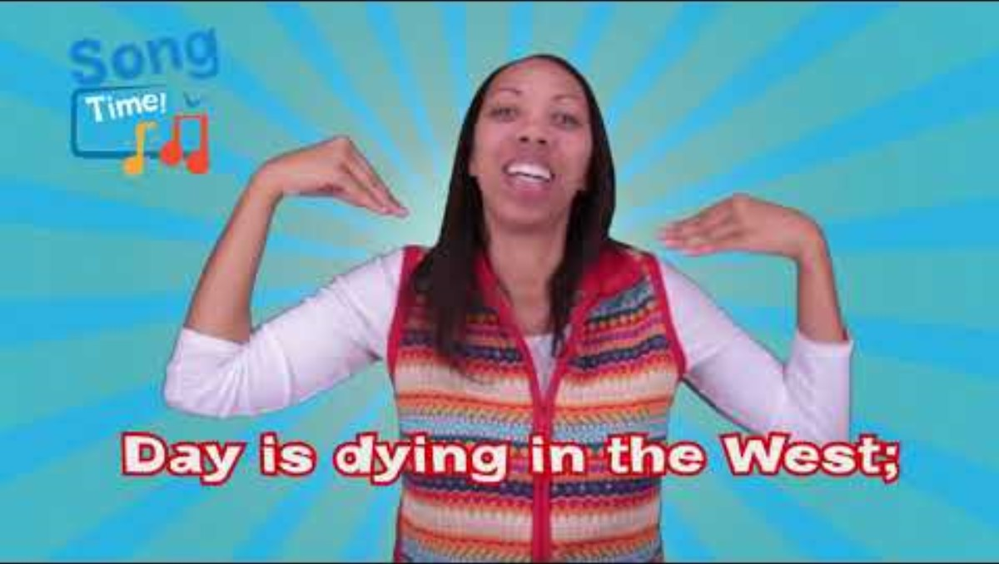

Slide 6
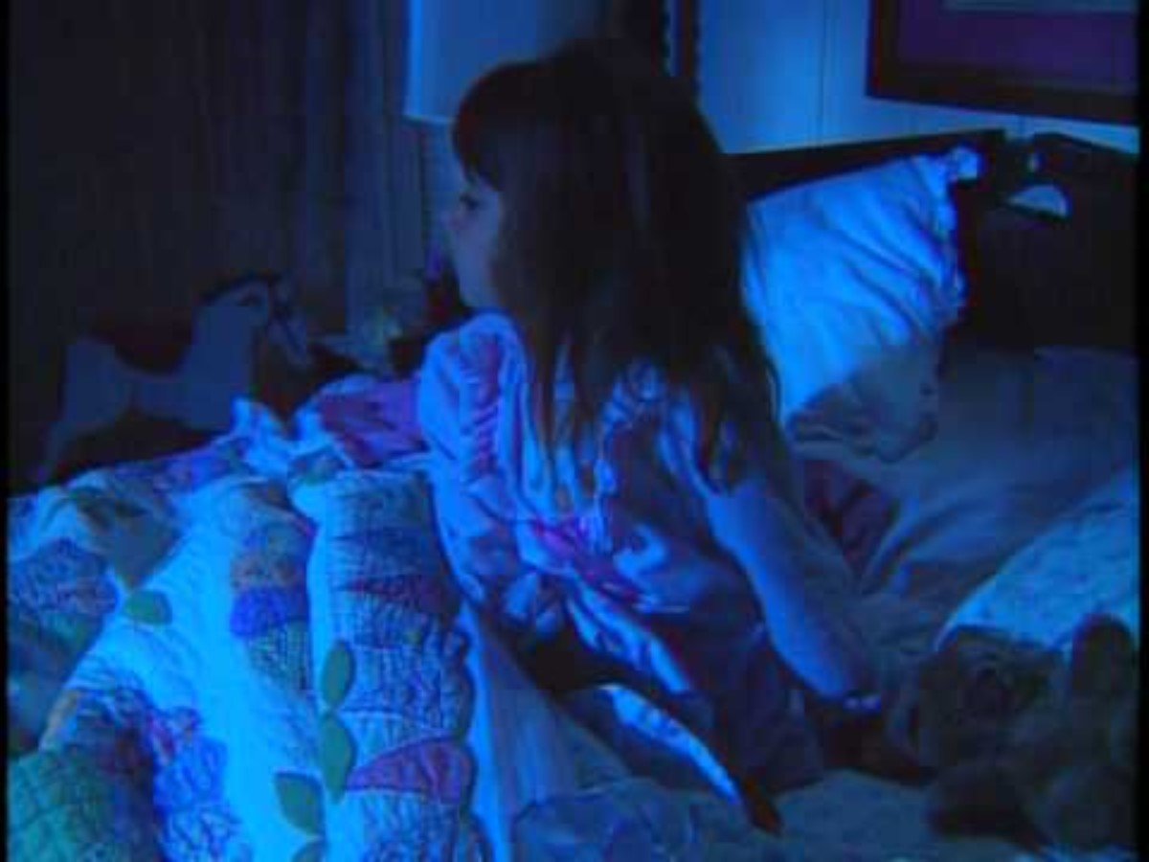
When I am afraid,
I put my trust in you.
In God,
whose word I praise—
in God I trust
and am not afraid.

Slide 7
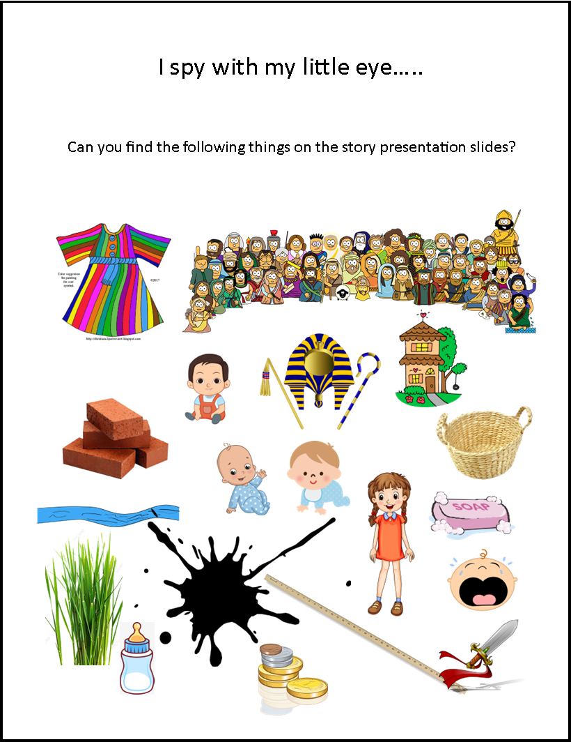
I SPY
As we go through our story today, there will be hidden pictures that have to do with that part of the story. They are hiding on each slide of the presentation. See if you can find them.
When you find the picture, you can make a mark on it.

Slide 8
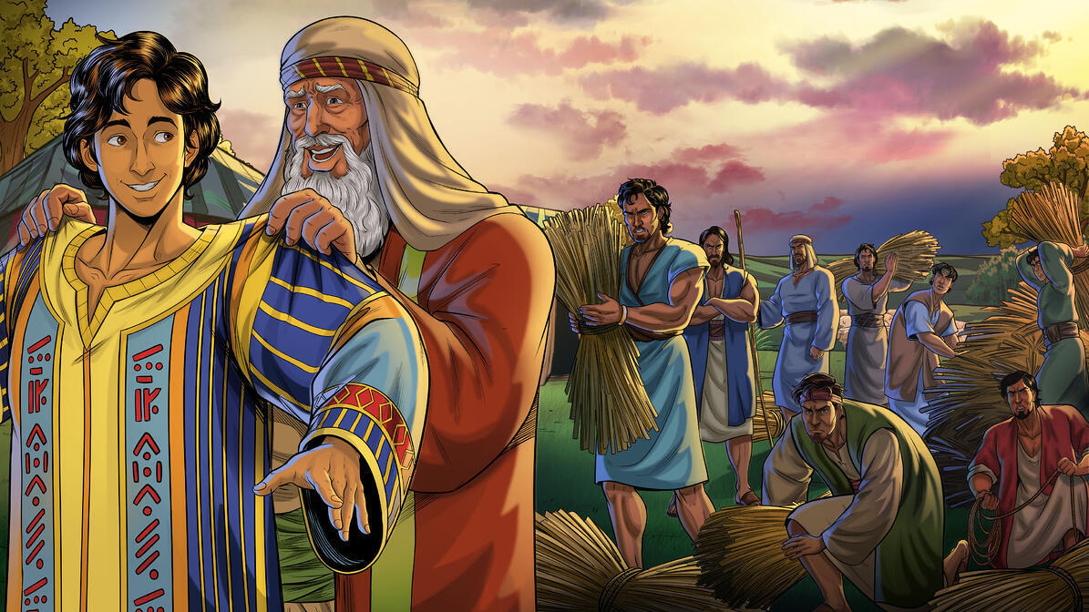
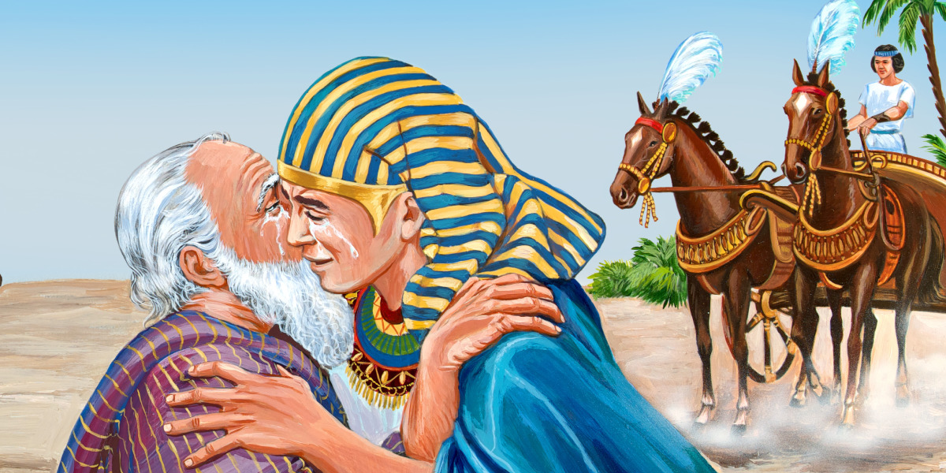
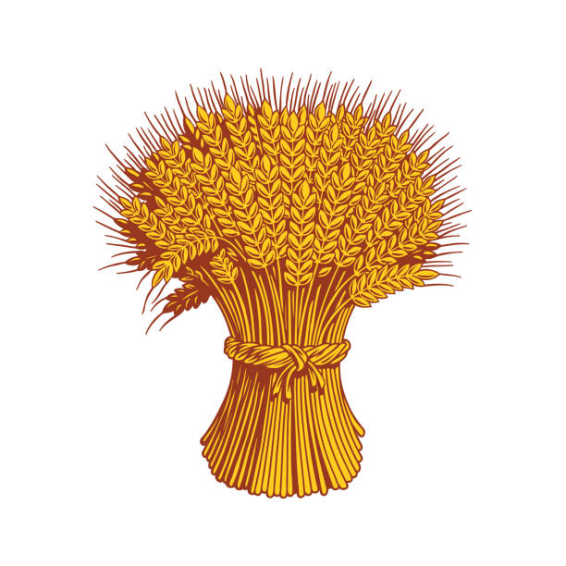
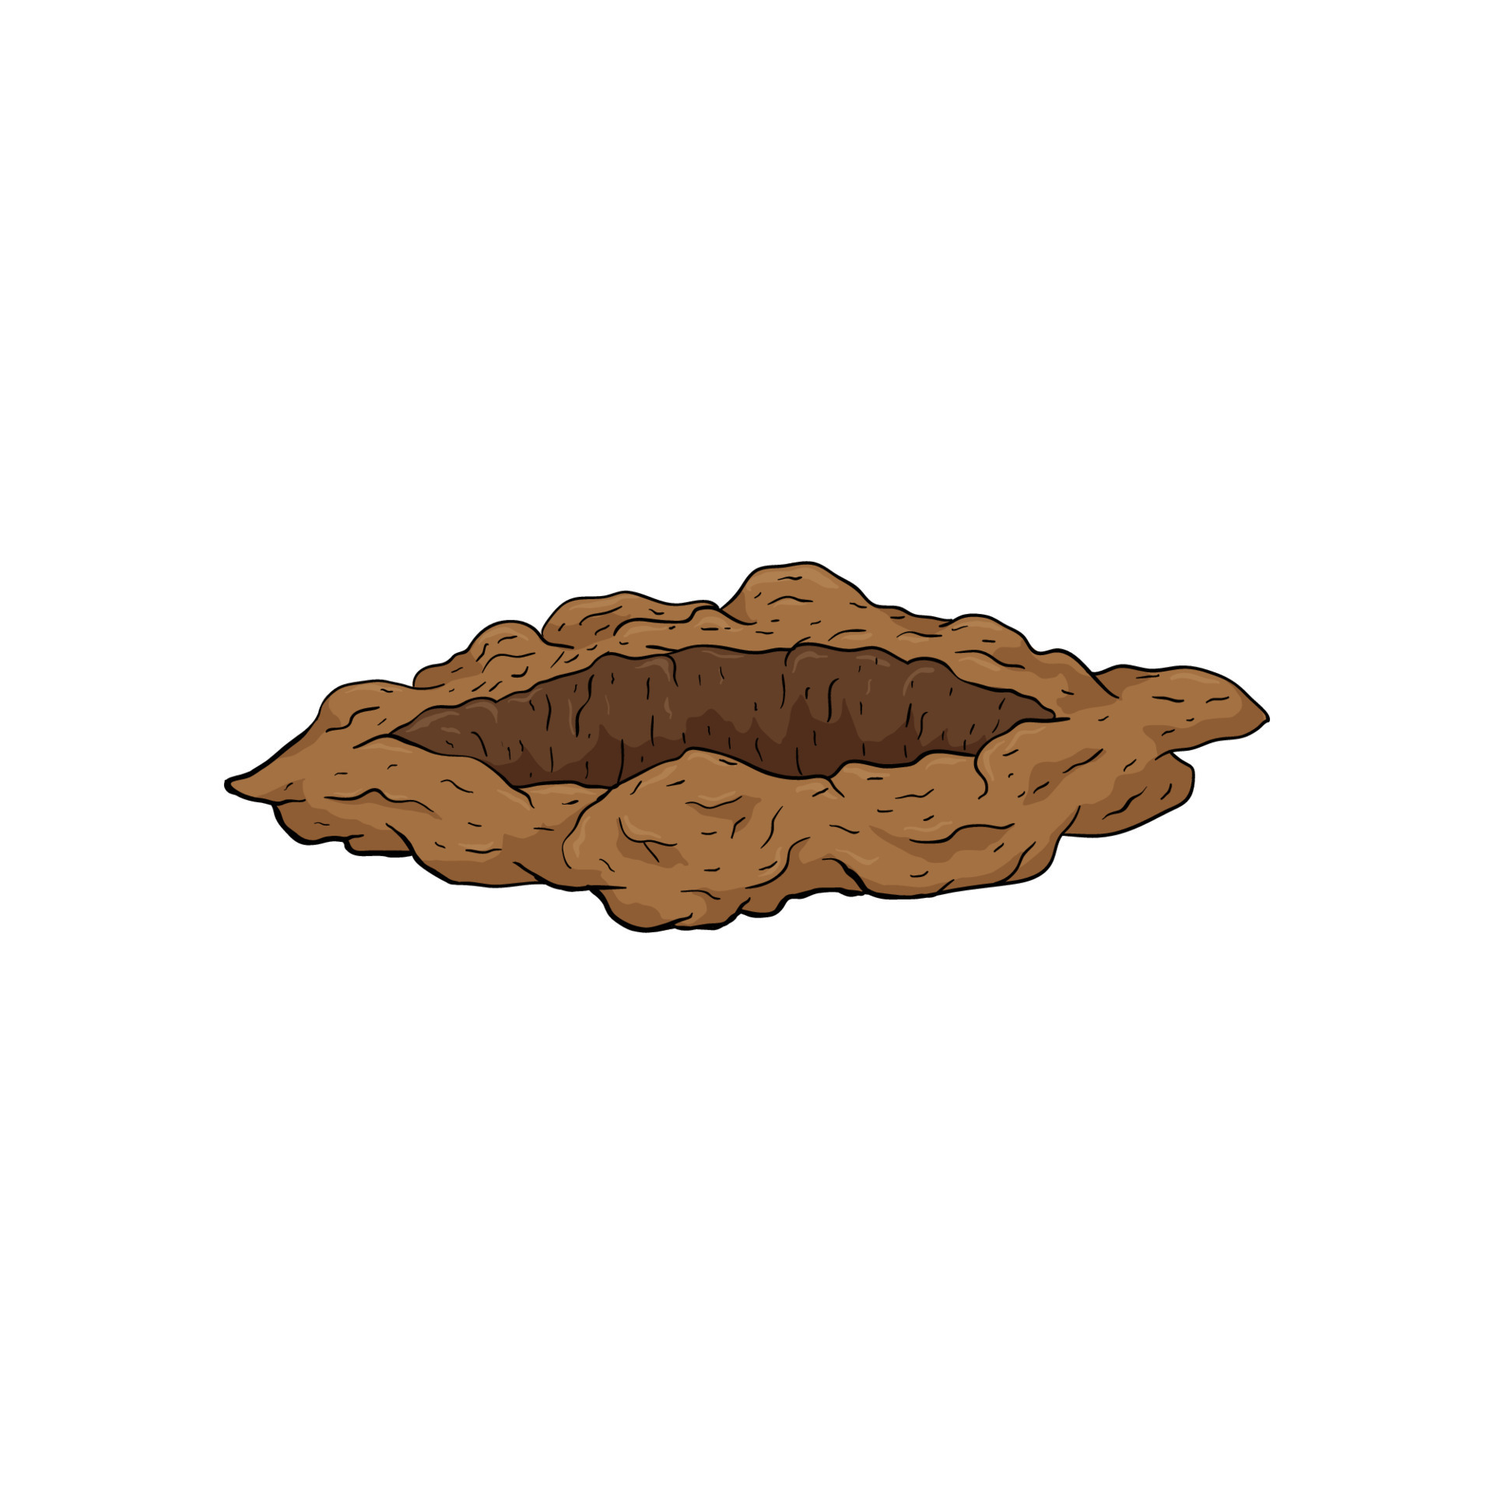
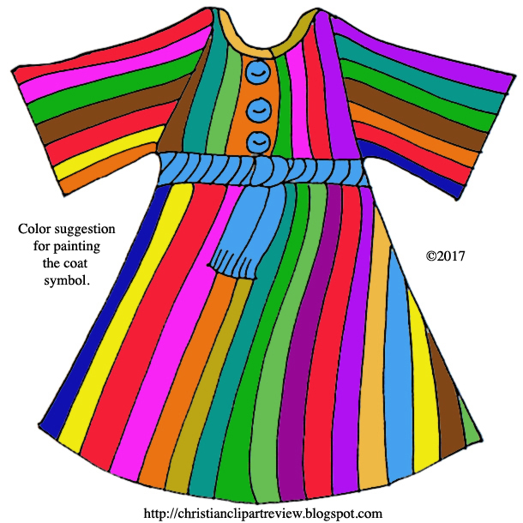
Do you remember Jacob and Joseph?
EXODUS 1
Now these are the names of the children of Israel who came to Egypt; each man and his household came with Jacob: ² Reuben, Simeon, Levi, and Judah; ³ Issachar, Zebulun, and Benjamin; ⁴ Dan, Naphtali, Gad, and Asher. ⁵ All those ^{[a]}who were descendants of Jacob were seventy^{[b]} persons (for Joseph was in Egypt already). ⁶ And Joseph died, all his brothers, and all that generation. ⁷ But the children of Israel were fruitful and increased abundantly, multiplied and ^{[c]}grew exceedingly mighty; and the land was filled with them.
Can you tell me part of their story?

Slide 9
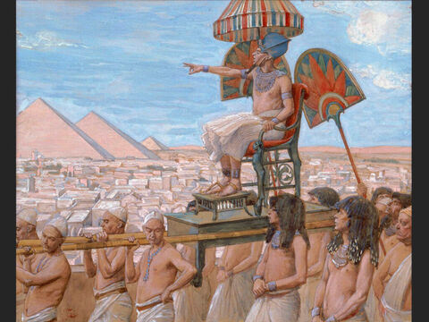
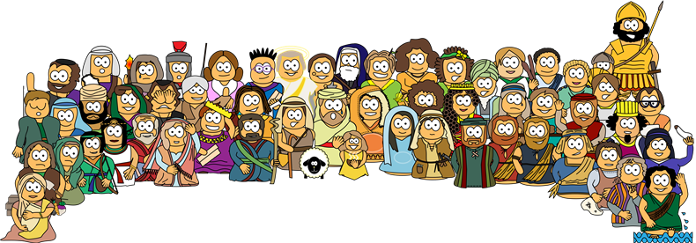
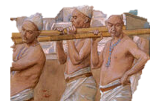
300 years later
Look, the people of Israel are more and mightier than we. If we go to war they might fight against us.
We need to do something!
⁸ Now there arose a new king over Egypt, who did not know Joseph. ⁹ And he said to his people, “Look, the people of the children of Israel are more and mightier than we; ¹⁰ come, let us deal shrewdly with them, lest they multiply, and it happen, in the event of war, that they also join our enemies and fight against us, and so go up out of the land.”

Slide 10
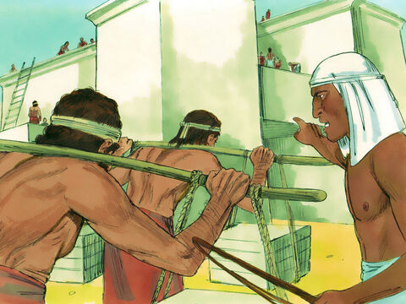

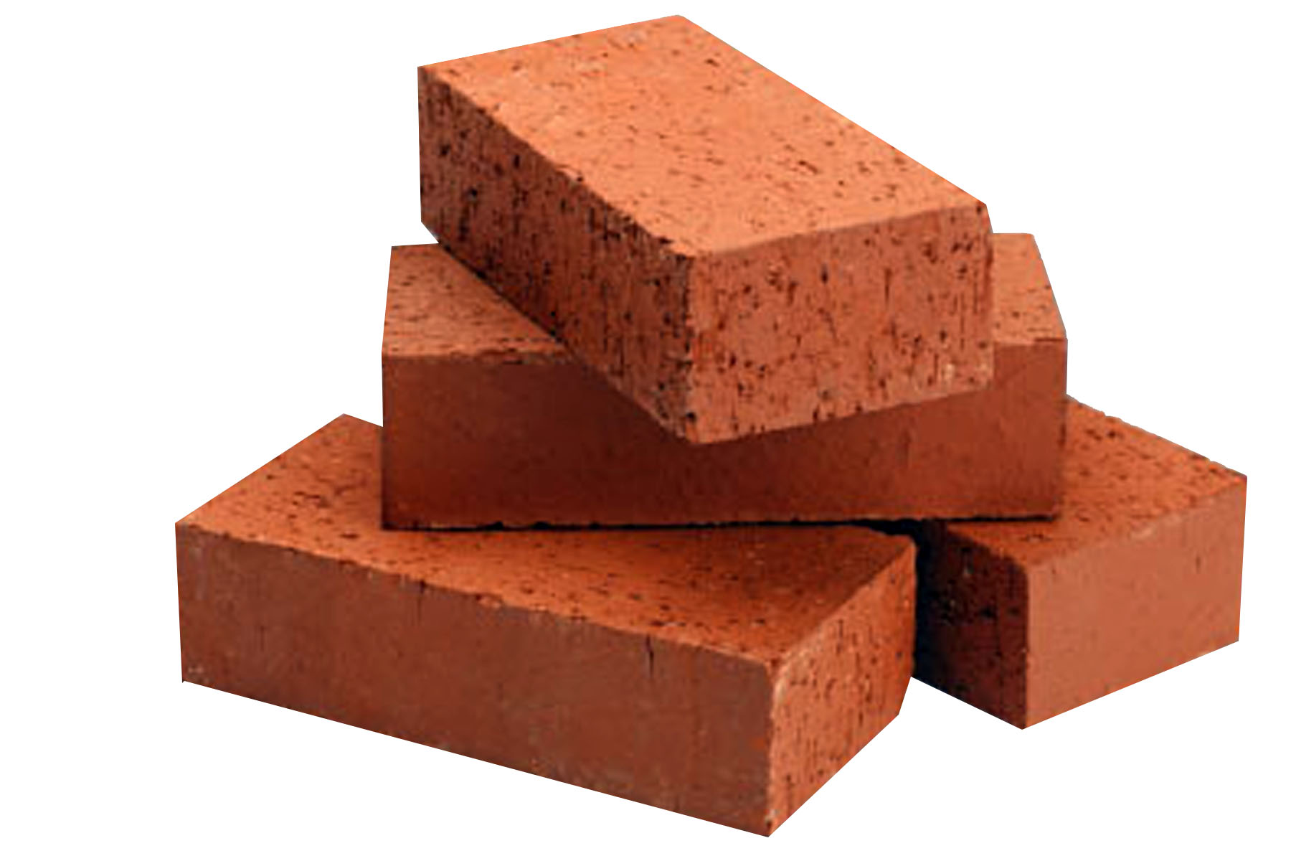
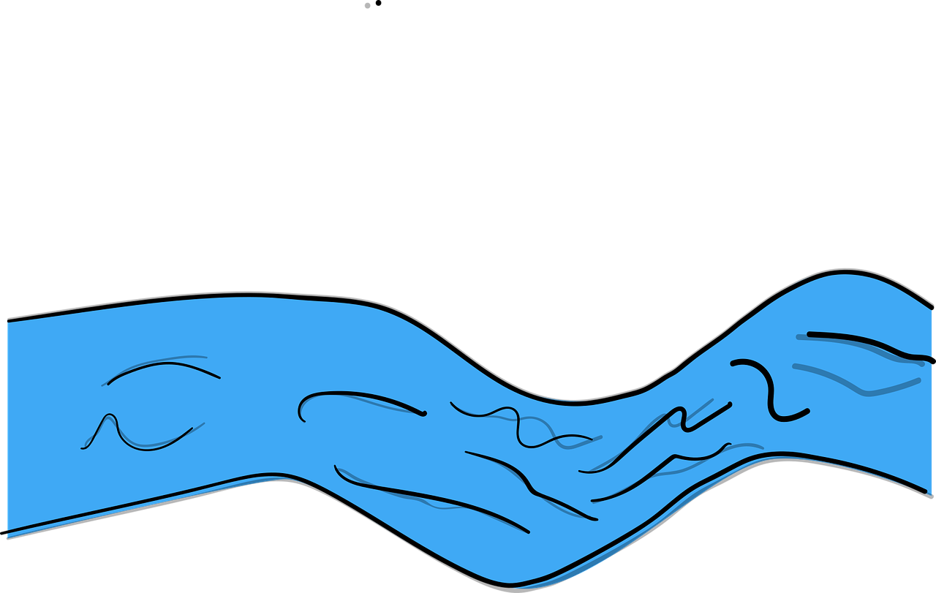
Slaves
Work harder!
You keep having too many babies. You must have too much time to rest. Work! Work! Work!
¹¹ Therefore they set taskmasters over them to afflict them with their burdens. And they built for Pharaoh supply cities, Pithom and Raamses. ¹² But the more they afflicted them, the more they multiplied and grew. And they were in dread of the children of Israel. ¹³ So the Egyptians made the children of Israel serve with ^{[d]}rigor. ¹⁴ And they made their lives bitter with hard bondage—in mortar, in brick, and in all manner of service in the field. All their service in which they made them serve was with rigor.

Slide 11
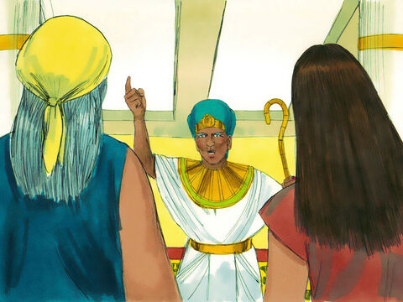
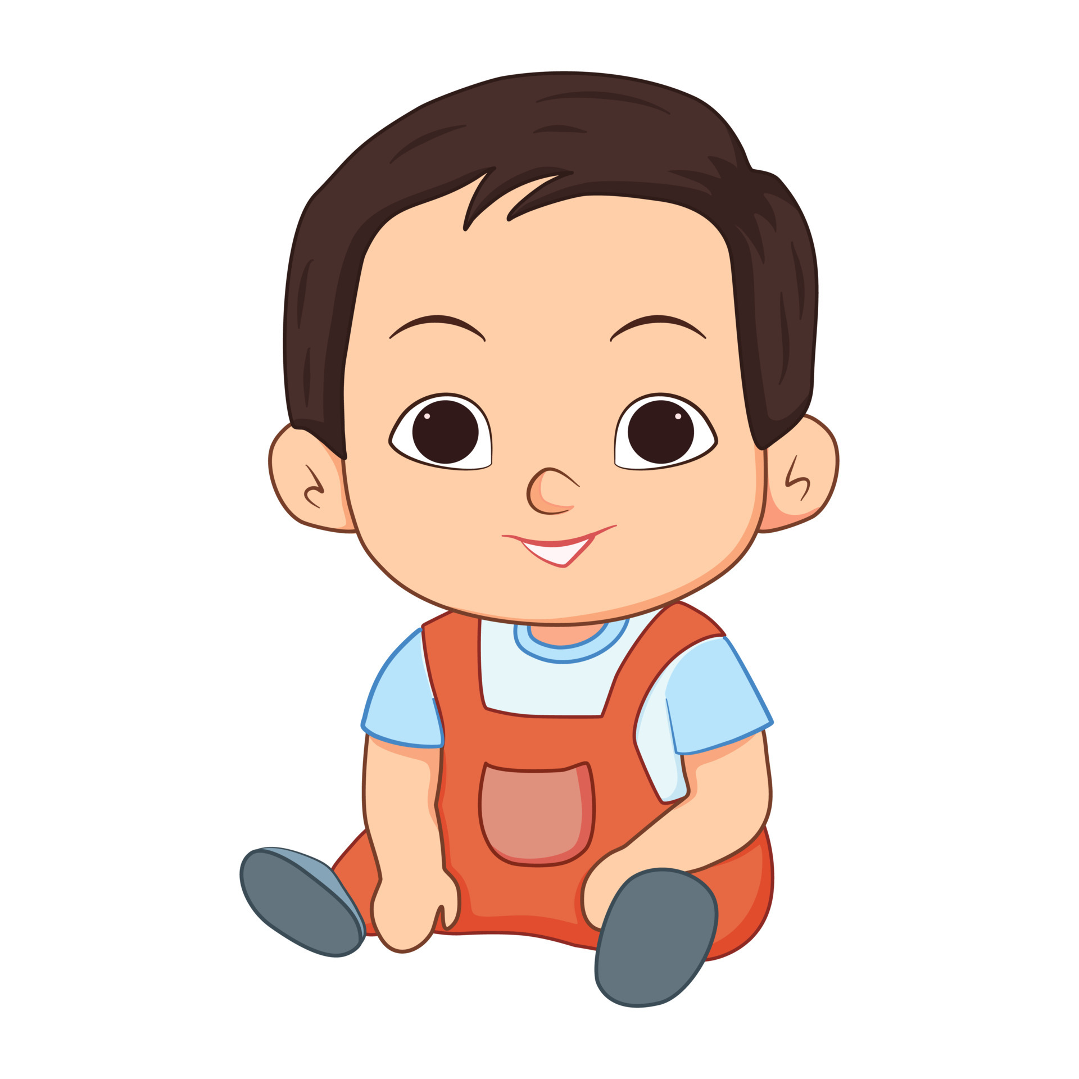
Kill the boys
When you’re helping the Israel women having babies, if you see the baby is a boy, kill him!
The girls can live.
¹⁵ Then the king of Egypt spoke to the Hebrew midwives, of whom the name of one was Shiphrah and the name of the other Puah; ¹⁶ and he said, “When you do the duties of a midwife for the Hebrew women, and see them on the birthstools, if it is a son, then you shall kill him; but if it is a daughter, then she shall live.”

Slide 12
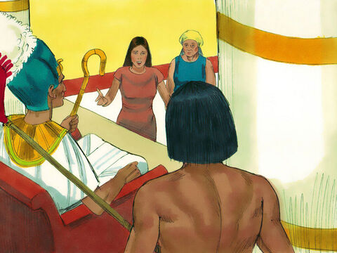
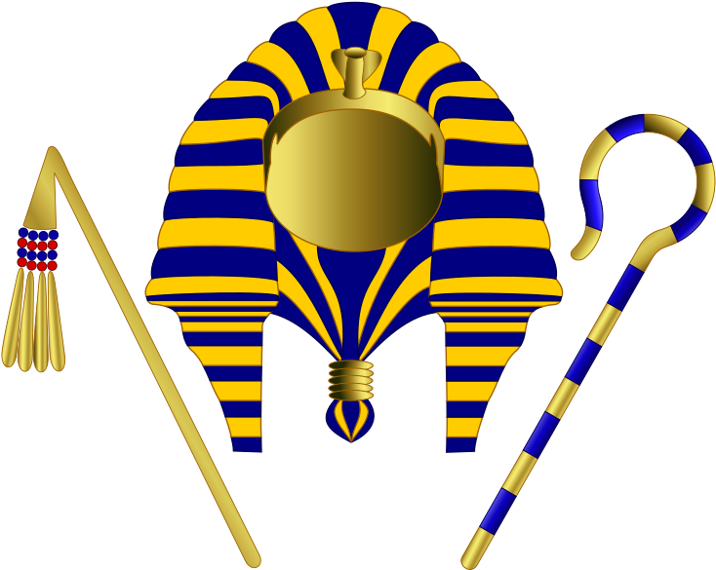
Nope
Pharaoh, the Israelite women are strong and have the babies before we get there.
There are new baby boy Israelites!
You didn’t obey me!
¹⁷ But the midwives feared God, and did not do as the king of Egypt commanded them, but saved the male children alive. ¹⁸ So the king of Egypt called for the midwives and said to them, “Why have you done this thing, and saved the male children alive?”
¹⁹ And the midwives said to Pharaoh, “Because the Hebrew women are not like the Egyptian women; for they ^{[e]}are lively and give birth before the midwives come to them.”
We aren’t going to kill the babies!

Slide 13
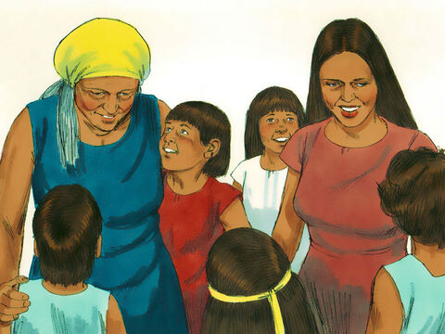

God blesses with more babies!
Praise the Lord of Israel!
He has given us children of our own!
²⁰ Therefore God dealt well with the midwives, and the people multiplied and ^{[f]}grew very mighty. ²¹ And so it was, because the midwives feared God, that He ^{[g]}provided households for them.

Slide 14
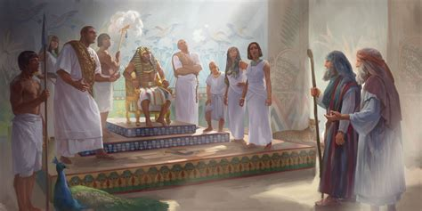

Throw the boys into the river!
Every Israelite son born must be cast into the river!
The daughters may live.
²² So Pharaoh commanded all his people, saying, “Every son who is ^{[h]}born you shall cast into the river, and every daughter you shall save alive.”

Slide 15
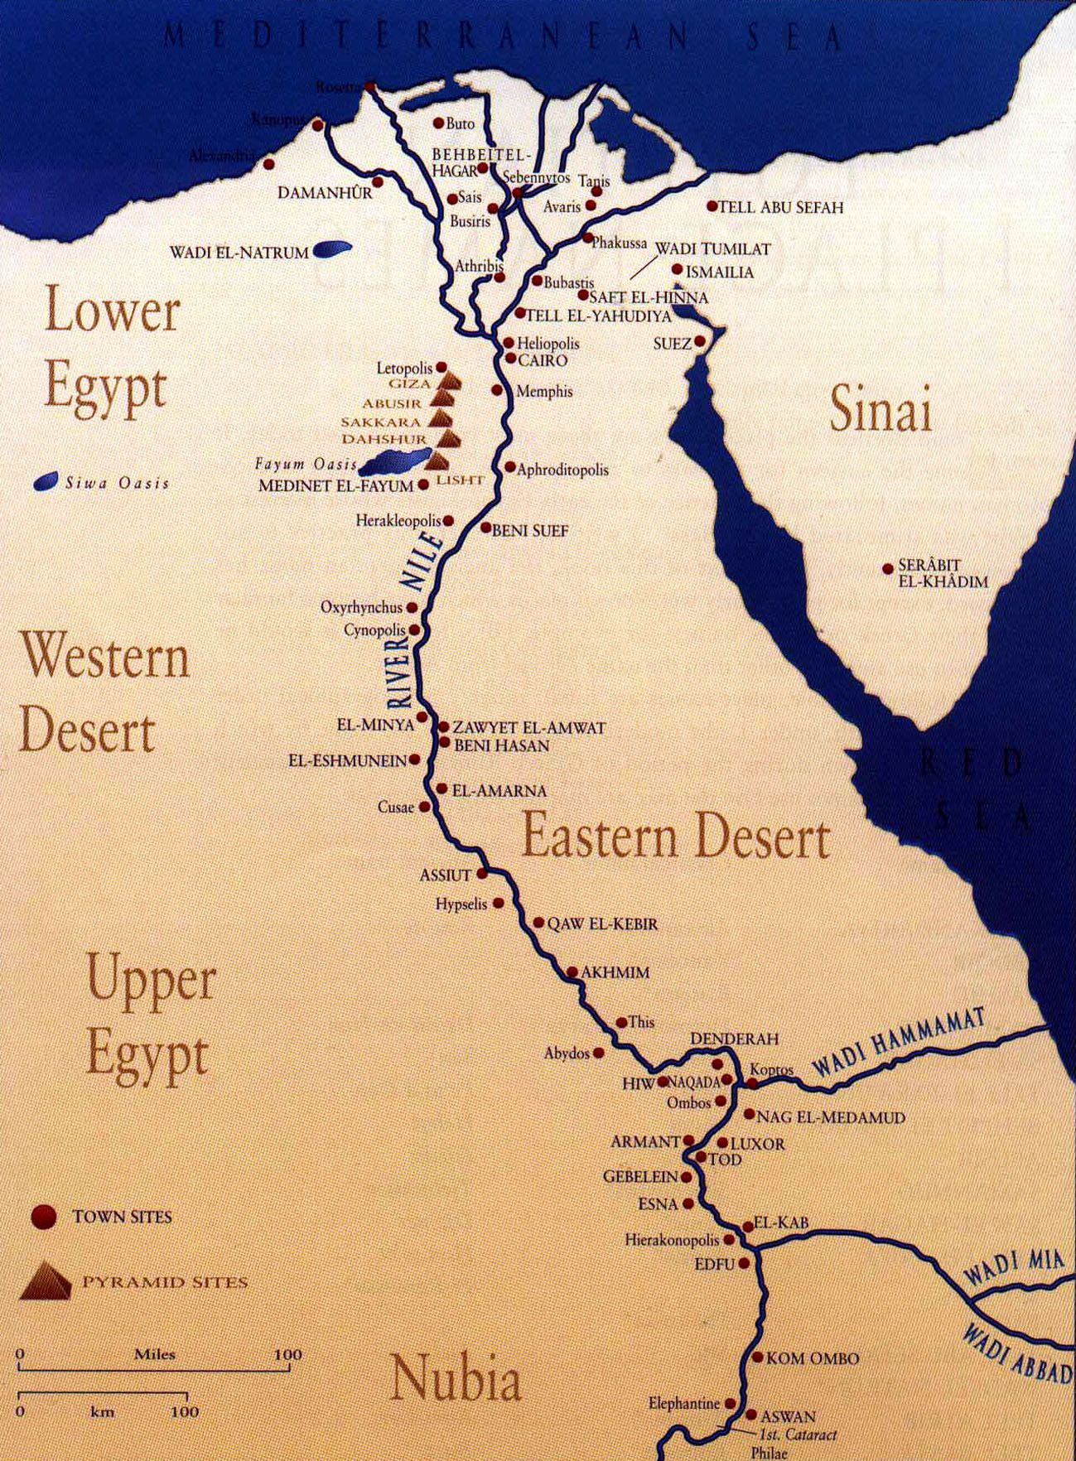
The Nile River
The Nile river is the second longest river in the world! It is 4,160 miles long
The average depth of the Nile River is between 26 and 36 feet
The Nile River at its widest point is 1.7 miles wide.
Bamboo (Bambusoideae) plant species can be found along and near the Nile River.
Animals that live in the Nile river include the crocodile, perch,

Slide 16
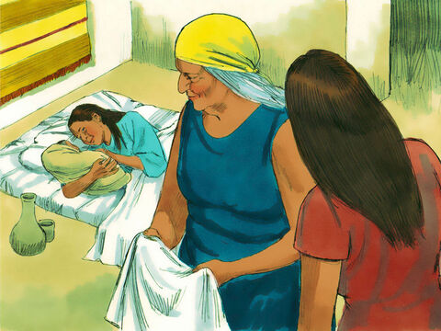
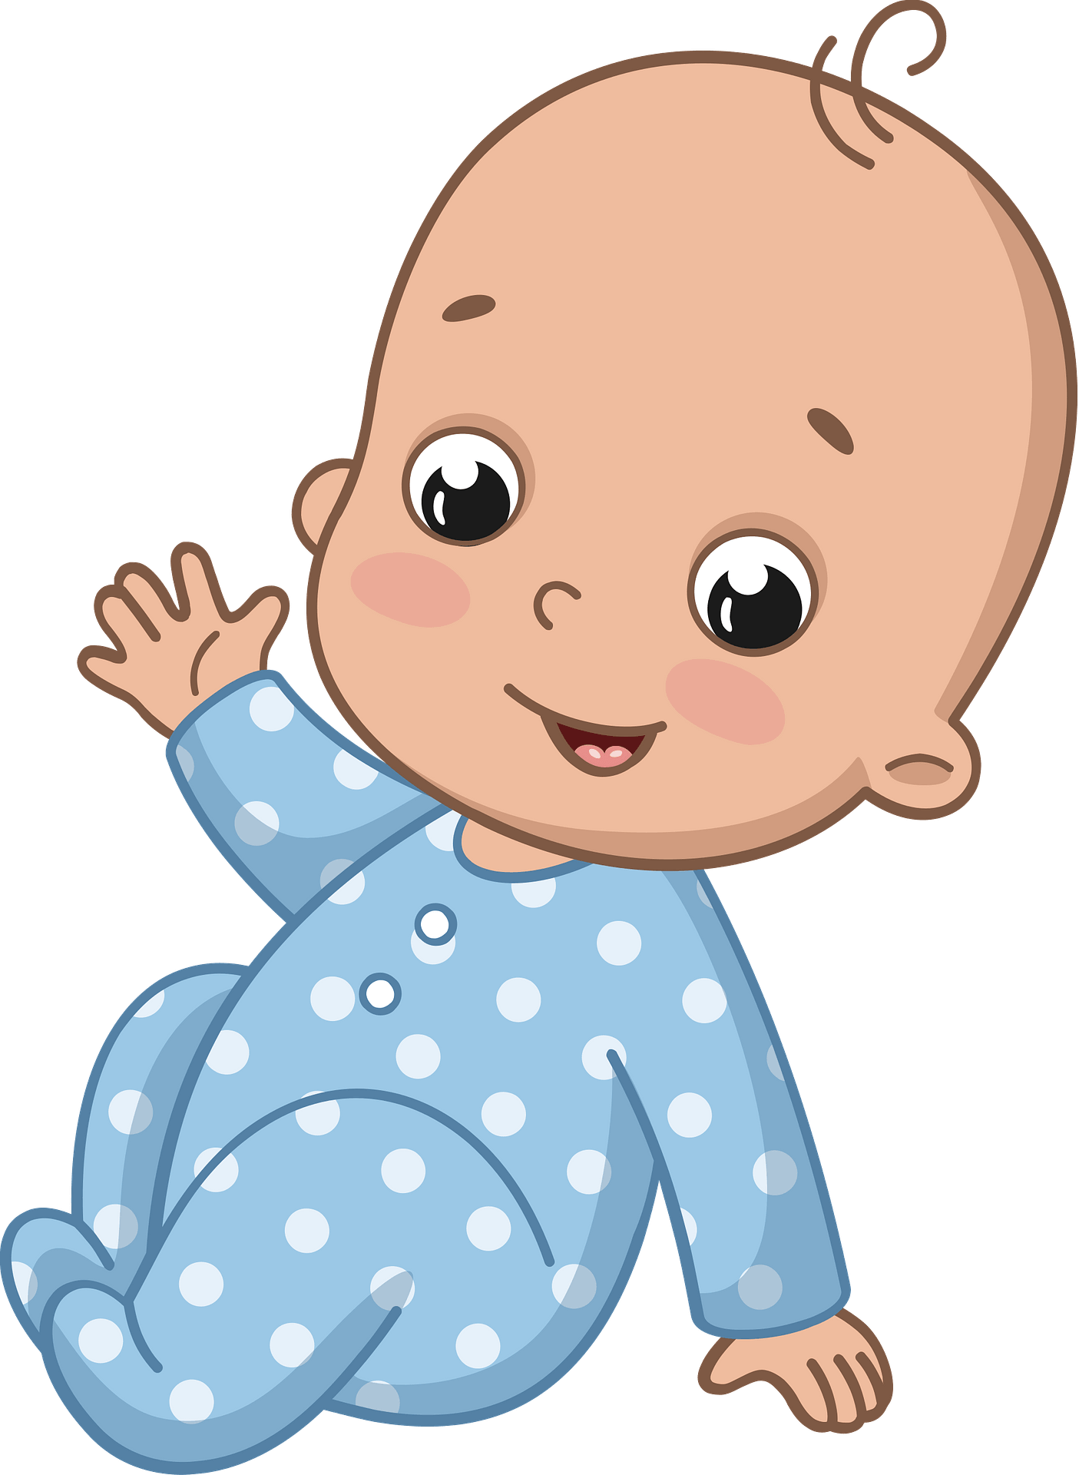
Moses is born
Oh, such a beautiful baby boy!
We will NOT throw him in the river!
I must hide him from the soldiers.
And a man of the house of Levi went and took as wife a daughter of Levi. ² So the woman conceived and bore a son. And when she saw that he was a beautiful child, she hid him three months.

Slide 17
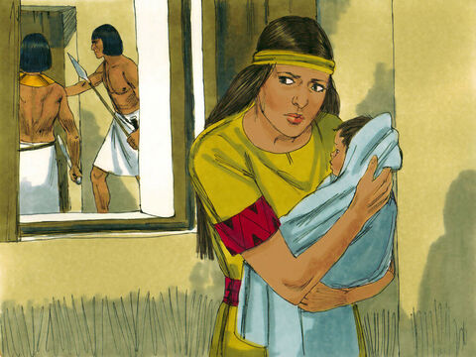
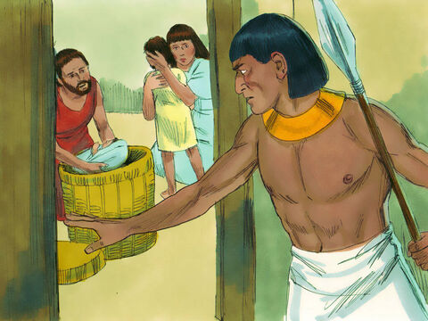
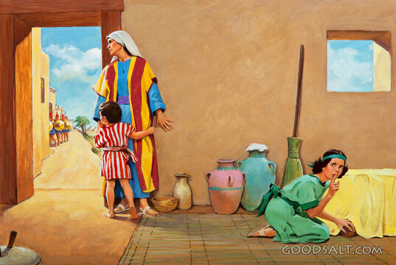
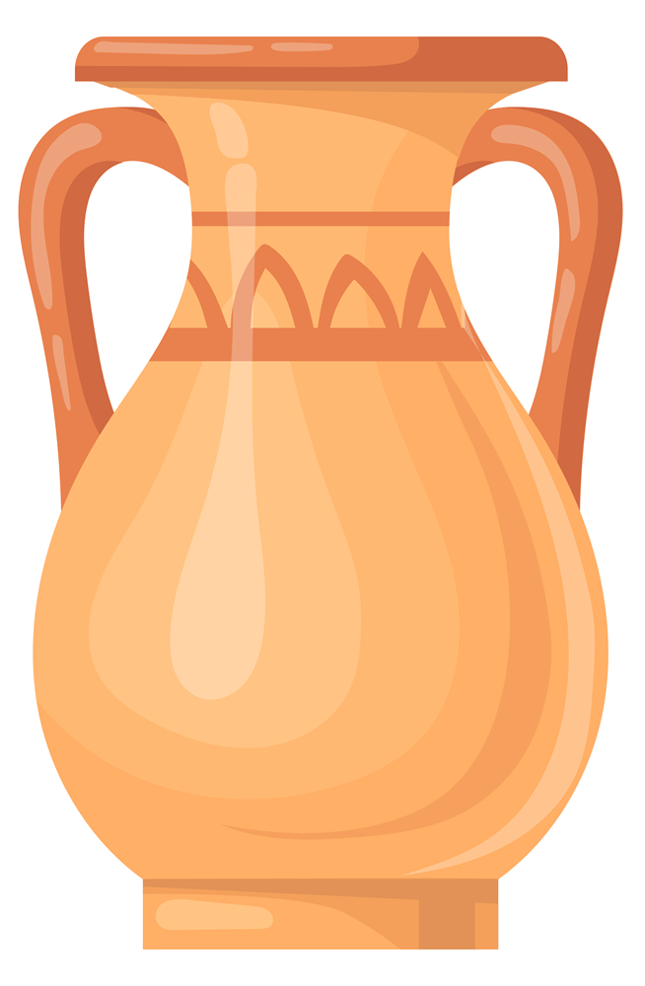
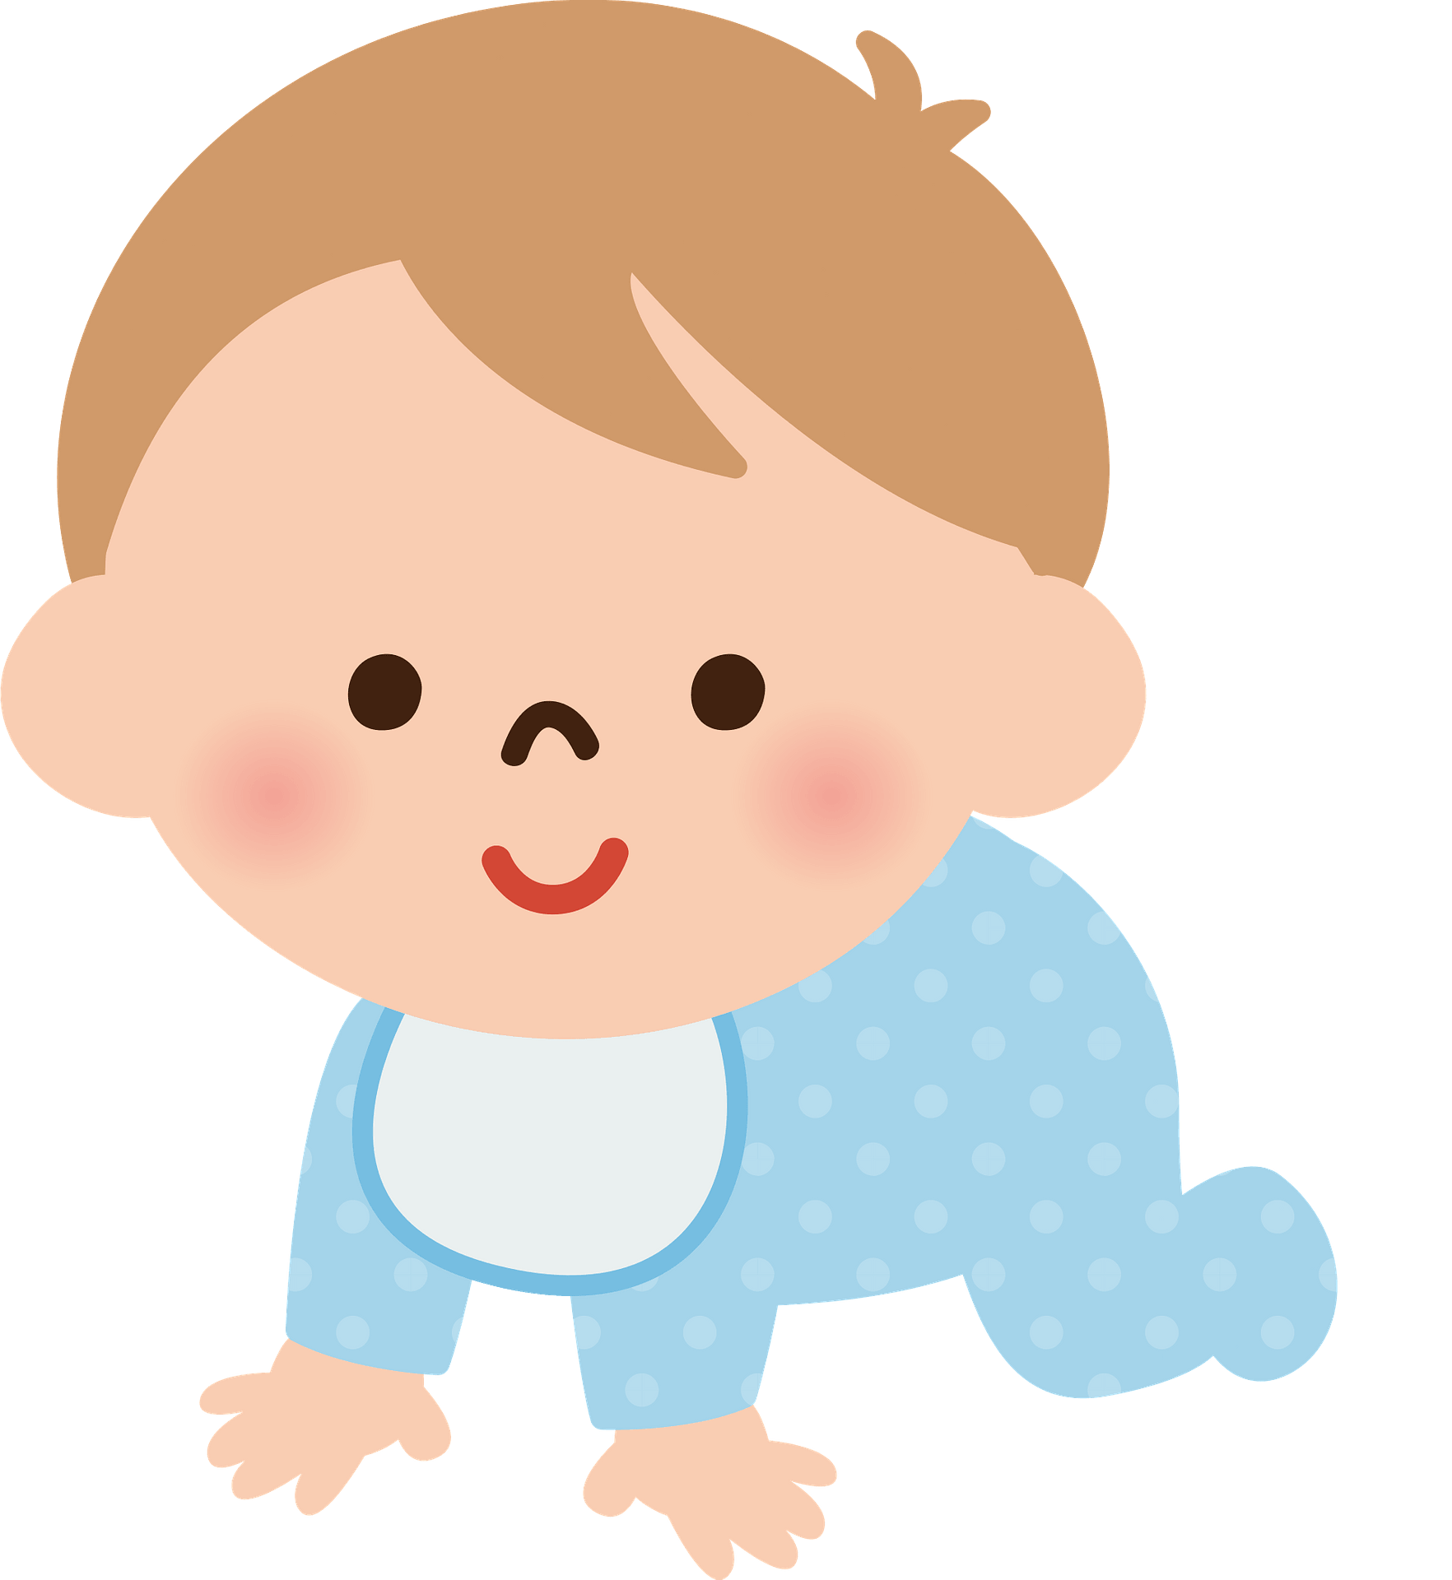
Hide Baby Moses
Mommy Jocabed hid Baby Moses for 3 months.
Can you hide the baby doll where the soldiers can’t find it?
Take turns hiding and finding the baby.

Slide 18
Psalms
25:1 & 20
Psalms 25
In you, Lord my God,
I put my trust.
²⁰ Guard my life and rescue me;
do not let me be put to shame,
for I take refuge in you.
⁴ Show me your ways, Lord,
teach me your paths.
⁵ Guide me in your truth and teach me,
for you are God my Savior,
and my hope is in you all day long.
⁶ Remember, Lord, your great mercy and love,
for they are from of old.

Slide 19
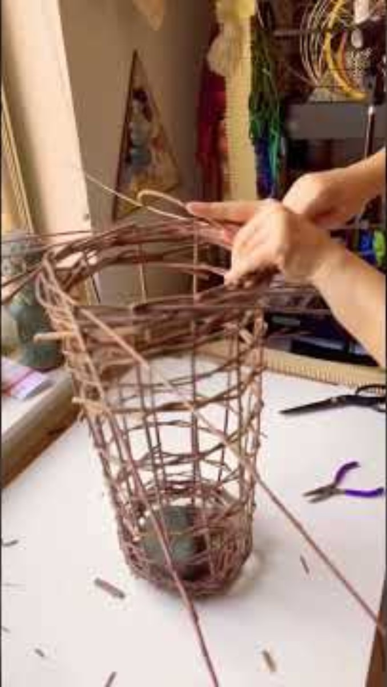
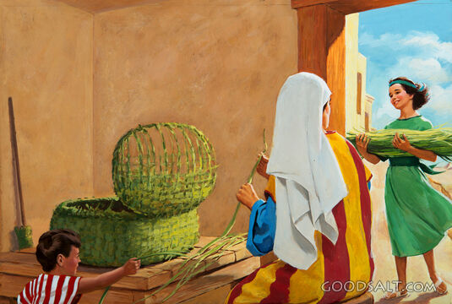
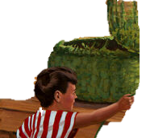
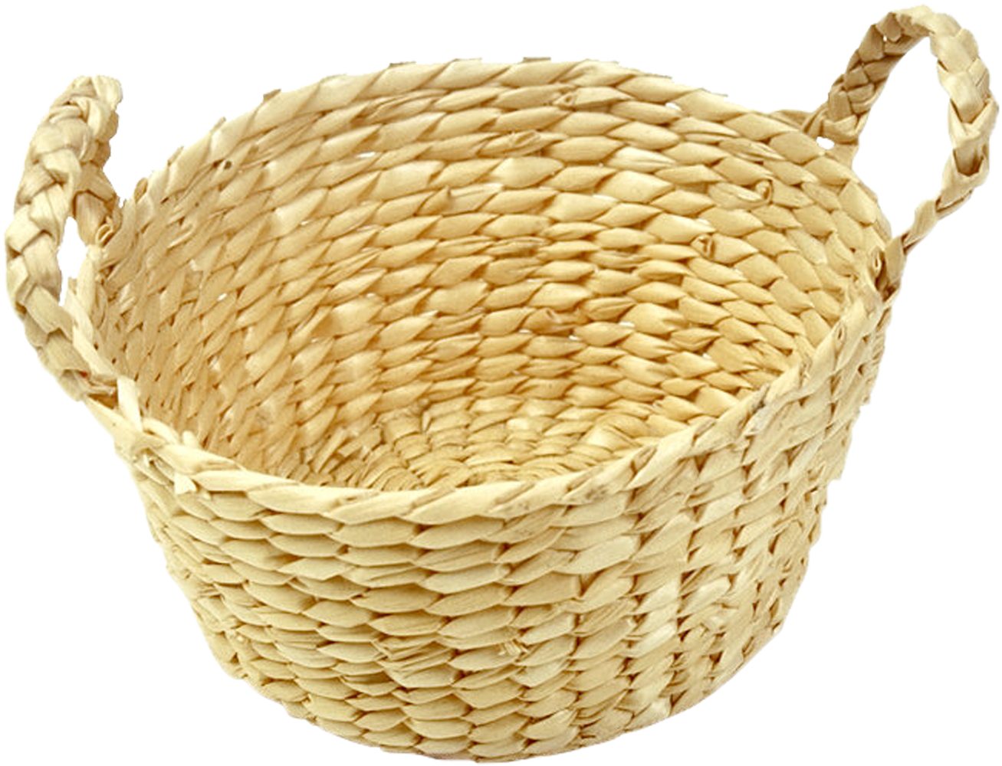
Basket Project
You are being so helpful Miriam. Thank you.
Our basket project is getting done.

Slide 20
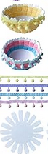
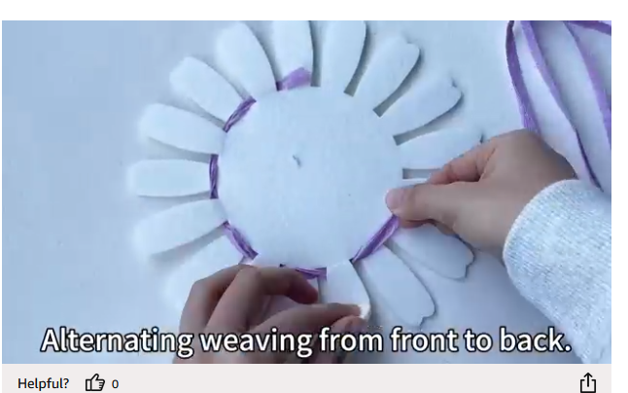
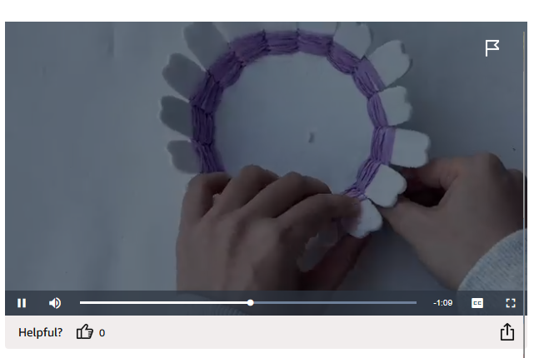

CRAFT TIME Make a basket
Amazon baskets
Using double stick tape, tape the raffia to a basket ‘petal’.
Weave the raffia alternating front to back…
Bring the basket ‘petals’ up as you weave.
When you reach the end of the raffia or the top of the basket, finish by taping the raffia to a ‘petal’.

Slide 21
CRAFT TIME Make a basket
Amazon baskets
Using double stick tape, tape the raffia to a basket ‘petal’.
Weave the raffia alternating front to back…
Bring the basket ‘petals’ up as you weave.
When you reach the end of the raffia or the top of the basket, finish by taping the raffia to a ‘petal’.

Slide 22
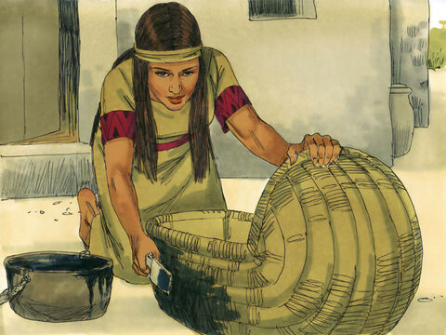

A Boat for baby Moses
The pitch and tar will make the basket waterproof.
It will be a safe place for baby Moses.
I will put my baby in the river – safely.
³ But when she could no longer hide him, she took an ark of bulrushes for him, daubed it with asphalt and pitch, …

Slide 23
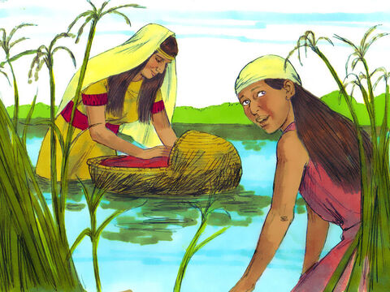
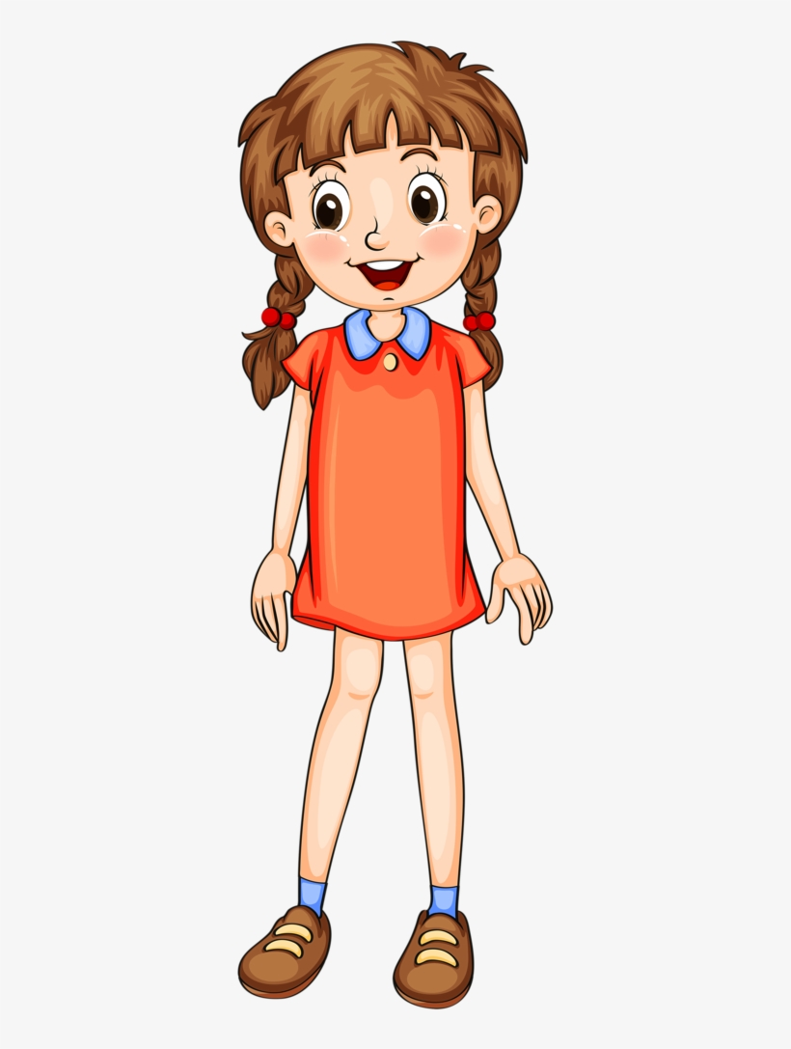
Taken to the river
Go to sleep my sweet child.
Dear Lord, please watch over my baby. Take care of him please.
Miriam. Watch what happens.
She took an ark of bulrushes for him, daubed it with asphalt and pitch, put the child in it, and laid it in the reeds by the river’s bank. ⁴ And his sister stood afar off, to know what would be done to him.
I will Mama.

Slide 24
Psalms
25:1 & 20
Psalms 25
In you, Lord my God,
I put my trust.
²⁰ Guard my life and rescue me;
do not let me be put to shame,
for I take refuge in you.
⁴ Show me your ways, Lord,
teach me your paths.
⁵ Guide me in your truth and teach me,
for you are God my Savior,
and my hope is in you all day long.
⁶ Remember, Lord, your great mercy and love,
for they are from of old.

Slide 25
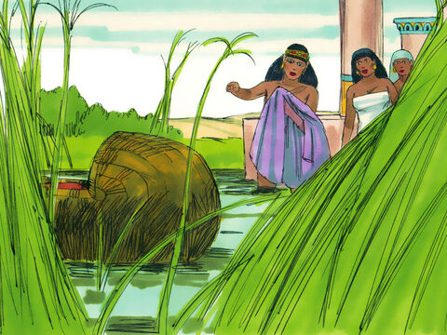
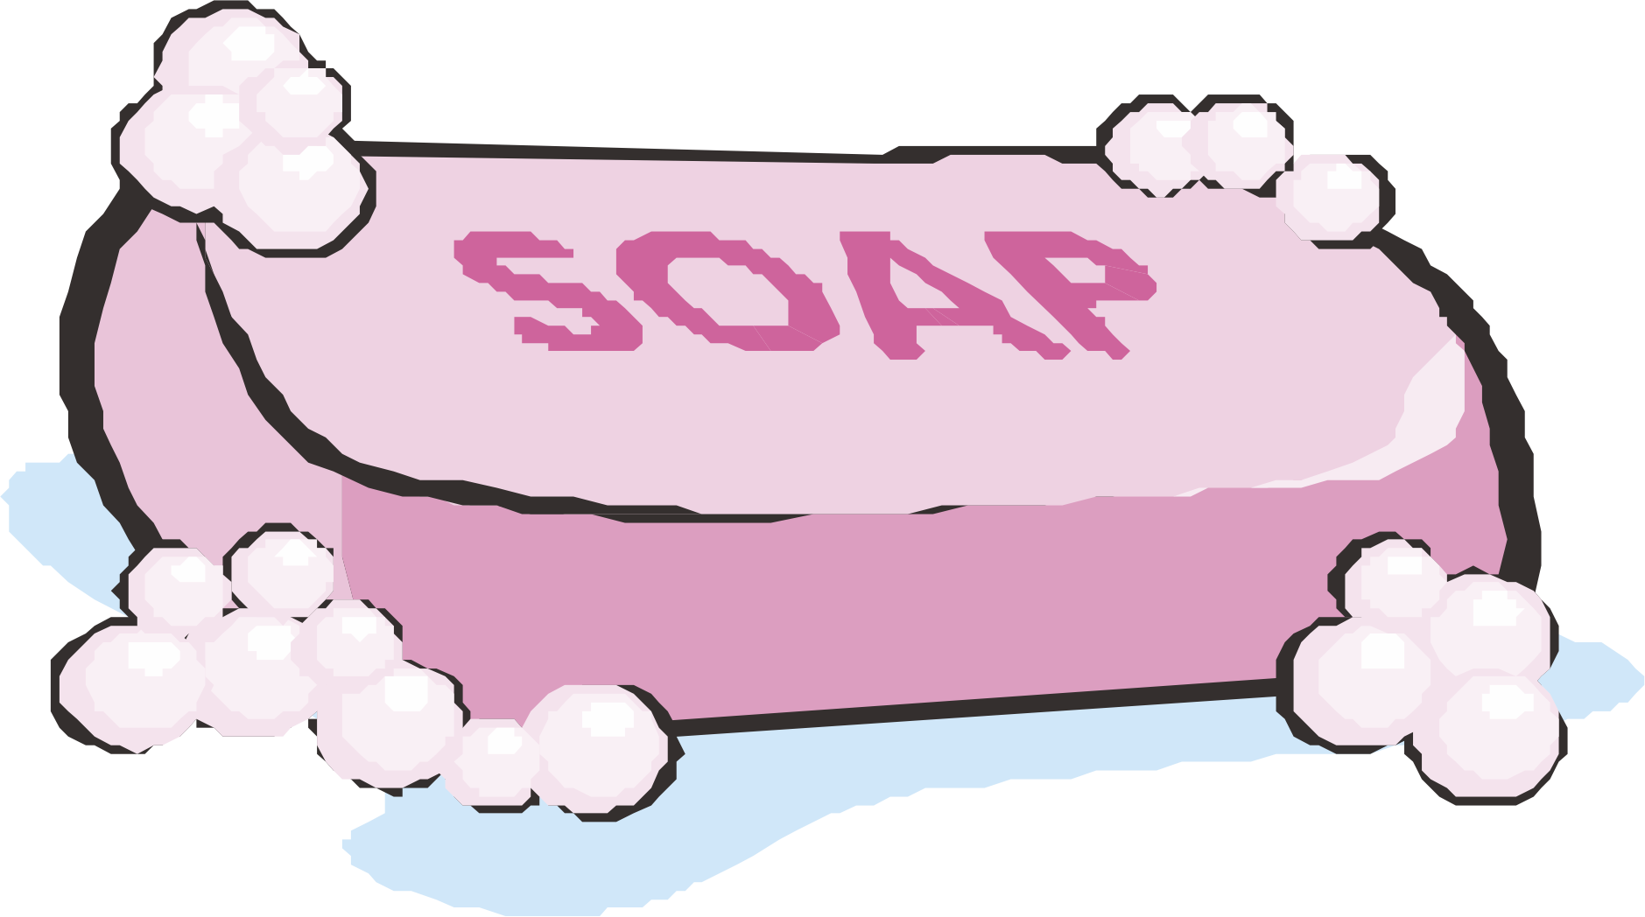
I spy a basket…
Look!
Is that a basket
hiding in the reeds?
Go get it for me.
⁵ Then the daughter of Pharaoh came down to bathe at the river. And her maidens walked along the riverside; and when she saw the ark among the reeds, she sent her maid to get it.

Slide 26
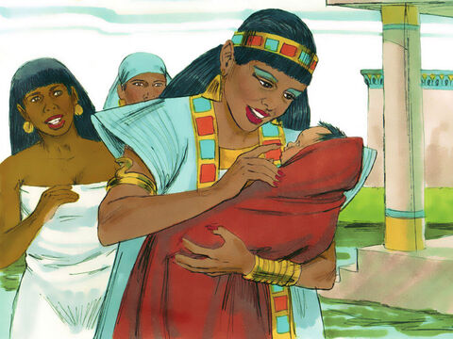

It’s a baby!
This is one of the Hebrews’ children.
What a precious baby!
⁶ And when she opened it, she saw the child, and behold, the baby wept. So, she had compassion on him, and said, “This is one of the Hebrews’ children.”

Slide 27
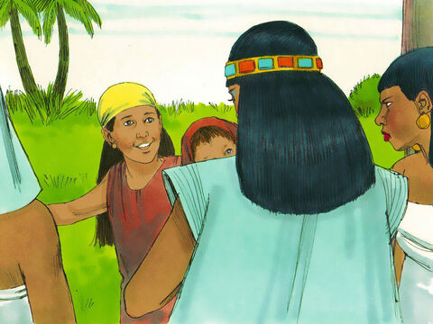

Paid to nurse and Mother
Shall I go and call a nurse for you from the Hebrew women, so that she may nurse the child for you?
Yes. Go.
⁷ Then his sister said to Pharaoh’s daughter, “Shall I go and call a nurse for you from the Hebrew women, that she may nurse the child for you?”
⁸ And Pharaoh’s daughter said to her, “Go.” So, the maiden went and called the child’s mother.

Slide 28
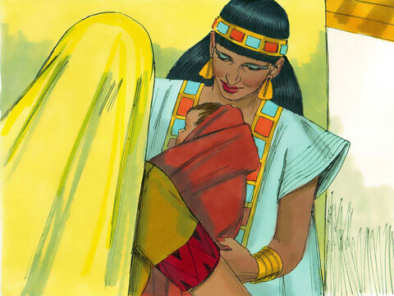
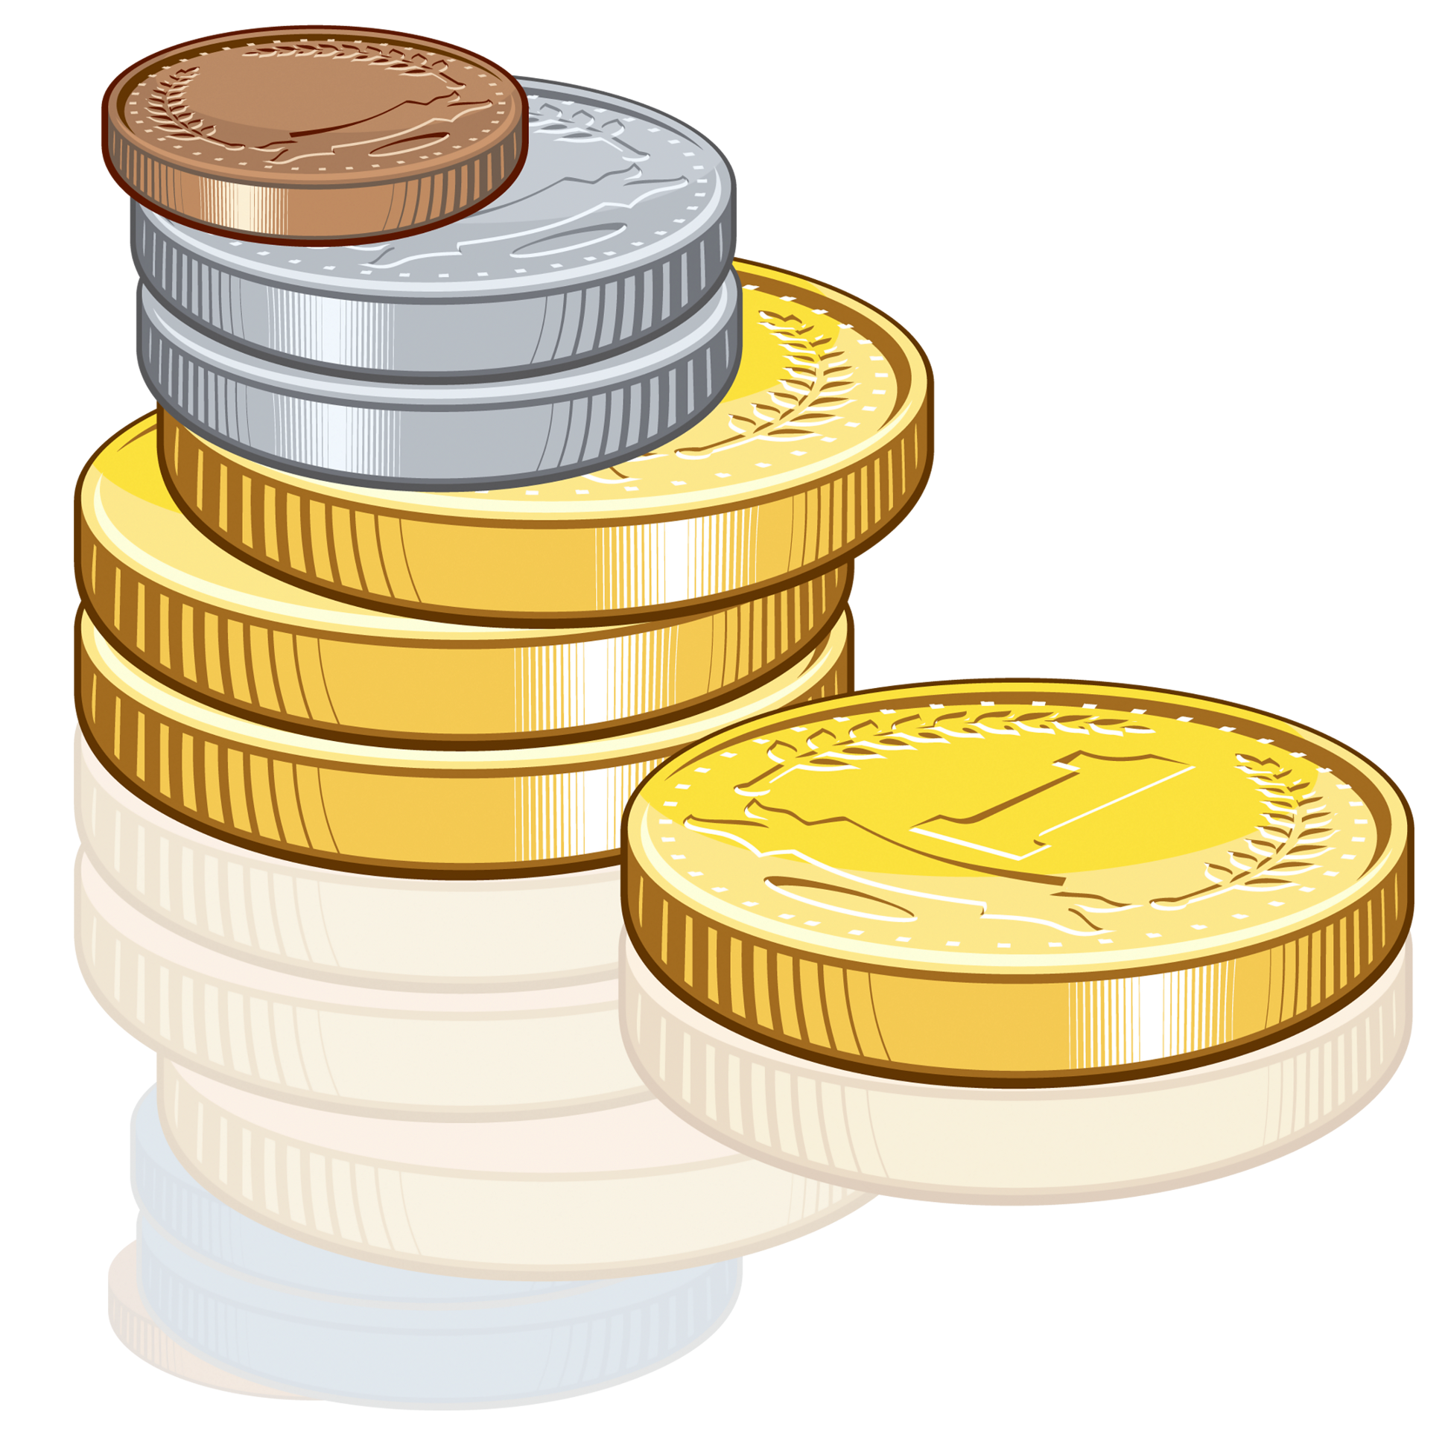
Paid to nurse and Mother
Take this child and nurse him for me, and I will give you your wages.
Yes, I will
⁹ Then Pharaoh’s daughter said to her, “Take this child away and nurse him for me, and I will give you your wages.” So, the woman took the child and nursed him.

Slide 29
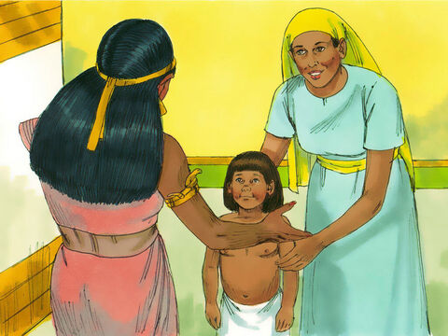
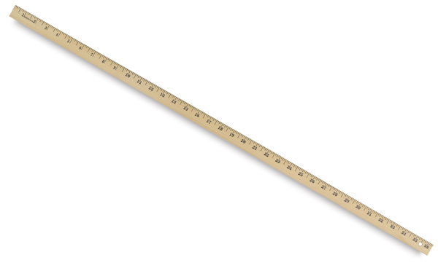
My son, you have grown so much. I see that you are strong and smart.
¹⁰ And the child grew, and she brought him to Pharaoh’s daughter, and he became her son. So, she called his name ^{[a]}Moses, saying, “Because I drew him out of the water.”
Thank you for taking good care of him.
I will call him Moses, because I drew him out of the water.

Slide 30


Moses grew up
Moses, let’s see your wisdom. You can solve this man’s problem.
Moses grew up in the palace. He went to school. He learned the Egyptian ways and language. He learned how to be a leader and a warrior.

Slide 31

Moses grew up in the palace of Pharaoh

Slide 32
Psalms
25
Psalms 25
In you, Lord my God,
I put my trust.
²⁰ Guard my life and rescue me;
do not let me be put to shame,
for I take refuge in you.
⁶ Remember, Lord, your great mercy and love, for they are from of old.
⁷ Do not remember the sins of my youth and my rebellious ways;
according to your love remember me, for you, Lord, are good.
⁸ Good and upright is the Lord;
therefore, he instructs sinners in his ways.
⁹ He guides the humble in what is right and teaches them his way.

Slide 33


Slide 34

Little Mo’ The Story of Moses
DG Bible Songs

Slide 35

CRAFT TIME option 2
On a paper plate, scrunch and glue on some blue tissue paper to be the river
Slit green green construction paper to look like grass reeds. Glue beside the river.
Color, cut out a baby and girl. Hide the girl in the reeds.
Put the baby in a muffin paper and glue it on the river.

Slide 36

https://activity-array.com/

