Slide 1
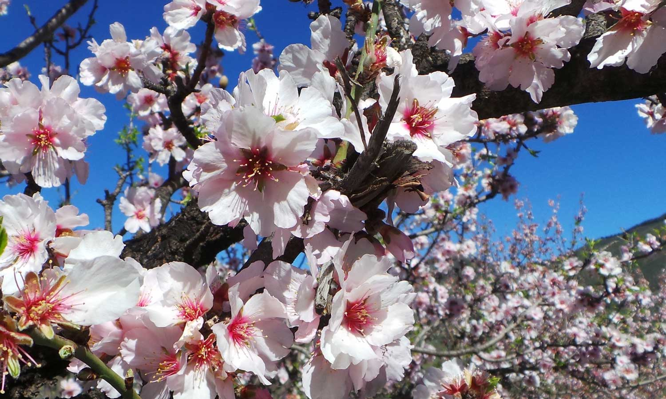
Who is the head priest?
Aaron’s Rod buds
Numbers 17

Slide 2
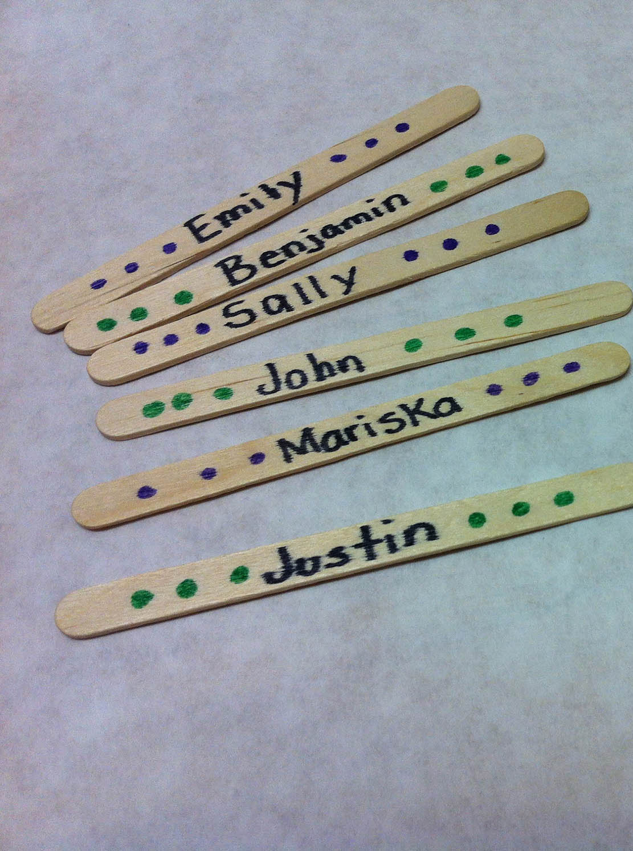
WHO’S THE WINNER
I have a bag of prizes.
Write your name on a stick and put it in this can.
I’ll draw a stick out and see who wins this prize.

Slide 3

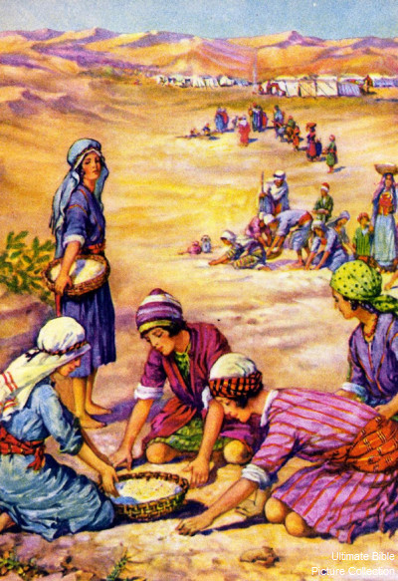
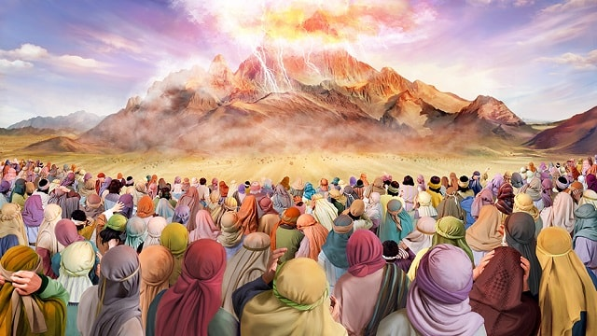
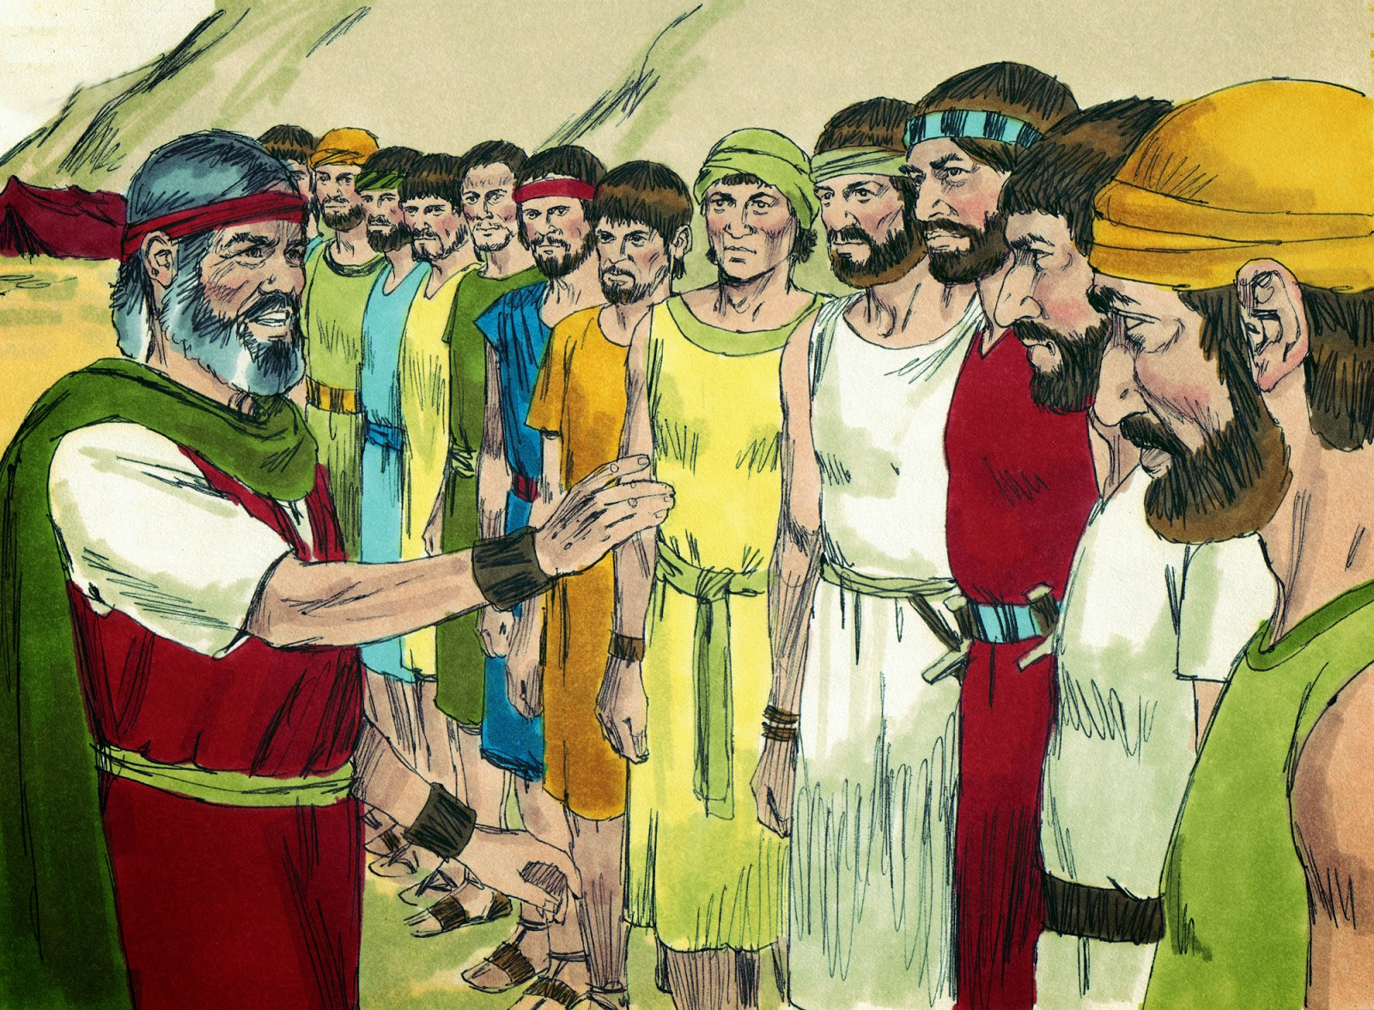
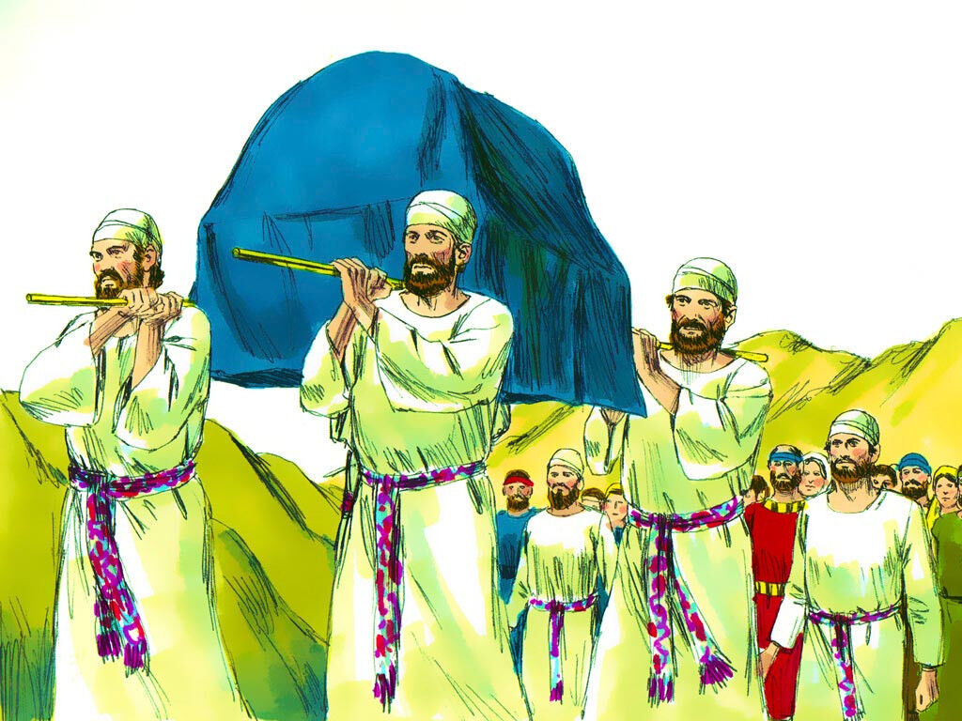
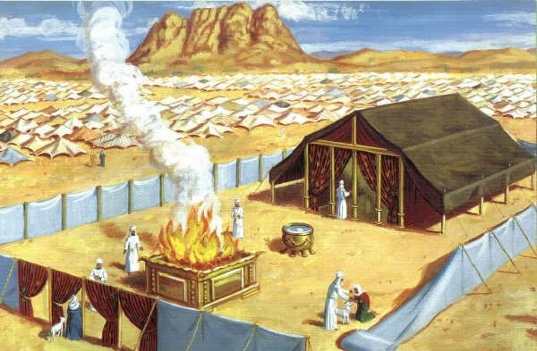
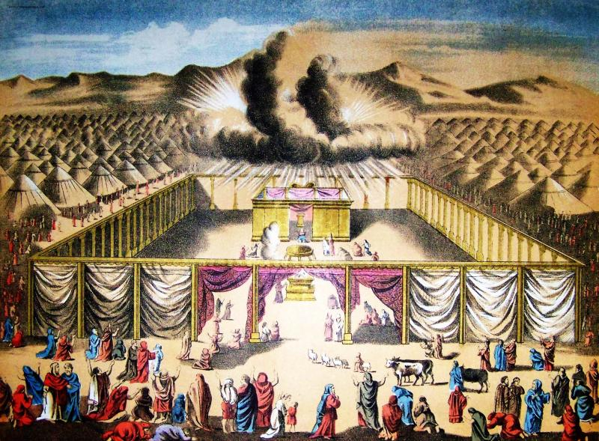
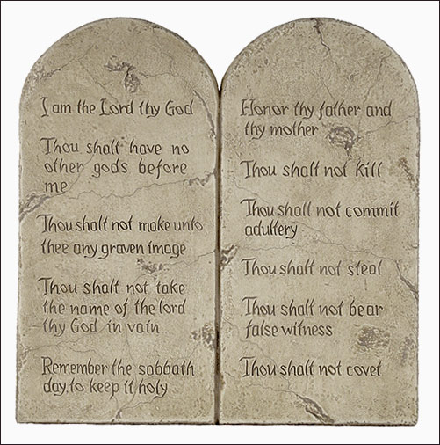
God continued to lead the Israelites
God gave them food
God gave them 10 good laws
He gave them the plans for the tabernacle sanctuary. The Israelites followed God’s instructions and spent almost a year building it. God’s glory came in and over the tabernacle.
God chose a man from each tribe to help Moses by leading their tribe.
God chose the tribe of Levites to take care of the tabernacle and help move it from place to place.
God chose Aaron and his sons to be priests and offer offerings and sacrifices. This way people’s sins were forgiven and they worshipped God.

Slide 4
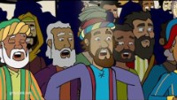
God’s Choice

Slide 5
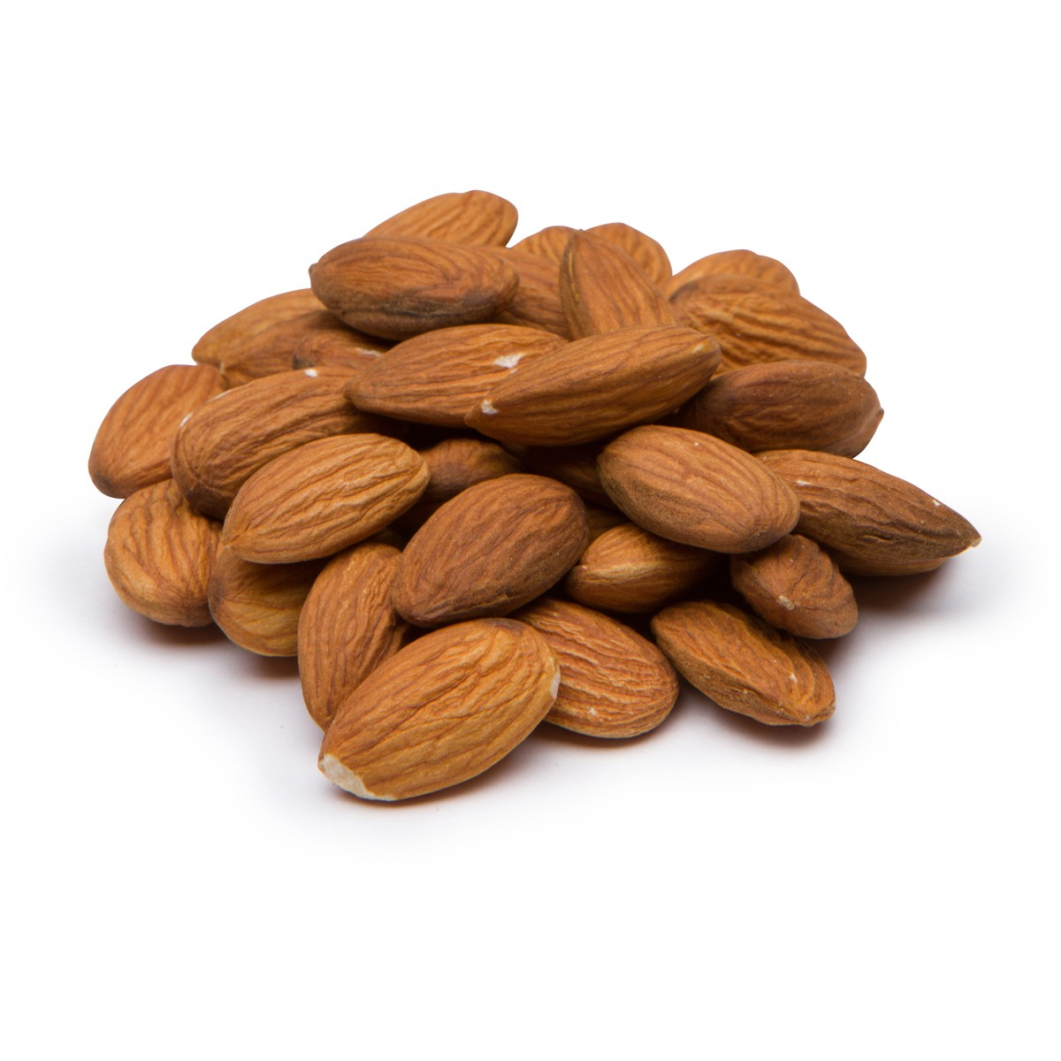

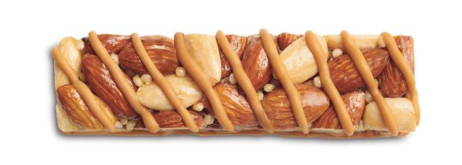
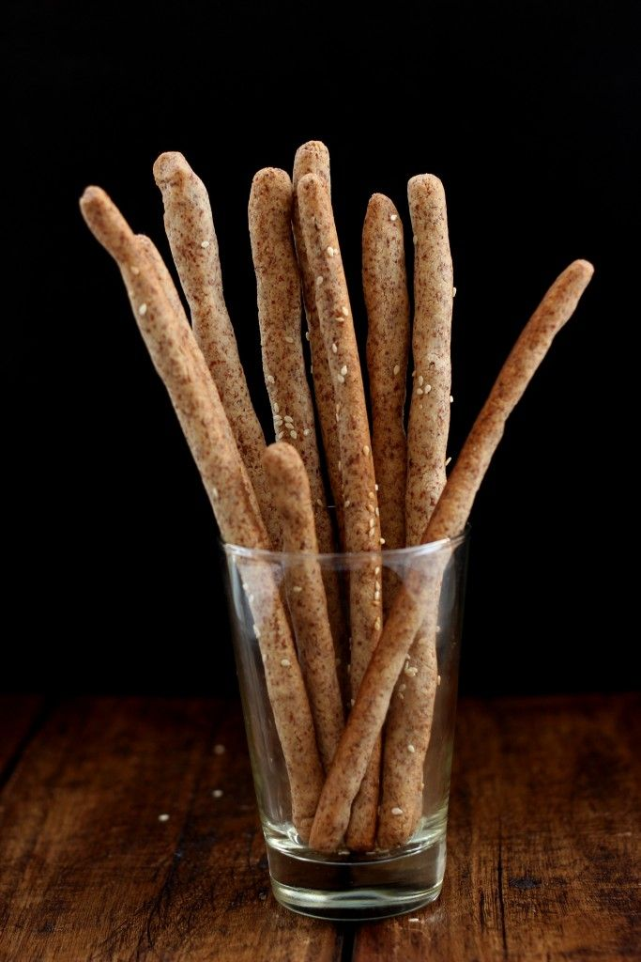
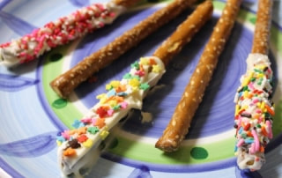
SNACK TIME ideas
Make Almond flour bread sticks
8 spoons white wheat flour
6 spoons almond flour
4 spoons powdered sugar
½ spoon baking powder
A shake of cinnamon
  MIX above together
Add 1 spoon of water
  MIX all together
  Squish and form 2 bread sticks
  BAKE 425º for 10 min.
    or until lightly golden

Slide 6
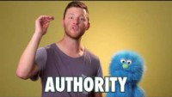
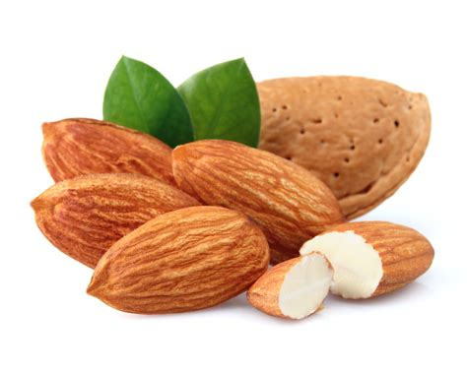
What is AUTHORITY?

Slide 7
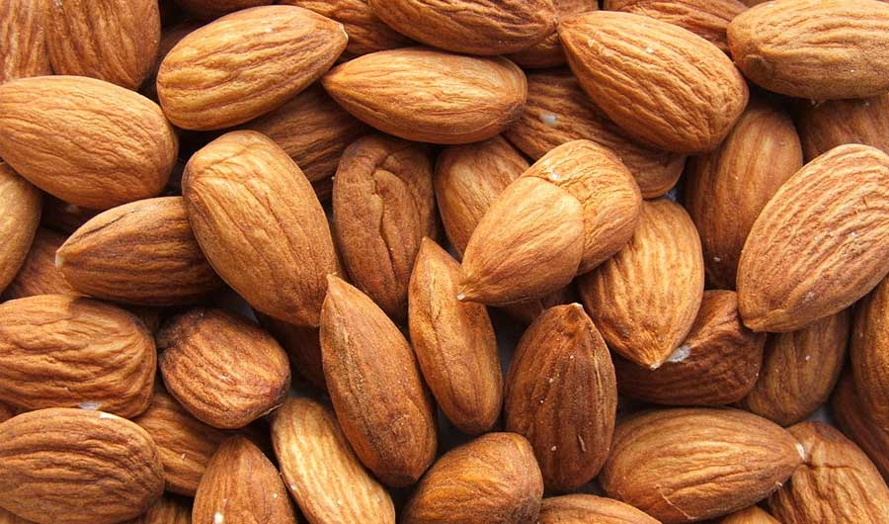
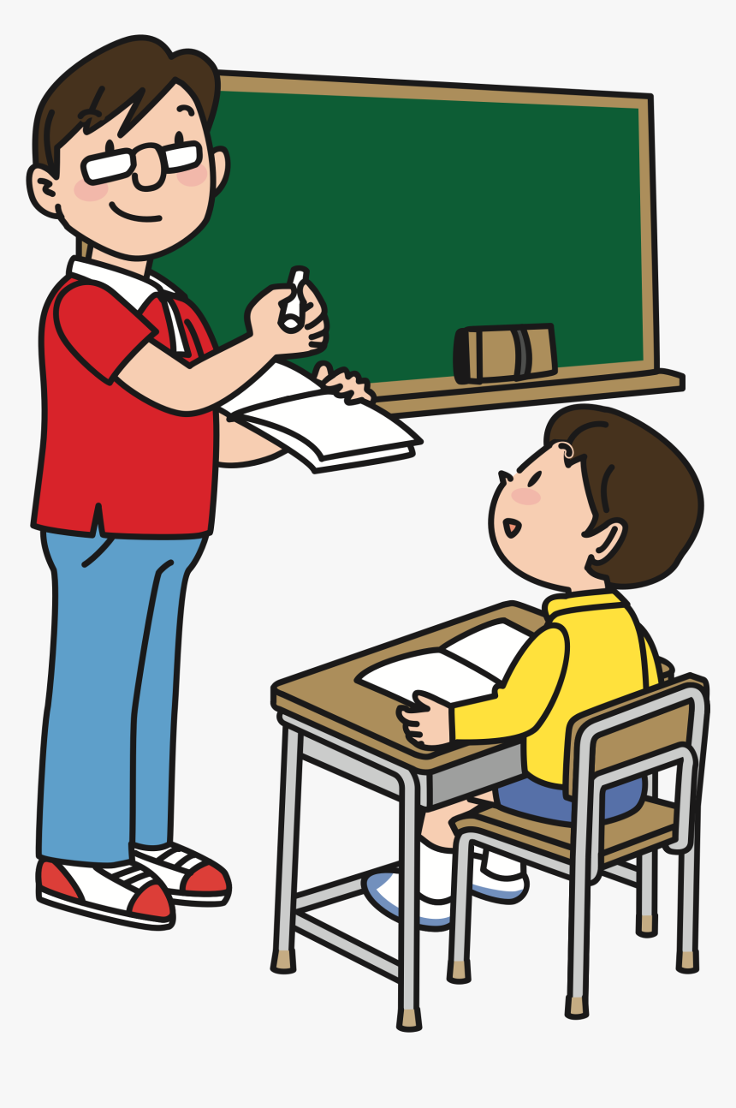
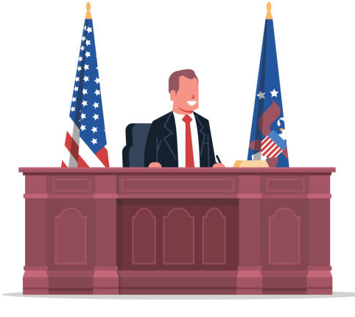
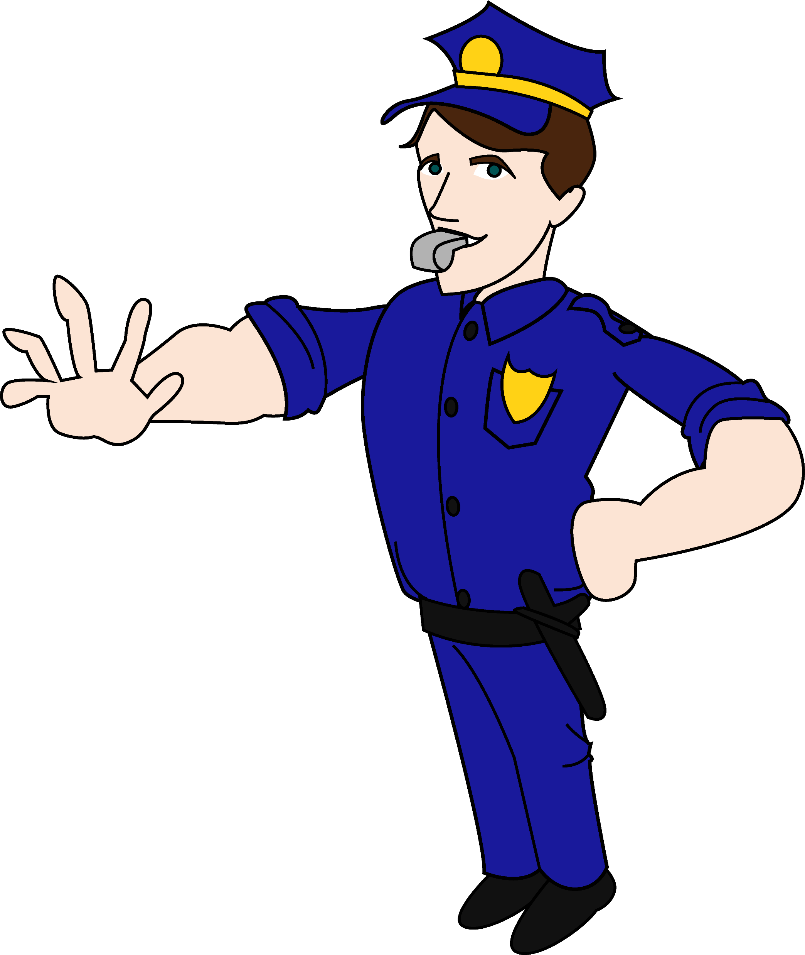

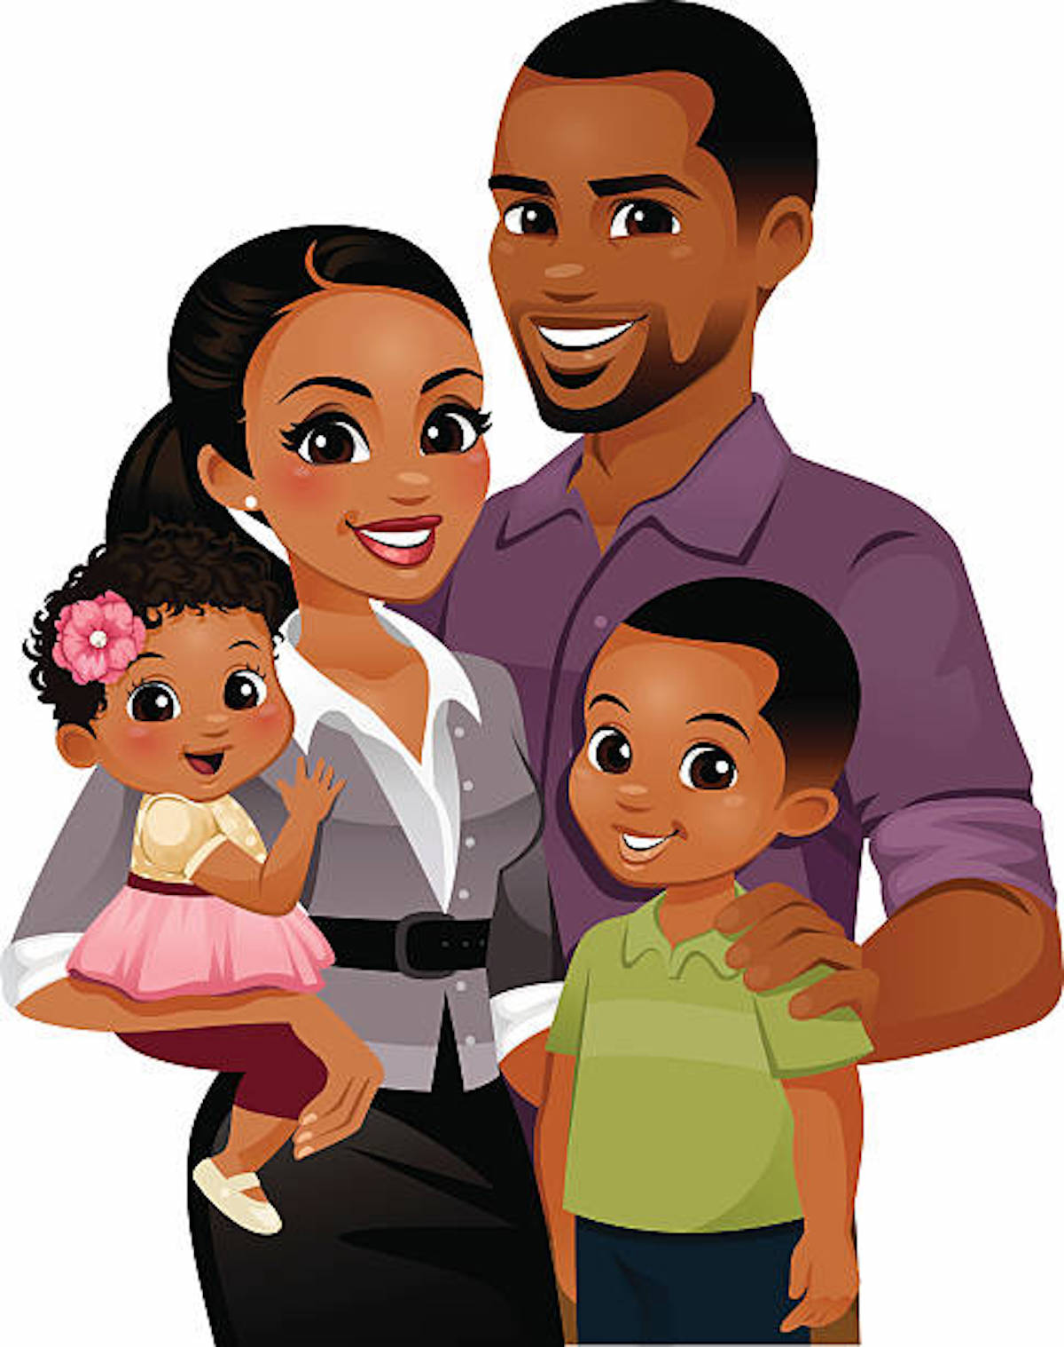
Respect authority – the leaders placed over you.
All of you must obey the government rulers.
Everyone who rules was given the power to rule by God.
And all those who rule now were given that power by God.
Romans 13:1
Let everyone be subject to the governing authorities,
for there is no authority except that which God has established.
The authorities that exist have been established by God.
Romans 13:1

Slide 8


Respect authority – the leaders placed over you.
Choose different kids to be in charge. What if all the boys give a command? Or all the girls are in charge at once?

Slide 9
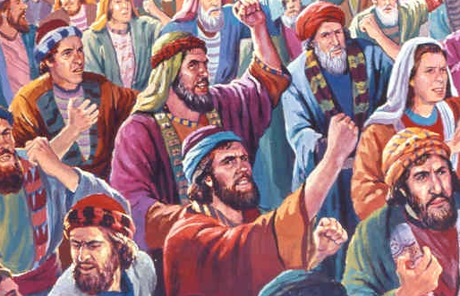
Many grumbled
Numbers 16
“ Korah, Dathan, Abiram, and On turned against Moses. (Korah was the son of Izhar. Izhar was the son of Kohath, and Kohath was the son of Levi. … ² These four men gathered 250 other men from Israel together and came against Moses. “
_____
These men started a rebellion. They wanted to be special priests and leaders too. But God had not chosen them for that job.
God had to get tough. Those who rebelled against God died.

Slide 10
God chose the tribe of Levi to work in the tabernacle.
They served in the sanctuary.
^{Numbers 16:8} Moses also said to Korah, “You Levites, listen to me. ⁹ You should be happy that the God of Israel chose you to be different from the rest of the Israelites. He lets you come near to him to do the special work in the Lord’s Holy Tent to help the Israelites worship him. Isn’t that enough? ¹⁰ He brought you Levites near to him to help the priests, but now you are trying to become priests also. ¹¹ You and your followers have joined together and turned against the Lord! Did Aaron do anything wrong? No, so why are you complaining against Aaron?” ….

Slide 11
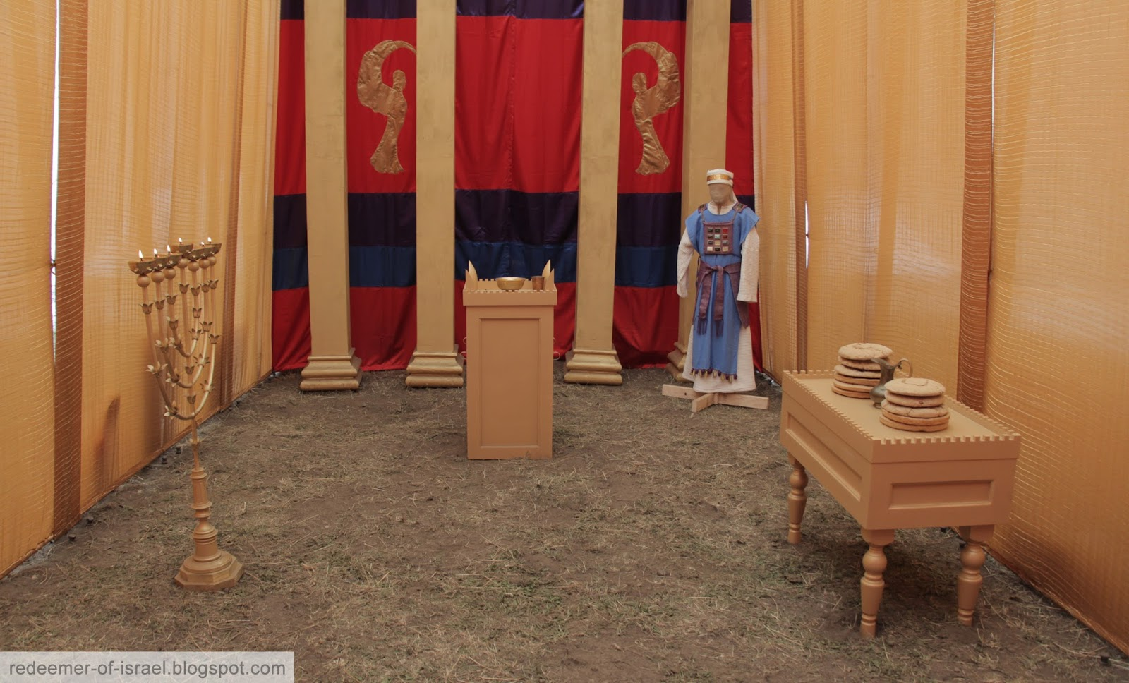
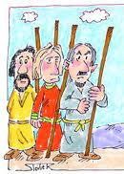
12 leaders put their name on their staffs and placed them before the Lord
Reuben Elizar
Simeon - Shelumiel
Gad - Eliasaph
Judah - Nahshon
Issachar - Nethanel
Zebulun - Eliab
Ephraim - Elishama
Manasseh - Gamaliel
Benjamin - Abidan
Dan - Ahiezer
Asher - Pagiel
Naphtali - Ahira
Levi - Aaron
17 The Lord said to Moses, ² “Speak to the Israelites. Get twelve wooden walking sticks from them. Get one from the leader of each of the twelve tribes. Write the name of each man on his walking stick. ³ On the stick from Levi, write Aaron’s name. There must be one stick for the head of each of the twelve tribes. ⁴ Put these walking sticks in the Meeting Tent in front of the Box of the Agreement. This is the place where I meet with you. ⁵ I will choose one man to be the true priest. You will know which man I choose because his walking stick will begin to grow new leaves. In this way I will stop the people from always complaining against you and me.”
⁶ So Moses spoke to the Israelites. Each of the leaders gave him a walking stick. There were twelve walking sticks. There was one stick from each leader of each tribe. One of the walking sticks belonged to Aaron. ⁷ Moses put the walking sticks before the Lord in the Tent of the Agreement.

Slide 12
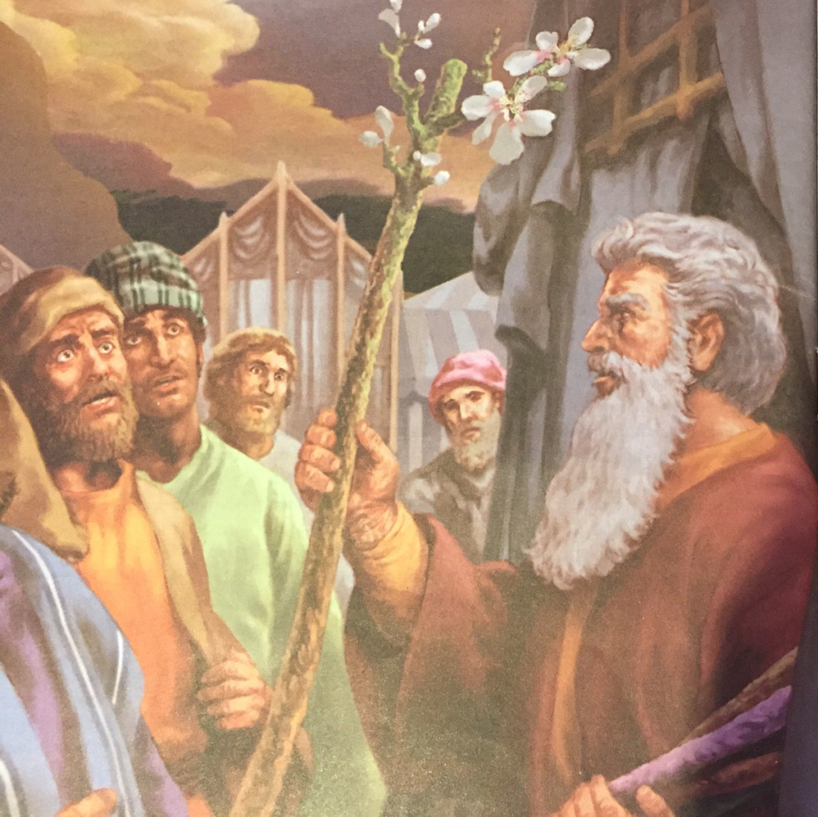

Aaron is the high priest
⁸ The next day Moses entered the Tent. He saw that Aaron’s walking stick, the stick from the family of Levi, was the one that had grown new leaves. That walking stick had even grown branches and made almonds. ⁹ So Moses brought out all the sticks from the Lord’s place. He showed the walking sticks to the Israelites. They all looked at the sticks, and each man took his own stick back.
Rueben
Naphtali
Asher
Issachar
Ephraim
Gad
Benjamin
Zebulun
Dan
Manasseh
Simeon
Judah
Levi - Aaron

Slide 13
Respect God. Respect His choices and commands.
God told Aaron, (Numbers 18:6-7)
“I myself chose the Levites from among all the Israelites. They are as a gift to you. I gave them to you to serve the Lord and work in the Meeting Tent.
⁷ But, Aaron, only you and your sons may serve as priests. You are the only ones who can go near the altar or behind the curtain into the Most Holy Place. I am giving you a gift—your service as a priest. Anyone else who tries to come too close must be killed.”

Slide 14
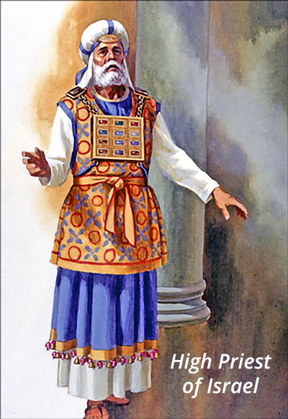
The High Priest
Offer gifts and sacrifices for sins
Teach the children of Israel all the commands of God.
Find out God’s will
Offer prayers
Bring the blood of offerings before God to cleanse the sanctuary

Slide 15
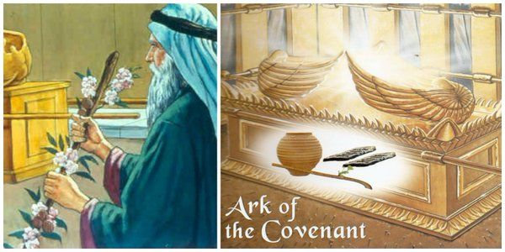
Remember to respect God’s chosen leader
¹⁰ Then the Lord said to Moses, “Put Aaron’s walking stick back in front of the Box that holds the Agreement.^{[a]} This will be a warning for these people who are always turning against me. This will stop their complaining against me so that I will not destroy them.” ¹¹ So Moses did what the Lord commanded him.
Levi - Aaron

Slide 16

Respect authority – the leaders placed over you.
All of you must obey the government rulers.
Everyone who rules was given the power to rule by God.
And all those who rule now were given that power by God.
Romans 13:1
Let everyone be subject to the governing authorities,
for there is no authority except that which God has established.
The authorities that exist have been established by God.
Romans 13:1

Slide 17
CRAFT TIME
I will respect leaders
All of you must obey the government rulers.
Everyone who rules was given the power to rule by God.
And all those who rule now were given that power by God.
Romans 13:1
Have a stick/dowel/twig
Glue green leaves to the stick
Glue real almonds to the stick
Make tissue paper blossoms by:
  Have a 2 inch square (or circle) of white tissue paper or napkin
  Color a Dark pink center
  Crumple the tissue paper a little
Glue on tissue paper ‘blossoms’

Slide 18
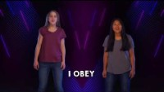
Let’s Sing

Slide 19
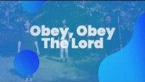
Let’s Sing

Slide 20

Let’s Sing

Slide 21
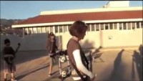
Let’s Sing

Slide 22
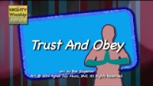
Let’s Sing

Slide 23
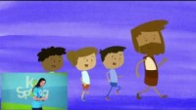
Let’s Sing

Slide 24

https://activity-array.com/

