Slide 1
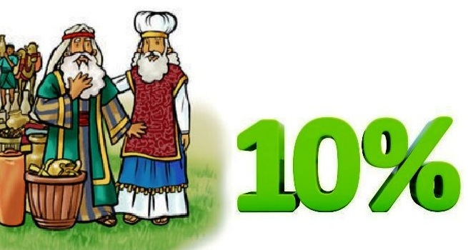
Abraham
Tithes
Spoils of War
Melchizedek, priest of the Most High God

Slide 2
Today we’re talking about sharing, caring, and generosity.
TITHE
SHARE
SAVE
SPEND
Thank you
God
for blessing
me.
I have been
blessed
to be a
blessing
I can save
for something
special.
God
provides
for my
needs.

Slide 3
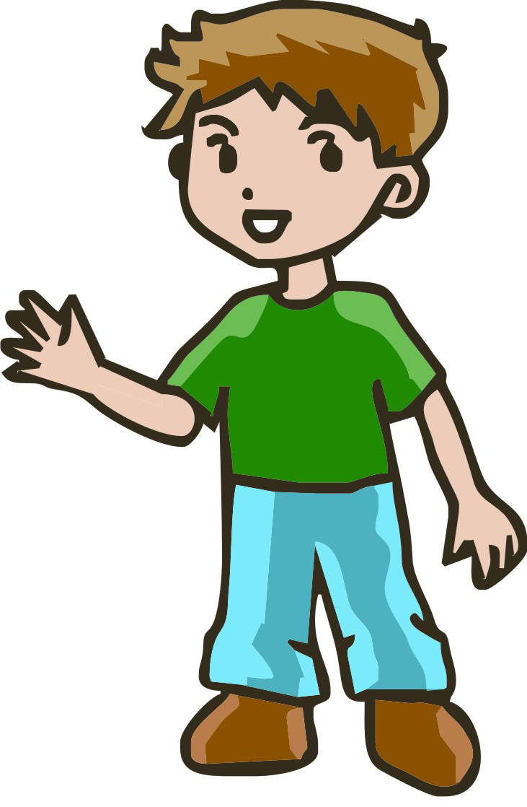
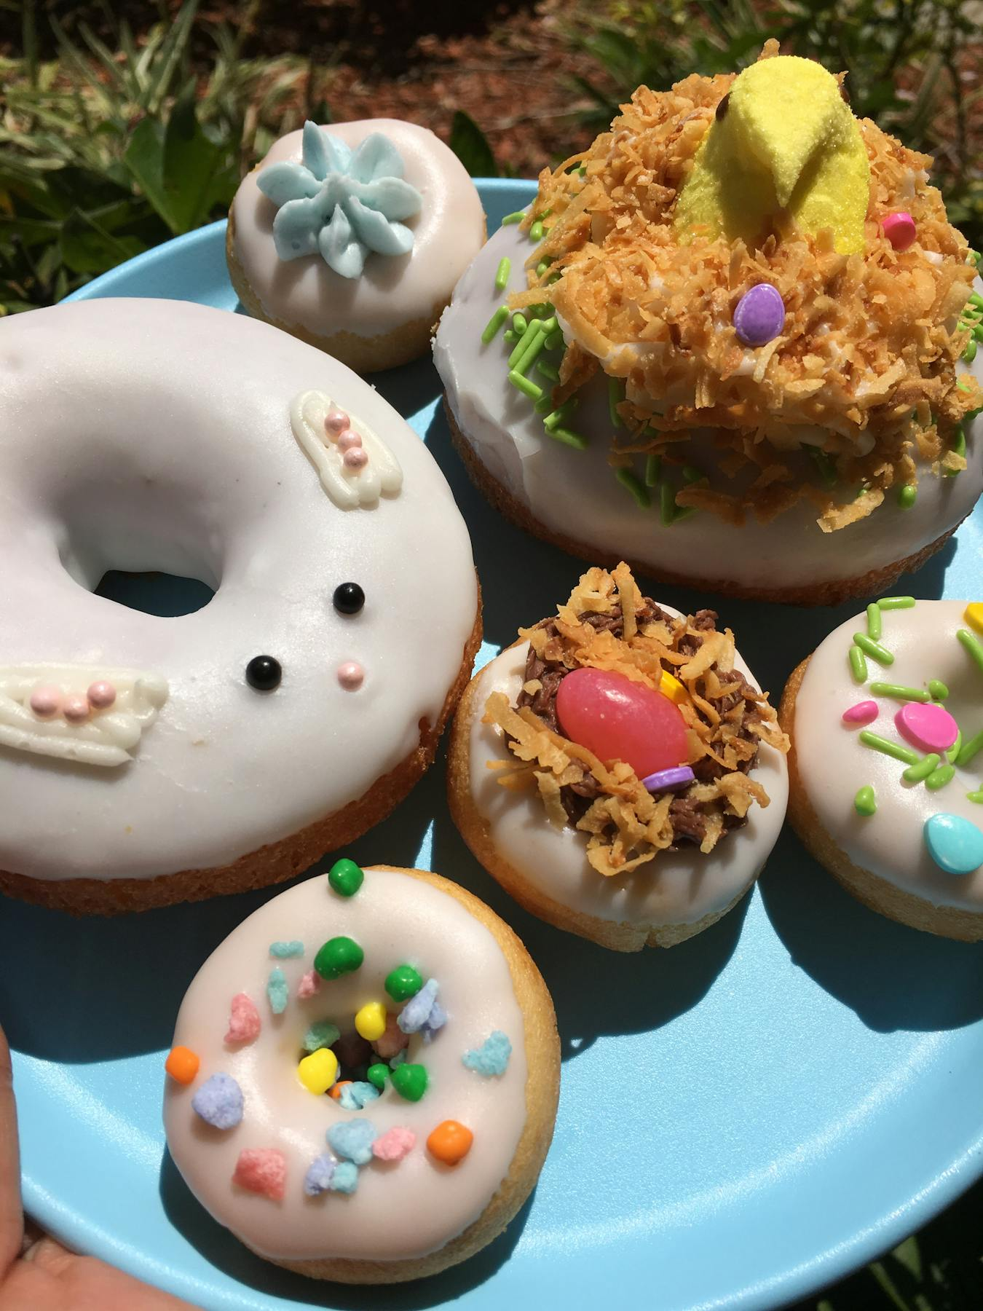
Has someone ever taken advantage of you?
Mine
If someone takes something the biggest and best, how do you feel?
But if you offer someone the biggest and the best, how do you feel?
How can you be generous?

Slide 4
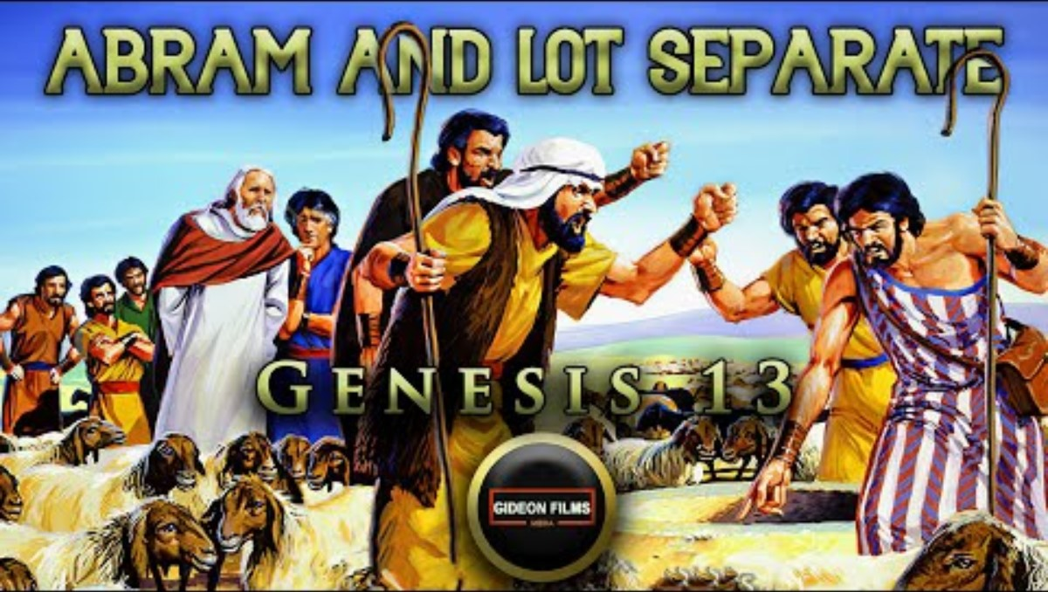

Slide 5

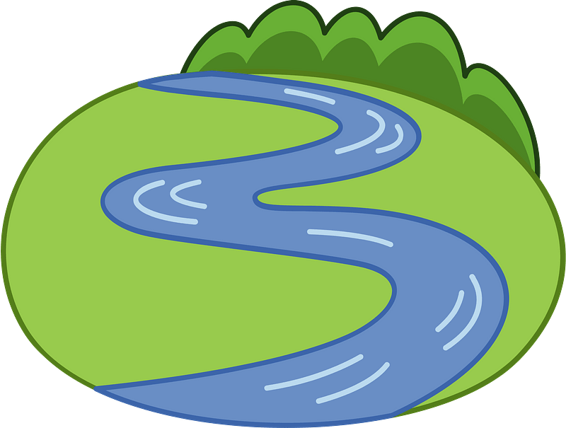
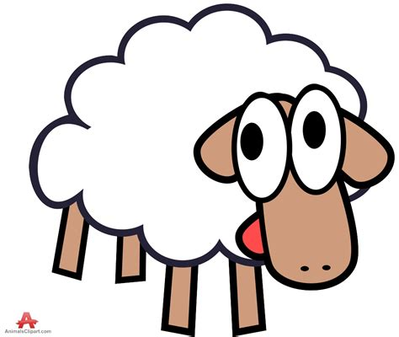
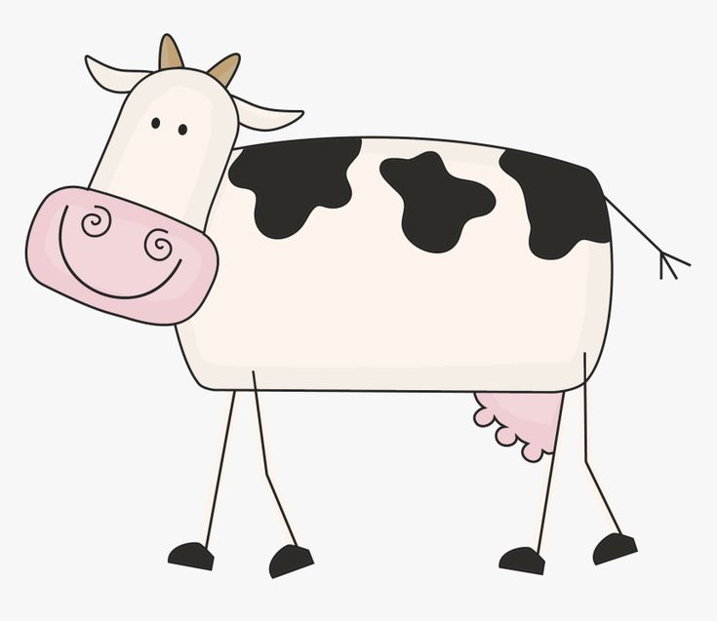

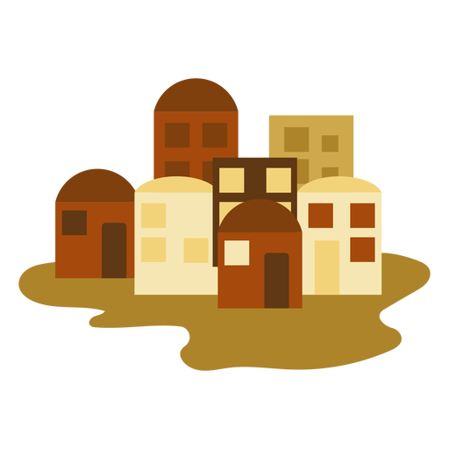

Let’s draw a picture of the story.
Abram and Lot had so many animals and people that they couldn’t live in one place. So, Abram let Lot choose where he wanted to live.
Lot chose the beautiful valley near the city.
On the upper left side:
Draw some mountains.
Make trees and grass.
Make some cows and sheep and Abram.
On the lower right side:
Draw a river and a lake.
Draw some trees and grass.
Draw a city.
Draw some cows and sheep and Lot.

Slide 6
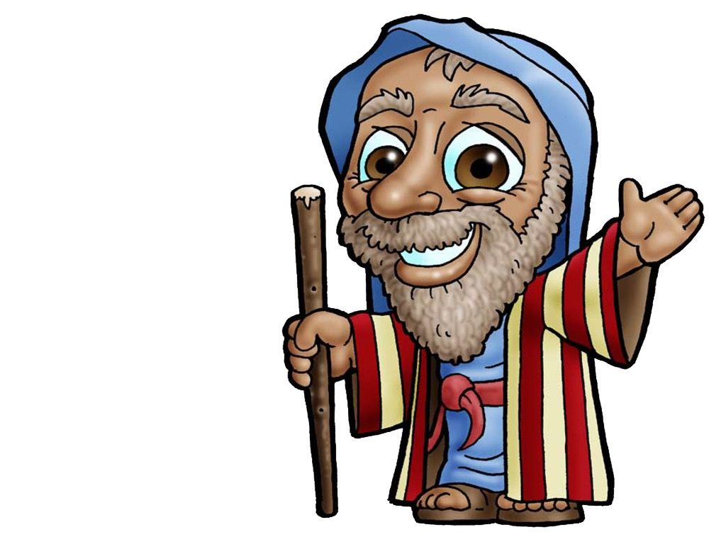
What did Abraham do?
It’s your choice.
You can have it.
Lot was the youngest, but Abram let Lot choose first. He offered him the first and best.
Lot took what looked like the best land.
But Abraham didn’t complain. He was content living away from the city.
Actually, that was a good thing because the people who lived in the city didn’t love nor obey God. They were mean and wicked.
God told Abraham that He would bless him. God was his reward.

Slide 7
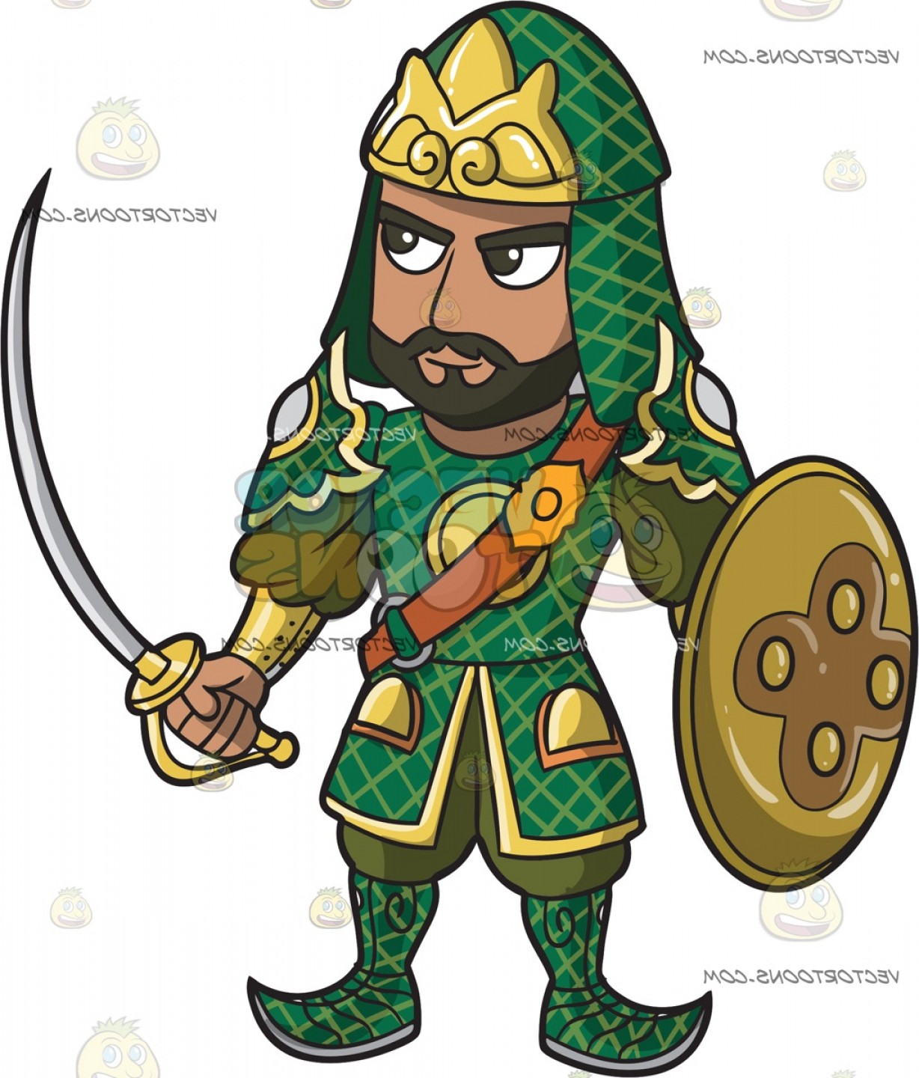
Another example…..
I’m in charge!
Give me the best!
The kings in the area also had a disagreement.
Let’s see what happened.

Slide 8
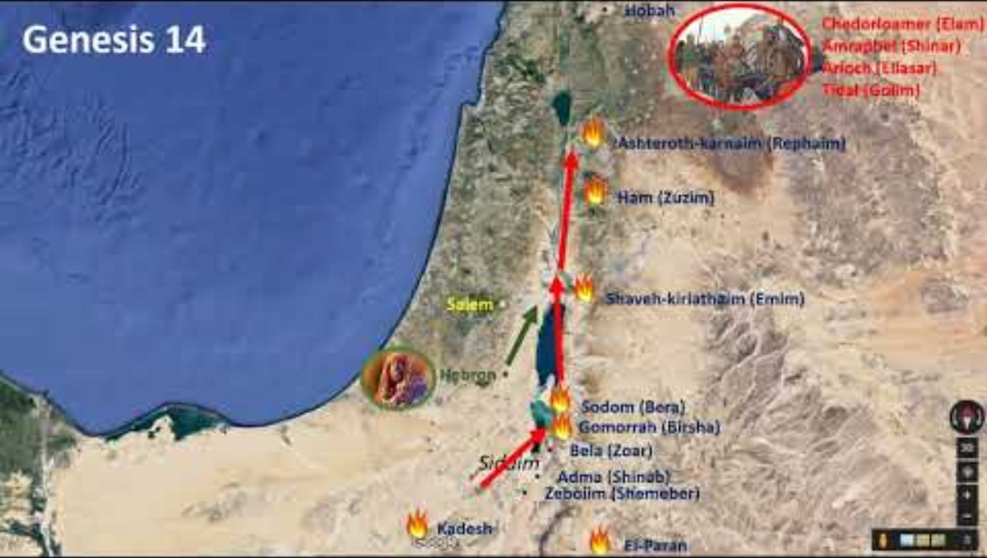

Slide 9



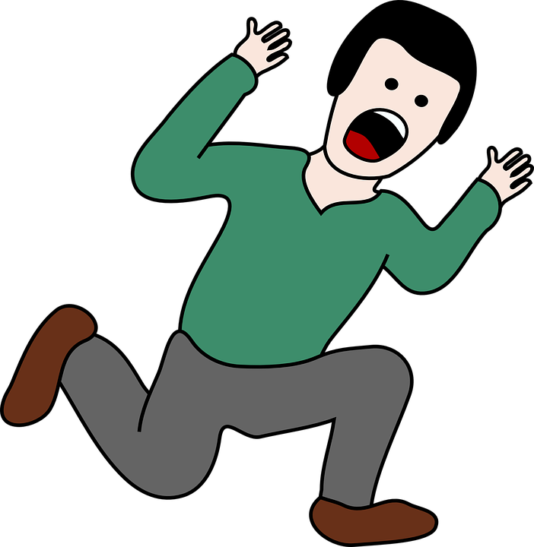
But the battle was fierce.
They ran scared not looking where they were going.
This Photo by Unknown Author is licensed under CC BY-SA
This Photo by Unknown Author is licensed under CC BY-SA-NC
This Photo by Unknown Author is licensed under CC BY-SA

Slide 10
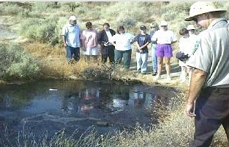
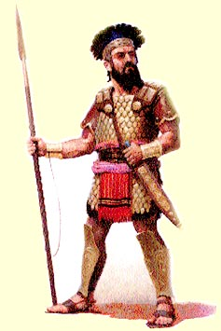
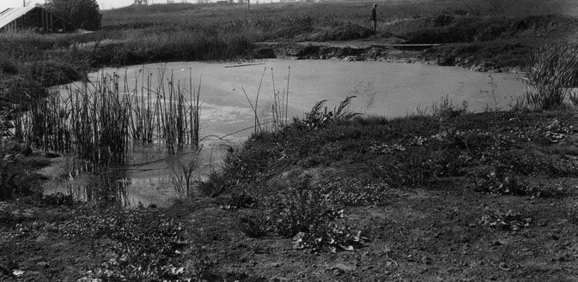
Canaanite kings got ready to fight
¹⁰ The Valley of Siddim was full of tar pits. The kings of Sodom and Gomorrah ran away from the battle. Some of their men fell into the pits, but the rest escaped to the hills.
Help I’m stuck!
I’m sinking!

Slide 11
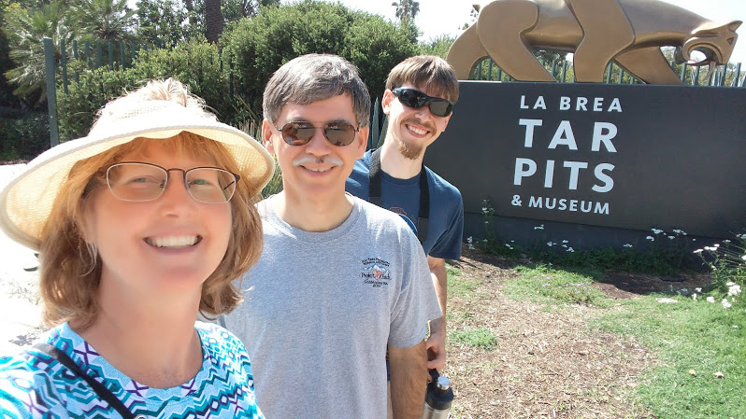
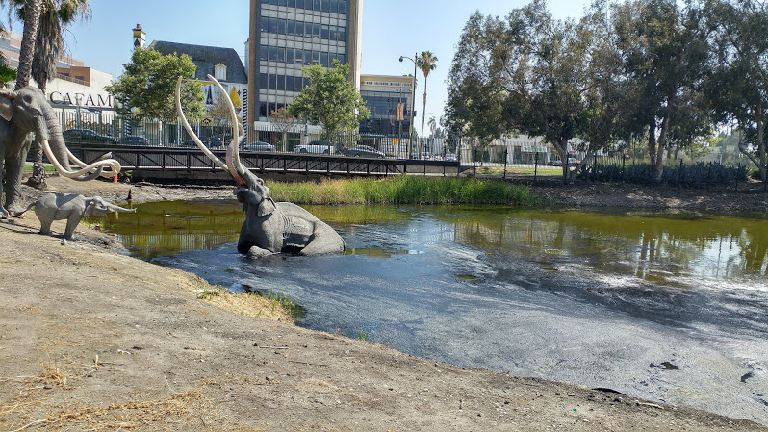
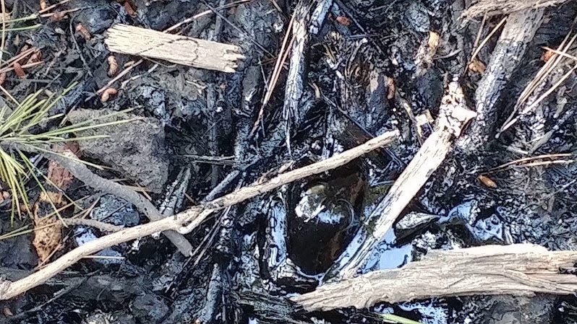
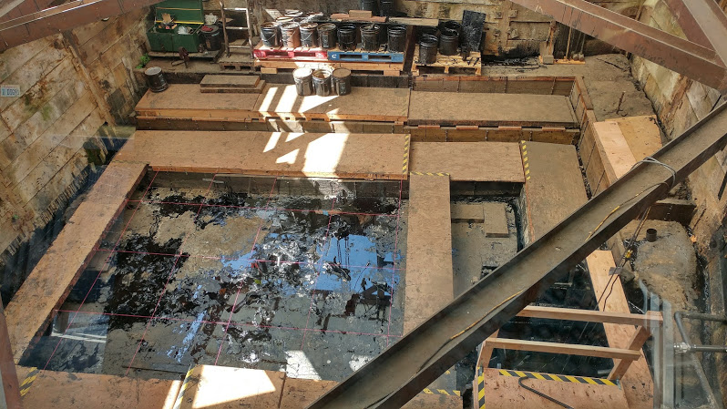
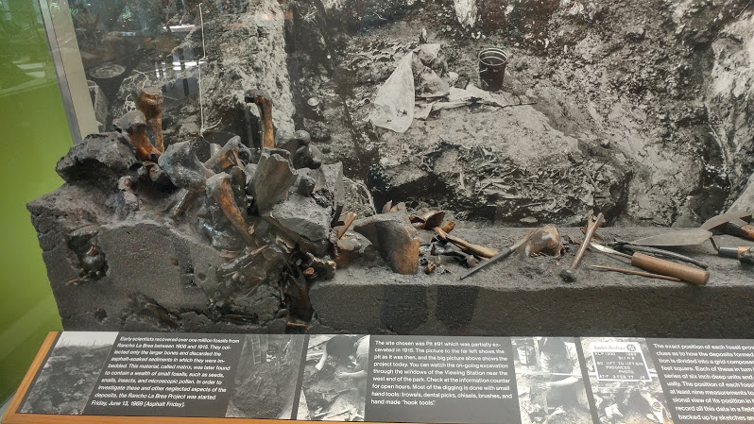
We visited some tar pits
These deep pits oozed with sticky tar.
Many were hidden with branches from surrounding trees. Those who fell in, sunk, and were doomed. Le Brea tar pits have a lot of bones in them, too.

Slide 12
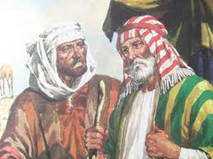
A man escaped and told Abram of the disaster.
We must rescue them.
I will talk to my friends and allies. They will help me. God will help us.
Abram. Kedorlaomar has won many battles. He took all the men and goods including Lot, your nephew.
¹³ A man escaped and came to report everything to Abram.
Abram was a Hebrew. He was living near the large trees of Mamre the Amorite.
Mamre was a brother of Eshkol and Aner.
All of them helped Abram.

Slide 13
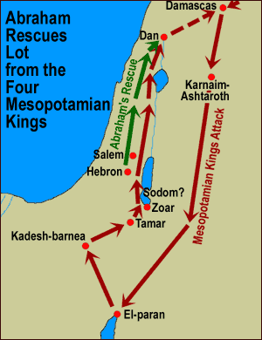
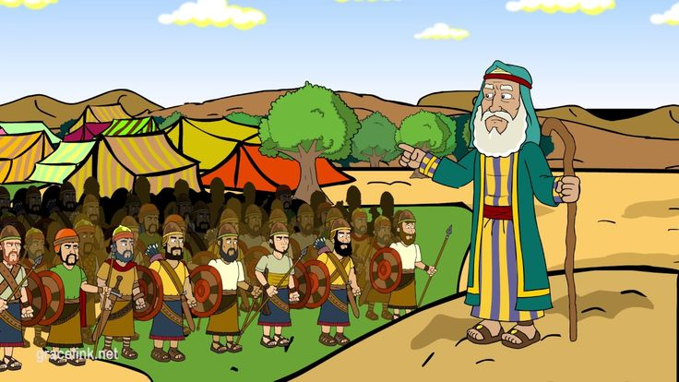
Abram rallied his troops and allies
Mamre was a brother of Eshkol and Aner.
All of them helped Abram. ¹⁴ Abram heard that Lot had been captured. So, he called out his 318 trained men. All of them were sons of his servants. Abram and his men chased their enemies as far as Dan.
¹⁵ During the night Abram separated his men into groups. They attacked their enemies and drove them away. They chased them north of Damascus as far as Hobah.
We must fight Kedolaomar and save Lot.
May God give us the victory!

Slide 14
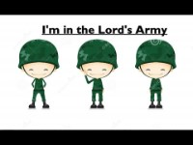

Slide 15
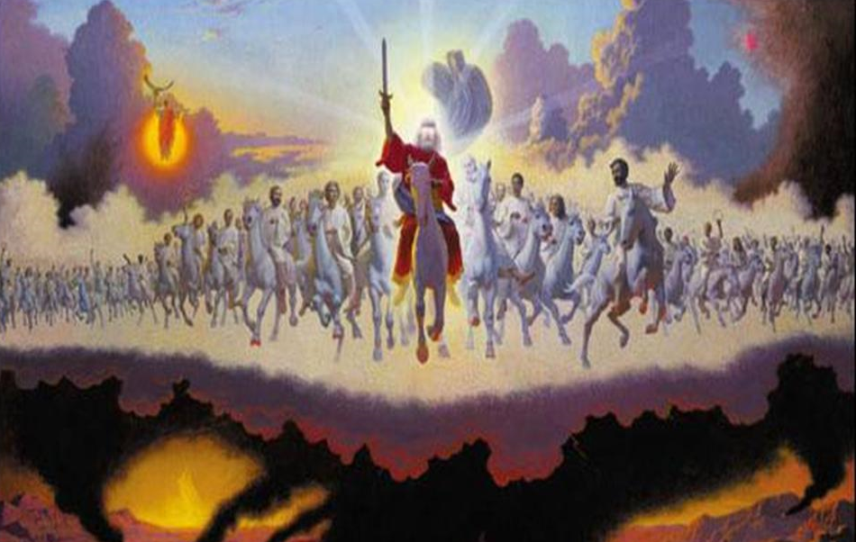

God was with Abram
God’s angel armies fight for us and with us. They guard us.
We don’t need to run away scared or be afraid.
We can trust in God!
Just like God protects us, we can protect others. We can show them God’s love and care. That is how we are in the Lord’s Army.

Slide 16
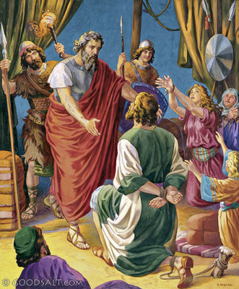
Abram rallied his troops and allies
Lot, I have come to rescue you and those with you.
^{Genesis 14:16}
Abram took back everything the kings had taken. He brought back his nephew Lot and the things Lot owned. He also brought back the women and the other people.

Slide 17
Abraham cared not only for his nephew lot, but for everyone who had been captured.
God wants us to care for others.

Slide 18
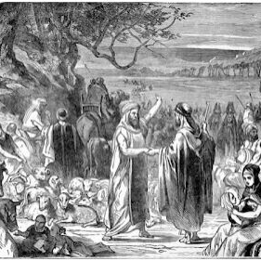
Abram returned home
^{Genesis 14:}
¹⁷ After Abram won the battle over Kedorlaomer and the kings who helped him, he returned home. The king of Sodom came out to meet him in the Valley of Shaveh. It was also called the King’s Valley.

Slide 19
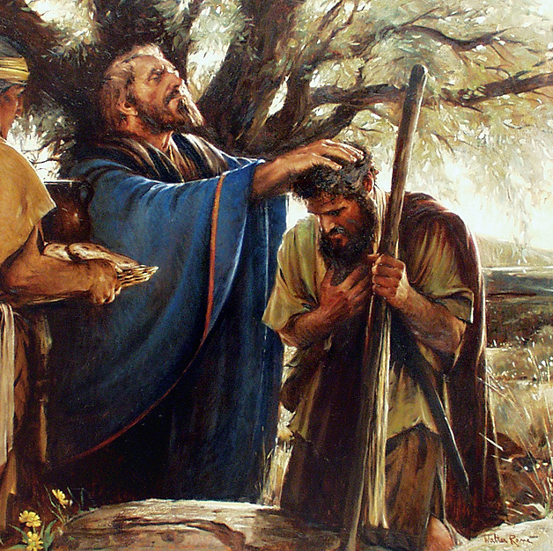
Melchizedek, priest of the Most High God, blessed Abram
May the Most High God bless you Abram. May the Creator of heaven and earth bless you.
He gave you the victory!
¹⁸ Melchizedek was the king of Jerusalem. He brought out bread and wine. He was the priest of the Most High God. ¹⁹ He gave a blessing to Abram. He said,
“May the Most High God bless Abram.
May the Creator of heaven and earth bless him.
²⁰ Give praise to the Most High God.
He gave your enemies into your hand.”

Slide 20

Abram gave a tenth
Yes, God has blessed us with the victory. I will give God 10% of everything.
^{Genesis 14:20}
Then Abram gave Melchizedek a tenth of everything.

Slide 21
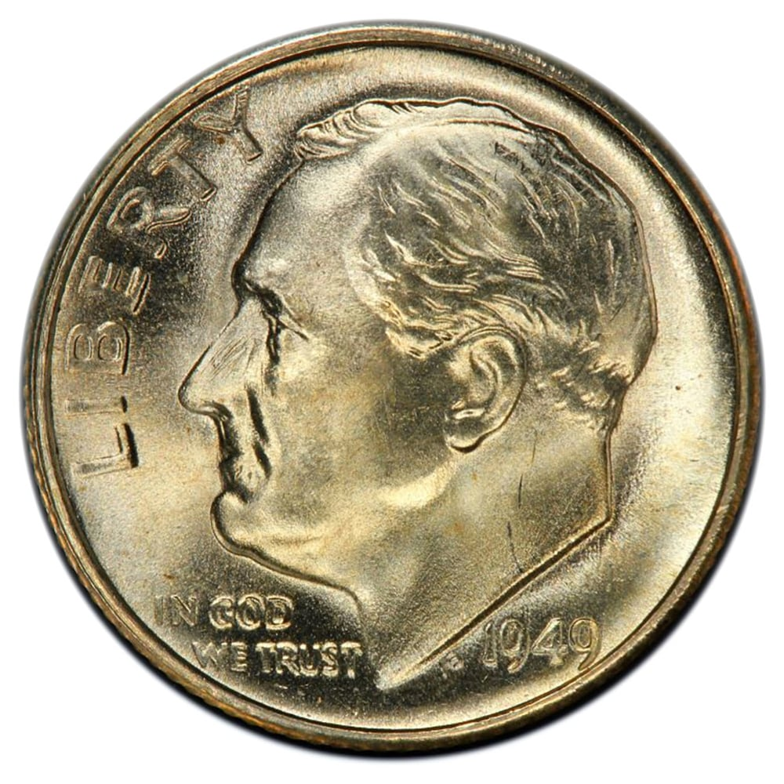
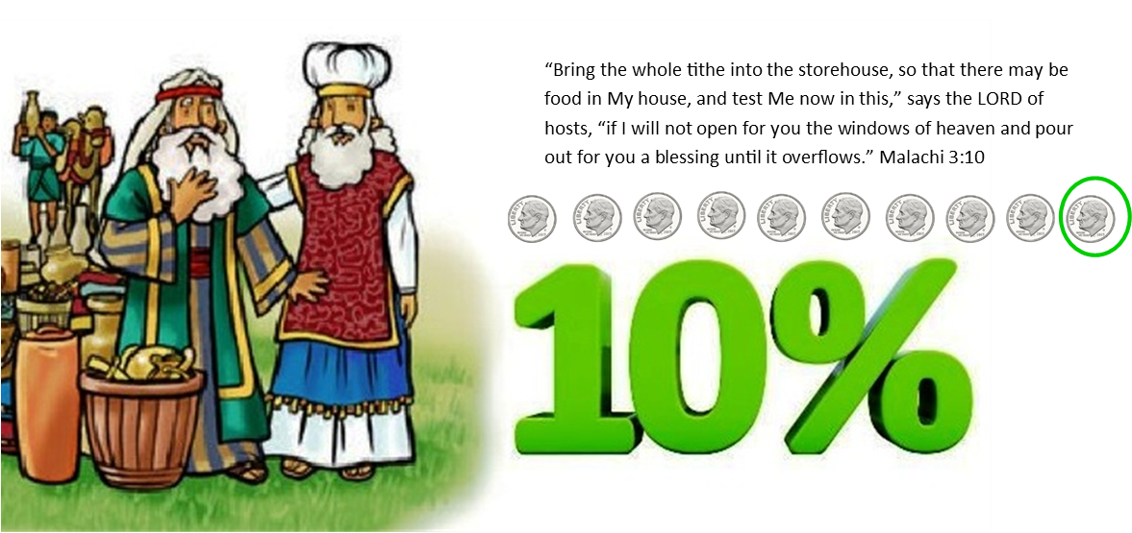
BANK for TITHE
CRAFT TIME
Get a container with 3 parts
Label one part SHARE
  This is where to put your THANK YOU tithe and offerings for God & others
  Remember that it is God you blesses us. Our money and resources are gifts from God.
Label one part SAVE
  This is where you can save money for a special something that costs a lot of money.
Label one part SPEND
  This is the money that you can spend whenever you want.
Add stickers to decorate your bank
SHARE
SAVE
SPEND

Slide 22
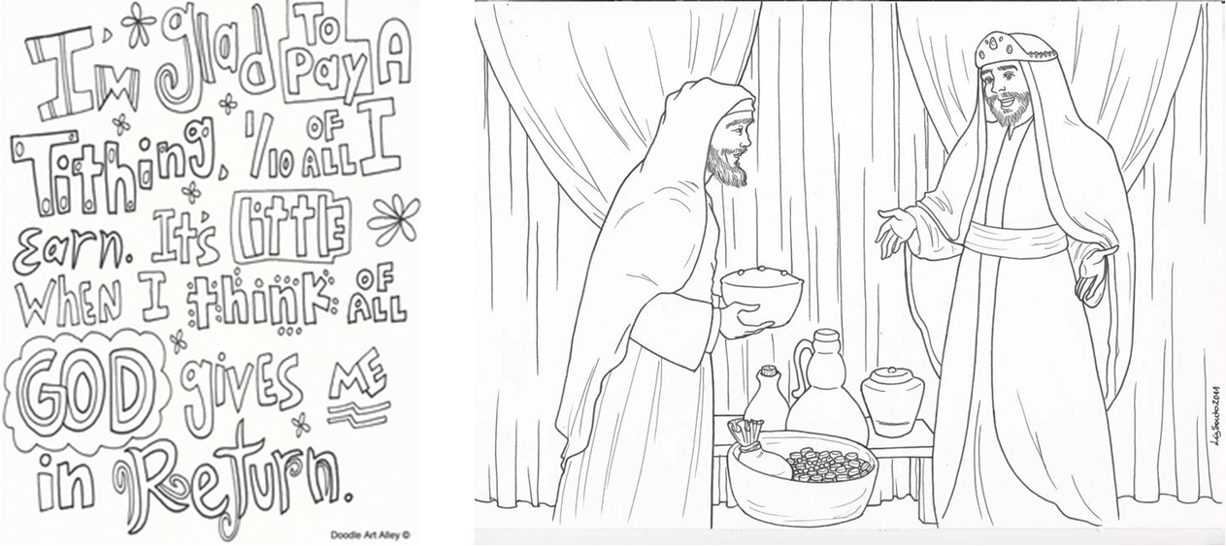
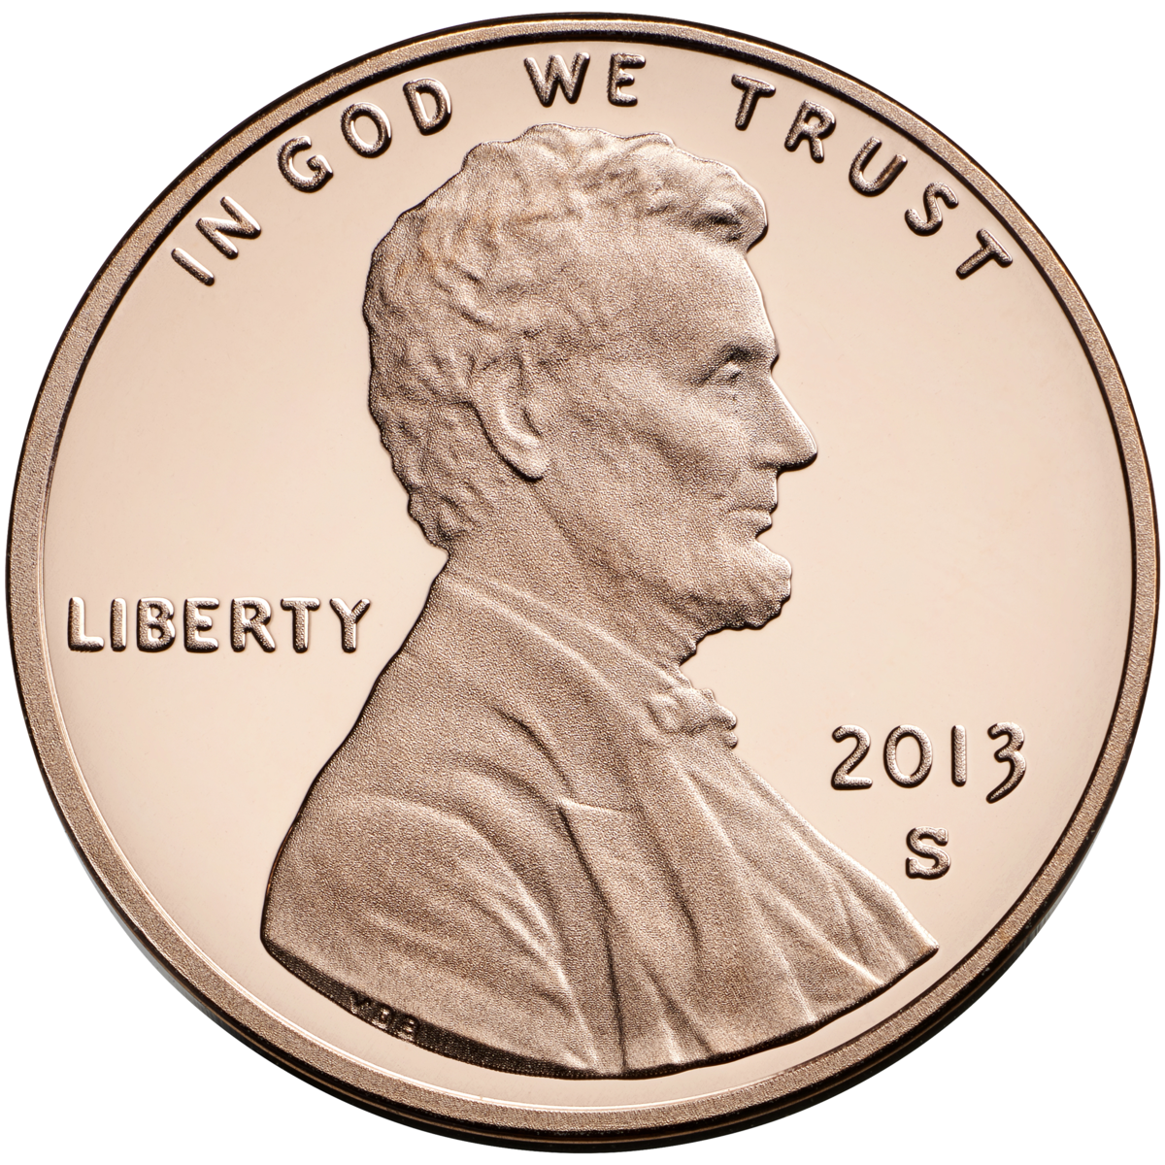

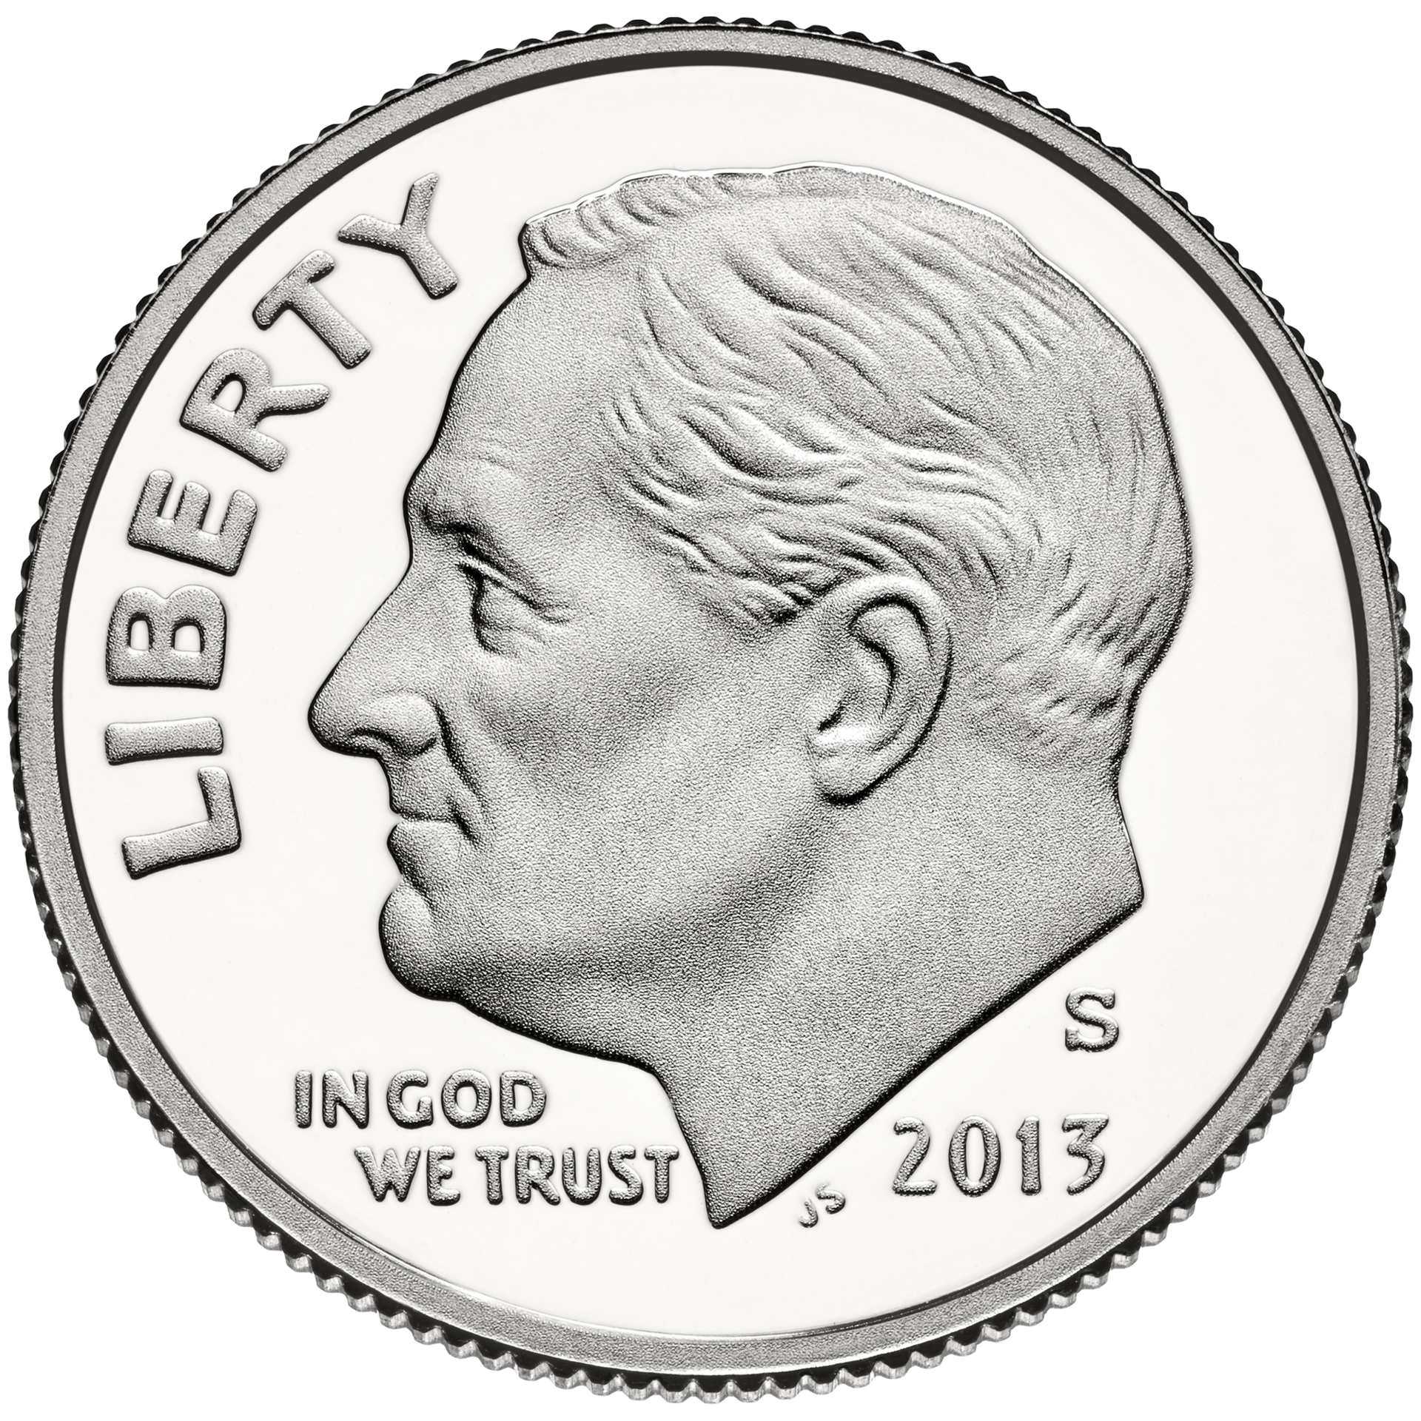
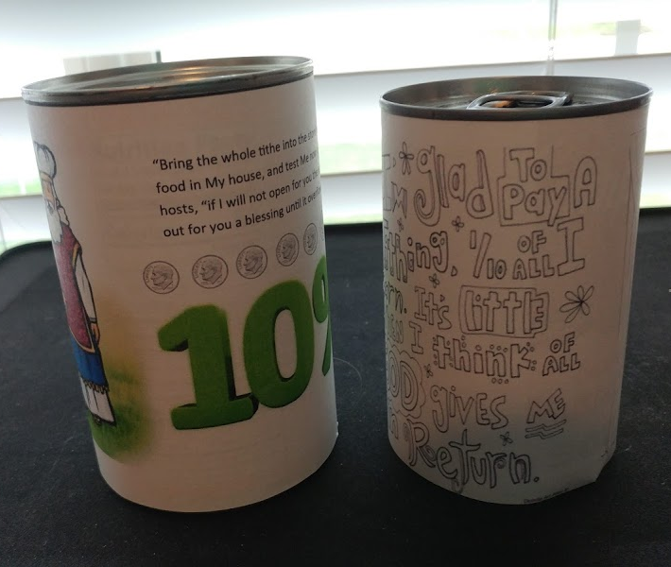
BANK for TITHE (option 2)
CRAFT TIME
Choose an empty, clean can
Print and cut out the cover paper.
  Choose either the top or bottom one.
Color the parts you want to.
Wrap the paper around the can.
Glue or tape the end.
Put your tithe into the can.
Bring your tithe to church.

Slide 23
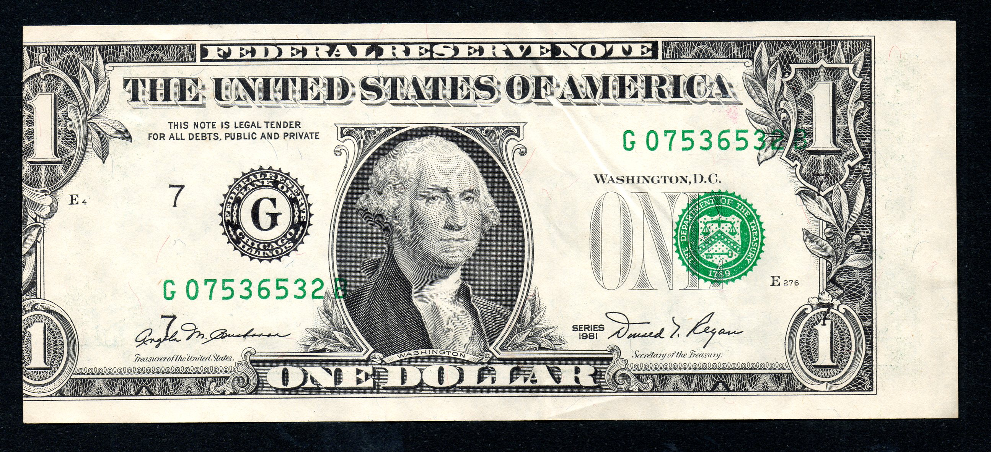
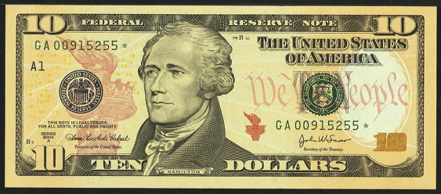
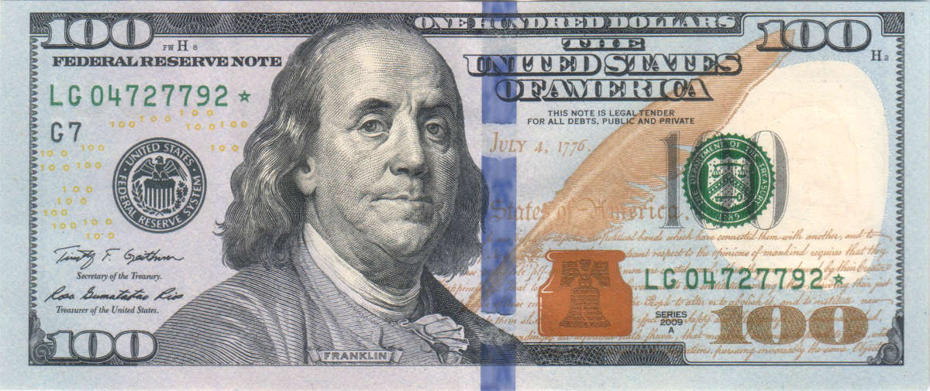
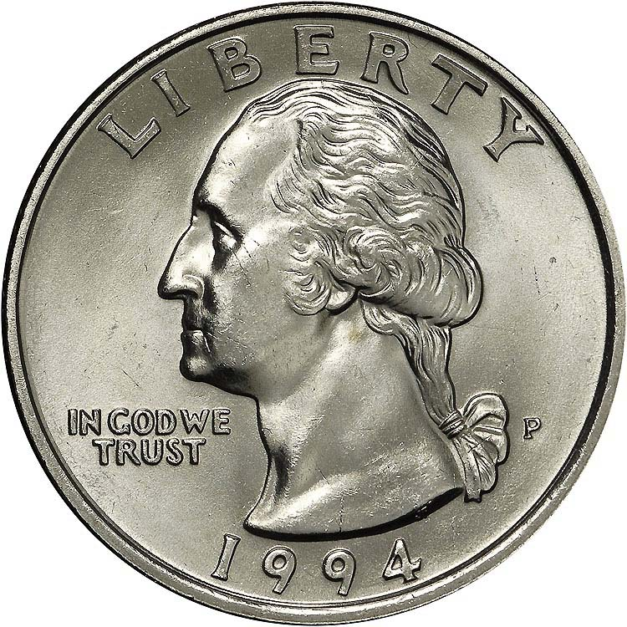
Circle the tithe
I give God back: | I have received….
 | 10 c
 | $1.00
 | $11.10
 | $100
 | $2.50
This Photo by Unknown Author is licensed under CC BY-SA
This Photo by Unknown Author is licensed under CC BY-SA
This Photo by Unknown Author is licensed under CC BY-SA
This Photo by Unknown Author is licensed under CC BY-SA
This Photo by Unknown Author is licensed under CC BY-SA
This Photo by Unknown Author is licensed under CC BY-SA
This Photo by Unknown Author is licensed under CC BY-SA
This Photo by Unknown Author is licensed under CC BY-SA
This Photo by Unknown Author is licensed under CC BY-SA
This Photo by Unknown Author is licensed under CC BY-SA
This Photo by Unknown Author is licensed under CC BY-SA
This Photo by Unknown Author is licensed under CC BY-SA
This Photo by Unknown Author is licensed under CC BY-SA
This Photo by Unknown Author is licensed under CC BY-SA
This Photo by Unknown Author is licensed under CC BY-SA
This Photo by Unknown Author is licensed under CC BY-SA
This Photo by Unknown Author is licensed under CC BY-SA
This Photo by Unknown Author is licensed under CC BY-SA
This Photo by Unknown Author is licensed under CC BY-SA
This Photo by Unknown Author is licensed under CC BY-SA

Slide 24
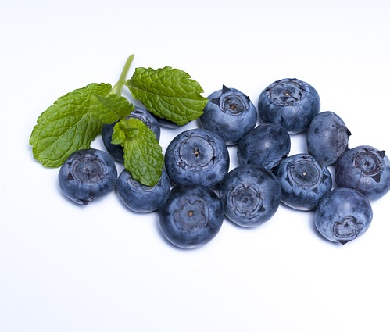
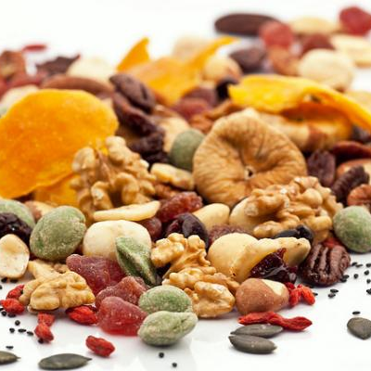
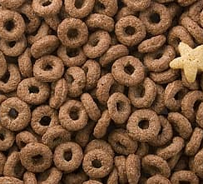
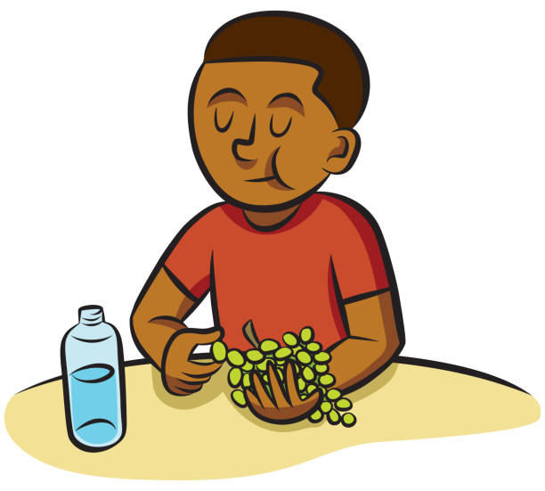
Snack time!
Choose something small snack such as
Cereal like Cheerios or Chex
Berries
Raisins
nuts
Small crackers
Count out 10. Set 1 aside as a tithe.
You can eat the 9.
Repeat
Give your tithe to your parents.
This Photo by Unknown Author is licensed under CC BY

Slide 25
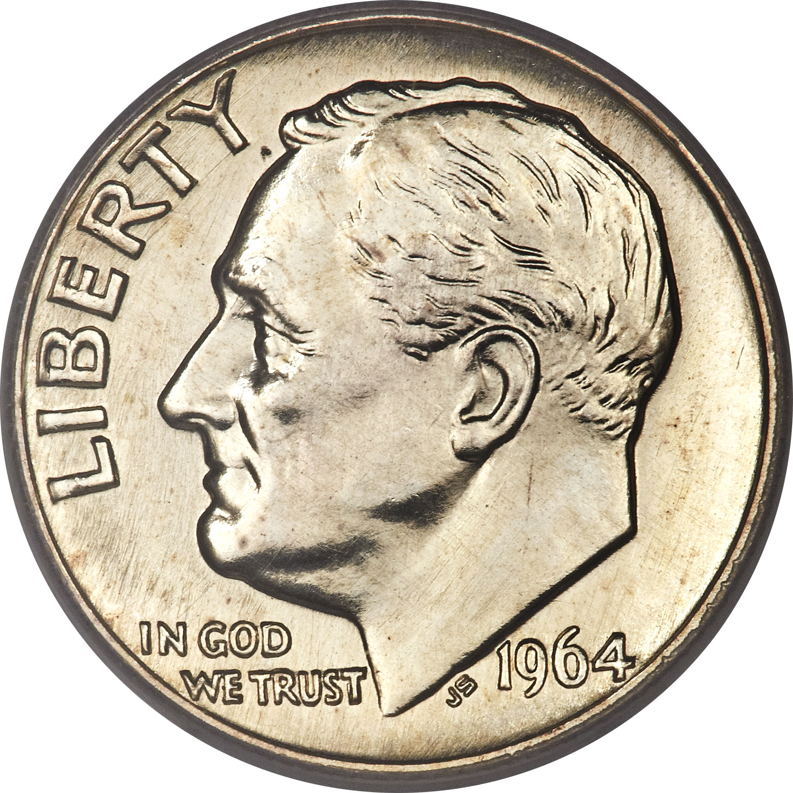
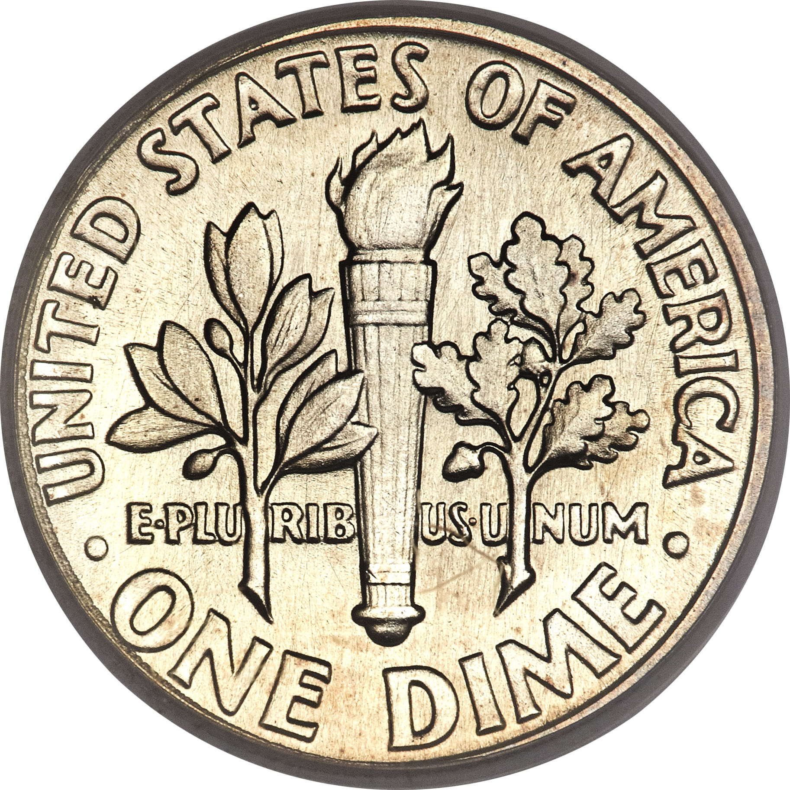
Let’s look at a dime
Do you see:
In God We Trust -- God provides for us
President Franklin D Roosevelt – 32nd President
Liberty – God gives us freedom
An olive branch – for peace
What choice did Abraham give to Lot
so that there would be peace in their family?
A torch -- for liberty
When Lot and others were captured,
What did Abraham do to give them liberty?
An oak branch – for strength and independence
Who gave Abraham strength so that others
could be free and have independence?

Slide 26
The king of Sodom was very grateful.
No. The things don’t belong to me.
You keep what is yours.
Everyone can keep what is their own.
Thank you for rescuing us! Just give me the people and you can have everything else.
²¹ The king of Sodom said to Abram, “Give me the people. Keep everything else for yourself.”
²² But Abram said to the king of Sodom, “I have raised my hand to make a promise to the Lord. He is the Most High God. He is the Creator of heaven and earth. ²³ I’ve said I will not accept anything that belongs to you. I will not take even a thread or the strap of a sandal. You will never be able to say, ‘I made Abram rich.’ ²⁴ I’ll accept only what my men have eaten and what belongs to Aner, Eshkol and Mamre. These three men went with me. Let them have their share.”

Slide 27
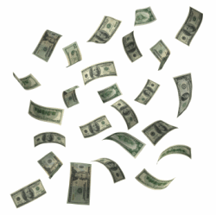


This Photo by Unknown Author is licensed under CC BY-SA
This Photo by Unknown Author is licensed under CC BY-SA

Slide 28
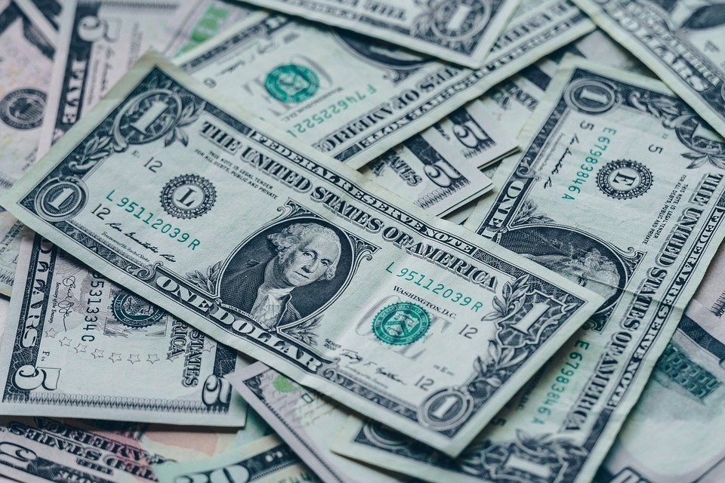
The Bible says:
“Bring the whole tithe into the storehouse, so that there may be food in My house, and test Me now in this,” says the LORD of hosts, “if I will not open for you the windows of heaven and pour out for you a blessing until it overflows.”
Malachi 3:10
This Photo by Unknown Author is licensed under CC BY-SA
This Photo by Unknown Author is licensed under CC BY-SA

Slide 29
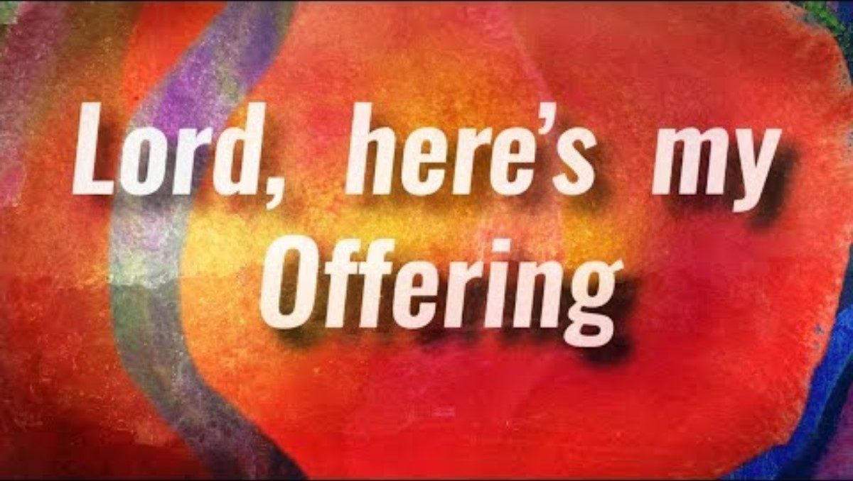

Slide 30
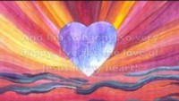

Slide 31
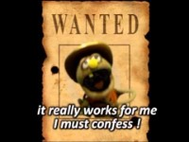

Slide 32


Slide 33


Slide 34
Extra Slides

Slide 35

https://activity-array.com/

Slide 36
What is tithe?
What is 10%? What is a tenth?
Tithe is 10% of what God has given us that we give back to God.
Tithe is 10% of all that we earn that we give to God.
10 % is one tenth.
It is 1 penny out of 10.
It is 1 dime out of 10.
It is 1 dollar out of 10.
This Photo by Unknown Author is licensed under CC BY-SA
This Photo by Unknown Author is licensed under CC BY-SA

Slide 37
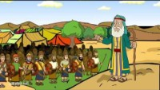

Slide 38


Slide 39

4 Kings in Charge
Genesis 14:1-2
Amraphel was the king of Babylon.
Arioch was the king of Ellasar.
Kedorlaomer was the king of Elam.
And Tidal was the king of Goyim.
² They went to war against five other kings.

Slide 40
5 Kings desire freedom
They were
Bera king of Sodom,
Birsha king of Gomorrah,
Shinab king of Admah,
Shemeber king of Zeboyim,
and the king of Bela. Bela was also called Zoar.
^{Genesis 14:3} These five kings all gathered their armies together in the Valley of Siddim. It was also called the valley of the Dead Sea.
⁴ For 12 years Kedorlaomer had ruled over them. But in the 13th year they opposed him.
We are tired of Kedorlaomer ruling over us!
Let’s fight for freedom!

Slide 41
Kedorlaomer set out to conquer Canaan
We WON!
Now their land is ours!
That will teach them who is boss! We are STRONG!
⁵ So in the 14th year, Kedorlaomer and the kings who helped him went to war. They won the battle against the Rephaites in Ashteroth Karnaim. They also won the battle against the Zuzites in Ham and the Emites in Shaveh Kiriathaim. ⁶ They did the same thing to the Horites in the hill country of Seir. They marched all the way to El Paran near the desert. ⁷ Then they turned back and went to En Mishpat. En Mishpat was also called Kadesh. They took over the whole territory of the Amalekites. They also won the battle against the Amorites who were living in Hazezon Tamar.

Slide 42
Canaanite kings got ready to fight
⁸ Then the kings of Sodom, Gomorrah, Admah, Zeboyim and Bela marched out. Bela was also called Zoar.
They lined up their armies for battle in the Valley of Siddim.
⁹ They got ready to fight against Kedorlaomer king of Elam, Tidal king of Goyim, Amraphel king of Babylonia, and Arioch king of Ellasar.
There were four kings against five.
We can’t give up!
We will continue to fight
for freedom!

Slide 43


Kedorlaomer conquered
Sodom and Gomorrah
¹¹ The four kings took all the things that belonged to Sodom and Gomorrah. They also took all their food and then left. ¹² They carried away Abram’s nephew Lot and the things he owned. Lot was living in Sodom at that time.

