Slide 1
When Life Isn’t Fair
JACOB LABORS FOR LABAN

Slide 2
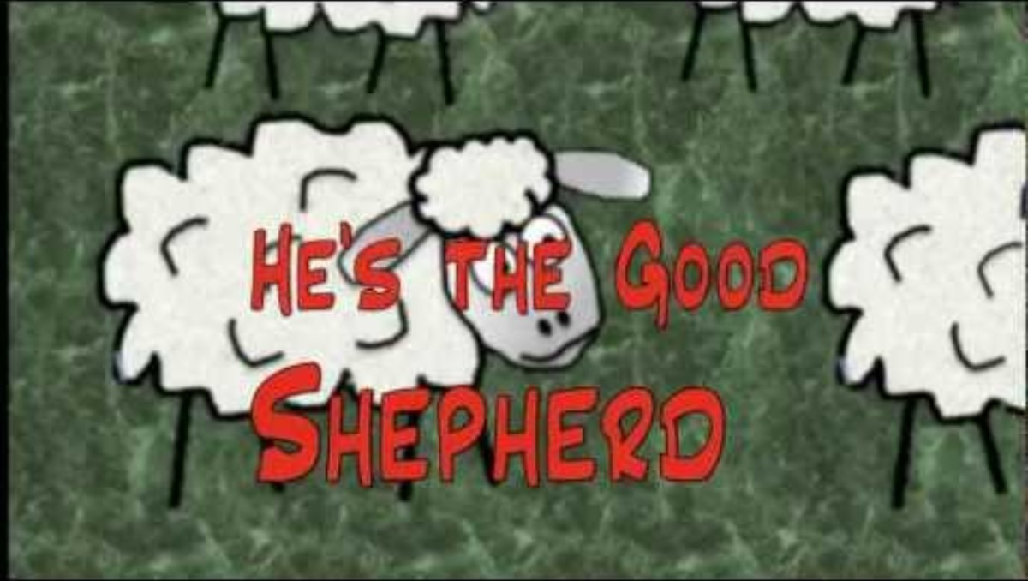
SING A LONG
Baa Baa He is the Good Shepherd By Sibling Harmony

Slide 3
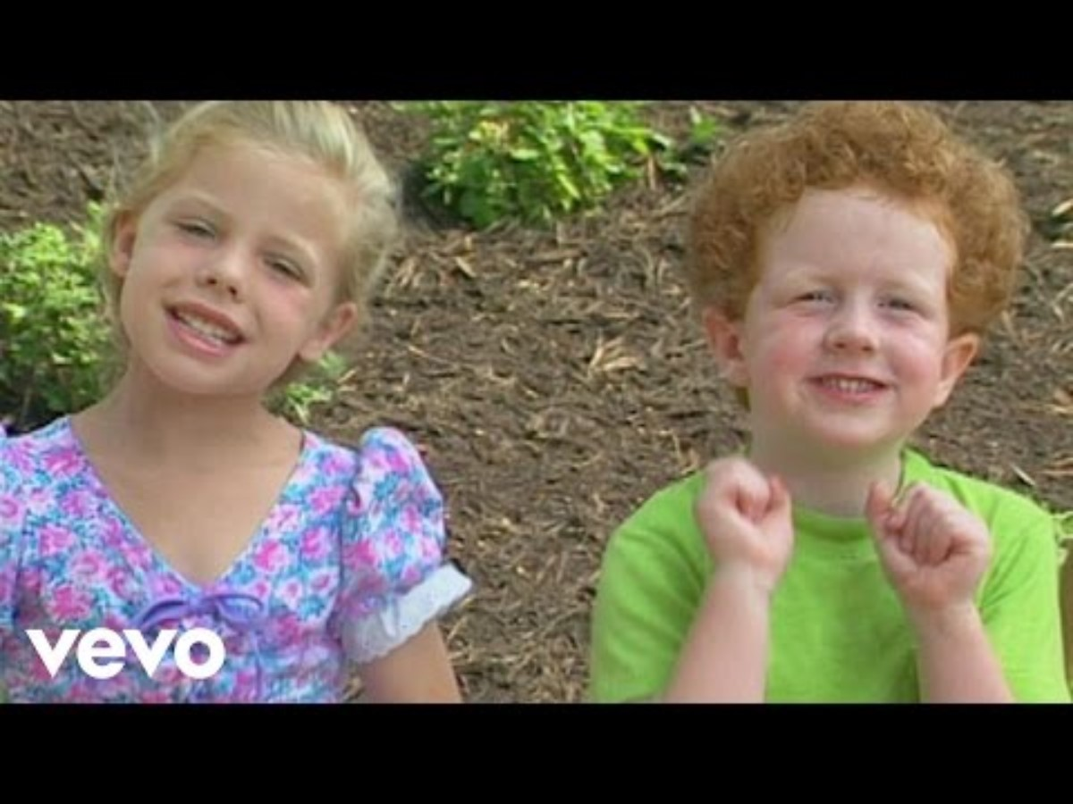
SING A LONG
Jesus Loves the Little Ones Like Me Me Me

Slide 4
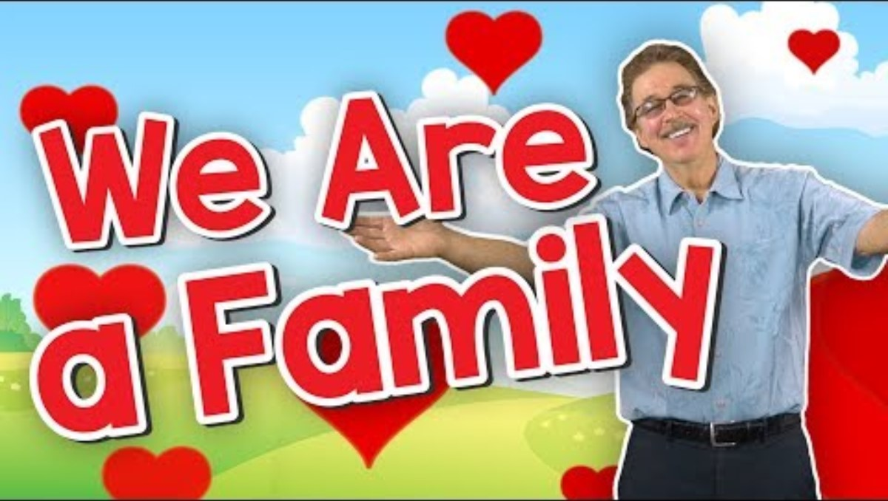
Sing A Long
We Are Family
with Jack Hartman

Slide 5


Sing A Long
Whatever you do. Whatever you do.
Work at it with all your heart.
Whatever you do. Whatever you do.
Work at it with all your heart.
As working for the Lord, not for men
Work at it with all your heart
As working for the Lord, not for men
Work at it with all your heart
Hear God’s call. Big or small. Give your all
(Get going!)
Make a start. Do your part. With all your heart.
(Get Going!)
[Repeat]
Colossians 3:23 Work At It with All Your Heart

Slide 6
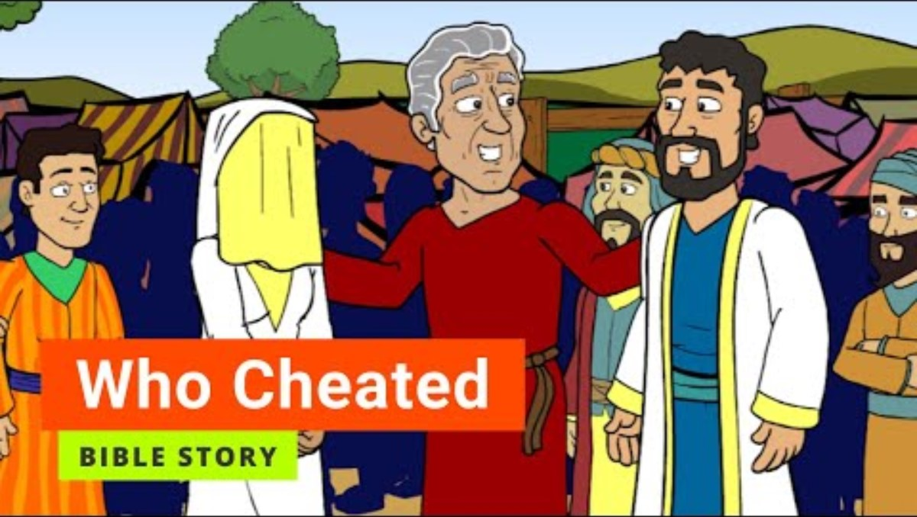
Primary GraceLink Video: https://www.youtube.com/watch?v=7UVn8ayyzNs

Slide 7
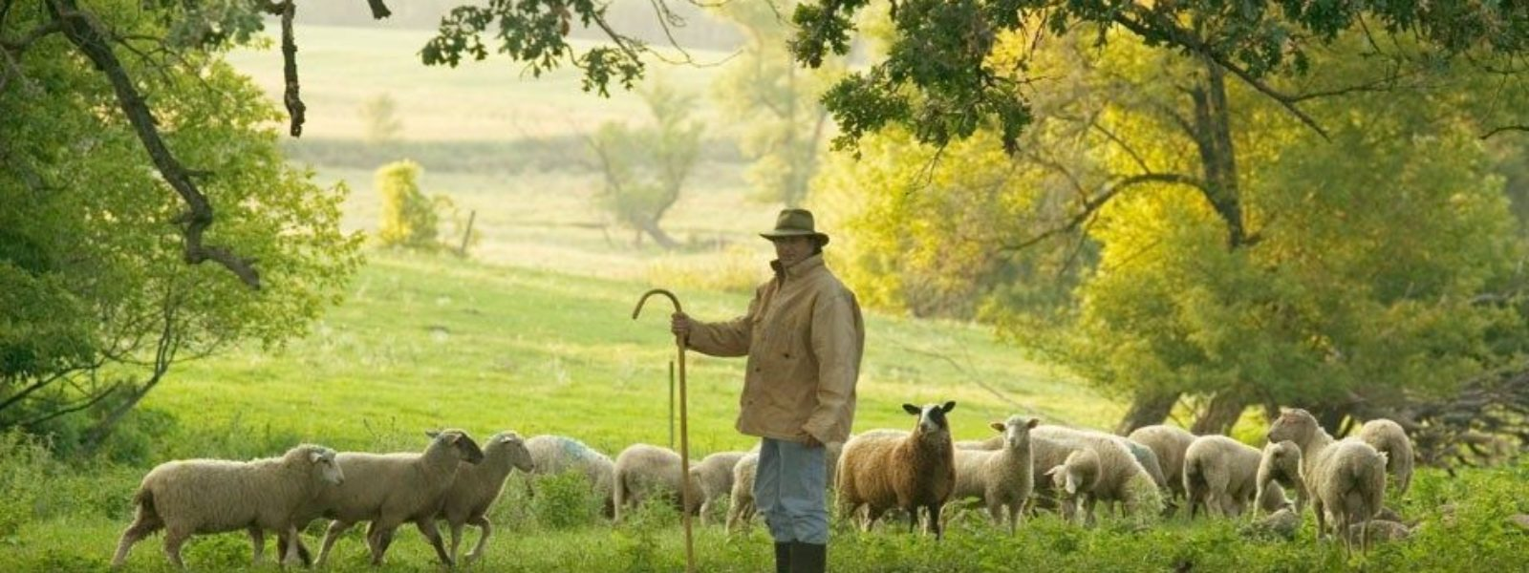
Work Faithfully
Jacob worked faithfully as a shepherd

Slide 8
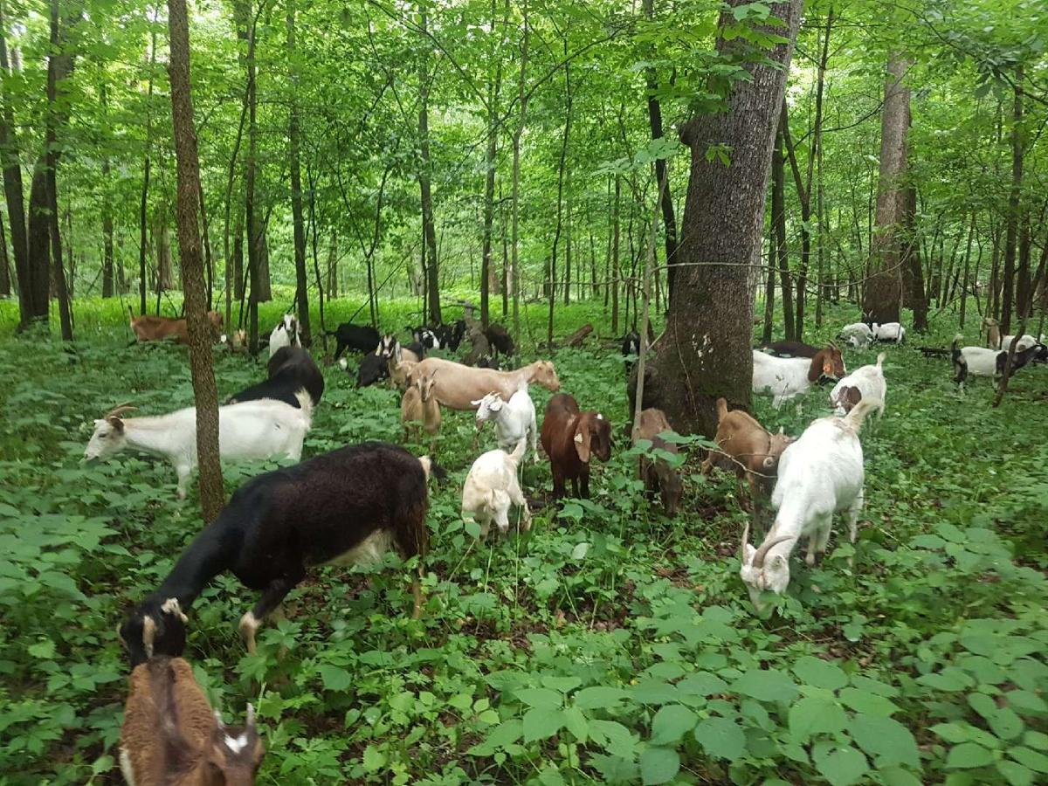
Work Faithfully
Even goats have a work to do.They help clear the land by eating the weeds.

Slide 9
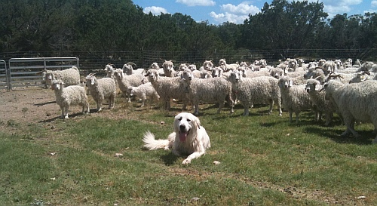
Work Faithfully
Even dogs have a work to do to help the shepherd.

Slide 10
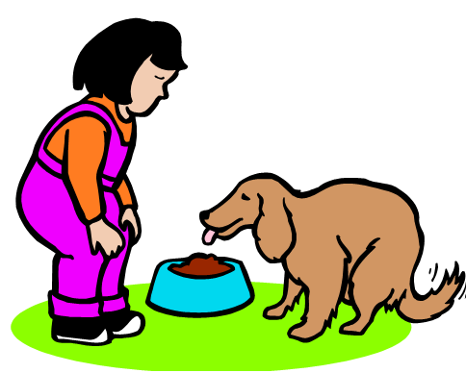
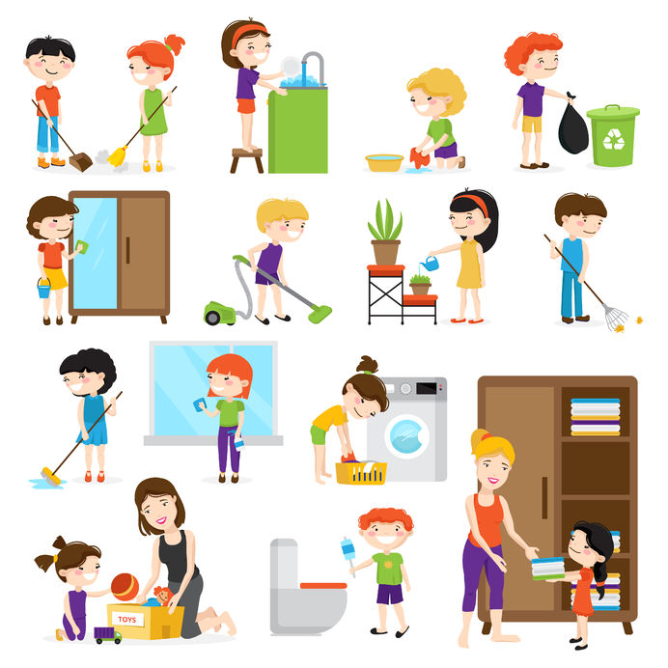
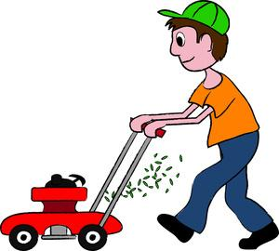
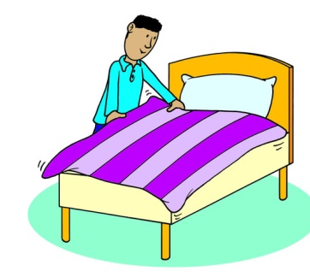
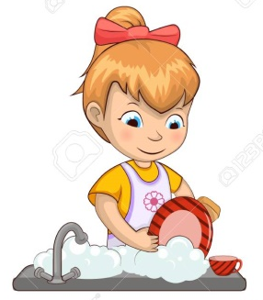

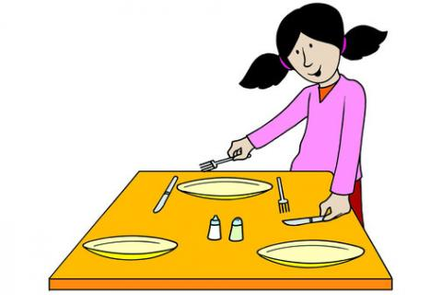
We each have work to do.
Let’s play charades. Choose a job to act out and we’ll try to guess what it is.

Slide 11



GOD WANTS US TO DO
GOOD WORK
“But as for you, be strong and do not give up, for your work will be rewarded.”
2 Chronicles 15:7

Slide 12

We’ll Work Hard

Slide 13
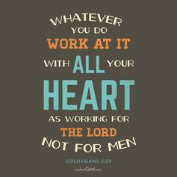
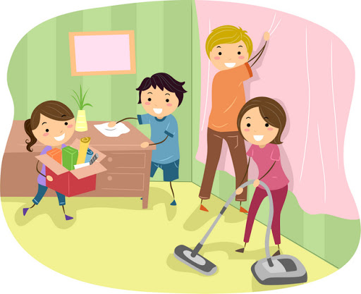
GOD WANTS US TO
DO GOOD WORK

Slide 14
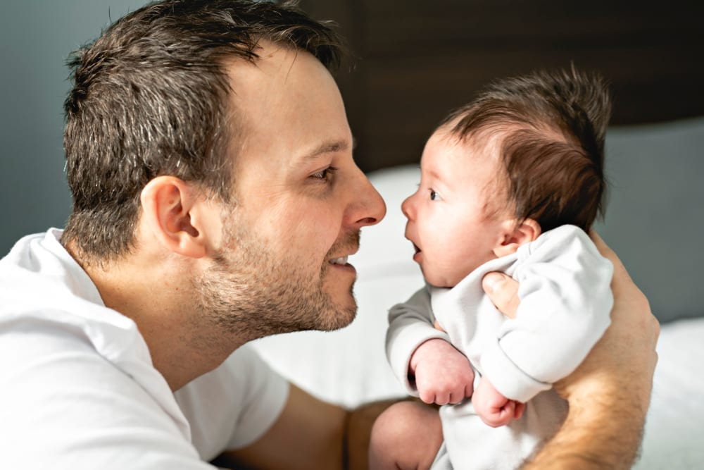
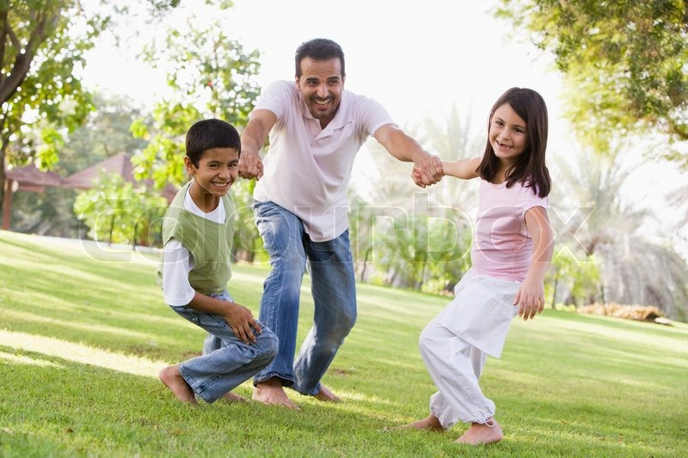
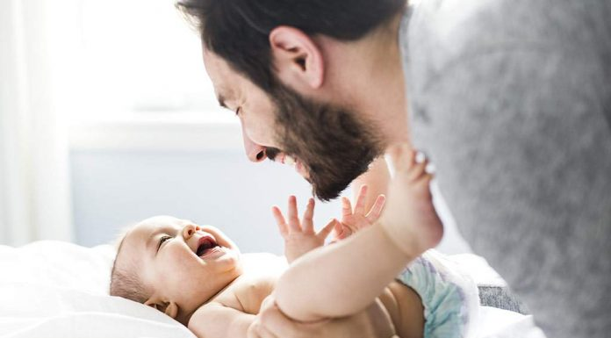
Jacob also became a daddy!

Slide 15
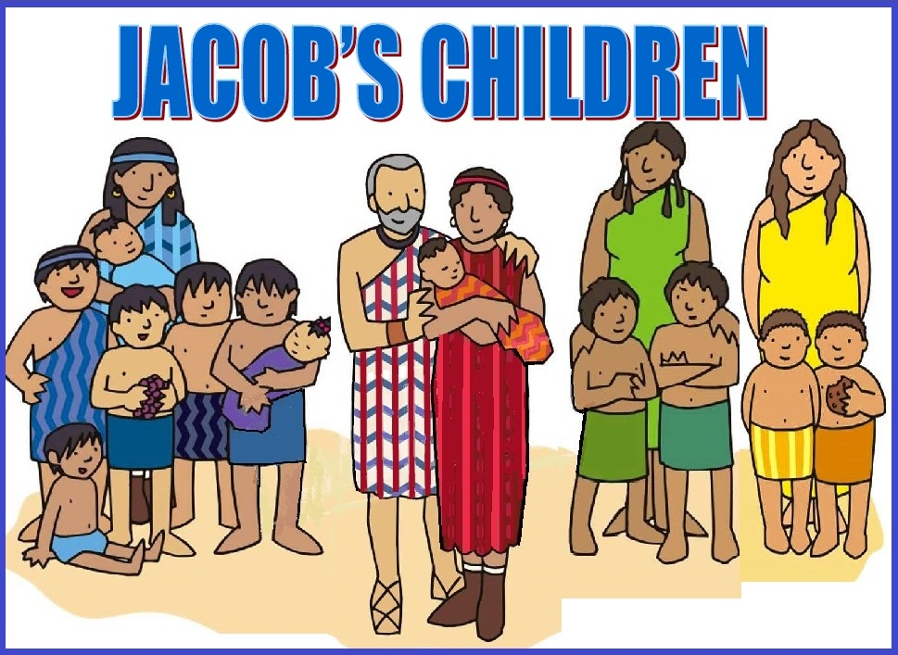

Genesis 29:31 – 30:24
Reuben
Simeon
Levi
Judah
Dan
Naphtali
Gad
Asher
Issachar
Zebulun
Joseph
....
Jacob had many sons
How many kids in all?
Just like God promised,
Jacob had many sons.
He had 11 sons and then later,
he had 1 more son and a daughter.

Slide 16
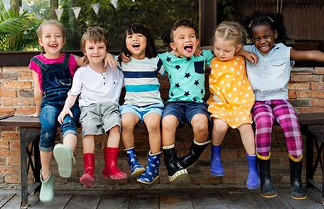
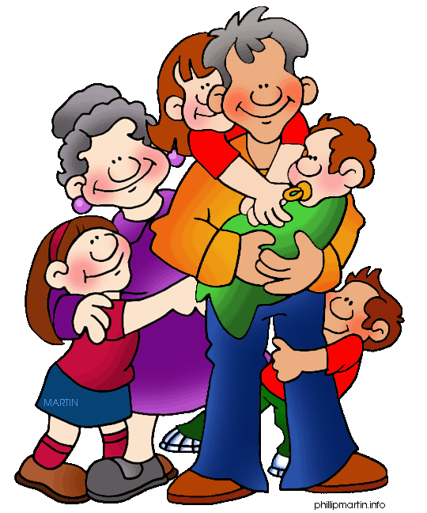
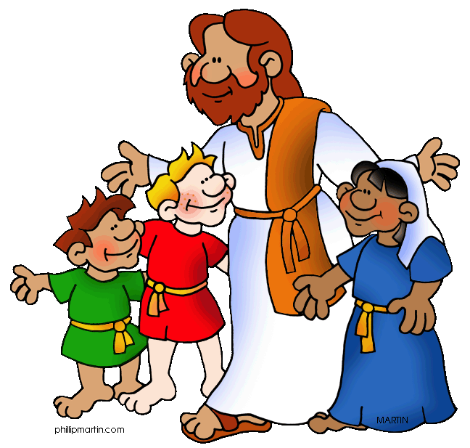
Every child is a gift from God.
God loves each and every one of us!

Slide 17

You are fearfully and wonderfully made.
We are God’s workmanship
created by Christ Jesus
to do good works which He prepared in advance for us to do.

Slide 18

Show and Tell
Choose something to show:
something that you like a lot
something that shows what you like to do
your favorite picture

Slide 19
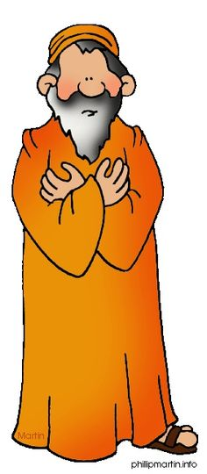
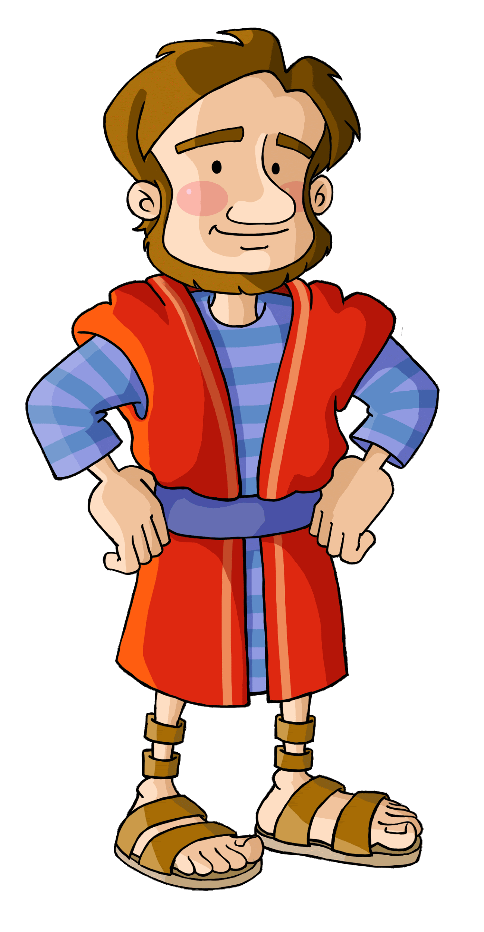
Laban, Please send me on my say so I can go back to my own homeland. Give me my wives and children, for whom I have served you, and I will be on my way. You know how much work I’ve done for you.
The Lord has blessed me because of you.
Please stay.
Name your wage
and I will pay it.

Slide 20

You know that
because of God’s blessing,
your livestock has increased
under my care.
Now I would like to do something for my own family.
What shall I give you?

Slide 21
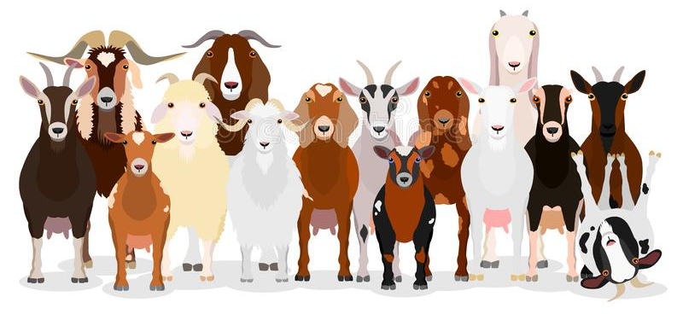
I will go on tending your flocks and herds if you let me keep every
speckled or spotted sheep,
every dark-colored lamb, and
every spotted or speckled goat.
they will be my wages.
Agreed. Let it be as you have said.

Slide 22
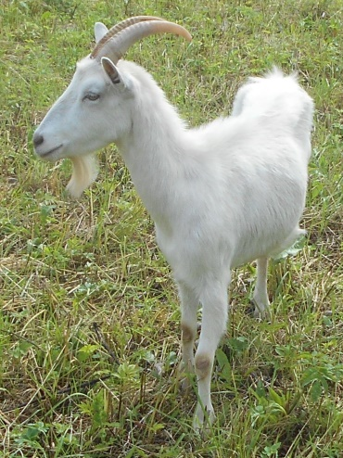
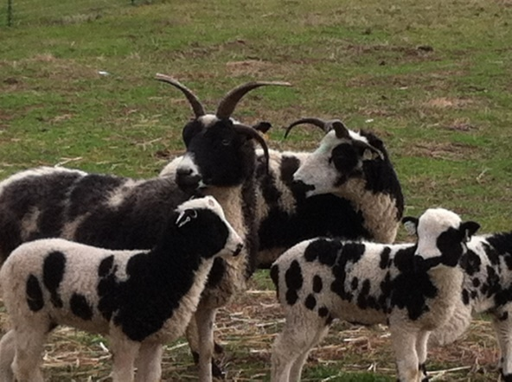
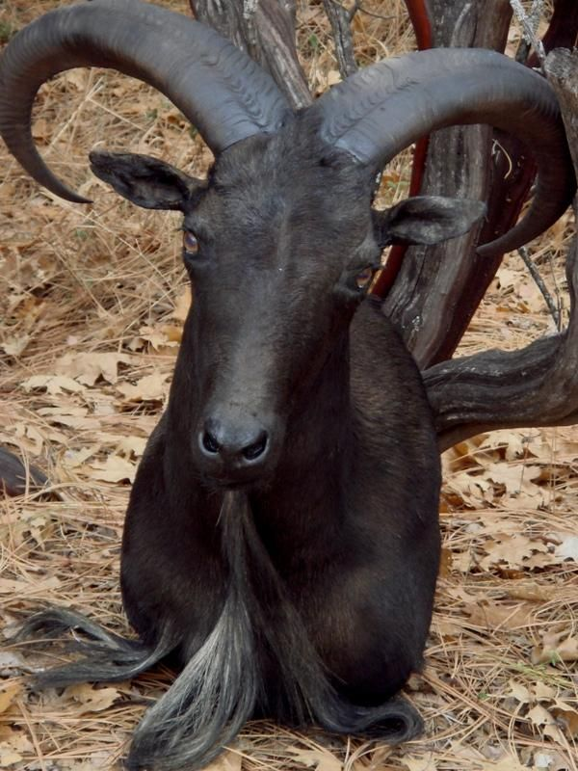
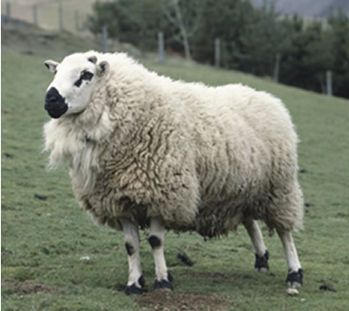
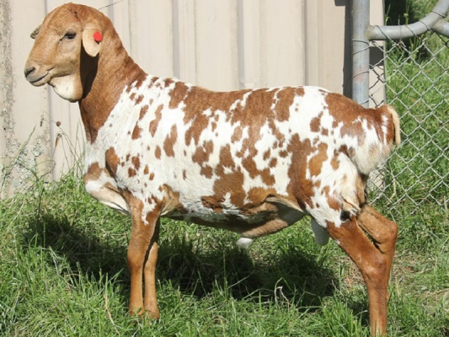
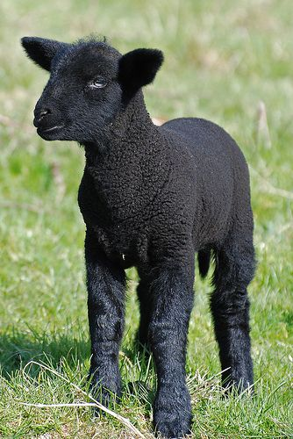
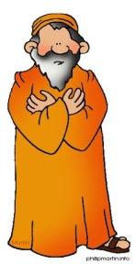
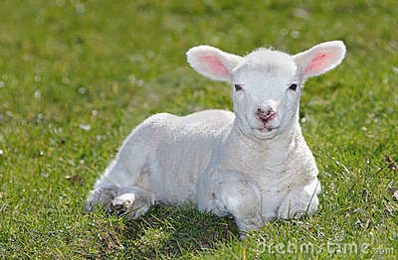
Sort the goats and sheep
Jacob’s: speckled or spotted sheep and goat,
And every dark-colored lamb.
Laban
Jacob

Slide 23
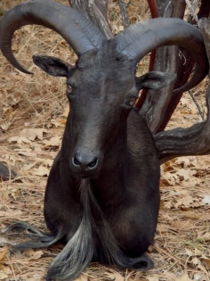





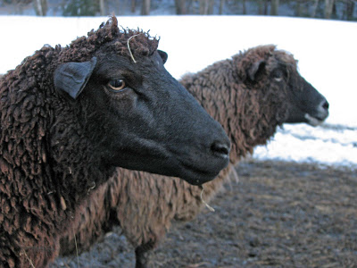
Jacob, take care of my sheep and goats. I will have my sons watch yours.
OK

Slide 24
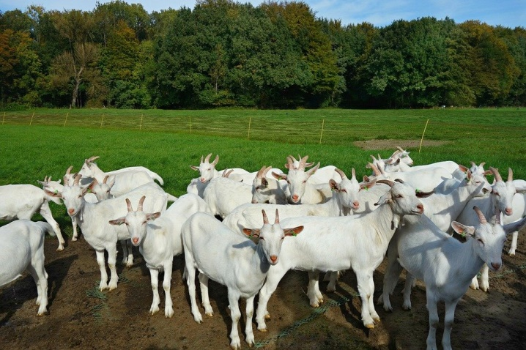
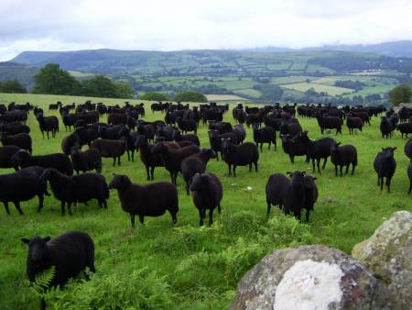
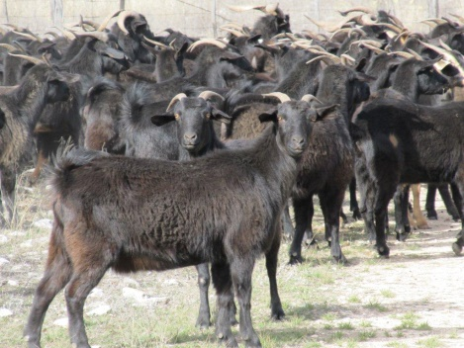
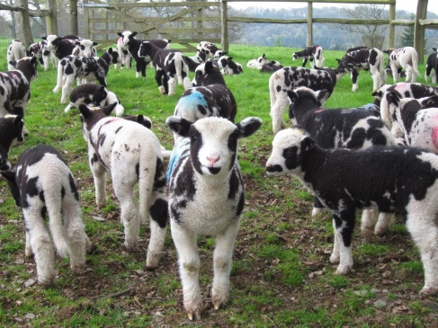
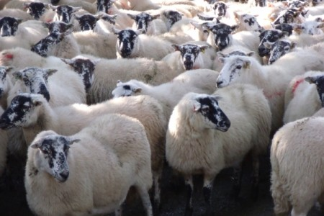
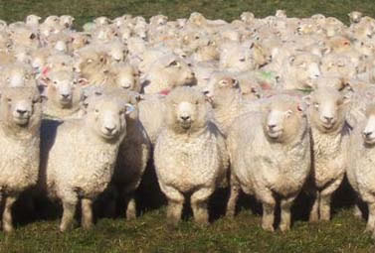
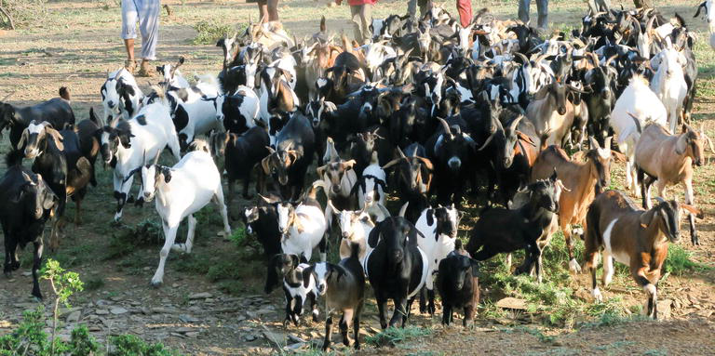
The sheep and goats had babies. The flocks and herds grew!

Slide 25
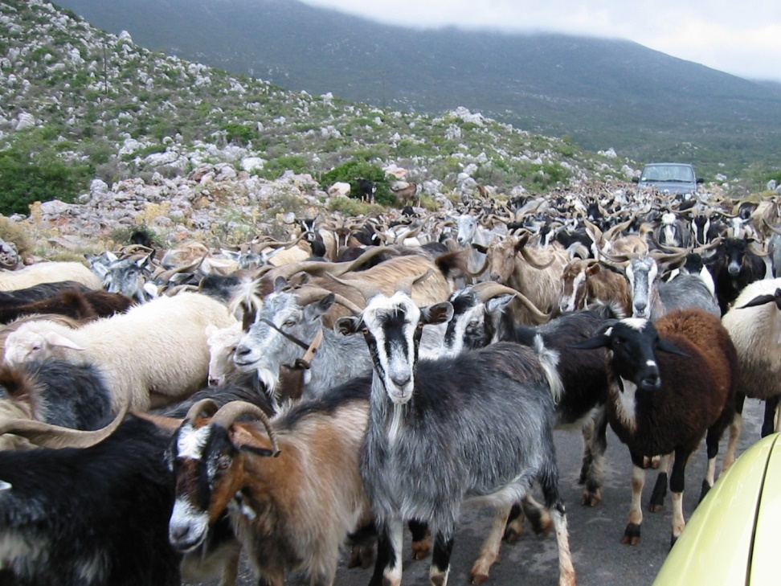
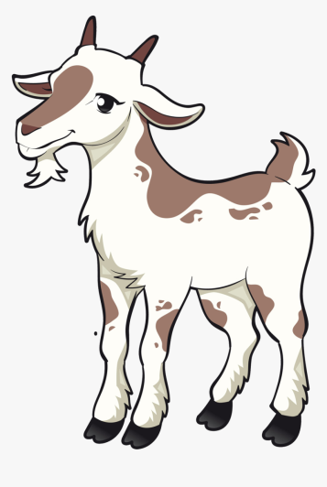
Genesis 30:25-43
Jacob took care of goats
Jacob took care of the goats and sheep when he was young at home and he took care of Laban’s flocks and herds also.
God kept his promise to bless Jacob.
He blessed Jacob with many goats and sheep!
God blessed the goat herd

Slide 26
GOD WANTS US TO DO
GOOD WORK
“But as for you, be strong and do not give up, for your work will be rewarded.”
2 Chronicles 15:7

Slide 27
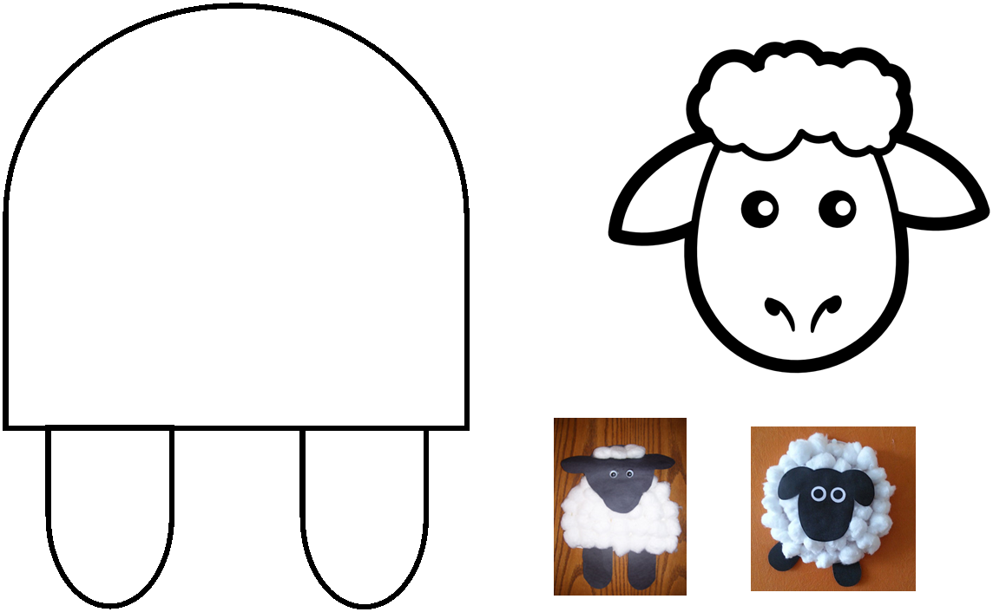
Craf Time
Supplies:
Lamb body & head
3 Cotton balls
scissors
glue
Cut out the body & legs
Cut out the lamb head
Color the lamb head
Pull apart each cotton ball to make smaller bits of cotton.
Glue the cotton bits to the lamb body and some to the top of the head.
Glue on the sheep head

Slide 28
Extra Videos
Teachers, use these for more info.

Slide 29
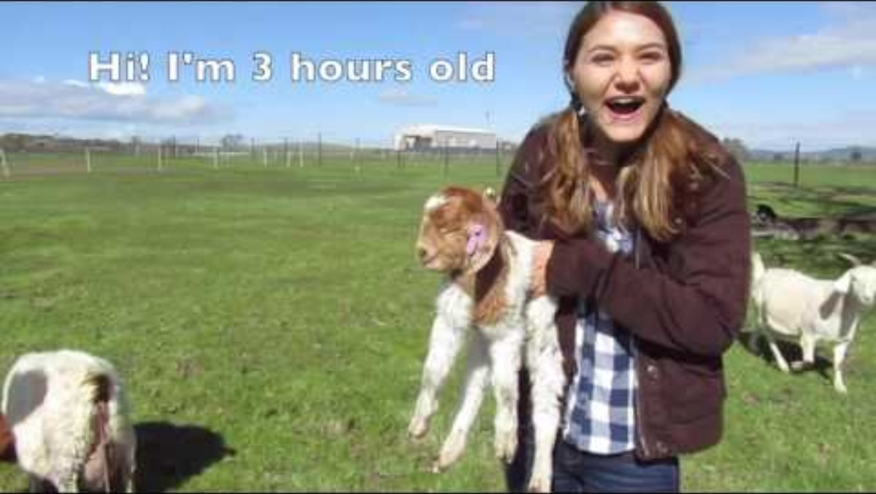
LET’S LEARN ABOUT GOATS
I GOAT THIS -- https://www.youtube.com/watch?v=BzsNBQBHDzU
21 min. (show part)

Slide 30
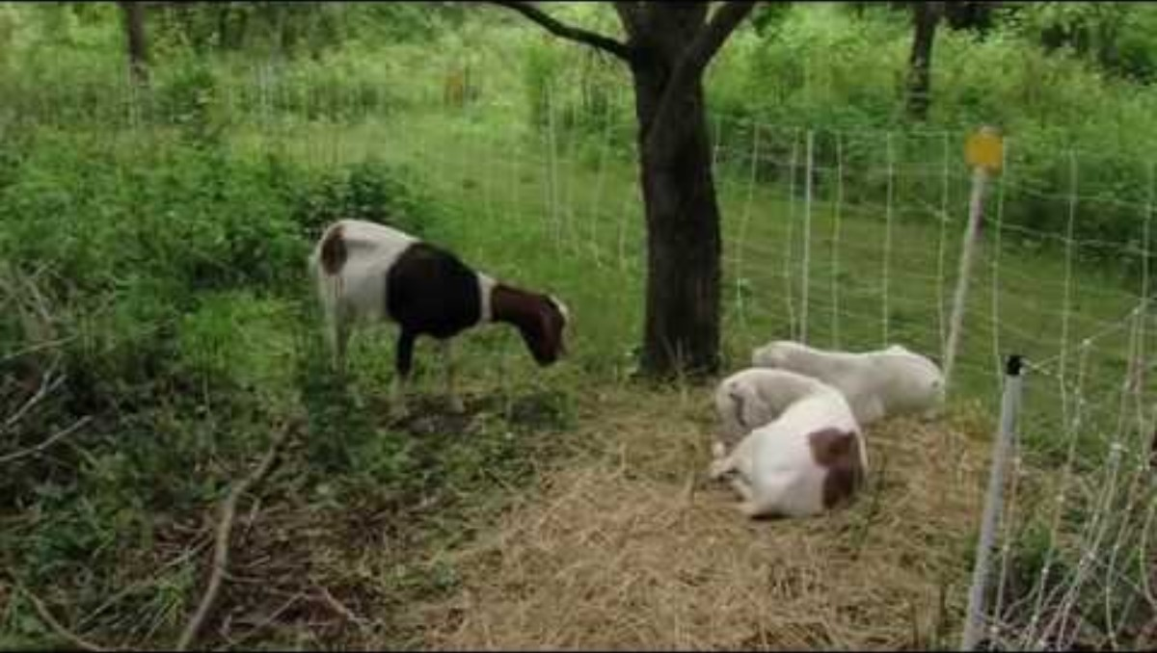
Goats work faithfully

