Slide 1
Noah’s Ark
Part 1
Noah Builds the Boat

Slide 2
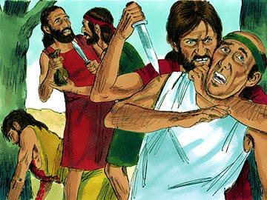
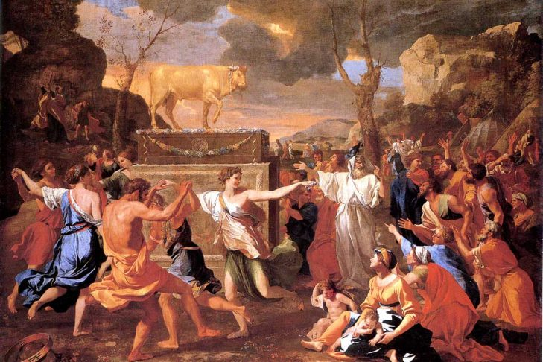
Why did Noah build an ark?
GENESIS 6: ⁵ The Lord saw that the people on the earth were very evil. He saw that they thought only about evil things all the time. ⁶ The Lord was sorry that he had made people on the earth. It made him very sad in his heart. ⁷ So the Lord said, “I will destroy all the people I created on the earth. I will destroy every person and every animal and everything that crawls on the earth. And I will destroy all the birds in the air, because I am sorry that I have made them.” …
¹¹⁻¹² When God looked at the earth, he saw that people had ruined it. Violence was everywhere, and it had ruined their life on earth.
The Lord saw that the people on the earth were very evil.
He saw that they thought only about evil things all the time.
They had ruined the earth. They were violent all the time.
This all made Jesus very sad!

Slide 3
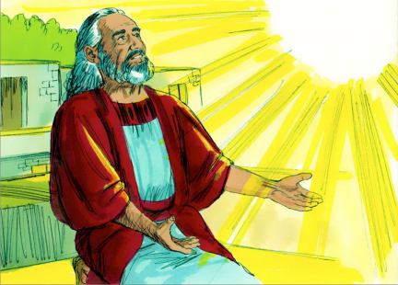
God spoke to Noah
Now I have a job for you to do. Build an ark to save animals, plants, and people from the flood. Warn the people. Maybe they will want to be saved, too. You and your family will be saved.
The earth is full of violence.
I’m going to destroy all the evil in the world.
Many humans, plants, & animals will die.
But I am pleased with you.
You continue to walk
faithfully with me.
You seek to respect and obey me.
Thank you.
He said:
“I am going to put an end to all people, for the earth is filled with violence because of them. I am surely going to destroy both them and the earth.
¹⁴ So make yourself an ark of cypress^{[c]} wood; make rooms in it and coat it with pitch inside and out.
¹⁷ I am going to bring floodwaters on the earth to destroy all life under the heavens, every creature that has the breath of life in it. Everything on earth will perish.
¹⁸ But I will establish my covenant with you, and you will enter the ark—you and your sons and your wife and your sons’ wives with you.
¹⁹ You are to bring into the ark two of all living creatures, male and female, to keep them alive with you. ²⁰ Two of every kind of bird, of every kind of animal and of every kind of creature that moves along the ground will come to you to be kept alive.
²² Noah did everything just as God commanded him.

Slide 4
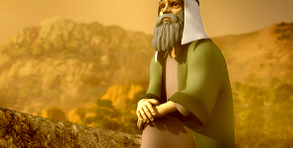
Why did God choose Noah?
⁸ But Noah pleased the Lord.
⁹ ….He was a good man all his life, and he always followed God.

Slide 5

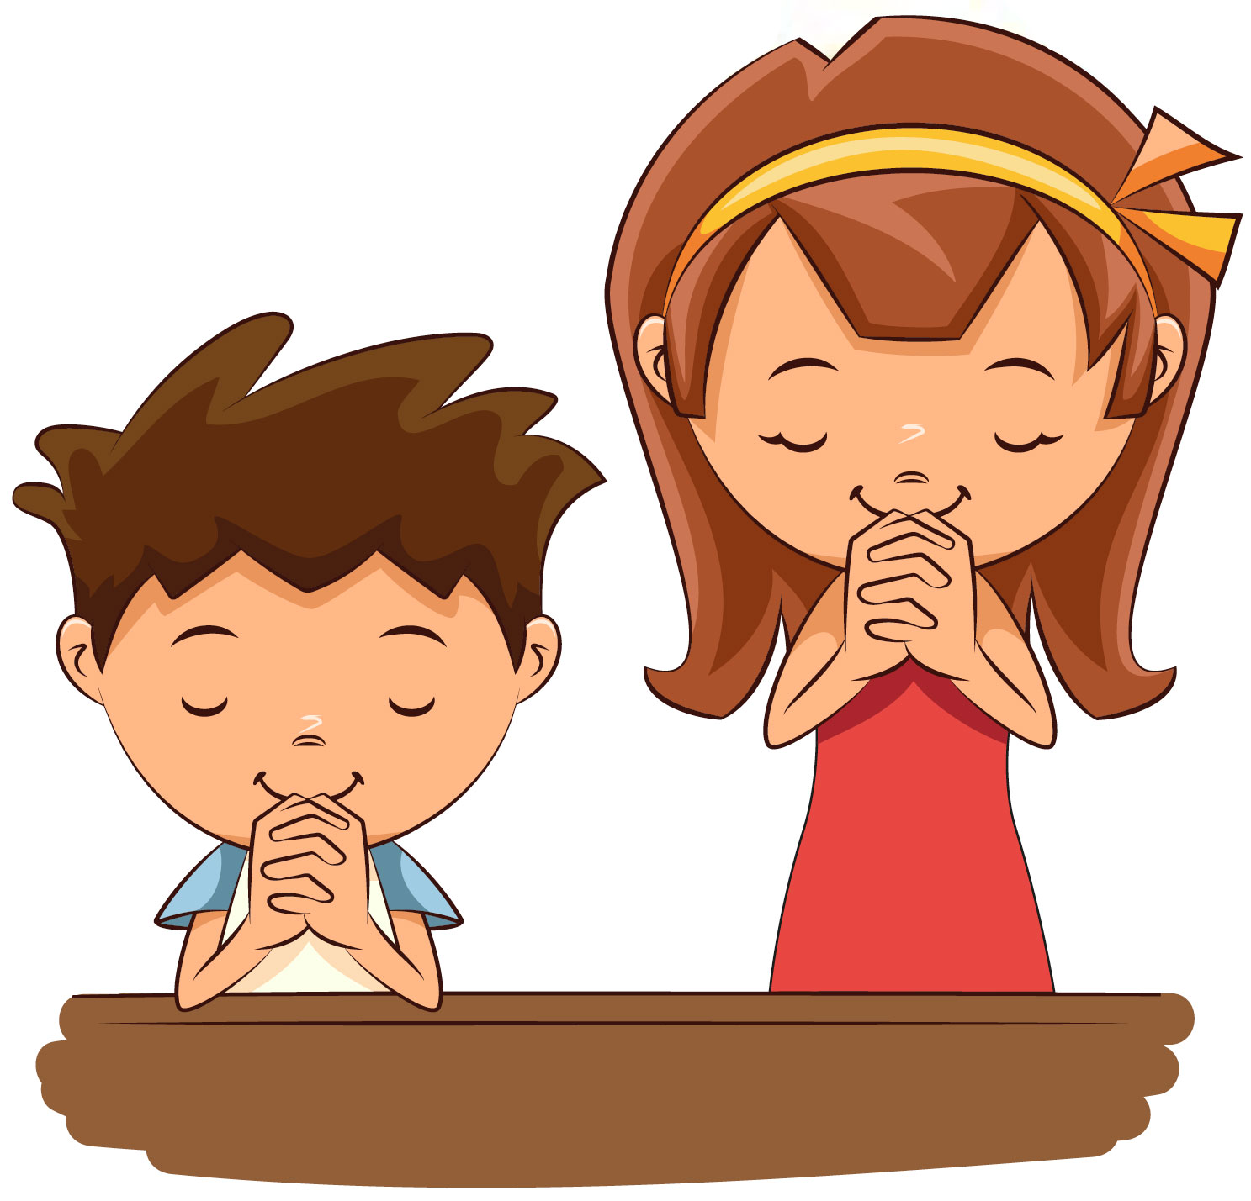
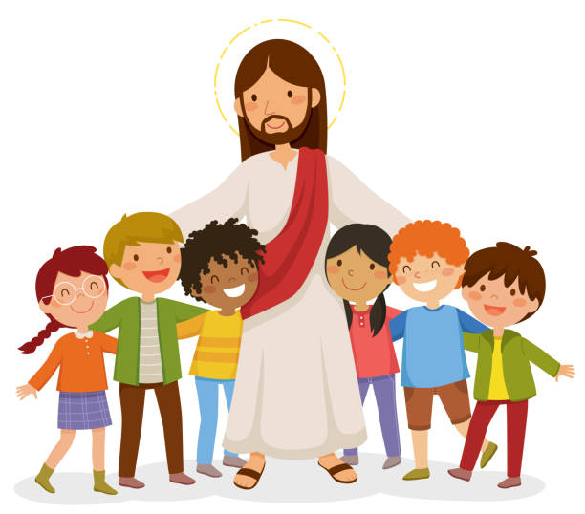


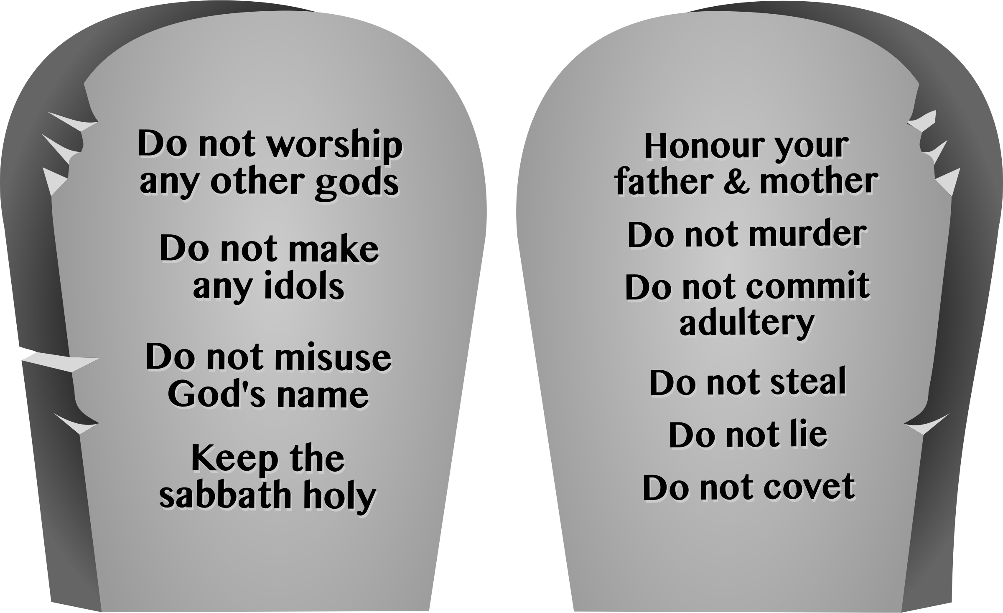
Last week we talked about how Enoch walked with God and how we, too, can walk with God.
How do we do that?
Jesus loves you and forgives you.
Love
God
Love
Others

Slide 6
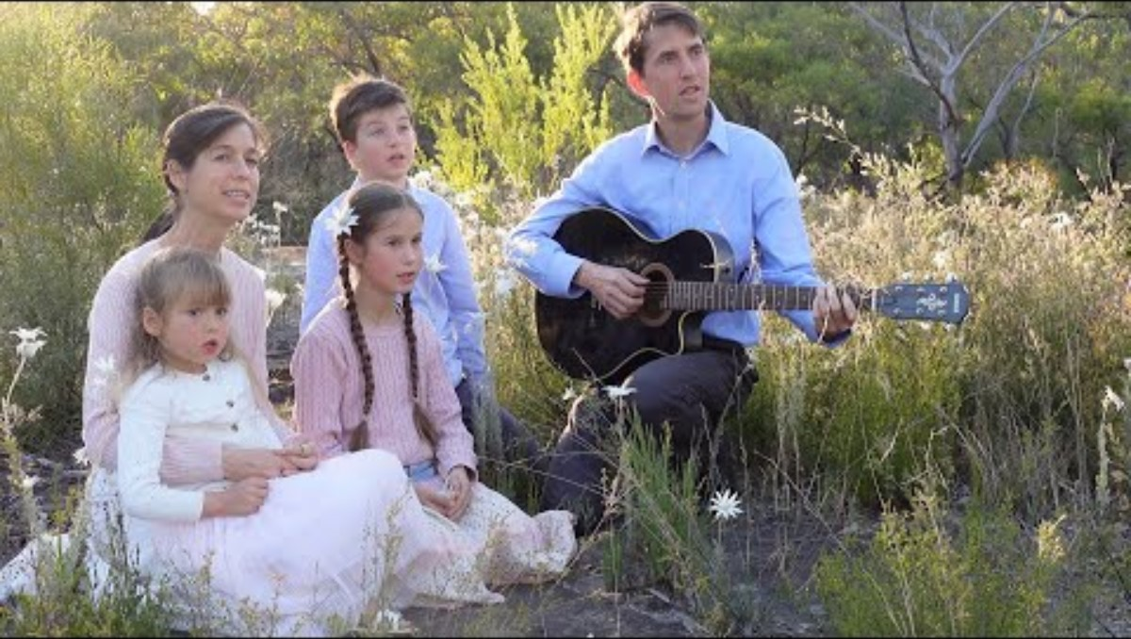
He has shown you, O man, what is good;
And what does the Lord require of you but to do justly,
To love mercy,
And to walk humbly with your God?
“…the Lord has told you what goodness is.
This is what he wants from you:
Be fair to other people.
Love kindness and loyalty,
and humbly obey your God.”
Micah 6:8

Slide 7
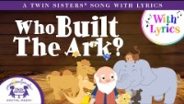

Slide 8
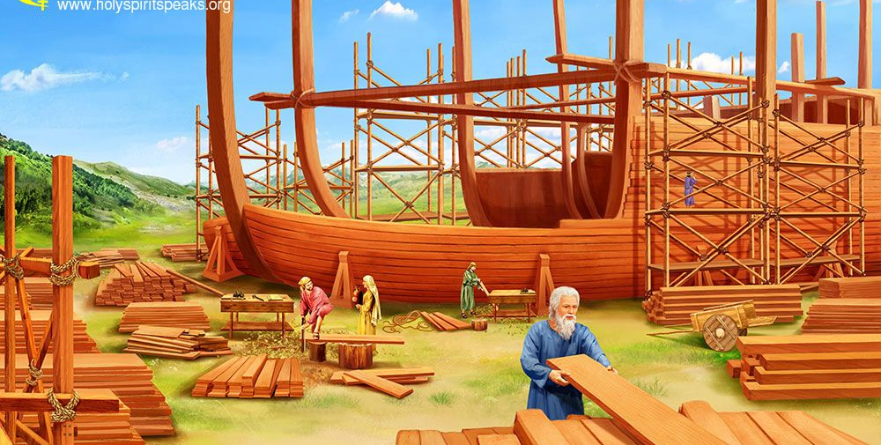
Noah built an ark. What did he use?
¹⁴ So make yourself an ark of cypress^{[c]} wood; make rooms in it and coat it with pitch inside and out.

Slide 9
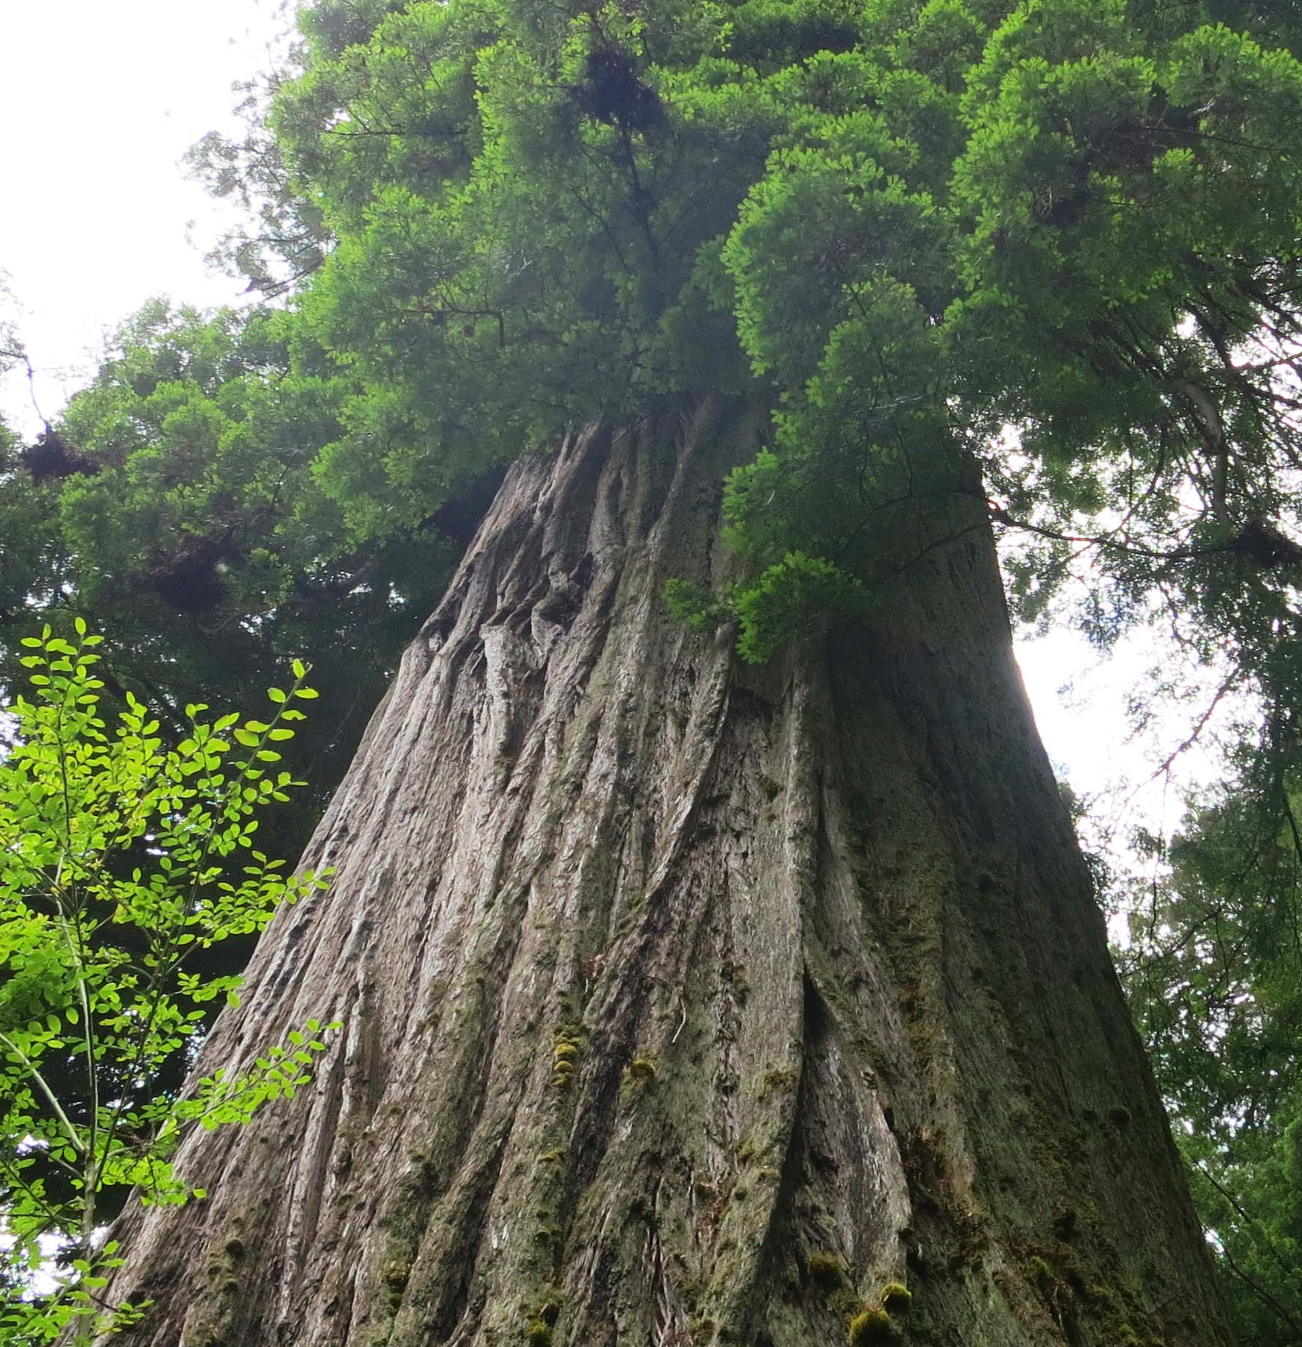
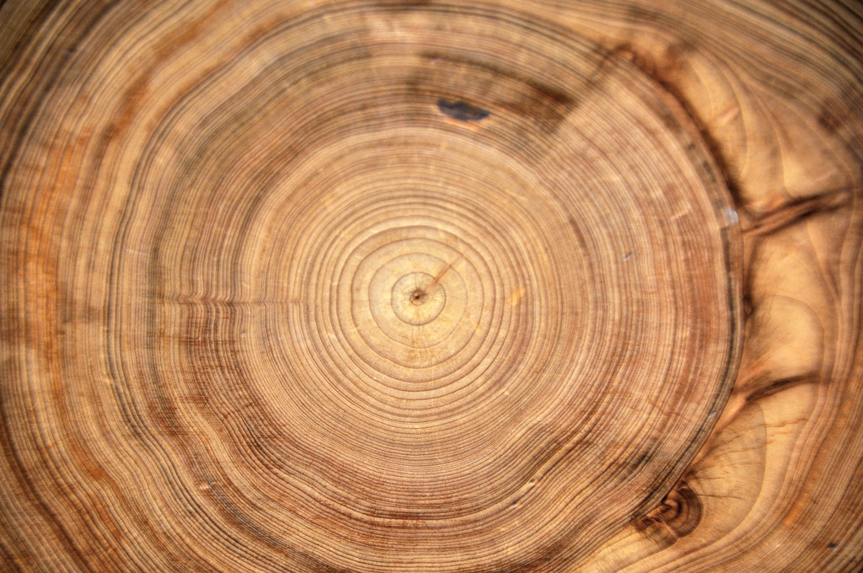
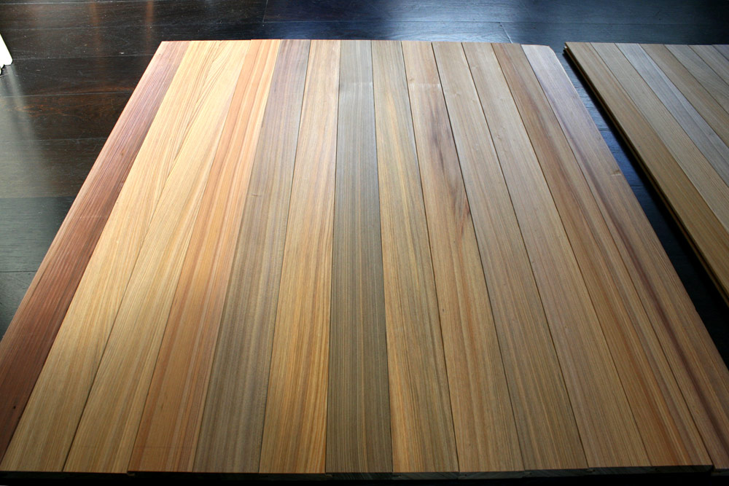
Gopher or Cypress wood..
It was very hard.

Slide 10
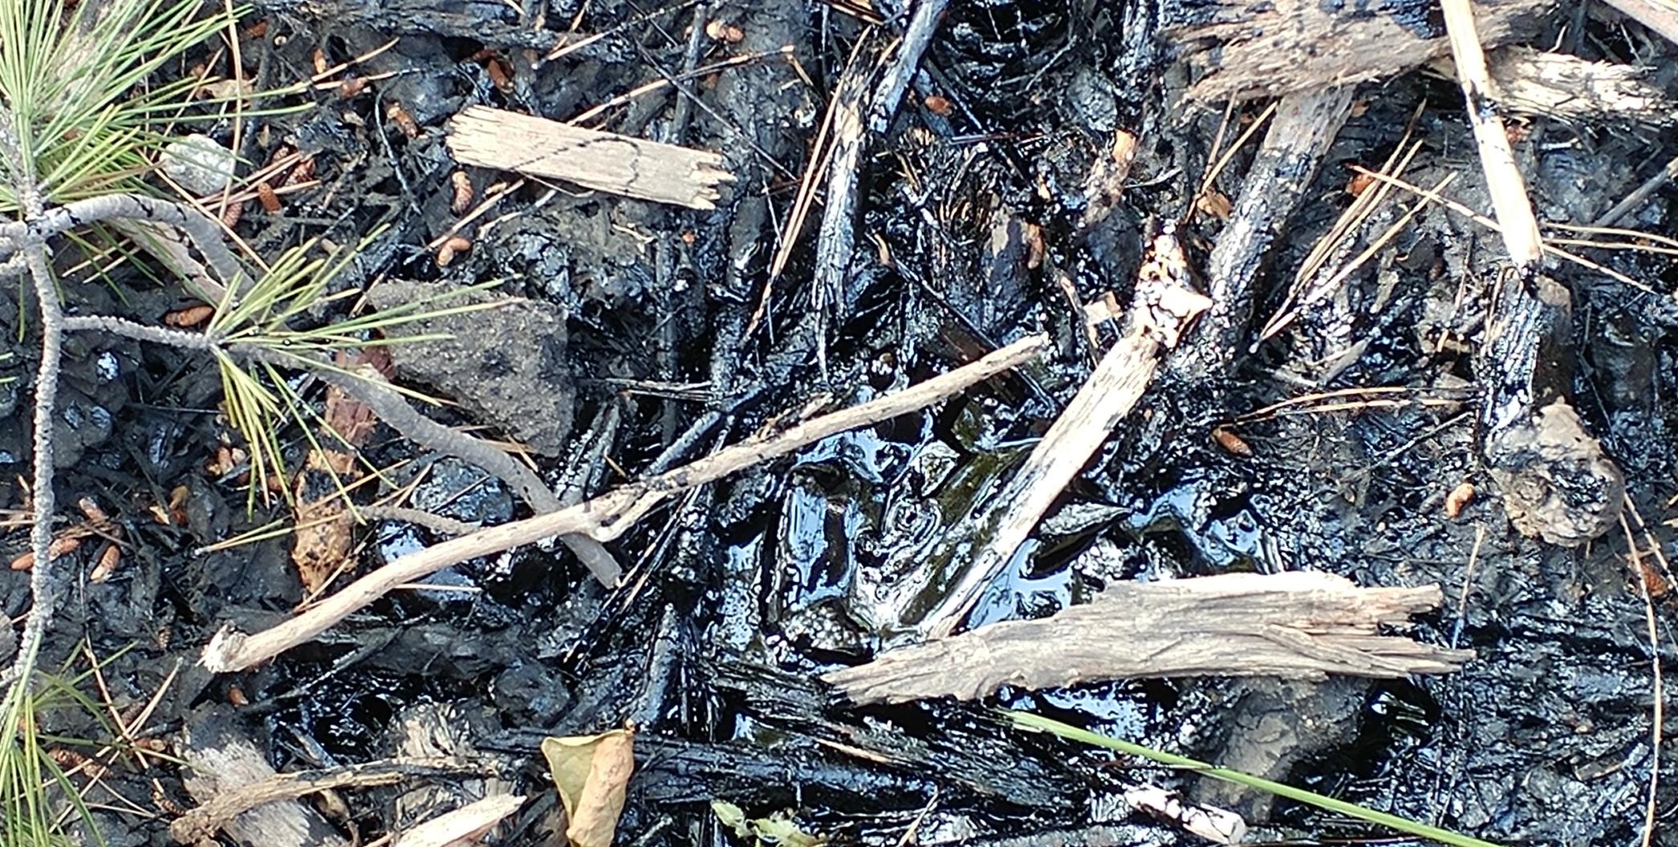
And tar. Here is a small tar pit in San Diego.
“cover it with tar inside and out.” Genesis 6:14
It oozes and bubbles. Sticks and grasses hide the pit.
Look out or you may fall in!

Slide 11
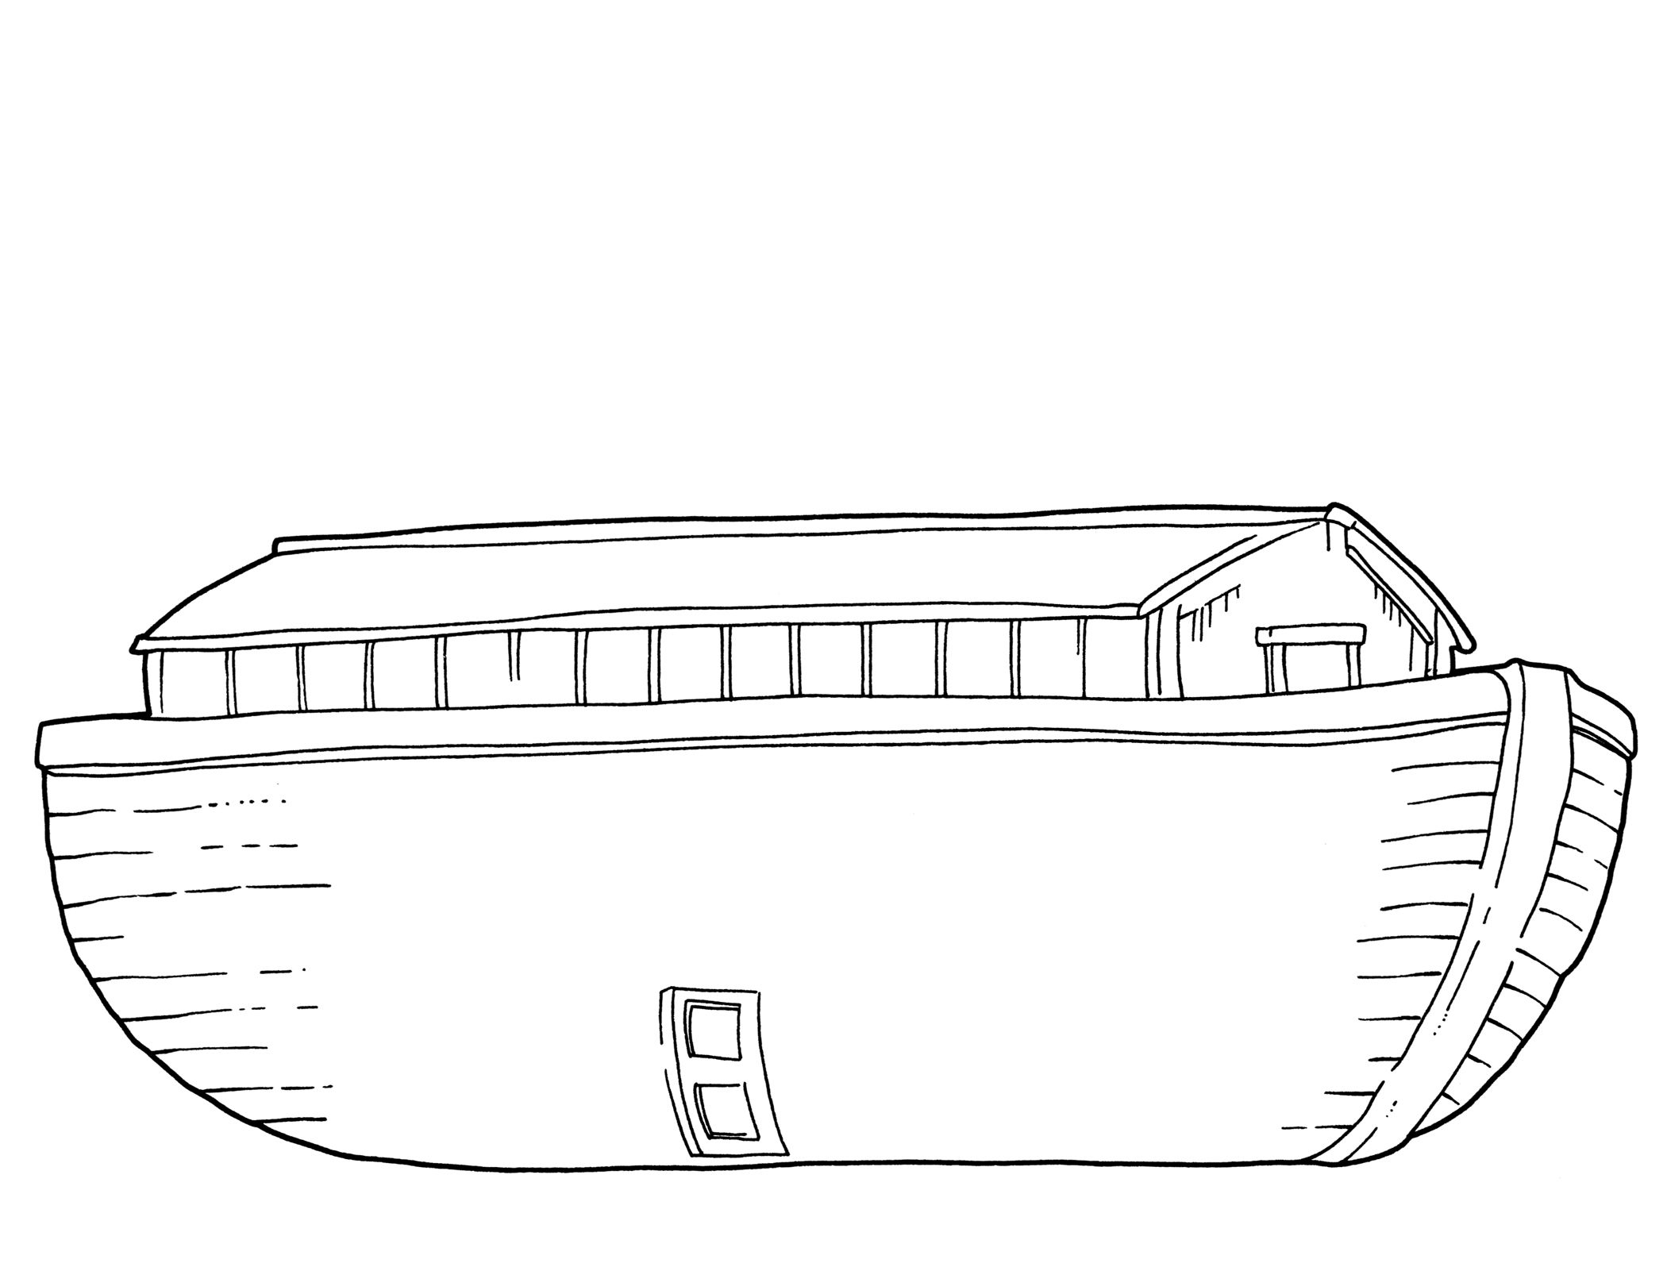
Craft Time – Build an Ark
Or design an ark.
Cut a paper in half lengthwise and put the 2 halves together end to end to make it long enough.
Draw it like this:
Then make rooms for the animals and plants.
Make bedrooms, the kitchen, bathroom, and what else?
Color the ark. Glue toothpicks or popsicle sticks on the ark.

Slide 12

²² Noah did everything just as God commanded him.
Is it important to follow directions?
Why?
Let’s see how well you follow directions. We’re going to make a yummy snack. But if you don’t follow the directions, it might not turn out very well.

Slide 13
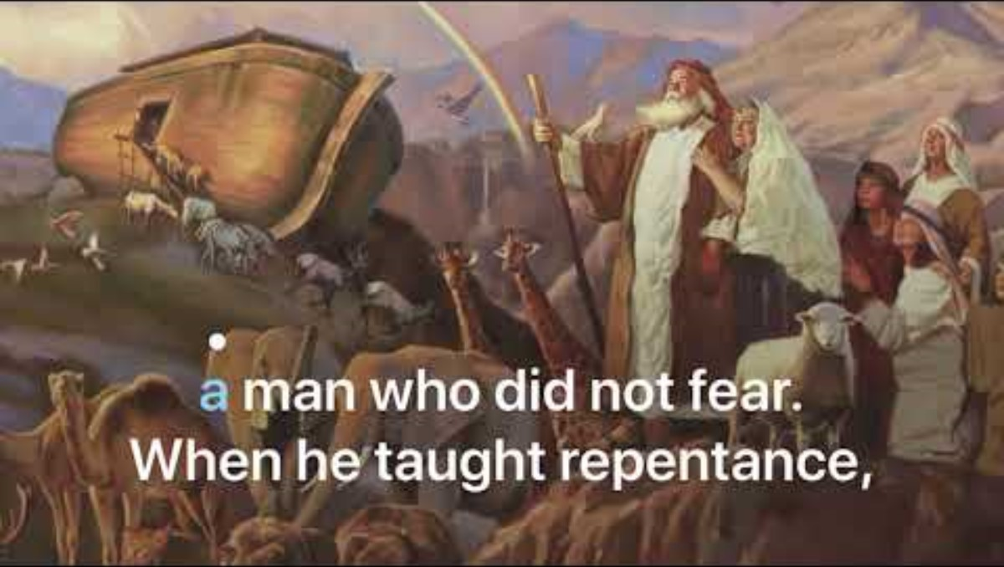

Slide 14
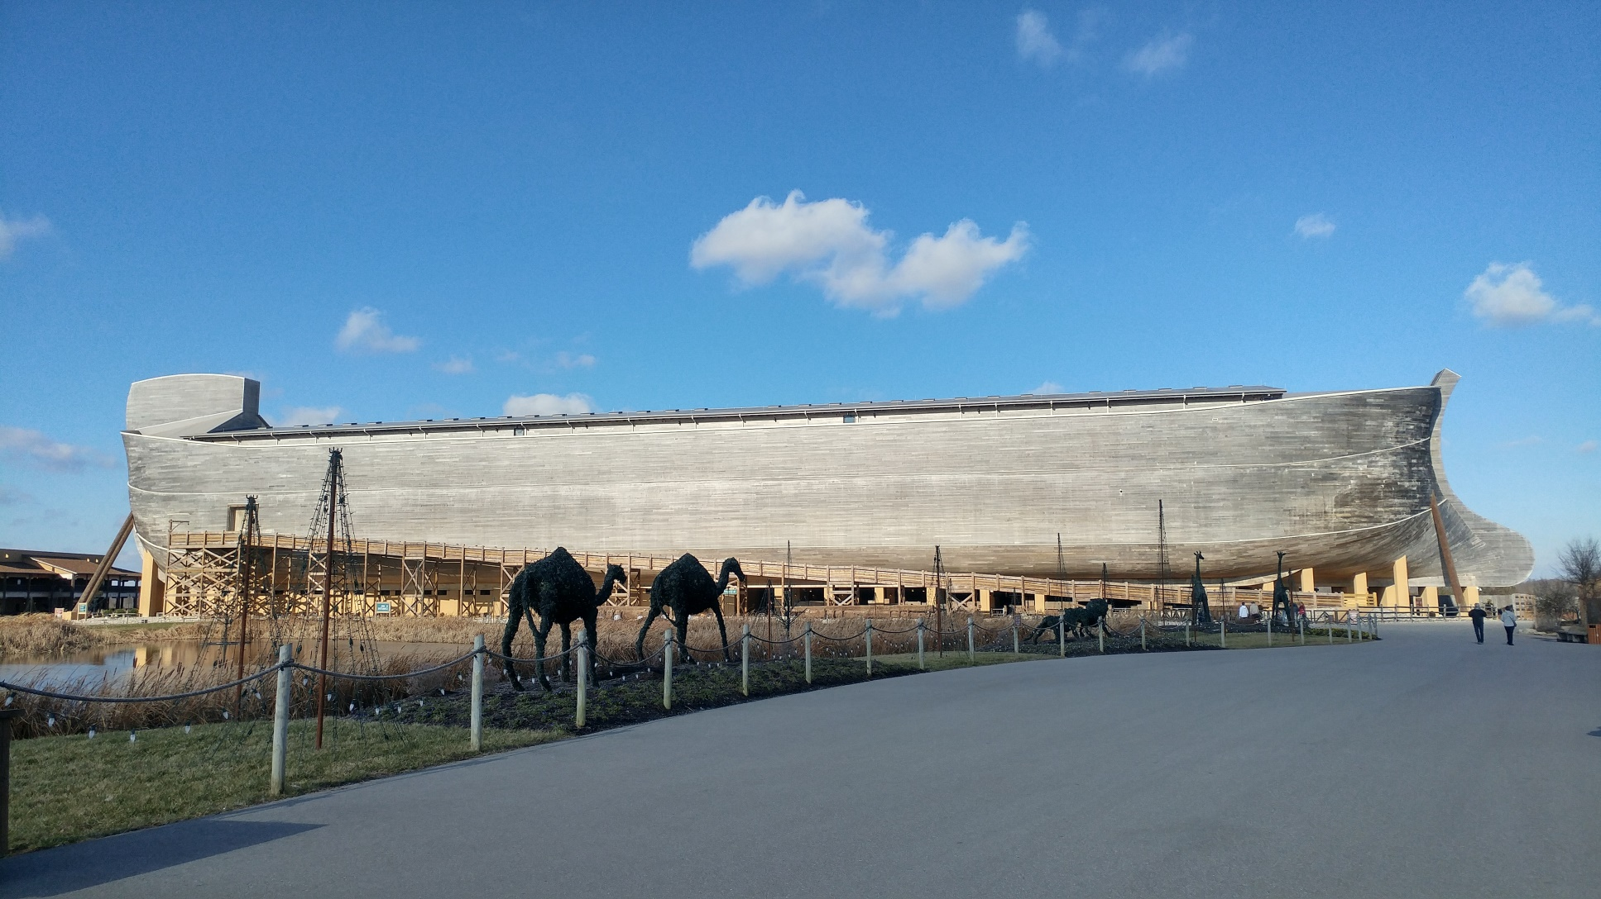
Noah’s Ark rebuilt near Williams, Kentucky

Slide 15
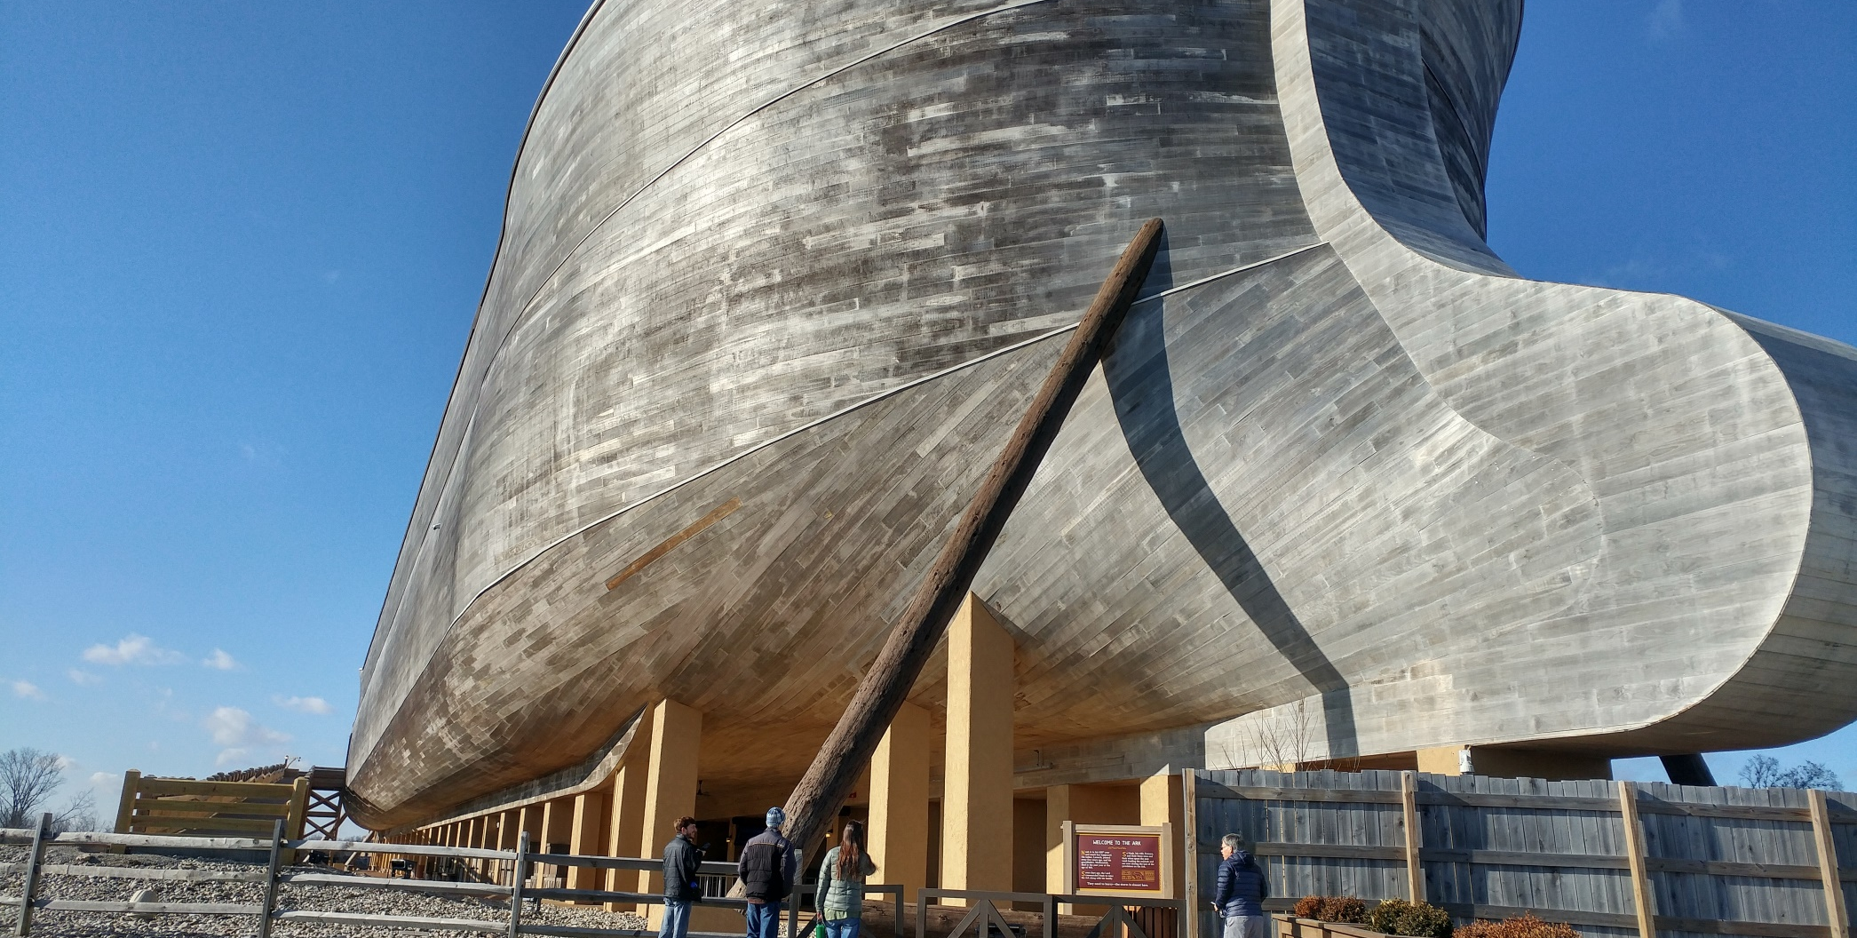
How long was the ark?
300 cubits^{[c]} long (about 450’) That’s more than 18 school busses end to end
and 50 cubits^{[d]} wide (about 80 feet) You could park at least 9 buses side by side.
So at least 486 buses could be parked in the ark!

Slide 16

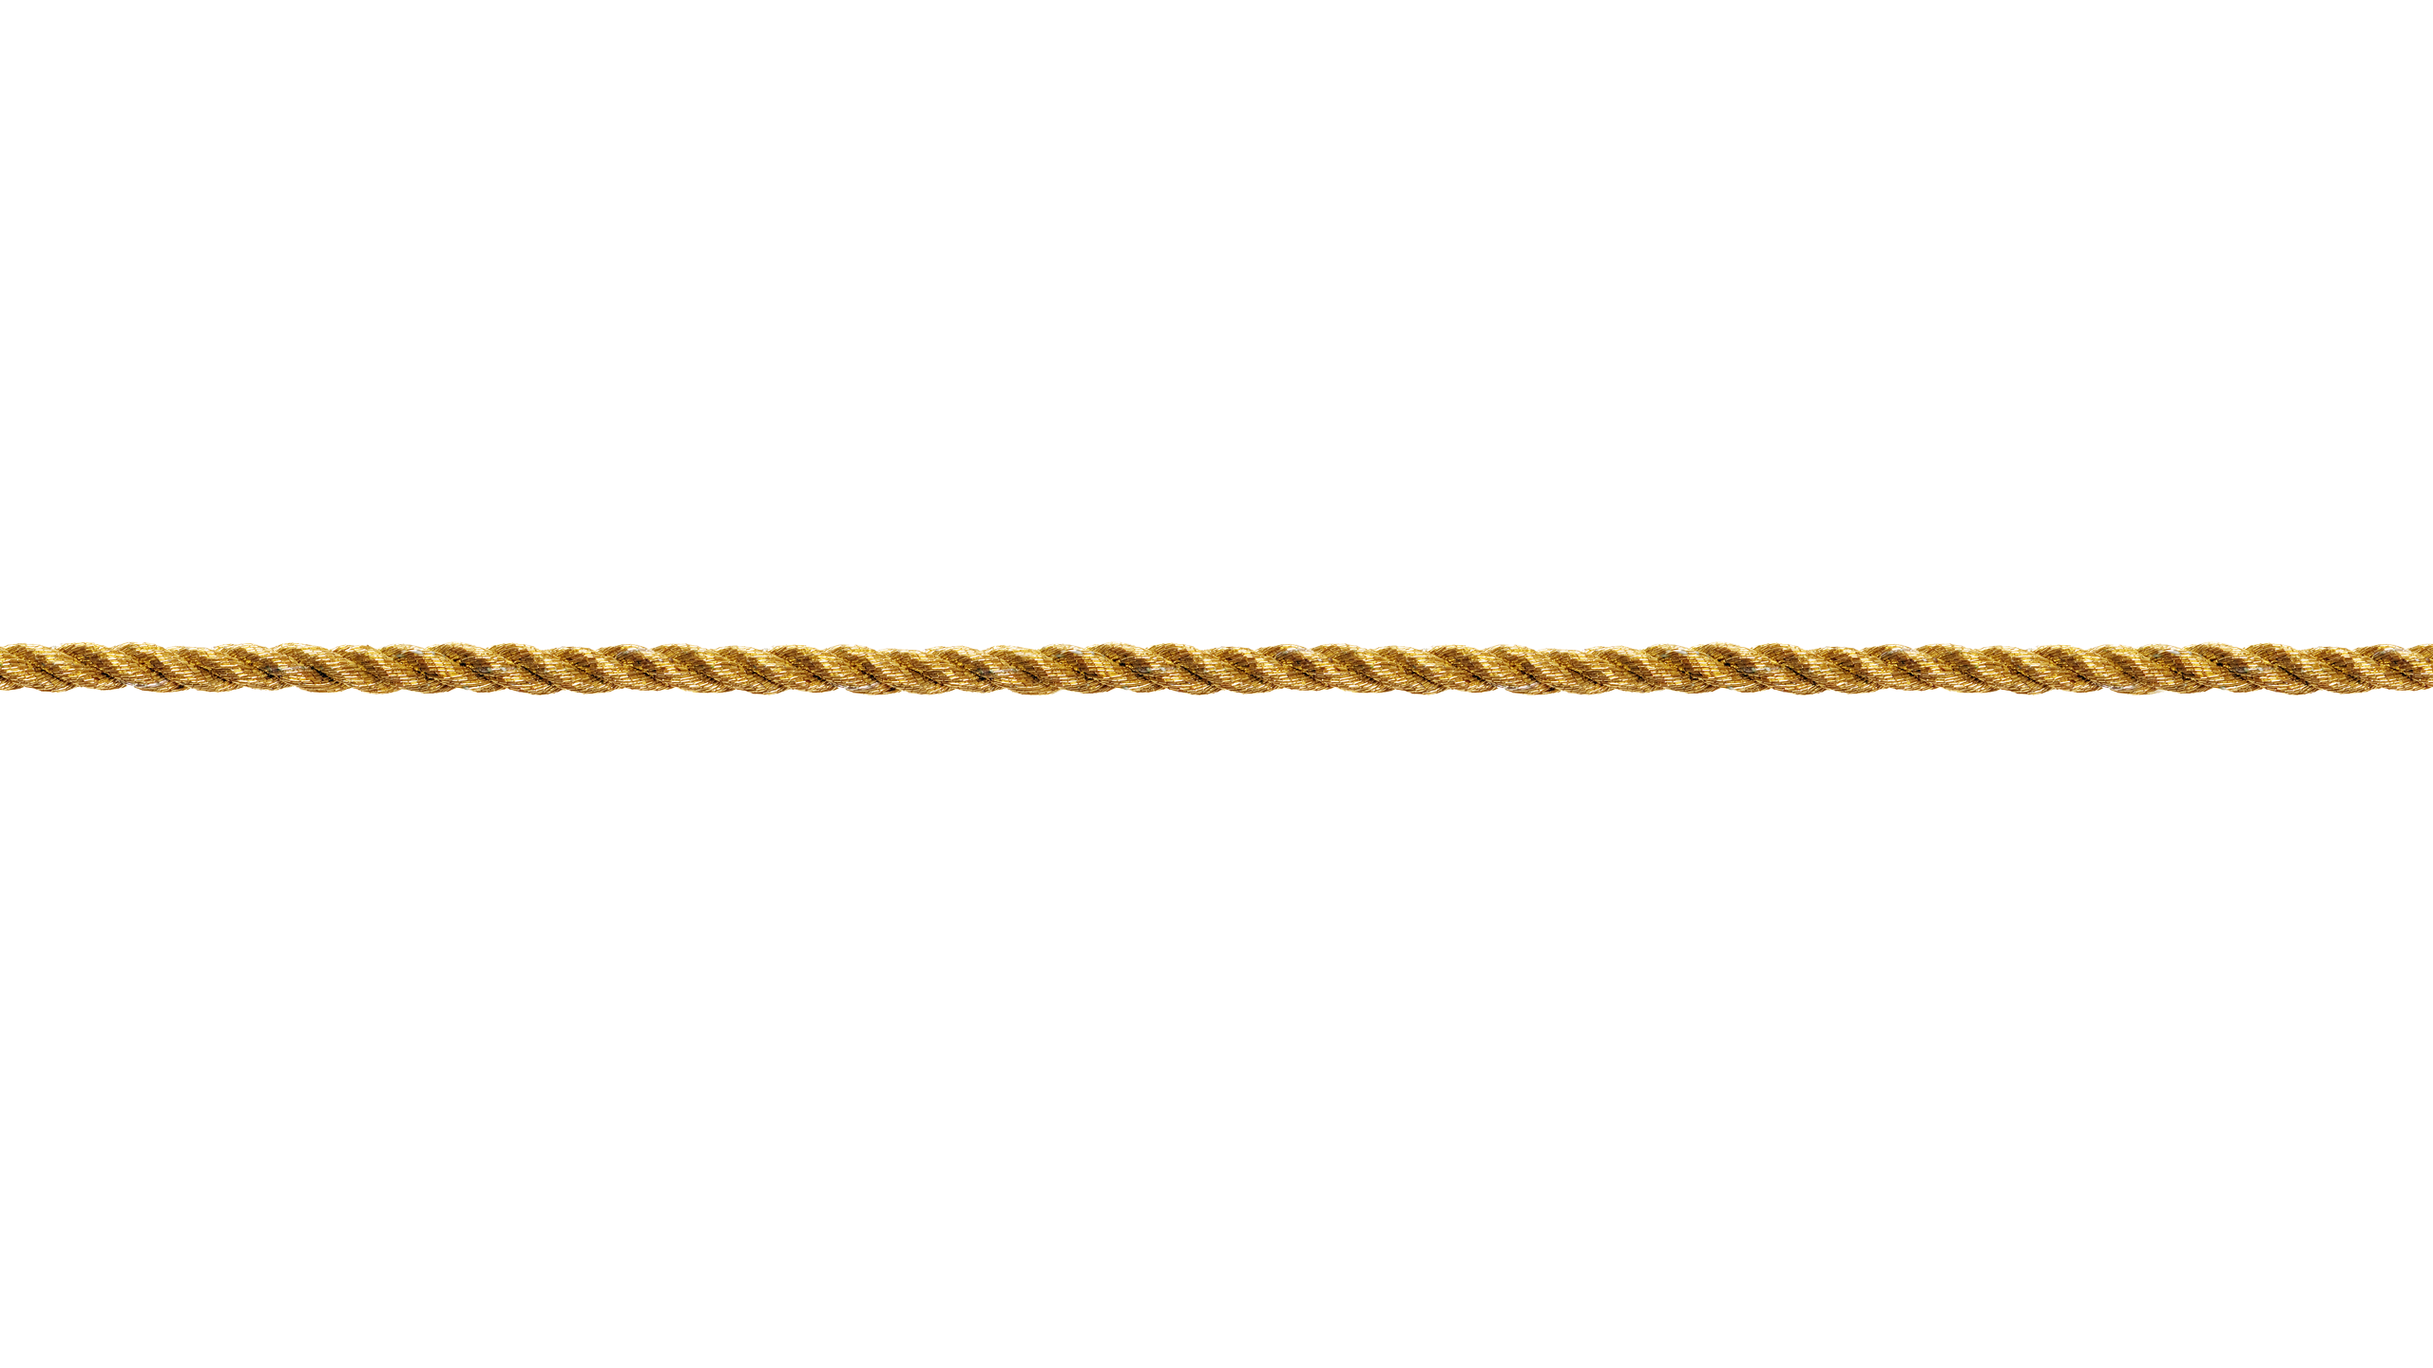
Let’s go outside and measure how big the ark was. I have some ropes that are 100 feet long. We will need 4 ½ ropes for the length and ¾ (75 feet) for the width.

Slide 17
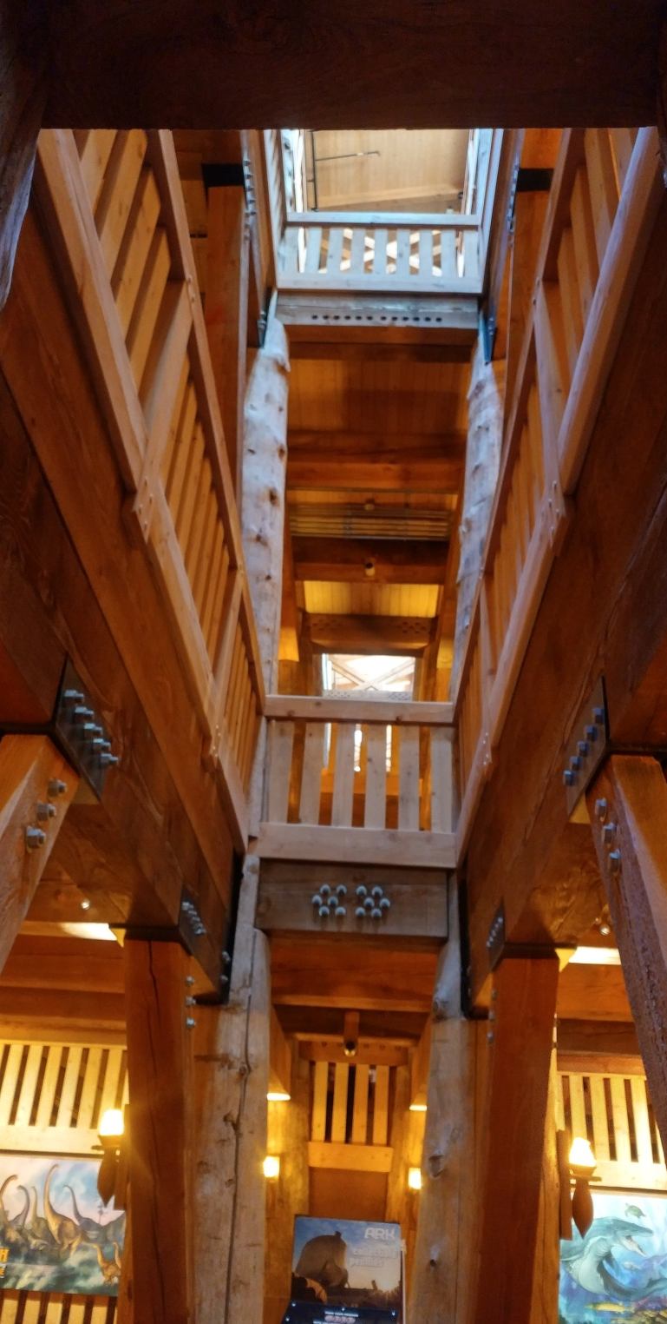
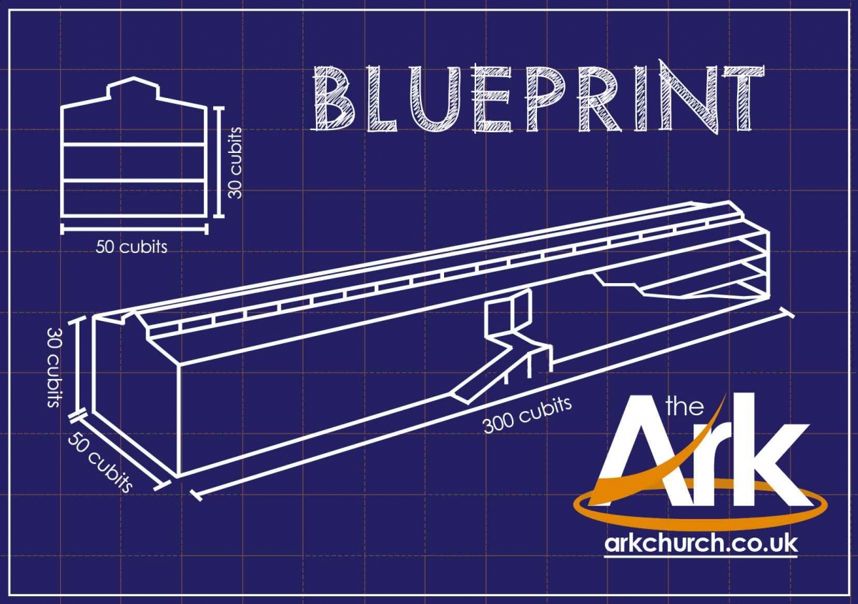
How tall was the ark?
30 cubits^{[e]} high (about 45 feet high)
That’s taller than our 4 story tall building.
God told Noah:
¹⁵ This is how you are to build it:
The ark is to be three hundred cubits long, fifty cubits wide and thirty cubits high.
¹⁶ Make a roof for it, leaving below the roof an opening one cubit[ high all around.
Put a door in the side of the ark and make lower, middle and upper decks

Slide 18
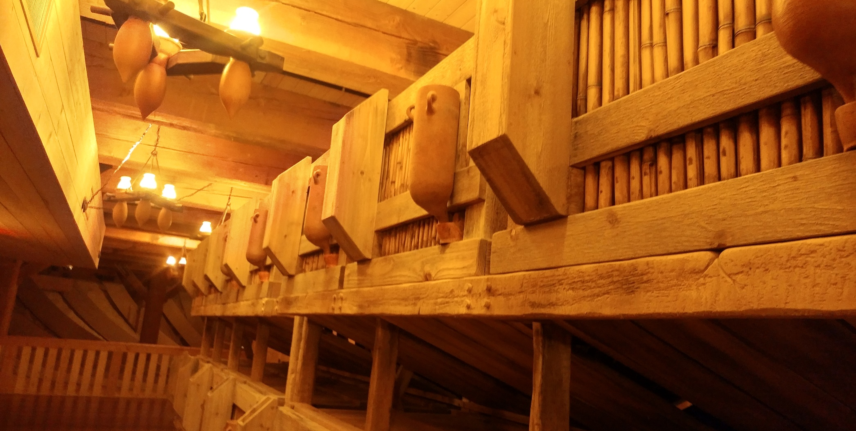
There were cages for small animals
¹⁹ You are to bring into the ark two of all living creatures, male and female, to keep them alive with you. ²⁰ Two of every kind of bird, of every kind of animal and of every kind of creature that moves along the ground will come to you to be kept alive.

Slide 19
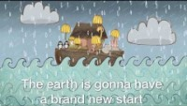

Slide 20
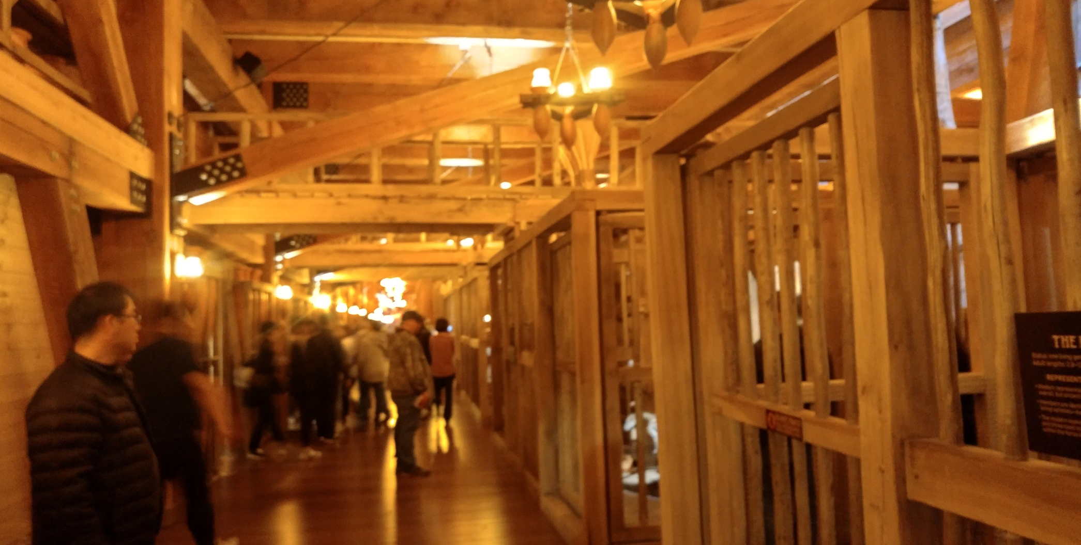
and cages for big animals!

Slide 21
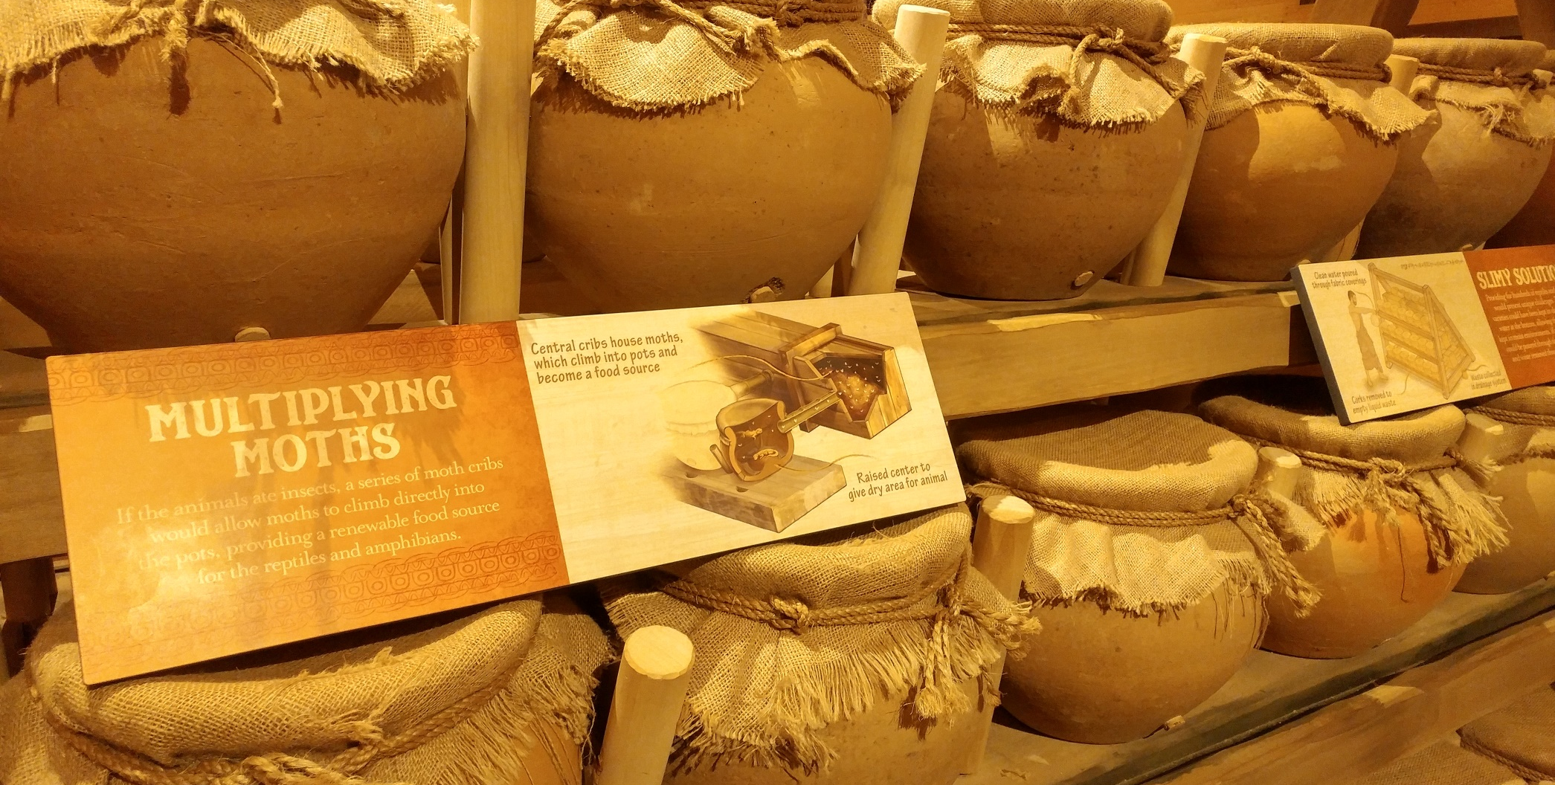
Places to keep food for the animals
²¹ You are to take every kind of food that is to be eaten and store it away as food for you and for them.”

Slide 22
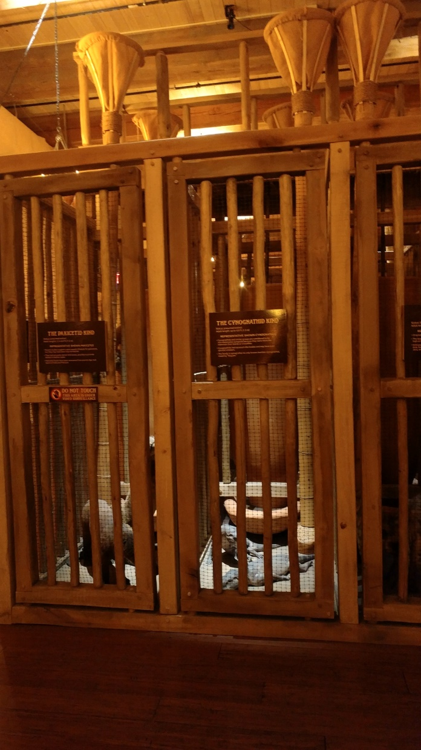
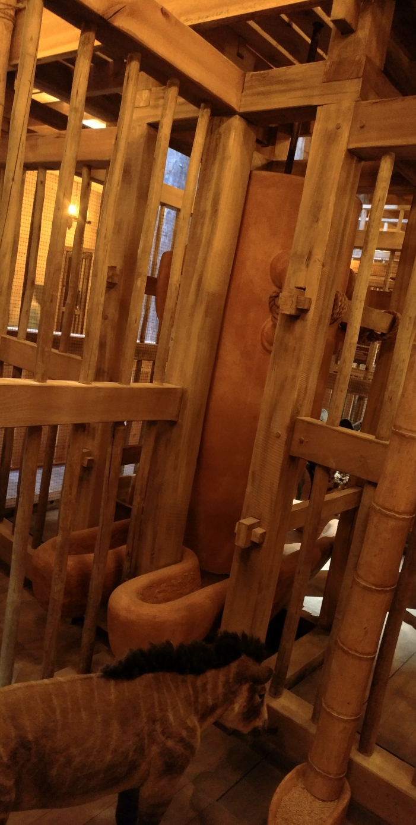
They had to have food and water

Slide 23
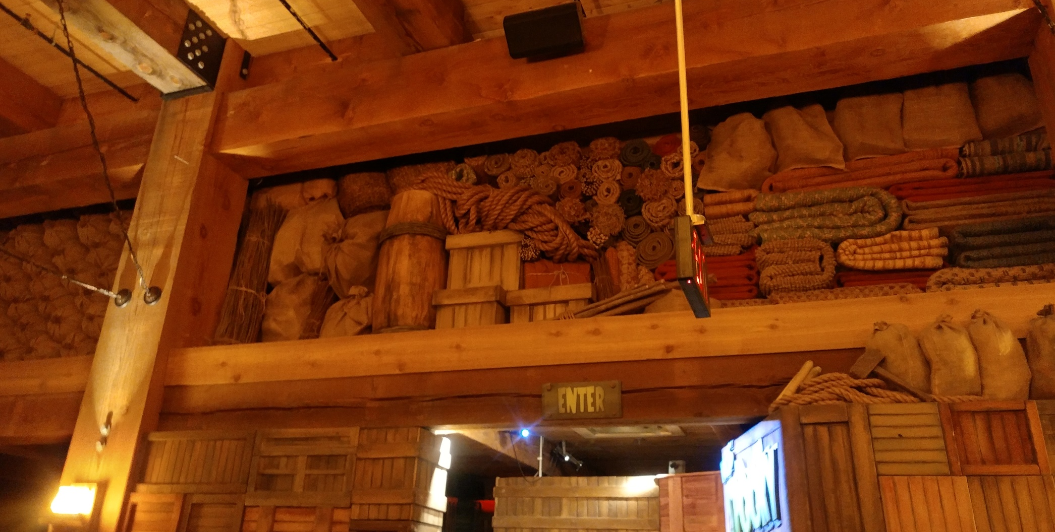
Noah and his family had to pack a LOT of things!

Slide 24
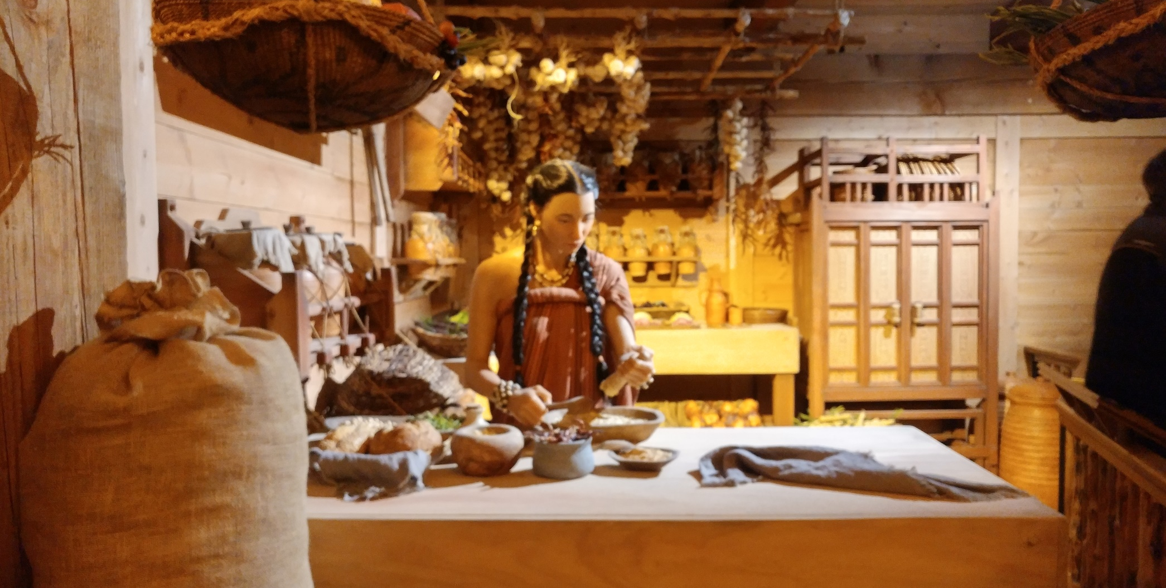
They needed a kitchen on the ark.

Slide 25
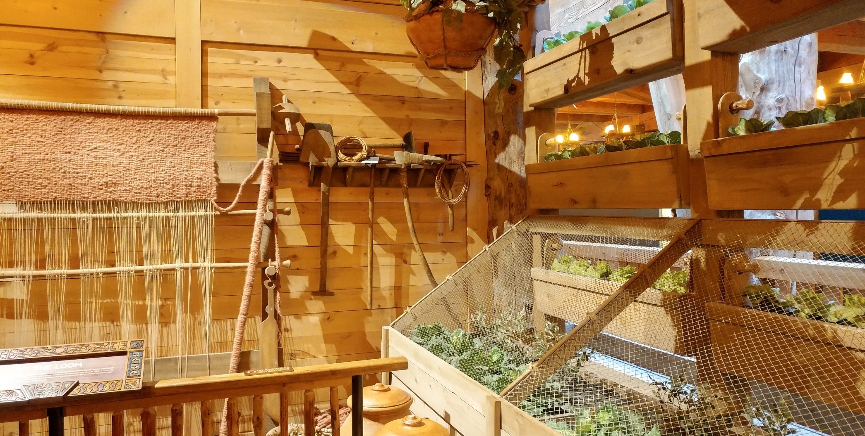
A place to grow fresh food would be nice.

Slide 26
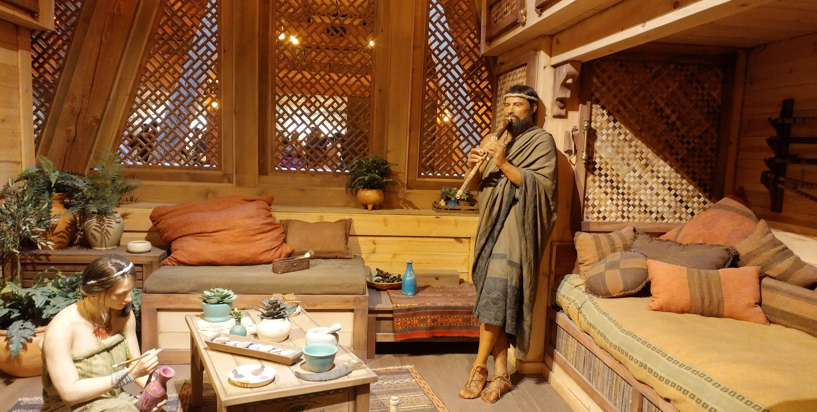
And they would need bedrooms and places to gather.

Slide 27
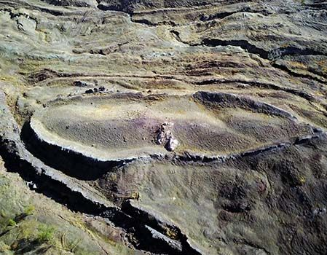
Some people think this looks like where the ark came to rest on Mt. Ararat

Slide 28


Slide 29
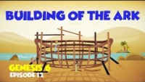

Slide 30
