Slide 1
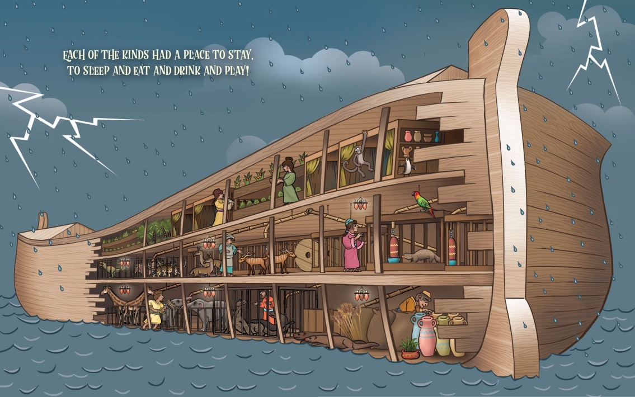
Noah’s Ark
Patiently
riding
out
the
storm
Part 3 In the Ark
Genesis 7:11 to 8:14

Slide 2
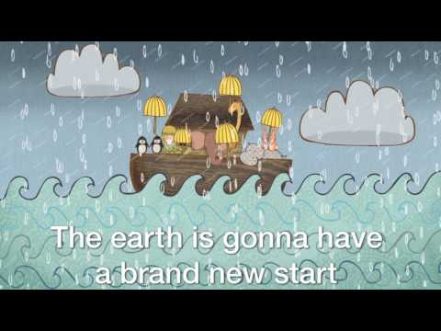
No One Knew God EXCET Noah knew God

Slide 3
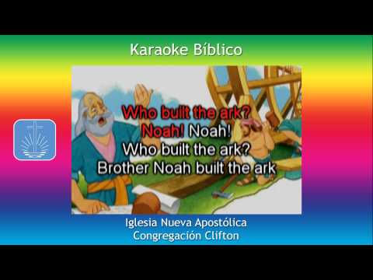

Slide 4
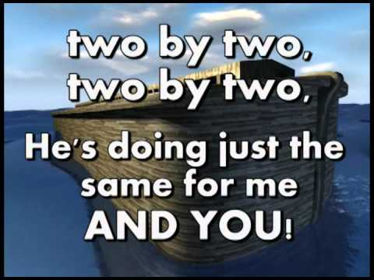

Slide 5

A Day in the Life of a Zookeeper

Slide 6
Galatians 6:9 (ERV)
We must not get tired of doing good. We will receive our harvest of eternal life at the right time. We must not give up.
Memory
Verse

Slide 7
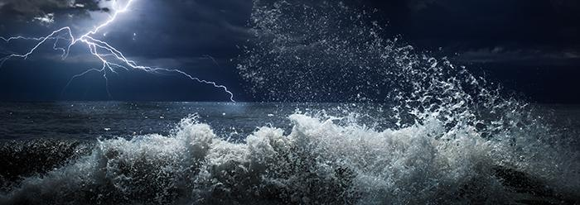
¹¹⁻¹³ On the 17th day of the second month, when Noah was 600 years old, the springs under the earth broke through the ground, and water flowed out everywhere. The sky also opened like windows and rain poured down. The rain fell on the earth for 40 days and 40 nights. That same day Noah went into the boat with his wife, his sons Shem, Ham, and Japheth, and their wives.

Slide 8
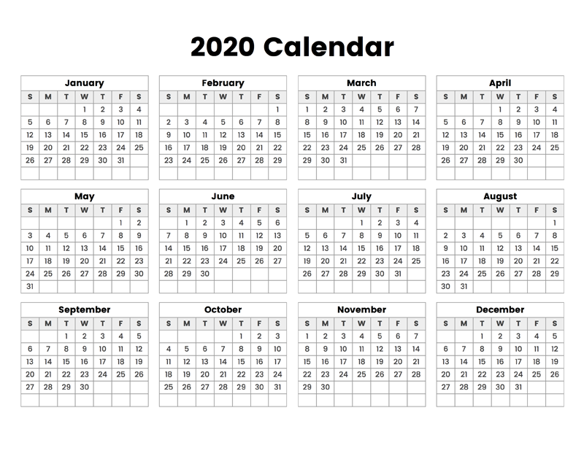
7 days – enter ark
40 days of rain
And they were still in the ark!

Slide 9
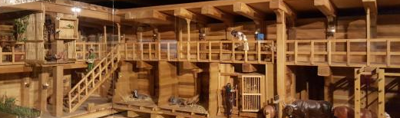
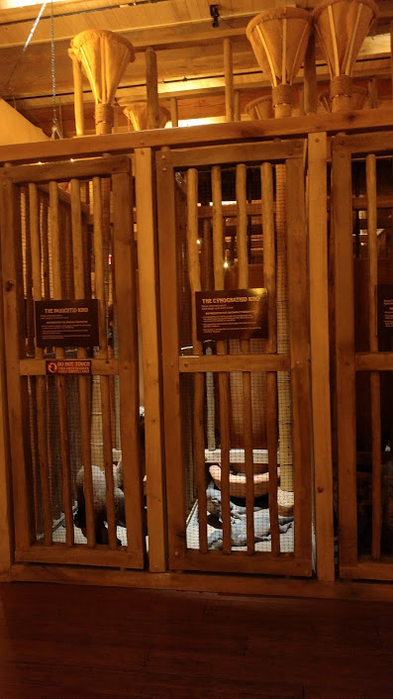
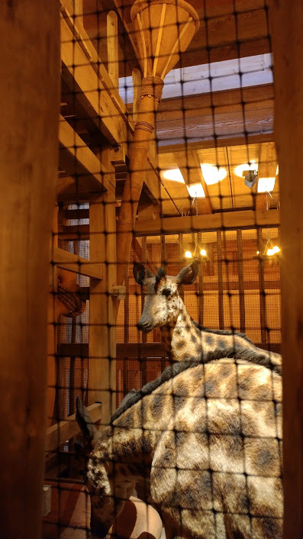
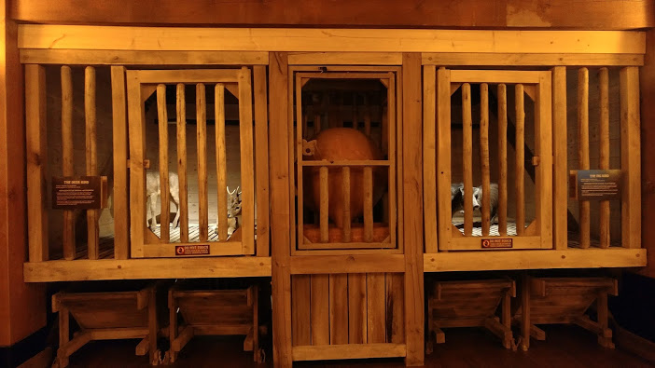
¹⁴ They and every kind of animal on the earth were in the boat. Every kind of cattle, every kind of animal that crawls on the earth, and every kind of bird were in the boat. ¹⁵ All these animals went into the boat with Noah. They came in groups of two from every kind of animal that had the breath of life. ¹⁶ All these animals went into the boat in groups of two, just as God had commanded Noah. Then the Lord closed the door behind Noah.

Slide 10
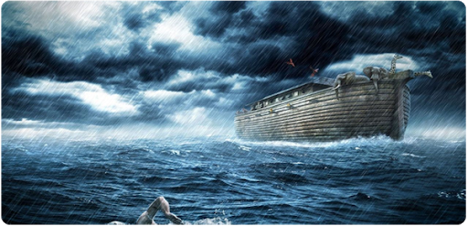
Genesis 7
¹⁷ Water flooded the earth for 40 days. The water began rising and lifted the boat off the ground. ¹⁸ The water continued to rise, and the boat floated on the water high above the earth. ¹⁹ The water rose so much that even the highest mountains were covered by the water. ²⁰ The water continued to rise above the mountains. The water was more than 20 feet^{[a]} above the highest mountain.

Slide 11
Genesis 7
²¹⁻²² Every living thing on earth died—every man and woman, every bird, and every kind of animal. All the many kinds of animals and all the things that crawl on the ground died. Every living, breathing thing on dry land died. ²³ In this way God wiped the earth clean—he destroyed every living thing on the earth—every human, every animal, everything that crawls, and every bird. All that was left was Noah and his family and the animals that were with him in the boat. ²⁴ The water continued to cover the earth for 150 days.

Slide 12
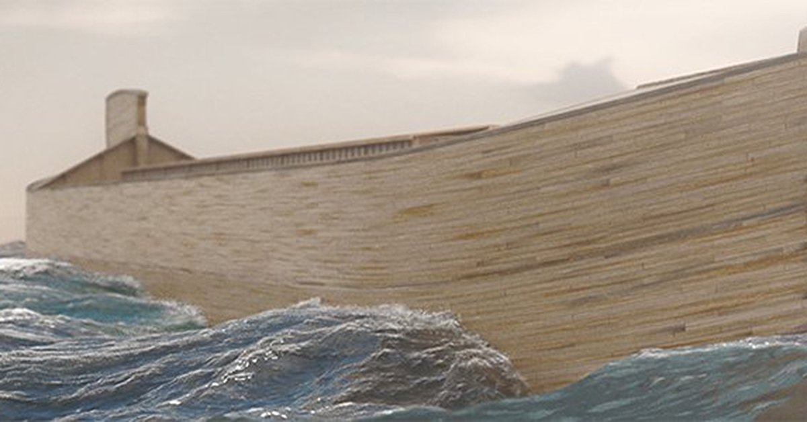
8 But God did not forget about Noah. God remembered him and all the animals that were with him in the boat. God made a wind blow over the earth, and all the water began to disappear.
² Rain stopped falling from the sky, and water stopped flowing from under the earth. ³⁻⁴ The water that covered the earth began to go down.

Slide 13
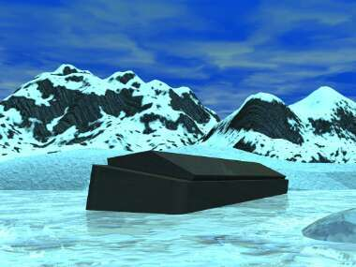
After 150 days the water was low enough that the boat touched land again. The boat stopped on one of the mountains of Ararat. This was the 17th day of the seventh month. ⁵ The water continued to go down, and by the first day of the tenth month, the tops of the mountains were above the water.

Slide 14
7 days – enter ark
40 days of rain
150 days water covered earth
Ark on Mt. Ararat
And they were still in the ark!

Slide 15
Psalms 46:1 (NLT)
ESV
God is our refuge and strength, a very present help in trouble.
A PROMISE
Isaiah 41:10 (NLT)
ESV
Don’t be afraid, for I am with you.
Don’t be discouraged, for I am your God.
I will strengthen you and help you.
I will hold you up with my victorious right hand.

Slide 16
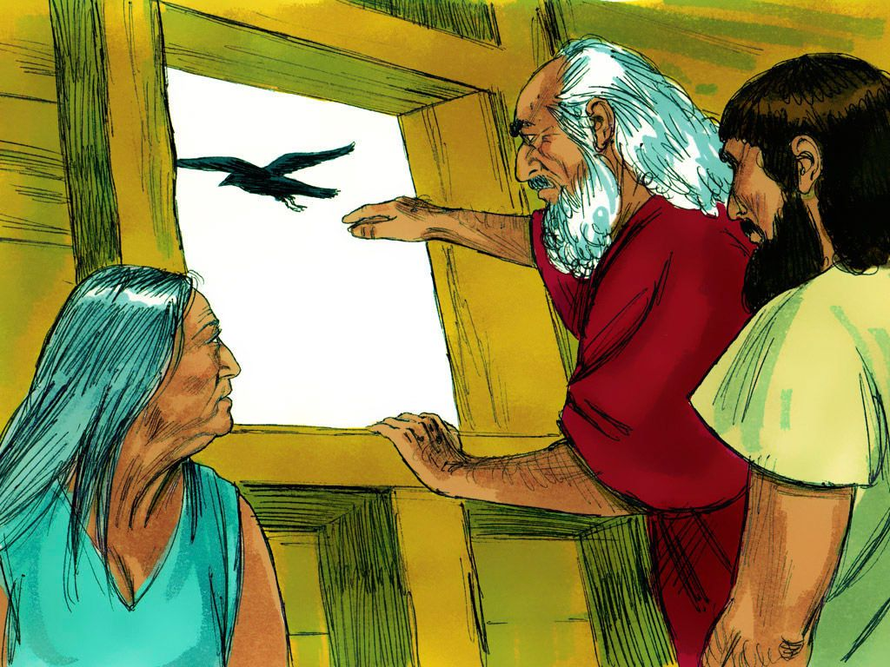
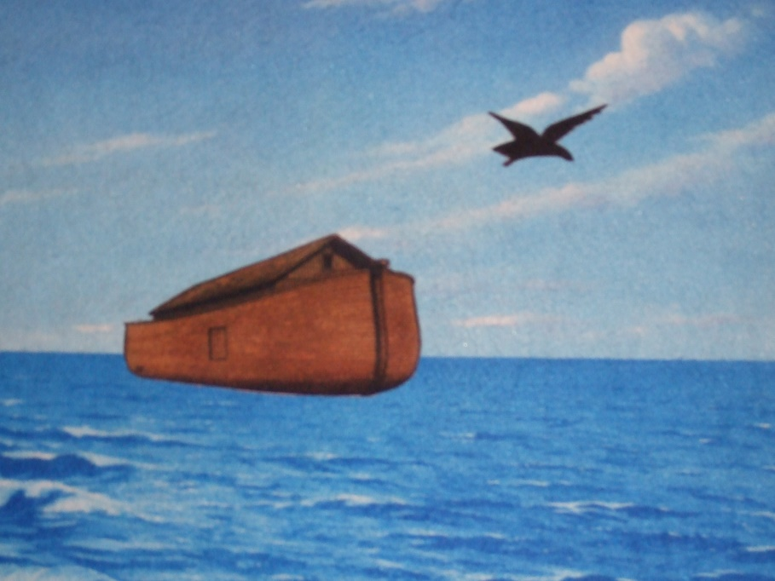
⁶ Forty days later Noah opened the window he had made in the boat. ⁷ Then he sent out a raven. The raven flew from place to place until the ground was dry and the water was gone.

Slide 17
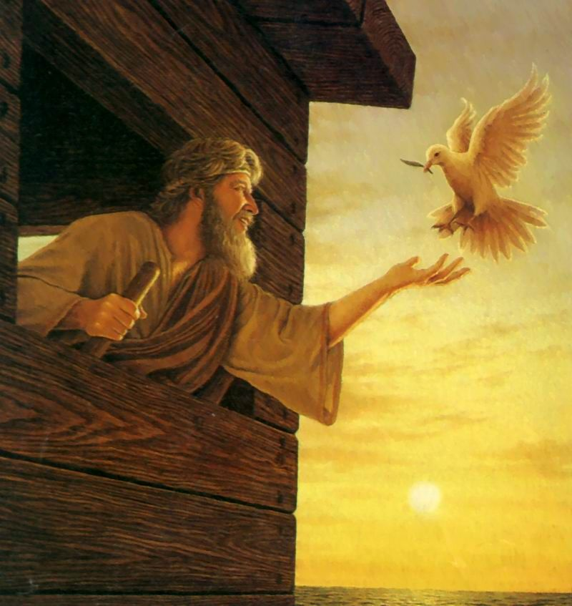
⁸ Noah also sent out a dove. He wanted it to find dry ground. He wanted to know if water still covered the earth.
⁹ The dove could not find a place to rest because water still covered the earth, so the dove came back to the boat. Noah reached out his hand and caught the dove and brought it back into the boat.
¹⁰ After seven days Noah again sent out the dove. ¹¹ And that afternoon the dove came back to Noah. The dove had a fresh olive leaf in its mouth. This was a sign to show Noah that there was dry ground on the earth. ¹² Seven days later Noah sent the dove out again. But this time the dove didn’t come back.

Slide 18


7 days – enter ark
40 days of rain
150 days water covered earth
Ark on Mt. Ararat
And they were still in the ark!

Slide 19
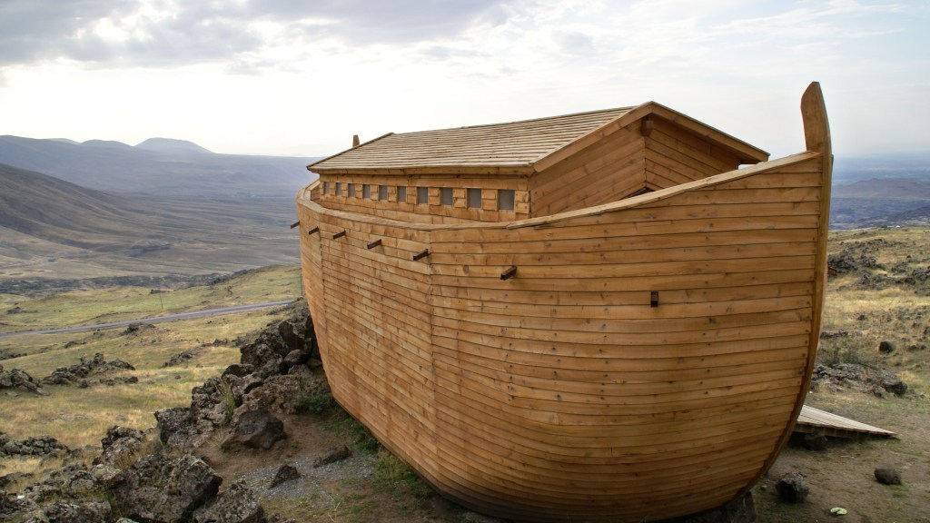
¹³ After that Noah removed the covering of the boat. He looked and saw that the ground was dry. This was the first day of the first month of the year. He was 601 years old. ¹⁴ By the 27th day of the second month, the ground was completely dry. ¹⁵ Then God said to Noah, ¹⁶ “Leave the boat. You, your wife, your sons, and your sons’ wives should go out now. ¹⁷ Bring every living animal out of the boat with you—all the birds, animals, and everything that crawls on the earth. These animals will make many more animals, and they will fill the earth again.”

Slide 20
7 days – enter ark
40 days of rain
150 days water covered earth
Ark on Mt. Ararat
And they were still in the ark!

Slide 21
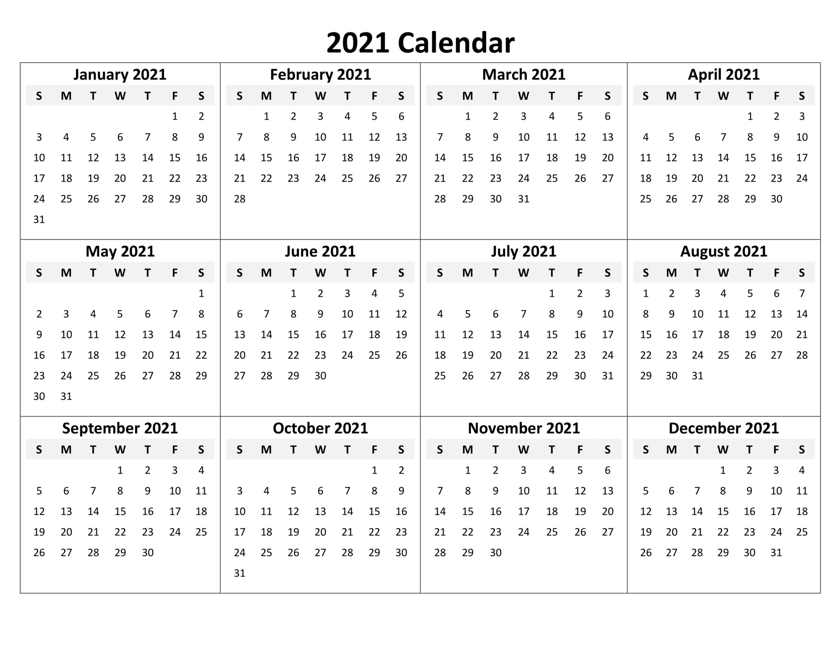


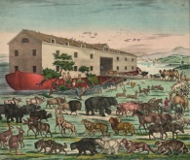
God said, now you and the animals can leave the ark!

Slide 22
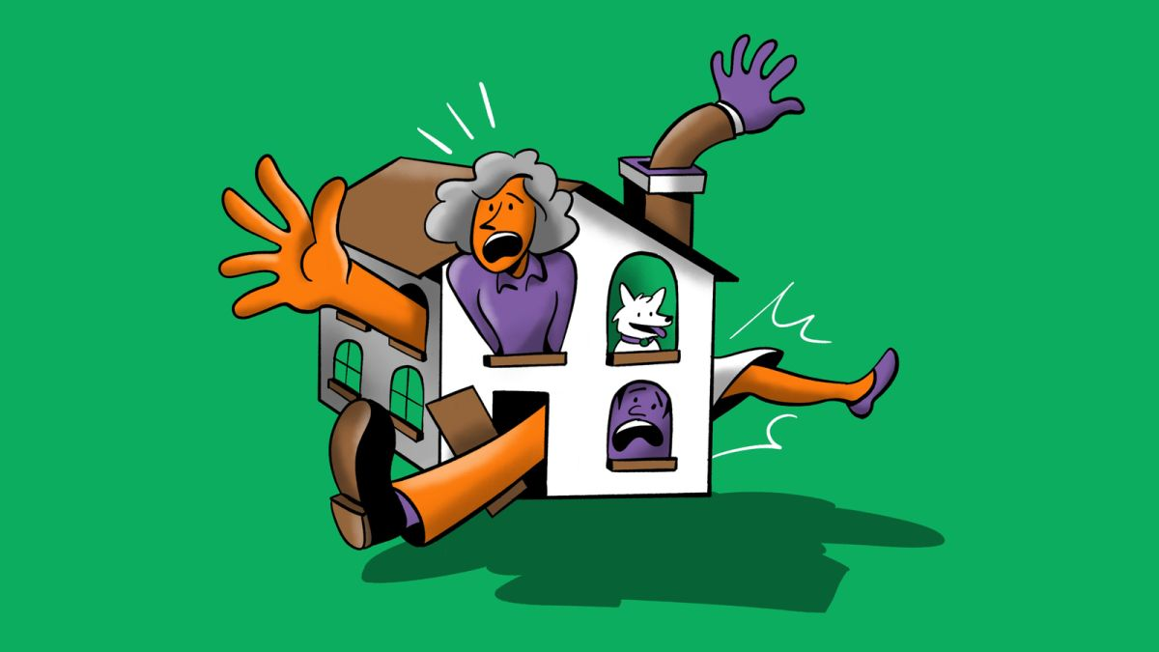

Noah and his family were in the ark for a full year!
Do you think they got ‘cabin fever’?
How do you think they felt being so close together for so long?

Slide 23

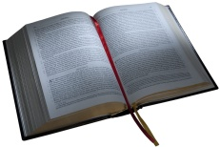
When we are anxious or frustrated, how can we calm down so that we can be loving and kind?
Psalms 94
Lord, great blessings belong to those you discipline,
to those you teach from your law.
¹³ You help them stay calm when trouble comes.
…¹⁴ The Lord will not leave his people.
He will not leave them without help.
¹⁵ Justice will return and bring fairness.
And those who want to do right will be there to see it….
¹⁸ I know I was ready to fall,
but, Lord, your faithful love supported me.
¹⁹ I was very worried and upset,
but you comforted me and made me happy!

Slide 24

Ephesians 4:2
Be completely humble and gentle; be patient, bearing with one another in love.
How do we show love to one another?
Leviticus 19:18
Forget about the wrong things people do to you. Don’t try to get even. Love your neighbor as yourself. I am the Lord.

Slide 25
Galatians 6:9 (ERV)
We must not get tired of doing good. We will receive our harvest of eternal life at the right time. We must not give up.
Memory
Verse

