Slide 1
Noah’s Ark
part 2
Animals come into the ark

Slide 2
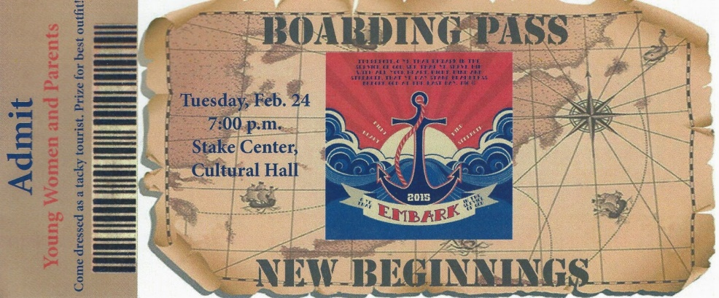
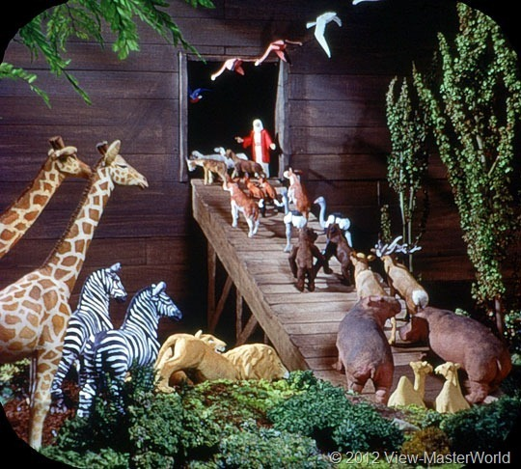
All Aboard!

Slide 3
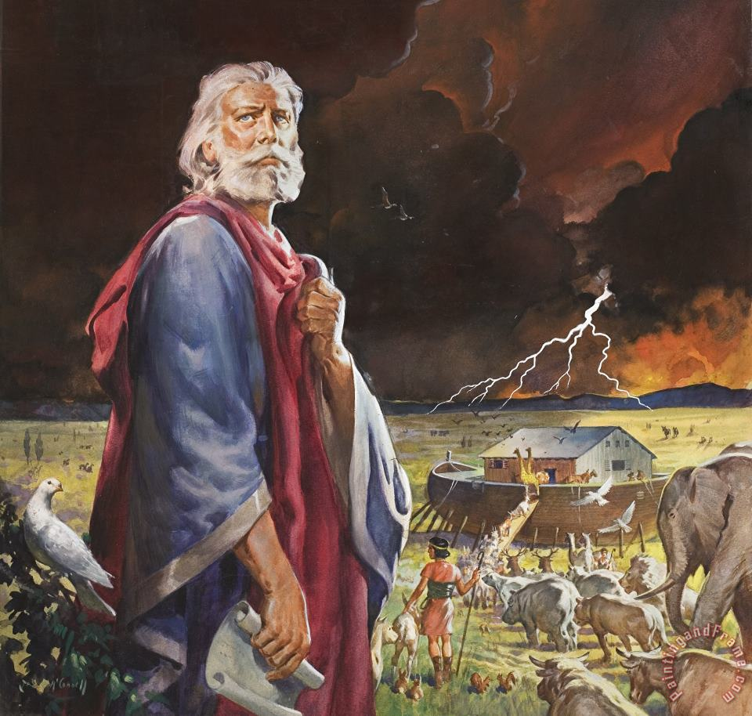
Who does right?
²⁷ Just be sure you live as God’s people in a way that honors the Good News of Christ. Then if I come and visit you or if I am away from you, I will hear good things about you. I will know that you stand together with the same purpose and that you work together like a team to help others believe the Good News. Philippians 1:27

Slide 4
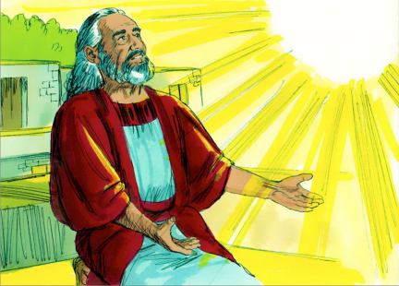
Genesis 7
The Flood Begins
7 Then the Lord said to Noah, “I have seen that you are a good man, even among the evil people of this time. So gather your family, and all of you go into the boat.
² Get seven pairs (seven males and seven females) of every kind of clean animal. And get one pair (one male and one female) of every other animal on the earth. Lead all these animals into the boat with you.
7 pairs (male & female) of each of the clean animals need to get on board.
1 pair of all the other animals need to get on board.
Now it is time to get in the boat.
So, go get your family
and go into the boat.
Get ready for the animals to come.
Noah. I have seen that you are a good man even when most everyone around you is evil. You have built the ark just like I told you to.

Slide 5
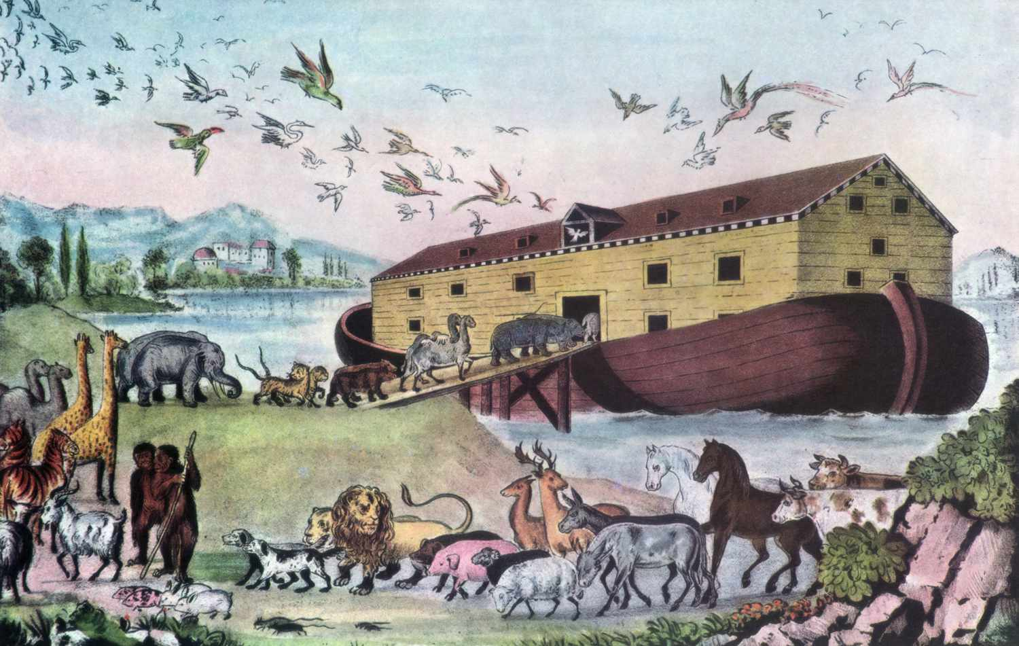
Genesis 7
The Flood Begins
7 Then the Lord said to Noah, ….
³ Get seven pairs (seven males and seven females) of all the birds. This will allow all these animals to continue living on the earth after the other animals are destroyed.
⁴ Seven days from now, I will send much rain on the earth. It will rain for 40 days and 40 nights, and I will wipe everything off the face of the earth. I will destroy everything I made.” ⁵ Noah did everything the Lord told him to do.
You have 1 week.
7 days from now I will send the rain.
It will rain for 40 days and 40 nights.
It will destroy the earth.
Also get 7 pairs (male & female)
of all the birds.
They will repopulate the earth.

Slide 6
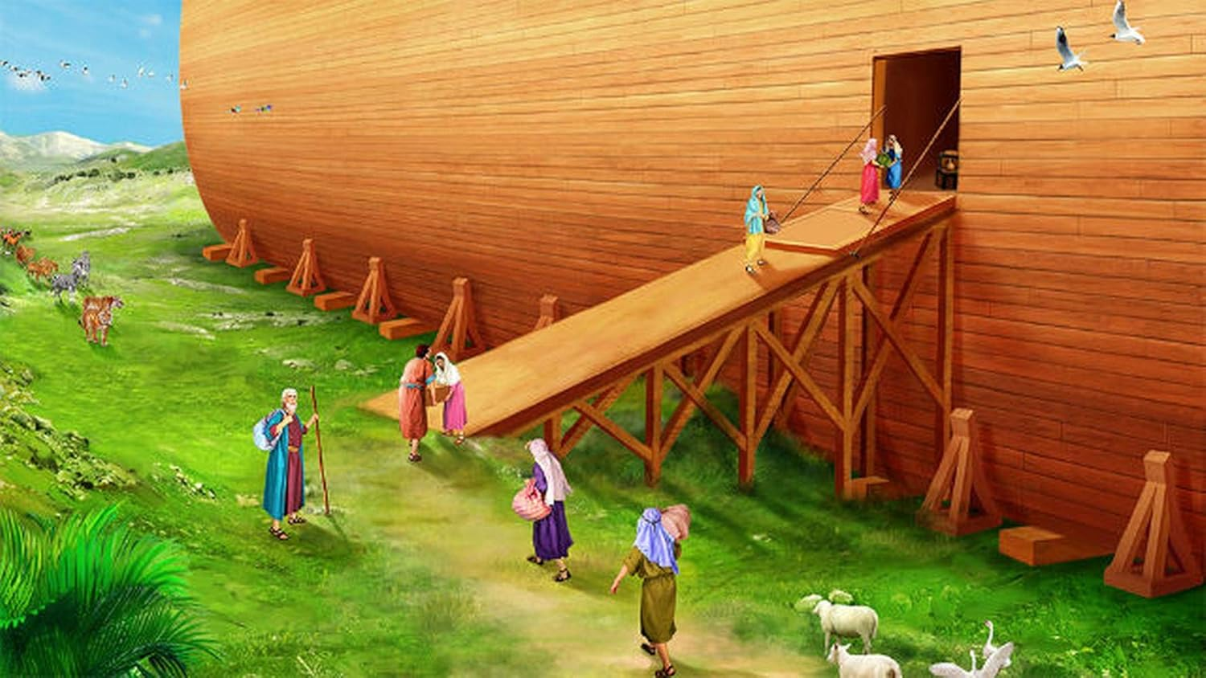
⁶ Noah was 600 years old at the time the rains came.
⁷ He and his family went into the boat to be saved from the flood. His wife and his sons and their wives were on the boat with him.
⁸ All the clean animals, all the other animals on the earth, the birds, and everything that crawls on the earth ⁹ went into the boat with Noah.

Slide 7
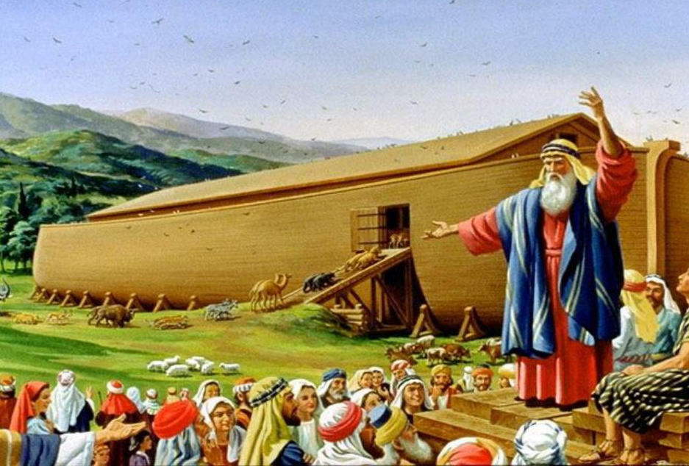
Soon there will be so much water!
There will be a gigantic flood! If you are not on the ark, you will die.
Please come and be saved!
Ha, ha, ha!
We will not die!
He is my God, the Rock I run to for protection. He is my shield; by his power I am saved. He is my hiding place, my place of safety, high in the hills. He is my savior, the one who rescues me from the cruel enemy. 2 Samuel 22:3

Slide 8
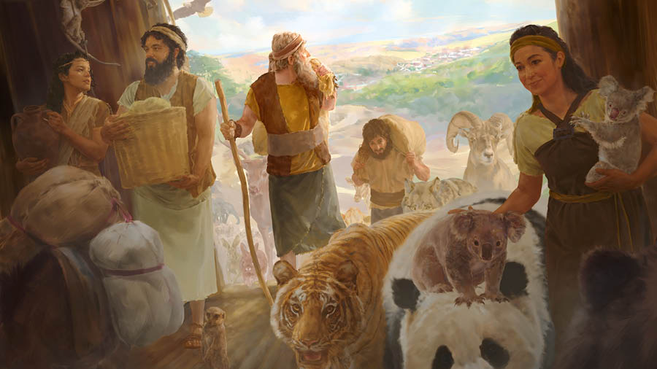
Genesis 7
¹¹ In the six hundredth year of Noah’s life, on the seventeenth day of the second month—on that day all the springs of the great deep burst forth, and the floodgates of the heavens were opened. ¹² And rain fell on the earth forty days and forty nights.
¹³ On that very day Noah and his sons, Shem, Ham and Japheth, together with his wife and the wives of his three sons, entered the ark. ¹⁴ They had with them every wild animal according to its kind, all livestock according to their kinds, every creature that moves along the ground according to its kind and every bird according to its kind, everything with wings. ¹⁵ Pairs of all creatures that have the breath of life in them came to Noah and entered the ark. ¹⁶ The animals going in were male and female of every living thing, as God had commanded Noah.
Soon it will rain.
Hurry!

Slide 9
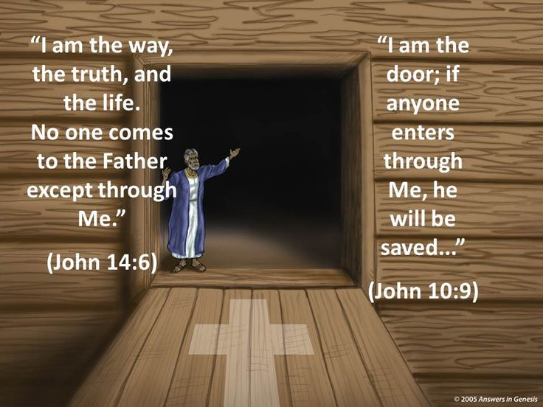
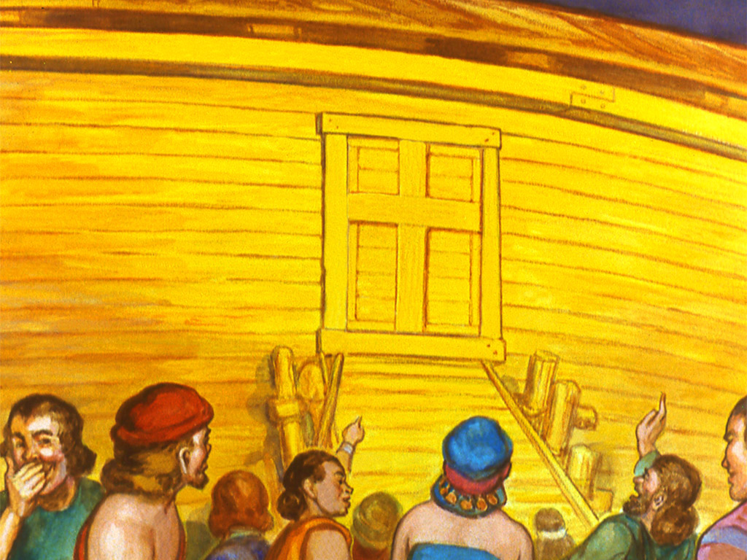
Then the Lord shut the door.
Noah’s family were safe in the ark.
The time to be saved was done.
Everyone had decided what they would do.

Slide 10

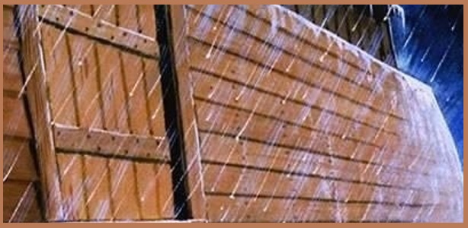

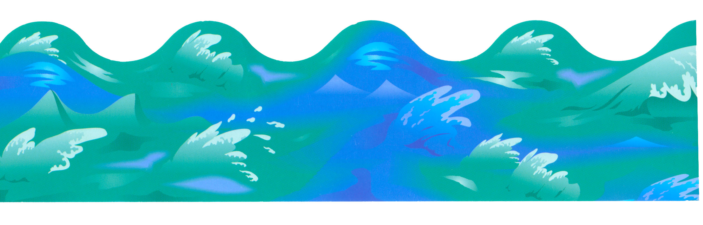
Genesis 7
That same day…
¹¹⁻¹³ On the 17th day of the second month, when Noah was 600 years old, the springs under the earth broke through the ground, and water flowed out everywhere. The sky also opened like windows and rain poured down. The rain fell on the earth for 40 days and 40 nights.

Slide 11
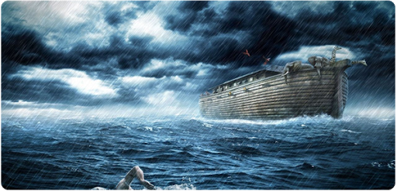
Genesis 7
¹⁷ Water flooded the earth for 40 days. The water began rising and lifted the boat off the ground. ¹⁸ The water continued to rise, and the boat floated on the water high above the earth. ¹⁹ The water rose so much that even the highest mountains were covered by the water. ²⁰ The water continued to rise above the mountains. The water was more than 20 feet^{[a]} above the highest mountain.

Slide 12
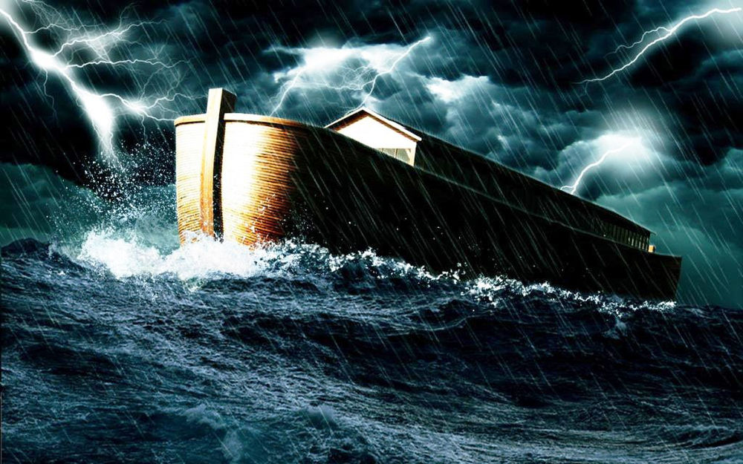
Genesis 7
²¹⁻²² Every living thing on earth died—every man and woman, every bird, and every kind of animal. All the many kinds of animals and all the things that crawl on the ground died. Every living, breathing thing on dry land died. ²³ In this way God wiped the earth clean—he destroyed every living thing on the earth—every human, every animal, everything that crawls, and every bird. All that was left was Noah and his family and the animals that were with him in the boat. ²⁴ The water continued to cover the earth for 150 days.

Slide 13





How long were they in the ark?
Let’s count the days it rained.

Slide 14
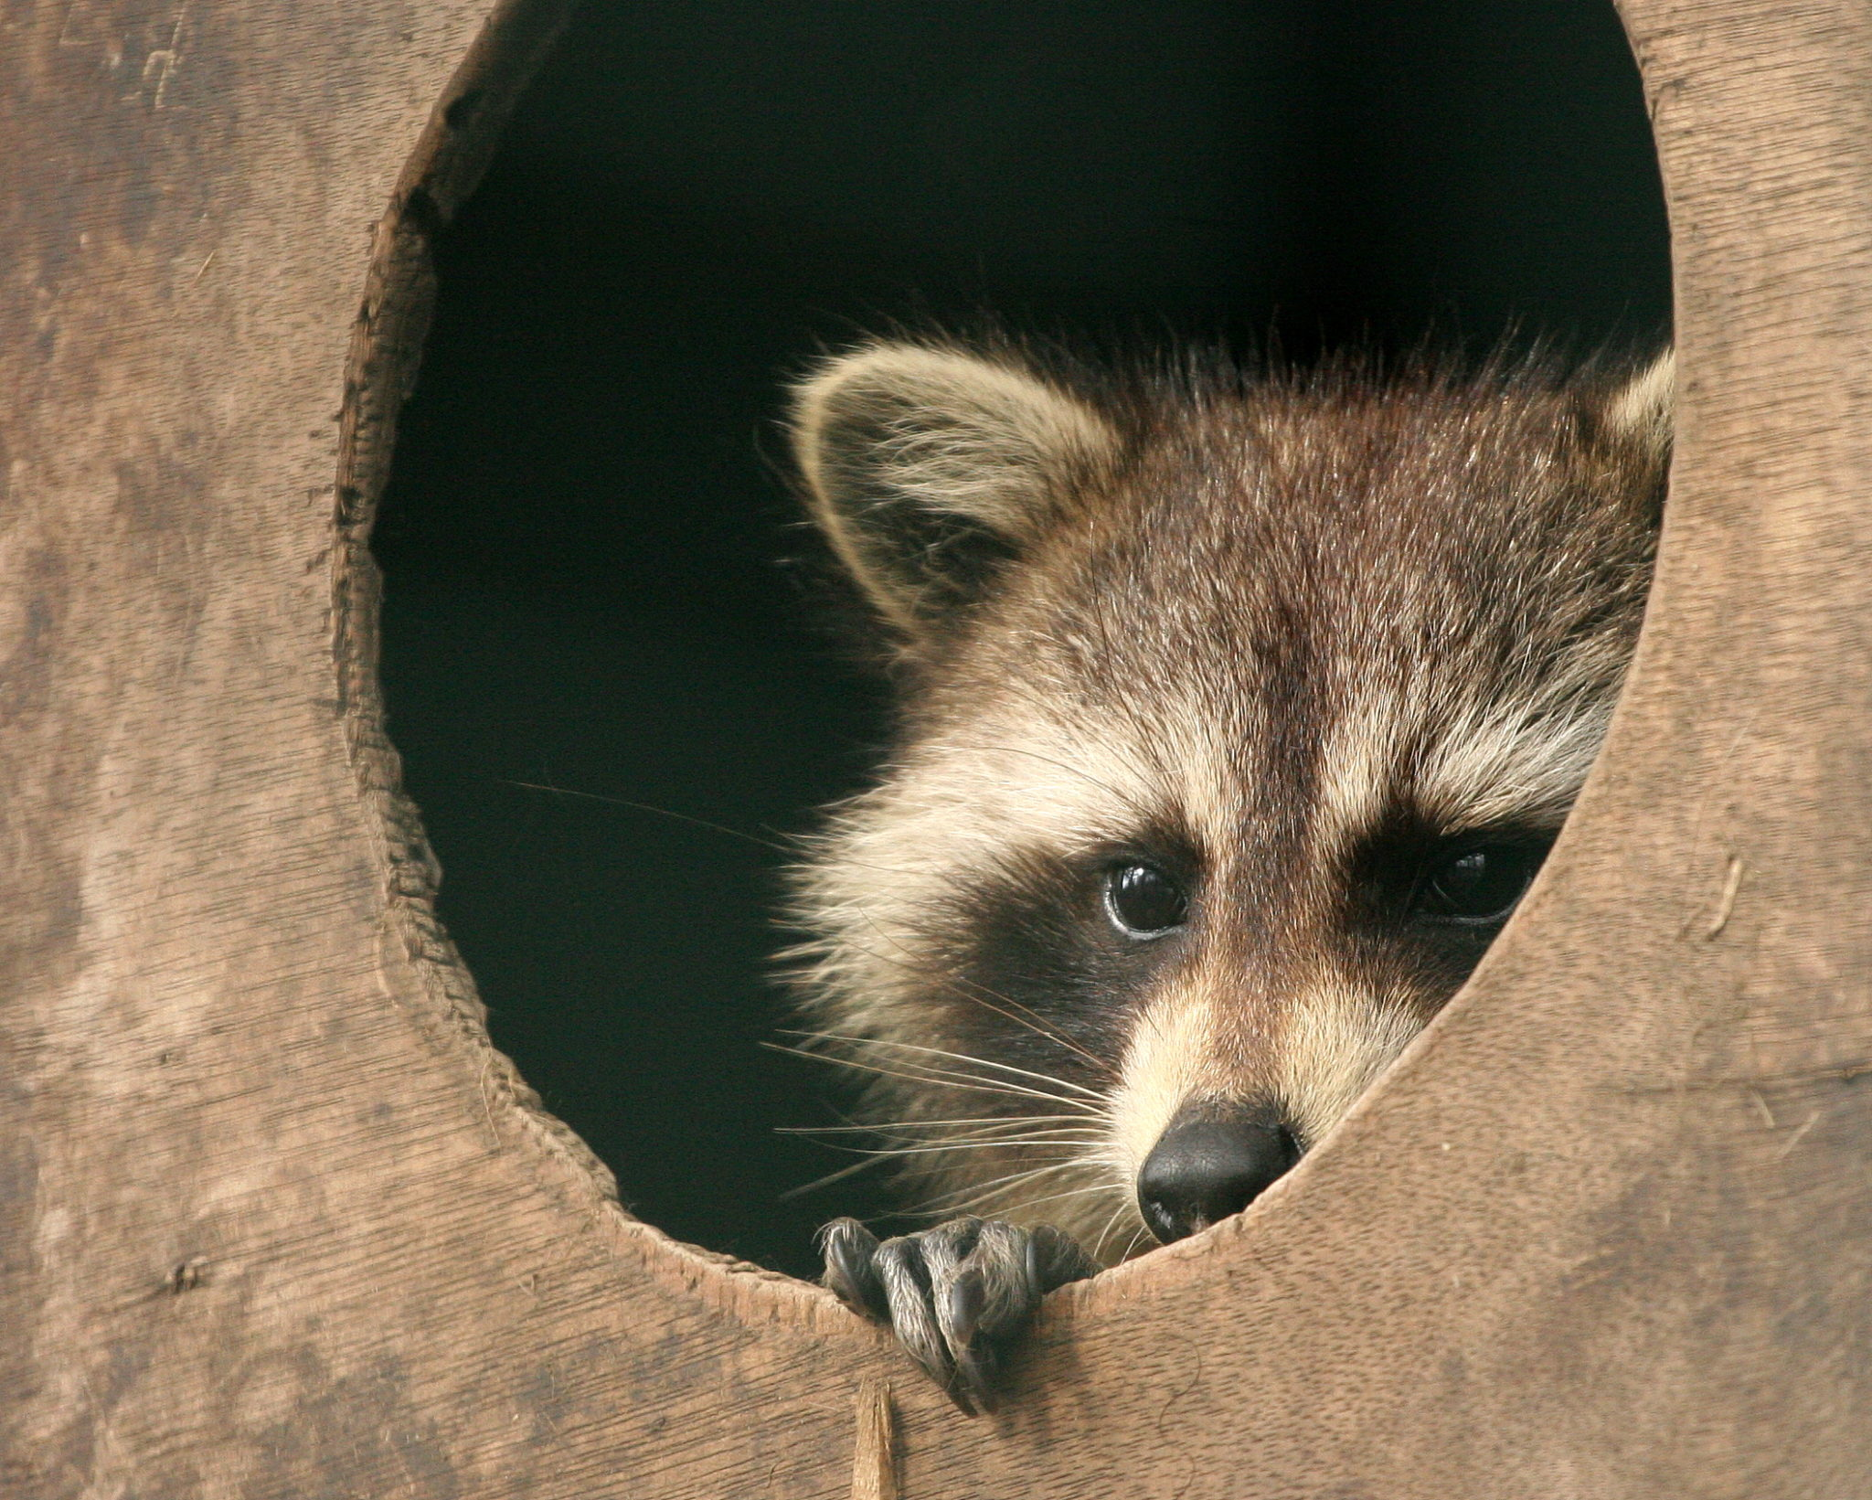
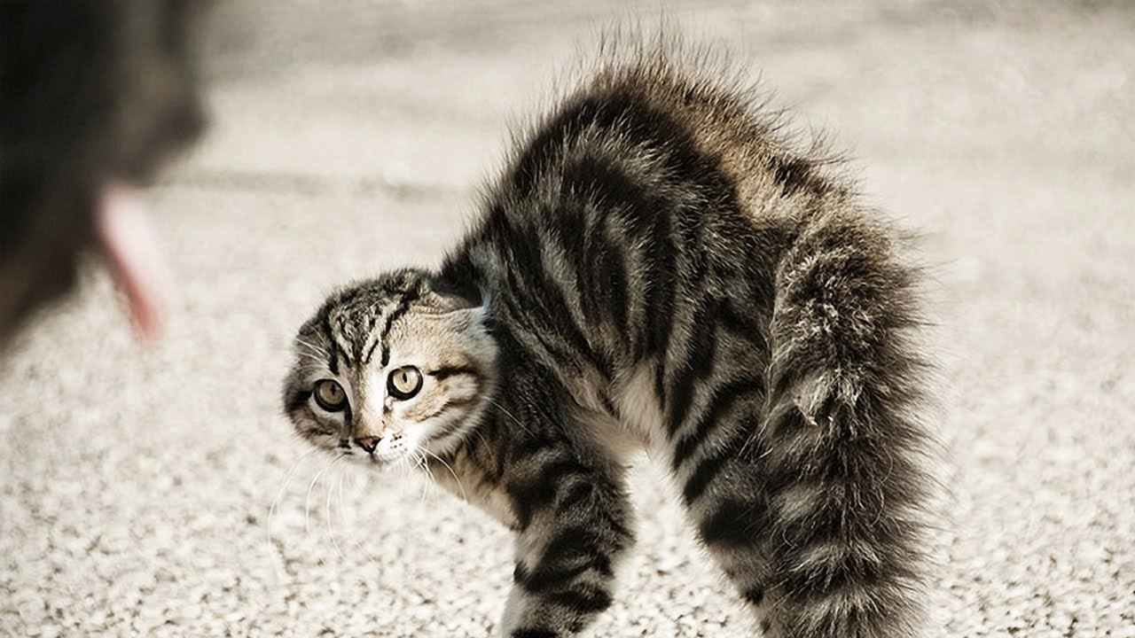

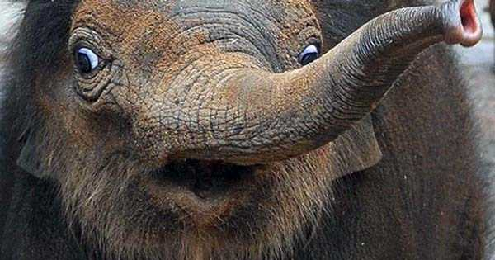
Noah and his family tried to take care of the animals.
Do you think the animals were scared?
Do you think they got sea sick?

Slide 15

Noah and his family still had to take care of the animals.
Do you think they got tired of their chores?
What is it like to be a zoo keeper?

Slide 16
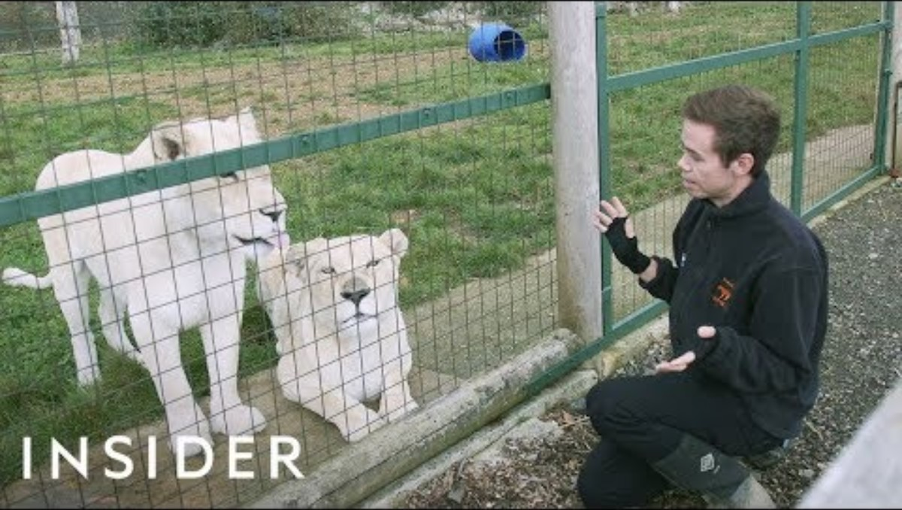
Noah and his family still had to take care of the animals.
Do you think it smelled nice?
What is it like to be a zoo keeper?

Slide 17
The water continued to cover the earth for 150 days.
Let’s count the days.

