Slide 1
Isaac & Rebecca Have Sons: Jacob and Esau
Genesis 25

Slide 2
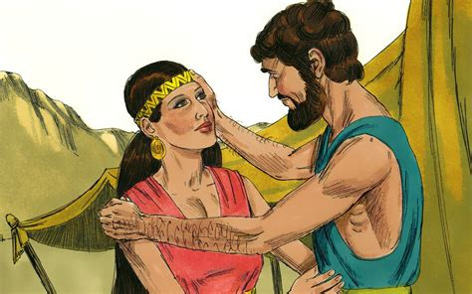
Genesis 25
Happy Anniversary, my love!
God has promised that our family will be as many as the stars in the sky.
I will pray that you will have a child soon.
Let’s pray now.
Dear LORD, we believe your promises.
Please give us a baby.
Amen.
Happy Anniversary Isaac! We’ve been married 20 years!
I just wish we had children. I want a baby!
¹⁹ This is the account of the family line of Abraham’s son Isaac.
Abraham became the father of Isaac, ²⁰ and Isaac was forty years old when he married Rebekah daughter of Bethuel the Aramean from Paddan Aram^{[c]} and sister of Laban the Aramean.
²¹ Isaac prayed to the Lord on behalf of his wife, because she was childless.

Slide 3


When you want something or don’t know something or have a problem, who do you talk to?
Do you have a prayer request?
Let’s talk to God.

Slide 4
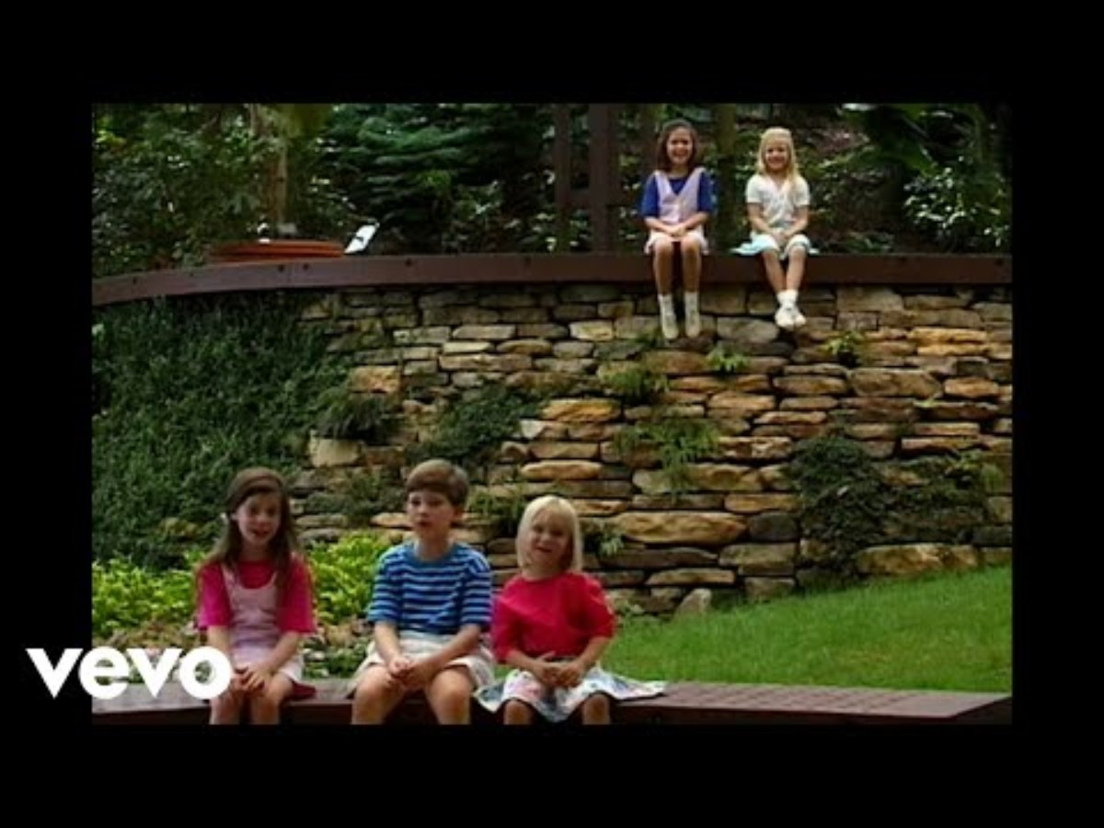
Whisper a Prayer

Slide 5
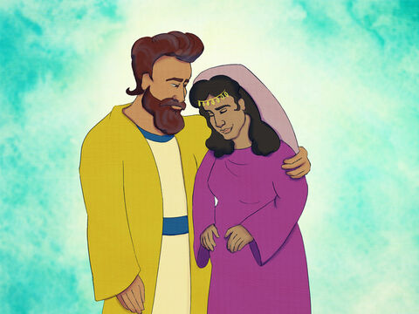
God answers prayer
God has answered
my prayer!
We’re going to have a baby!
Praise the LORD!
Thank you for praying.
The Lord answered his prayer, and his wife Rebekah became pregnant.

Slide 6
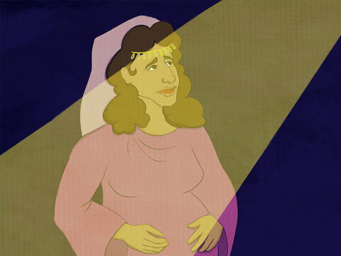
Why? God
LORD, there is so much movement! Why?
What is happening?
You have 2 babies within you.
They will become 2 nations.
One will be stronger.
The older will serve the younger.
²² The babies jostled each other within her, and she said, “Why is this happening to me?” So she went to inquire of the Lord.
²³ The Lord said to her,
“Two nations are in your womb, and two peoples from within you will be separated; one people will be stronger than the other, and the older will serve the younger.”

Slide 7
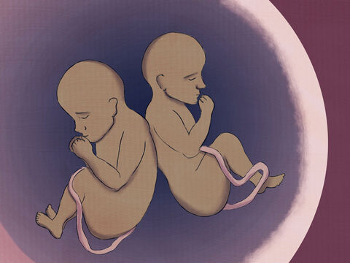
2 Babies
God designed you and me
²⁴ When the time came for her to give birth, there were twin boys in her womb.
Psalms 139
¹³ For you created my inmost being; you knit me together in my mother’s womb. ¹⁴ I praise you because I am fearfully and wonderfully made; your works are wonderful, I know that full well. ¹⁵ My frame was not hidden from you when I was made in the secret place, when I was woven together in the depths of the earth. ¹⁶ Your eyes saw my unformed body; all the days ordained for me were written in your book before one of them came to be. ¹⁷ How precious to me are your thoughts,^{[a]} God! How vast is the sum of them!

Slide 8

For we are God’s workmanship,
created in Christ Jesus to do good works,
which God prepared in advance, for us to do.
Ephesians 2:10
Ephesians
2:10

Slide 9

Ephesians 2:10

Slide 10

Psalms 139

Slide 11
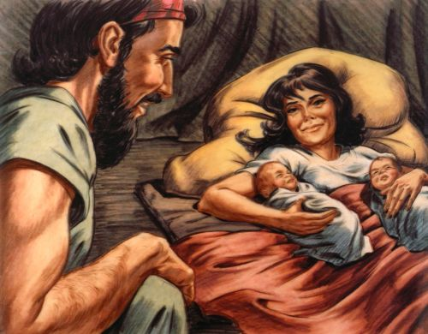
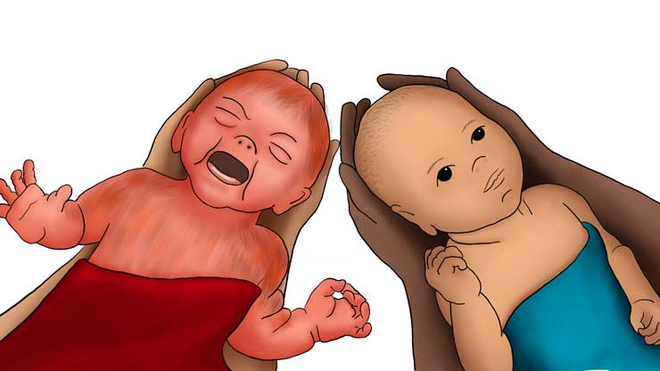
Jacob and Esau are born!
We’ll call the hairy one Esau. He was born first.
And the 2nd one who was clutching his heel, we’ll call Jacob.
²⁵ The first to come out was red, and his whole body was like a hairy garment; so they named him Esau.^{[d]}
²⁶ After this, his brother came out, with his hand grasping Esau’s heel; so he was named Jacob.^{[e]}
Isaac was sixty years old when Rebekah gave birth to them.

Slide 12
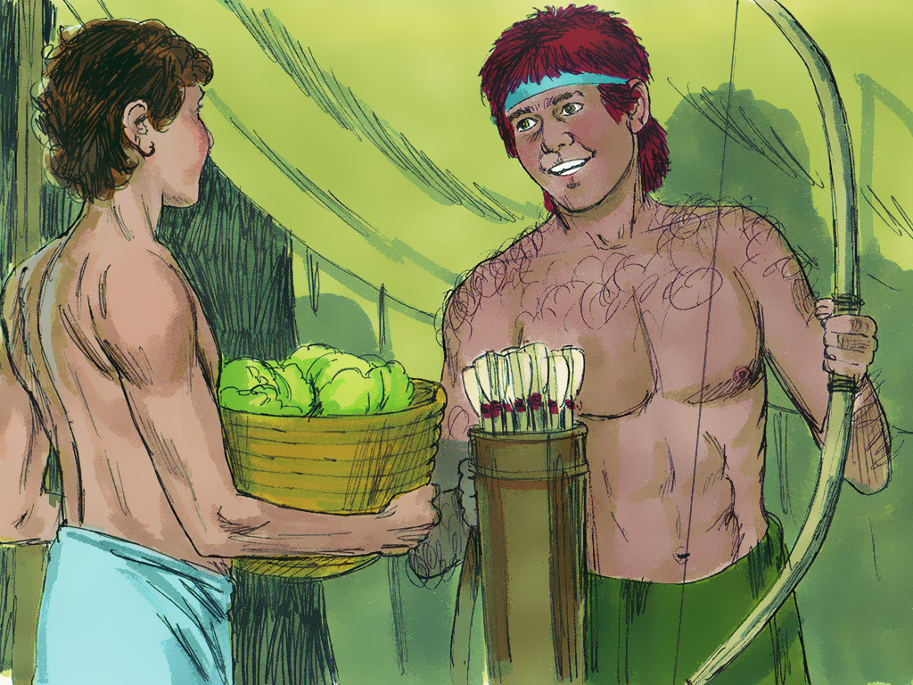
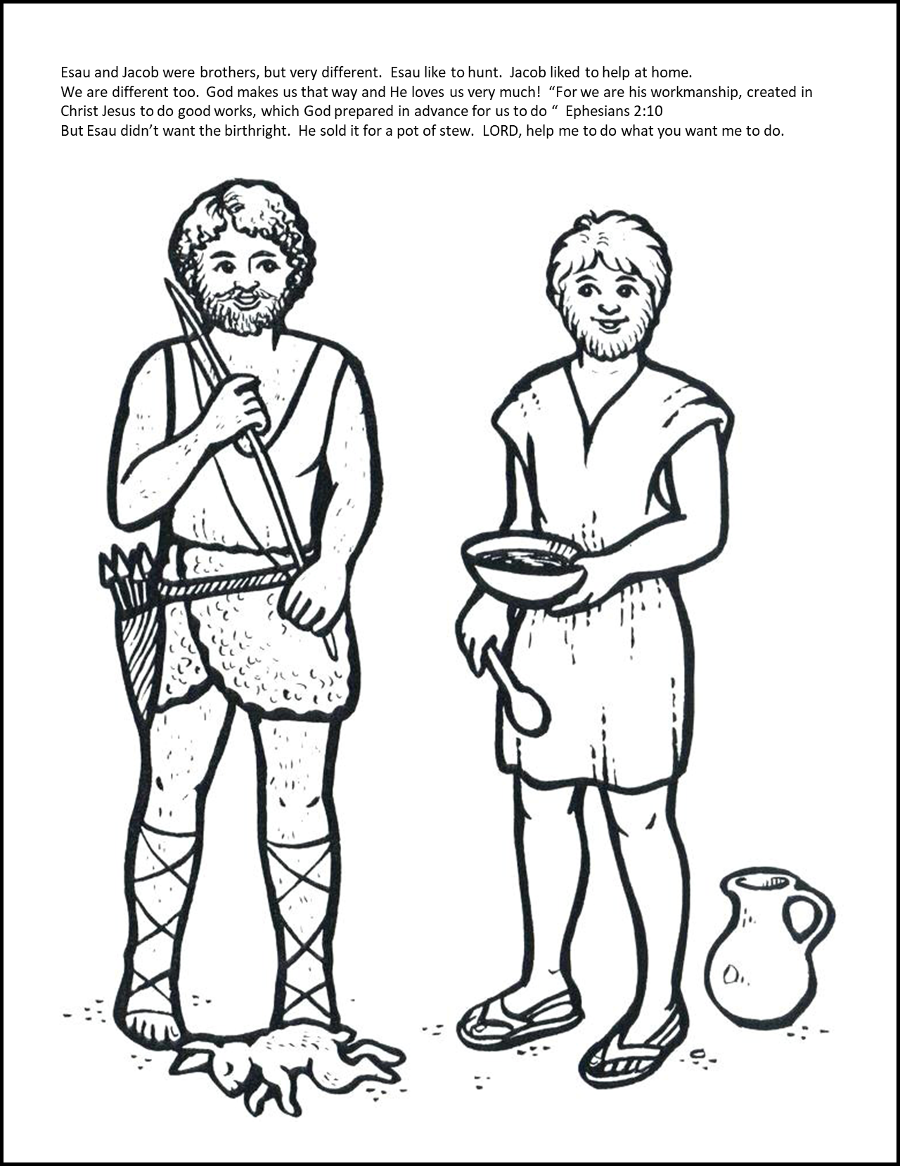
Two Boys
²⁷ The boys grew up, and
Esau became a skillful hunter, a man of the open country,
while Jacob was content to stay at home among the tents.

Slide 13
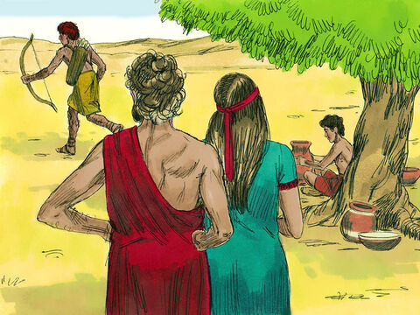
Proud parents
I’m so proud of Esau!
I’m looking forward some wild game for supper tonight!
I’m proud of Jacob!
He is so helpful!
Look at him making such beautiful pots!
²⁸ Isaac, who had a taste for wild game, loved Esau, but Rebekah loved Jacob.

Slide 14
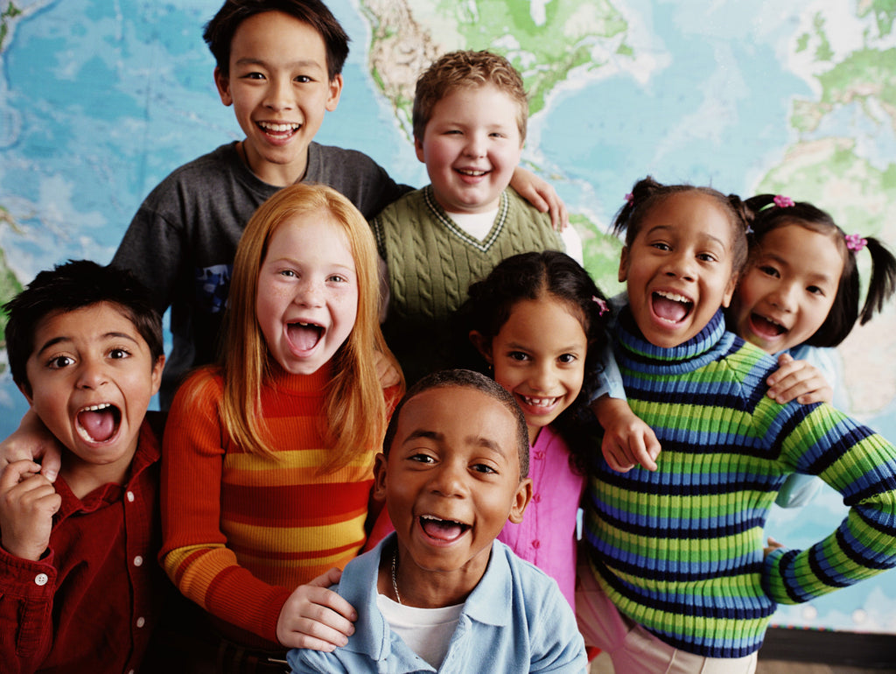
Each Unique
Two different brothers.
Each one unique.
God creates us that way and He loves each one of us very much!
Let’s play a game –
Would you rather
Everyone stand in the middle here.
I will say 2 different things and you will choose which one you would rather do.
I will point to the right and say 1 thing. If you would rather do that, then move to the right.
I will point to the left and say a 2nd thing. If you would rather do that, then move to the left.

Slide 15
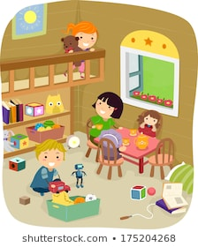

Would you rather …. ??
PLAY OUTSIDE
PLAY INSIDE

Slide 16
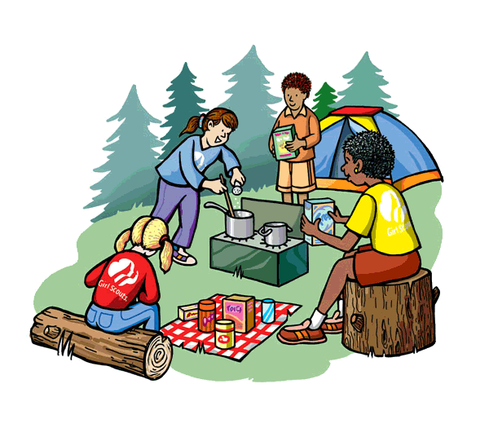

Would you rather …. ??
GO CAMPING & PICNIC
EAT AT HOME & SLEEP IN BED

Slide 17
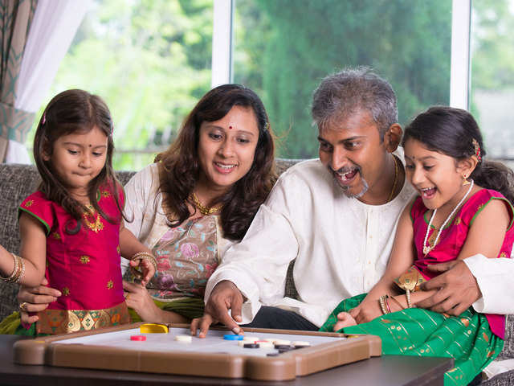
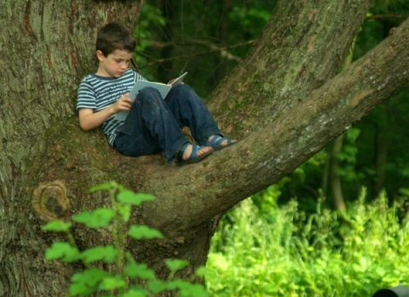

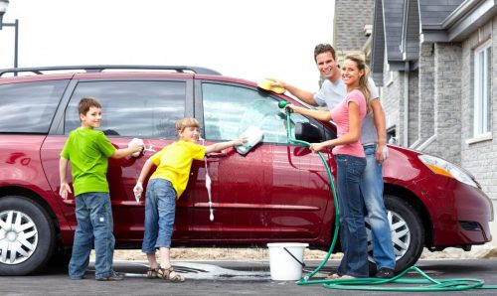
Would you rather …. ??
WORK AND PLAY TOGETHER
BE ALONE

Slide 18
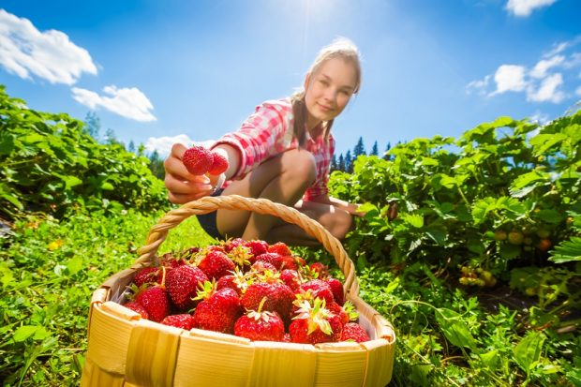
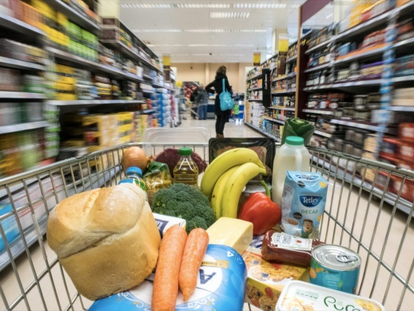
Would you rather …. ??
GROW FOOD IN A GARDEN
BUY FOOD AT THE STORE

Slide 19


Would you rather …. ??
BE A LEADER
FOLLOW SOMEONE ELSE

Slide 20

How are you different from your brothers and sisters?
Jacob and Esau were different.
We are different too.

Slide 21
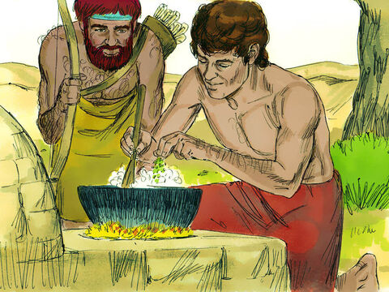
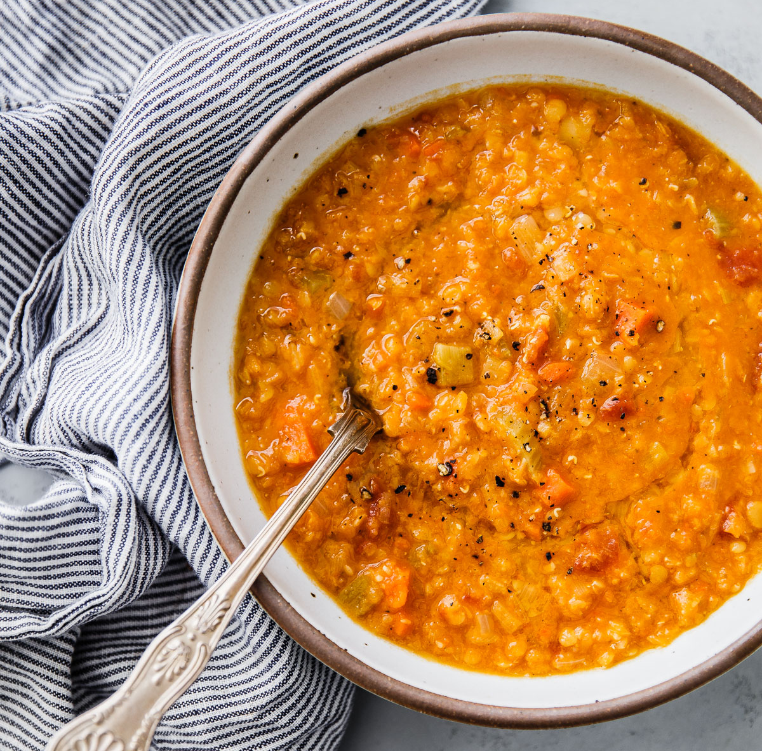
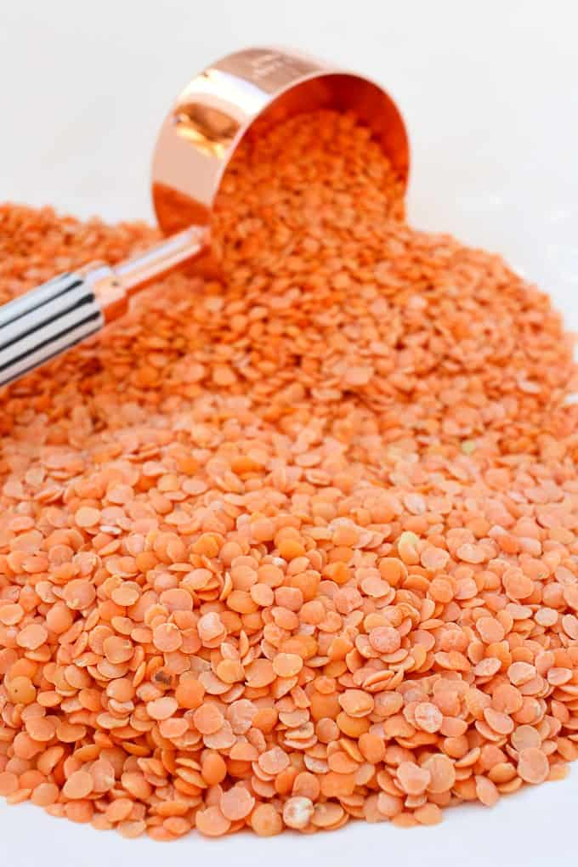
Red Lentil Stew
I’m STARVING!
Quick! Give me some of your red lentil stew!
Edom you really do like red, don’t you?!
²⁹ Once when Jacob was cooking some stew, Esau came in from the open country, famished.
³⁰ He said to Jacob, “Quick, let me have some of that red stew! I’m famished!” (That is why he was also called Edom.^{[f]})

Slide 22
Stew for birthright
Look, I’m about to die I’m so so very hungry!
What good is the birthright
to me?
First sell me your birthright.
OK whatever.
I promise before God that you can have the birthright given to the first born.
Promise before God, that you will give me the birthright and then I’ll give you some red stew.
I don’t care –
you can lead the family,
OK Thanks
I’ll dish you up some stew.
³¹ Jacob replied, “First sell me your birthright.”
³² “Look, I am about to die,” Esau said. “What good is the birthright to me?”
³³ But Jacob said, “Swear to me first.” So he swore an oath to him, selling his birthright to Jacob.

Slide 23

Birthrights
Take over dad’s responsibilities when he is gone.
Be responsible for protecting and providing for the family.
Be the family’s spiritual leader.
Make the rules and maintain law and order in the family.
Get a double portion of inheritance.

Slide 24
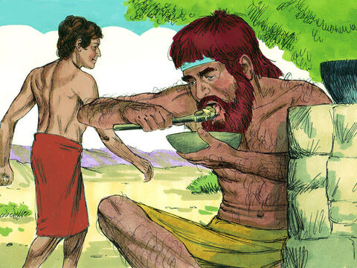
Bread & Stew
I would love to have the birthright responsibility.
I don’t want the responsibility!
I want to be free!
³⁴ Then Jacob gave Esau some bread and some lentil stew. He ate and drank, and then got up and left.
So, Esau despised his birthright.

Slide 25
For we are God’s workmanship,
created in Christ Jesus to do good works,
which God prepared in advance, for us to do.
Ephesians 2:10
Ephesians
2:10

Slide 26
Ephesians 2:10

Slide 27
Psalms 139

Slide 28
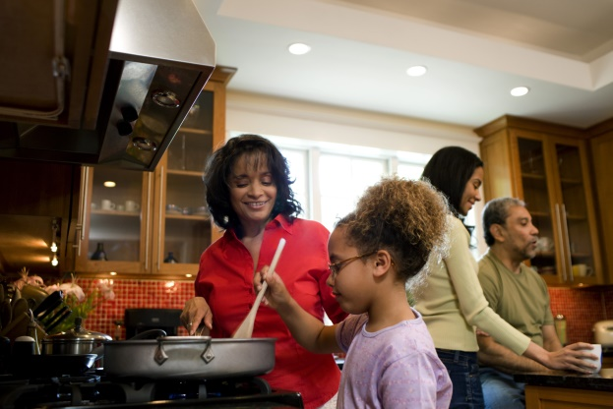
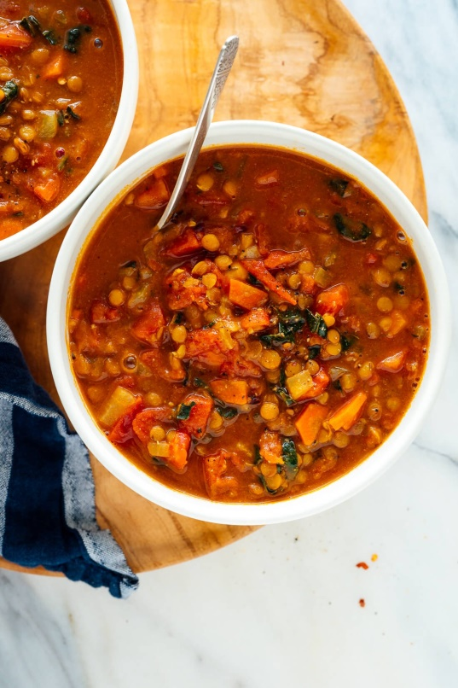

Family Activity
Lentil Stew
Basic Lentil Stew
Saute’ onions, celery, garlic
In a pot with oil.
Add rinsed lentils
Add vegetables such as:
Carrots, corn, greens, beans
Add stewed tomatoes and water to cover them.
Season with salt, onion, cumin, coriander, oregano
https://www.acouplecooks.com/lentil-stew/

Slide 29

https://activity-array.com/

