Slide 1
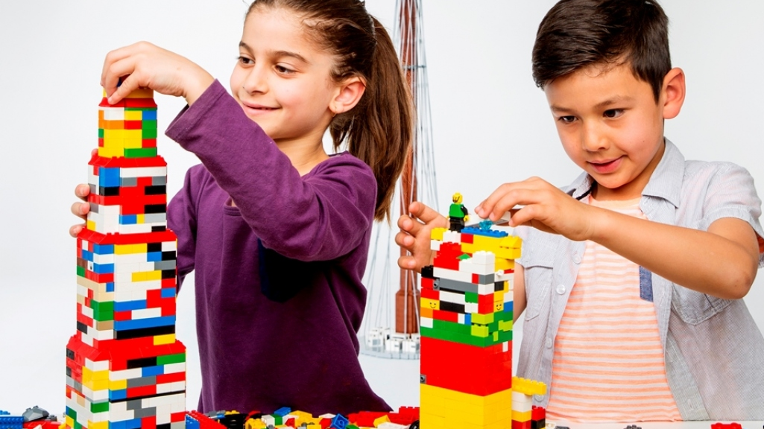
Confusion at the Tower of Babel
Genesis 11:1-9

Slide 2
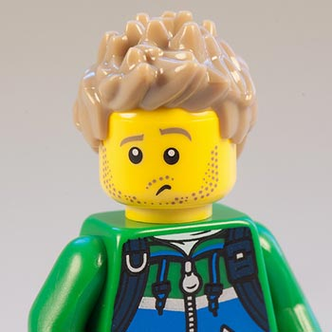
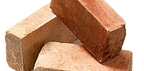
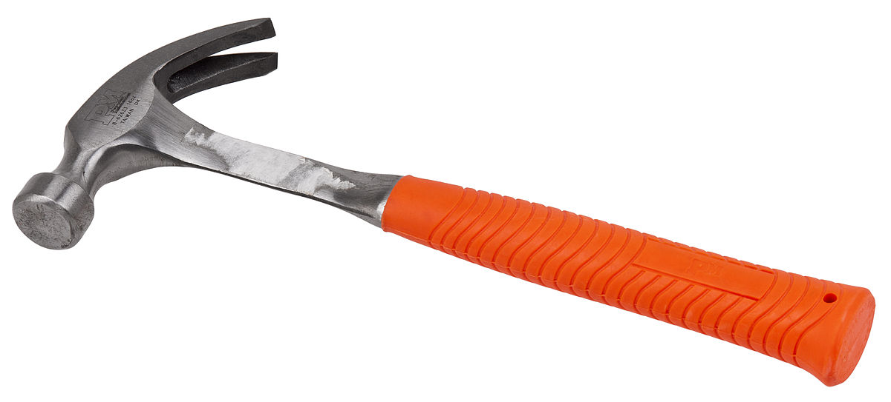
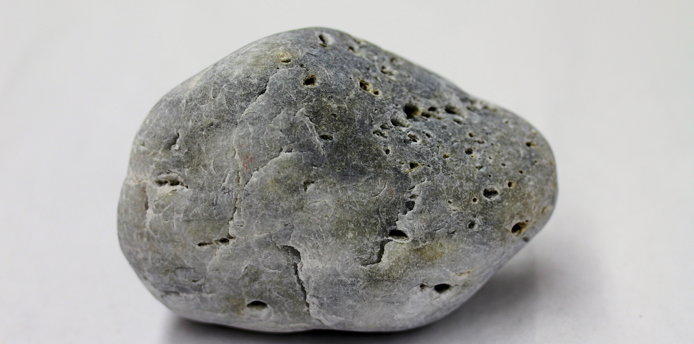
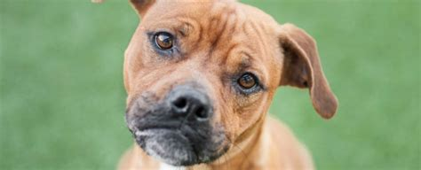
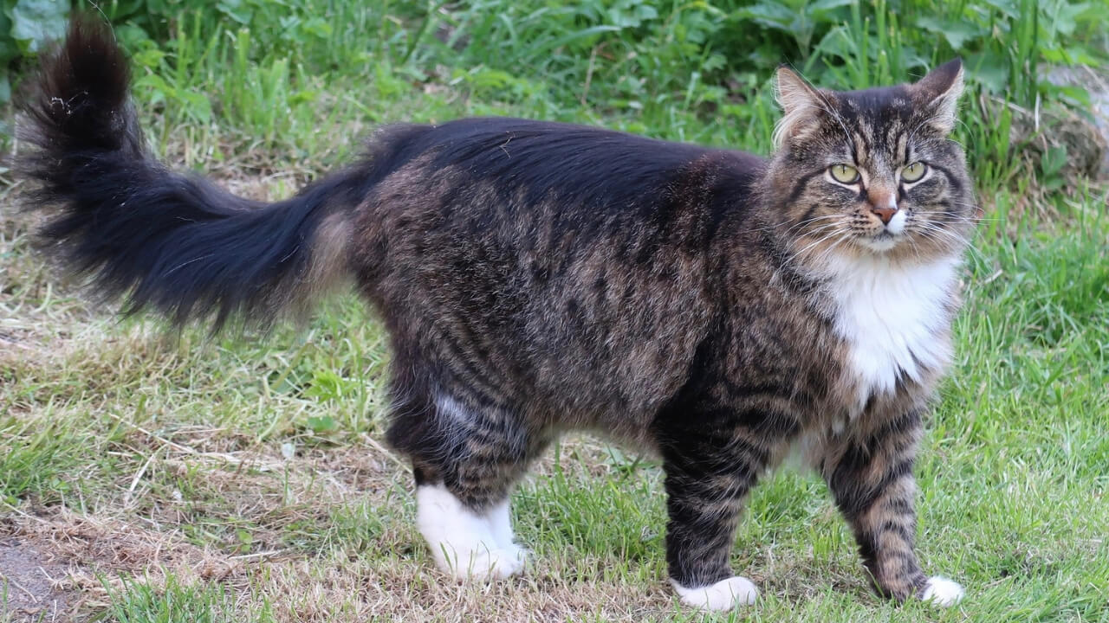
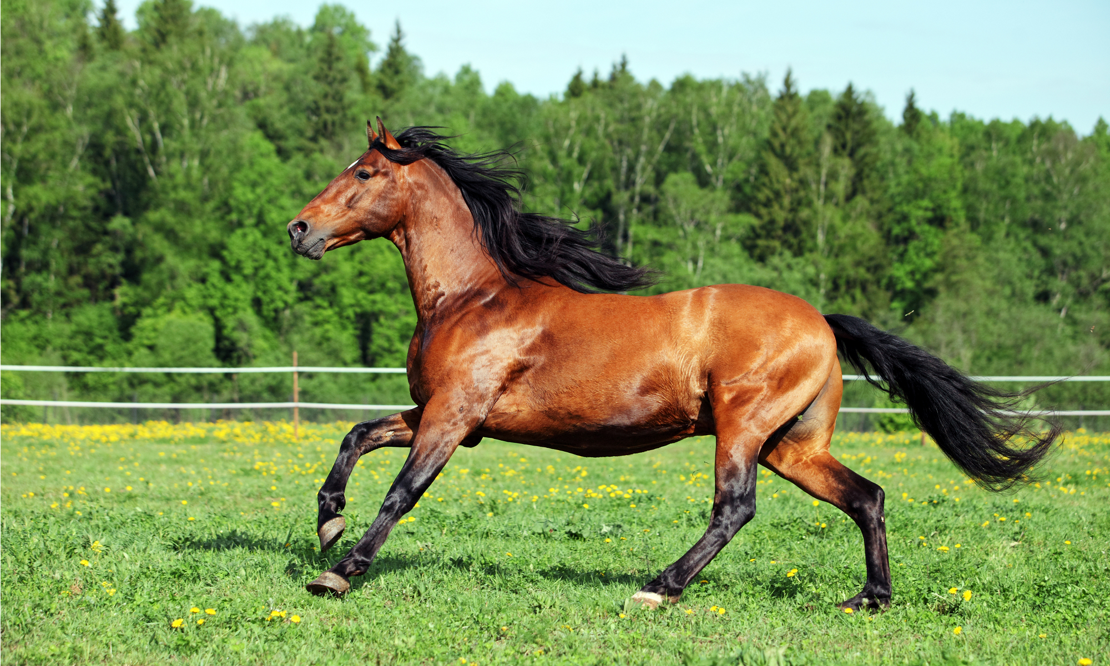
What does it mean?
I have no idea what they are saying or what language they are using.
El ladrillo
marteau
stein
hond
kot
konj

Slide 3

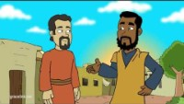
STORY TIME

Slide 4
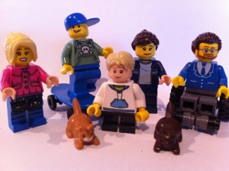
“I now realize how true it is that God does not show favoritism but accepts from every nation the one who fears him and does what is right
Peter said this after God told him to go with some soldiers from Caesarea.
They wanted to know more about Jesus and God’s gift of salvation.
Acts 10:34-35

Slide 5

SING-A-LONG

Slide 6

SING-A-LONG
Jesus Loves Me

Slide 7
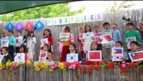
SING-A-LONG
Jesus Loves Me

Slide 8

SING-A-LONG

Slide 9
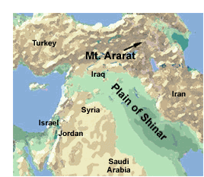
Confusion at the Tower of Babel
Genesis 11
Now the whole world had one language and a common speech. ² As people moved eastward,^{[a]} they found a plain in Shinar^{[b]} and settled there.

Slide 10
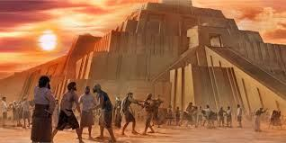
Let’s build a city and a tower.
Let’s make a name for ourselves.
³ They said to each other, “Come, let’s make bricks and bake them thoroughly.” They used brick instead of stone, and tar for mortar. ⁴ Then they said, “Come, let us build ourselves a city, with a tower that reaches to the heavens, so that we may make a name for ourselves; otherwise we will be scattered over the face of the whole earth.”

Slide 11
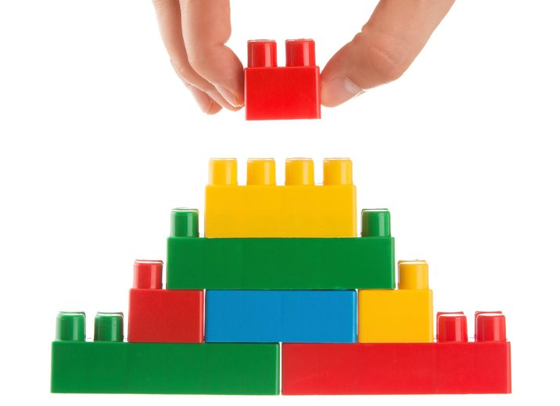
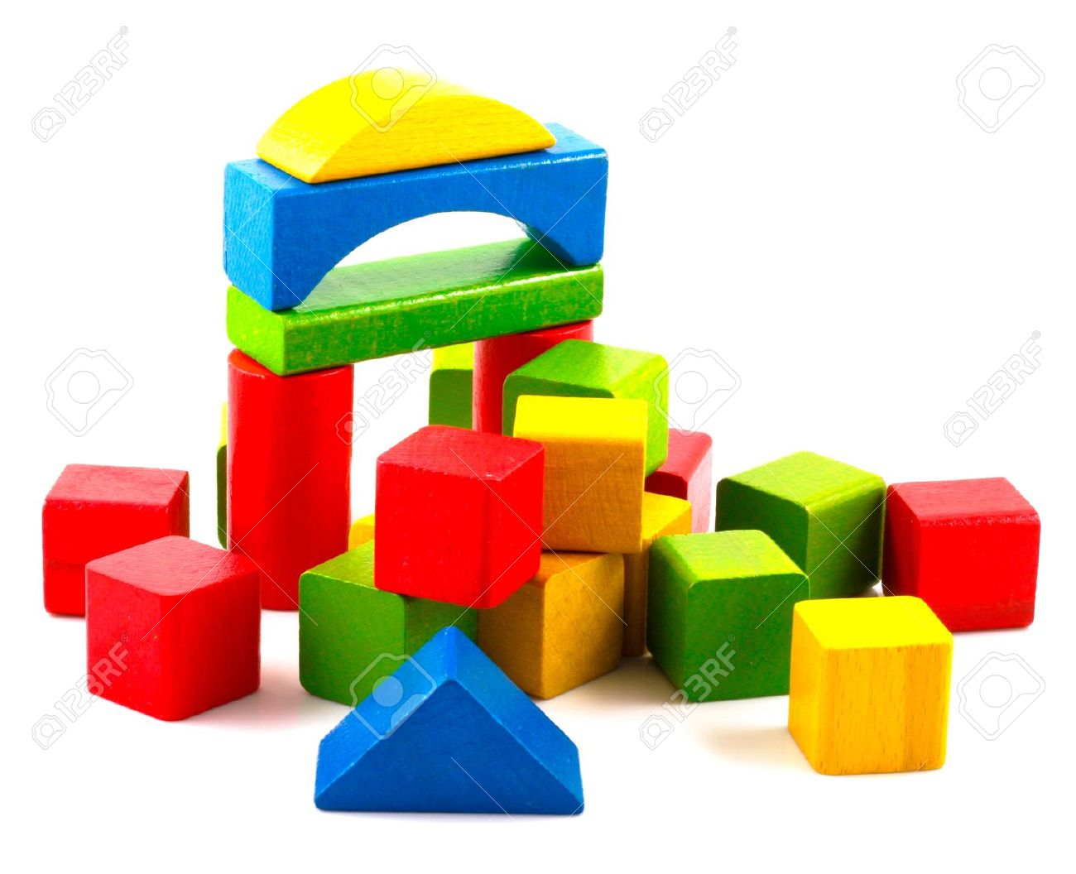
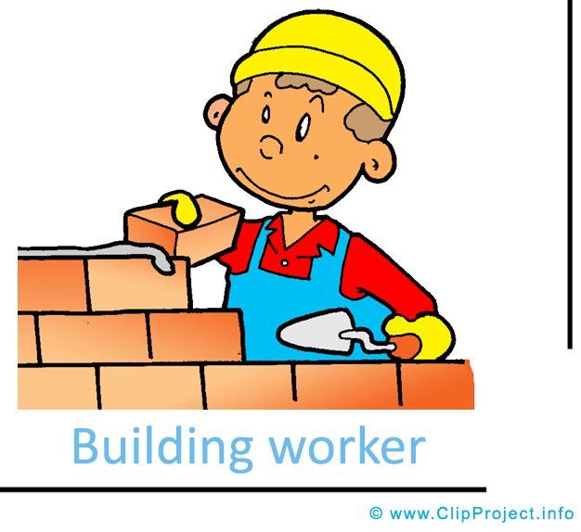
Let’s build a tower
Start Building
You can use Legos or wood blocks or _____

Slide 12
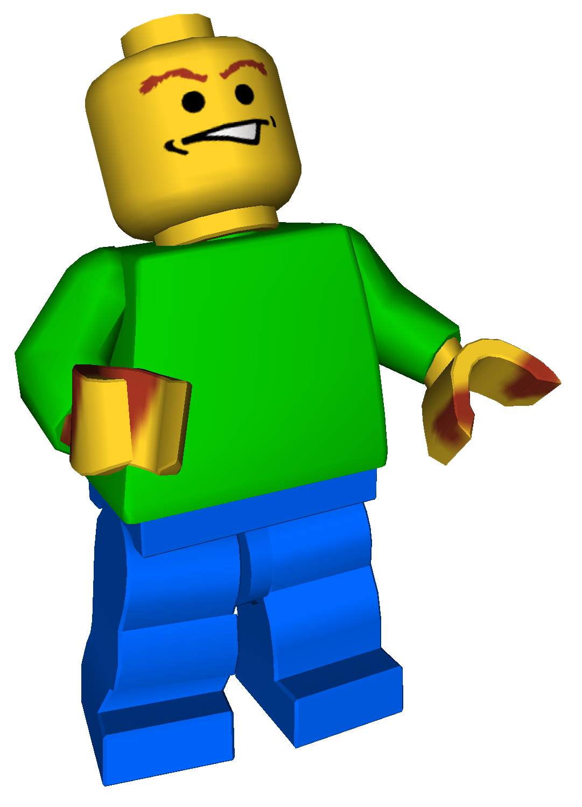
Wait a minute. What did they say?
³ They said to each other, “Come, let’s make bricks and bake them thoroughly.” They used brick instead of stone, and tar for mortar. ⁴ Then they said, “Come, let us build ourselves a city, with a tower that reaches to the heavens, so that we may make a name for ourselves; otherwise we will be scattered over the face of the whole earth.”

Slide 13
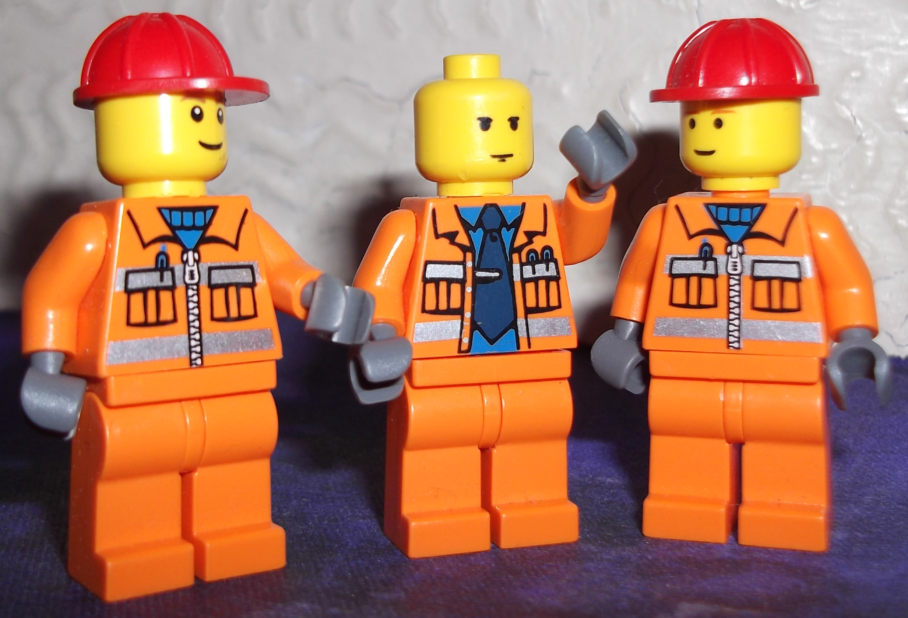
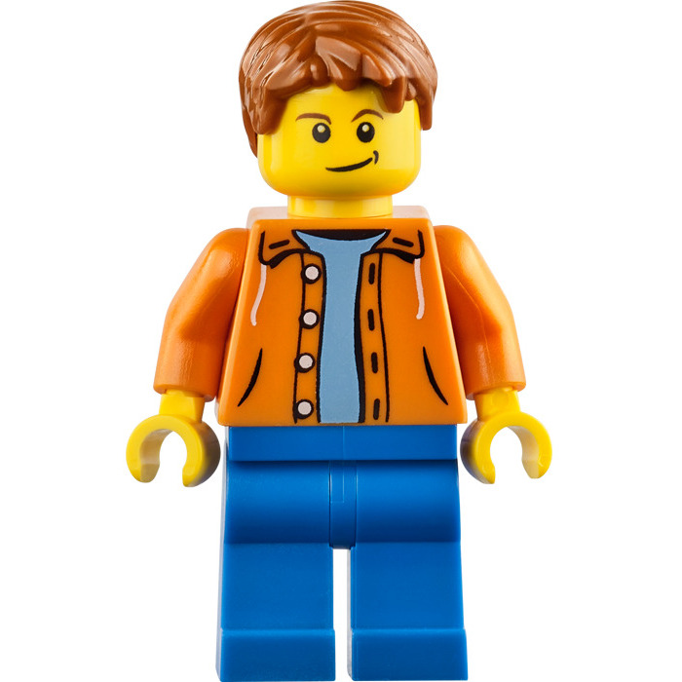
We will be great!
WE ARE GREAT!
Everyone will know we are awesome!
We’ll be as high in the heavens as God!
That sounds very arrogant!
They are being proud
and selfish!
Only God is that great!

Slide 14
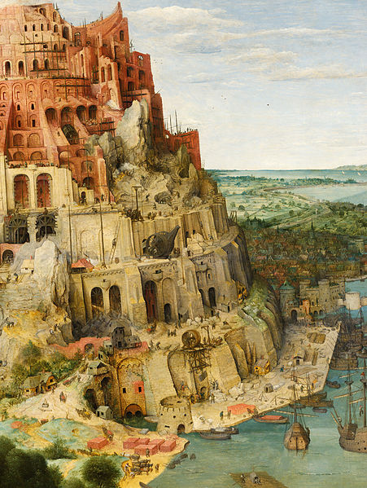
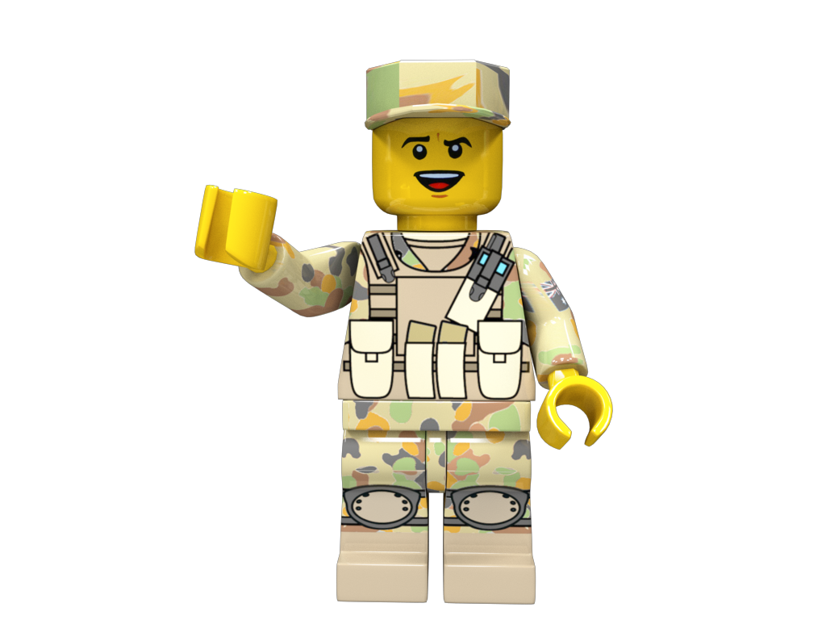
God was not pleased
⁵ But the Lord came down to see the city and the tower the people were building. ⁶ The Lord said, “If as one people speaking the same language they have begun to do this, then nothing they plan to do will be impossible for them.

Slide 15
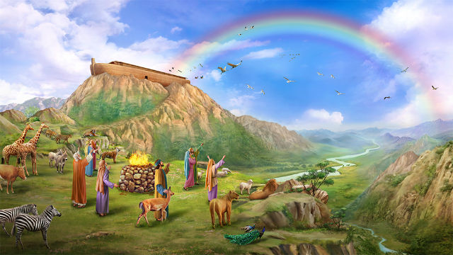
Why was this a problem?
What did God want them to do?
Genesis 9 [After the flood]
¹“Then God blessed Noah and his sons, saying to them, “Be fruitful and increase in number and fill the earth.
¹¹ I establish my covenant with you: Never again will all life be destroyed by the waters of a flood; never again will there be a flood to destroy the earth.”

Slide 16

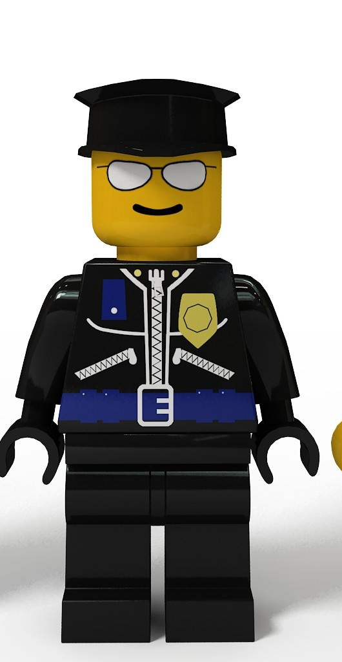
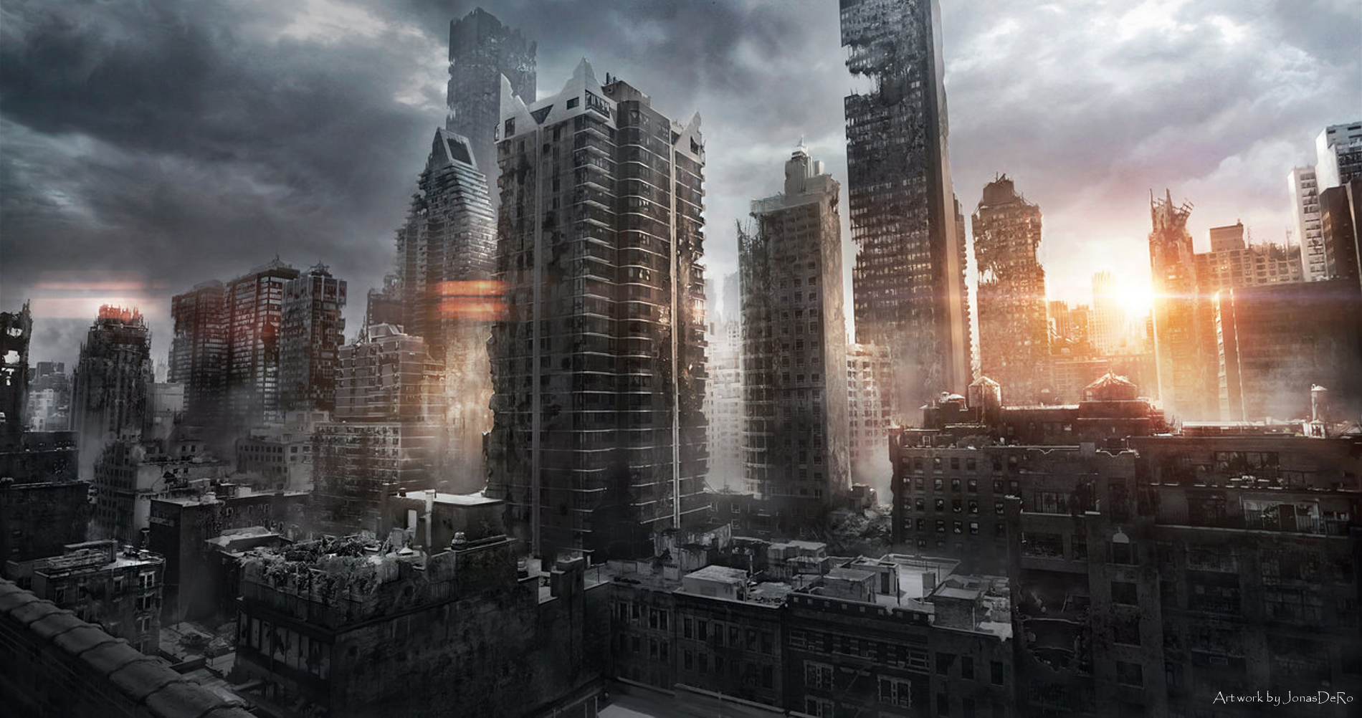
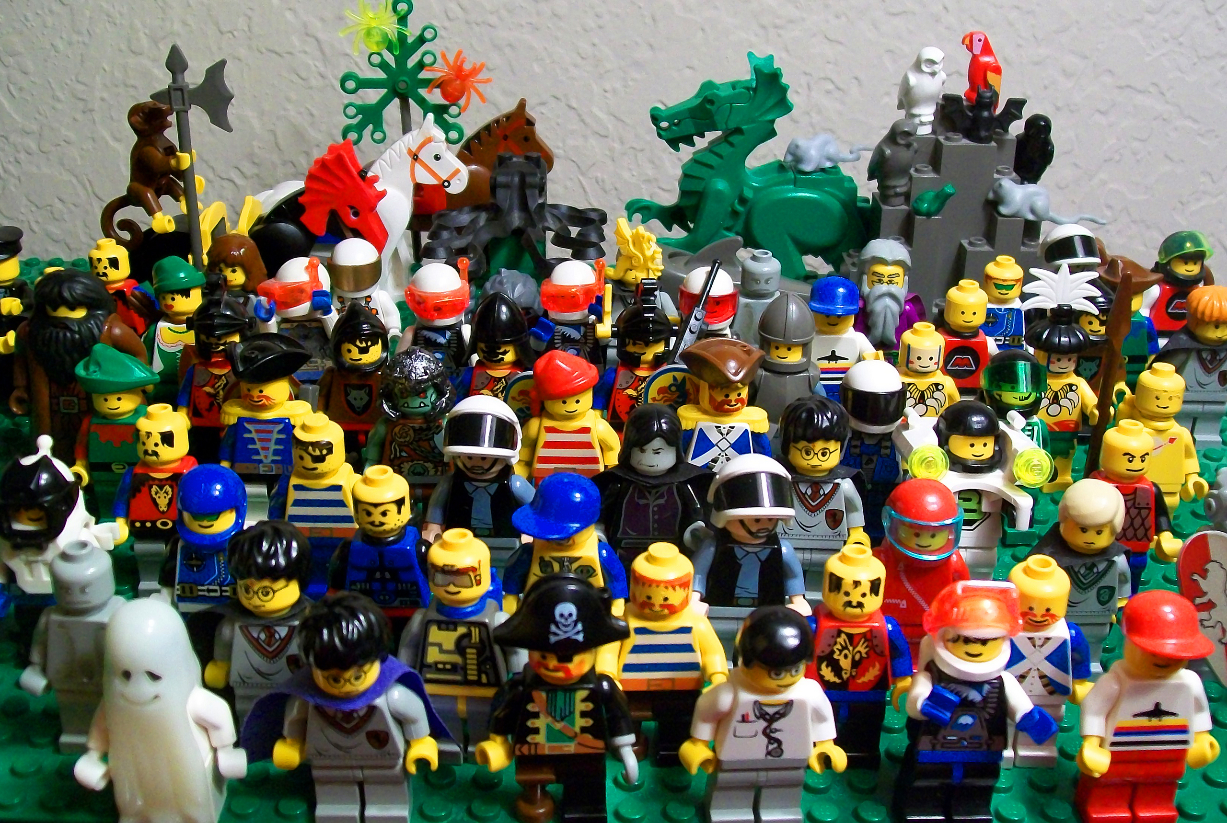
Crime increases
Crime increases in big cities and where crowds of people have gathered.
God did not want crime to increase.
He wanted to protect the people of the earth

Slide 17
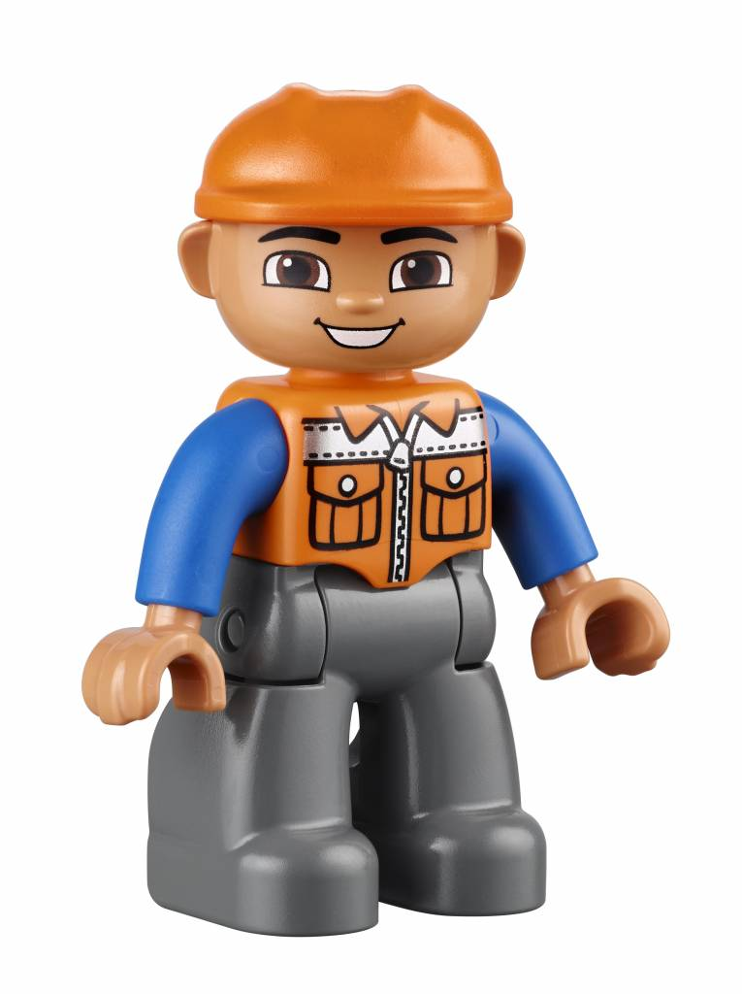
“God opposes the proud but shows favor to the humble.”
“Humble yourselves before the Lord, and He will lift you up.”
James 4:6 and 10
The people were being arrogant and proud.
They were exalting and praising themselves not God.

Slide 18
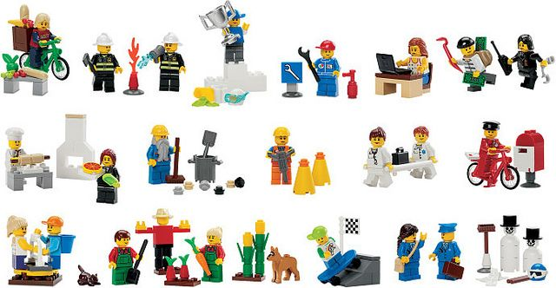
Do nothing out of selfish ambition or vain conceit. Rather, in humility value others above yourselves, not looking to your own interests but each of you to the interests of the others.
Philippians 2:3-4
Be humble and helpful

Slide 19
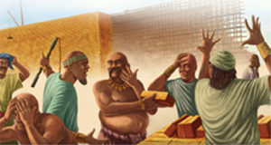
So, God said….
⁷ Come, let us go down and confuse their language so they will not understand each other.”

Slide 20
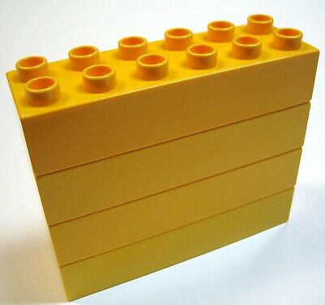

Bou met lang geel blokkies.
Builders. You must now listen to Simon.
Use only the blocks that Simon says to use. Listen carefully.

Slide 21

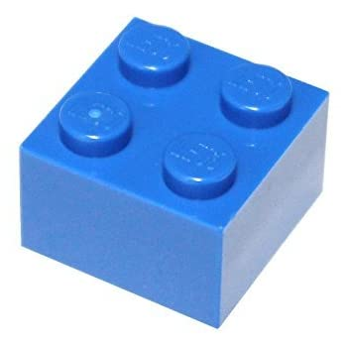
Construisez avec des blocs bleus carrés.
Builders. You must now listen to Simon.
Use only the blocks that Simon says to use. Listen carefully.

Slide 22

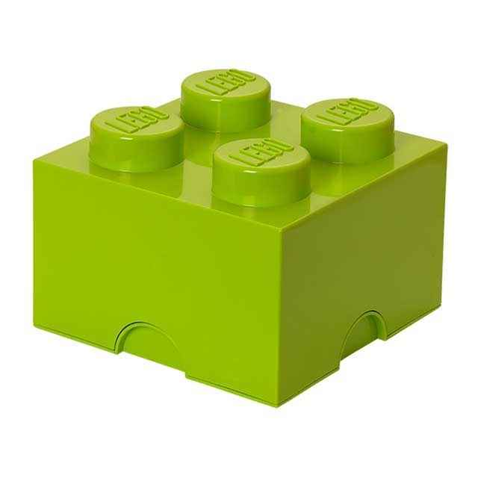
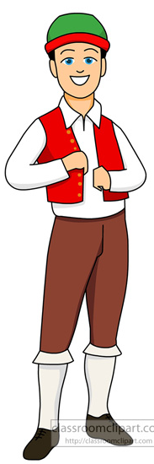
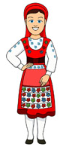
Construa com blocos verdes curtos.
Do you understand?

Slide 23



Aedificate ergo rubrum rectangulo DE, caudices.
How do you feel? The workers didn’t understand each other.

Slide 24
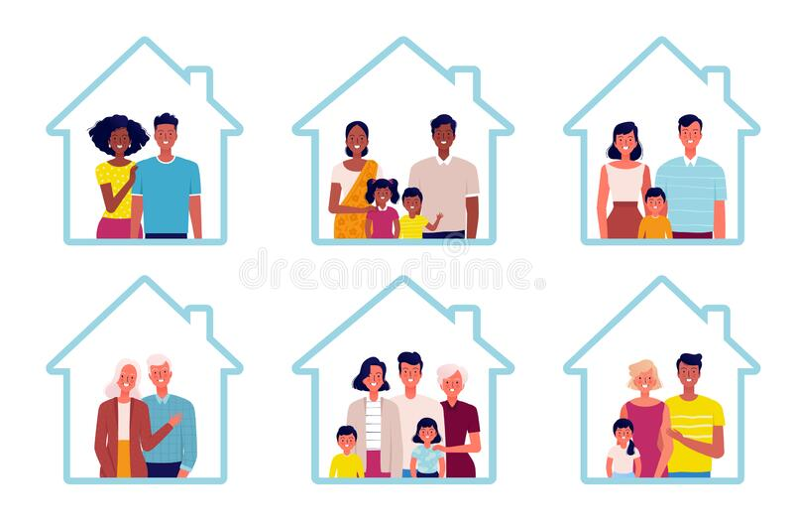
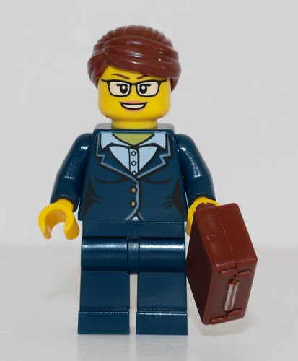
People with the same language grouped together and moved to different places. They started smaller towns away from each other.

Slide 25
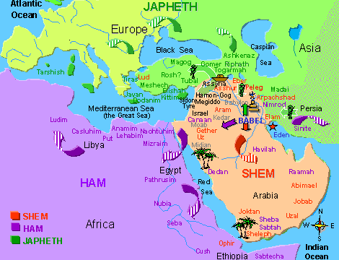
Scattered
⁸ So the Lord scattered them from there over all the earth, and they stopped building the city. ⁹ That is why it was called Babel^{[c]}—because there the Lord confused the language of the whole world. From there the Lord scattered them over the face of the whole earth.

Slide 26
God proved that HE is GREATER!
He is in charge.
He wants what is best for each of us.
True. God gave us the ability to be creative and to build, but we should be humble and use our talents to glorify Him and to help others.
We will do what He wants us to do.

Slide 27

Be Humble

Slide 28
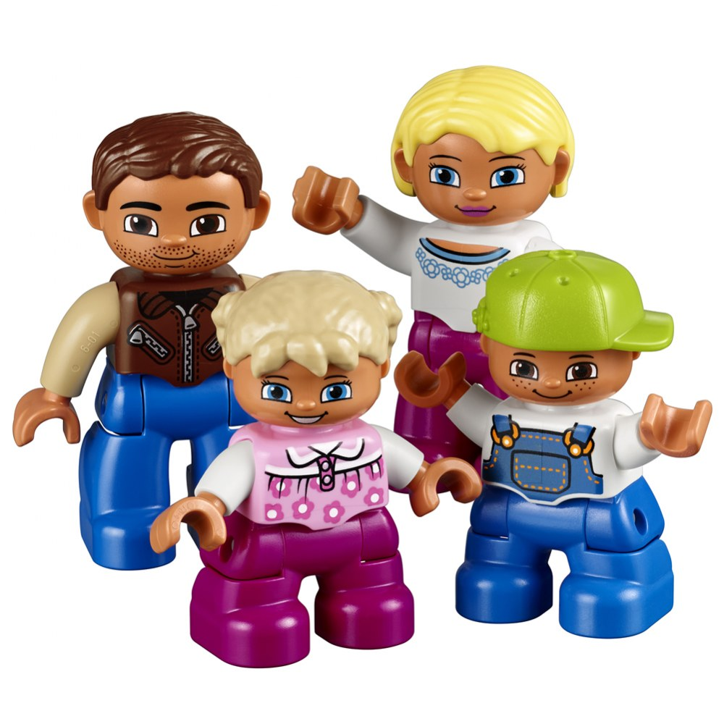
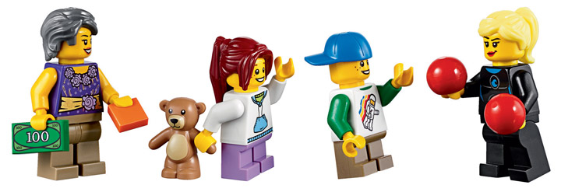
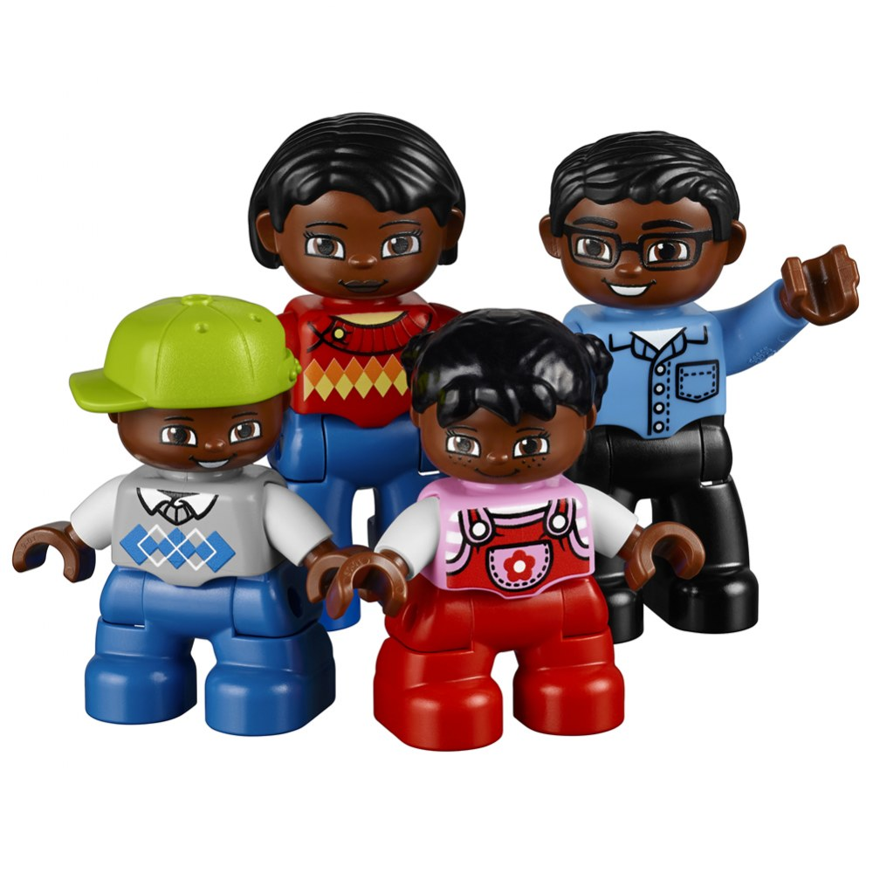

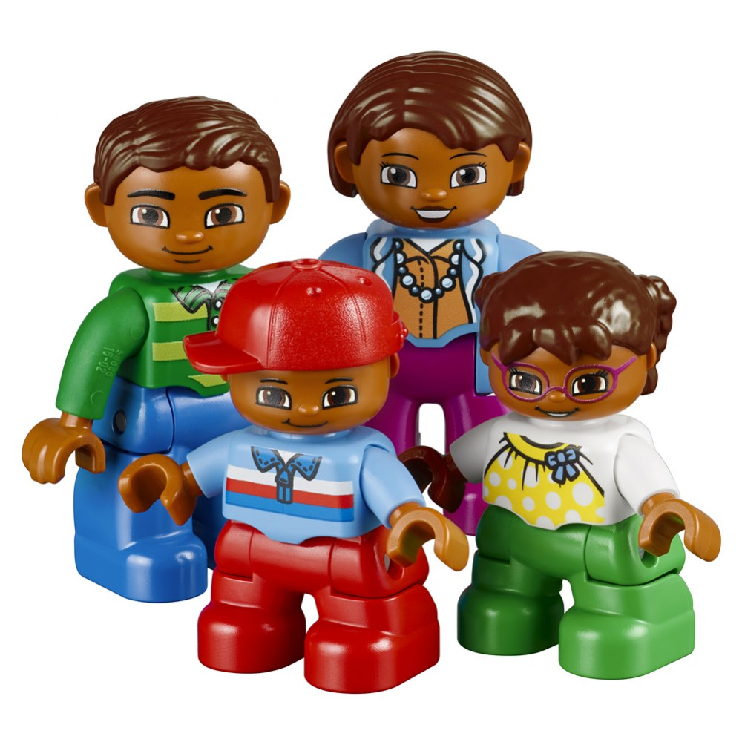
They moved away from each other. Good bye

Slide 29
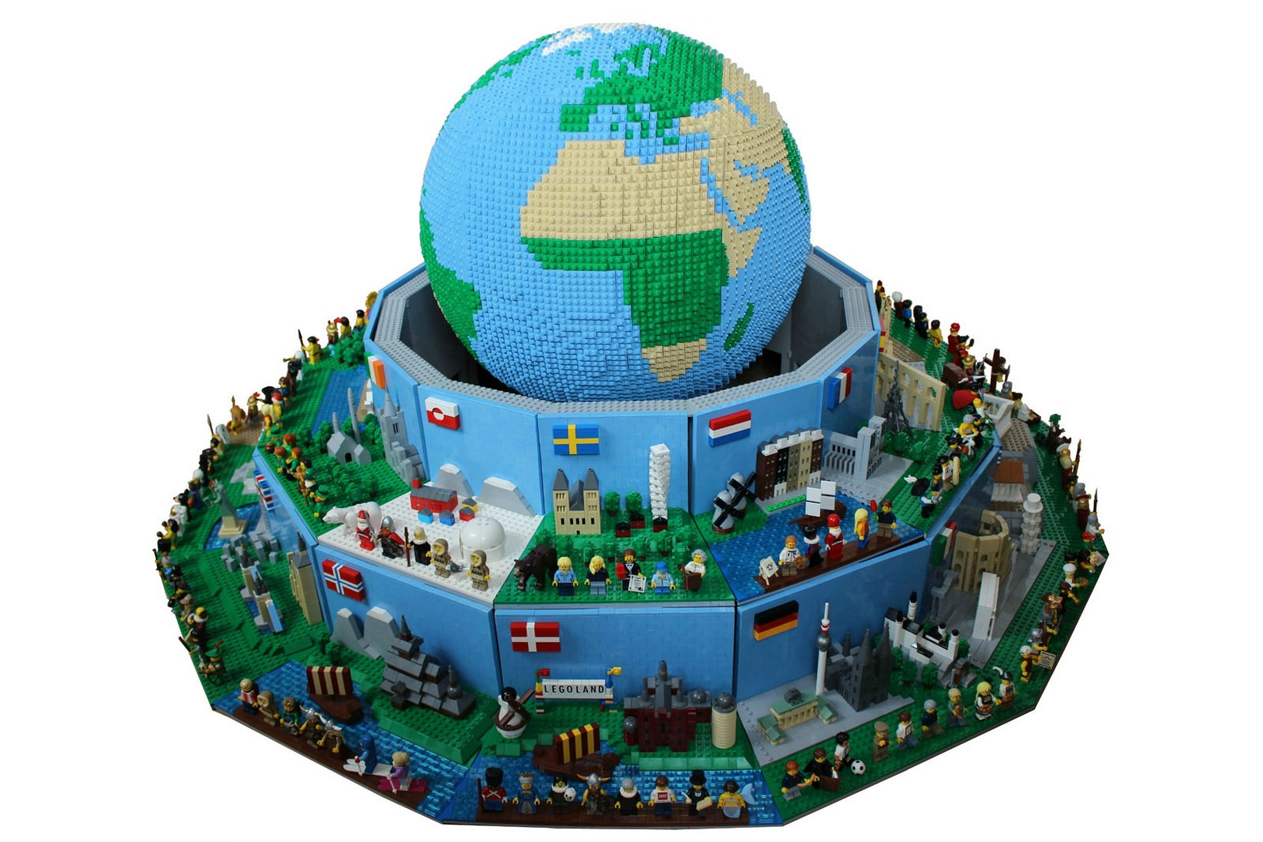
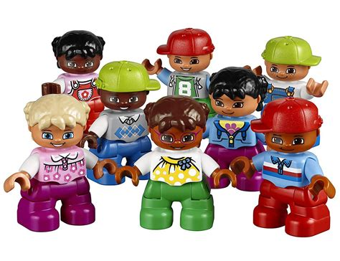
^{John 3:16} For God so loved the world that he gave his one and only Son, that whoever believes in him shall not perish but have eternal life. ¹⁷ For God did not send his Son into the world to condemn the world, but to save the world through him.
God loves everyone every where!

Slide 30
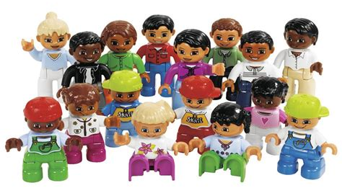
“I now realize how true it is that God does not show favoritism but accepts from every nation the one who fears him and does what is right
Peter said this after God told him to go with some soldiers from Caesarea.
They wanted to know more about Jesus and God’s gift of salvation.
Acts 10:34-35

Slide 31
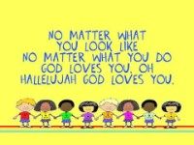
GOD LOVES YOU

Slide 32
