Slide 1
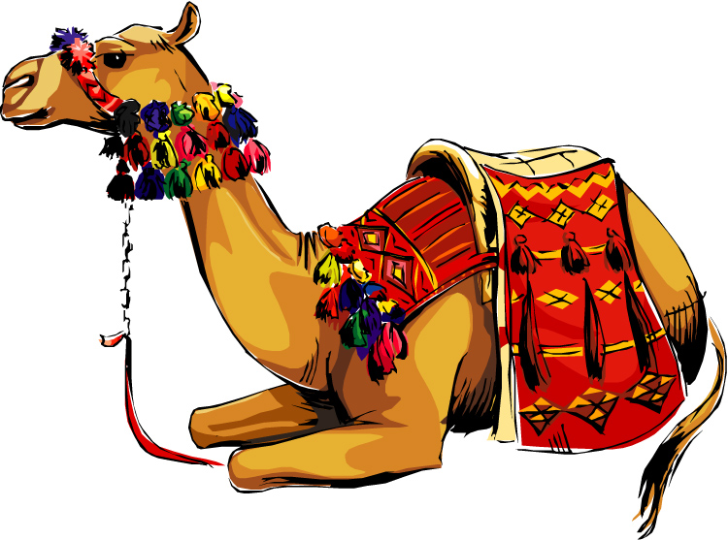
A Wife for Isaac
Genesis

Slide 2
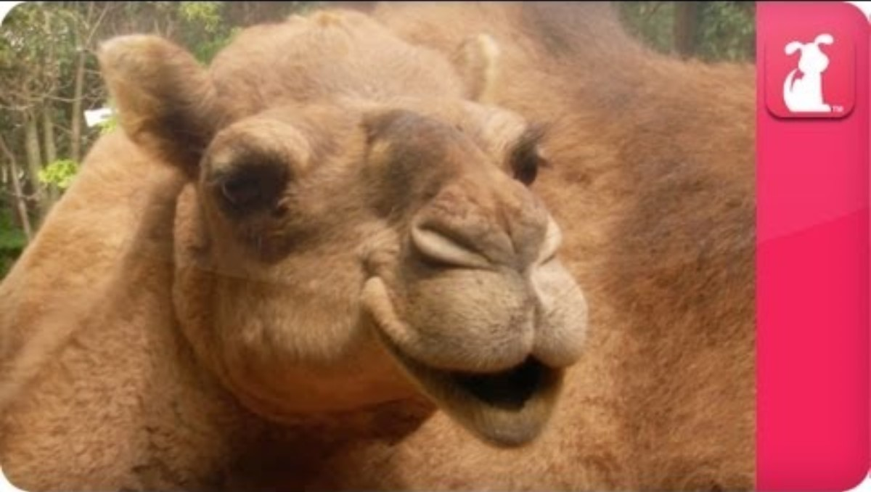
CAMELS

Slide 3

BIBLE STUDY – MEMORY TEXT
“I desire to do your will,
my God; your law is within my heart.”
Psalms 40:8
Psalms
40:8
What does it mean to do God’s will?

Slide 4

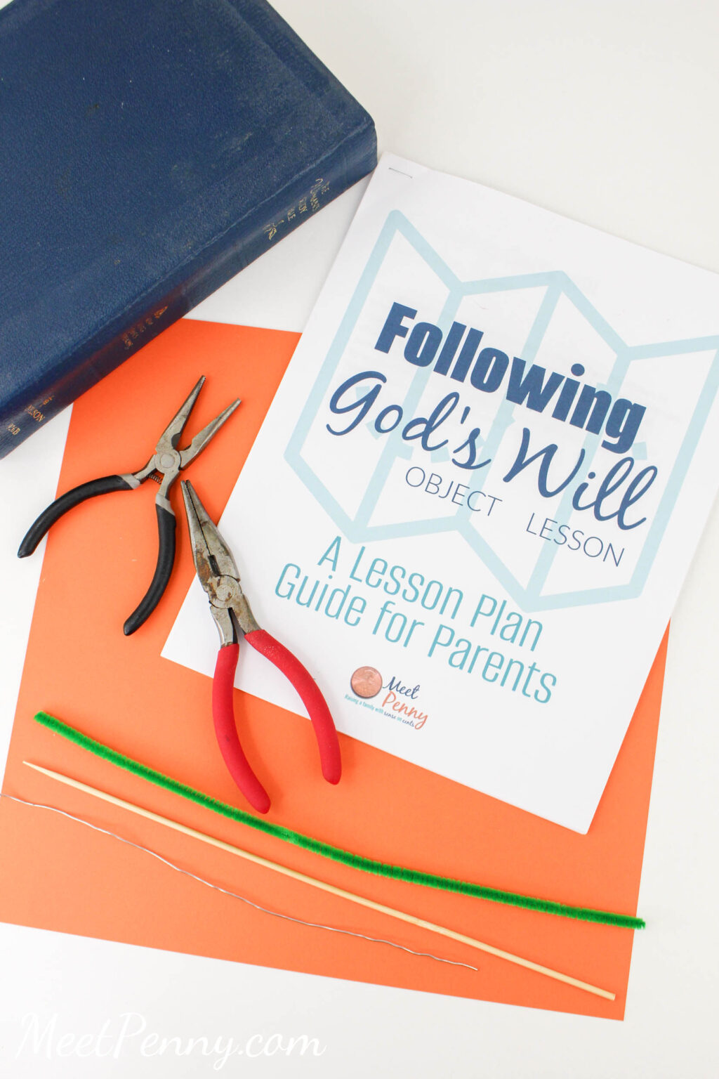

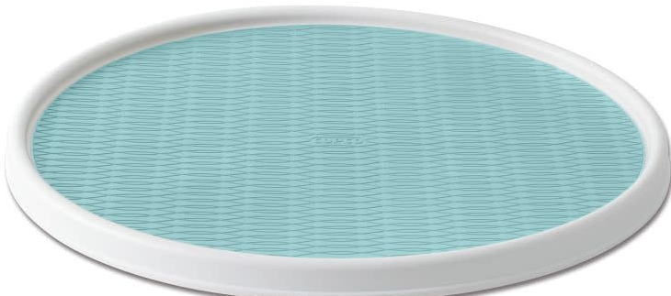
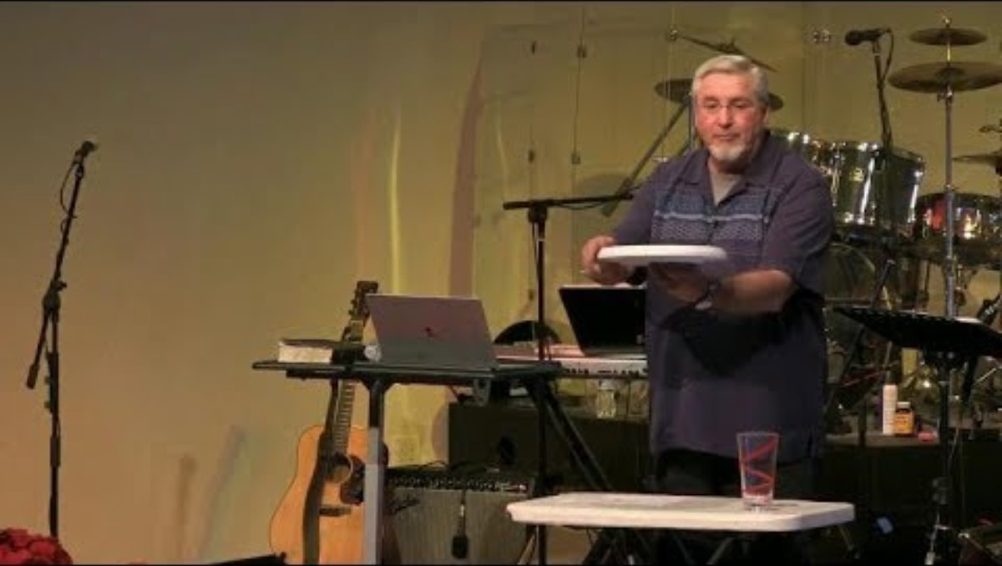
Object Lesson – choose 1
What does it mean to do God’s will?
https://storage.snappages.site/6673G4/assets/files/Elementary-Lesson-11-Object-Lesson-and-Q-18.pdf
https://www.meetpenny.com/what-is-gods-will-object-lesson/

Slide 5
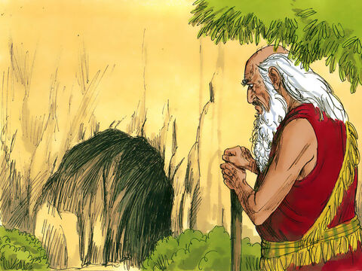
Sadly, Sarah died
Sarah has died.
She lived to be 127.
She was a good wife and mother.
I will miss her.
Genesis 23
Sarah lived to be a hundred and twenty-seven years old. ² She died at Kiriath Arba (that is, Hebron) in the land of Canaan, and Abraham went to mourn for Sarah and to weep over her.
³ Then Abraham rose from beside his dead wife and spoke to the Hittites.^{[a]} He said, ⁴ “I am a foreigner and stranger among you. Sell me some property for a burial site here so I can bury my dead.”
¹⁶ Abraham agreed to Ephron’s terms and weighed out for him the price he had named in the hearing of the Hittites: four hundred shekels of silver, according to the weight current among the merchants. …
¹⁷ So Ephron’s field in Machpelah near Mamre—both the field and the cave in it, and all the trees within the borders of the field—was deeded ¹⁸ to Abraham as his property in the presence of all the Hittites who had come to the gate of the city. ¹⁹ Afterward Abraham buried his wife Sarah in the cave in the field of Machpelah near Mamre (which is at Hebron) in the land of Canaan. ²⁰ So the field and the cave in it were deeded to Abraham by the Hittites as a burial site.

Slide 6
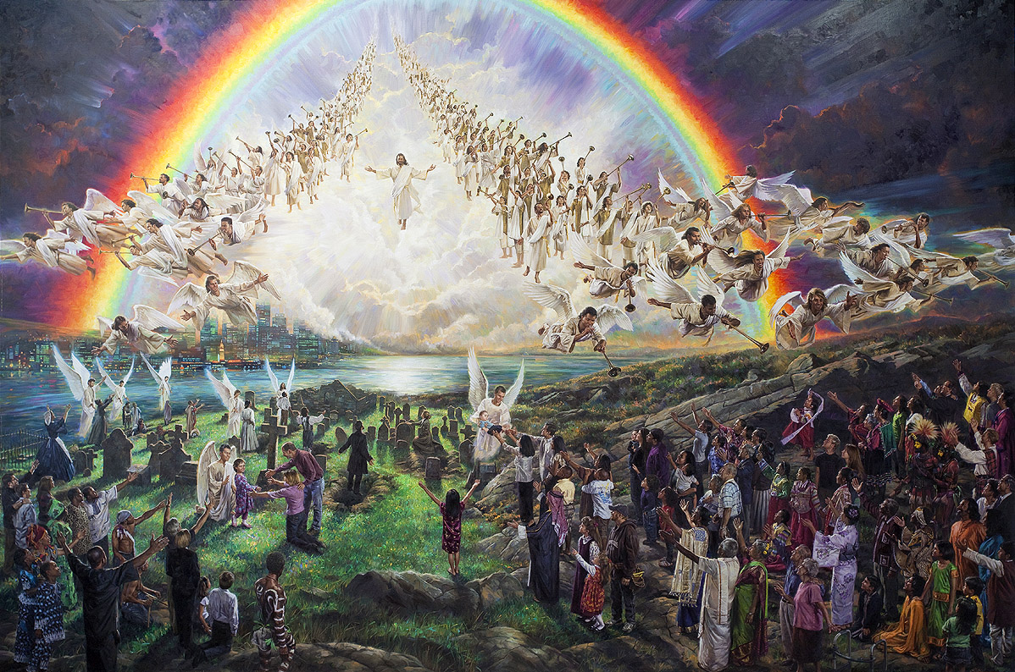
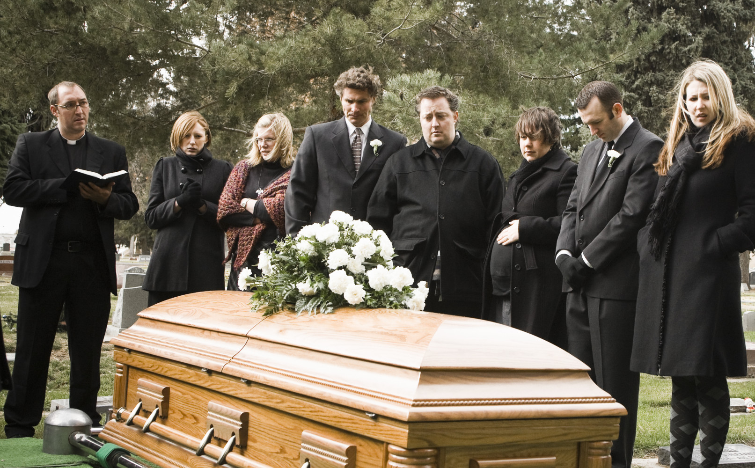
Have you ever been to a funeral?
Has someone that you loved very much died?
That is very sad!
It’s OK to cry and miss them.
It’s good to remember all the fun times you have had.
We can also remember God’s promise that some day we will see them again when Jesus comes again!

Slide 7

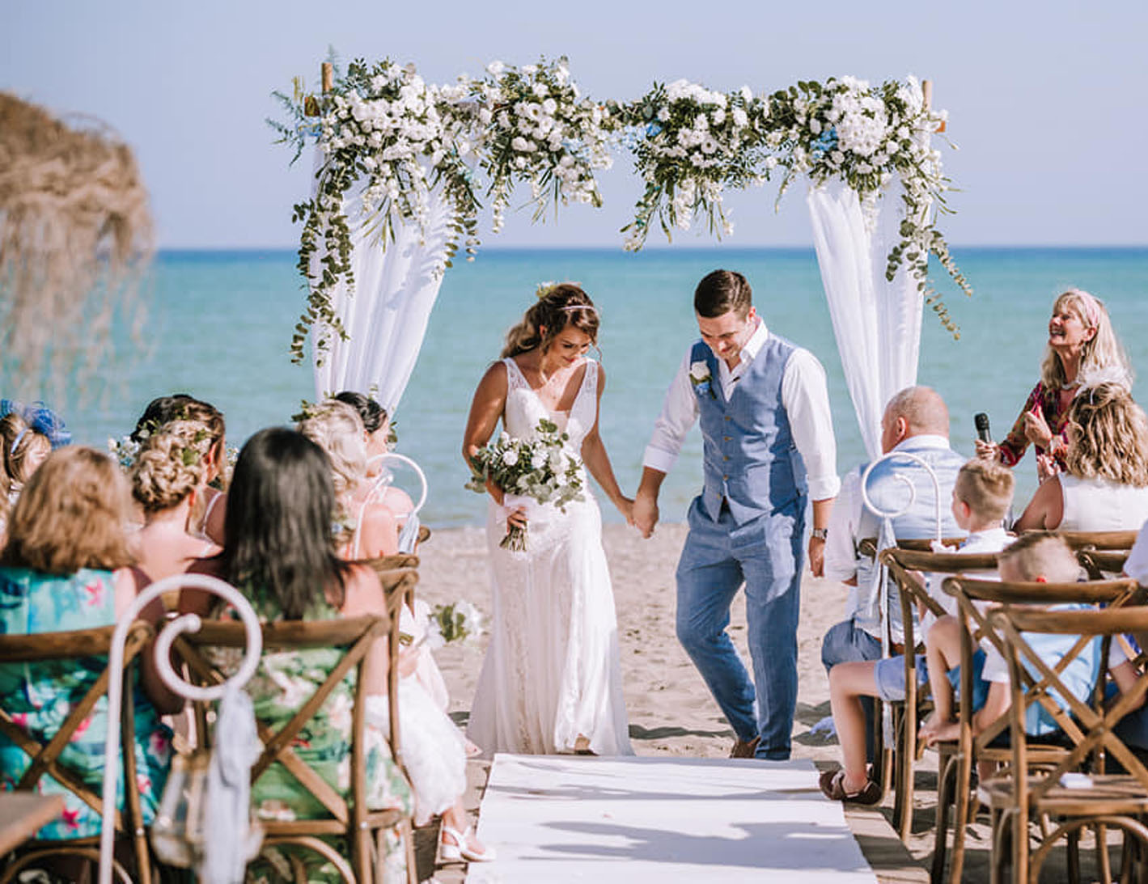
Have you ever been to a wedding?
They are happy occasions!
Do you want to get married some day?
Some day, you will meet someone very special who loves you very much! You both will want to live with each other and enjoy life together forever! So, you will decide to get married.
A long, long time ago, it was the parents’ responsibility to choose a spouse for their child.

Slide 8
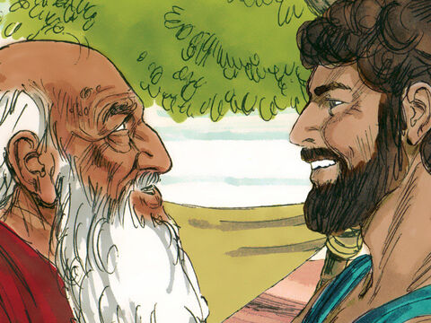
Genesis 24
Eliezer, Isaac is 40 years old. He needs a wife.
I want you to go get a wife for him from my own relatives from where I used to live.
I don’t want him to marry a Canaanite here.
Promise me that you will do this.
Genesis 24 – A wife for Isaac
Abraham was now very old, and the Lord had blessed him in every way. ² He said to the senior servant in his household, the one in charge of all that he had, “Put your hand under my thigh. ³ I want you to swear by the Lord, the God of heaven and the God of earth, that you will not get a wife for my son from the daughters of the Canaanites, among whom I am living, ⁴ but will go to my country and my own relatives and get a wife for my son Isaac.”
I promise you before God, that I will go back to your relatives to get a wife for Isaac.

Slide 9
I will do your will
Eliezer, Isaac is 40 years old. He needs a wife.
I want you to go get a wife for him from my own relatives from where I used to live.
I don’t want him to marry a Canaanite here.
Promise me that you will do this.
Think about it….
Who’s will was Eliezer doing? Was he doing what he wanted to do or what Abraham asked him to do?
We show our love and respect for others when we do their will -- what they ask us to do.
I promise you before God, that I will go back to your relatives to get a wife for Isaac.

Slide 10
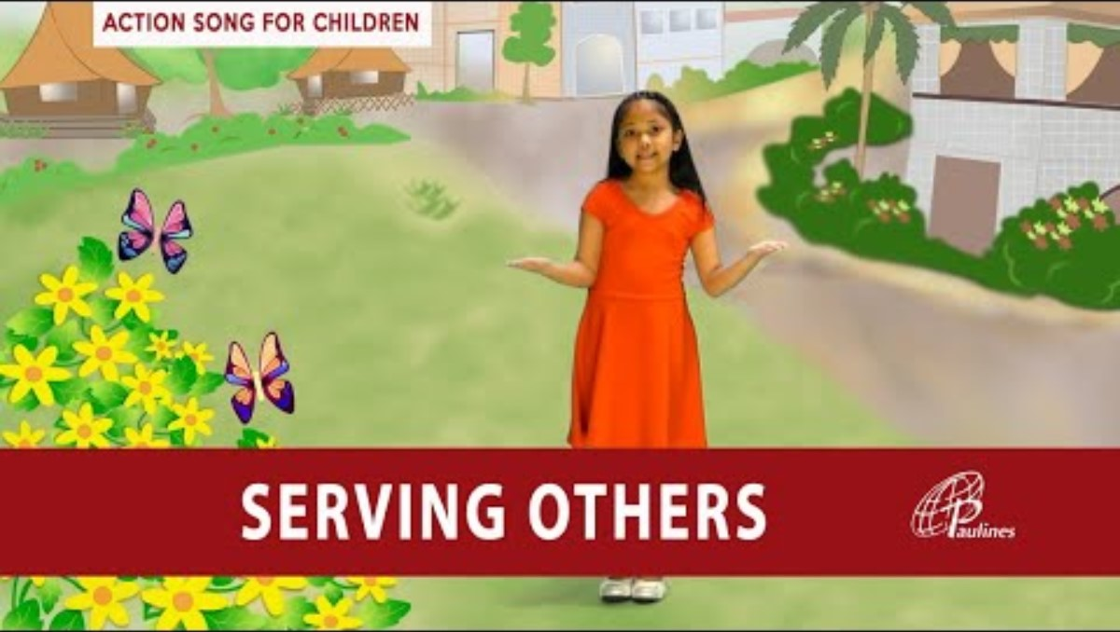
Serving Others
3 Don’t do anything only to get ahead. Don’t do it because you are proud. Instead, be humble.
Value others more than yourselves. 4 None of you should look out just for your own good.
Each of you should also look out for the good of others. Philippians 2:3-4

Slide 11

Love Each Other Honor Others Romans 12:10

Slide 12
A Promise made I will do your will
What if the woman is not willing to come back with me?
Shall I take Isaac to live there with her?
I promise before God that if I find a wife for Isaac and she is willing to come back, that I will bring her back.
I will not take Isaac there.
May God give me success.
Genesis 24 – A wife for Isaac
⁵ The servant asked him, “What if the woman is unwilling to come back with me to this land? Shall I then take your son back to the country you came from?”
⁶ “Make sure that you do not take my son back there,” Abraham said. ⁷ “The Lord, the God of heaven, who brought me out of my father’s household and my native land and who spoke to me and promised me on oath, saying, ‘To your offspring^{[a]} I will give this land’—he will send his angel before you so that you can get a wife for my son from there. ⁸ If the woman is unwilling to come back with you, then you will be released from this oath of mine. Only do not take my son back there.” ⁹ So the servant put his hand under the thigh of his master Abraham and swore an oath to him concerning this matter.
Make sure that you do NOT take Isaac back there. God has promised us that this land is our home. Isaac must stay here. If she doesn’t want to return, you are released from this promise.

Slide 13
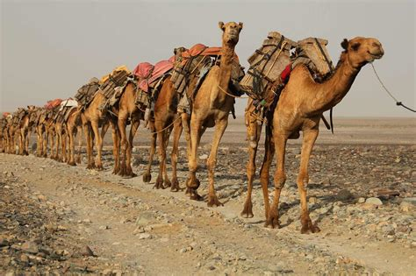
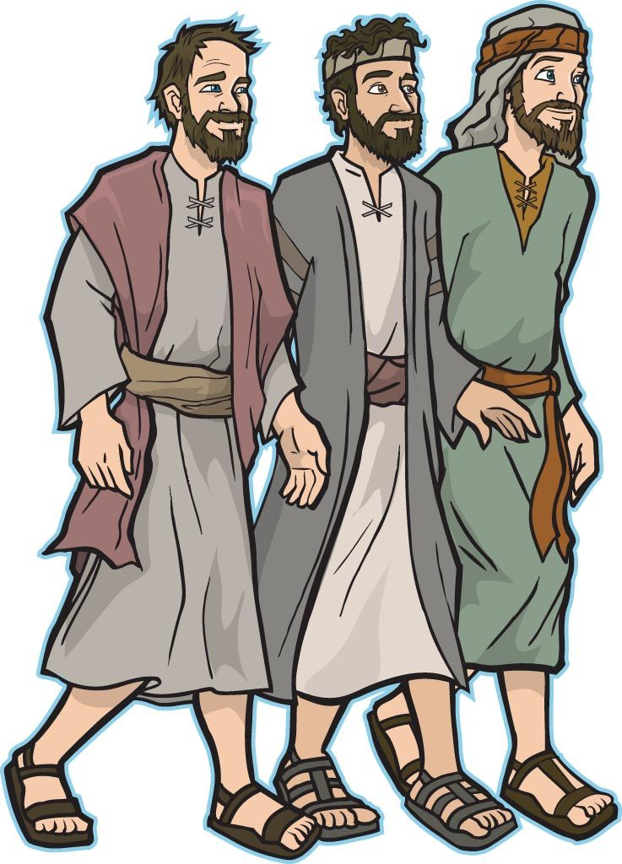
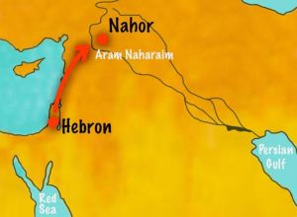
Get ready Get set -- GO
¹⁰ Then the servant left, taking with him ten of his master’s camels loaded with all kinds of good things from his master.
He set out for Aram Naharaim^{[b]} and made his way to the town of Nahor.
What ‘good things’ would you take?

Slide 14
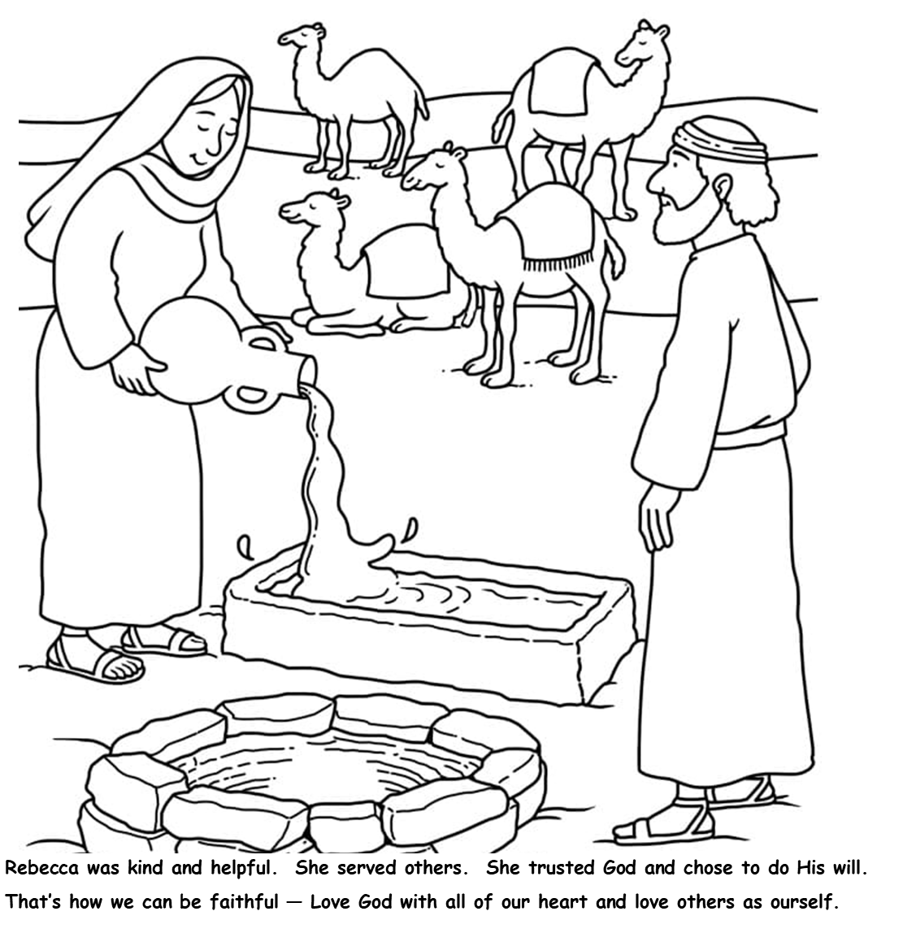
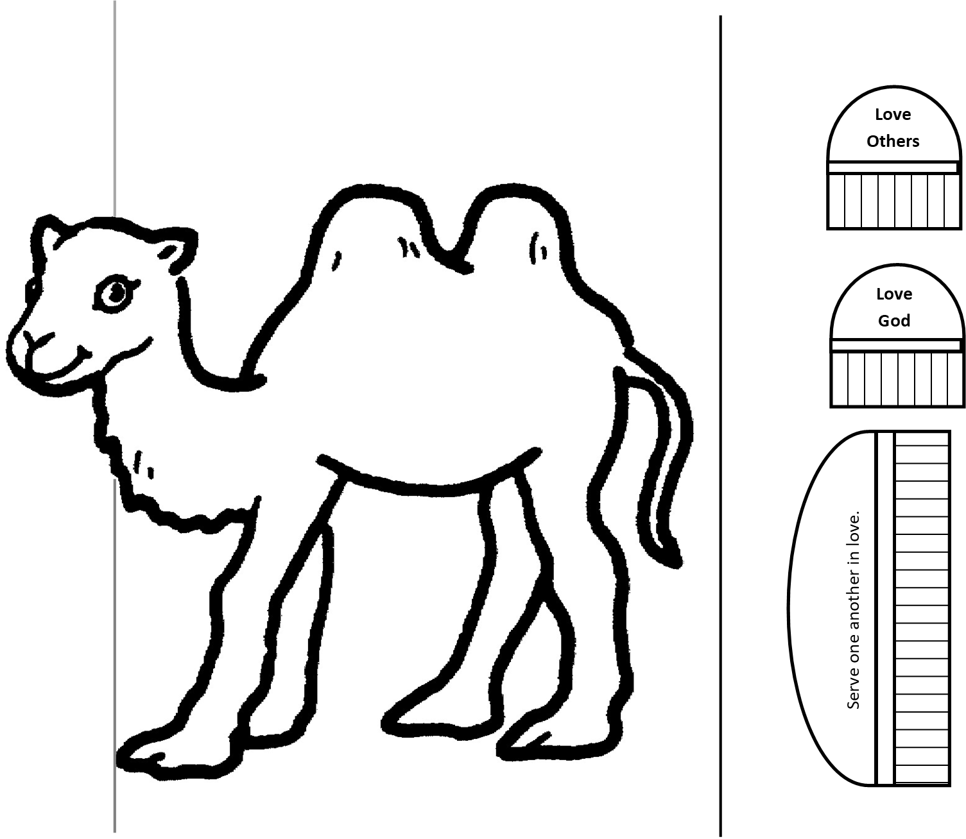
CRAFT TIME – opt. 1
CUT
CUT
Let’s make a camel
Color your camel and its blankets/pack
Cut down the line and around the camel head.
Cut down the line behind the camel.
You can cut on all the little lines from the bottom to the middle line to make a fringe on the blanket pack.
Glue the big blanket pack on the camel, just under the humps.
Glue the smaller blanket packs on the camel’s humps.
Glue the camel page onto the right side of the page with Rebecca pouring water for the camels.
CUT

Slide 15
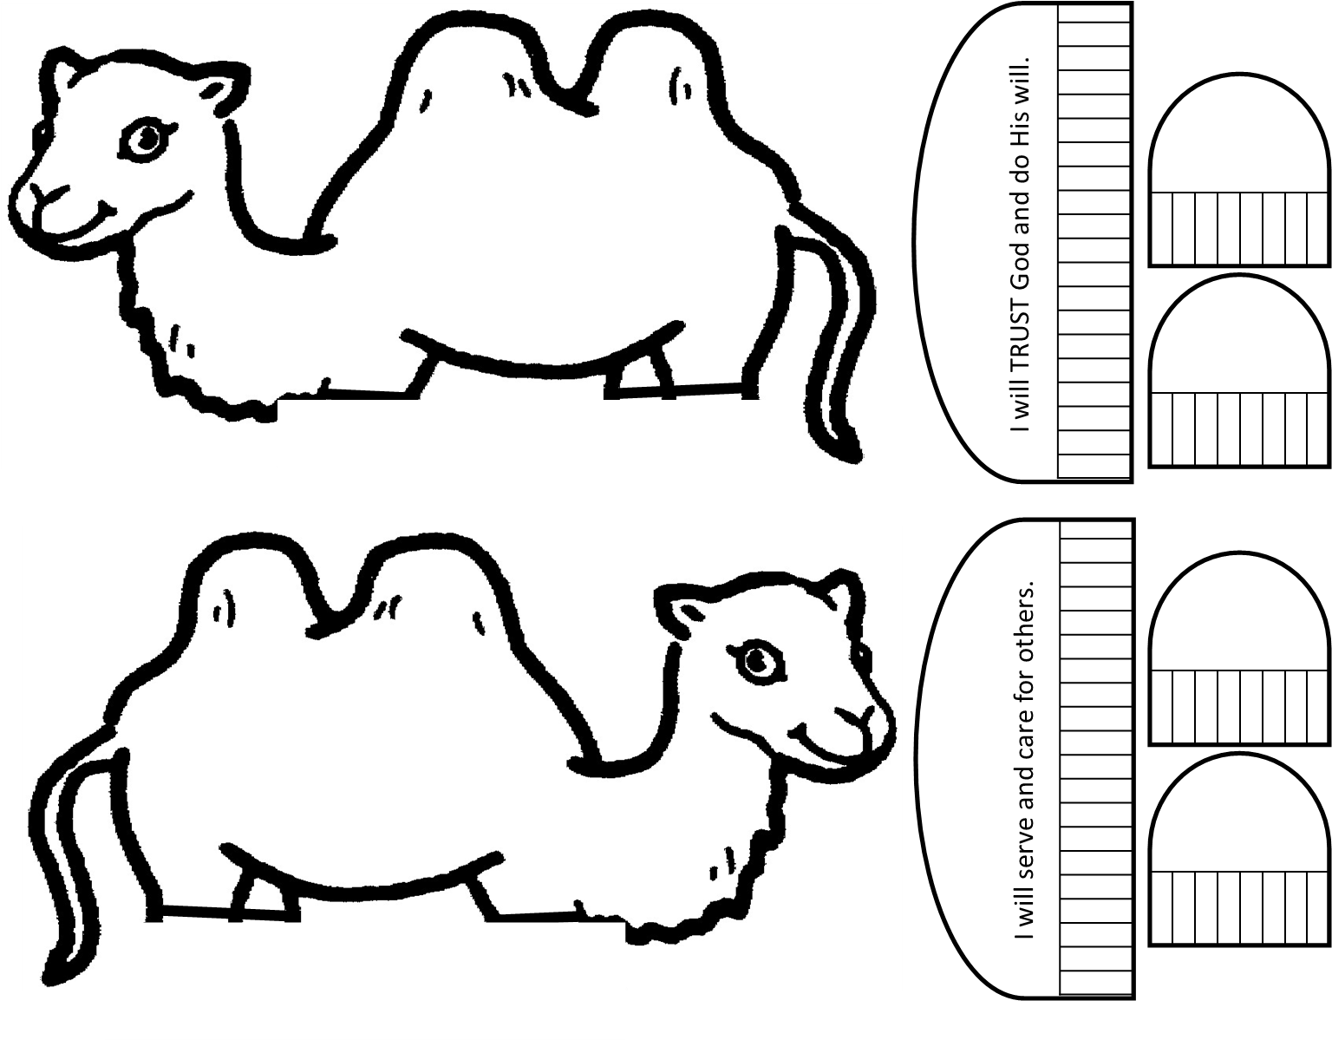
CRAFT TIME – opt. 2
Let’s make a camel
Color your camel and all it’s parts
Cut out the parts.
You can cut on all the little lines from the bottom to the middle line to make a fringe.
Glue the camels back to back.
We will put clothespins for the legs.

Slide 16
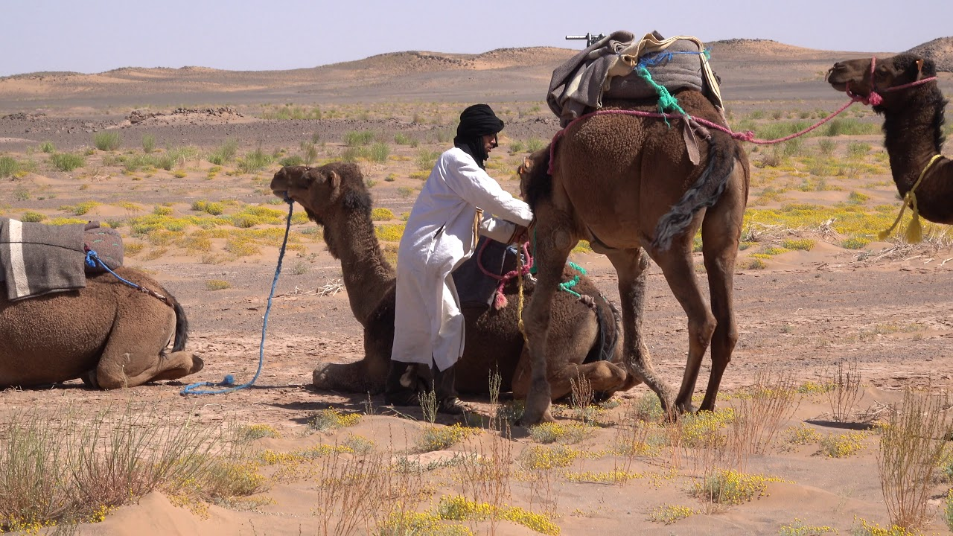
We have arrived!
¹¹ He had the camels kneel down near the well outside the town; it was toward evening, the time the women go out to draw water.

Slide 17
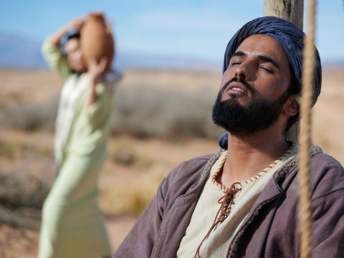
Eliezer prayed
LORD, God of Abraham, please make me successful today.
See, I’m standing by this spring.
The daughters of the townspeople are coming to get water.
I’m here to find a wife for Isaac.
I need your help knowing who the right lady is – someone kind, strong and who respects You and Your will.
May it be when I ask a young woman to “please let me have a drink,” that she will say, “drink, and I’ll water your camels, too” – Let that be the right woman to be Isaac’s wife.
¹² Then he prayed, “Lord, God of my master Abraham, make me successful today, and show kindness to my master Abraham. ¹³ See, I am standing beside this spring, and the daughters of the townspeople are coming out to draw water. ¹⁴ May it be that when I say to a young woman, ‘Please let down your jar that I may have a drink,’ and she says, ‘Drink, and I’ll water your camels too’—let her be the one you have chosen for your servant Isaac. By this I will know that you have shown kindness to my master.”

Slide 18
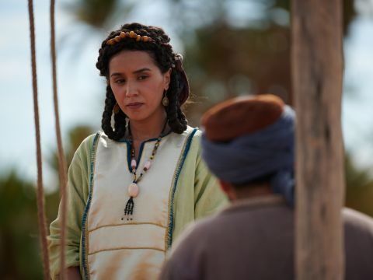
Rebecca came
Please give me a little water from your jar.
¹⁵ Before he had finished praying, Rebekah came out with her jar on her shoulder.
She was the daughter of Bethuel son of Milkah, who was the wife of Abraham’s brother Nahor. ¹⁶ The woman was very beautiful, a virgin; no man had ever slept with her. She went down to the spring, filled her jar and came up again.
¹⁷ The servant hurried to meet her and said, “Please give me a little water from your jar.”

Slide 19
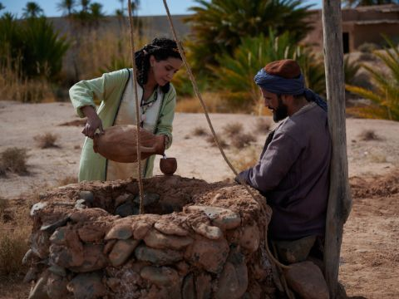
Have a drink
Drink, my lord.
I’ll draw water for your camels, too until they have enough to drink.
¹⁸ “Drink, my lord,” she said, and quickly lowered the jar to her hands and gave him a drink.
¹⁹ After she had given him a drink, she said, “I’ll draw water for your camels too, until they have had enough to drink.”
What a kind thing
to say and do!
Rebecca loved
and served others.

Slide 20
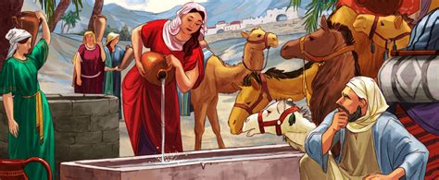
Fill it up
How much water
can a thirsty camel drink?
Camels that are thirsty enough can drink around 30 gallons of water in just a few minutes!
30 gallons x 10 camels = 300 gallons
²⁰ So she quickly emptied her jar into the trough, ran back to the well to draw more water, and drew enough for all his camels. ²¹ Without saying a word, the man watched her closely to learn whether or not the Lord had made his journey successful.
Game Time – Fill it up RELAY
Take turns getting a glass of water from the bucket and emptying it into this pan ‘for the camels’

Slide 21
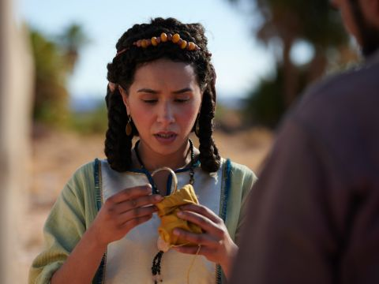
Who are you?
Whose daughter are you?
Please tell me,
is there room in your father’s house for us to spend the night?
You are a blessing from the Lord.
Please accept my gift – a ring and bracelets.
² When the camels had finished drinking, the man took out a gold nose ring weighing a beka^{[c]} and two gold bracelets weighing ten shekels.^{[d]} ²³ Then he asked, “Whose daughter are you? Please tell me, is there room in your father’s house for us to spend the night?”
²⁴ She answered him, “I am the daughter of Bethuel, the son that Milkah bore to Nahor.” ²⁵ And she added, “We have plenty of straw and fodder, as well as room for you to spend the night.”
Thank you!
I am the daughter of Bethuel, the son that Milkah bore to Nahor.
Yes, we have plenty of straw and fodder as well as a room for you to spend the night!

Slide 22
Thank you God!
Praise the LORD, God of Abraham!
He is faithful! He has answered my prayer!
He has led me to my master’s relatives!
²⁶ Then the man bowed down and worshiped the Lord, ²⁷ saying, “Praise be to the Lord, the God of my master Abraham, who has not abandoned his kindness and faithfulness to my master. As for me, the Lord has led me on the journey to the house of my master’s relatives.”

Slide 23
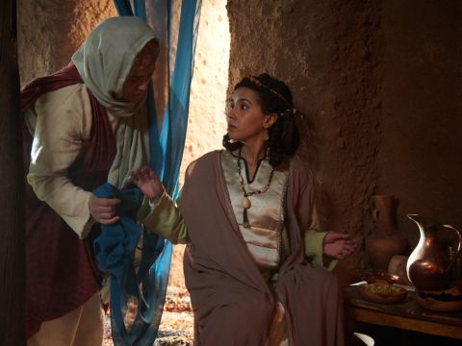
LOOK!
Mom look!
I gave a man a drink at the spring and watered his camels. He gave me this ring a bracelets!
Oh! He asked if he could stay the night.
I told him we had room.
²⁸ The young woman ran and told her mother’s household about these things.
Those are beautiful!
This man must be rich!
Laban!
Come here.
You must go to the spring. We have a visitor waiting!

Slide 24
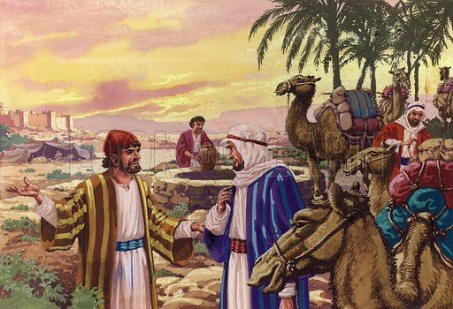
Thank you God!
My sister has told us about you.
Come, you who are blessed by the LORD.
You don’t need to stand here.
I have prepared the house and a place for the camels.
²⁹ Now Rebekah had a brother named Laban, and he hurried out to the man at the spring. ³⁰ As soon as he had seen the nose ring, and the bracelets on his sister’s arms, and had heard Rebekah tell what the man said to her, he went out to the man and found him standing by the camels near the spring.
³¹ “Come, you who are blessed by the Lord,” he said. “Why are you standing out here? I have prepared the house and a place for the camels.”

Slide 25
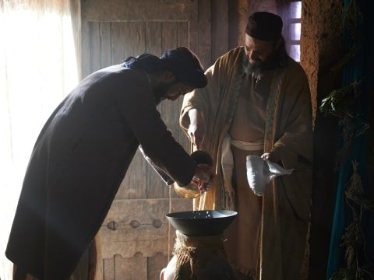
Welcome!
Your camels will be unloaded and well cared for.
Here, wash your hands and feet.
Then, come and eat.
Then tell us.
Come everyone, let us sit down.
³² So the man went to the house, and the camels were unloaded. Straw and fodder were brought for the camels, and water for him and his men to wash their feet.
³³ Then food was set before him, but he said, “I will not eat until I have told you what I have to say.”
“Then tell us,” Laban said.
Thank you so much for your kindness!
However, I can’t eat
until I tell you why I have come.

Slide 26
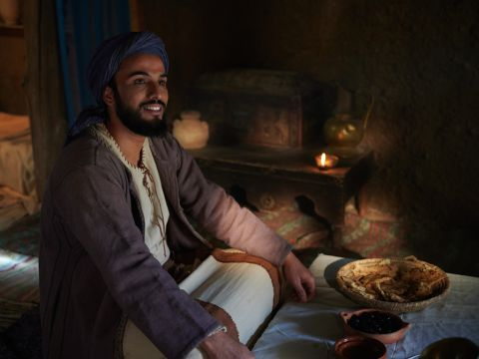
Let me tell you …
And now Abraham has a son, Isaac, bore to him in his old age by Sarah.
Abraham has given Isaac everything that he owns.
Abraham has sent me here
to get a wife for Isaac.
I am Abraham’s servant.
The LORD has blessed my master abundantly and he has become wealthy. He has many sheep, cattle, camels and donkeys.
He has silver, gold, servants.
³⁴ So he said, “I am Abraham’s servant. ³⁵ The Lord has blessed my master abundantly, and he has become wealthy. He has given him sheep and cattle, silver and gold, male and female servants, and camels and donkeys. ³⁶ My master’s wife Sarah has borne him a son in her old age, and he has given him everything he owns. ³⁷ And my master made me swear an oath, and said, ‘You must not get a wife for my son from the daughters of the Canaanites, in whose land I live, ³⁸ but go to my father’s family and to my own clan, and get a wife for my son.’
³⁹ “Then I asked my master, ‘What if the woman will not come back with me?’…

Slide 27
Eliezer told Laban, Rebecca and their whole family the whole story including every detail.
Can you re tell the story?

Slide 28
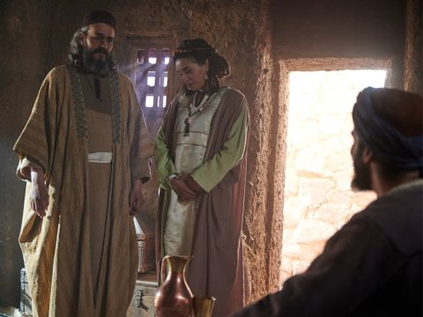
This is God’s will We will do what God wants
Now if you will show kindness to my master, Abraham,
tell me what I must do.
^{…48} and I bowed down and worshiped the Lord. I praised the Lord, the God of my master Abraham, who had led me on the right road to get the granddaughter of my master’s brother for his son.
⁴⁹ Now if you will show kindness and faithfulness to my master, tell me; and if not, tell me, so I may know which way to turn.”
⁵⁰ Laban and Bethuel answered, “This is from the Lord; we can say nothing to you one way or the other. ⁵¹ Here is Rebekah; take her and go, and let her become the wife of your master’s son, as the Lord has directed.”
This is God’s will.
We can not say anything except,
We will do what God wants.
Here is Rebekah, take her and let her become the wife of your master Abraham’s son, Isaac as the LORD has directed.

Slide 29
Gifts for you!
⁵² When Abraham’s servant heard what they said, he bowed down to the ground before the Lord.
⁵³ Then the servant brought out gold and silver jewelry and articles of clothing and gave them to Rebekah; he also gave costly gifts to her brother and to her mother.
⁵⁴ Then he and the men who were with him ate and drank and spent the night there.
Now let’s eat and praise God!
Praise God!
I have brought many gifts from Abraham.
Here’s gold, silver, and clothing for Rebekah.
I also have some for Laban and your mother.
SNACK
TIME

Slide 30
The next morning….
Let the woman remain here with us for about 10 days, then you may go.
Let’s call in Rebekah and ask her.
When they got up the next morning, he said, “Send me on my way to my master.”
⁵⁵ But her brother and her mother replied, “Let the young woman remain with us ten days or so; then you^{[e]} may go.”
⁵⁶ But he said to them, “Do not detain me, now that the Lord has granted success to my journey. Send me on my way so I may go to my master.”
⁵⁷ Then they said, “Let’s call the young woman and ask her about it.”
Please send me to my master Abraham.
I am anxious to get back.
Please don’t keep me waiting.
God has granted me success.

Slide 31
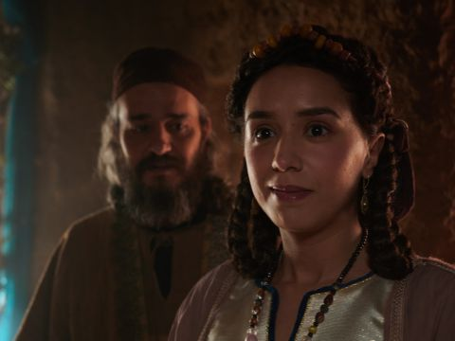
Will you go?
Will you go with this man and become Isaac’s wife?
⁵⁸ So they called Rebekah and asked her, “Will you go with this man?”
“I will go,” she said.
I will go.
I will do God’s will – what He wants me to do.
Are you willing to do God’s will?

Slide 32
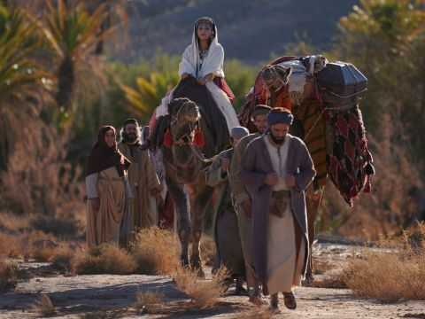
Will you go?
Our sister,
May you increase to thousands up thousands;
May your offspring possess the cities of their enemies.
⁵⁹ So they sent their sister Rebekah on her way, along with her nurse and Abraham’s servant and his men. ⁶⁰ And they blessed Rebekah and said to her,
“Our sister, may you increase to thousands upon thousands; may your offspring possess the cities of their enemies.”
⁶¹ Then Rebekah and her attendants got ready and mounted the camels and went back with the man. So, the servant took Rebekah and left.
Interesting.
That sounds like the promise God gave to Abraham and Isaac.
This is God’s will.

Slide 33
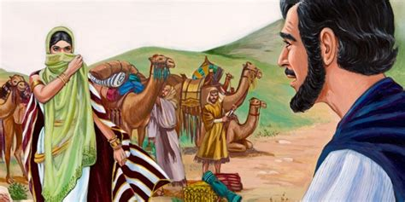
Finally, they reached Abraham’s home
Who is that man in the field coming to meet us?
⁶² Now Isaac had come from Beer Lahai Roi, for he was living in the Negev. ⁶³ He went out to the field one evening to meditate,^{[f]} and as he looked up, he saw camels approaching.
⁶⁴ Rebekah also looked up and saw Isaac. She got down from her camel ⁶⁵ and asked the servant, “Who is that man in the field coming to meet us?”
“He is my master,” the servant answered. So she took her veil and covered herself.
.
That is my master, Isaac, Abraham’s son.

Slide 34
Finally, they reached Abraham’s home
This is the wife God has given me.
She is beautiful!
⁶⁶ Then the servant told Isaac all he had done.
God has blessed in my journey.
Rebecca is the granddaughter of Abraham’s brother Nahor.
She and her family have consented to this marriage.

Slide 35

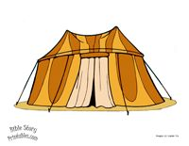
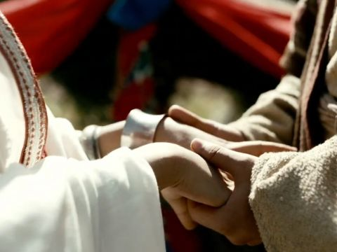

They got married!
⁶⁷ Isaac brought her into the tent of his mother Sarah, and he married Rebekah. So she became his wife, and he loved her; and Isaac was comforted after his mother’s death.
²⁰ and Isaac was forty years old when he married Rebekah daughter of Bethuel the Aramean from Paddan Aram (Northwest Mesopotamia) and sister of Laban the Aramean.

Slide 36
CRAFT TIME – opt. 1
CUT
CUT
Let’s make a camel
Color your camel and its blankets/pack
Cut down the line and around the camel head.
Cut down the line behind the camel.
You can cut on all the little lines from the bottom to the middle line to make a fringe on the blanket pack.
Glue the big blanket pack on the camel, just under the humps.
Glue the smaller blanket packs on the camel’s humps.
Glue the camel page onto the right side of the page with Rebecca pouring water for the camels.
CUT

Slide 37
CRAFT TIME
Let’s make a camel
Color your camel and all it’s parts
Cut out the parts.
You can cut on all the little lines from the bottom to the middle line to make a fringe.

Slide 38

I Will Trust You God

Slide 39
Serving Others

Slide 40
Love Each Other Honor Others Romans 12:10

Slide 41
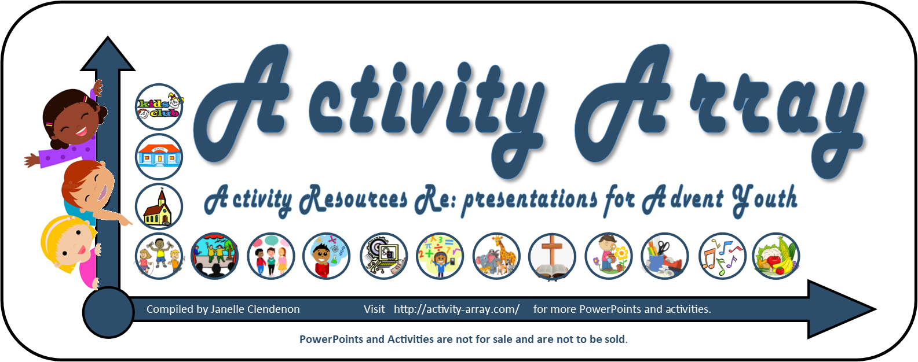
https://activity-array.com/

