Slide 1
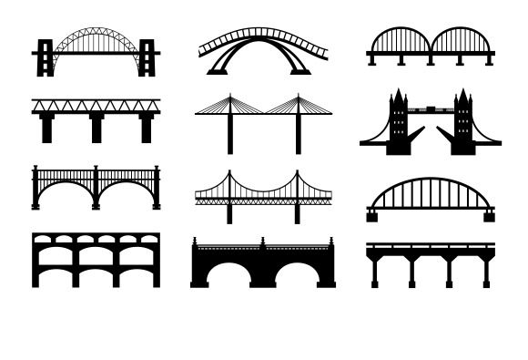
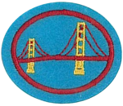
BRIDGES HONOR
Requirements and info here:
Bridges Honor at wiki Pathfindersonline

Slide 2
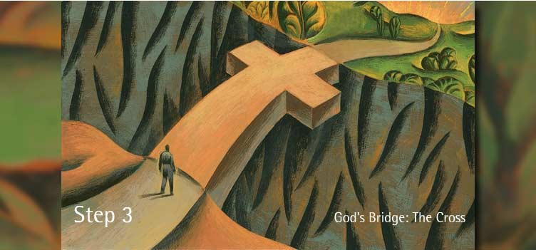

Jesus is the Bridge
9. Recite John 3:16, then tell how this verse describes Jesus’ role as a bridge between heaven and earth.
“For God so loved the world, that He gave His only begotten Son, that whosoever believeth in Him should not perish, but have everlasting life.”

Slide 3

How to build a bridge…
To view videos make sure you’re connected to the internet and that your power point is in slide show – view mode; enable view content.
Bridge test 200 + lbs
(1:21 min.)
note simple design
Build with triangles
(2:48 min.)

Slide 4
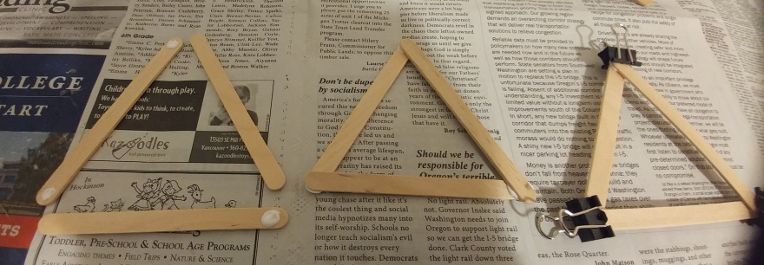
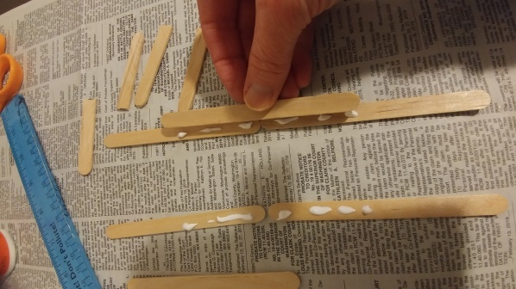
Start Building: Step 1
Time limit:
15 minutes
TRUSS BRIDGE
Build 6 triangles.
Clamp each vertices
CABLE BRIDGE
Build the sides of the tower.
Clamp each overlapping stick end

Slide 5

When you are done….
Continue the presentation.
This will give your work time to dry.

Slide 6
What is a….
1. Know these vocabulary words.

Slide 7
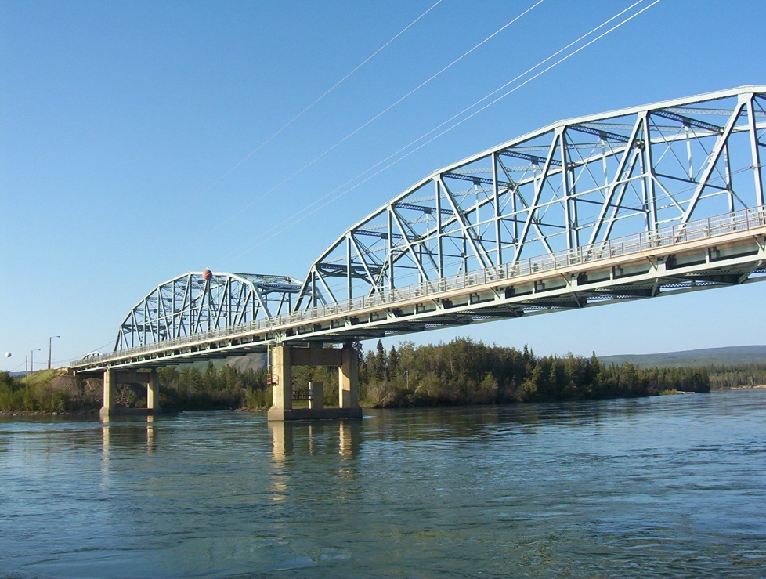

BRIDGE
A structure built to span a valley, road or railroad, body of water, or other physical obstacle, for the purpose of providing passage over the obstacle.
Tell your neighbor
what a bridge is.

Slide 8
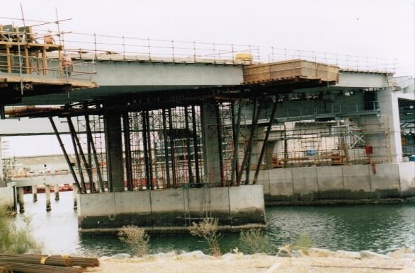

FALSEWORK
The temporary support scaffolding used during the construction of some types of bridges.
Tell your neighbor
what falsework is.
PORT RIVER BRIDGE

Slide 9
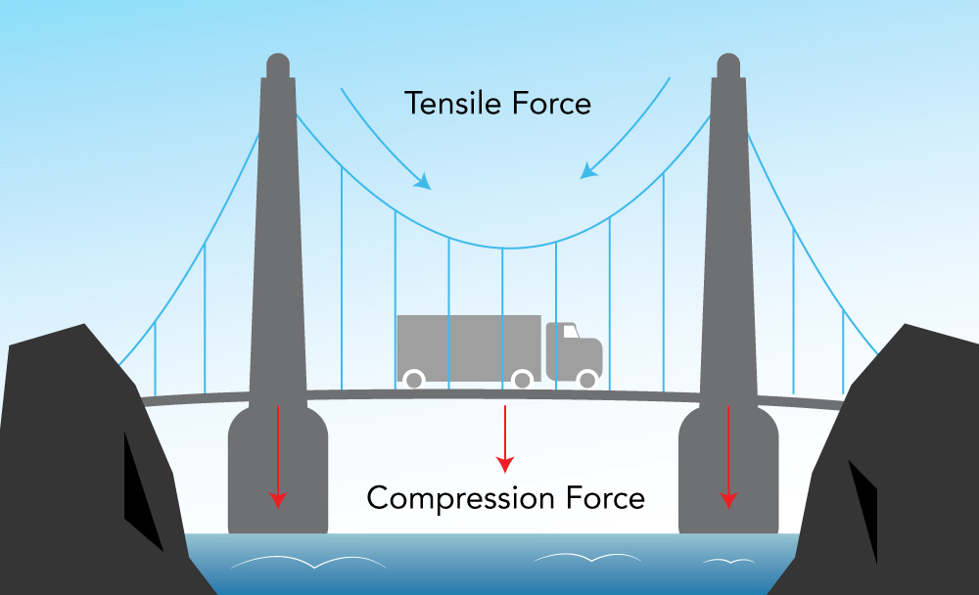
TENSION FORCE
The tightening or pulling together force (usually horizontal or at an angle other than vertical) that helps to stabilize a bridge design, and transfers compression force back to the supports of a bridge design.
PORT RIVER BRIDGE

Slide 10
Tension Demonstration
Take a piece of string.
Choose a partner.
Play a little tug-of-war with the string.
You are feeling tension.
What happened?
Try it with thread and then with rope.
Were there differences? What happened?
How thick did the string need to be?
Tell your neighbor
what tension force is.

Slide 11
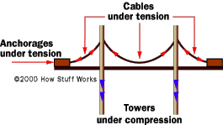
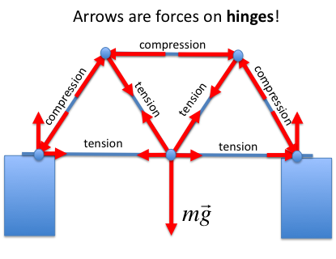
Compression Demonstration
Now instead of playing tug of war, one person will push the string toward the other person.
What happened?
Can you do this without the string bunching up?
In a bridge, the member under compression needs to be rigid. If it buckles – BIG problem!
So try pushing a thin dowel against the wall or table. Then try a thicker dowel or pencil.
How thick does it need to be so it won’t bend?
Tell your neighbor
what compression force is.

Slide 12
COMPRESSION FORCE
The downward pressure (usually vertical) that is applied to the supporting columns of a bridge design by the weight of the bridge materials as well as the traffic load that is on the bridge
PORT RIVER BRIDGE

Slide 13
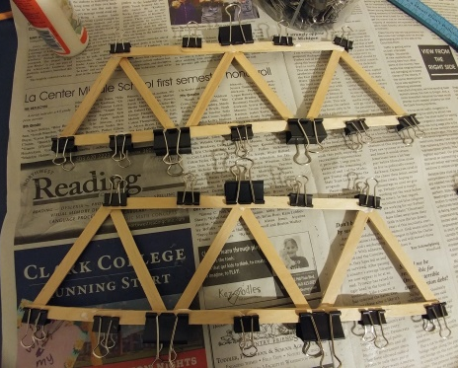
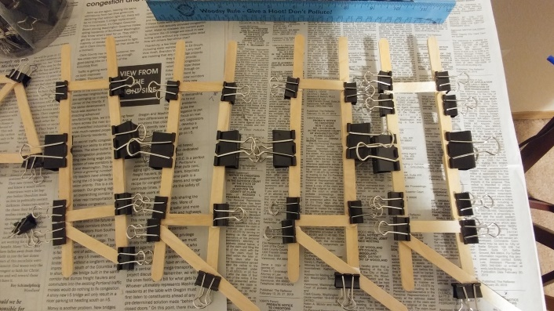
Keep Building: Step 2
Time limit:
15 minutes
TRUSS BRIDGE
Connect 3 triangles with overlapping sticks to be a truss for the left and another 3 for the truss on the right
CABLE BRIDGE
Connect the sides of each tower with perpendicular and diagonal sticks.

Slide 14
When you are done….
Continue the presentation.
This will give your work time to dry.

Slide 15
Describe …
2. Describe these six main types of bridge design and give two examples of each:
Arch Bridge
Beam Bridge
Cable-stayed bridge
Cantilever bridge
Suspension bridge
Truss bridge

Slide 16
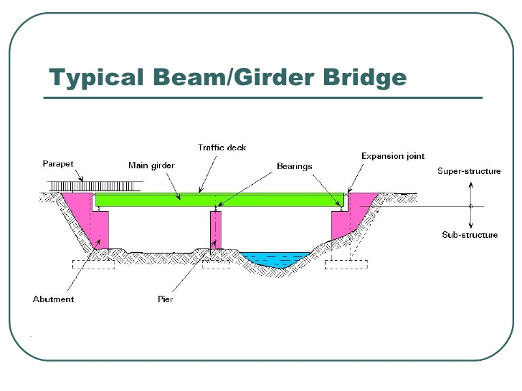
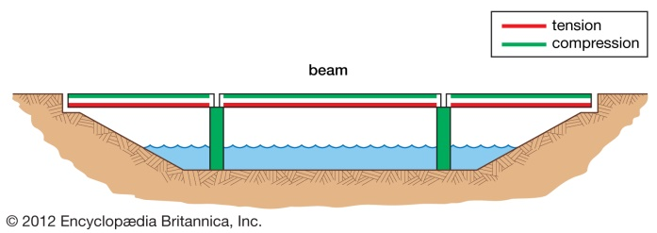
Beam Bridge
The beam bridge is the simplest kind of bridge today. Like most bridges that are characterized by how they are supported, beam bridges consist of one horizontal beam with 2 supports, usually on either end.
The earliest beam bridges were simple logs that sat across streams and similar simple structures. In modern times, beam bridges are more commonly made from shallow steel “I” beams, box girders, reinforced concrete, or post-tensioned concrete. Weight on top of the beam pushes straight down on the piers at either end of the bridge.
Examples include most highway overpasses, and any single log bridge.
More information at: wikki.pathfinders online

Slide 17

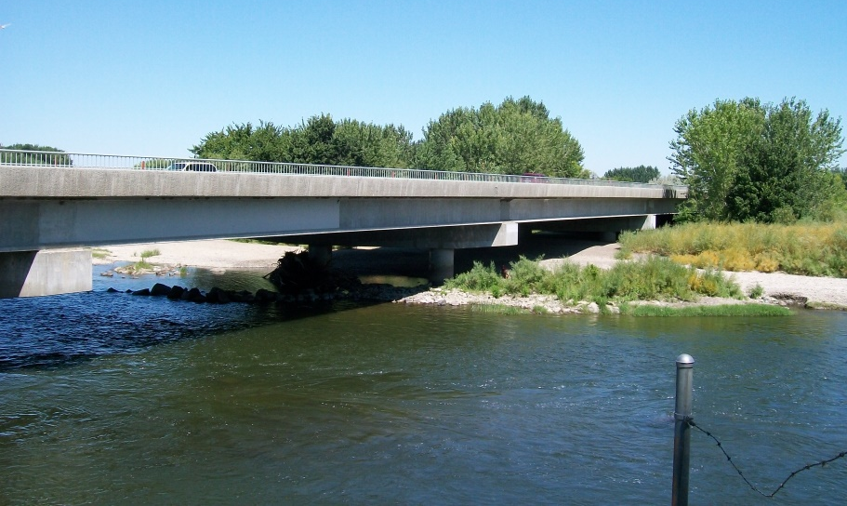
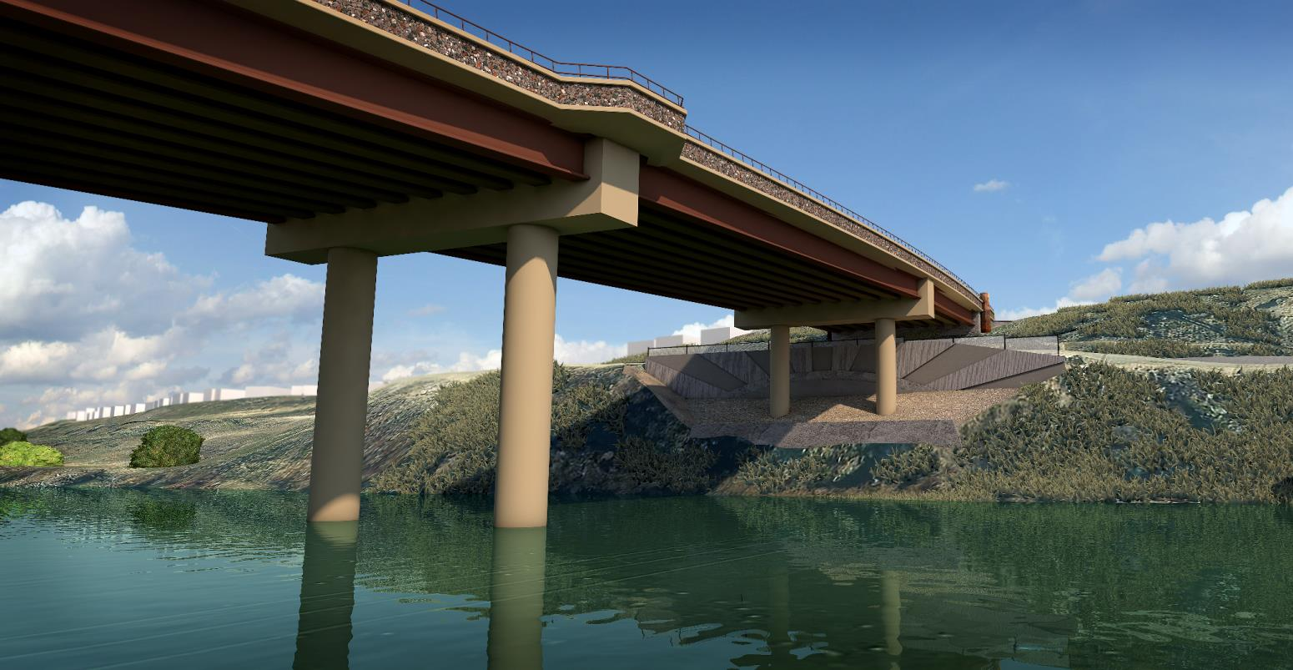
For example there’s ….
these Beam Bridges
Van Giesen bridge West Richland
Duportail Bridge under construction
Richland, WA

Slide 18
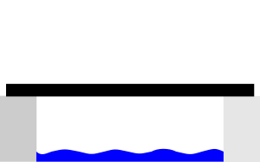
Draw …
5.Draw or illustrate the basic design of each of the following bridge types.
Make a page in your journal for each bridge.
Beam Bridge

Slide 19

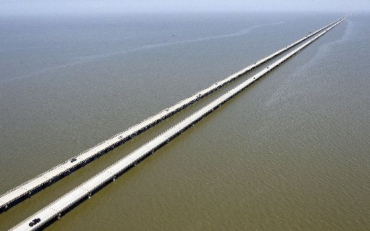
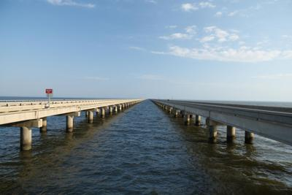
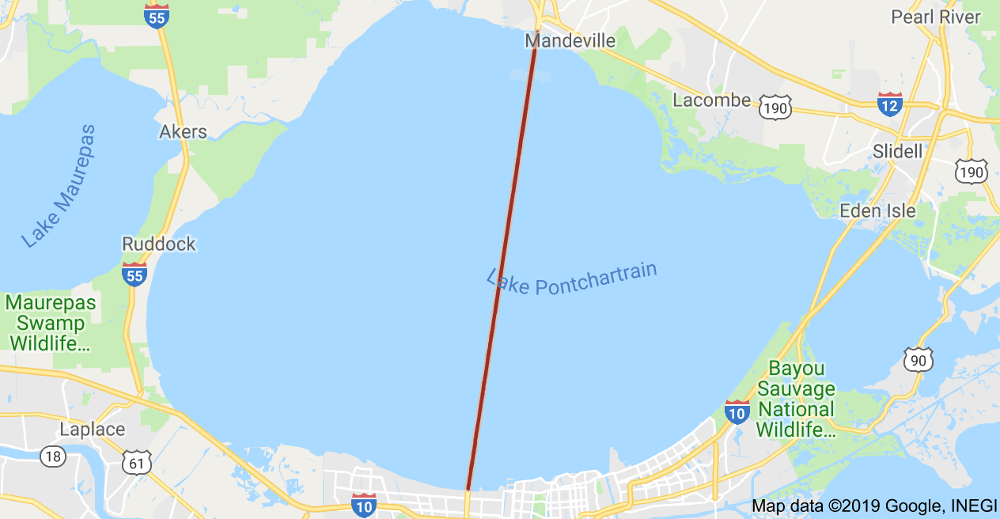
How l … o … n … g can that bridge be?
Beam Bridge
The Lake Pontchartrain Causeway in Louisiana is the world’s longest beam bridge and bridge over water. It is 24 miles long and is supported by over 9,000 concrete pilings. The first span opened in 1956 and 2nd in 1969.

Slide 20
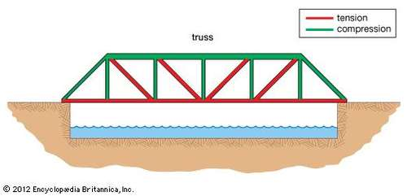
Truss Bridge
A bridge composed of connected elements (typically straight) which may be stressed from tension, compression, or sometimes both in response to dynamic loads. The ability to distribute the forces of compression, tension, shear and bending in various ways has led to a large variety of truss bridges.
The basic types of truss bridges have simple designs which could be easily analyzed by 19th and early 20th century engineers. A truss bridge is economical to construct owing to its efficient use of materials.
Modern materials such as pre-stressed concrete and fabrication methods, such as automated welding, and the changing price of steel relative to that of labor have significantly influenced the design of modern bridges.
More information at: wikki.pathfinders online

Slide 21
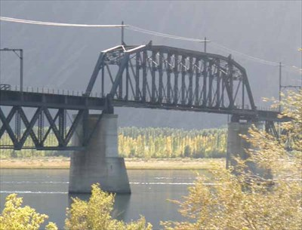
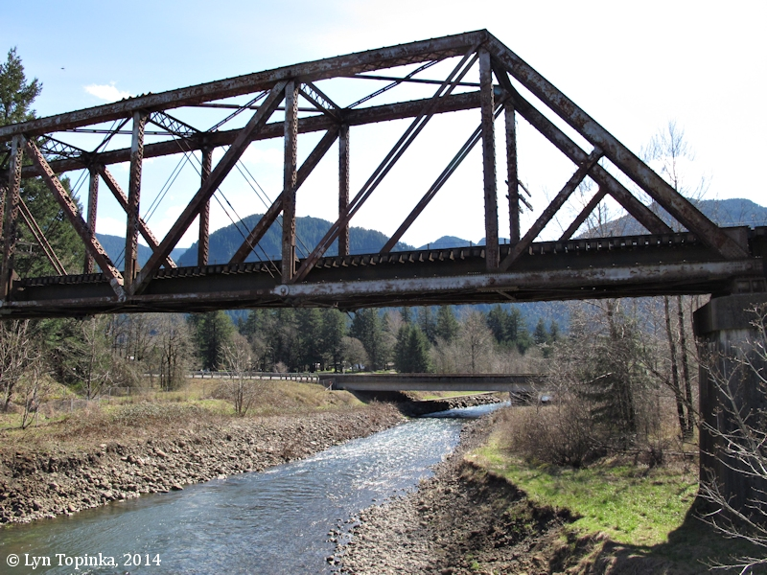
For example there’s ….
these Truss Bridges
Beverly Railroad Bridge
Beverly Washington
Hamilton Creek, North Bonneville, WA

Slide 22
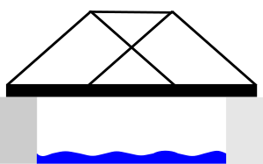
Draw …
5.Draw or illustrate the basic design of each of the following bridge types.
Make a page in your journal for each bridge.
Truss Bridge

Slide 23
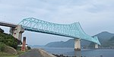
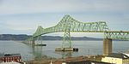
How l … o … n … g can that bridge be?
Truss Bridge
Ikitsuki Bridge in Nagasaki Prefecture, Japan is #1 and spans 1,312 feet.
Astoria Megler Bridge in Astoria, OR, is #2 and spans 1,232 feet.
There are a wide variety of truss bridge designs and they are very common because they can be built from a wide variety of materials and use the material efficiently. They are good for short to medium crossings.

Slide 24
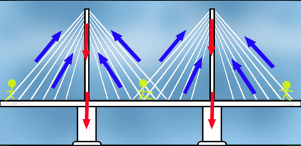
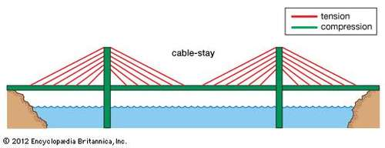
Cable-stayed Bridge
A bridge that consists of one or more columns (normally referred to as towers or pylons), with cables supporting the bridge deck. Like suspension bridges, cable-stayed bridges are held up by cables. However, in a cable-stayed bridge, less cable is required and the towers holding the cables are proportionately shorter.
There are two major classes of cable-stayed bridges: In a harp design, the cables are made nearly parallel by attaching cables to various points on the tower(s) so that the height of attachment of each cable on the tower is similar to the distance from the tower along the roadway to its lower attachment. In a fan design, the cables all connect to or pass over the top of the tower(s).
More information at: wikki.pathfinders online

Slide 25
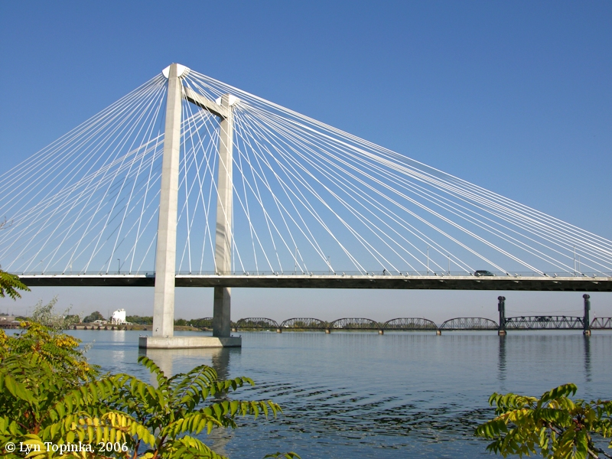
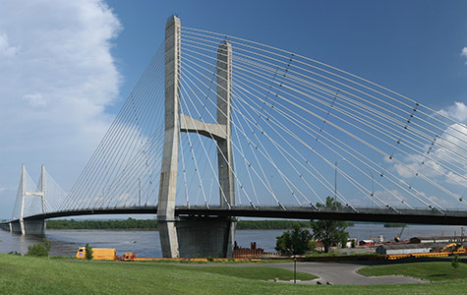
For example there’s ….
these Cable-stayed Bridges
Cable Bridge Pasco-Kennewick
Peterson Memoria Bridge
Cape Giradequ, MO

Slide 26


Draw …
5.Draw or illustrate the basic design of each of the following bridge types.
Make a page in your journal for each bridge.
Cable-stayed Bridge

Slide 27
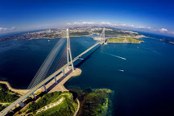
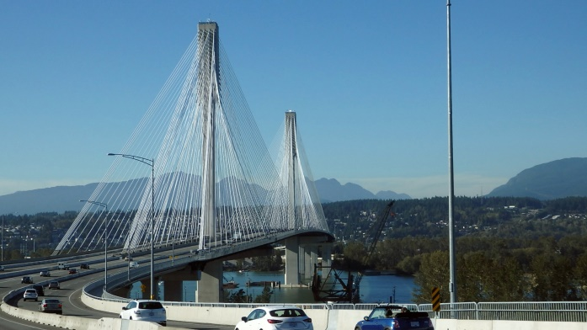
How l … o … n … g can that bridge be?
Cable-stayed Bridge
Compared to other bridge types, the cable-stayed is optimal for spans longer than typically seen in cantilever bridges and shorter than those typically requiring a suspension bridge.
On April 12, 2013 the Russky Bridge in Vladivostok, Russia with its 3,622 ft span (11 km)replaced the Sutong Bridge over the Yangtze River in China as the world's longest cable-stayed bridge.
The second or third longest cable-stayed bridge in the western hemisphere is the Port Mann Bridge near Vancouver, BC. It is 6,867 ft long. At 10 lanes (65m wide) it is the world's widest long span bridge of any type.

Slide 28
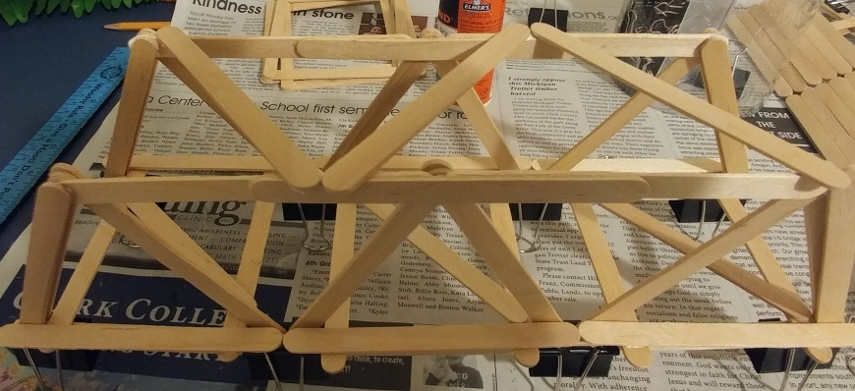
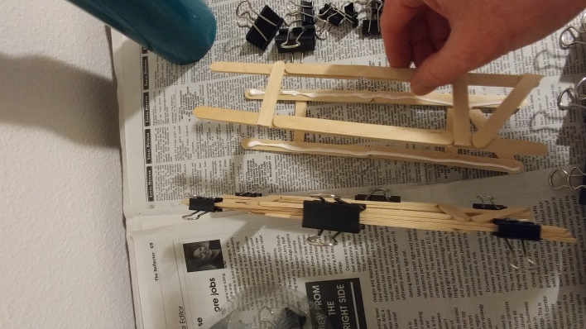
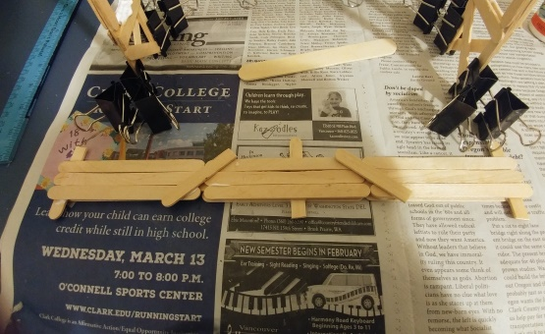
Keep Building: Step 3
Time limit:
15 minutes
TRUSS BRIDGE
Stand up your trusses and glue in connecting sticks to support your deck and upper.
CABLE BRIDGE
Glue 2 towers to each other for tower #1 and the other 2 for tower #2. Clamp.
.

Slide 29
What is a….
1. Know these vocabulary words.

Slide 30
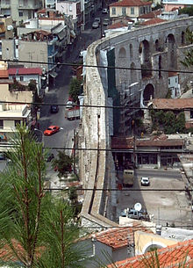
AQUEDUCT
A bridge that carries water. Popular before we had electric pumps.
Tell your neighbor
what an aqueduct is.
Kavala aqueduct, Greece

Slide 31
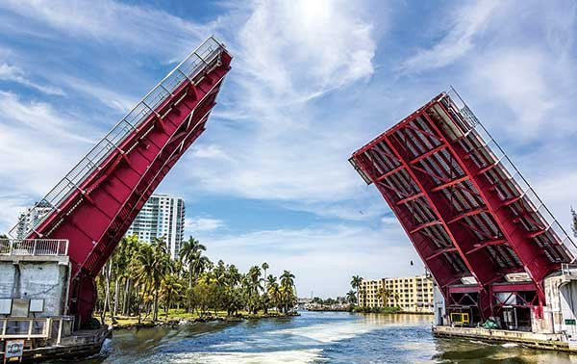
BASCULE BRIDGE
A movable bridge with a counterweight that continually balances the span throughout the entire upward swing in providing clearance for boat traffic. They are the most common type of movable bridge in existence because they open quickly and require relatively little energy to operate. Bascule is a french word. In English this is usually called a draw bridge..
Tell your neighbor
what a bascule bridge is.

Slide 32
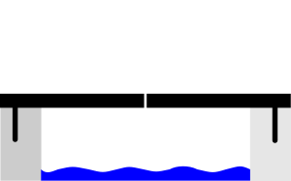
Draw …
5.Draw or illustrate the basic design of each of the following bridge types.
Make a page in your journal for each bridge.
Bascule Bridge

Slide 33
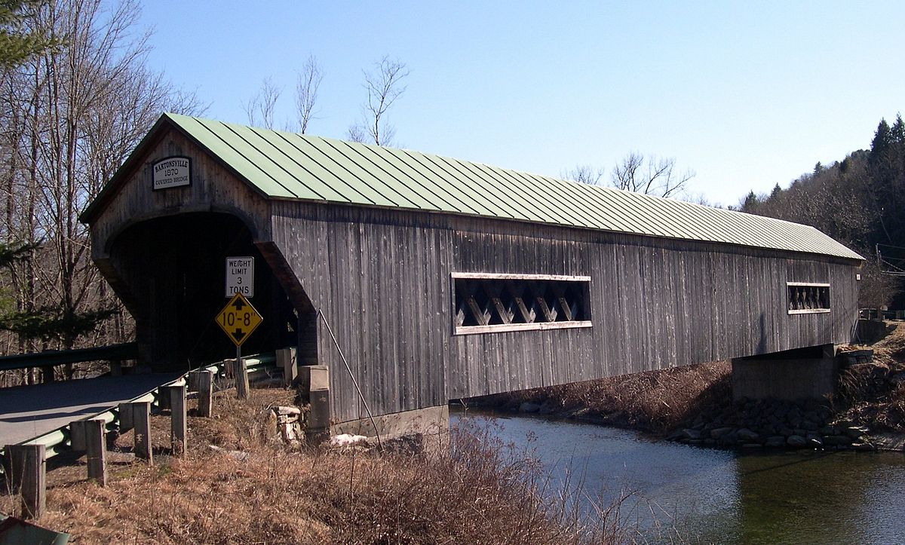
COVERED BRIDGE
A structure with enclosed sides
and a roof that often has only a
single lane, and typically is made of wood. Since wooden bridges tended to deteriorate rapidly from exposure to the elements, they only had a useful lifespan of nine years. Covering them protected their structural members, thus extending their life to 80 years or more.
Tell your neighbor
what a covered bridge is.

Slide 34
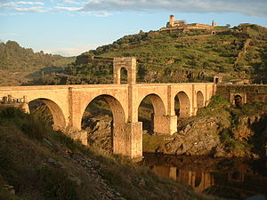
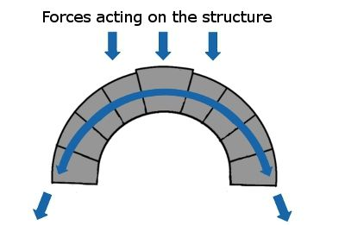
Arch Bridge
Arch-shaped bridges that have abutments at each end. Arch bridges work by transferring the weight of the bridge and its loads partially into a horizontal thrust restrained by the abutments at either side.
A viaduct (a long bridge) may be made from a series of arches, although other more economical structures are typically used to span a long distance today. The greatest bridge builders of antiquity were the ancient Romans. The Romans built arch bridges and aqueducts that could stand in conditions that would damage or destroy earlier designs. An example of one that still stands today is the Alcantara Bridge in Spain.
The earliest known arch bridges were built by the Greeks and include the Arkadiko Bridge.
More information at: wikki.pathfinders online

Slide 35
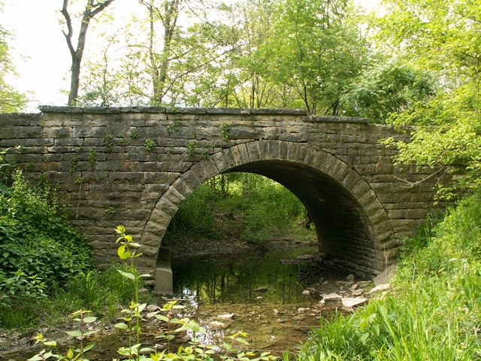
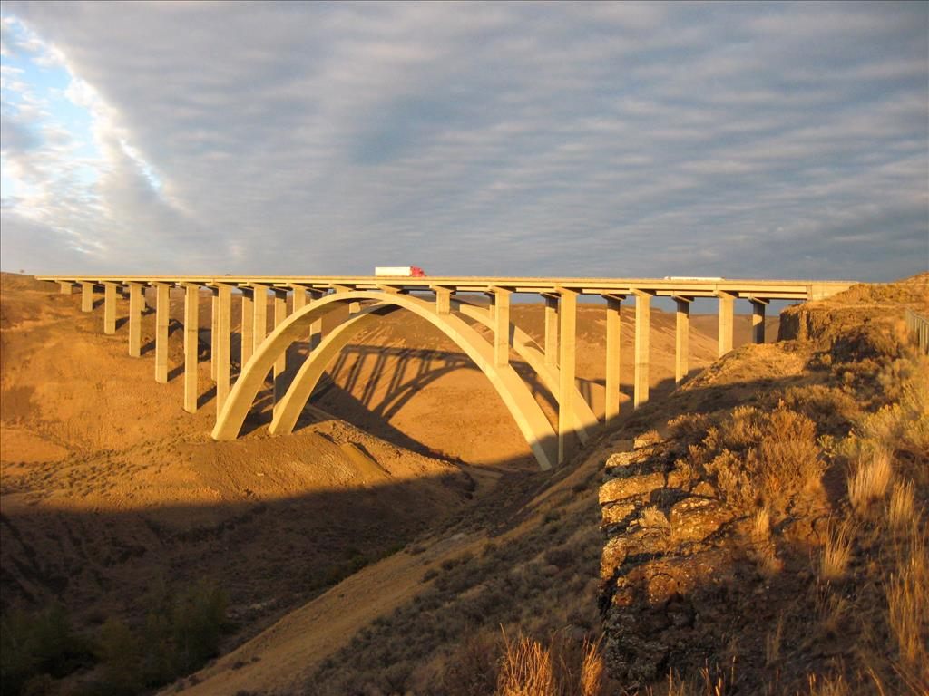
For example there’s ….
these Arch Bridges
Falknor Road Arch Bridge
Fred Redmon Bridge
over Selah Creek near Yakima

Slide 36
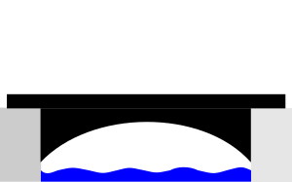
Draw …
5.Draw or illustrate the basic design of each of the following bridge types.
Make a page in your journal for each bridge.
Arch Bridge

Slide 37
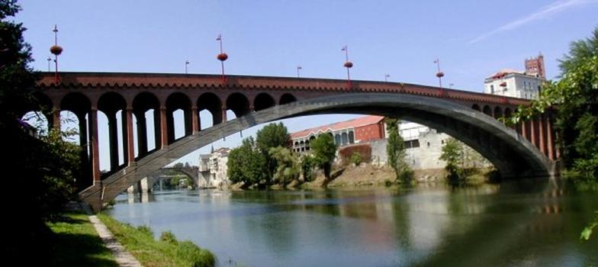
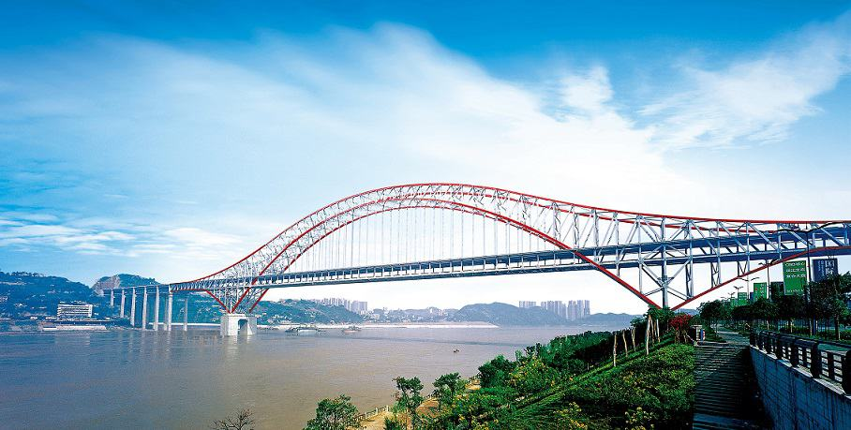
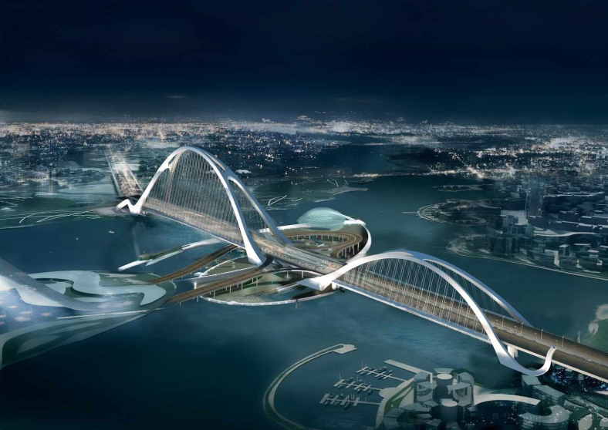
How l … o … n … g can that bridge be?
Arch Bridge
The longest masonry arch bridge is 315 feet; completed in 1919, in Pont de la Liberation, France
The Chongqing-Chaotianmen Bridge over the Yangtze River in China is a two-deck, steel truss-arch bridge with a main span of 552 m (1,811 ft). The bridge was opened on 29 April 2009.
Dubai in the United Arab Emirates is currently building the Sheikh Rashid bin Saeed Crossing which is scheduled for completion in 2012. When completed, it will be the largest arch bridge in the world. It is 1.6 km long (0.994 miles)

Slide 38
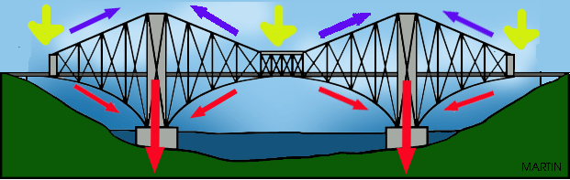
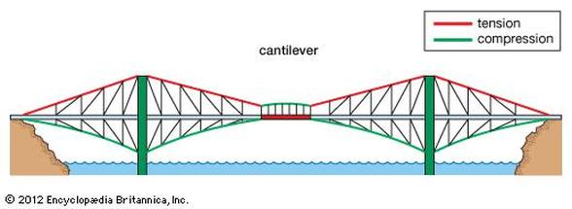
Cantilever Bridge
A bridge built using cantilevers, structures that project horizontally into space, supported on only one end.
For small footbridges, the cantilevers my be simple beams; however, large cantilever bridges designed to handle road or rail traffic use trusses built from structural steel, or box girders built from pre-stressed concrete. The steel truss cantilever bridge was a major breakthrough when first put into practice, as it can span distances of over 1,500 feet, and can be more easily constructed at difficult crossings by virtue of using little or no falsework.
The most famous early cantilever bridge is the Forth Rail Bridge Firth of Forth in the east of Scotland constructed from 1882-1890. This bridge held the record for longest span in the world for 17 years.
More information at: wikki.pathfinders online

Slide 39
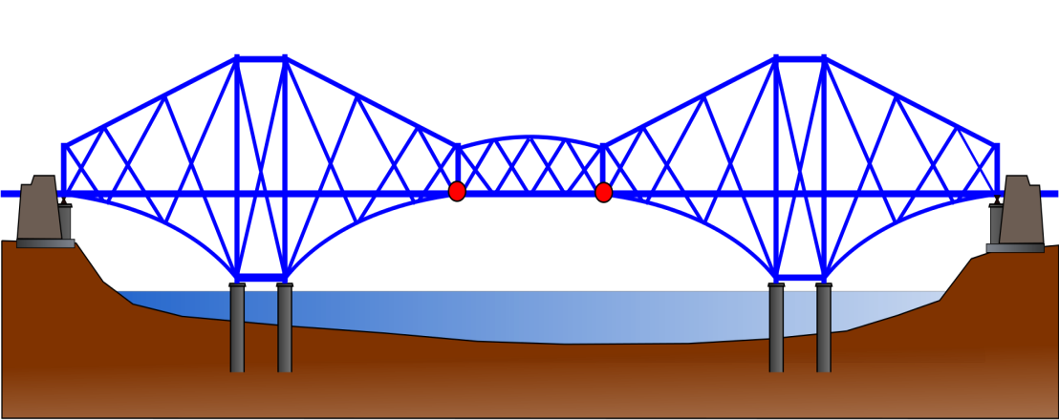
Draw …
5.Draw or illustrate the basic design of each of the following bridge types.
Make a page in your journal for each bridge.
Cantilever Bridge

Slide 40


For example there’s ….
these Cantilever Bridges
Columbia River Bridge
Wenatchee, WA
Lyons Ferry Bridge
originally crossed Columbia River at Vantage 1927- (dismantled in)1963
rebuilt over Snake River at Lyons Ferry in 1968

Slide 41


How l … o … n … g can that bridge be?
Cantilever Bridge
The Quebec City Bridge has a main span of 1,801 ft and a total length of3,215 ft. The project failed twice, at the cost of 88 lives, and took over 30 years to complete.
The Commodore Barry Bridge has a total length of 13,912 feet (4,240 m), and a main span of 1,644 feet (501 m), making the bridge the fourth longest cantilever bridge in the world, and the longest in the United States

Slide 42



Keep Building: Step 4
Time limit:
15 minutes
TRUSS BRIDGE
Make pilings to hold up your bridge.
CABLE BRIDGE
Stand up your towers and glue the deck on.

Slide 43


Suspension
Bridge
This type of bridge has cables suspended between towers, plus vertical suspender cables that carry the weight of the deck below, upon which traffic crosses. This arrangement allows the deck to be level or to arc upward for additional clearance. Like other suspension bridge types, this type often is constructed without falsework.
The suspension cables must be anchored at each end of the bridge, since any load applied to the bridge is transformed into a tension in these main cables. The main cables continue beyond the pillars to deck-level supports, and further continue to connections with anchors in the ground. The roadway is supported by vertical suspender cables or rods, called hangers. In some circumstances the towers may sit on a bluff or canyon edge where the road may proceed directly to the main span, otherwise the bridge will usually have two smaller spans, running between either pair of pillars and the highway, which may be supported by suspender cables or may use a truss bridge to make this connection. In the latter case there will be very little arc in the out-board main cables.
More information at: wikki.pathfinders online

Slide 44


For example there’s ….
these Suspension Bridges
Lava Canyon Trail Mt St Helens
Tacoma Narrows Twin Bridges

Slide 45

Draw …
5.Draw or illustrate the basic design of each of the following bridge types.
Make a page in your journal for each bridge.
Suspension Bridge

Slide 46


How l … o … n … g can that bridge be?
Suspension Bridge
The longest spans are suspension bridges, including the 17 longest bridge spans in the world, as of 2014.
Ambassador_Bridge between Detroit and Windsor was completed in 1929. It is still in use and also a National Historic Site. It is 7,500 ft long.
The current longest suspension bridge is the Akashi Kaikyō Bridge aka Pearl bridge in Kobe Japan at 1,991 metres/6,532 ft. It carries 6 lanes of traffic and opened in 1998.

Slide 47
Which bridge is the l … o … n … g … e … s … t?
The Suspension Bridge

Slide 48
Finish Building: Step 5
Time limit:
15 minutes
TRUSS BRIDGE
Glue your bridge onto the pilings.
CABLE BRIDGE
Add string for your cables.

Slide 49
Watch a video on bridges:
Megastructures: The Golden Gate Bridge 40:09 min.
Discovery Channel Hangzhou Bay Bridge 6:49 min.
How bridges are built – Time lapse for St. Croix Crossing 2:23 min.

Slide 50




Finish Building: Step 5
Time limit:
15 minutes
Put the finishing touches on your bridge.

Slide 51
More Video options
Top 10 Most famous bridges and their facts 5:29 min.
The Top 12 Coolest Bridges
7:47 min.

Slide 52
Presentation:
7. Make a video/multimedia presentation
Video yourself and a friend talking about your bridges and telling a story or memory of you on a bridge.
OR a scrapbook presentation about bridge(s) you have seen:
Add to your journal. Cut out or draw bridges you’ve seen. Place them on the correct page. Add a memory or two of a bridge.

Slide 53
Congratulations!
You earned the BRIDGE honor!

