Slide 1

Play large video just for DEMO
Play small video – across slides – to practice the presentation – click on NEXT slide
Do NOT play video for live performance

Slide 2
Sometimes He Calms the Storm
Song by Scott Krippayne
Musical Dramatization by Janelle

Slide 3
All who sail the sea of faith find out before too long
Light blue lifted up like sky (top corner held high, bottom corners touching floor or hanging down)

Slide 4
How quickly blue skies can grow dark and gentle winds grow strong
Light blue lowered, all corners held, flapped like waves. And darker blue held up like sky (top corner held high, bottom corners touching floor or hanging down)

Slide 5
Suddenly fear is like white water pounding on the soul
Add white, a little higher than the light blue, all corners held tight and flapped furiously like white cap waves

Slide 6

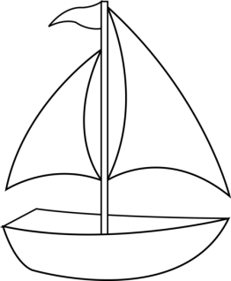
Still we sail on knowing that our Lord is in control
Jesus figure enters scene and stands behind boat

Slide 7

Sometimes He calms the storm with a whispered peace be still
Jesus figure holds up hands. White and light blue stop flapping and lower to floor. Darker blue settles to floor.

Slide 8
He can settle any sea but it doesn't mean He will
Lt blue, white and dark blue raised and ready

Slide 9
Sometimes He holds us close and lets the wind and waves go wild
Lt blue, white, and dark blue, all corners held tightly, flapped vigorously like waves

Slide 10
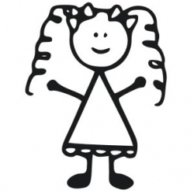
Sometimes He calms the storm and other times He calms His child
Child figure enters. Jesus figures opens arms, inviting a hug. They hug. Meanwhile waves of all colors continue to flap.

Slide 11
He has a reason for each trial that we pass through in life
Jesus and child figures walk across stage parallel to waves, arm in arm, side by side. All colors continue to flap.

Slide 12
And though we’re shaken, cannot be pulled apart from Christ
Dark figure joins the scene, pulls on the child figure’s arm, trying to pull him from the Jesus figure, but cannot do so. Meanwhile waves of all colors continue to flap.

Slide 13
No matter how the driving rain beats down on those who hold to faith
Dark figure joins the scene, pulls on the child figure’s arm, trying to pull him from the Jesus figure, but cannot do so. Meanwhile waves of all colors continue to flap.

Slide 14

A heart of trust will always be a quiet peaceful place
Jesus figure pushes aside dark figure and he leaves. Child faces Jesus. Jesus holds both of child’s hands. Child kneels in front of Jesus continuing to hold hands.

Slide 15
Sometimes He calms the storm with a whispered peace be still
Jesus figure holds up hands. White and light blue stop flapping and lower to floor. Darker blue settles to floor. Then child figure skips across stage.

Slide 16
He can settle any sea but it doesn't mean He will
Lt blue, white and dark blue raised and ready

Slide 17

Sometimes He holds us close and lets the wind and waves go wild
Lt blue, white, and dark blue, all corners held tightly, flapped vigorously like waves. At the same time, the child figure comes slowly crosses to mid stage holding stomach and/or head like really ill.

Slide 18
Sometimes He calms the storm and other times He calms His child
Jesus figure opens arms, inviting a hug. They hug, but child continues to act sick. Meanwhile waves of all colors continue to flap.

Slide 19
Sometimes He calms the storm with a whispered peace be still
Jesus figure holds up hands. White and light blue stop flapping and lower to floor. Darker blue settles to floor. Then child figure skips across stage.

Slide 20
He can settle any sea but it doesn't mean He will
Lt blue, white and dark blue raised and ready

Slide 21
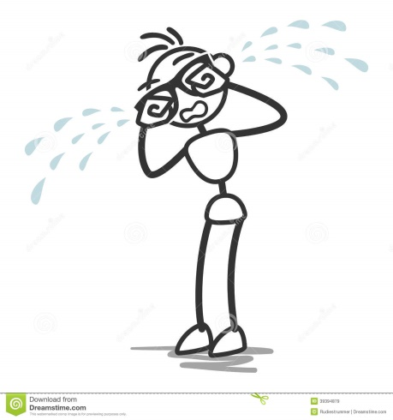
Sometimes He holds us close and lets the wind and waves go wild
Lt blue, white, and dark blue, all corners held tightly, flapped vigorously like waves. At the same time, the child figure come slowly crosses to mid stage, head down, sobbing uncontrollably.

Slide 22
And sometimes He calms the storm
Jesus lifts arms. All colors cease flapping. Child wipes away tears and smiles.

Slide 23

Sometimes He calms the storm
Dark figure enters, but Jesus stands between him and child, raising his hand in a stop motion. Child blissfully walks, skips, or dances across the stage in the opposite direction.

Slide 24

Sometimes He calms the storm
Jesus raises arms up like a cross. Child kneels with arms uplifted.

Slide 25
And other times He calms His child
All colors raise up and flap. Jesus turns to child and lifts child up. They hug.

