Slide 1

Pathfinder Bible Experience
2017
Paul’s Writings

Slide 2
Paul’s Writings
Galatians
Ephesians
Philippians
Colossians
1 & 2 Timothy
http://www.uccsda.org/Pathfinders/bibleachieve

Slide 3
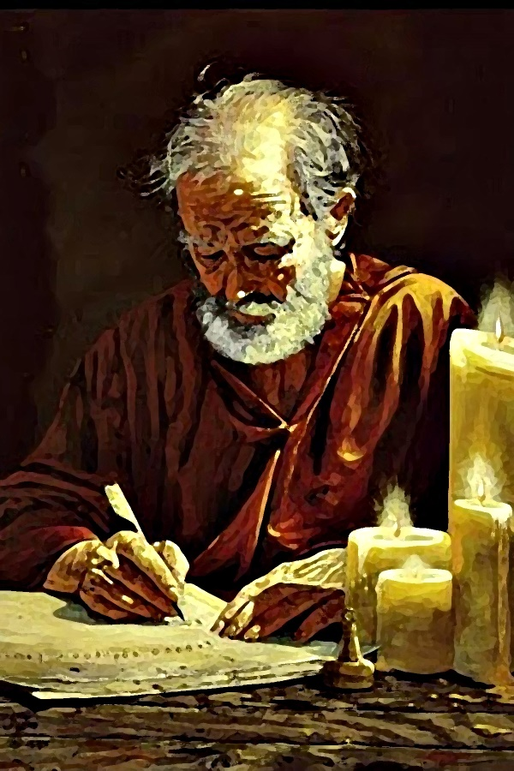
Philippians
Paul’s letter to the

Slide 4

Chapter 1

Slide 5
According to Philippians 1:1, who wrote Philippians?
1 point
25
Paul and Timothy

Slide 6
1 point
25
According to Philippians 1:1
to whom is the book of Philippians written to?
all the saints in Christ Jesus who are in Philippi
the (bishops) overseers
the deacons
those in Philidelphia
a, b, and c

Slide 7
1 point
25
According to Philippians 1
how did Paul feel about the church in Philippi?
he was upset that they followed other gods
he was disappointed that they never helped him
he thanked God for them and longed to be with them

Slide 8
Complete Philippians 1:6, “being confident of this very thing, that He who has begun a good _____ in you will _________ it until the day of Jesus Christ?”
2 points
25
Answer: work, complete

Slide 9
According to Philippians 1, was Paul in chains at that time?
1 points
25
Answer: yes (Phil. 1:7 & 14)

Slide 10
Complete Philippians 1:9, “And this I pray, that your ____ may abound still more and more in _______ and all discernment,”
2 points
25
Answer: love, knowledge

Slide 11
True or False All the things that happened to Paul actually helped to further the gospel.
1 point
25
Answer: True (Phil. 1:12-14)

Slide 12
Complete Philippians 1:21, “For to me, to live is _____, and to die is ____.”
2 points
25
Answer: Christ, gain

Slide 13
Paul was willing to live or to die for Christ. Which did he think was more beneficial for the church in Philippi? Bonus: Tell why
1 point + 2
25
Answer: to live (Phil. 1:25) [Bonus: I shall remain and continue with you all for your progress and joy of faith, that your rejoicing for me may be more abundant in Jesus Christ by my coming to you again.]

Slide 14
1 point
25
According to Philippians 1:27-29
how should the church live?
let your conduct be worthy of the gospel
stand fast in one spirit
with one mind strive together for the faith of the gospel
don’t be terrified by adversaries
believe in God
all the above

Slide 15
Chapter 2

Slide 16

1 point
25
According to Philippians 2:2, how could the church respond to God’s love and fulfill Paul’s joy?
by being like-minded and having the same love
by bringing dates and olives
by being of one accord, of one mind
by pleading for his release
“a” and “c”
“b” and “d”

Slide 17
Complete Philippians 2:3: “Let nothing be done through selfish ambition or ________, but in lowliness of mind let each esteem others better than _________.”
2 point
25
conceit, himself

Slide 18
According to Philippians 2:5-8, Did Jesus show humility or pride?
1 point
25
Answer: humility

Slide 19

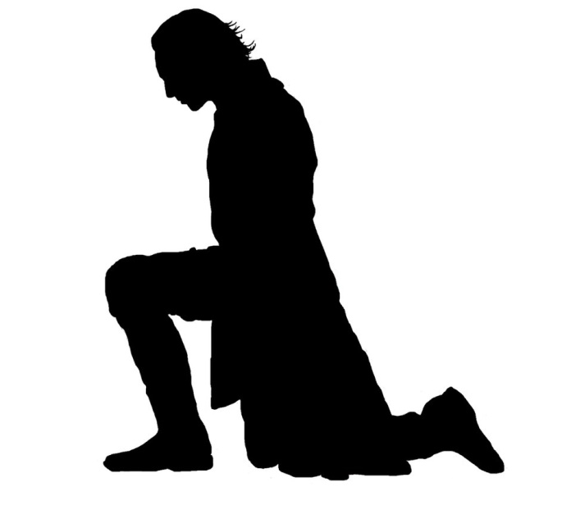
HUMILITY
Humility is not thinking
less of yourself
But thinking
of yourself less.
-- C. S. Lewis
How did Jesus demonstrate humility?
How do you show humility?

Slide 20

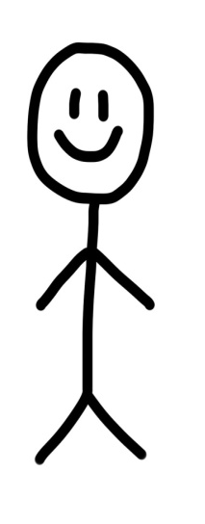





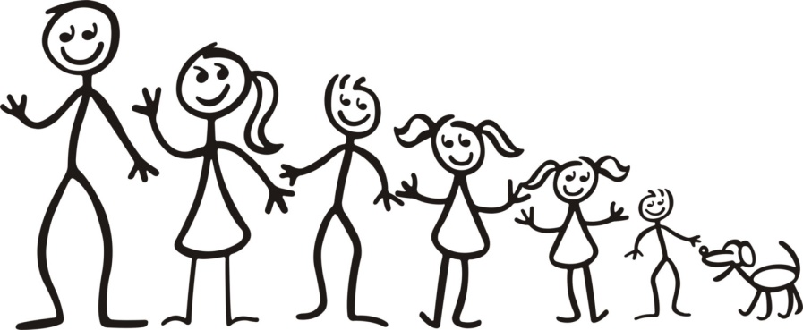


Slide 21
1 point
25
According to Philippians 2:7-8
how did Jesus show humility?
made Himself of no reputation
took the form of a bondservant
came in the likeness of men
was obedient to the point of death, even death on a cross
all the above

Slide 22
Complete Philippians 2:9, “Therefore God also has highly e______ Him and given Him the name which is above every ______,”?
2 points
25
Answer: exalted, name

Slide 23
Complete Philippians 2:10-11, “…that at the name of _____ every knee should bow, of those in heaven, and of those on _____, and of those under the earth, and that every t_____ should confess that Jesus Christ is Lord, to the glory of God the Father.?
1 point
25
Answer: Jesus, earth, tongue

Slide 24
True or False: Do all things without complaining and disputing,
1 point
25
Answer: True (Phil. 2:14)

Slide 25
1 point
25
According to Philippians 2:12-16
How should we live so we can “shine as lights in the world”?
be obedient
don’t complain
hold fast the word of life
be glad and rejoice
all the above

Slide 26
1 point
25
According to Philippians 2:25-27
what do we know about Epaphroditus?
Paul’s brother in Christ, a fellow worker and soldier
he was a messenger from Philippi
he ministered to Paul’s needs
he was sick and almost died
he was a good cook
all the above
a, b, c, d

Slide 27
Chapter 3

Slide 28
Complete Philippians 3, are we supposed to have confidence in flesh? Are we saved by our good deeds?
1 point
25
Answer: No, No (Phil. 3:3-6)

Slide 29
1 point
25
According to Philippians 3:4-6
Paul (Saul) had been a proud Pharisee. Why could he have been confident in the flesh?
Born an Israelite, of the tribe of Benjamin
circumcised on the 8th day
zealously persecuted the church
blameless according to the law
a Pharisee
all the above

Slide 30
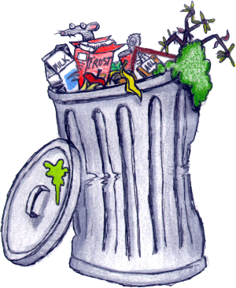
Complete Philippians 3:8, “Yet indeed I also count all things l____ for the excellence of the knowledge of Christ Jesus my Lord, for whom I have suffered the loss of all things, and count them as r________, that I may gain Christ?
2 points
25
zeal, law keeper, circumcision
Answer: loss, rubbish

Slide 31
According to Philippians 3:9, Does our righteousness come from keeping the law or through faith in Jesus Christ?
1 point
25
Answer: through faith in Christ OR from God by faith

Slide 32

Complete Philippians 3:12, “Not that I have already attained, or am already p________; but I p_____ on, that I may lay hold of that for which Christ Jesus has also laid hold of me.”
2 points
25
Answer: perfected, press

Slide 33
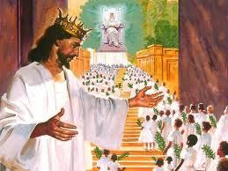
Complete Philippians 3:13-14, “…but one thing I do, forgetting those things which are behind and reaching f_______ to those things which are ahead, I press toward the g____ for the prize of the upward call of God in Christ Jesus.?
2 points
25
Answer: forward, goal

Slide 34
1 point
25
According to Philippians 3:19
What is the end of those who’s god is their belly, are enemies to the cross of Christ, and are proud of shameful things?
they will end up fat
their end is destruction
they will end up last in the kingdom

Slide 35
Complete Philippians 3:20, “For our citizenship is in h______, from which we also eagerly wait for the Savior, the Lord Jesus Christ, who will transform our lowly b____ that it may be conformed to His glorious body, …”
2 points
25
Answer: heaven, body

Slide 36
Chapter 4

Slide 37
1 point
25
According to Philippians 4:2, What 2 women did Paul want to “be of the same mind”? (Maybe they were always arguing.)
Euodia & Syntyche
Lydia & Grace
Clement & Ephraphaditus

Slide 38
Complete Philippians 4:4, “Rejoice in the _____ always. Again I will say, ______!”
2 points
25
Answer: Lord, rejoice

Slide 39
Say Philippians 4:4 from memory “Rejoice …
10 points
25
Answer: Rejoice in the Lord always. Again I will say, rejoice!

Slide 40
Complete Philippians 4:5, “Let your g_________ be known to all men. The Lord is at hand.”
1 points
25
Answer: gentleness

Slide 41
Say Philippians 4:5 from memory “Let …
10 points
25
Answer: Let your gentleness be known to all men. The Lord is at hand.

Slide 42
Complete Philippians 4:6, “Be a_______ for nothing, but in everything by p_____ and supplication, with ___________, let your requests be made known to God.”
3 points
25
Answer: anxious, prayer, thanksgiving

Slide 43
Say Philippians 4:6 from memory “Be …
10 points
25
Answer: Be anxious for nothing, but in everything by prayer and supplication, with thanksgiving, let your requests be made known to God;

Slide 44
According to Philippians 4:7, Instead of being anxious, we pray with thanksgiving, what will guard our hearts and minds?
1 point
25
Answer: peace of God

Slide 45
Complete Philippians 4:8, “Finally, brethren, whatever things are t___, whatever things are noble, whatever things are just, whatever things are p____, whatever things are l_____, whatever things are of good report, if there is any virtue and if there is anything praiseworthy—meditate on these things.”
3 points
25
Answer: true, pure, lovely

Slide 46



Slide 47
Say Philippians 4:8 from memory “Finally …
10 points
25
Answer: Finally, brethren, whatever things are true, whatever things are noble, whatever things are just, whatever things are pure, whatever things are lovely, whatever things are of good report, if there is any virtue and if there is anything praiseworthy—meditate on these things

Slide 48
1 point
25
According to Philippians 4:11
Paul said he learned to be content in which of the following situations:
either to be abased (humble) or to abound (successful)
whether he was full or hungry
both to abound and to suffer need
all the above

Slide 49
Complete Philippians 4:13, “I can do ___ things through ______ who strengthens me.”
1 point
25
Answer: all, Christ

Slide 50
Say Philippians 4:13 from memory “I …
10 points
25
Answer: I can do all things through Christ who strengthens me.

Slide 51
According to Philippians 4:15, True or False The Philippians sent aid to Paul to fulfill his necessities.
1 point
25
Answer: True

Slide 52
Complete Philippians 3:19-20, “And my God shall supply all your ____ according to His _____ in glory by Christ Jesus. Now to our God and Father be _____ forever and ever. Amen.
3 points
25
Answer: need, riches, glory

Slide 53
1 point
25
According to Philippians 4:22, Who, besides Paul and Timothy sent their greetings to the church in Phillipi?
All the saints
Caesar’s household
Nero
Mickey Mouse
a & b

Slide 54

With God all things are possible
Rejoice in God!

